Slide 1
Status of ePIC µRWELL-BOT + PED Test Article
Kondo Gnanvo, Jefferson Lab
On behalf of the ePIC MPGD DSC
TIC Weekly Meeting
August 19, 2024

Slide 2
Outline
µRWELL-BOT Detector Layout: Requirements & Design Considerations
PED - Engineering Test Article
Plans & schedule of the production µRWELL-BOT modules assembly
Summary

Slide 3
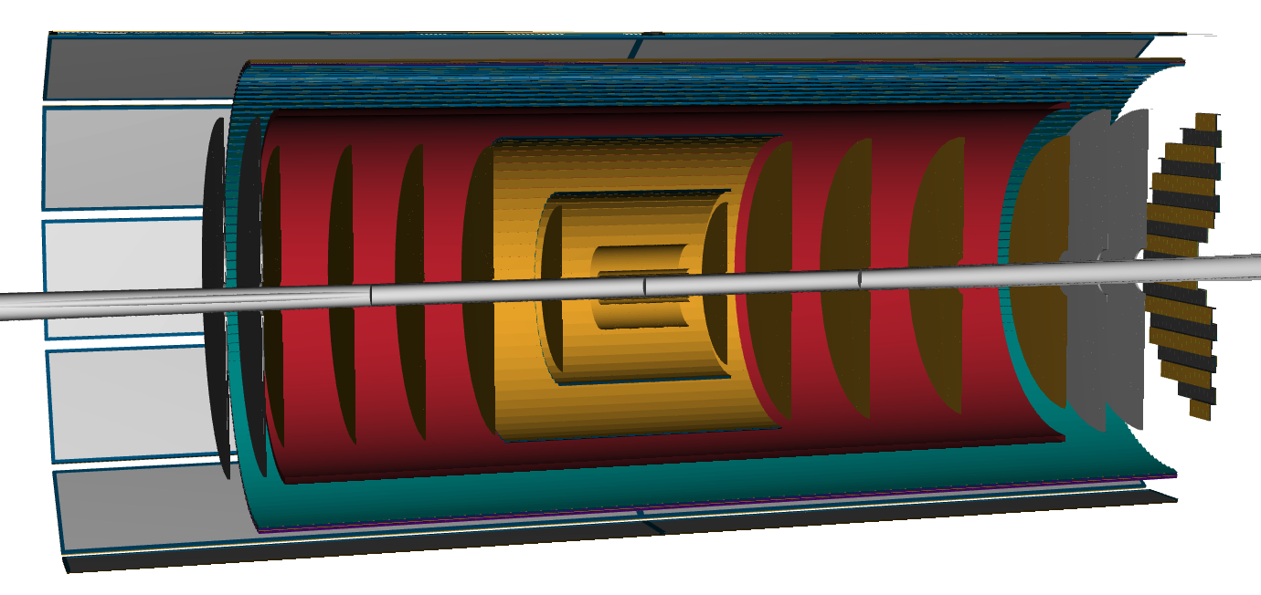



Overview of ePIC Tracking Detector
$µ$RWELL-ECT
$µ$RWELL-BOT
CyMBaL
$µ$RWELL-ECT
Technologies
MAPS (Si)
MPGDs (Gaseous)
AC-LGADs (Si)
AC-LGAD Endcap
AC-LGAD Barrel
SVT Endcaps
SVT Barrels
SVT
SVT Endcaps

Slide 4
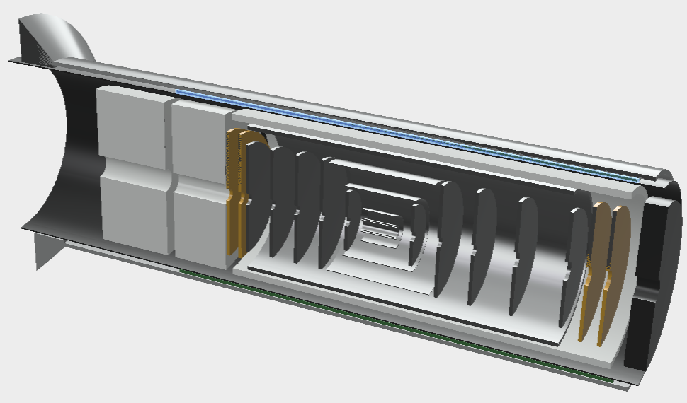
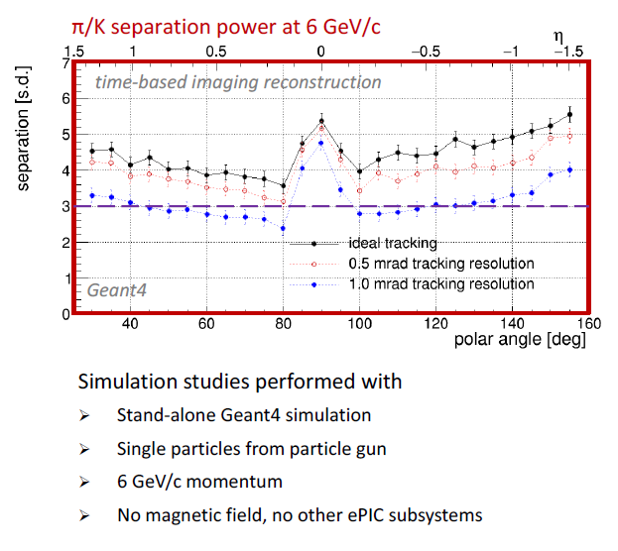
µRWELL-BOT to enhance tracking for hpDIRC: Improve angular resolution?
Impact of angular resolution on hpDIRC performance
hpDIRC (barrel PID)
Barrel Outer Tracker
ePIC Barrel Outer Tracker (µRWELL-BOT)
Tracking layer close to hpDIRC detector to help improved and angular and space point resolution at the DIRC level
Acceptance matching with hpDIRC bars
Good spatial resolution?: simulation results resolution improvement with μRWELL not conclusive
Matt Posik simulation angular resolution slides

Slide 5
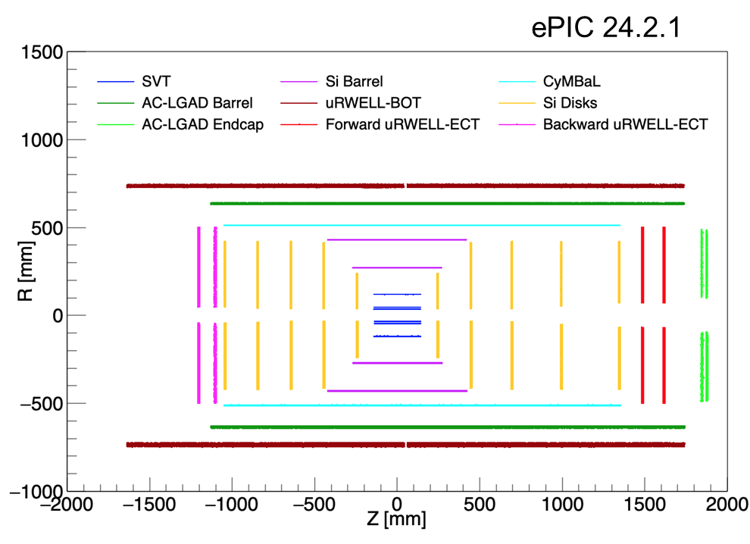
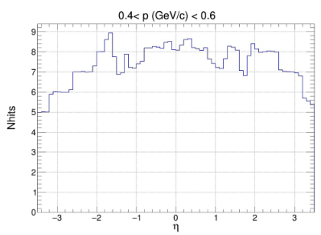
µRWELL-BOT for pattern recognition: Fast timing and additional hit point
ePIC Barrel Outer Tracker (µRWELL-BOT)
Fast timing layer together with the TOF & Inner MPGD (CyMBaL) to assist the slow Si trackers with pattern recognition.
What timing requirement? 10 - 20 ns or worse?
  Need clarification here from simulation ➔ detector design choices depend on that
Additional hit point to tracking for redundancy
  If hit point resolution is not required, how bad of the resolution is acceptable

Slide 6
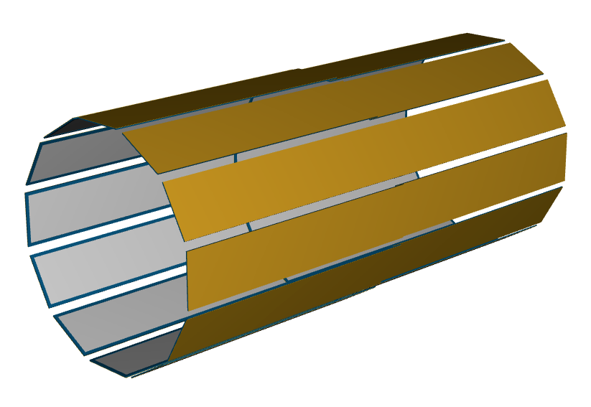
µRWELL-BOT Layout
µRWELL-BOT Layout
Coverage: L = 340 cm (−165 cm ≤ 𝑍 ≤ 175 cm) & R = 72.5 cm
24 planar modules configured in 12-sided polygon shape trackers
  Segmented into 12 sectors along azimuthal direction (phi)
  2 modules (left) & (right) per sector in z along beam axis
hpDIRC (barrel PID)
Barrel Outer Tracker
Left module
Right module
Technology:
Thin-gap & double amplification (GEM & µRWELL)
Capacitive-sharing U-V strip readout
  Nominal 70 µm for perpendicular tracks i.e. along phi direction
  On average 150 µm on for tracks in angle range [0, 45 degrees]
Fast timing layer ~ 10 ns
Radiation length < 2% in active area

Slide 7
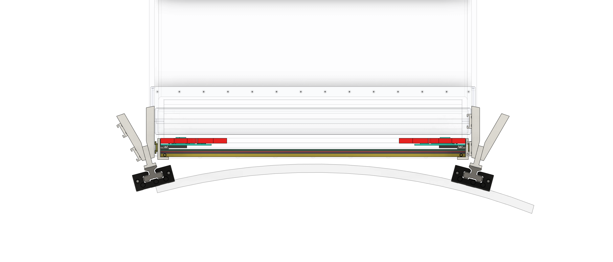
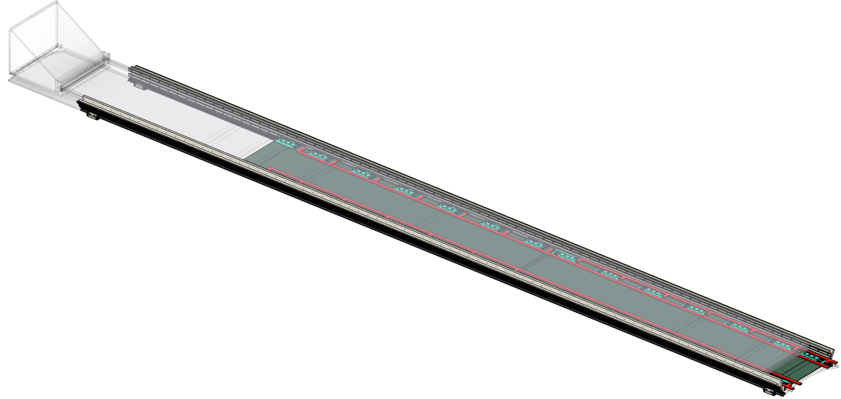
µRWELL-BOT Module: Services & Integration in ePIC
Service line
Main integration challenges:
Space limitation in ePIC detector environment
µRWELL-BOT detector envelop in ePIC
  In radial direction: 2.5 cm
Installed in support structure of barrel ECAL in front (from IP) of hpDIRC bar
Installation
dRICH have to be moved out 4 meters to remove BOT Or Remove DIRC
Removal & Service
Seung Joon’s talk at ePIC Coll. Meeting (July 2024)
https://indico.bnl.gov/event/20727/contributions/93669/attachments/56059/95920/BOTandECT.Integration.SeungjoonLee.pdf

Slide 8
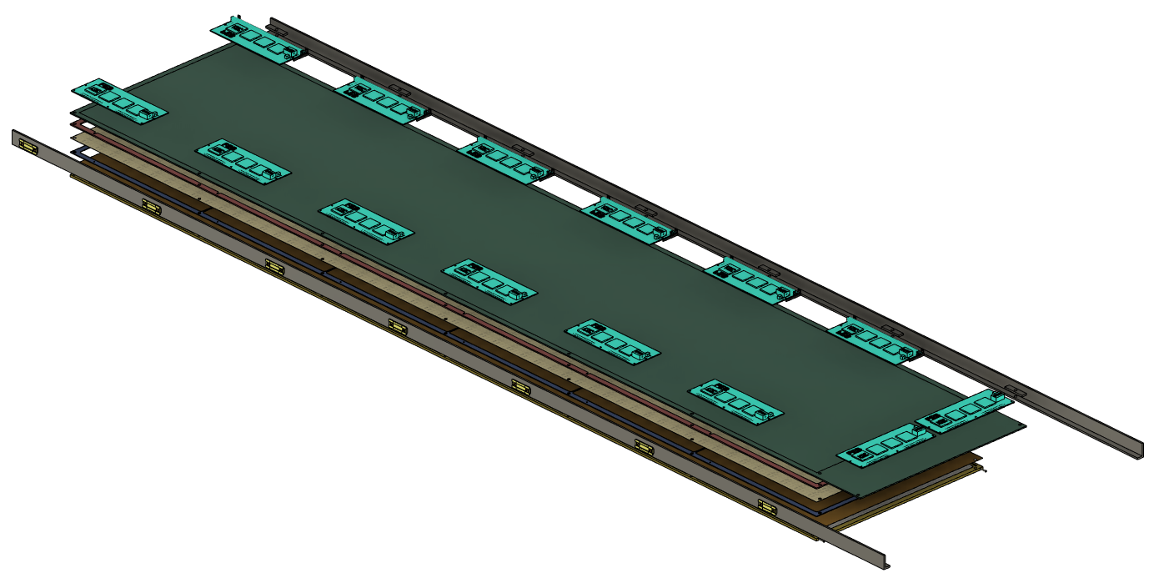
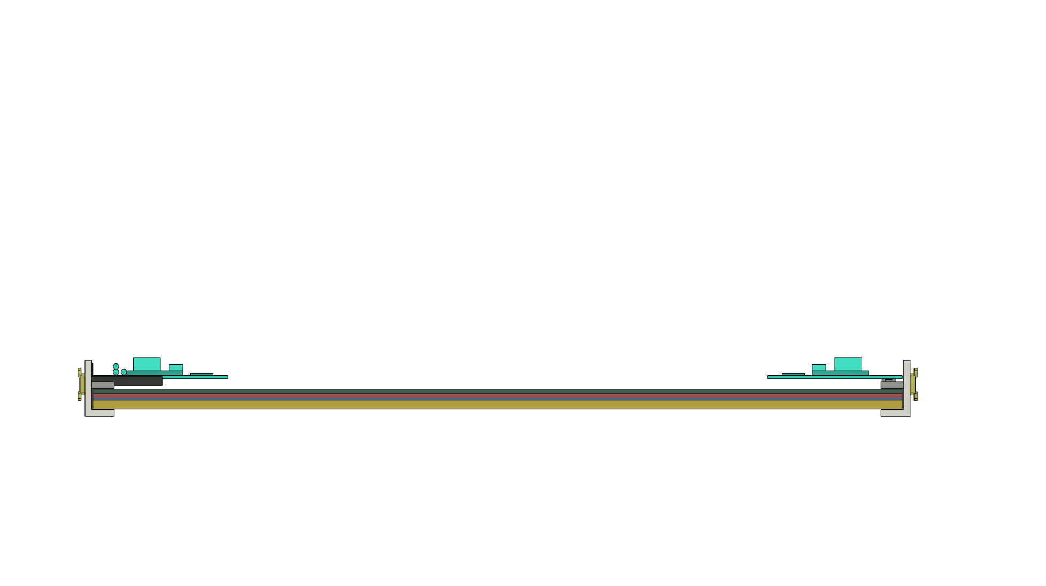
µRWELL-BOT Module: Integration & Services & integration in ePIC
Main integration challenges:
Space limitation in ePIC detector environment
µRWELL-BOT detector envelop in ePIC
  In radial direction: 2.5 cm
Installed in support structure of barrel ECAL in front (from IP) of hpDIRC bar
Optimization of the acceptance matching with hpDIRC
Dimension: 180 cm x 38 cm x 2.5 cm
F
B2B connector
Service area
SALSA-FEB
MPGD chamber
Seung Joon’s talk at ePIC Coll. Meeting (July 2024)
https://indico.bnl.gov/event/20727/contributions/93669/attachments/56059/95920/BOTandECT.Integration.SeungjoonLee.pdf
FEB support bracket

Slide 9
µRWELL-BOT Module: Thin-gap GEM-µRWELL Hybrid Detector
Active area 330 mm
3 mm honeycomb
G10 frames
readout PCB
µRWELL
GEM
cathode
cross-section view of thin-gap GEM-µRWELL detector
FEB
V-strips
U-strips
µRWELL-BOT module
Thin-gap (1-mm drift) hybrid amplification GEM-µRWELL
Capacitive-sharing U-V strips readout layers(45^{O} stereo angle)
Pitch: 1.14 mm (1790 U-strips and 1790 V-strips per modules)
On-detector Front End Boards (FEBs) based on SALSA chips
14 FEB / modules (assuming 4 SALSA chips i.e 256 e-ch / FEB)
Connectors on the back of the modules (no need for flex cables)
Top view
330 mm
360 mm
1700 mm
Back view
1800 mm

Slide 10
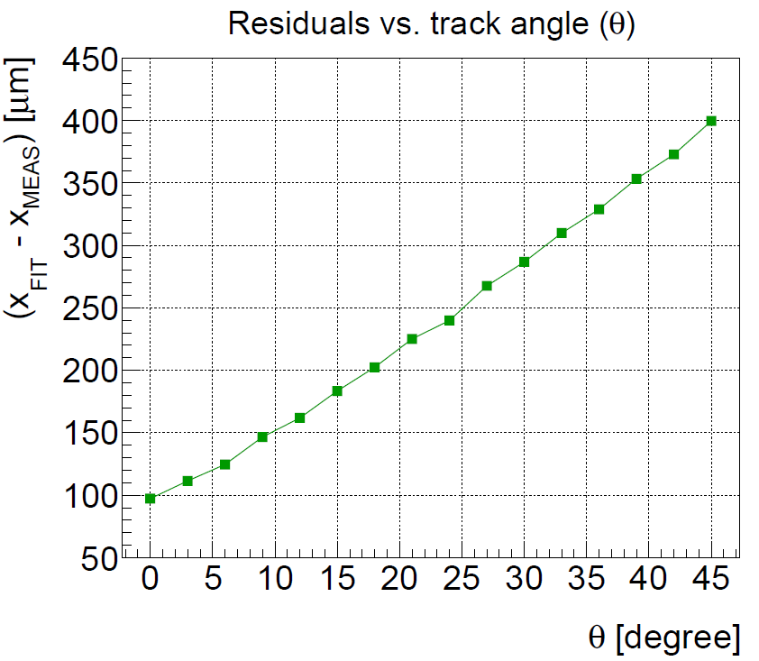
Technology choice: Thin-gap GEM-µRWELL Hybrid Detector
Challenges with standard (~3 mm drift gap) MPGDs
Degradation of the spatial resolution with track angle .
E × B in magnetic field negatively impact resolution
Development of Thin-gap MPGDs (~1 mm drift gap):
Improve spatial resolution at large angle
Reduce E × B effect in magnetic field
        Improve the detector timing resolution
        Trade off ➔ lose a couple of % in detector efficiency
Technology: Thin-gap GEM-µRWELL hybrid detector
hybrid amplification MPGD:
  GEM (preamplification) and µRWELL (main amplification)
  Large detector gain & stable operating HV
Readout layer: 3-layer capacitive-sharing U-V strip readout
  Achieve excellent spatial resolution with thin gap detector
Active area 36 cm
Active area 34 cm
3 mm honeycomb
G10 frames
µRWELL
GEM
cathode
3 mm μRWELL prototype
readout PCB
FEB
cross-section view of thin-gap GEM-µRWELL detector
https://wiki.bnl.gov/eic/upload/ERD_tgMPGD_FY22_endOfYearReport_final.pdf

Slide 11
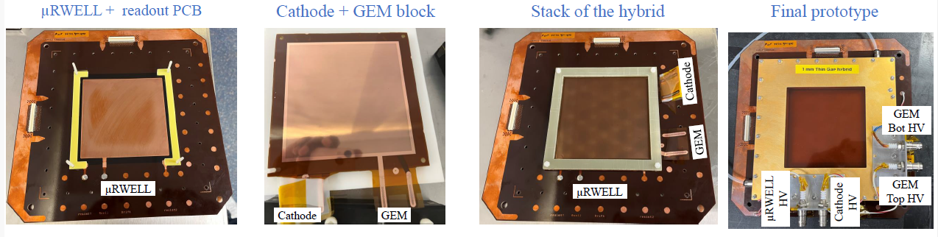
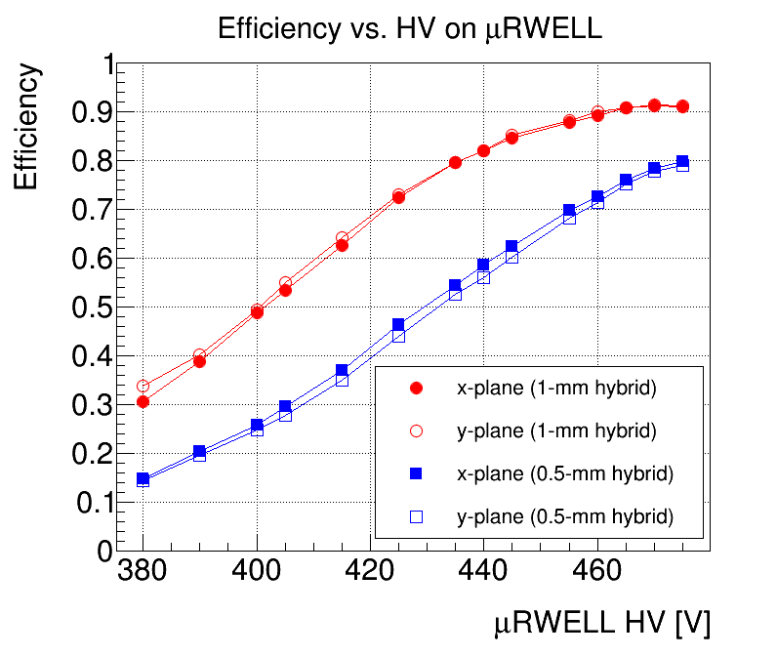
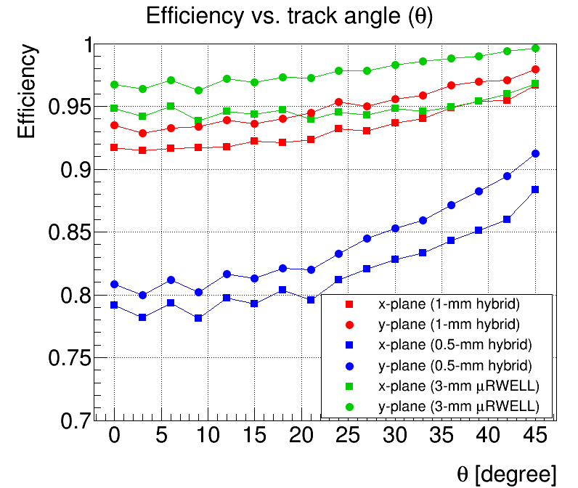
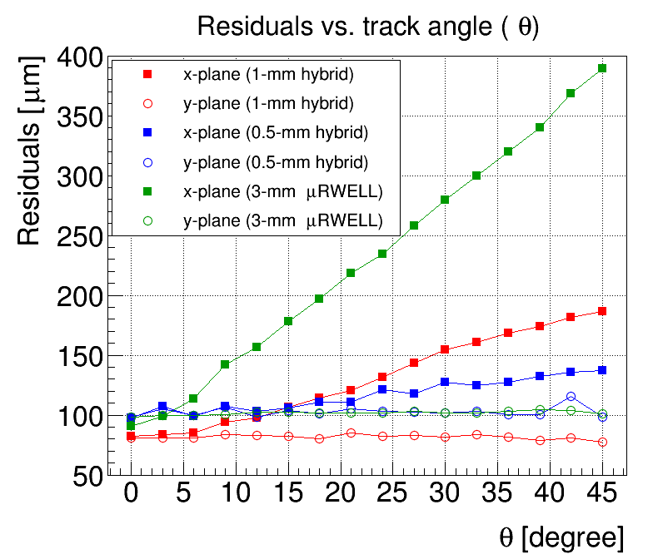
Technology choice: Performance of thin-gap GEM-µRWELL in test beam
Proof of concept
Concept of thin-gap GEM-µRWELL hybrid prototype demonstrated in beam test at the Fermilab Test beam Facility in Summer 2023 (red plots)
Space resolution < 150 µm and efficiency of 92% on average for 1-mm thin-gap GEM-µRWELL prototype (red dots) and for track in an angle range between 0 – 45 degrees.
R&D funded by JLab administered DOE EIC Generic R&D Program as EICGENRandD_2022_23
Efficiency
Residuals
Efficiency
Baseline technology for ePIC Barrel Outer MPGD tracker
https://wiki.bnl.gov/eic/upload/ERD_tgMPGD_FY22_endOfYearReport_final.pdf

Slide 12
Few consideration on technology choice options: based on personal experience
“Slow” gas mixture like Ar-iC₄H₁₀ (90/10)
 | efficiency | spatial resolution | Timing resolution | E × B
Thin (1 mm) gap hybrid amplification – 2D readout |  (need to be demonstrated) |  |  |  (optimized)
Standard (3 mm) gap single amplification – 2D readout |  |  |  |  (acceptable)
Standard (3 mm) gap hybrid amplification – 2D readout |  |  |  |  (acceptable)
Efficiency:
 < 95% < 
Spatial resolution:
< 150 µm < 
timing resolution:
< 20 ns < 
E× B effect:
< 20 degree < 
“Fast” gas mixture like Ar/CO2 (70/30)
 | efficiency | spatial resolution | Timing resolution | E × B
Thin (1 mm) gap hybrid amplification – 2D readout |  (~90% for perpendicular tracks) |  |  |  (minimized)
Standard (3 mm) gap single amplification – 2D readout |  |  |  | 
Standard (3 mm) gap hybrid amplification – 2D readout |  |  |  | 

Slide 13
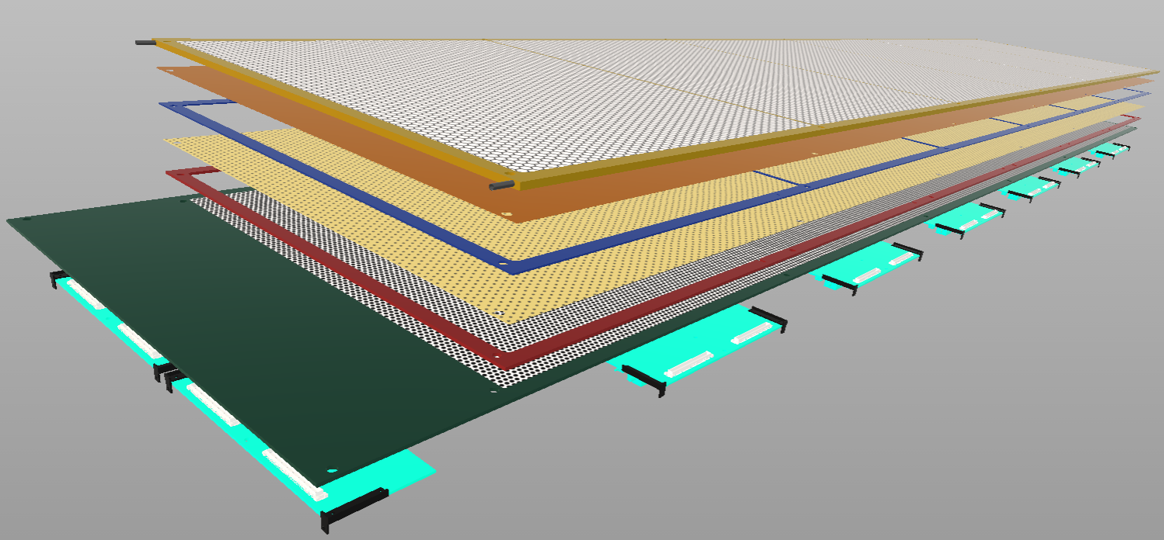
PED Engineering Test Article: Design of µRWELL-BOT module
Top honeycomb support
Cathode foil
Drift frame
GEM foil
induction frame
µRWELL foil
PED engineering test article module (2024–2025):
Full scale 1-mm thin-gap GEM-µRWELL prototype
Validation of the concept on large area detector
Will address production and integration challenges of ePIC
Design at JLab and CERN MPT workshop ongoing
Test article module fabrication completion 2024
Expect to be tested in beam at FNAL summer 2025
UV readout PCB
FEBs

Slide 14
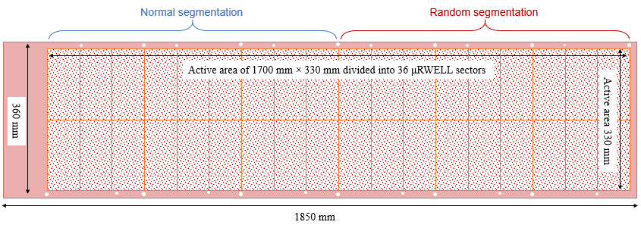
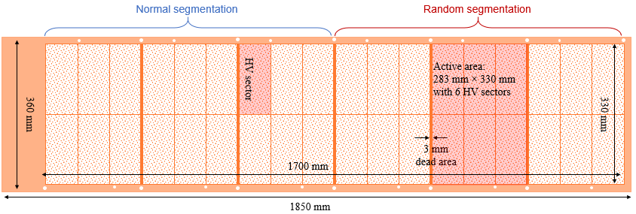
Design consideration: µRWELL PCB and GEM foil (JLab & CERN MPT)
µRWELL PCB:
Active area divided into 36 HV sectors (~ 156 cm²)
Same segmentation pattern as the GEM foil ➔ minimize dead area
GEM foil:
foil divided into 36 HV sector ~ 156 cm²
Trade-off between active-to-dead area ratio for gap uniformity (~1% dead area)
New concepts to be tested to enhance performance:
Random HV segmentation of both GEM and μRWELL
Higher hole density (pitch 100 µm instead of 140 µm)
Design of both uRWELL and GEM is being finalized a lot of back and forth between CERN MPT workshop and JLab RD & I Group
Parts delivery is expected by December 2024 – January 2025

Slide 15
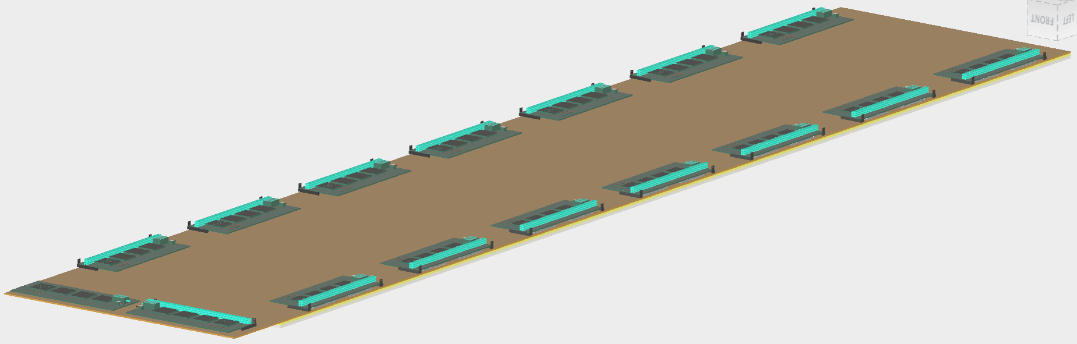
Design consideration: 2D (U-V)-strip readout layer
3-layer capacitive-sharing U-V strip readout
Strip pitch: 0.8 mm (along U and V axis)
Trace pitch: 1.14 mm along horizontal axis (traces(
Max strip length is 46.7 cm
1780 U-strips + 1780 V-strips
7 FEBs / U (V) planes ➔ 14 FEBs / µRWELL-BOT modules
140-pins Hirose connectors
All connectors on the back of the rigid µRWELL / readout PCB
1.14 mm
V-strips
U-strips
U-V strip configuration
0.8 mm

Slide 16
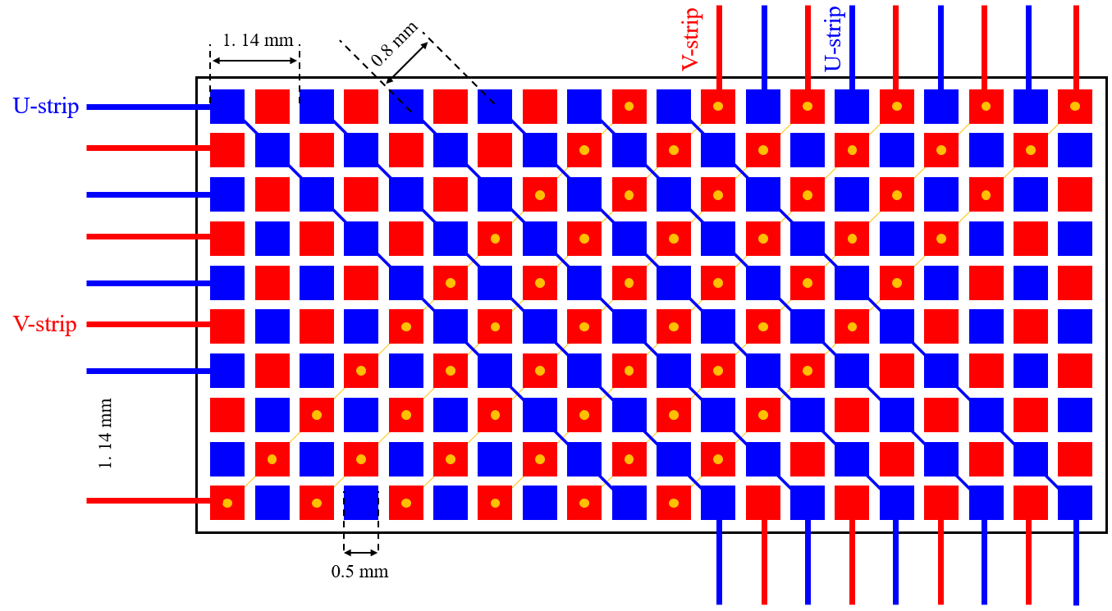
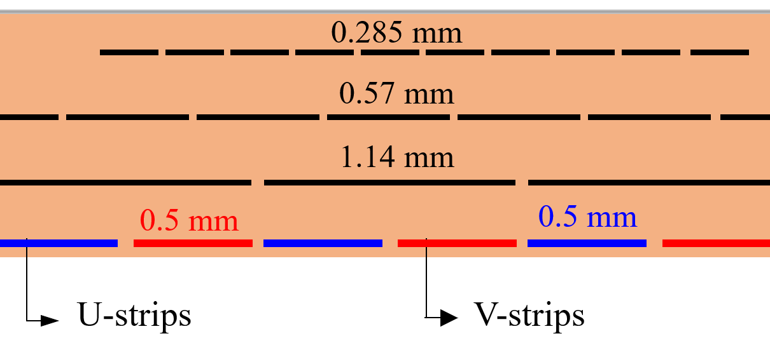
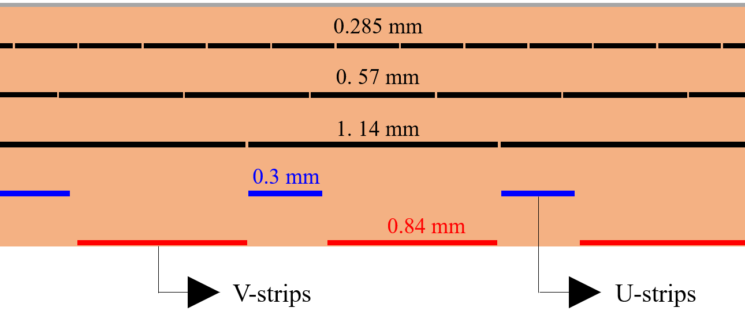
Design consideration: 2D (U-V)-strip capacitive-sharing readout options
ASACUSA-like R/O design
COMPASS-like R/O design
ASACUSA-like design: preferred option
Equal U-V charge sharing guaranty
Perfect one-to-one matching with pads capacitive sharing layer 3 pad
But large number of vias ➔ challenging fabrication issues.
COMPASS-like design: alternative option
Fabrication easier for Rui’s workshop
Need to fine tune parameter for equal U-V sharing ➔ width of top and bottom strips
Might require a couple of iteration
No vias in the active area
1.14 mm
0.8 mm
V-strips
U-strips
cross-section view of 3-layers capaSh readout
cross-section view of 3-layers capaSh readout
https://doi.org/https://doi.org/10.1016/j.nima.2022.167782

Slide 17
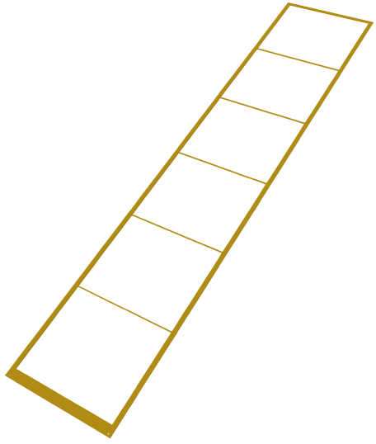
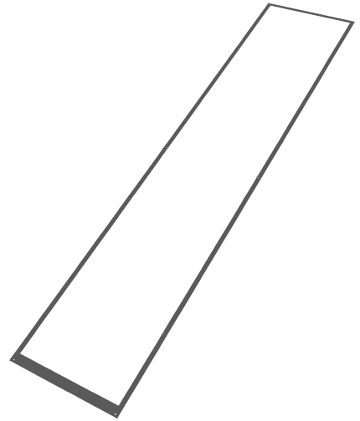
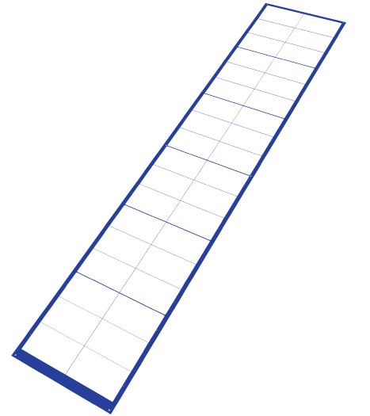
Design consideration – Support frames
Honeycomb support: Top frame
GEM top support: Drift Frame
GEM bottom support: Induction Frame
2 mm wide spacers divide the active area into 6 sectors
36 × 500 µm wide spacers to keep uniform gap in drift region ➔ match the 36 HV sectors
No spacers in induction frame ➔ no contact with µRWELL
µRWELL foil
Honeycomb support
Capacitive-sharing X-Y strip readout
Cathode foil
GEM foil
Fully assembled detector

Slide 18
Plans & timeline for PED Engineering Test Article: µRWELL-BOT module
Jan 2024 – Dec 2024: Mechanical drawing of all parts of the detector almost completed
Dec. 2024 – Jan. 2025: Complete design of GEM foils, μRWELL PCB and U-V capacitive-sharing readout ➔ JLab RD&I – CERN MPT
October 2024 – March 2025: Setup class 1000 Clean Room at JLab with all required equipment and infrastructure for test and assembly of the μRWELL-BOT engineering test article module
End January 2024: Expect delivery of the GEM foils, μRWELL PCB and U-V capacitive-sharing readout
March 2025 – June 2025: HV test of the GEM foils, μRWELL PCB and assembly into a detector in clean room
June / July 2025 – : Characterization of μRWELL-BOT engineering test article in cosmic and in beam test (Fermilab or CERN)

Slide 19
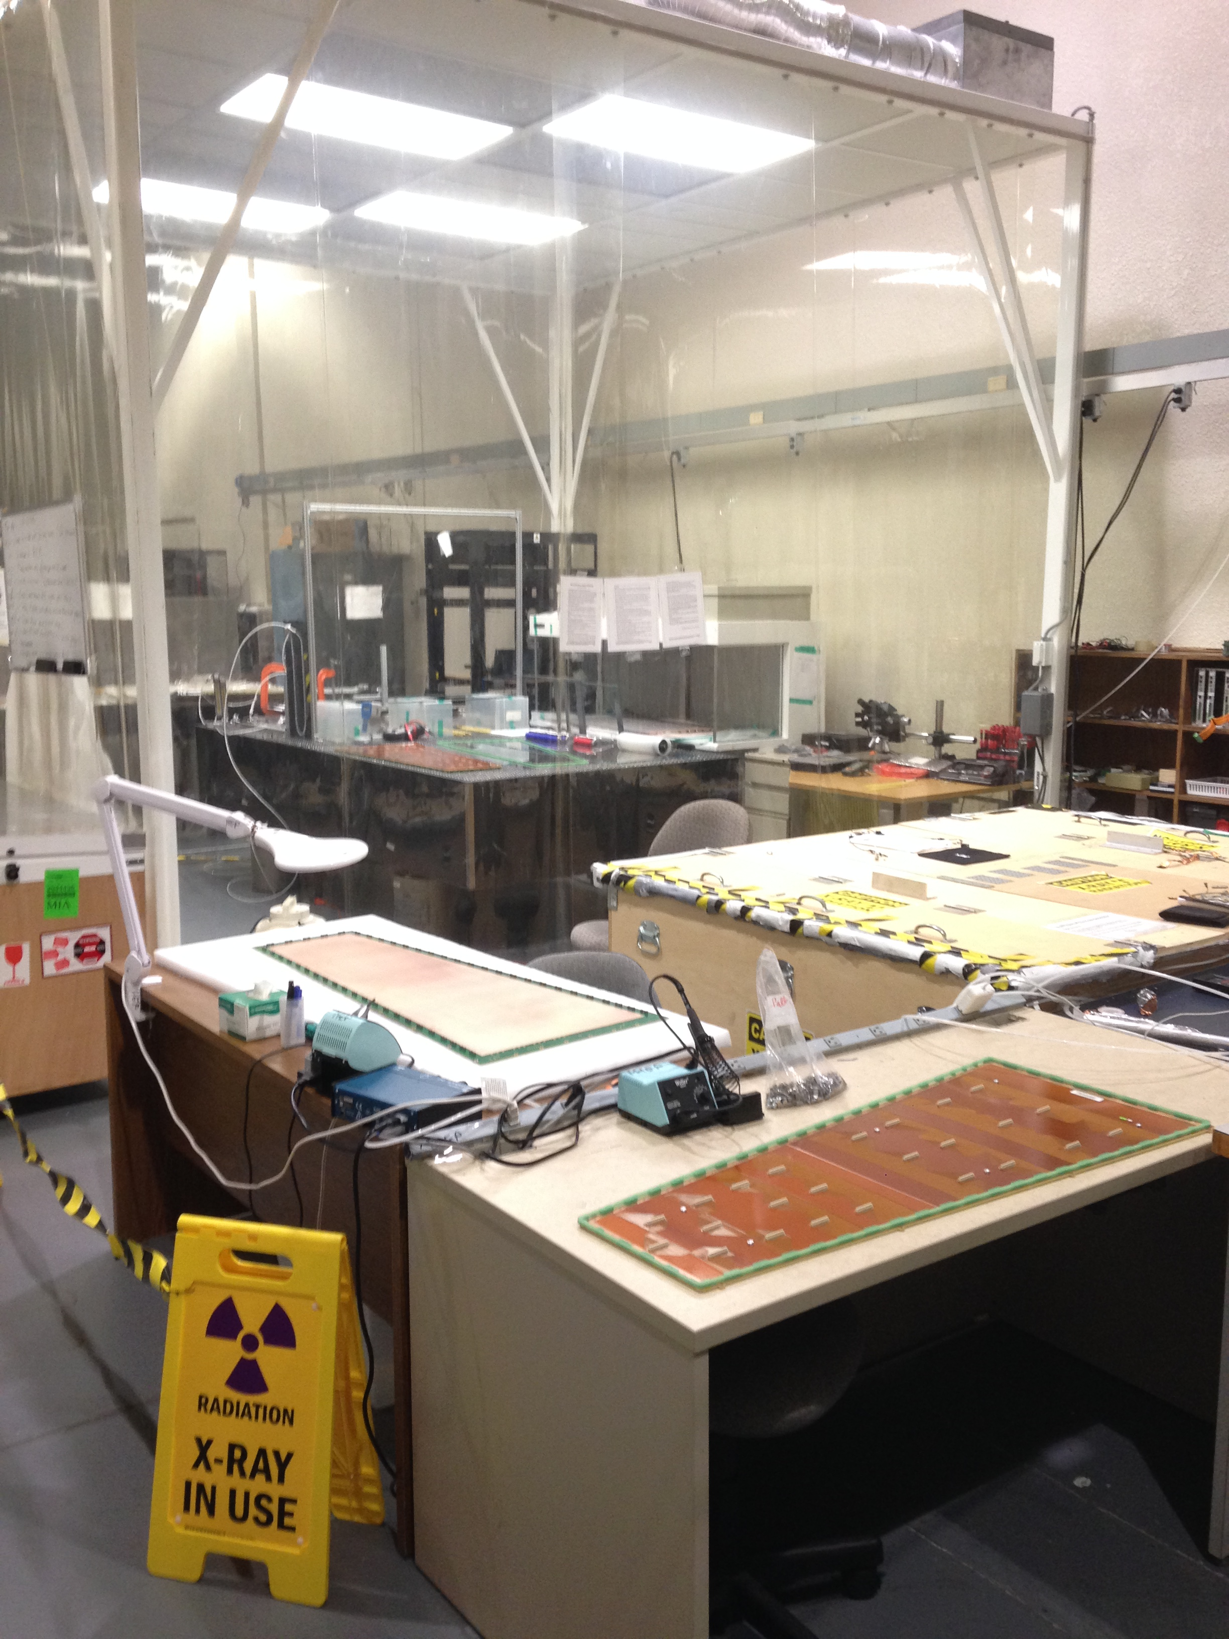
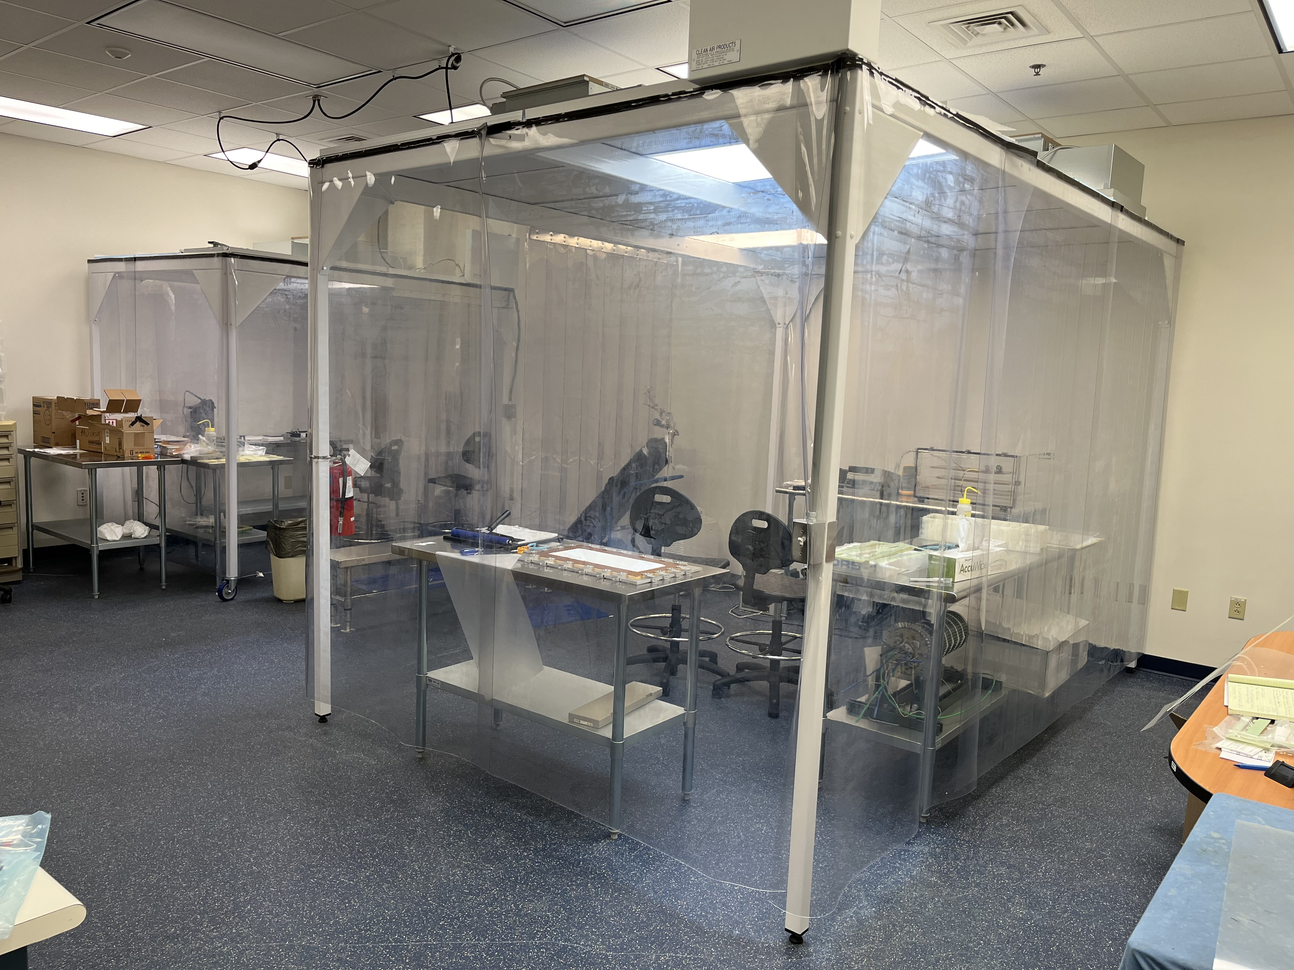
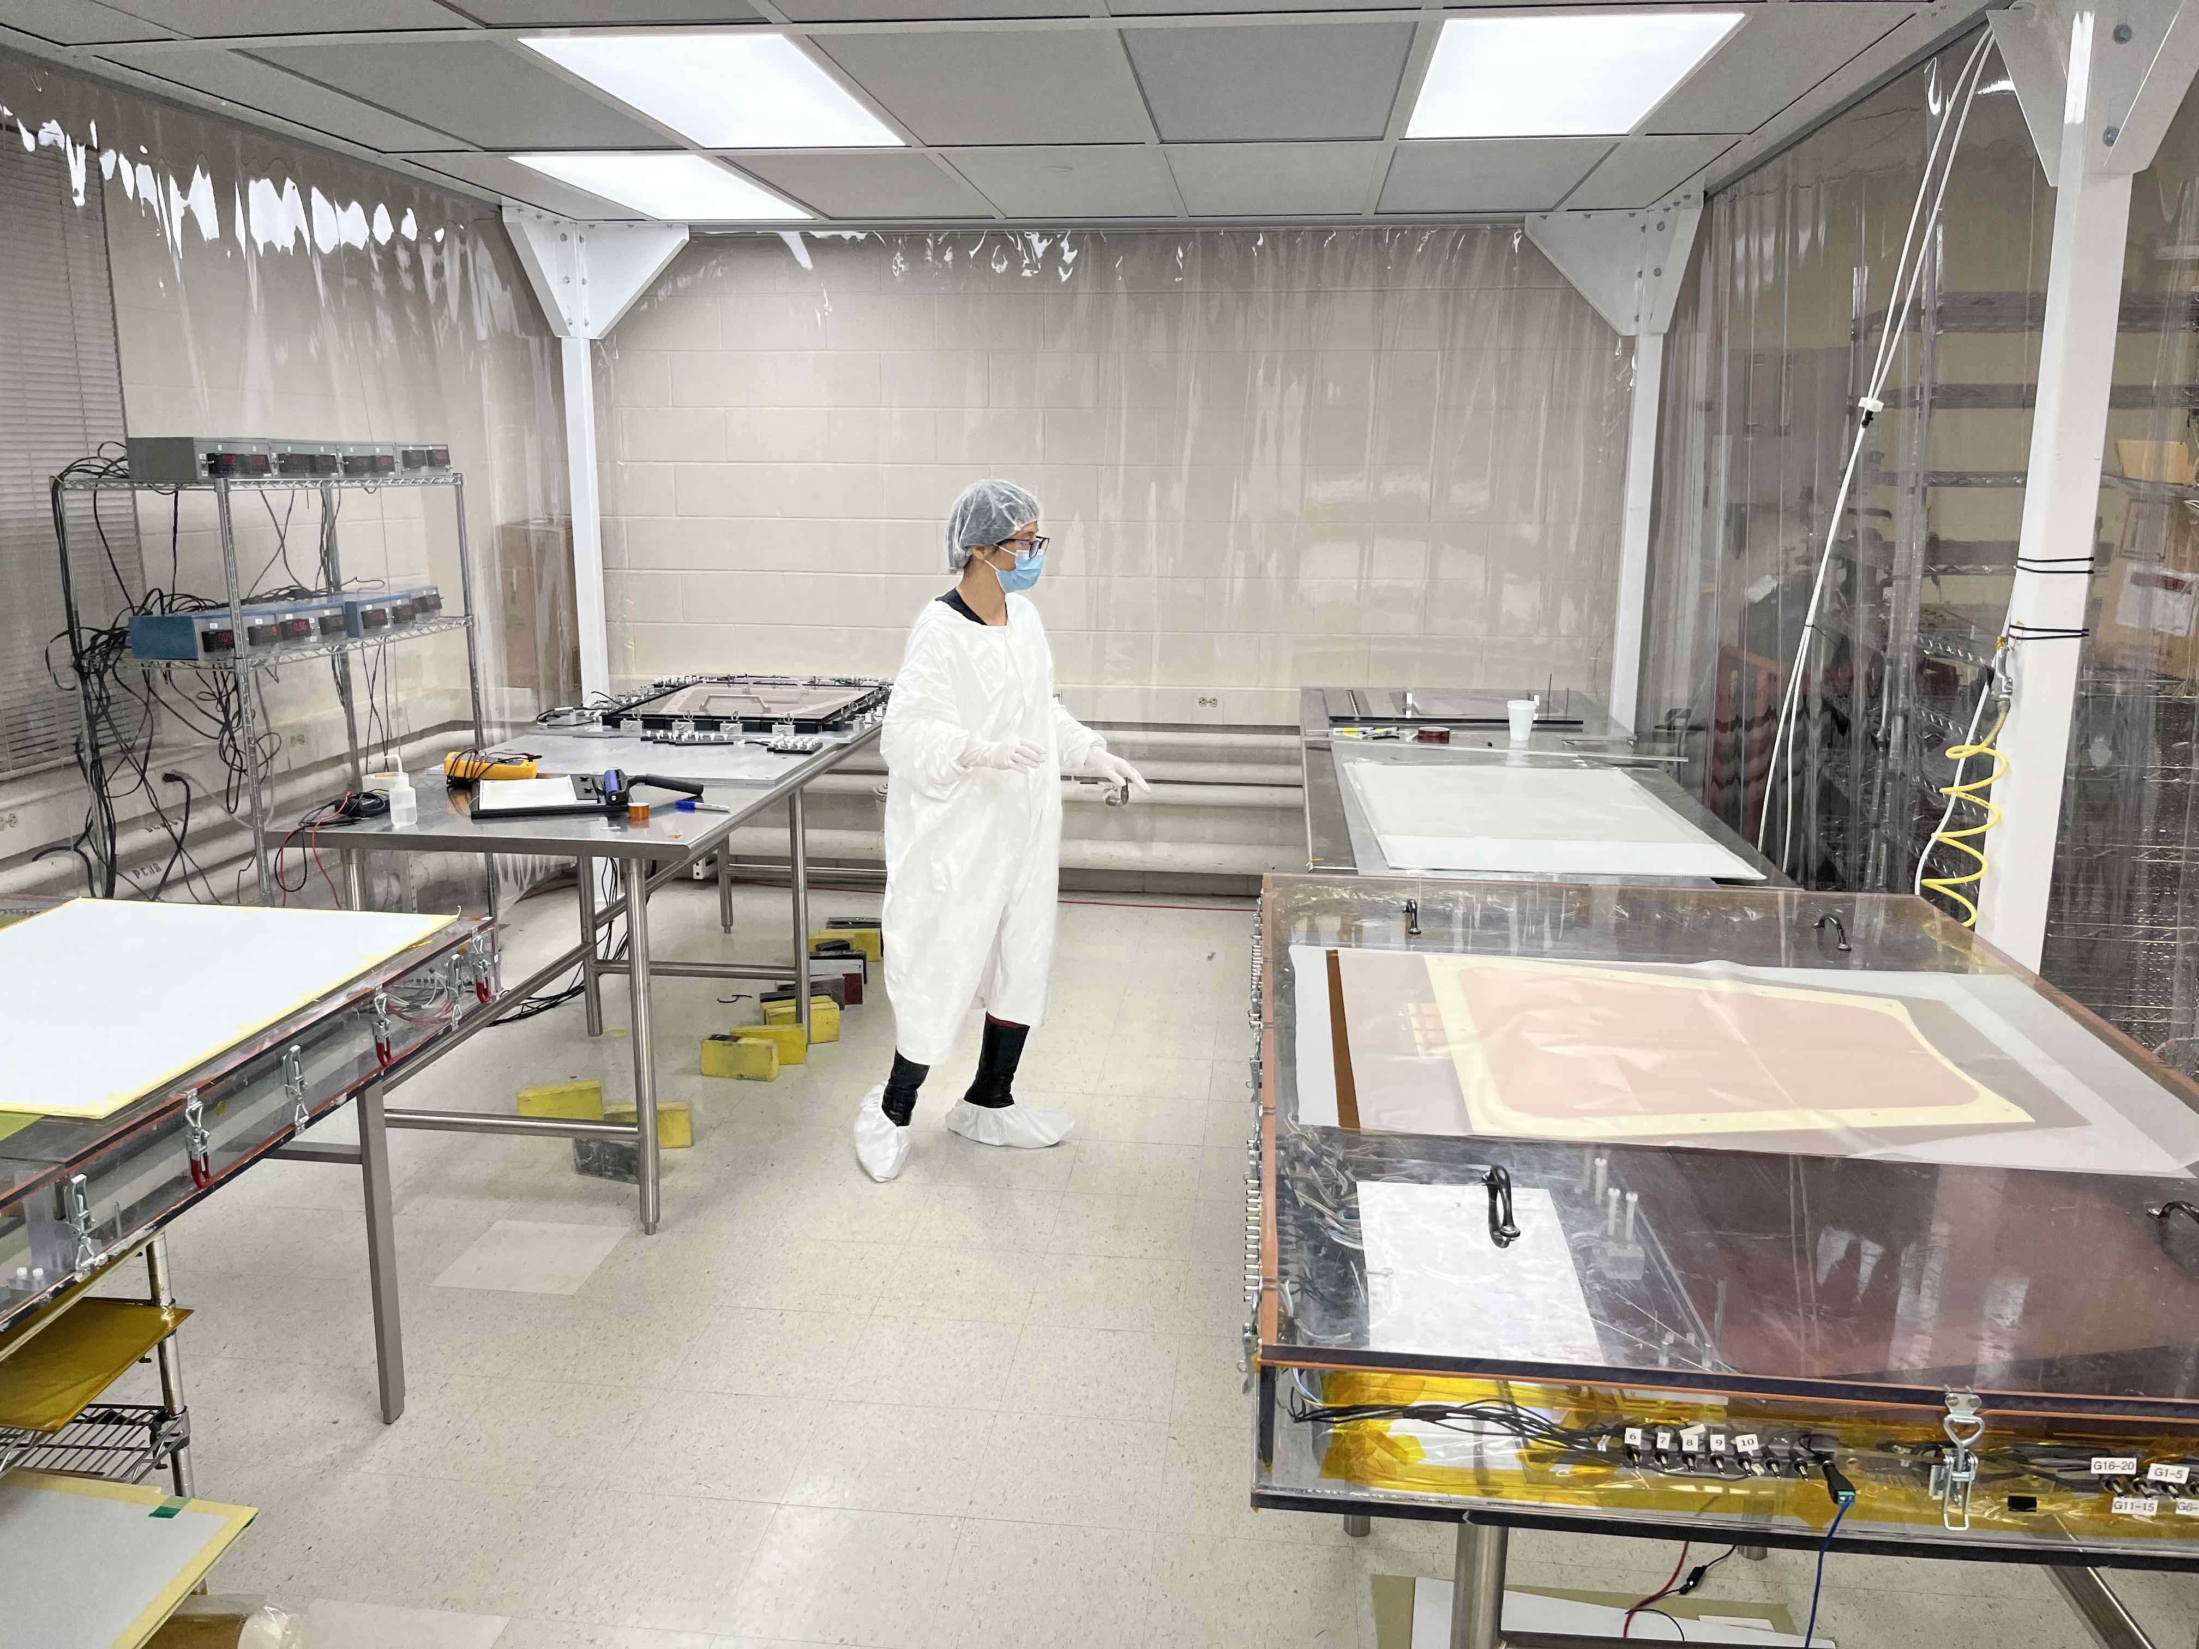
Assembly plans for the production modules: Equipment at the assembly sites
3 assembly sites with fully equipped MPGD Detector Lab
  Fully equipped CLASS 1000 Clean rooms for module assembly
  Cosmic tracking telescope setup with coincidence trigger counters and readout & DAQ system
  X-ray setup for high rate studies and long term stability …
  Will setup DAQ and readout system for SALSA – MPGD readout system
FIT Clean Room: assembly of
CMS GE1/1 GE2/1 and ME0 GEMs
JLab MPGD Clean Room: New capacity for large MPGD module assembly
UVa Clean Room: SBS GEMs, MOLLER GEMs, PRad GEMs, CLAS12 µRWELL, Hall D GEM-TRD prototype
CMS GEMs
Moller GEM foil

Slide 20
Assembly plans: Planning & schedule
06/2025
06/2026
04/2029
06/2029
PED & validation
Pre-production
Production
Shipment to BNL
Commissioning & Installation
Ongoing design of full size µRWELL-BOT module
Procurement of GEM foils, µRWELL PCB – 12 / 2024
Assembly at JLab test in at FNAL - 06/2025
Assembly of one pre-production module (module#0)
Setup of infrastructure and equipment in assembly sites
Assembly and QA of 9 production modules at assembly sites
Full characterization at assembly sites of each module on cosmic stand and with radioactive sources
Shipment of all 24 modules to BNL
Commissioning at BNL cosmic test stand of all µRWELL-BOT as well as µRWELL-ECT
Commissioning
Installation

Slide 21
Summary
The ePIC Barrel Outer MPGD Tracker (µRWELL-BOT) is based on thin-gap GEM-µRWELL amplification technology
µRWELL-BOT provides improved tracking option to the hpDIRC and pattern recognition with fast timing hit to Si tracker in the barrel
Design of the µRWELL-BOT is well advanced and integration issues and mechanical constraints are being addressed in the design
The engineering test article pre-production module is under development and expected to be validated by Summer 2025
Preliminary plans and schedule for the production of µRWELL-BOT modules in assembly sites is initiated
The ePIC MPGD DSC is established and very active with several institutions with vast experience with large MPGD productions

Slide 22
Backup

Slide 23
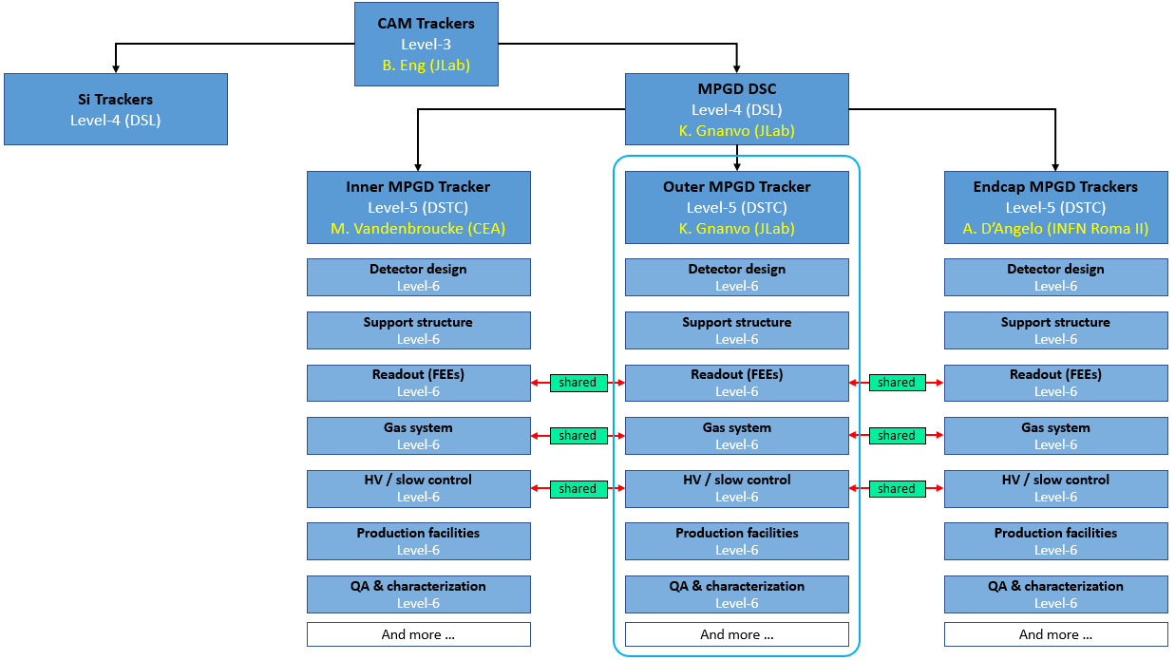
MPGD-DSC: Organization of ePIC MPGD Subsystem Collaboration
Outer MPGD Tracker: Module assembly
Production sites: University of Virginia (UVa), Florida Institute of Technology (FIT) and Jefferson Lab (JLab)
Vast experience with large scale and large MPGD projects among the 3 institutions
10 modules per site (8 + 2 spares)
Welcome to new institutions to join the effort

Slide 24
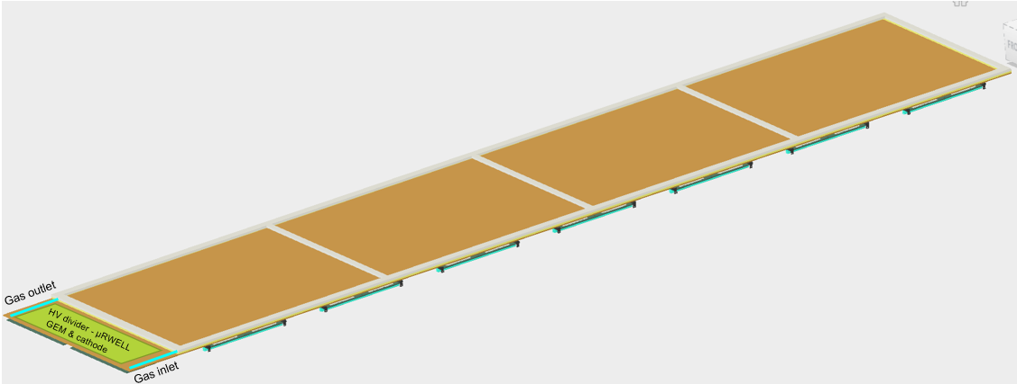
Design consideration: µRWELL-BOT module
Front view of the µRWELL-BOT module design
back view of the µRWELL-BOT module design

Slide 25
Design consideration: Honeycomb frame
3 – 5 mm honeycomb
1720 mm
1700 mm
honeycomb
360 mm
330 mm
3 mm

Slide 26
Design consideration: Drift frame
3 – 5 mm honeycomb
Active area 1700 mm
360 mm
Active area 330 mm
0.4 mm
165 mm
2 mm
89 mm
0.4 mm
283 mm
1720 mm

Slide 27
Design consideration: Induction frame
3 – 5 mm honeycomb
1720 mm
1700 mm
360 mm
330 mm

Slide 28
Assembly plans: ES&H
ES&H procedure will derived from past experience in each assembly site with similar system
  Non flammable operation gas mixture Ar / CO2 ➔ no special safety concern or implementation procedure needed
  HV supply via simple passive divider ➔ Procedure to isolate any electric point on the detector
  Will follow JLab ES & H procedures for handling radiation sources during QA at the lab
  Similar procedures will be implemented in the various institutions
  Will have all these procedure documented in the appropriate ePIC documentation database (for example EICLOG @ JLab)

Slide 29
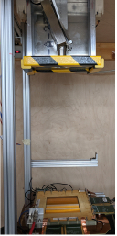
Assembly plans: Quality Assurance (QA)
Test and characterization of µRWELL-BOT modules
  HV test in N₂ of GEM and µRWELL sectors before, during and after assembly (in clean room)
  Gas leak test and sealing after module assembly
  Electrical connection capacitance and pedestal noise test of all U & V and strips
  Tag dead strips and replace FEB cards with dead readout channels
  Efficiency and relative gain uniformity studies with cosmic setup
  absolute gain measurement with radioactive source (local measurement)
  Large 2D X-Ray scanner for absolute gain uniformity (JLab)
UVa X-Ray box

Slide 30
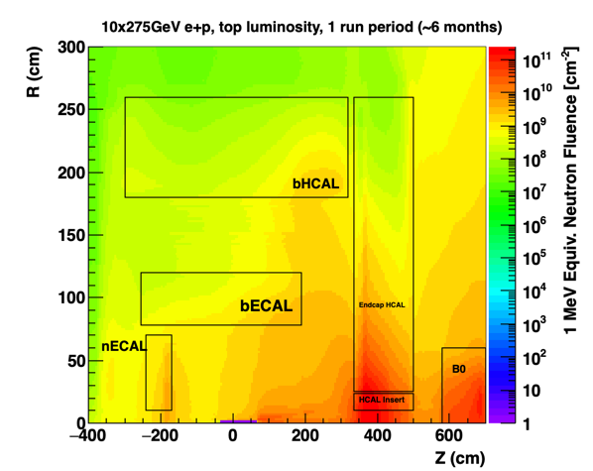
Design consideration: Some General considerations
Charge 2,3
Rate Capability
    Not critical ~ 1 kHz/cm² or less
Radiation Hardness
    Not critical for the detectors
    Important for FEBs and RDO electronics boards
Temperature Stability
    Not critical for the detector performances
    Detector calibration should consider gas pressure variations
Electronics power consumption and cooling
    SALSA ASIC consumption ~ 15 mW/ channel at 1.2V
    Air vs liquid cooling is under study at Saclay – see Irakli’s talk
1 MeV neutrons
4 × 10⁹
µRWELL-BOT

