Slide 1
Electron ID performance
Currently implemented algorithm:
Require negative particles with 0.9 < $E/p$ < 1.2, take particle with largest $E-p_{z}$
Using reconstructed energy and momentum, but truth track-cluster matching
Success/failure rates from simulation (Pythia8 NC DIS, tag 24.06.0) (note all events have $Q^{2}$ > 1 GeV²)
 | Success | Fail, no ID (reduced acceptance) | Fail, wrong ID (contamination)
5x41 GeV | 87.3% | 9.9% | 2.8%
10x100 GeV | 91.5% | 6.5% | 2.0%
18x275 GeV | 80.7% | 16.0% | 3.3%
Subject to increase with inclusion of photoproduction, min-bias events

Slide 2
Impact of electron ID algorithm on acceptance
$$C_{acc}=\frac{N_{rec}(x_{gen},Q_{gen}^{2})}{N_{gen}(x_{gen},Q_{gen}^{2})}$$
True ID
eID
ePIC 24.06.0
ep 18x275 GeV
Pythia8 NC DIS
$Q^{2}$ > 2 GeV²
$W$ > 4 GeV
0.05 < $y$ < 0.95
$≥$99% acceptance nearly across the board, excepting edges of acceptance
Reduced acceptance everywhere, some regions down from 99% to 70%

Slide 3
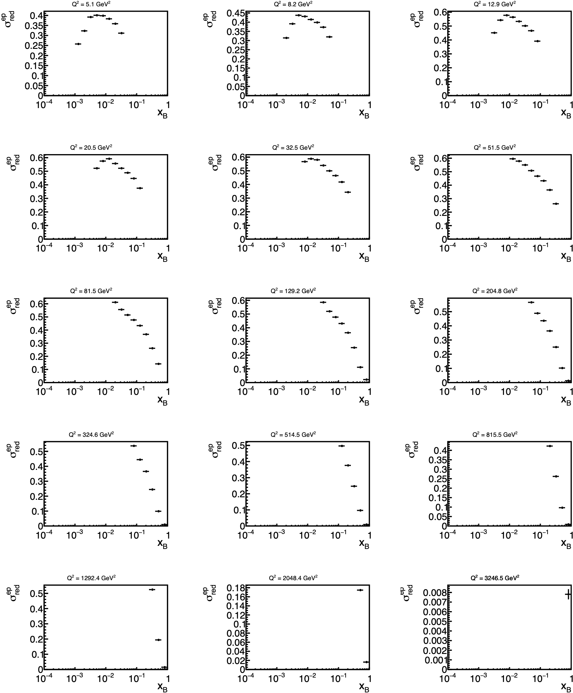
Inclusive observables: NC reduced cross section
$$\frac{dσ}{dx_{B}dQ^{2}}=\frac{N}{C_{acc}⋅C_{bin}⋅L⋅Δx_{B}ΔQ^{2}}$$
Acceptance, bin migration corrections obtained from simulation
Scaled to integrated luminosity $L$ 10 fb⁻¹.
$$σ_{red}=\left(\frac{dσ}{dx_{B}dQ^{2}}\right)⋅\frac{Q^{4}x_{B}}{2πα^{2}Y_{+}ℏ^{2}c^{2}}$$
$$Y_{+}=1+(1-y)^{2}$$
$Q^{2}$ > 2 GeV²
$W$ > 4 GeV
0.05 < $y$ < 0.95
ePIC 24.06.0
10x100 GeV

Slide 4
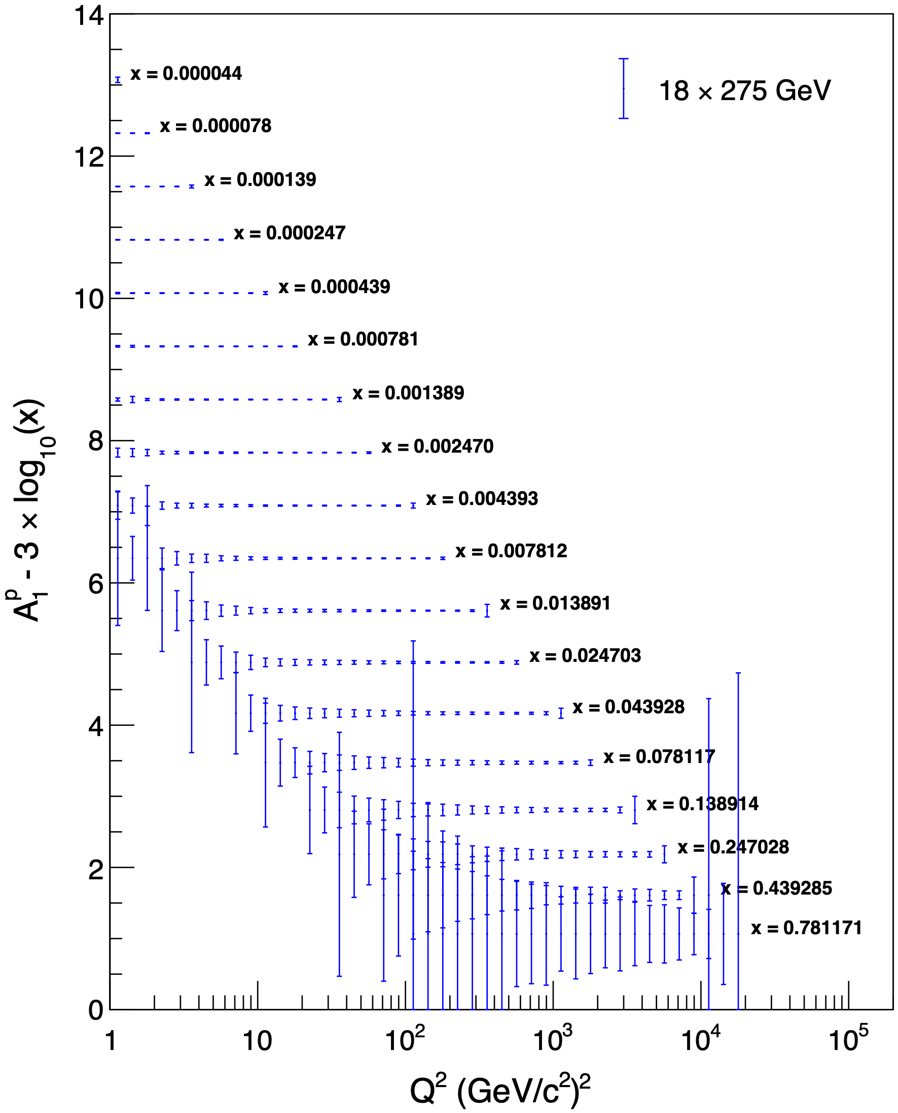
Inclusive observables: double-spin asymmetry
Work by Win Lin
ePIC 24.04.0
0.01 < $y$ < 0.95
$A_{||}=\frac{σ_{↓⇑}-σ_{↑⇑}}{σ_{↓⇑}+σ_{↑⇑}}$, $A_{⊥}=\frac{σ_{↓⇒}-σ_{↑⇒}}{σ_{↓⇒}+σ_{↑⇒}}$
$$→A_{1}≈g_{1}/F_{1}$$
Use model to calculate $A_{1}$ for each bin (bin center)
$δA_{||,⊥}=\frac{1}{\sqrt{N}P_{e}P_{p}}$, propagated to $δA_{1}$
Scaled to total luminosity $L$ = 10 fb⁻¹ (2.5 fb⁻¹ per spin configuration)

Slide 5
In progress
Electron ID/reconstruction (see Electron ID & Holistic Reconstruction workfest!):
Track-cluster matching
Calorimeter shower shape cuts
Resolution-weighted electron energy (tracking and calorimeter)
Quantifying systematics:
Acceptance/resolutions
Energy calibration
Pion contamination

