Slide 1
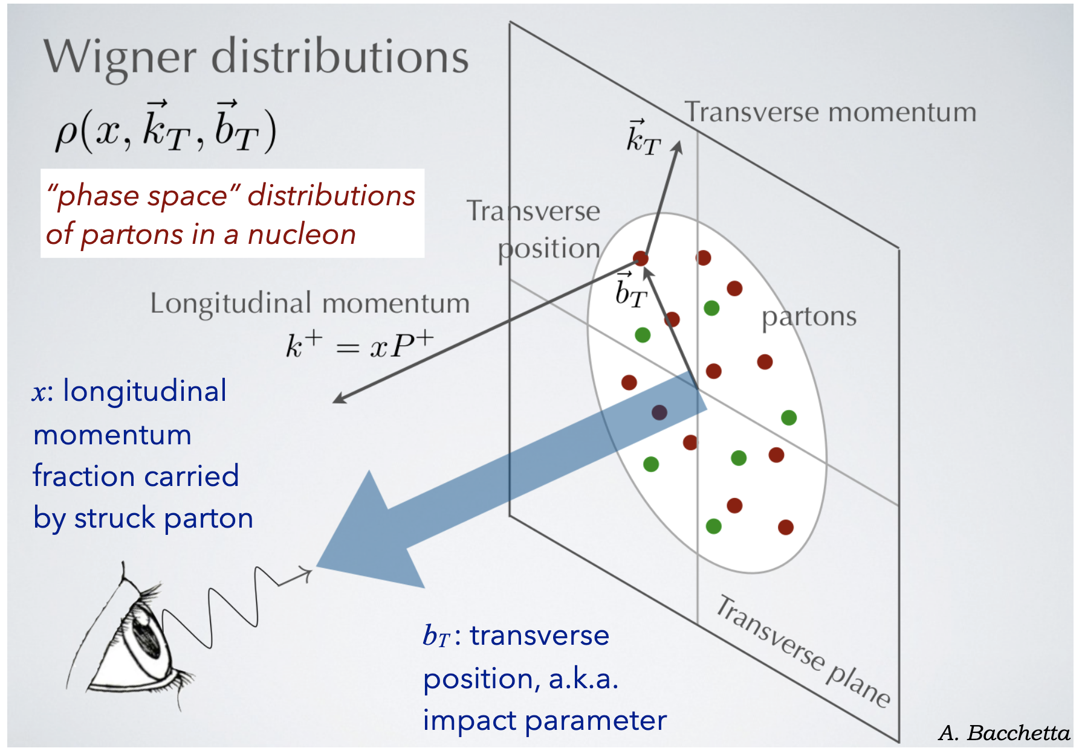
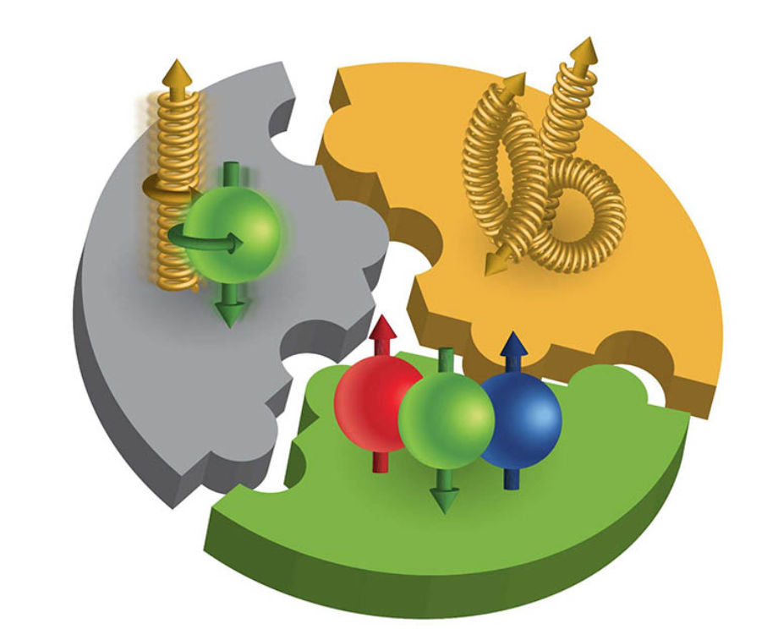
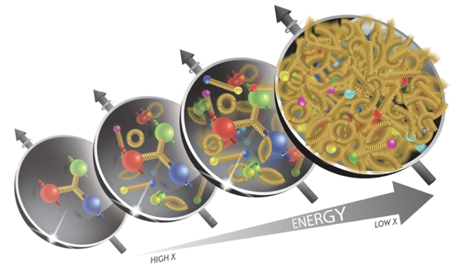
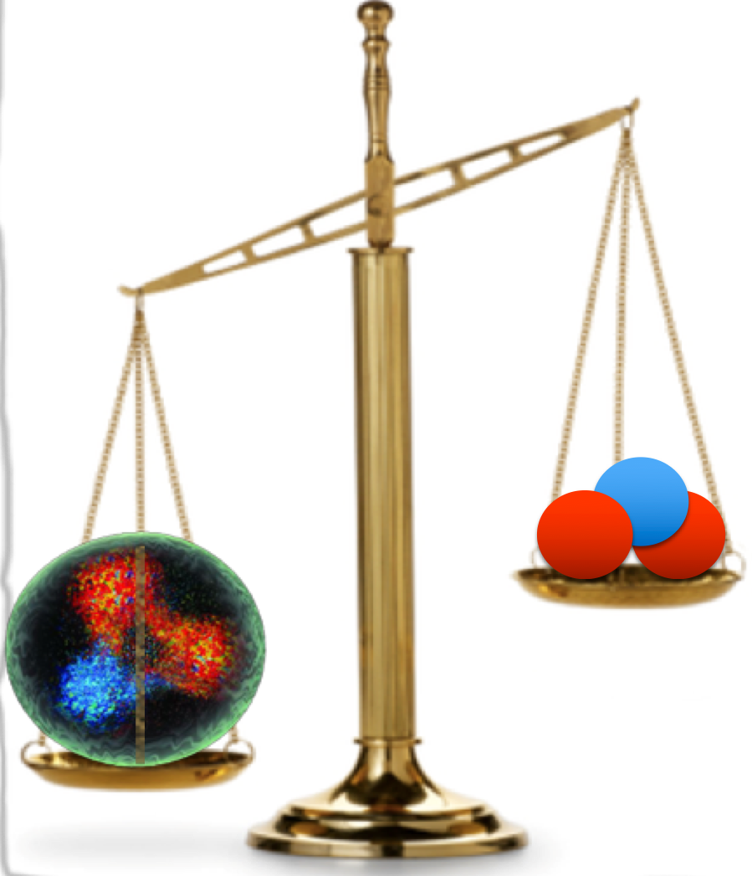
Exclusive, Diffractive and Tagging Physics Working Group
Group encompasses numerous different reactions
Many on-going and planned studies
Different NAS topics linked to on-going EDT PWG activities:
Origin of nucleon spin
3D structure of nucleons and nuclei (tomography)
Gluon structure of nucleon/nuclei
Origin of hadron mass
Open to any science beyond this and to extending the scope to more topics…!
Nucleon
Bare Quarks
Nucleon
<numéro>

Slide 2
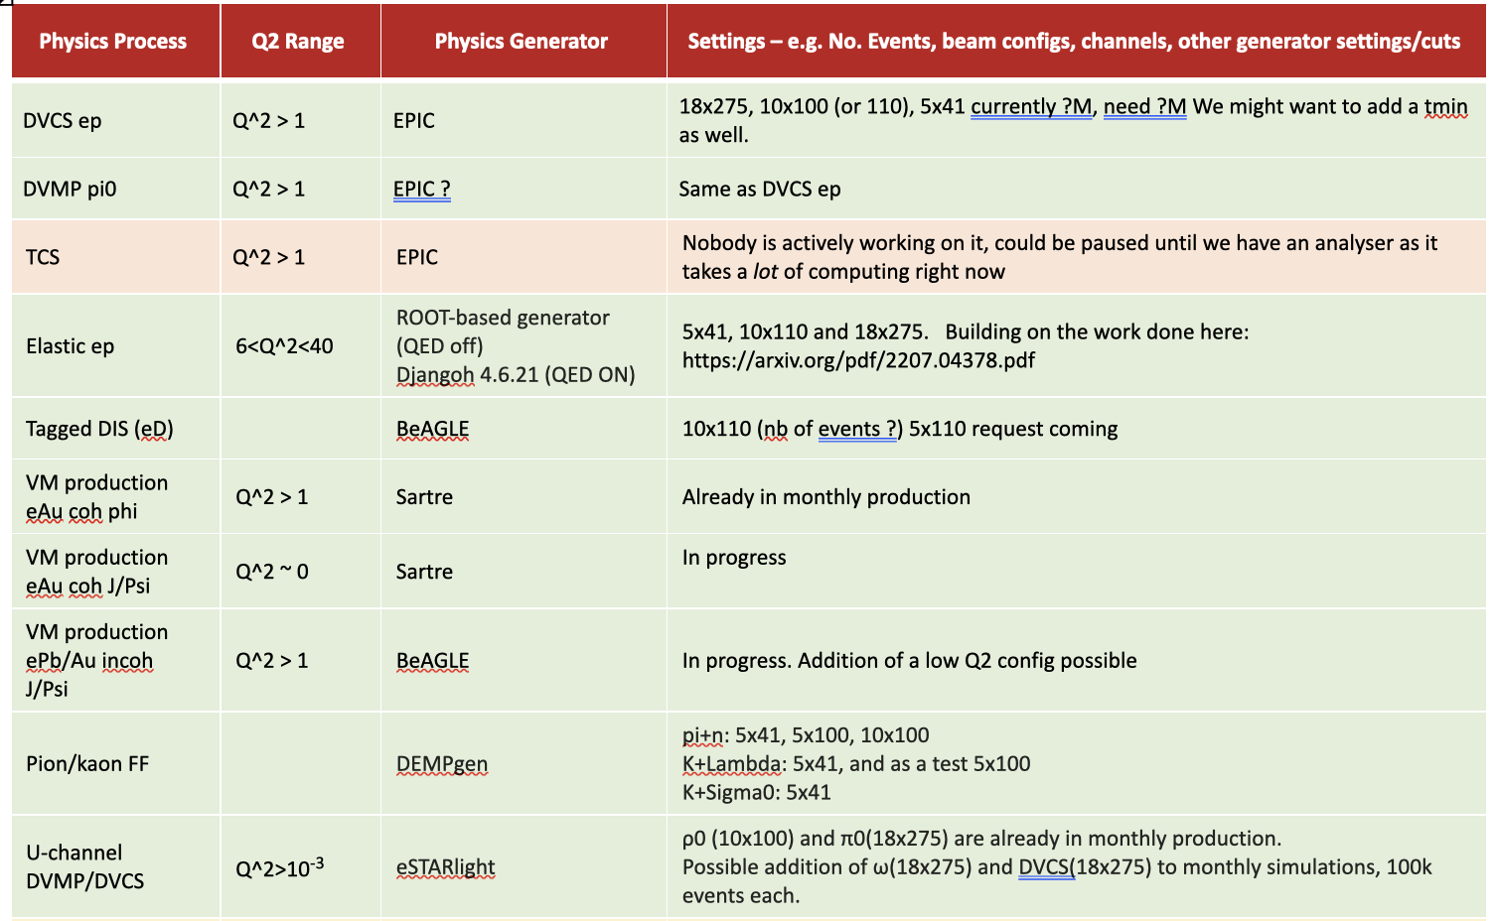
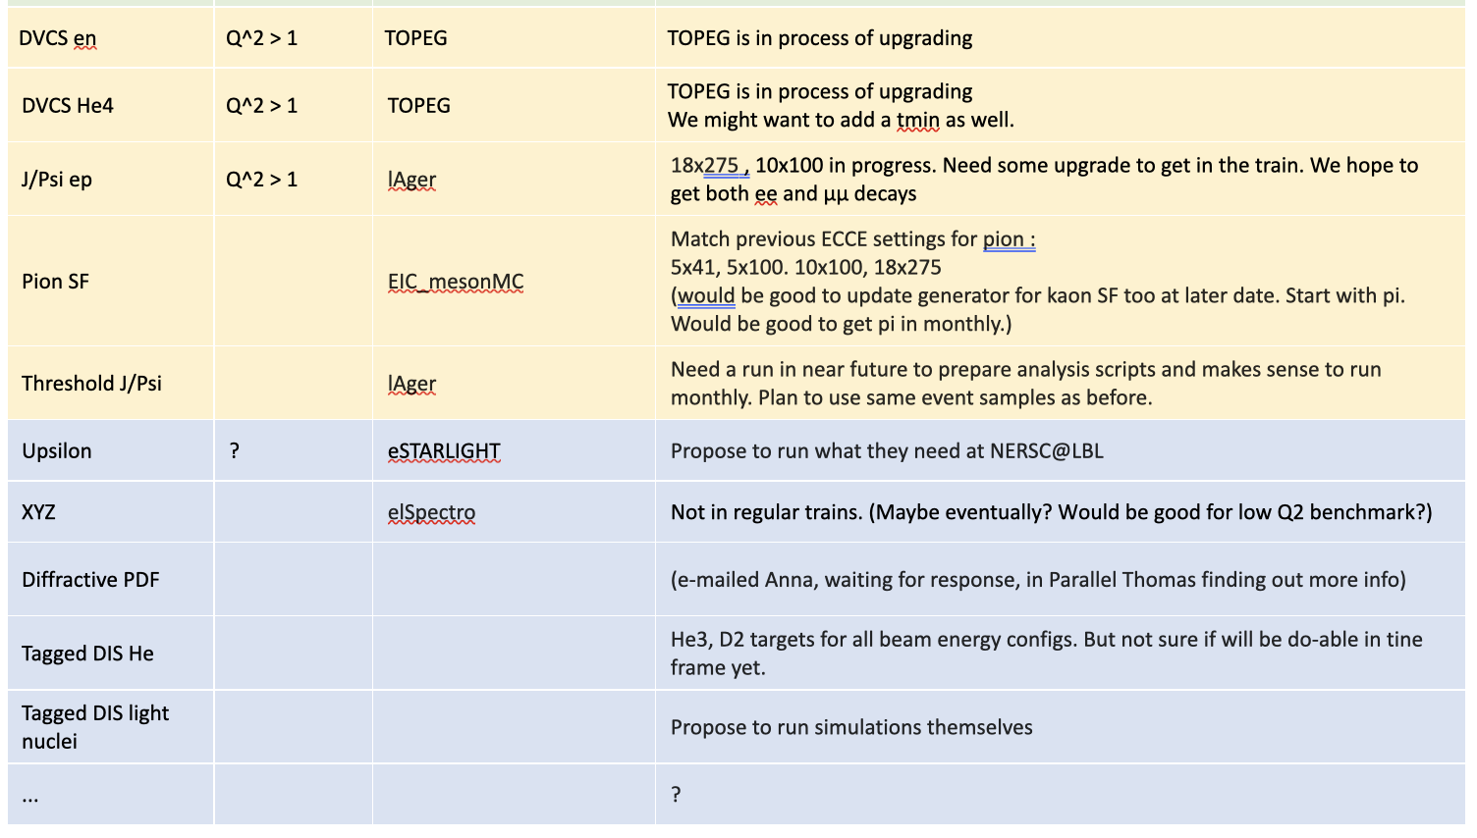
Update On Monthly Production Requests and Active Channels
Monthly production (MP)
MP,
Not Active
Self-run, but will request MP soon
Self-run
“MP” and “self-run” analyses are underway and developing
Today only show some recent examples
Either ReconstructedParticles or ReconstructedChargedParticles used in analyses
MP and already a benchmark
Self-run
Self-run
MP - and would like to request a special run of 5x100 setting
MP and now a benchmark
In development - generator being upgraded
In development - He ion in FF region needs reconstruction
Self-run
Self-run, but will request MP soon
Self-run
Self-run, but we have an outstanding request for MP
Self-run
In development - generator checks underway
Not Active
Self-run - needs FF region work
<numéro>

Slide 3
u-Channel ρ⁰ Benchmark for B0
Backwards (u-channel) physics → nucleon/nuclear tomography
Forward (t-channel) cross-sections → parton distributions in transverse plane via GPDs
Backwards cross-sections → quark clusters and baryon number distributions in transverse plane via TDAs
Connections with baryon stopping
See paper: https://journals.aps.org/prc/abstract/10.1103/PhysRevC.106.015204
In ePIC:
Produced vector meson takes most of momentum of struck nucleon → ends up in FF region
Nucleon shifts by several units in rapidity to mid-rapidity
Zachary Sweger (UCDavis) et al
Backwards ρ⁰ meson production
Low Mandelstam u, high t
Benchmark for B0 developed
B0 is critical for pions in ρ⁰ → π⁺ π⁻
<numéro>
Notes:
TDAs - transition distribution amplitudes
• Similar to normal meson photo-production, but proton at mid-rapidity and meson goes forward with high momentum: u-channel.
• Sensitivity to Transition Distribution Amplitudes (TDA).
• Proton (a few hundred MeV) detected in central detector. Photons from meson decay
detected in a combination of central and ZDC.

Slide 4
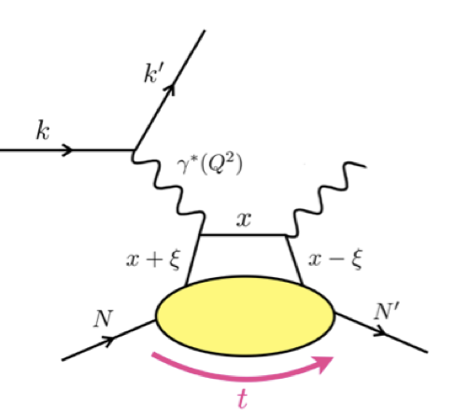
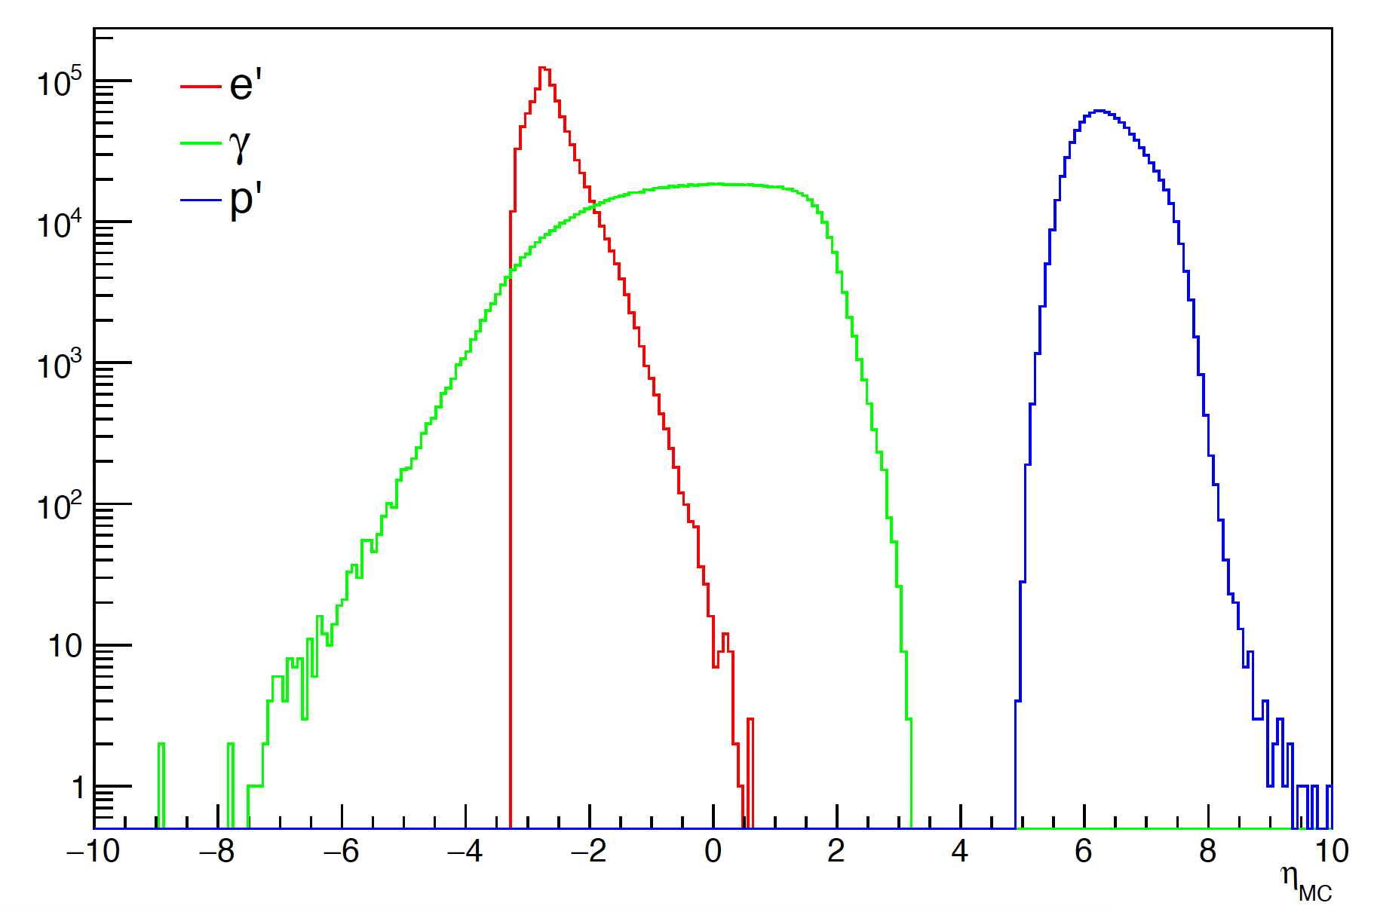
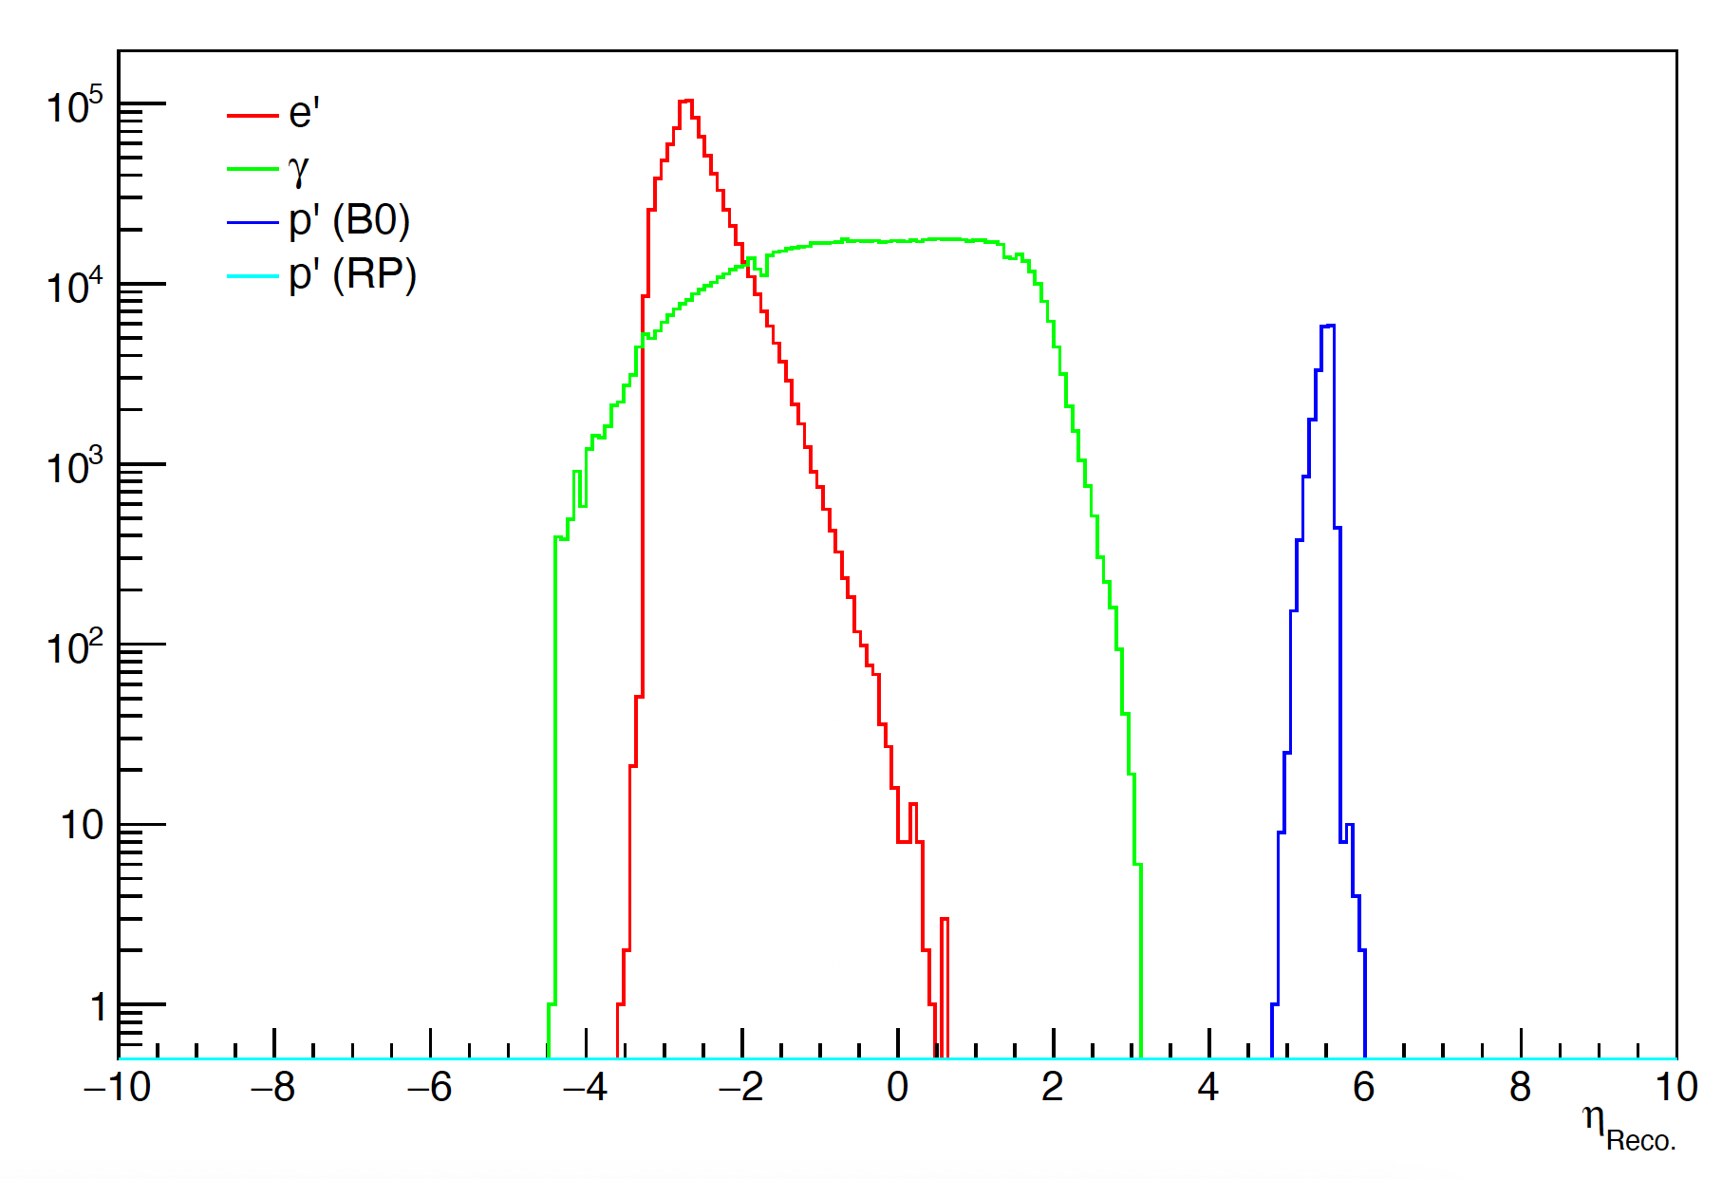
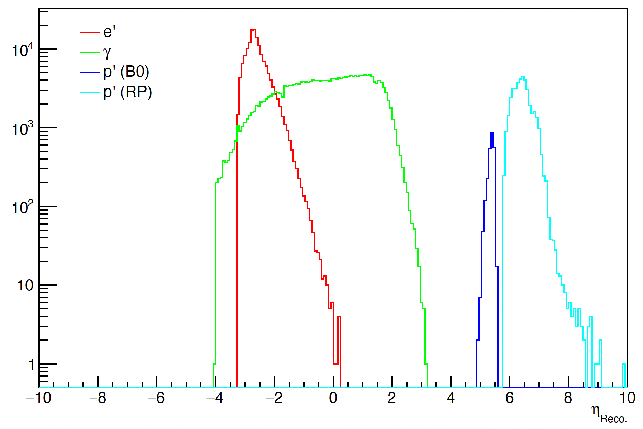
Plots: O. Jevons (Glasgow)
DVCS ep
Nucleon tomography, origin of mass and spin
Electron PID crucial and FF region critical for p’
Development of analysis underway
Oliver Jevons (University of Glasgow)
ReconstructedParticles collection
High acceptance and 10x100 ep setting shown
Nb 24.04.0 was missing RP (restored in 24.05.0)
24.05.0 and 24.06.0 analysis originally missing p’ in B0 due to new PID implementation
No particles with PDG 2212 in B0 due to lack of PID system
RP still uses truth PID
Need to figure out how to overcome this for analysis
Initial look at lower stats sample from 24.06.0 shown
Reconstructed p’ in B0 identified by recorded mass and charge of track
Electrons/photons use identified PID value
Can compare with 24.04.0 for electron finder/PID
10 x 100 Generated
10 x 100, monthly production 24.04.0
10 x 100, monthly production 24.06.0
(Truth PID)
<numéro>
Notes:
TDAs - transition distribution amplitudes

Slide 5
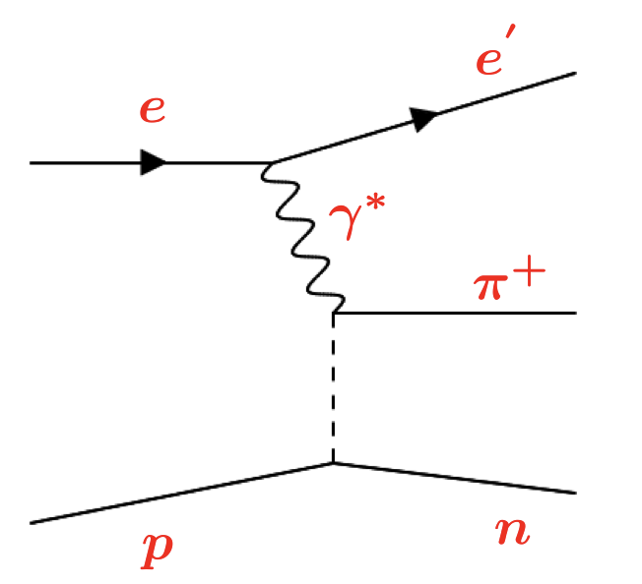
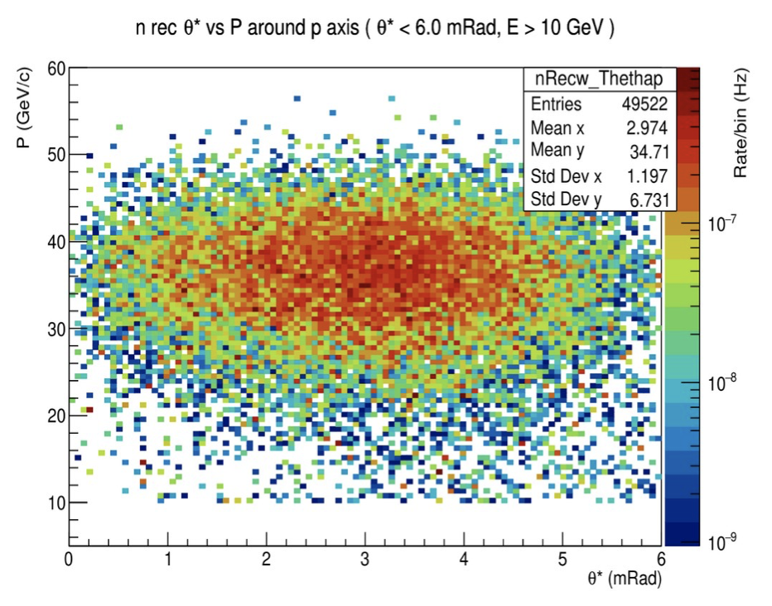
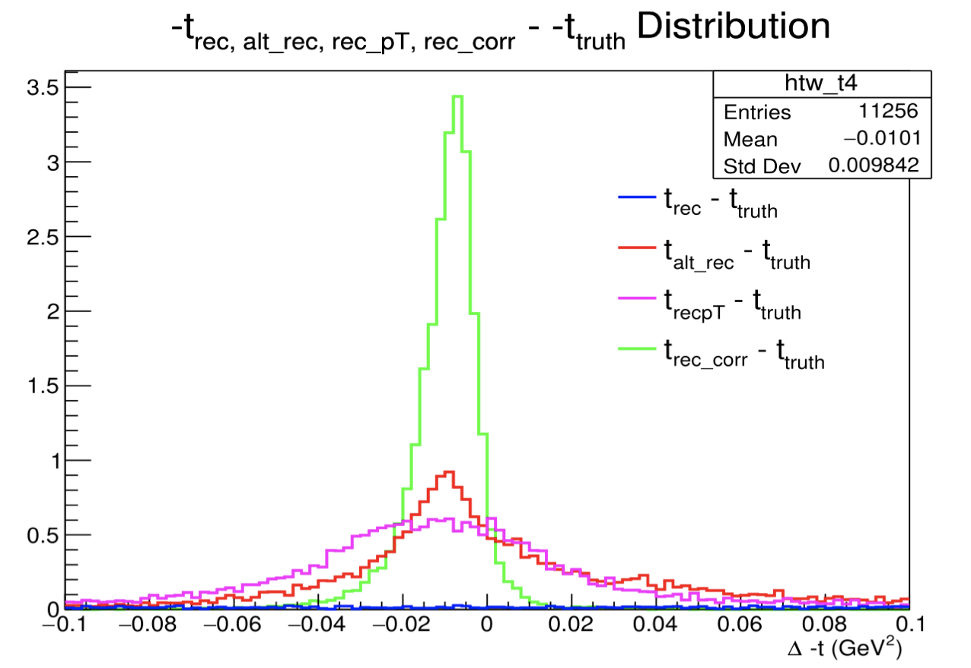
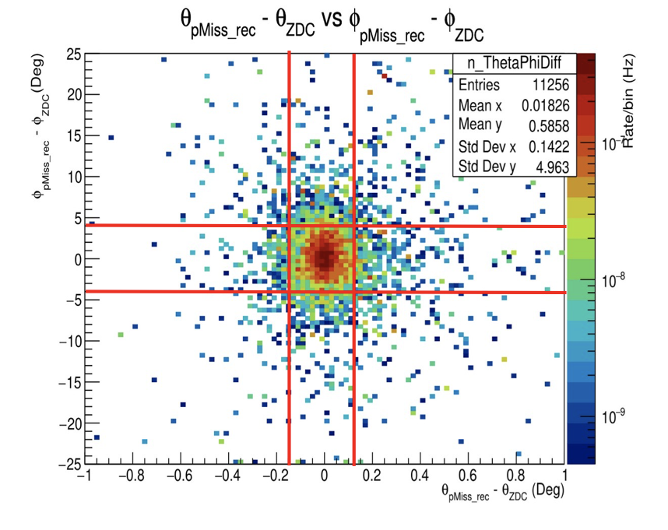
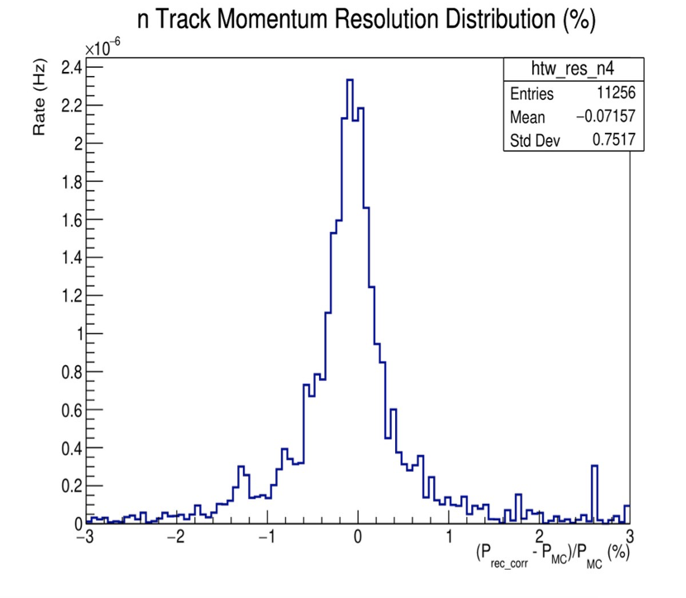
Meson Form Factors
Emergent hadronic mass enigma
Love Preet et al. (University of Regina and University of York)
More info: https://indico.bnl.gov/event/23814/contributions/92533/attachments/55095/94308/Love_slides.pdf
ZDC
Pion form factor under study, ep→e’π⁺n, all final state particles reconstructed
e’ and π⁺ central detector, n FF region (mainly ZDC)
Analysis in recent campaigns also likely affected by new PID implementation in 24.05.0
ReconstructedFarForwardZDCNeutrons branch
Results promising and comparable to previous resolutions (eg neutron track angle and momentum resolutions)
Previous t-reconstruction method still working well
Post-burner next month will check offset
Request a 5x100 campaign from simulation team for important direct comparison with previous YR results
Fπ(Q²) projections for TDR expected imminently
Further plans to extend to kaons (more challenging)
Plots: L. Preet (Regina)
5x41 24.05.0 monthly campaign
<numéro>
Notes:
Neutron track angle and momentum resolutions
Kaon: Main issue is to separate photons from the low-energy neutrons in the both ZDC – EMCAL
& HCAL.

Slide 6
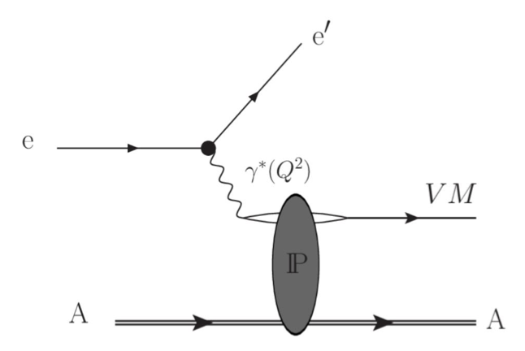
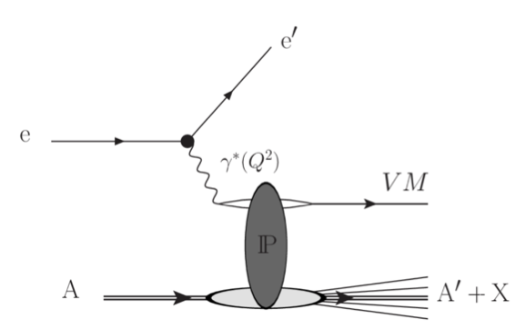
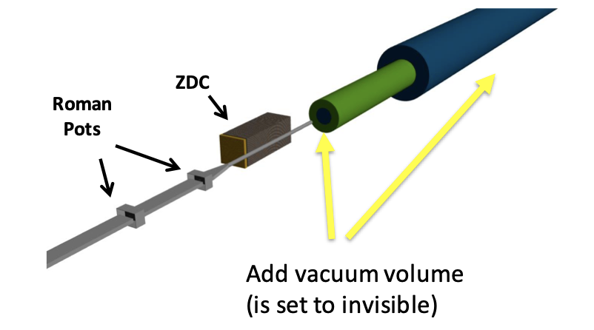
Diffractive Vector Meson Production
Probe low-x structure, sensitivity to gluon distributions in nucleon/nuclei, probe spatial parton structure of nuclei
Challenges: incoherent background, t-reconstruction
Michael Pitt et al. (Ben Gurion University of the Negev)
More info: https://indico.bnl.gov/event/23345/contributions/91508/attachments/54637/93485/Jpsi_in_eA.pdf
Self-run simulation
On-going study of coherent VM production (J/Psi in ePb) and background veto for TDR
Planning to make incoherent veto benchmark for FF region
Coherent events eStarlight, incoherent events BeAGLE
Using latest merged FF design (PR-665) from April and April detector geometry
To speed up reconstruction in FF, vacuum added inside hadron beam pipe (vacuum extended for Z>40)
Eg coherent 183.2s/ev → 16.23 s/ev
Incoherent 320s/ev → 35s/ev
This is PR720 → now merged to master branch DD4HEP
Necessary for incoherent study
Credit: M. Pitt (Ben Gurion)
<numéro>

Slide 7
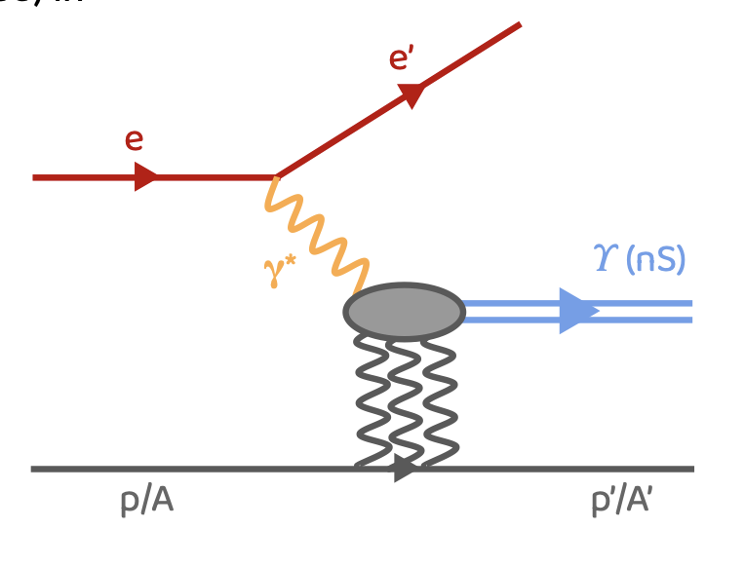
ϒ Production
Sensitivity to gluon distributions; near threshold production - mass enigma
Saeahram Yoo (Berkeley Lab) et al
Resolution study for ϒ(1S), ϒ(2S), ϒ(3S) → e⁺e⁻
Tracking crucial
More details: https://indico.bnl.gov/event/23163/contributions/90798/attachments/54163/92658/EICUpsilon_ExcdffTag_SaeahramYoo_Apr29.pptx.pdf
April 2024, self-run, eAu, 10x100
ϒ(1S), ϒ(2S), ϒ(3S) generated for 0<Q²<0.01GeV² (truth seeding)
eSTARlight (generate seeds) → afterburner (nb afterburner not used here, due to a bug but will be used in future plots) → npsim → EICrecon
Next:
Add afterburner; larger samples
realistic seeding and study different regions of detector (barrel vs endcap)
Want to develop this into a tracking benchmark
Have requested this to be included in monthly campaigns
Plots: S. Yoo (Berkeley)
<numéro>
Notes:
The resolution of the three peaks was obtained using DSCB fits in the region of 0 < Q2 < 0.01 GeV2 with the truth seeding
→ Seem to have consistent resolution in each peak within the uncertainties
→ Need fine-tuning of the fits
→ Need to obtain the resolution value using a larger sample size
● Next steps:
⚬ Add beam spreads using AfterBurner and generate a larger sample
⚬ Detector resolution study using realistic seeding and in different region of the
detector (barrel vs end cap)
The separation appears reasonable​
Study to be followed on as tracking and PID get more realistic

Slide 8
Elastic e-p
Nucleon structure, input for multi-dimensional imaging; over-constrained kinematics would make it useful for detector calibrations
Barak Schmookler (UC Riverside) et al
Reconstruction of elastic e-p for high Q² events 5 x 41, self run simulation with April version of ePIC/EICRecon (ie truth PID)
At 5x41 e’ and p are in central detector
More details: https://indico.bnl.gov/event/23163/contributions/90802/attachments/54165/92670/epic_elastic_042924.pdf
Good reconstruction of x and Q² possible if detect both e’ and p’
Next steps
Over next month check PID/electron finder effects on analysis
Check higher energy configuration where p’ is in FF
Look at low Q² events and QED effects
Develop a benchmark
We will likely request monthly productions in future
Plots: B. Schmookler (UC Riverside)
<numéro>
Notes:
The resolution of the three peaks was obtained using DSCB fits in the region of 0 < Q2 < 0.01 GeV2 with the truth seeding
→ Seem to have consistent resolution in each peak within the uncertainties
→ Need fine-tuning of the fits
→ Need to obtain the resolution value using a larger sample size
● Next steps:
⚬ Add beam spreads using AfterBurner and generate a larger sample
⚬ Detector resolution study using realistic seeding and in different region of the
detector (barrel vs end cap)
The separation appears reasonable​
Study to be followed on as tracking and PID get more realistic

