Slide 1
Pre-TDR Writing Exercise Update
Brian Page
July 18, 2024
pfRICH General Meeting

Slide 2
Near-Term Goals and Timeline
Strive to have updates and progress reports every 2 weeks
Immediate goal (which should be completed ~now) is to confirm that the potential responsible editors are willing / available to work and that they are assigned to the correct section(s)
Over the next week: all collaborators please have a look at the draft and submit any comments on the overall structure – are there topics missing? Are there topics which should be removed?
By the meeting on July 18th (three weeks): Responsible editors should have a summary of what changes need to be made to the sections that have existing text and an outline of what needs to be written for greenfield sections
By the second week of August (give extra time due to collaboration meeting): Modification of sections with existing text should be well under way and drafts of greenfield sections should be started
Note: Timelines shown in previous TIC meetings have the main Pre-TDR drafting period extending to the end of October with the full ePIC contribution ready by late 2024 – early 2025

Slide 3
General (Modified) Writing Strategy
We will have significantly more detail / material than will fit in the main part of the Pre-TDR
“Overflow” can be distributed via appendices
Use working document to collect all material we want to make available to the Pre-TDR audience organized in accordance with the agreed upon structure
Having all material in one document will make it easier to ensure accuracy, consistency, completeness, etc
Once the material in the working document has been verified, we can then work on editing down to reach the 15 page limit and populating the appendices
Given severe page limits, editing down full material to 15 pages will be inefficient
Proposal: In addition to the detailed information, responsible editors for each section write ~half page executive summary. This summary goes in TDR proper and details go directly to appendices

Slide 4
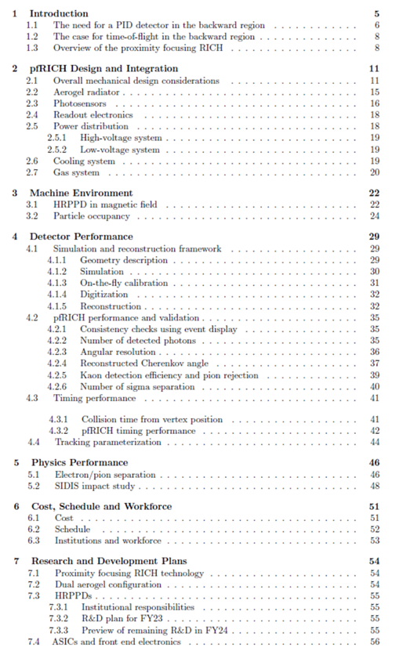
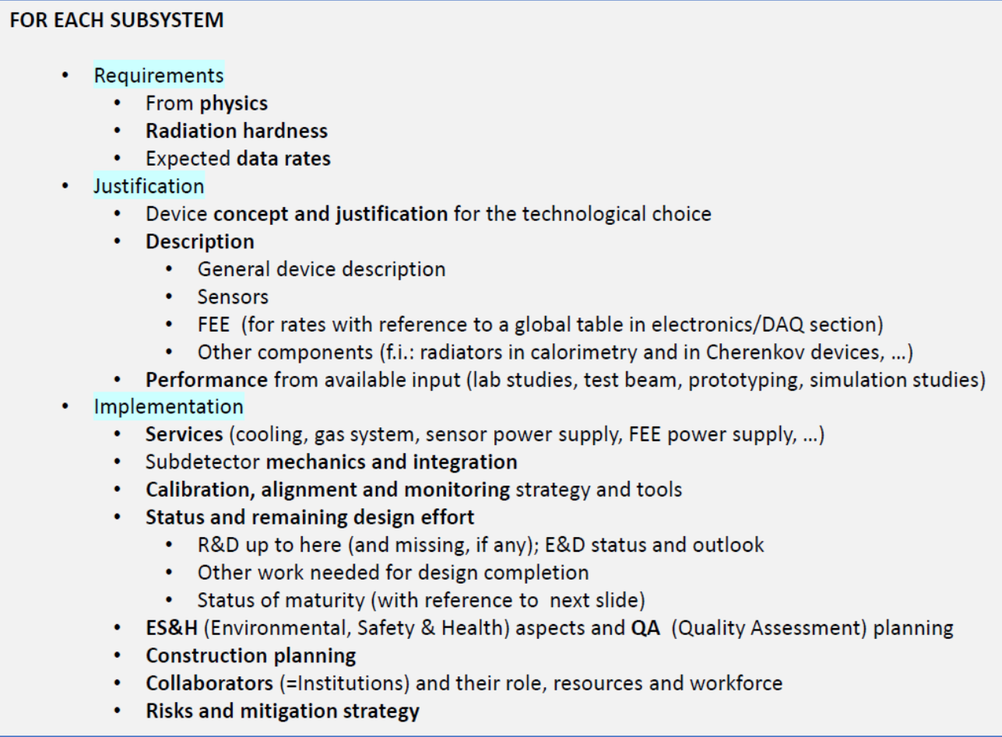
Last Time…
The material from the existing pfRICH CDR has been mapped into the agreed-upon Pre-TDR structure
Resulting document resides on a private overleaf (pro account) that the pfRICH team will be able to edit freely
Existing pfRICH CDR
Pre-TDR Structure

Slide 5
Working Document
The pfRICH Pre-TDR working draft (read-only) can be found at: https://www.overleaf.com/read/qxmdkqghtsrx#ec0243
The draft contains 27 ‘tracked’ sections, each with a number of responsible editors and general tasks
A preliminary list of 15 responsible editors has been compiled and are in the process of being confirmed
Roughly 12 sections do not have any corresponding text from the CDR and will need to be written from scratch
Working draft is currently 45 pages long and as communicated via the TC, we will only have ~15 pages of space in the Pre-TDR proper – much material will need to be transferred to appendices

Slide 6
Timeline
process design phase
structuring the
effort
draft ePIC pre-TDR
ePIC pre-TDR (CD-2)
writing
(TDR/notes)
Preparing papers for
publication
Mid Jan.24
Mid Mar.24
End Oct. 24
Late 2024
Early 2025
Putting the tools in place:
Overleaf/Github for TDR (TBA RSN)
Zenodo.org selected as document database solution

