Slide 1
First Look at Automated Jet Benchmarks
Brian Page
July 18, 2024

Slide 2
Automated Jet Benchmarks
A set of jet benchmark plots is now being generated with each monthly production and can be accessed via a web interface: https://eic.jlab.org/epic/image_browser.html# (navigate to Physics -> Jets and Heavy Flavor)
Results obtained from the ReconstructedChargedJets (truth seeded tracks) and GeneratedChargedJets branches
Plots from productions 24.02 – 24.06 currently available
Can select on energy (shown is 10x100) and minQ2 (shown is Q2 > 1)
As an example use case, compare jet and jet constituent quantities from productions 24.05 and 24.06 (before and after ambiguity solver introduced)

Slide 3
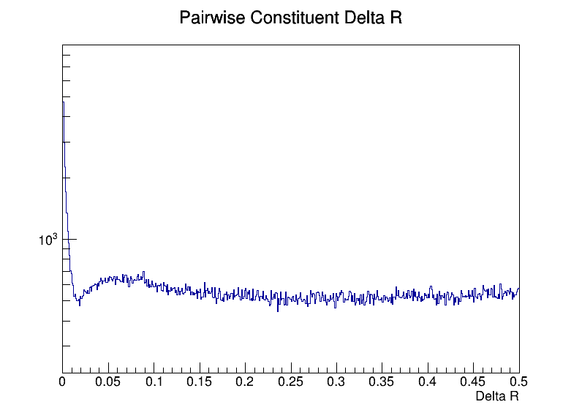
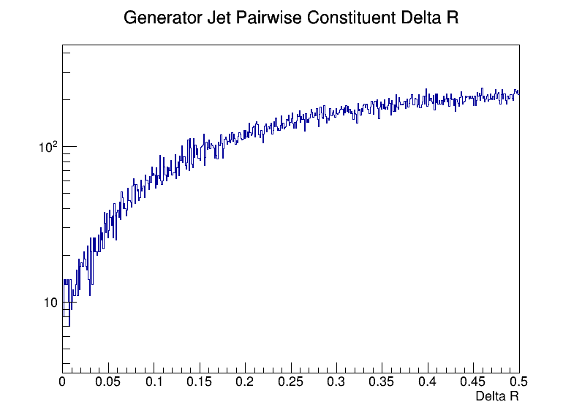
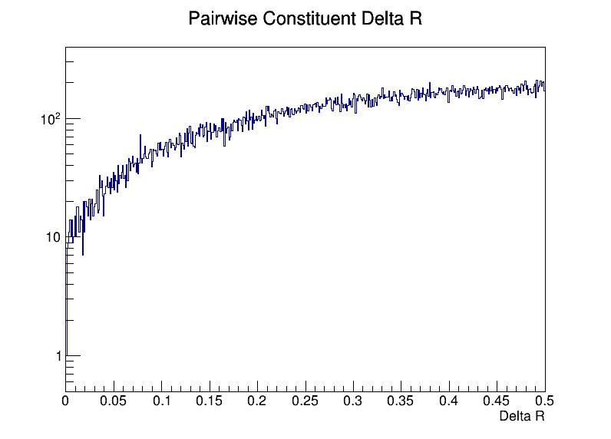
Duplicate Tracks
Duplicate Tracks
24.05.0
24.05.0
24.06.0
Distance in eta-phi between every pair of particles/tracks inside the jet
Peak at small delta R indicates duplicate tracks
June production sees marked reduction of duplicate tracks (ambiguity solver)

Slide 4
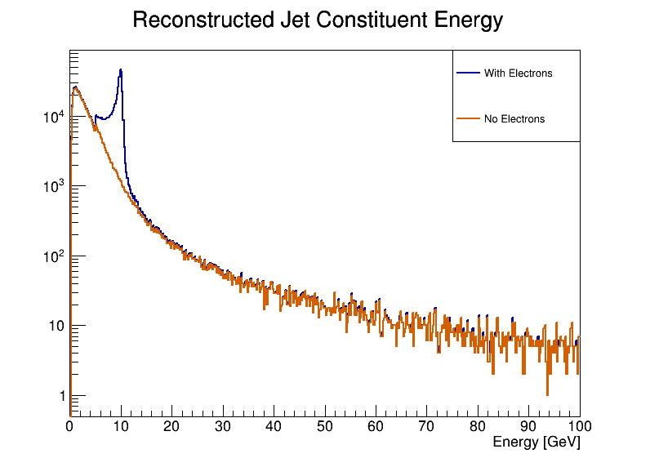
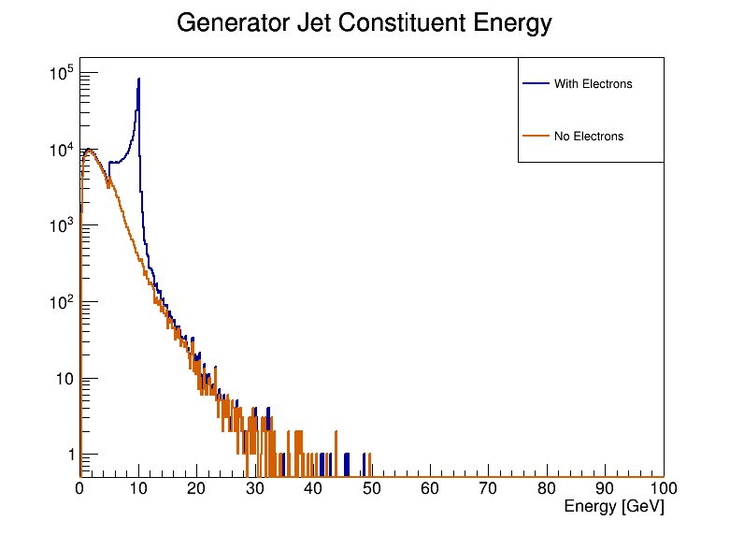
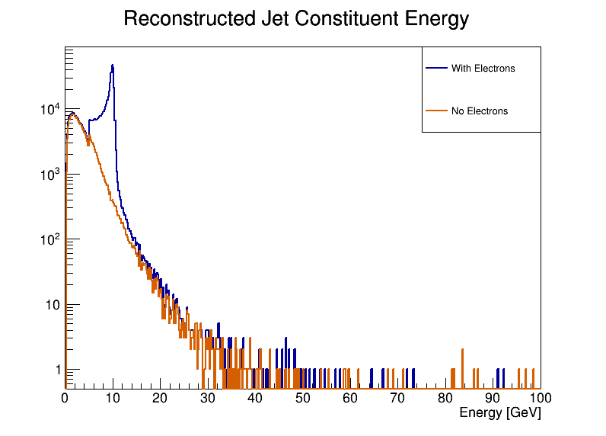
Jet Constituent Energy
24.05.0
24.05.0
24.06.0
Energy spectra of particles/tracks inside jets
High energy tail in 24.05 disappears in 24.06 – matches much better with truth spectrum

Slide 5
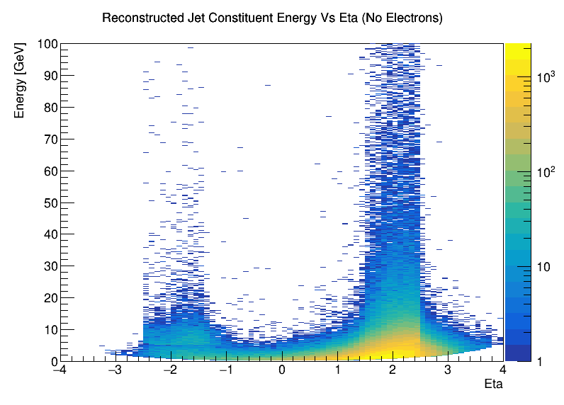
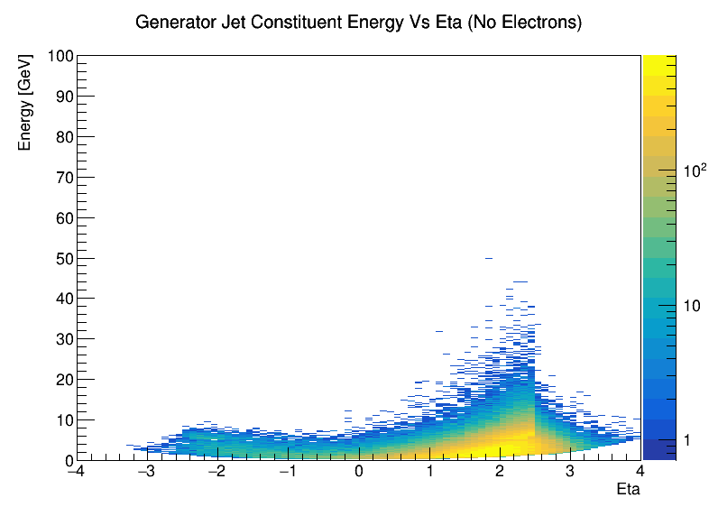
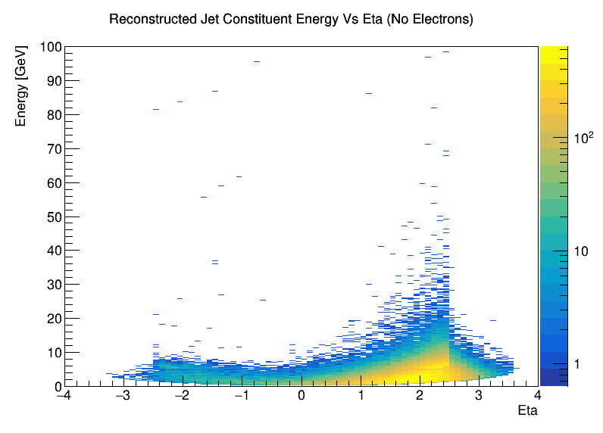
Jet Constituent Energy Vs Eta
24.05.0
24.05.0
Plotting constituent energy vs eta seems to show most artificially high momentum tracks concentrated around 1.5 < |eta| < 2.5
Any correlation between ambiguity solver / removal of duplicate tracks and disappearance of high momentum tracks?
24.06.0

Slide 6
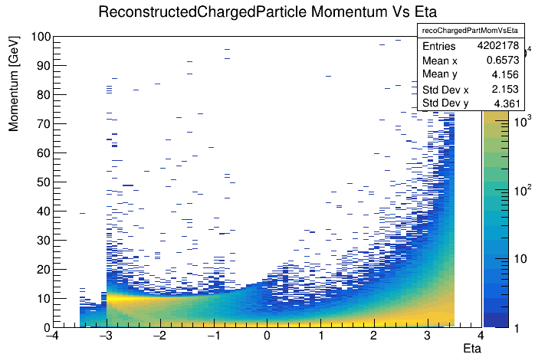
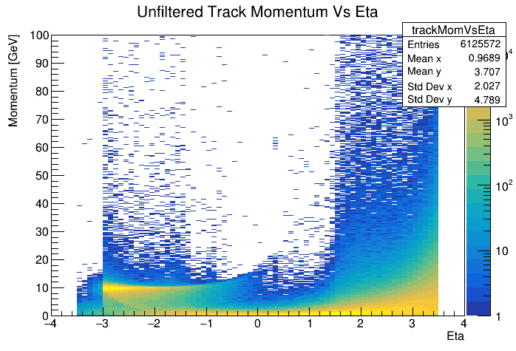
High Momentum Tracks
Is the reduction in high momentum tracks in the June campaign due to the introduction of the ambiguity solver or some other change such as material map?
Compare track spectra from 24.06 with and without ambiguity solver – removes possible influence on geometry / material maps
Ambiguity solver spectrum (left) lacks prominent high momentum tracks seen before solver is applied
Solver must be in some way removing these pathological tracks

Slide 7
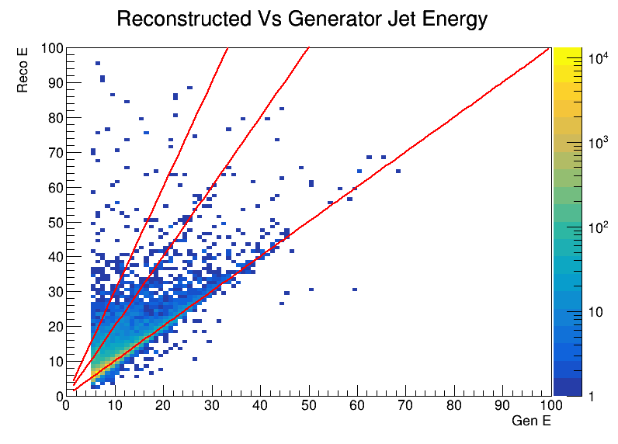
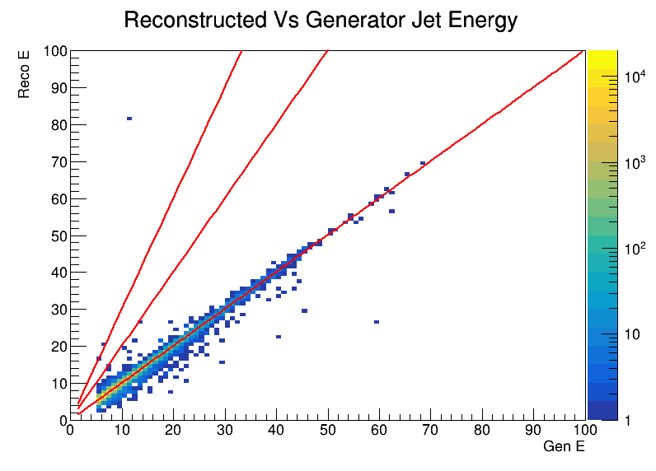
Reco Vs Gen Jet Energy
24.05.0
24.06.0
Find geometrically matched reco – generated jet pairs
Energy correlation between reco and generated jets much better in 24.06 production

