Slide 1
SBND Updates
Hanyu Wei for the SBND Wire-Cell team
Jul 18, 2024

Slide 2
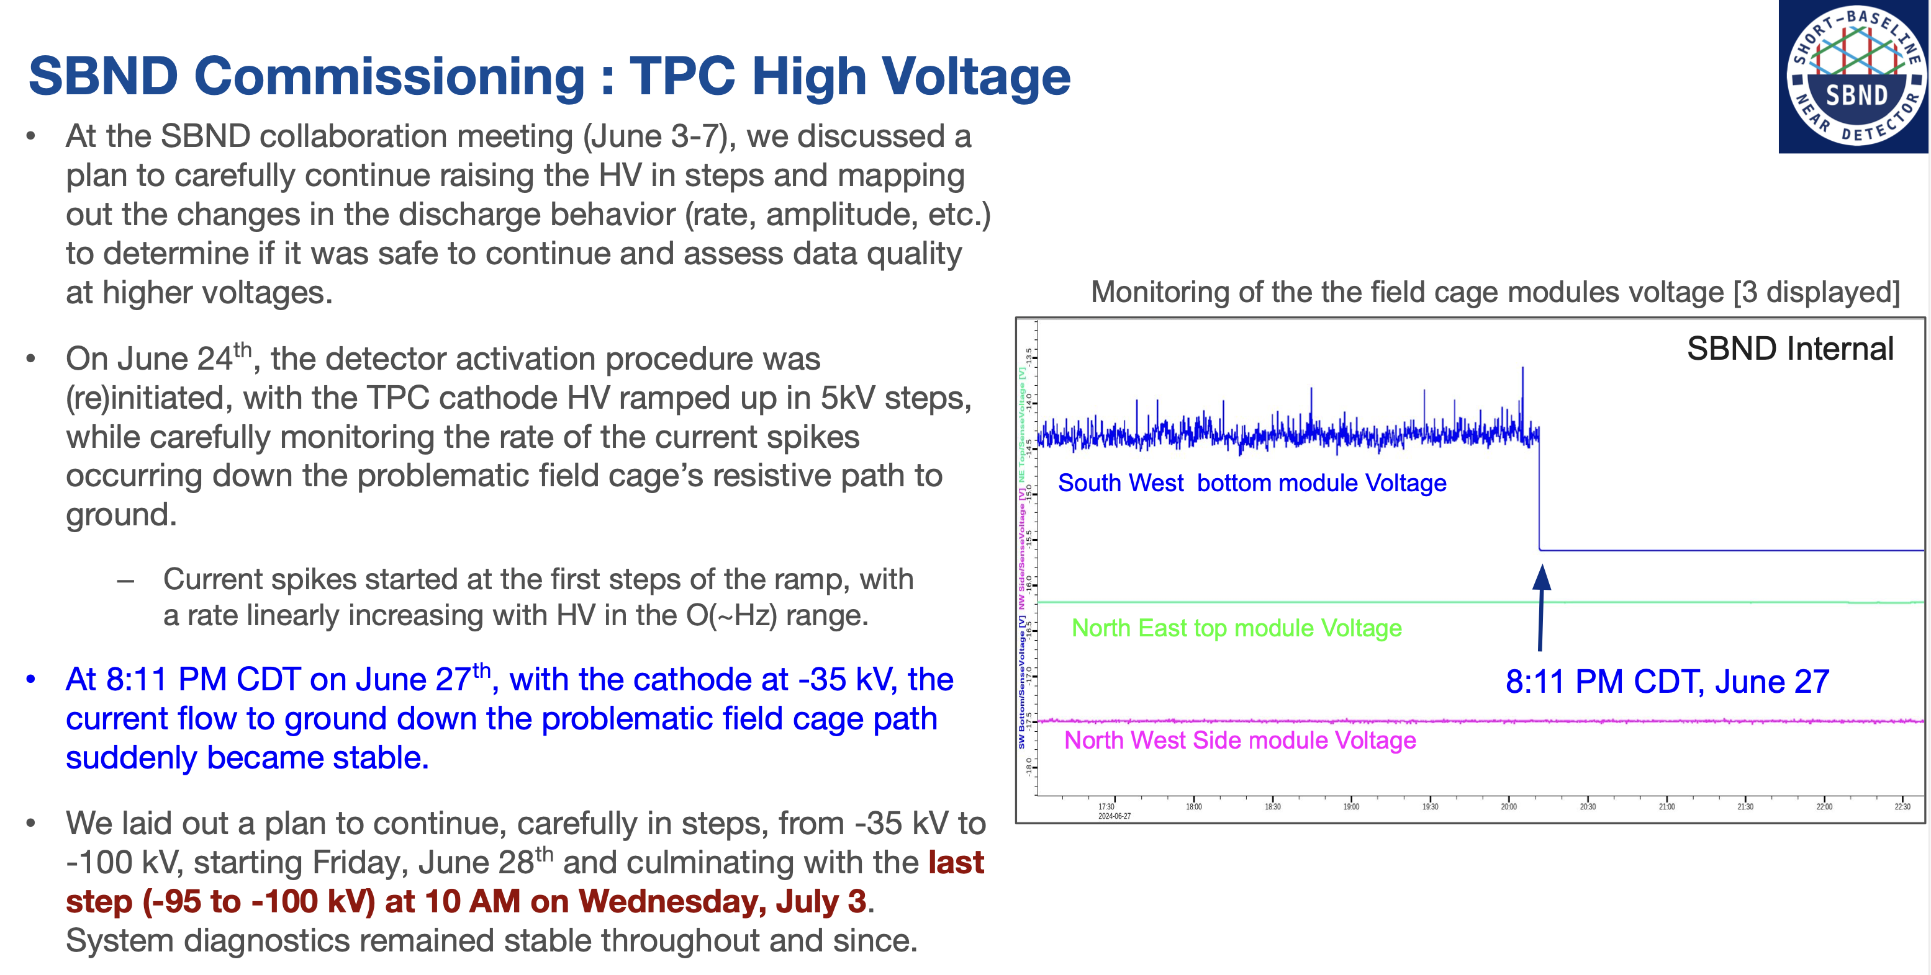
Ornella’s PAC talk

Slide 3
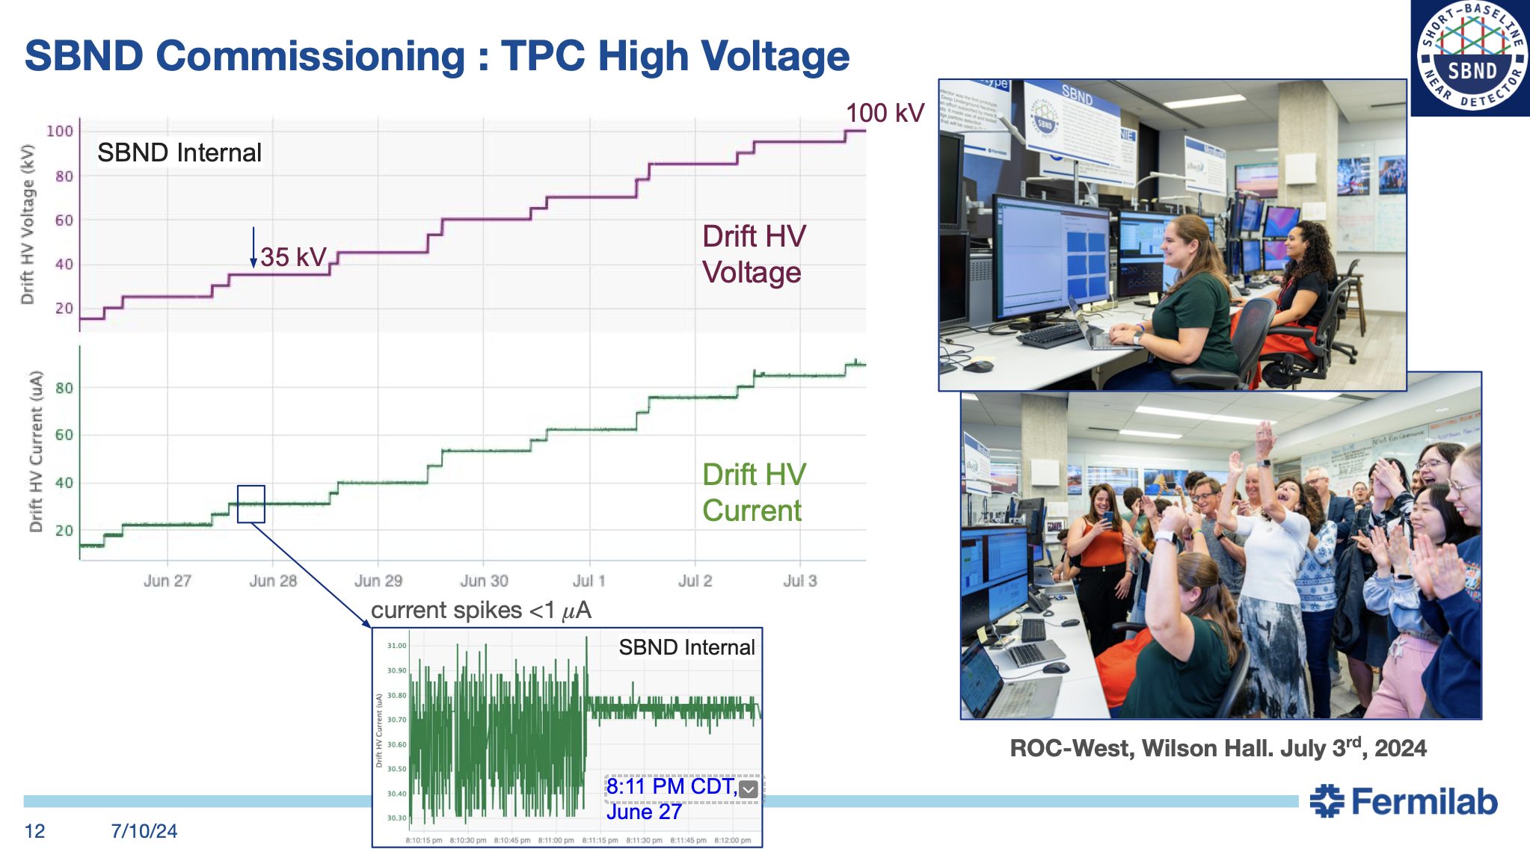
Ornella’s PAC talk
All previously observed issues in TPC and PMT data are gone!

Slide 4
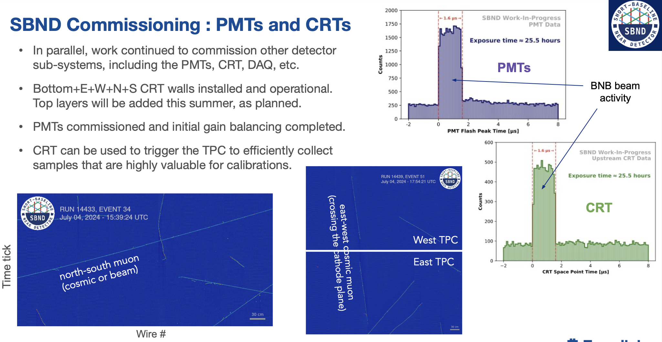
Ornella’s PAC talk

Slide 5
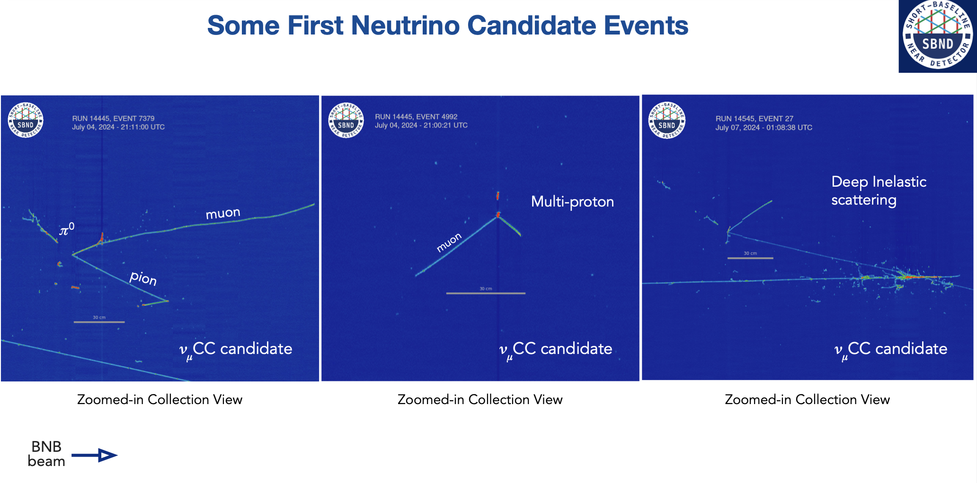

Slide 6
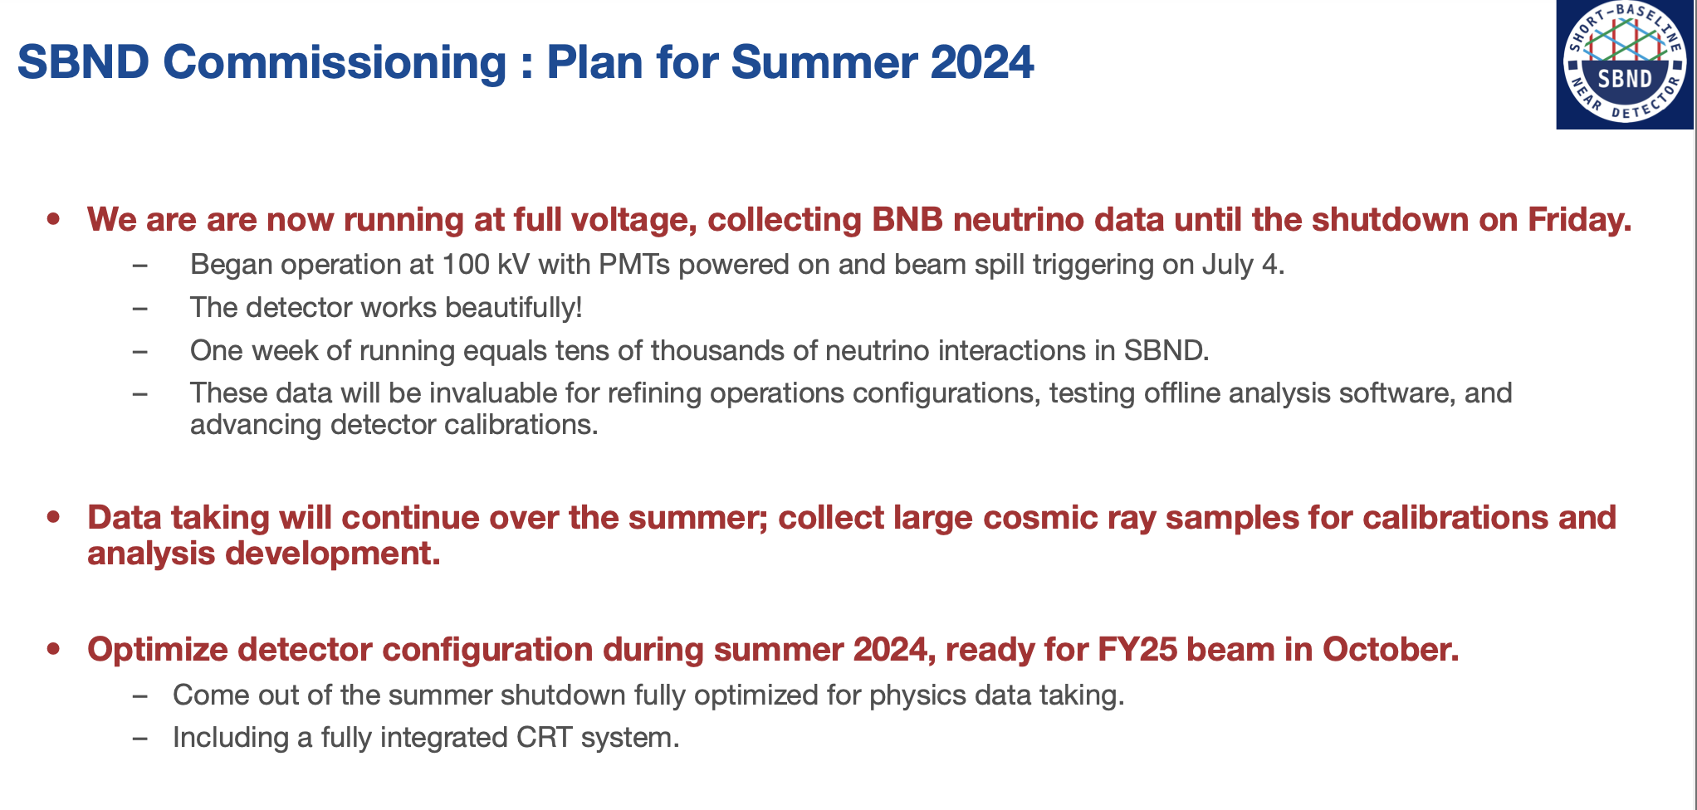
Ornella’s PAC talk
Last Friday

Slide 7
First look at wirecell signal processing
Thanks to the SBND wirecell team
Initial noise filtering + signal processing optimized on MC
Traditional ROI finding
DNN ROI not used yet

Slide 8
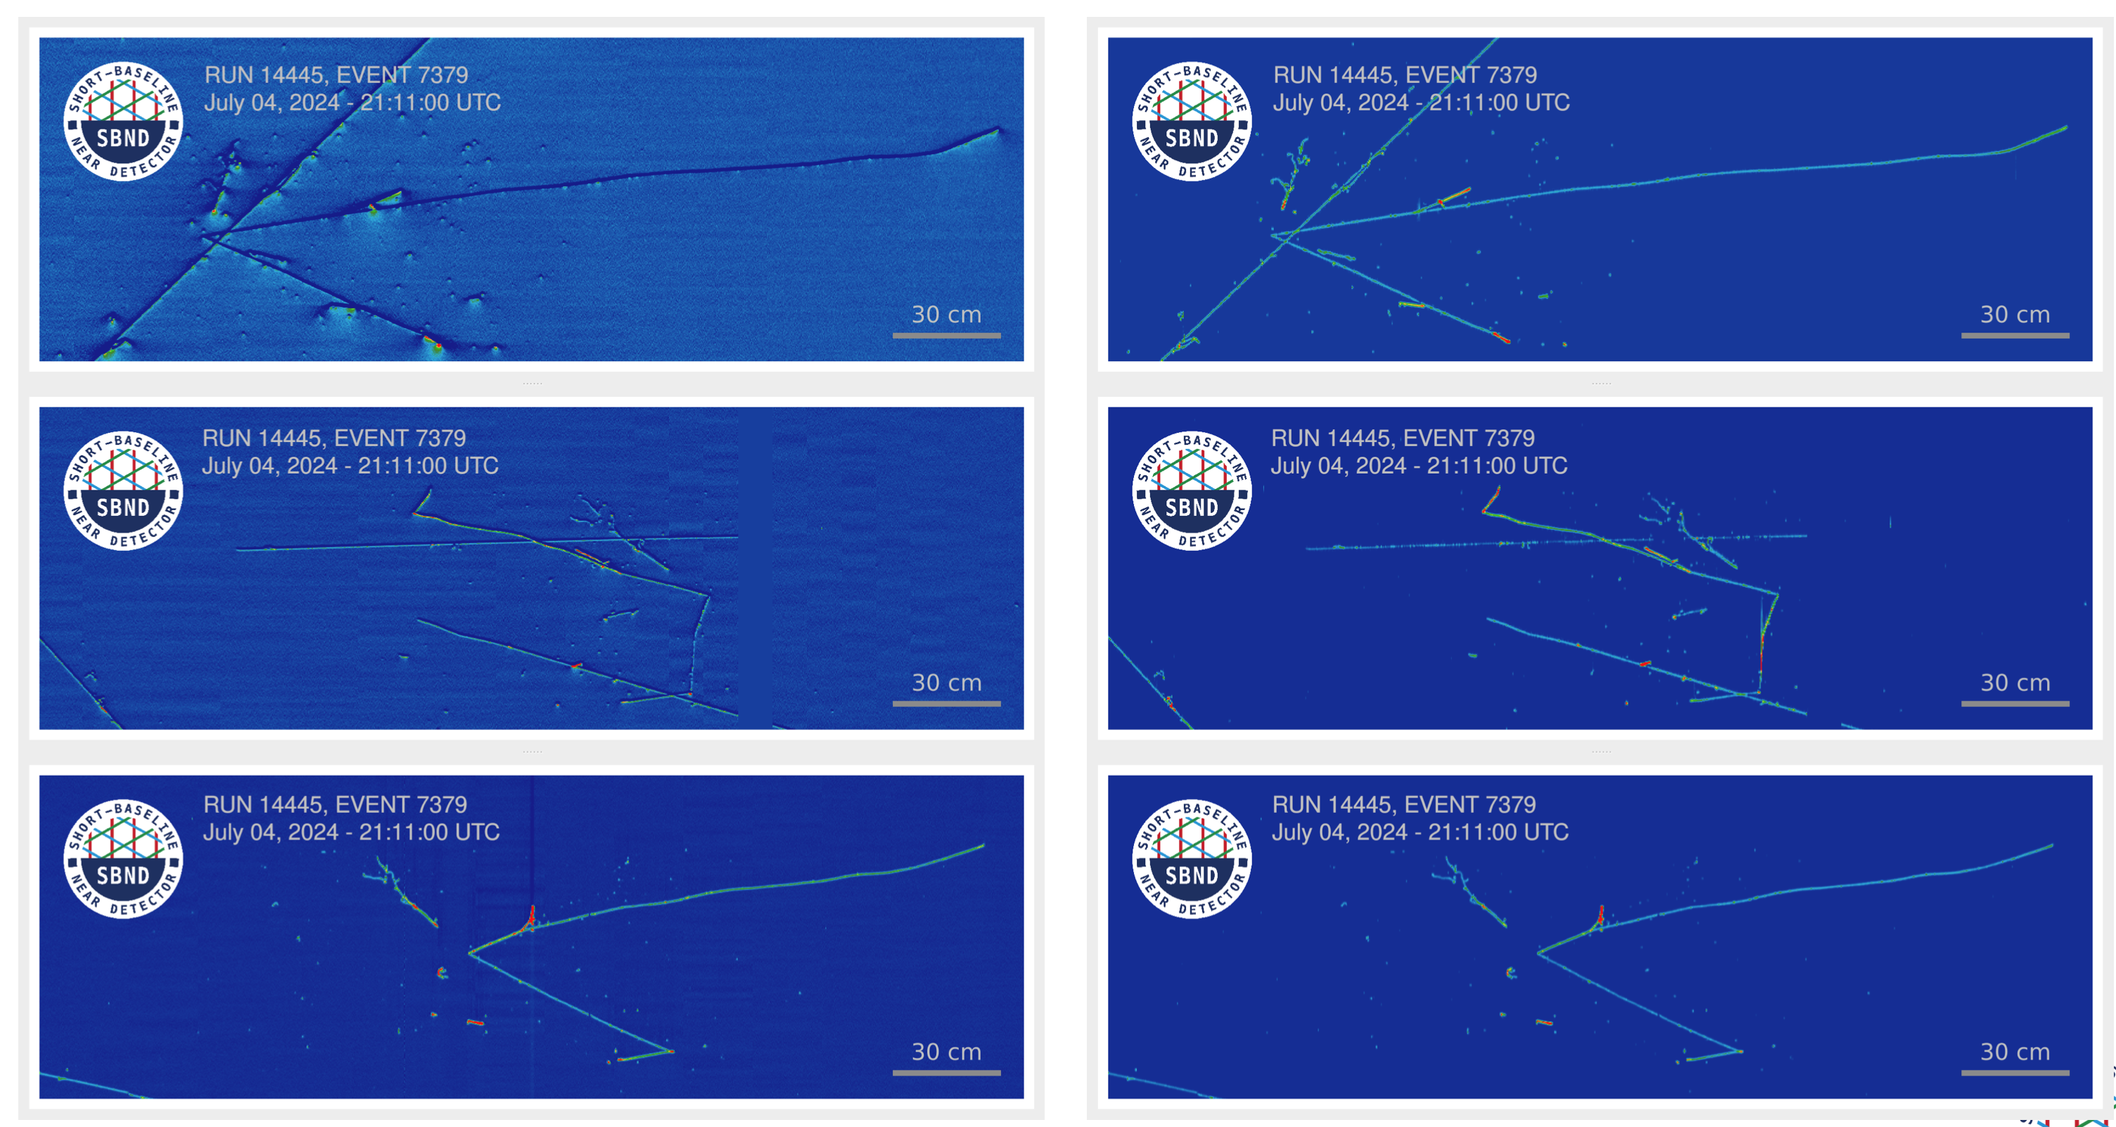
SBND “standard” event display
From Lynn
Raw waveforms
Decon waveforms
(initial NF + SP)

Slide 9
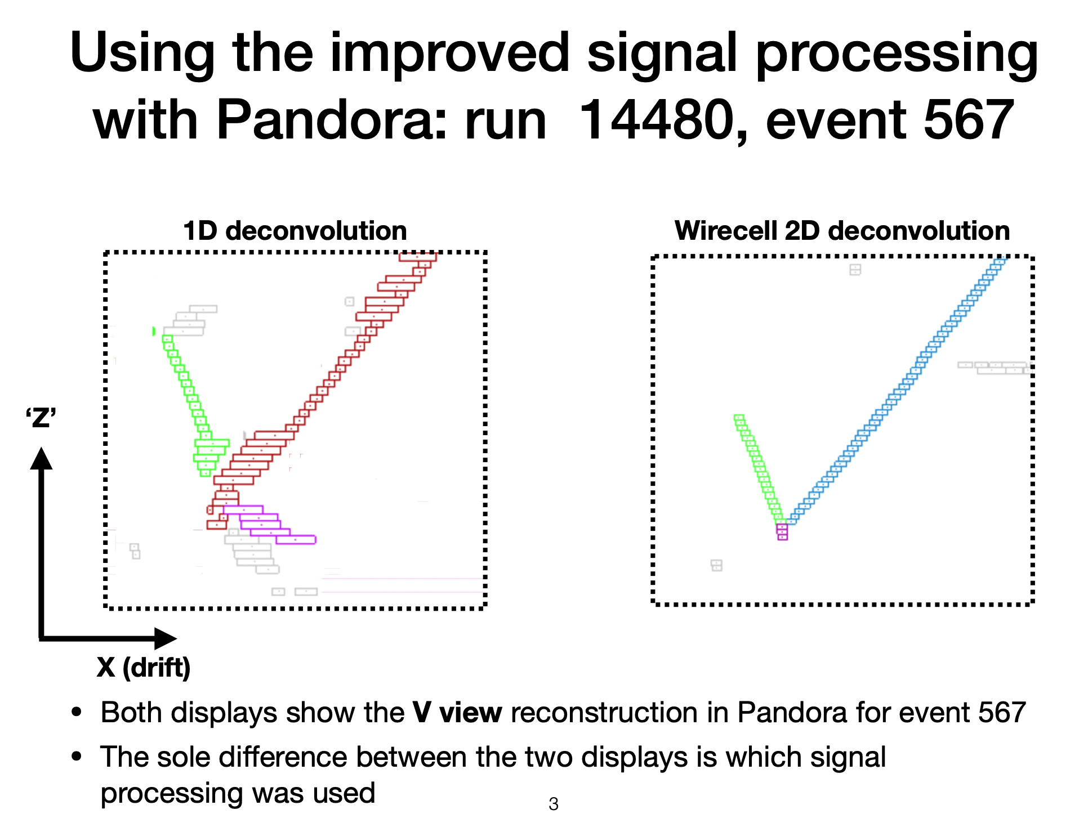
1D signal processing vs wirecell 2D signal processing on data
From Dom Brailsford
Docdb: 37107
Using initial NF+SP pushed to SBNDCODE by Ewerton

Slide 10
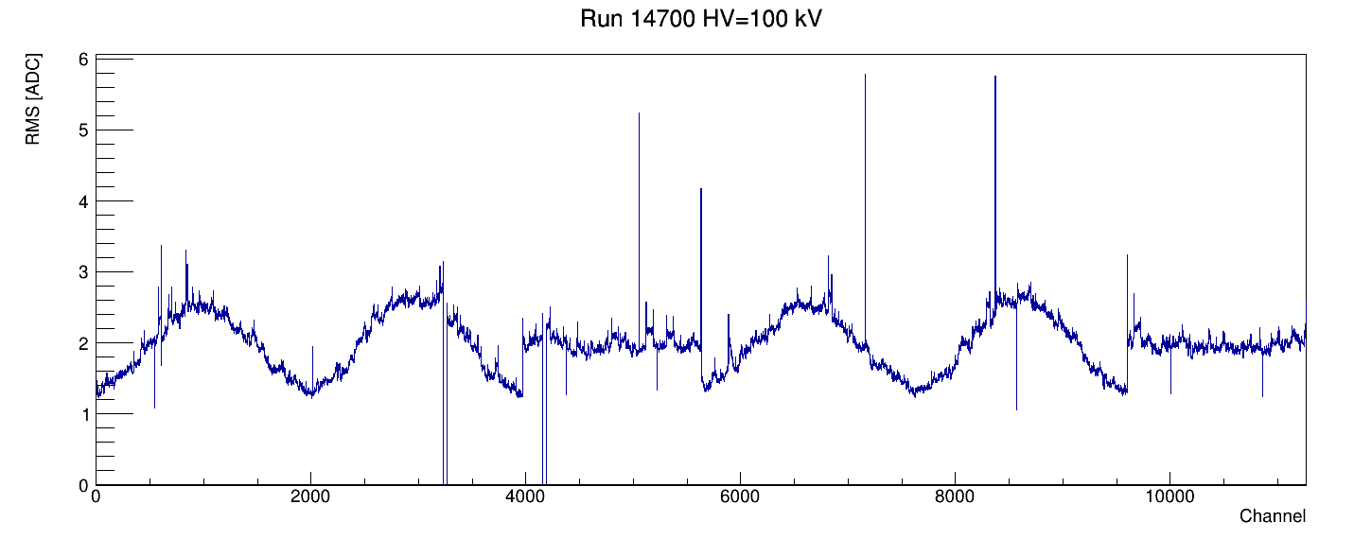
RMS ADC
Without noise filtering
Plot from Tom Junk
5054
7163
8372
76 bad channels
0.67% of all channels
Blue: dead FEMB
Red: missing wires due to combs (in the center of each ½ APA)
Green: shorted
Purple: noisy or special pattern
Black: non-responsive
5630, 5631
607
3232:3263
4374
5225
10006
10857
546
8568
4160:4191
Channel indexing follows LArSoft convention

Slide 11
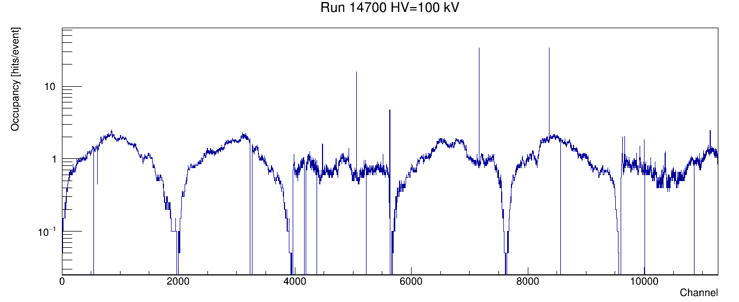
Hit occupancy hit -- 20 ADC counts away from pedestal in either direction; 100 ticks away from each other
Without noise filtering
Plot from Tom Junk
7163
8372
76 bad channels
0.67% of all channels
5054
Blue: dead FEMB
Red: missing wires due to combs (in the center of each ½ APA)
Green: shorted
Purple: noisy or special pattern
Black: non-responsive
5630, 5631
607
3232:3263
4374
5225
8568
546
10006
10857
4160:4191
Channel indexing follows LArSoft convention

Slide 12
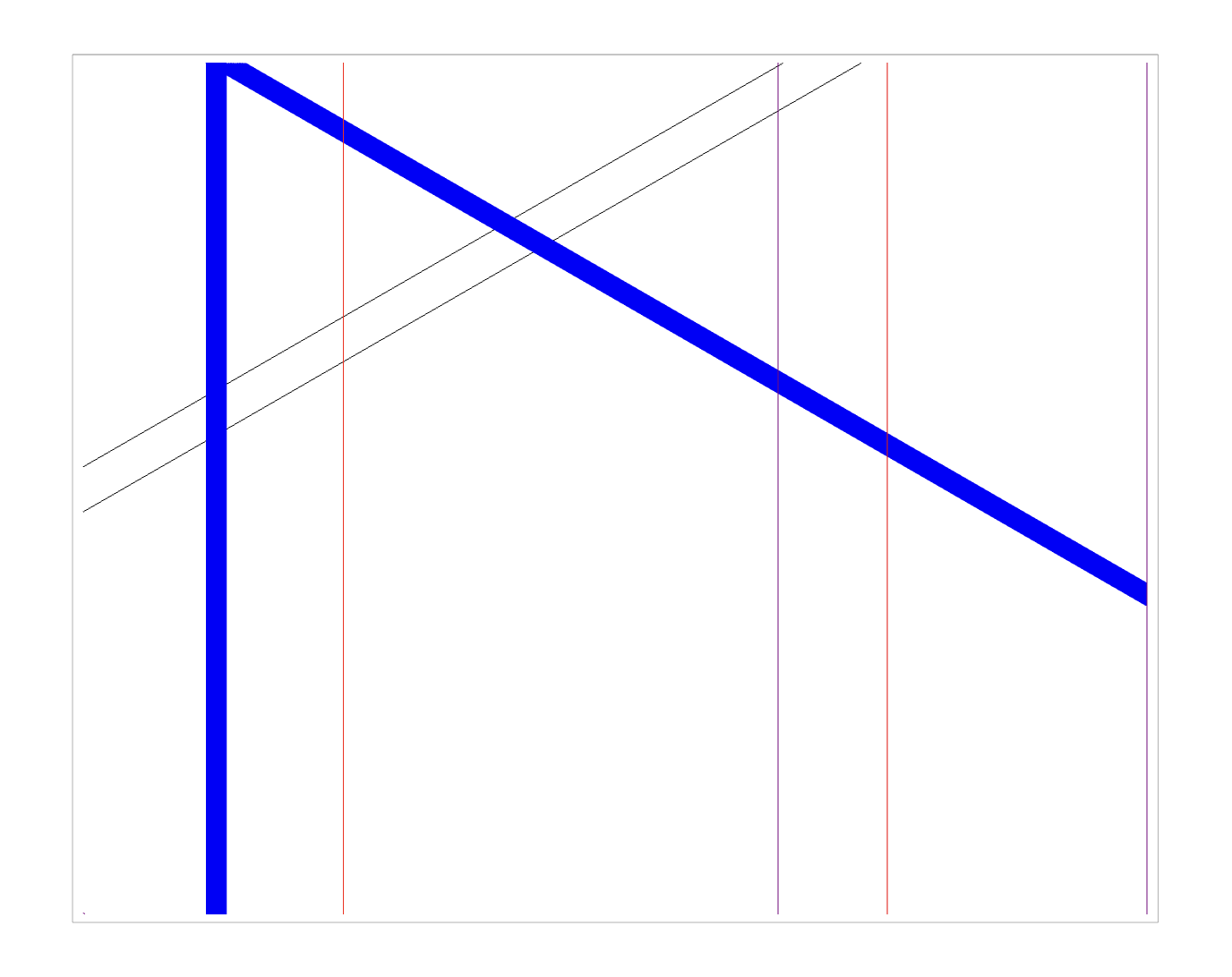
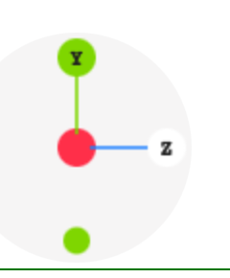
APA0 (East) bad channels [real geometry]
Top north east corner
Blue: dead FEMB
Red: missing wires
Green: shorted
Purple: noisy (RMS>4)
Black: non-responsive
Beam to the right
Stand outside of the detector and look at it in front of APA0 (from east)

Slide 13
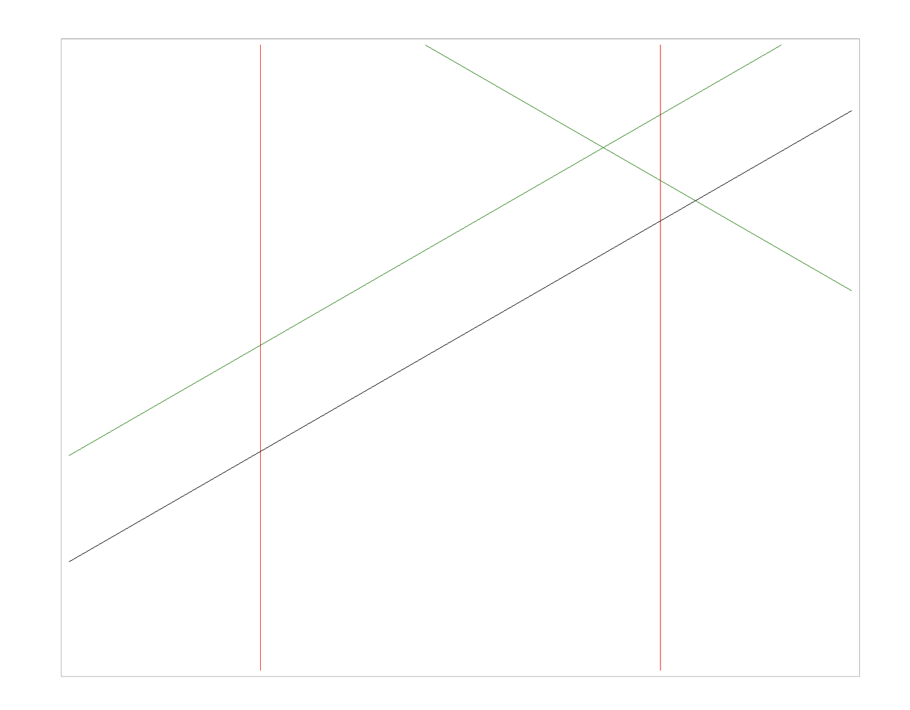
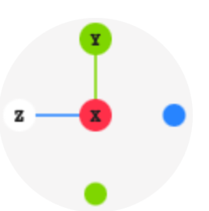
APA1 (West) bad channels [real geometry]
Top south west corner
Blue: dead FEMB
Red: missing wires
Green: shorted
Purple: noisy
Black: non-responsive
Beam to the left
Stand outside of the detector and look at it in front of APA1 (from west)

Slide 14
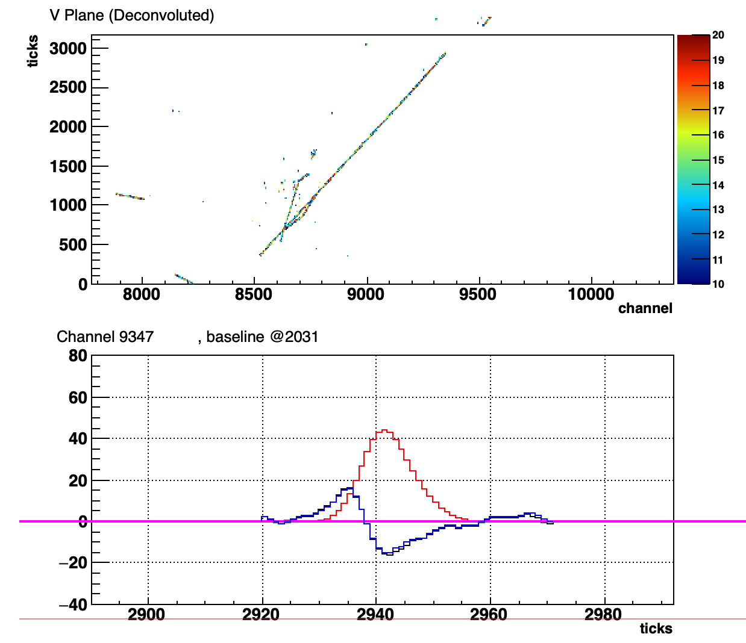
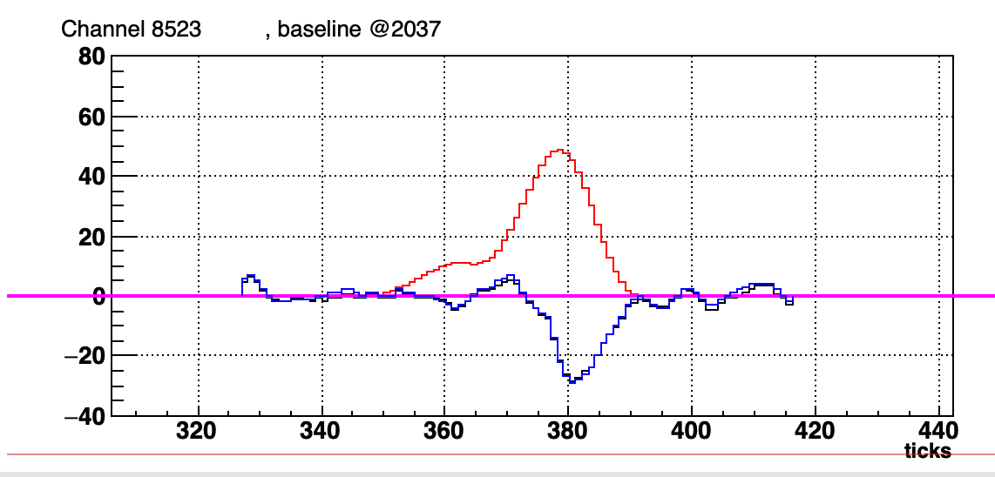
14624_1_549
This is a cathode-anode crossing track in APA1. Another one in APA0 exhibits a consistent max drift time 1281.5 us.
This track should be one crossing cathode and anode.
Drift time = 2942 – 378 = 2564 ticks = 1282 us
Average drift speed = 2000 mm/1282 us = 1.56 mm/us --> perfectly consistent with the theoretical value

Slide 15
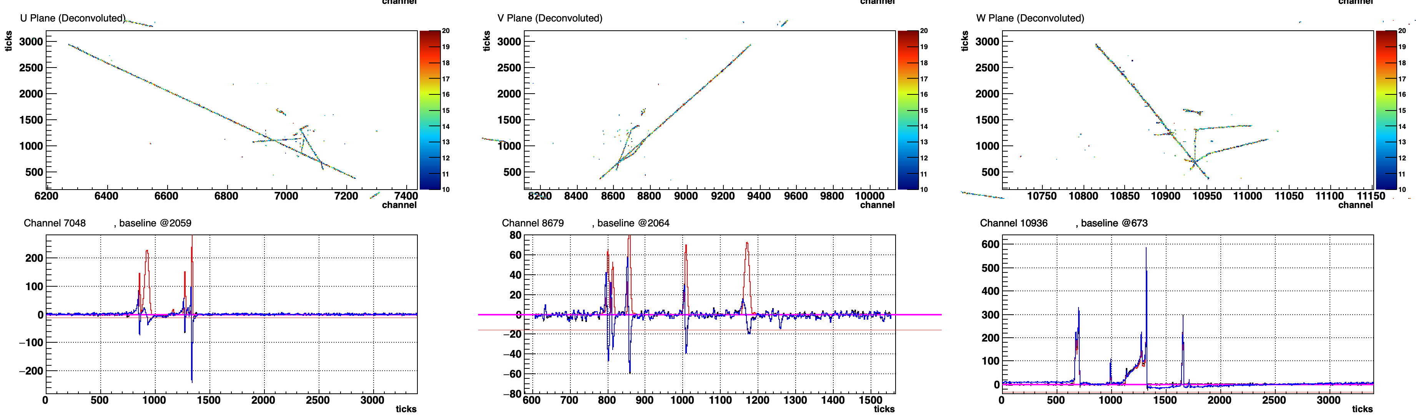
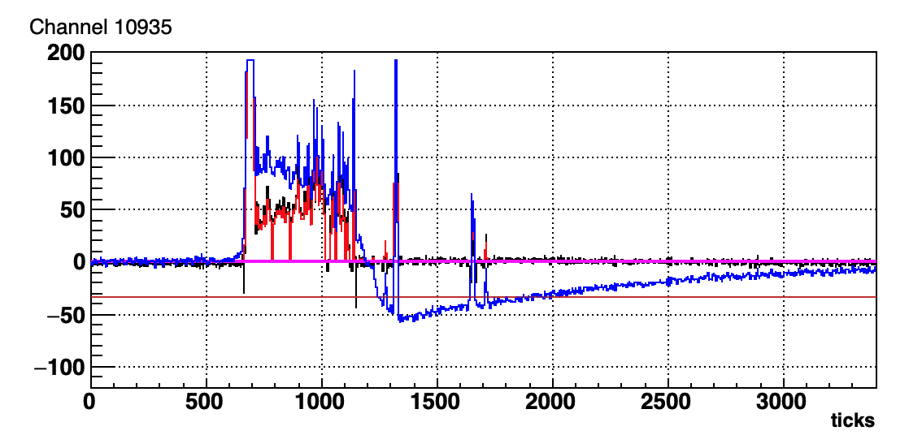
14624_1_549
Overall good
Interesting event!
Clear RC and RC deconvolution

Slide 16
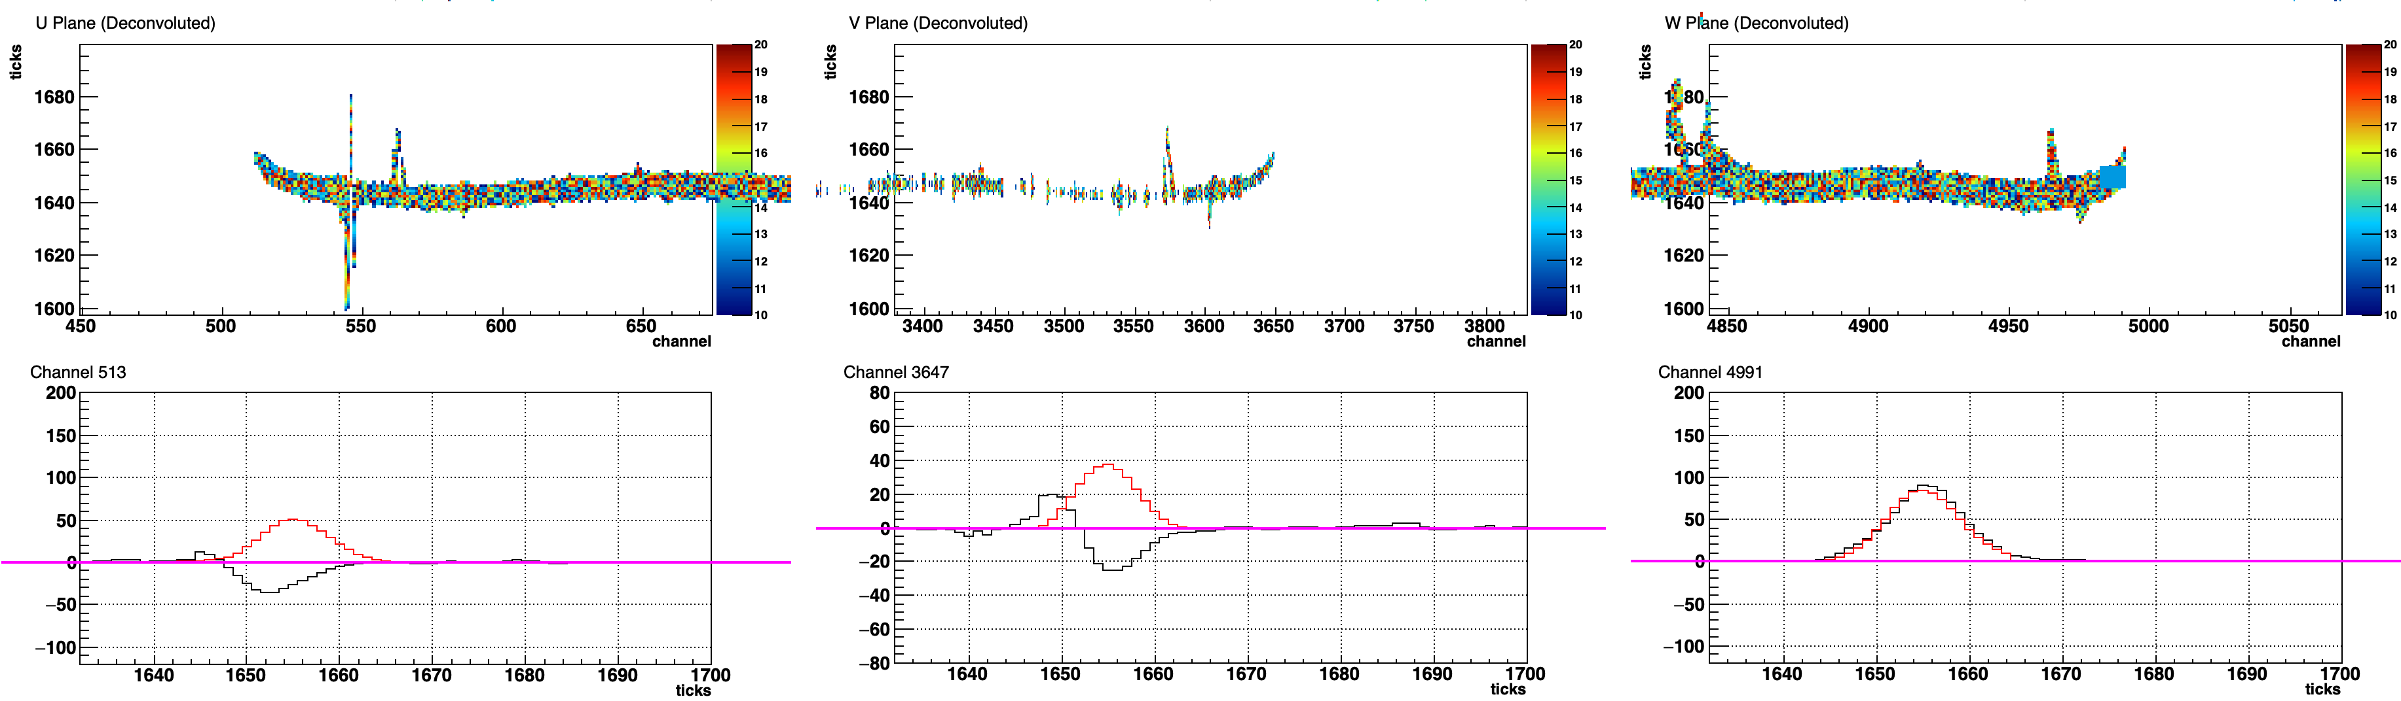
14624_1_501
Overall good
Peak times of decon for three wire planes are consistent
display threshold
Collection raw waveform peak is 2 ticks after decon peak – good; electronics delay

Slide 17
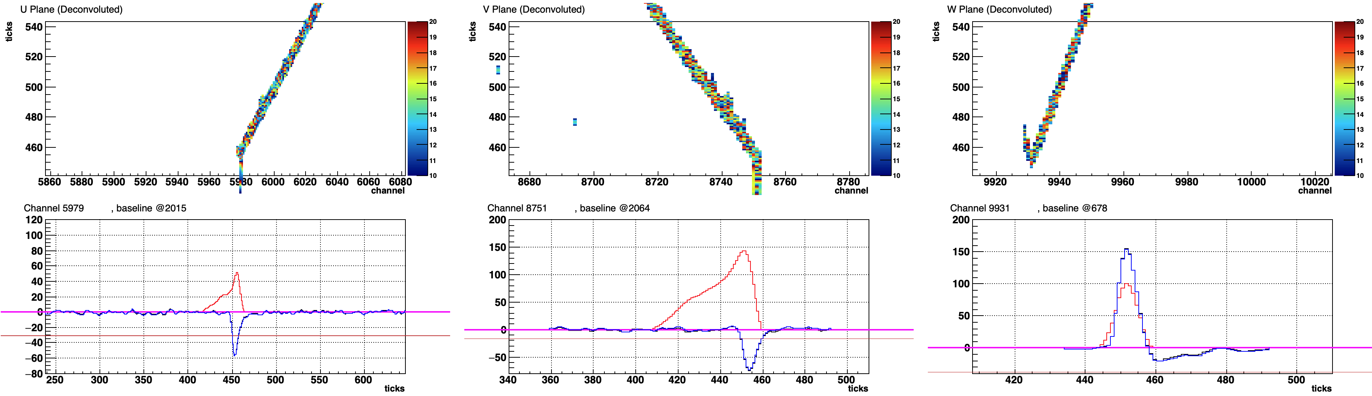
Tear drops due to anode crossing tracks
Dashed lines: the time of where “tear drop” stops
U plane tear drop stops 3-4 ticks later than V plane, and V plane tear drop stops 3-4 ticks later than Y plane.
3-4 ticks is ~ 3 mm which is the wire plane spacing
14624_1_585
A bit “induction” signal as well
No positive porch because charge starts to drift behind U plane.
Along with the tear drops in the other two induction planes, the ”check mark” at the track end in collection plane view indicates the backward drifting of charges beyond the collection plane but still within the active volume.

Slide 18
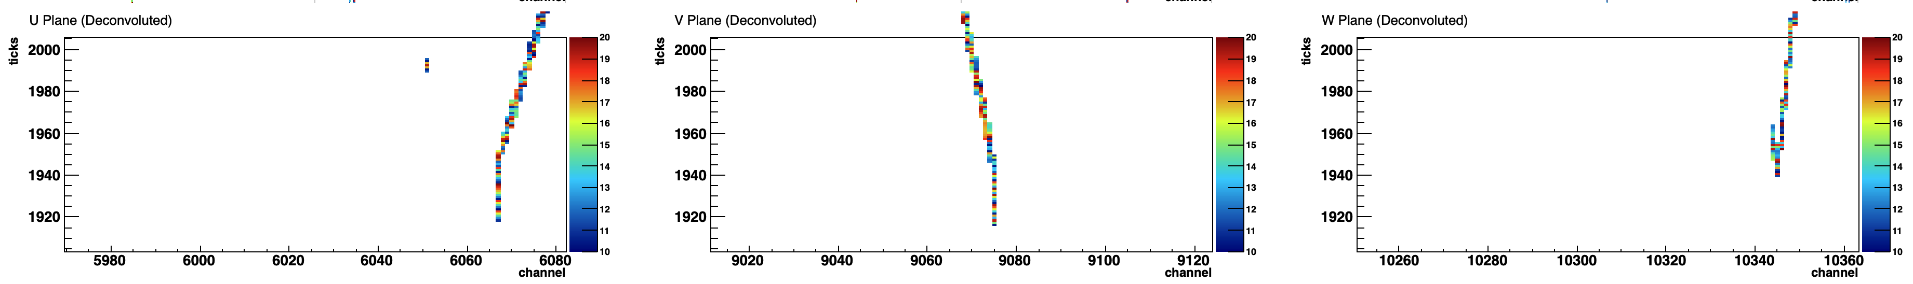
Another example
Such pattern confirmed by cathode-anode crossing muon samples.

Slide 19
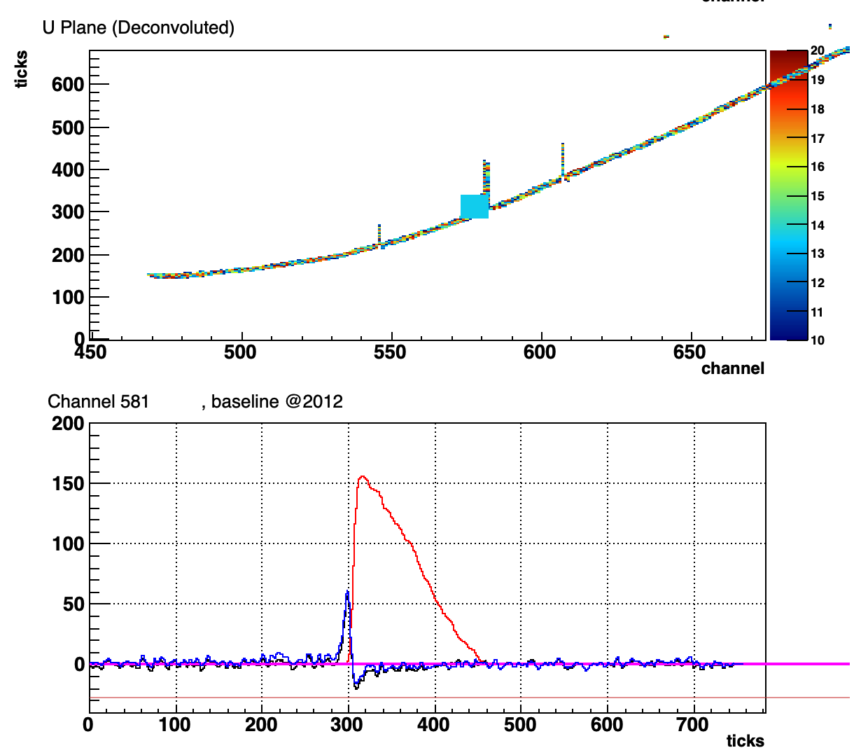
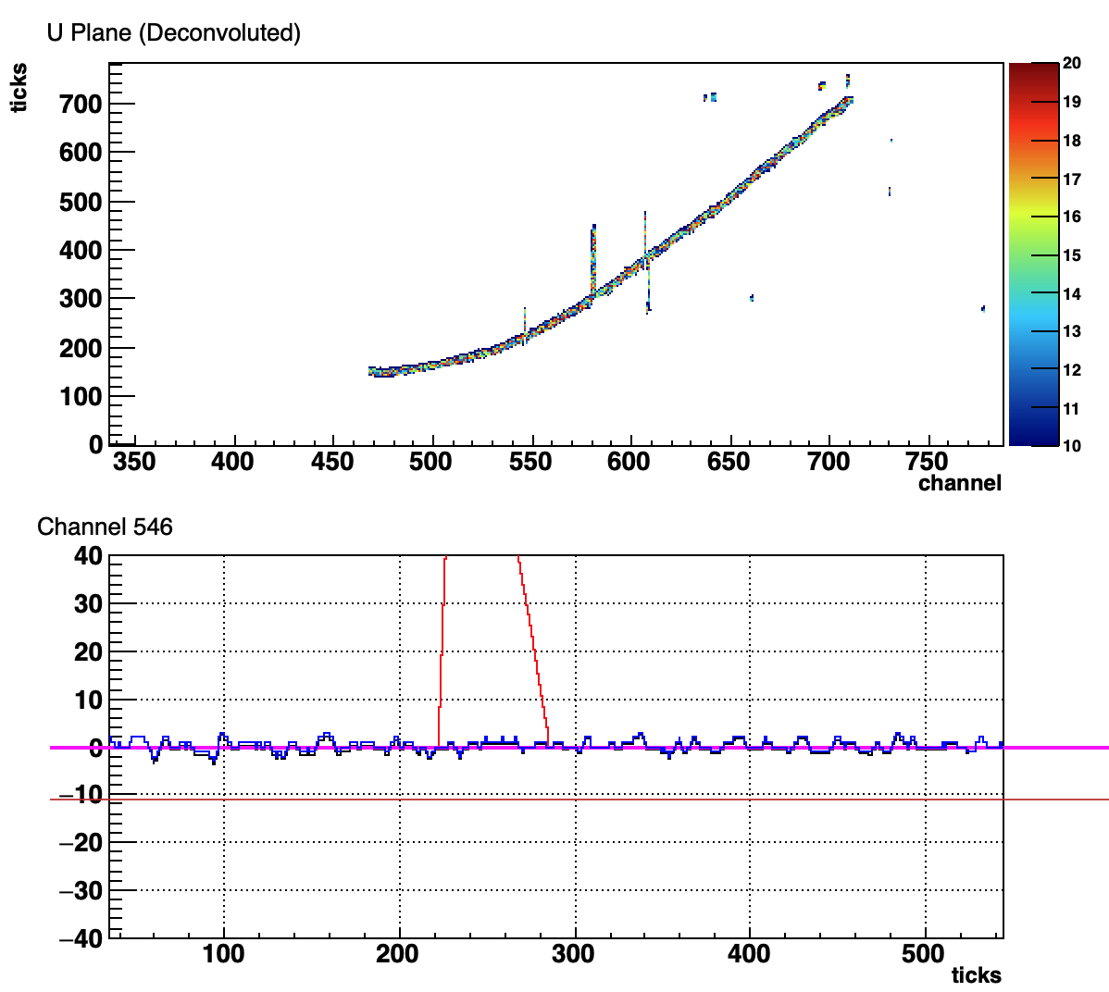
14624_1_513
Overall good
Tear drop not at track end
  NF good
Channel 546 ---> no signal but noise
Channel 607 ---> no signal but noise
Channel 581 ---> small negative porch, likely noise fluctuation

Slide 20
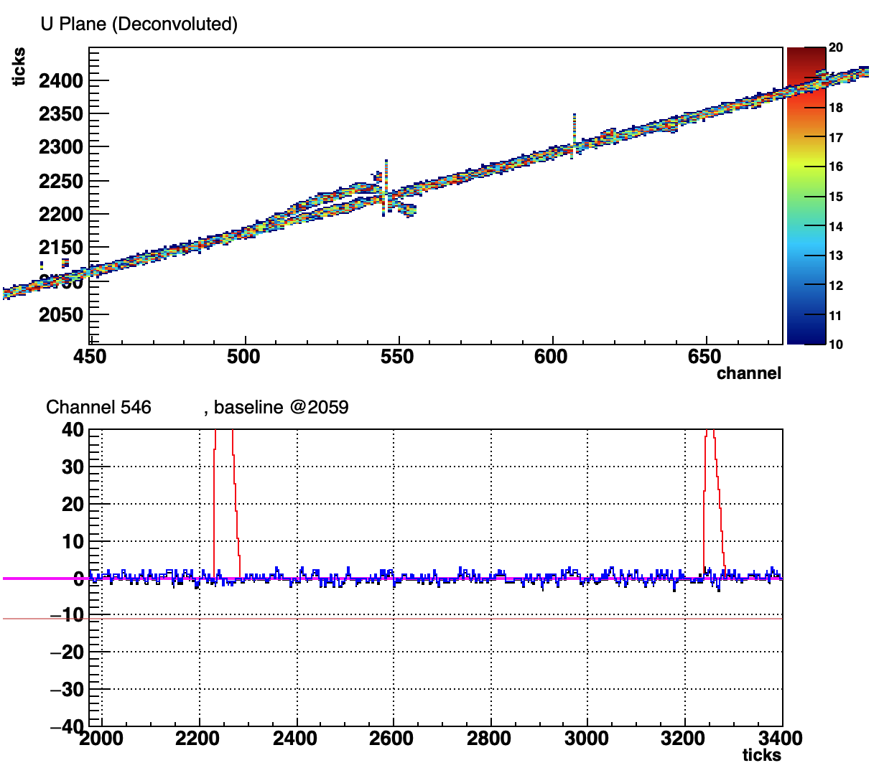
14624_1_537
Similar issues as the previous one in last slide
Most likely electronics issue
Channel 546 ---> no signal but noise
Channel 607 ---> no signal but noise

Slide 21
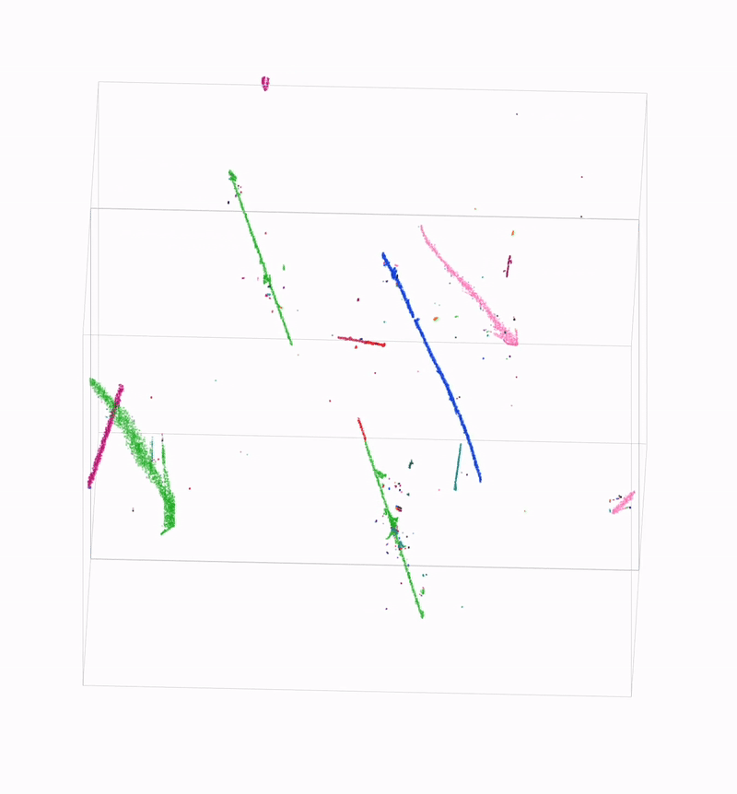
First look at imaging on one event
Noticed some events that crash imaging processing.
Will take a look at later.

Slide 22
Summary
SBND detector has been running stable & normal since two weeks ago
Noise is low; insignificant coherent noise
<1% bad channels
Out-of-box signal processing works well
Tear drops observed in event display
  Anode-crossing track tear drops are no problem because they are at the TPC boundary
  Electronics issue --> tagged as bad channels
  DNN ROI to fix any tear drop
    MP2/MP3 match will get rid of it
    DNN will learn about it
Next steps in near term
  dedicated noise analysis and fine tuning of noise filtering [Ewerton]
  visual scan and coarse tuning of imaging + clustering [Ewerton]
  electronics calibration and channel-by-channel correction [Lynn]
  demonstration of decon charge consistency across three wire planes using data [Lynn]
  DNN ROI further testing and improvement [Moon, Avinay]
  field response validation/calibration using cosmic data [Harry, Avinay]

