Slide 1
DNN-ROI
Status:
Moon added additional prolonged tracks in the training, now the performance on that is good.
Yet, the memory usage is high (10GB peak) and the computing time is long on CPU (100sec/plane)
large image for SBND: 2k x 340
Working on: Reducing memory and works on more topologies

Slide 2
DNN-ROI
Moon:
profiling: main memory is used at the torch side
Python side half precision - not easy
reducing input channels?
seem promising on reducing the memory
checking the performance
chunking?
experience from LS4GAN?
alternative production facility?
100 sec on gpvm vs. 15 sec on Polaris of Argonne
Avinay: more topologies to make sure DNN-ROI works on more than prolonged tracks
adding Shower
Using DNN-ROI to fix teardrops?
Haiwang:
C++ side half precision – similar issue as Python side?

Slide 3
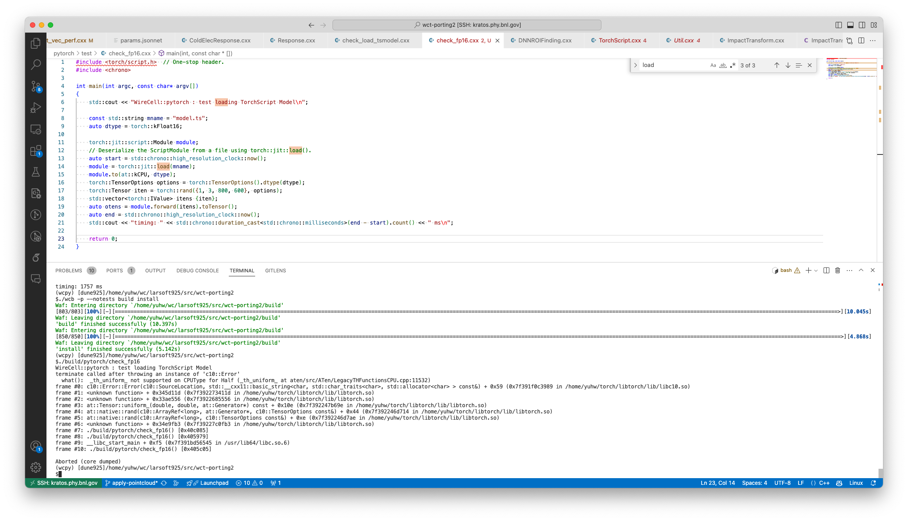
libtorch: 1.3

Slide 4
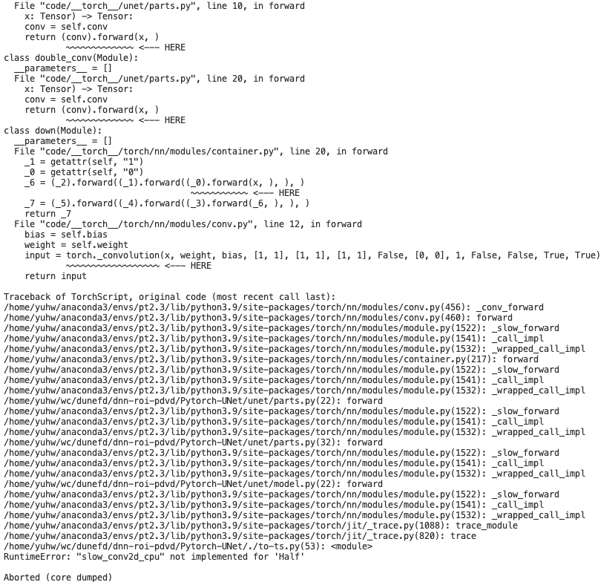
ts model: 2.3 libtorch: 2.1

Slide 5
https://discuss.pytorch.org/t/libtorch-fp16-question/38864

