Slide 1
ppRDO clock (recovered clock from DAM) measurements
ppRDO clock design
ADCLK944 output quality
DAM clock recovery (Si5345 output)
FPGA clock output (FPGA internal clock)
William GU @Jlab

Slide 2
ppRDO clock design
SMA cables to oscilloscope
SMA
RED/RED: FPGA package pins, or Si5345 package pins
Zero Delay FB
optional emergency circuit I²C
IN3
Out9
(N/M)* 98.5 MHz
Out1
pseudoClock
98.5 MHz
Out0
23/24
Out1
1:4 ADCLK944
Si5345
27/28
RX
SMA
197 or
394 MHz
SMA
Fiber
14/15
IN2
DAM
SMA
SMA
Optic transceiver
Out0
Out2
Si53302
30/31
W16/Y16
W17/W18
TX
H1/H2
Phase difference detection
RX
RxRECclk
K5/K6
GTY
control
G3/G4
TX
(reset)
RxPLL
ClkRef
M5/M6
RX
SMA
Optic transceiver
Data/control
To/from MGT
ePIC_Clock
( Pll_cc )
SMA
AA4/AA3
RX
ClkRef1
P6/P5
17/18
TX
Si5338
FPGA
9/10
RDO
Y6/Y5
TX
ClkRef0
V6/V5
William GU @Jlab

Slide 3
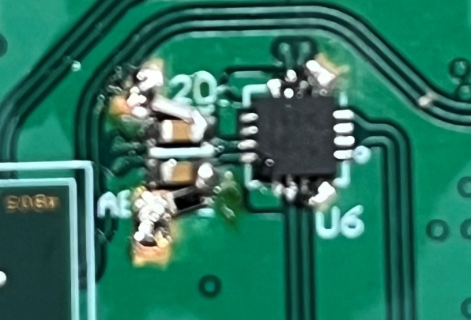
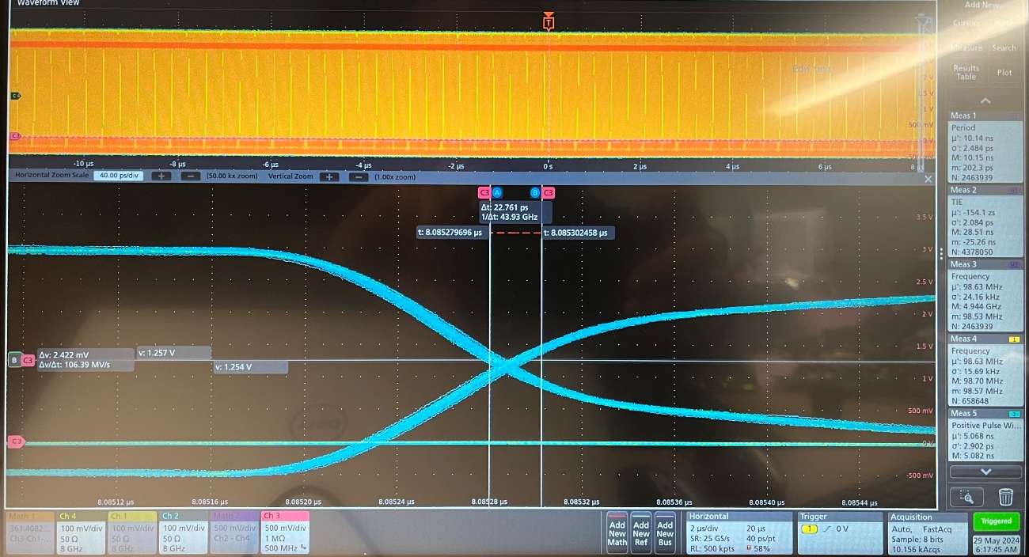
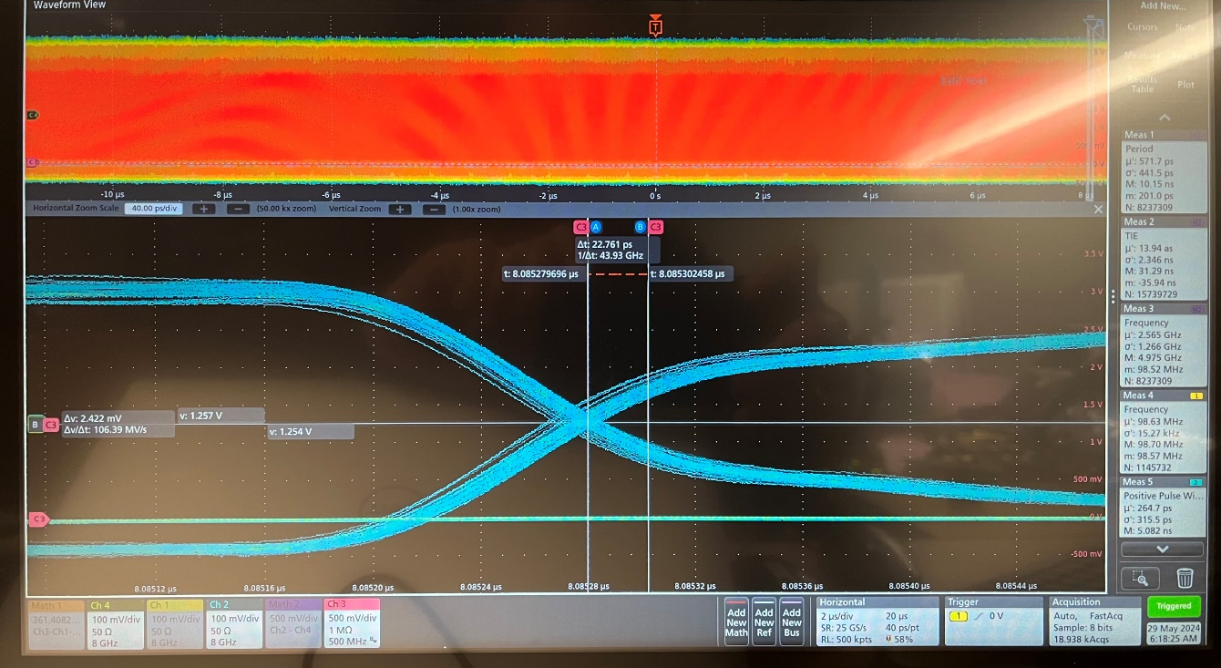
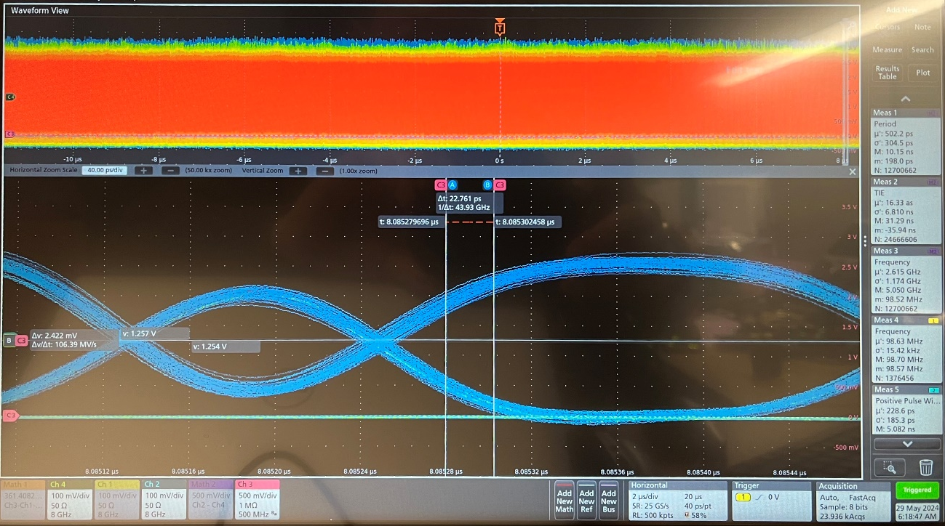
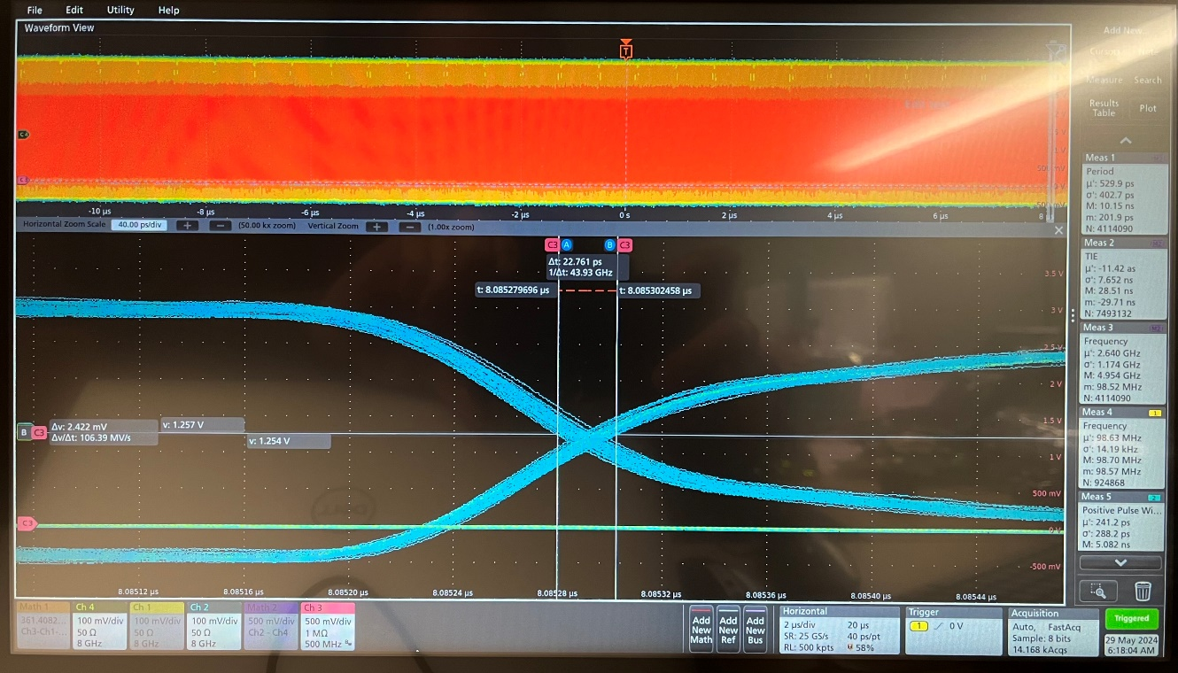
2. ADCLK944 output of pseudoClock
May 29, 2024: SMA Rx_SPF output with ppRDO, ADCLK944 test
FLX182, _240228 firmware, after the pulldown resistor fixes.
Three pairs of 200Ω pulldown resistors
00: _|~~~~~~|___
01: ~|_XXXXXXXXXX
11: XXXXXXXXX_~
10: _|~XXXXXXXXX

Slide 4
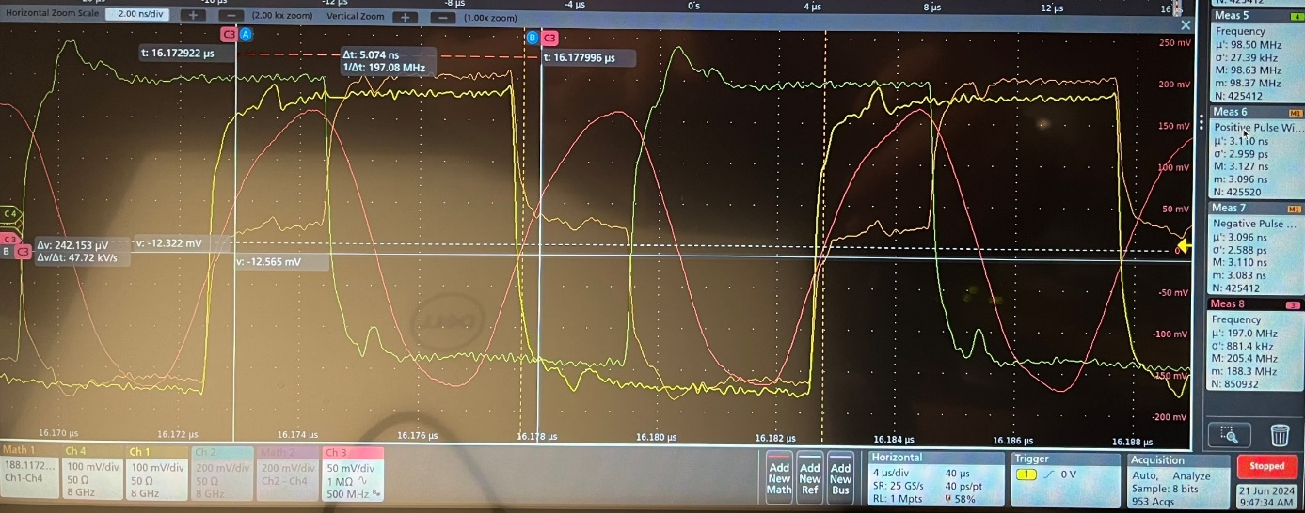
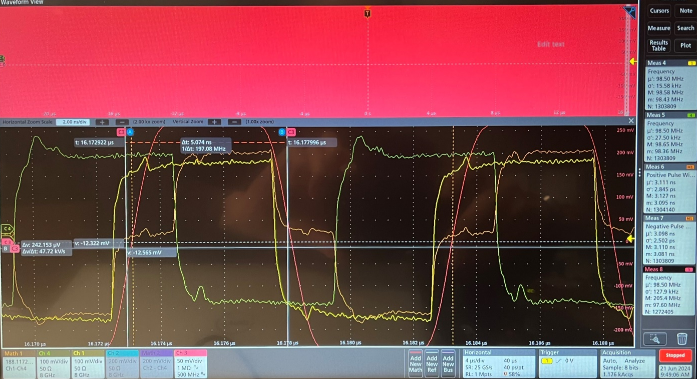
3. DAM clock recovery (Si5345 output)
Firmwares: ppRDO: pprdo_download_0xAB30B024.bit, June 21, 11:00
Flx182: flx182_240111_1602.pdi, Si5345_A2_register.h, Si5345_B1_register.h, 98.5MHz;
Si5344H: outputs at (0,2) 98.5 MHz, (1) 197 MHz, and (3) 250 MHz.
(June 21, 2024)
Flx182 will not work with Si5345_A3/A4 config file (98.63 MHz generated configure file) even if the clock (on FLX182) is set to 98.5 MHz, and Si5344H outputs 98.5 MHz.
Clk_98.5
Si5344H
FLX182
Fiber_7.88
CH#1
CH#2
1:4
RxRECclk
CH#4
Phase
Detect
MGT
ClkSys_98.5
Si5345
RxRecClk_197
RxUSR2clk
ClkRef
FPGA
CH#3
Si5338
ppRDO
Pseudoclock: positive width (ADCLK944 output – Si5344H output): 3.113ns ± 2.9ps; negative width: 3.100ns ± 2.6ps
William GU @Jlab

Slide 5
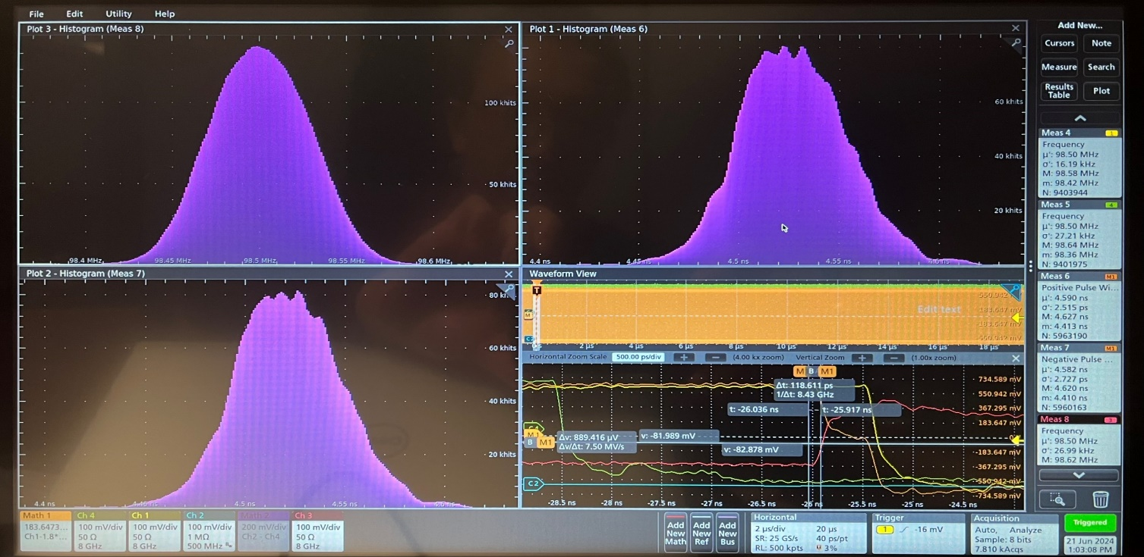
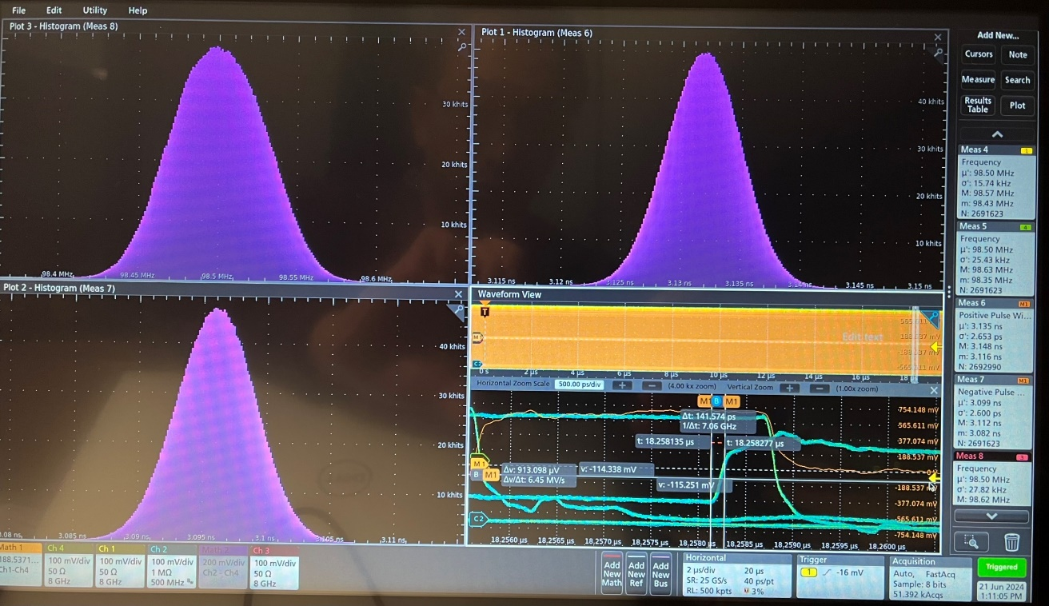
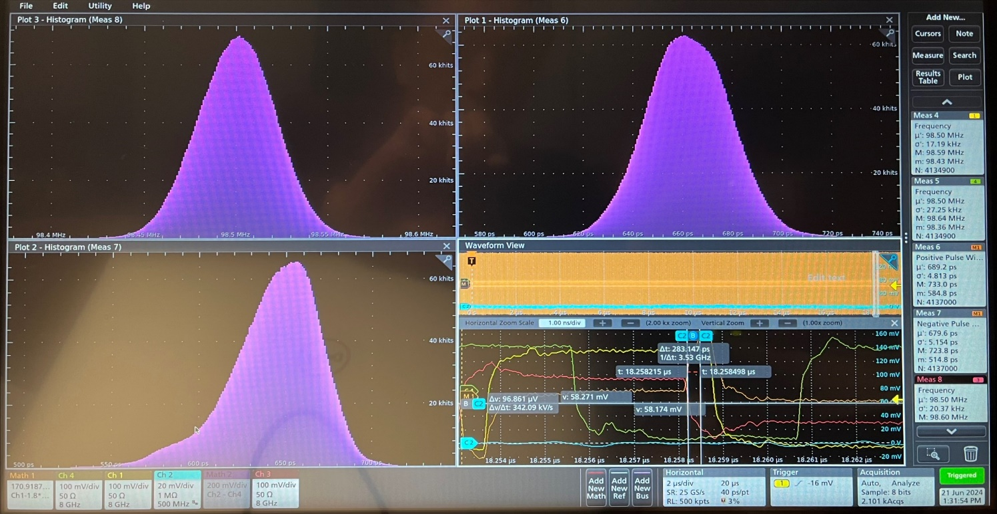
June 21, 2024: SMA output with ppRDO, at 98.5 MHz, with inappropriate Si5345 settings
Si5345 output is locked to the reference clock at 98.5 MHz.
The measured RMS of positive width is ~2.7ps, and RMS of negative width is ~2.6ps, but the center value moves as shown in the left two scope captures. The spread is over 100ps. This is caused by the Si5345 loop bandwidth setting (~100 Hz).
Double check the ADCLK944 output, the center value plot is consistent with the RMS, as shown in the scope capture (bottom right), ~3ps.
William GU @Jlab

Slide 6
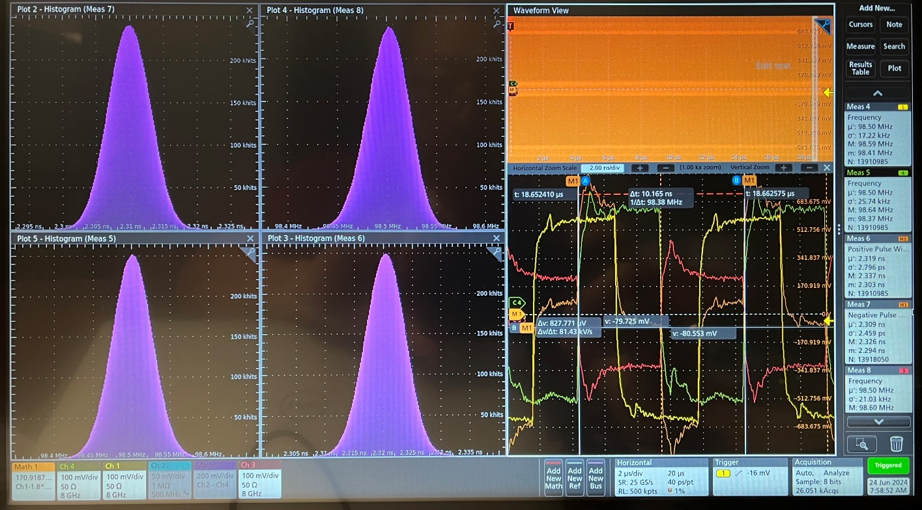
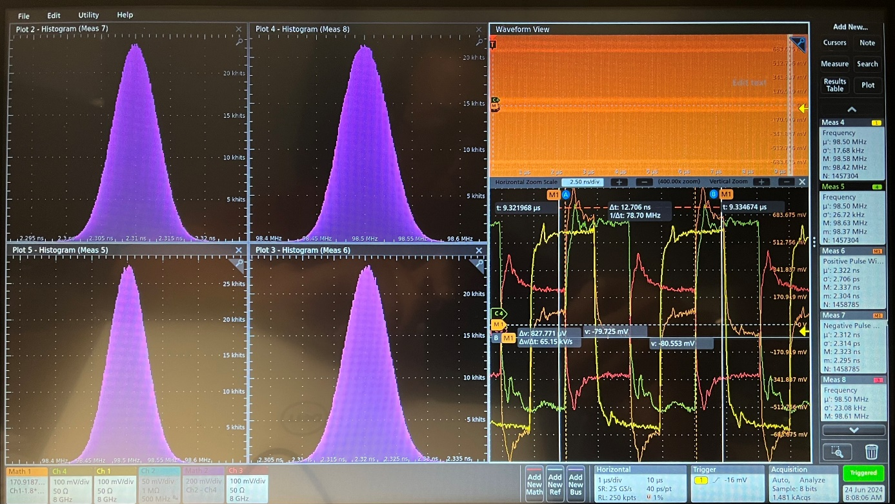
June 24, 2024: SMA output with ppRDO, at 98.5 MHz, same setting as June 21st, except ppRDO_Si5345
Firmwares: ppRDO: pprdo_download_0xAB30B024.bit, June 21, 11:00
Flx182: flx182_240111_1602.pdi, Si5345_A2_register.h, Si5345_B1_register.h, 98.5MHz;
Si5344H: outputs at (0,2) 98.5 MHz, (1) 197 MHz, and (3) 250 MHz.
pprdo: Si5345 setting: Loop BandWidth: 2KHz (actual: 1.42 KHz), Fast lock: 4KHz (actual 2.84 KHz)
The MATH = Ch1 (Si5344H output) – 1.8*Ch3 (Si5345 output/ppRDO)
At ~18us range,
Si5345 output: center 98.5 MHz, HWFM: 50 KHz, σ: 21 KHz;
MATH positive: center 2.320 ns, HWFM: 9 ps, σ: 2.9 ps;
MATH negative: center 2.310 ns, HWFM: 8 ps, σ: 2.5 ps.
At ~8us range,
Si5345 output: center 98.5 MHz, HWFM: 50 KHz, σ: 21 KHz;
MATH positive: center 2.320 ns, HWFM: 9 ps, σ: 2.7 ps;
MATH negative: center 2.310 ns, HWFM: 8 ps, σ: 2.3 ps.
William GU @Jlab

Slide 7
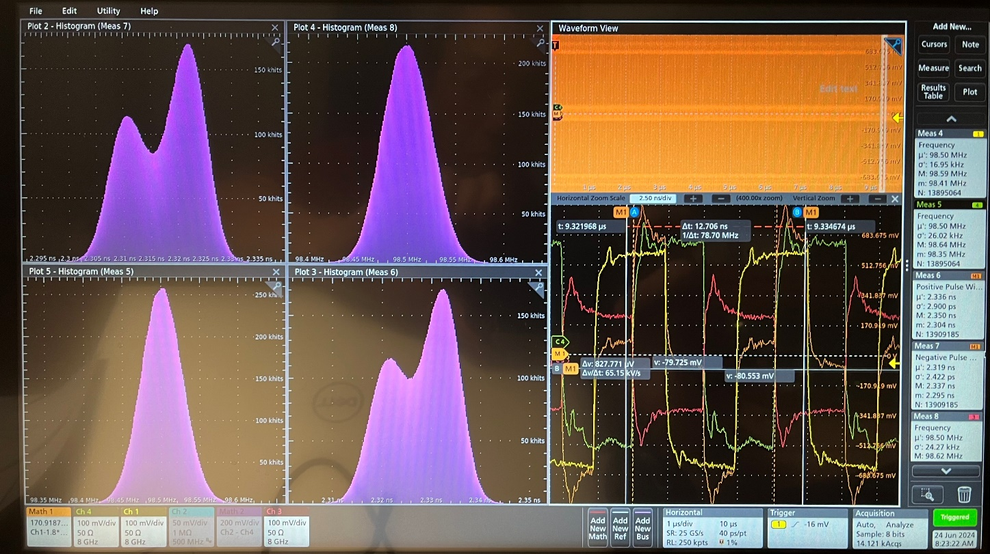
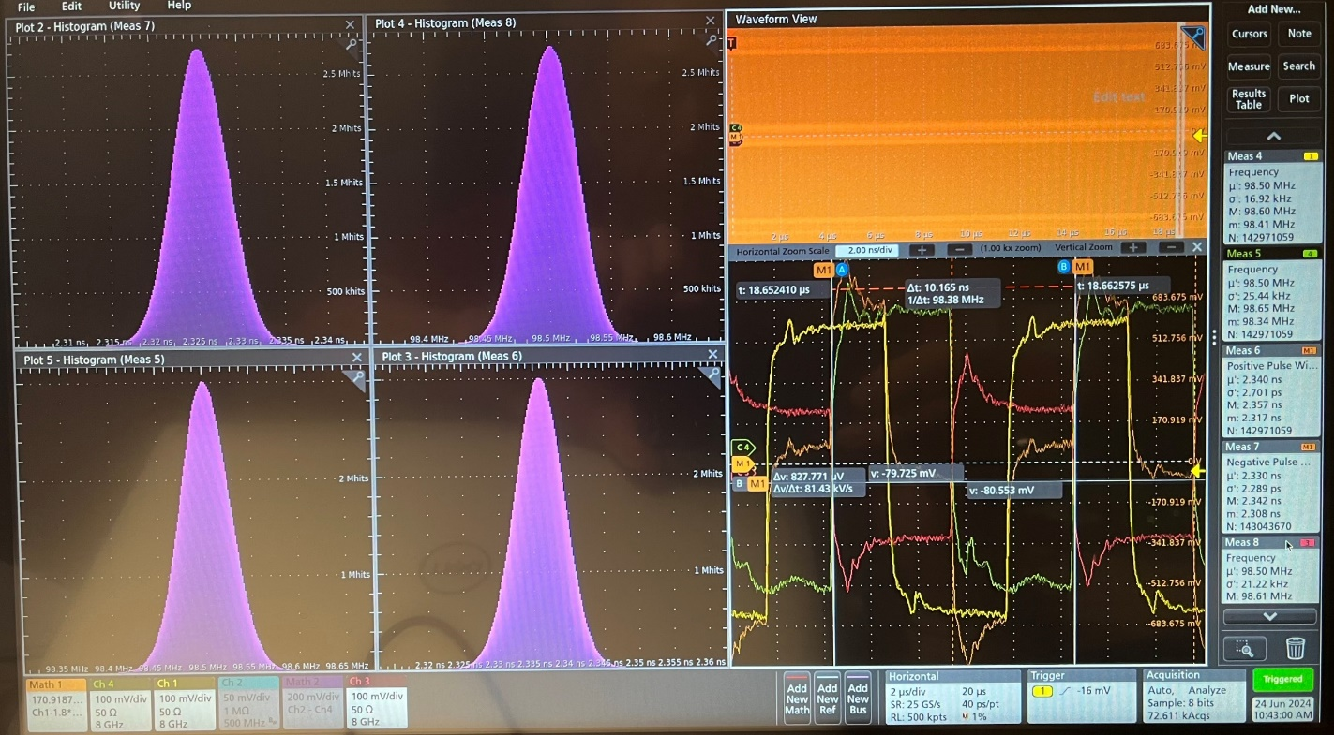
June 24, 2024: SMA output with ppRDO, at 98.5 MHz, same setting as June 21st, except ppRDO_Si5345, long term stability
Firmwares: ppRDO: pprdo_download_0xAB30B024.bit, June 21, 11:00
Flx182: flx182_240111_1602.pdi, Si5345_A2_register.h, Si5345_B1_register.h, 98.5MHz;
Si5344H: outputs at (0,2) 98.5 MHz, (1) 197 MHz, and (3) 250 MHz.
pprdo: Si5345 setting: Loop BandWidth: 2KHz (actual: 1.42 KHz), Fast lock: 4KHz (actual 2.84 KHz)
The MATH = Ch1 (Si5344H output) – 1.8*Ch3 (Si5345 output/ppRDO)
The FLX182 FPGA cooling fan ran into high speed, which increased the MATH width by over 10 ps. (jump)
Si5345 output: center 98.5 MHz, HWFM: 50 KHz, σ: 21 KHz;
MATH positive: center 2.336 ns, σ: 2.9 ps;
MATH negative: center 2.319 ns, σ: 2.5 ps.
After ~2 hours accumulation, (stable)
Si5345 output: center 98.5 MHz, HWFM: 50 KHz, σ: 21 KHz;
MATH positive: center 2.336 ns, HWFM: 9 ps, σ: 2.7 ps;
MATH negative: center 2.3255 ns, HWFM: 8 ps, σ: 2.3 ps.
(HWFM = 2.335 σ). Extra σ is ~2.5 ps)
William GU @Jlab

Slide 8
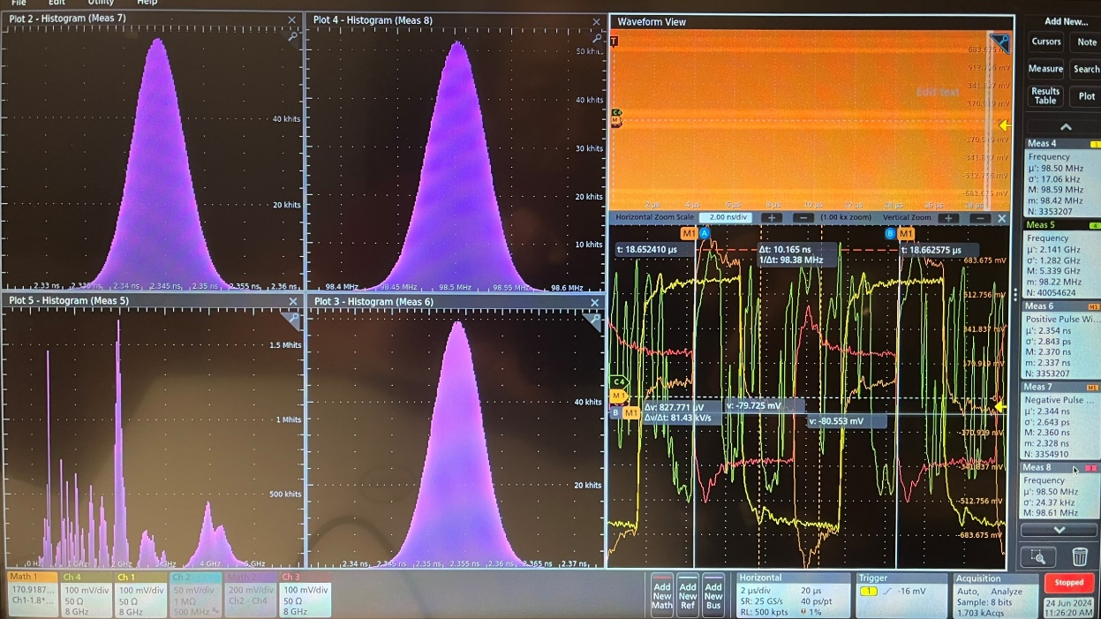
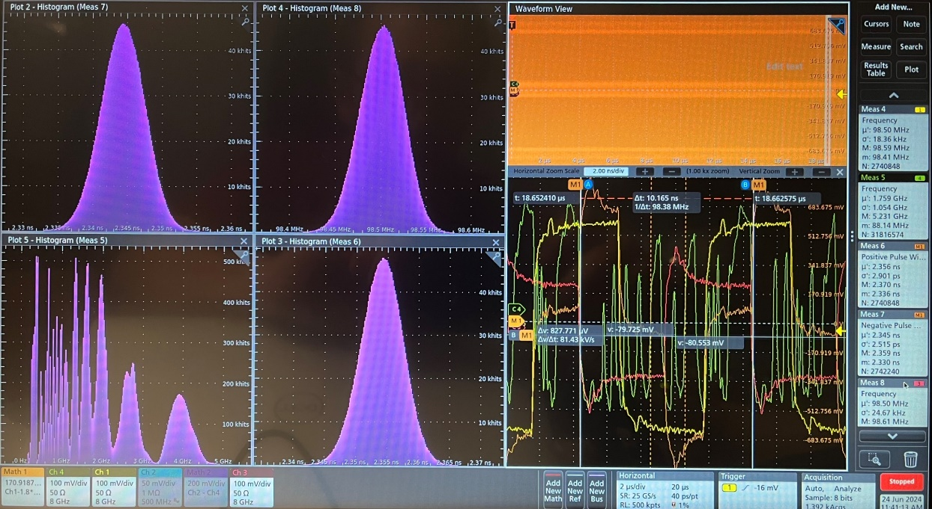
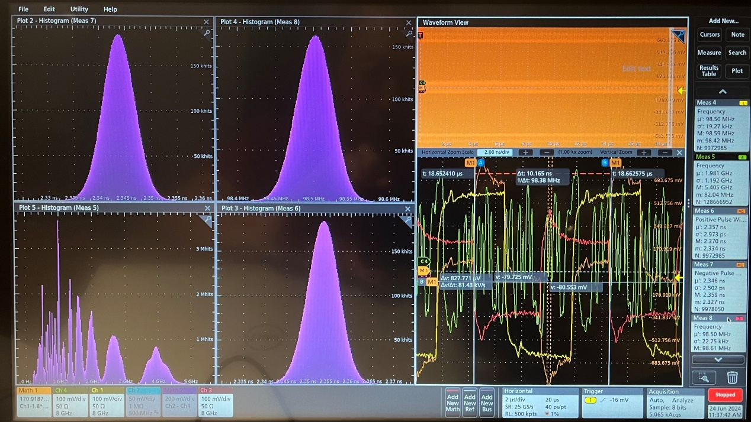
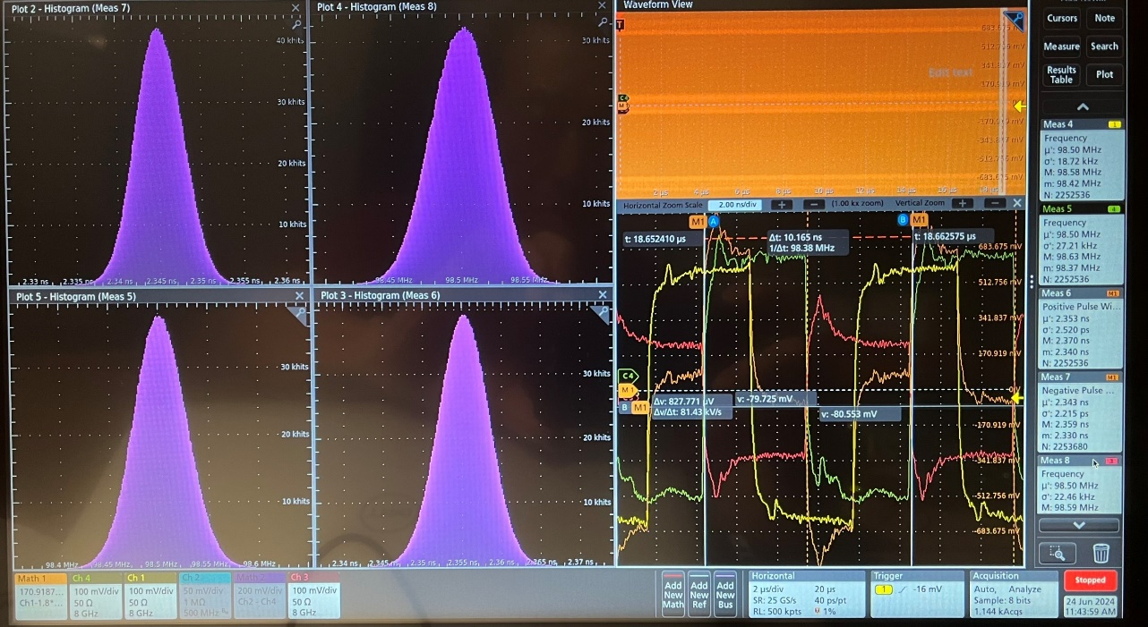
June 24, 2024: SMA output with ppRDO, at 98.5 MHz, same setting as page65/66, check with different FLX182 TX patterns
FLX182 TX output
“10” “01”
“11” “00”
The Si5345 output shifted 20ps even after the pattern went back to “00”, pseudoclock.
The 20ps jump can be calibrated, even if we cannot control in firmware
William GU @Jlab

Slide 9
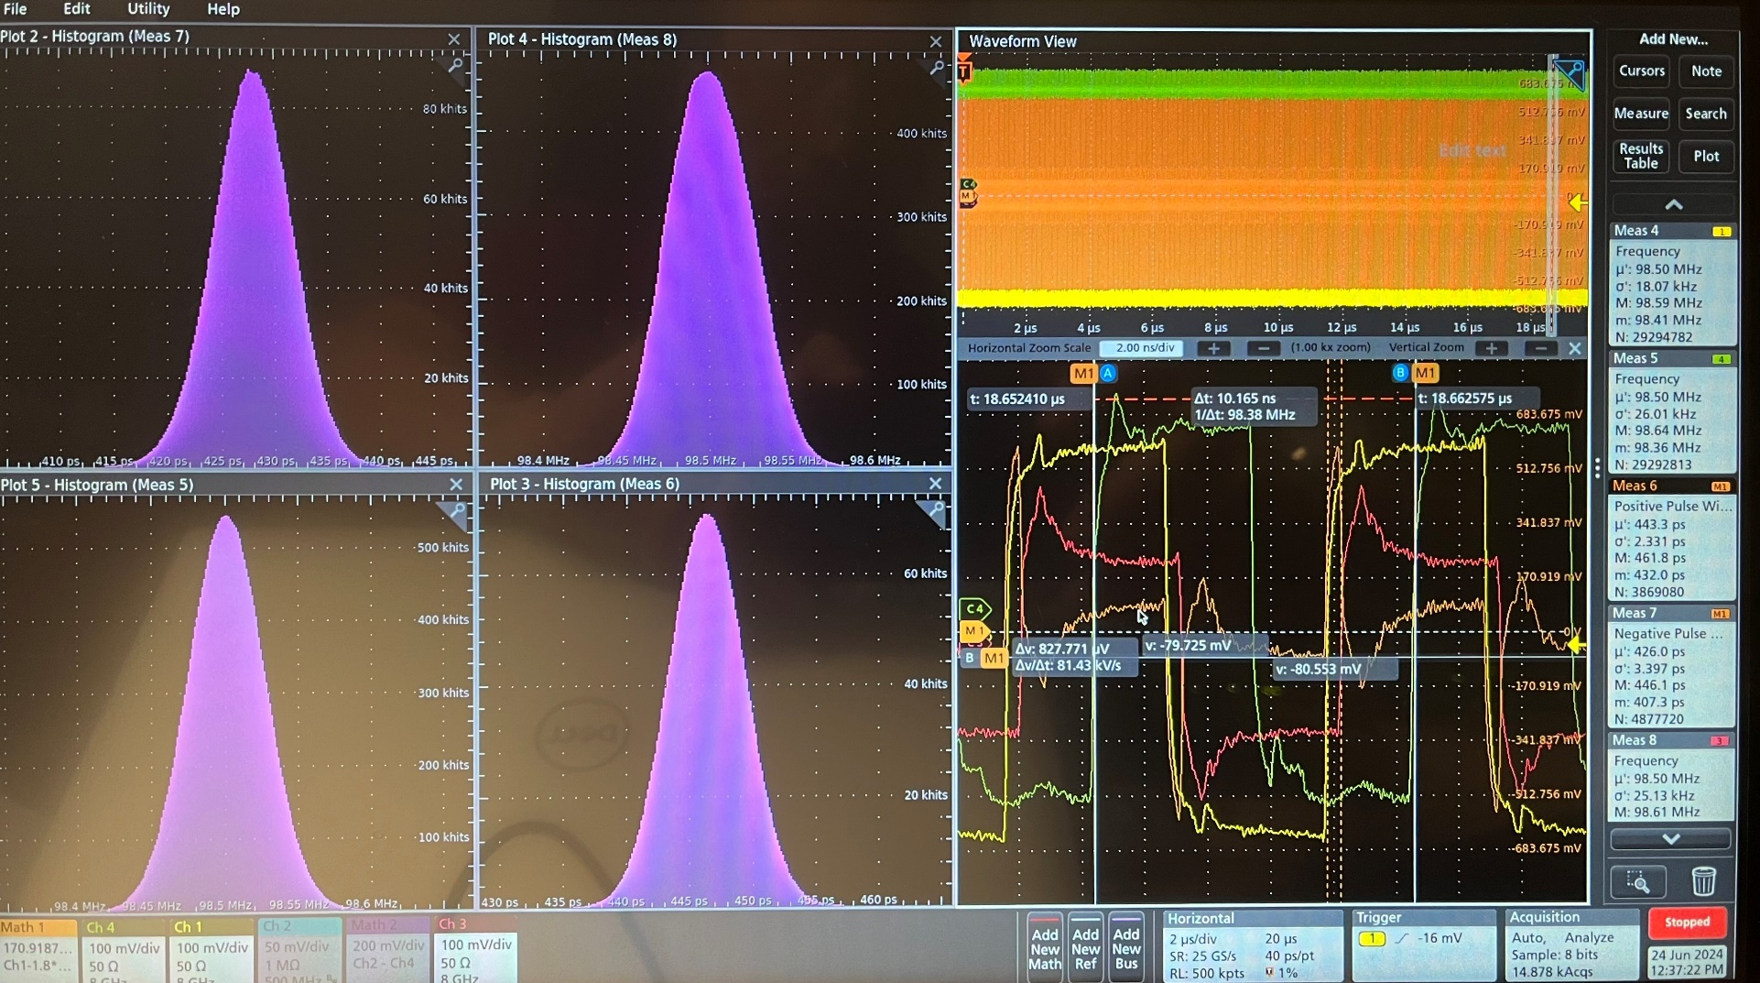
June 24, 2024: SMA output with ppRDO, at 98.5 MHz, same setting as page65/66, ppRDO MGT Rx Reset
The effects of Rx related resets were reproduced (Mar. 1st 2024’s tests).
The MATH measurement reference was adjust from +-600 mV to +- 500 mV for the ‘narrow’ pulses,
Positive: center 446 ps, FWHM: 8 ps, RMS: 2.4 ps
Negative: center 427 ps, FWHM: 8 ps, RMS: 3.2 ps
William GU @Jlab

Slide 10
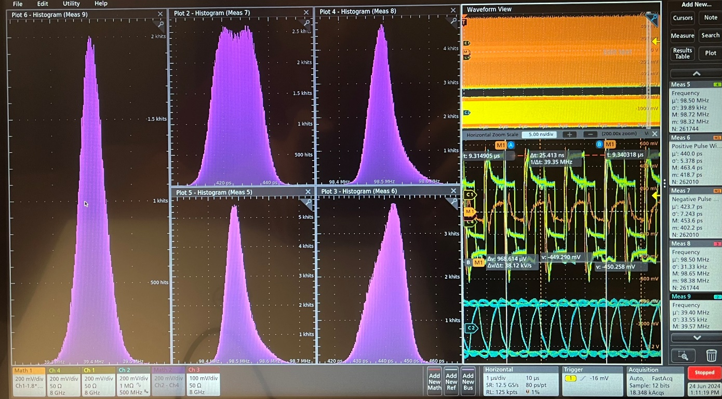
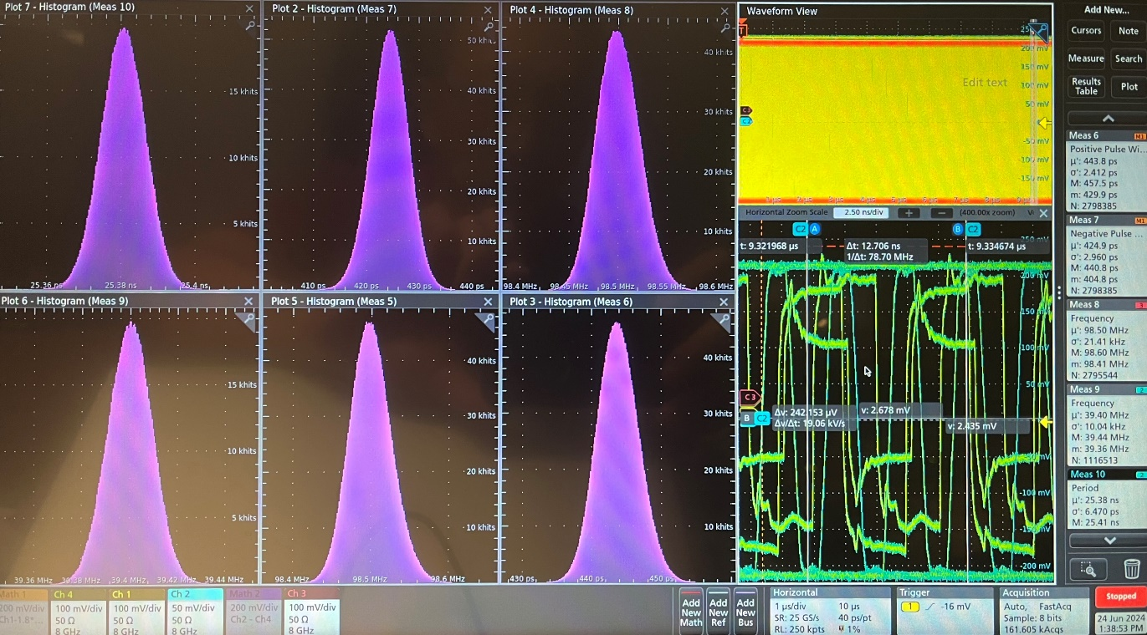
4. FPGA clock output (FPGA internal clock)
June 24, 2024: SMA output with ppRDO, at 98.5 MHz, same setting as page65/66, 39.4 MHz clock measurement
Using the passive probe, and triggering on Si5344H output,
Clock freq: center 39.4 MHz, FWHM: 70 KHz, RMS: 33.6 KHz
The other measurement is weird because of the scope sampling at 12.5 GS/s
Probing the J7 SMA connector. It is diff_sstl12_dci output of the Clock_40 via FPGA_MMCM, and triggering on Si5344H output,
Clock freq: center 39.4 MHz, FWHM: 22 KHz, RMS: 10 KHz;
The period is 25.38 ns, FWHM: 14 ps, RMS: 6.4 ps.
The other (Clk_98.5) measurements are normal.
William GU @Jlab

Slide 11
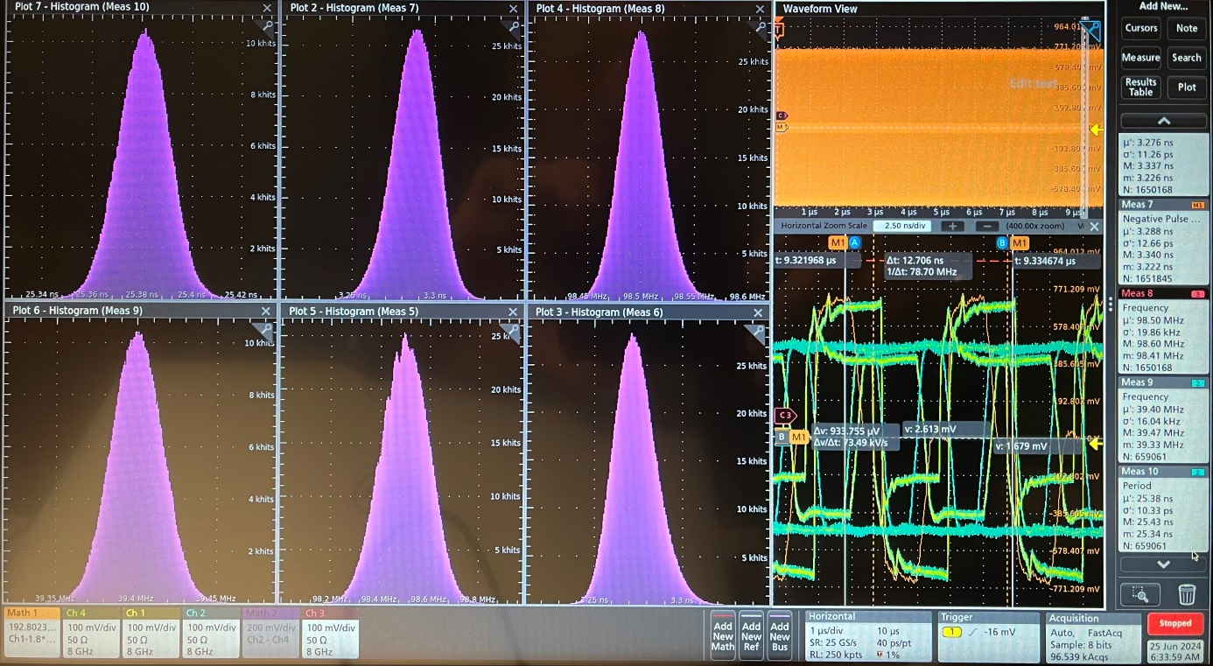
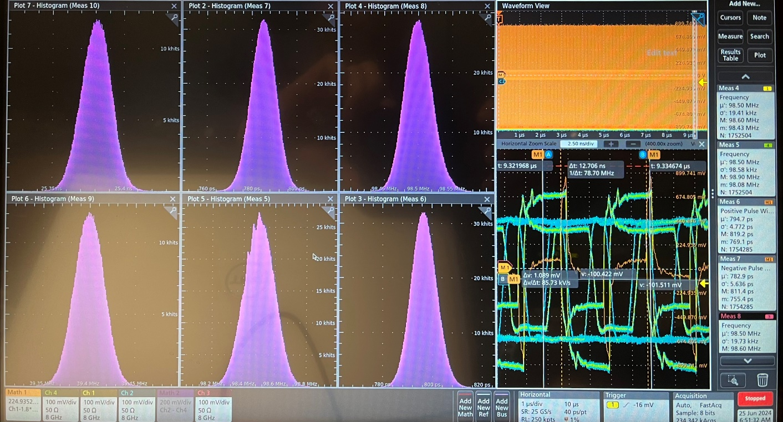
June 25, 2024: SMA output with ppRDO, at 98.5 MHz, 39.4 MHz clock measurement, same setting as before except: SMA/J7 (sstl12) == Ch2, clk_39.4; SMA/J6 (sstl12) == Ch4, clk_98.5 from pprdo_FPGA
Si5344H output, Ch#1 (meas#4): 98.50 MHz, σ: 18 KHz; FLX182: pseudo_clock
MATH == Ch#1 – 1.8*Ch#4
MATH == Ch#1 – 1.8*Ch#3
Clk_39.4: Meas#9: 39.4 MHz, FWHM: 35 KHz, σ: 16 KHz
Meas#10: 25.38 ns, FWHM: 24 ps, σ: 10 ps
Clk_39.4: Meas#9: 39.4 MHz, FWHM: 35 KHz, σ: 18 KHz
Meas#10: 25.38 ns, FWHM: 24 ps, σ: 11 ps
Clk_98.5: Meas#5: 98.50 MHz, FWHM: 240 KHz, σ: 92 KHz
Meas#6: 3.272 ns, FWHM: 30 ps, σ: 11.3 ps
Meas#7: 3.288 ns, FWHM: 30 ps, σ: 12.7 ps
Clk_98.5: Meas#5: 98.50 MHz, FWHM: 240 KHz, σ: 92 KHz
Clk_Si5345out: Meas#8: 98.50 MHz, FWHM: 45 KHz, σ: 19.7 KHz
Meas#6: 796 ps, FWHM: 16 ps, σ: 4.77 ps
Meas#7: 785 ps, FWHM: 16 ps, σ: 5.6 ps
Clk_Si5345out: Meas#8: 98.50 MHz, FWHM: 45 KHz, σ: 20 KHz
William GU @Jlab

Slide 12
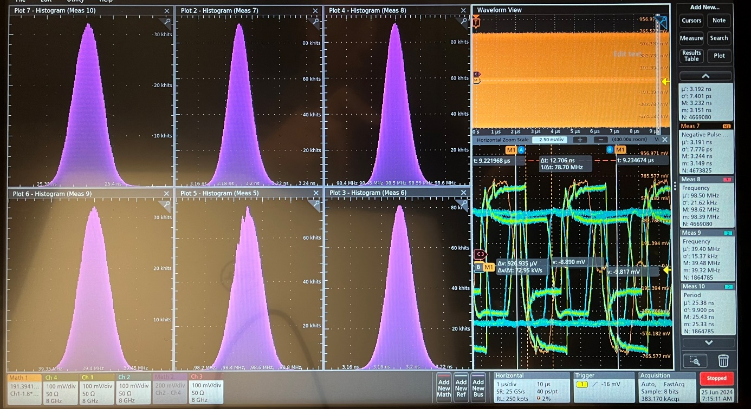
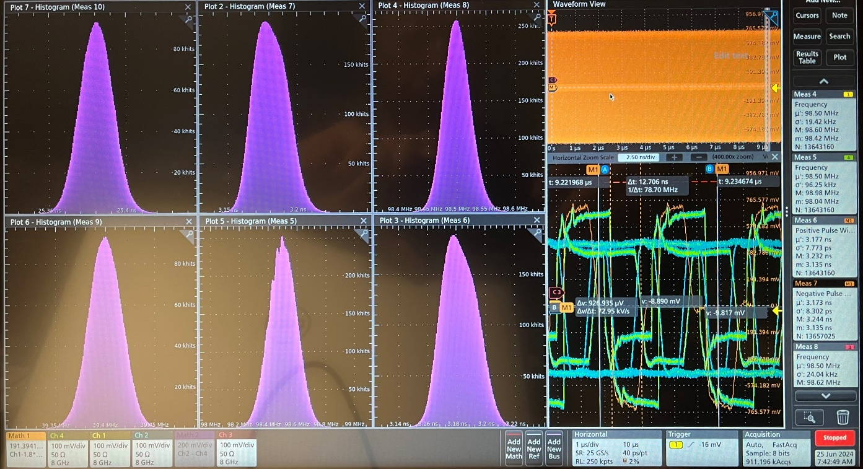
June 25, 2024: SMA output with ppRDO, at 98.5 MHz, 39.4 MHz clock measurement, same setting as before except: SMA/J7 (sstl12) == Ch2, clk_39.4; SMA/J6 (sstl12) == Ch4, clk_98.5 from pprdo_FPGA
Si5344H output, Ch#1 (meas#4): 98.50 MHz, σ: 18 KHz; FLX182: “10”, normal downlink, MATH == Ch#1 – 1.8*Ch#4
FLX182 fan speed low
MATH ref: 100, 350, 600 mV
FLX182 fan speed low, and high
Clk_39.4: Meas#9: 39.4 MHz, FWHM: 40 KHz, σ: 16 KHz
Meas#10: 25.38 ns, FWHM: 25 ps, σ: 10 ps
Clk_39.4: Meas#9: 39.4 MHz, FWHM: 40 KHz, σ: 18 KHz
Meas#10: 25.38 ns, FWHM: 30 ps, σ: 11 ps
Clk_98.5: Meas#5: 98.50 MHz, FWHM: 240 KHz, σ: 92 KHz
Meas#6: 3.194 ns, FWHM: 20 ps, σ: 7.4 ps
Meas#7: 3.190 ns, FWHM: 20 ps, σ: 7.8 ps
Clk_98.5: Meas#5: 98.50 MHz, FWHM: 260 KHz, σ: 92 KHz
Meas#6: 3.180 ns, FWHM: 30 ps, σ: 7.6 ps
Meas#7: 3.180 ns, FWHM: 28 ps, σ: 8 ps
Clk_Si5345out: Meas#8: 98.50 MHz, FWHM: 50 KHz, σ: 21.6 KHz
Clk_Si5345out: Meas#8: 98.50 MHz, FWHM: 50 KHz, σ: 20 KHz
William GU @Jlab

Slide 13
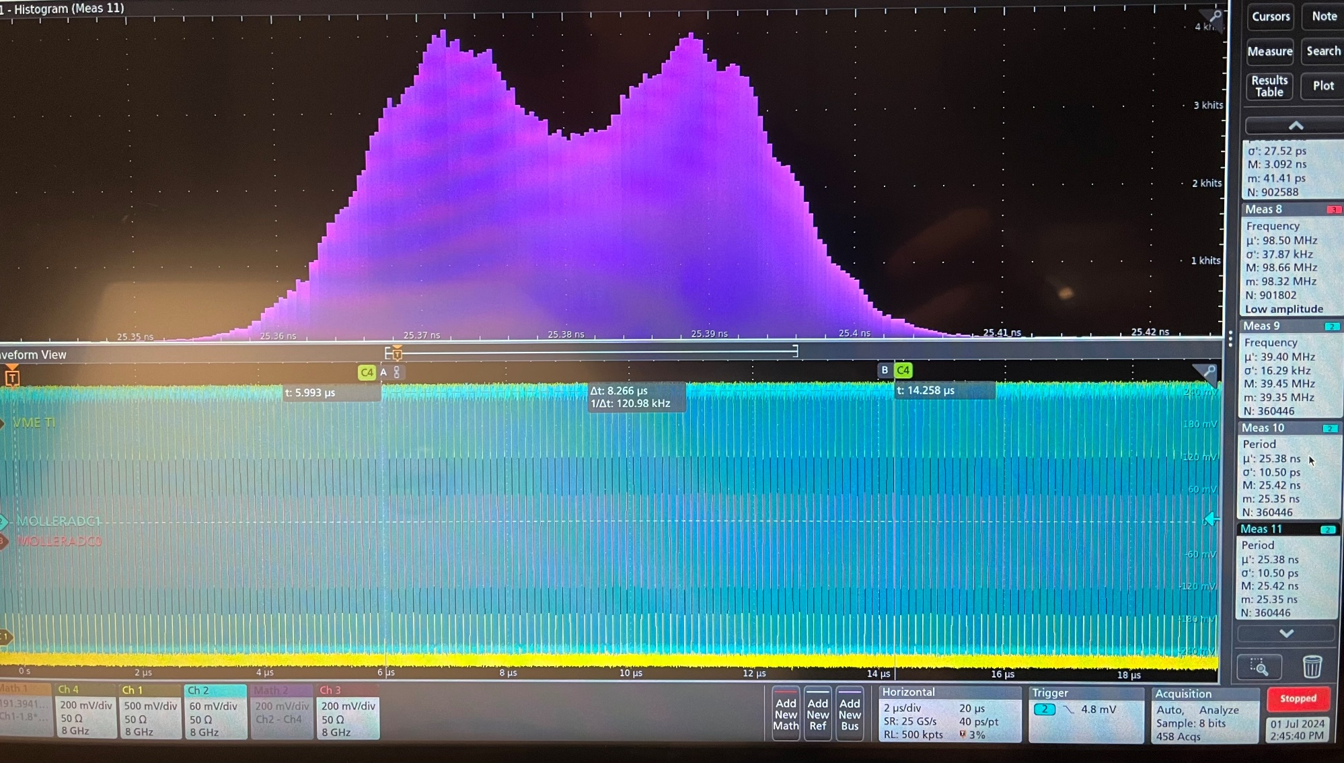
July 2, 2024: SMA output with ppRDO, at 39.4 MHz clock measurement, same setting as before except: SMA/J7 (sstl12) == Ch2, clk_39.4; SMA/J6 (sstl12) == Ch4, clk_98.5 from pprdo_FPGA
Clk_39.4: Meas#9:
39.4 MHz, σ: 16 KHz
Meas#10/11:
25.38 ns, σ: 10 ps, FWHM: 25 ps
The scope is triggered on the Ch2 itself. When triggering on the falling edge (as shown in the picture), the double peak is more visible. I can not explain the double peak, because the clock goes through many processes.
MGT_RxRECclk (197 MHz) → Si5345 (39.4 MHz) → FPGA Input_pads and differential receiver → FPGA MMCM → FPGA SSTL12 driver and Output_pads → SMA connector (39.4 MHz).
The effect may also be caused by PCB J6 98.5MHz synchronous clock.
William GU @Jlab

Slide 14
BACKUP slides
William GU @Jlab

Slide 15
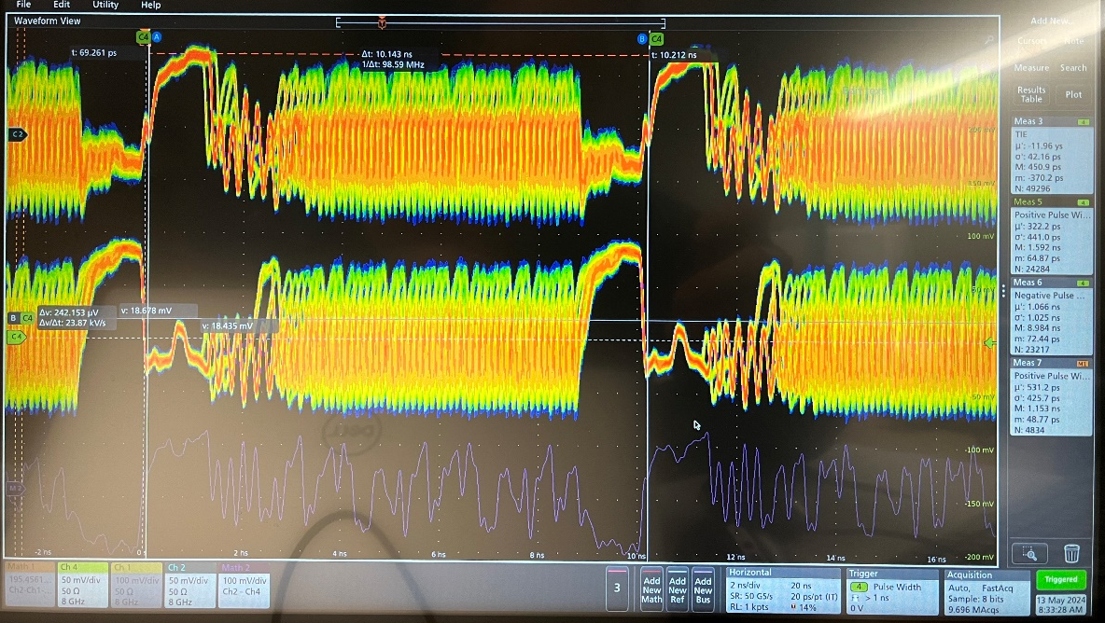
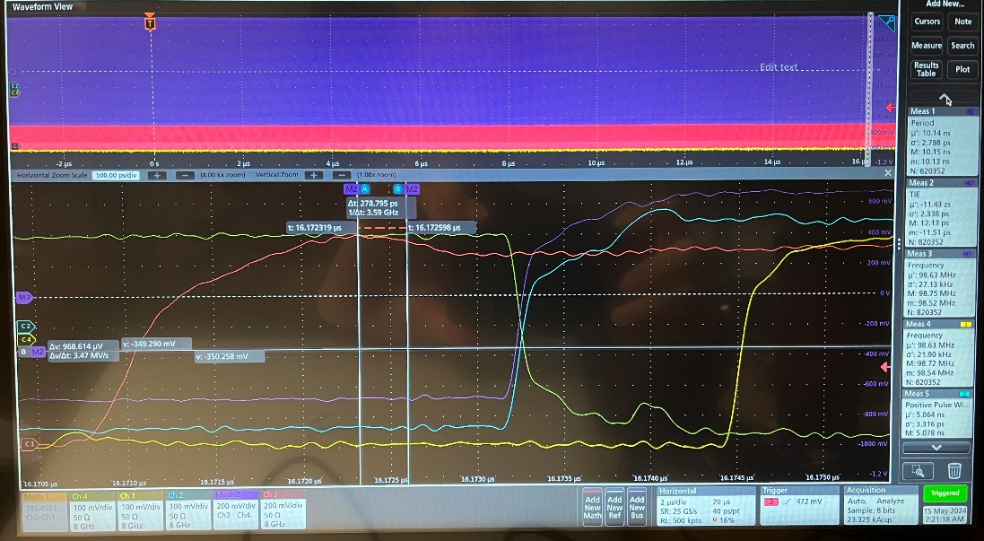
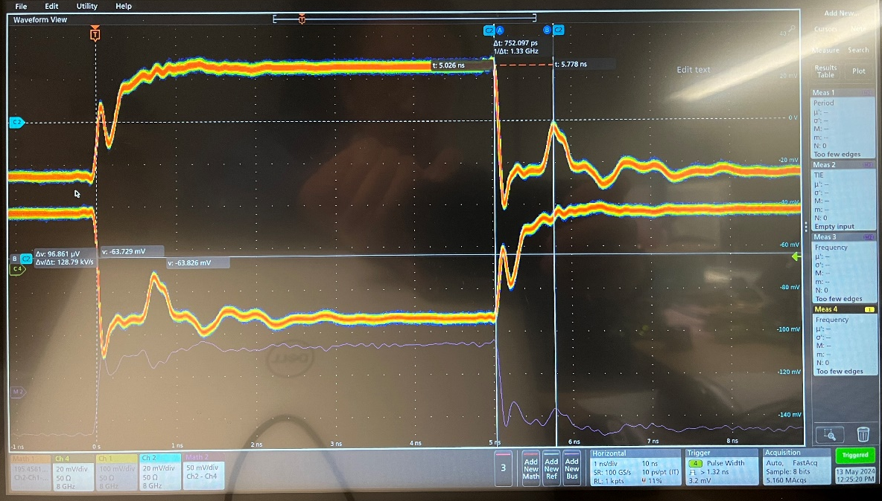
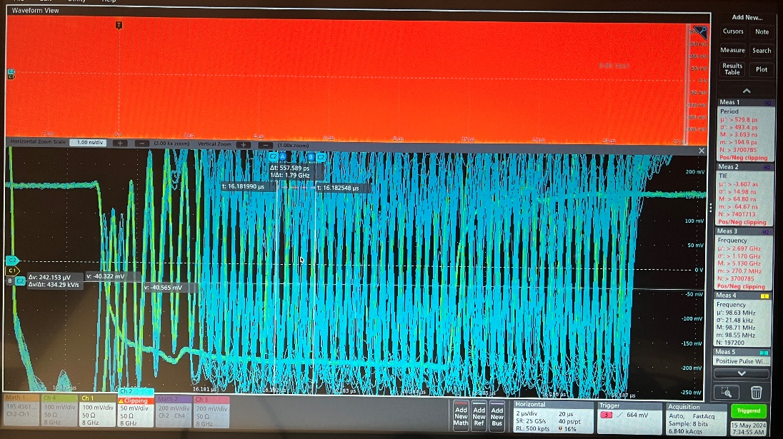
May 17, 2024: SMA Rx_SPF output with ppRDO, ADCLK944 test
There is large reflection on the signal, no eye-opening, pseudo clock show the reflection at 200ps, and 700 ps.
After put in the 200 Ohm pulldown resistor at the SMA area, the signal is much better (still not perfect).
William GU @Jlab

Slide 16
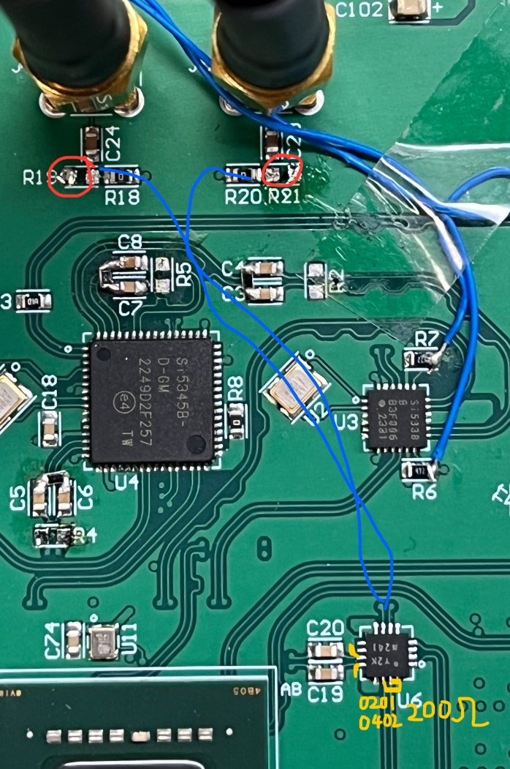
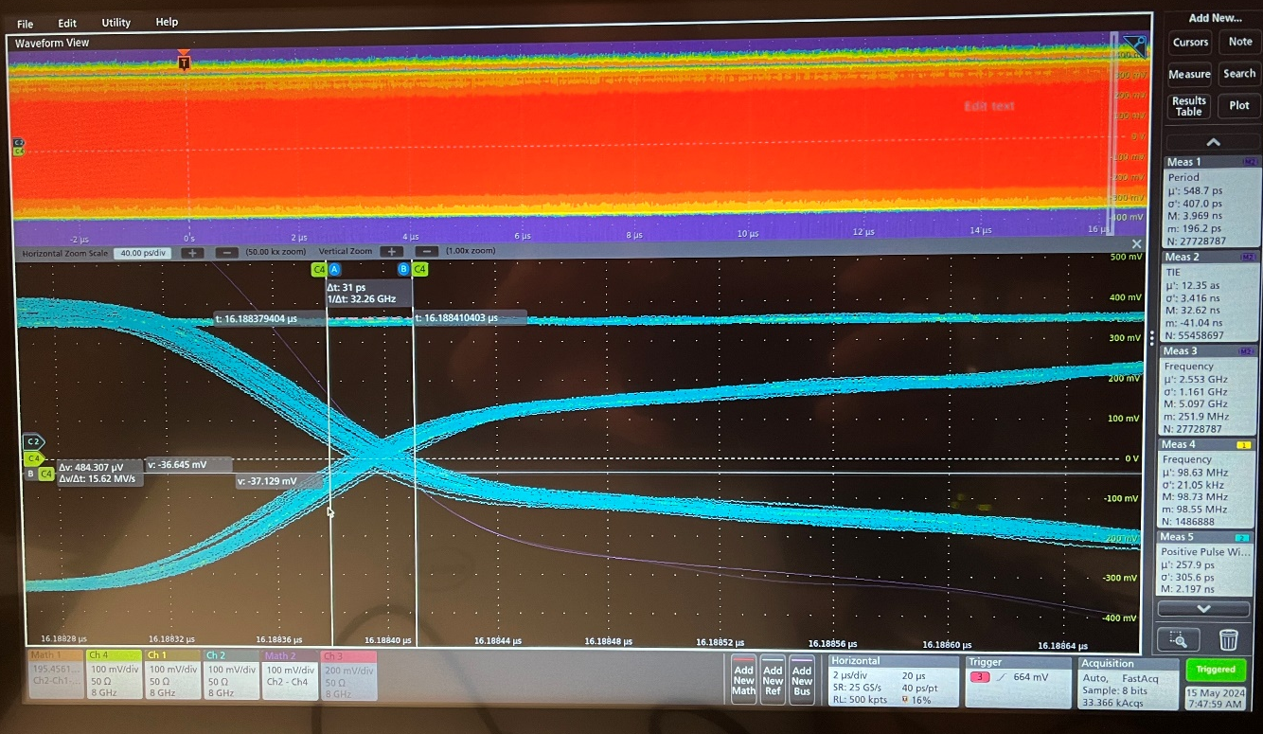
May 17, 2024: SMA Rx_SPF output with ppRDO, ADCLK944 test
Same as previous page, the signal came from FLX182, _240228 firmware
The proper fix is to add a pair of 200 Ohm pull down resistors on every output near the ADCLK944, as shown in the picture (Orange). (LVPECL outputs)
After put in the 200 Ohm pulldown resistor at the SMA area, the signal is much better (still not perfect), the edge is very stable (RX_P/N cross). For over six hours, the crossing movement is not visible (<2 ps).
From the scope trace, the Math (Ch2-Ch4) has a smaller P_P than the Ch2/Ch4 crossing (~half).
William GU @Jlab

Slide 17
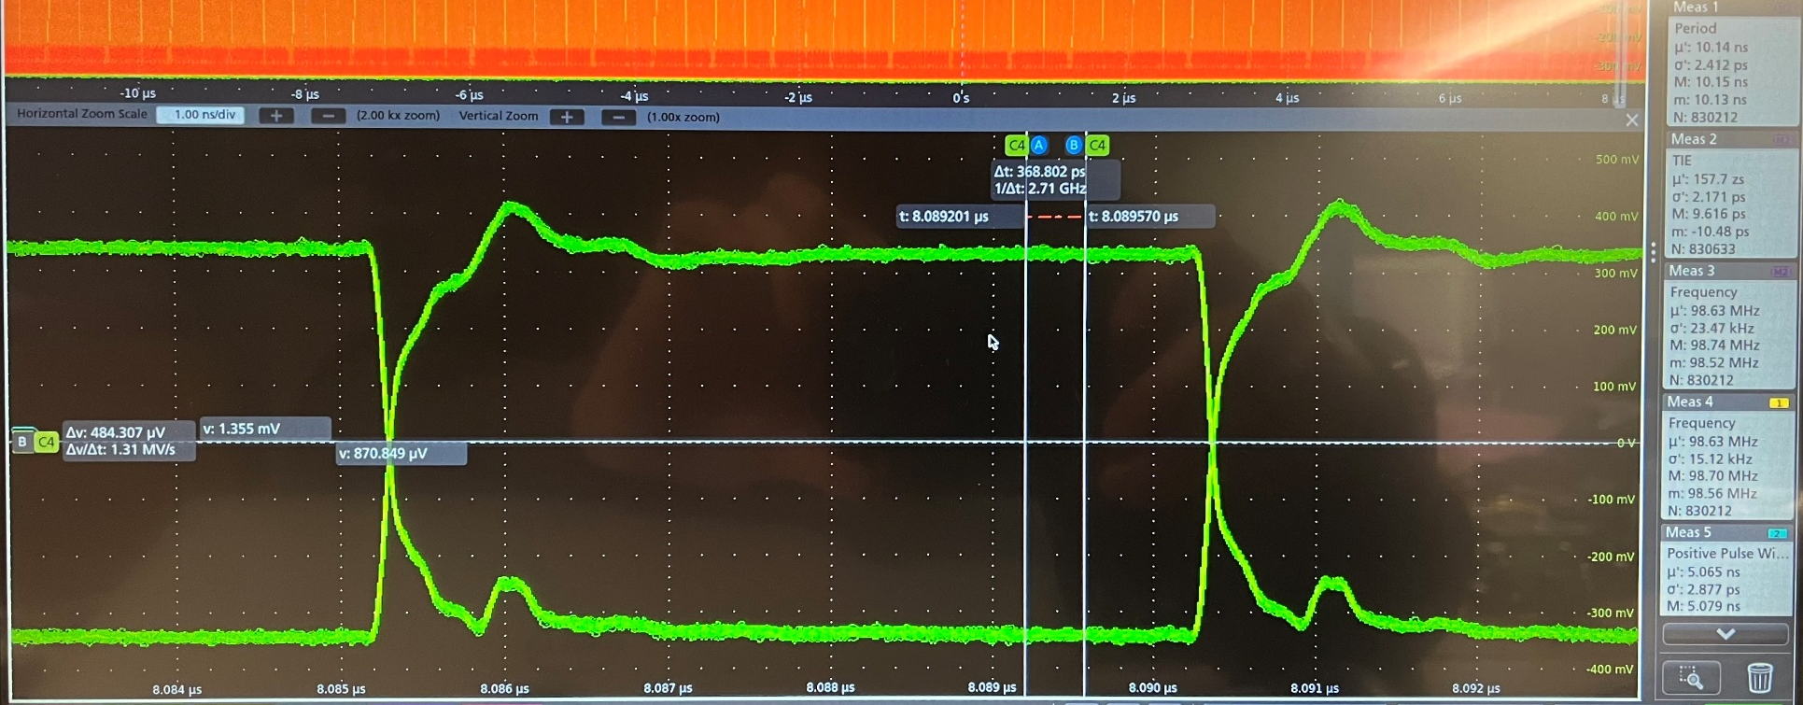
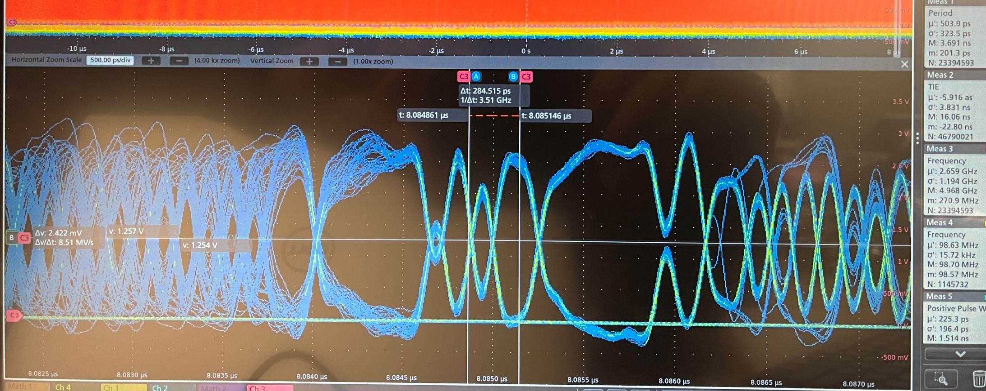
May 29, 2024: SMA Rx_SPF output with ppRDO, ADCLK944 test
There are still reflections at ~750ps, The 1110111 or 0001000 does not seem get the right differential amplitude
The same direction reflection, what’s the source?
(June 14: Test with a 10 MHz clock from Si5344H, There are two reflections, one at ~1ns, and the other at ~15.3ns. They correspond to PCB trace length and coax cable length, may include the size of the connector, SMA and BNC).
Time alignment
The differential amplitude does not seem to be enough
William GU @Jlab

