Slide 1
SRO Overview:
Test Experiences
at JLAB
Carl Timmer speaking for David Lawrence
Dec. 1, 2024
Notes:
Minasan Konnichiwa. Watashi no namae wa Caru Tima desu.
And no, I won’t be giving the rest of this talk in Japanese.
I’m giving this talk in place of David Lawrence who, unfortunately, could not be here at this time.
We are both part of the Experimental Physics and Software Computing Infrastructure or EPSCI group at Jefferson Lab, Dave leads the group.
Some of the Test Experiences at Jefferson Lab has already been covered in the previous 2 talks, so I’m not going to go over those in any detail.

Slide 2
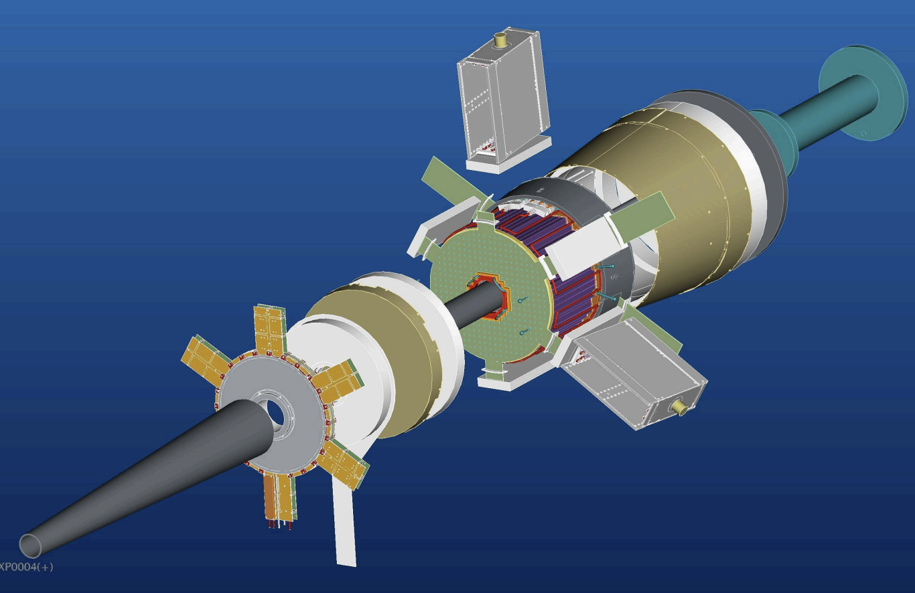
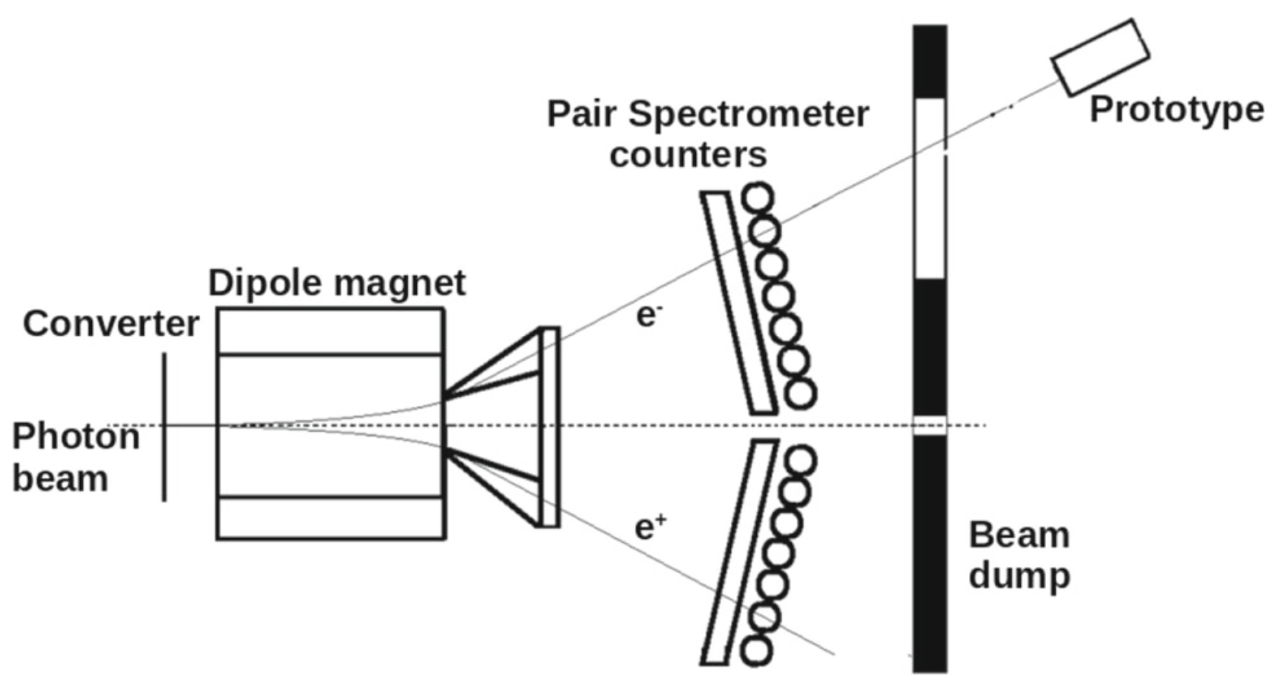
TriDAS + JANA2 SRO Beam Tests in 2020
CLAS12 Forward Tagger
(FT-CAL and FT-HODO only)
PbWO4 prototype
(behind GlueX Pair Spectrometer)
TriDAS => Trigger and Data Acquisition System
JANA => JLAB Data Analysis Framework
Notes:
Let’s go over some of the earliest tests.
When efforts to setup a Streaming Readout system started, there was not yet any existing SRO software..
The need to jump-start the process required the use of existing software and this is where TRIDAS was very helpful.
The difficulty at Jefferson Lab was how to incorporate TRIDAS into existing experimental control and data analysis.
The idea was to setup SRO tests for 2 different detectors (but not for production).
One was Hall B’s forward tagger
The other was a Lead Tungstate prototype detector related to the EIC effort

Slide 3
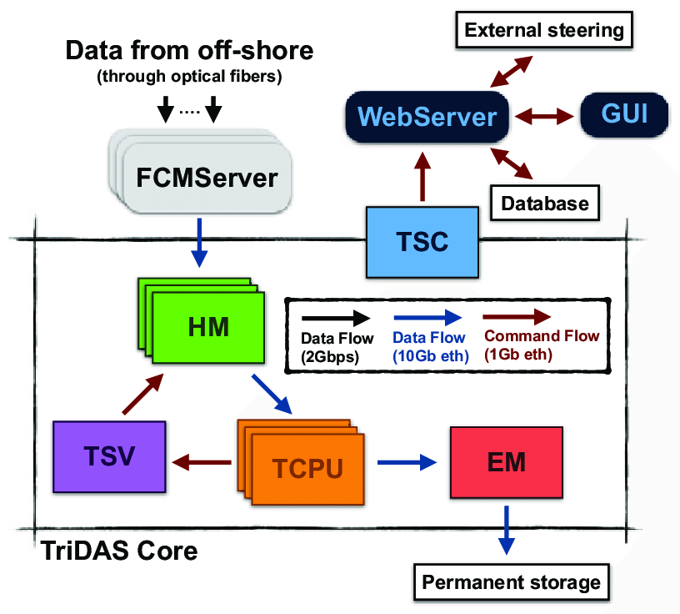
Trigger and Data Acquisition System TriDAS
developed for the KM3NeT- Italy
underwater neutrino telescope
Notes:
Backing up for a minute. TRIDAS = Trigger and Data Acq System, It was created for the underwater neutrino telescope off the coast of Italy
Starting at the upper left …
Hardware signals are sampled at a fixed frequency
This fixed-time-slice data is streamed in UDP packets to the FCM Servers.
Each server finds the hits in a time slice and passes it to a Hit Manager using TCP
Each HM sends a particular processed time slice of a detector sector to a TCPU – Trigger CPU – which then ends up with a single, complete time slice from all parts of the detector
Each TCPU then does an analysis.
This is passed to the EM which stores the data
So the important point is that the data is streamed and the triggers are software triggers applied at the end of the process – which is what we’re looking for in Streaming Readout

Slide 4
TriDAS Testing
from Apr. 2020 EIC YR SRO Meeting
https://docs.google.com/presentation/d/1fn6k8d2MsK9yOx7rsQk4HKazAMecCxzFmQRdJenglSo/edit#slide=id.p
TriDAS system testing in Experimental Halls B and D at JLab
Existing Flash-ADC systems using VTP module with high speed VXS interconnects
Multiple testbeds currently available (Sergey B.)
Supports multi-node, multi-process and multi-threaded scaling options
integrated JANA2 for triggering
Preliminary testing done so far at JLab
Open issues
System designed for deep sea neutrino experiments (how well does it scale?)
Overall process management
200ns Event
10 components
50ms Time Slice
10 components
HM
TCPU
64us Time Frame
HM
TCPU
HM
TCPU
VTP (left)
coda_sro
HM
VTP (right)
TCPU
HM
TCPU
HM
TCPU
HM
TCPU
Notes:
This slide is a few years old and is out of date.
However, focus on the figure.
Lower left VTP modules (VXS Trigger Processor) are VXS modules that participate in the Level 1 trigger in front-end crates as well as in the global-trigger.
Since that is not needed in a streaming system, its FPGA and CPU were reprogrammed to become a source of streamed data read from the VXS crate modules.
To marry JLAB’s hardware and the TRIDAS software, Sergey in HallB had to write what you see as the coda_sro blue block.
It was an interface between the 2 so that the Hit Managers of TRIDAS received data in the format they were expecting.

Slide 5
Note:
AI cluster finder implemented in JANA2 (CPU only, C. Fannelli)
from Tommaso Chiarusi talk at vCHEP2021
https://indico.cern.ch/event/948465/contributions/4324189/attachments/2245901/3808786/SRO_Clas12_TriDAS_JANA_20210519_chiarusi.pdf
Notes:
One piece of the puzzle not shown in the previous diagram is the HallD Jana2 reconstruction software package.
TRIDAS was developed for an neutrino detection.
That made it necessary to switch the analysis package to Jana.
Put your attention on the top middle.
This was done by using making a Jana plugin for the TRIDAS TCPU component.
Furthermore, Jana itself had Level 2 plugins for tagging and filtering
(that’s right plugins to the plugins).
The bottom line for these 2 tests was that the SRO system that was setup worked well and analysis produced good results .
In other words, everything WORKED.
The unanswered questions were:
How would it scale when applied to a whole detector?
Could this be made a permanent part of JLAB DAQ?

Slide 6
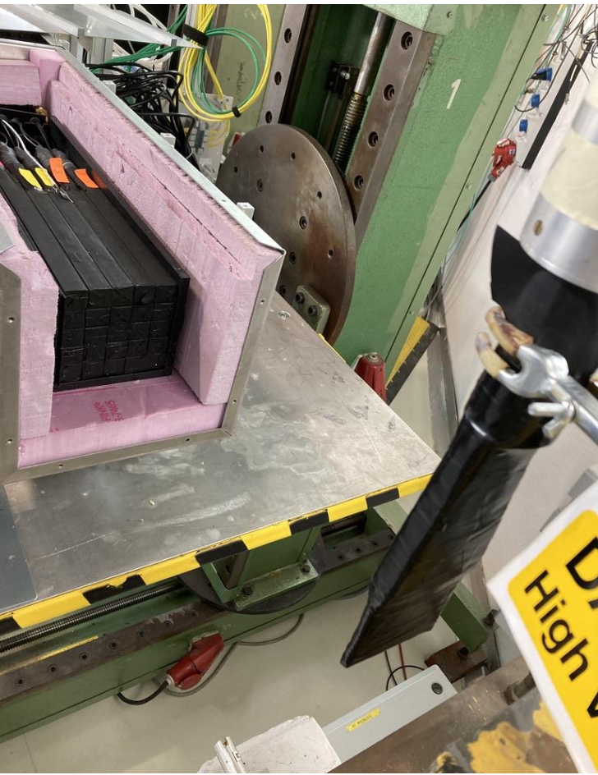
CODA & ERSAP SRO Beam Tests in 2020 and 2023
PbWO4 prototype
(at JLAB behind GlueX Pair Spectrometer)
PbWO4 prototype
(at DESY)
CODA = CEBAF Online Data Acquisition
ERSAP = Environment for Real-time Streaming, Acquisition and Processing
Notes:
Let me back up a little and say that CODA – the DAQ software package at JLAB - was designed around triggered experiments.
But as SRO became a possibility, (EVEN BEFORE THE USE OF TRIDAS),
there was always the thought that CODA could be modified to be used in streaming experiments as well.
The benefits of doing things this way are the use of existing software infrastructure, its builtin scalability, and the familiarity with CODA at JLAB.
We just had a talk by Dave Abbott on this.
In any case, it was fairly straight-forward to change the traditional triggered event builders to time-slice aggregators while still fitting into CODA.
1) 2020 TEST: Modified CODA software , ERSAP-based software trigger Created histograms in real time (no ER) 2) 2023 TEST: at DESY CODA SRO + ERSAP Hybrid hardware L1(VME) + software trigger

Slide 7
EIC prototype calorimeter SRO pipeline at DESY. CODA & ERSAP
CODA
ERSAP
Discriminator
trigger
Cosmic Event
Identifier
EIC Calorimeter
10 Gbps
DAG
ET
VTP
Receiver
Format2
DR
VTP
Frame Decoder
Data
Lake
VTP
File
Writer
VTP
TI
EB
ER
1 Gbps
Beam Event
Identifier
CPU ROC
Triggered data readout
VTP ROC
Configures and manages SRO
VTP FPGA streaming readout
Triggered data are waveforms read out over the VME bus.
Stream data are integrated sums and times of all hits over a threshold in the calorimeter regardless of the trigger status.
Trigger scintillator
PbWO4 Crystal Array with 2-5GeV electron test beam
Notes:
This is a full CODA DAQ system setup so that, simultaneously, a triggered and streaming system were run side by side.
On the triggered side, events were built and stored in a file (as is usually done)
On the streaming side, time slices were aggregated then passed into ERSAP for analysis, then stored to file.
Jeng already spoke of this test in more detail.
Results were essentially that both types of DAQs had compatible results with the streaming side able to identify events more efficiently.

Slide 8
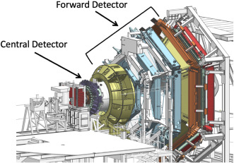
RTDP - CLAS12 SRO Packet Capture in 2024
Data streamed from Hall-B directly to Data Center
FADC250 and DCRB(drift chamber) modules
TCP packets captured (i.e. includes network time structure)
CLAS12 Detector
(Forward Detector, 2 sectors only)
RTDP => Real Time Development (and Testing) Platform
Notes:
Moving to more recent tests:
The Real-Time Development (and Testing) Platform is a tool that will help develop the technical aspects of future JLAB experiments​.
This platform will also benefit the High Performance Data Facility (or HPDF) being built at JLAB by being flexible enough to provide streaming profiles for even non-NP experiments.
RTDP means starting with Streaming Readout from a detector
The first stage of RTDP was to capture all network communications coming from part of a detector (in this case CLAS 12) during an actual experiment.
Once captured, it could be played back, creating a simulated, but realistic, experiment to run at any time.
This allows for development of anything downstream in real time instead of having to piggy back off of an actual experiment.

Slide 9
original plan to read out 9 VTP crates
ejfat-fs-daq.jlab.org
VTP01
VTP01 stream (x2)
VTP01 stream (x2)
netcat
(port 7001)
/dev/null
VTP02
VTP02 stream (x2)
VTP02 stream (x2)
tcpdump
(libcap)
/nvme/proj/RTDP/2023.12.17.CLAS12/
VTP01_S1_R1234.pcap
VTP03
VTP03 stream (x2)
VTP03 stream (x2)
VTP04
VTP04 stream (x2)
VTP04 stream (x2)
repeated for each stream. 18 streams total
Hall-B Switch (100Gbps)
VTP05 stream (x2)
EJFAT Switch (100Gbps)
VTP05
VTP05 stream (x2)
VTP06
VTP06 stream (x2)
VTP06 stream (x2)
100Gbps NIC w/ hardware timestamping ability
VTP07
VTP07 stream (x2)
VTP07 stream (x2)
VTP08
VTP08 stream (x2)
VTP08 stream (x2)
VTP09
VTP09 stream (x2)
VTP09 stream (x2)
CODA SRO
RTDP Capture Tooling
Notes:
On the left are detector front end crates, the VTPs, each producing 2 TCP streams of data.
Some portion of these would, instead of being part of the CODA DAQ, would send data to a node (gray right side) in the computer center (ejfat-fs).
Each stream was be recorded into its own file.
Tcpdump stored pcap files on a nvme (nonvolatile memory express) with flash or SSD drives – delivering high-bandwidth, low-latency storage via PCIe bus.
// TODO: What has this packet capture been used to develop so far??

Slide 10
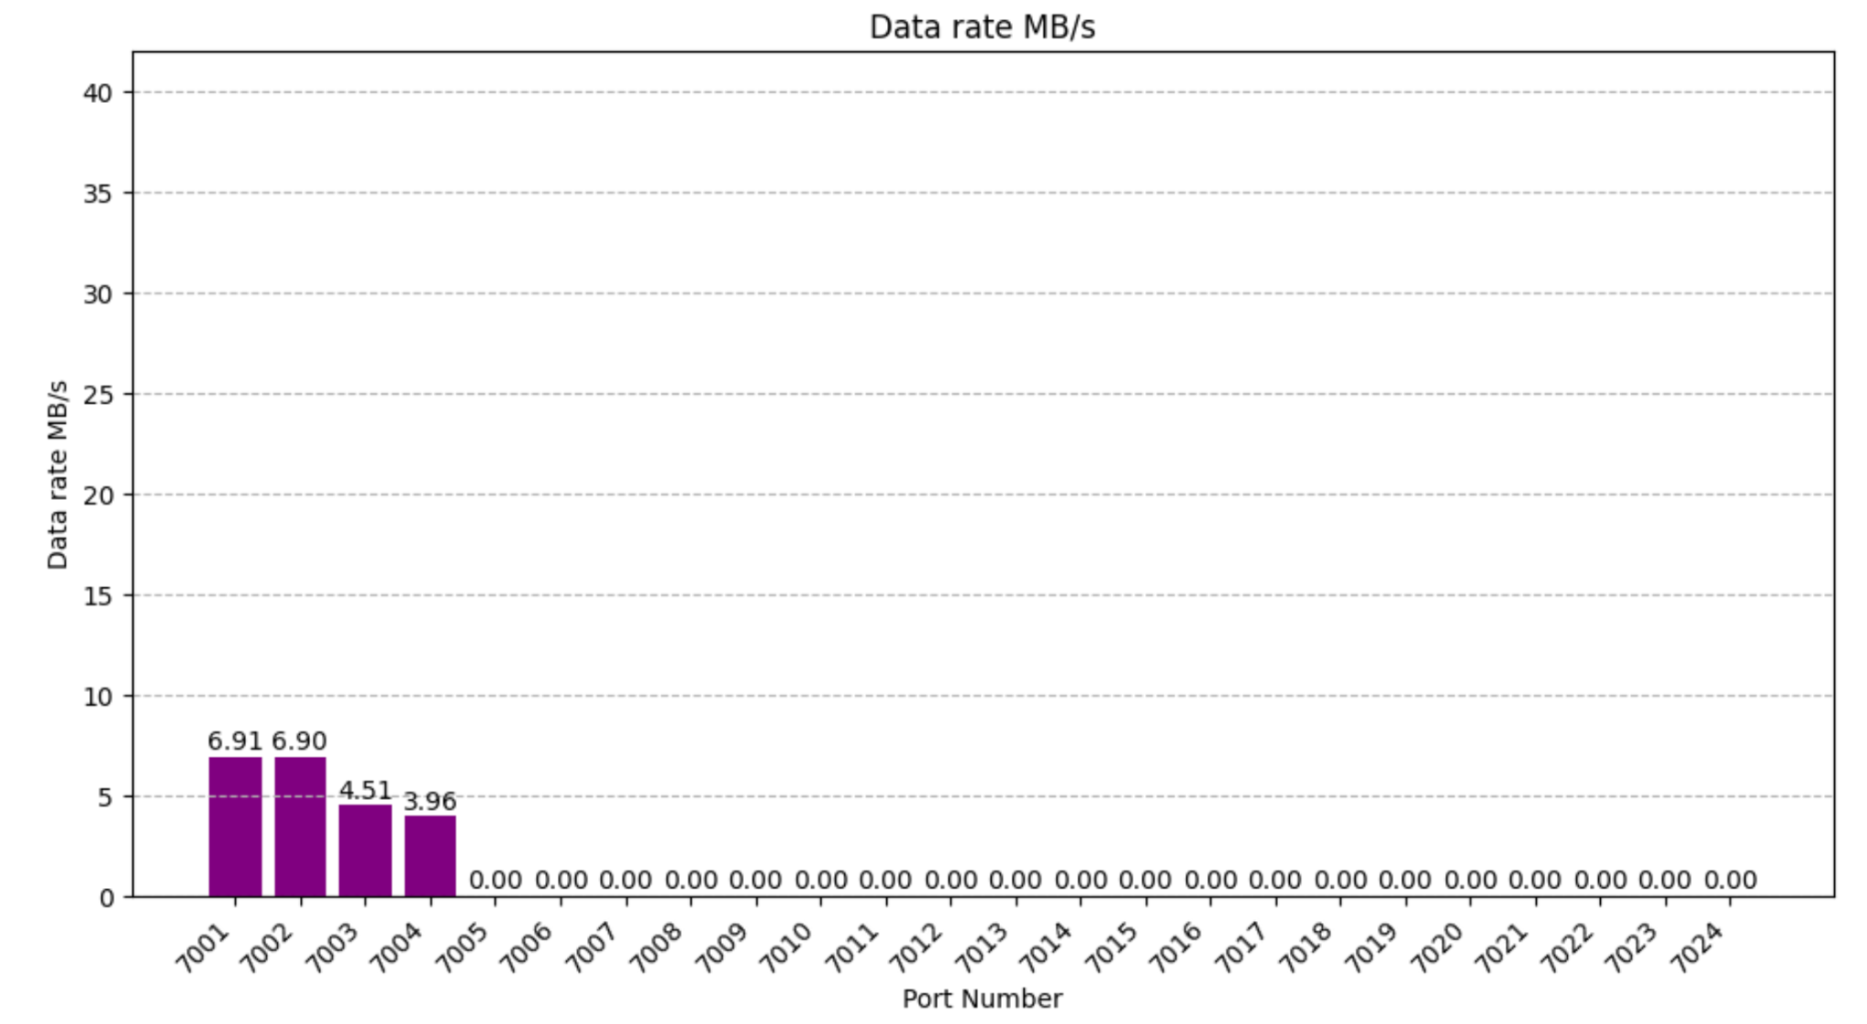
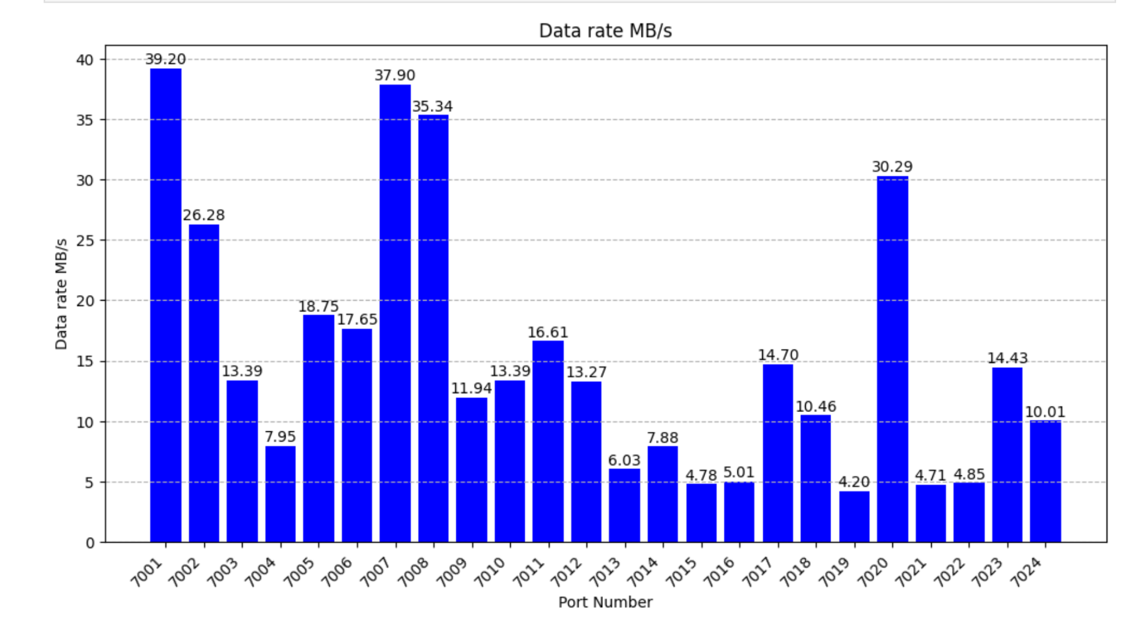
GCII: CLAS12 Data Capture
Data stream from VTPs in Hall-B to Data Center
Packets captured with hardware timestamps est. x10s of us resolution
Dec. 2023
(RG-K 100nA)
May 2024
(RG-E 5nA)
ECAL and PCAL for sector 2
Drift Chambers + all FADC250 for sectors 2 and 5
May 16th beam test where data streamed from CLAS12 to Data Center and packets captured with hardware timestamps.
355 MB/s
(sectors 2,5)
beam trip
Notes:
I show you this slide you you can see that these 2 tests successfully captured the streaming data into files.
Dec 2023 had 2 crates of 2 streams each,
The later test had 12 crate of 2 streams each.
A data rate of 355MB/s was capture for a brief period of time.

Slide 11
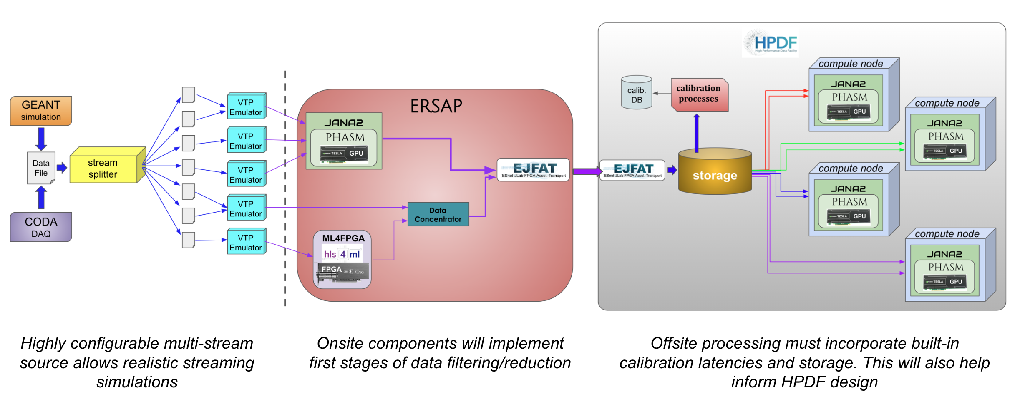
RTDP Final Deliverable
11
Notes:
The ultimate aim of RTDP is seen here.
We just went over the very first steps in getting the left side of this diagram operational.
The goal is to get something more extensive and generic.
The idea is to eventually take a data file with built events in it and deconstruct it into its original data streams - thus the stream splitter and emulated VTPs.
Once the data flow is simulated, then the next red block, the onsite or online event reconstruction and data analysis pieces can be developed.
Finally the grey block, the offsite and remote processing can also be developed
All component testing can then be done without the experiment having to be running.

Slide 12
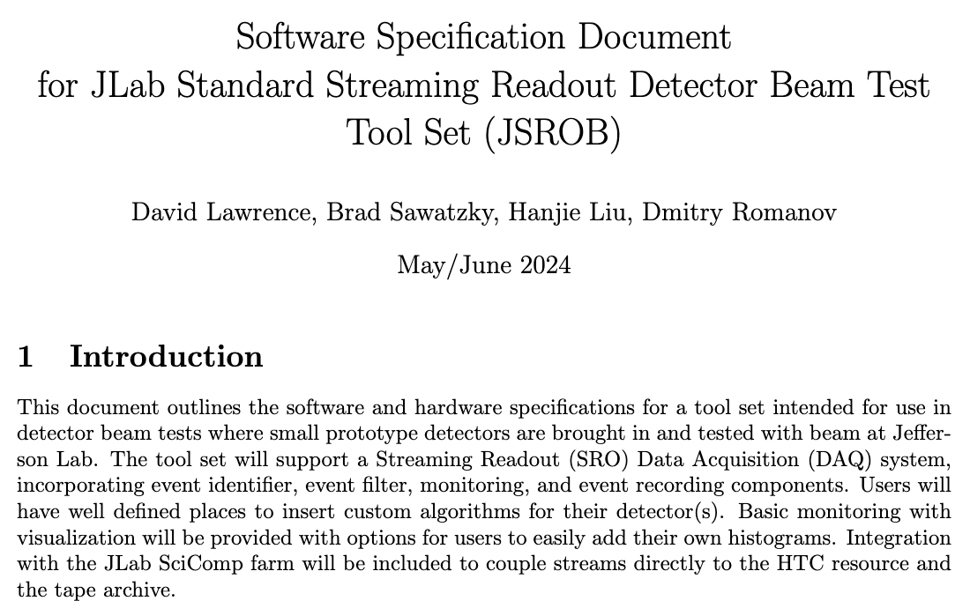
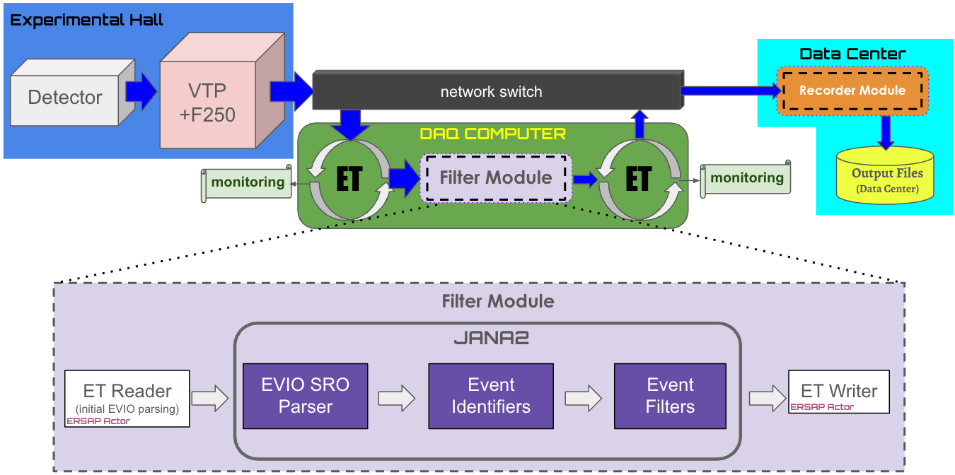
GCII: Standard Test Setup
Hanjie L. - Hall-C
Dmitry R. - EIC
Brad S. - SciComp+ENP
David L. - EPSCI
Notes:
A recent addition to JLAB’s testing capabilities is the Standard Test Setup in HallC.
Focusing on the diagram.
The idea is that small prototype detectors (BLUE BOX) can be brought in and hooked up to a provided streaming DAQ system with a minimum of effort.
Data flows thru switch into a (GREEN) computer.
The DAQ software would be setup to do all the boilerplate moving, formatting, and the storing of data.
All the user would have to do is provide (PURPLE) plugins for the Jana2 analysis package – for identifying and filtering events - appropriate to the detector being tested.
// TODO: has this been used yet?

Slide 13
EJFAT → ESnet / JLaB FPGA Accelerated Transport
JLAB’s future SRO efforts & tests will be built using
EJFAT technology.
Notes:
Let’s switch gears a little bit.
When talking about SRO at JLAB, you can’t avoid talking about EJFAT since it will be a foundational piece of that effort.
EJFAT stands for …
Esnet is the network provider for JLAB and all the US national labs.
It’s been an excellent partnership in developing an FPGA-based smart NIC that is turning out to have many uses.

Slide 14
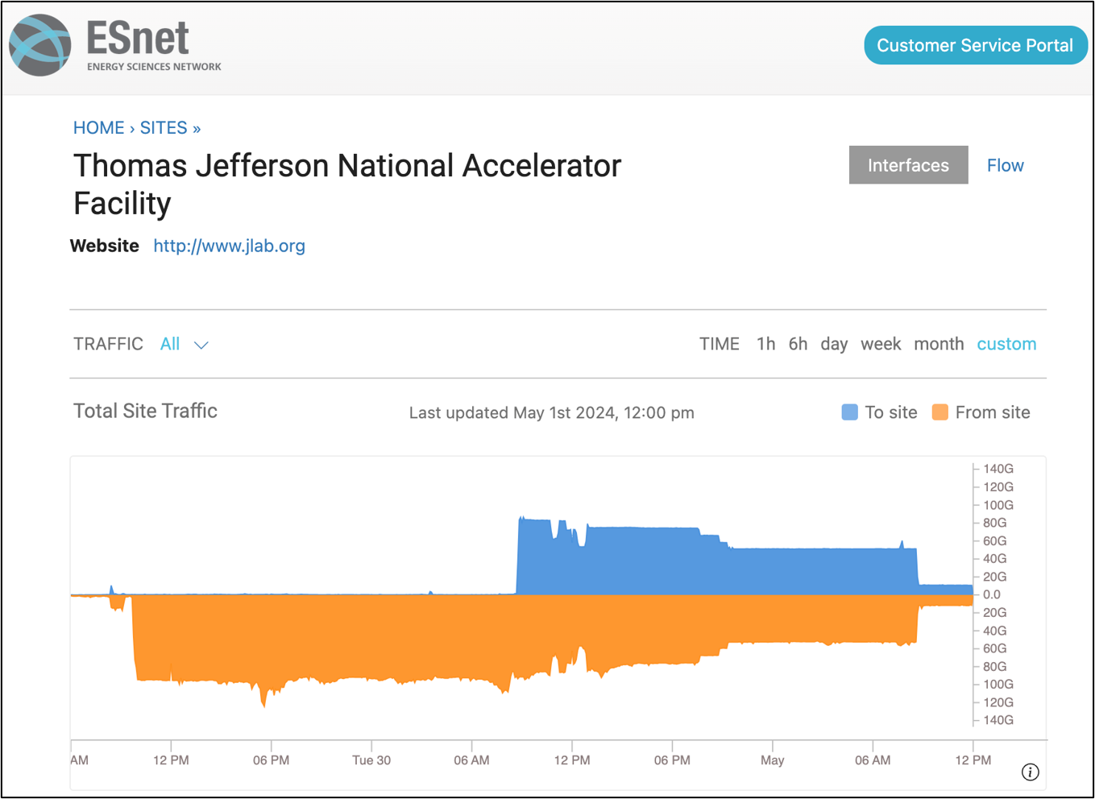
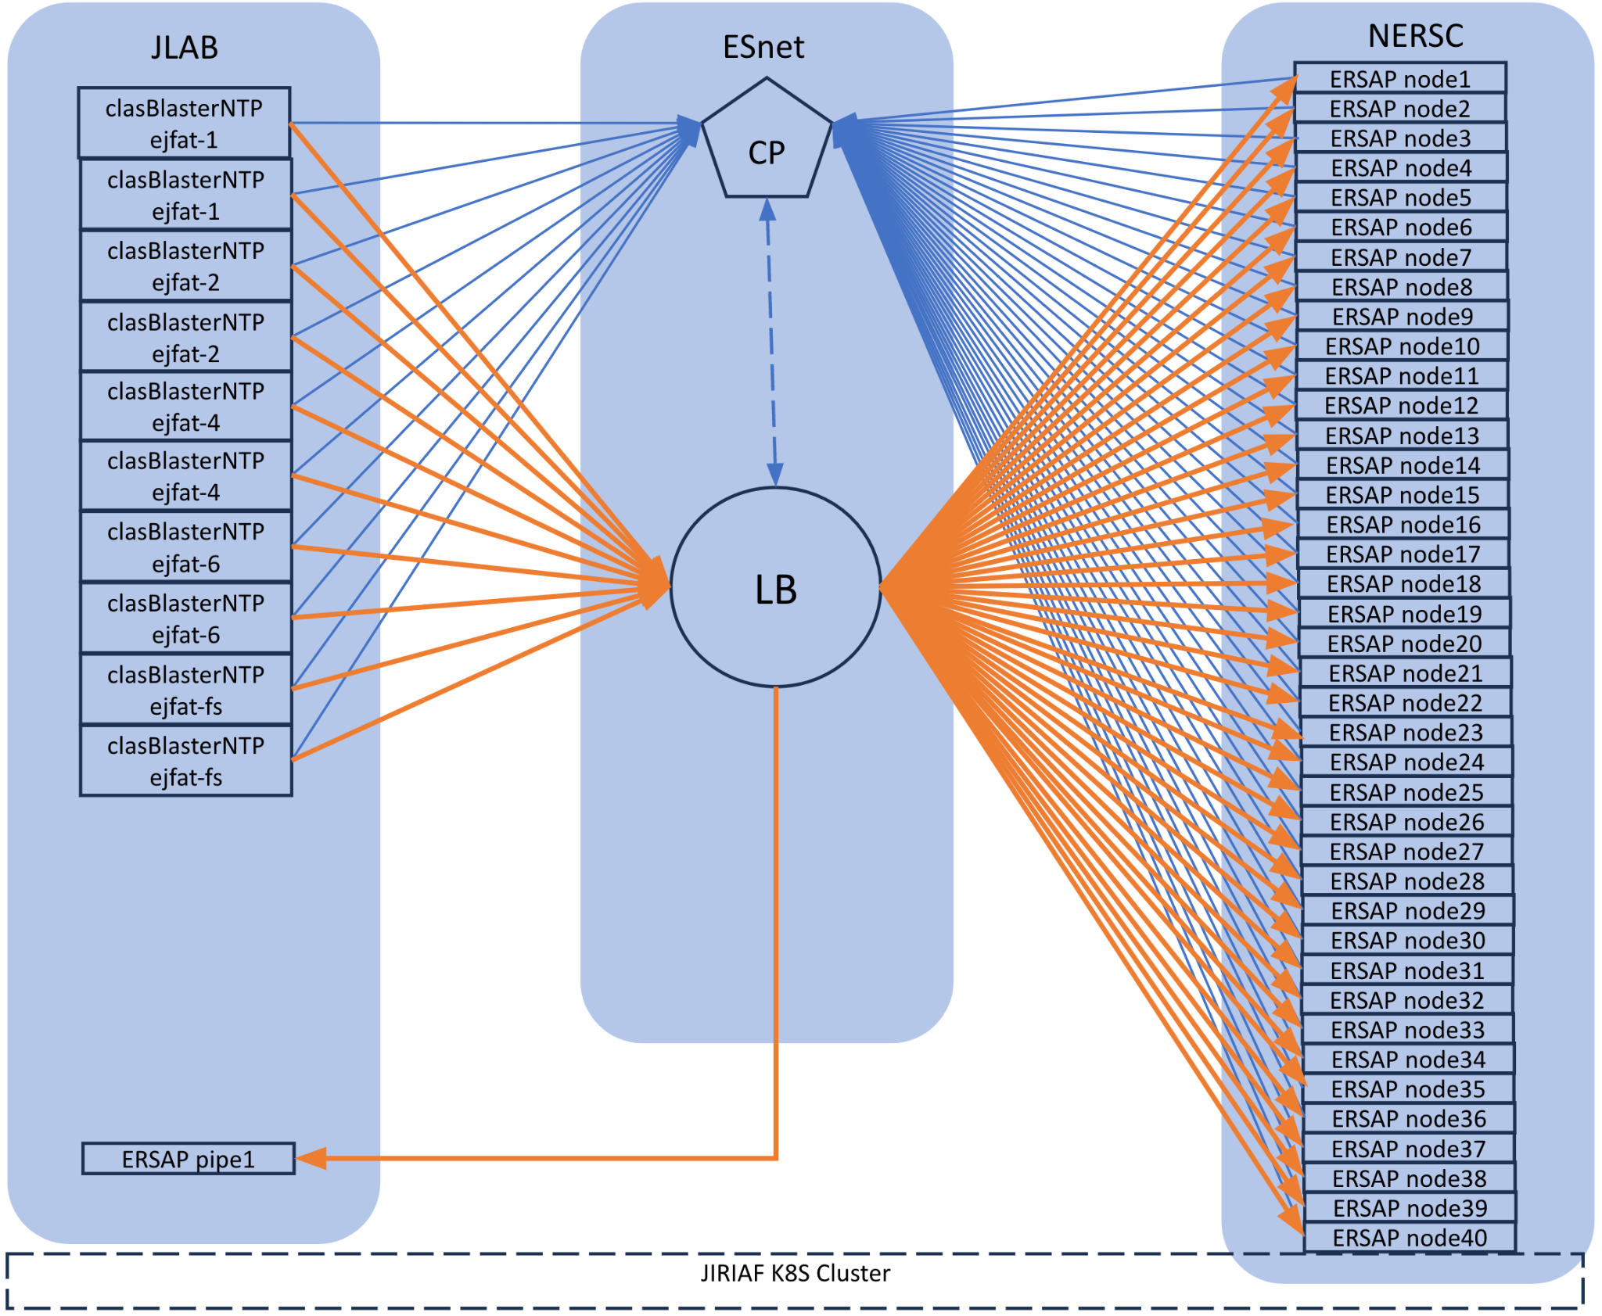
GCII: JIRIAF + EJFAT + NERSC Testing
PI: Vardan Gyurjyan LDRD Project (funding FY23, FY24)
PI: Graham Heyes
ASCR Project
Project Lead: Michael Goodrich
Stream exercise sending CLAS12 data from JLab to NERSC using the JIRIAF system​
CLAS12 Data
(archival)
Virginia
California
80Gbps returning to JLab
100Gbps from JLab to NERSC
Notes:
I won’t go into this since we just heard about it from Jeng and Vardan.
But a number of significant – milestone tests have been done to test / debug / build-up the JLAB software infrastructure to be able to move data from its source to compute nodes over the WAN.
And with the compute results sent back to original data site.
Data movement with EJFAT -- workflow & analysis with JIRIAF & ERSAP.

Slide 15
EJFAT
Key Properties ( Unlimited Scale. No Storage IOPS )
Sub detector
Events or Time Slices
Create ( UDP Packets )
Switching & Routing
Load Balancing
Merge Packets
Compute
Server
HPC
or
Edge Compute
DAQ
Server
FPGAs
Server
DAQ
EJFAT
FPGAs
Server
DAQ
EJFAT looks for the event_id ( color ) and matches up the packets
EJFAT selects a server for each event
Server
Server
Real Time UDP Streaming.
No TCP retransmission
No buffers or queues
N x 100G rates
Any number of servers
Mix of fast and slow servers
Dynamic add / sub of servers
LB adjusts to server queue fills servers CAN come and go
NO EVENT LOSS
Notes:
This is a slide I borrowed from Yatish, one of the network experts at ESnet.
The data sources are on the far left.
Every green box, on the left, is data either from the same event or time-slice

Slide 16
Possible Future Improvements for EJFAT
Notes:
This technology has been well tested at JLAB and worked well.
But … there are coming improvements that are in various stages of development.
I think it’s worth some time to look at its future, its possibilities.

Slide 17
Node
DAQ
Node
FPGAs
Node
DAQ
EJFAT
LBs
Node
DAQ
Node
Node
DOE Labs
HPC Compute
ESnet
EJFAT
EJFAT
Others
Cloud Providers
Any Compute Rack
CPU / GPU / DSP
Edge Compute
1) Cascading Load Balancers
Notes:
One possibility is to make EJFAT LBs cascading.
This allows for more of a “DIVIDE AND CONQUER” approach.
Look at the nodes on the far right.
Currently, a processing NODE may be in a remote computing facility, but each remote node will need to know the JLAB LB’s IP address and Port.
With cascading LB’s, the destination HPC compute nodes, for example, will only need to know the address of the local LB.
Allows for a much cleaner separation between different facilities.
This is in the conceptual phase.

Slide 18
Node
DAQ
Node
FPGAs
Node
DAQ
EJFAT
LBs
Node
DAQ
Node
Node
Load Balancer
Telemetry
AI Steering System
Cluster
Telemetry
Node
Node
Network Telemetry
Node
Add/Remove X Nodes
2) AI steering system to predict backend compute needs
Notes:
Another possibility that’s been a goal from the start is to incorporate some form of AI.
The thinking here is to have a separate process, the Steering System, that would handle the allocation of resources, namely the compute nodes.
You could have various inputs like:
network usage,
knowledge of the cluster - how many nodes are available?
how stressed are the Load Balancers? Nodes?
Based on this telemetry, AI predictions could be made and resources allocated BEFORE they’re needed.
Since it takes some time to register a node with a LB, doing this before it’s needed may save data from being discarded.
This also is in the conceptual phase.

Slide 19
Node
DAQ
Node
FPGAs
Node
DAQ
EJFAT
LBs
Node
DAQ
Node
Node
FPGA Packetization
FPGA Reassembly
3) Hardware based packetization and reassembly of data
Notes:
Both the packetization of buffers and their reassembly take a fair amount of compute power.
The efficiency and speed, of ESPECIALLY the reassembly in particular, has a direct bearing on how many UDP packets you will drop.
So the idea here is to do both operations in hardware, saving compute power for other things and getting a much more efficient system with higher throughput.
This is very much still in the conceptual phase.

Slide 20
Node
DAQ
Node
FPGAs
Node
DAQ
EJFAT
LBs
Node
DAQ
Node
Node
DAOS Server
fast storage
4) For data rate bursts, fast storage and playback to eliminate packet loss. Distributed Asynchronous Object Storage (DAOS) storage.
Notes:
The idea here is for data rate bursts on a node, to use fast storage and playback to eliminate packet loss.
Currently there is feedback between node and the LB (a signal that says, Send me less data!!)
but there is a delay of over 2 seconds for any changes to be put into place.
In the meantime, especially if consumption of data slows, the internal node’s queue can fill – resulting in lost data.
Distributed Asynchronous Object Storage (DAOS)
open-source, software-defined, high-performance, scalable storage system useful for a wide spectrum of AI and HPC workloads.
We have access to DAOS storage from one of our test machines, but have yet to program up a prototype to do this.
So it’s possible, on the drawing board, and waiting to be implemented.

Slide 21
Node
DAQ
Node
FPGAs
Node
DAQ
EJFAT
LBs
Node
DAQ
Node
Node
Packets
Network Switch
Node
LAG
1 LB 1 CP
FPGA 1
FPGA 2
FPGA 8
5) High throughput LB with FPGA clusters
8 x 200 = 1600 Gbps
Notes:
What is pictured here already exists, but is of yet untested at JLAB.
A cluster of FPGA smart NICS can be combined into 1 Logical Load Balancer, with 1 Control Plane (ie, all cards have the same node clients).
Each smart NIC has 2 x 100 Gbps connections to the switch.
They are all lagged together at the switch. (LAG === Link Aggrefation)
They can be configured to make 1 load balancer with (in this case) 8 boards for a total of 1600 Gbps max throughput.
We don’t the have facilities at JLAB to fully test that kind of data rate, but it’s theoretically possible.
I didn’t want to make the diagram too complicated, but you can do something like the reverse,
Each FPGA board can have multiple virtual Load Balancers running on it – each with their own CP and thus can operate independently

Slide 22
Node
DAQ
Node
FPGAs
Node
DAQ
EJFAT
FPGAs
Node
DAQ
Node
Node
Linux IP Stack
port
XDP Socket / Stack Bypass
NIC Driver
eBDF code
Kernel
User Space
UDP packet Reassembly into events
6) extended Berkley Data Filter
(eBDF) & eXpress Data Path
(XDP) sockets
Analyze events
Node
Notes:
Finally, let’s look at a new way to do packet reassembly, which has already been implemented and tested.
Take a look at the internals of a processing node that’s been expanded. Particularly start by looking at the packets coming into the NIC.
2 technologies are used, eBDP and XDP.
eBDF is like a virtual machine inside the Linux kernel. It can execute user-defined programs inside a sandbox in the kernel (in our case in the NIC driver).
These programs are generally quite small snippets of C code.
XDP provides a data path which we can intercept, redirect or even edit UDP packets using an eBDF program. In our case, we redirect packets to a user space socket.
BY-PASSING the entire Linux IP Stack! This results in a big performance improvement!
My initial testing using XDP sockets to by-pass the IP stack shows a user program can receive and reassemble data at 2x the regular rate with no packet drops.
I got about 5GB/s reassembly rate.
Note that using normal UDP sockets (at 2.5 GB/s) will always drop some packets.
This can be a big win in some situations. Limitations: You’ll need to run things as root and have a compatible NIC card and driver. Mellanox ConnectX-6 NIC.
One downside is that packets must fit in a linux page so no jumbo packets (MTU max < 3500).
https://wiki.jlab.org/epsciwiki/index.php/How_to_install,_build_and_use_XDP_related_packages

Slide 23
Thanks for your attention
Notes:
So, in conclusion, I hope that gave you somewhat of an overview of SRO activities at Jefferson Lab. Thank you very much.

Slide 24
BACKUPS

Slide 25
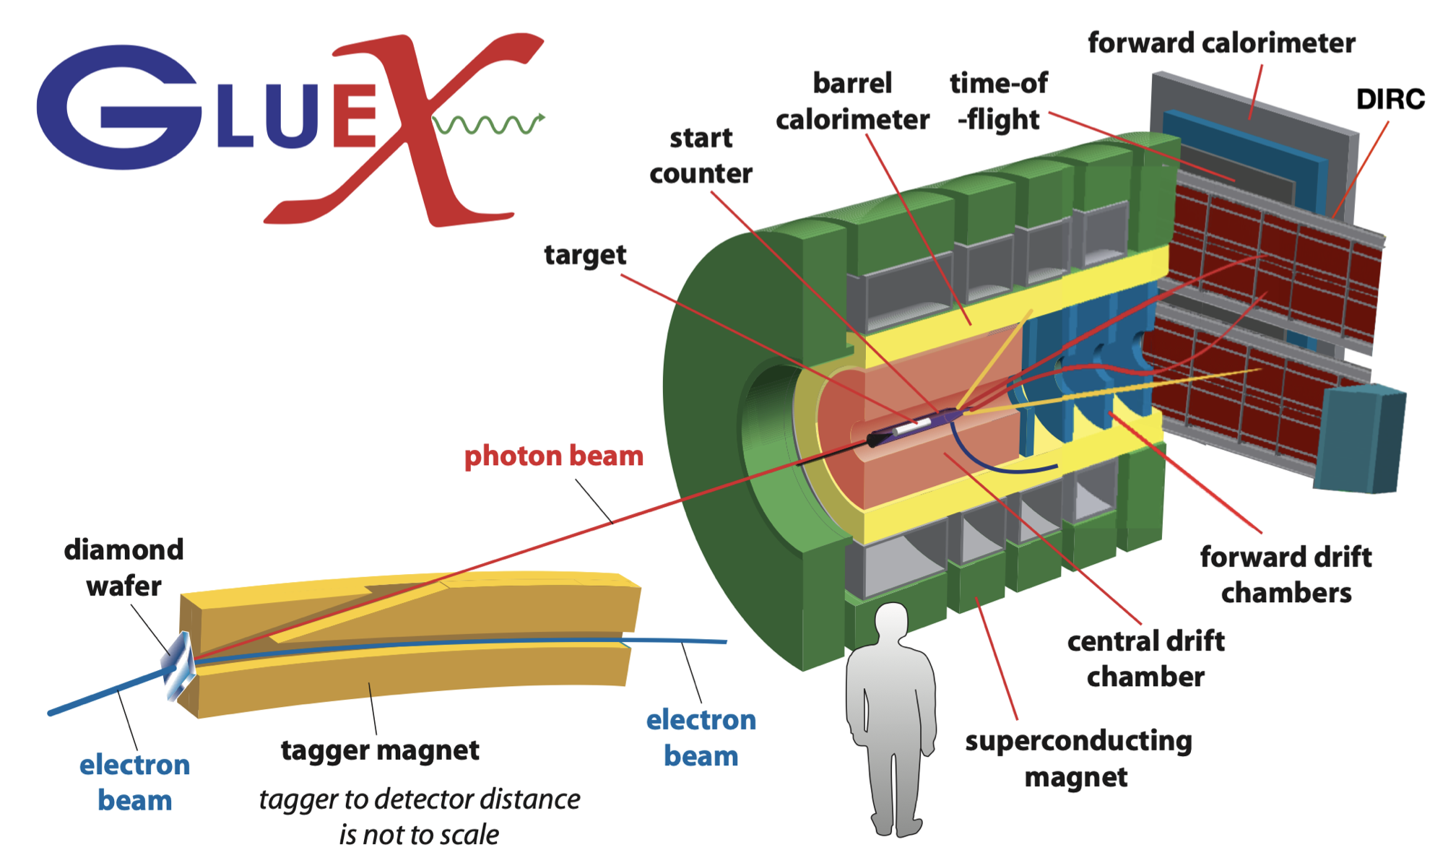
GlueX experiment update
Hall D is dedicated to the operation with a linearly-polarized photon beam produced by ~12 GeV electrons from CEBAF at Jefferson Lab.
Readout electronics:
FADC250 (calorimeter,PS,tagger,etc.)
FADC125 (tracking detectors)
F1TDC (tracking FDC)
CAEN TDC 1290 (TOF)
Only FADC250 can be upgraded to work in streaming mode using VTP boards
hence streaming mode would require expensive upgrade of readout electronics.
Notes:
The Gluex experiment in HallD is shown here. So what is its progress in going from a triggered to streaming RO?
There are 4 main type of readout electronics, and, unfortunately only one the FADC250 can be operated in streaming mode.
That leaves out the tracking detectors and Time of Flight.
Additionally, to upgrade the rest of the electronics is too expensive at this point.
So currently making everything SRO is not possible.
However.

Slide 26
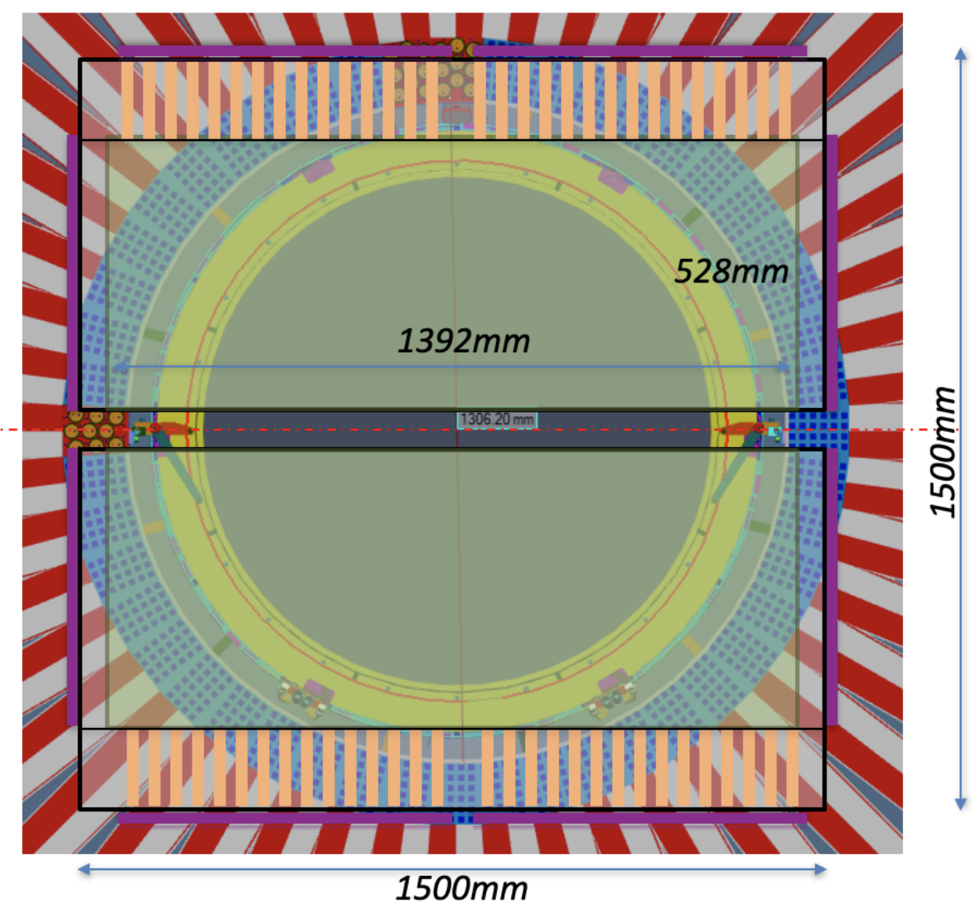
GEMTRD
The GlueX III experiment has been approved with a recommendation to improve the electron-pion separation by adding a GEMTRD detector based on GEM technology (GEM-TRD).
Notes:
TRD – transition radiation detector
However, there is an approved addition of a GEM TRD detector in order to improve the electron – pion separation.

Slide 27
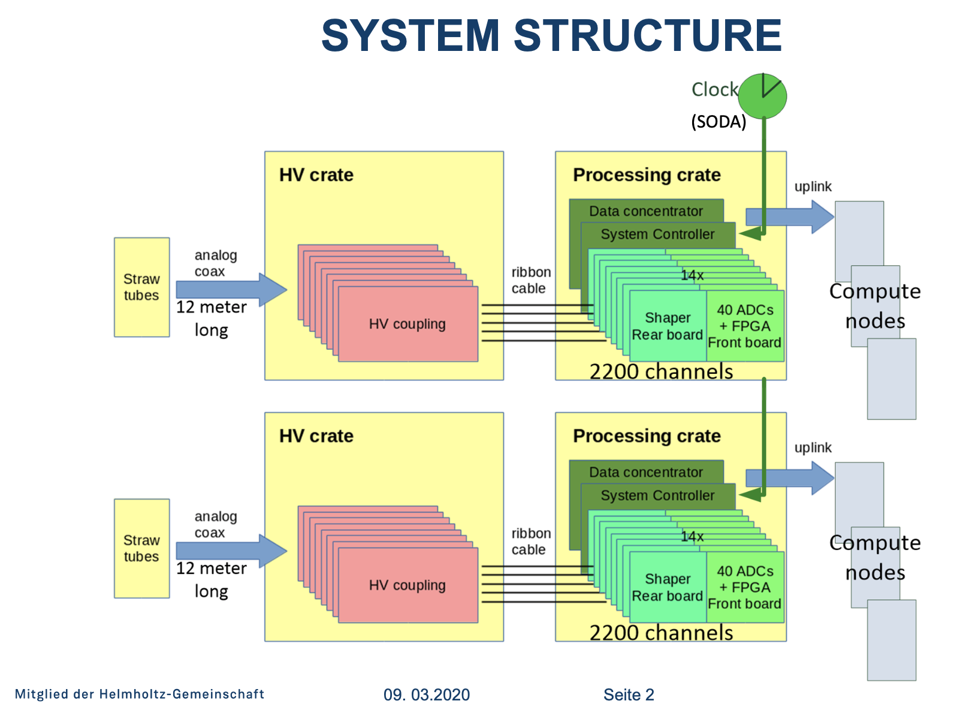
GEMTRD readout
GEMTRD readout is based on OpenVPX/FADC readout developed for PANDA experiment in Juelich.
Originally designed for a straw tracker, but can also be used for other tracking detectors and calorimeters.
Boards interconnected via a full mesh backplane - streaming capable.
Version with analog inputs:
2240 channels .
160 channels per board, 166 MHz
arrival time resolution ~100-200 ps.
output up to 1 Tbit/s
Version with digital inputs (from ASIC: tracks,vertex, etc.):
total input speed up to ~ 5 Tbit/s per crate
total output speed up to ~ 1 Tbit/s per crate
~11000 LVDS inputs per crate
Notes:
This new GEMTRD subdetector will be SRO compatible.
Already there have been talks on how to incorporate this into CODA SRO system.

Slide 28
EJFAT Operational Model
Sub detector
Events or Time Slices
Create ( UDP Packets )
Switching & Routing
Load Balancing
Merge Packets
Compute
Server
DAQ
Server
FPGAs
Server
DAQ
EJFAT
FPGAs
Server
DAQ
Server
Server
Well Known EJFAT LB IP Address
UDP Payload
EJFAT header with event_id
LB IP DST
DAQ IP SRC
UDP
EVENT
ID
DAQ Data
DAQs can reside at any IP domain
DAQs don’t know compute IP addresses
Zero coordination of firewall rules,
Can stream to multiple HPC sites
NERSC OLFC HPDF FABRIC
Simultaneously
Computers Register and join a pool
Dynamically

Slide 29
A Workflow I Would Trust
Reliable Operations !
Local or Remote Choices Always Available
DOE Labs
Local Compute
Local Storage
HPC Compute
ESnet
EJFAT
DAQ
EJFAT
EJFAT
Others
Cloud Providers
Any Compute Rack
CPU / GPU / DSP
Edge Compute
Streaming to storage
Local and Remote resources working together
Instrument + ESnet + HPC cascaded load balancers

Slide 30
Possible Future Improvements for EJFAT
Cascading Load Balancers
AI steering system to predict backend compute needs
Hardware based packetization and reassembly of data
For data rate bursts, fast storage and playback to eliminate packet loss. DAOS server Distributed Asynchronous Object Storage (DAOS) is an open-source software-defined high-performance scalable storage system that has redefined performance for a wide spectrum of AI and HPC workloads.
EBFP and XDP sockets

Slide 31
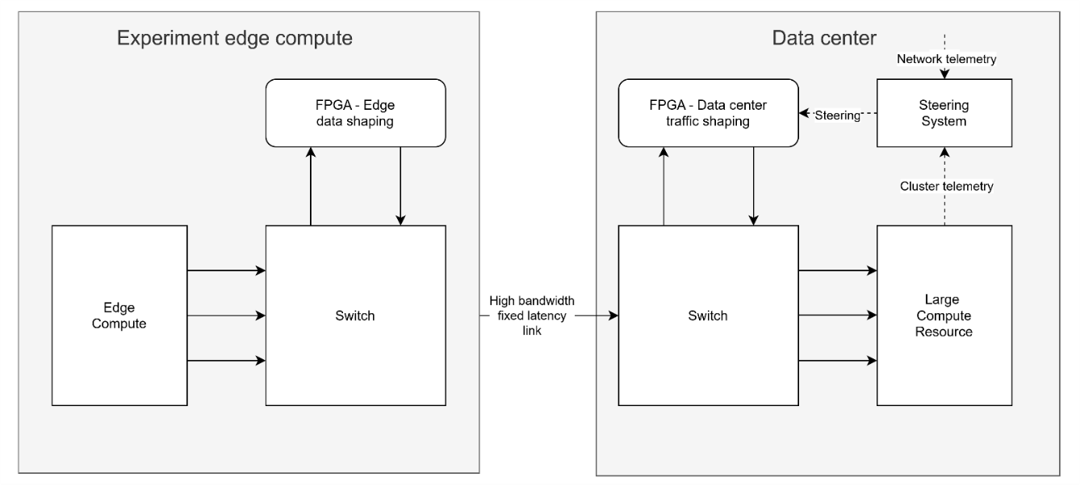
EJFAT Concept : Edge to Data Center Traffic Shaping / Steering

Slide 32
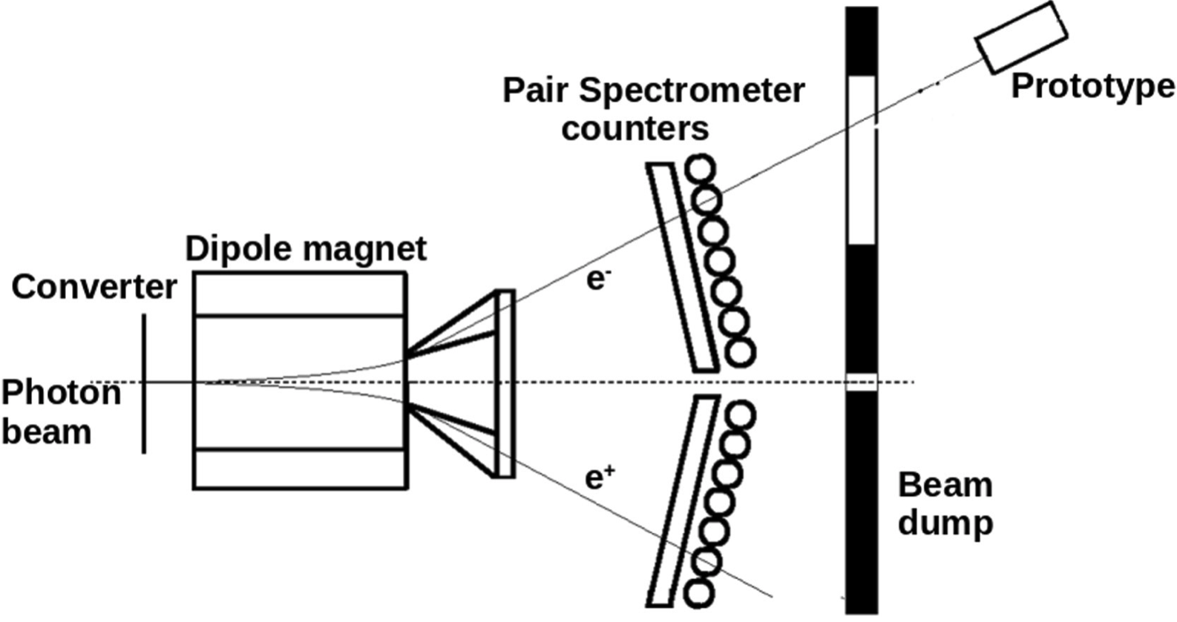
EIC prototype calorimeter SRO pipeline at JLAB Hall-D using ERSAP
ERSAP
Cosmic Event
Identifier
Calorimeter
VXS Crate
VTP payload
F
ADC
VT
P
Data
Lake
VTP
Receiver
Format1
VTP
Frame Decoder
Beam Event
Identifier
VXS Trigger Processor
Zero
Suppression
4Gbyte
DDR3
Frame Builder
10Gbps Ethernet
(TCP) Stream
1 FADC250
Stream
(9 channels)
Notes:
Writer not implemented in 2020, but was for 2023

Slide 33
Event Identification. Fixed-size sliding window technique
Stream of 65.5us VTP frames
Sliding pointers
Find min/max time of hits within the frame
Cosmic Event
Hits in only 3 modules on the path of muons
Beam Event
Only 1 hit/channel
Cut on min number of hits
Central channel energy deposition > than any other
Sliding step – 1ns
Sliding window – 32ns
Notes:
Ask Vardan

Slide 34
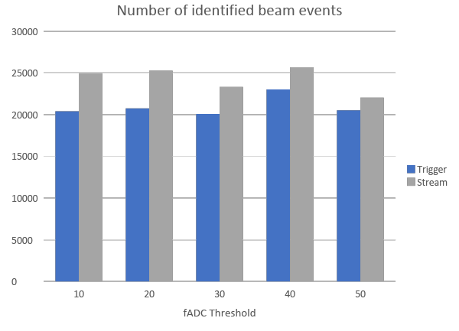
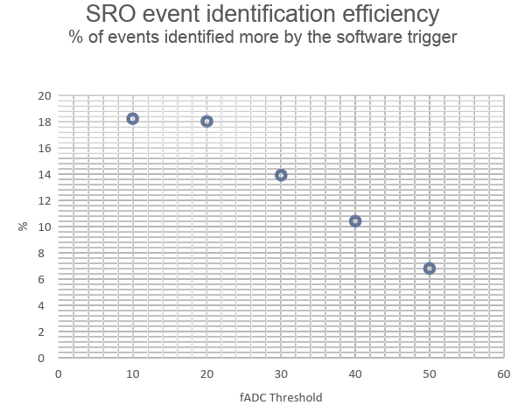
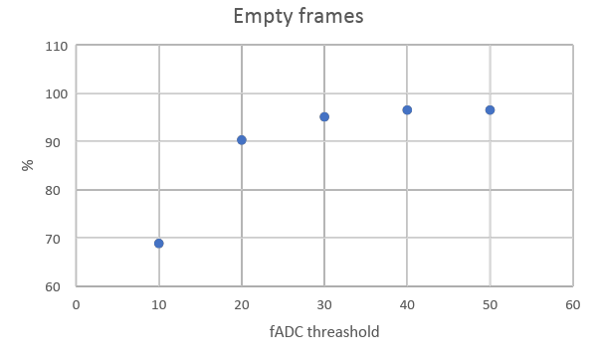
Stream Identification Efficiency
Notes:
Vardan slide
Why is efficiency so small?

Slide 35
Event Identification based on adaptive window clustering algorithm
Stream of events
Initialize Window W<-W U {x₁}
Loop {
W←W ∪ {x_{t}} // Move W_{R}+1
If ( | t_{xt} – t_{xt-1} |) <= T_{h} ) {
cluster_event_count++
channel[i++] = txt_channel
if ( cluster_event_count >= N_{n}
&&
no duplicates in channel[]) {
cluster is identified
move W_{L}+cluster_event_count
cluster_event_count = 0
clear channel[]
}
} else {
move W_{L}+cluster_event_count
cluster_event_count = 0
clear channel[]
}
}
W_{L} Edge
Moves based on
t_{xt} – t_{xt-1} check
W_{R} Edge
Moves to get stream events
Adaptive window
Adaptive window edge movement direction

Slide 36
Event identification based on anomaly detection
ADWIN algorithm based actor
Initialize Window W for each t > 0
Do
W←W ∪ {x_{t}}
Repeat
Drop elements from the tail of W
until |μˆW₀ − μˆW₁ | ≥ ε_{cut} holds for every split of W into W = W₀ · W₁
output μˆW
Harmonic mean
This actor is used for:
Change detection in the stream
Stream average estimator

Slide 37
Streaming Grand Challenge
slide from Jan. 5, 2024 presentation by Rolf Ent
The Streaming Grand Challenge began in 2018.
Significant progress has been made since then on several fronts that include deployment of SRO-capable fast electronics, firmware development, and software (ERSAP, JANA2, InstaRec,...).
Phase II of the SRO GC is now beginning.

Slide 38
monitoring
Calib.
calib
DB
Analyzer
(recon)
SHMS
Filter Module
ET
Data
Lake
EJFAT
Filter Module
HMS
ROOT files
(recon)
Filter Module
CODA
streaming
monitoring
Filter Module
JANA2
EJFAT reassembly
EVIO SRO Parser
Event Identifiers
Event Filters
Legacy Data Formatter

Slide 39
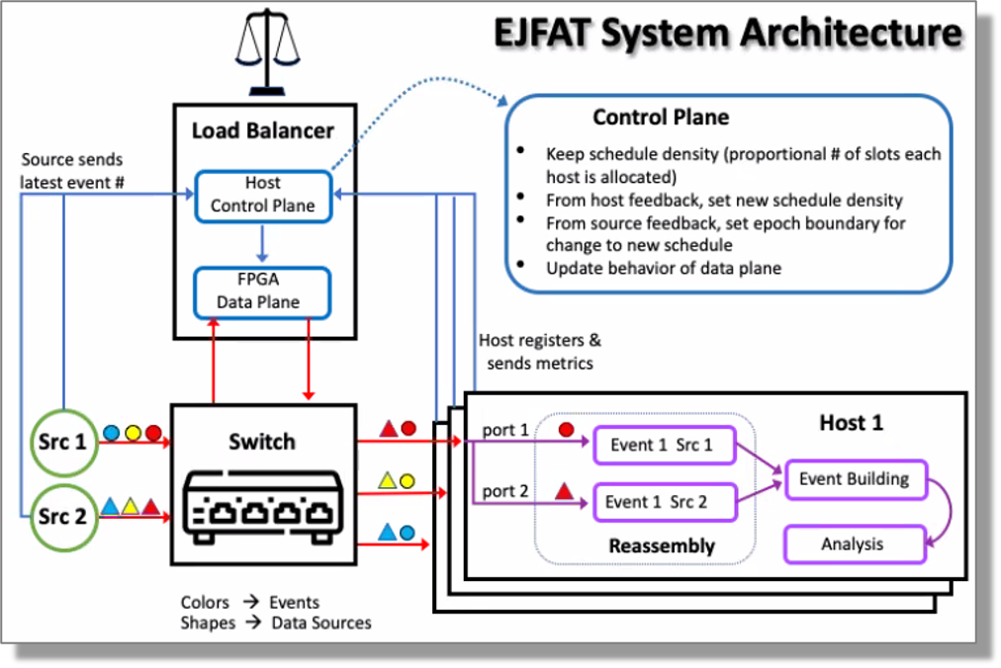
ESnet/JLab FPGA Accelerated Transport

Slide 40
PODIO ROOT Streaming
Disclaimer: This is not an efficient way to stream data and will almost certainly not be part of the final ePIC standard streaming configuration. It does provide a continuous streaming source that can be consumed by the current ePIC reconstruction software allowing other components of the streaming system to be sketched out.
Multiple pieces
Modified PODIO (allows data to come in form other than ROOT file on disk) Added openTDirectory() to ROOTReader as alternative to openFiles() https://github.com/AIDASoft/podio/issues/565 https://github.com/AIDASoft/podio/pull/579
podio2tcp utility (read from ROOT file and send data over network) Use zmq PUSH-PULL to do automatic load balancing https://github.com/JeffersonLab/SRO-RTDP/tree/main/src/utilities/cpp/podio2tcp
podiostream JANA2 event source plugin Reads events from network and provides them to EICrecon

Slide 41
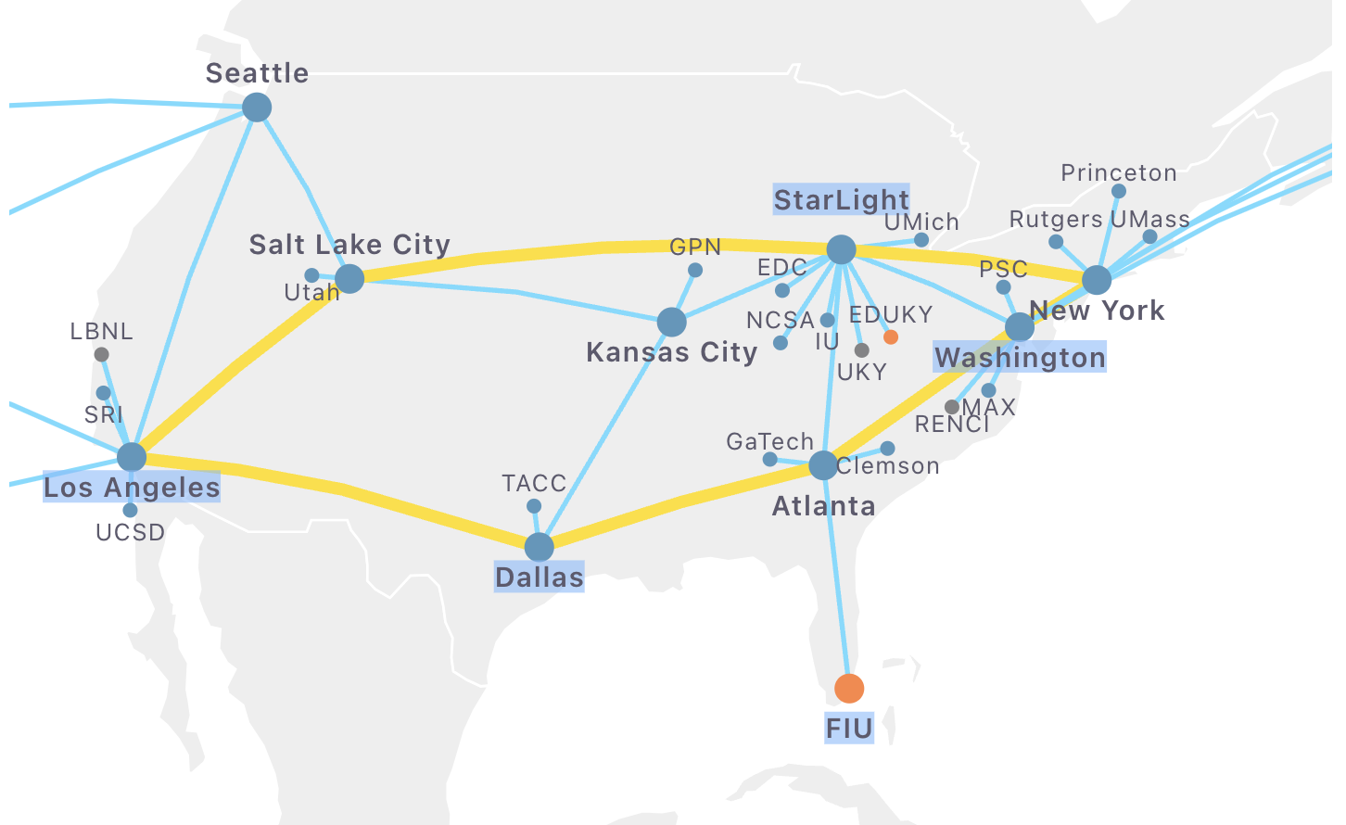
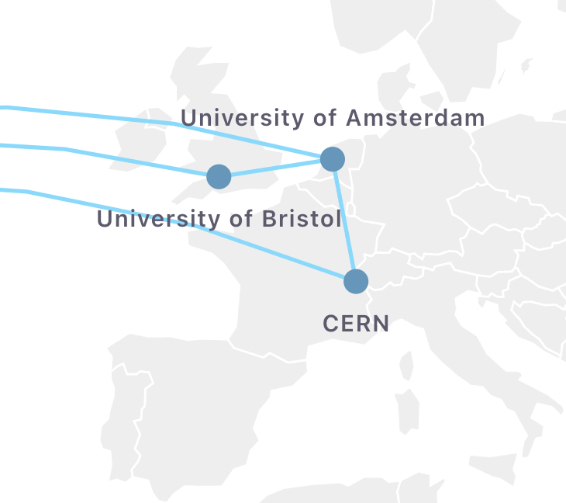
FABRIC Testbed
https://portal.fabric-testbed.net/
Create configuration of network+compute
(includes GPU and FPGA elements)
No large HPC resources, but good for testing distributed applications

Slide 42
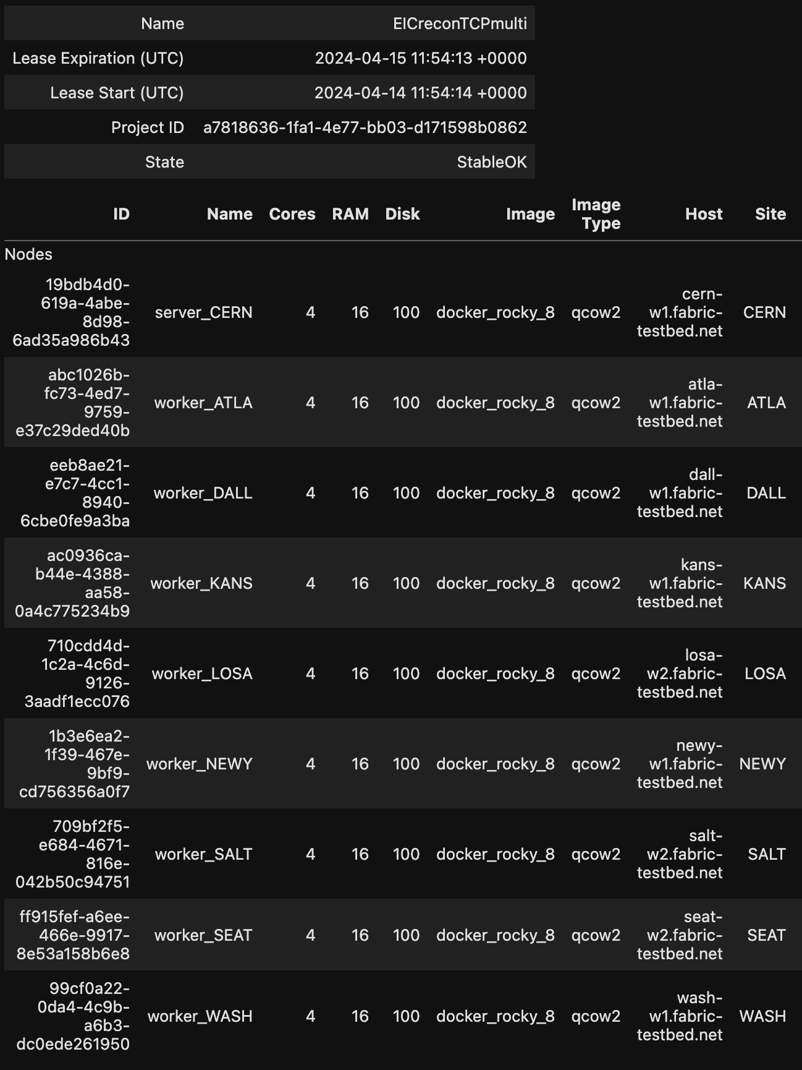
FABRIC test
Tested sending data from CERN to 8 locations in US.
Four EICrecon processes running at each location
32 consumers total
(event processing rate is few seconds per event)
Input file: SIDIS 10x100
/work/eic2/EPIC/EVGEN/SIDIS/pythia6-eic/1.0.0/10x100/q2_0to1/pythia_ep_noradcor_10x100_q2_0.000000001_1.0_run48.ab.hepmc3.tree.root

Slide 43
RTDP poster from ACAT2024

Slide 44
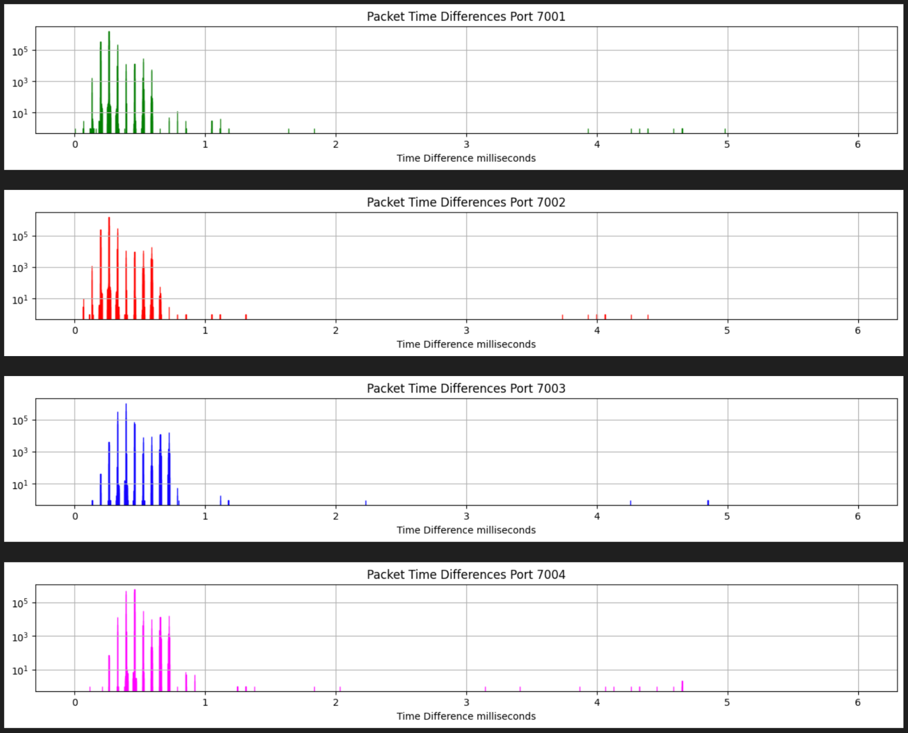
Time difference between packets by port
100nA
Standard 1.5kB MTU used
for TCP packets
Packets w/ time structure metadata captured into industry standard .pcap files
Crates report every 64μs, even if no hits present for that crate
~4.5MB/s
port 7001
(VTP1)
~4.4MB/s
port 7002
(VTP1)
~3.0MB/s
port 7003
(VTP2)
port 7001
~2.7MB/s
port 7004
(VTP2)
beam trip

Slide 45
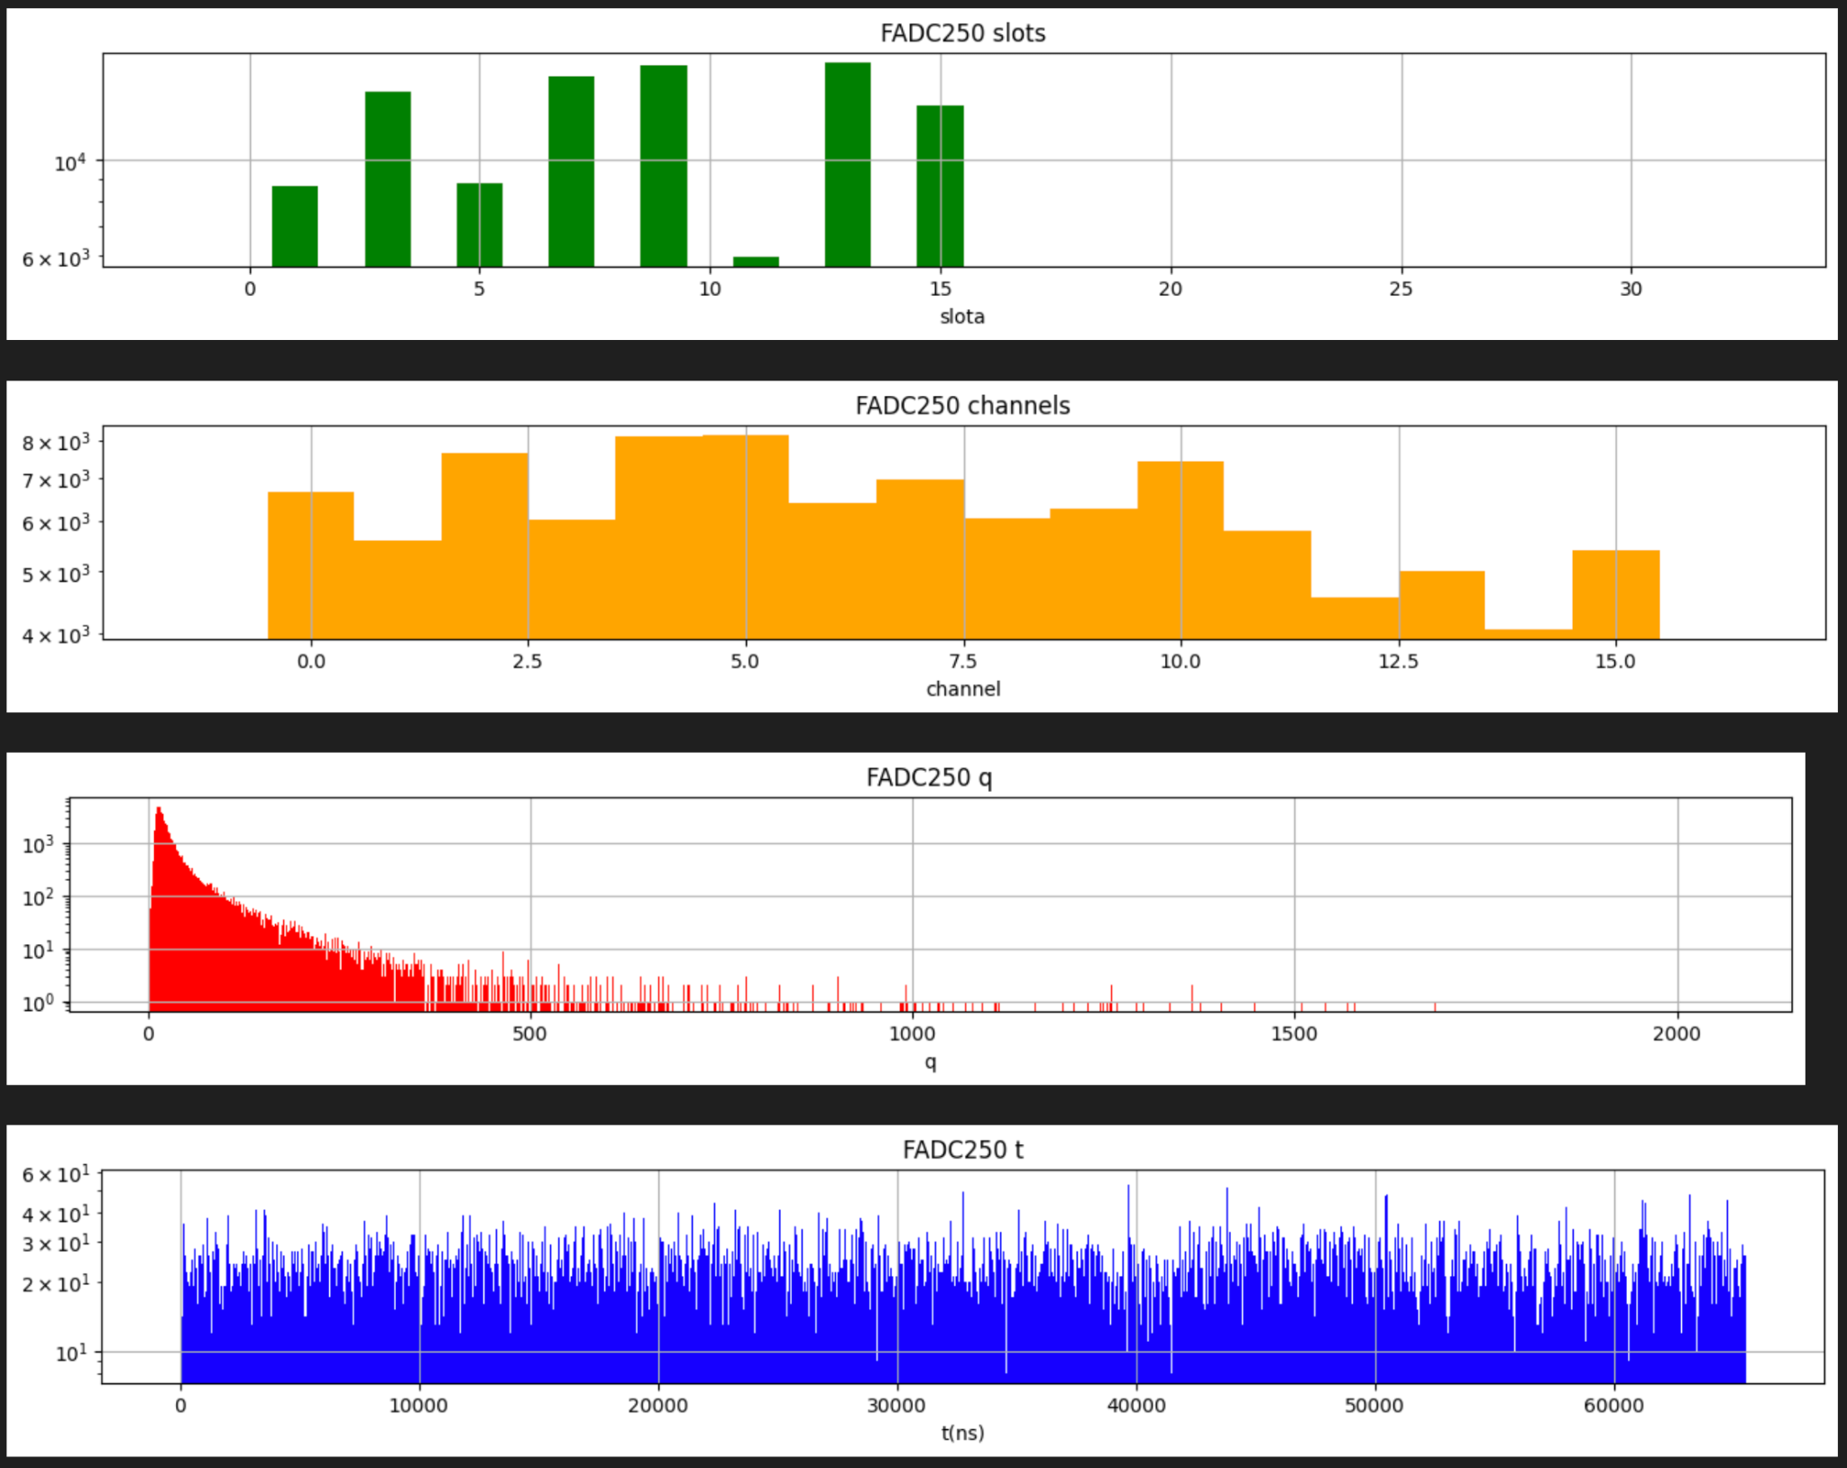
Parsed from EVIO in payload
Slot Number
Channel Number
ADC
TDC
TDC timing is relative to frame start time

