Slide 1
SRO Application:
Streamlined Generic DAQ Tool for Detector R&D
Hanjie Liu
Streaming Readout Workshop SRO-XII

Slide 2
Outline
Overview of Jefferson Lab
Motivation of the project
Development plan
Summary

Slide 3
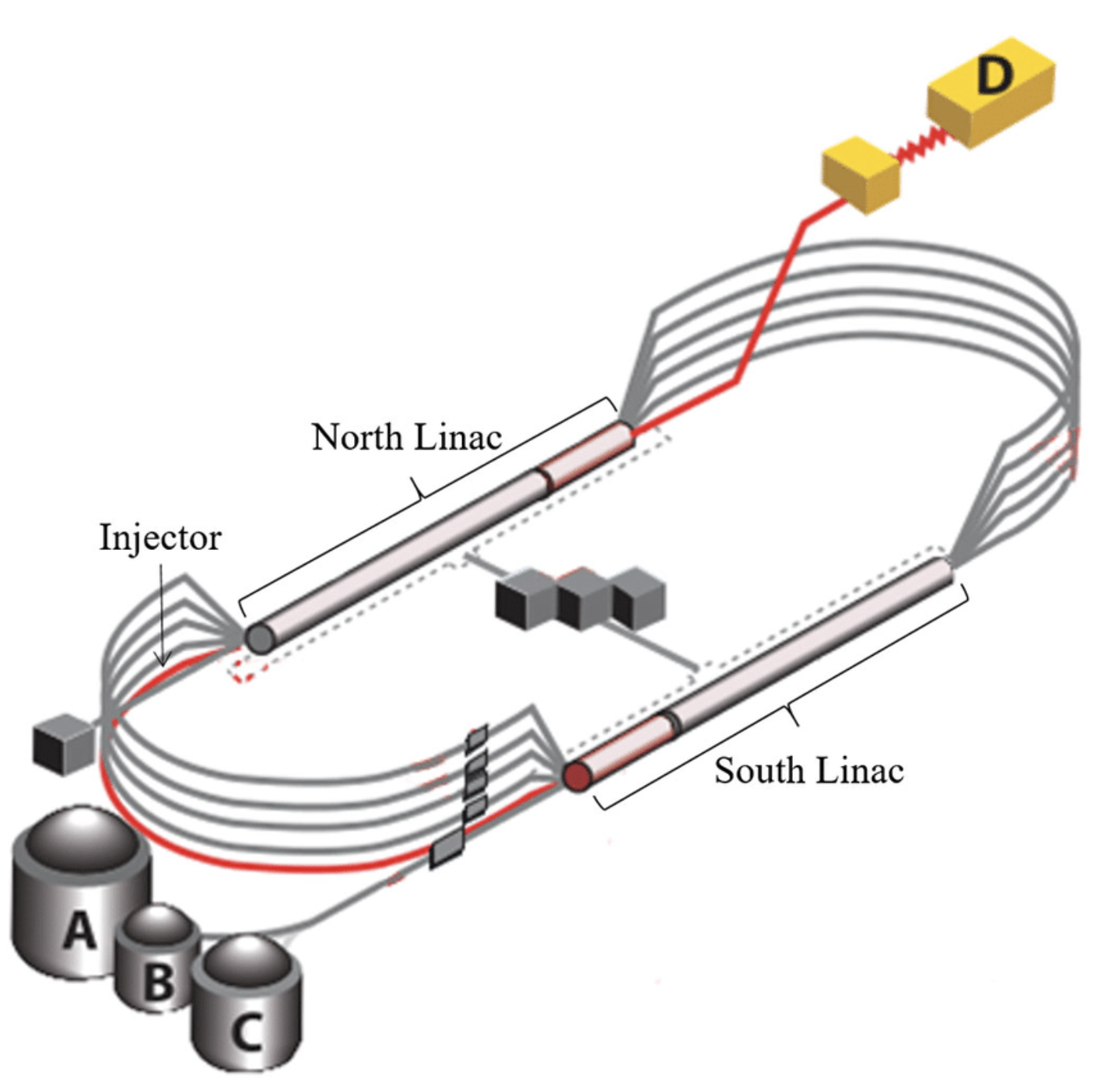
Jefferson Lab
Continuous Electron Beam Accelerator Facility (CEBAF)
5 Arcs: 2.2 GeV, 4.4 GeV, 6.6 GeV, 8.8 GeV, 11 GeV
Four experimental halls (A, B, C, D): fixed-target nuclear physics experiments
Two running period per year: Spring, Fall (~ 4 months each period)
For each running period, each hall focuses on one or two experiments that are approved by the PAC committee

Slide 4
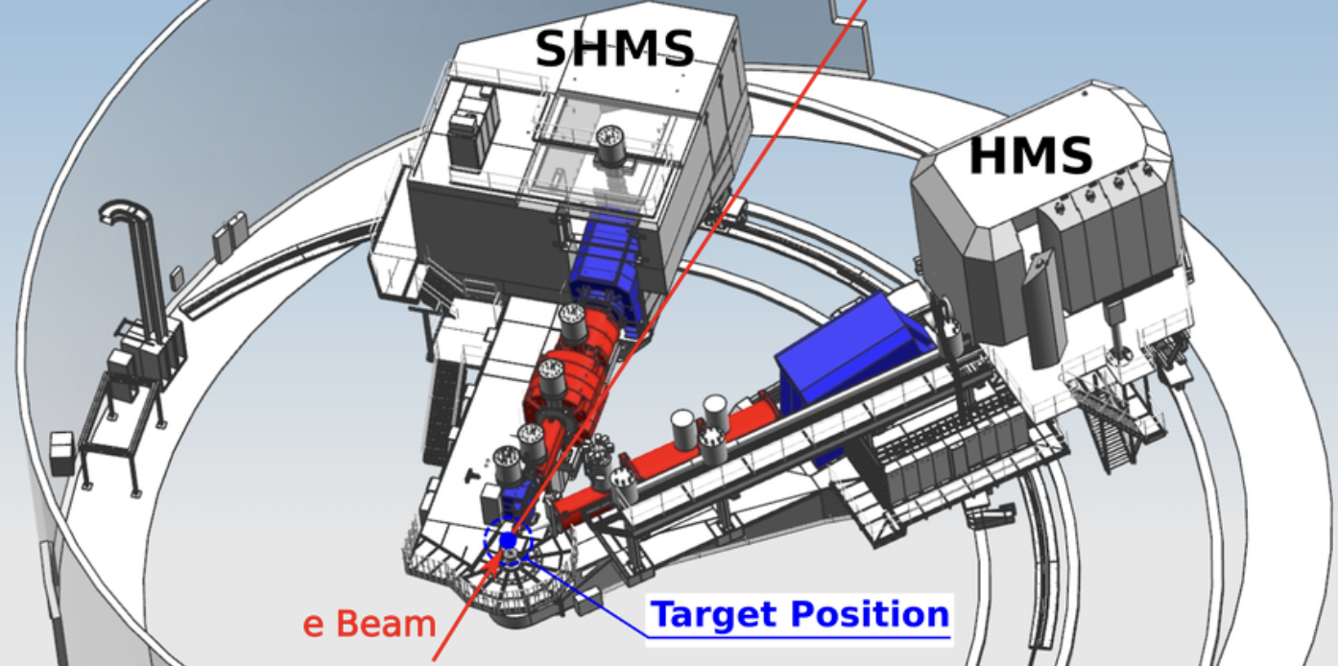
Experimental Halls A and C
Hall C Standard Spectrometers: SHMS, HMS
But it’s like LEGO …...

Slide 5
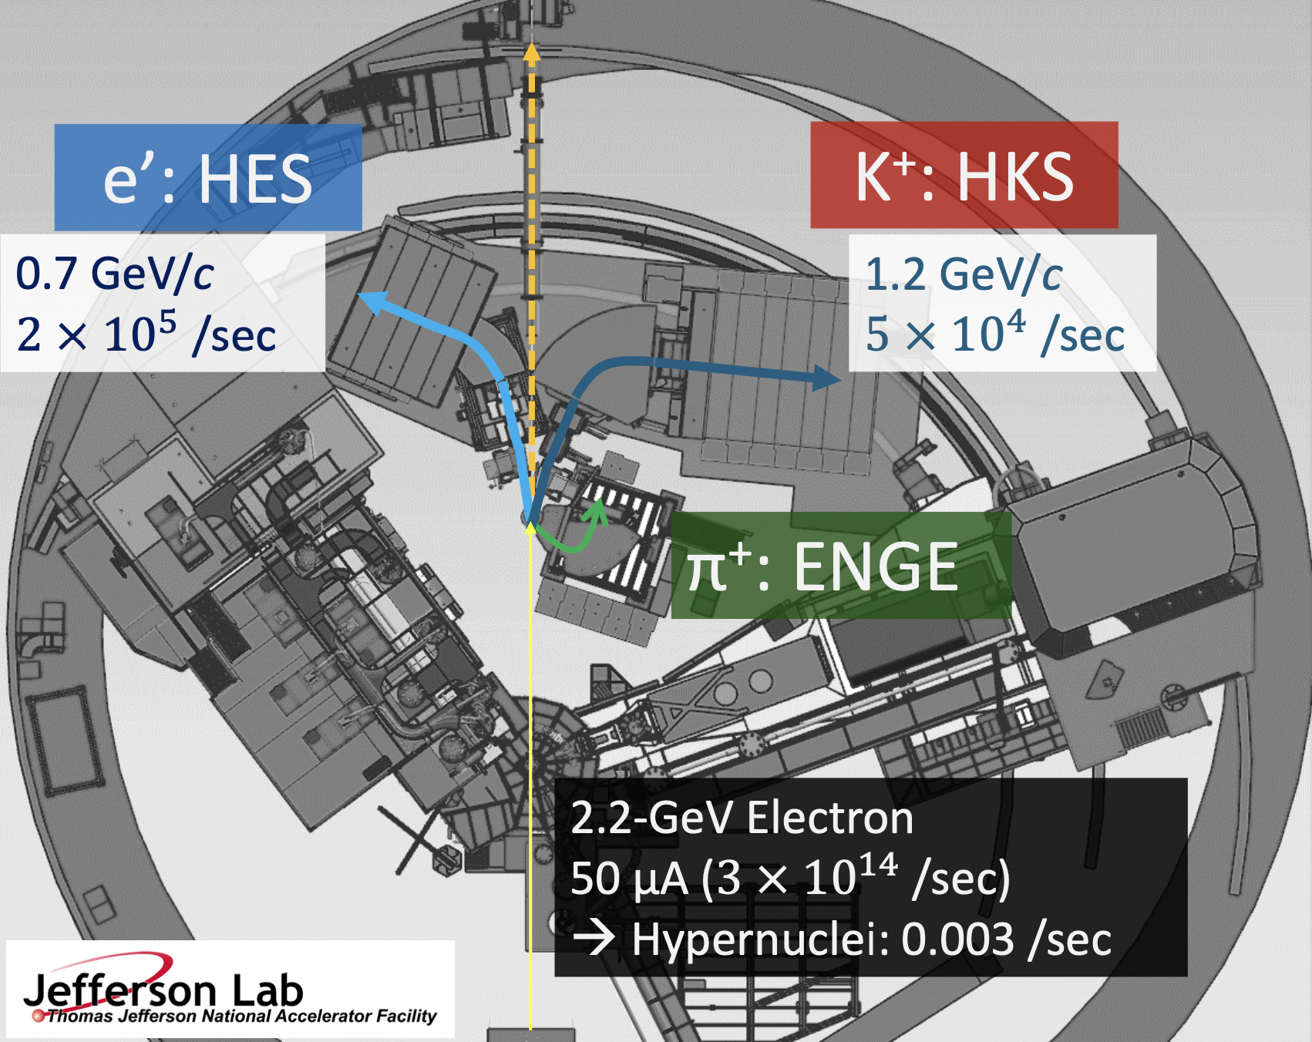
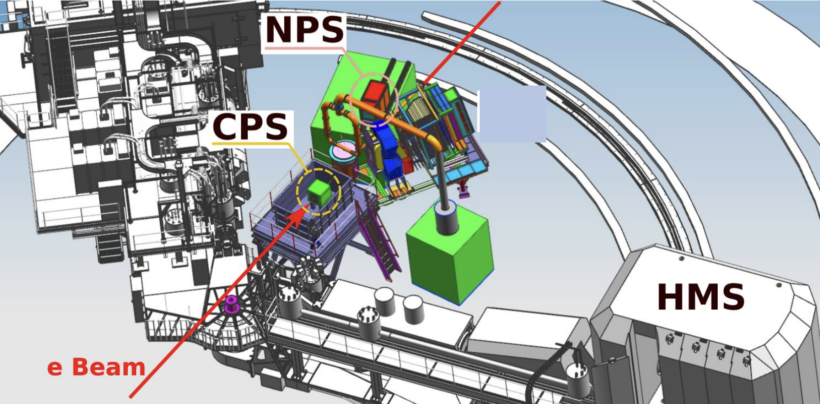
Experimental Halls A and C
Experiments bring in new detectors
NPS experiment (2023)
HKS experiments (~2027)

Slide 6
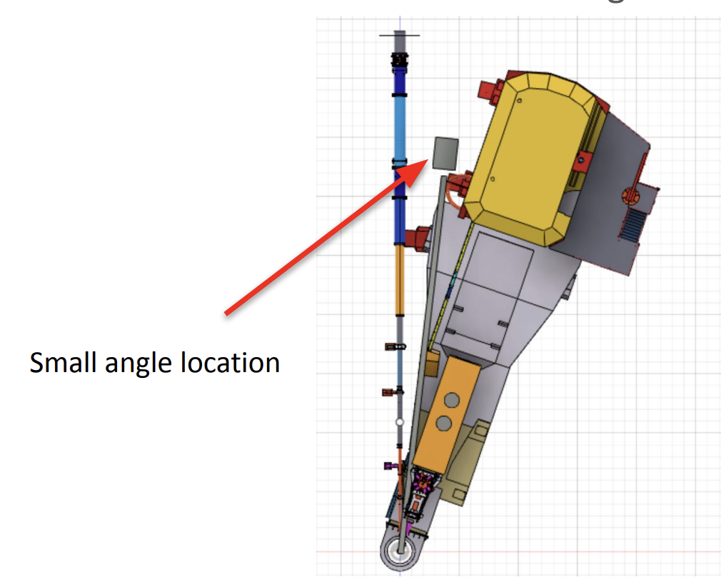
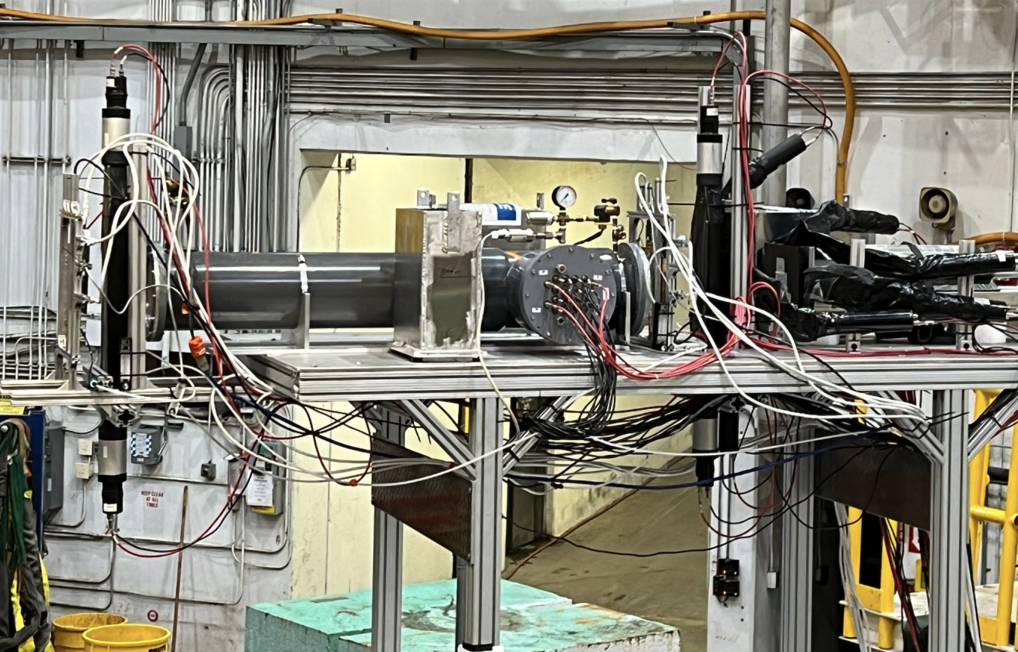
Experimental Halls A and C
Beam test for detector R&D: rates, backgrounds, radiation tolerance
HMS
SOLID detectors beam test (2023)

Slide 7
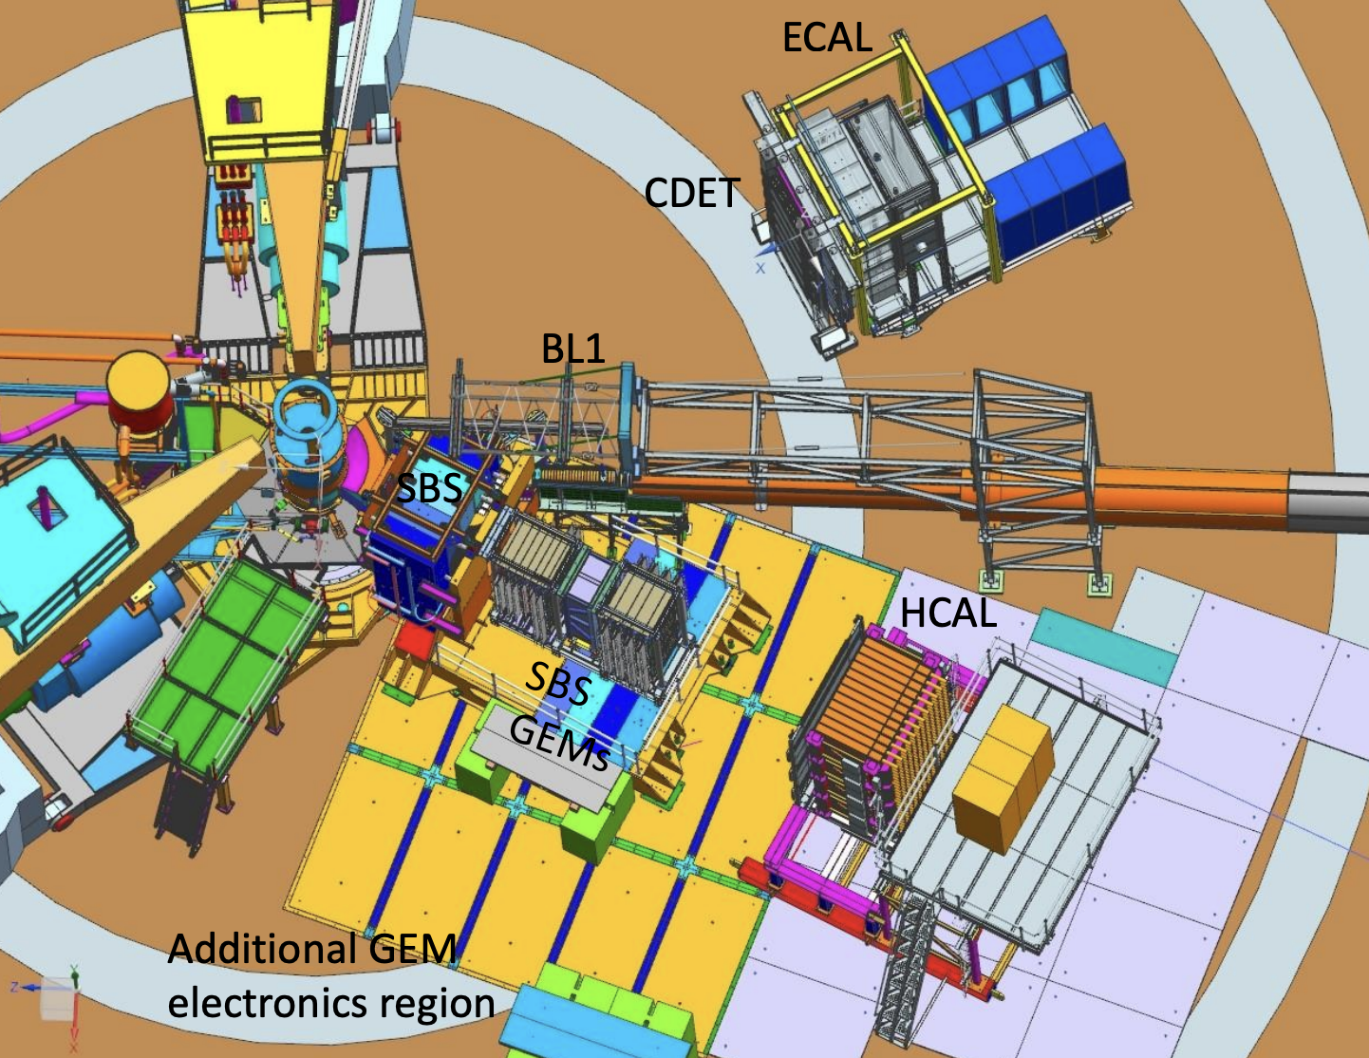
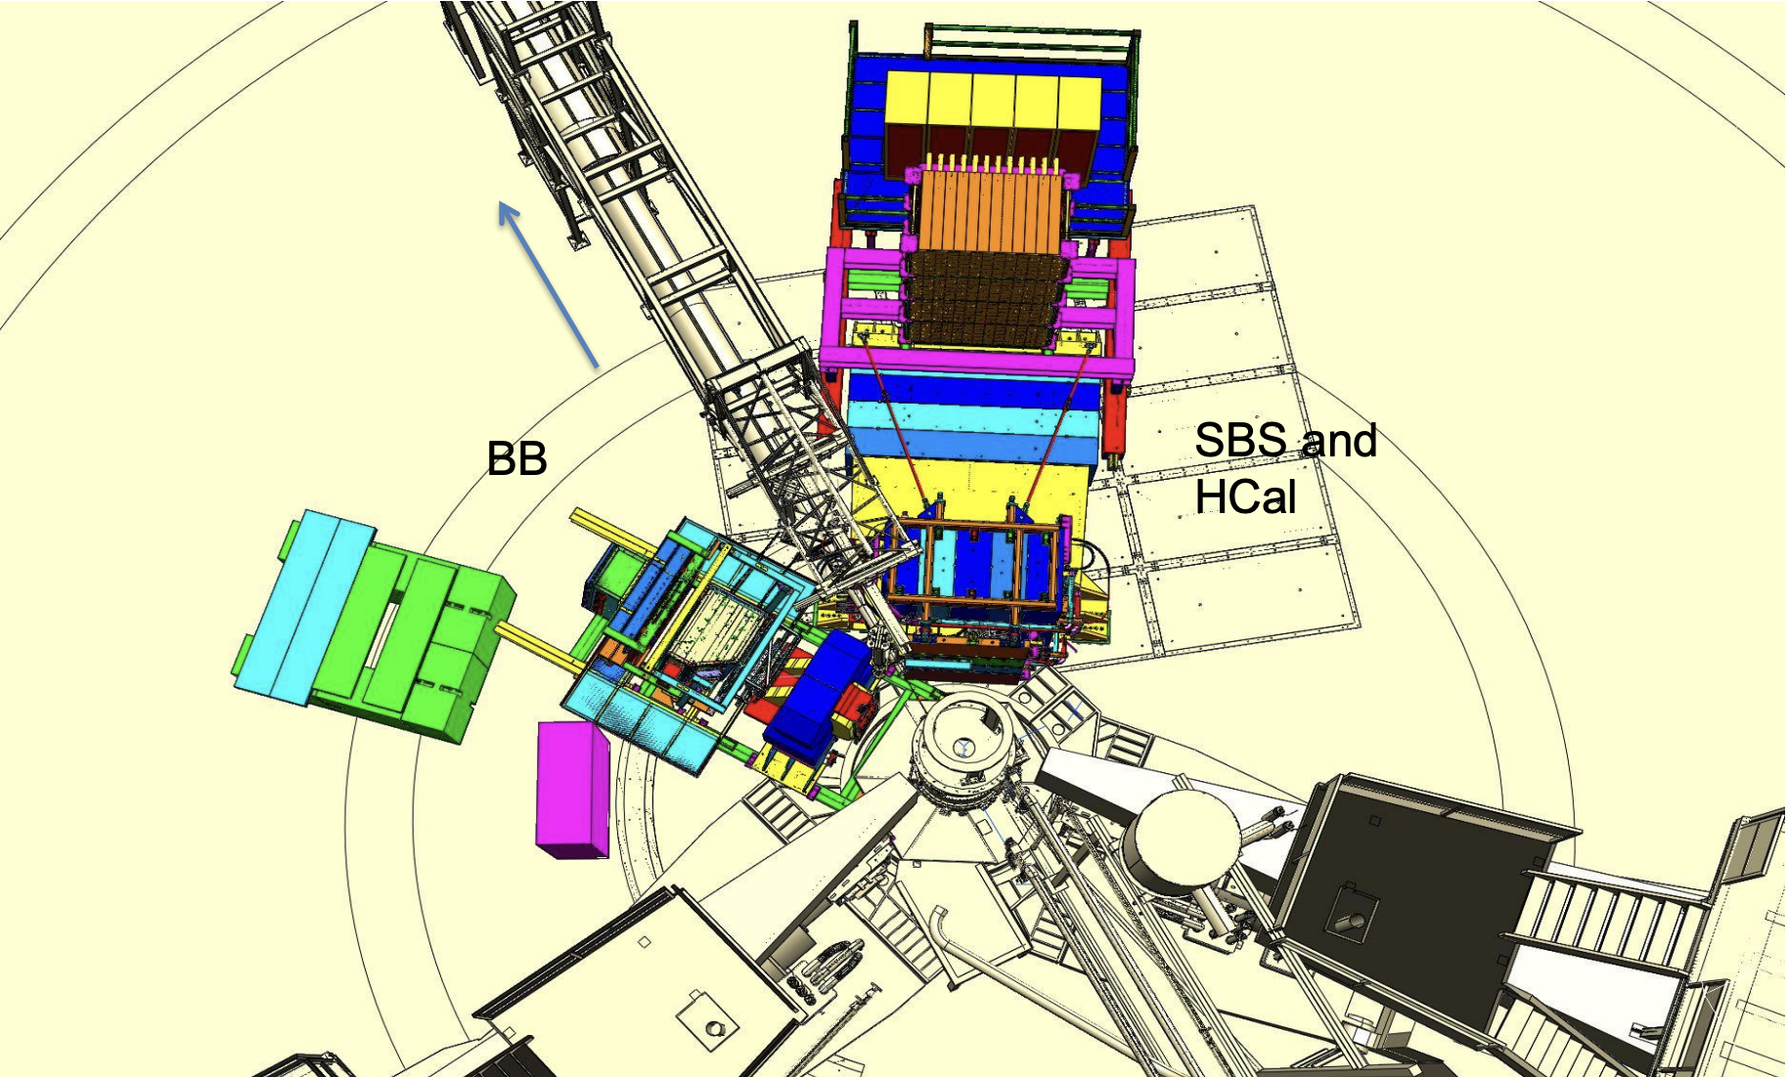
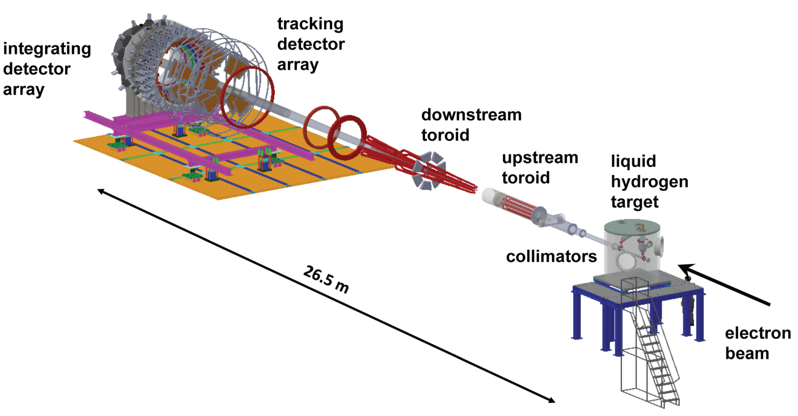
Experimental Halls A and C
Hall A experiments
SBS GEP5 experiment
(2024 – 2025)
SBS experiments (2021 – 2023)
Moller experiment (2026 – 2029)

Slide 8
Motivation
All the new detectors R&D (testing, commission etc.) need DAQ systems
Not even mention all those detectors in EIC …...

Slide 9
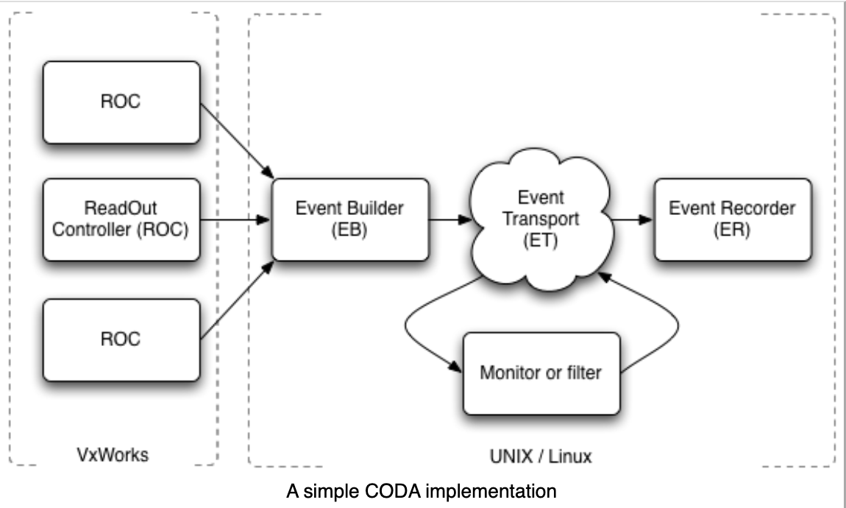
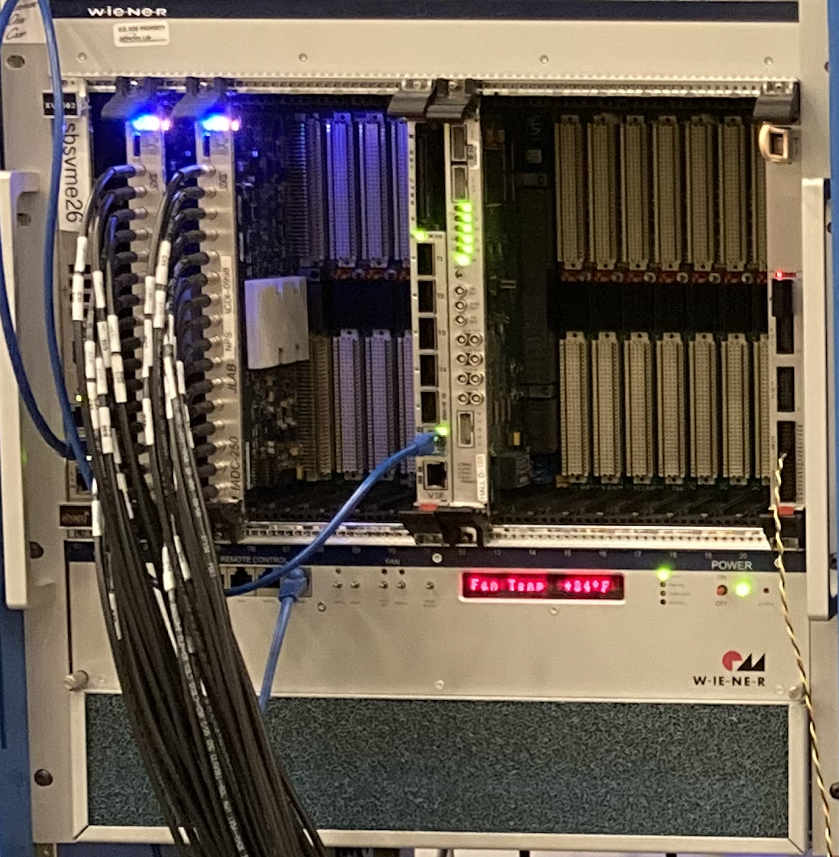
Standard JLab DAQ system
DAQ modules and CODA
CODA
VXS crate
VME CPU (ROC)
VTP (trigger processor, ROC)
SD (signal distribution)
TI (trigger interface)
FADC (flash ADC)
TDC etc….
https://coda.jlab.org/drupal/
Current two ways of running:
NIM trigger TI ROC read out ADC/TDC data that are associated to the trigger
VTP generates trigger using FADC trigger path data. TI ROC read out associated data

Slide 10
Motivation
Users are heavily involved in the detector R&D
Building physical triggers requires extra modules and setup time (repetitive work )
NIM triggers usually require scintillators (size limitation etc.)
SRO that allows online trigger, it would reduce the setup time and provide more flexibility on the readout data
Note: in these situations, normally the trigger rate is few Hz and the data rate is small

Slide 11
A Generic SRO DAQ tool for detector R&D
The current DAQ modules support SRO (Chris Cuevas talk this morning)
First version of SRO CODA is ready (David Abbott talk this morning)
Need a plugin program that allows user designed online triggers
VXS backplane
Event Builder
Event Transfer
Event Transfer
Event Recorder
FADC
VTP
QSFP links
Hardware
Software

Slide 12
A Generic SRO DAQ tool for detector R&D
Development
Information provide to the user: time slice data that shows hit or not hit at a channel
User writes a C++ program to determine the channels and algorithms that generates a trigger using multiple time slices’ data
Filter and reorganize the time slices’ data that are associated to the trigger, and build them into an event
Pass the event to the ET for recording
Users keep using their familiar decoder
Users will program the trigger

Slide 13
A Generic SRO DAQ tool for detector R&D
Validation and Monitoring
TI
NIM trigger
Compare NIM trigger events and online trigger events
VMECPU
VXS backplane
Event Builder
Event Transfer
Event Transfer
Event Recorder
FADC
VTP
QSFP links
Hardware
Monitoring
Software
Monitoring
Online trigger
(designed to be same as the NIM trigger logic)

Slide 14
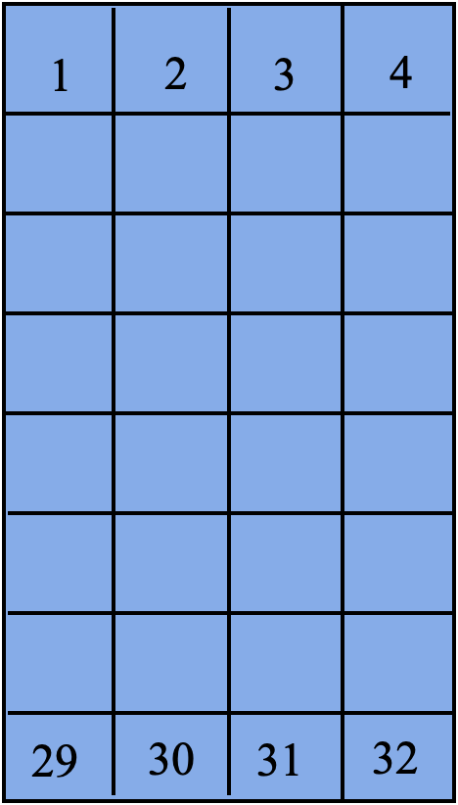
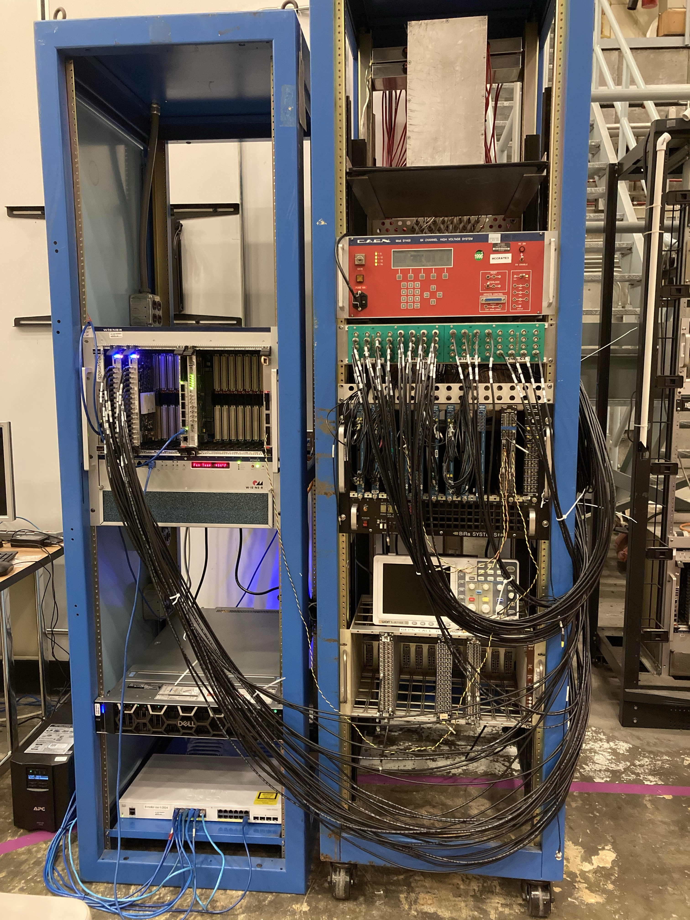
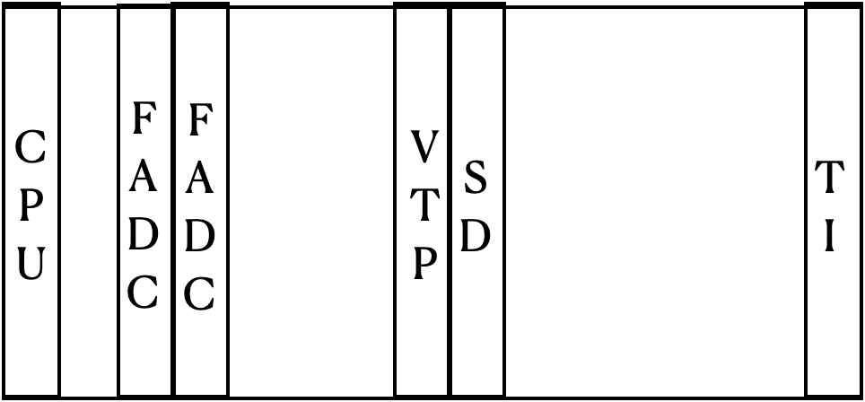
Current Status and Plan
Test stand with a simple detector
Active Analyzer:
4 by 8 blocks, each block is detected by a PMT
The signals coming from the PMTs are sent to the FADCs
NIM trigger:
(1 || 2 || 3 || 4) || (29 || 30 || 31 || 32 )
Rate ~ 10 Hz

Slide 15
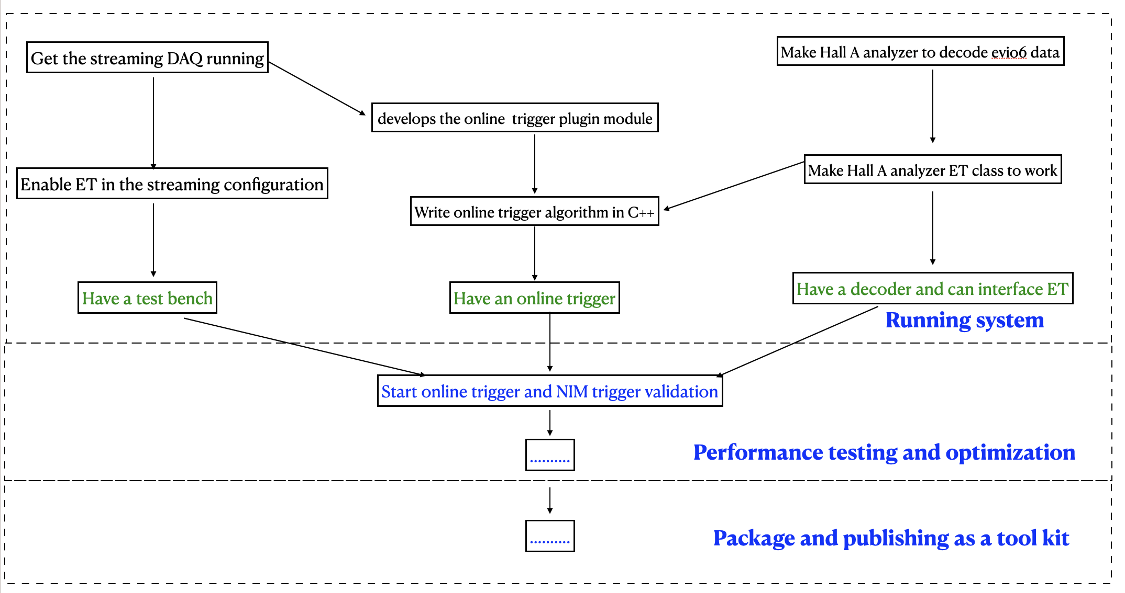
Current Status and Plan

Slide 16
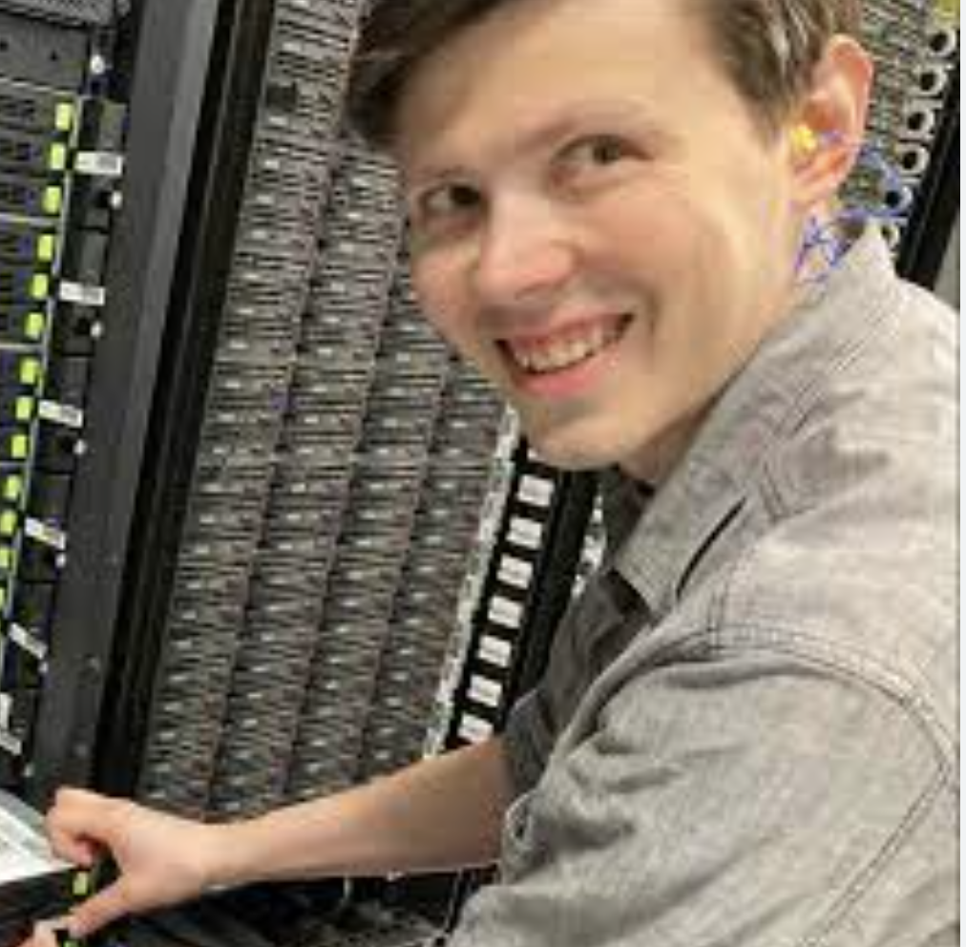
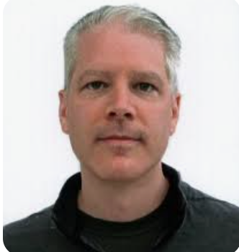
Collaborators
David Lawrence
EPSCI group
Nathan Brei
EPSCI group
Dmitry Romanov
EIC group
Brad Sawatzky
SCI
Bryan Moffit
FEDAQ group
Hanjie Liu
Hall A/C

Slide 17
Summary
SRO is not only useful for large setups, but also can be useful for small detector R&D stands, which will save setup time and provide flexibility on data taking
The SRO generic DAQ tool can be deployed anywhere on/off site for four Halls, EIC etc.

