Slide 1
Streaming Experience with sPHENIX TPC
Charles Hughes
on behalf of the sPHENIX TPC Group Streaming Readout Workshop SRO-XII - December 2024
University of Tokyo

Slide 2
Outline
sPHENIX and sPHENIX TPC Intro
TPC Front & Back End Electronics Readout
sPHENIX Streaming
sPHENIX Run ‘24
Noise Reduction
100 % streaming
Hybrid trigger + streaming (physics program)
(see also talks by Yihui Ren, Martin Purschke, and Cameron Dean)
Charles Hughes - Streaming Readout Workshop - University of Tokyo - December 2 2024

Slide 3
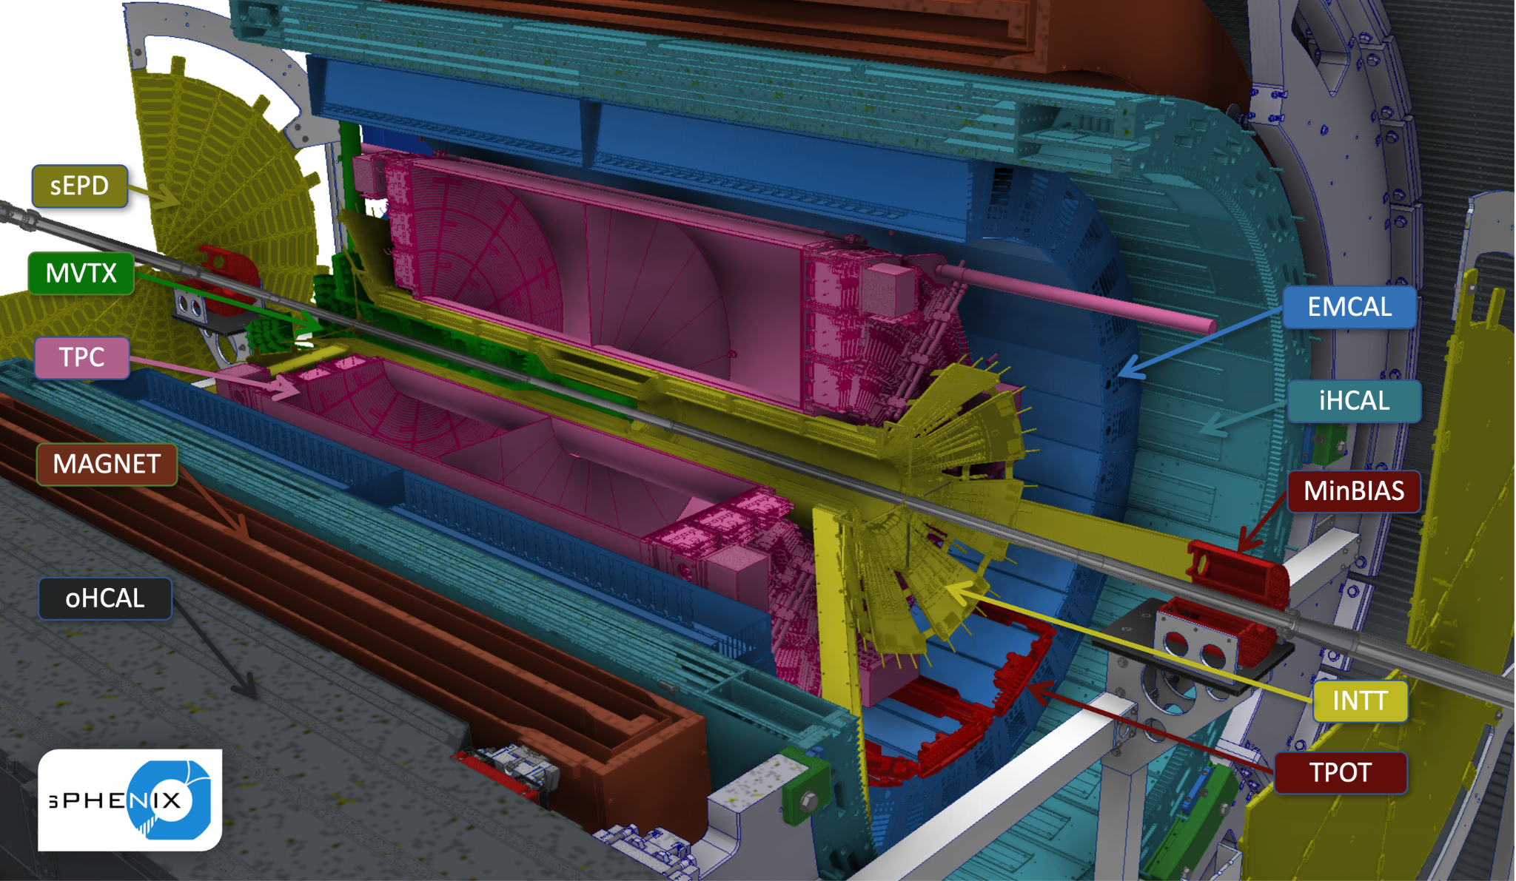
sPHENIX Overview
Tracking Detectors
MVTX
INTT
TPC
TPOT
Calorimetry
EMCAL
HCAL (inner/outer)
Magnet
Forward Detectors
sEPD
MBD (minBIAS)
Charles Hughes - Streaming Readout Workshop - University of Tokyo - December 2 2024

Slide 4
sPHENIX Overview
Tracking Detectors
MVTX
INTT
TPC
TPOT
Calorimetry
EMCAL
HCAL (inner/outer)
Magnet
Forward Detectors
sEPD
MBD (minBIAS)
Charles Hughes - Streaming Readout Workshop - University of Tokyo - December 2 2024

Slide 5
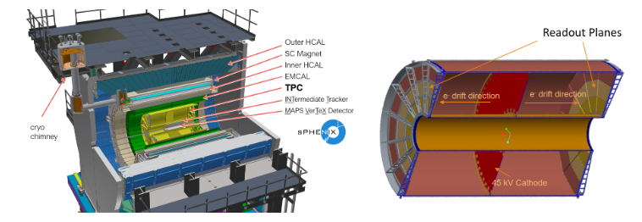
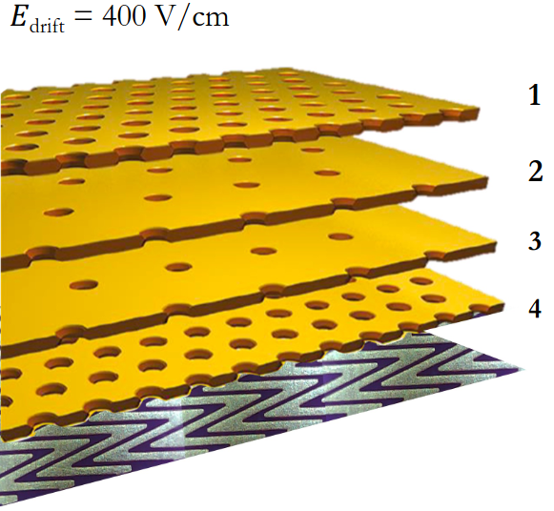
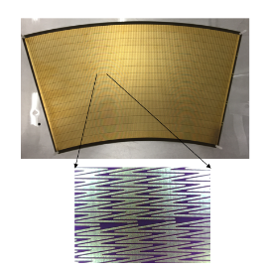
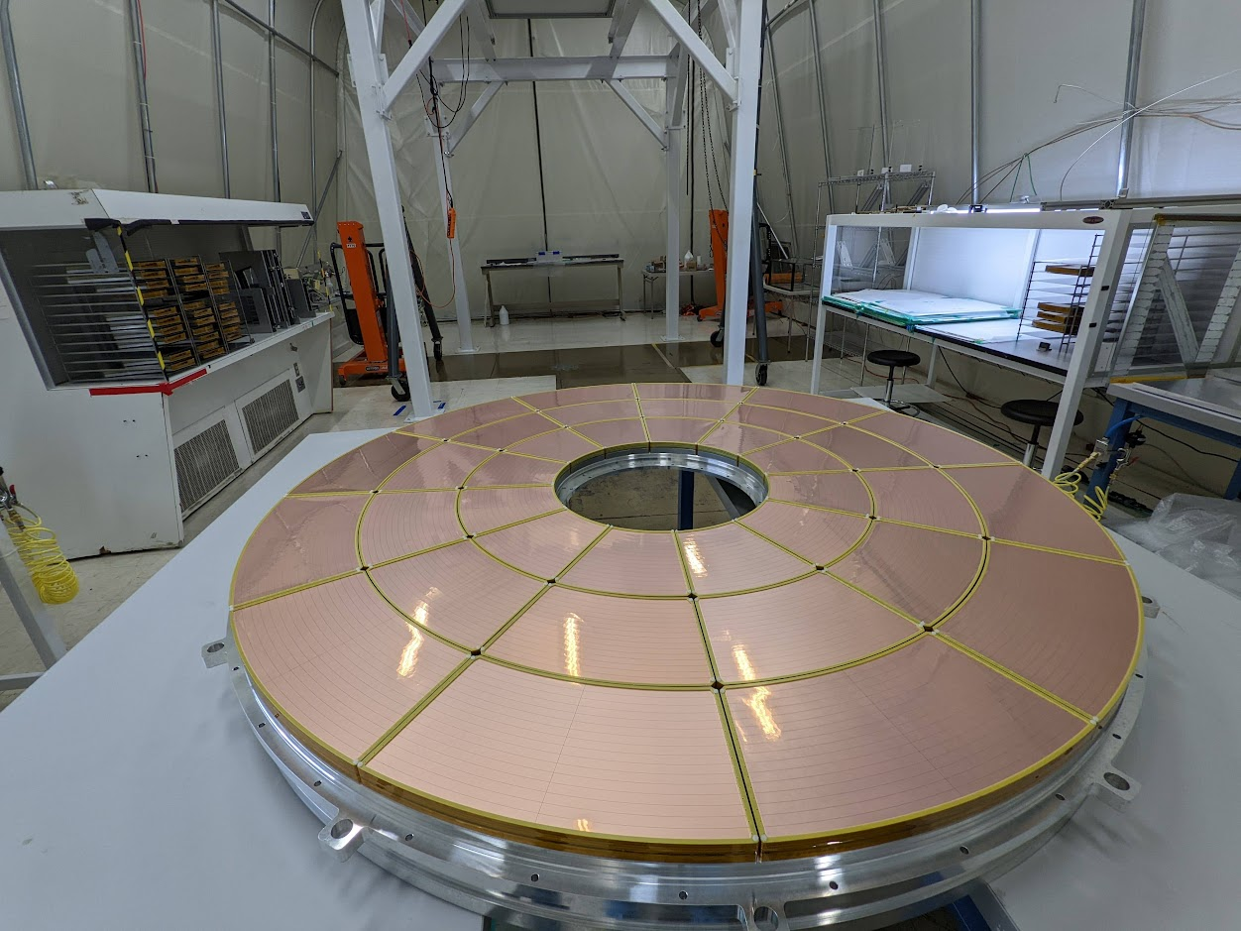
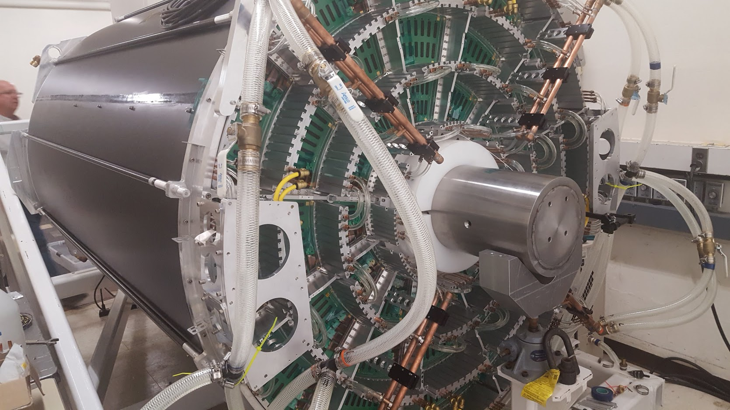
sPHENIX TPC
Gaseous Drift Detector
Ar/CF₄/ISO 75:20:5 % drift gas
O(13 μs) drift time
GEM (Gaseous Electron Multiplier) amplification
4 Kapton + Copper GEMs / module
Un-gated like ALICE TPC
Allows for streaming readout
Zig-zag segmented copper sensor pads
Improves position resolution
72 GEM modules/2 sides
36 modules / full φ
3 modules / full r
20 < r < 78 cm, |η| < 1.1, full φ
Measures Momentum
Momentum resolution:
Δp/p ~ 0.02 * p (for p ~ 5 GeV/c)
O(150 μm) spatial resolution
Standard pitch not rotated
Large pitch rotated
Large pitch not rotated
Standard pitch rotated
padplane
Charles Hughes - Streaming Readout Workshop - University of Tokyo - December 2 2024

Slide 6
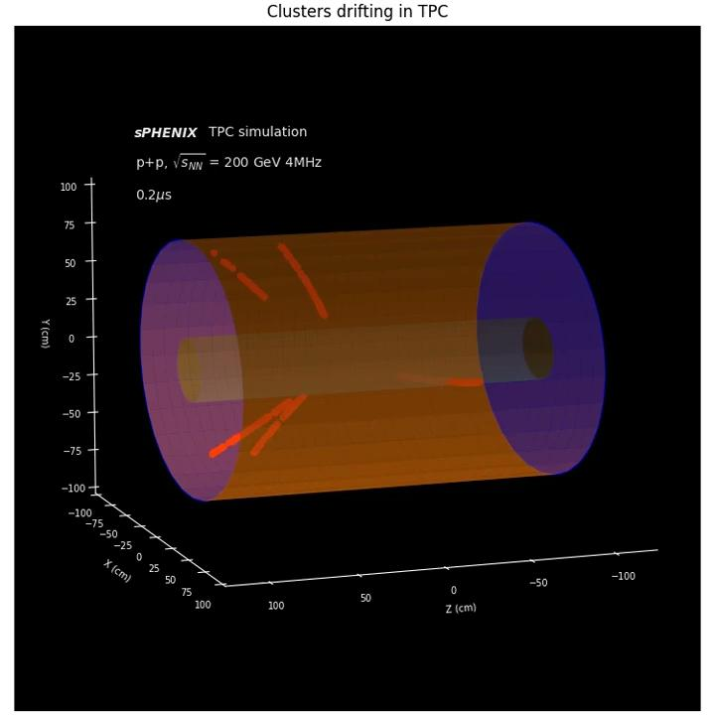
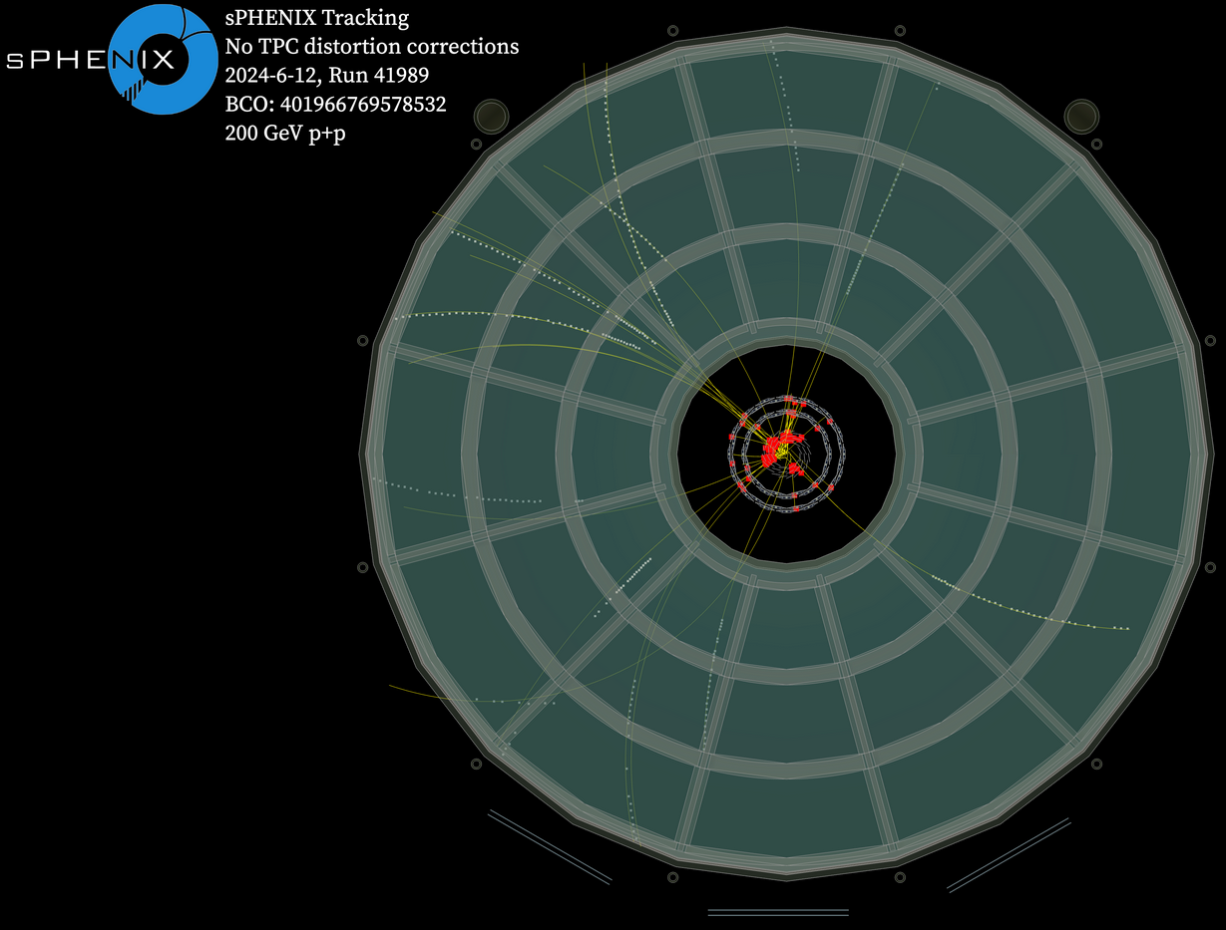
sPHENIX TPC Event Display
Charles Hughes - Streaming Readout Workshop - University of Tokyo - December 2 2024

Slide 7
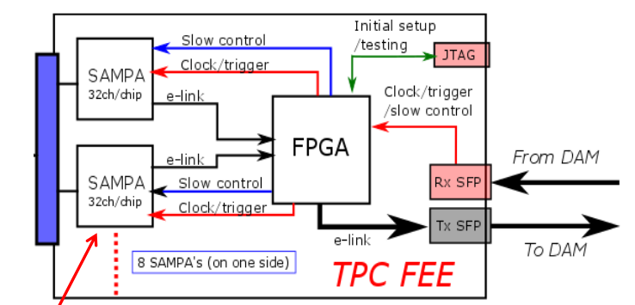
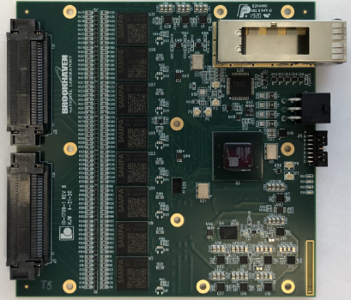
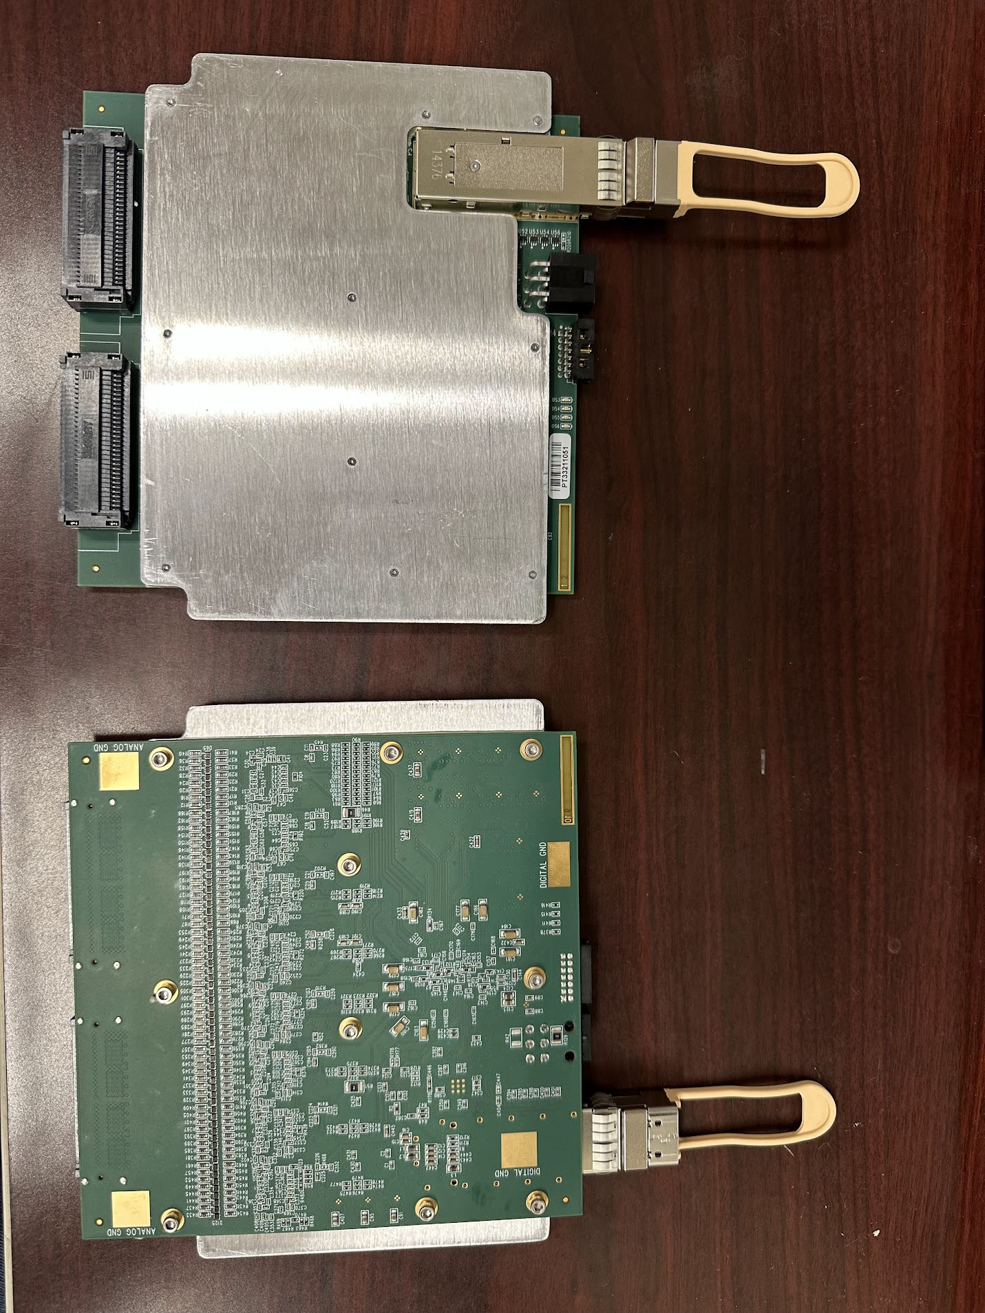
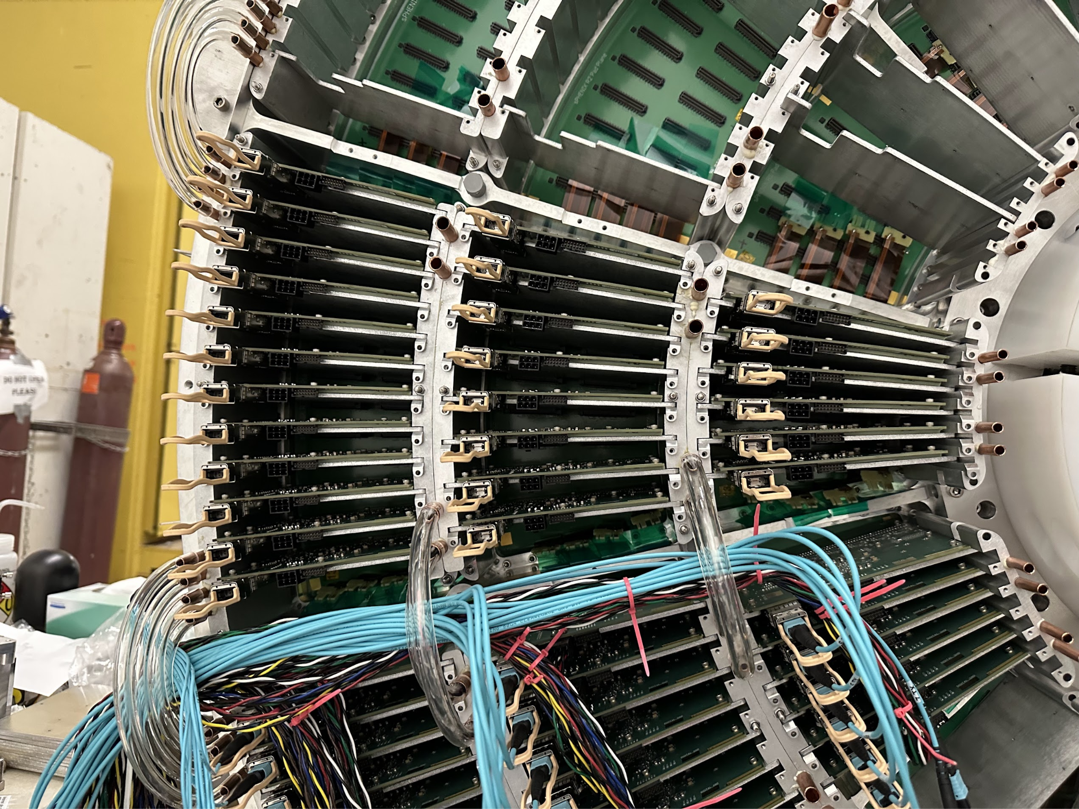
sPHENIX TPC Front End Electronics
Front End Electronics (FEE) Card
8x Sampa v5 ASIC
80 ns shaping time
20 MHz sampling frequency
Operated in ZS mode
3E12 ADC samples/s prior to ZS
1x Xilinx Artix-7 FPGA
256 pads
Aluminum Plate for liquid cooling
26x FEE per sector, 24 sector total
~ 160K channel
Charles Hughes - Streaming Readout Workshop - University of Tokyo - December 2 2024

Slide 8
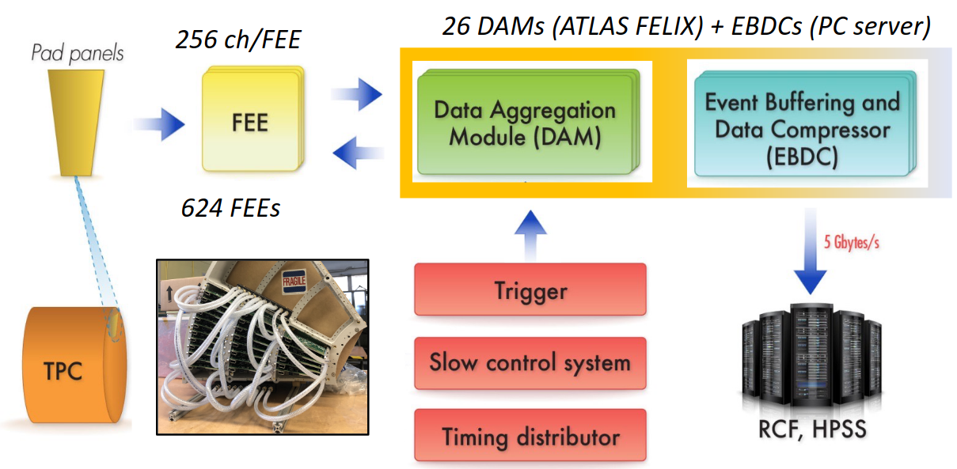
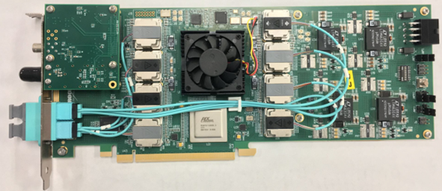
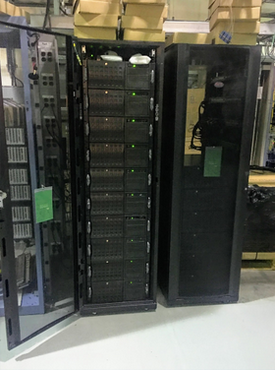
sPHENIX TPC Backend
24 x Data Aggregation Module
ATLAS FELIX cards [doi:10.1109/TIM.2019.2947972]
Distribute Clock + Trigger, readout
47x 10 Gbps bidirectional optical link
Kintex Ultrascale FPGA
24 x Event Buffer Data Compressor (4U Servers)
Hosting FELIX card via PCIe Gen3x16
Lossless data compression, transmit via 25GbE
Online buffer disk
6PB
>10GB/s logging for TPC
Charles Hughes - Streaming Readout Workshop - University of Tokyo - December 2 2024

Slide 9
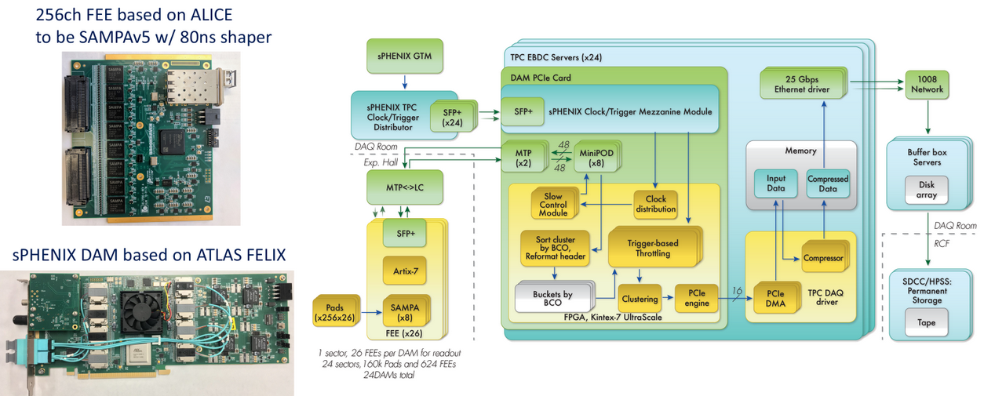
sPHENIX TPC Backend Continued
Charles Hughes - Streaming Readout Workshop - University of Tokyo - December 2 2024

Slide 10
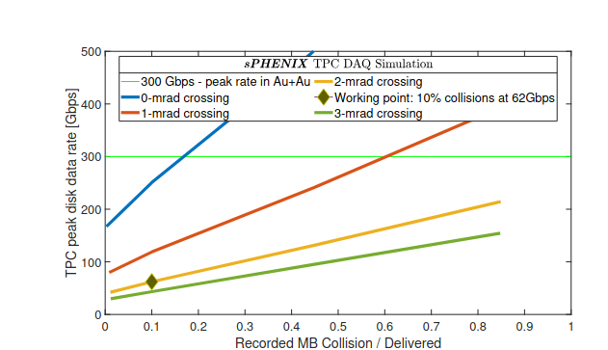
sPHENIX TPC - Streaming
sPHENIX planned to run hybrid trigger + streaming mode during Run 24
Streaming desired for capturing low momentum HF decays (see talk by Cameron Dean)
Hybrid scheme uses extended readout - beyond 14 us drift time - additional xings captured
BUP 2022 projection is 10 % true streaming rate (true streaming rate ~ 20 kHz)
Run 24 achieved 30 % true streaming rate
Possible because of careful preparation and data pipeline monitoring
Additionally, TPC ran 100 % streaming standalone during Run 24
Run with raised noise threshold + lowered GEM Voltage (low gain)
Charles Hughes - Streaming Readout Workshop - University of Tokyo - December 2 2024

Slide 11
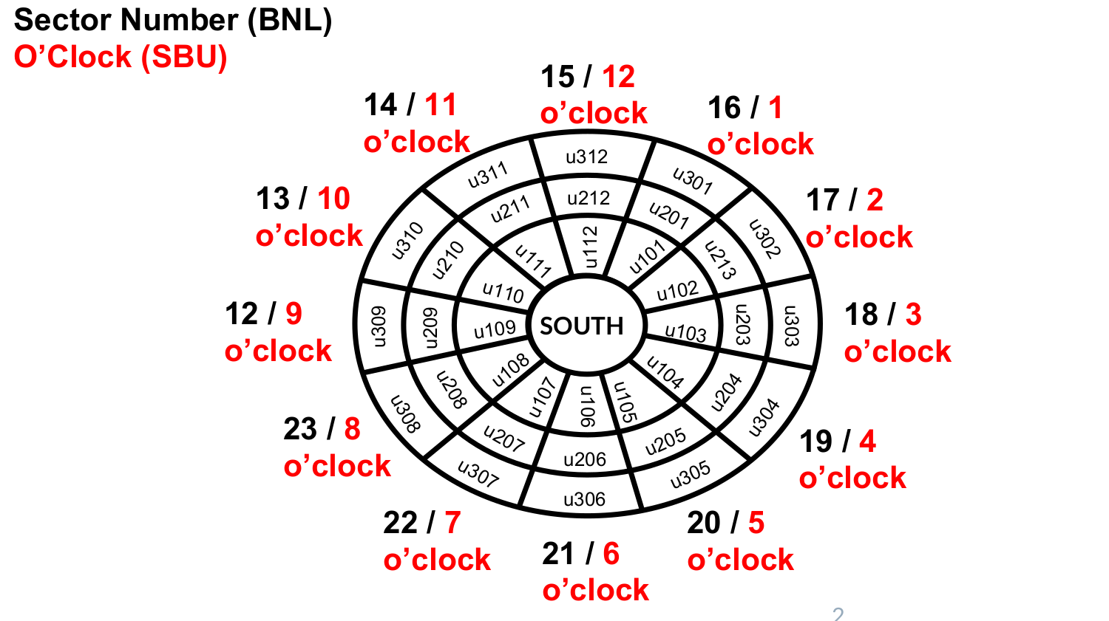
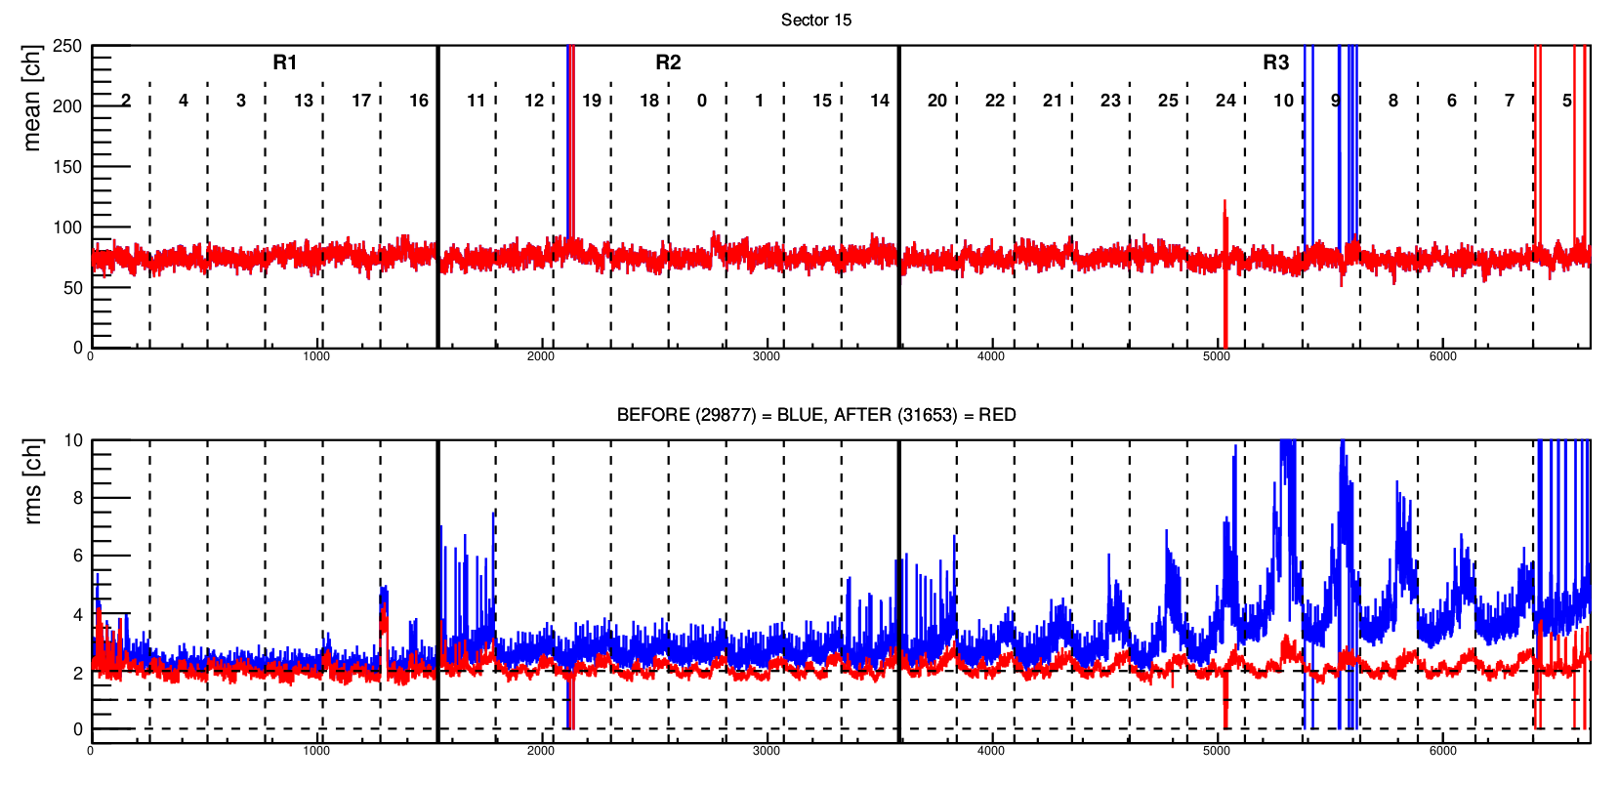
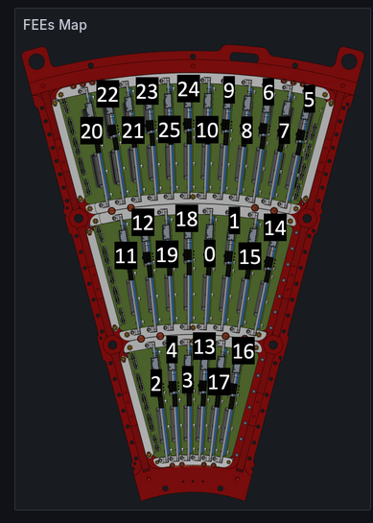
sPHENIX TPC Noise Reduction
Reducing noise important for streaming/hybrid operations
Limiting case: noisy FEE/sectors are effectively dead (MIP indistinguishable from noise)
Run 29877 (02/15/24) - BEFORE
Run 31653 (03/04/24) - AFTER
Charles Hughes - Streaming Readout Workshop - University of Tokyo - December 2 2024

Slide 12
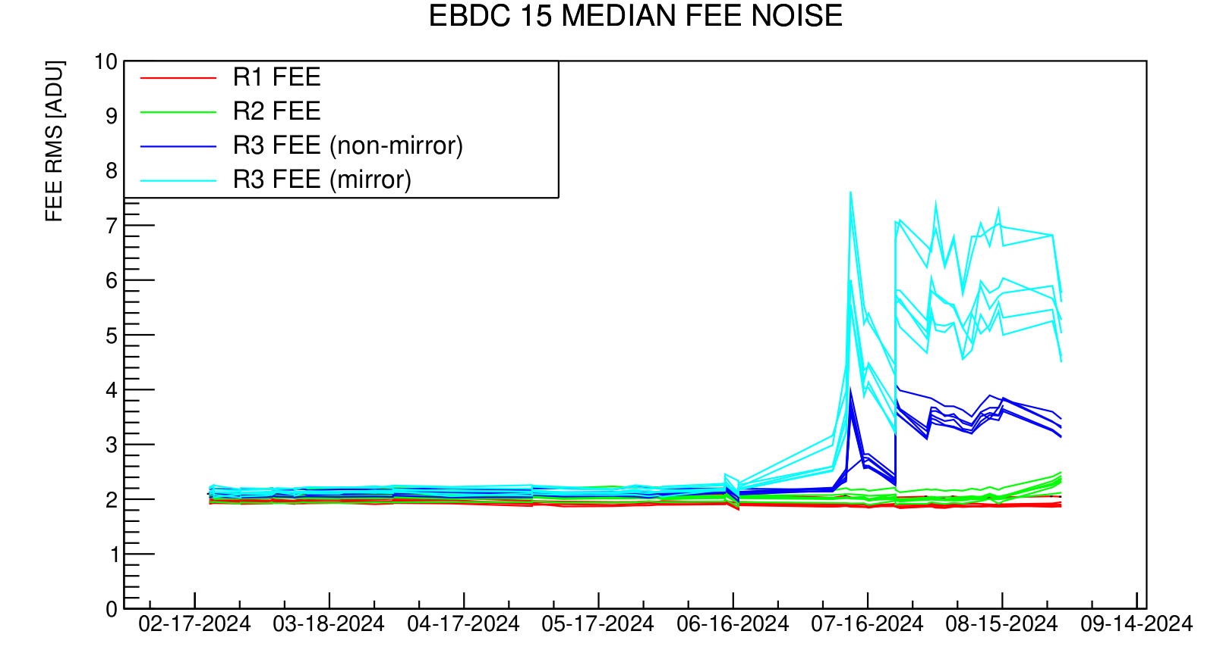
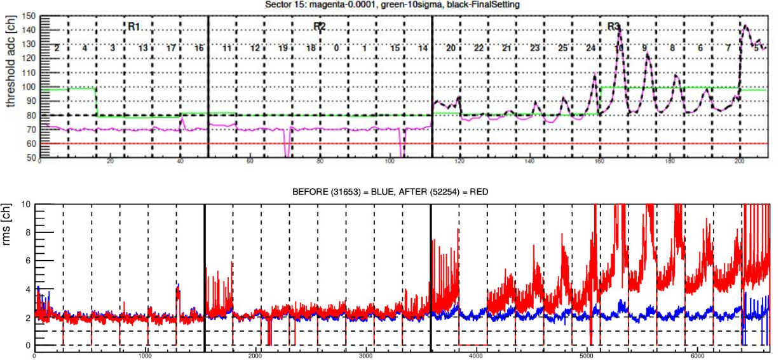
sPHENIX TPC Noise Threshold Tuning
Though noise was reduced before start of run, it crept back in over time as run progressed - in particular non-Gaussian noise
ZS threshold tuned to account for this
“The threshold comparison with 10sigma setting is shown in the plot. Magenta shows the thresholds at which the noise picking probability is 1.0e-4. Green shows the 10sigma threshold. The black ones are thresholds to be applied in the FEE. Each threshold is as: if Magenta is below 80ADU, it will be ADU, if Magenta is above 80ADU, it will be Magenta values.”
Charles Hughes - Streaming Readout Workshop - University of Tokyo - December 2 2024

Slide 13
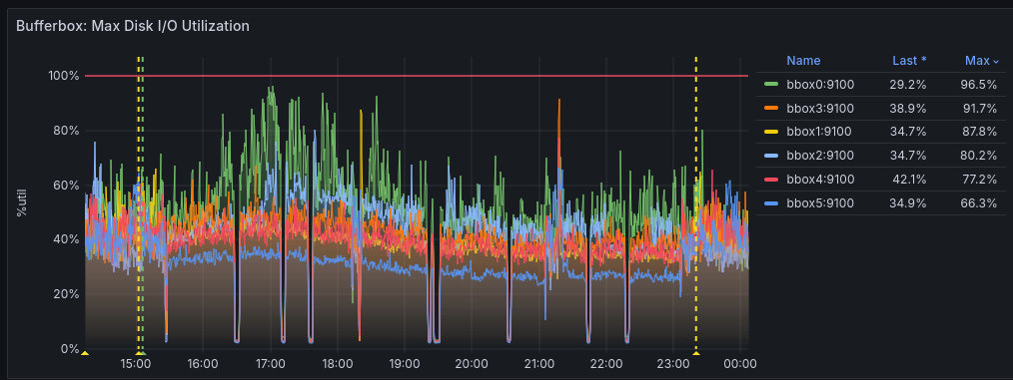
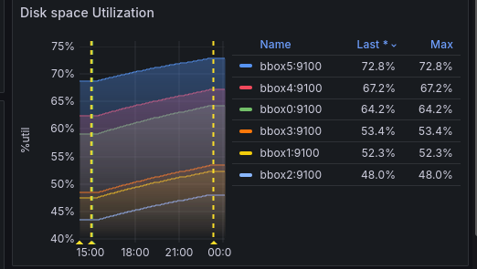
sPHENIX TPC Data Pipeline Monitoring
DAM DMA buffer -> RCDAQ Buffer -> Disk on EBDC
Additional Monitoring EBDC -> Buffer Box
Charles Hughes - Streaming Readout Workshop - University of Tokyo - December 2 2024

Slide 14
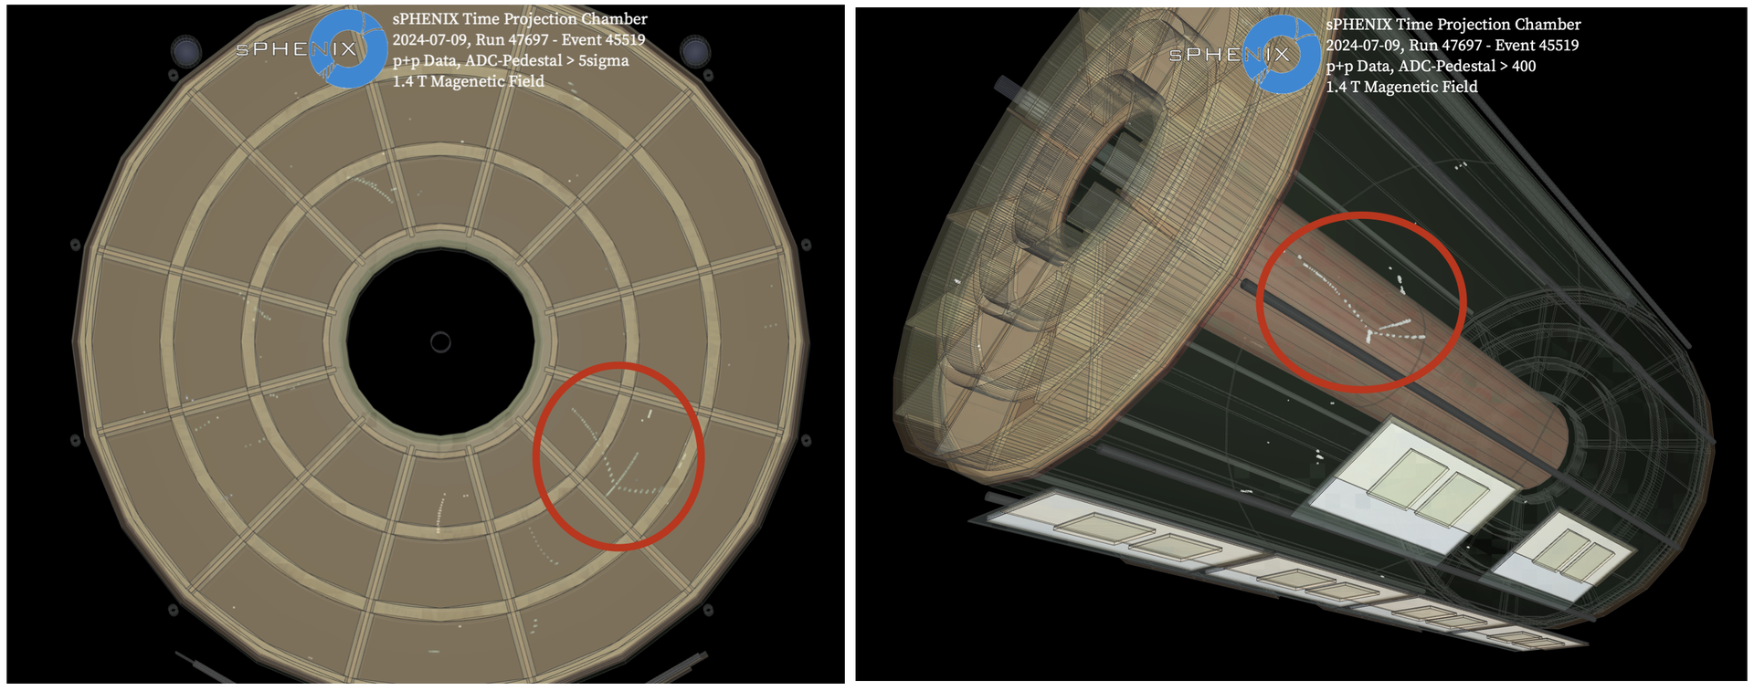
sPHENIX TPC Run 24 - 100 % Streaming Standalone Runs
100 % streaming
20 kHz clock trigger, 200 ADU ZS threshold (~ 70σ), 50 us readout
Lowered GEM operating point
~ 86 % operating voltage
Shows heavy ionizing events, likely nuclear fragmentation (spallation) in TPC gas
Charles Hughes - Streaming Readout Workshop - University of Tokyo - December 2 2024

Slide 15
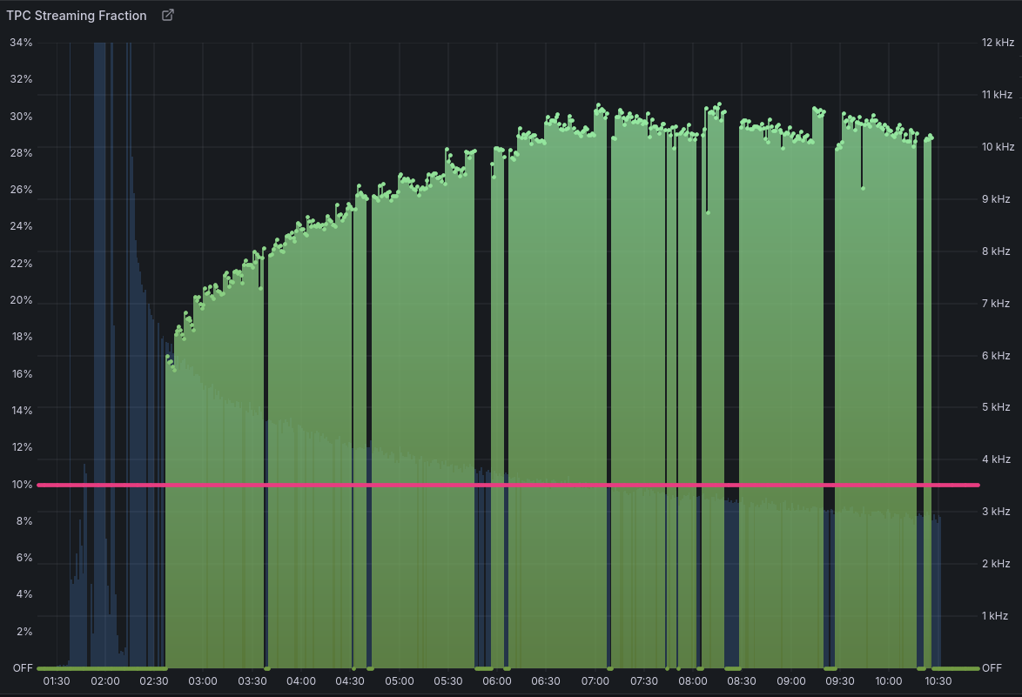
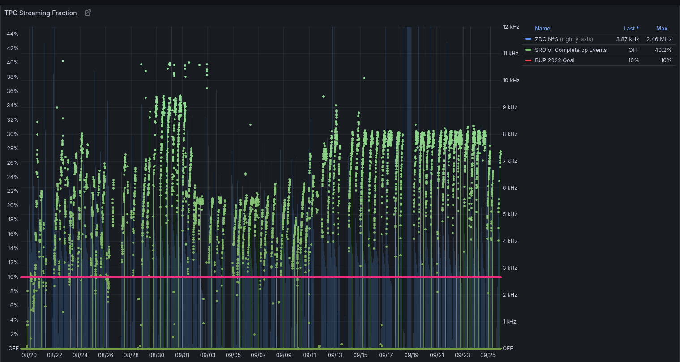
sPHENIX TPC Run 24 - Hybrid Trigger + Streaming Physics Runs
During Run ‘24 TPC was run hybrid triggered + streaming mode
Achieved up to 30 % true streaming fraction
Expectation from 2022 BUP was 10 %
Single fill 09/20/24
Streaming fraction increases as collision rate decreases within a fill -> works around disk bandwidth limitations
Charles Hughes - Streaming Readout Workshop - University of Tokyo - December 2 2024

Slide 16
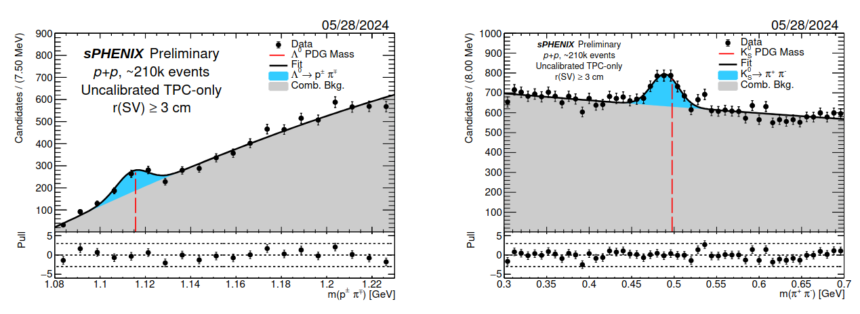
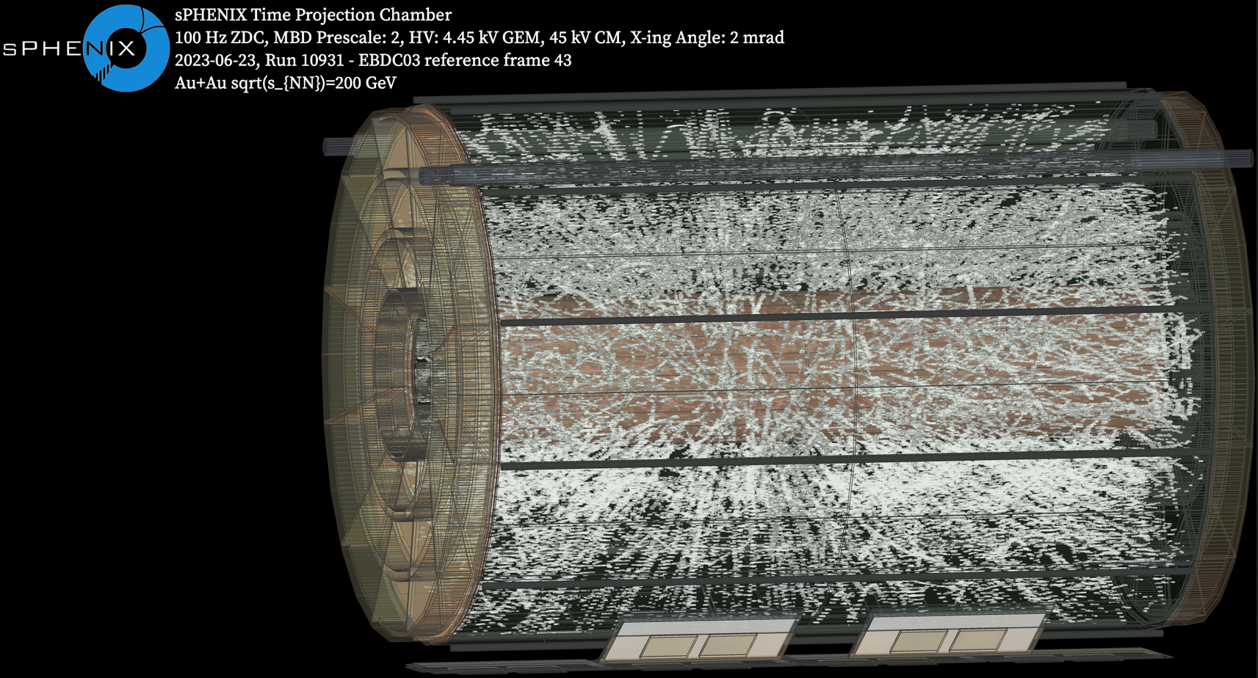
Outlook & Summary
sPHENIX TPC has a versatile and robust readout system
Leverages latest versions of well-tested hardware (SAMPA v5 & FELIX card)
TPC readout was run in hybrid trigger + streaming mode in Run ‘24 for p+p physics
30 % streaming exceeding BUP 2022 goal
TPC also run in 100 % streaming standalone
Useful for heavily ionizing events in TPC
Run ‘25: long AuAu run in triggered mode
Lower collision rate - all physics triggerable
Challenge is the higher data volume/collision
Charles Hughes - Streaming Readout Workshop - University of Tokyo - December 2 2024

Slide 17
Outlook & Summary continued
Important to prepare a quiet (noise free) system to the extent possible for streaming
Important to monitor the data streaming off the detector
Charles Hughes - Streaming Readout Workshop - University of Tokyo - December 2 2024

Slide 18
Backup
Charles Hughes - Streaming Readout Workshop - University of Tokyo - December 2 2024

Slide 20
Streaming operation

Slide 21
