Slide 1
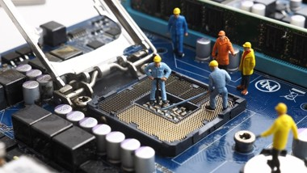
Experimental Nuclear Physics Division
Streaming Readout @Jefferson Lab
Fast Electronics & Data Acquisition Group

Slide 2
Overview
    Progressive evolution has made the transition to SRO a reality!
      DAQ readout hardware was designed for 12GeV experiments
        Very high trigger rate requirement of 200kHz
        Selection of FPGA in 2012 was state of the art [Virtex V/VII]
          Gigabit transceiver capabilities sufficient to move data off front end FPGA in real-time via backplane and with fiber optics to servers
    2. Present status of SRO
      Hardware and experimental application examples
      Progress to use CODA software on front end processor electronics
        Flash ADC 250Msps and Drift Chamber ReadOut modules
          Used successfully with experiment during beam operations
    3. Future applications and experiment plans for SRO
      CLAS12 – Many detector subsystems for 12GeV high luminosity program
        VMM3 for uMegas upgrade and new uRWell MPGD
      SoLID experiment program proposes SRO DAQ
        ECAL channels will use VXS flash ADC boards
    Summary
    Important Links:
      Detector Working Groups have started a spreadsheet for detector details such as cabling, channel counts, Electronic board counts etc. Please see:
        Project Information - Electron-Proton/Ion Collider Experiment (bnl.gov)

Slide 3
CLAS12 SRO Beam Test
  TEST DEMONSTRATES FULL DATA-STREAMING CAPABILITY OF CLAS12 FORWARD DETECTOR
  On Thursday, May 16, a successful beam-test of a streaming readout system comprised of 24 data streams covering one-third of the CLAS12 Forward Detector was conducted.
  The data were streamed from a real physics experiment that was running at various beam currents on the dual LD2-Pb target in Hall B as part of Run Group E. The data streamed directly from the front-end crates to the Data Center in CEBAF Center.
  This is a significant advance beyond earlier tests that were limited in scope and not performed under realistic conditions. The test demonstrated that full streaming is possible for the CLAS12 Detector Subsystems.
    Important Links:
      Detector Working Groups have started a spreadsheet for detector details such as cabling, channel counts, Electronic board counts etc. Please see:
        Project Information - Electron-Proton/Ion Collider Experiment (bnl.gov)

Slide 4
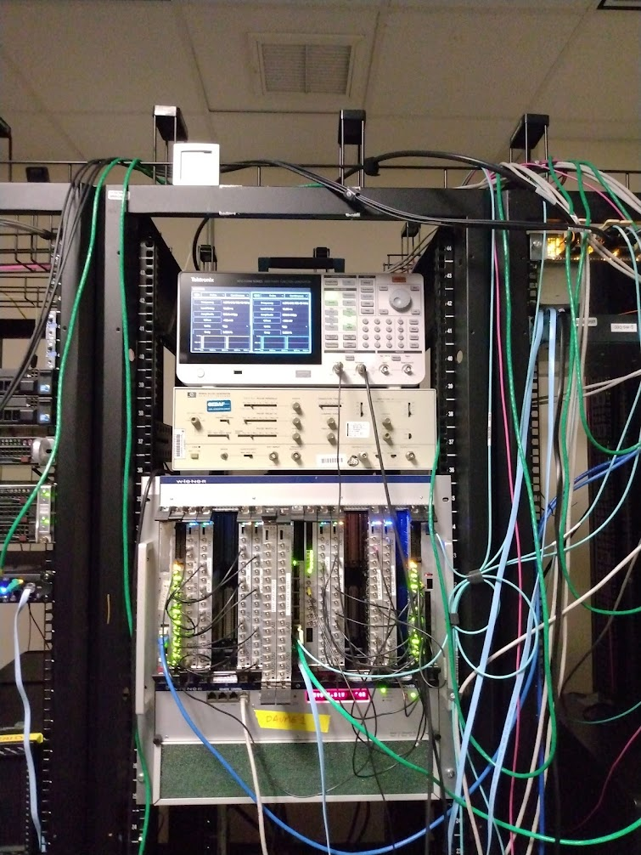
SRO Readout/Control Development <-->Network
FEDAQ Group
INDRA FADC Streaming Setup
We continue to benefit from our initial investment in SRO and the development lab allows testing of new software for network data transfer testing.
Significant success last year to achieve CODA EVIO compliant data format for SRO.
High performance testing and debug of new code for our front end DAQ modules, servers and network equipment are key examples of how this investment has enabled the successful implementation of new SRO DAQ techniques.
8x FADCs, 4x 10Gbps Ethernet links from VTP, 10G/100G switch to indra-s1 server (on 100Gbps)

Slide 5
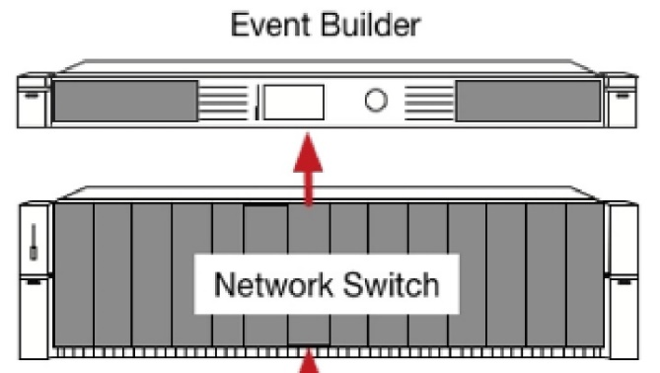
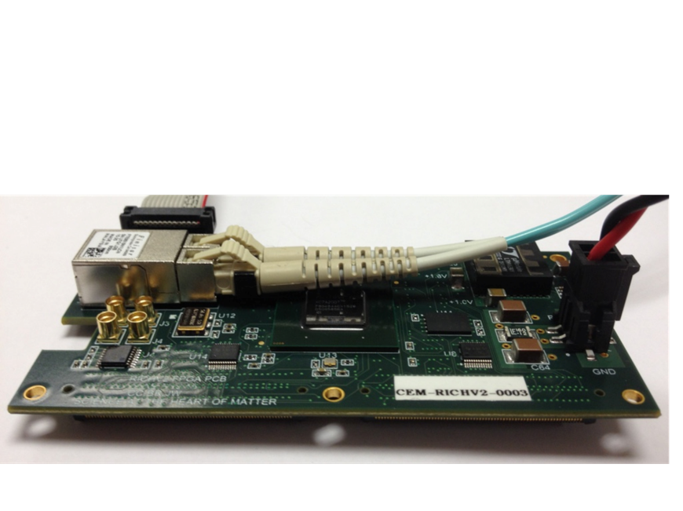
Progress Since 2023 SRO Workshop
FPGA ReadOut & Control[ROC]
Develop interfaces with ASIC:
MAROC3 ASIC for CLAS12 RICH and GlueX DIRC detectors
Petiroc 2A -> 32 Channel SiPM with Q and T conversion {10 bit ADC; 18ps timing[ALERT TOF Experiment]
Petiroc 2A used for PET imaging project
For CLAS12 RICH and GlueX DIRC there several hundred of these Readout Boards installed, equivalent to tens of thousands of pixels.
Not used in ‘Streaming’ mode, however, plans exist to implement these detector sub-systems with SRO methods for the high luminosity experiment program.
JLAB FPGA Readout/Control Board
Easily interfaces to ASICs
Custom Real-Time Algorithms Features; Examples
  1ns TDC
  Scalers for each channel
Fixed Latency up to 8us
Optical Ethernet – Use Commercial 1Gbe
  Finisar Transceiver capable of 10Gbps
  Artix could run @3.125Gpbs
Mates to ASIC
+5VDC @1A

Slide 6
Streaming Status – CODA updates
David Abbott
Ben Raydo
EVIO Data Frame and File formats for streaming data – Defined.
New CODA software component (Stream Aggregator) functional.
  Still working on ”congestion control” at the aggregator for high data rates. We must drop frames in a well-defined and controlled way.
CLAS Drift Chamber Readout Boards are now supported in hardware for streaming readout via the VTP along with FADC250 modules.
Next steps are to update FADC250 firmware to support streaming region of interest samples (around a threshold crossing) as well as integrated sums.

Slide 7
Future SRO Projects @JLAB
FEDAQ Group
  We have a precision clock/synch distribution system at JLAB which is critical for the flexibility of the CODA Hybrid DAQ
  Our VXS platform works extremely well with high reliability for the four experimental Halls.
  We have used many ASIC Front-End Readout boards over the years that use our FPGA Readout board to manage deterministic data streams
  These Readout boards interface to many different detector types:
    RICH => MaPMT=>MAROC3
    MPGD => GEM/uMegas/uRWell=>VMM/SALSA [future]
    ALERT TOF=>PMT/SiPM=>PetiRoc [Weeroc]
    PET=>MaPMT=>PetiRoC [Weeroc]
  Of course we use many thousands of 250Msps ADC channels to interface to PMT and other readout devices where the converted data can be streamed efficiently.
    Important Links:
      Detector Working Groups have started a spreadsheet for detector details such as cabling, channel counts, Electronic board counts etc. Please see:
        Project Information - Electron-Proton/Ion Collider Experiment (bnl.gov)

Slide 8
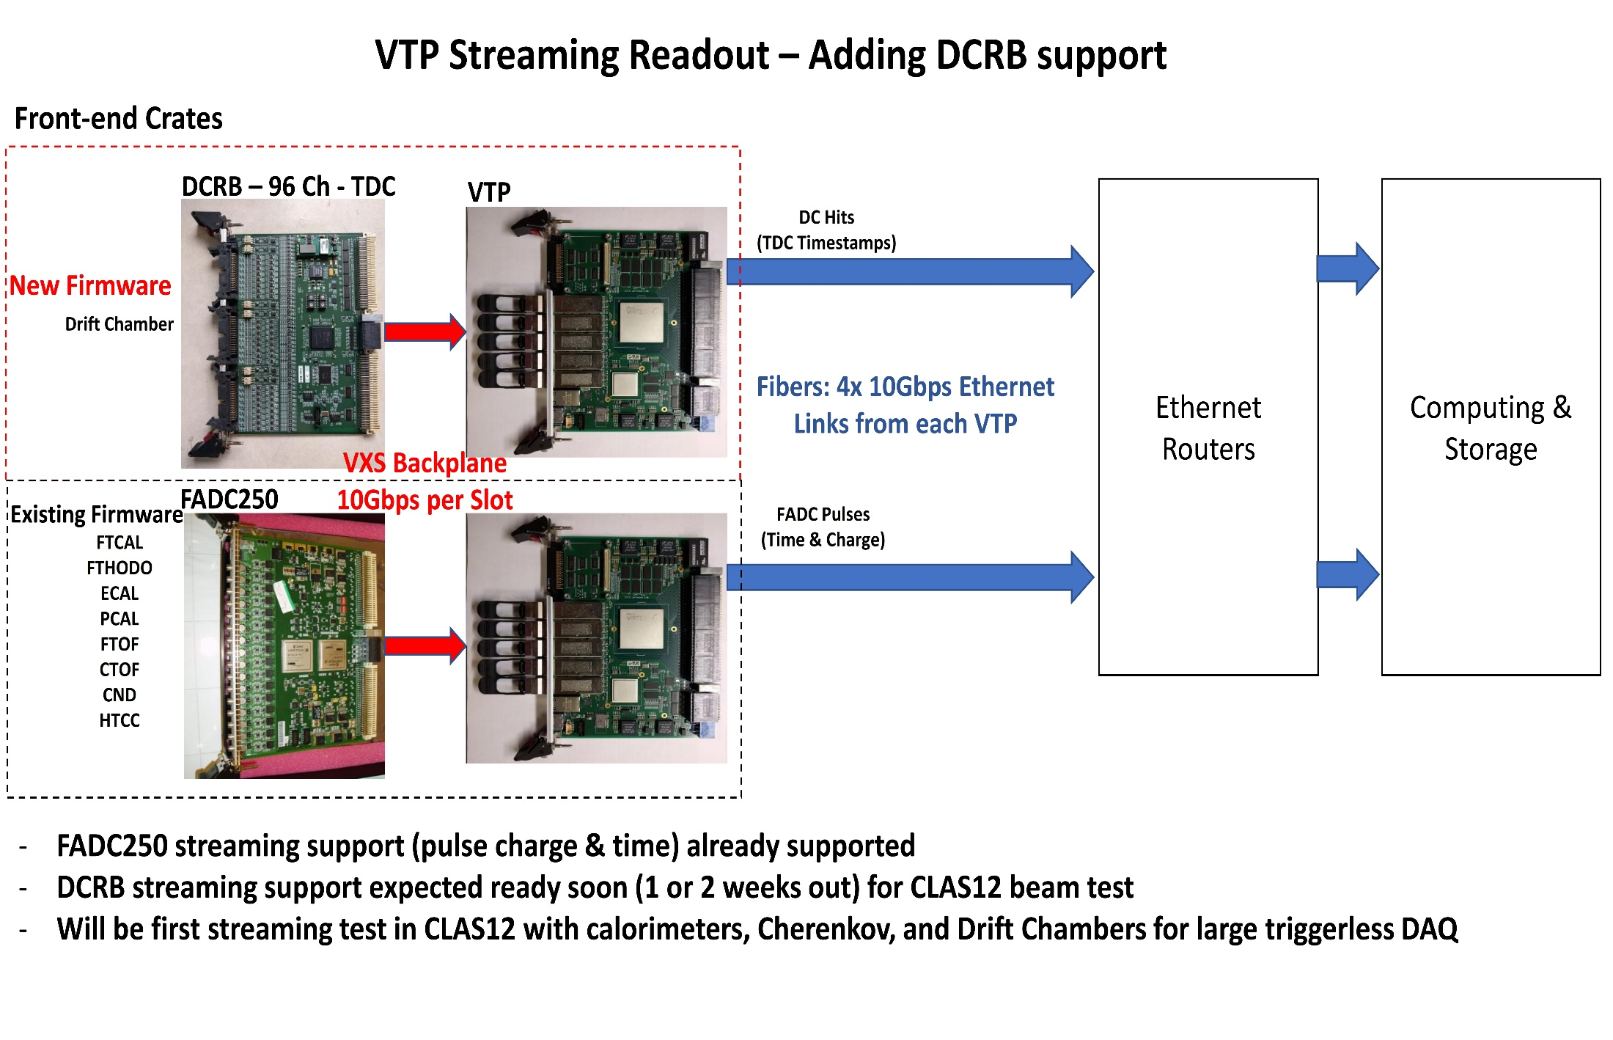
VXS Trigger Processor – Streaming ReadOut
Adding 96 Channel Drift Chamber Readout Board TDC
Ben Raydo
David Abbott
FEDAQ

Slide 9
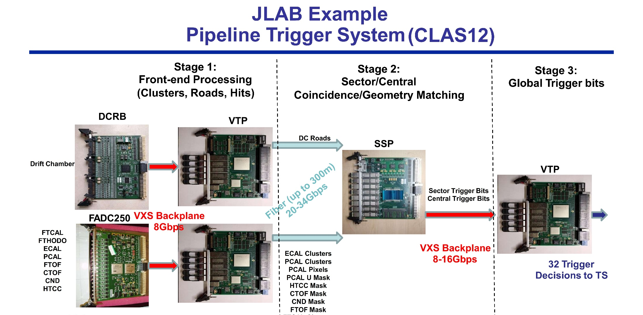
FEDAQ Group
Ben Raydo
David Abbott
FEDAQ Group

Slide 10
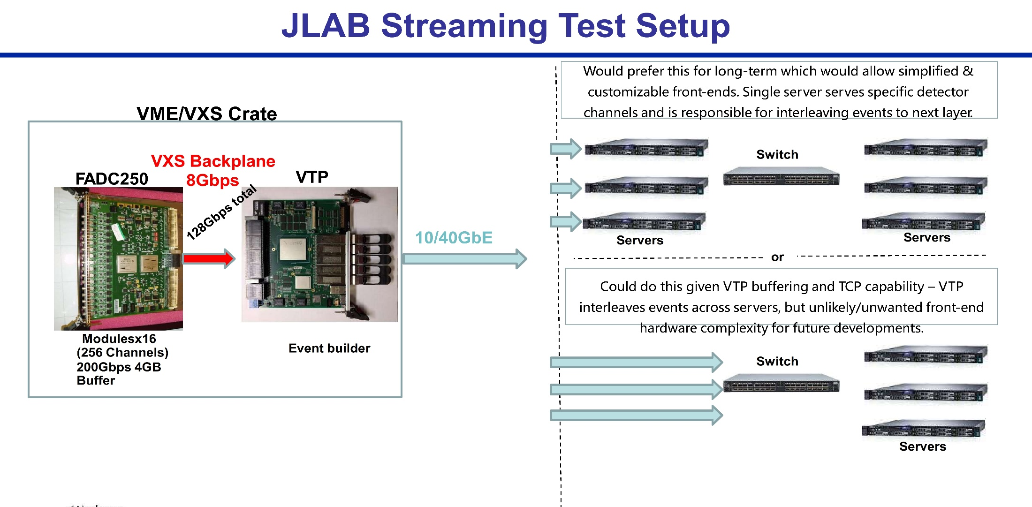
Ben Raydo
David Abbott
J. Gu
Use other JLAB VXS Boards to Stream:
96 Channel Drift Chamber Readout board
Enormous tracking detector system
24,192 wires
Successful SRO in May 2024
Replace CAEN TDC modules for ECAL
Implement the SRO mode for the VETROC
in summer 2025
96 Channel VETROC TDC Readout board
Forward ToF detector system
90 plastic scintillator panels/sector
Double sided PMT readout
Production modules on site

Slide 11
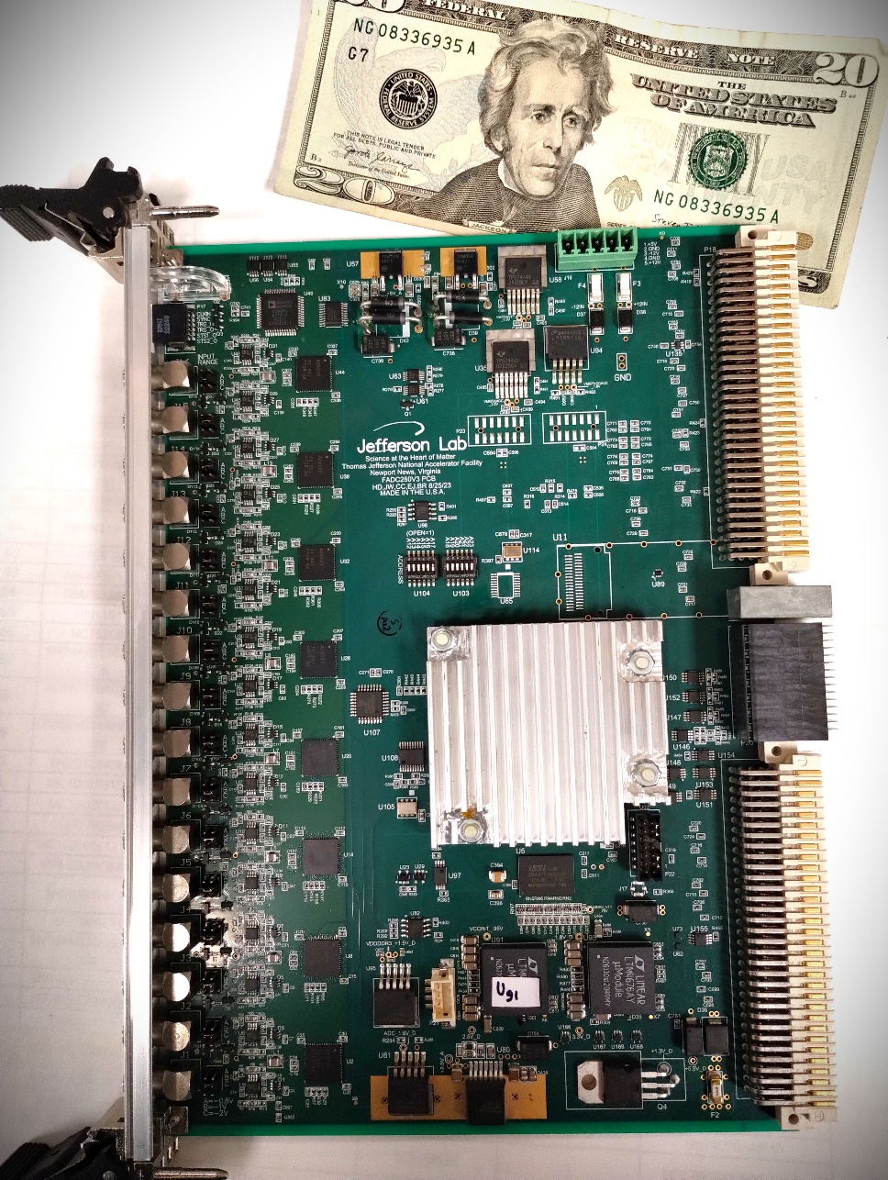
FADC250-v3 Board Modernization
FEDAQ
H. Dong
E. Jastrzembski
J. Wilson
Ben Raydo
Re-Use Front panels
FADC250_V3
Two prototypes pass acceptance testing
Testing was successful and a few minor changes have been updated on the circuit board.
Production fabrication data has been sent to contract assembly company.
- Long lead items purchased
- Expect delivery to begin in April
- 86 assemblies are ordered
- ~200 more are requested
- Capital equipment funds restored
Optical Port – NOT populated
Used in Stand-Alone mode only
Xilinx Kintex Ultrascale FPGA
Single FPGA solution!
Significantly lower power than previous version

Slide 12
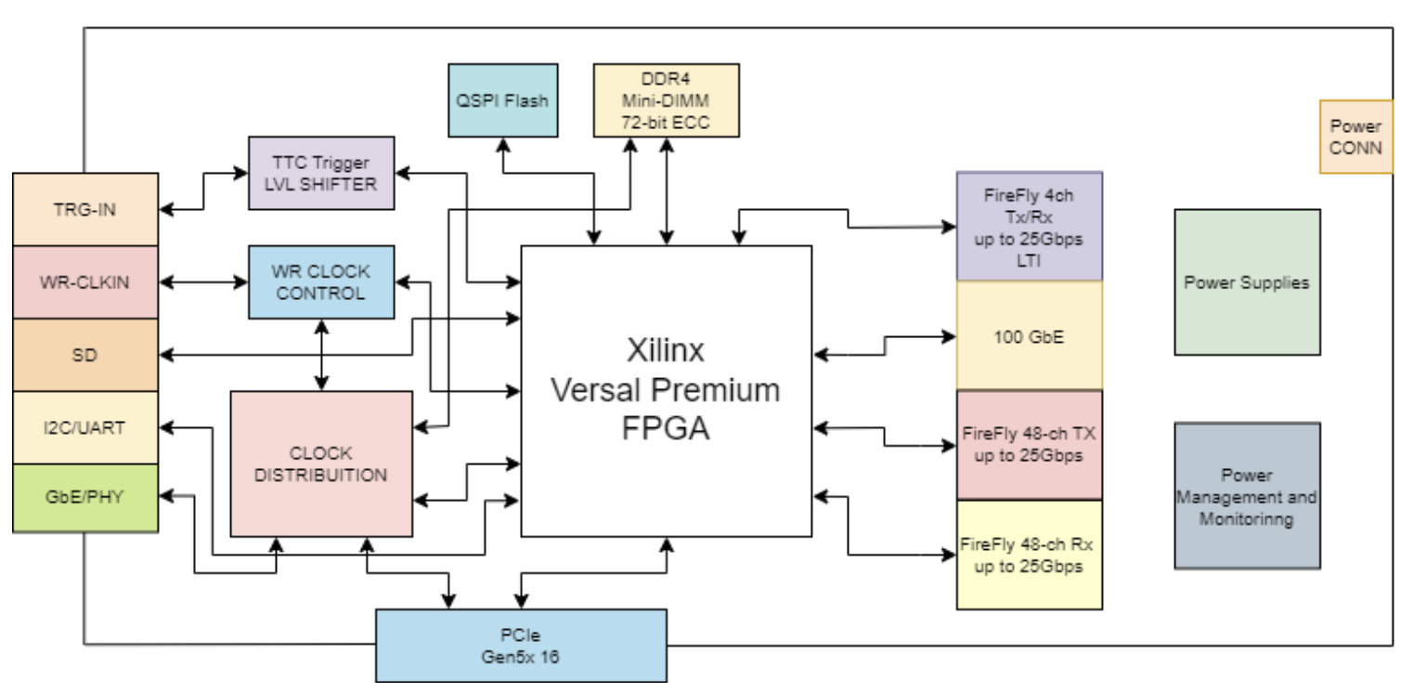
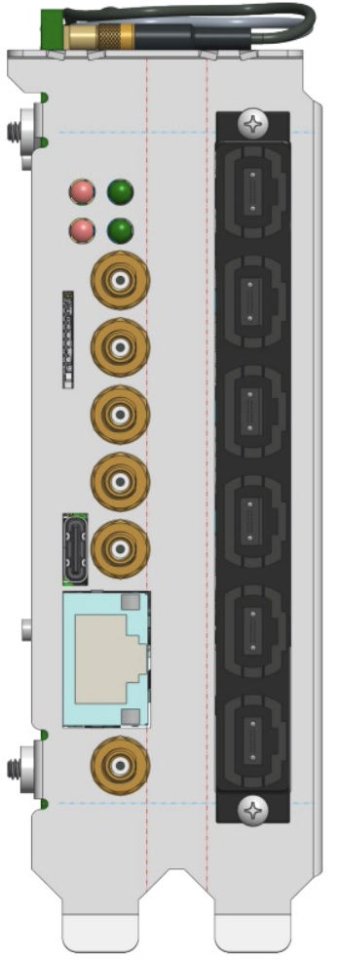
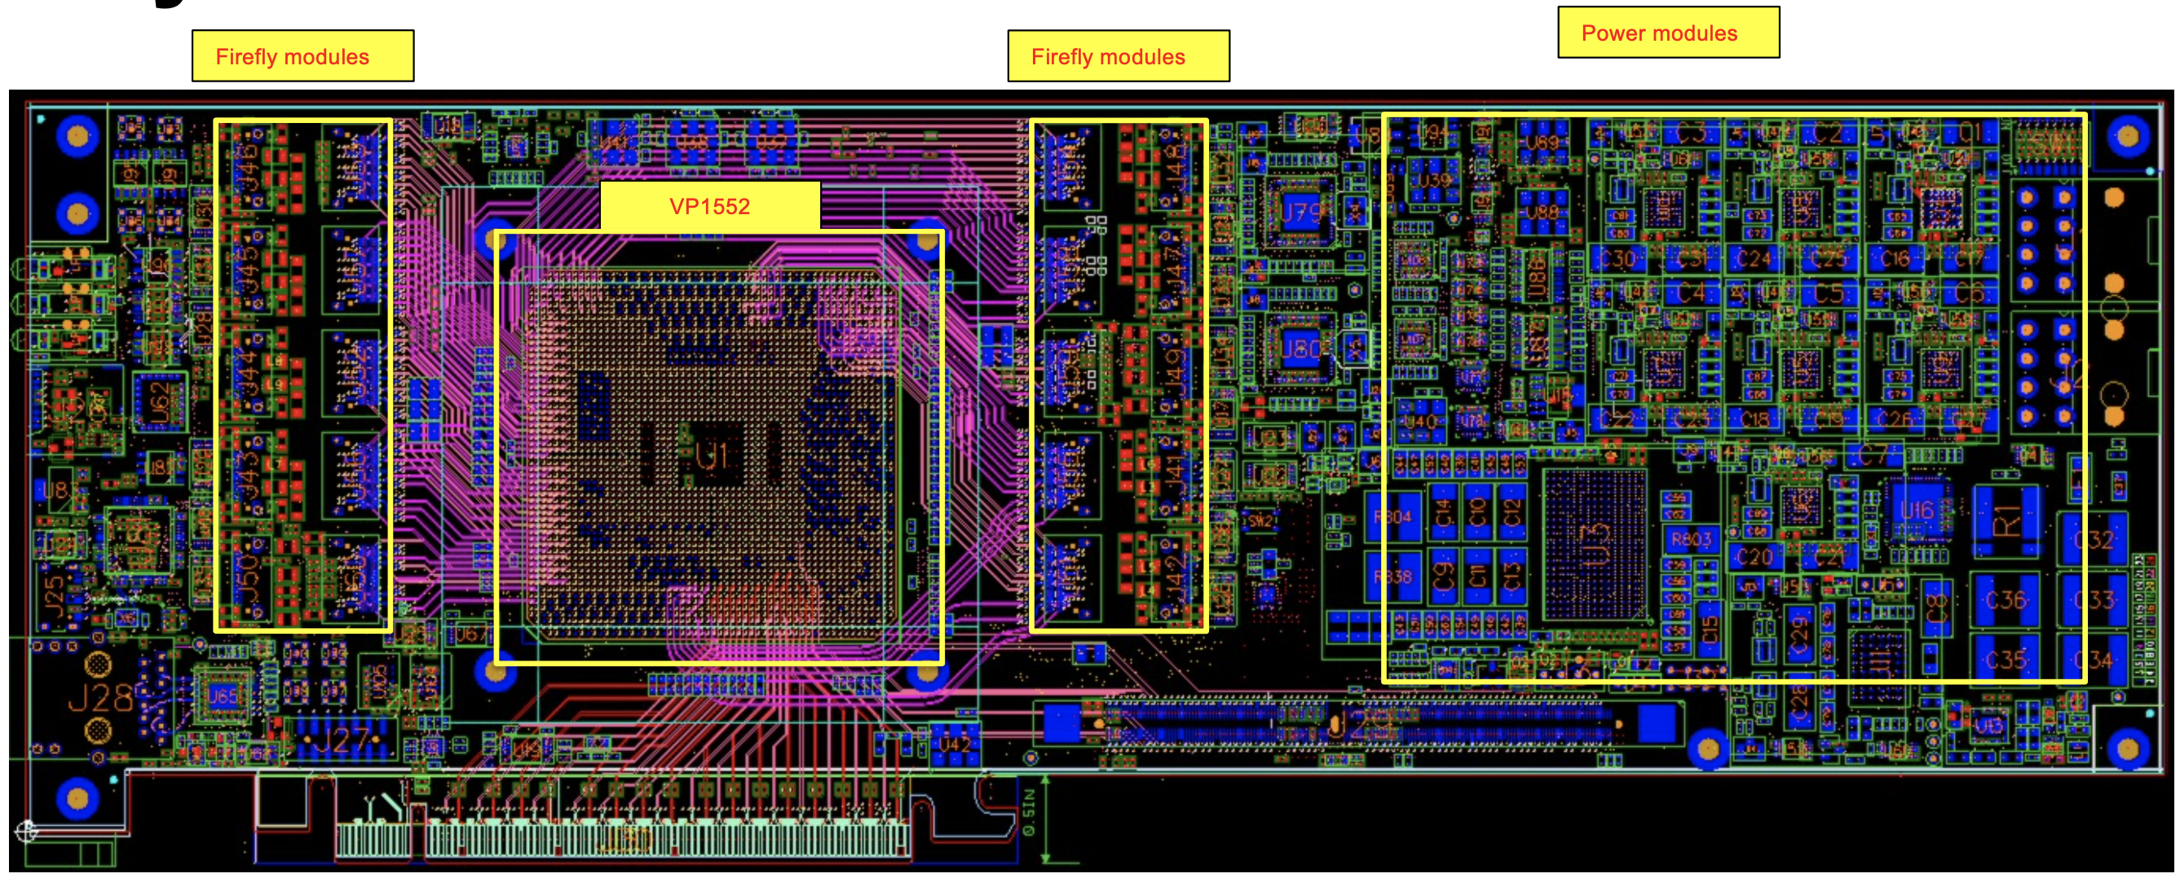
Streaming Support – Longer Term
David Abbott
Ben Raydo
Replace crate-based VTP with a more general FPGA board.
  Discussions to use Bittware FPGA Accelerator boards for HVMAPS readout for MOLLER
  Commercial product that would need to be interfaced to the MAPS detector components
J. William Gu and David Abbott have been testing the FELIX (version 182)
  CODA ported to device
  Global Timing Unit design effort underway
  Discussions for implementing a detector subsystem with one of the FELIX DAM boards
    CLAS12 uRWell with VMM ASIC Readout?
    Other subsystems?
Proprietary fiber link
(Embedded clock)
VXS/VTP
FELIX?
FEE
ROC
SoC
FEE
ethernet
Server
FEE
FPGA
PCIe
Server
FEE
Front End Link Exchange -> FELIX

Slide 13
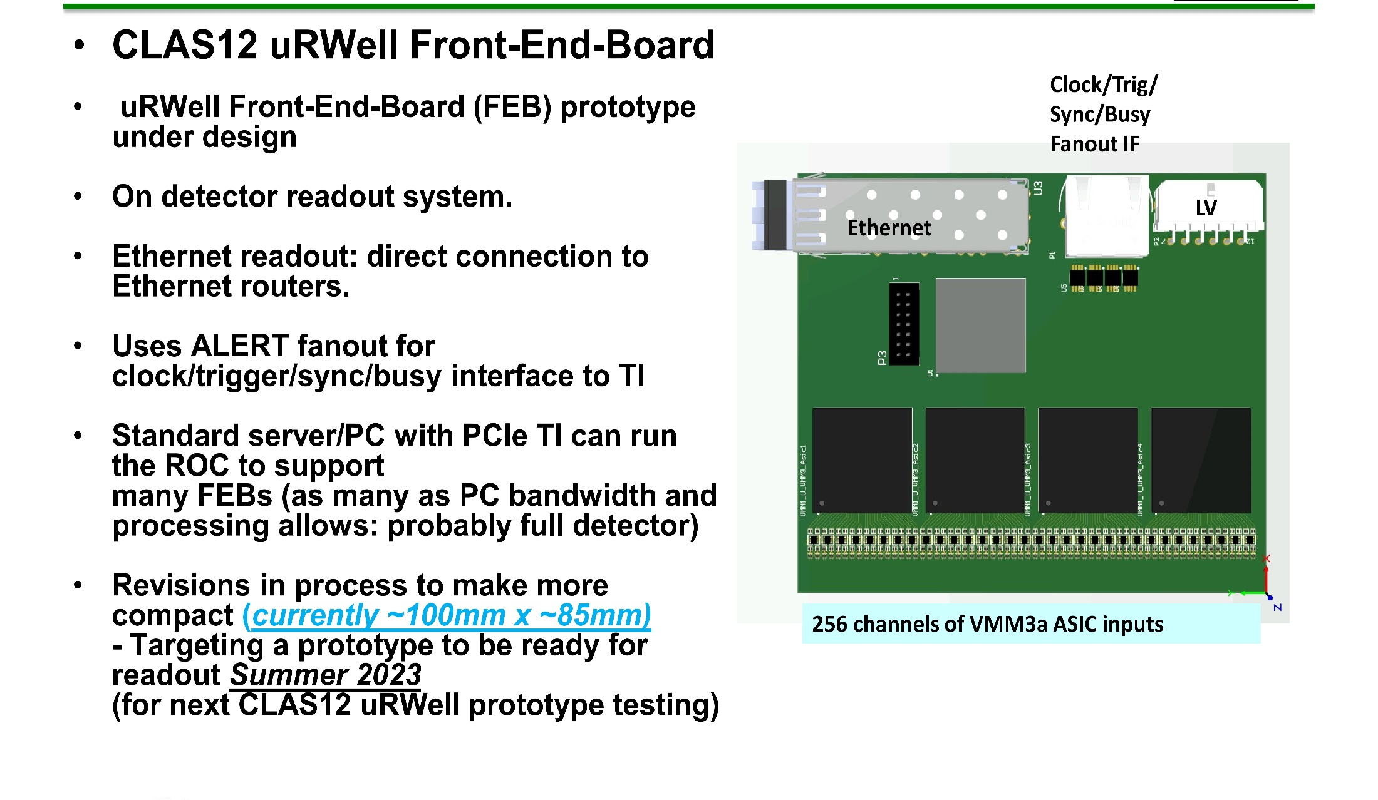
FEDAQ Group
Near Future SRO - CLAS12 uRWell Read-Out
Xilinx
Virtex7
FPGA
VMM
ASiC
VMM
ASiC
VMM
ASiC
VMM
ASiC
VMM ASIC testing has not gone smoothly
Test board with ASIC BGA socket was broken.
Delay to obtain new socket but solution is on the way.

Slide 14
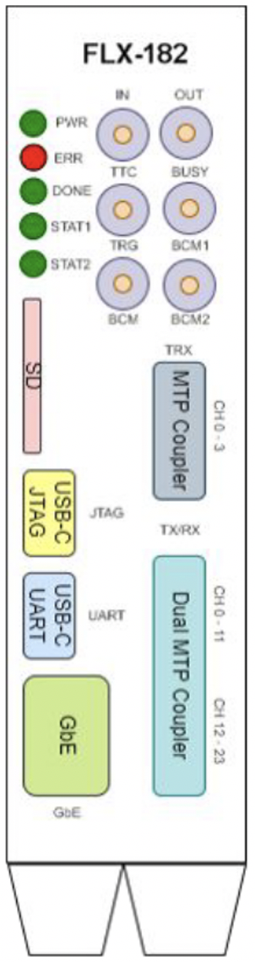
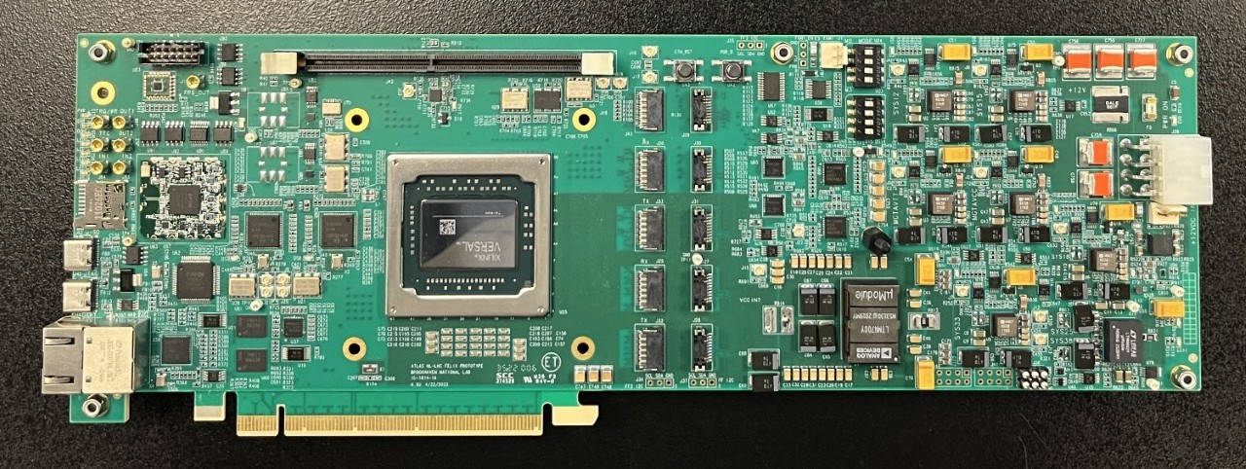
Future SRO - Applications
FEDAQ Group
FELIX 182
~10 boards were produced in early 2023.
JLAB FEDAQ Group has purchased 2 and they are on site now.
CODA ReadOut Control [ROC] ported to the board
  Linux OS
No JLAB detector system has used the FELIX 182 DAM board but the uRWell detector with VMM ASIC is proposed.
General technical support for the FELIX Hardware should be available through the end of HL-LHC operation. (i.e. into the late 2030s for Run 5)

Slide 15
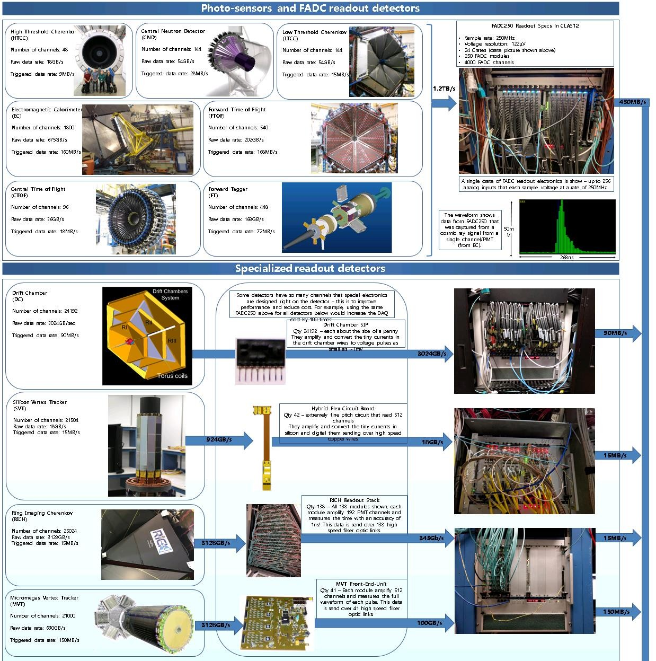
Possible Use Case?
This is the full CLAS12 DAQ System
Many crates already equipped with VTP
modules and could support the streaming readout concept.
Rough estimates would put the streaming data
rate in the ~50GByte/s range.
Only 1 detector would not be compatible – the Micromegas tracker (which uses the DREAM ASIC) Plans to implement SALSA ASIC soon.
•
•
•
SRO Test with beam in May included
24 VXS crates for the Forward Carriage ECAL subsystem
Drift Chamber Readout modules also included in the beam test though not the complete system because of network fiber connection limitations.
Page 11

Slide 16

Summary
  Work activities for existing 12GeV experiment programs have been significant this year. Streaming Readout application progress with our 12GeV front end electronics continues though and the initial beam test was successful.
  CODA DAQ software development effort for Streaming applications is also progressing nicely with new applications considered using new hardware and commercial alternatives.
  We have many options for Streaming implementation with VXS hardware, Front-End ASIC readout boards, smart switches and will continue plans with the FELIX 182 board with CODA [Linux ‘ROC’]
  There will be several presentations that overlap my information at this workshop and I want to express my gratitude to the group for their collective focus on exciting SRO applications at JLAB and ePIC/EIC projects.
  What are your questions?

Slide 17
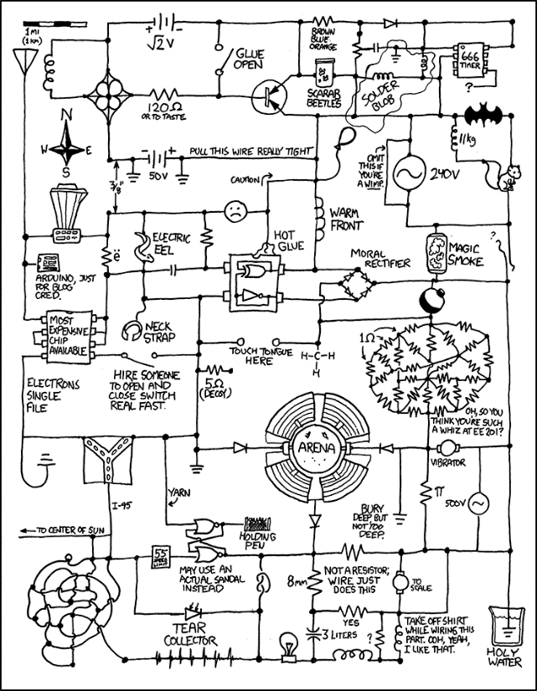
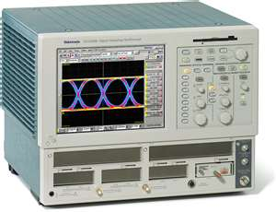
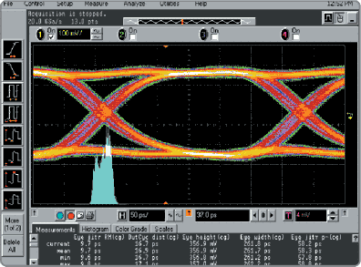
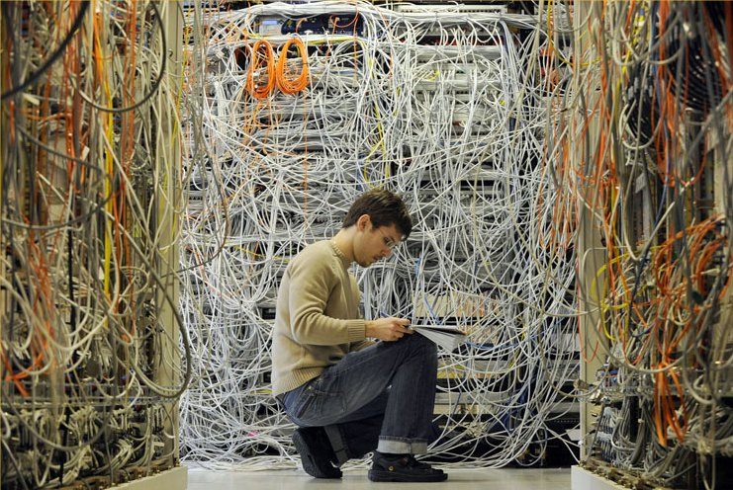
Backup slides
They said we were going “wireless”,,,
The Eye

Slide 18
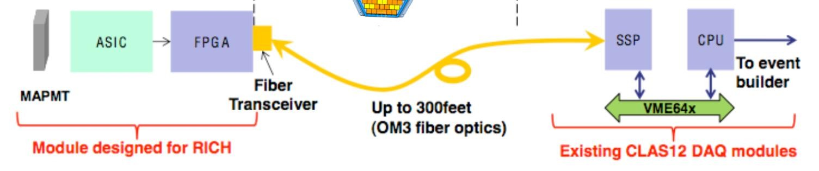



More Examples of VXS Readout/Control of ASIC
C. Dickover
B. Raydo
CEA Saclay** INFN*
2.5Gbps line rate 16bit bus @ 125MHz for transmit and receive
RICH 25,000 pixels
2.5Gbps line rate 16bit bus @ 125MHz for transmit and receive
SBS GEM
+40K pads
APV25
FPGA MPD*
2.5Gbps line rate 16bit bus @ 125MHz for transmit and receive
DREAM
FPGA FEC**
MicroMegas
+20K strips
Forward Tracker
+3300 uMegas Strips
VME64x Readout Bandwidth [~200MBs]
OK Because Detector occupancy Is low (~1%)
Thomas Jefferson National Accelerator Facility

Slide 19
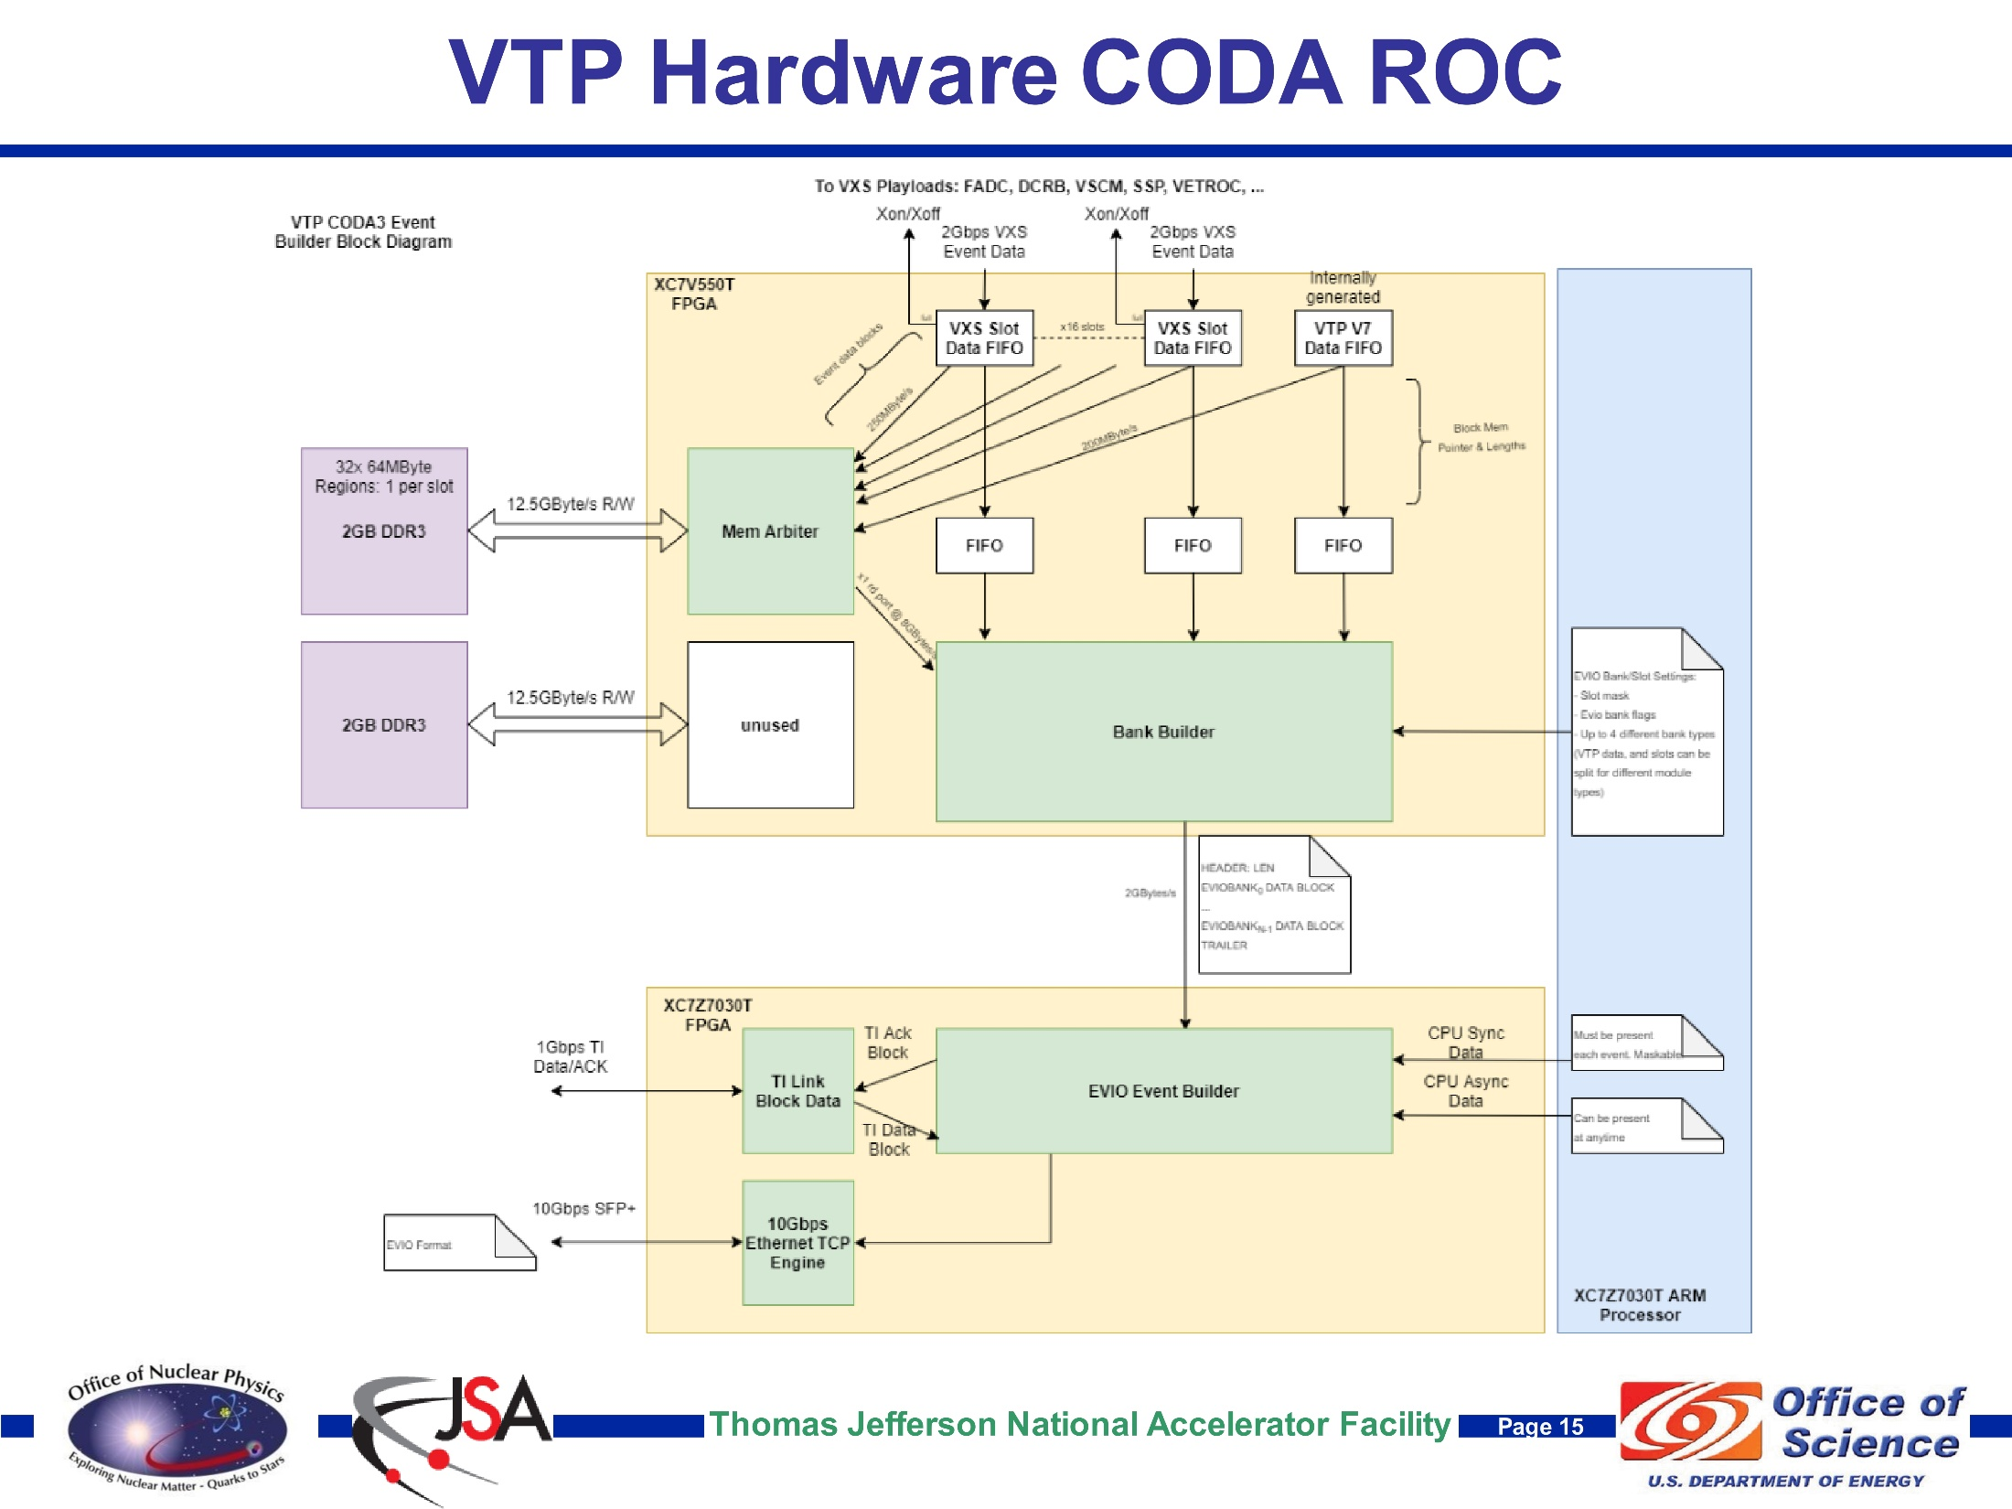
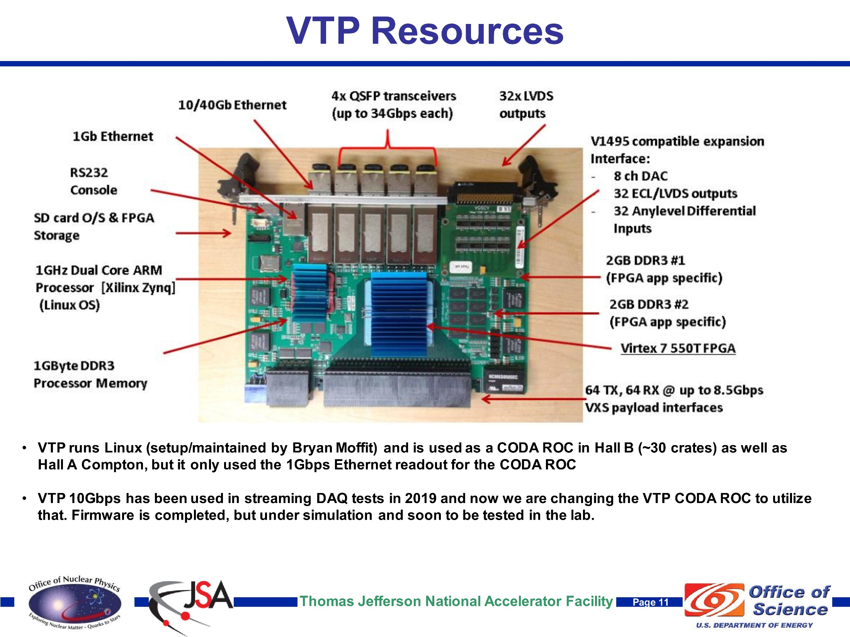
This Design will carry JLAB DAQ for another decade!!
Amazing Electronic Device!
Thomas Jefferson National Accelerator Facility

Slide 20

Streaming Without ‘Crates’
Readout/Control of ASIC <-->Network
FEDAQ Group
FPGA ReadOut & Control[ROC]
Develop interfaces with new ASIC:
Used MAROC3 for CLAS12 RICH and GlueX DIRC detectors
Petiroc 2A -> 32 Channel SiPM with Q and T conversion {10 bit ADC; 18ps timing[Prototype in development]
Xilinx Artix7
Fiber Optic
Arista Network Switch
Uses Xilinx FPGA
Innovation in Nuclear Data Readout and Analysis
INDRA Test Lab in CEBAF Center
Readout R&D lab for future 12GeV experiments
  - TDIS
  - SoLID
  - Moeller
Development of new Software for managing streaming data storage
Developing Software Framework for processing tasks. i.e.) Calibration, monitoring, reconstruction.
Use new COTS {Aritsta} network gear that includes high level FPGA for control of data stream
Development of High Level Synthesis code for creating ‘virtual triggers’ from streaming data
JLAB FPGA Readout/Control Board
Easily interfaces to ASICs
Custom Real-Time Algorithms Features; Examples
  1ns TDC
  Scalers for each channel
Fixed Latency up to 8us
Optical Ethernet – Use Commercial 1Gbe
  Finisar Transceiver capable of 10Gbps
  Artix could run @3.125Gpbs
Mates to ASIC
+5VDC @1A

Slide 21
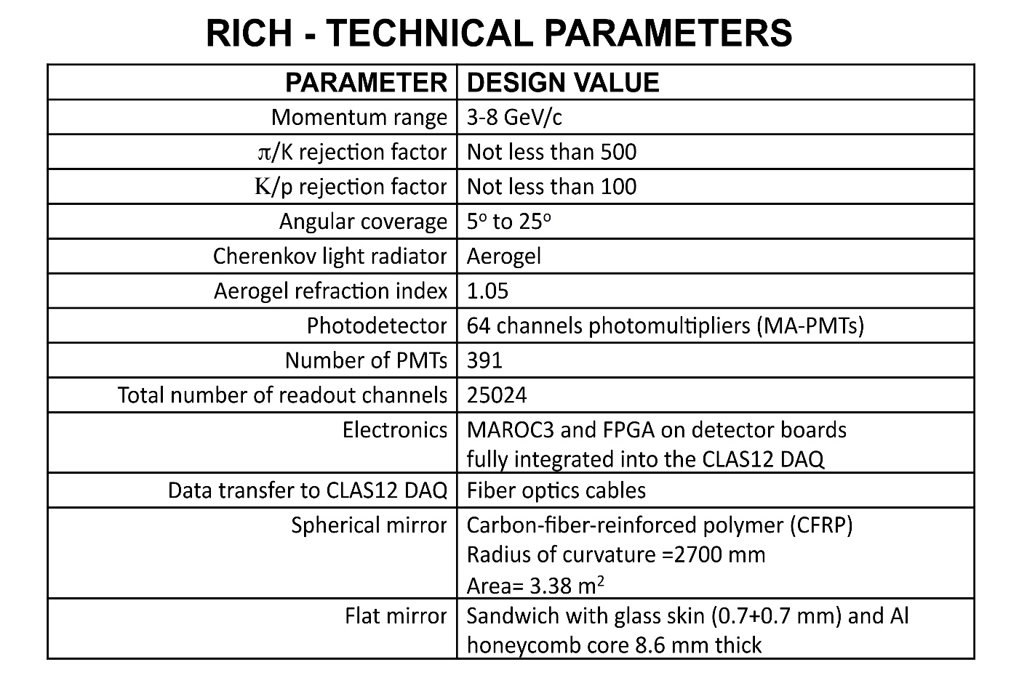
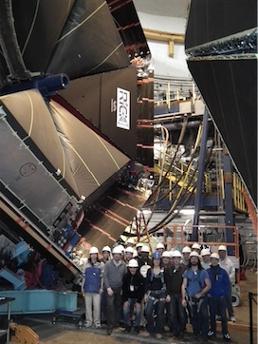










ePIC DAQ & Electronics Workshop
Brief 12GeV RICH detector example

Slide 22
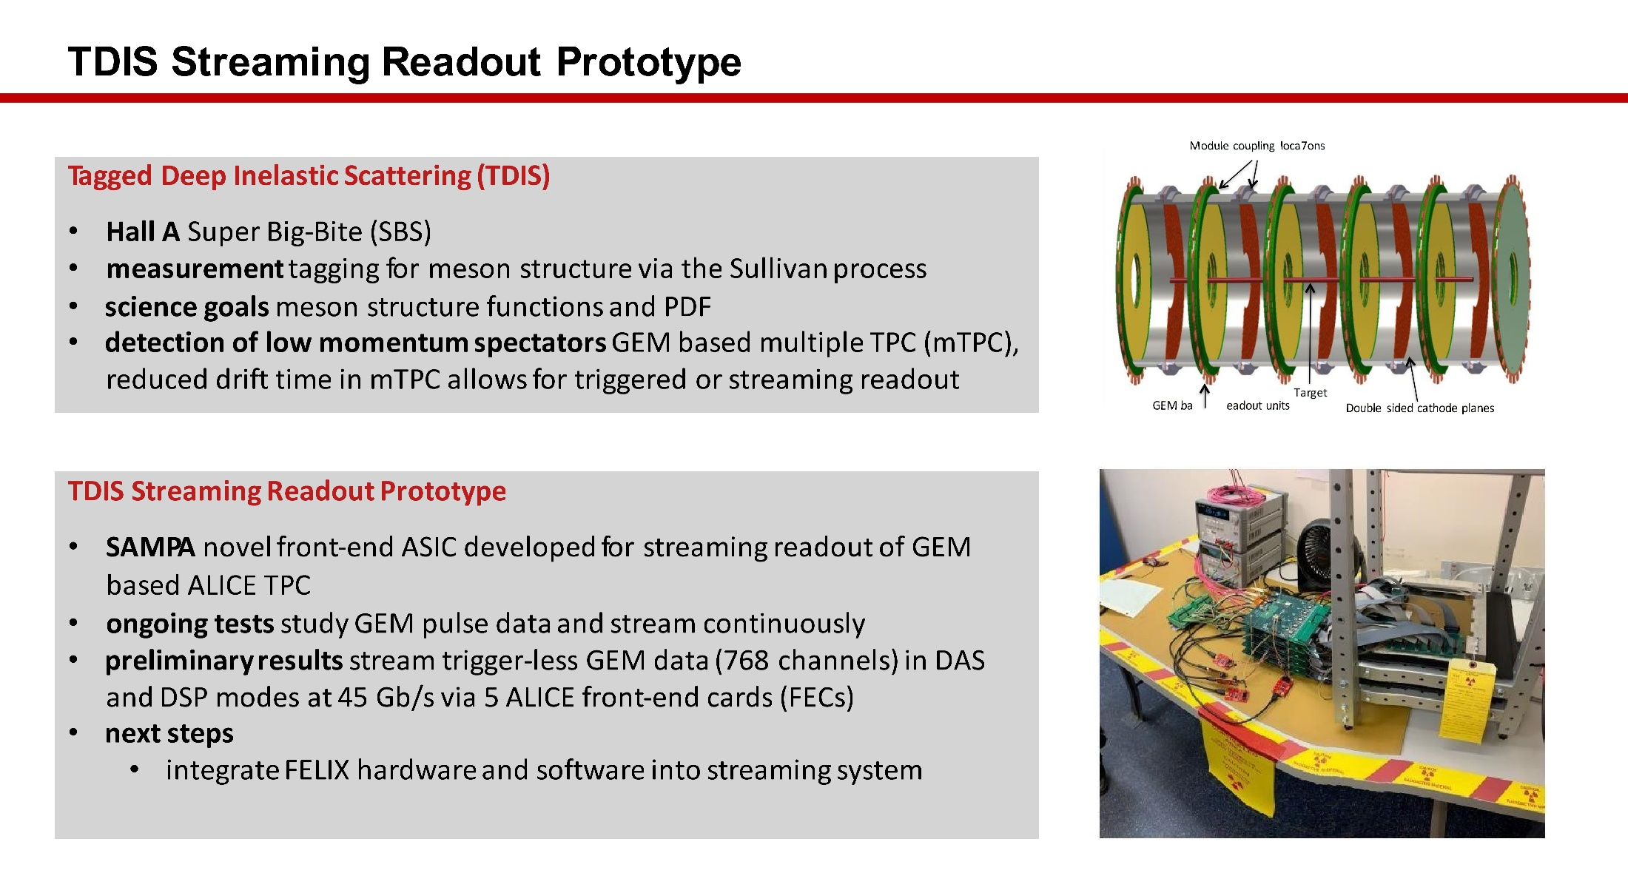
Streaming Without ‘Crates’
Readout/Control of ASIC <-->Network
FEDAQ Group

Slide 23
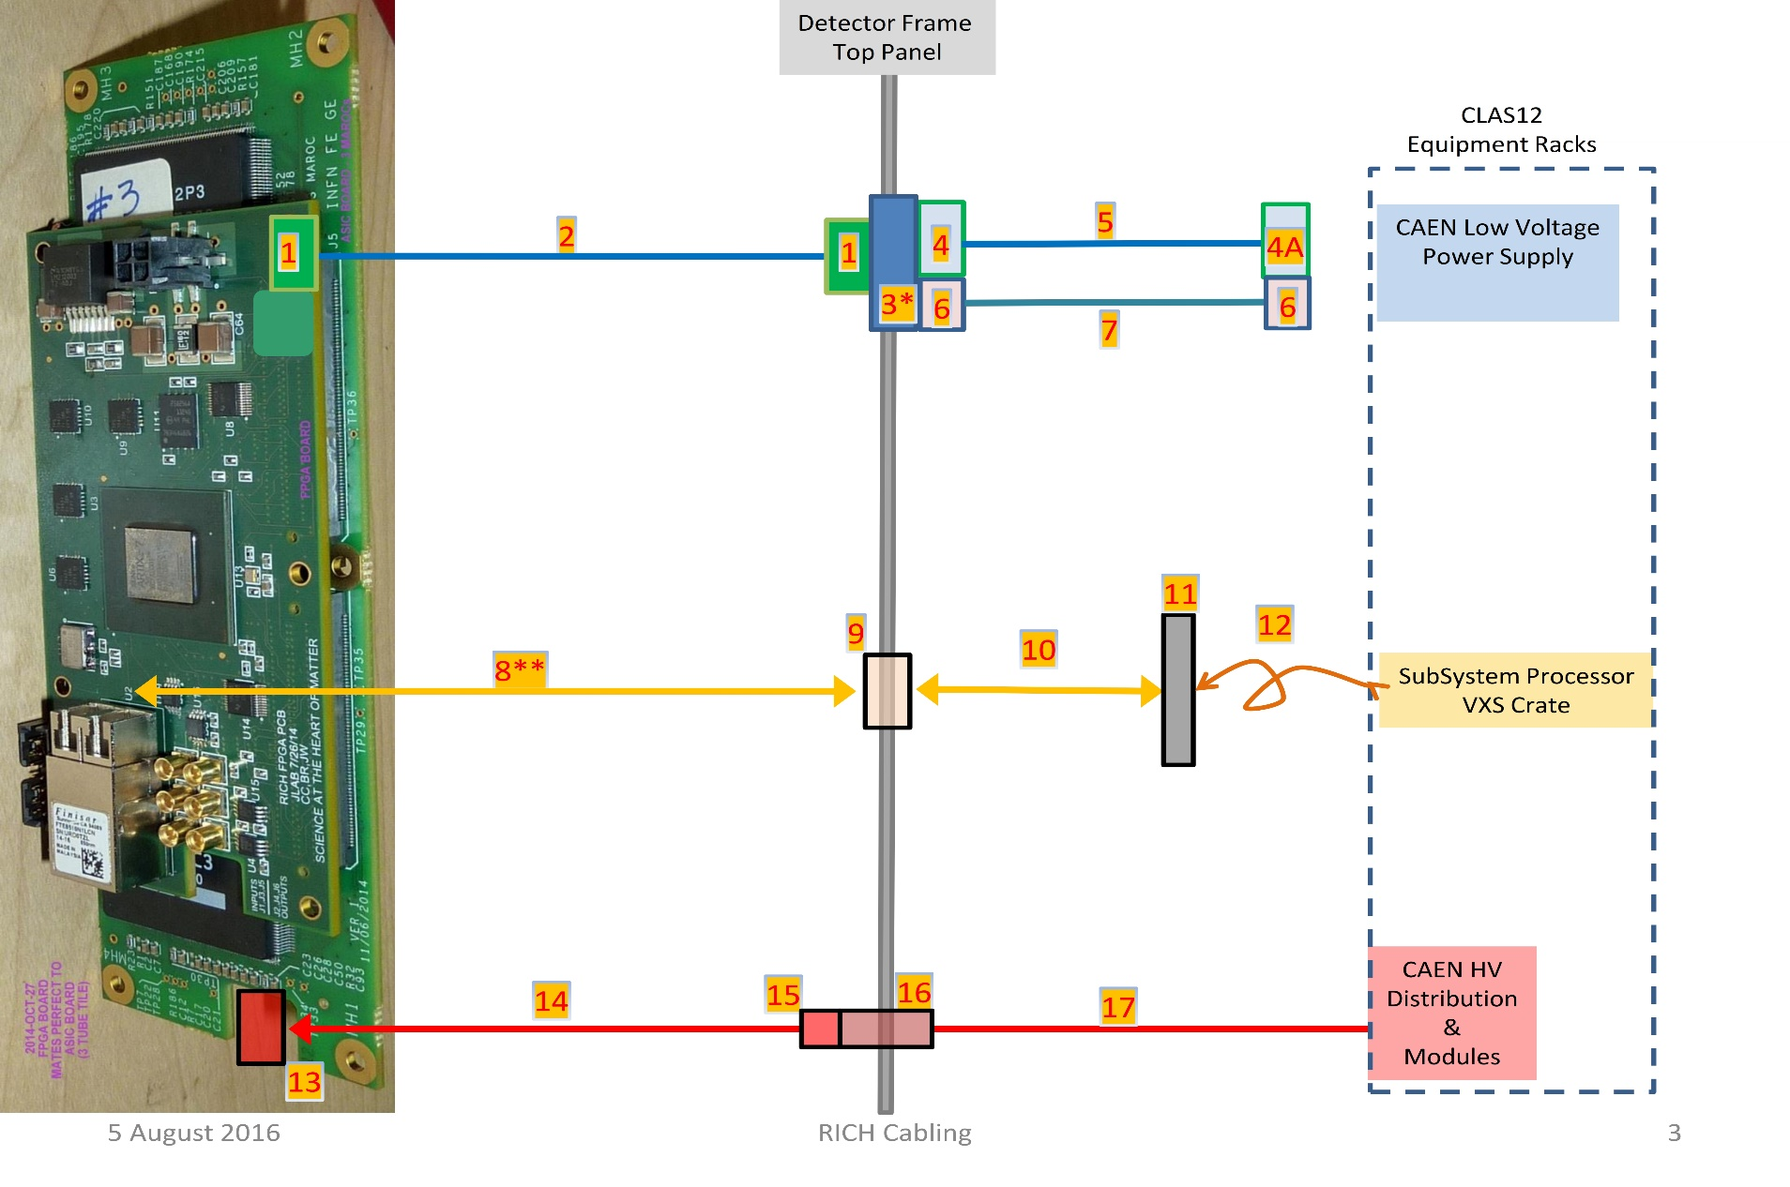
ePIC DAQ & Electronics Workshop
Brief 12GeV RICH detector example
64 Pixel
maPMT
64 Pixel
maPMT
64 Pixel
maPMT
192 “Channels”
MAROC3 +FPGA 1ns TDC

