Slide 1
ePIC DAQ Overview
ePIC Electronics and DAQ WG Conveners
Fernando Barbosa (JLab), Jin Huang (BNL), Jeff Landgraf (BNL)
WBS 6.10.08 Electronics
Fernado Barbosa (Jlab)
WBS 6.10.09 DAQ
David Abbott (Jlab), Jeff Landgraf (BNL)

Slide 2
Contents
EIC Collider/DAQ Environment
ePIC Detector Electronics and DAQ
Readout Technologies
Streaming Concept
Components and Architecture
Scale of DAQ system and data
Readout chain and protocols
Component Status
Schedule

Slide 3
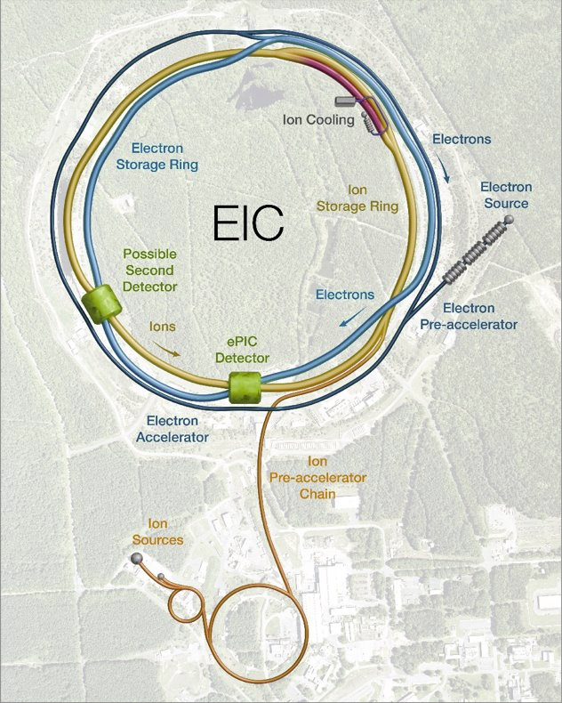
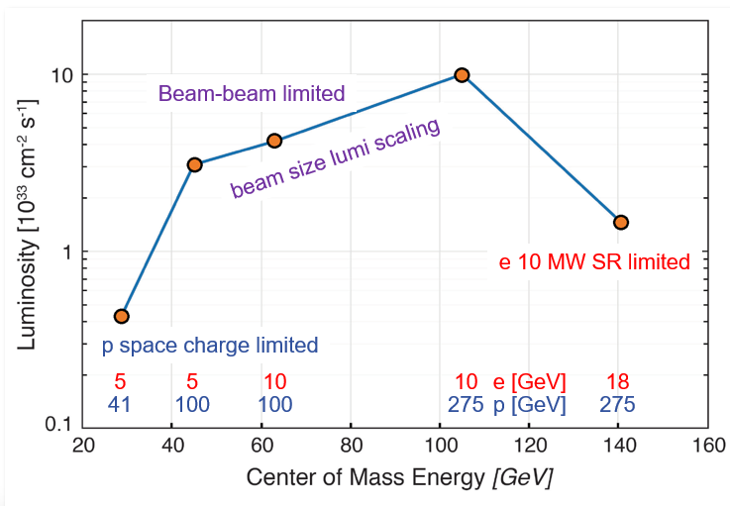
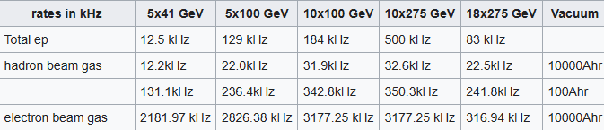
EIC Collider & DAQ Environment
Collider Parameters
Located at Brookhaven National Lab, NY
1260 Bunches arriving at 98.5Mhz (10.15ns bunch separation)
1.015us abort gaps (100 bunches)
$\sqrt{s }$ ⇒ 20 – 141 GeV
𝓛_{max} ⇒ 10³⁴ cm⁻² s⁻¹
Electron, proton, and light nuclei beams can be polarized
Each bunch can have different polarization states
DAQ must tag data to specific bunch crossings
Need to track luminosity for each bunch crossing
Physics Performance
Maximum DIS rate ~500kHz
Large number of Channels
Low occupancy

Slide 4
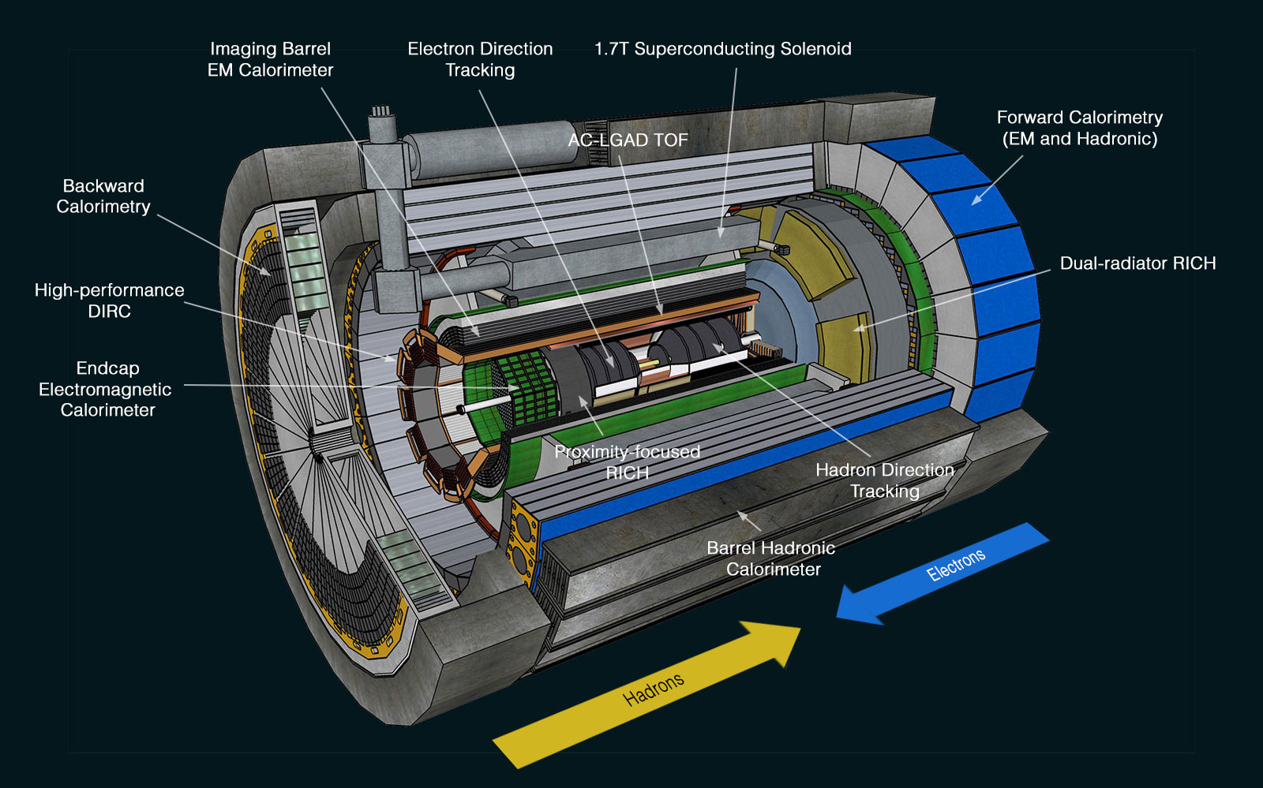
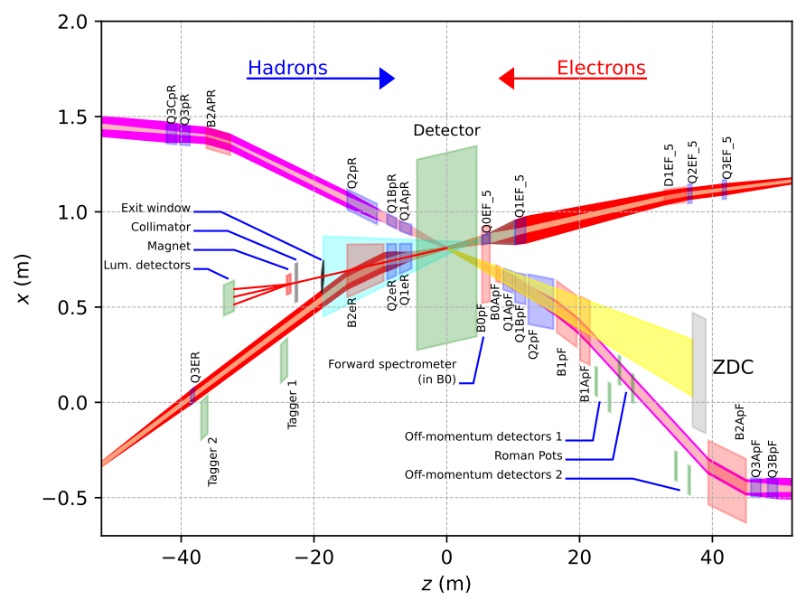
ePIC Detector Readout Technologies
~30 Detectors
Spread over +/- 40 meters
(13 bunch crossings @ c)
5 main digitization ASICs, as well as dedicated sensors and discrete readouts (See Fernando Barbosa’s Talk Tomorrow!)
Many technologies, but effort has been made to make use of possible synergy…

Slide 5
ePIC Detector Readout Technologies
13 Calorimeters:
7 x SiPM – CALOROC
5 x SiPM – Discrete
1 x SiPM – Commercial fADC250

Slide 6
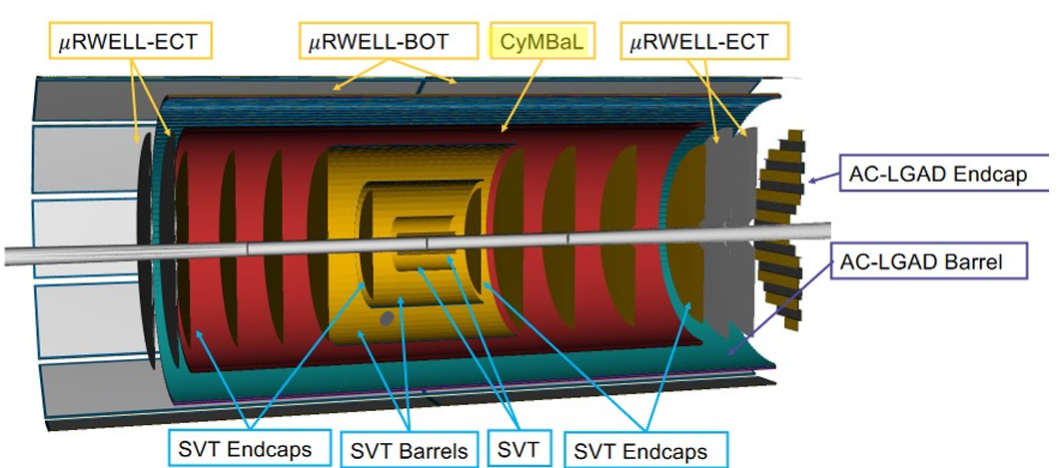
ePIC Detector Readout Technologies
Tracking:
4 x ITS3 – VTRX+ / lpGBT
3 x uRWELL – SALSA
1 x Micromegas – SALSA
AC-LGAD time of flight

Slide 7
ePIC Detector Readout Technologies
AC-LGADs:
6 x Pixels: EICROC
2 x Strips: FCFD / EICROCx

Slide 8
ePIC Detector Readout Technologies
3 RICH Detectors:
dRICH: SiPM – ALCOR
(needs single photon sensitivity)
pfRICH: HRPPD – FCFD / EICROCx
hpDIRC: MCPPMT – FCFD / EICROCx
(same FCFD / EICROCx as for
AC-LGAD strip detectors)

Slide 9
Streaming in ePIC
DAQ
Definition of streaming is “No L0 trigger”
All data is zero suppressed by the front end electronics
No system wide deadtime in normal operation
Collaboration should have the full ability to make data selection cuts on the widest possible criteria
Flexible event selection
Flexible data selection
Full background characterization
But subject to an overall throughput budget of ~100Gb/sec
ePIC Streaming will include
Capabilities for hardware and firmware based triggering
Capability for flow control
Zero suppression & aggregation within data packets
Greater sensitivity to noise than triggered system
Greater sensitivity to backgrounds than triggered system
Computing
Definition of streaming is “Process data as it arrives”
Fast Analysis (~3 weeks not months or years) using automation of calibration and reconstruction.
Requires some overlap between DAQ/computing
Automation of calibrations
Mapping calibration dependencies
Mapping application of calibrations
Mapping evolution of calibrations
QA and monitoring can make use of full offline structure
Consistent schemes and language for data/metadata
Event selection / tagging / and accounting

Slide 10
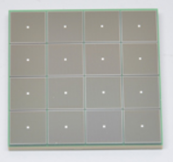
ePIC Readout Chain
WBS 6.10.x
WBS 6.10.08
WBS 6.10.09
Off Project
ECSJI – Joint Institute
Global Timing Unit (GTU)
- Interfaces to Collider
Run Control & DAM
- Config & Control
- Clock & Timing
(BNL)
On Detector
SMT BGA
(JLAB)
Name
Design
Function
Attributes
Sensor
Detector Specific
Multi-Channel Sensor
MAPS, AC-LGAD
MPGD, MCP-PMT
SiPM, LAPPD
Adapter
Detector Specific
-HV/Bias Distribution
-HV divider
-Interconnect Routing
-Sensor Specific
-Passive
Front End Board
(FEB)
Detector Specific
-Amplification
-Shaping
-Digitization
-Zero Suppression
-Bias Control & Monitoring
-ASIC/ADC
-Discrete
-Serial Link
Readout Board
(RDO)
Few Variants
-Communication
-Aggregation
-Formatting
-Data Readout
-Config & Control
-Clock & Timing
-FPGA or lpGBT
-Fiber Link
Data Aggregation Module (DAM)
Common
-Computing Interface
-Aggregation
-Software Trigger
-Config & Control
-Clock & Timing
-Large FPGA
-PCIe
-Ethernet
Echelon 0
Computing
Common
-Data Buffering and Sinking
-Calibration Support
-QA/Scalers
-Collider Feedback
-Event ID/Building
-Software Trigger
-Monitoring
-COTS
-Ethernet
Echelon 1
Computing
Common
- Archive
- Reconstruction
- Analysis

Slide 11
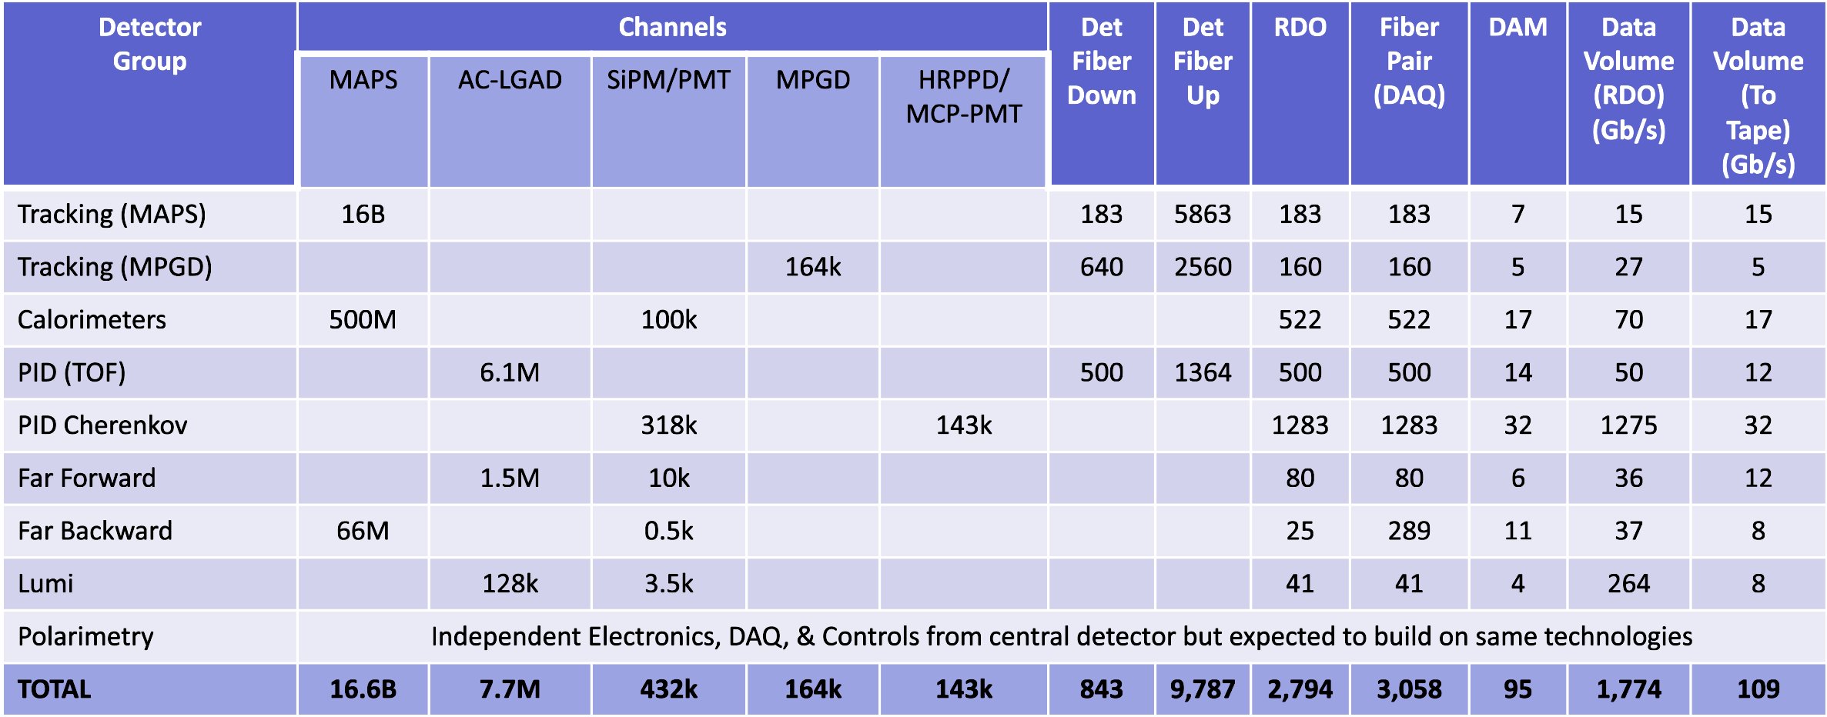
Summary of Channel Counts and Data Flow
Scale of the system:
Electronics
~ 24 detectors
~ 5 Readout Technologies
~ 3000 RDOs (on detector/in racks)
~ 100 DAM boards (DAQ room)
GTU (with interface boards)
Detailed simulations of DIS events, Proton and Electron beam gas lead to maximum Data Volume
~ 2 Tb/sec digitized
~ 100Gb/sec recorded
Synchrotron Radiation Simulations ongoing
Summary of Data Flow
PCI/Eth
Eth
Detector
FEB
Copper
RDO
Fiber
DAM
Readout Computer
Aggregate | 2.0 Tb/sec
Noise | 1.6 Tb /sec
Signal from Physics + Background | 400 Gb / sec
Aggregate | 109 Gb/sec
Collision Signal | 62 Gb/sec
Synchrotron Rad | Under design
Electron Beam | 4.5 Gb/sec
Hadron Beam | 1.0 Gb/sec
Noise | 41 Gb/sec
Aggregate | 2.0 Tb/sec
Per RDO (Avg) | 0.7 Gb/sec

Slide 12
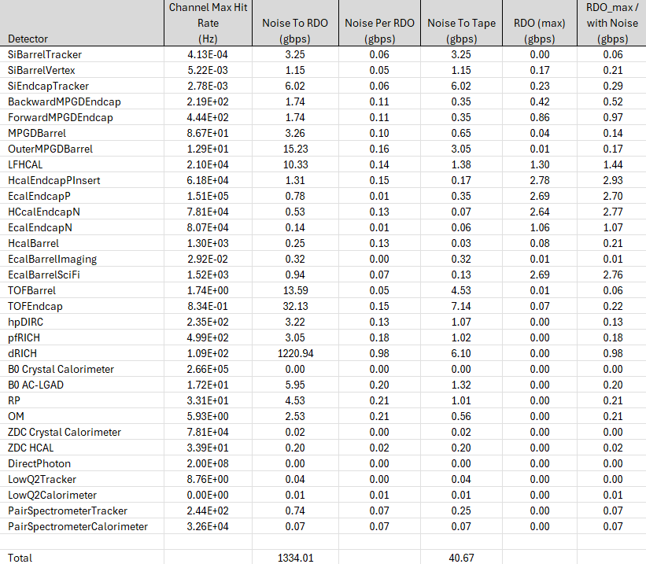
Data Bottlenecks
Evaluated Data Bottlenecks by tiling detector regions with RDO/ASIC combos
RDO data volume spec 8 gbps
Several detectors with max RDO rate ~1/4 bandwidth
Potential data reduction in RDO
Use fewer populated FEB per RDO in strategic locations
dRICH dark currents handled by firmware trigger
Lumi Monitoring:
Direct Photon Calorimeter ~100 channels direct streaming, readout only summary
Track lumi by bunch
Polarimetry
Readout by collider DAQ, not directly by detector
Preliminary Noise Assumptions
Detector | Noise (hz/channel)
ITS3 | 0.01
Astropix | 0.01
Timepix | 0.01
AC-LGAD | 30
HRPPD | 230
dRICH(initial) | 3000
dRICH(Max) | 300,000
All others | 4.5σ = 340

Slide 13
Readout Chain: lpGBT & VTRX+
CERN developed readout lpGBT and VTRX+ present opportunity for ePIC:
Existing electronics
Radiation hard
Small footprint in space and material
Meet performance specs
Low-cost relative to commercial options
Operate independently, but designed to co-exist
They also represent challenges:
VTRX+
Will be obsolete soon: final production run orders by 2025!
EIC Project CD-2 (baseline) targeted for early 2026
EIC Project CD-3 (construction) targeted for late 2026
Operation frequency tied to 40MHz (has been tested at 39.4MHz = 2:5 harmonic of EIC frequency)
Prevents features such as time windows centered on bunch crossings
Complicates assignment of collisions to bunch crossings
Maps ASIC links to a through serial links to a parallel interface.
Avoids need for flow control as deterministic ASIC output rates supported by definition
Complicates further aggregation for ePIC (large numbers of channels, small data rates!)
lpGBT
Additional factors:
ITS-3 integrates lpGBT
ITS-3 needs lpGBT for control interfaces
Targeted ASICs not tied to the EIC Clock (EICROC, CALOROC, possibly FCFD will digitize at 39.4MHz, SALSA will digitize at 49.25MHz)
Decisions:
CD-3B request for VTRX+ (and some lpGBT)
VTRX+ and lpGBT to be used for central detectors (SVT, MPGDs, eTOF, bTOF, dRICH, pfRICH) and similar readouts (B0, RP, OffM)

Slide 14
Readout Chain Links
GTU
ASIC
FEB
(lpGBT)
DAM
Sensors
RDO
E.g. bTOF, eTOF
Sensors
ASIC/
Sensor
FEB
(lpGBT)
RDO
DAM
E.g. SVT
ASIC/
Discrete
FEB
(Stave)
(Module)
RDO
DAM
Sensors
E.g. Forward ECAL
 | Link | Frame Rate (MHz) | Bit Rate (MHz) | Comments
 | Digitization | 39.4, 49.25, 197
 | ASIC Downlink | 39.4, 98.5 | 80,160,320,788 | Still documenting choices by ASIC
 | ASIC Uplink | 39.4, 98.5 | 320,640,788,1000,1280 | Still documenting details by ASIC, including number of links per ASIC
 | lpGBT Fiber Downlink | 39.4 | 2560 | lpGBT protocol carries reconstructed clock
 | lpGBT Fiber Uplink | 39.4 | 10240 | lpGBT protocol
 | RDO Fiber Downlink | ?39.4?, 98.5 | 4925, 9850 | VTRX+, Firefly, or SFP+ transceivers. ePIC DAQ common protocol carries reconstructed clock
 | RDO Fiber Uplink | ?39.4?, 98.5 | 9850 | VTRX+, Firefly, or SFP+ transceivers. ePIC DAQ common protocol
 | GTU DAM Up/Downlinks | 98.5 | 9850 | Synchronized to Beam Clock, but does not need to carry reconstructable clock
 | Clock Interface | 9.85 | 9.85 | Dedicated Clock from GTU --> DAM (suggested value: awaits GTU design)

Slide 15
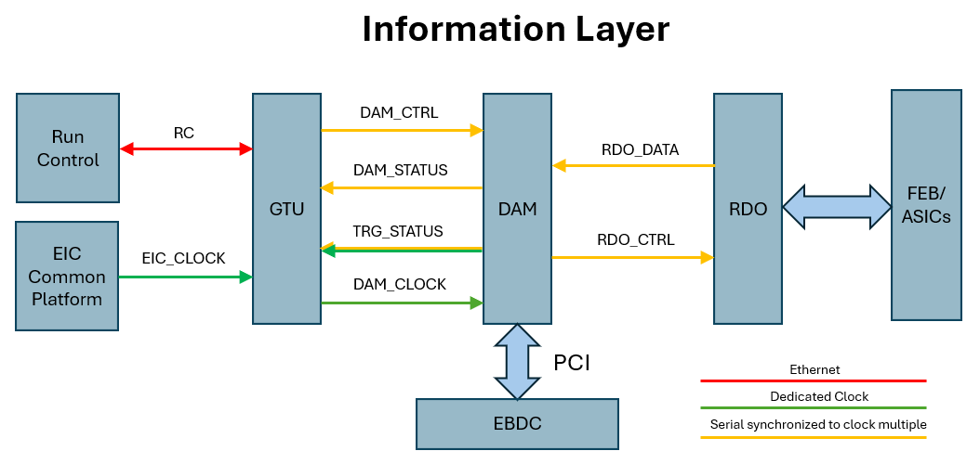
Fiber Protocol / DAQ operation
Synchronous ASIC Commands:
DAQ requires
SYNC_RESET – Defines reference for time
SYNC_READ – Read current time
RUN_START – Set internal state for readout
Collecting Requirements from ASICs
E.g. fire pulser, set pedestal mode, etc…
Expect to require 5 BX synchronization boundaries
Synchronous RDO Commands:
Fit low level protocol to RDO links
64/32 bits (80/40 bits 8b/10b encoded) per clock
Carries reconstructed clock
Redundant bunch crossing counter
Time Frame Control & Definition
Flow Control
FEB links (lpGBT) are deterministic
RDO_DATA link throughput depends upon expected data volumes
(Firmware) Trigger control
Data Readout / formatting
Configuration
Slow Controls (routed to EPICS IOCs)
Document Started – requires significant revision
Time Frame Definition:
16 bits BCO (0.66ms -> 8MB @ 100Gbps)
Flexible formatting
Filtered & Unfiltered data can coexist
Time Frames are built, they contain the full set of detectors for the time period
Tiered Data Format.
High level flexible, named navigation via banks (e.g. star SFS, sPHENIX DAQRC)
Low level supports direct, detector specific (eg ASIC) formats.

Slide 16
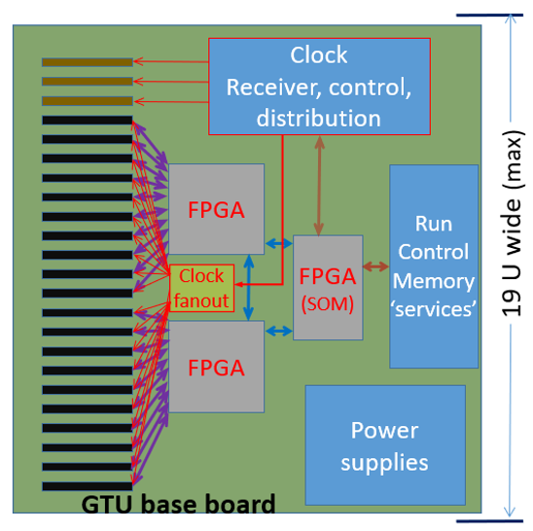
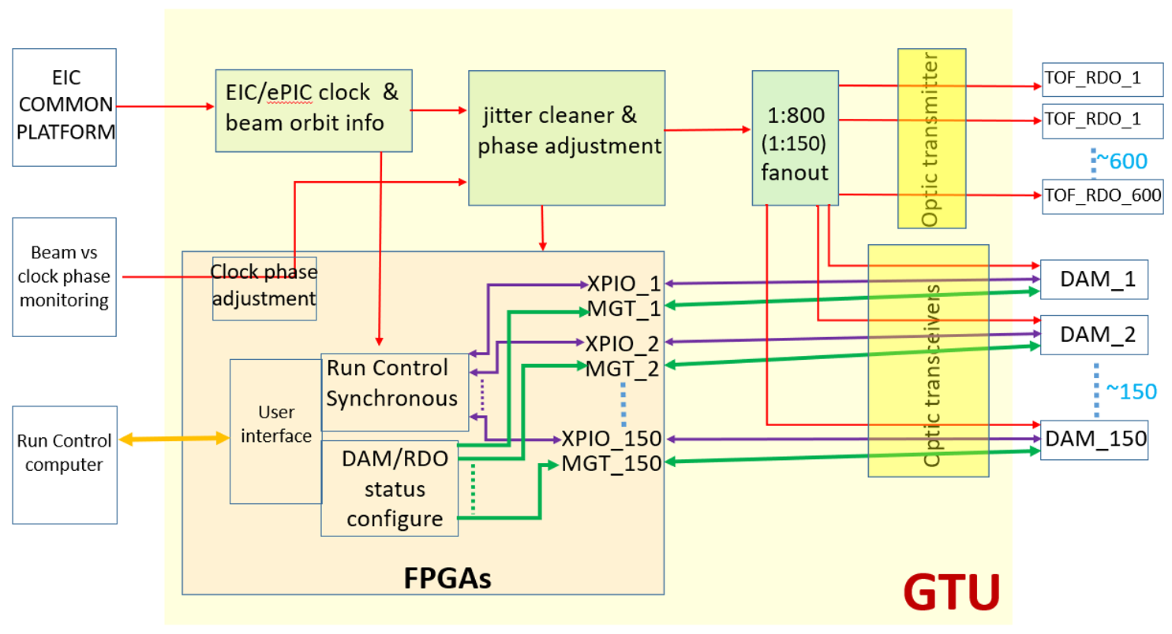
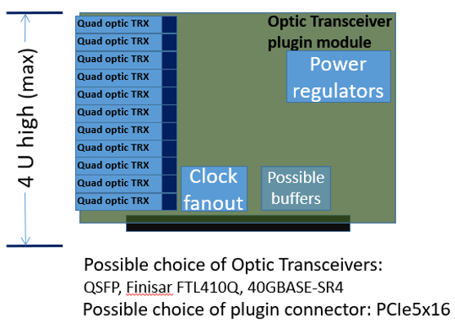
Global Timing Unit Functional Design
GTU idea
FPGA Based Motherboard
Daughter cards with optical interfaces to DAM boards
Plan Engineering Design During 2025 @ JLab

Slide 17
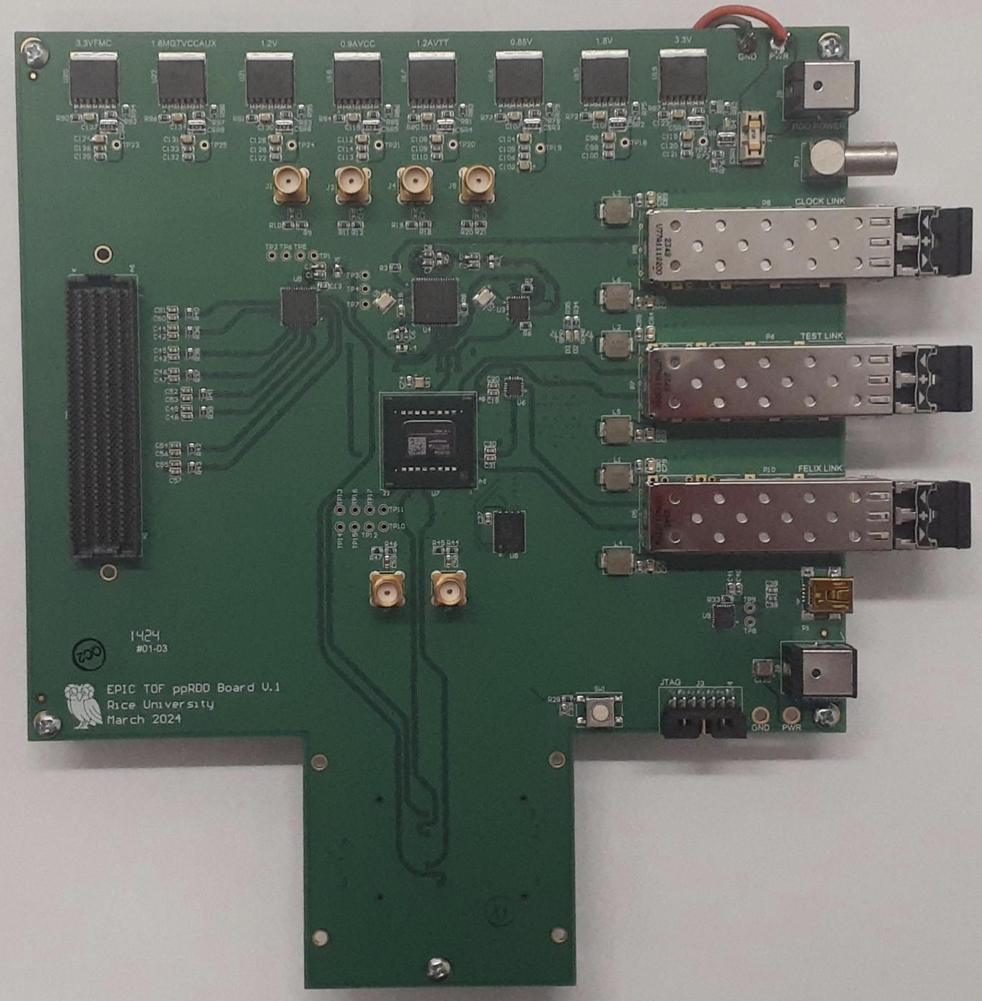
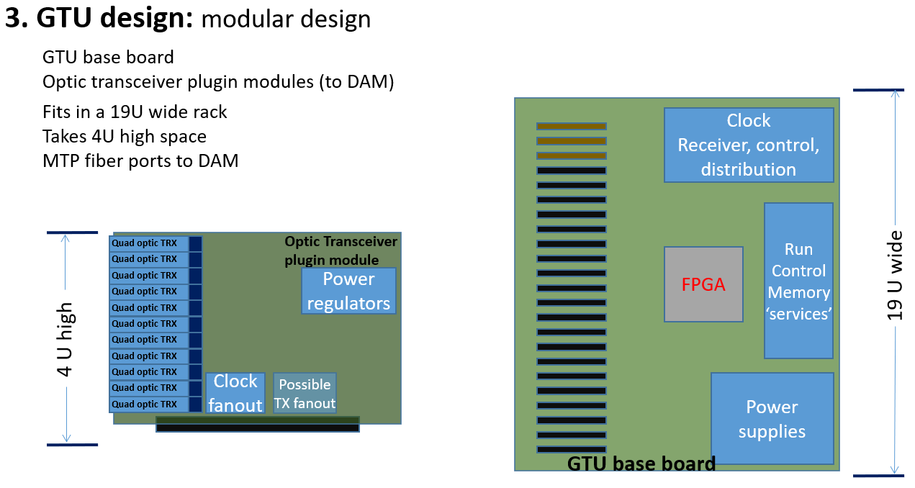
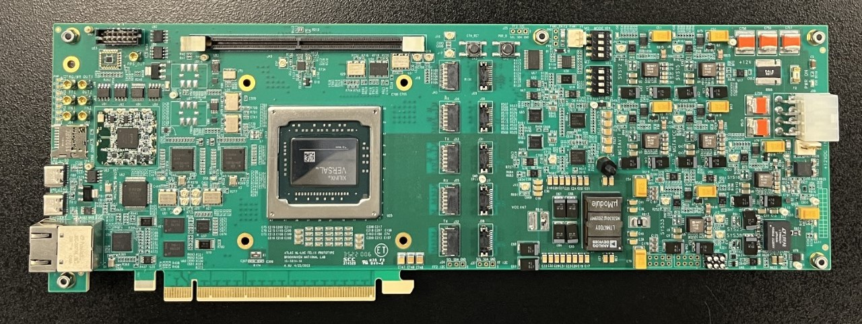
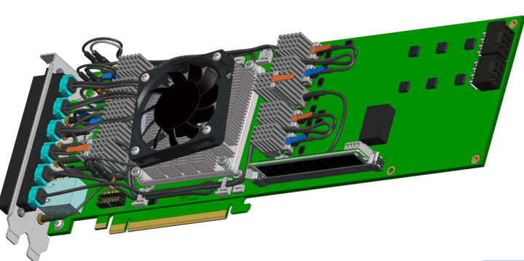
System Components Status
RDO
FPGA/SFP+
Pre-prototype now available for timing studies and firmware development (TOF)
FPGA: Artix Ultrascale+ Class
FPGA/VTRX+
dRICH
Electronics design progressing, engineering article early 2025
FPGA: Artix Ultrascale+ Class
Fiber Aggregation (MAPS)
(ITS3/AC-LGAD/others)
Component Counts
Astropix / Timepix
Existing designs need adaption for integration
GTU
Reconstructed Clock Timing Tests:
Mocked up with dev-kits
< 5ps timing measured with Ultracale+ FPGA and with lpGBT/VTRX+
Electronics Design:
Defined data paths
Component selection / Block Design ongoing
Form Factor
DAM
FLX-182
Developed by ATLAS (Omega Group at BNL)
2 FELIX engineering articles obtained
FLX-155
Targeted for ePIC use
Undergoing testing in Omega Group
Test articles late 24/early 25
Protocol
Data paths defined
Mapping to hardware
Time frames defined
.66 ms -> 8MB @ 100Gbps)
Functions defined
Developing many aspects
Integration of 40Mhz/100Mhz systems
Integration of lpGBT & ePIC protocol
Flow control detail
Firmware trigger & Data Reduction detail

Slide 18
System Components Status
William Gu: ePIC Timing and Synchronization: (Tomorrow)
Hao Xu: Felix DAM (Tomorrow)
Luca Pontisso: Data filtering on GPU for dRICH (Yesterday)
Cristian Rossi: Noise reduction for dRICH (Yesterday)
RDO
FPGA/SFP+
Pre-prototype now available for timing studies and firmware development (TOF)
FPGA: Artix Ultrascale+ Class
FPGA/VTRX+
dRICH
Electronics design progressing, engineering article early 2025
FPGA: Artix Ultrascale+ Class
Fiber Aggregation (MAPS)
(ITS3/AC-LGAD/others)
Component Counts
Astropix / Timepix
Existing designs need adaption for integration
GTU
Reconstructed Clock Timing Tests:
Mocked up with dev-kits
< 5ps timing measured with Ultracale+ FPGA and with lpGBT/VTRX+
Electronics Design:
Defined data paths
Component selection / Block Design ongoing
Form Factor
DAM
FLX-182
Developed by ATLAS (Omega Group at BNL)
2 FELIX engineering articles obtained
FLX-155
Targeted for ePIC use
Undergoing testing in Omega Group
Test articles late 24/early 25
Protocol
Data paths defined
Mapping to hardware
Time frames defined
.66 ms -> 8MB @ 100Gbps)
Functions defined
Developing many aspects
Integration of 40Mhz/100Mhz systems
Integration of lpGBT & ePIC protocol
Flow control detail
Firmware trigger & Data Reduction detail

Slide 19
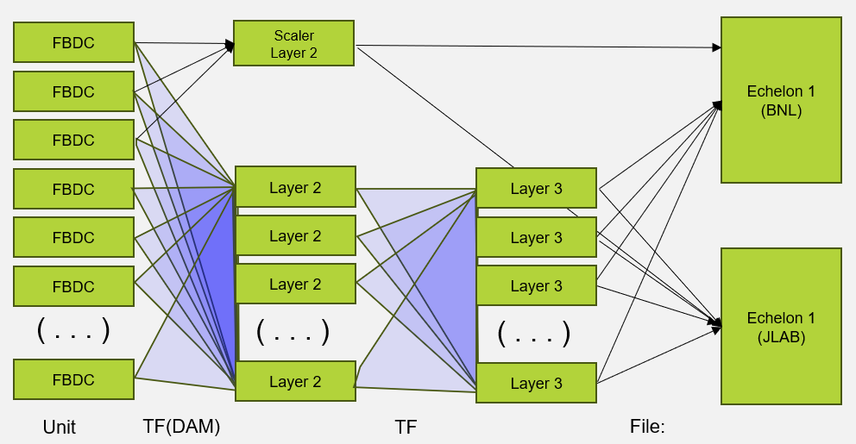
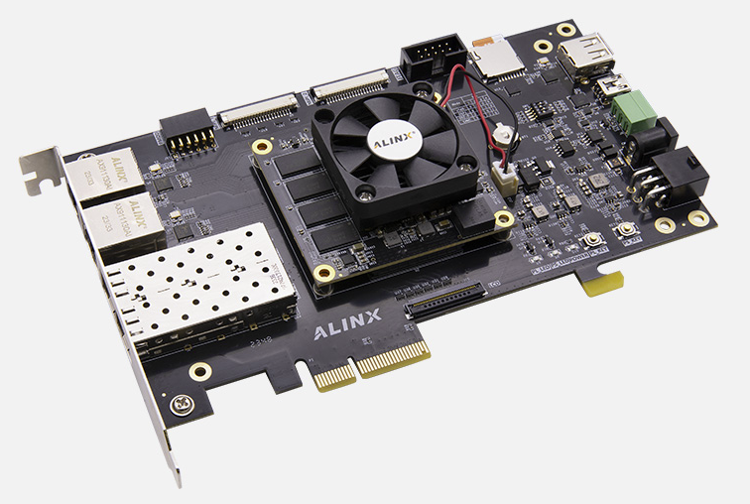
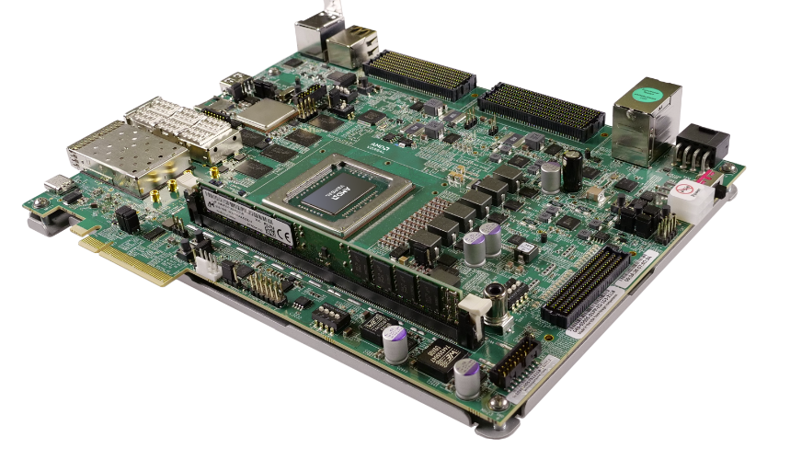
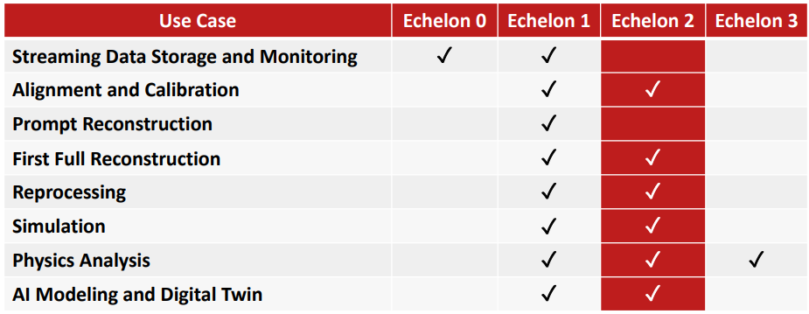
System Components Status
Echelon 0
Compute
Readout Computers
Frame Building Computers
Data Reduction
Filters
Compression
High Level Triggering
DAQ Logging
DAQ Monitoring
DAQ QA
Configuration / Run Control
Slow Controls interface (IOC)
Buffering and Data Transfer
Echelon 0 location
DAQ Computing:
~100 Readout computers in DAQ Room
~100 computers located anywhere with sufficient network
Splitting farm reduces DAQ room renovations but increases network requirements, space in SDCC, and complicates access
Cost/benefit analysis to be done
Detector Test Support
Firmware Support for Commercial Development Boards as FELIX substitutes for test stands (to be developed)
2 Port VD100 ($800)
48 port VMK180 ($10k)
Echelon 1
Compute
Interface
Interface:
Full Data to be streamed to JLAB/BNL echelon 1
Full Data to be archived at both facilities for redundancy
Scientific software and computing is off project dependency:
RRB
ECSJI
Latest Collaboration Review Sept 26-27, 2024

Slide 20
System Components Status
Echelon 0
Compute
Readout Computers
Frame Building Computers
Data Reduction
Filters
Compression
High Level Triggering
DAQ Logging
DAQ Monitoring
DAQ QA
Configuration / Run Control
Slow Controls interface (IOC)
Buffering and Data Transfer
Echelon 0 location
DAQ Computing:
~100 Readout computers in DAQ Room
~100 computers located anywhere with sufficient network
Splitting farm reduces DAQ room renovations but increases network requirements, space in SDCC, and complicates access
Cost/benefit analysis to be done
Markus Diefenthaler: ePIC SRO Calibration and Computing (next)
Torre Wenaus: Orchestration of Streaming Data Processing (next)
Detector Test Support
Firmware Support for Commercial Development Boards as FELIX substitutes for test stands (to be developed)
2 Port VD100 ($800)
48 port VMK180 ($10k)
Echelon 1
Compute
Interface
Interface:
Full Data to be streamed to JLAB/BNL echelon 1
Full Data to be archived at both facilities for redundancy
Scientific software and computing is off project dependency:
RRB
ECSJI
Latest Collaboration Review Sept 26-27, 2024

Slide 21
Schedule
The DAQ and computing schedule is planned to be accelerated in relation to the full detector construction.
A functional DAQ will be necessary for small scale detector testing as well as commissioning and pre-ops.
Computing resources are staged to make purchases when the hardware is needed, taking advantage of price savings and performance improvements in time.
Hardware and software development early in the construction phase will produce a series of releases with increasing functionality.
Detector Install: FY29Q2 - FY31Q2
Cosmics: FY31Q3
Early CD-4: FY32Q4
DAQ Releases:
PicoDAQ FY26Q1
Readout test setups
MicroDAQ: FY26Q4
Readout detector data in test stand using engineering articles
MiniDAQ: FY28Q1
Readout detector data using full hardware and timing chain
Full DAQ-v1: FY29Q2
Full functionality DAQ ready for full system integration & testing
Production DAQ: FY31Q3
Ready for cosmics
PDR1
PicoDAQ
MiniDAQ
Production
DAQ
PDR2
MicroDAQ
Full DAQ-V1
PDR3
Non-LLP pre-baseline schedule is in progress

Slide 22
Summary
Description of the streaming ePIC DAQ
Scale of the system
It’s architecture
Components
Status and Schedule

Slide 23
Backup

Slide 24
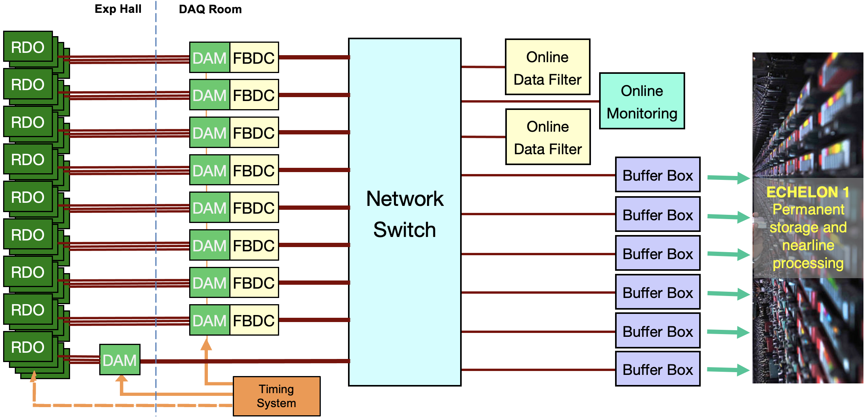
EIC Streaming DAQ/Computing Architecture
Bunch Crossing ~ 10.2 ns/98.5 MHz
Interaction Rate ~ 2 us/500 kHz
Low occupancy
BW O(100Tbps)
ePIC DETECTOR
BW O(10Tbps)
BW O(100Gbps)
GTU/Distributed clock (jitter ~5ps)

Slide 25
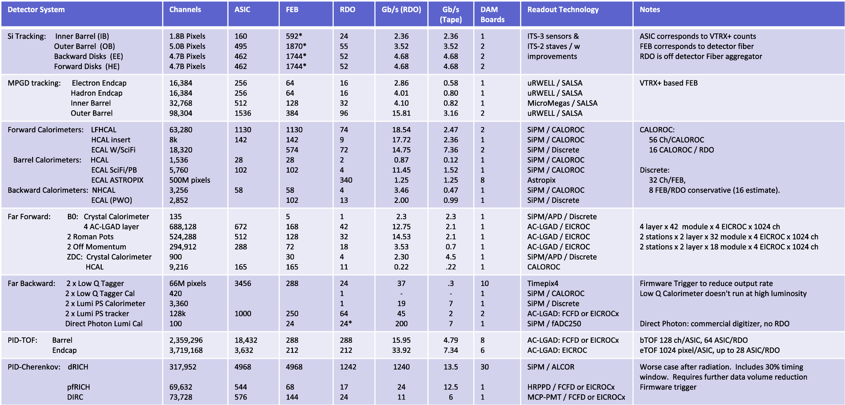
ePIC Detector Scale and Technology Details

Slide 26
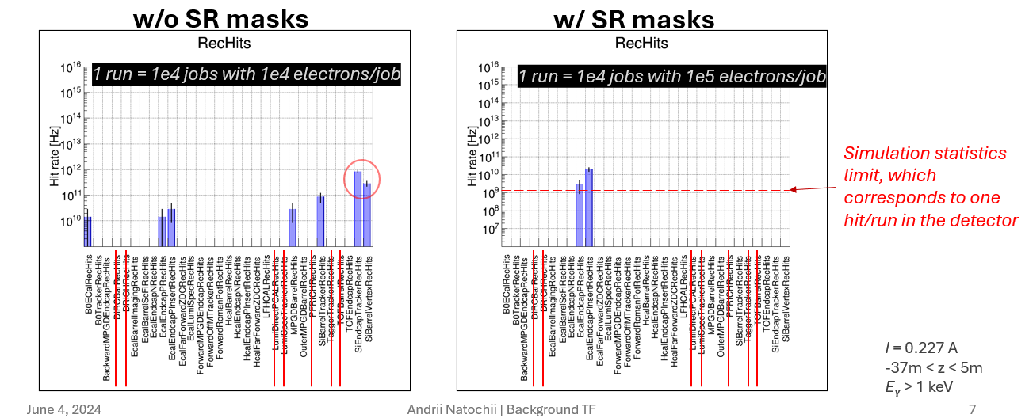
Simulations of Data Volumes
The ePIC background group has evaluated background sources.
For data volume evaluation we have used:
18x275 DIS events, scaled to the maximum event rates to be seen in 10x275GeV DIS
10 GeV Electron beam gas events scattered from realistic vacuum under 10000Ahr of pumping
275 GeV Proton Beam gas events scattered from realistic vacuum under 10000Ahr of pumping
Synchrotron radiation (SR) is still under evaluation
Recent results have shown:
SR is a potentially serious issue with the currently implemented beam line
Relatively simple remediation schemes can lower the rate significantly
With the currently available CPU resources and still ongoing simulation optimization, we can not yet study SR background rates below ~1 GHz

Slide 27
Readout Chain: FEB & RDO
Global Timing Unit (GTU)
-Interfaces to Collider, Run Control & DAM
-Config & Control
-Clock & Timing
On Detector
SMT BGA
Name
Design
Function
Attributes
Sensor
Detector Specific
Multi-Channel Sensor
MAPS, AC-LGAD
MPGD, MCP-PMT
SiPM, LAPPD
Adapter
Detector Specific
-HV/Bias Distribution
-HV divider
-Interconnect Routing
-Sensor Specific
-Passive
Front End Board
(FEB)
Detector Specific
-Amplification
-Shaping
-Digitization
-Zero Suppression
-Bias Control & Monitoring
-ASIC/ADC
-Discrete
-Serial Link
Readout Board
(RDO)
Few Variants
-Communication
-Aggregation
-Formatting
-Data Readout
-Config & Control
-Clock & Timing
-FPGA
-Fiber Link
Data Aggregation Module (DAM)
Common
-Computing Interface
-Aggregation
-Software Trigger
-Config & Control
-Clock & Timing
-Large FPGA
-PCIe
-Ethernet
Computing
Common
-Data Buffering and Sinking
-Calibration Support
-QA/Scalers
-Collider Feedback
-Event ID/Building
-Software Trigger
-Monitoring
-COTS
-Ethernet
Readout Board Flavors
Detector | Characteristics
TOF | Highest Timing Requirement (Generic)
dRICH | Small Footprint (VTRX+ optics)
ITS-3 | Detector side uses fiber (VTRX+)
Imaging Calorimeter | Integrated with ASTROPIX Sensor
Low Q Tracker | High Rates, 20 TX fibers expected / RDO
Direct Photon Calorimeter | Pure 200MHz Streaming (bypass DAQ protocol)

Slide 28
Timing Resolution with Reconstructed Clock
The timing requirement for ePIC DAQ is currently ~5ps, for selected detectors. This is driven by TOF with desired timing of ~25ps
Timing tests have been done at JLAB/ORNL
Promising results for both lpGBT and XiLINX Ultrascale+ FPGA
(See William Gu’s Talk tomorrow!)
5ps is still very challenging because of multiple interfaces between delivered clock and digitization!

Slide 29
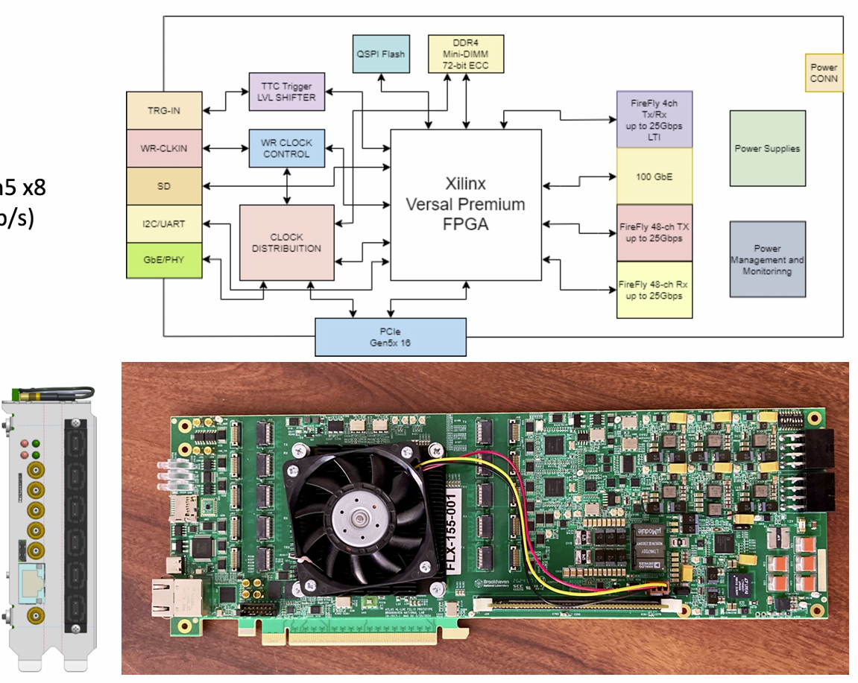
DAM Board – FLX-155
FELIX (Front-End Link Exchange) hardware for future ATLAS experiments at HL-LHC is being developed at BNL (Omega Group)
Long term support is insured. Development timelines are compatible with EIC.
ePIC is collaborating with Omega to use this design as our DAM board.
FLX-155 currently being tested by Omega
See Hao Xu’s talk tomorrow!

Slide 30
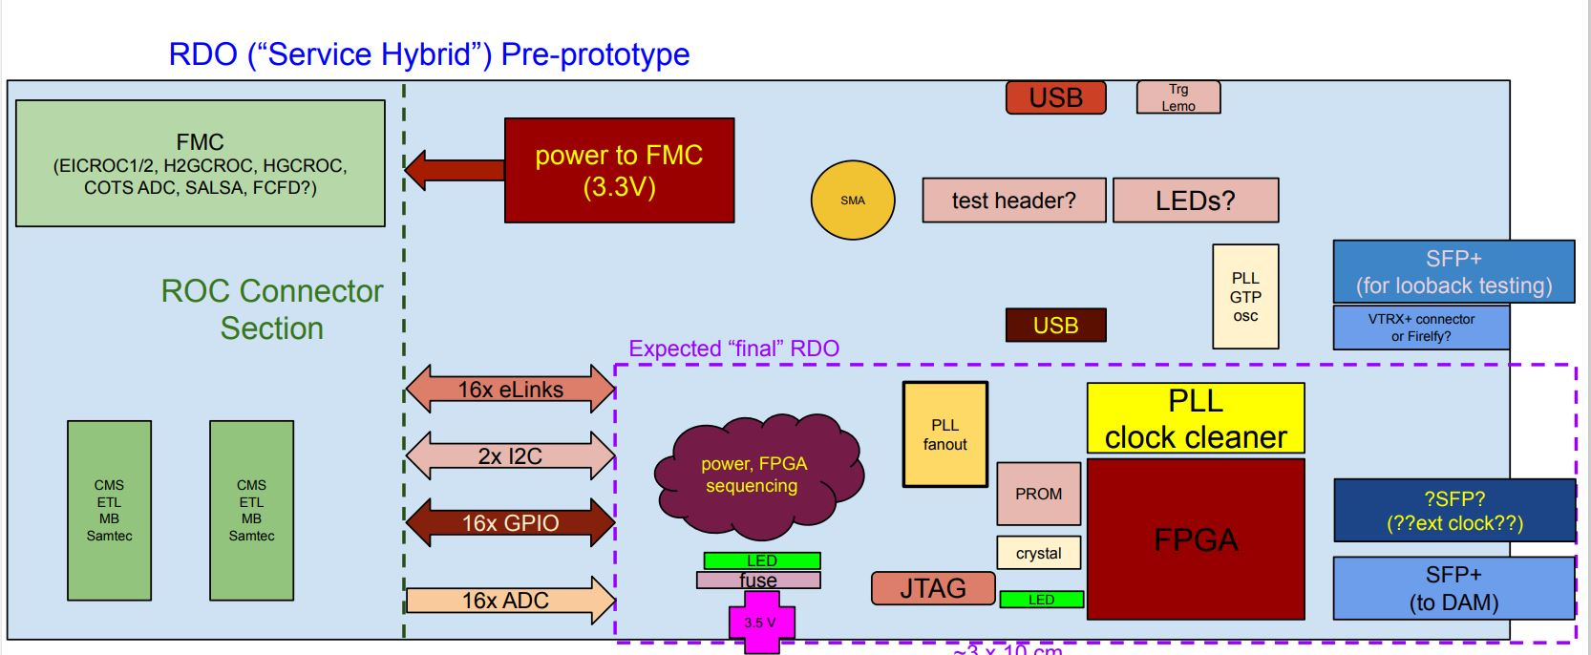
RDO development Activities
The Readout Board (RDO) is the first processing interface of the DAQ with the front-end electronics/digitizers.
There are currently 6 identified “flavors” of RDO - dependent on the detector subsystems (see Pietro’s for dRICH example)
It must support both a common DAQ communication protocol as well as manage configuration and control with the different front-ends
A pre-prototype board has been produced to support early DAQ and detector development (See Tonko’s talk for more details)
ppRDO
Readout Board Flavors
Detector | Characteristics
TOF (ppRDO) | Artix Ultrascale+
dRICH | Small Footprint (VTRX+ optics)
ITS-3 | Aggregates Fiber from lpGBT
Imaging Calorimeter | Integrated with ASTROPIX Sensor
Low Q Tracker | High Rates, 20 TX fibers expected / RDO
Direct Photon Calorimeter | Pure 200MHz Streaming (bypass DAQ protocol)

Slide 31
Implementation of Firmware Trigger
Given the requirement for a backup triggered readout for RICH, it is necessary to carefully define the physics trigger rate, trigger conditions, and trigger latency in order to facilitate design of the RICH front-end.
ePIC depends upon a flexible scheme in which sufficient bandwidth is available for data to the dRICH DAM in the worst case. (> 4x safety). The selecting detectors (ex FWD HCAL) generate information characterizing beam in O(10us). The decision is made by the GTU and returned to DAM boards with fixed latency. The maximum latency is orders of magnitudes less than available buffering in DAM board memory. A hardware trigger is supported by the GTU but uses the same dRICH buffering scheme and delays as the firmware trigger option.
FWD HCAL RDO
FWD HCAL RDO
FWD HCAL RDO
FWD HCAL RDO
FWD HCAL RDO
FWD HCAL RDO
FWD HCAL RDO
dRICH
RDO
RDO_DATA
48
48
48
48
48
48
FWD HCAL DAM
dRICH DAM
FWD HCAL DAM
dRICH DAM
Activitiy | Notes
Data Arrives at DAM | <=10us from Bunch Crossing
Data Evaluation (DAM) | 100ns
TRG_STATUS to GTU | Data transmitted to GTU after fixed delay from source crossing O(10us)
Trigger Evaluation on GTU | Fixed Latency O(100ns)
Keep/Drop Bit to DAM | Fixed Latency O(40ns)
Drop data / forward data | Drop Forward after fixed time O(11us)
DAM Buffer | 16GB
Buffer Time available | 2.6 seconds
FWD HCAL DAM
dRICH DAM
TRG_STATUS
64 bits
Bunch Data
Fixed delay O(10us)
DAM_CTRL
3
(Keep/Drop
Bunch bit)
30
GTU
Fixed delay O(10us)
Hardware Trigger Option
Ex: Hcal generates trigger
dRICH is triggered

Slide 32
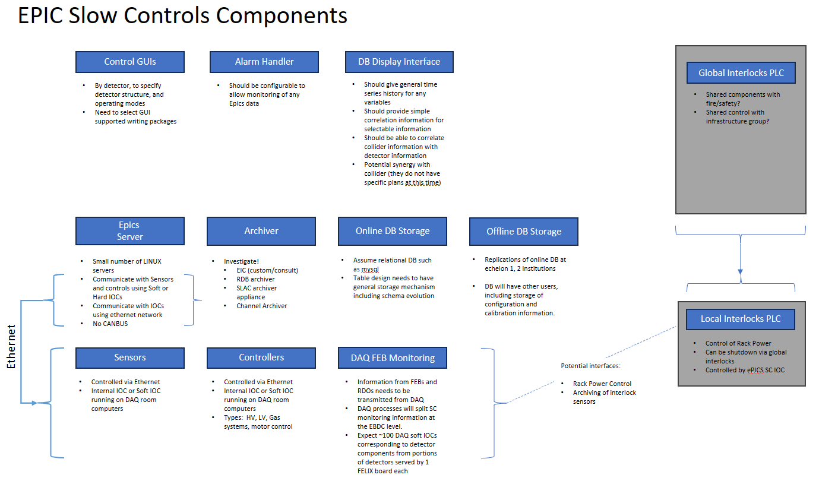
Slow Controls Status
Slow Controls Components and architecture are identified
EPICs Base
Allows use of existing tools
Synergy with EIC Controls

Slide 33
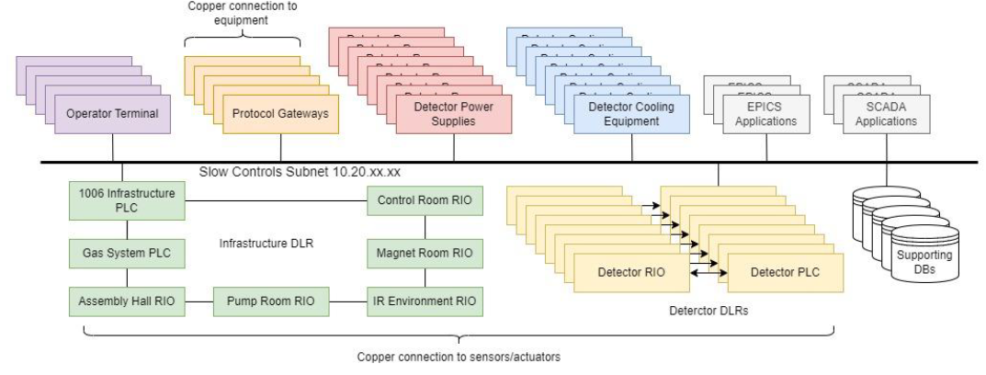
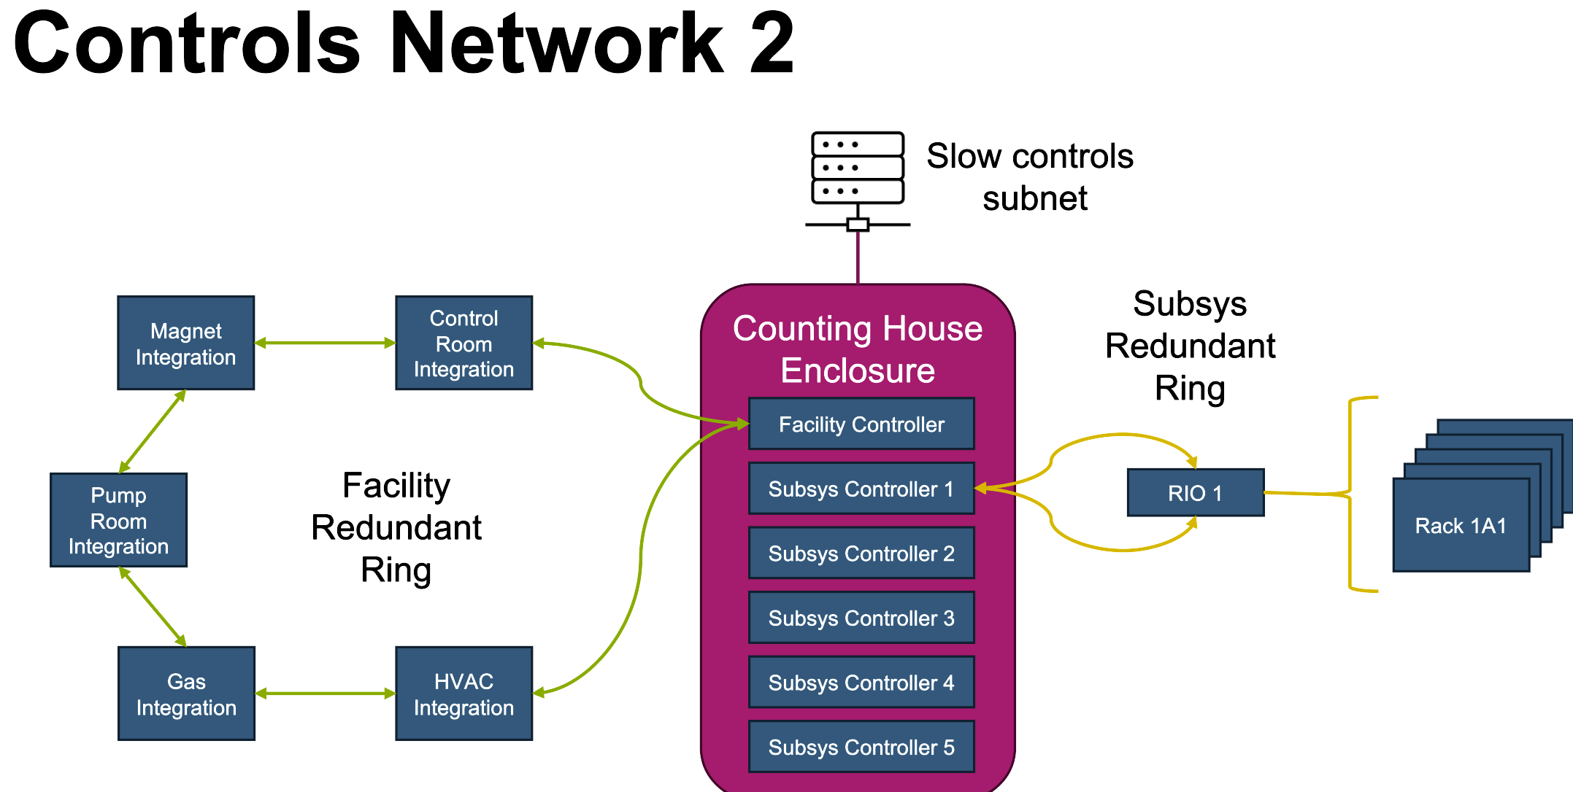
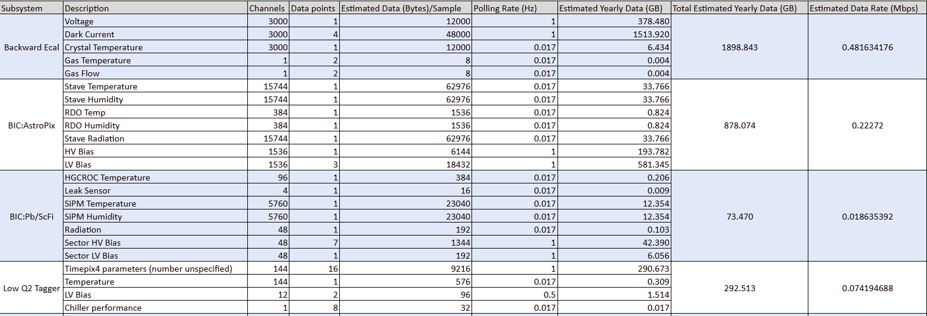
Slow Controls Status
Detector DSCs have been surveyed for detector requirements
Resource Requirements have been Documented
~ 500k variables to be tracked
~ 55 TB/year
~ 73 Mbps network traffic
Preliminary hardware recommendation policies / lists drafted
PLC schemes have been investigated
Hiring slow control’s expert to continue these efforts

Slide 34
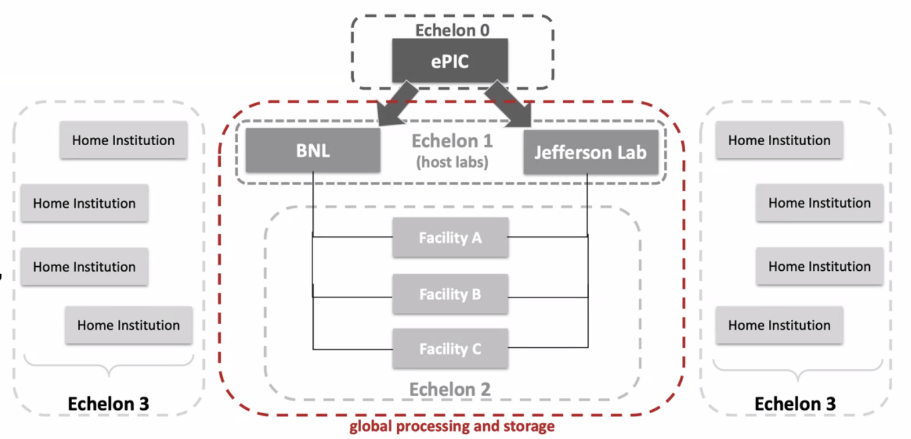
Boundary between Online and Offline
The streaming architecture allows for some blurring of the offline and online processing with respect to calibrations, QA monitoring, and potential seed analysis to improve reconstruction turn around.
Require an interface to allow sharing of code between offline / online processing
Local buffering (Echelon 0) provides elasticity in the transfer of data to computing facilities
Offline procedures (Echelon 1) will allow several weeks for calibration and reconstruction. (The computing will be discussed by Markus Diefenthaler in the next talk)
ePIC Scientific Computing
Is a dependency for the project handled in conjunction with host labs.
The Resource Review Board (RRB) looks at the international detector and computing resources.
The ePIC computing groups are actively implementing scientific software as well as working with the DAQ to define the interface with the streaming DAQ system.

