Slide 1
Neural Compression for sPHENIX sparse TPC Data
Yi Huang, Yihui “Ray” Ren, Yeonju Go, Xihaier Luo, Shuhang Li, Thomas Marshall, Joseph D. Osborn, Christopher Pinkenburg, Evgeny Shulga, Shinjae Yoo, Byung-Jun Yoon, Jin Huang (PI)
Presenter: Yihui “Ray” Ren, AI-CoDesign Group Leader, BNL
SRO XII, University of Tokyo, Dec. 2-4, 2024

Slide 2
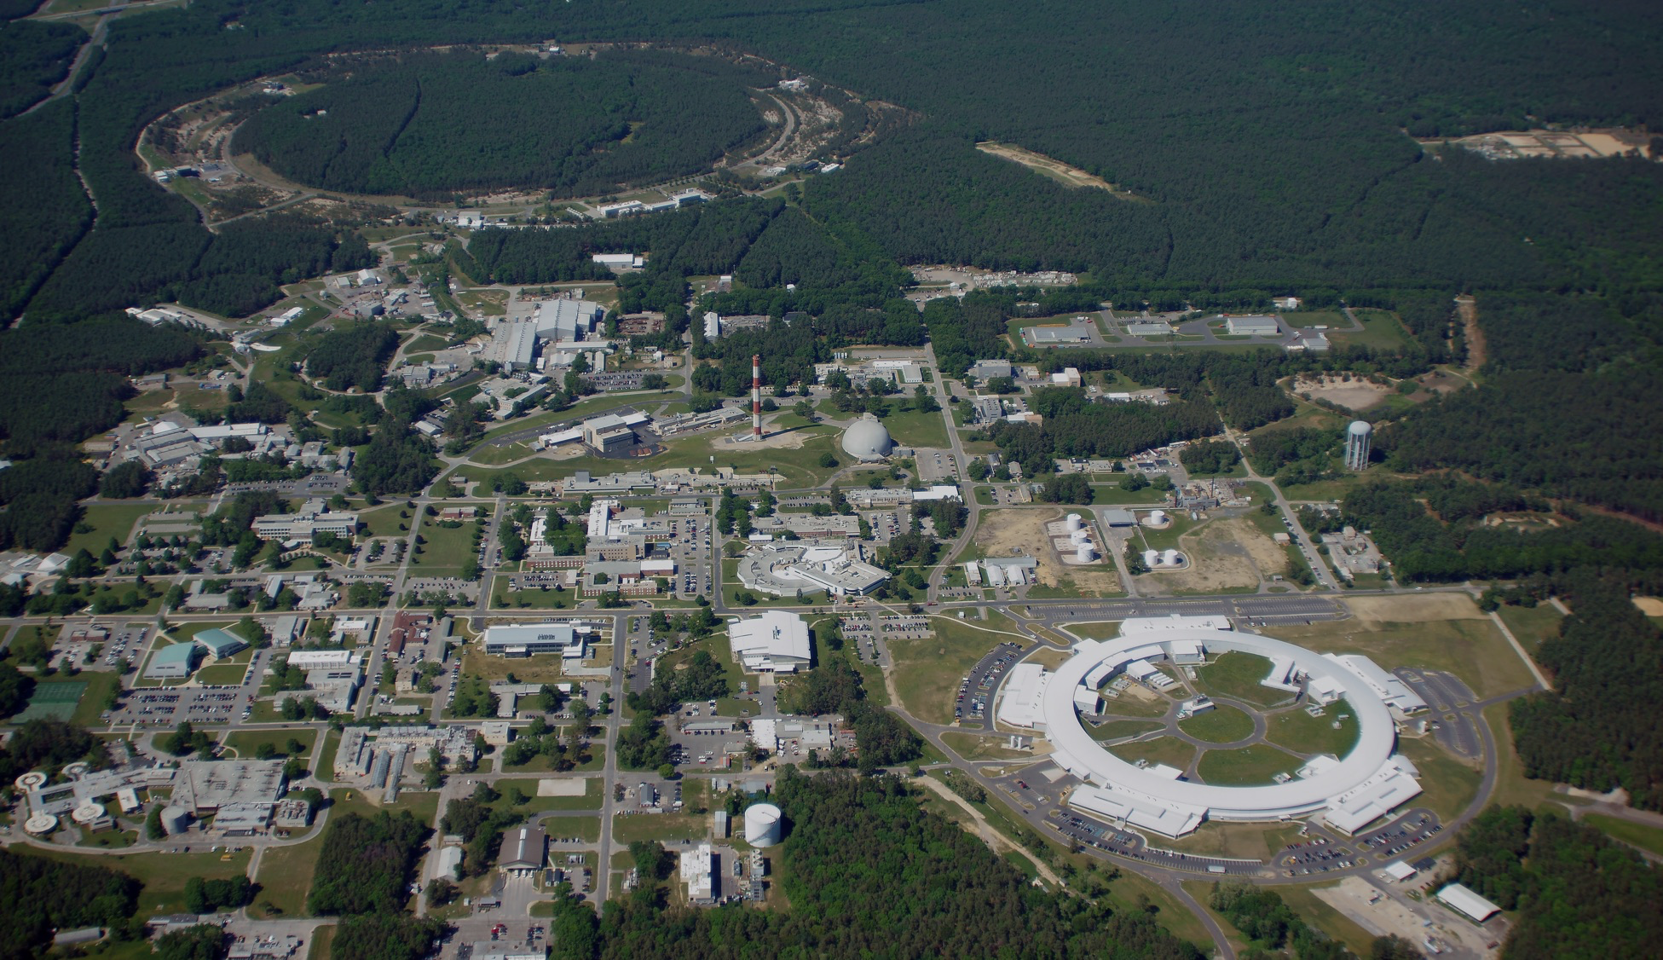
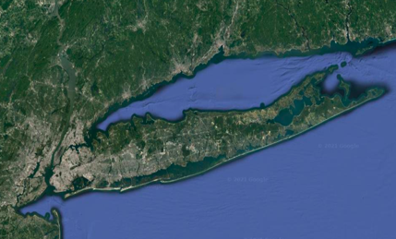

CT
NYC
Long Island
NJ
Atlantic Ocean
Notes:
https://www.bnl.gov/newsroom/factsheets/files/pdf/rhic-by-the-numbers.pdf

Slide 3
CT
NYC
Long Island
Relativistic Heavy Ion Collider,
future Electron-Ion Collider
(2.4 miles in circumference)
NJ
Atlantic Ocean
National Synchrotron
Light Source II

Slide 4
CT
NYC
Long Island
NJ
Atlantic Ocean
Prev: Computational Science Initiative (CSI)
Now: Computing and Data Science (CDS)

Slide 5
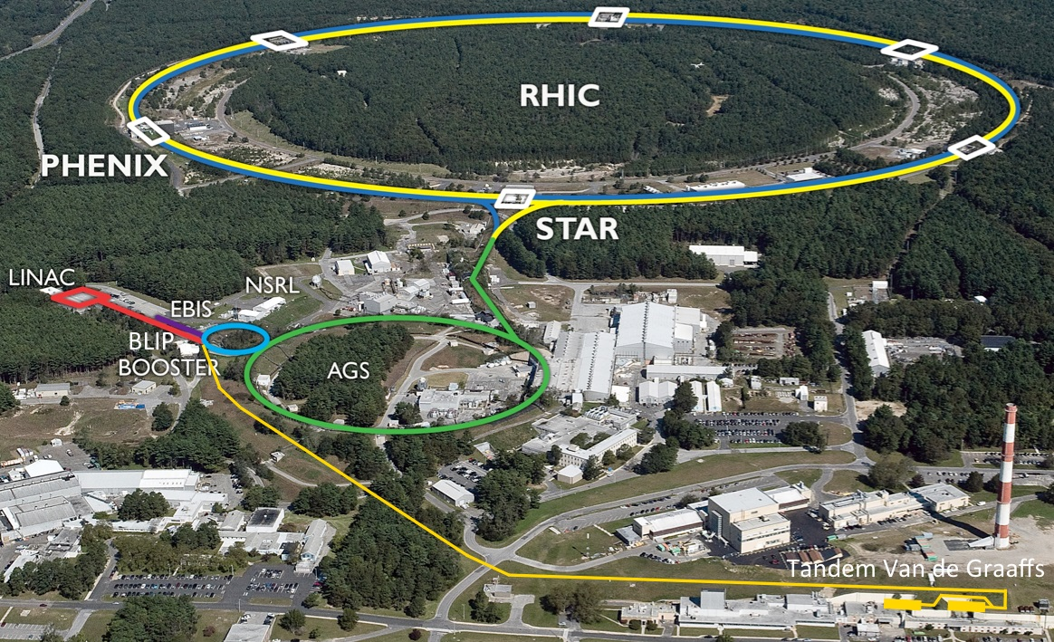

Slide 6
s

Slide 7
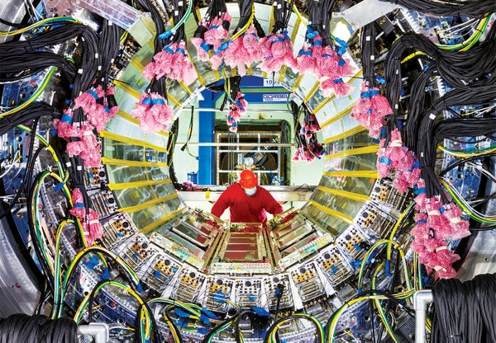
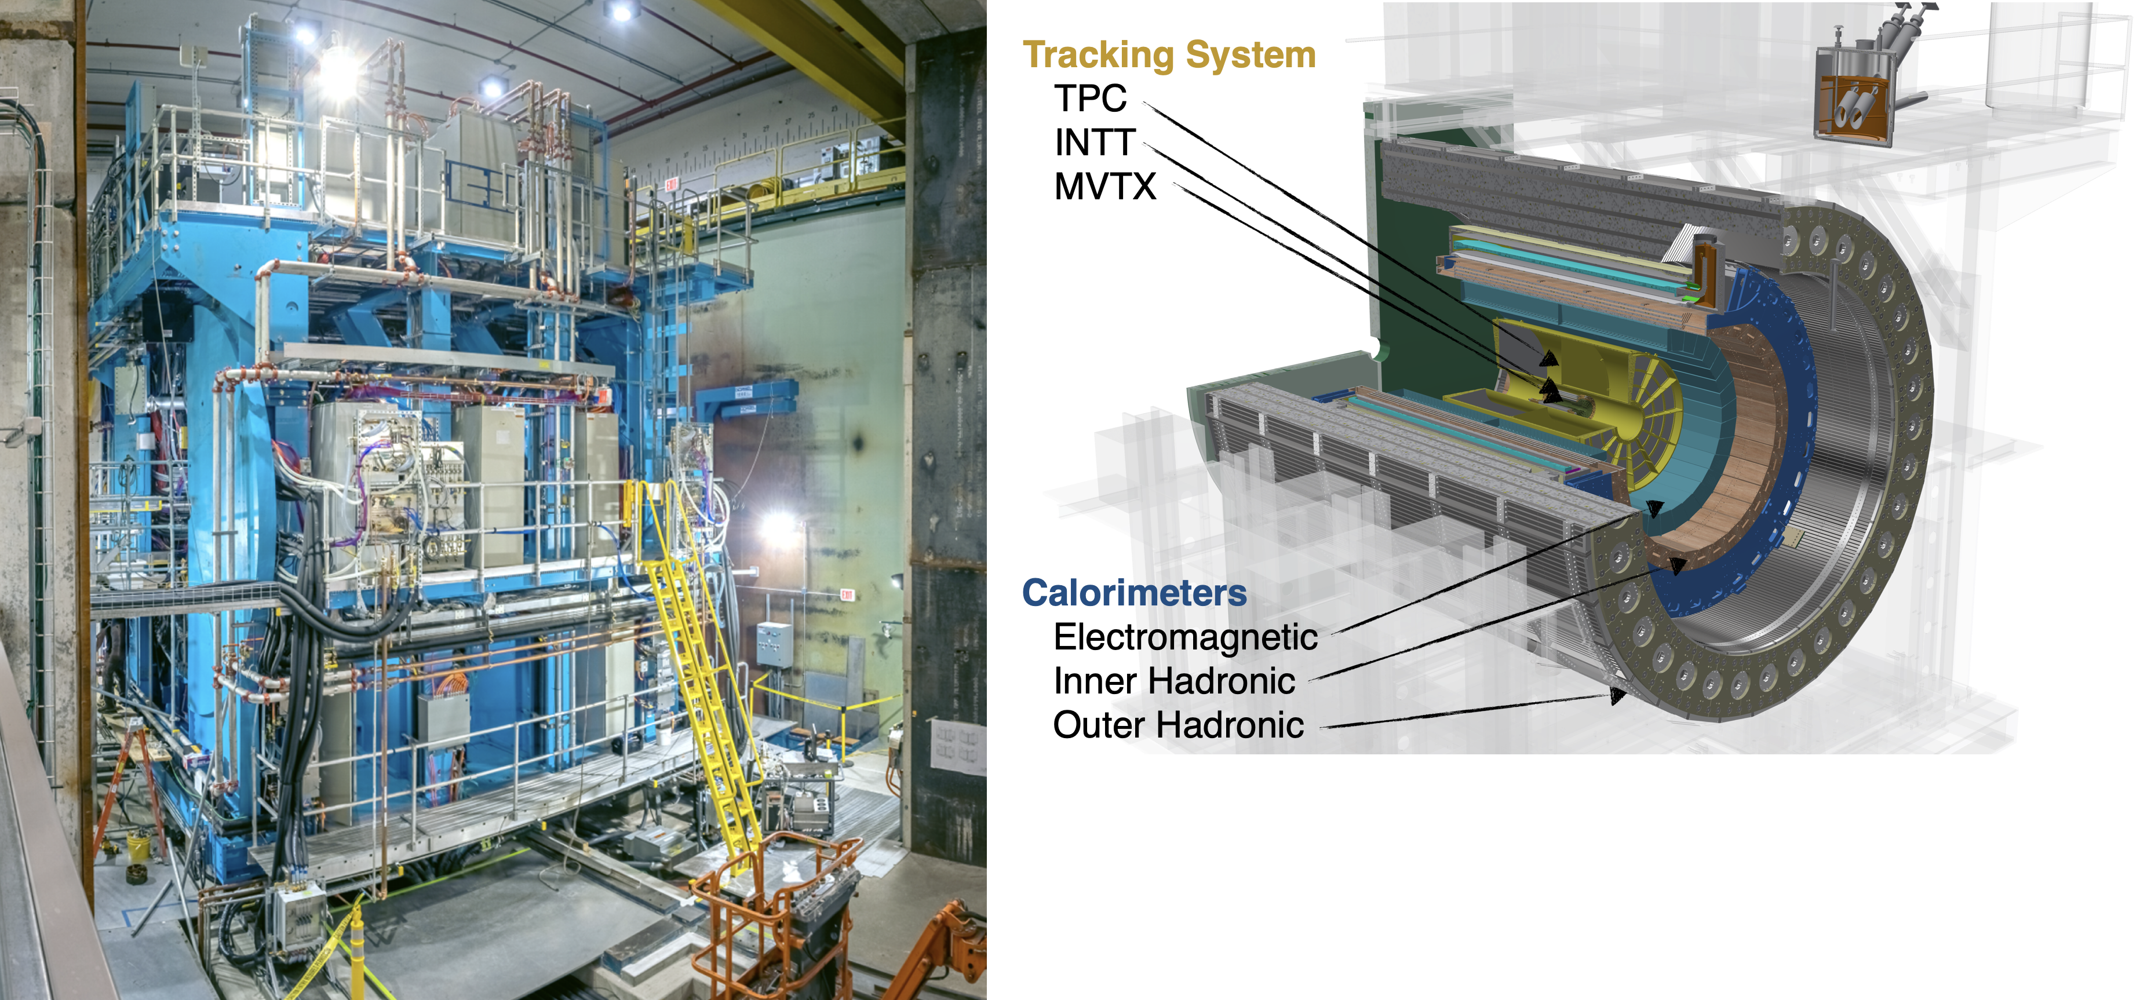
SPHENIX at BNL
Scientific American, 03/01/2023
Data taking began last year!
High-precision tracking system + Hermetic Electromagnetic & Hadronic calorimeters

Slide 8
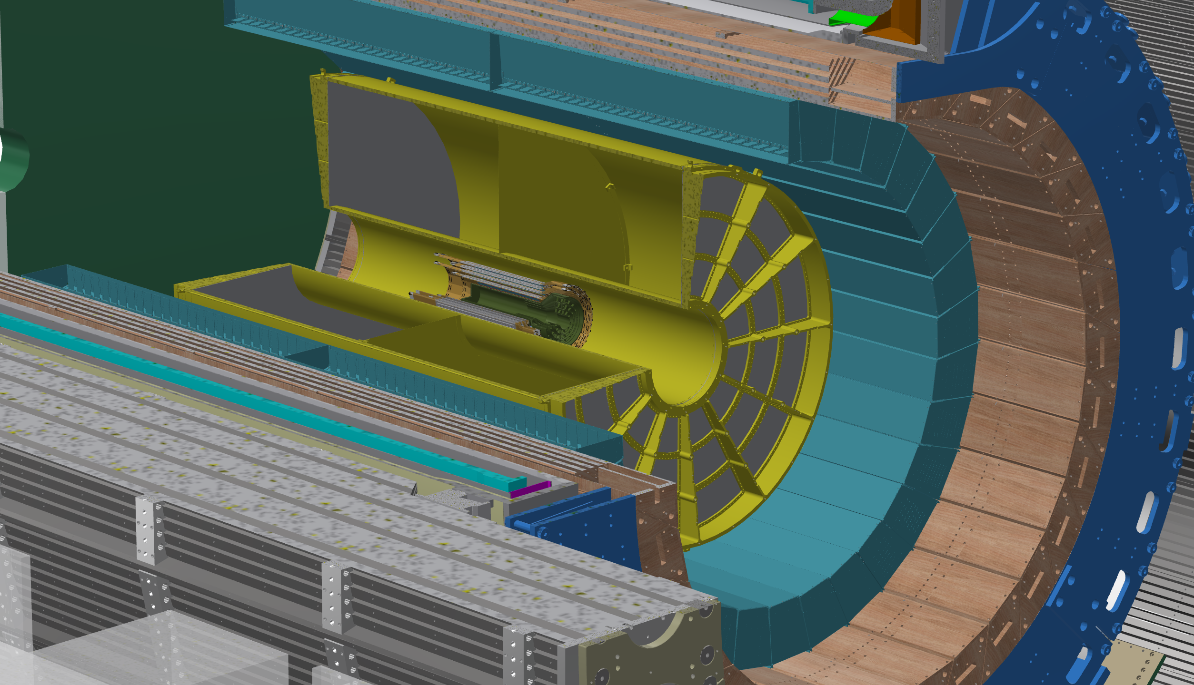


Time projection Chamber (TPC)
A TPC is composed of 48 layers of rectangular grid of sensor nodes. It acts as a camera capturing 3D particle trajectories.
three layer groups, 16 layers each
two sides, divided by the transverse plane passing the collision point
12 sectors, $30$ degree each
Notes:
Time projection chamber produce tracking data at extremely high data rate and we cannot save all the data produced to the permanent storage for future study. The currently solution is to use a trigger system to select collision most valuable events and discard the remaining. However, as we move gradually to streaming data intake, we want to see whether we develop fast compression algorithm based on deep neural network to make saving all data possible.

Slide 9
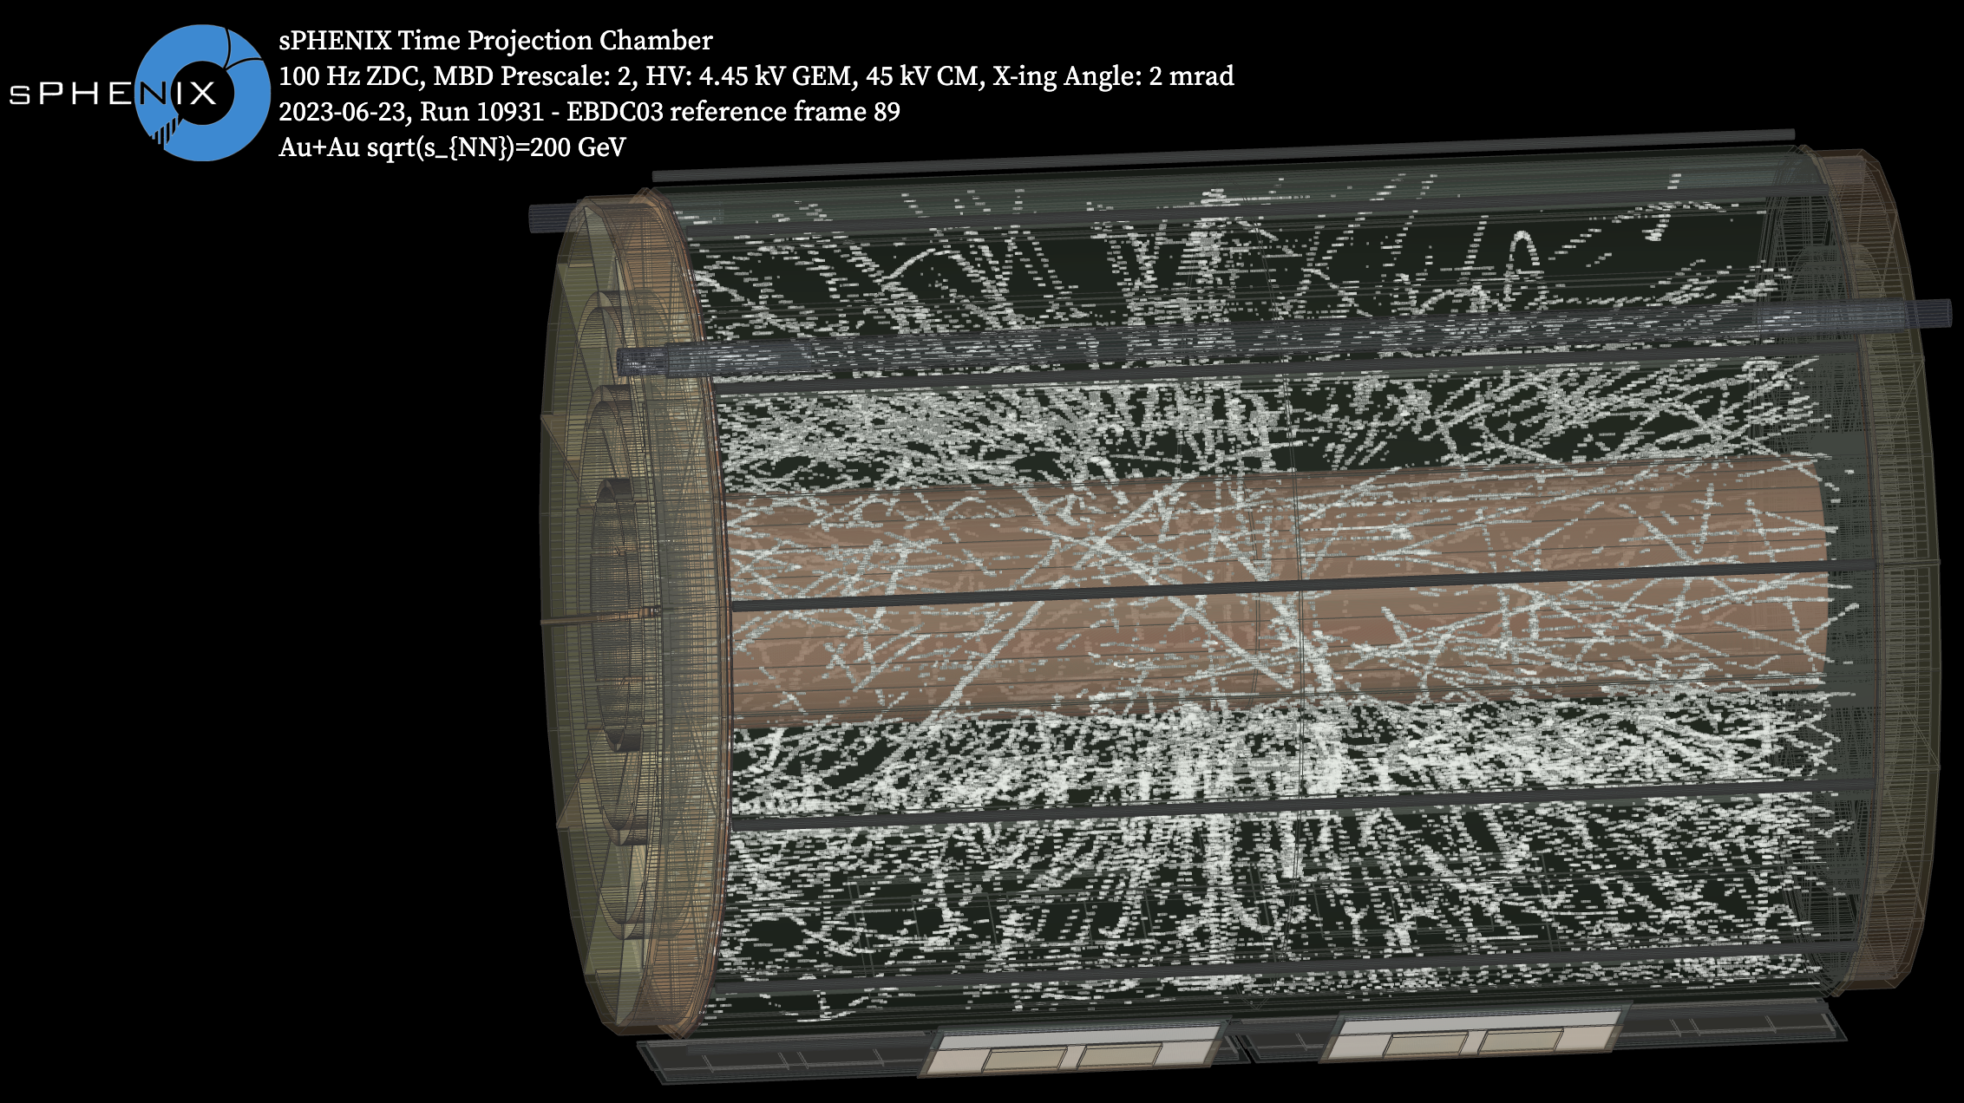

Slide 10
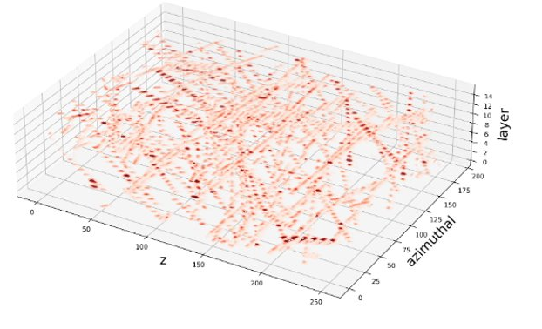
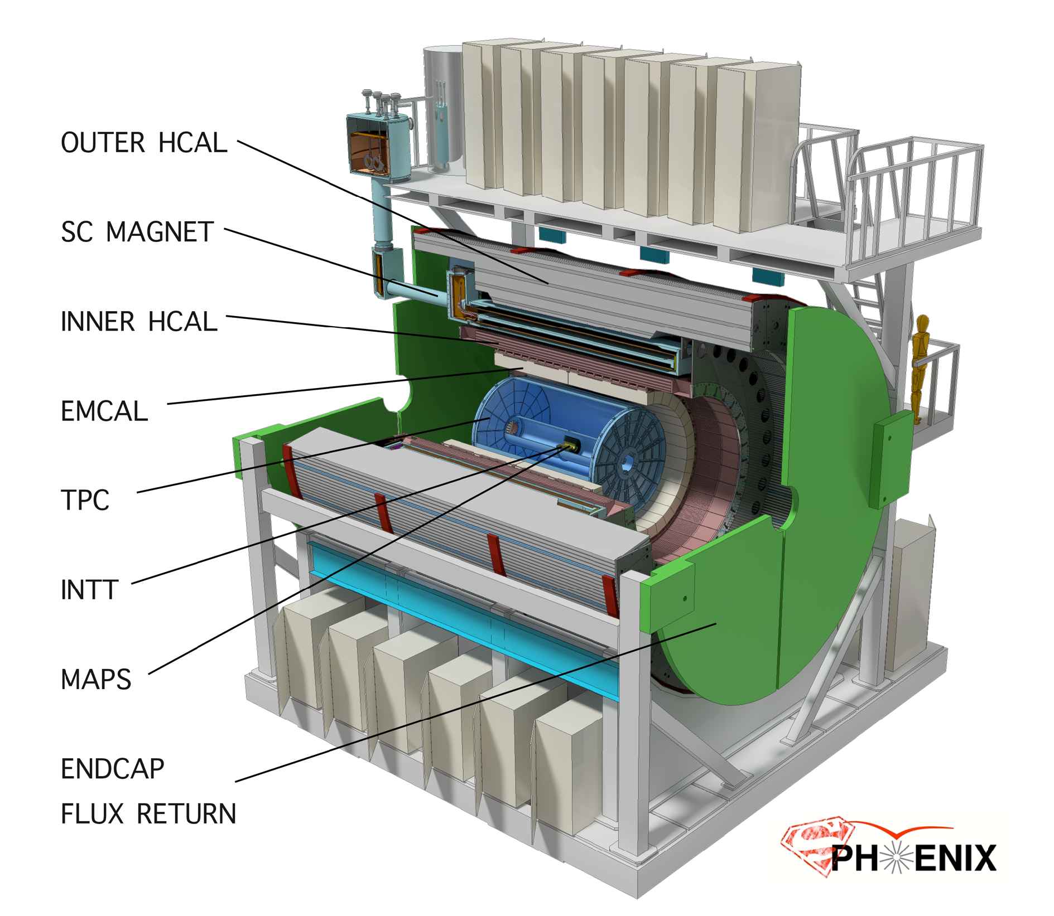

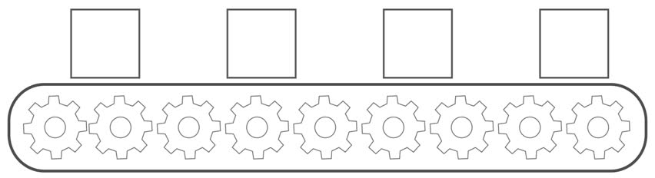
TPC Data
Dataset: MDC1 AuAu 0-10%C + 170kHz pileup
192
Number of voxels: (azimuth × z × layer):
  Outer layer group: 2304 × 498 × 16 ≈ 18M;
  Middle layer group: 1536 × 498 × 16 ≈ 12M;
  Inner layer group: 1152 × 498 × 16 ≈ 9M
Outer Layer Section:
  192 × 249 × 16
  Sparser
TPC Drift field
Notes:
Q: left-z drift to the left, and right-z drift to the right.
Note: this section will be sent together to the same FELIX card.

Slide 11
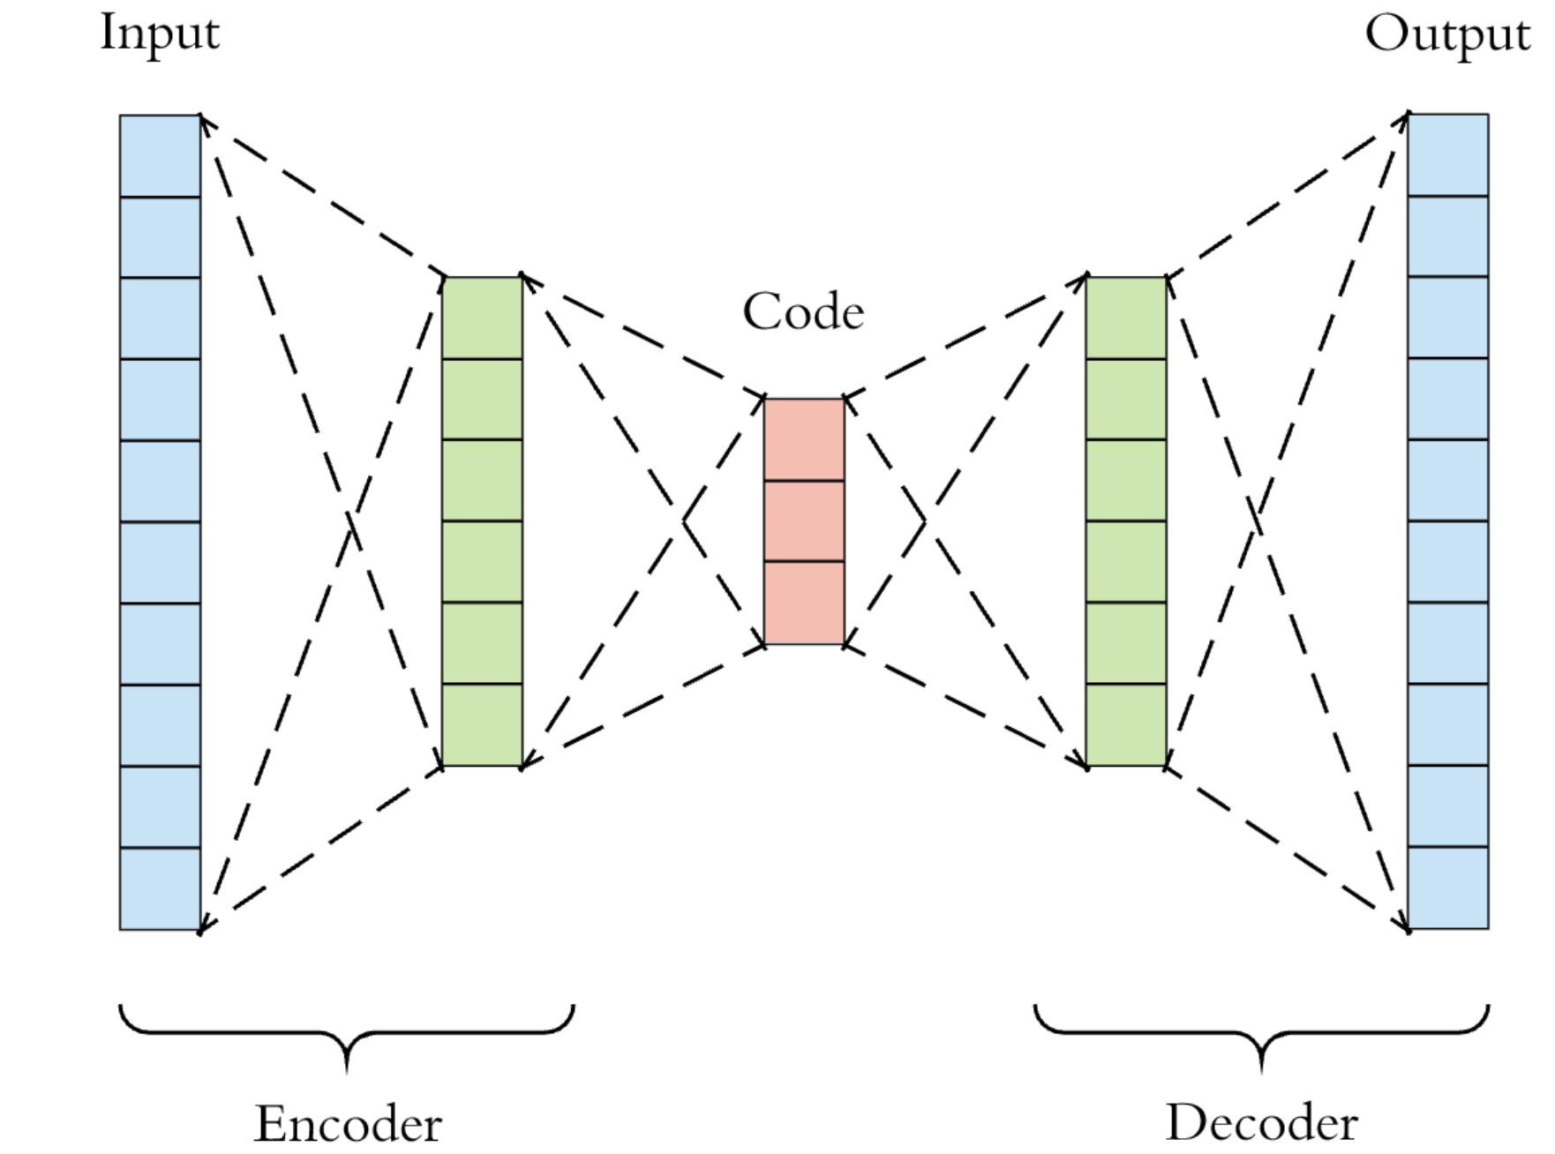
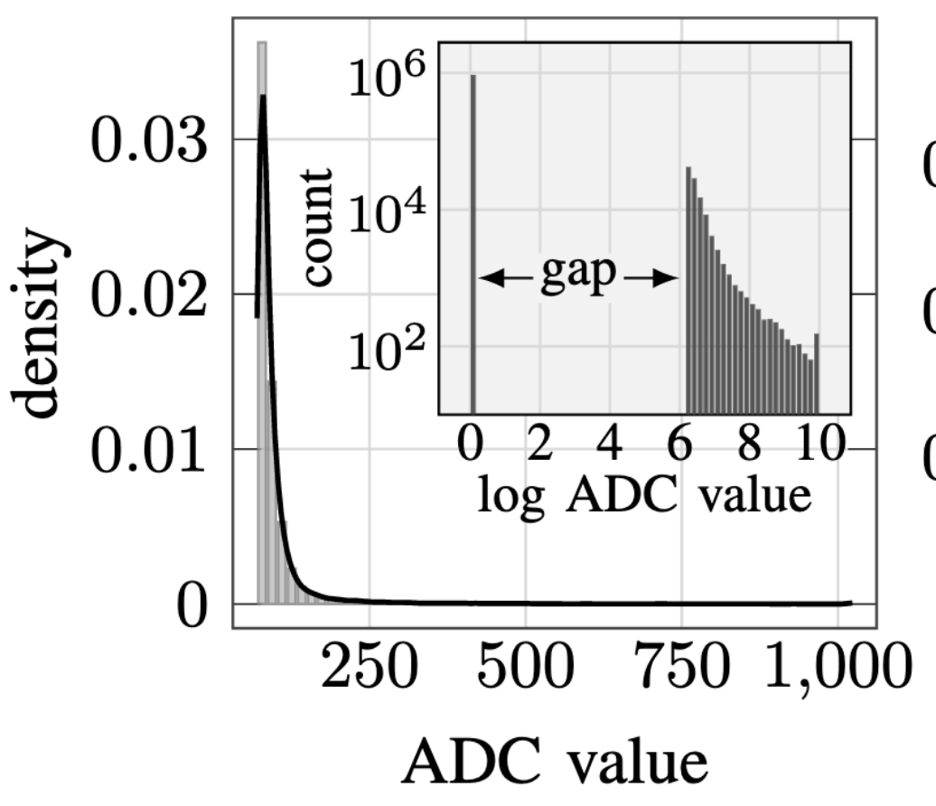
Neural Auto-Encoder
A typical Auto-Encoder uses an Encoder network to compress the data into “code”; and a Decoder network to reconstruct the original input.
The voxel distribution:
  long-tailed (skewed)
  sparse (many zero values)
  zero-suppressed (discontinued)
  10-bit integer (saturated)
Very Challenging for a regular auto-encoder!

Slide 12
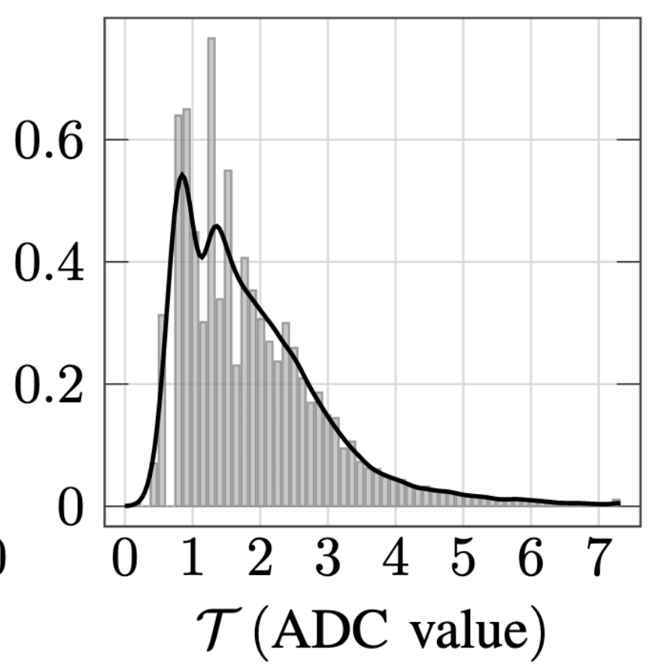
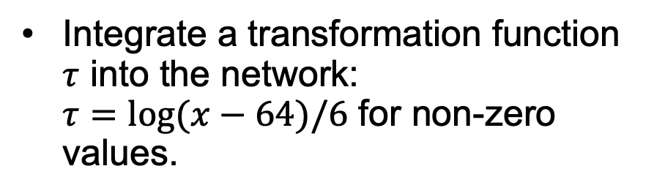
Bicephalous Convolutional Auto-Encoder
(BCAE)
A dedicated Segmentation decoder to determine whether a voxel has been zero-suppressed.
Integrate a transformation function $τ$ into the network:
$τ=\log{(x−64)/6}$ for non-zero values.

Slide 13
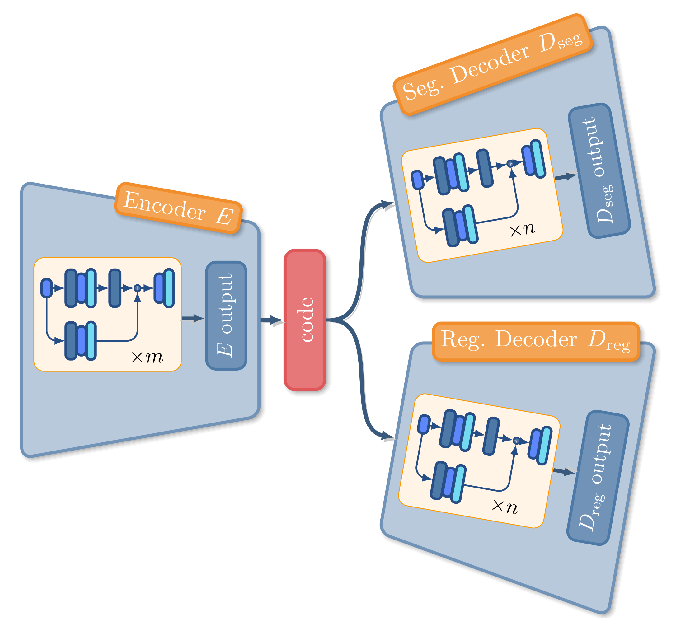
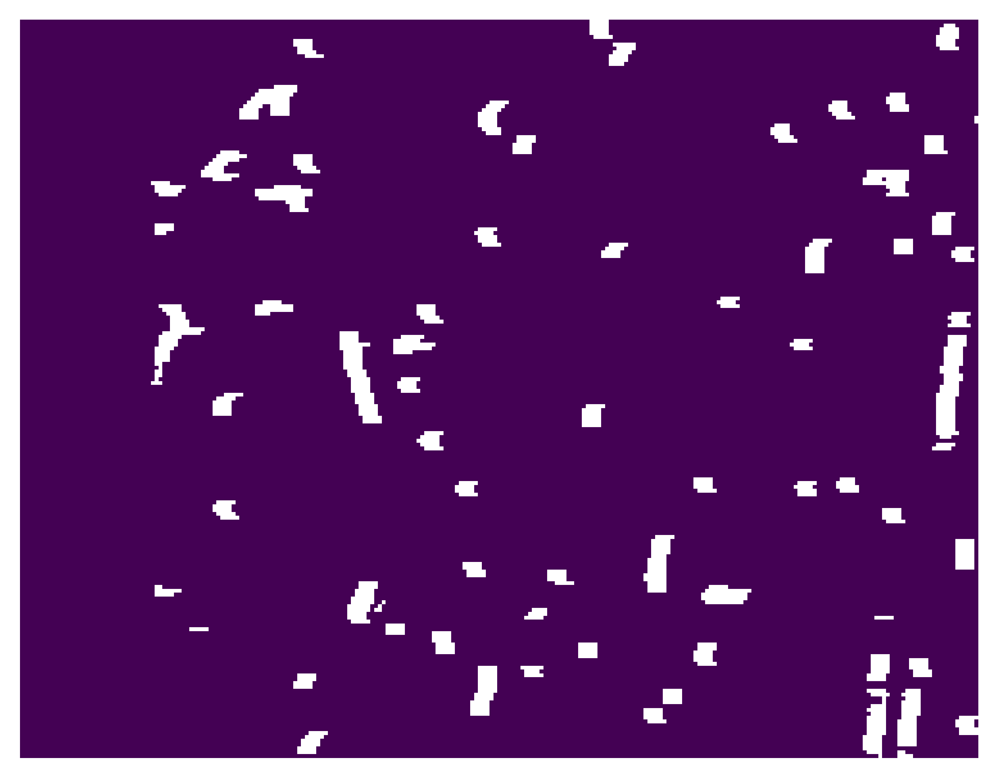
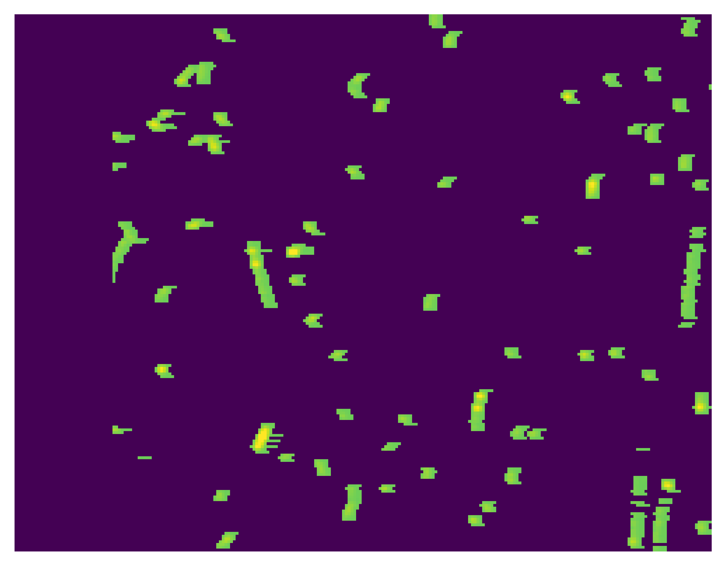

Segmentation output (mask)
input
Regression output
Permanent storage

Slide 14

Regression output $×$ mask
input

Slide 15
Results
Compression Ratio:
  1:27
Mean-Squared Error (MSE):
  218.44

Slide 16
Other Lossy Compression Algorithms
We identified three conventional lossy compression algorithms, which were mainly designed for dense data matrices such as in fluid dynamic simulations.
MGARD: MultiGrid adaptive reduction of data.
  https://github.com/CODARcode/MGARD
SZ: Error-bounded lossy compressor.
  https://github.com/szcompressor/SZ
ZFP: Compressor for integer and floating-point data stored in multidimensional arrays.
  https://github.com/LLNL/zfp

Slide 17
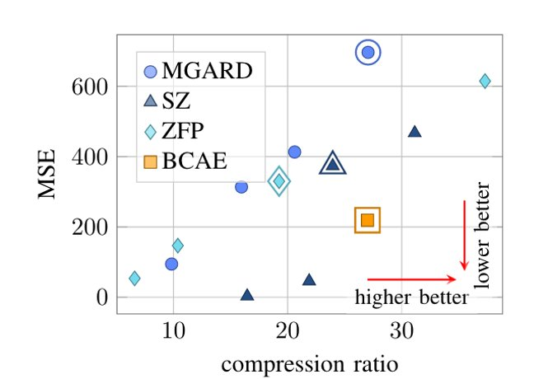
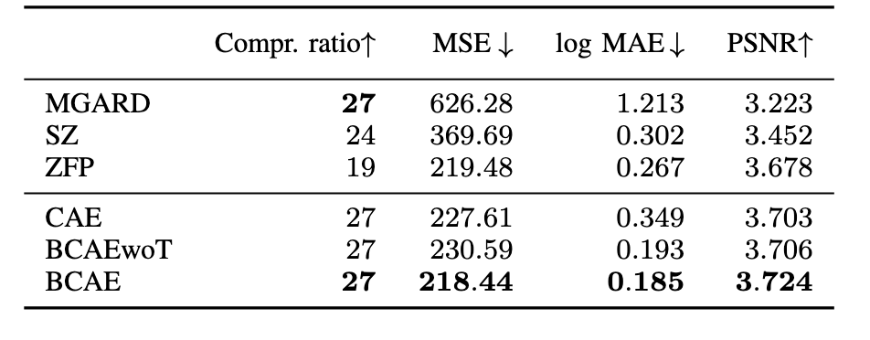
Results
Conventional methods allow users to change compression ratio.
Our model has better compression ratio and lower MSE. (good balance)
Conventional methods do not require “training”.

Slide 18
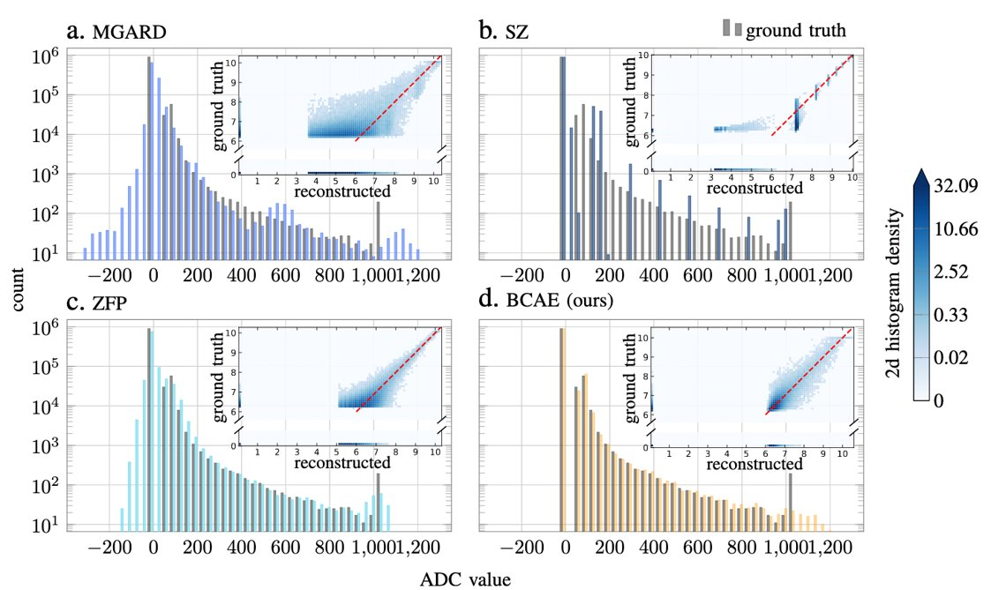
Results
Conventional methods allow users to change compression ratio.
Our model has better compression ratio and lower MSE.
Recover entry value distributions (histogram)
Huang, Y., Ren, Y., Yoo, S., & Huang, J. (2021, December). Efficient data compression for 3d sparse TPC via bicephalous convolutional autoencoder. In 2021 20th IEEE International Conference on Machine Learning and Applications (ICMLA) (pp. 1094-1099). IEEE. arxiv:2111.05423
Jin Huang (BNL) “SRO for sPHENIX TPC and Real-time AI” in SRO XI

Slide 19
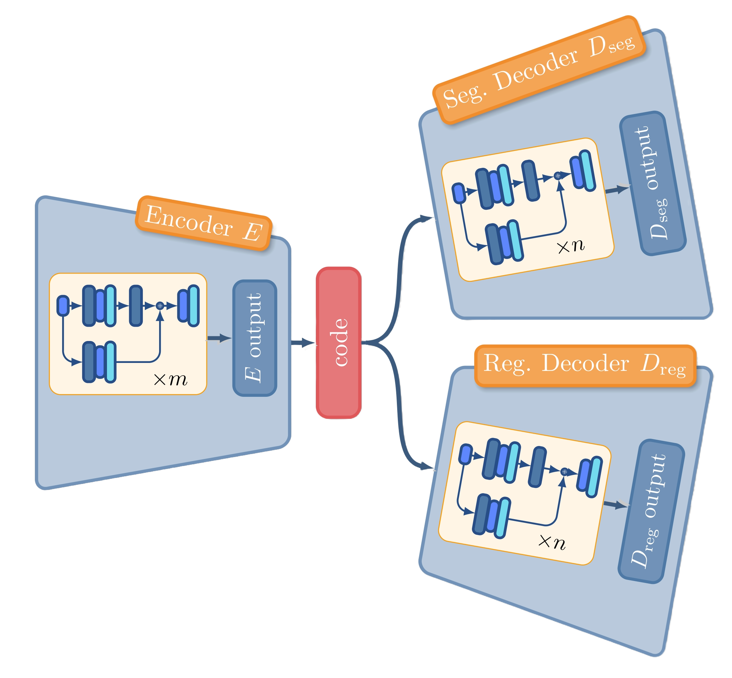
2D Encoder and Decoder
Time Sensitive
Not Time Sensitive
Smaller, faster encoder
Bulkier, slower decoder
Can stronger decoder compensate for a weaker encoder?

Slide 20
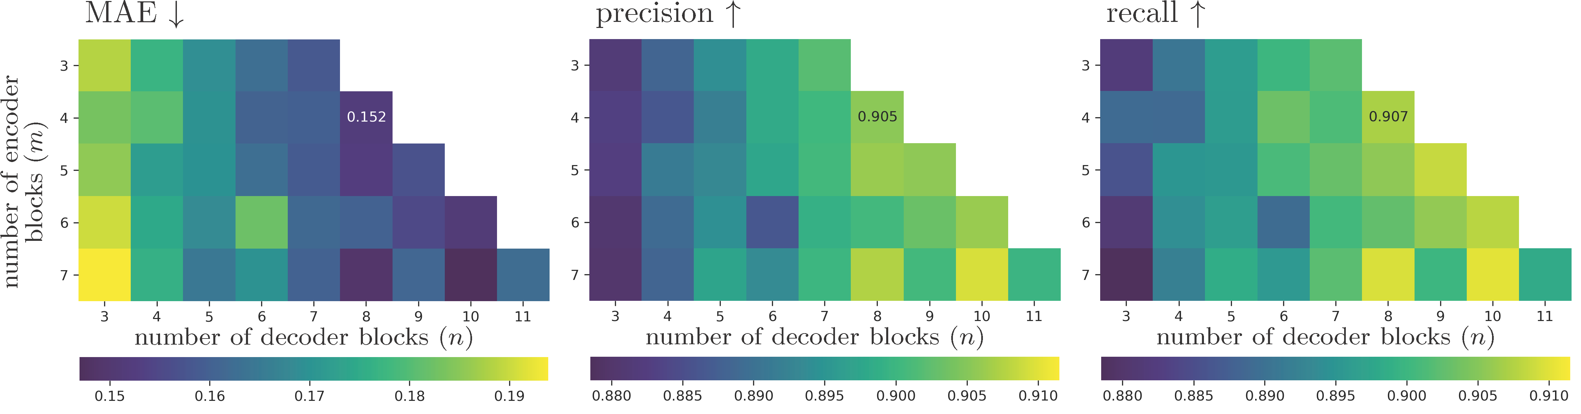
2D Encoder and Decoder
tunable encoder decoder sizes

Slide 21
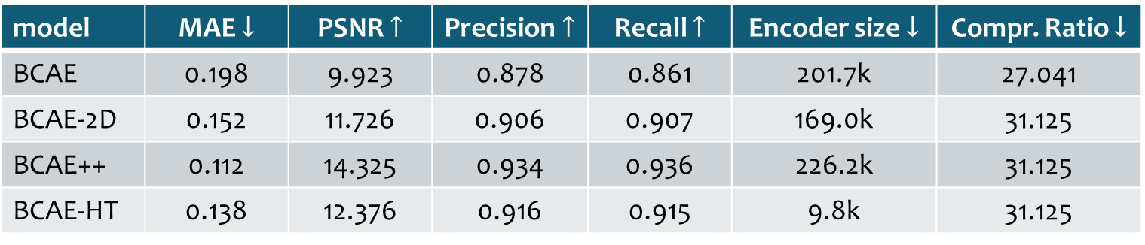
Performance comparison original BCAE versus BCAE-2D

Slide 22
Performance comparison
original BCAE versus BCAE-2D
From BCAE to BCAE++
3D convolution
Pad (16, 192, 249) to (16, 192, 256) for easy halving and an increased compression ratio
Remove normalization
Better reconstruction performance
Still slow

Slide 23
Performance comparison
original BCAE versus BCAE-2D
From BCAE to BCAE-HT
3D convolution
Pad (16, 192, 249) to (16, 192, 256) for easy halving and an increased compression ratio
Remove normalization
Much smaller intermediate output channels for higher throughput
Slightly better reconstruction performance
Super small model size
Higher throughput

Slide 24
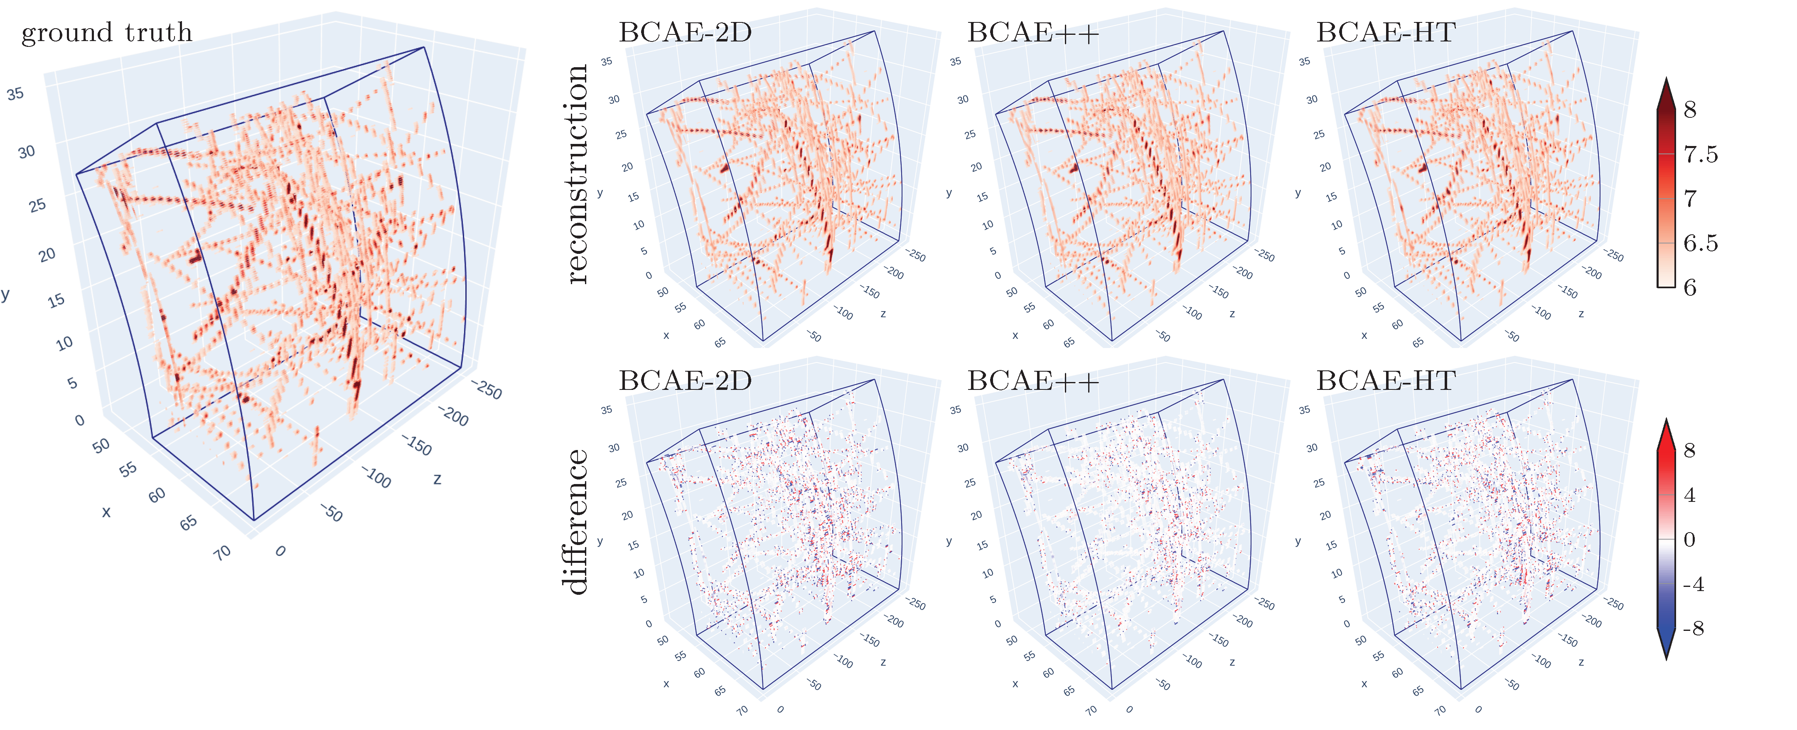
Performance comparison
original BCAE versus BCAE-2D

Slide 25
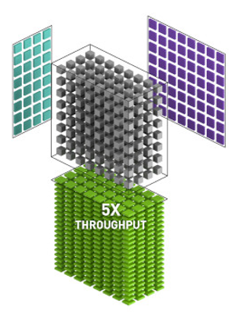
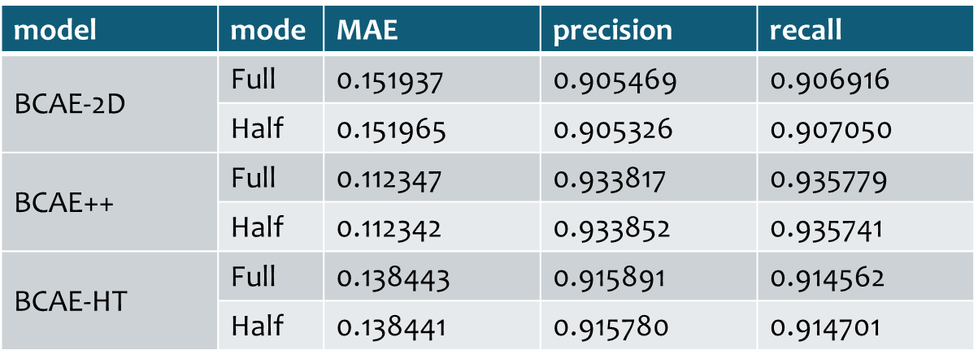
Throughput comparison
Full: encode with float 32, save code as float 16, decode with float 32
Half: encode with float 16, save code as float 16, decode with float 32

Slide 26
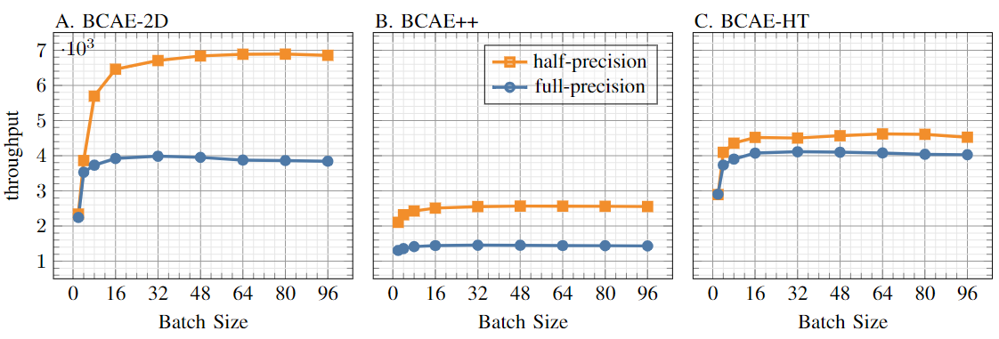
Throughput comparison
Measured on A6000

Slide 27
BCAE-2D
BCAE-HT
BCAE++
Huang, Y., Ren, Y., Yoo, S., & Huang, J. (2023, November). Fast 2D Bicephalous Convolutional Autoencoder for Compressing 3D Time Projection Chamber Data. In Proceedings of the SC'23 Workshops of The International Conference on High Performance Computing, Network, Storage, and Analysis arxiv:2310.15026
Question 1:
Can we have better performance and better throughput?
Higher throughput
Question 2:
Can we have variable compression ratio depending on occupancy?
Question 3:
Can we have variable throughput? Sparser the data, the less compute
Better recon. performance

Slide 28
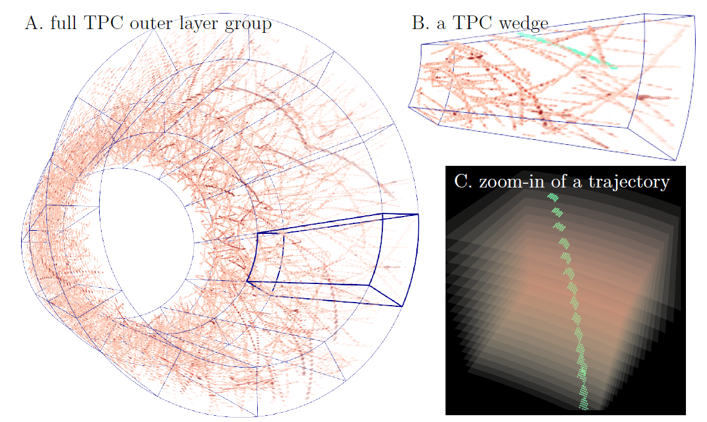

Slide 29
layer
time
azimuthal

Slide 30
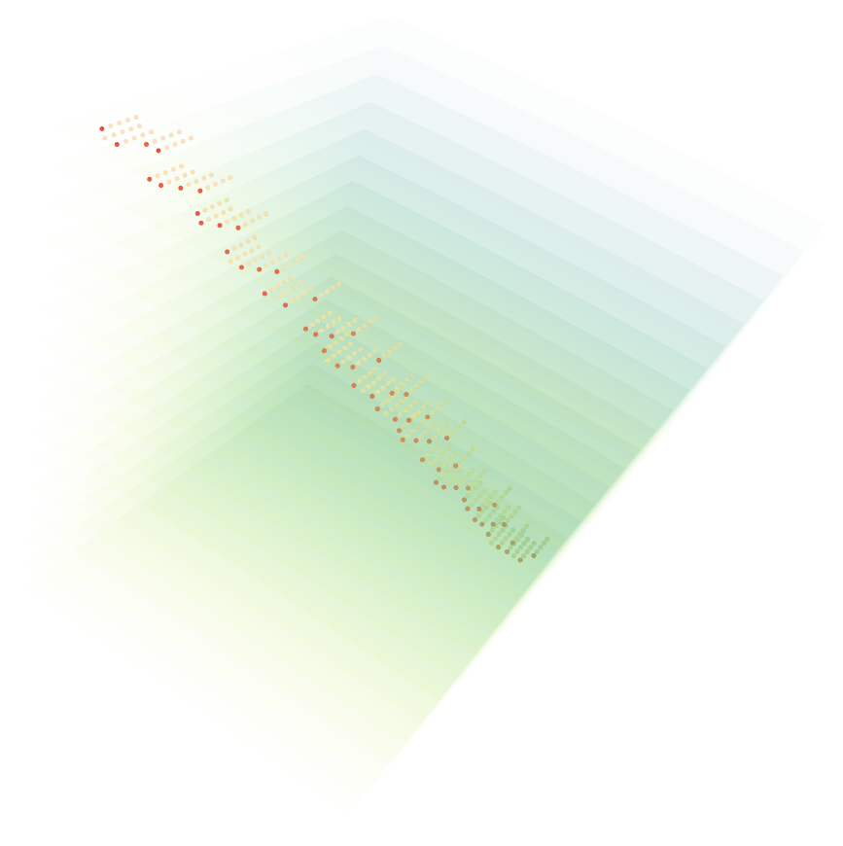
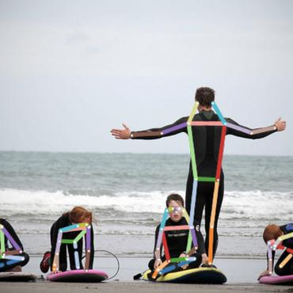
BCAE-VS: Bicephalous Convolutional Autoencoder with Variable ratio Compression for Sparse input
Locate the most valuable signals, and compress by down-selecting the signals
Keypoint Detection
layer
azimuthal
time

Slide 31
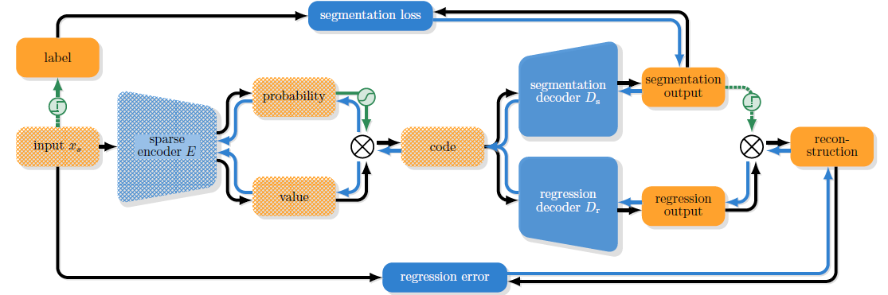
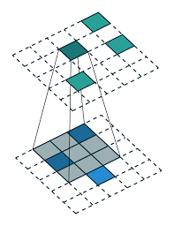
BCAE-VS
Bicephalous Convolutional Autoencoder with Variable ratio Compression for Sparse input
p₁=.92
p₂=.03
p₃=.12
Threshold = .9
…
x₁,y₁,z₁,a₁
x₁,y₁,z₁,v₁
p_{n}=.99
x₂,y₂,z₂,a₂
x₂,y₂,z₂,v₂
Sparse input
x₃,y₃,z₃,a₃
x₃,y₃,z₃,v₃
…
Sparse code
…
x_{n},y_{n},z_{n},a_{n}
v₁
v₂
x_{n},y_{n},z_{n},v_{n}
Implemented by MinkovskiEngine from NVIDIA
v₃
…
v_{n}

Slide 32
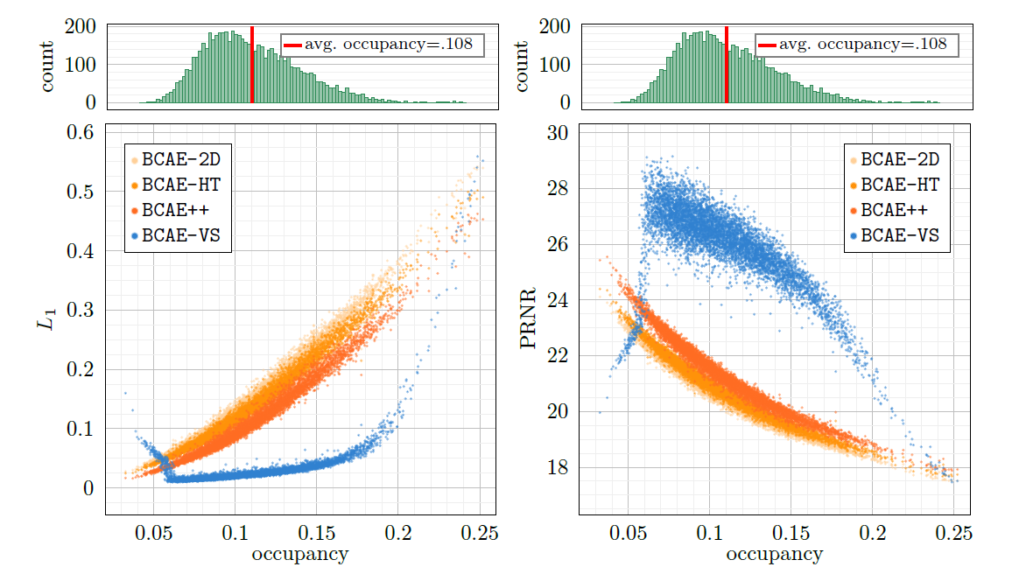
Reconstruction Accuracy

Slide 33
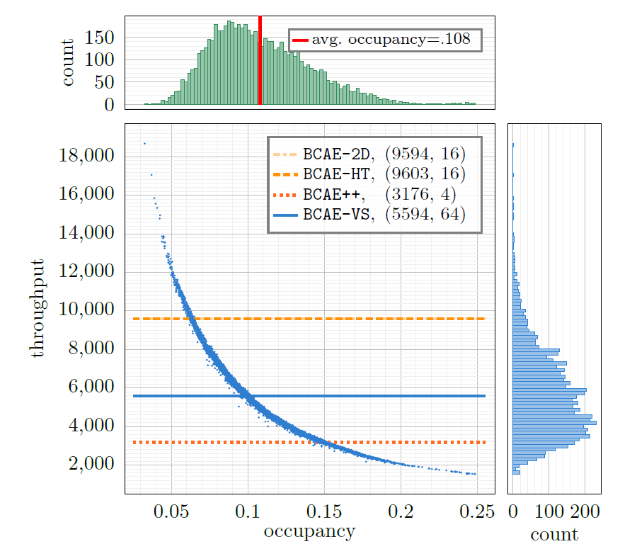
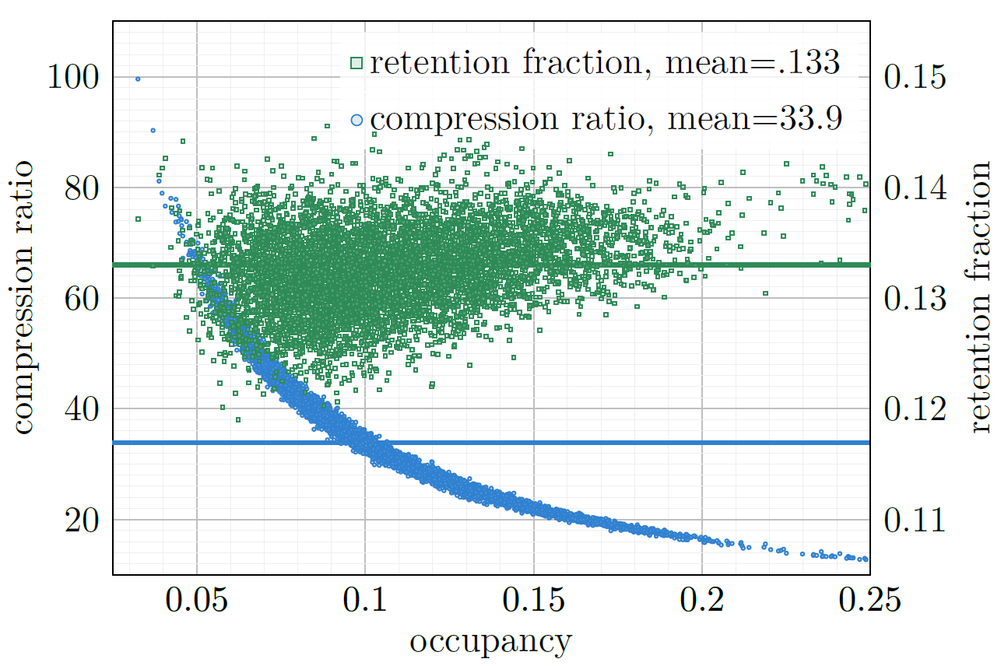
Variable Compression Ratio and Throughput
as Function of Occupancy
throughput = number of TPC wedges processed by one GPU per second. GPU we used is NVIDIA 6000 ADA.
fraction of signals saved to the persistent storage (~1/compression_ratio for ZS data)
Compress ratio of dense BCAEs:
Zero-padded Input size: code size

Slide 34
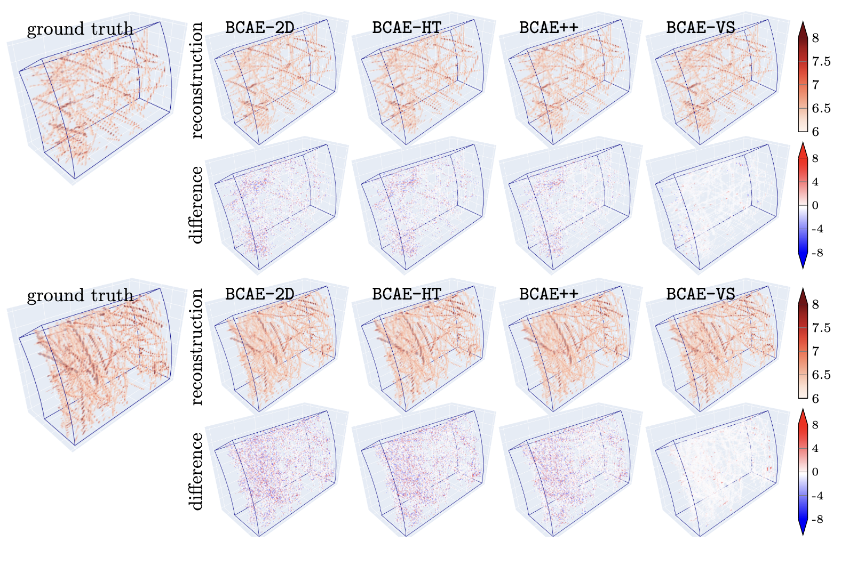

Slide 35
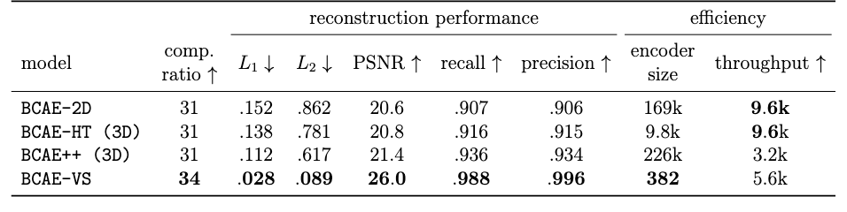
Performance comparison
Huang, Y., Go, Y., Huang, J., Li, S., Luo, X., Marshall, T., ... & Yoon, B. J. (2024). Variable Rate Neural Compression for Sparse Detector Data. arXiv preprint arXiv:2411.11942.
Notes:
1/5600 = 179 us per frame

Slide 36
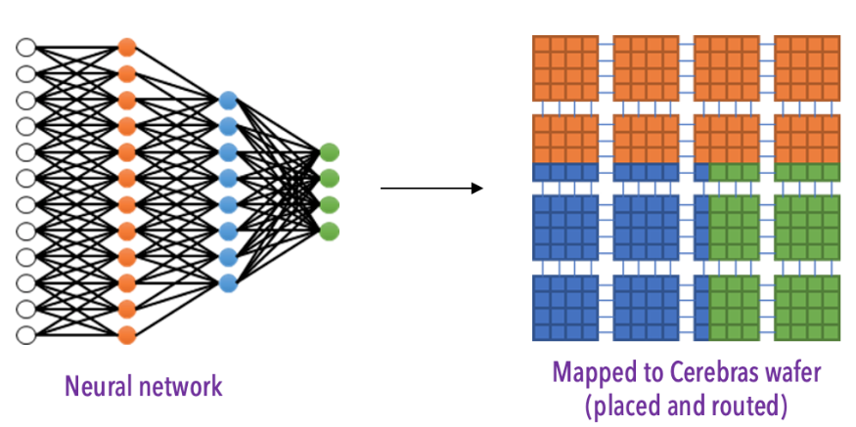
Summary
Bicephalous Convolutional Auto-encoder (BCAE) for sparse TPC data
Faster BCAE-2D with Encoder-Decoder tradeoff
Variable compression rate and computation with BCAE-VS.
(Future) Improve BCAE-VS in low occupancy region
(Future) Improve throughput of BCAE-VS on GPU and other hardware
(Future) noise rejection, tracking efficiency, etc.
Source Code:
BCAE https://github.com/BNL-DAQ-LDRD/NeuralCompression
BCAE-2D https://github.com/BNL-DAQ-LDRD/NeuralCompression_v2
BCAE-VS https://github.com/BNL-DAQ-LDRD/NeuralCompression_v3

Slide 37
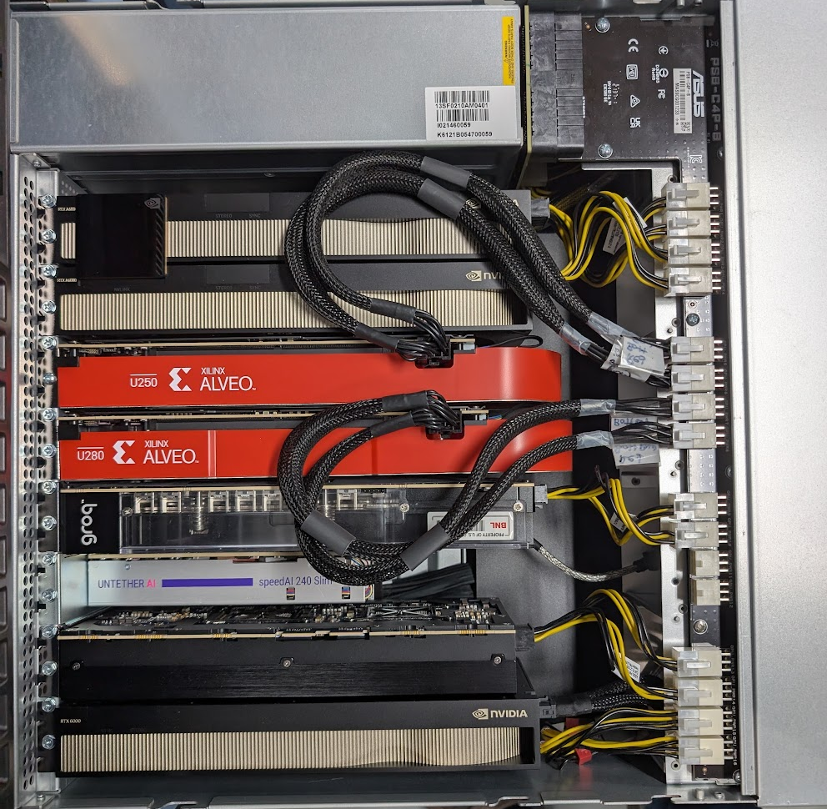
Summary
Bicephalous Convolutional Auto-encoder (BCAE) for sparse TPC data
Faster BCAE-2D with Encoder-Decoder tradeoff
Variable compression rate and computation with BCAE-VS.
(Future) Improve BCAE-VS in low occupancy region
(Future) Improve throughput of BCAE-VS on GPU and other hardware
(Future) noise rejection, tracking efficiency, etc.
GPU RTX A6000
x2 + nvbridge
FPGA x2
Xilinx ALVEO
Groq card
Feel free to try on your streaming detector data! Source Code:
BCAE https://github.com/BNL-DAQ-LDRD/NeuralCompression
BCAE-2D https://github.com/BNL-DAQ-LDRD/NeuralCompression_v2
BCAE-VS https://github.com/BNL-DAQ-LDRD/NeuralCompression_v3
UntetherAI SpeedAI
Tenstorrent n300s
GPU 6000 ADA

Slide 38
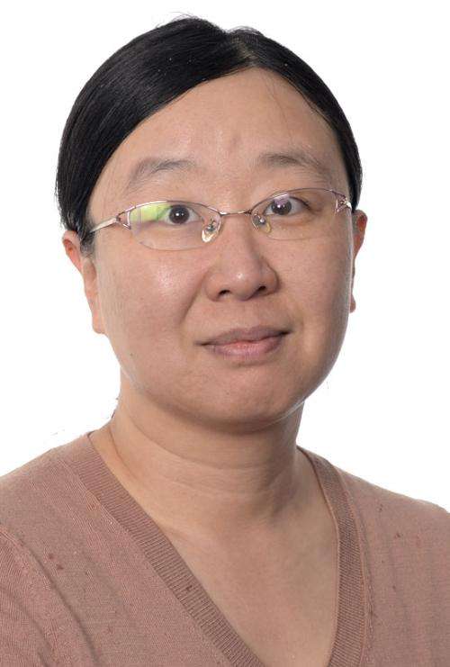
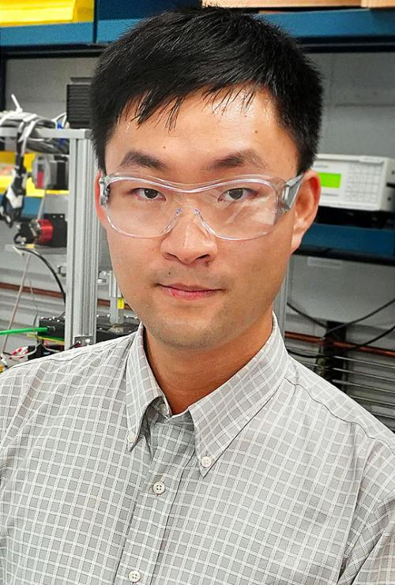
Thank you!
ありがとうございます
Yihui “Ray” Ren (yren@bnl.gov)
Yi Huang, Yihui “Ray” Ren, Yeonju Go, Xihaier Luo, Shuhang Li, Thomas Marshall, Joseph D. Osborn, Christopher Pinkenburg, Evgeny Shulga, Shinjae Yoo, Byung-Jun Yoon, Jin Huang (PI)

Slide 39
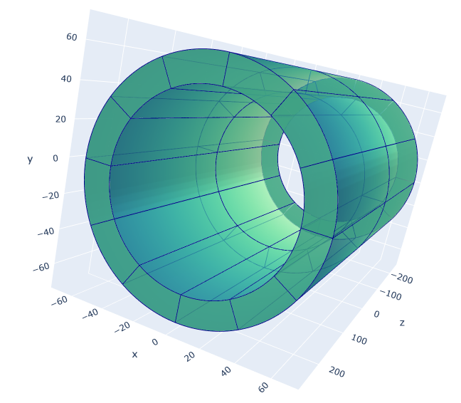
In this study, we are going to focus on the outer layer group:
16 layers along the radial direction
2304 columns of sensor nodes along the azimuth direction
498 rows along the beam direction
Subdivided into 24 TPC wedges of shape (16, 192, 249)

Slide 40
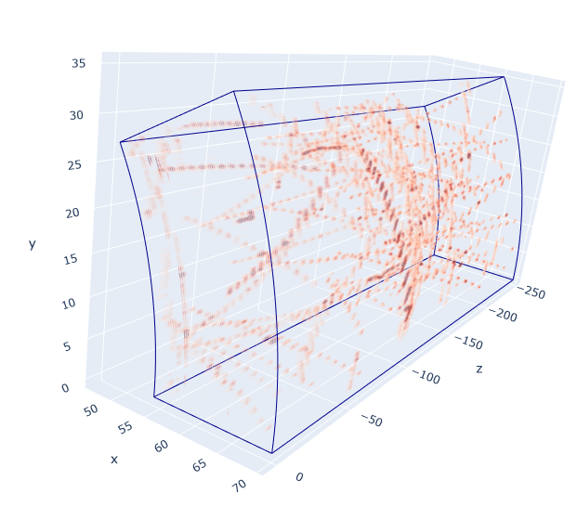
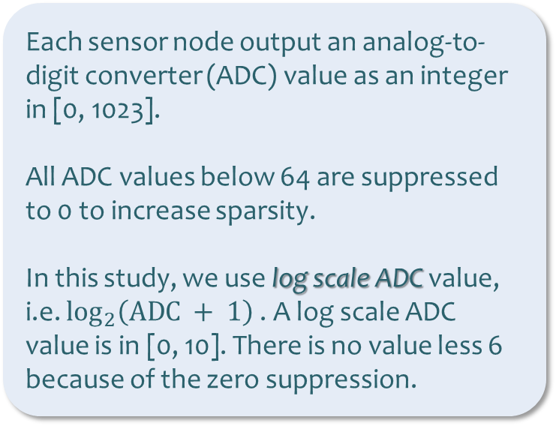
TPC wedges of shape (16, 192, 249)
Input to the neural compression algorithm
Each sensor node output an analog-to-digit converter (ADC) value as an integer in [0, 1023].
All ADC values below 64 are suppressed to 0 to increase sparsity.
In this study, we use log scale ADC value, i.e. $\log_{2}\left(\text{ADC} + 1\right)$. A log scale ADC value is in [0, 10]. There is no value less 6 because of the zero suppression.
Fig. Log scale ADC value in a TPC wedge

Slide 41
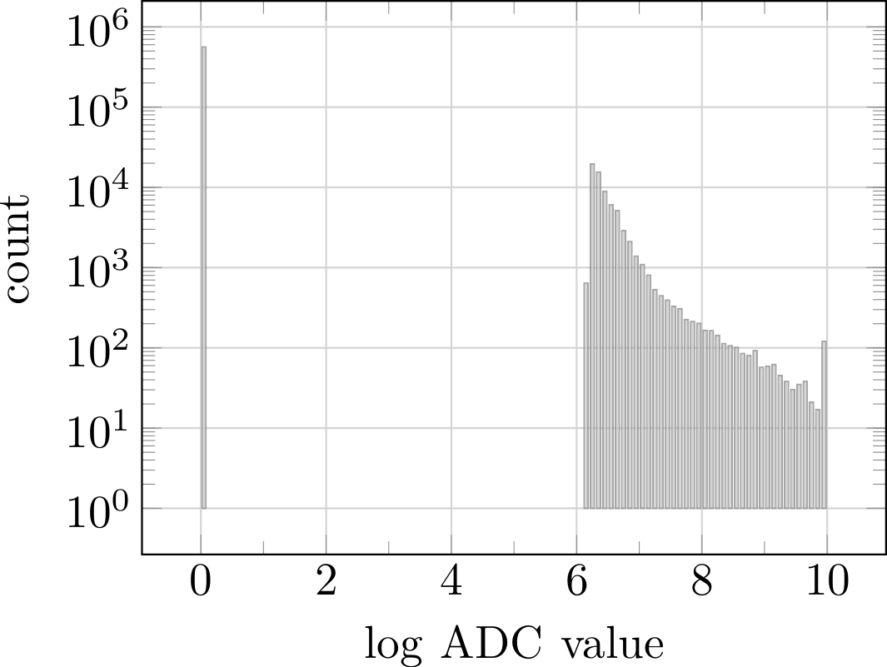
Discontinuous, bi-modal distribution

Slide 42
Neural Compression
Design neural compressor for discontinuous distribution

Slide 43
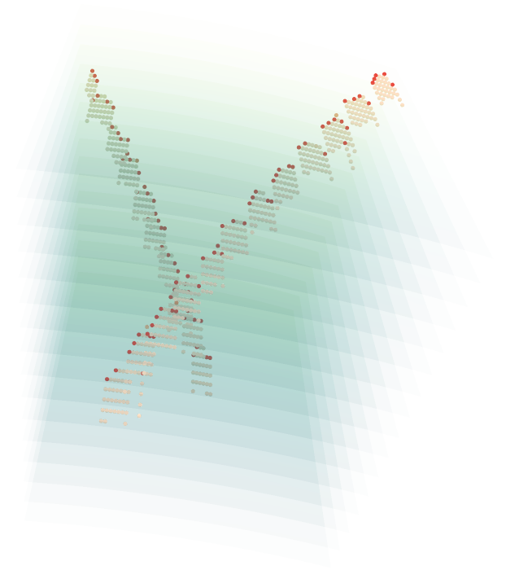
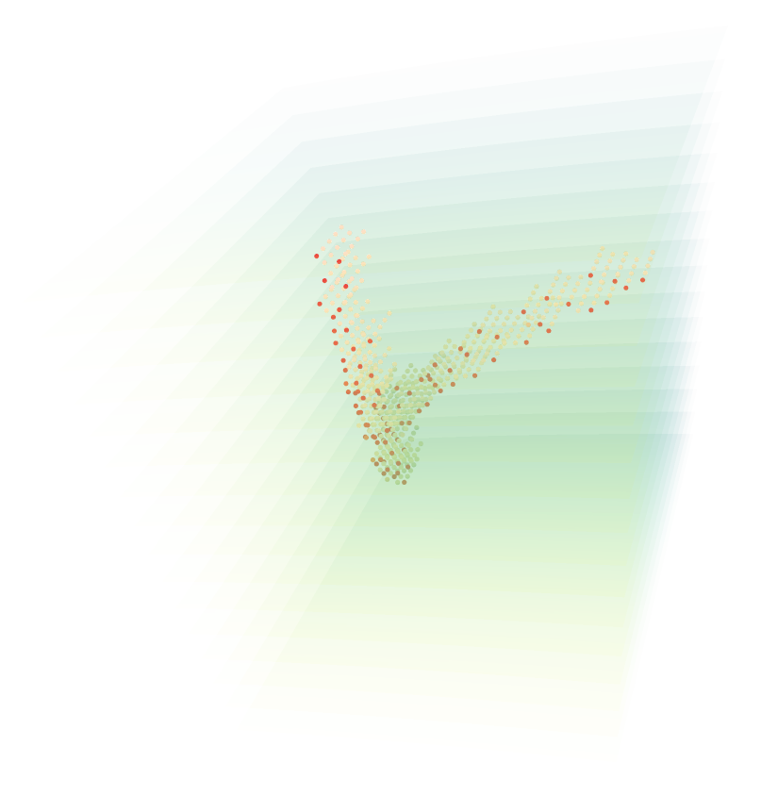
Locate the most valuable signals

Slide 46
BCAE-VS
Variable ratio Compression for Sparse input
Sparse
Convolution

Slide 47
Reconstruction Accuracy

Slide 48
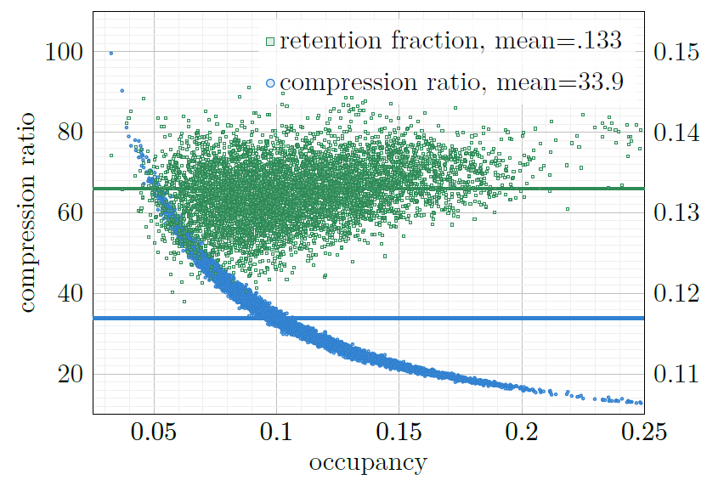
Variable compression ratio and Throughput
as function of sparsity

Slide 49
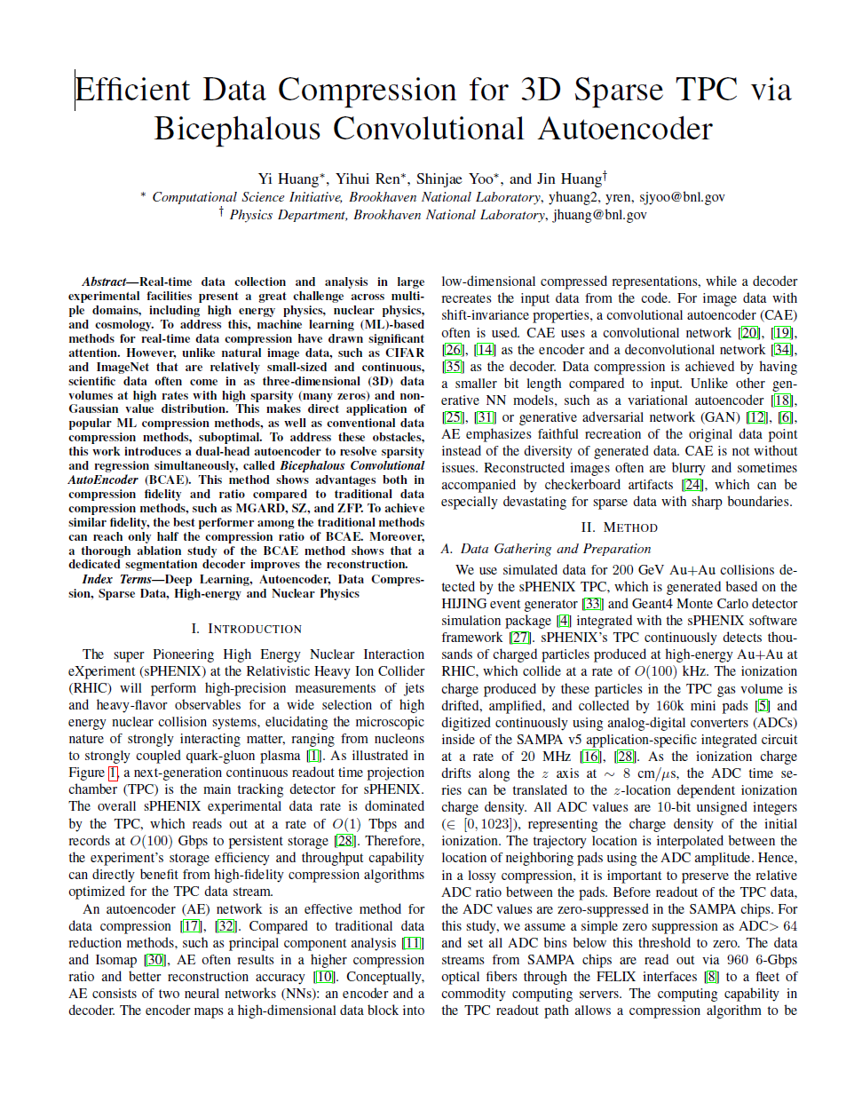

BCAE
https://arxiv.org/pdf/2111.05423.pdf

Slide 50


Sanity Check with lossless compressions
Compare to lossless compression tools. More than twice compression ratio.
Compressed code of BCAE can not be compressed further.
How is our model comparing to
other lossy compression algorithms?

Slide 51

Real-time AI accelerator
gpuserver0.sphenix.bnl.gov
Gpuserver0 upgrade yesterday
L40S removed for RMA
Three AI chips:
  Groq: TPU based
  UntetherAI: INT8 optimizes
  Tenstorrent: RISC-V cores
More photos: https://photos.app.goo.gl/z3AnNhfrd4bqZTeN6
GPU RTX A6000
x2 + nvbridge
FPGA x2
Xilinx ALVEO
Groq card
UntetherAI SpeedAI 240
Tenstorrent n300s
GPU 6000 ADA

Slide 52

Summary
Bicephalous Convolutional Auto-encoder (BCAE) for sparse TPC data
Faster BCAE-2D with Encoder-Decoder tradeoff
Variable compression rate and computation with BCAE-VS.
(Future) Improve BCAE-VS in low occupancy region
(Future) Improve throughput of BCAE-VS on GPU and other hardware
(Future) noise rejection, tracking efficiency, etc.
Source Code:
BCAE https://github.com/BNL-DAQ-LDRD/NeuralCompression
BCAE-2D https://github.com/BNL-DAQ-LDRD/NeuralCompression_v2
BCAE-VS https://github.com/BNL-DAQ-LDRD/NeuralCompression_v3

