Slide 1
ePIC Timing and Synchronization
The requirements
The designs
Test results
Summary

Slide 2
1. The requirements
1.1 Synchronized control
Streaming Data
Time Frame 1 …
Time Frame M
Time Frame M+1
Time Frame M+2
Time Frame M+3
Time Frame M+4
Time Frame M+5
START
RE-START
RE-START
STOP
START
RE-START
RE-START
RE-START
RE-START: STOP and START at the same Beam Crossing
Whole detector dead time
1.2 Jitter of the FEB/ASIC received clock: less than 5ps;
1.3 For TOF detectors, the phase of the clock relative to the beam crossing center point is stable (less than 5ps);
1.4 For dRICH detector, the phase of the clock relative to the beam crossing center point is stable (< ~100ps) for shutter implementation (zero suppression)

Slide 3
2. The designs
2.1 The EIC beam crossing
 | Electron Storage Ring (ESR) | Hadron Storage Ring (HSR) (N_{b}=290) | HSR (N_{b}=1160)
Circumference C [m] | 3833.940 | match T_{rev} | match T_{rev}
Revolution period T_{rev}=C/c [µs] | 12.7886
RF harmonic number h [-] | match HSR | 2520 | 7560
RF bucket spacing T_{b}=T_{rev}/h [ns] NOT bunch spacing!!! | match HSR | 5.075 | 1.692
Number of bunches N_{b} | match HSR | 290 | 1160
Bunch spacing T_{bun} [ns] | match HSR | 40.599 | 10.150
Gap length [ns] | match HSR | 1015 | 1015
Beam crossing: 98.525 MHz or 10.150ns
Orbit period: 12.7886 µs or 1260 Beam Crossing
 | ESR | HSR
RMS bunch length σ_{z} [mm/ps] | 7-9/23-30 | 75-60/250-200
RMS momentum spread [10⁻⁴] | 5.8-10.9 | 10.3-6.8
RMS horiz beam size σ_{x} [um] | 100-250
σ_{z}/σ_{x} ratio [-] | 28-90 | 240-750
Electron Beam Energy: 5 – 18 GeV
Proton Beam Energy: 41, 100 – 275 GeV
Luminosity: 10³⁴ cm⁻²s⁻¹

Slide 4
2. The designs
2.2 The ePIC clocks:
Single clock source, distributed to the whole system
Streaming Data
Time Slice M-1
Time Slice M
Time Slice M+1
Time Slice M+2
Time Slice M+3
Time Slice M+4
Time Slice M+5
Beam crossing ( * electron ion collision )
* * * * * * * *
* * * * * * * *
* * * * * * * *
1 1 1 1
1 1 1 1 1 1 1 1 1 1 1 1
1 1 1 1
2 2 2 2
1 1 1 1 1 1 1 1 1 1 1 1
2 2 2 2
5 5 5 6
5 5 5 5 5 5 5 6 6 6 6 6
5 5 5 6
SRO data header:
Packet number,
Data source ID,
Starting orbit count
Starting BX count
SRO data trailer:
Ending orbit count
Ending BX count
Sync/Error/buffer status
Total word count
7 8 9 0
1 2 3 4 5 6 7 8
3 4 5 6 7 8 9 0 1 2 3 4
7 8 9 0
1 2 3 4
1160 (all or 1/4 with beam)
100 (no-beam /gap)
BX_Clock, 98.5 MHz
GTU→DAM, 9.85 MHz
lpGBT_Clock, 39.4 MHz
Any other clocks
All the clocks are phase aligned (fixed)
Nominal Time Slice: 65530 (~2¹⁶) BX, ~0.6 ms, settable in GTU (Synchronization check)

Slide 5
2. The designs
System Clock: 9.85 MHz
2.3 The ePIC Timing/Control distribution
Online computer
Status
GTU: Global Timing Unit
control encoding, status decoding.
The interface for machine clock source,
Data acquisition control and monitor etc.
DAM: Data Aggregation Module:
The clock/control fanout, and status/busy accumulation.
local control over the RDO boards connected, though the main function of the DAM is for Data Acquisition.
RDO: optical interface of detector ReaDOut
control decoding, status encoding.
The clock/control interface to the front end electronics.
Data collection from Frontend boards, and data transmission to the DAM
FEB:
Detector dependent Front End / ASIC carrier boards.
GTU
GTU (O)1
Control
EIC
Common
Platform
Clock
Data Acquisition
DAM
(O)100
DAM
DAM
RDO
(O)1000
RDO
RDO
RDO
RDO
FEB
FEB
FEB
GTU distributes 9.85 MHz clock, and DAM reconstructs the 98.5 MHz, (and) 39.4 MHz clock

Slide 6
2. The designs
2.3: Synchronization
GTU
DAM/RDO to implement time measurement, so that RDOs can compensate the fiber length delay to within one clock period; but, it is easier to use same-length fibers.
GTU/DAM to keep a 11-bit beam crossing counter (terminates at 1260), synchronization check with streaming readout time slice (start/stop) commands; online/offline check with beam orbit structure (collision or no collision);
RDO to keep a 11-bit beam crossing counter (terminates at 1260), or a 9-bit beam crossing counter (terminate at 504 for lpGBT protocol), and a 6-bit (min. ~818 ms), 21-bit (preferred, ~26seconds), or 32-bit (over 15 hours) beam orbit counter;
GTU and DAM should keep a larger beam orbit counter;
RDO to keep a 16-bit (min), or 32-bit (preferred) time slice counter. This counter should not overflow for the maximum DAQ computer buffer.
RDO should assert buffer high_marker no later than one orbit period before it is full and starts to lose data.
RDO starts a new data packet upon receiving time-slice_start, and end the current packet upon receiving time-slice_end or upon receiving a new time-slice_start.
RDO to hold data if the DAM is busy (potential buffer full), and the DAM to hold data if the host computer/Network switch is busy.
The GTU can record dead time by sending TimeSlice_end, and holding TimeSlice_start in responding to RDO busy.
RDO should generate one packet on every readout time slice. The RDO can discard detector data to avoid buffer overflow, or out of synchronization, but this occurrence must be recorded in the data package/trailer.
Data flow
DAQ
Data Buffer ‘FULL’ backpressure
DAM
Status accumulation:
Data Buffer conditions, Out of Sync, Reset_request, etc.
Run_control:
SRO_time_start/stop, RESETs, etc.
RDO

Slide 7
2. The designs
2.4 The hardware design
2.4.1 GTU
GTU required:
EIC common platform interface;
Run Control;
~150 DAM interface
Risk mitigation:
Beam vs clock phase monitoring;
Dedicated clock fanout to TOF
Between GTU and DAM
Same-length Multimode fibers: 4 Tx/4 Rx (inexpensive, standard, commercially available)
Clock @ 9.85 MHz
GTU_CONTROL
GTU
DAM/RDO Status
DAM
Optional/extra

Slide 8
2. The designs
2.4 The hardware design
2.4.2 DAM
DAM clock reconstruct,
98.5 MHz and 39.4 MHz,
Phase aligned with the 9.85 MHz clock,
Additive Jitter ~1ps;
Phase: fixed
Run control
SYNC the run control from GTU and repack in lpGBT format at 39.4 MHz, or non-lpGBT format at 98.5 MHz
ASIC setup, and RDO/FEB monitoring
The DAM will have one MTP fiber port connects to GTU, 48 ports (duplex) connect to 48 RDOs (one port each), and PCIexpress to host PC.

Slide 9
2. The designs
2.4 The hardware design
2.4.3 RDO
For non-lpGBT,
RDO MGT RECovered Clock:
Additive Jitter <3ps;
Phase: stable,
fixed with PseudoClock (serialized clock/control from DAM)
The RDO de-codes the control synchronously, and the RDO/FEB/ASIC configuration;
Assemble time-frame data, also RDO/FEB/ASIC status
(non-lpGBT data format)
The RDO will have one fiber port (two fibers) connect to the DAM, and several ports connect to FEB/ASIC
VTRX+ on the RDO for radiation
This (3.94 Gb/s stream) can also be received by 7.88 Gb/s receivers
For lpGBT (on the RDO or FEB), the RDO will pass on the downlink (in lpGBT format) from DAM to lpGBT

Slide 10
2. The designs
2.5 The risk mitigation
2.5.1 Clock phase (RDO/lpGBT recovered clock versus electron beam) monitoring:
2.5.2 Dedicated clock from GTU to TOF_RDO
GTU: Phase Correction
GTU_Optic Transmitter plugin modules
Clock only, to TOF_RDO (optional)
Optic transmitter
Optic Transceiver plugin module
RF-SoC (?)
Optic transmitter
Power
regulators
PhaseOrbit (average)
Optic transmitter
4 U high
Optic transmitter
Optic transmitter
Clock fanout
Phase#1
Phase#2
Phase#1160
Phase#1
Optic transmitter
RDO(area) Clock
Possible choice of Optic Transmitters:
Samtec FireFly, 12 ch TX,
MTP_12 at GTU
LC at RDO
e⁻ Beam pickup

Slide 11
2. The designs
2.6 The data format
2.6.1 Between GTU and DAM
PCB Transmitters
Clock @ 9.85 MHz
PCB Receiver
Downlink
GTU_CONTROL, “(min) 8-bits (+ 1 k_bit) @ 98.5 MHz” & “480-bits @9.85 MHz”
FPGA MGT Transceivers
FPGA_MGT Transceiver
Uplink
DAM/RDO Status, “(min) 8-bits (+ 1 k_bit) @ 98.5 MHz” & “480-bits @9.85 MHz”
FPGA IOB Transceivers
To fully use the DAM connection
FPGA_MGT Transceiver
GTU
DAM
The 9.85 MHz clock is also used to align the DAM boards by using the same (length, type) fibers (Synchronization)
2.6.2 Between DAM and RDO/FEB (one-pair of fibers)
Downlink
64-bit at 39.4 MHz for lpGBT, or 64-bit @ 98.5 MHz (for example) for non-lpGBT
lpGBT or FPGA_MGT Transceiver
FPGA MGT Transceivers
Uplink
256-bit at 39.4 MHz for lpGBT, or 64-bit @ 98.5 MHz (for example) for non-lpGBT
DAM
RDO
DAM aligns and repacks the packet (from GTU), and sends the relevant information to the RDO at 39.4 MHz, or 98.5 MHz. The RDO receives the ‘downlink’ after a fixed (same) delay (relative to the GTU generation).

Slide 12
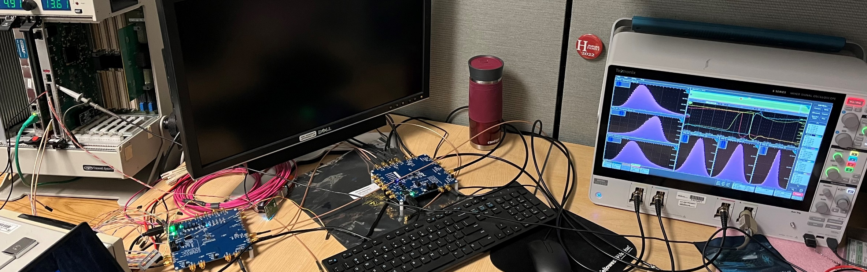
3. Test results
3.1 Clock distribution
Test SETUP
MM
fiber
Si5344H
Clk: 98.5 MHz
Clk: 39.4 MHz
Jlab TI
(/10) 9.85 MHz
SYNC
Optic Tx, Rx
Clk: 9.85 MHz
Si5394A
(x10) Clk: 98.5 MHz
(x4) Clk: 39.4 MHz
Copper
cable
Copper
cable
Copper
cable
EIC_Clock
GTU
DAM

Slide 13
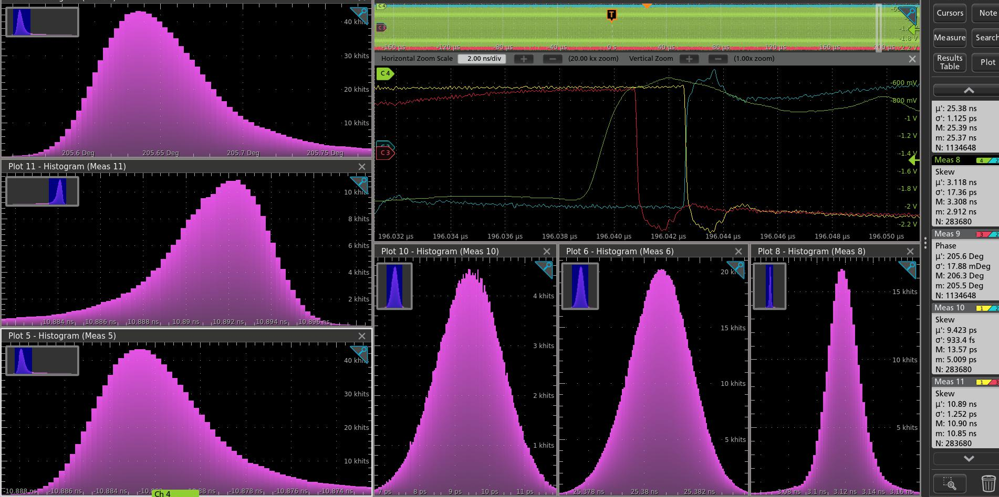
3. Test results
3.1 Clock distribution
Test SETTING
/10 SYNC: on the Jlab’s TI (GTU simulator) every 1,073,741,830 Clock_98.5 MHz cycles → ~ 11 seconds,
The Si5394A (DAM simulator) needs ~ 2 seconds to synchronize (0x001E[2], R divider reset) the X10, X4 clocks
Results:
The “/10” or 9.85 MHz distribution works (DAM can recover the 98.5 MHz and 39.4 MHz clock synchronously)
The phase stability (jitter): std: < 1.5 ps
The tails (10s ps) are caused by the cable noises (more in BACKUP slides)

Slide 14
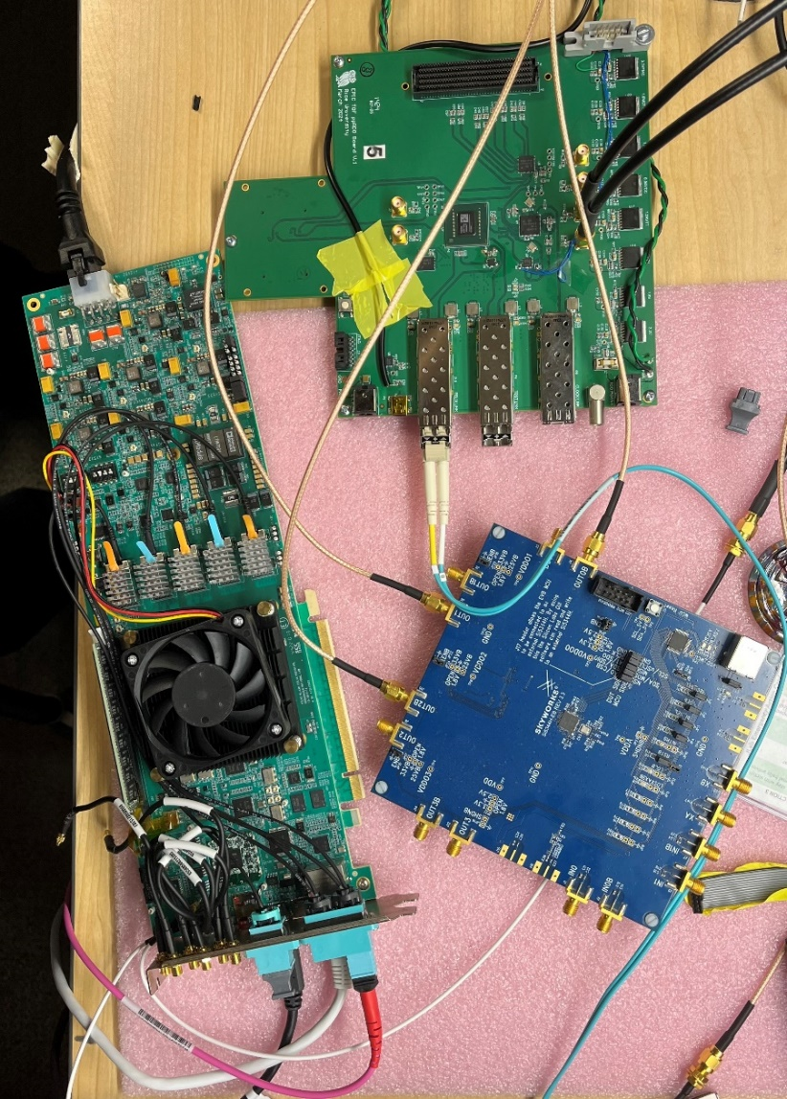
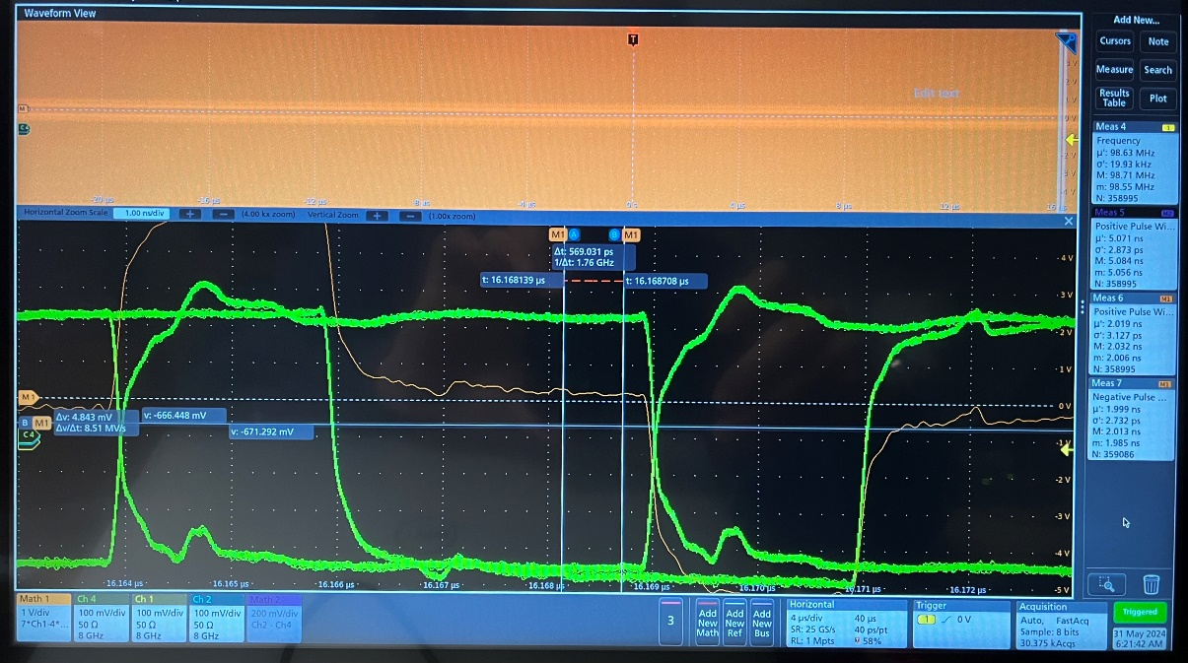
3. Test results
3.2 DAM TX serialized clock/control
3.2 non-lpGBT RDO recovered clock
Si5344 → FLX182 → ppRDO
(Reference_Clock → Txserilizer → PseudoClock)
ppRDO
(ADCLK944)
Si5344H
(ref Clock)
FLX182
Pseudo_Clock (TxSerializer and RDO_fanout): Jitter: 3ps; Phase: stable
RxRECclk (from FPGA’s MGT) jitter < 3 ps. RxRECclk phase can be fixed at ~(0)ps precision (by measuring the phase difference between the RxRECclk and the pseudoClock, and resetting the RxRECclk CDR.)

Slide 15
3. Test results
3.3 test results from others
3.3.1 results from Jlab’s 12 GeV upgrade: dedicated clock distribution
3.3.2 results from CERN (related) on the lpGBT
Trigger SuperVisor
PCB and backplane
Copper traces
Signal Distributor
PCB and backplane
Copper traces
Trigger Distributor
schambachjj@ornl.gov
Optic Transceivers
Multi-Mode fibers
lpGBT recovered clock (through VTRX+ optic transceiver):
TIE: σ = 1.0 ps
Phase difference (jitter) : σ = 1.78 ps
Trigger Interface
Clock Jitter (from Trigger Interface) σ < 3ps
The synchronization (run control, busy feedback, etc.) works

Slide 16
4. Summary
4.1 Status
4.1.1 GTU: prototype is being considered
we plan on finalizing the development in 2025.
Clock
Receiver, control, distribution
A 4U (high, 19 inch wide) rack mounted box consisting of one GTU base board (16.8 inch wide max), and many Optic transceiver plugin modules (4U high max, to DAM)
16.8 inch wide (max)
FPGA
Run Control
Memory
‘services’
Quad optic TRX
Optic Transceiver plugin module
4 U/7” high (max)
Quad optic TRX
FPGA (SOM)
Quad optic TRX
Power
regulators
Quad optic TRX
Clock fanout
Quad optic TRX
Quad optic TRX
FPGA
Quad optic TRX
Quad optic TRX
Quad optic TRX
Clock fanout
Possible buffers
Power
supplies
Quad optic TRX
Quad optic TRX
Possible choice of Optic Transceivers: Finisar FTL410Q, or SAMTEC firefly B04-14
GTU base board
Possible choice of plugin connector: PCIe x16
All the electrical signals are differential signals (PCB and connector). Three FPGAs with fast interconnect.

Slide 17
4. Summary
4.1 Status
4.1.2 DAM: FLX155 (ePIC DAM) engineering article is expected early next year (after the tests in BNL going on right now)
FLX155: Designed for ATLAS FELIX upgrade,
it is consistent with EIC/ePIC schedule.
GTU
RDO
PCIe to host computer

Slide 18
4. Summary
4.1 Status
4.1.3 RDO: preprotype RDO
Clock reconstruction is tested. Moving on to VTRx+ and lpGBT compatible design and testing

Slide 19
4. Summary
4.2 Conclusion
4.2.1 The design can satisfy all these four requirements, the tests and other experiments’ implementations proved that the requirements can be met.
4.2.2 More tests are needed to see if the risk mitigations (designed for requirement 1.3) are needed. The tests are expected to finish in 2025 with the new hardware.

Slide 20
Thank you

Slide 21
2. The designs
2.2 The ePIC clocks
Single clock source, distributed to the whole system
BX_Clock, 98.5 MHz
GTU→DAM, 9.85 MHz
lpGBT_Clock, 39.4 MHz
Any other clocks
One orbit cycle = 1260 Beam Crossing
1260 = 2x2 x 3x3 x 5 x 7 ; 1160 + 100 = 2x2 x 5 x (58 + 5)
BX: 98.525 MHz,
lpGBT: 98.525 x 2 / 5 = 39.41 (MHz)
SALSA: 98.525 / 2 = 49.26 (MHz)
dRICH: 98.525 *4 = 394.1 (MHz)
……

Slide 22
2. The designs
RunControl computer
2.3 RunControl and DAQ
2.3 The ePIC Timing Control distribution
EIC, RF
Ethernet
PCB and fanouts:
Additive Jitter <1ps
Phase: fixed
System clock
(98.5MHz /10)
Two-level fanouts
Beam orbit
Beam Orbit synchronized RunControl
RunControl: Run_Start/Stop, Run_type, config, Reset, Synchronization, SRO time_start/stop, Throttling…
GTU
Status: Buffer busy, out of sync …
Dedicated fiber:
Additive Jitter <1ps
Phase: fixed
9.85 MHz
7.88 Gbps
Host PC
PCB and fanouts:
Additive Jitter <1ps
Phase: fixed
Clock reconstruct
(Si5395A, ZDM)
DAM
Control config, status
DAQ
RunControl: forward or ‘hijack’ the GTU control;
DAM, RDO, FEE/ASIC configuration, readout backpressure
9.85 MHz, 98.5 MHz, 39.4 MHz
RefClk
TX/RX
Status: Buffer, sync, etc.
GTY
Optic fiber cable:
Additive Jitter <1ps
Phase: fixed
lpGBT compatible: Tx: 2.52 Gbps, Rx: 10.09 Gbps
Non-lpGBT: Tx: 3.94/7.88 Gbps, Rx: 7.88 Gbps
GTY Rec Clock:
Additive Jitter <3 ps
lpGBT rec Clock:
Additive jitter < 3 ps
Clock recovery
(optional iitter cleaner)
Clock fanouts
RefClk
TX/RX
Control
Config
DAQ
Config synchronized with beam crossing /10, FEE/ASIC readout and control
RecClk
GTY
lpGBT
RDO
Status: Buffer, sync, etc.
FEE/ASIC

Slide 23
2.3: Synchronization
Synced CONTROL Distribution
Fixed latency from GTU to DAM, and RDO
The fibers from GTU to DAM will be the same length/delay routed in the DAQ computer racks.
The fiber delays from DAM to RDO will be measured individually, and saved on the RDO. The RDO will delay the received GTU control commands (compensating for the fiber latency), so that all the RDOs will send the GTU commands at the SAME time. It is easier using the same length fibers.
Beam orbit information is embedded in GTU control command
The GTU, DAM and RDO will all keep (at least) two counters, Beam Crossing counter (11-bit from 1 to 1260, 9-bit from 1 to 504 with lpGBT), and Beam Orbit counter (at least 5-bit, for a total time period of about 400 µs)
The GTU will send SRO (Streaming ReadOut) time window start command and some other SYNC commands on the first, eleventh, …(every tenth) beam crossing of the orbit. The size of RDO time window can be set on the GTU.
DAQ data flow control
There are data buffers on DAMs and RDOs. The buffer status is monitored by GTU, DAM and RDO.

Slide 24
2.4.1. GTU design: Inputs and Outputs
MTP fibers, ~10 meters
Online computer
Run Control
GTU
Clock, Control, status
DAM
GBE
MTP
MTP: 4 Tx/4 Rx
MTP
Clock, Control, status
DAM
Clock @ 9.85 MHz
EIC common platform
Beam synced Clock, orbit
~150
GTU_CONTROL
CLOCK distribution
DAM/RDO Status
MTP
Clock, Control, status
DAM
Optional/extra
LC fibers, ~100 meters
Beam monitor
RDO clock phase
LC
Clock
TOF_RDO
LC
Clock
TOF_RDO
~600
LC
Clock
TOF_RDO
Risk mitigation for extremely stringent requirement by TOF

Slide 25
2. The designs
2.4.1 GTU detailed design: clock ‘area’
ZDM
EIC common platform interface
OSC
IN3
OUT9
Si5395
OUT0
To plugin optic transmitters
98.5 MHz
IN1
9.85 MHz
OUT1
AD9510
IN0
OUT0
OUT2
OUT3
AD5330x
To plugin optic transceivers
BXclock
IN0
OUT4
OUT4
AD5330x
OUT5
Clock phase adjustment
Clock_Sync
SPI
Fanout
I2C
Beam Phase monitoring
Orbit
To FPGAs
FPGA (SOM)

Slide 26
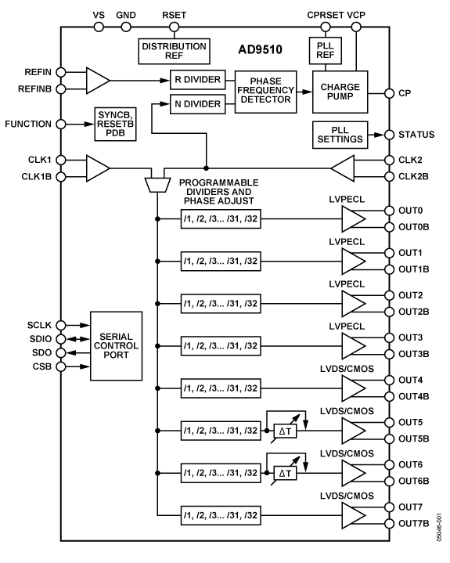
2.4.1 GTU detailed design: AD9510 synchronous clock divider (clk1 input)
Analog Devices AD9510
Additive output jitter (rms)
LVPECL: 225 fs
LVDS/CMOS: 275 fs
Used on the Jlab’s Trigger Interface (TI) modules to generate SYNCHRONIZED /2, /4, /6 and /8 lower frequency clocks.

Slide 27
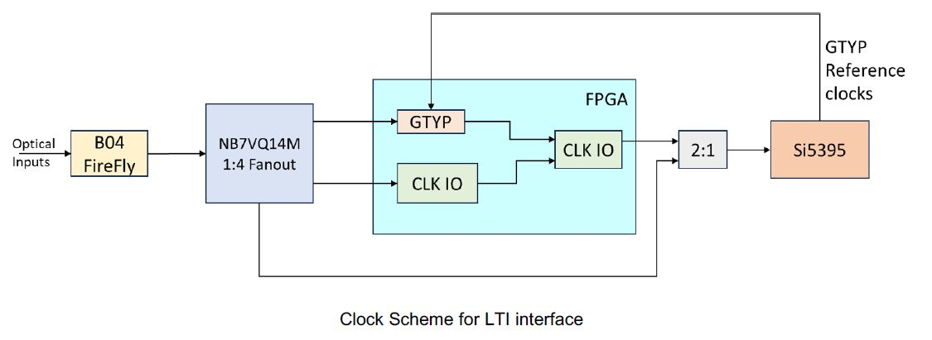
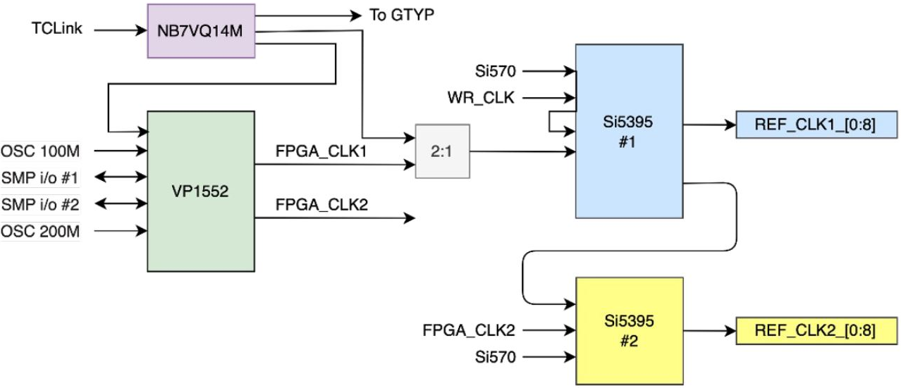
2.4.2 DAM (FLX155) clock interface
Dedicated Clock input,
up to three MGT lanes (Tx/Rx)
MTP multimode 850µm optical
* These two diagrams are from FLX155 presentations

Slide 28
3.2 ppRDO clock design
SMA cables to oscilloscope
SMA
RED/RED: FPGA package pins, or Si5345 package pins
Zero Delay FB
optional emergency circuit I²C
IN3
Out9
(N/M)* 98.5 MHz
Out1
pseudoClock
98.5 MHz
Out0
23/24
Out1
1:4 ADCLK944
Si5345
27/28
RX
SMA
197 or
394 MHz
SMA
Fiber
14/15
IN2
DAM
SMA
SMA
Optic transceiver
Out0
Out2
Si53302
30/31
W16/Y16
W17/W18
TX
H1/H2
Phase difference detection
RX
RxRECclk
K5/K6
GTY
control
G3/G4
TX
(reset)
RxPLL
ClkRef
M5/M6
RX
SMA
Optic transceiver
Data/control
To/from MGT
ePIC_Clock
( Pll_cc )
SMA
AA4/AA3
RX
ClkRef1
P6/P5
17/18
TX
Si5338
FPGA
9/10
ppRDO
Y6/Y5
TX
ClkRef0
V6/V5

Slide 29
2.6.1 GTU → DAM communication (Downlink, example)
packet | One packet at 9.85 MHz, or 10 ( one word at 98.5 MHz)
word | 1 | 2 | 3 | 4 | 5 | 6 | 7 | 8 | 9 | 10
Bit(9:0) abcdeifghj- | K28.1_3C 0011111001 x0111110xx | K28.2_5C 0011110101 | K28.3_7C 0011110011 | K28.4_9C 0011110010 | K28.5_BC 0011111010 x0111110xx | K28.6_DC 0011110110 | K28.7_FC 0011111000 x0111110xx | K23.7_F7 1110101000 | K27.7_FB 1101101000 | K28.0_1C 0011110100
Bit(19:10) | GTU_RC | GTU_RC | GTU_RC | GTU_RC | GTU_RC | GTU_RC | GTU_RC | GTU_RC | GTU_RC | GTU_RC
Bit(29:20) | BX(7:0) | BX(15:8) | Obx(7:0) | Obx(15:8) | Orbit(47:0), BX(63:16), etc.
Bit(39:30) | DAM | DAM | DAM | DAM | DAM | DAM | DAM | DAM | DAM | DAM
Bit(79:40) | USER | USER | USER | USER | USER | USER | USER | USER | USER | USER
2.6.1 DAM → GTU communication (uplink, for example)
packet | One packet at 9.85 MHz, or ten (single word at 98.5 MHz)
word | 1 | 2 | 3 | 4 | 5 | 6 | 7 | 8 | 9 | 10
Bit(9:0) abcdeifghj- | K28.1/3C 0011111001 x0111110xx | K28.2/5C 0011110101 | K28.3/7C 0011110011 | K28.4/9C 0011110010 | K28.5/BC 0011111010 x0111110xx | K28.6/DC 0011110110 | K28.7/FC 0011111000 x0111110xx | K23.7/F7 1110101000 | K27.7/FB 1101101000 | K28.0/1C 0011110100
Bit(39:10) | Status | Status | Status | Status | Status | Status | Status | Status | Status | Status
Bit(79:40) | RDO/ASIC | RDO/ASIC | RDO/ASIC | RDO/ASIC | RDO/ASIC | RDO/ASIC | RDO/ASIC | RDO/ASIC | RDO/ASIC | RDO/ASIC

Slide 30
2.6.1 GTU ←→ DAM communication
GTU to DAM:
Bit(9:0): 8b/10b encoded, used as word count, and word alignment in the receiver
Bit(19:10): GTU run-control, 8-bit at 98.5 MHz
Bit(29:20): Clock sync counters,
BX(63:0): Beam Crossing counter;
Obx(15:0): beam crossing counter within the orbit;
Orbit(47:0): Orbit counter
Bit(39:30): DAM specific, 8-bit at 98.5 MHz;
Bit(79:40): User-specific, 32-bit at 98.5 MHz;
DAM to GTU:
Bit(9:0): 8b/10b encoded, used as word count, and word alignment in the receiver
Bit(39:10): DAM status, 24-bit at 98.5 MHz
Bit(79:40): RDO/ASIC status, 32-bit at 98.5 MHz
Available on DAM: (MTP, 8 fibers can be used)
4 MGT (MultiGigabit Transceivers) (One Rx for Clock)
Design on GTU: (MTP, 5 fibers used)
Clock,
1 Tx and 1 Rx using FPGA’s MGT;
1 Tx and 1 Rx using FPGA’s regular IO (HPIO/XPIO)
The Streaming Readout time window will be 65530 (or 6553 if counting on 9.85 MHz), instead of 65536 (2¹⁶) BX.

Slide 31
2.6.2 DAM ←→ RDO communication (alignment, example)
Packet | (GTU ←→ DAM) One packet at 9.85 MHz, or 10 ( one word at 98.5 MHz)
word | 1 | 2 | 3 | 4 | 5 | 6 | 7 | 8 | 9 | 10
Bit(9:0) abcdeifghj- | K28.1_3C 0011111001 x0111110xx | K28.2_5C 0011110101 | K28.3_7C 0011110011 | K28.4_9C 0011110010 | K28.5_BC 0011111010 x0111110xx | K28.6_DC 0011110110 | K28.7_FC 0011111000 x0111110xx | K23.7_F7 1110101000 | K27.7_FB 1101101000 | K28.0_1C 0011110100
Bit(19:10) | GTU_RC | GTU_RC | GTU_RC | GTU_RC | GTU_RC | GTU_RC | GTU_RC | GTU_RC | GTU_RC | GTU_RC
Bit(29:20) | BX(7:0) | BX(15:8) | Obx(7:0) | Obx(15:8) | Orbit(47:0), BX(63:16), etc.
Bit(39:30) | DAM | DAM | DAM | DAM | DAM | DAM | DAM | DAM | DAM | DAM
Bit(79:40) | USER | USER | USER | USER | USER | USER | USER | USER | USER | USER
Packet | lpGBT compatible (DAM ←→ RDO) One packet at 9.85 MHz, or 4 ( one word at 39.4 MHz)
word | 1 | 2 | 3 | 4
Bit(63:0) | Downlink#1 | Downlink#2 | Downlink#3 | Downlink#4
Bit(255:0) | Uplink#1 | Uplink#2 | Uplink#3 | Uplink#4
2.5.2 between DAM and non-lpGBT RODs
Packet | Non-lpGBT (8b/10b encoded) (DAM ←→ RDO) One packet at 9.85 MHz, or 10 ( one word at 98.5 MHz)
word | 1 | 2 | 3 | 4 | 5 | 6 | 7 | 8 | 9 | 10
Bit(79:0) | Downlink#1 | Downlink#2 | Downlink#3 | Downlink#4 | Downlink#5 | Downlink#6 | Downlink#7 | Downlink#8 | Downlink#9 | Downlink#10
Bit(79:0) | uplink#1 | uplink#2 | uplink#3 | uplink#4 | uplink#5 | uplink#6 | uplink#7 | uplink#8 | uplink#9 | uplink#10
“DAM → RDO” packets are synchronized (same timing on all the DAMs, and same timing on all the RDOs)
00: Pseudo-clock (pattern)

Slide 32
Jitter and Phase measurement using an oscilloscope
EIC/Common Platform/GTU clock: Si5344H as reference;
Beam Crossing/Reference Clock
Clk_98.6
Si5344H
FLX182
DAM MGT_TX output: FLX182/KCU105 pseudoClock
Encoded Clock
CH#3
CH#2
1:2
CH#1
Fiber_7.89
RDO/FEB Recovered Clock: XEM8320/KCU105 plus Si5394A
Recovered Clock
ClkPD_98.6
Phase
Detect
MGT
ClkSys_98.6
Si5394A
KCU105
RxRecClk_197.3
Phase/Jitter measuring method using a scope (Tektronix MSO64):
Phase difference == WIDTH of the difference of the two signals
Jitter == uncertainty of the WIDTH of the difference of the two signals assuming the reference clock is perfect.
CH#3
Oscilloscope Probes

Slide 33
3.1 Clock distribution
3.1.1 9.85 MHz clock distribution via fiber
10 M loopback ➔ 20 meters
Si5344H
O3: 197 MHz
O1: 9.85 MHz
O2: 98.5 MHz
O0: 39.4 MHz
QSFP
TX0
QSFP
RX0
Si5394A
IN0: 9.85 MHz
O0: 39.4 MHz
O1: 9.85 MHz
O2: 98.5 MHz
O3 → IN3 ZDM
MSO64
CH4
CH3
CH2
CH1
“DAM”
“GTU”
MATH1 = CH1 – CH4, 39.4 MHz clock
MATH2 = CH2 – CH3, 98.5 MHz clock

Slide 34
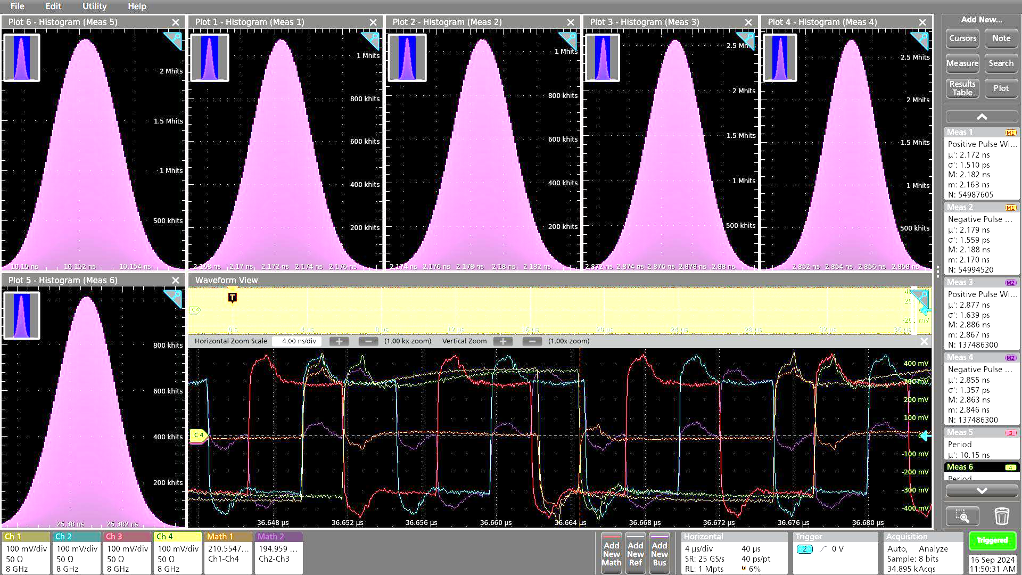
3.1 Clock distribution
3.1.1 9.85 MHz clock distribution via fiber
Clock: 39.4 MHz
Period: 25.3805ns
MATH1 = CH1 – CH4
Positive width: 2.1725 ns
FWHM: 4 ps
40 µs data: σ: 1.51 ps
Negative width: 2.1788ns
FWHM: 4 ps
40 µs data: σ: 1.56 ps
Clock: 98.5 MHz
Period: 10.1522 ns
MATH2 = CH2 – CH3
Positive width: 2.877ns
FWHM: 3.5ps
40 µs data: σ: 1.64 ps
Positive width: 2.7ns
FWHM: 3 ps
40 µs data: σ: 1.34 ps
* ~ one hour accumulation

Slide 35
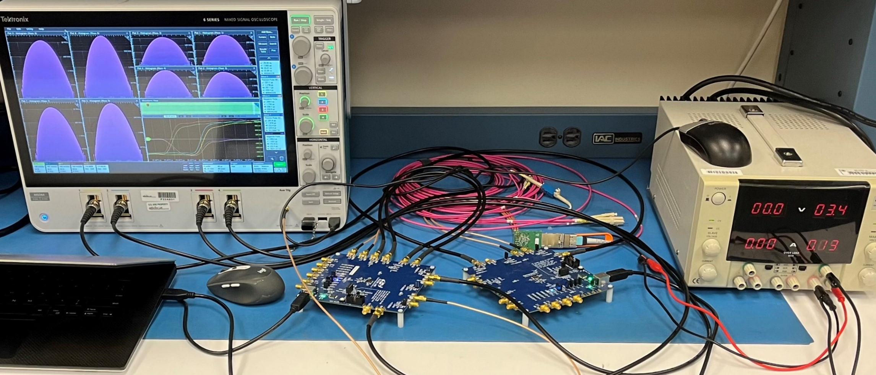
3.1 Clock distribution
3.1.2 long term stability test (>15 hours)
Setup in CC_F110, room (AC) temp 72ºF.
No phase drift (differences of Si5394A outputs and Si5344H outputs) ➔ Fiber and QSFP are stable.

Slide 36
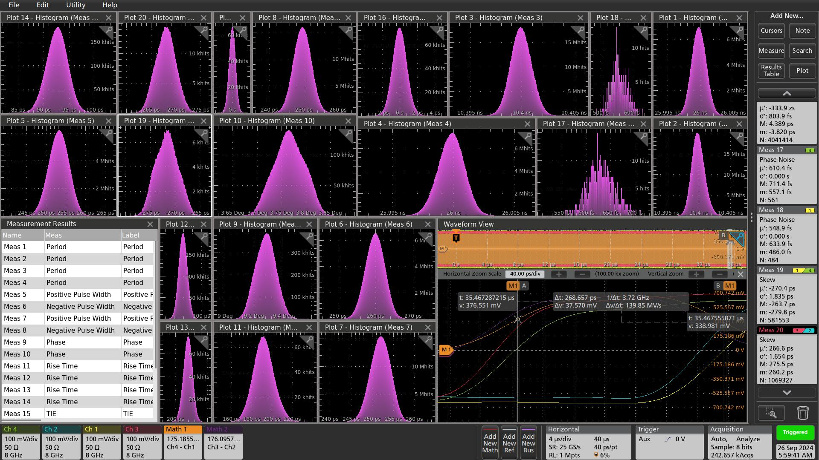
3.1 Clock distribution
3.1.2 long term stability test (>15 hours)
σ < 2 ps
Overnight accumulation (9/25-9/26), very stable
The Phase measurement (meas 9/10), and the skew measurement (meas19/20) gave the similar results as MATH widths measurement (meas 5/6/7/8)

Slide 37
3.1 Clock distribution
3.1.3 AD9510 clock divider
TI
MC100 EP90
MC100 EP57
AD9510 (/8)
SY58607 1:2
9.85 MHz
78.8 MHz
9.85 MHz
Si5344H
Tektronix MSO64
Si5394A
9.85 MHz
98.5 MHz
39.4 MHz
9.85 MHz
98.5 MHz
39.4 MHz
Si5344H @78.8MHz
Phase stability (phase shift and jitter): FWHM < 4 ps

Slide 38
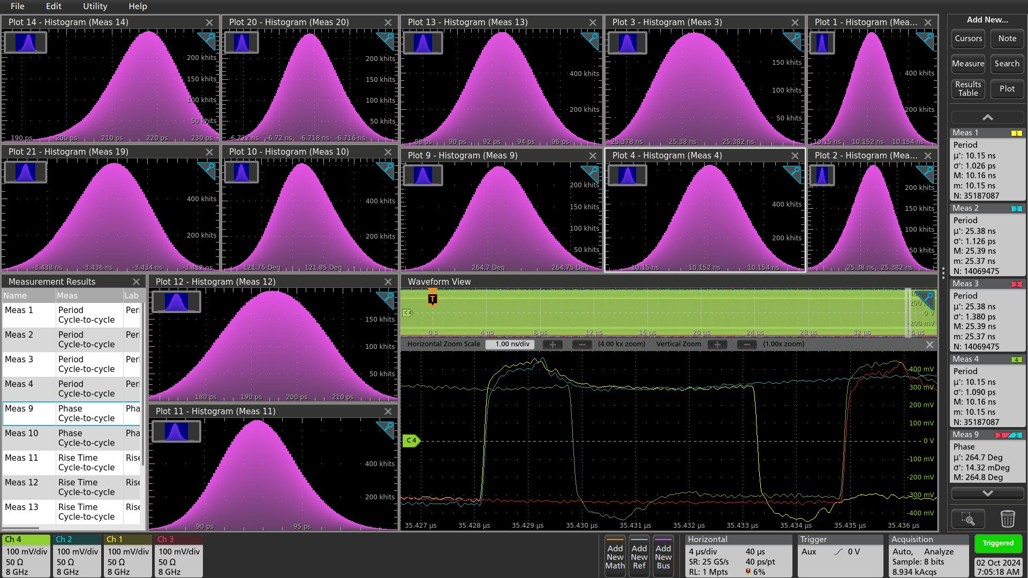
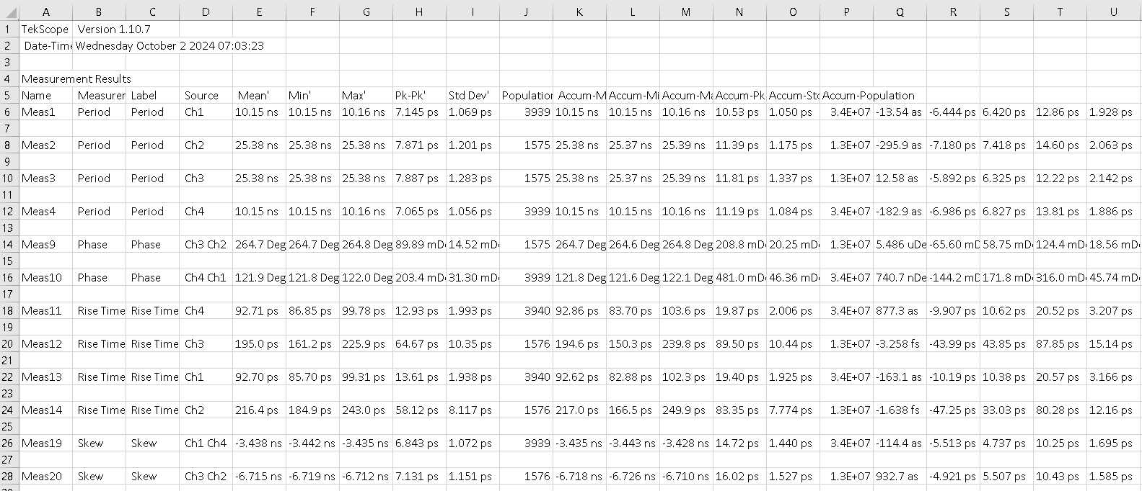
3.1 Clock distribution
3.1.3 AD9510 clock divider
Meas19: FWHM_{_Ch1-Ch4} ~ 3.4 ps
Meas20: FWHM_{_Ch2-Ch3} ~ 3.4 ps

Slide 39
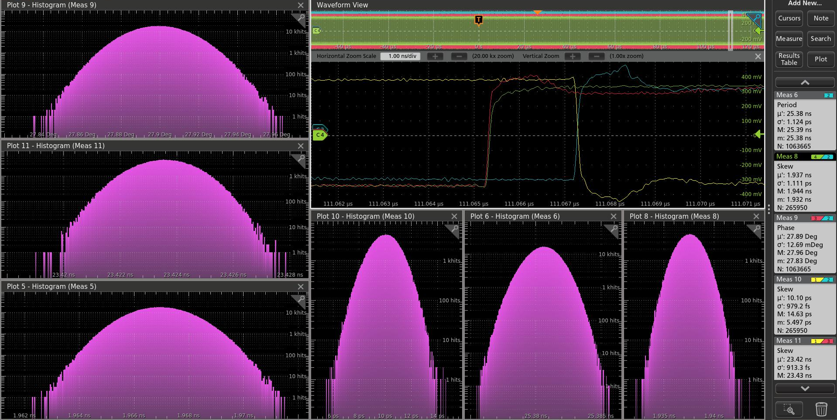
3.1 Clock distribution
3.1.4 9.85 MHz clock distribution via SMA cables (best signal integrity)
Bypassing the TI and the optic transceivers, Si5344H generates 9.85 MHz, and the Si5394A reconstruct the 98.5 MHz, and 39.4 MHz clock, Phase stability (jitter): ~ 1 ps, P_P: ~ 9 ps.

Slide 40
3.2 Clock distribution
RDO clock recovery (non-lpGBT)
RDO clock recovery procedure: During this procedure, the DAM sends pseudo-clock of 98.5MHz
Step 1: Measure the clock phase difference between the PseudoClock and the clock output from the AD9510.
Step 2: If the phase difference is not the preset value (nominal serial data UI), do the MGT RxRECclk reset, and go back to step 1. If the phase difference is the preset value, the RDO clock recovery is finished.
Before the run start, the GTU will send a clock_sync command. When the RDO receives this command, the RDO sends the Clock_Sync to the AD9510, so that all the slower clocks are synchronized (by re-align the rising edges of AD9510 outputs).

Slide 41
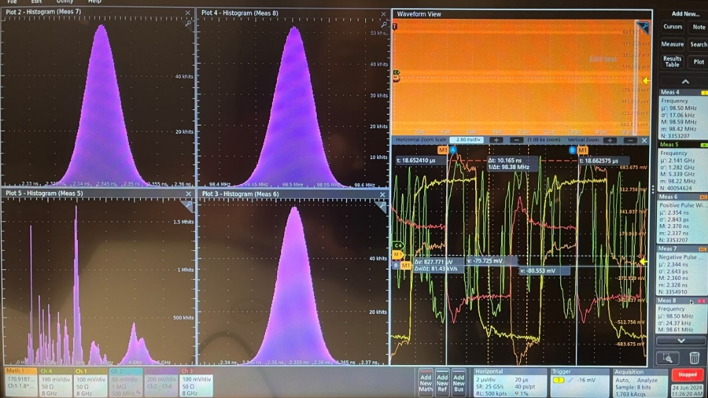
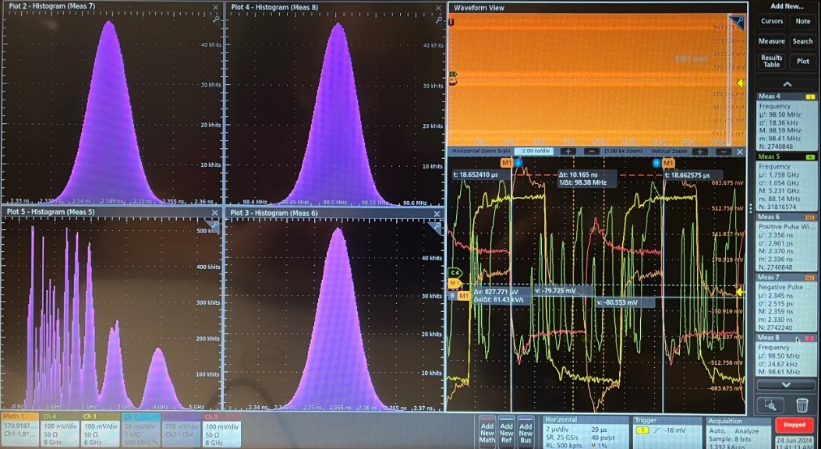
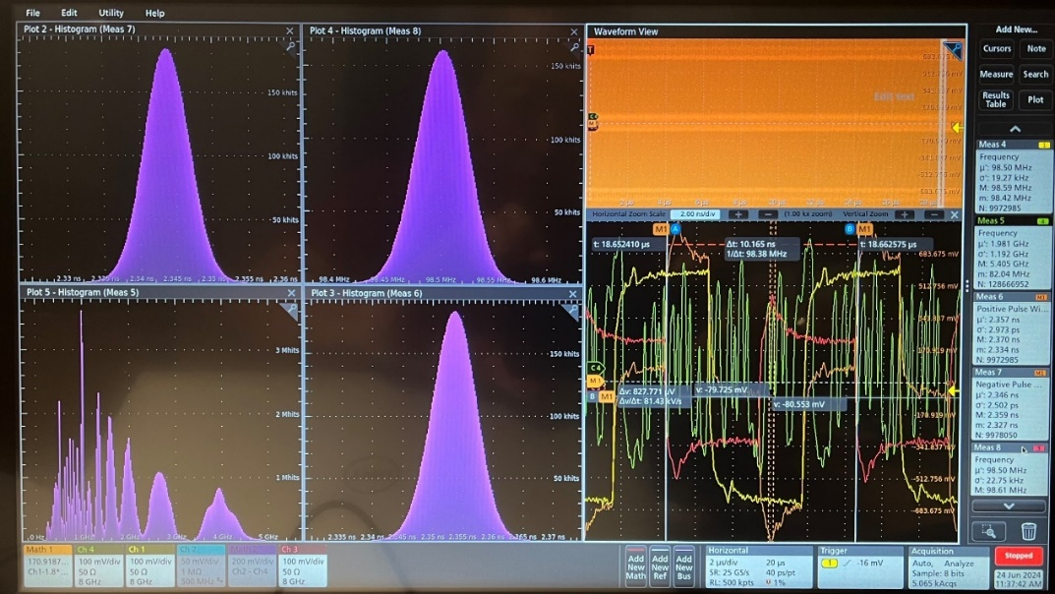
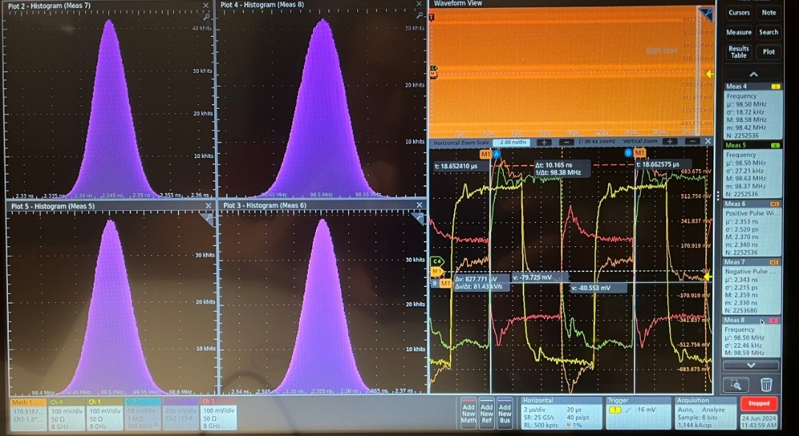
3.2 non-lpGBT RDO recovered clock
June 24, 2024: SMA output with ppRDO, at 98.5 MHz, checking with different FLX182 TX patterns
FLX182 TX output
“10” “01”
“11” “00”
The Si5345 output shifted 20ps even after the pattern went back to “00”, pseudoclock.

Slide 42
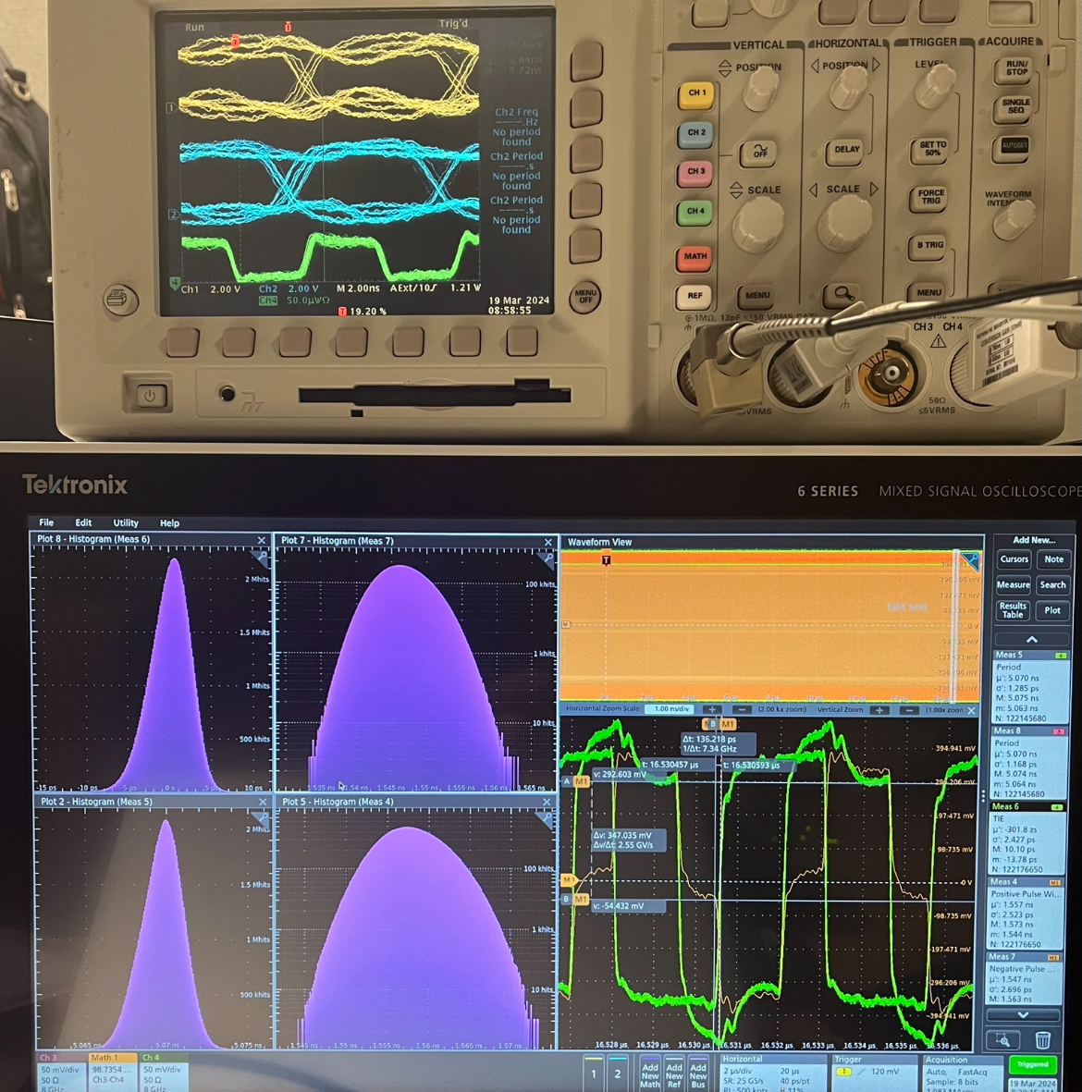
3.2 non-lpGBT RDO recovered clock
7.88 Gb/ps
Serial Data,
PseudoClock
~one hour’s accumulation
Positive Width: 1.557ns ± 2.5ps;
Negative Width: 1.546ns ± 2.7ps;

