Slide 1
ProtoDUNE HD Updates, Field Response & Signal Processing
Wenqiang Gu, Xuyang Ning

Slide 2
News
Over the past two weeks, we have had stable beam condition and detector performance, with few beam downs but nothing exceptional.
There is no beam this week, but it will be followed by a continuous 5-week beam period.
The run plan will focus on +/- 1GeV/c for pion cross-sections and one work of kaons at +5GeV/c.

Slide 3
Field Response in APA1

Slide 4
Electron drift simulation in GARFIELD
W collected
Mesh collected
Yichen Li
x = 0.471 mm
(1/10 pitch)
x = 0.942
x = 1.413
x = 1.884
x = 2.355
(1/2 pitch)
x = 0 mm
Replace with total induction?

Slide 5
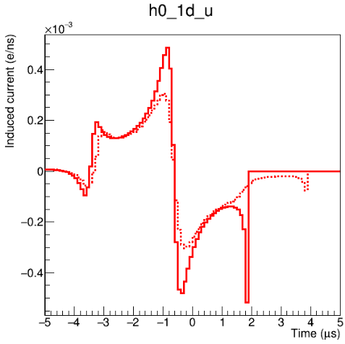
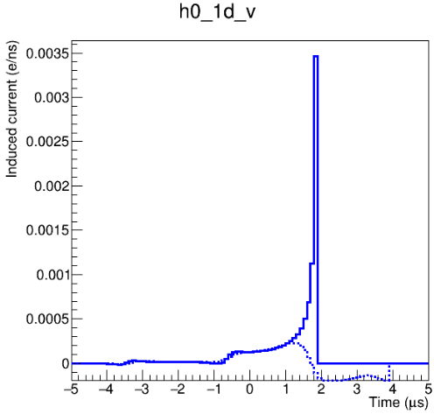
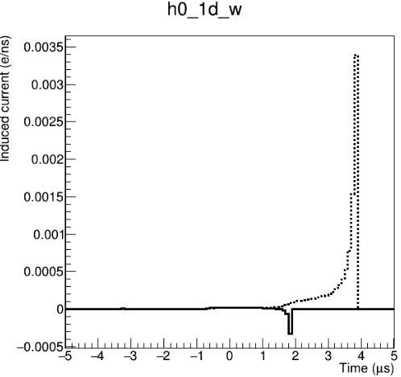
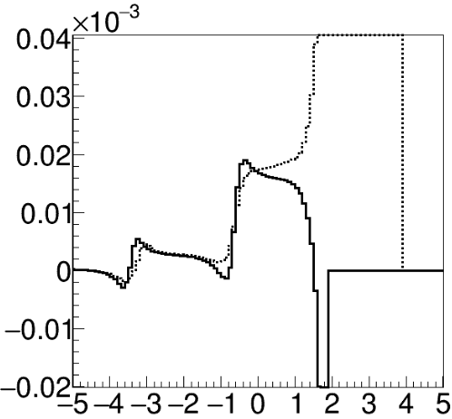
Field response: central path electron (x=0)
All plots w/o electronics response
U plane
V plane
W plane
max current: 2.3E-4
max current: 1.9E-5
APA 1
Other APA
Nominal speed 1.6mm/us used in the APA1 simulation
Normalize central path electron’s FR integral to 1 electron
Compared with other APA’s V wire, APA1’s W wire only have 1/10 of max transient current

Slide 6
Signal Processing in APA1

Slide 7
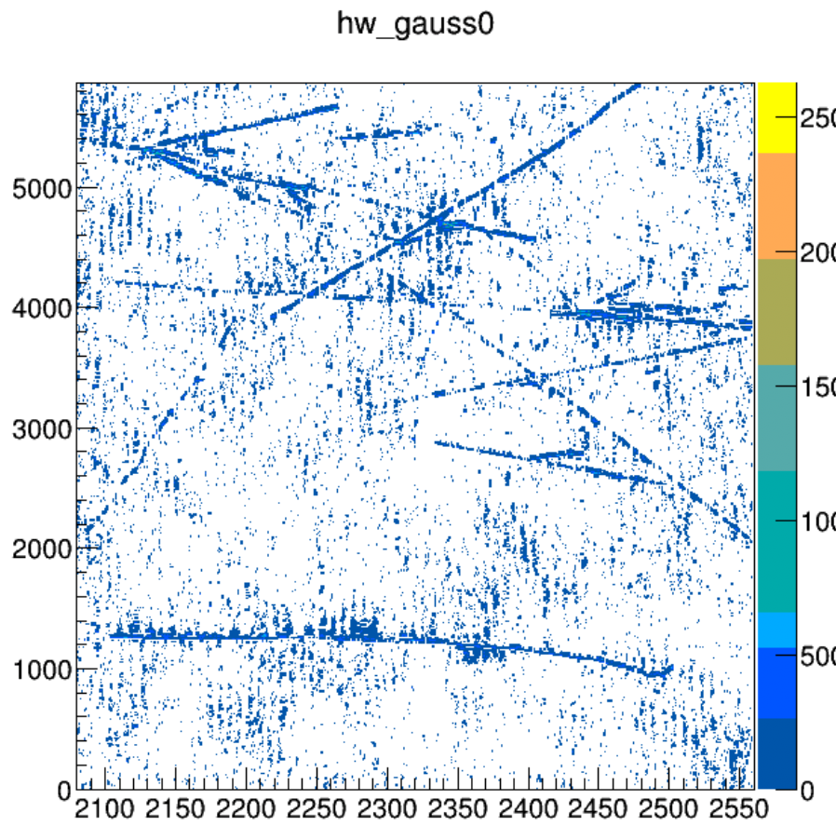
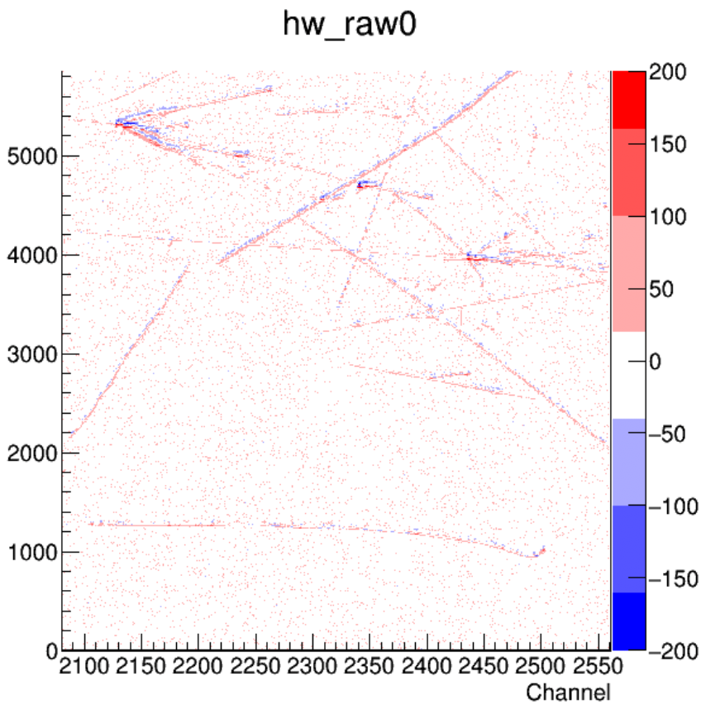
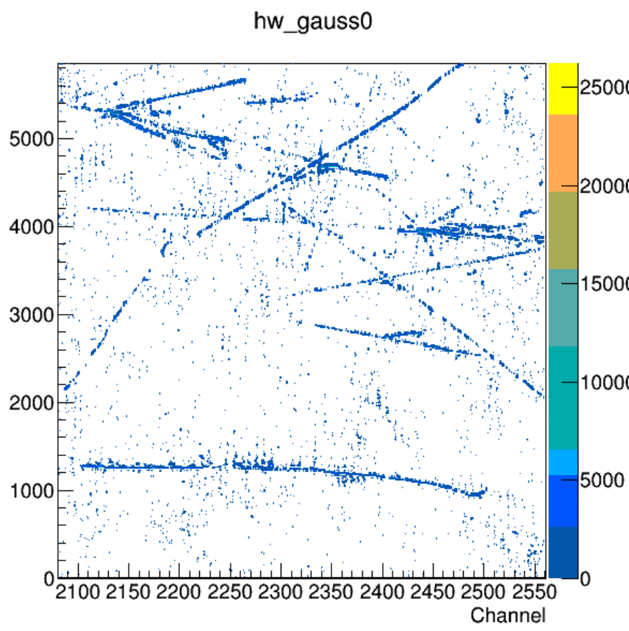
signal processing
w/ 2*RMS threshold for tight ROI
Deconvolution
signal processing
w/ 2.5*RMS threshold for tight ROI
Raw Waveform
Deconvolution

Slide 8
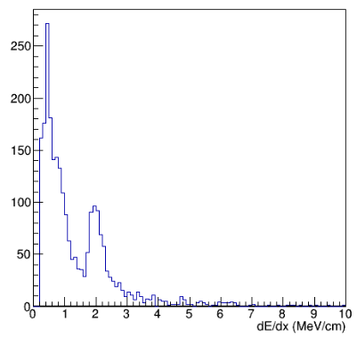
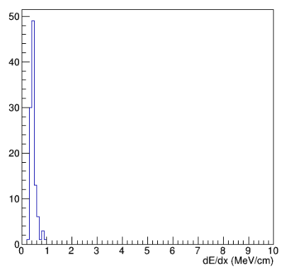
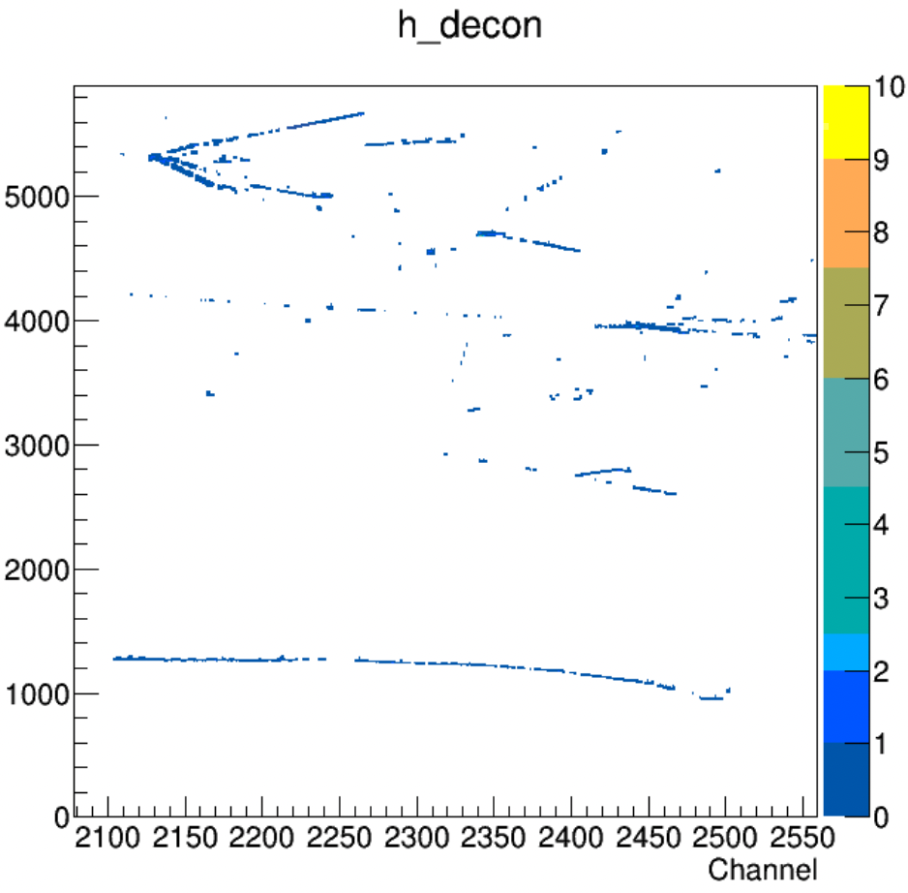
Calorimetry in APA1’s W view
APA1
W view
APA1
W view
Updated signal processing
Previous version

Slide 9
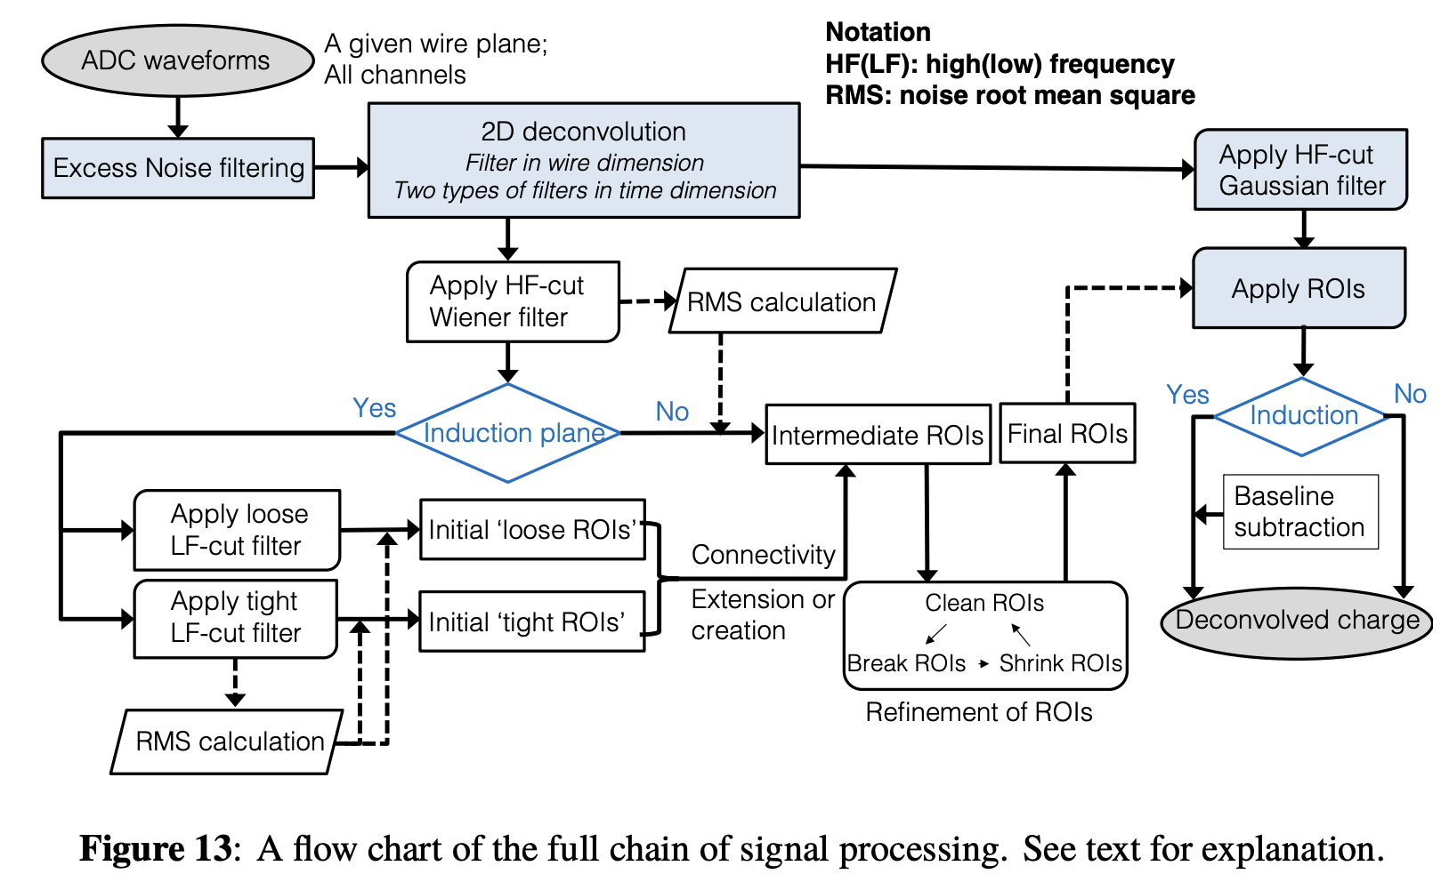
What’s next?
Filters
Threshold for tight/loose ROI
Separate treatment for ind/col

Slide 10
Threshold parameters used in ROI finding
troi_col_th_factor: 2.0, // default 5
ROI formation:: find_ROI_by_decon_itself() // self ROIs, i.e. tight ROIs
self_rois_u, v, w:
extend_ROI_self(int plane), create_ROI_connect_info (int plane), extend_ROI_loose(plane, r_data)
lroi_th_factor: 3.5, // default 3.5
ROI formation:: find_ROI_loose()
loose_rois_u,v,w: extend_ROI_loose(plane, r_data) -> ensure loose ROI can contain tight ROI
r_th_factor: 3.0, // default 3
ROI refinement:: load(), checkROIs(), shrinkROI(),

