Slide 1
NJOY for ENDF/B-VIII.1 and ENDF/B-IX
W. Haeck, C. Josey, N. Gibson, P. Talou
CSEWG, November 4 – November 8, 2024

Slide 2
Outline
NJOY2016 updates
ENDF/B-VIII.1 libraries for MCNP
Lib80 and ENDF81SaB
eprdata24
A modernization update
Why modernize
Format components
The math core and a format agnostic interface
Putting it all together
Conclusions

Slide 3
Our main objective: smooth processing of ENDF/B-VIII.1
Over the last 5 years we have worked towards this goal
This represents 26 updates to NJOY2016
Every ENDF/B generation makes changes and so did ENDF/B-VIII.1
Mixed mode thermal scattering (coherent and incoherent elastic scattering)
Thermal scattering information in MF7 MT451
Background R-matrix elements for resonance parameters in MF2 MT151
New features that require changes in MCNP have been prioritized
We can say that MCNP6.3 is now ENDF/B-VIII.1 ready
Our new objective: smooth processing of ENDF/B-IX.0

Slide 4
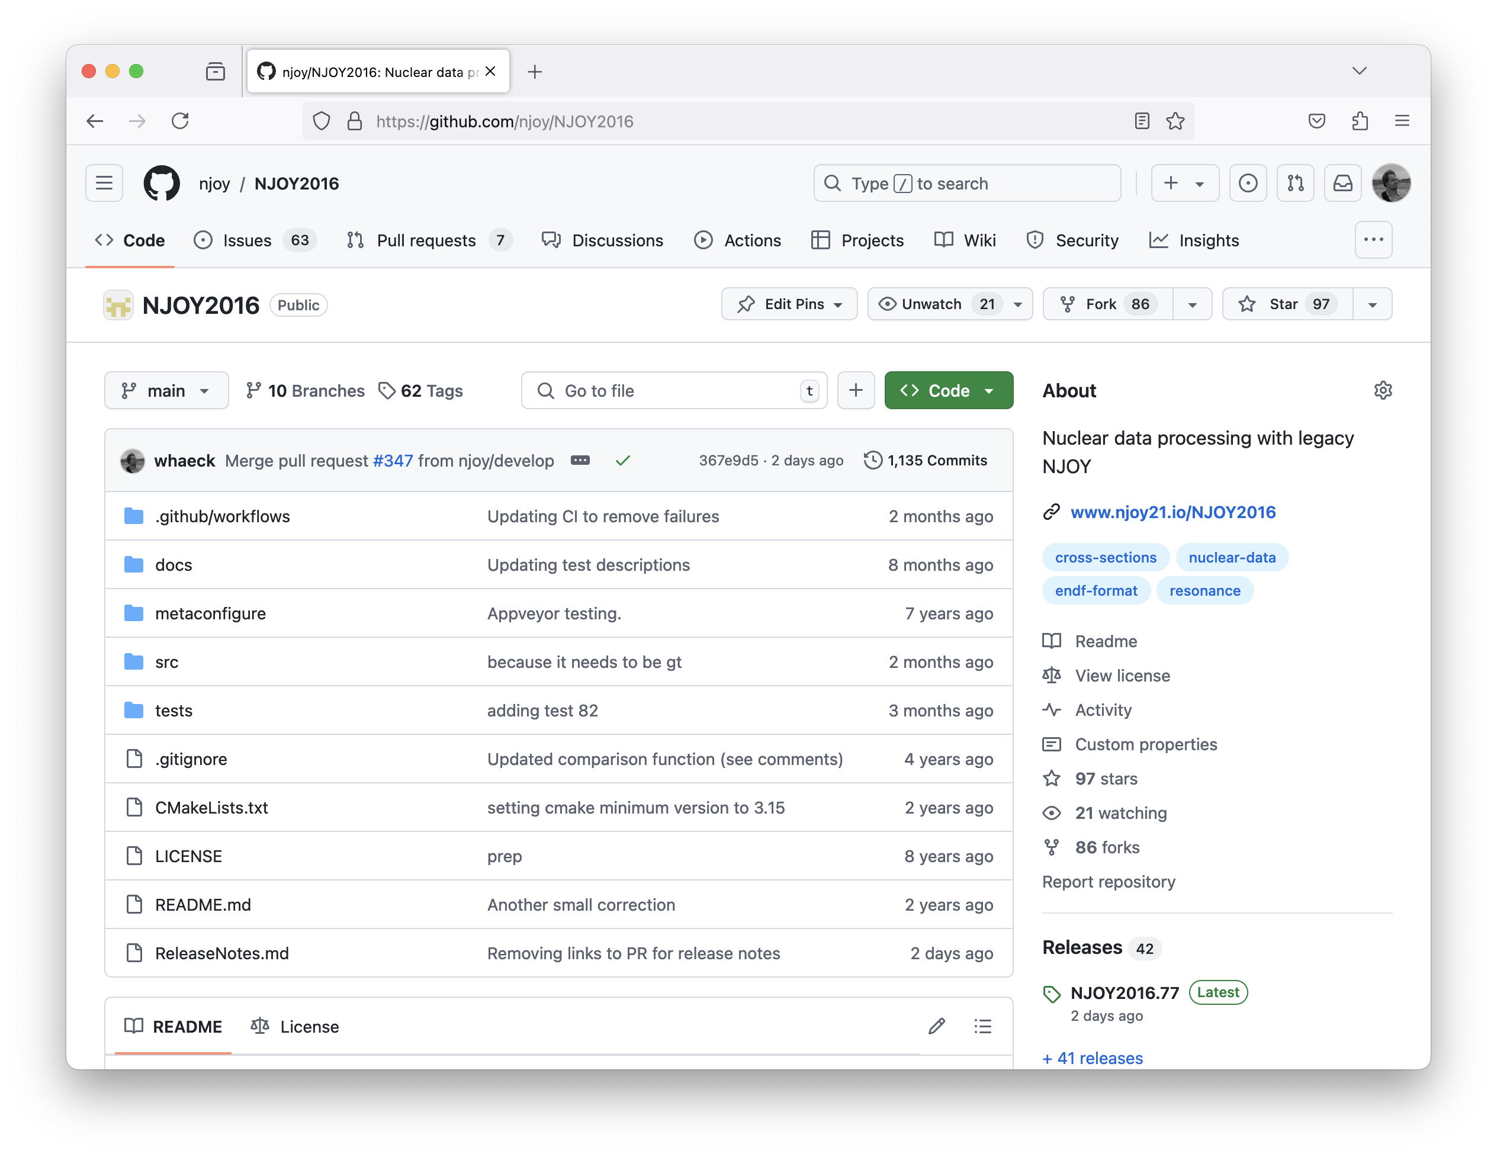
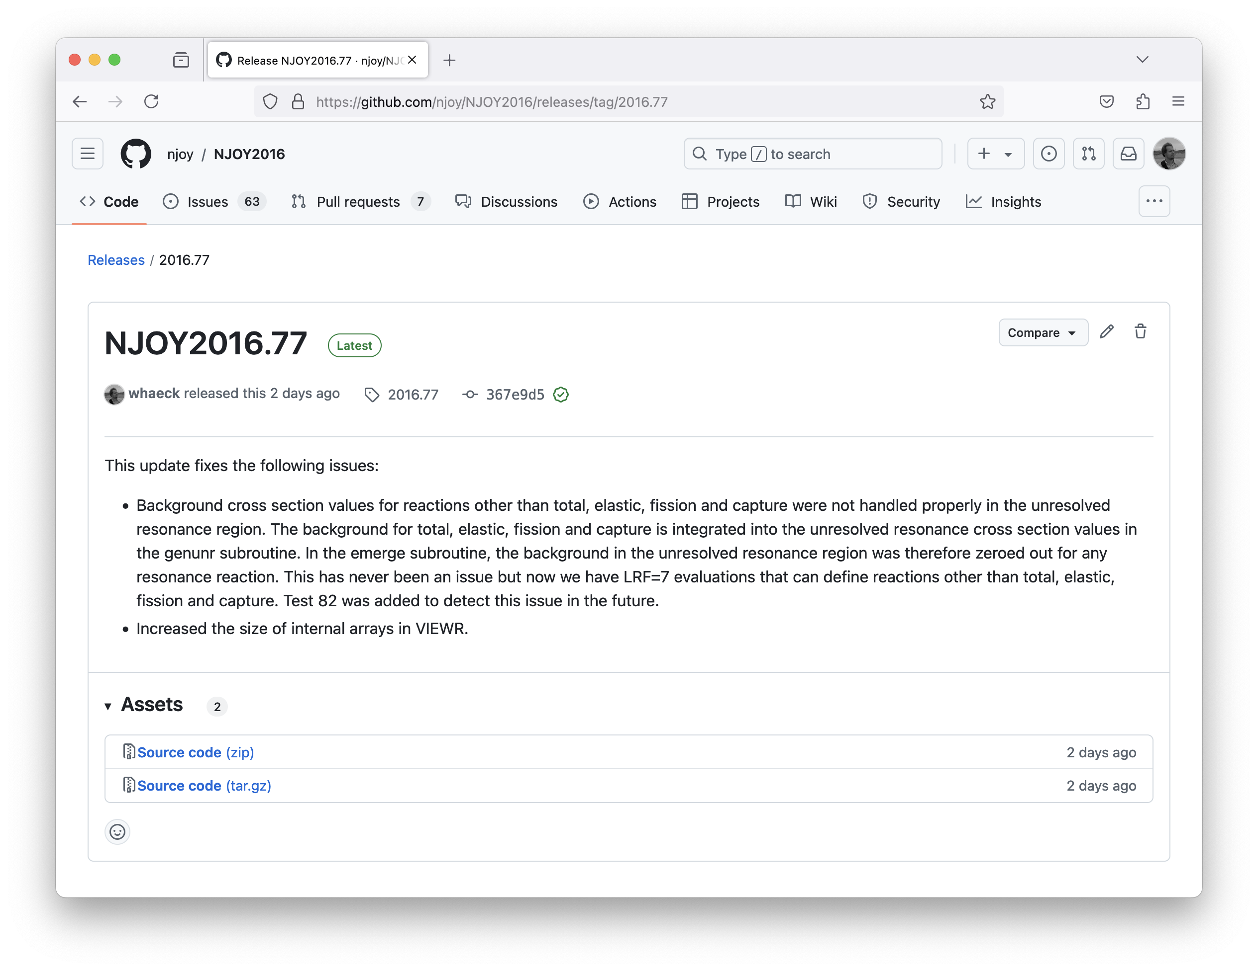
Maintaining our production version
Get it at https://github.com/njoy/NJOY2016
Latest version is NJOY2016.77 (October 2024)
We aim to release updates every three months – even if the changes are minor
This coincides with quarterly reports that we give to our funding sources

Slide 5
Noteworthy updates to NJOY2016
NJOY2016.77:
Fixed an issue where cross sections for some reactions in the URR where zero for evaluations with both a RRR using LRF=7 and URR
Only when the RRR has resonances for a reaction other than elastic, capture and fission
This does NOT occur in ENDF/B-VIII.1
NJOY2016.75:
ACE file updates:
Adding isomeric state S, atom number Z and mass number A to the NXS array
MCNP ZA naming conventions for metastable states (e.g. 95642 for Am242g)
NJOY2016.74
Corrected value for the Euler-Mascheroni constant (impacts Coulomb wave functions)

Slide 6
MCNP libraries for ENDF/B-VIII.1
Lib81 : incident neutron files
557 targets
8 temperatures : 293.6 K, 600 K, 900 K, 1200 K, 2500 K, 0.1 K, 233.15 K, 273.15 K
Extensions : 10c to 17c
ENDF81SaB : thermal scattering files
103 materials
Extensions : 70t to 89t depending on the material
70t will either be room temperature or the lowest available temperature
This is a big library at over 40 GB
We foresee a release of these files before the end of the year

Slide 7
MCNP libraries for ENDF/B-VIII.1
Important notes concerning the content of Lib81
Neutron on neutron is not included
We may add Am239 as an extension to Lib81
Important notes concerning the content of ENDF81SaB
H in H2O : only 19 out of 94 temperatures (ENDF/B-VIII.0 temperatures + 273.15 K)
Only the graphite and Be with Sd effects are included (consultation with ORNL)
H and Zr in ZrH : only the epsilon and delta phase ZrH materials are included
SiO2 is replaced with O and Si in SiO2 (alpha quartz)
No CaH2 materials are included
Older mixed moderators like benzene, liquid and solid methane are not included

Slide 8
MCNP libraries for ENDF/B-VIII.1
Name | Description | Name | Description | Name | Description | Name | Description
al-27 | Aluminium | orthod | Ortho-D | c-zrc | C in ZrC | n-un1 – n-un6 | N in UN
fe-56 | Iron | orthoh | Ortho-H | d-7ld | D in 7LiD | o-sap | O in sapphire (Al2O3)
be-met | Be metal | parad | Para-D | f-bef | F in BeF2 | o-mgo | O in MgO
be-beo | Be in BeO | parah | Para-H | f-ptfe | F in teflon (CF2) | o-puo | O in PuO2
c-sic | C in SiC | grph10 | 10% porous graphite | f-flb | F in FLiBe | o-aqu | O in alpha quartz (SiO2)
d-d2o | D in heavy water | grph30 | 30% porous graphite | f-hf | F in HF | o-uo1 – o-uo6 | O in UO2
h-luci | H in lucite | 7l-7ld | 7Li in 7LiD | f-mgf | F in MgF2 | pu-puo | Pu in PuO2
h-poly | H in polyethylene | 7l-7lh | 7Li in 7LiH | h-7lh | H in 7LiH | si-aqu | Si in alpha quartz (SiO2)
h-h2o | H in light water | al-sap | Al in sapphire (Al2O3) | h-styr | H in styrene (C8H8) | u-met1 – u-met6 | U in U metal
h-ice | H in ice | be-bec | Be in Be2C | h-hf | H in HF | u-uc1 – u-uc6 | U in UC
h-yh2 | H in YH2 | be-bef | Be in BeF2 | h-poil | H in paraffinic oil | u-un1 – u-un6 | U in UN
o-beo | O in BeO | be-flb | Be in FLiBe | h-uh3 | H in UH3 | u-uo1 – u-uo6 | U in UO2
o-d2o | O in heavy water | c-bec | C in Be2C | h-ezh | H in epsilon ZrH2 | zr-zrc | Zr in ZrC
o-ice | O in ice | c-luci | C in lucite (C5O2H8) | h-dzh | H in delta ZrHx | zr-ezh | Zr in epsilon ZrH2
si-sic | Si in SiC | c-styr | C in styrene (C8H8) | li-flb | Li in FLiBe | zr-dzh | Zr in delta ZrHx
y-yh2 | Y in YH2 | c-ptfe | C in teflon (CF2) | mg-mgf | Mg in MgF2 | grph20 | 20% porous graphite
grph | Graphite | c-uc1 – c-uc6 | C in UC | mg-mgo | Mg in MgO

Slide 9
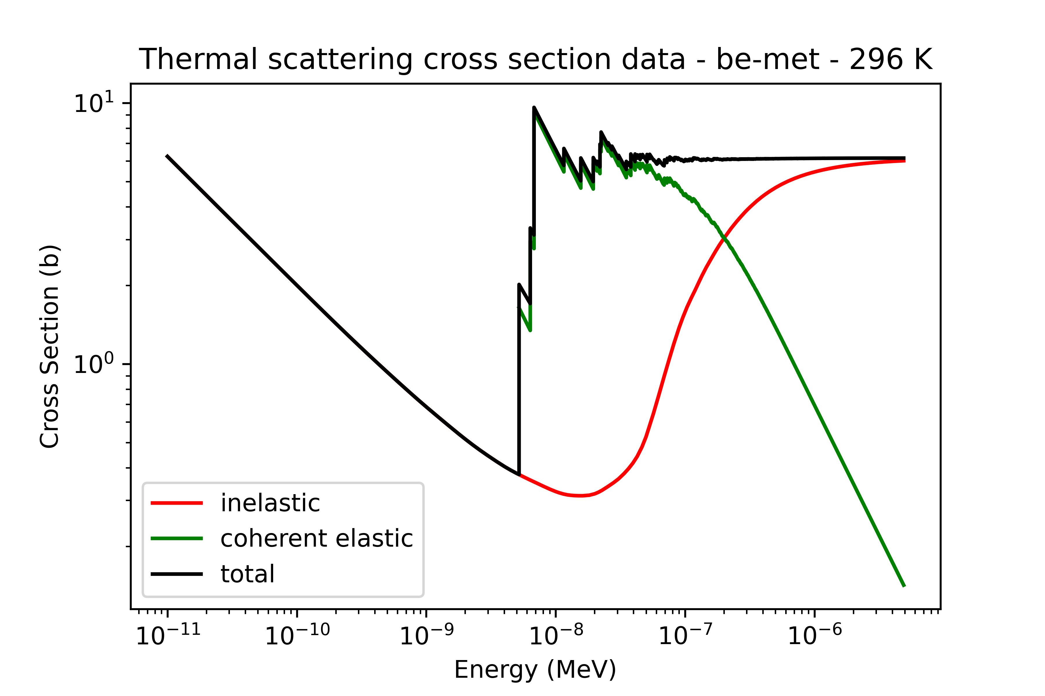
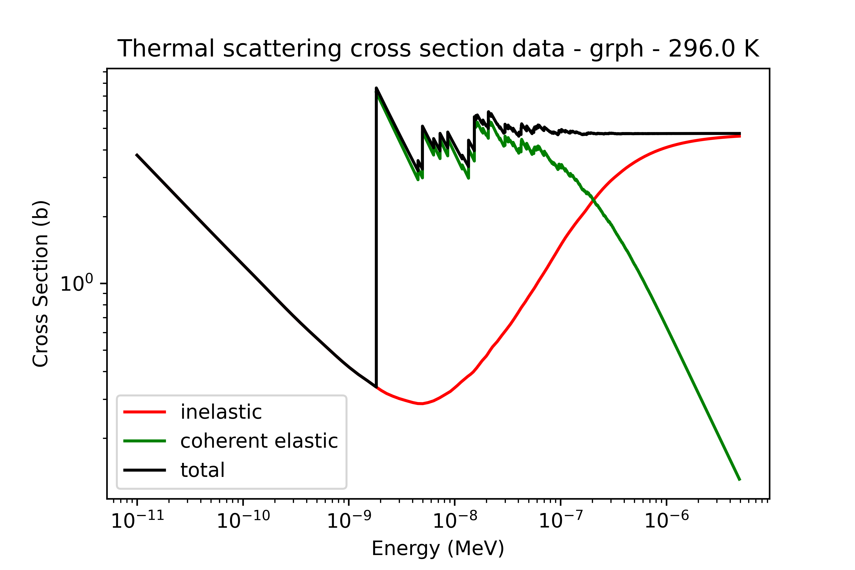
MCNP libraries for ENDF/B-VIII.1

Slide 10
Future MCNP libraries for ENDF/B-VIII.1
eprdata24 : photoatomic and electroatomic files
NJOY2016 does not process this type of ACE library
We are using this as a first application for a modern NJOY
Incident charged particle and photonuclear files
We processed these for beta4 but may release these as a regular MCNP library
Photonuclear files will need work in NJOY2016
Y89, Rh103, Tb159, Ho165, Tm169, Ta181 fail with inconsistent XSS locators
We foresee a release of the eprdata24 library next year

Slide 11
Why do we need to modernize our processing code?
New nuclear data features are hard to introduce in NJOY2016
Energy dependent fission yield data
Incident charged particle resonance parameters
Thermal scattering covariance data
Better knowledge of implemented methods
Modernization allows us to explore different methods and identify shortcomings
NJOY is too closely linked to the ENDF format
Introducing new evaluation formats like GNDS is “impossible” in NJOY2016
Our users have needs that NJOY2016 does not provide

Slide 12
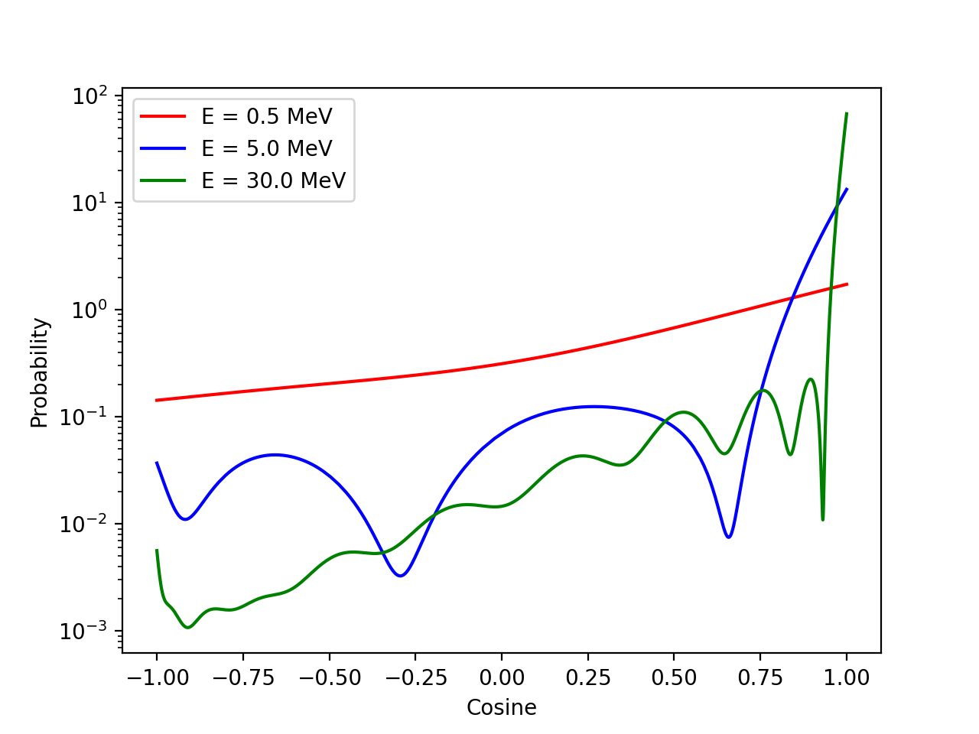
Example: linearize a Legendre angular distribution
The general process of linearization:
Generate the initial grid
Ideally the minima, maxima and inflection points
Any points to ensure the interpolation does not intersect with the function
For each interval in the grid:
Evaluate the function at a point in the interval
This is generally the midpoint of the interval
Verify convergence:
If converged: move to the next interval
Else: add the point to the grid and move to the previous interval
Repeat until there are no intervals left

Slide 13
Example: linearize a Legendre angular distribution
Potential shortcomings in NJOY2016:
Only -1 and 1 are chosen for the initial grid
This can cause potential false convergence
Alleviated by using a smaller tolerance (0.02%) and thinning the final grid using a 0.2 % tolerance
Tolerances cannot be changed by the user
Legendre series evaluation is not as efficient as it could be
Improvements in a modern NJOY:
Use minima, maxima and inflection points
Use Clenshaw recursion for series evaluation
Minimize grid size by optimizing panel splitting

Slide 14
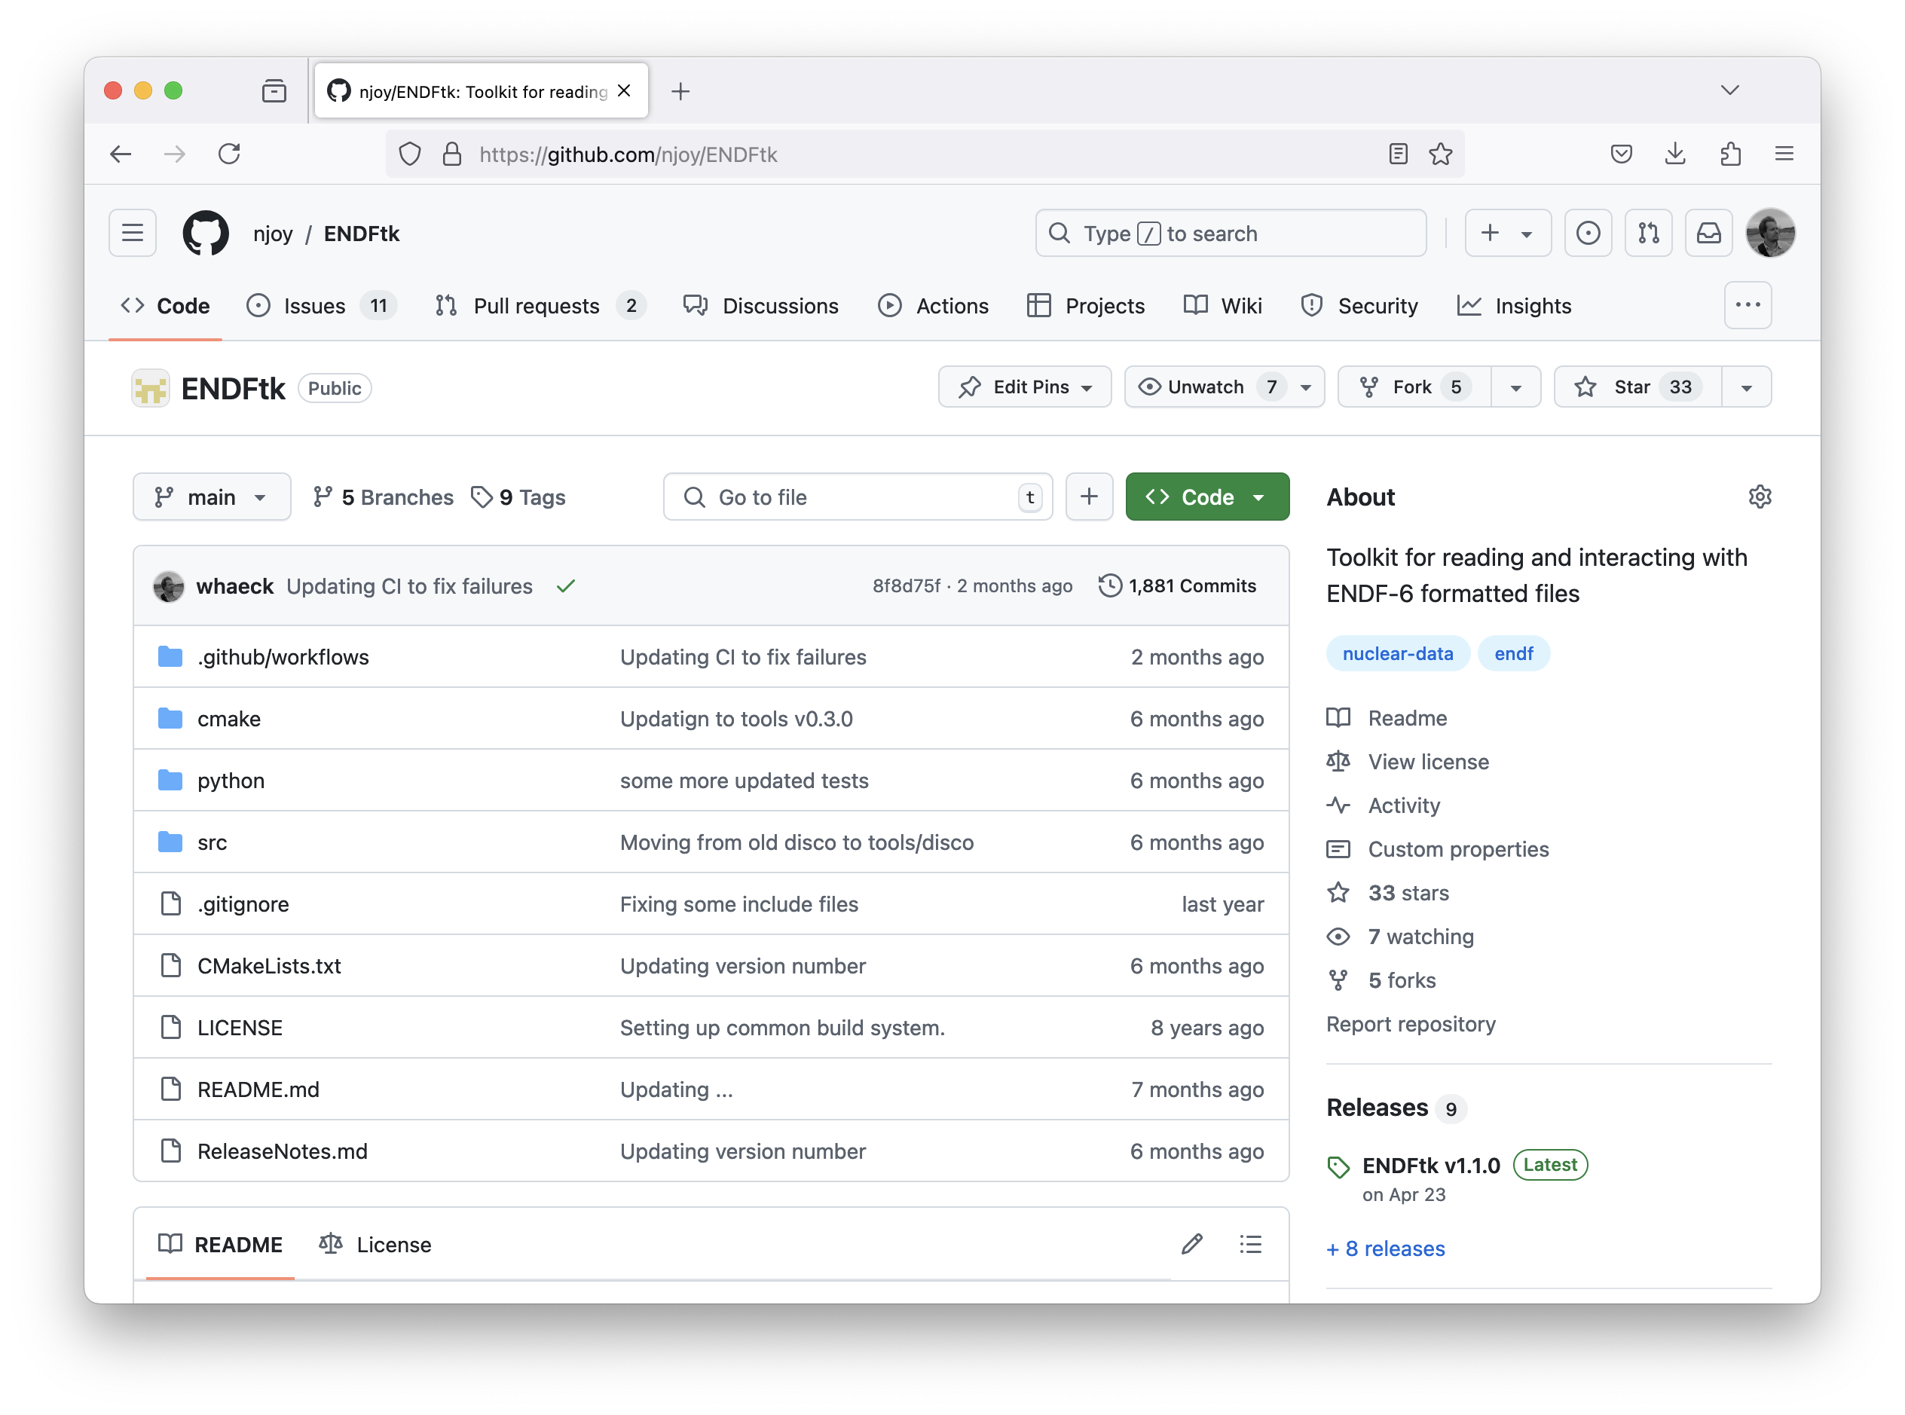
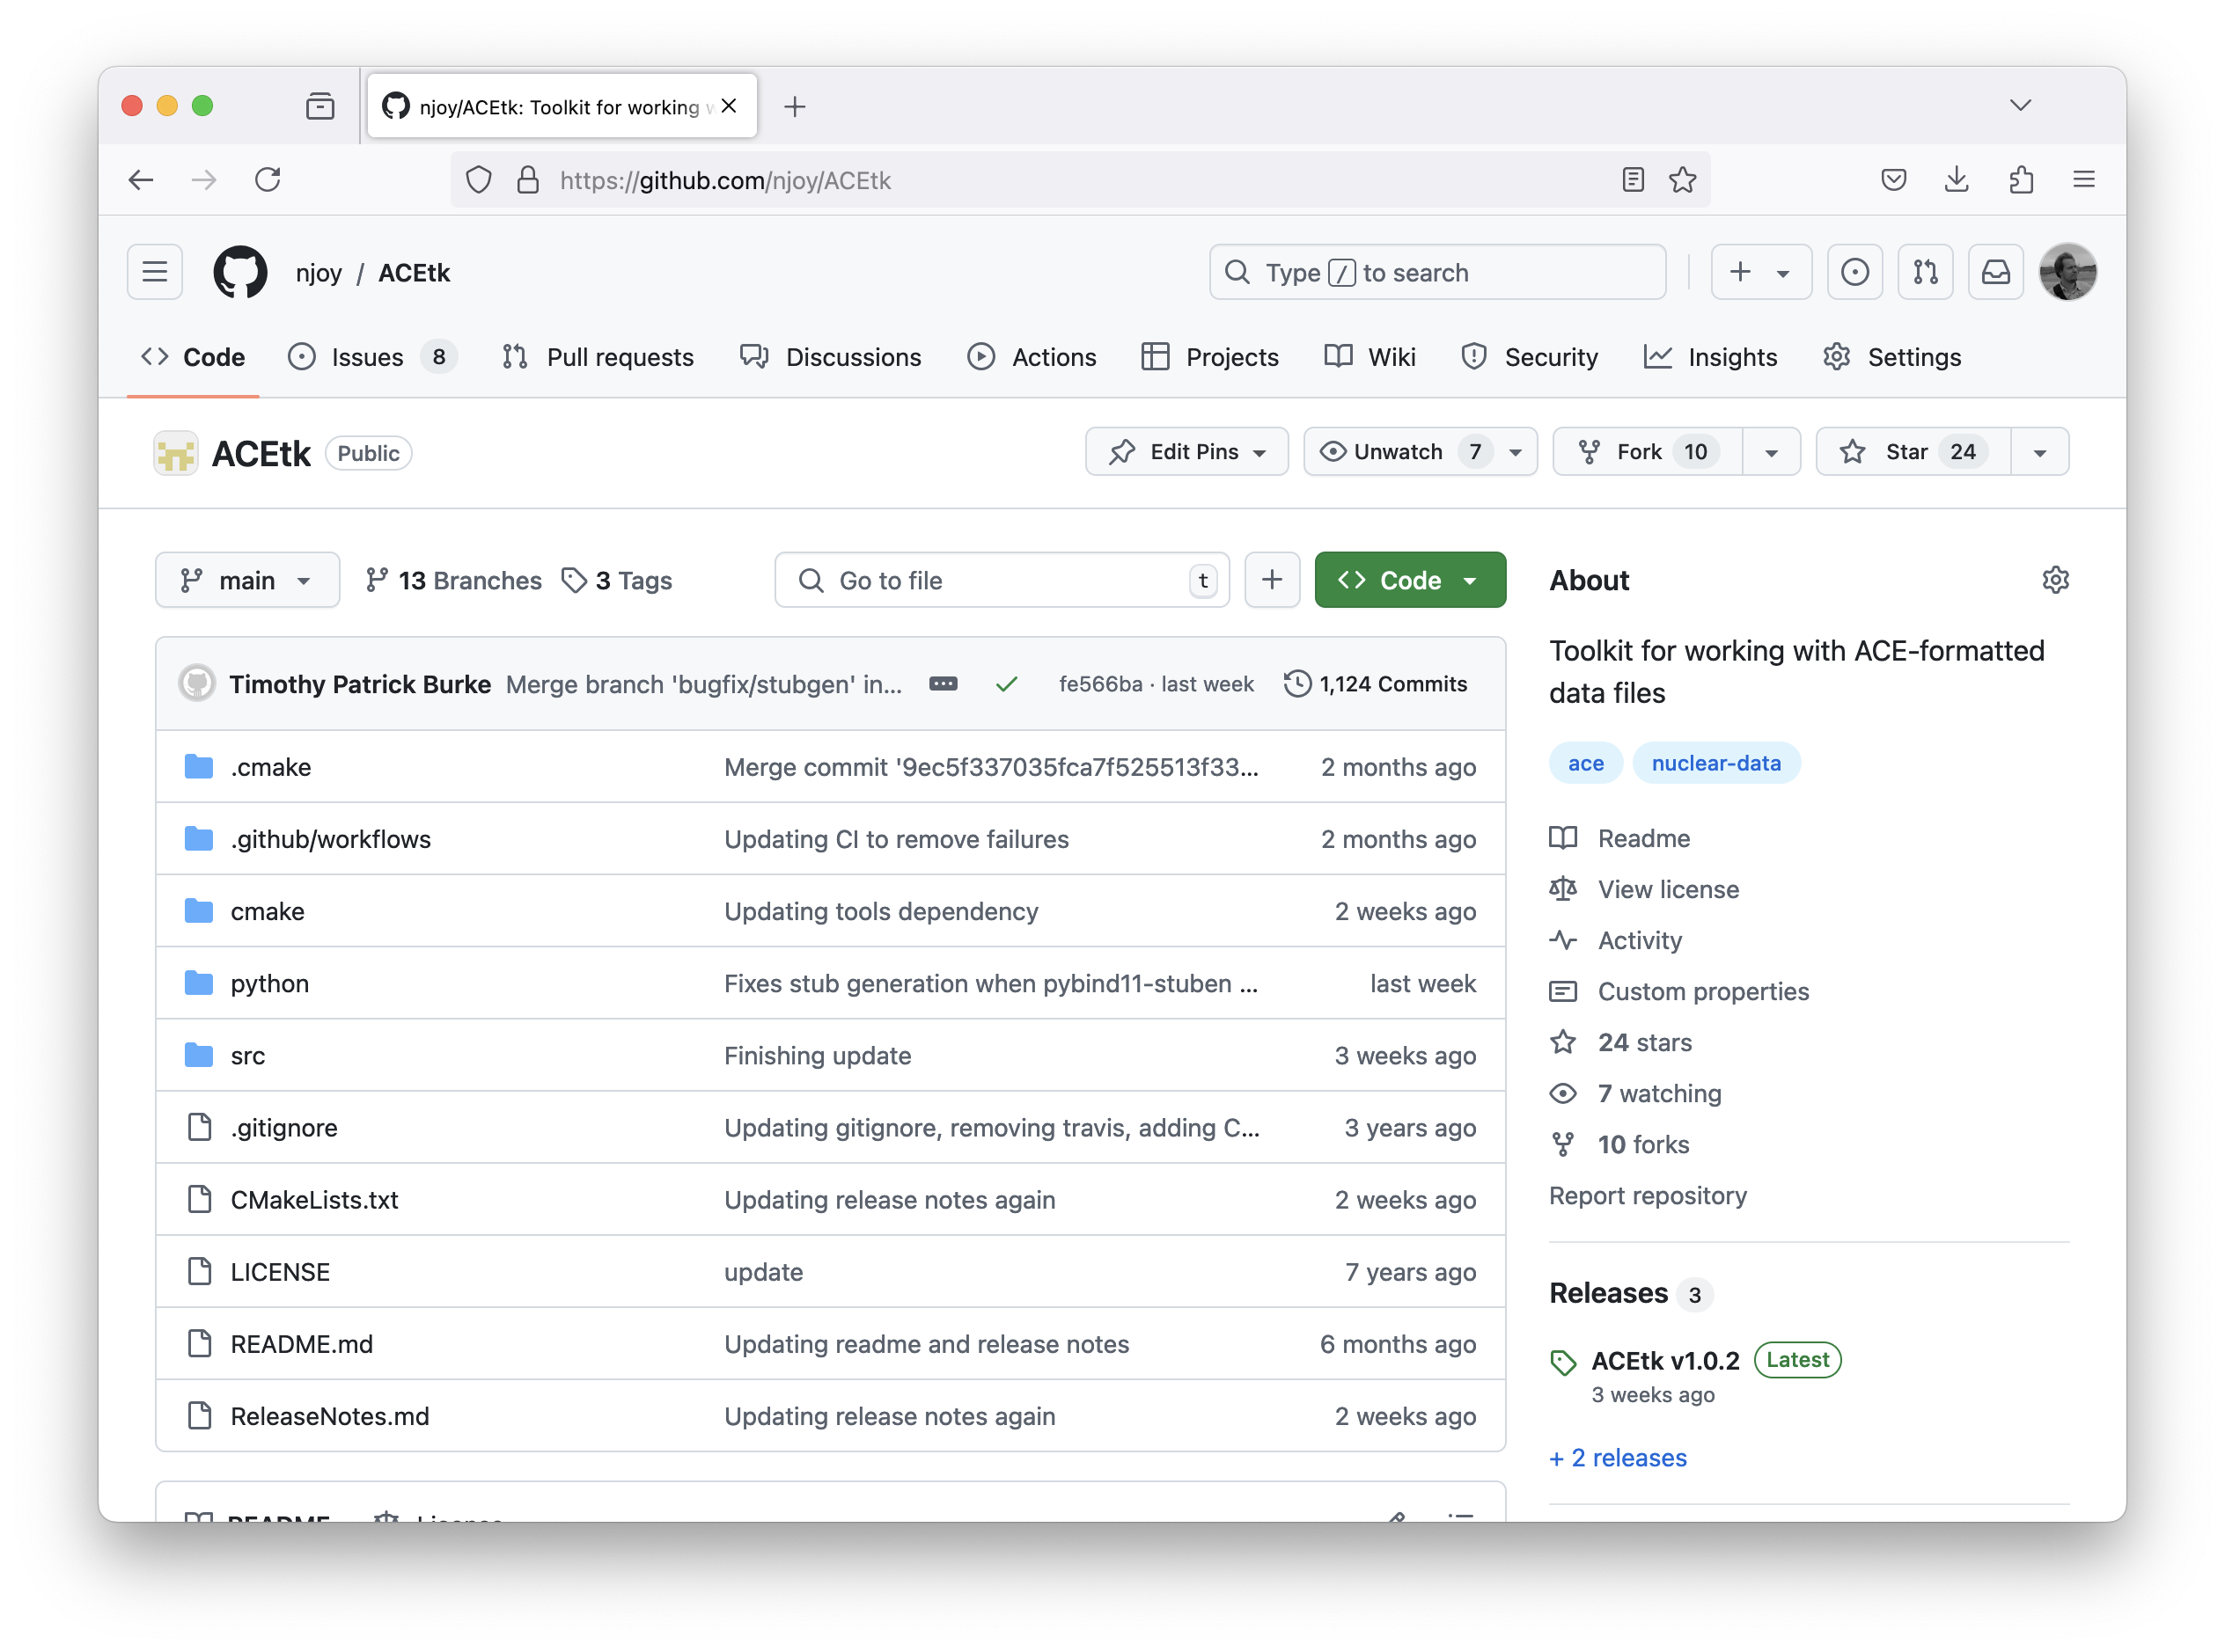
A component based modernization strategy
Modernized modules are built from components
Format components: ENDF, ACE, GNDS, NDI, etc.
Processing components: resonance reconstruction, linearization, etc.
Components can be developed and deployed faster than modules
Using a C++ and Python API at the same time

Slide 15
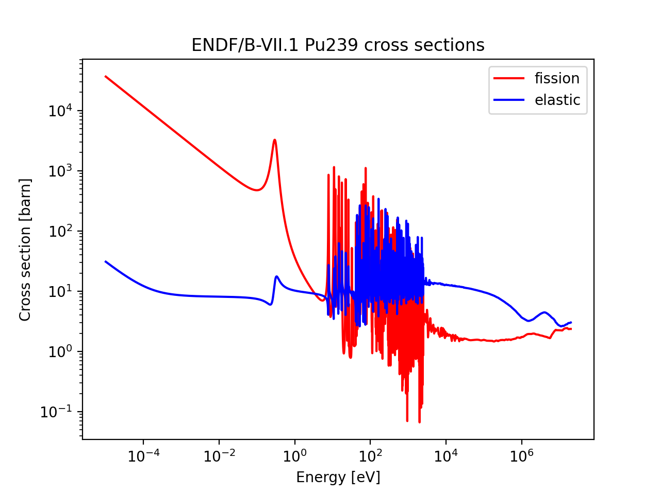
ENDFtk : an ENDF format component
Latest release is ENDFtk v1.1.0
Fixing a parser issue where numbers are sometimes off by a very small value
Parsing ENDF files is now 10-20% faster
https://github.com/njoy/ENDFtk
ENDFtk v1.2.0 will be released soon
Significantly faster compilation
Reduced memory usage during compilation
Several bug fixes and interface extensions
W. Haeck, N. Gibson, P. Talou, “ENDFtk: A robust tool for reading and writing ENDF-formatted nuclear data,” Comp. Phys. Comm., 303 (2024), DOI: 10.1016/j.cpc.2024.109245
import ENDFtk
# open an endf file and extract elastic and fission
tape = ENDFtk.tree.Tape.from_file( '94239.pendf' )
elastic = tape.materials.front().section( 3, 2 ).parse()
fission = tape.materials.front().section( 3, 18 ).parse()

Slide 16
ACEtk : an ACE format component
Latest release is ACEtk v1.0.2
Several bug fixes and interface extensions
https://github.com/njoy/ACEtk
Supported ACE format types:
neutron and charged particles files
photonuclear files
thermal scattering files
photoatomic and electroatomic files (eprdata)
dosimetry files
import ACEtk
# open an ace file and extract elastic and fission
table = ACEtk.ContinuousEnergyTable.from_file( '94239.710nc' )
index = table.reaction_number_block.index(18)
energies = table.principal_cross_section_block.energies
elastic = table.principal_cross_section_block.elastic
fission = table.cross_section_block.cross_sections(index)

Slide 17
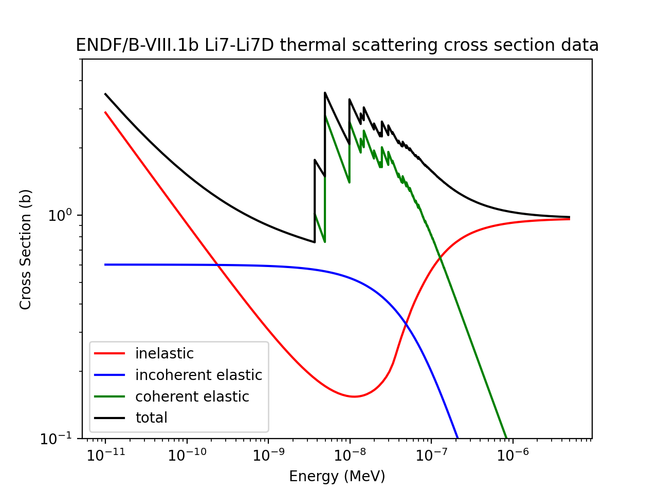
scion : the mathematical core of a modern NJOY
New capabilities since last year:
Analytical integration of $f(x)$ and $xf(x)$ (mean or first raw moment) for tabulated data
Tabulated two-dimensional data $z=f\left(x,y\right)$
The basis for our format agnostic interface
Most NJOY modules need to perform a common set of operations:
Interpretation of various data representations (tables, analytical functions, etc.)
Linearisation of various data representations
Unionisation of data on a common energy grid
Differentiation and integration of the data

Slide 18
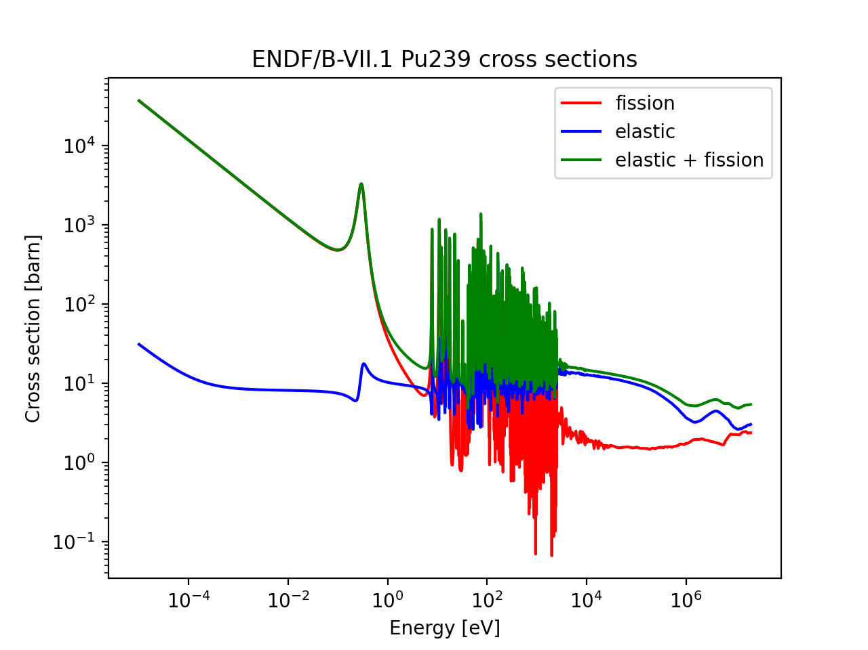
dryad : a format agnostic data interface
As a nuclear data user, you should not have to worry about format details
Nuclear data is represented in its most generic form using consistent units
Conversion at read time to the base units
ACE files in MeV and ENDF in eV
dryad classes built upon scion classes
Makes basic operations available
Linearization of Legendre distributions
Operations on tabulated data
import dryad
# open an endf file and extract elastic and fission
pt = dryad.ProjectileTarget.from_endf_file( '94239.pendf' )
elastic = pt.reaction('2').cross_section
fission = pt.reaction('18').cross_section
sum = elastic + fission

Slide 19
dryad : a format agnostic data interface
Neutron, charged particles and photonuclear data
Reading from ENDF only
Cross section data
Limited outgoing particle distribution support
Atomic relaxation data
Reading from ENDF only
Full capability
Photoatomic and electroatomic data
Reading from both ENDF and ACE
Cross section data
Full distribution data
import dryad
# open an endf file and extract elastic and fission
pt = dryad.ProjectileTarget.from_endf_file( '94239.pendf' )
elastic = pt.reaction('2').cross_section
fission = pt.reaction('18').cross_section
sum = elastic + fission

Slide 20
dryad : a format agnostic data interface
ProjectileTarget
Reaction
ReactionProduct
ResonanceParameters
Internal storage for resonance parameters
Reaction metadata such as the identifier, reaction type, etc.
Reaction product metadata such as the identifier, etc.
Reaction
Internal storage for reaction data
TabulatedCrossSection
Multiplicity information
Q value information
Distribution
Various distribution representations
Reaction
Internal storage for reaction data
ReactionProduct
Internal storage for reaction product data
Derived data such as average energy and cosine, damage and heating numbers
CovarianceData
Internal storage for covariance data
ReactionProduct
Internal storage for reaction product data

Slide 21
dryad : a format agnostic data interface
import dryad
# ENDF/B-VIII.1 Pu239 data
pt = dryad.ProjectileTarget.from_endf_file( 'n-094_Pu_239.endf' )
# get elastic angular distribution data
elastic = pt.reaction('2')
angular = elastic.products[0].distribution_data.angle
# linearise the distribution pdf at 0.5, 5 and 30 MeV
linearised1 = angular.distributions[8].pdf.linearise()
linearised2 = angular.distributions[22].pdf.linearise()
linearised3 = angular.distributions[-1].pdf.linearise()
# plot the distributions
plot.figure()
plot.plot( linearised1.cosines, linearised1.values )
plot.plot( linearised2.cosines, linearised2.values )
plot.plot( linearised3.cosines, linearised3.values )
plot.xlabel( 'Cosine' )
plot.ylabel( 'Probability' )
plot.show()

Slide 22
Putting it all together
Resonance reconstruction
Doppler broadening
Heating and damage
Unresolved probability tables
Covariance processing
ProjectileTarget
ResonanceParameters
Internal storage for resonance parameter data
Reaction
Internal storage for reaction data
Reaction
Internal storage for reaction data
CovarianceData
Internal storage for covariance data
dryad & scion
ENDFtk
GNDStk
ACEtk
NDItk
ENDF
GNDS
ACE
NDI

Slide 23
Conclusions and future work
NJOY2016 can process ENDF/B-VIII.1
Fix issues in NJOY2016 as soon as they become apparent
Known issues: some photonuclear data processing
We continue our work on NJOY modernisation
A format agnostic data interface developed for photoatomic and electroatomic data
Identified potential improvements in photoatomic physics in MCNP
Future work
A first modern NJOY version to process eprdata ACE files
Further development of the dryad interface (secondary distribution types)
A new physics testing module for a modern NJOY

