Slide 1
ADVANCE Software: Feature and Code Integration Priorities
Presenter(s)
Date

Slide 2
Introduction
Objective: Review of feedback from users regarding feature prioritization and integration of additional checking/processing codes into the ADVANCE and the ADVANCE CI/CD system.
Overview:
Improvements we are already working on
Top feature requests
Suggested checking/processing code integrations
General feedback on system improvements

Slide 3
ADVANCE Improvements we are already working on
In progress:
AMPX integration into ADVANCE: adding AMPX analysis as a part of the ADVANCE workflow.
Better output reports: we know that you didn’t like the Markdown documents, and so we are looking into using Wiki outputs instead.

Slide 4
Feature Prioritization Overview
Survey Question: "Please help us prioritize what features to (re)enable into the ADVANCE CI/CD system. "
Top Priorities:
Per-isotope error summaries
Per-element checks (e.g., total cross sections)
Re-envisioned resonance checks

Slide 5
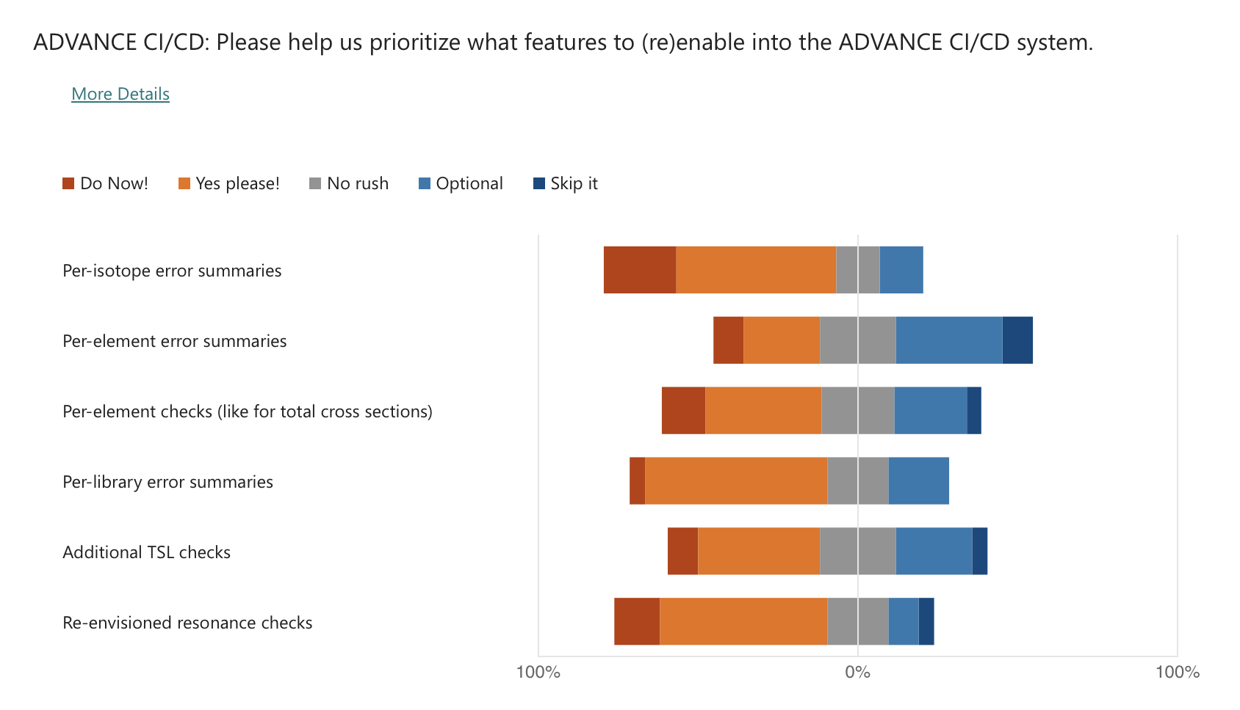
Feature Prioritization Results
Top Features Voted as ‘Do Now!’:
Per-isotope error summaries
Per-element checks
Re-envisioned resonance checks

Slide 6
Suggestions for New Features
Survey Question: "What other features/checks would you like to see added to the system?"
Notable Responses:
More TSL-related codes/scripts
Sub-library specific checks
Processing using NJOY for basic capability verification
Groupwise processing via NJOY/FUDGE

Slide 7
Suggestions for New Features (Cont.)
Additional Feedback:
Multiplicity corrections
Comparisons to quasi-integral measurements
Detecting loss of important information through comparisons with previous evaluations

Slide 8
Checking/Processing Code Integration
Survey Question: "Please list what additional checking/processing codes you would like to see integrated into the ADVANCE CI/CD system."
Top Suggestions:
ENDFtk, FRENDY, OpenMC's library builder
Covariance testing
NJOY for generating ACE files

Slide 9
Additional Code Integration Suggestions
Other Requests:
Improved stability in the pipeline workflow
Cross-section plots, neutron scattering plots, and gamma assessments
Benchmark suite that is cross-validated
Enhanced format checking and processing for lesser sub libraries

Slide 10
Summary of Key Recommendations
Key Features to Prioritize:
Per-isotope and per-element error summaries
Improved NJOY processing and additional TSL checks
Code Integration:
Focus on ENDFtk, FRENDY, NJOY, and OpenMC
AI-driven summaries of checking results

Slide 11
Conclusion
Next Steps:
Begin work on highly prioritized features and code integrations.
Address pipeline stability and enhance system visualization (plots, gamma assessments).
Collaborate with the community to finalize TSL checks and benchmarking processes.

