Slide 1
International Nuclear Data
Evaluation Network (INDEN)
Updates on ²³³U, ²³⁹Pu, ^{54,56}Fe, ^{50,53}Cr, and ¹⁹F
Roberto Capote
Deputy Section Head, NDDU head
CSWEG November 2024, Brookhaven National Laboratory, Upton, NY

Slide 2

































International Nuclear Data
Evaluation Network (INDEN)
https://www-nds.iaea.org/INDEN

Slide 3
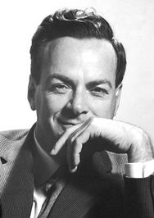
Outlook
U-233: Brooks & Leal-Cidoncha data, PROFIL
Pu-239: EUCLID crit. experiments, NIFFTE TPC
Fe-54,56: New elastic/inelastic data by
Gkatis et al (EC JRC Geel)
Cr-50,53: New capture data by
Maroto et al (CNA Sevilla, Spain)
F-19: Quasidiff. RPI data (G. Siemers et al)
“It doesn't matter how beautiful your theory is,
it doesn't matter how smart you are.
If it doesn't agree with experiment, it's wrong.”
Richard Philips Feynman, Nobel Prize in Physics 1965

Slide 4
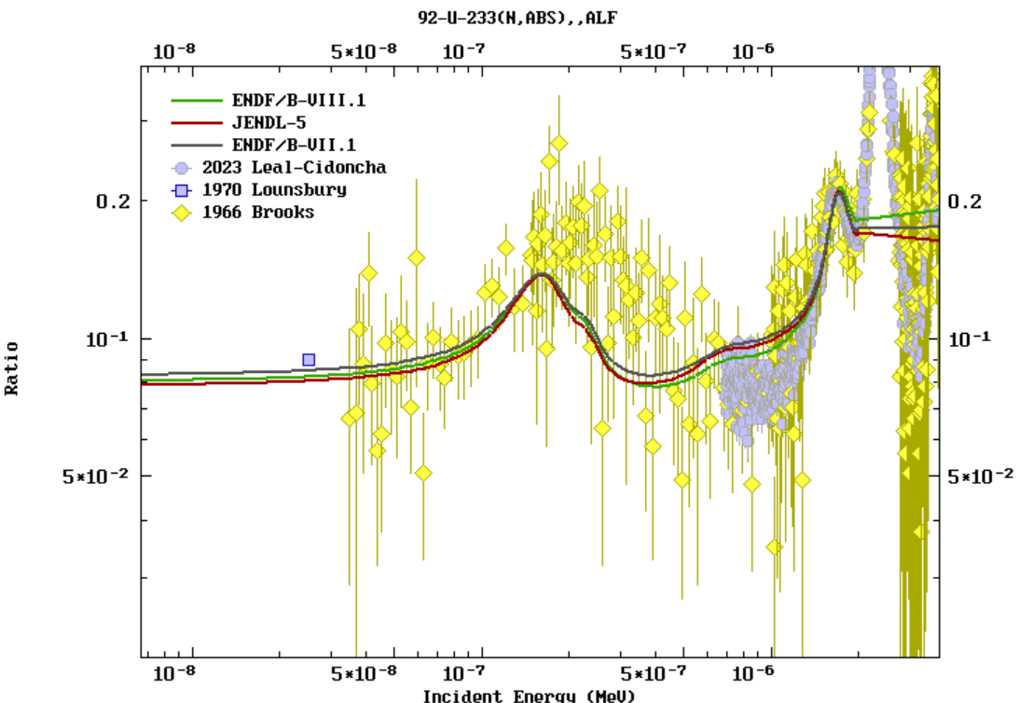

U-233 below 2eV (thermal systems)
α=σ_{γ}/σ_{f}
New RRR fit needed for En<2eV!

Slide 5
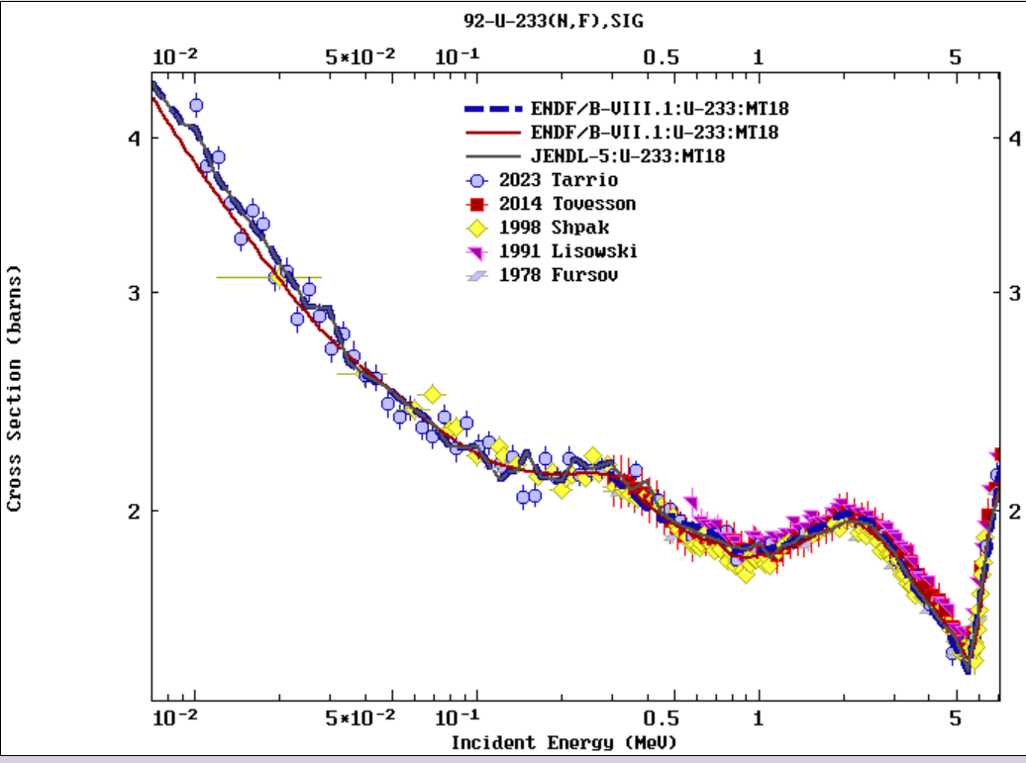
U-233 fission XS (from U3/U5 ratios)
(n,f) data in good agreement,
-> problems in capture
B8.1 = JENDL-4 = JENDL-5 fission XS

Slide 6
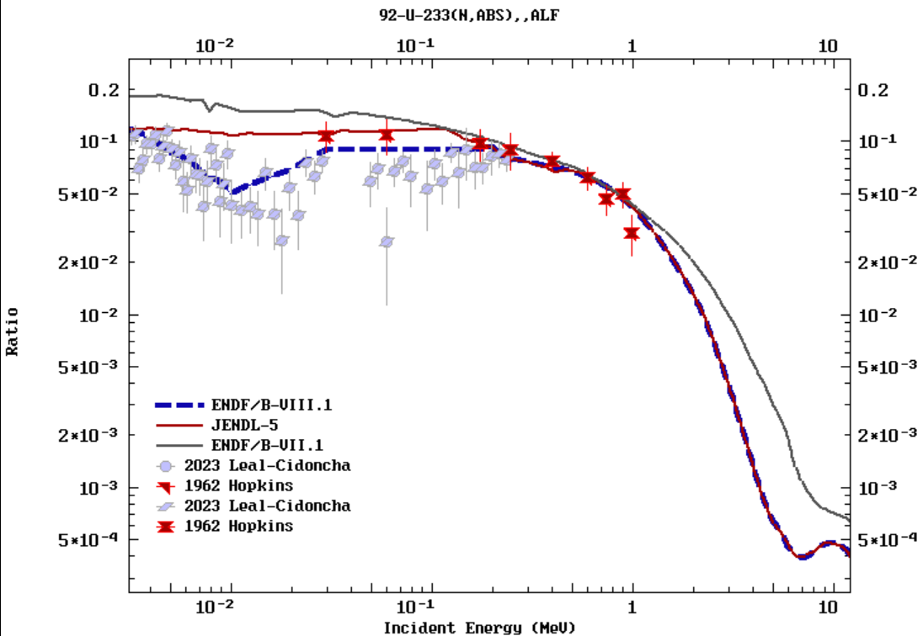
U-233 (URR & fast)
α=σ_{γ}/σ_{f}
(adopted by JEFF-3.3)
J. Tommasi and G. Noguere, Nucl. Sci. Eng. 160, 232 (2008) - PROFIL
JENDL-5 eval (URR) agrees with CEA PROFIL data
JEFF-3.3 (B71) and B81 in disagreement with PROFIL

Slide 7
Pu-239 updates

Slide 8
²³⁹Pu(n,f)/²³⁵U(n,f) NIFFTE (2021,2024)
Provided by Pronyaev
Snyder L et al, Nucl Data Sh. 178 (2021) 1–40. https://doi.org/10.1016/j.nds.2021.11.001
Dongwi D.H. et al, https://doi.org/10.48550/arXiv.2409.18279 (2024)

Slide 9
²³⁹Pu(n,f)/²³⁵U(n,f) NIFFTE (2021,2024)
Provided by Pronyaev
+2%
Snyder L et al, Nucl Data Sh. 178 (2021) 1–40. https://doi.org/10.1016/j.nds.2021.11.001
Dongwi D.H. et al, https://doi.org/10.48550/arXiv.2409.18279 (2024)

Slide 10
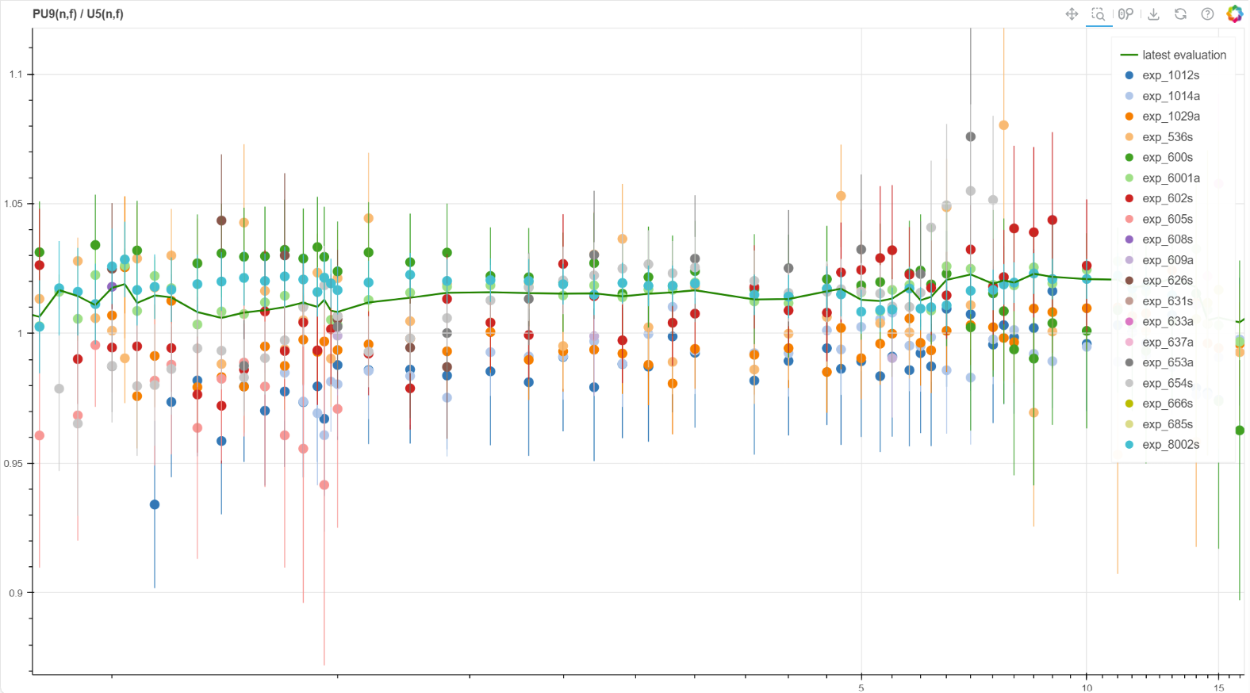
²³⁹Pu(n,f)/²³⁵U(n,f) NIFFTE (2021,2024)
Latest fit (with USU), 10/24
+2%
0.9 0.95 1.0 1.05 1.1
exp_6001a = TPC 2021 (TPC 2024 not used yet)
exp_1029a = Lisowski exp_609a = White
5 10 15
Correlations TPC2024 - TPC2021 being assessed!

Slide 11
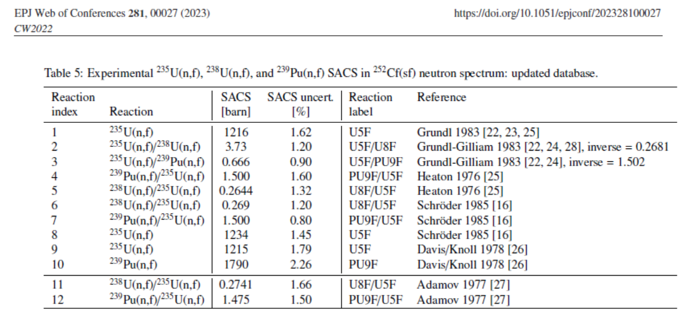
²³⁹Pu(n,f)/²³⁵U(n,f) impact on SACS-STD
Updated SACS(Cf) experimental database (*)
SACS fission cross sections | SACS meas. (*) evaluation (2023) | STD 2017 (B-VIII.0) | Difference to SACS eval (%) | Latest 10/2024 (MCMC) (*) | Difference to SACS eval (%)
²³⁵U(n,f) | 1.221 (0.91%) | 1.227 (1.2%) | 0.5% | 1.225 | 0.3%
²³⁹Pu(n,f) | 1.826 (1.03%) | 1.798 (1.3%) | 1.5% | 1.826 | 0.0%
²³⁸U(n,f) | 0.327 (1.06%) | 0.322 (1.3%) | 1.5% | 0.325 | 0.6%
²³⁹Pu/²³⁵U ratio | 1.495 (1.7%) | 1.465(1.2%) | 2.1% | 1.49 | 0.3%
²³⁸U/²³⁵U ratio | 0.268 (1.8%) | 0.262(1.2%) | 2.2% | 0.265 | 1.1%

Slide 12
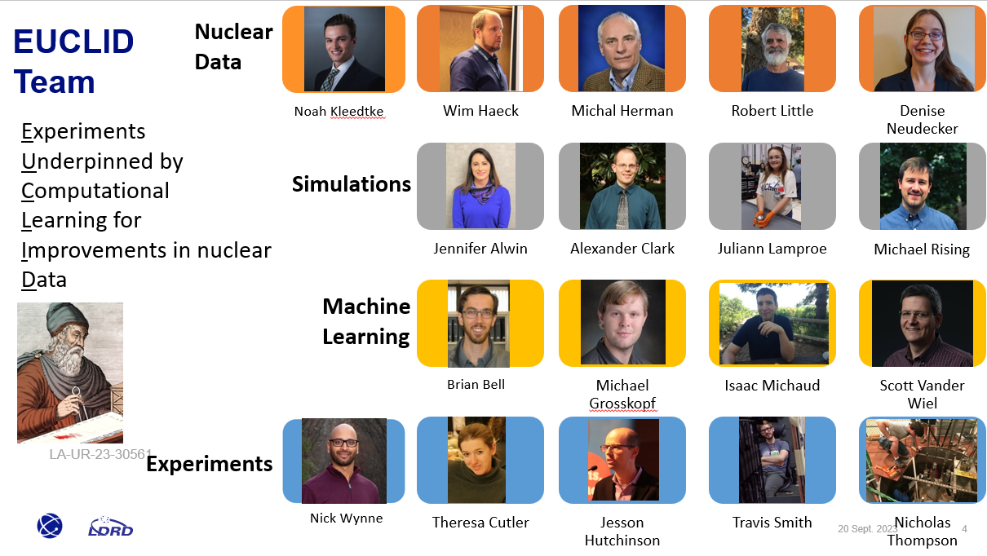




J. Hutchison et al, EUCLID: A New Approach to Constrain Nuclear Data via Optimized Validation Experiments using Machine Learning,
EPJ Web of Conferences 284, 15006 (2023)
J. Hutchison et al, Reaction Rate Ratios for Recent Fast Metal Experiments withLarge Plutonium Masses, Nucl. Sc. & Eng. 2024
https://doi.org/10.1080/00295639.2024.23431181

Slide 13
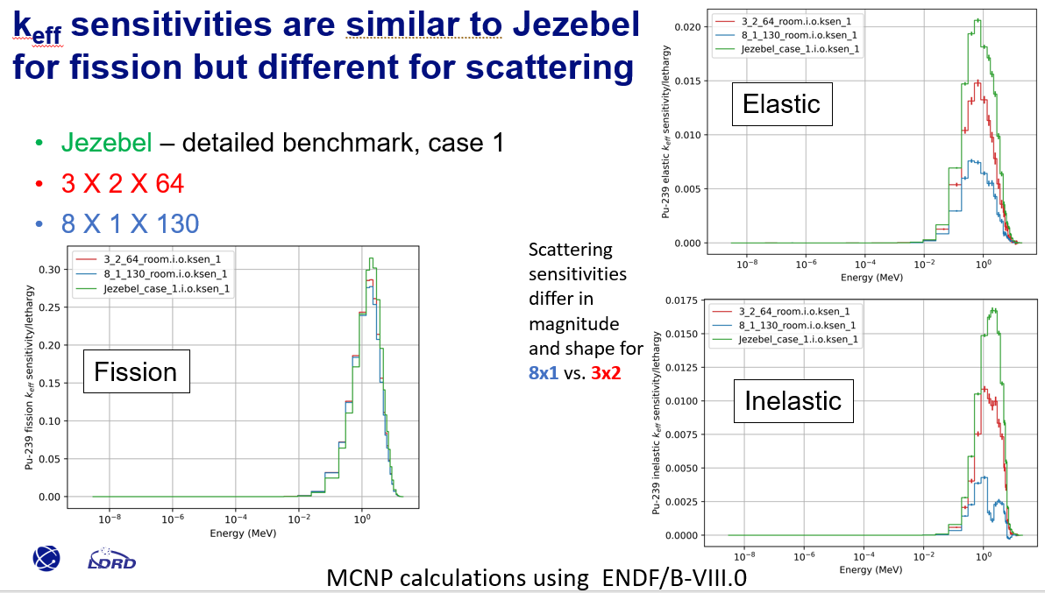
EUCLID sensitivities: Jezebel, 3x2, 8x1
J. Hutchison et al, EUCLID: A New Approach to Constrain Nuclear Data via Optimized Validation Experiments using Machine Learning,
EPJ Web of Conferences 284, 15006 (2023)
J. Hutchison et al, Reaction Rate Ratios for Recent Fast Metal Experiments withLarge Plutonium Masses, Nucl. Sc. & Eng. 2024
https://doi.org/10.1080/00295639.2024.23431181

Slide 14
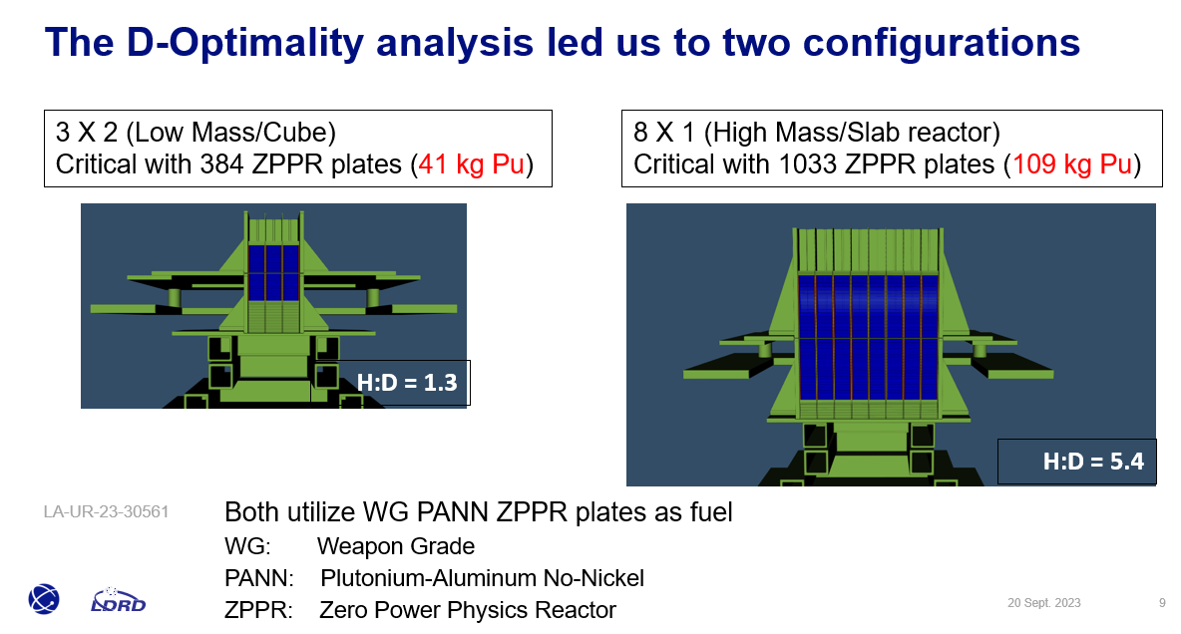
EUCLID design: 3x2, 8x1 (+Jezebel)

Slide 15
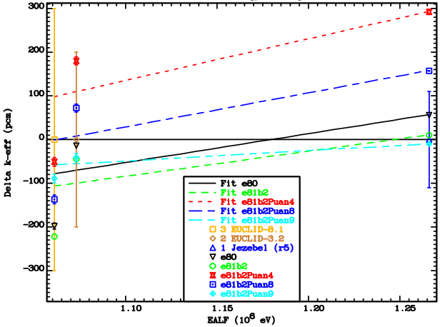
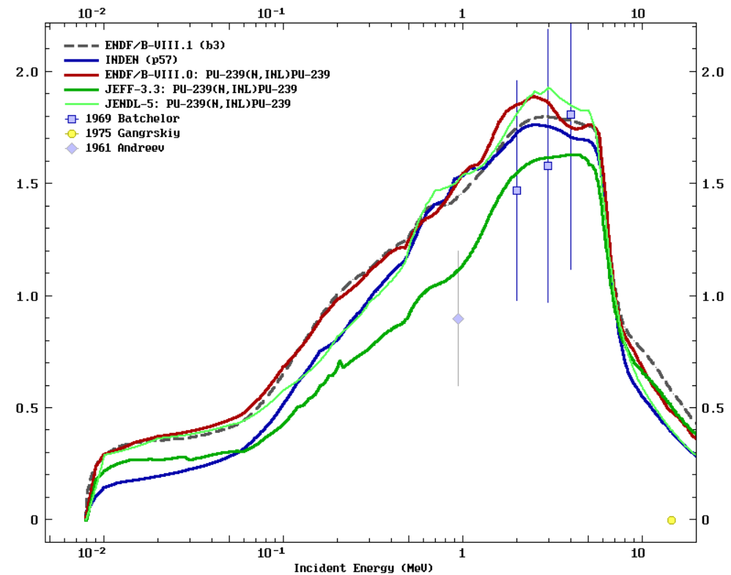
EUCLID + Jezebel for trials
e81b2 ~ e80 ~ INDEN p57 (3x2->8x1 drop ~ -200pcm)
e81b2Puan9 (INDEN p57 with JEFF-3.3 INL and EL recalculated)
=> Lower inelastic and (corresp) higher elastic XS strongly favored

Slide 16
Summary: EUCLID & analysis
Two new critical experiments were especially designed to be sensitive to compensating errors in elastic/inelastic XS
Simulation results favor lower inelastic and higher elastic than in current ENDF/B libraries
JEFF-3.3 gives better (but not perfect) results
New file using JEFF-3.3 INL confirmed improvement. Improved modelling required
J. Hutchison et al, EUCLID: A New Approach to Constrain Nuclear Data via Optimized Validation Experiments using Machine Learning,
EPJ Web of Conferences 284, 15006 (2023)
J. Hutchison et al, Reaction Rate Ratios for Recent Fast Metal Experiments withLarge Plutonium Masses, Nucl. Sc. & Eng. 2024
https://doi.org/10.1080/00295639.2024.23431181

Slide 17
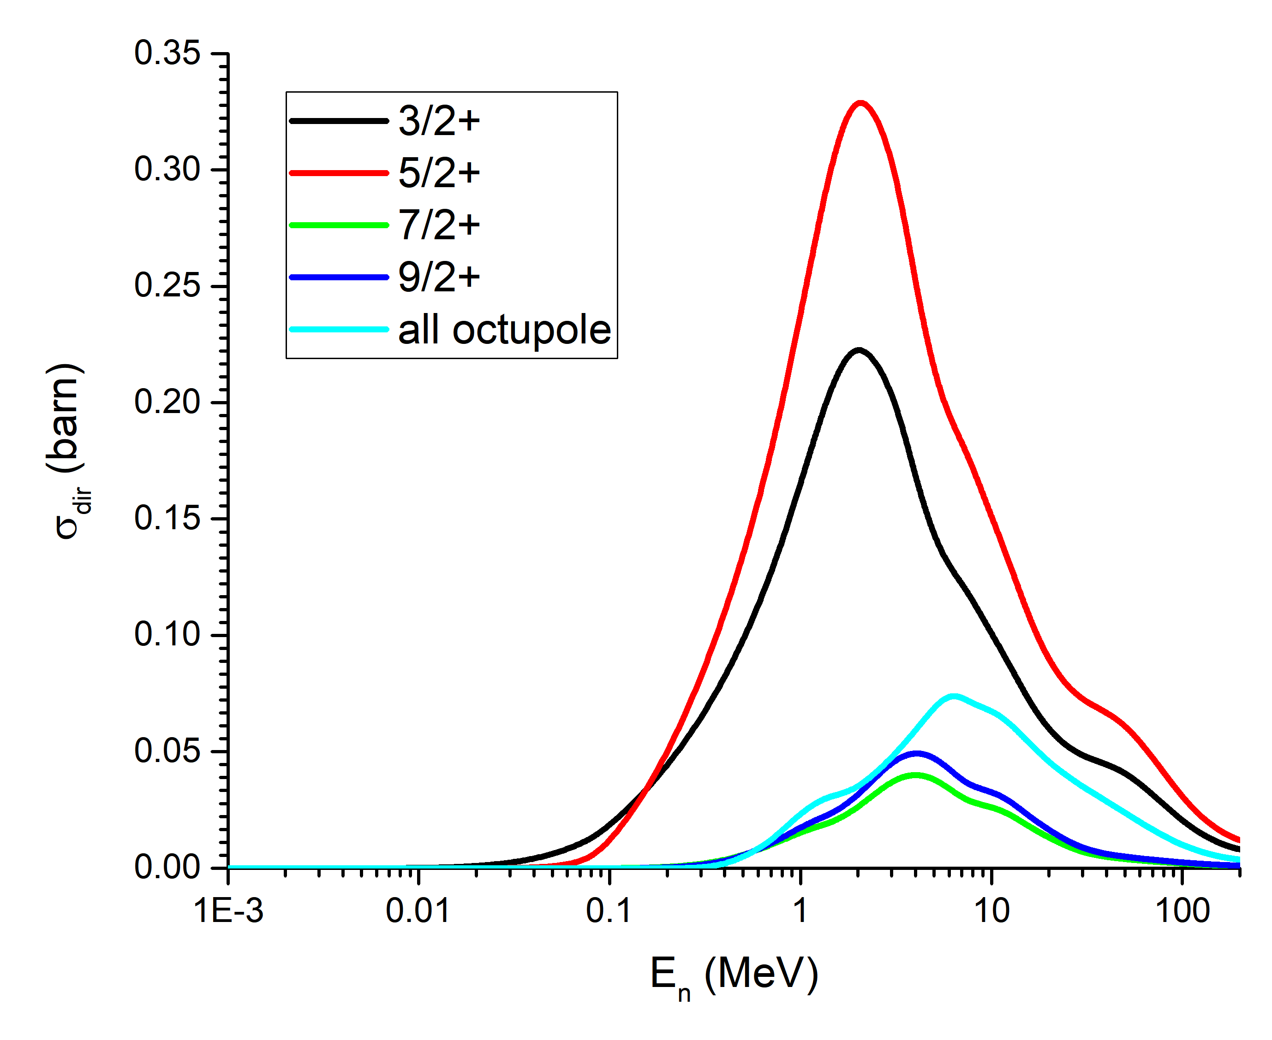
²³⁹Pu coupling scheme: New OMP 2420
Important octupole band (built on ½⁻ state) coupled with SRM:
½⁻ ≡ (core exc) 0⁻ ⊗ ½⁺ (single-particle GS)
better physics lead to better nuclear data
U_{exc}(MeV)

Slide 18
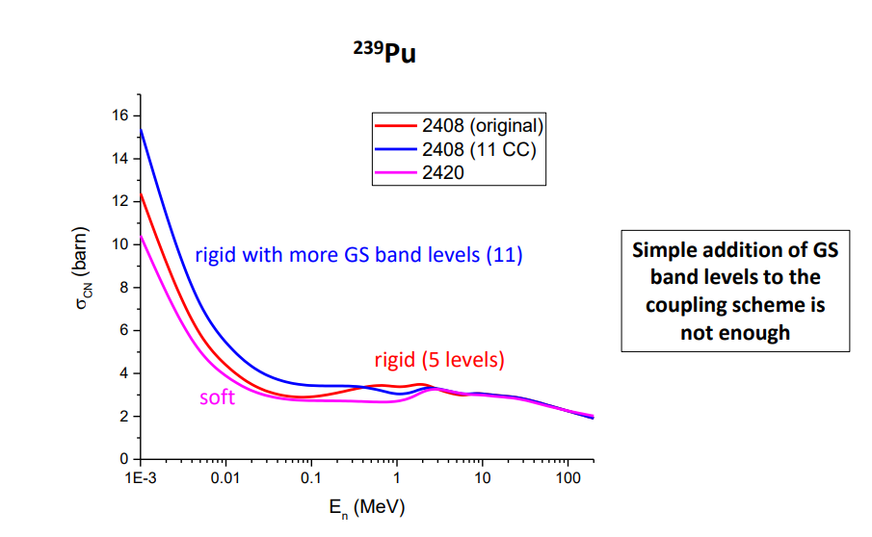
Pu239(n,inl): SRM vs Rigid OMP
SRM lead to significant reduction of the CN cross section below 2 MeV !

Slide 19
Iron updates

Slide 20
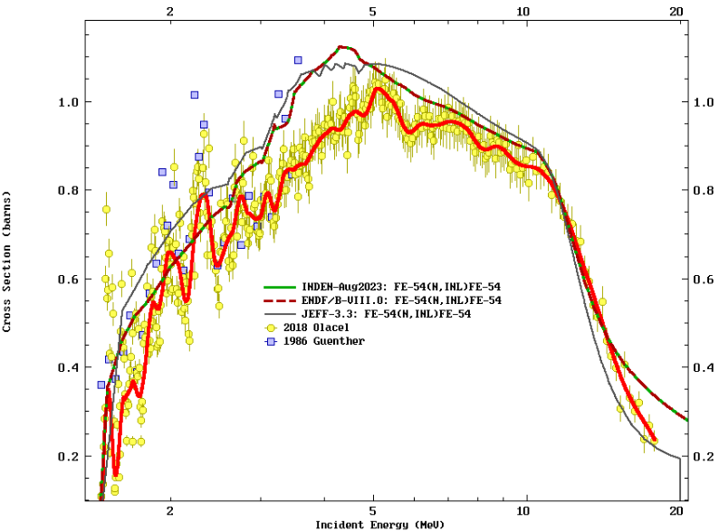
Fe-54 inelastic cross sections

Slide 21
Chromium updates

Slide 22
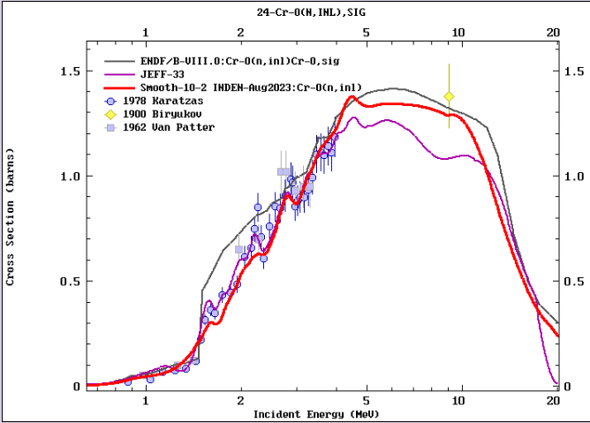

Slide 23
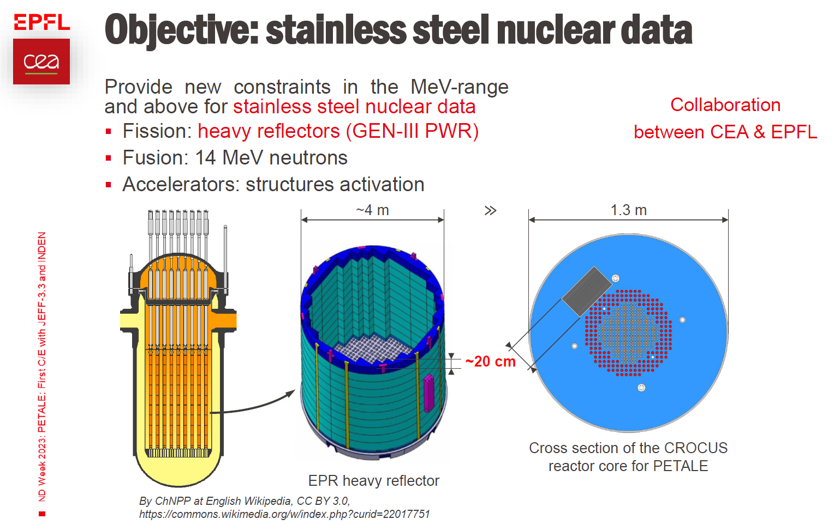
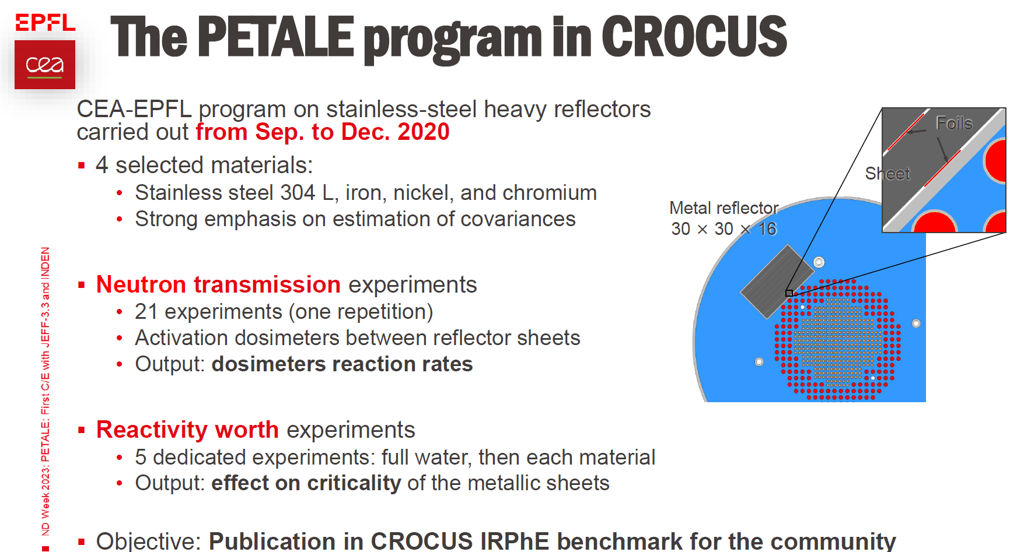
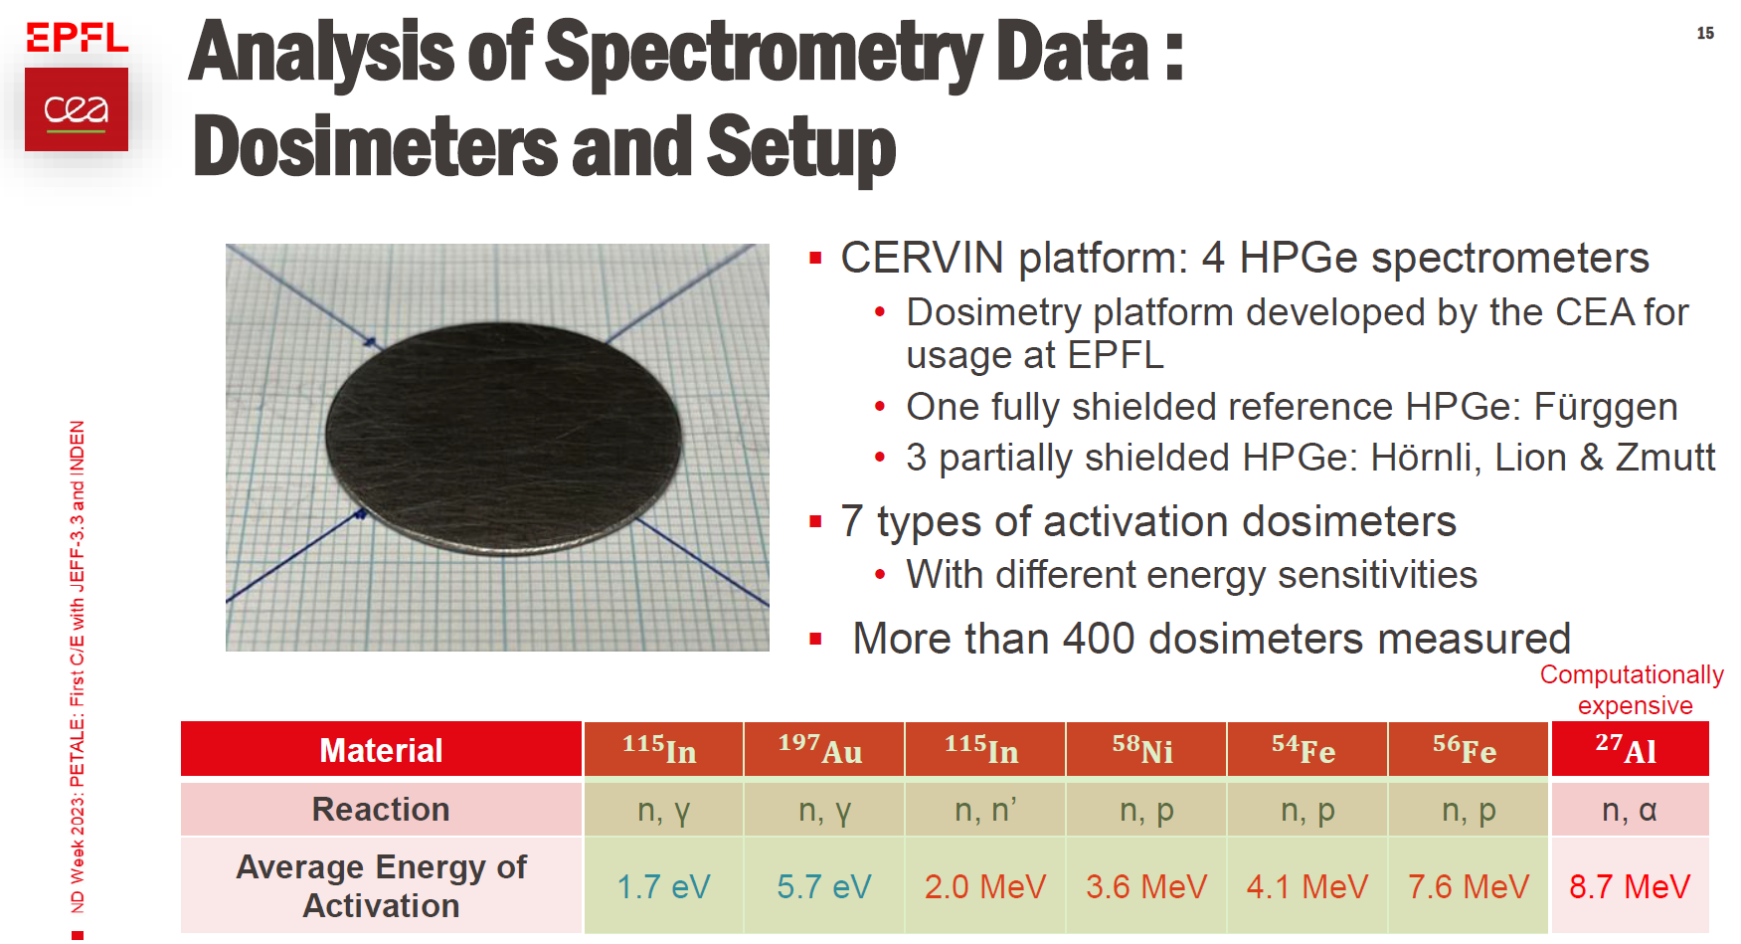
jefdoc-2269: T. Ligonnet et al (2023)
T. Ligonnet et al, presented at JEFF meeting. November 2023, jefdoc-2269

Slide 24
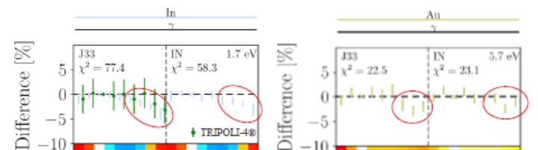
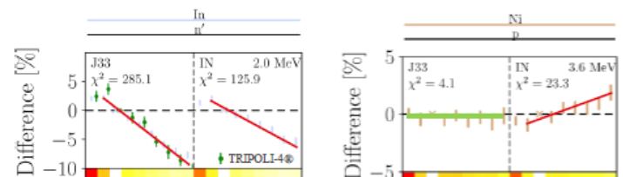
PETALE: Cr reflector (preliminary)
“Near thermal” range: Au-197(n,g) In-115(n,g)
fast range: In-115(n,n’) fast range: Ni-58(n,p)
T. Ligonnet et al, presented at JEFF meeting. November 2023, jefdoc-2269

Slide 25
Fluorine updates

Slide 26
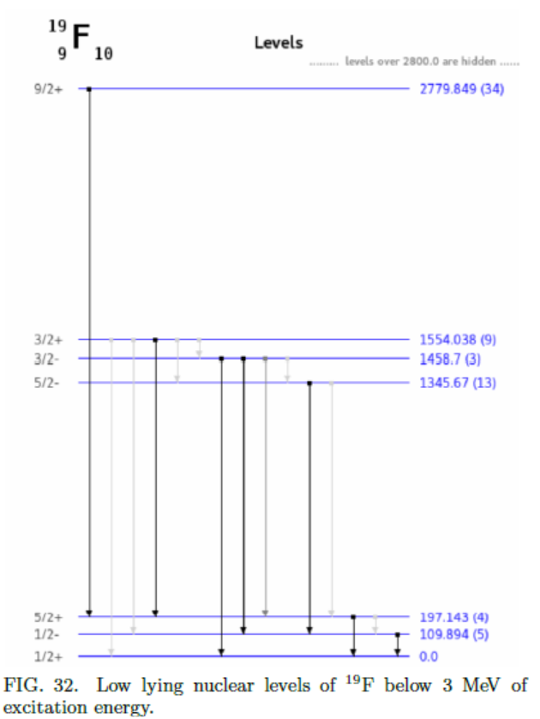
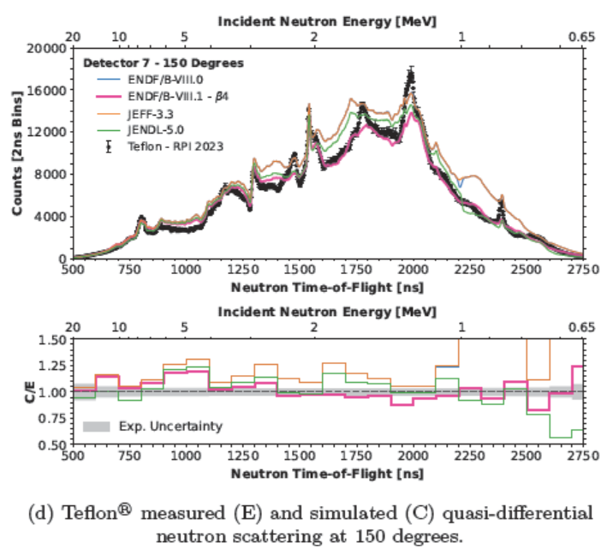
RPI quasi-diff. test on Teflon
G. Siemers et al, RPI, analysis for the ENDF/B-VIII.1 paper (2024)

Slide 27
SUMMARY
U-233: New RRR fit, new URR (PROFIL)
Pu-239: New OMP with soft-rotor model multi-band coupling to reevaluate the fast neutron range (elastic , inelastic )
Check with EUCLID 1x8 & 3x2 + PMF001
Fe-54,56: Gkatis data to be considered
Cr-50,53: RRR reevaluation (Maroto & PETALE)
F-19: To improve 2nd-6th (n,n’) XS & ang. distrib.
Additional work on O-16, Pb, Zr, Ni, Cu (covar)

Slide 28
Thank you!
Notes:
Thank you!

