Slide 1
Semi-microscopic approach to nucleon-nucleus scattering and nuclear data
Aaina Thapa (LLNL)
Nuclear Data Week 2024, BNL
871111
Notes:
Hello everyone. I am Aaina Thapa. Today I will be discussing some of the work that I have been doing as a postdoc with Jutta Escher at LLNL on semi-microscopic approach to nucleon-nucleus scattering and some of the applications of this approach that could be of interest to you..

Slide 2
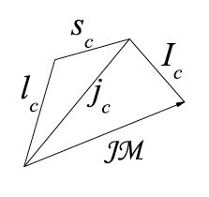
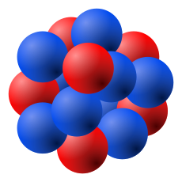

Nucleon-nucleus scattering and microscopic structure of the nucleus
.
.
.
E
1. Structure of the nucleus as seen in– HFB+QRPA with Gogny D1M nucleon-nucleon interaction
2. Ground state and transition densities from microscopic calculations are used to generate nucleon-nucleus scattering potentials for coupled-channels code (FRESCOX in our case).
Key Idea : Microscopic structure of the target tells reaction theory the quantized states that target can get excited to during inelastic scattering.
Notes:
I would like to begin with summarizing our approach schematically. The idea is to use the microscopic structure of the target (CLICK) to inform two-body quantum scattering equation about the quantized states that target can get excited to during direct inelastic scattering and if we are doing it right it should match what is observed in the detectors in the scattering experiments.
For structure input, we use Hartree-Fock Bogoliubov many-body method with Gogny D1M nucleon-nucleon interaction. After which we use Quasi-particle-random phase approximation to obtain the vibrational excited states from one-phonon excitations on top of the HFB ground state. Then we use the ground state and transition densities, for going from ground state to different QRPA excited states, of the nucleus to calculate Vcc and Vcc' scattering potentials that are input to coupled-channels code FRESCOX.

Slide 3

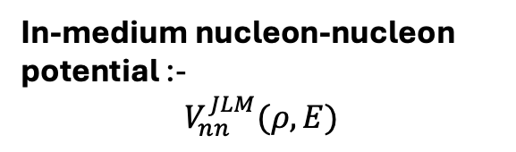
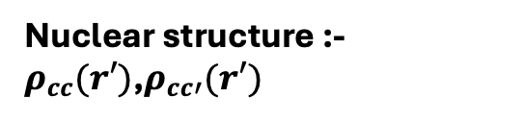
JLM-B Folding model to Nucleon-nucleus (N-A) scattering
Jeukenne Lejeune Mahaux (JLM) folding model using the Bauge et al (2001) parameterization potentials
E. Bauge, J.P. Delaroche, M. Girod, Phys. Rev. C 63, 024607 (2001)
Semi-microscopic -$6 λ’s$ and effective range parameters tr,ti were fitted to elastic and quasi-elastic (p,n) scattering data
$$e^{\left\{\frac{{−\left|r−r^{′}\right|}^{2}}{t^{2}}\right\}}$$
Nuclear structure :-$ρ_{cc}(r′)$,$ρ_{cc′}(r′)$
In-medium nucleon-nucleon potential :-
$$V_{nn}^{JLM}(ρ,E)$$
Improved local density approximation
Notes:
To summarize the approach JLM-B model

Slide 4
JLM-B nucleon-nucleus optical potential
Jeukenne Lejeune Mahaux (JLM) folding model using the Bauge et al (2001) parameterization
E. Bauge, J.P. Delaroche, M. Girod, Phys. Rev. C 63, 024607 (2001)
Uses nucleus specific information - Folded with ground state densities from HFB.
Plot on the left – 94Zr(p,p) differential cross section for two different incident energies and the comparison to experimental data
Plot on right : 90Zr+n total cross sections as function of neutron incident energies and its comparison to data
Exp data from Phys. Rev. 168, 1355 (1968), Phys. Rev. 135, B706 (1964)

Slide 5
Direct inelastic scattering: 90,92 Zr(p,p’) at different incident energies
Left panel : 90Zr, right panel : 92Zr
Curves : Inelastic differential cross sections for target excitation to the first 3- state.
Markers : Experimental data
Different colors : different incident proton energies as shown in the label.
Conclusion : We can successfully use the microscopic structure of spherical nuclei to study nucleon-nucleus elastic and inelastic scattering

Slide 6
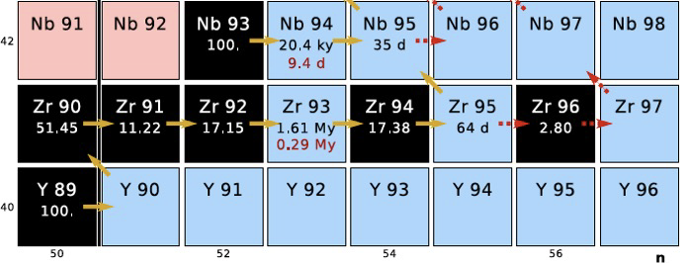
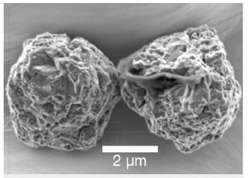



Application : (p,p’) inelastic scattering as surrogate for (n,$γ$) reaction
p’
96Zr
A Surrogate experiment gives
P_{(p,p’γ)} (E) = Σ_{J,π} F_{(p,p’)}^{CN}(E,J,π).G^{CN}_{γ}(E,J,π)
⁹⁵Zr(n,γ) cross section:
σ_{(n,γ)}(E) = Σ_{J,π} σ_{n+target}^{CN} (E,J,π) . G^{CN}_{γ}(E,J,π)
Desired reaction
p
)))
Surrogate
n
)))
)))
95Zr
96Zr*
$$γ$$
95Zr
Concept: Escher et al, RMP 84 (2012) 353; EPJConf 122 (2016) 12001
Surrogate method by design requires both theory and experiment
From theory – F(p,p’,J,pi) [Spin population]
From Experiment – P(p,p’,gamma) [gamma decay probabilities]
Fig. from J. Escher
Notes:
To connect the
Another application of the microscopic approach is its surrogate applications. Inelastic scattering can be used as a surrogate reaction for neutron capture on unstable nuclei, like Zr95 shown here.
The idea is to learn the decay of the compound nucleus, in this case the excited 96Zr nucleus, from inelastic scattering and then use it to predict neutron capture cross section.
The computed neutron capture cross section can then be used as input to astrophysical simulations that predict the isotopic ratios (ratio of the atomic abundances of two isotopes of the same element) in presolar grains.
fingerprints of the nuclear reaction chain that led to formation of those isotopes

Slide 7





What do I mean by spin populations?
Compound nucleus : The common thread between surrogate reaction and desired reaction.
For a given reaction, spin population tells us about the different spin-parity states that get populated as function of the excitation energy of the compound nucleus.
.
.
$$Spin−population$$
)))
.
E
$$E_{ex}$$
)))
)))
96Zr*
Comes from Lorentzian spreading of $∫\frac{dσ}{dΩ} dΩ$

Slide 8

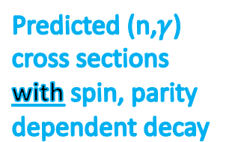
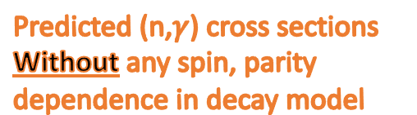
Why are spin-populations important?
Evidence -
        ⁹⁵Mo(d,p) surrogate reaction prediction for ⁹⁵Mo(n,$γ$)
Predicted (n,$γ$) cross sections
Without any spin, parity
dependence in decay model
Predicted (n,$γ$)
cross sections
with spin, parity
dependent decay
Fig : A. Ratkiewicz et al- PhysRevLett.122.052502 (2019)
Not surprisingly, The probability of a compound nucleus decaying via gamma emission depends on its spin and parity. And Surrogate reaction and neutron capture cross section can differ.
Explicitly accounting that dependence through spin populations improves the decay modeling

Slide 9
Ongoing work - 90Zr(p,p’) surrogate for 89Zr(n,$γ$)
Red dots : Experimental data from P_{(p,p’γ)} (E) (S. Ota et al Phys. Rev. C 92, 054603 (2016))
Black curve : From Hauser-Feschbach runs Σ_{J,π} F_{(p,p’)}^{CN}(E,J,π).G^{CN}_{γ}(E,J,π)
Spin-populations from QRPA+HFB+JLM-B for 90Zr(p,p’)
Figures – not yet fitted to gamma decay probability data from experiments shown in red dots ,
generated form MC prior sampling of parameters in decay modelling using phenomenological LD and GSF models that are default in YAHFC ,
1. level densities (combination of constant temperature and Fermi-gas descriptions – Gilbert-Cameron)
2. E1 and M1 gamma-ray strength parameters (Modified Lorentzian by Kopecki and Uhl)

Slide 10
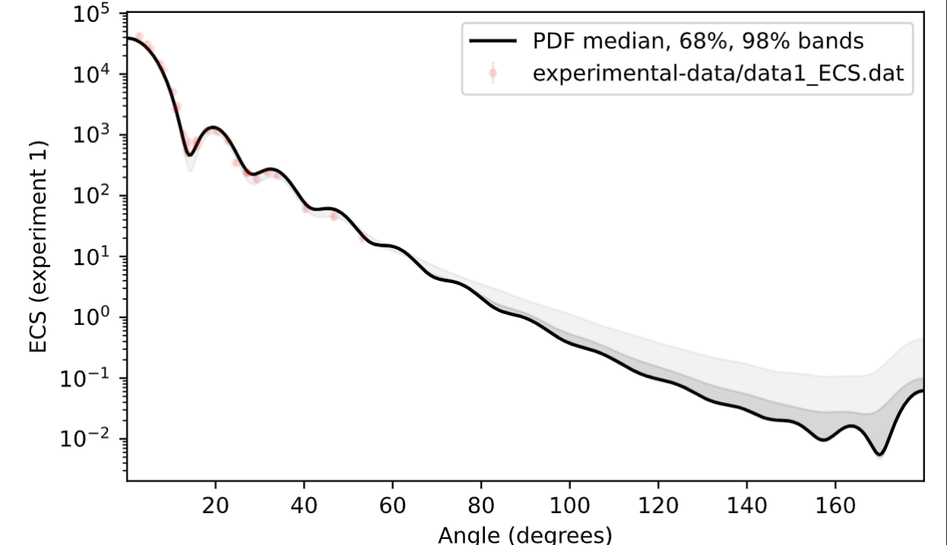
Towards uncertainty quantified JLM-B optical potential
Work with summer student Maxwell Paik (NYU)
Refitting the lambda parameters to scattering data (ECS, TCS, RCS and analyzing power) using Markov chain Monte Carlo
208Pb(n,n)
Preliminary
Elastic scattering results (black curve), with theoretical uncertainty bands (dark and light grey), compared to experimental data (red dots).
We are currently working on including charge-exchange data in the fits to better constrain iso-vector terms ${(λ}_{V1},λ_{W1})$

Slide 11
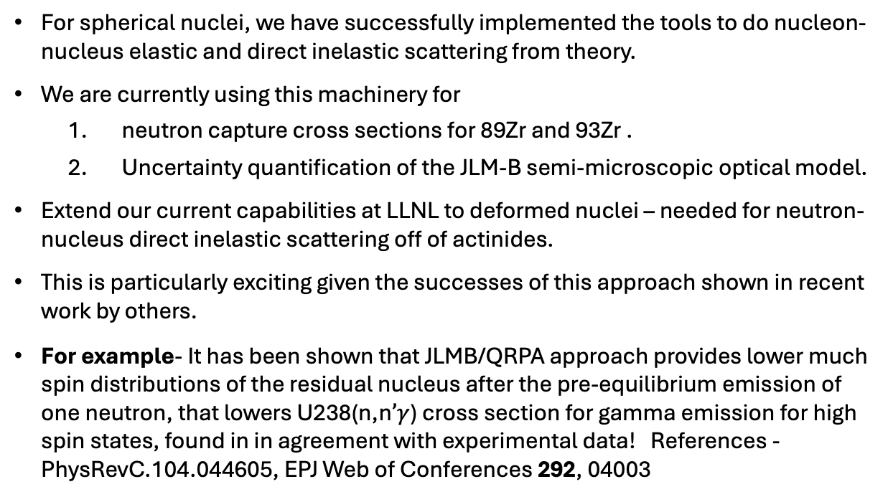
Conclusions and Outlook
Thank you to my collaborators -
Emanuel Chimanski (BNL), Jutta Escher (LLNL), Eun Jin In (LLNL), Walid Younes (LLNL),
UQ work – Maxwell Paik (NYU), Simone Perrotta (LLNL), Oliver Gorton (LLNL)
Marc Dupuis (CEA), Sophie Pèru (CEA). [NNSA/LLNL – CEA DAM DIF]
Nuclear Structure
Nuclear Reactions
QRPA code
1+2-step reaction formalism
Projectile-target effective interaction
HPC calculation
QRPA projection formalism
Projection code
For spherical nuclei, we have successfully implemented the tools to do nucleon-nucleus elastic and direct inelastic scattering from theory.
We are currently using this machinery for
  neutron capture cross sections for 89Zr and 93Zr .
  Uncertainty quantification of the JLM-B semi-microscopic optical model.
Extend our current capabilities at LLNL to deformed nuclei – needed for neutron-nucleus direct inelastic scattering off of actinides.
This is particularly exciting given the successes of this approach shown in recent work by others.
For example- It has been shown that JLMB/QRPA approach provides lower much spin distributions of the residual nucleus after the pre-equilibrium emission of one neutron, that lowers U238(n,n$’γ$) cross section for gamma emission for high spin states, found in in agreement with experimental data! References - PhysRevC.104.044605, EPJ Web of Conferences 292, 04003
QRPA transition densities
Folding code
Transition potentials
Legend
Research activities
Coupled-channels reaction code
New codes
Physics outcomes
Scattering predictions
Existing codes
Applications
Neutron
Scattering,
Etc.
Surrogate
Reactions
Fig. from J.E. Escher

Slide 12
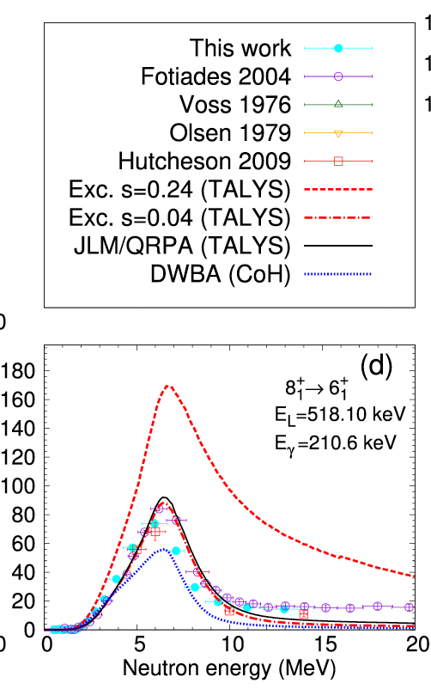
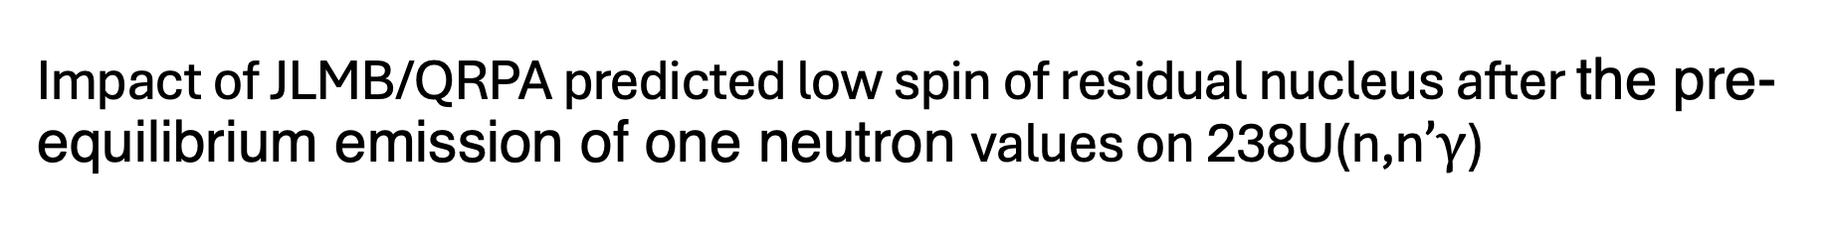
Impact of JLMB/QRPA predicted low spin of residual nucleus after the pre-equilibrium emission of one neutron values on 238U(n,n$’γ$)
Data for 238U(n, n
γ ) cross sections for transitions within the ground state rotational band. Spin and parity of the initial and final
states, energy of the γ ray, experimental data (symbols) and calculations (curves) are defined in the plots. Calculations based on four different
preequilibrium models are compared: excitons with s = 0.24 or s = 0.04, JLM/QRPA (TALYS code) and DWBA (CoH code).

Slide 13

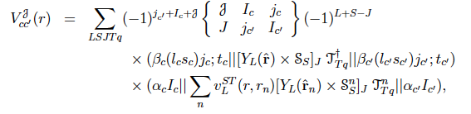
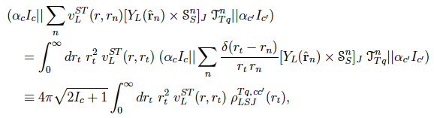
Outline of the underlying formalism: coupling potentials
Coupled-channels equations:
V_cc are the coupling potentials that can be used by coupled-channels codes like FRESCO
From QRPA

Slide 14
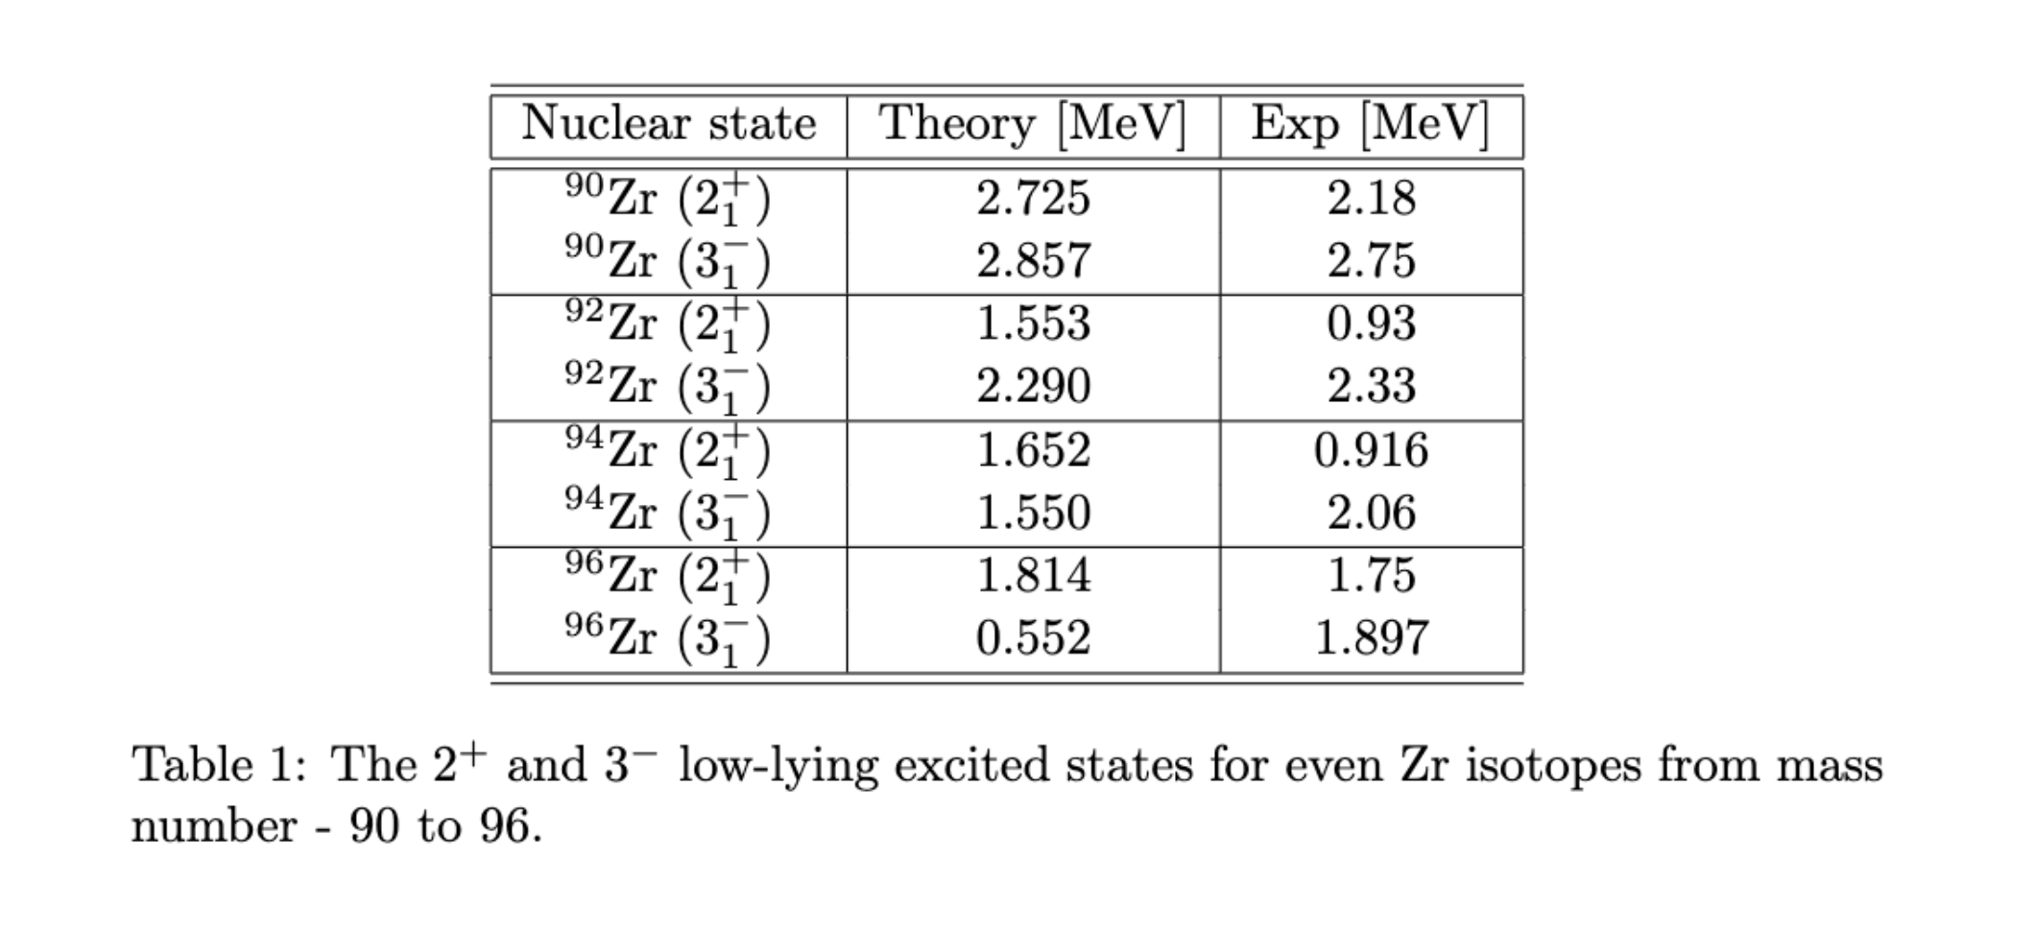
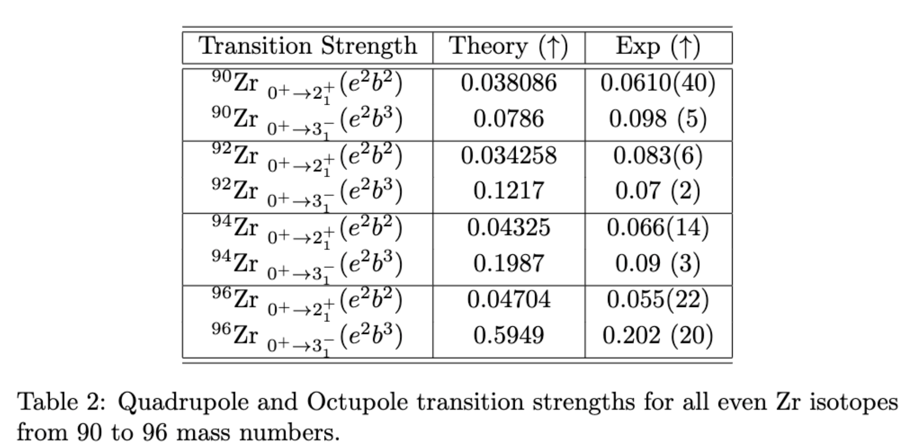
QRPA vs exp : Low-lying spectrum and the transition strengths

Slide 15
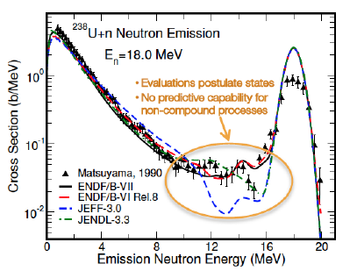
Outlook : Where are we headed?
Add ref
Cross section as a function of energy of the emitted neutron for 18MeV neutron incident on 238U nucleus.
18MeV – direct elastic scattering peak, left side, neutron emitted after compound nucleus formation.
The bumps in between these two ends of the plot depend on direct inelastic scattering which depends on the structure/low-lying excitation spectrum of the target nucleus.

Slide 16
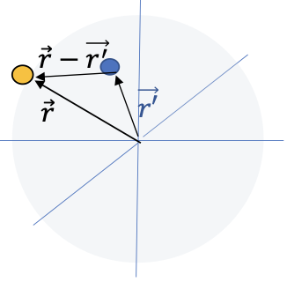
JLM model
1. Reid’s hard-core potential
2. Parametrized effective nucleon-nucleon interaction
in presence of other nucleons
In infinite nuclear matter of constant density
3. Add a finite range to account for non-uniform density of the nucleus over the range of the interaction
E. Bauge, J.P. Delaroche, M. Girod, Phys. Rev. C 58, 1118 (1998)
E. Bauge, J.P. Delaroche, M. Girod, Phys. Rev. C 63, 024607 (2001)
4. Nucleon-nucleus interaction obtained from single-folding :
$$V_{cc′}\left(r,E \right)={ ∫[Re(V}_{nn}^{JLM}\left(ρ,E\right))e^{\left\{\frac{{−\left|r−r^{′}\right|}^{2}}{t_{r}^{2}}\right\}}ρ_{cc′} (r′)+{Img(V}_{nn}^{JLM}\left(ρ,E\right))e^{\left\{\frac{{−\left|r−r^{′}\right|}^{2}}{t_{i}^{2}}\right\}}ρ_{cc^{′}} (r′)] dr′$$
Notes:
The JLM approach, first published in 1977 in the reference mentioned here and the named after the names of its authors, essentially give a parameterized nucleon-nucleon interaction in a medium, the medium being infinite nuclear matter of constant density, using the Reid’s hard-core potential as the model for the nuclear force between free nucleons.
To go from nuclear matter to finite nucleus, a finite range is added to account for non-uniform density of the nucleus over the range of the interaction. The results that I will present later use an improved JLM model, which uses some elastic and quasi-elastic scattering data to fit the renormalization parameters, lambda’s, shown in the first equation.
The last and final step is to perform single-folding using the JLM-B in-medium nucleon-nucleon interaction and the ground state and transition densities from HFB+QRPA calculations to obtain the nucleon-nucleus scattering potentials.

Slide 17
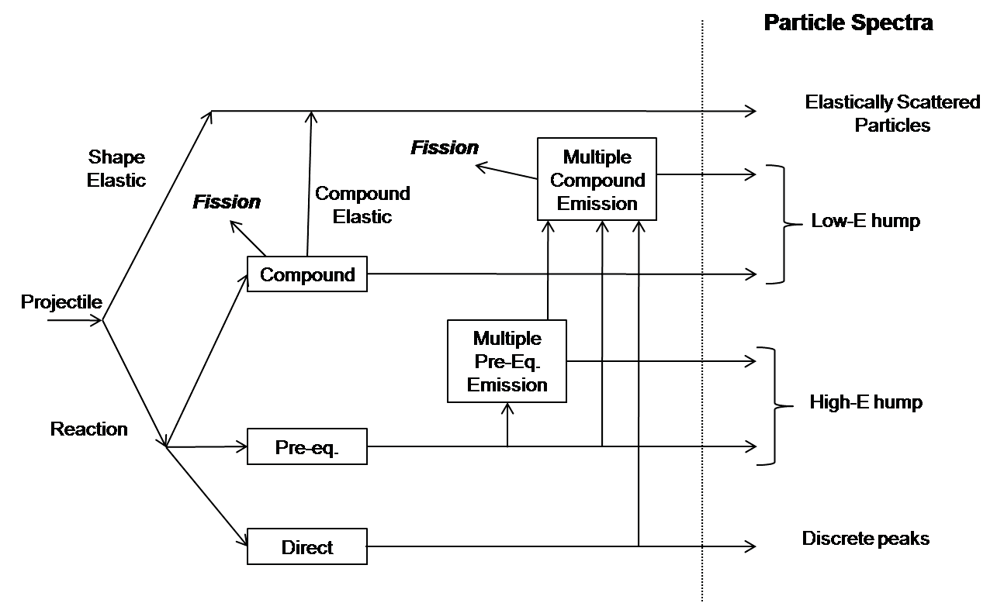
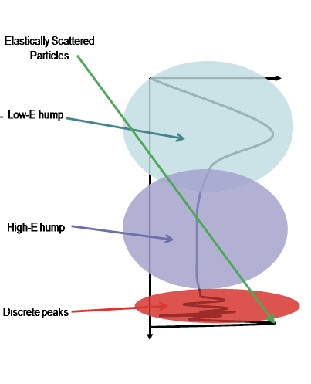

Slide 18
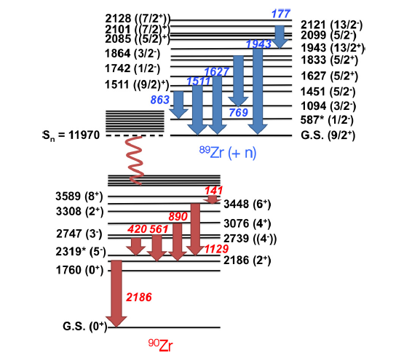
Why 8+->6+ transitions have higher coincidence probability in experiment than what I see from DWBA calculations?
4.5+
909
Sp = 8.5 MeV
0.5-
89Y

Slide 19
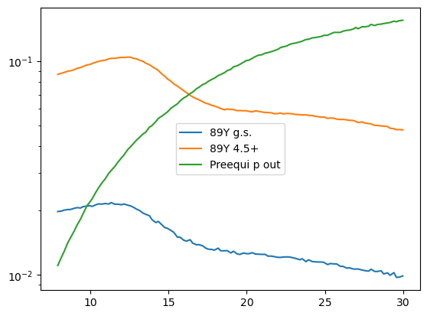
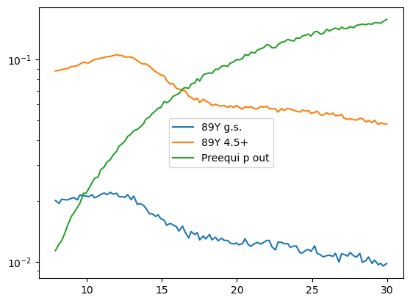
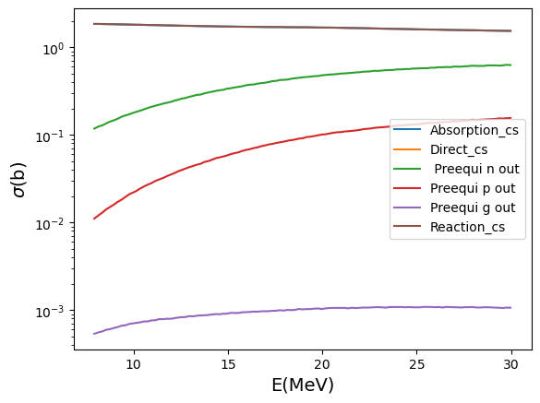
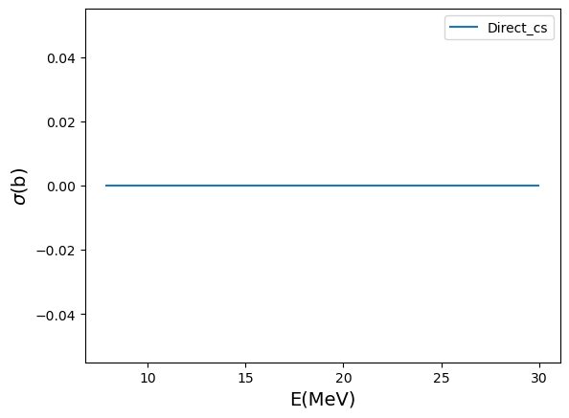
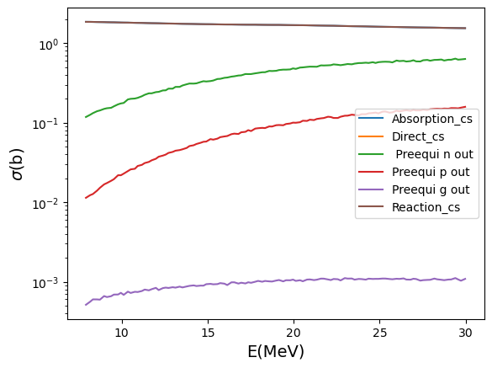
Proton emission from 90Zr vs preequilibrium proton cross sections

