Slide 1
Unique Questions and Answers Revealed in Automated Resonance Fitting and Demonstrated on Ta-181
Noah Walton¹, Vladimir Sobes¹, Oleksii Zivenko¹, Jesse Brown², Jake Forbes¹, Cole Fritsch¹, Aaron Clark¹
Collaborators: Dave Brown³ , Denise Neudecker⁴ , Mike Grosskopf⁴
The University of Tennessee¹
Oak Ridge National Laboratory²
Brookhaven National Laboratory³
Los Alamos National Laboratory⁴
Notes:
Introduce myself

Slide 2
Unique Questions and Answers Revealed in Automated Resonance Fitting and Demonstrated on Ta-181
Does differential data have information on the spin group of resonances?
Quantitatively assess the impact of the PPP correction for Data Covariance Matrix
Smooth deterioration of evaluation performance approaching the URR
Notes:
While there are many interesting questions that we hope to investigate in the future with the automated fitting, today, I’d like to present to you these three specific investigations backed up by quantitative data.
The end of the presentation, we will welcome suggestions from the community for additional interesting questions that can be investigated in this type of approach. (You can thank Jesse at this point for providing the insightful suggestion to look at energy average transmission in additional to performance in cross section space).

Slide 3
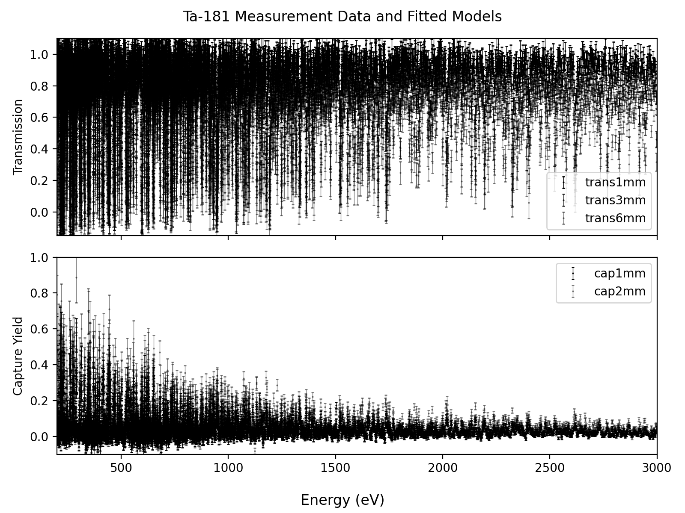
Can automation help?
Composite observables used to infer resonance parameters
Manual effort and reproducibility
Prior evaluations
Uncertainty quantification
Trans
$$Yγ$$
Incident Neutron Energy (eV)
Notes:
Lastly, UQ is hard because assumptions are violated
Small resonances are missed

Slide 4
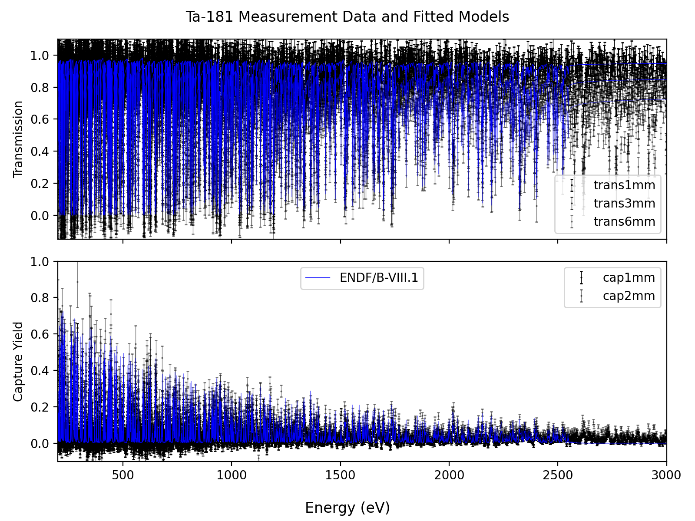
Challenges in resonance parameter inference
Composite observables used to infer resonance parameters
Manual effort and reproducibility
Prior evaluations
Uncertainty quantification
Trans
$$Yγ$$
Incident Neutron Energy (eV)

Slide 5
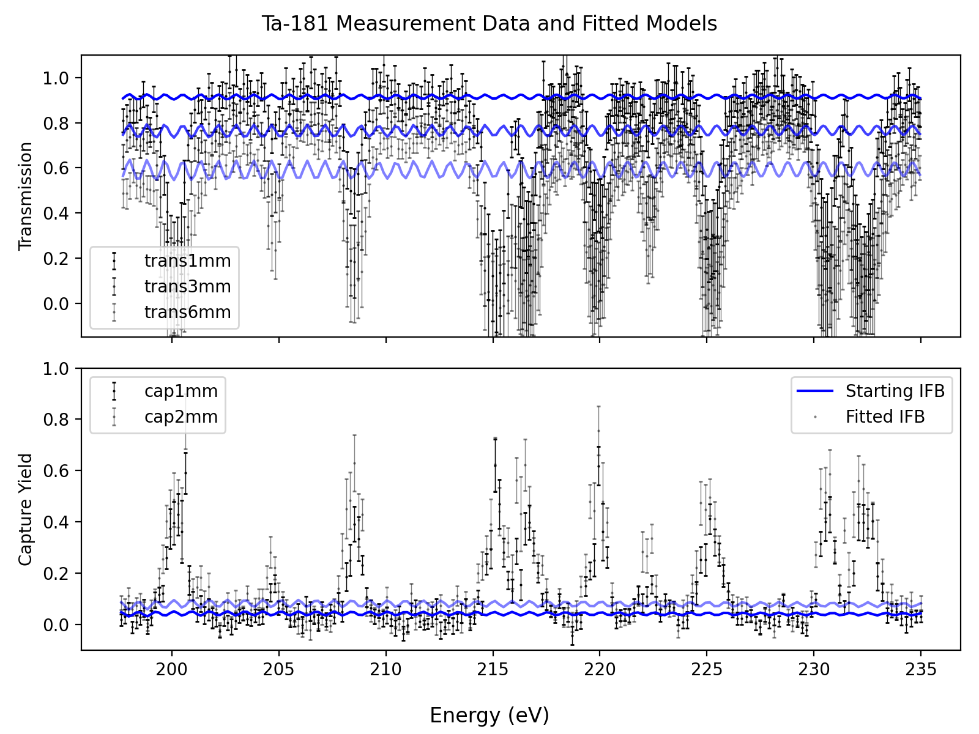
Automated parameter inference
Composite observables used to infer resonance parameters
$$\text{Trans}$$
Design initial feature bank
$$Yγ$$
Incident Neutron Energy (eV)

Slide 6
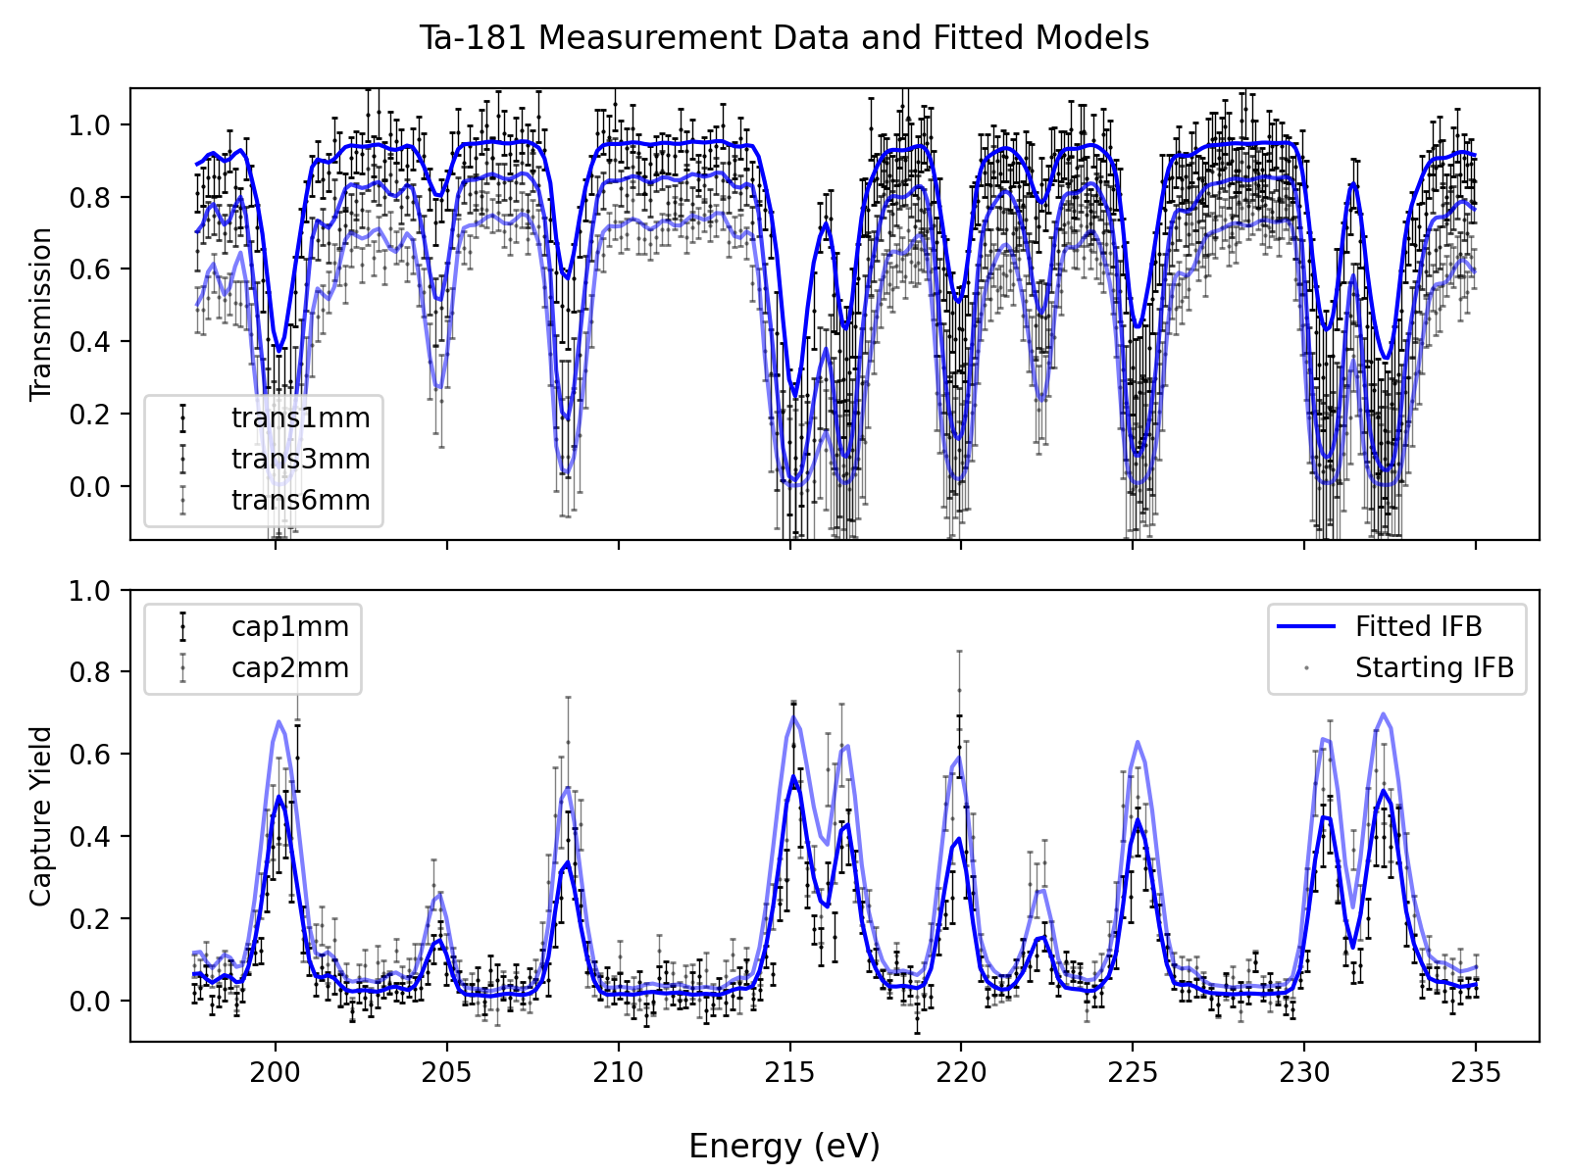
Automated parameter inference
Composite observables used to infer resonance parameters
$$\text{Trans}$$
Design initial feature bank
Non-linear optimization
$$Yγ$$
Incident Neutron Energy (eV)

Slide 7
Automated parameter inference
Composite observables used to infer resonance parameters
$$\text{Trans}$$
Design initial feature bank
Non-linear optimization
Stepwise variable selection
$$Yγ$$
Incident Neutron Energy (eV)

Slide 8
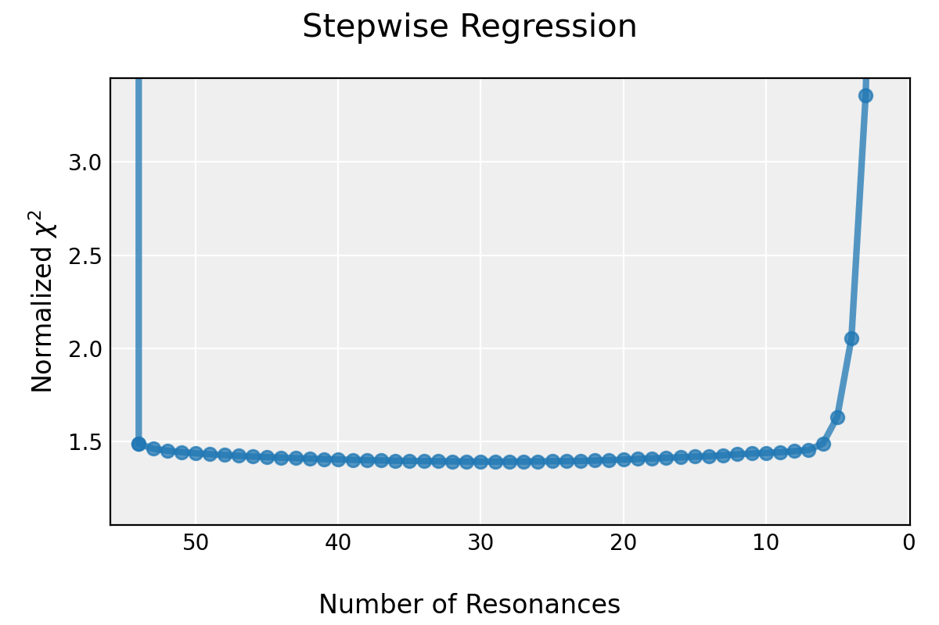
Automated parameter inference
IFB
Design initial feature bank
Non-linear optimization
Stepwise variable selection

Slide 9
Automated parameter inference
Full Data Set
Fold 1
Fold 2
Fold 3
Fold 4
Fold 5
1mm T
1mm T
1mm T
1mm T
1mm T
Design initial feature bank
Non-linear optimization
Stepwise variable selection
Cross validation for model selection
3mm T
3mm T
3mm T
3mm T
3mm T
Train
6mm T
6mm T
6mm T
6mm T
6mm T
Test
1mm Y
1mm Y
1mm Y
1mm Y
1mm Y
2mm Y
2mm Y
2mm Y
2mm Y
2mm Y
$$χ^{2}$$
$$χ^{2}$$
$$χ^{2}$$
$$χ^{2}$$
$$χ^{2}$$
$$CVE±δ$$

Slide 10
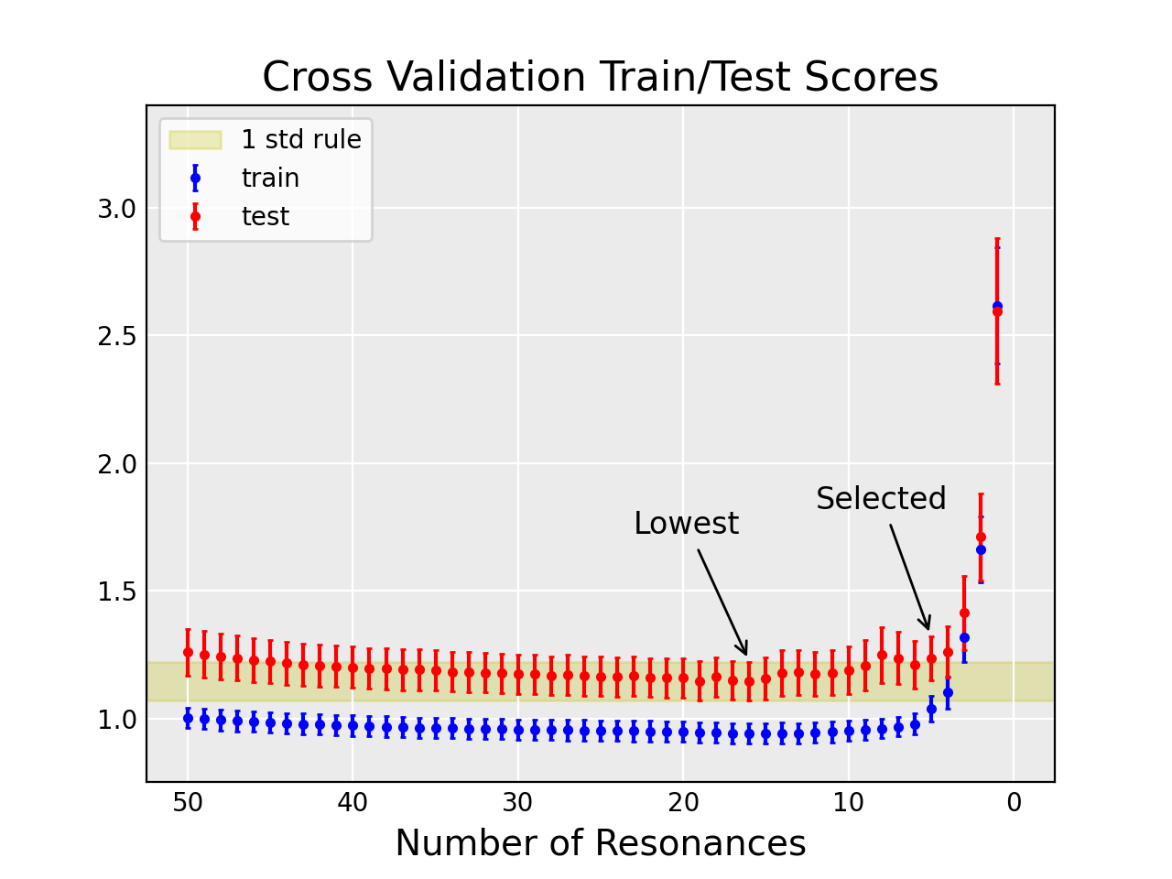
Automated parameter inference
Design initial feature bank
Non-linear optimization
Stepwise variable selection
Cross validation for model selection
$$CVE±δ$$

Slide 11
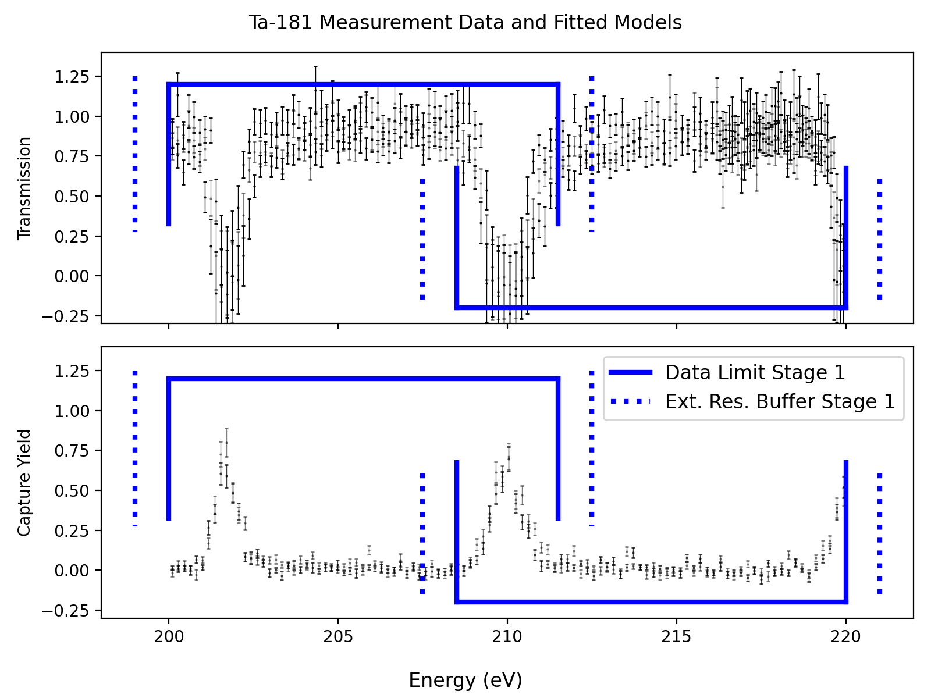
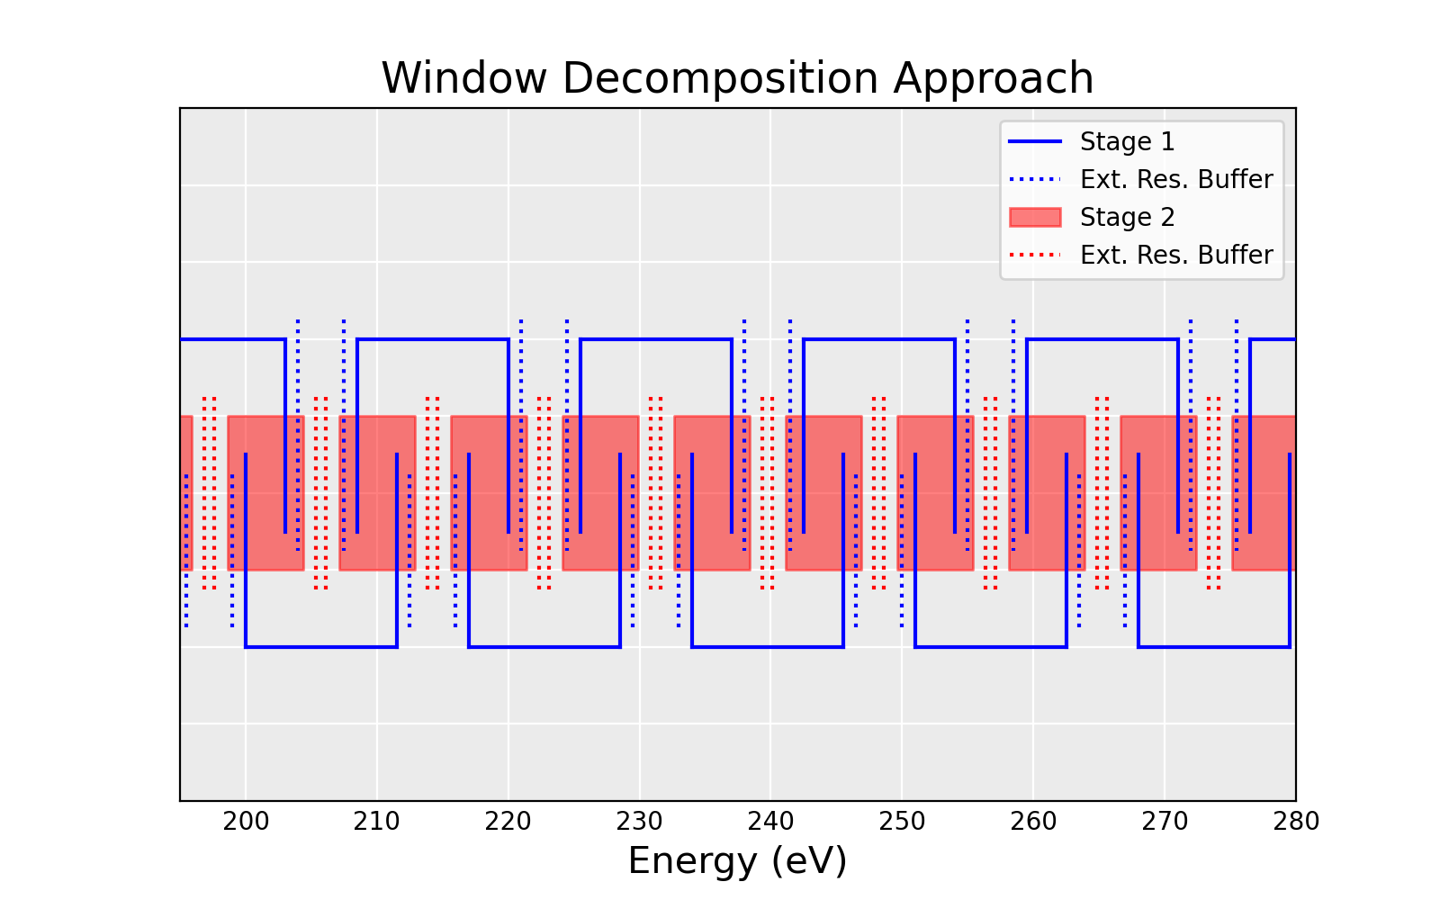
Solved in overlapping windows
20 eV Window
Trans
$$Yγ$$
Incident Neutron Energy (eV)
Incident Neutron Energy (eV)

Slide 12
AutoFit “Hyperparameters”
Parameter | Setting
Initial feature bank design | $$∆E_{λ}=Q_{W}\left(0.01\right)$$
 | $$Γ_{γ}=\left\langle Γ_{γ}\right\rangle$$
 | $$Γ_{n}=Q_{PT}\left(0.1\right)$$
Fitting precision | $$\frac{∆χ^{2}}{N_{d}}<0.01$$
Stepwise greediness | Low
CV window size | 20 eV
Few inputs reproducible estimates
Intuition for good settings
Initial feature bank can integrate with prior knowledge
Notes:
Talk about how this could integrate with current evaluator practices/processes. For example: Known resonance, blackout trans feature
Talk about the application of this to other isotopes
You can put in anything you know or believe to be true

Slide 13
Differences in evaluation methods
 | AutoFit | ENDF/B-VIII.1
Spin group selection | $$χ^{2}$$ | Atlas/resonance statistics
Fitting method | Simultaneous | Sequential
Small fake resonances added | No | Yes
Datasets used in 200-2550eV | 5 | 6
Fit $Γ_{γ}$ | Average +/- 2% | Average +/- 2%
Prior evaluation | None | JEFF-3.3

Slide 14
AutoFit prefers parsimonious models
Notes:
59 fake resonances in ENDF

Slide 15
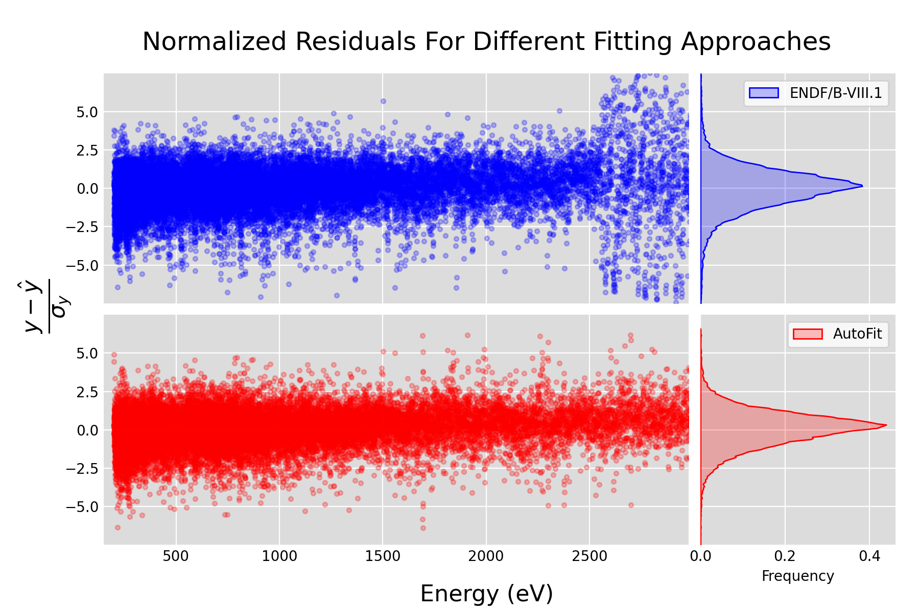
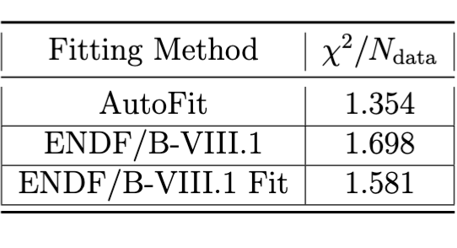
$χ^{2}$ calculated below 2500 eV
Incident Neutron Energy (eV)
Frequency
Notes:
Says that even though we are missing resonances, we are still fitting the data just as well
This is generally known, as the experimental resolution results in fewer data points
However, the approach to URR study shows that, on average, we are also getting the theoretical objective just as good
Clearly there is spin information in the shape of the data, as the chi2 of the data for autofit is much better
This is surprising, and

Slide 16
Synthetic Data Testing Framework

Slide 17
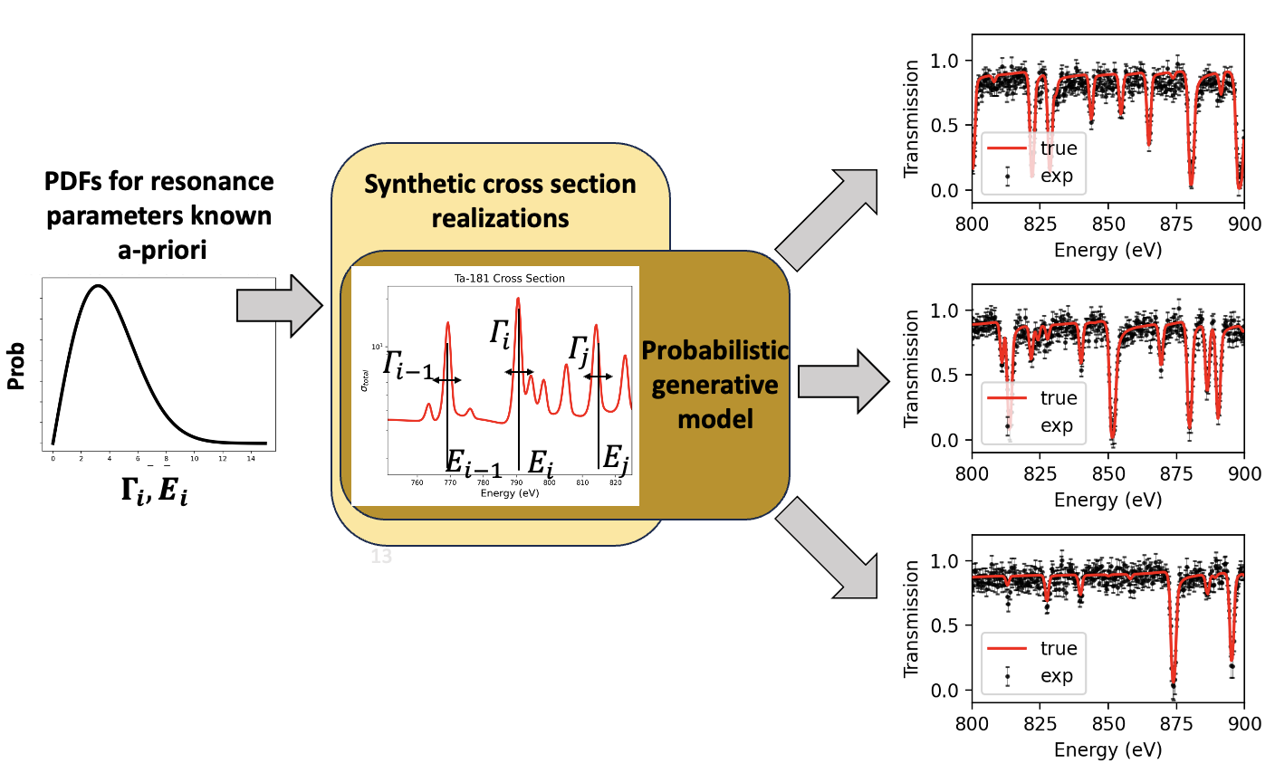
Sampled Resonance Ladders
Notes:
We can use statistical theory of resonances to draw random realizations of resonance ladders for an isotope
This is done for other purposes such as probability tables
Then, synthetic data corresponding to those resonance parameters are simulated

Slide 18
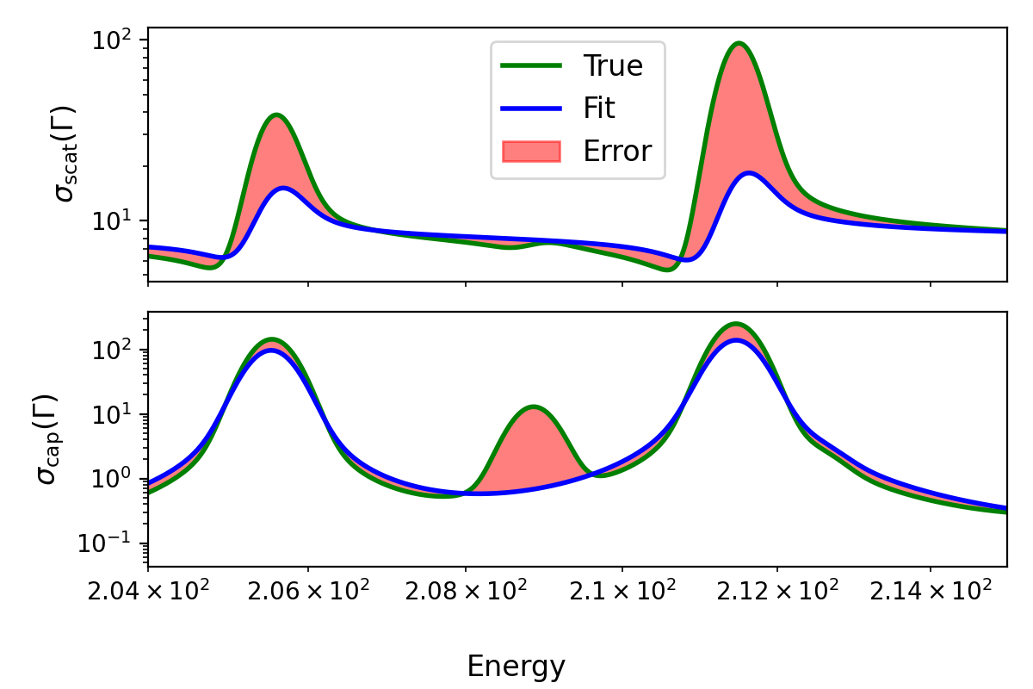
The Theoretical Objective
Doppler Broadened Reaction Cross Sections
$$True=σ_{rxn}\left(Γ_{True}\right)$$
$$Fit=σ_{rxn}\left(Γ_{Fit}\right)$$
Root Mean Squared Error (RMSE)
$$σs (Γ)$$
$$σγ (Γ)$$
Incident Neutron Energy (eV)
Notes:
- Ultimately, we chose to compare the models by the calculated Doppler broadened cross sections at room temperature
Pointwise, standard error metrics MSE and MAE can be calculated
Capture how close resonance parameters are and accounts for missing resonances
Also, this is actually what is used in transport simulations

Slide 19
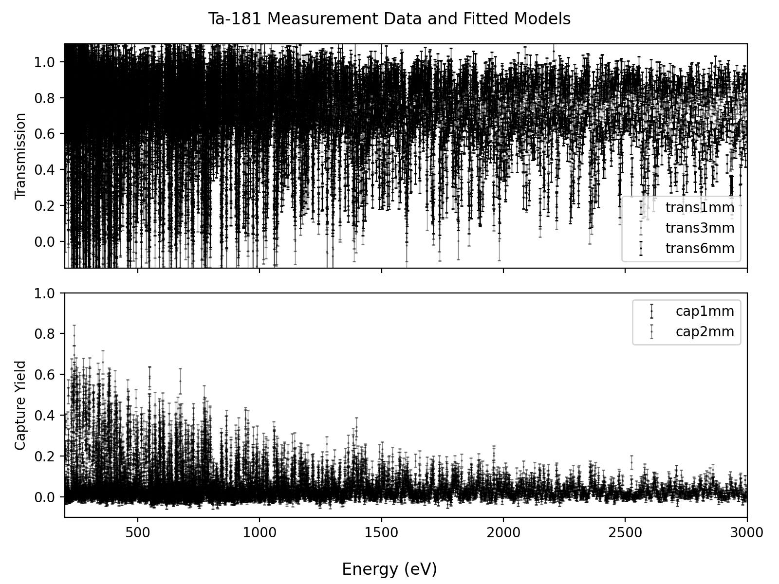
Generative Models Developed Mimicking Actual Measurements
5 Measurements Synthetically Generated
5 Measurements by Brown, et al.
Trans
Trans
$$Yγ$$
$$Yγ$$
Incident Neutron Energy (eV)
Incident Neutron Energy (eV)

Slide 20
What questions does this allow us to ask?

Slide 21
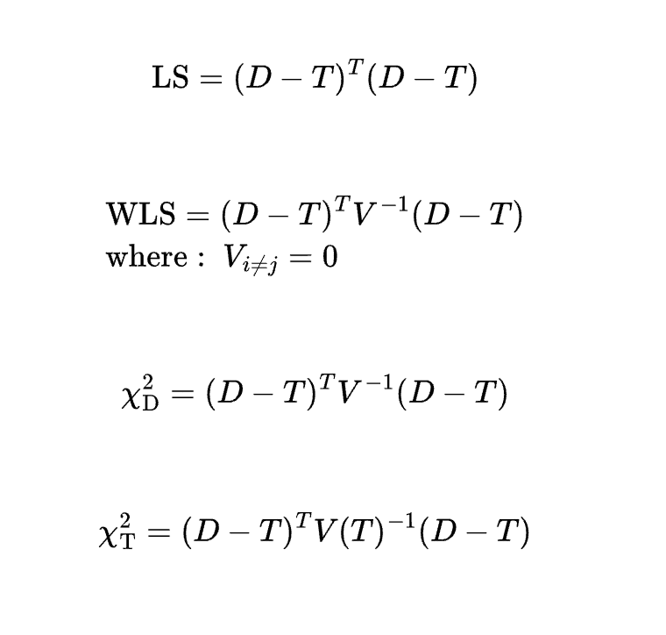
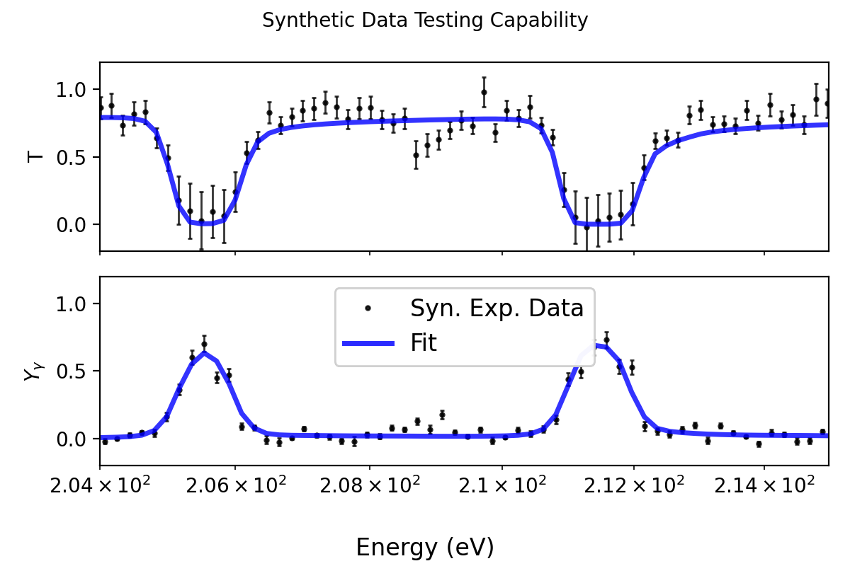
Different Regression Objectives
Accessible
Trans
$$Yγ$$
Incident Neutron Energy (eV)

Slide 22
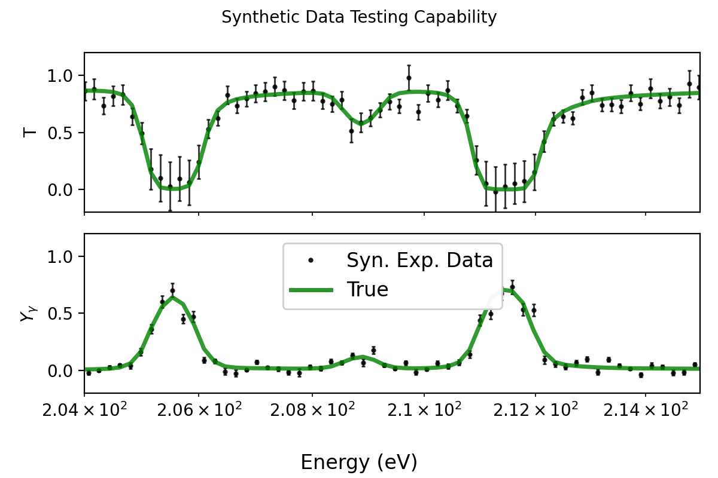
Start From True Parameters
Start From True Parameters
Trans
$$Yγ$$
Incident Neutron Energy (eV)

Slide 23
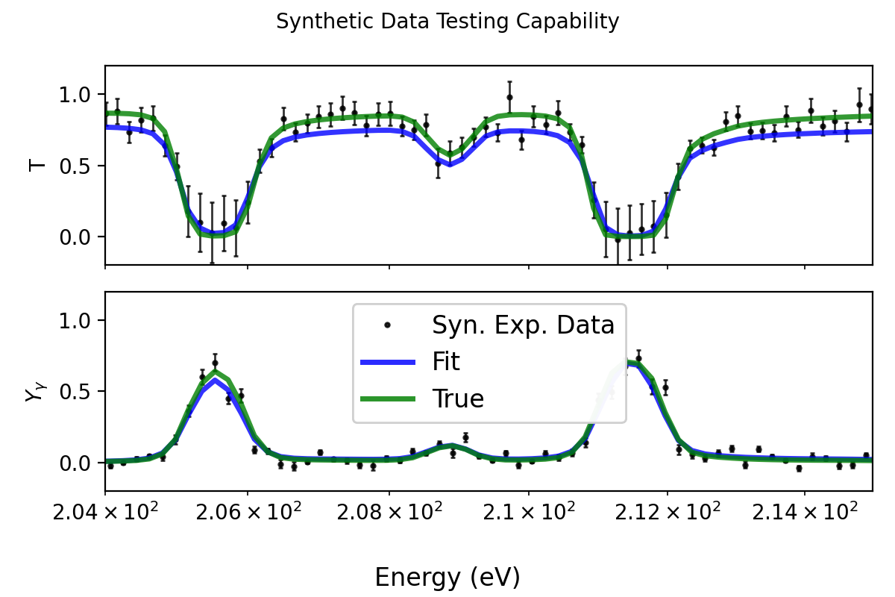
Fit Regression Objective
Fit Regression Objective
Trans
$$Yγ$$
Incident Neutron Energy (eV)

Slide 24
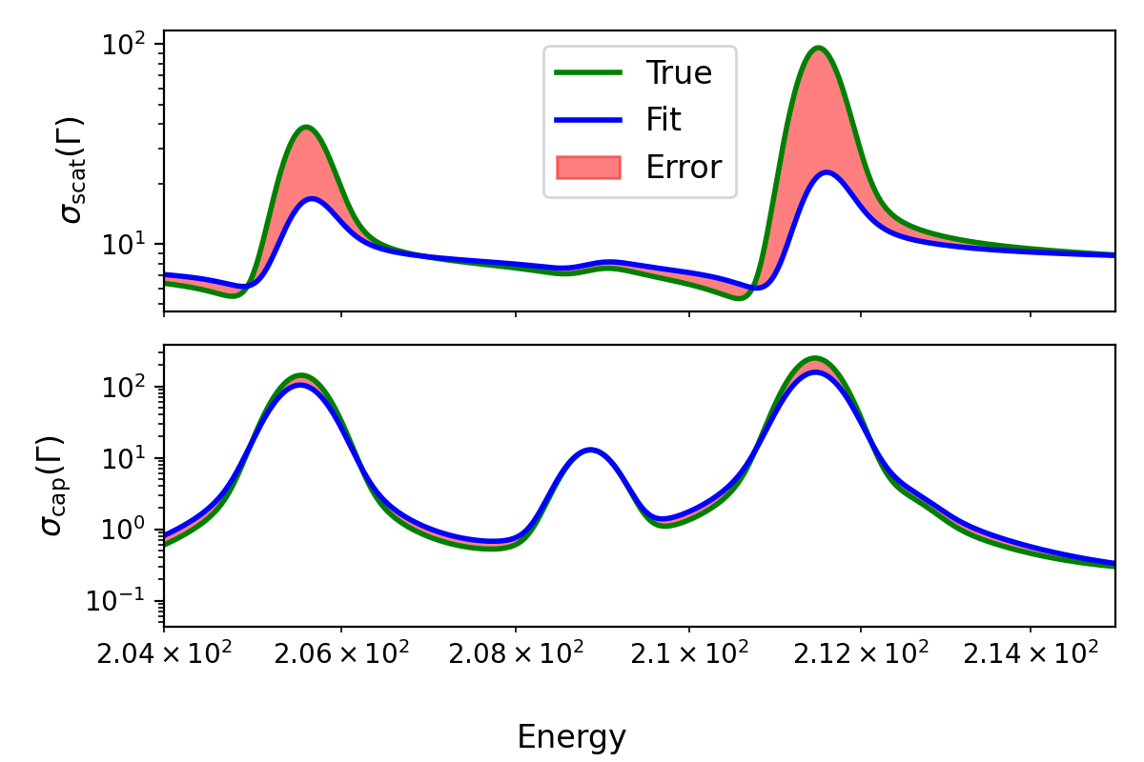
Inaccessible Objective = Metric
Compare Theoretical Objective
Fit Regression Objective
$$σs (Γ)$$
$$\text{Trans}$$
$$σγ (Γ)$$
$$Yγ$$
Incident Neutron Energy (eV)
Incident Neutron Energy (eV)

Slide 25
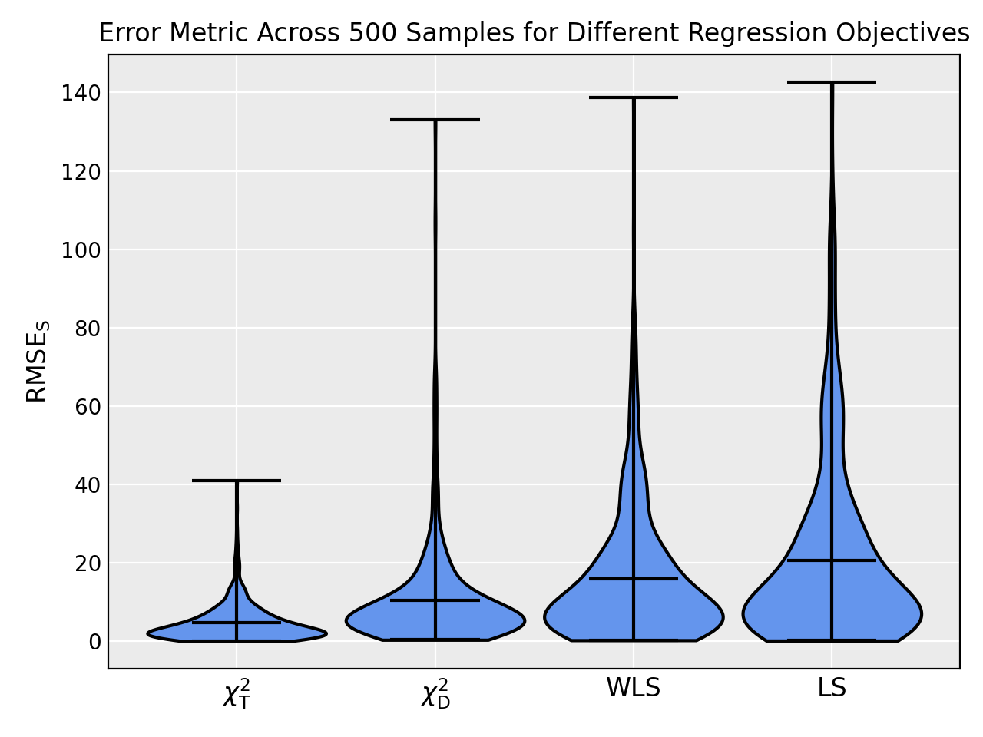
Repeated over 500 Samples
Notes:
Over 500 samples
Shows the metric (spit between reaction cross sections) for each regression objective
Expected the chi2 performs better the LS
PPP fix is not expected
Difference with PPP fix to Chi2 is not just the outlying cases, the probability mass is shifted higher constant o
Quantification of error in evaluation
Lower bound for uncertainty

Slide 26
URR Study

Slide 29
Conclusions
ATARI
AI/ML Tool for Automated Resonance Inference
Computational framework: ATARI
Automated resonance inference is reproducible and fast
Performance can be tested and benchmarked
Constant PPP bias even if correlations are small
Future work: resonance parameter statistics, uncertainty quantification
Ta-181 Analysis
Minimal deterioration of theoretical objective approaching URR
Regression objective is as-good-or-better that ENDF/B-VIII.1 evaluation
Differential data has some spin information
This material is based upon work supported by the Department of Energy National Nuclear Security Administration through the Nuclear Science and Security Consortium under Award Number DE-NA0003996.
Notes:
What does the automated fitting and synthetic data framework allow!!!

Slide 30
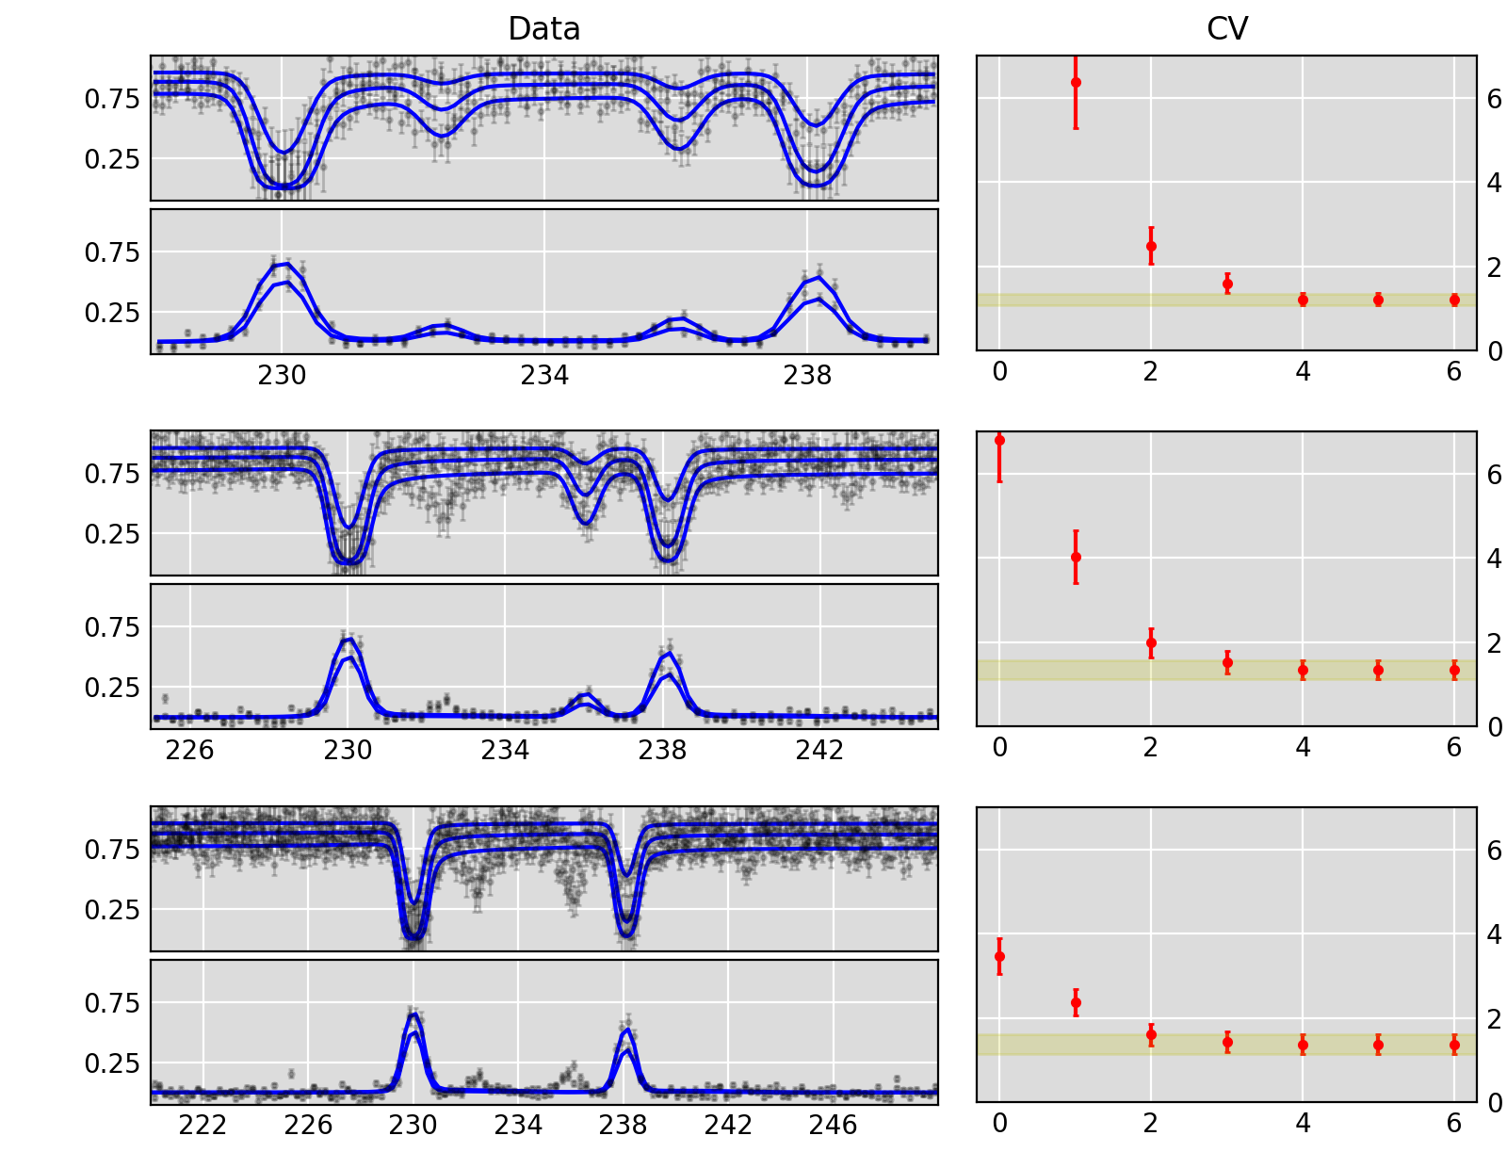
Impact of Window Size on CV-model selection
Trans
CVE
$$Yγ$$
Incident Neutron Energy (eV)
Resonances
Trans
CVE
$$Yγ$$
Trans
CVE
$$Yγ$$
Incident Neutron Energy (eV)
Resonances

Slide 31
Impact of Window Size on CV-model selection
Trans
CVE
$$Yγ$$
Trans
CVE
$$Yγ$$
Incident Neutron Energy (eV)
Resonances
Trans
CVE
$$Yγ$$

Slide 32
Impact of Window Size on CV-model selection
Trans
CVE
$$Yγ$$
Trans
CVE
$$Yγ$$
Trans
CVE
$$Yγ$$
Incident Neutron Energy (eV)
Resonances

Slide 33
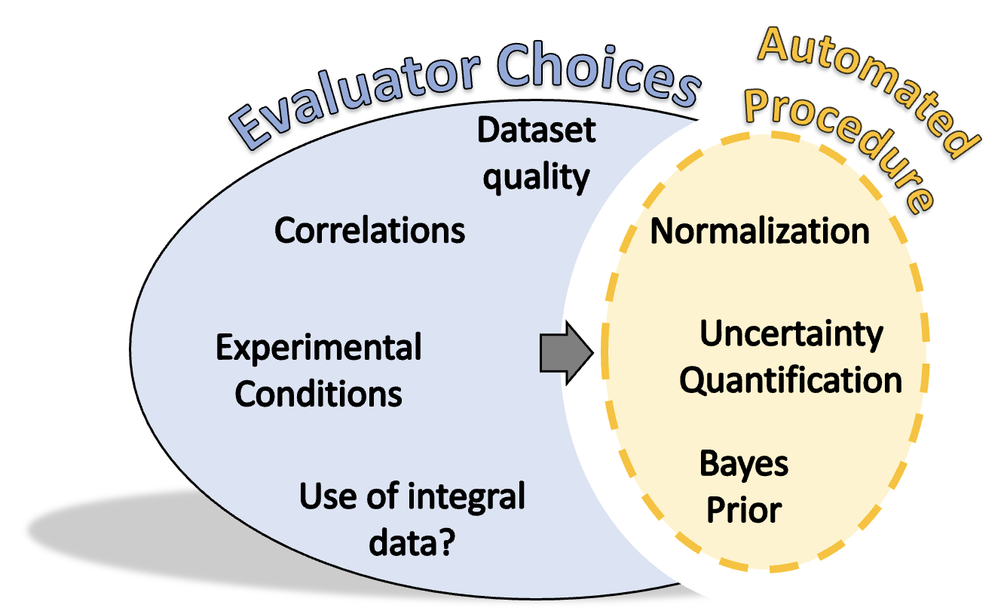
Automated parameter inference
Develop automated tool
Augment evaluators
Computational experiments
Benchmark tool
Improve tool
Learn new physics

Slide 34
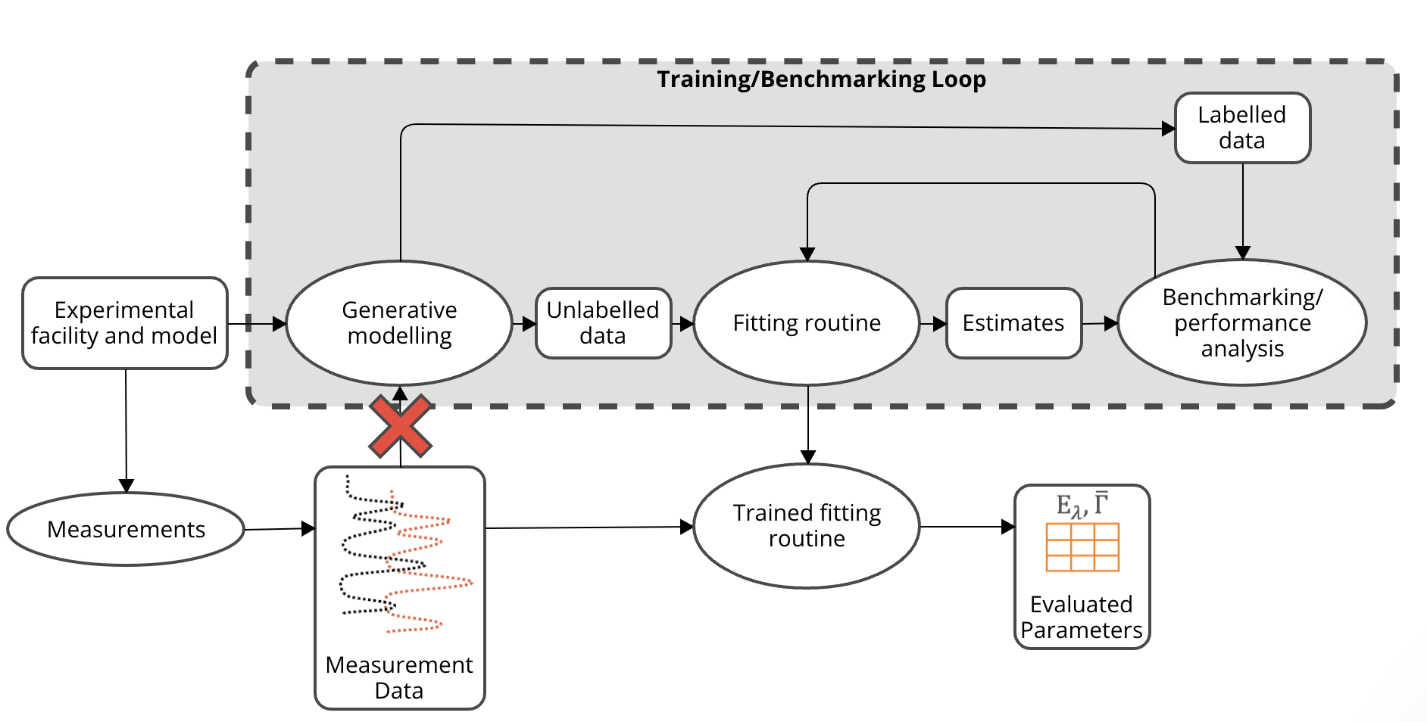
Computational Framework

