Slide 1
Zr-91 Measurements at GELINA
Jesse M. Brown¹, Klaus Guber¹, Carlos Paradela², Peter Schillebeeckx², Stefan Kopecky²
¹Oak Ridge National Laboratory
²EC-JRC Geel, IRMM
Cross Section Evaluation Working Group (CSEWG) Meeting
Nov 4th – 8th, 2024

Slide 2

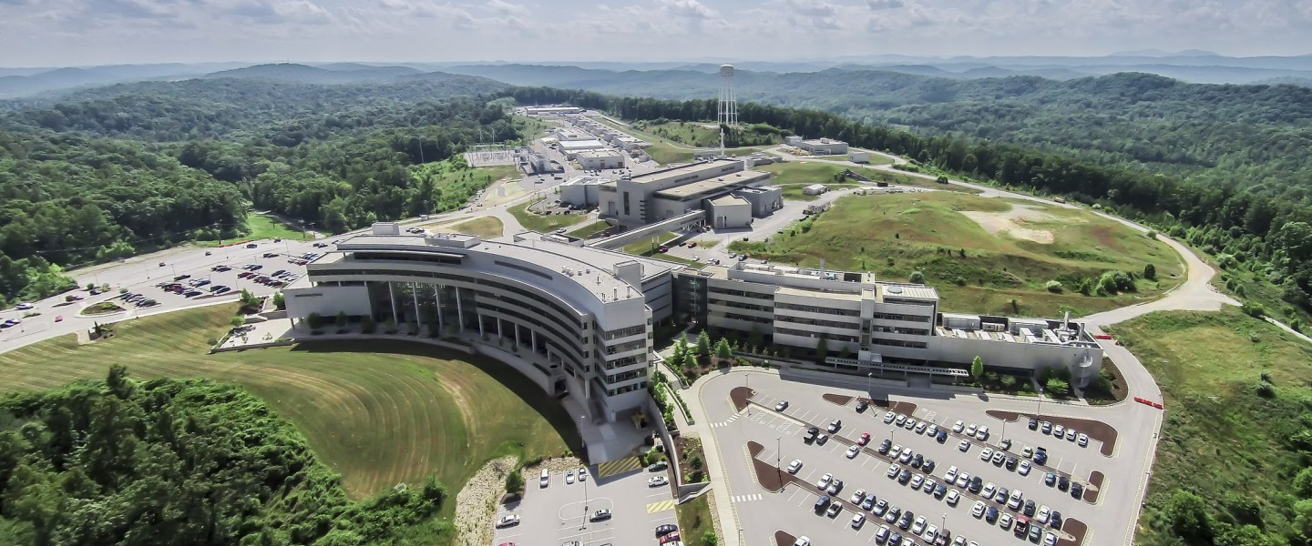

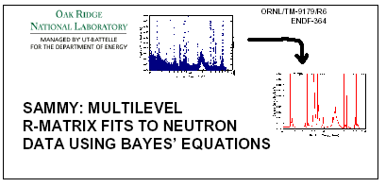
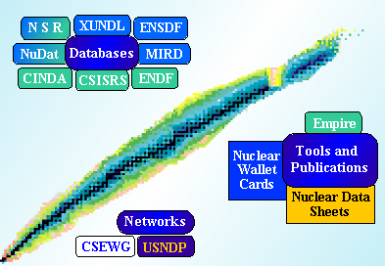

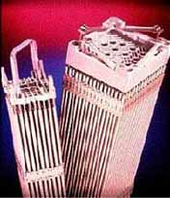

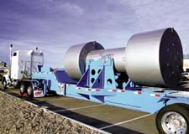
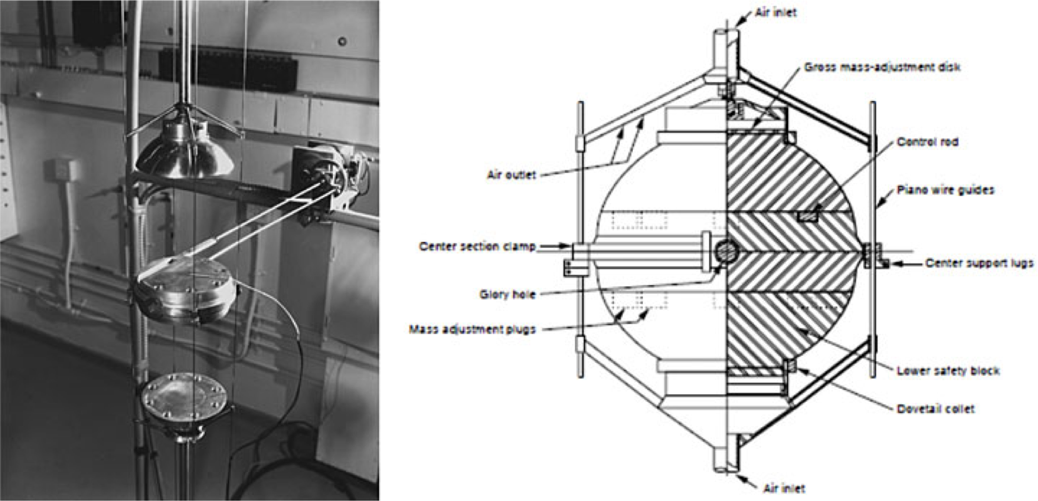
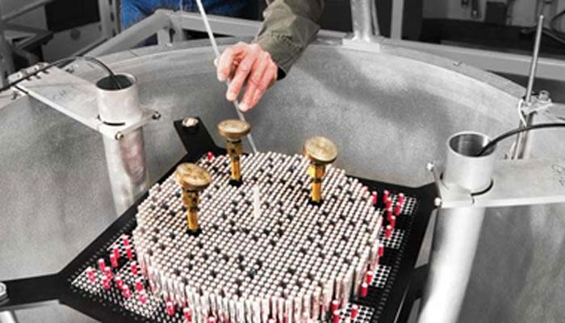

Basic Science Cross Section
GELINA
Cross Section Evaluations
Applications
ORNL ND Support for NCSP
Applications
Computational Modeling
and Processing
Integral Experiments
AMPX
ND testing and adjustments

Slide 3
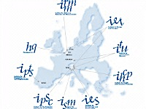
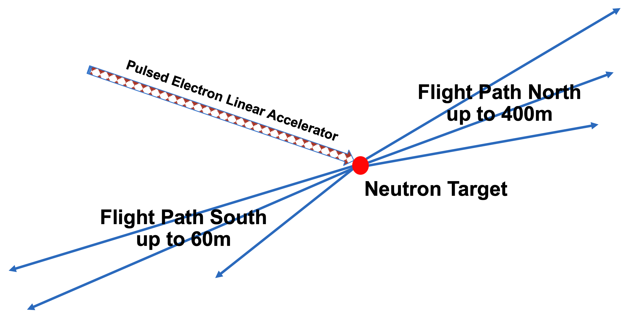
GELINA
Time-of-flight facility
Pulsed white neutron source
(10 meV < E_{n} < 20 MeV)
Multi-user facility with 10 flight paths (10–400 m)
Measurement stations have special equipment to perform the following:
Total cross section measurements
Partial cross section measurements
Pulse width : 1 ns
Frequency : 40–800 Hz
Average current : 4.7–75 μA
Neutron intensity :1.6 10¹²–2.5 10¹³ n/s

Slide 4
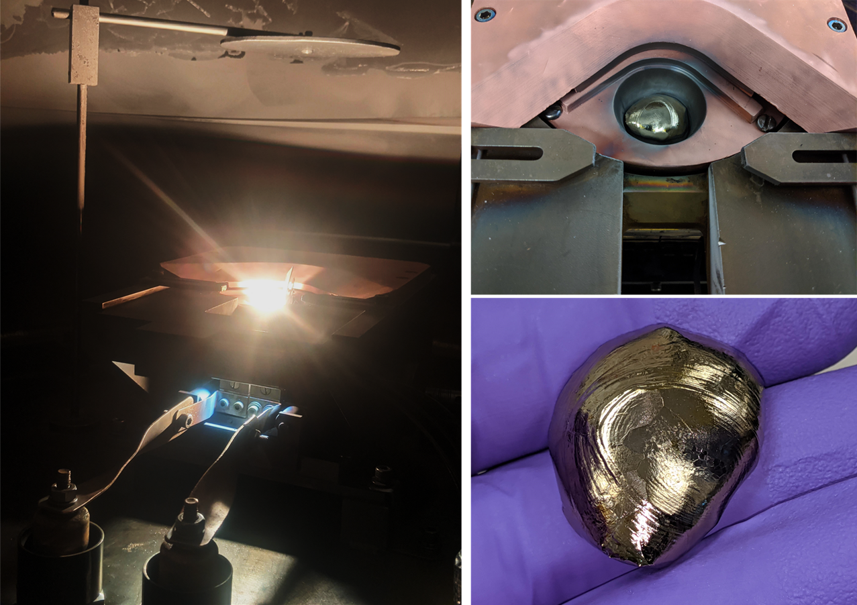
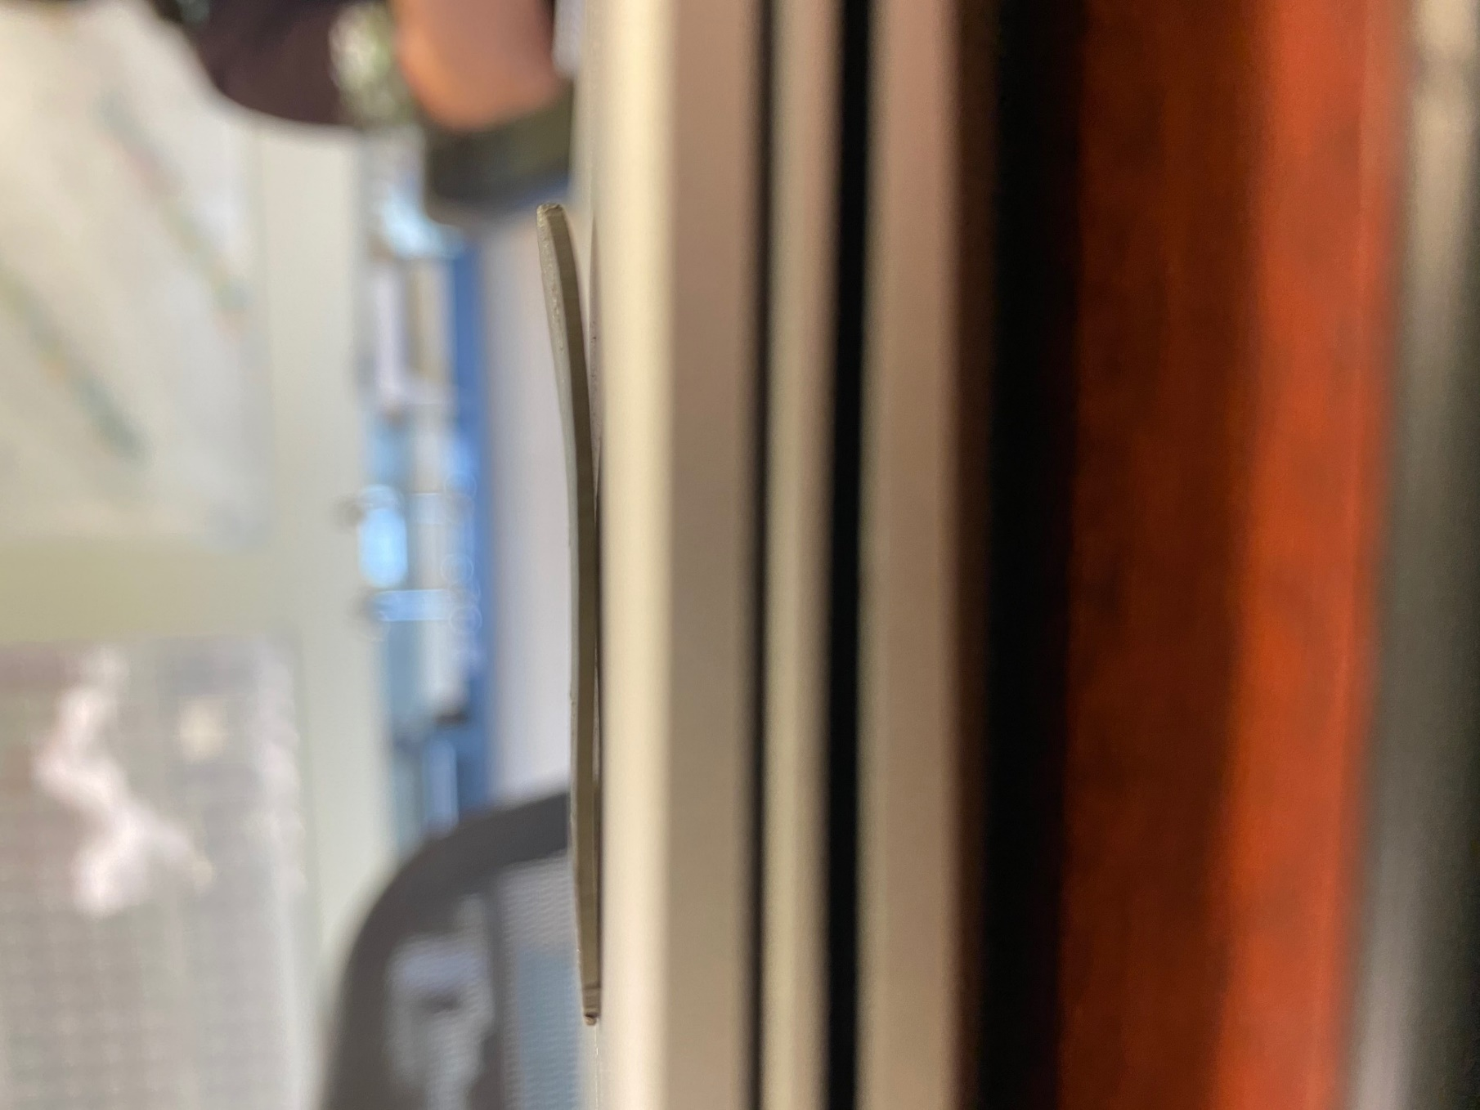
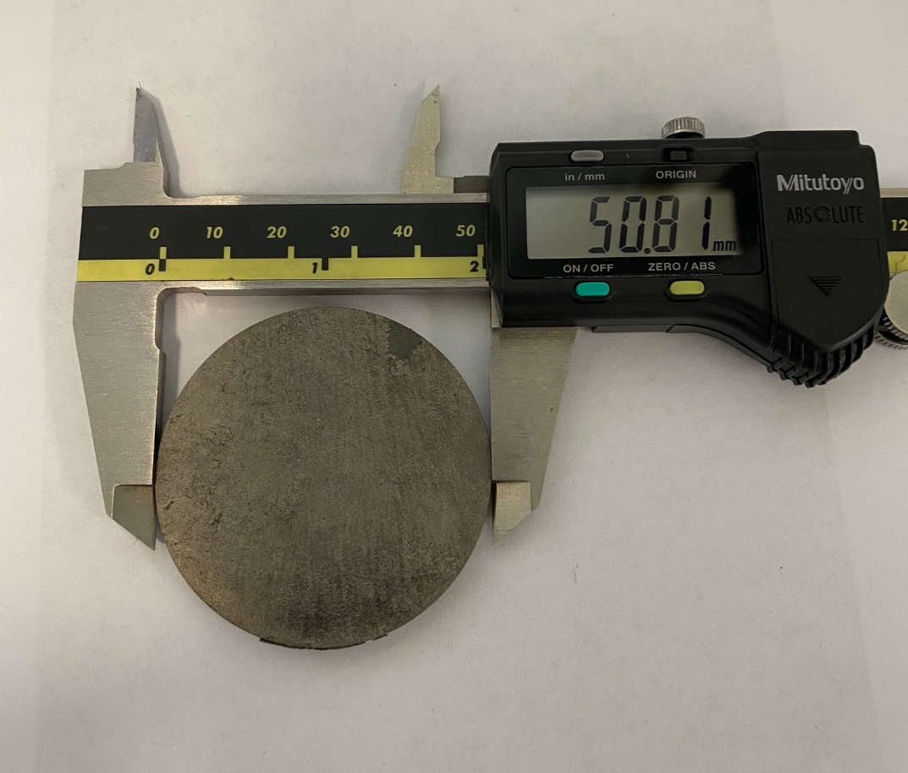
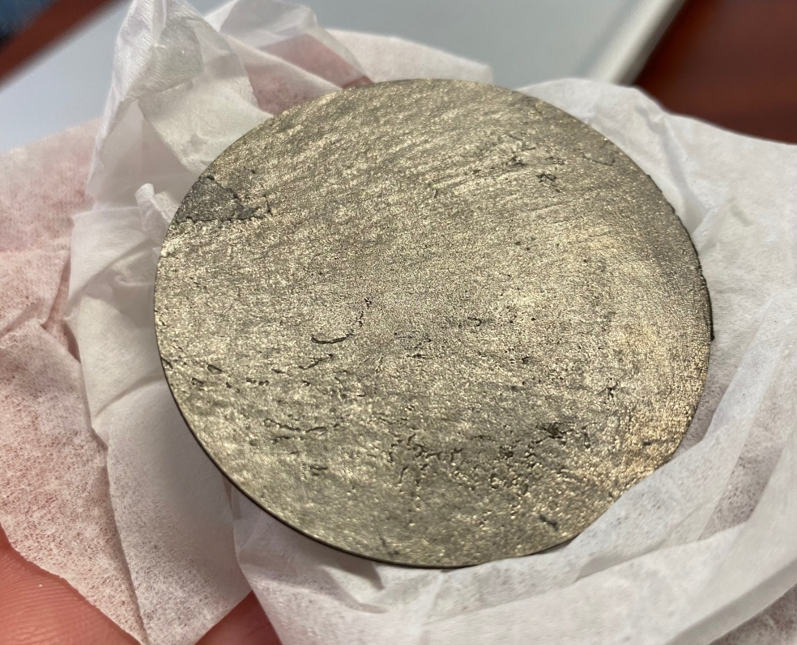
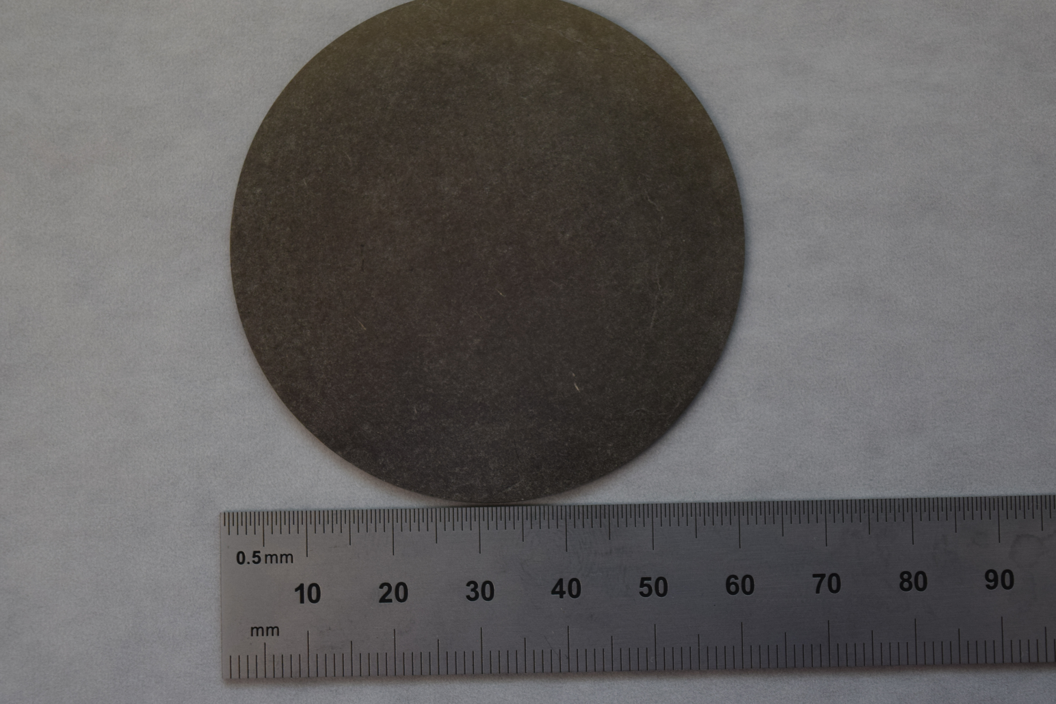
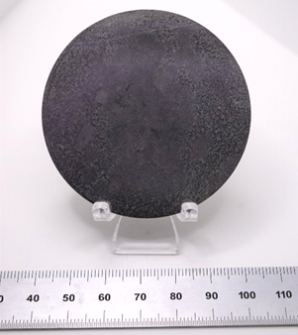
^{90,91,92}Zr sample
Zr-90 has a closed neutron shell, hence, the capture cross section is very small for the Zr isotopes.
Metallic samples are the first choice for capture experiments, as they help reduce backgrounds from sample scattered neutrons due to the lack of scattering compound material such as H,O and C
The Zr-90 sample is not very uniform and is warped, but for capture experiments, this is not a real problem
However, the other Zr-91, -92, -94 samples produced are much better in shape.
Cost to produce a metallic sample is about 40 K.
⁹⁰Zr
⁹¹Zr
⁹²Zr

Slide 5
Zr-91 Data Reduction Progress
AGL -> AGS is traditional software from GELINA
Used to reduce Zr-90 and Zr-91 data, now complete
AGL and AGS have become difficult to maintain and use on modern computers
Modern python implementation 90% written to replace and optimize data reduction process
Used to reduce Zr-91

Slide 6
Traditional AGL and AGS data reduction
Confident in results
Full suite of dead-time correction, monitor normalization, etc.
Works on limited hardware (32-bit app on Unix-like)

Slide 7
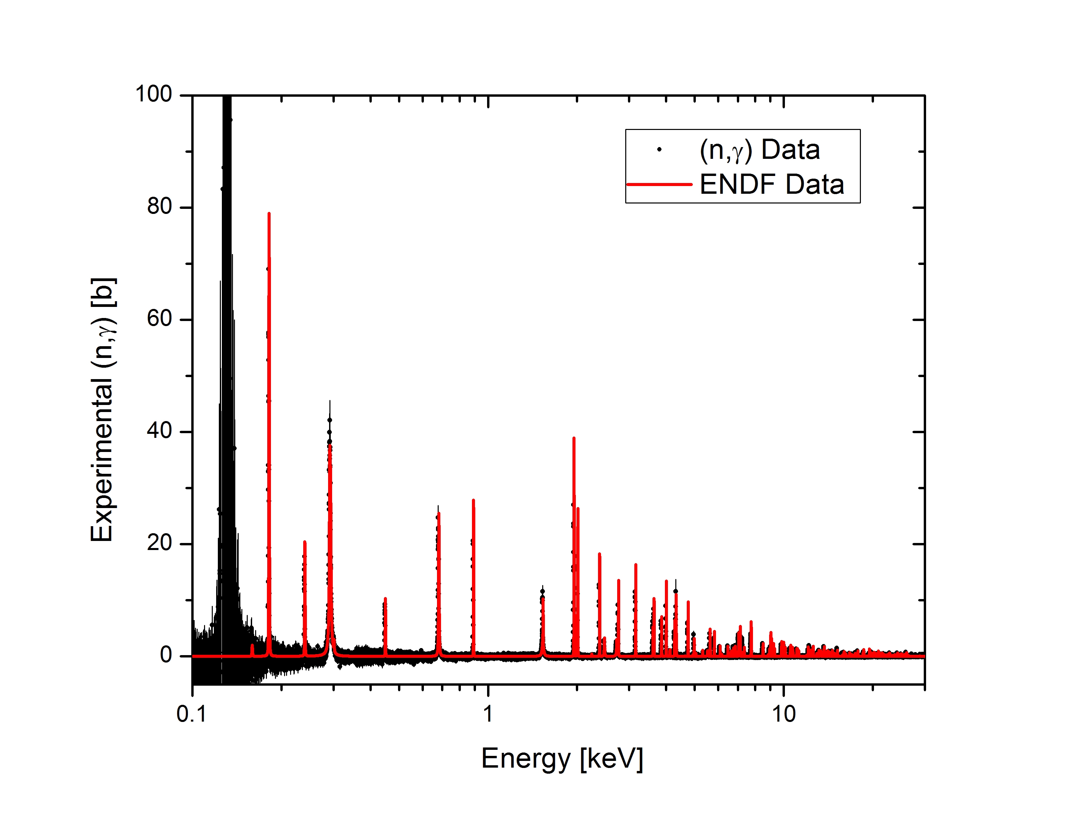
Zr-91 (n,γ) Data compared to ENDF/B
The resonance energies from ENDF a slightly off. Confirmed by GELINA capture and ORELA transmission data.

Slide 8
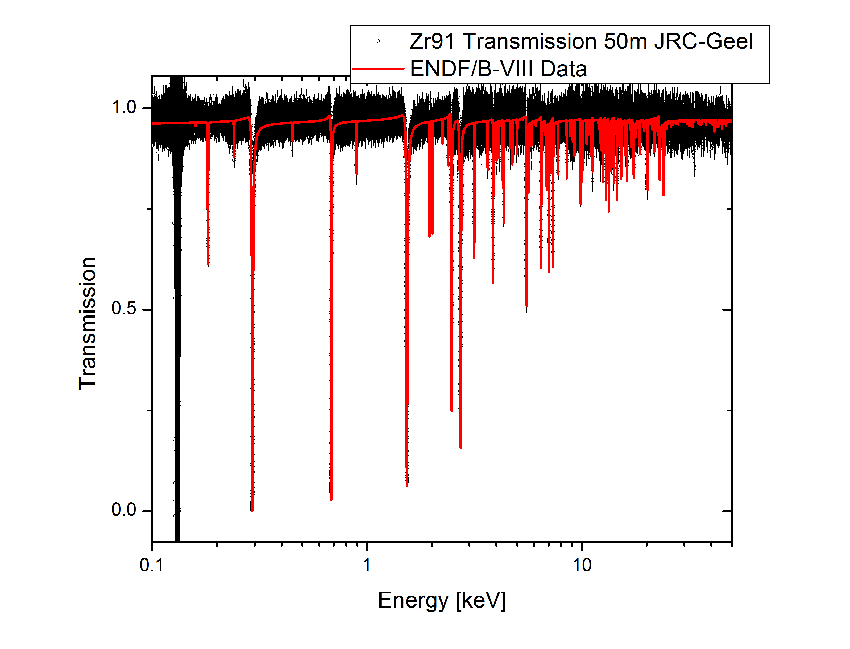
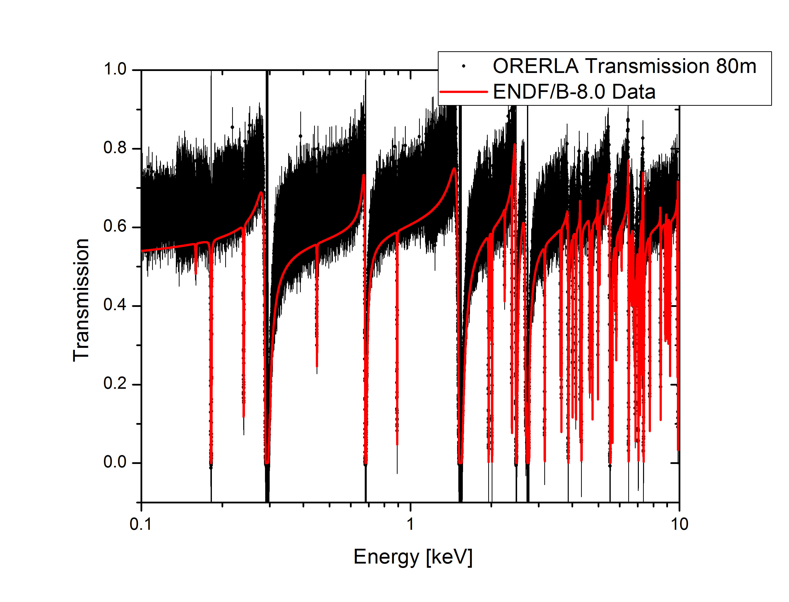
Zr-91 Transmission compared to ENDF/B
Discrepancies between GELINA and ORELA transmission data

Slide 9
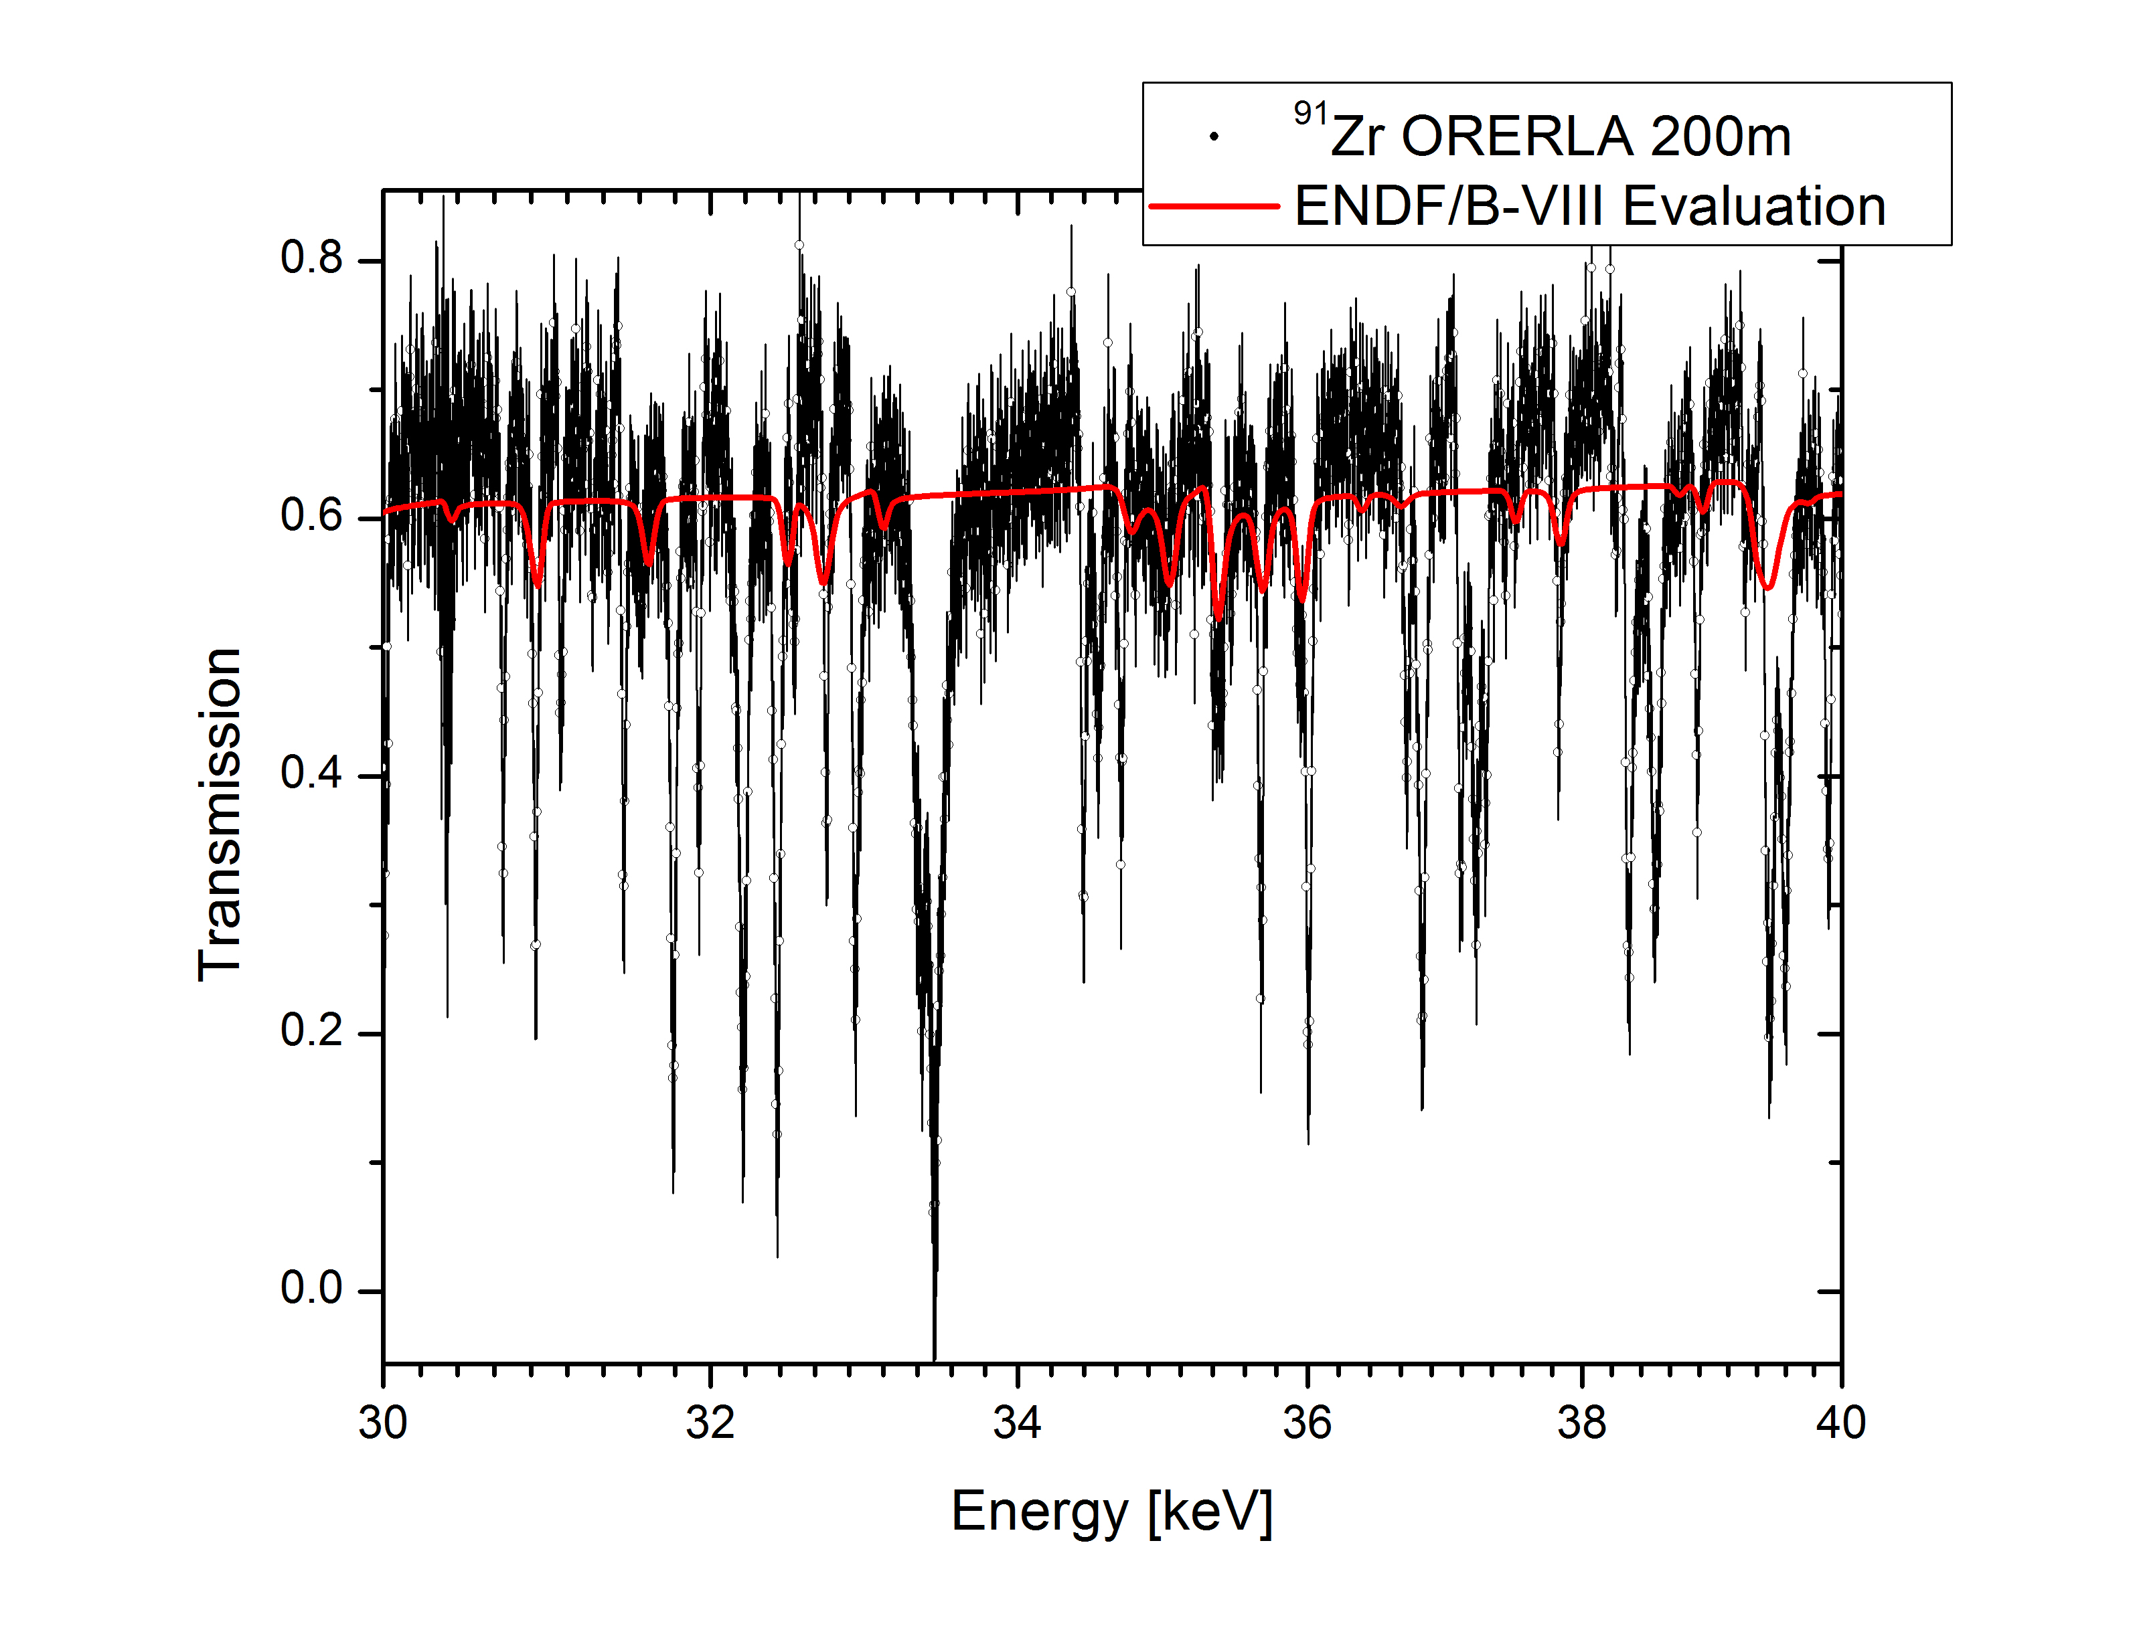
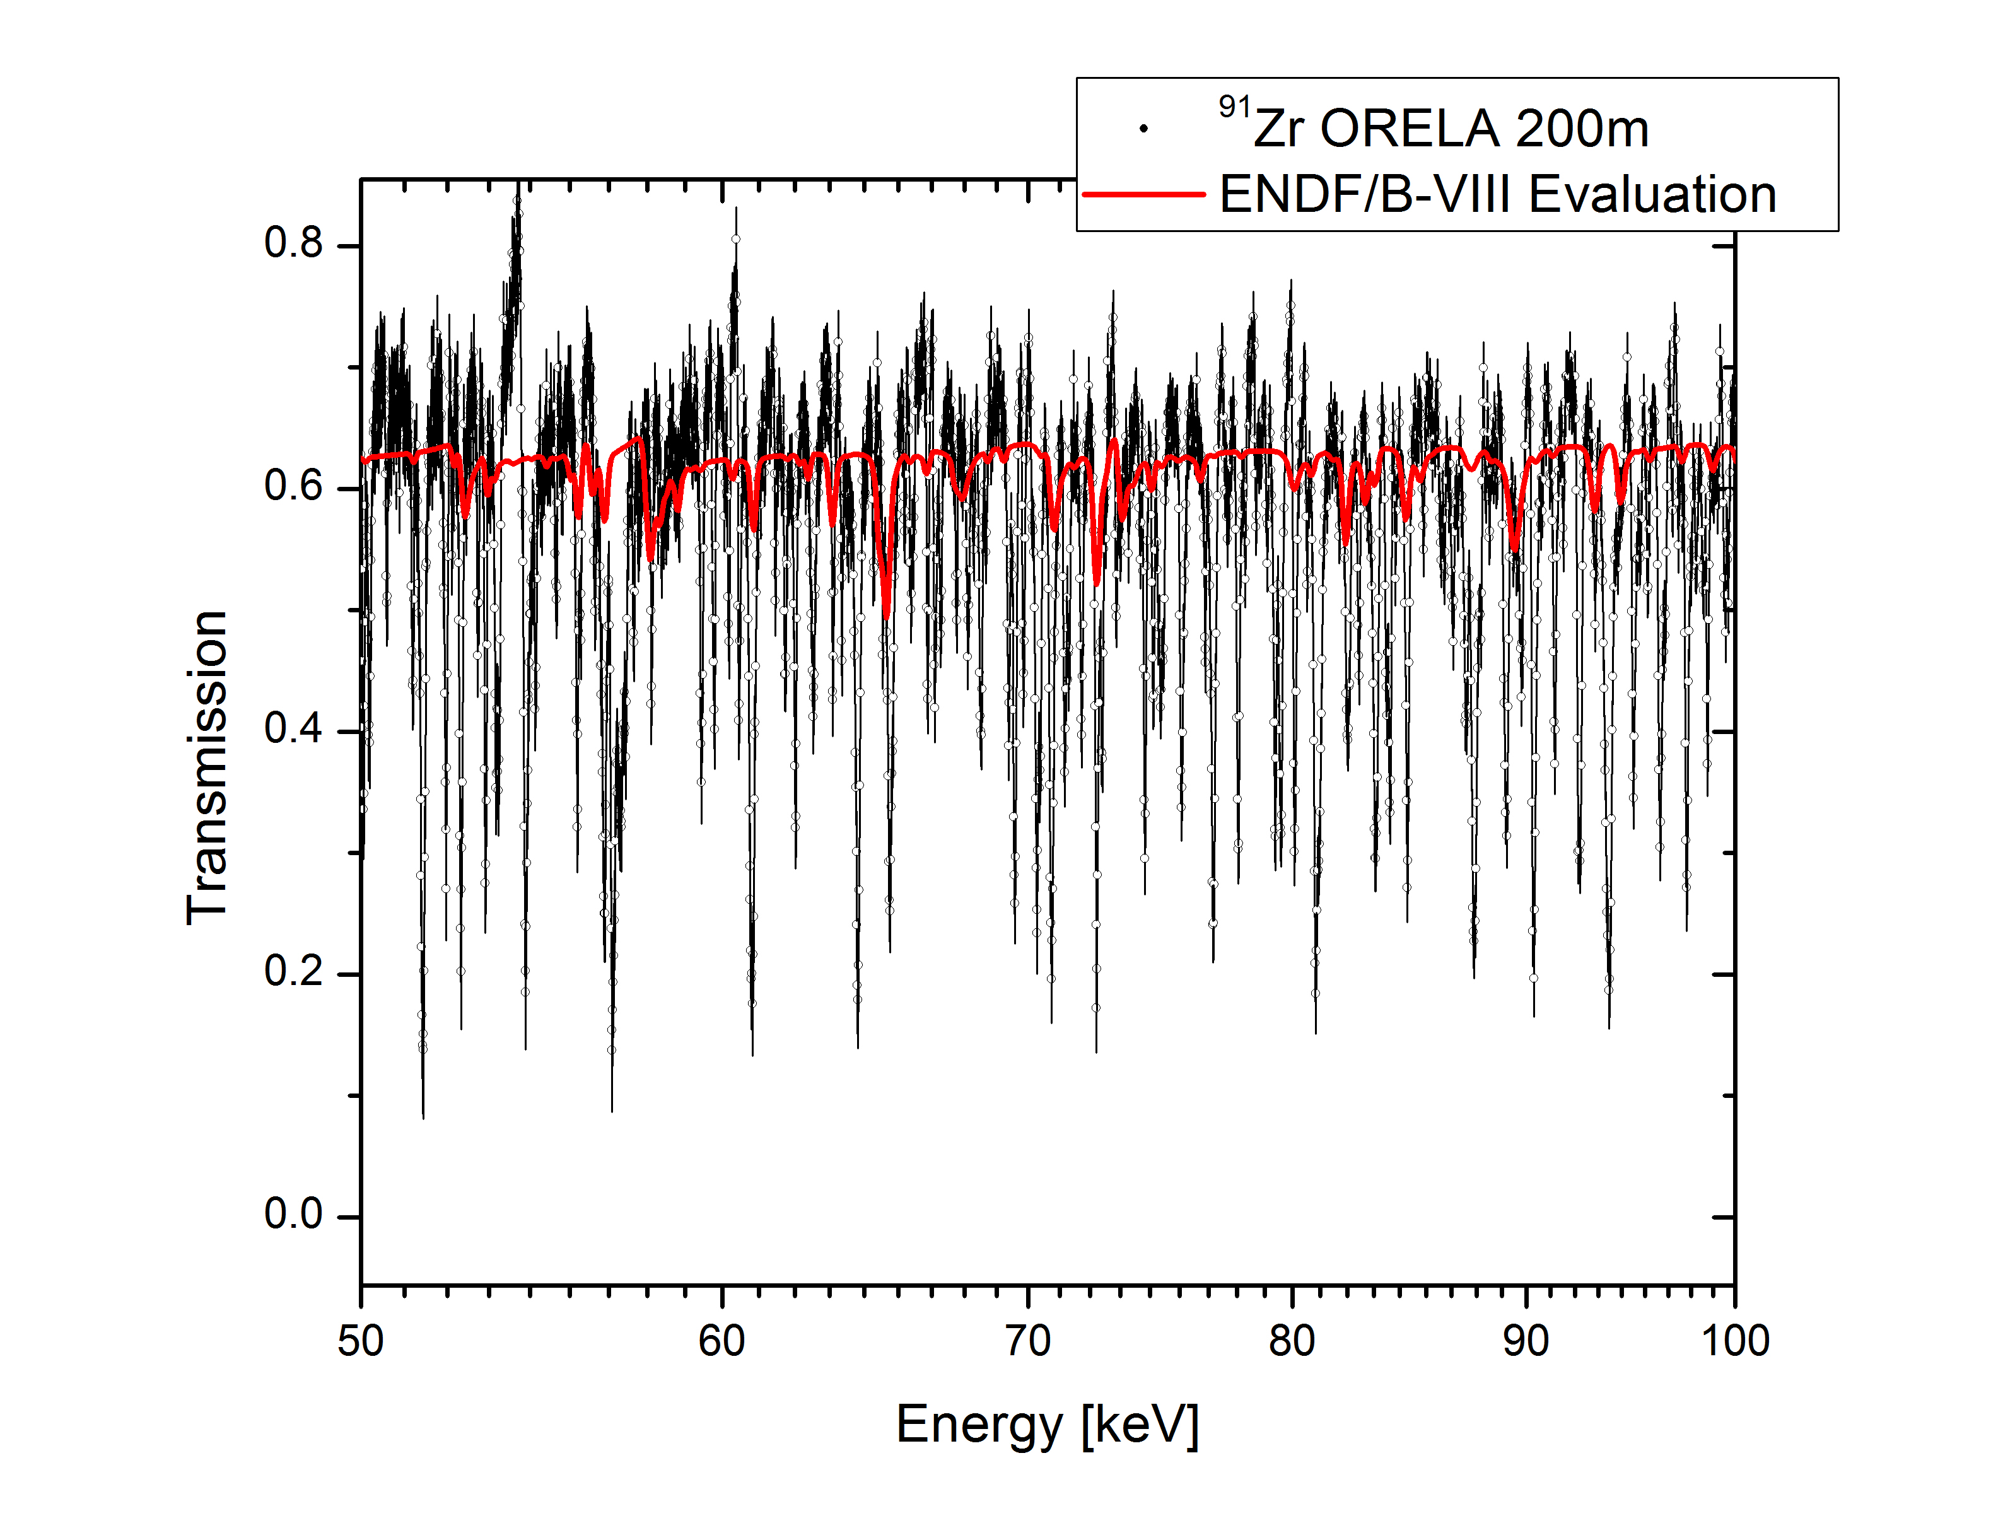
Zr-91 ORELA Transmission compared to ENDF/B
This data can be used to at least triple the resolved resonance range

Slide 10
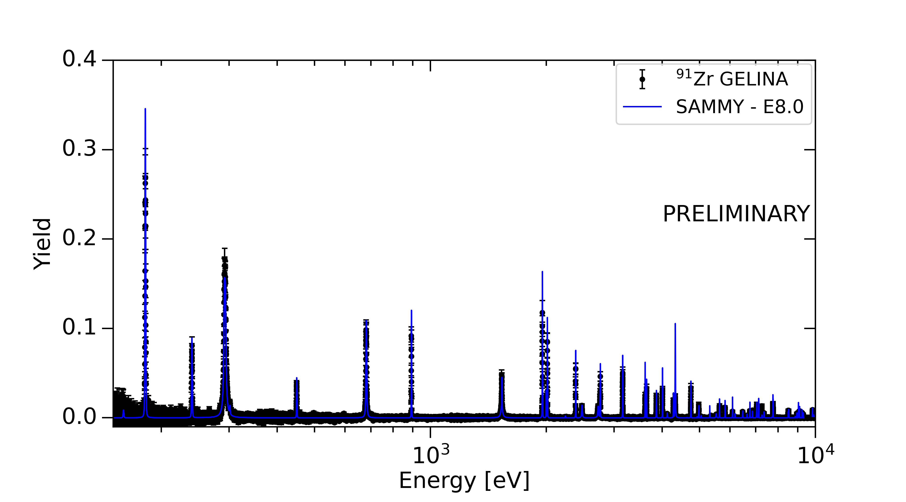
Zr-91 Yield Data Reduction (pyAGL+pyAGS)
(contains additional unc. compared to AGL w.r.t. ¹⁰B flux normalization)

Slide 11
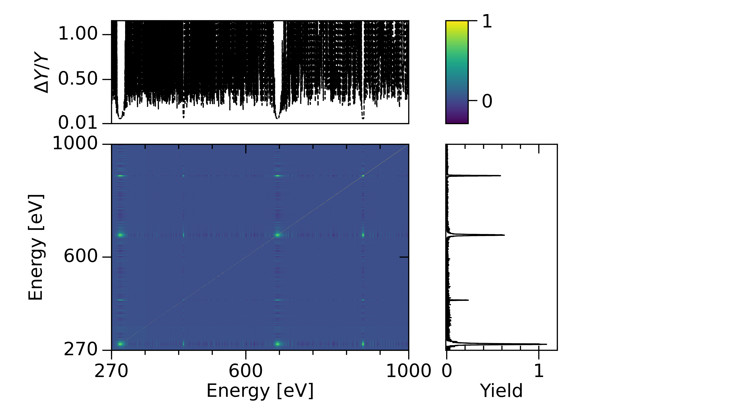
Zr-91 Data Covariance (pyAGL+pyAGS)

Slide 12
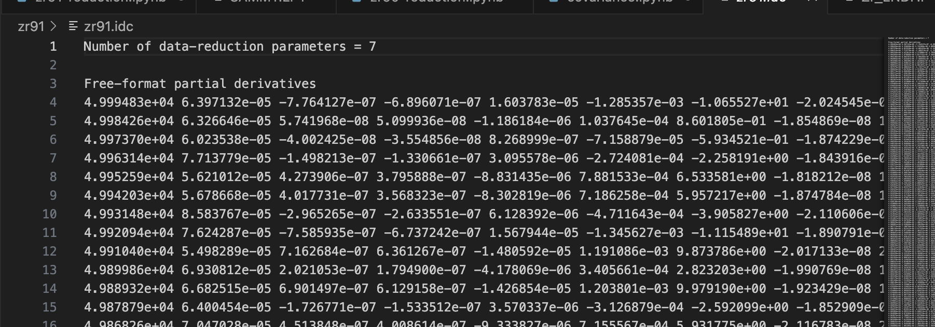
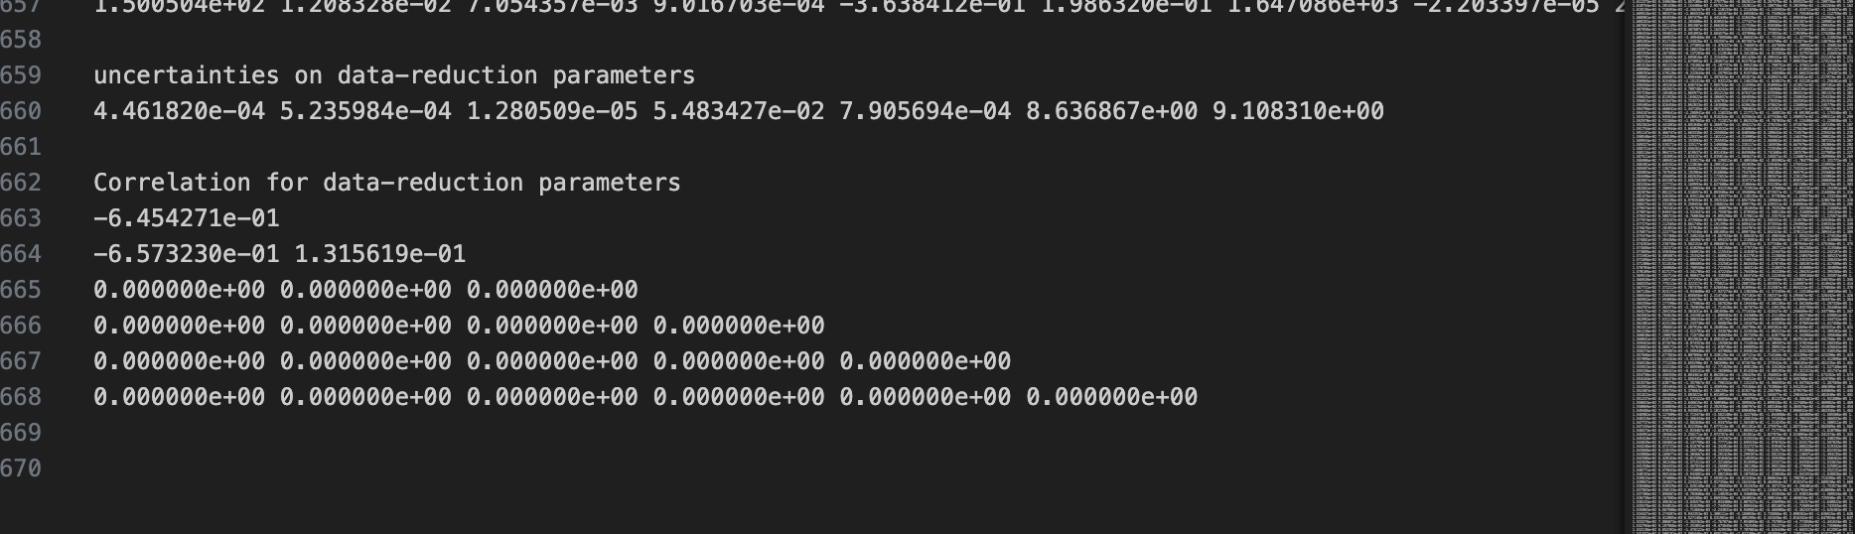
Zr-91 Data Covariance (pyAGL+pyAGS)
Workflow produces IDC file
Evaluators encouraged to use the IDC data, or incorporate it into the fit parameters
…

Slide 13
Status of NCSP experiments at EC-JRC Geel
 | W | Cu | Ca | Ce | V | La | Zr
Sample | Metallic disks 182,183,184,186 2009–2011 | Metallic disks 63 and 65 2011–2012 | Metallic disks Nat Ca 2013–2014 | Metallic disks Nat Ce, Ce-142 oxide 2014–2015 2018–2019 | Metallic disks 2015–2016 | Nat La metallic disks 2017–2018 | Nat Zr metallic disks ^{90,91,92,94}Zr 2016–2017 2021–2023
Experiments GELINA | 60 m, 30 m (n,γ) transmission | 60 m (n,γ) | 60 m (n,γ) transmission | Nat Ce 60 m (n,γ) Nat Ce transmission, ¹⁴²Ce experiments completed | 60 m (n,γ) transmission | 60 m (n,γ) transmission | Nat Zr 60 m (n,γ) + transmission ^{90,91}Zr transmission and (n,γ) data
Data sorting | Finished 60 m + transmission | Finished 60 m | Finished 60 m transmission | Finished for thin and thick sample, ¹⁴²Ce data sorting finalized | Finished for thin and thick sample | Finalized | Finished for thin and thick natural sample, ⁹⁰Zr (n,γ)+ transmission, ⁹¹Zr transmission + (n,γ)
Reduced to cross section | X-section, transmission | X-section | X-section transmission 0.6, 1.0, 5 cm samples | 2 mm X-section 2 mm transmission 10 mm transmission ¹⁴²Ce data | Thin X-section 0.35 and 2 mm, transmission | X-section, transmission | ⁹⁰Zr transmission + (n,γ) ⁹¹Zr transmission + (n,γ)
Data testing | Data ready for evaluation | Data ready for evaluation | Data ready for evaluation | Data ready for evaluation | Data ready for evaluation | Data ready for evaluation | In progress ^{90,91}Zr Data ready for evaluation
Analysis and evaluation | Finalized and submitted to National Nuclear Data Center | Finalized and submitted to National Nuclear Data Center | Finalized and submitted to National Nuclear Data Center | Finalized and submitted to National Nuclear Data Center | Finalized and submitted to National Nuclear Data Center | In progress Final stages, i.e. join RRR with HE evaluation | In progress RPI PhD Student ORNL

Slide 14
Summary
First cut of Zr-91 data reduction is been completed
New python-based AGS and AGL replacements are nearing completion
Improves workflow
Lower effort required for maintenance
Combination of Zr-90 and Zr-91 will enable some evaluations, but still have to wait for Zr-92 and Zr-94 measurements for full analysis

Slide 15
People supporting JRC experiments and evaluations
Peter Schillebeeckx, EC-JRC Geel
Carlos Paradela, EC-JRC Geel
Stefan Kopecky, EC-JRC Geel
Ruud Wynats, EC-JRC Geel
Mike Zach, Jenny Conner, ORNL/Isotopes
Goran Arbanas, Jesse Brown, Chris Chapman, Luiz Leal, Jordan McDonnell, Marco Pigni, Klaus Guber, ORNL-ND group
Acknowledgments
This work was supported by the DOE Nuclear Criticality Safety Program, funded and managed by the National Nuclear Security Administration for the US Department of Energy. The isotope used in this research was supplied by the U.S. Department of Energy Isotope Program, managed by the Office of Science for Nuclear Physics.
Additionally, this work was also supported by JRC-Geel and the European Union

