Slide 1
The Present Status of the EXFOR Project
Boris Pritychenko
National Nuclear Data Center, Brookhaven National Laboratory, Upton, NY 11973-5000, USA
October 2, 2024
USNDP 2024

Slide 2
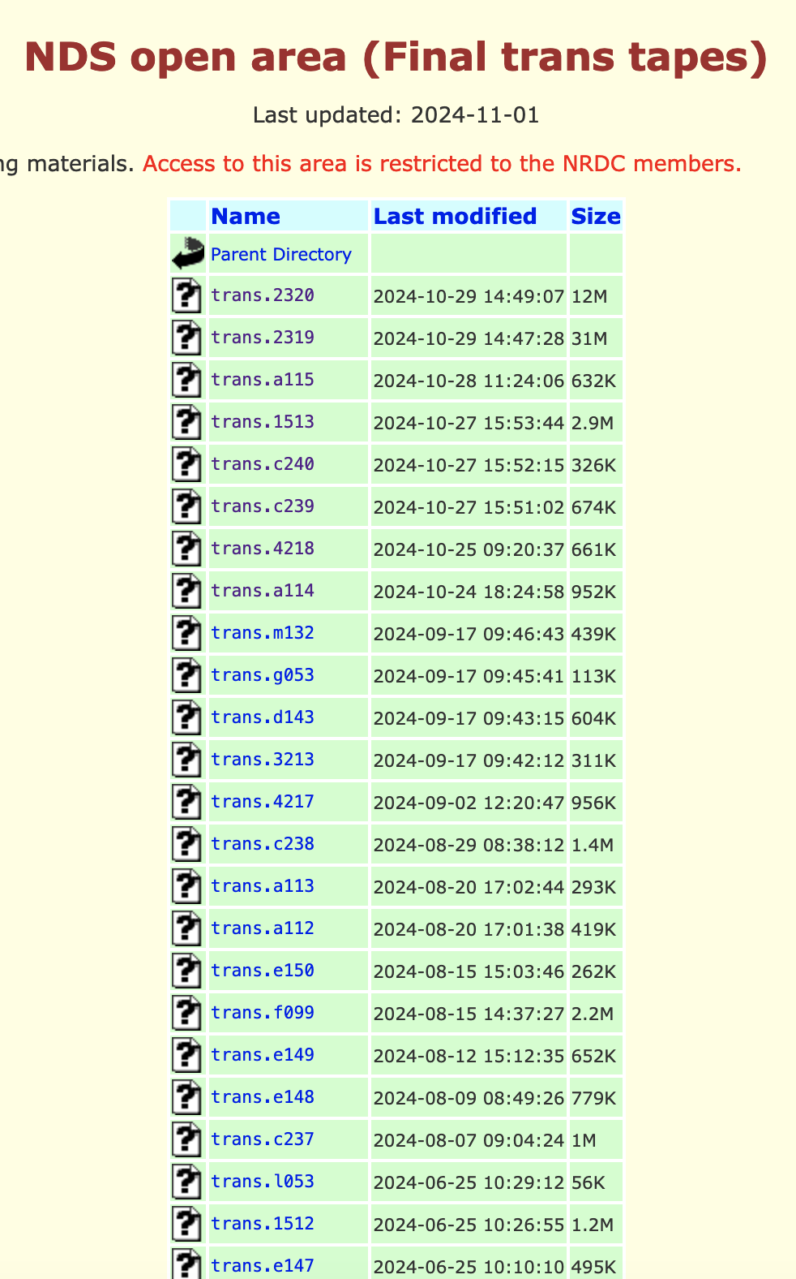
Experimental Nuclear Reaction Data (EXFOR)
EXFOR is a leading low- and intermediate-energy nuclear reaction database.
Refereed compilations: final and preliminary transmissions.
Presently managed by the NRDC under the auspices of the IAEA.
NNDC is responsible for the USA & Canada (Area #1).
As of October 30, 2024, EXFOR includes
25,127 experiments,
167,425 data tables,
184,837 datasets,
and 20,348,339 data points.

Slide 3
Area #1 FY 2024 Statistics
FY 2023 Team: B.Pritychenko (BNL), O.Schwerer, S.Hlavac, O.Gritzay (Contractors).
FY 2024 Team: B.Priychenko (BNL), O.Gritzay (Contractor).
We re-grouped in FY 2024.
Close collaboration with the NDS-IAEA and NRDC on EXFOR.
EXFOR | FY2024 | FY2023
New Compilations | 95 | 152
Updated Compilations | 95 | 181
Preliminary Transmissions | 15 | 19
Final Transmissions | 20 | 22
Database Updates | 15 | 40

Slide 4
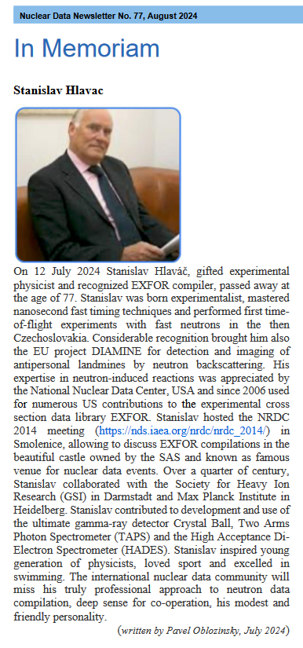
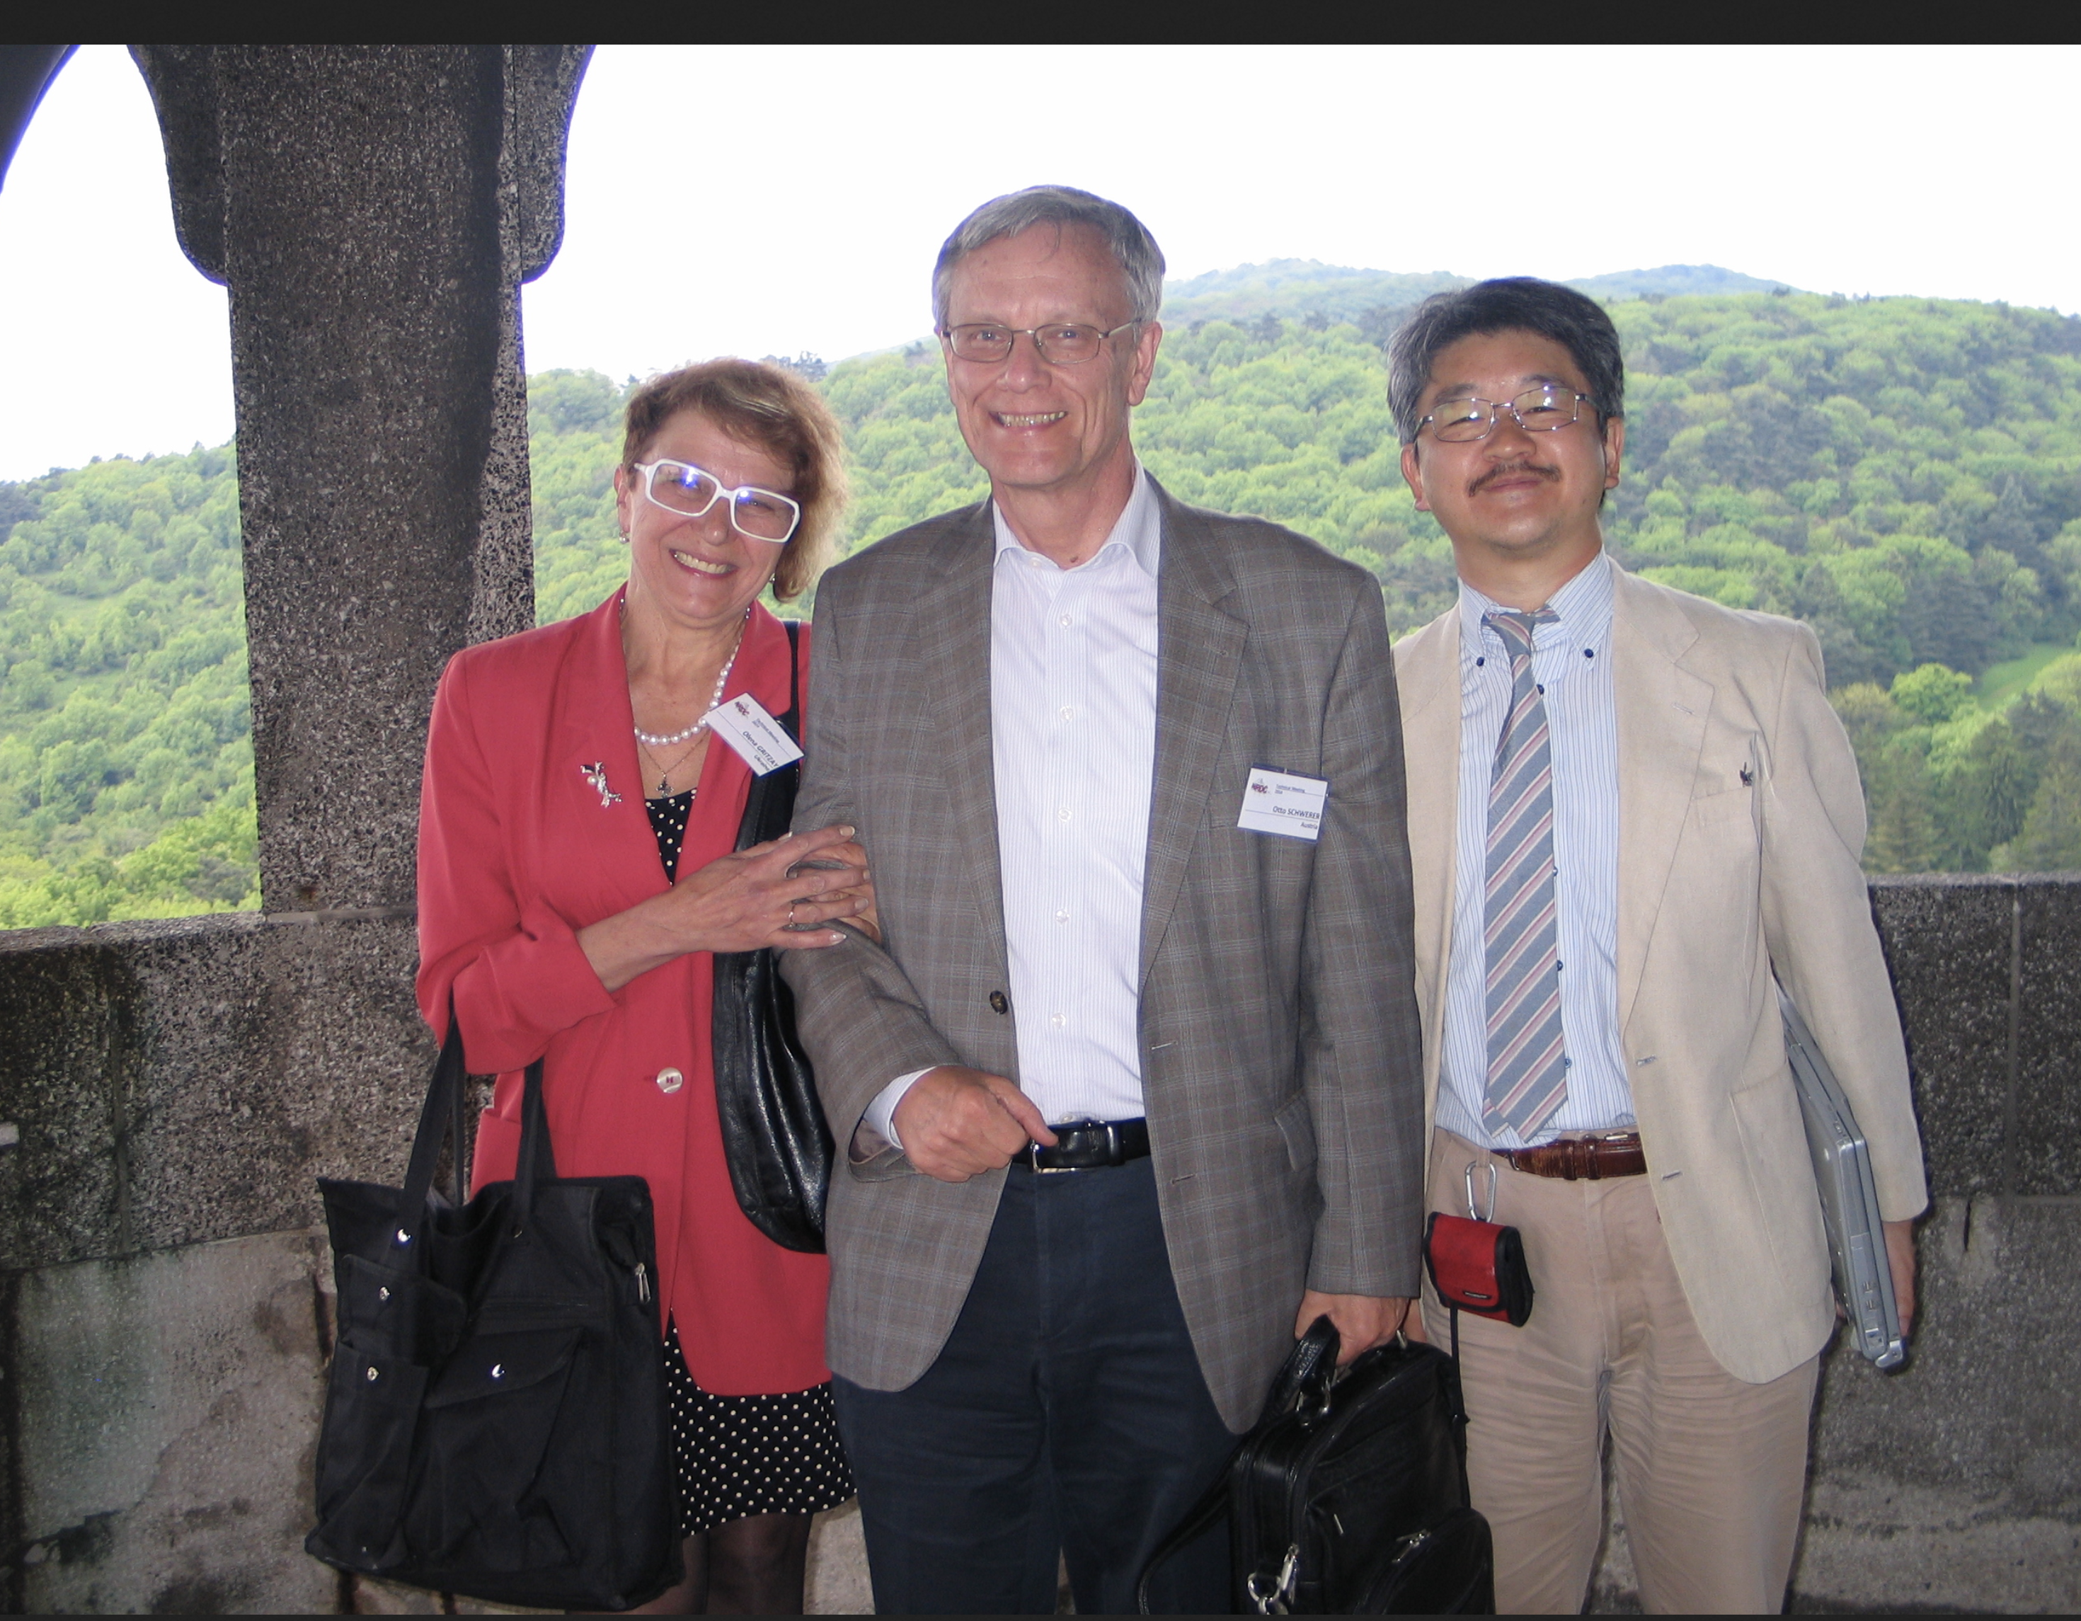
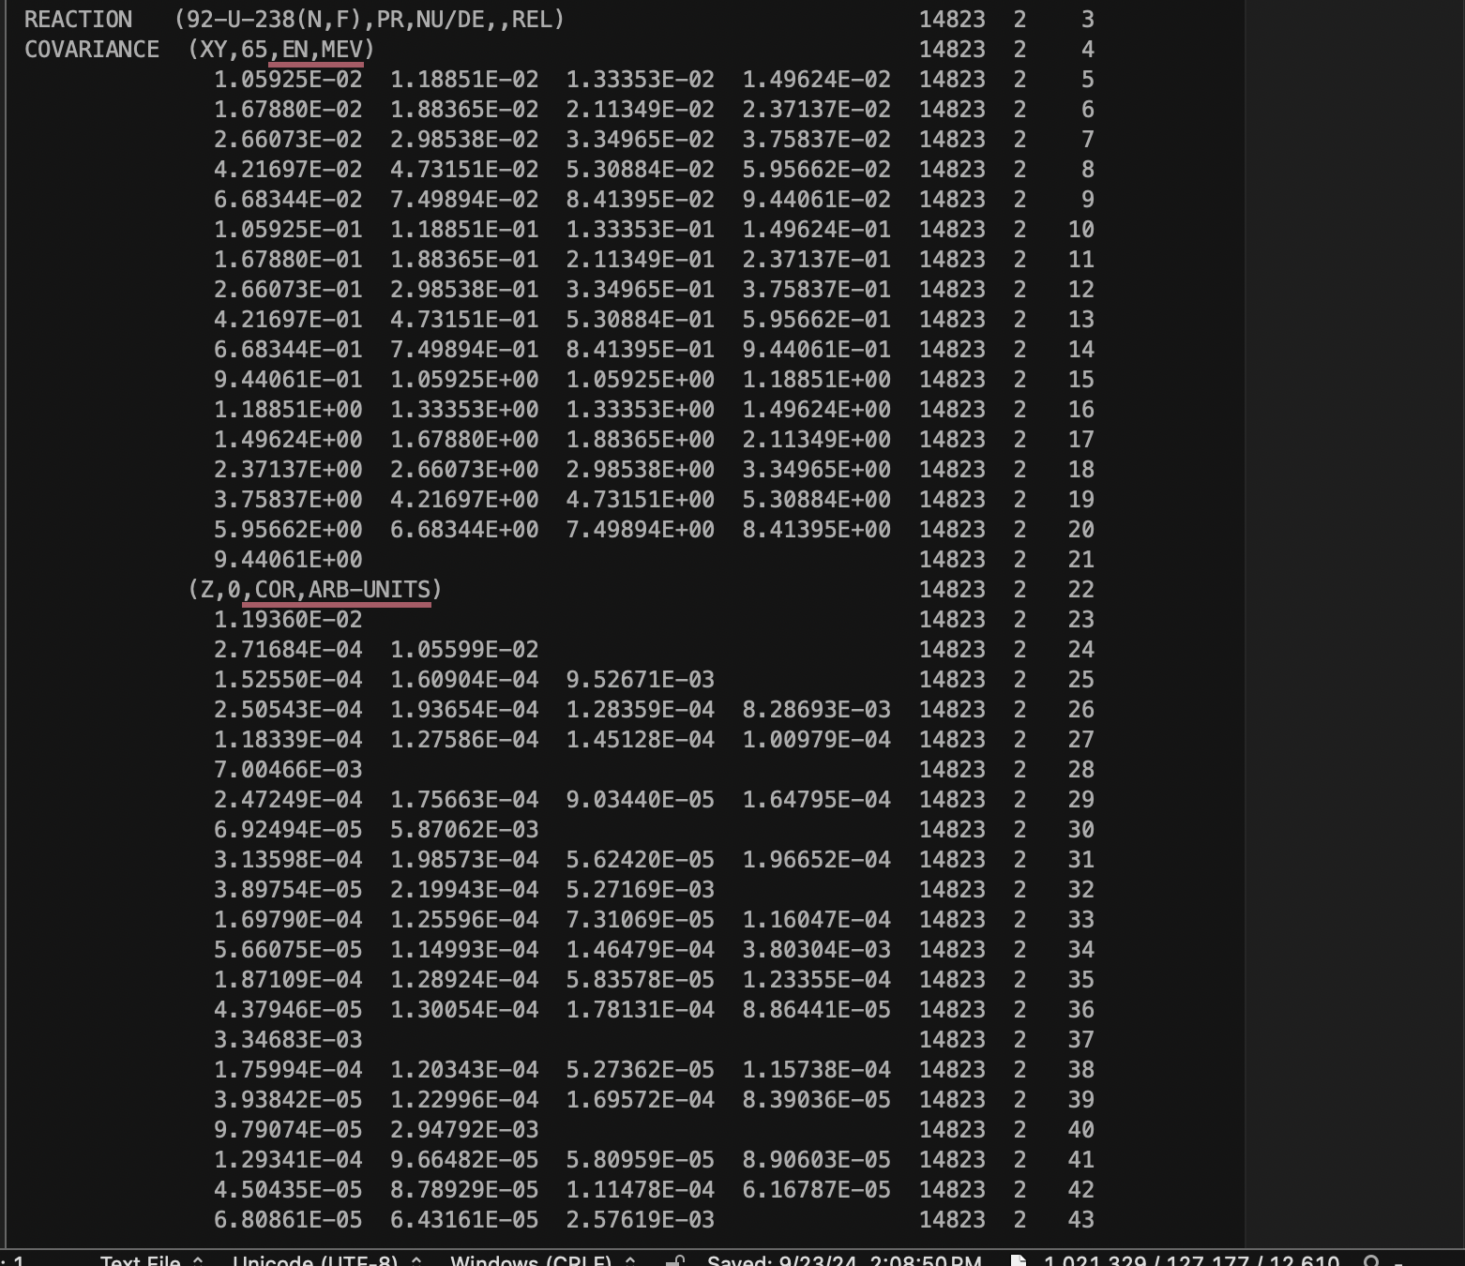
EXFOR Challenges and Solutions in FY2024
We have lost Drs. O. Schwerer (retired) and S. Hlavac.
Dr. Stanislav Hlavac made very substantial contributions to EXFOR, we were shocked when he passed away.
Dr. Olena Gritzay worked for four months and produced many valuable contributions.
We are really happy to work with Olena on EXFOR. Otto is contributing as a volunteer.
Dr. Naohiko Otuka (NDS-IAEA) is very helpful with EXFOR and covariances.

Slide 5
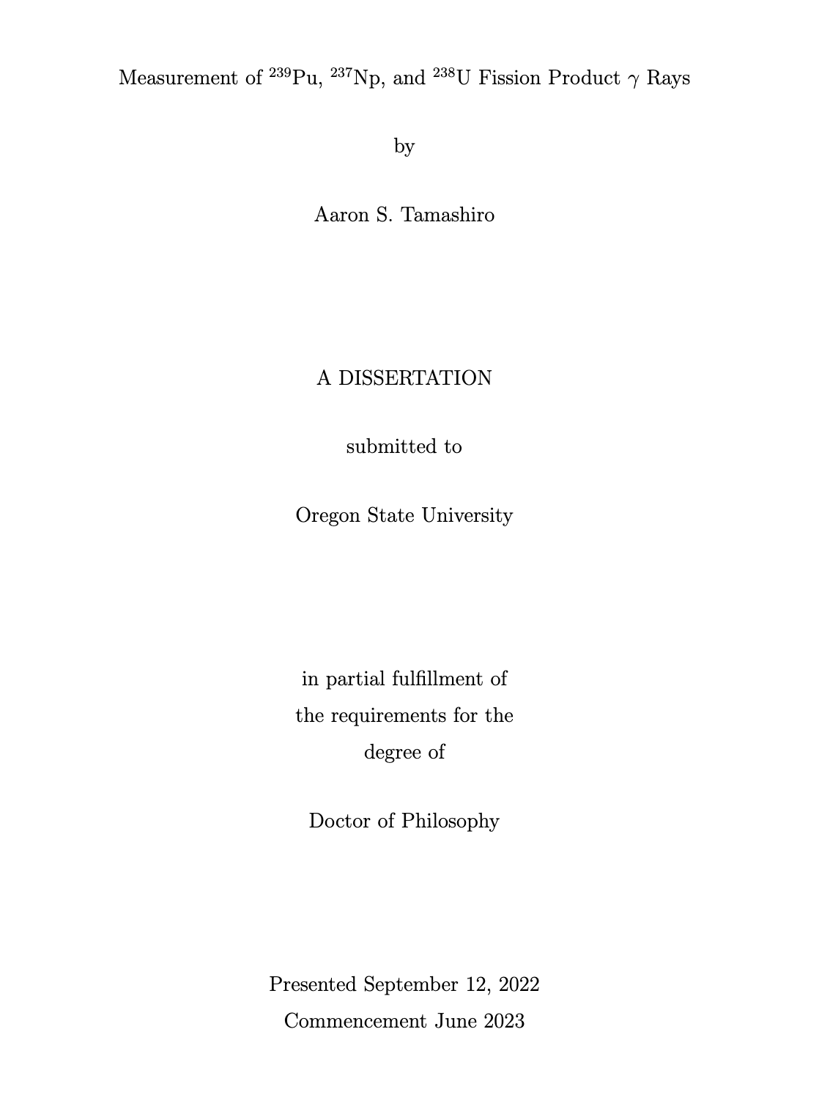
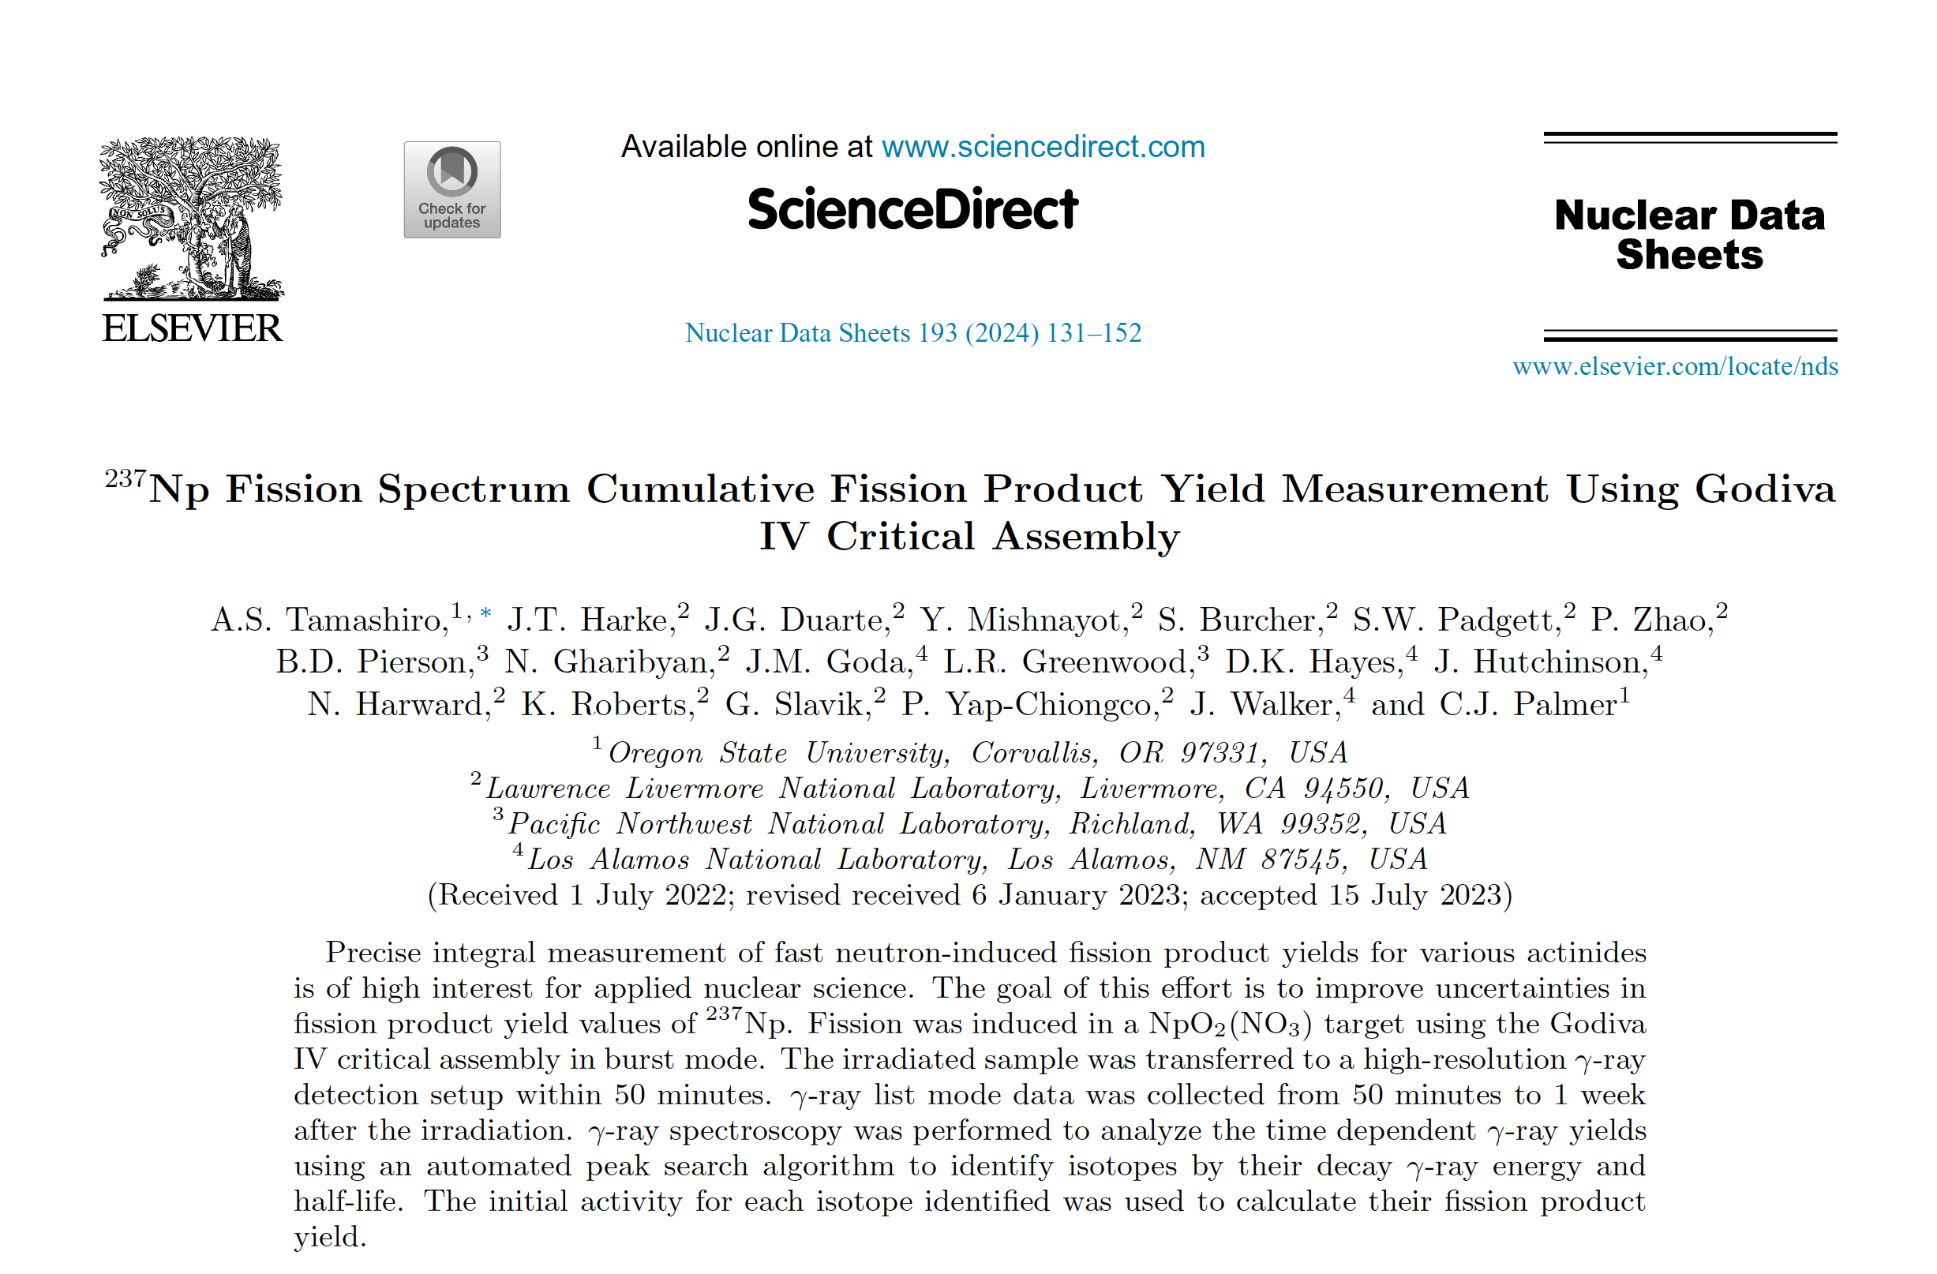
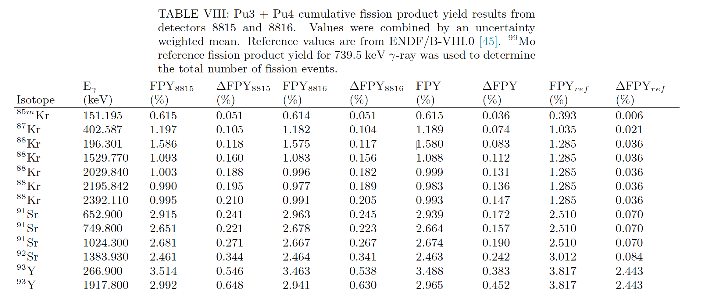
EXFOR Compilations #14834, 14835
The Godiva IV critical assembly, Ph.D. Thesis of Aaron S. Tamashiro.
²³⁷Np(n,F): ⁸⁸Kr-6, ⁹⁷Zr-8, ¹³⁵I-10, ¹⁴²La-7 gamma lines, ….
²³⁹Pu(n,F): ⁸⁸Kr-6, 97Zr-6, ¹³⁵I-14 gamma lines, …
Activation results could deviate up to 50% for ⁸⁸Kr…
Activation measurements strongly depend on nuclear data, multiple gamma lines are needed.
`

Slide 6
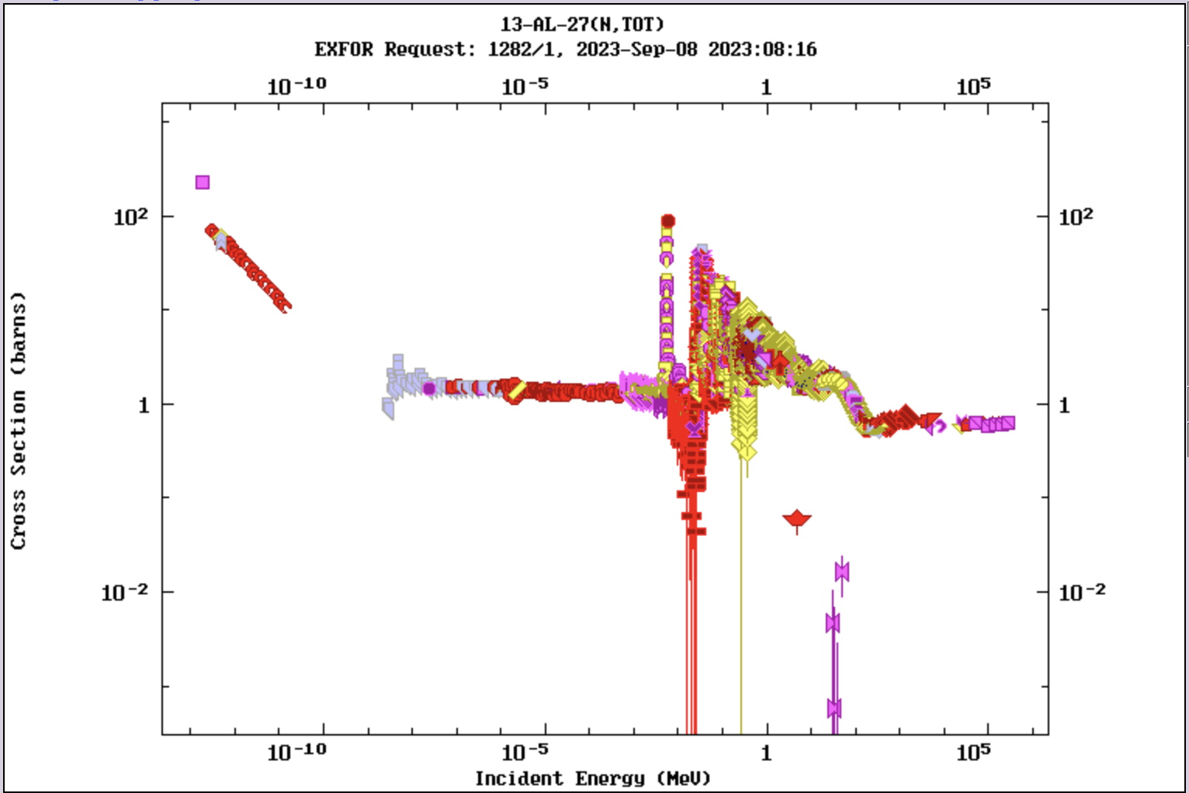
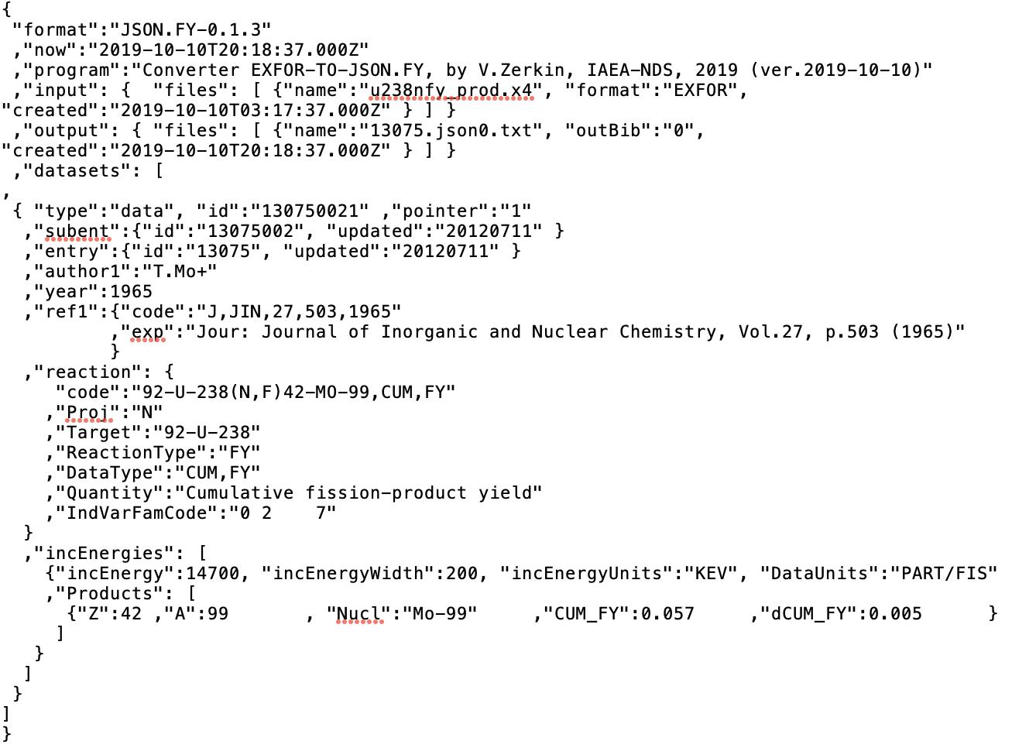
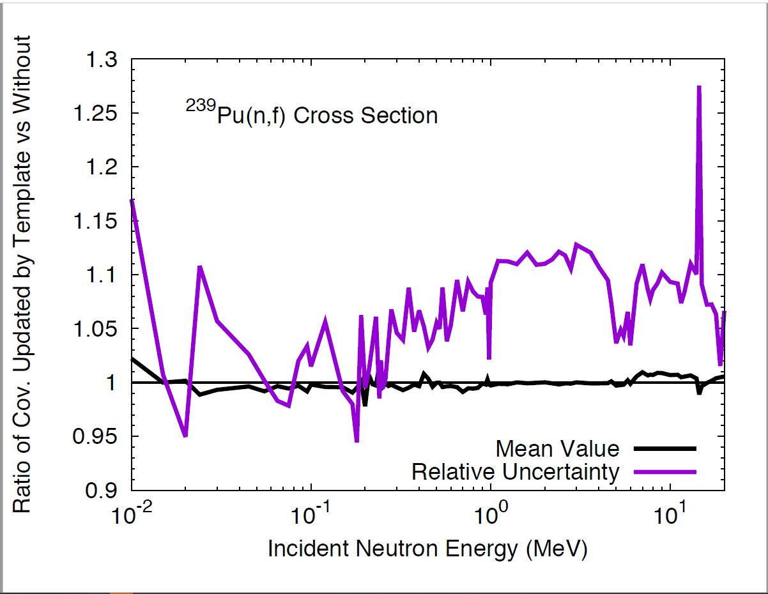
EXFOR Database Modernization
EXFOR is 75 years old, and it accumulated many issues.
We need to capitalize on modern computer technologies: Automatization of the EXFOR life and production cycle.
Development of EXFOR Application Programming Interface (API): IAEA X4Pro, x4i, …
New data formats: JSON (JavaScript Object Notation) lightweight data-interchange format for EXFOR is now in progress at the NNDC and IAEA-NDS.
Implementation of uncertainty templates developed by Denise Neudecker et al. (LANL) for resolving issues with missing uncertainties and covariances.
Potential collaboration: BNL, Los Alamos, IAEA, LBNL, NEA-DB, LLNL, …

Slide 7
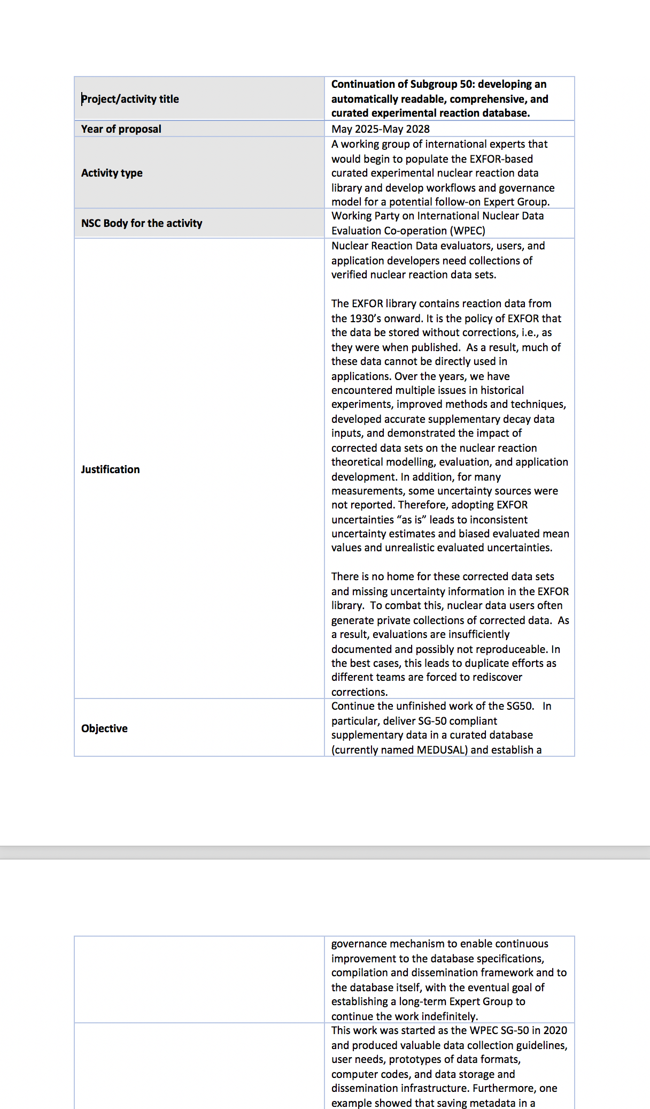
WPEC SubGroup 50/54
SubGroup 54 was approved in August 2024: Continuation of Subgroup 50: developing an automatically readable, comprehensive, and curated experimental reaction database.
B. Pritychenko (BNL) was elected as a chair of the SubGroup 54, and Georg Schnabel (IAEA) as a monitor.
Production of a curated EXFOR database.
Development of JSON format and codes for EXFOR.
Open access software development.
If time and funding permits …..

Slide 8
Takeaways
People are the most important resource in nuclear data.
NNDC EXFOR compilation efforts are complex and well-organized: B. Pritychenko (BNL), O. Gritzay (Under contract with BNL); O. Schwerer, N. Otuka (IAEA).
Funding issues had a negative impact in FY 2024. We lost a few excellent people.
We re-grouped, and new approaches for data compilations were developed.
SG 54 was approved by WPEC.

