Slide 1
Testing ¹⁷⁷Hf Evaluation on the TEX-Hf benchmark
Luiz Leal and Travis Greene
  2024 CSEWG, NDAG Meeting
  Long Island, NY
  November 4-8, 2024

Slide 2
Motivation:
  Review existing Hf evaluations, ENDF/B-VII.1, ENDF/B-VIII.0, ENDF/B-VIII.1, JEFF3.3, and JENDL5
  Start with the ¹⁷⁷Hf evaluation
  Perform benchmark calculations using the ORNL SCALE/CE_KENO tool
  Test the ¹⁷⁷Hf evaluation with the TEX-Hf benchmark

Slide 3
Hf Evaluations
Isotope | Abundance (%) | Spin | 𝜎_{𝜸} (b) (ATLAS) | I_{𝜸} (b) (ATLAS)
¹⁷⁴Hf | 0.16 | 0+ | 549 ± 7 | 307 ± 15
¹⁷⁶Hf | 5.26 | 0+ | 23.5 ± 3.1 | 708 ± 15
¹⁷⁷Hf | 18.60 | 7/2− | 375 ± 10 | 7200 ± 200
¹⁷⁸Hf | 27.28 | 0+ | 84 ± 4 | 1882 ± 20
¹⁷⁹Hf | 13.62 | 9/2+ | 41 ± 3 | 630 ± 30
¹⁸⁰Hf | 35.08 | 0+ | 13.04 ± 0.07 | 33.0 ± 1.0

Slide 4
¹⁷⁷Hf Evaluations
Isotope | Resolved resonance upper limit (eV) | Unresolved resonance upper limit (keV) | 𝜎_{𝜸} (b) | I_{𝜸} (b) | Resonance parameter covariance
ENDF/B-VII.1 | 510 | 50 | 373.59 | 7213.1 | No
ENDF/B-VIII.0 | 510 | 50 | 373.59 | 7213.3 | No
ENDF/B-VIII.1 | 250 | 50 | 371.89 | 7215.8 | No
JENDL5 | 250 | 50 | 371.89 | 7210.8 | No
JEFF3.3 | 1000 | 112 | 371.24 | 7167.9 | Yes

Slide 5
Seven Critical Experiments Sensitive to the Hafnium Cross Sections
Benchmark | Energy of average lethargy causing Fission (eV)
HEU-MET-THERM-037-005 | 3.82
HEU-MET-MIXED-022-004 | 88.65
HEU-MET-INTER-013-003 | 930.06
HEU-MET-INTER-013-006 | 1178.60
HEU-MET-INTER-013-002 | 6097.69
HEU-MET-FAST-105-001 | 1.22 × 10⁵
HEU-MET-FAST-105-007 | 3.51 × 10⁵

Slide 6
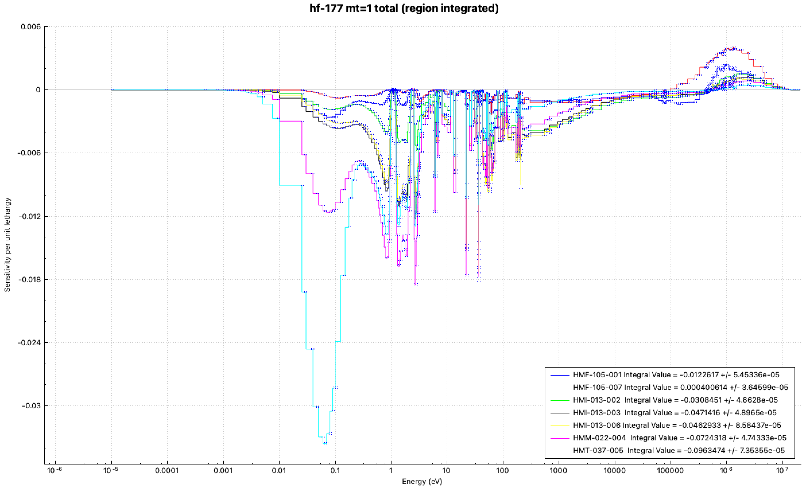
Sensitivities to the ¹⁷⁷Hf total cross sections

Slide 7
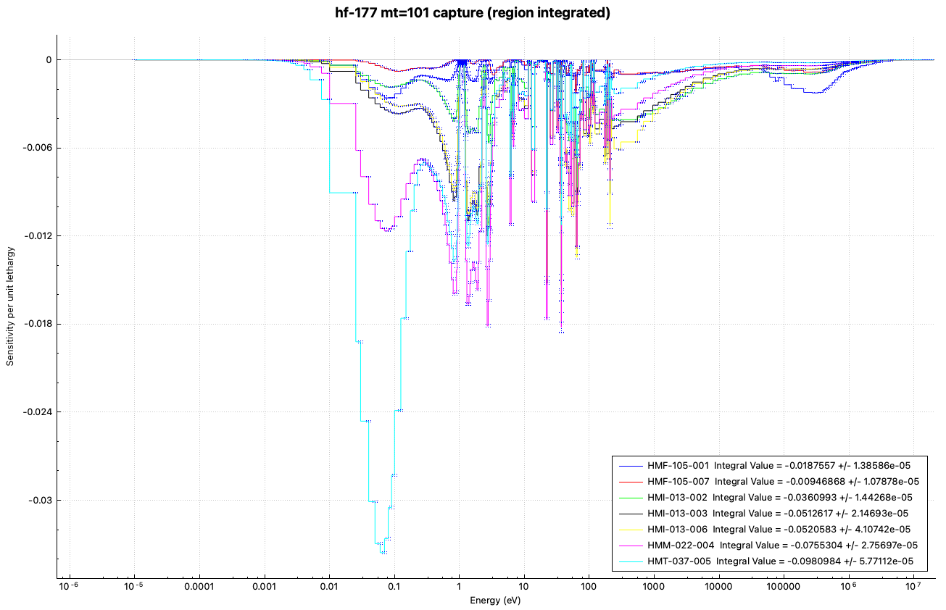
Sensitivities to the ¹⁷⁷Hf capture cross sections

Slide 8
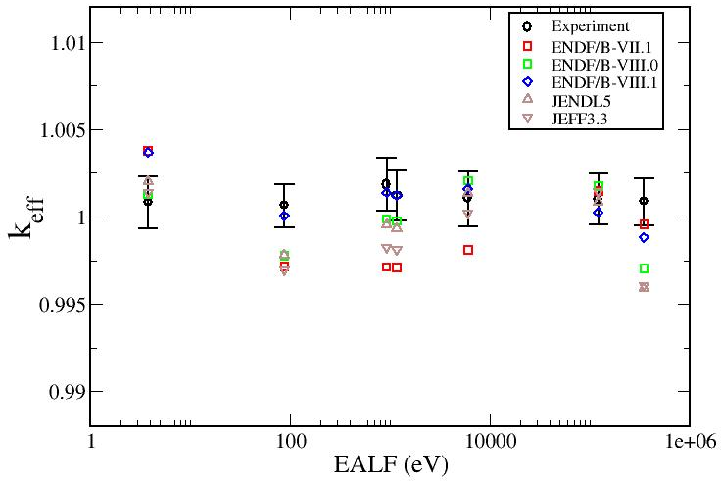
Benchmark Results (Experiment)

Slide 9
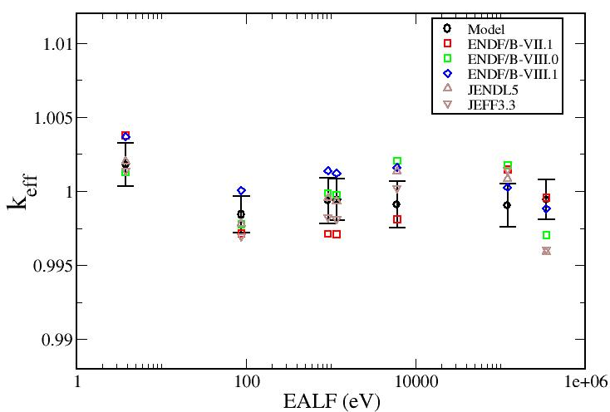
Benchmark Results (Model)

Slide 10
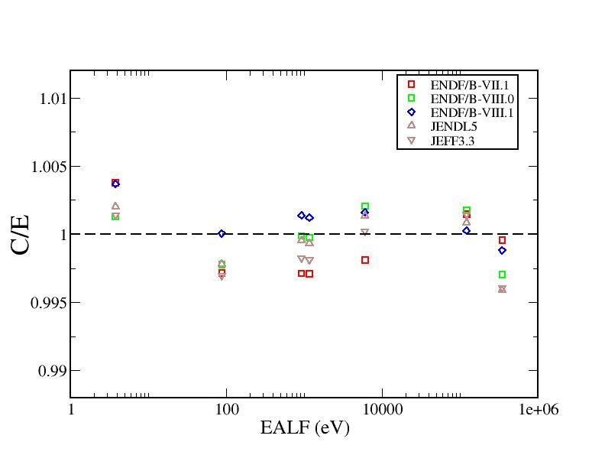
Benchmark Results (Experiment)

Slide 11
Benchmark Results (Model)

Slide 12
Concluding Remarks
Measurements of Hf transmission and capture cross sections are needed
Resolved and unresolved energy region require evaluation
Resonance parameter covariance needed

