Slide 1
WANDA 2025 CSEWG Discussion
Jesse Brown¹, Ellen O’Brien², Todd Bredeweg², Jo Ressler³
¹ Oak Ridge National Laboratory
² Los Alamos National Laboratory
³ Lawrence Livermore National Laboratory
CSEWG 2024: November 4th – 8th, 2024
LA-UR-24-31707

Slide 2
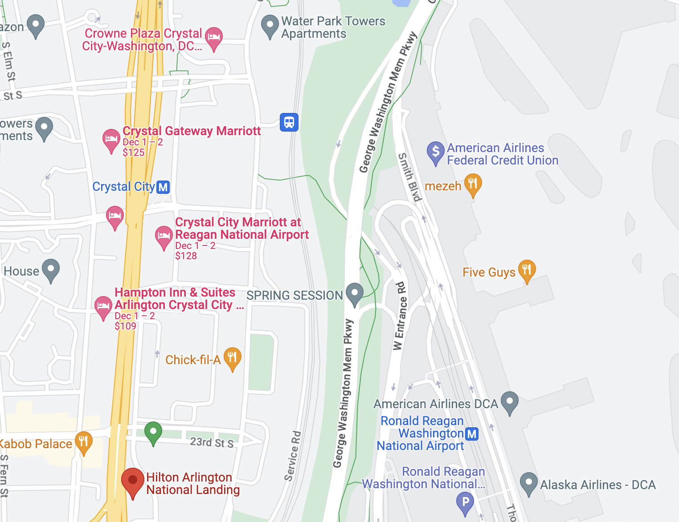
WANDA 2025 Location: Hilton Arlington National Landing
February 10th – 13th, 2025
Same location as WANDA 2024.
Close to DCA and metro stations (shuttle from the airport).
Returning poster session for WANDA 2025, with dedicated space and alternate time.

Slide 3
WANDA 2025 Contact Information
WANDA chairs: Jesse Brown (brownjm@ornl.gov, ORNL) and Ellen O’Brien (emobrien@lanl.gov, LANL)
Logistics point of contact: Lisa Felker (felker7@llnl.gov, LLNL)
Nuclear Data Working Group chair: Todd Bredeweg (toddb@lanl.gov, LANL)
Nuclear Data Working Group vice chair: Jo Ressler (ressler2@llnl.gov, LLNL)
Please send names & emails of attendees to Jesse, Ellen, and Lisa!

Slide 4
Sessions
HALEU
Data Preservation and Data Workflows (Full-day session)
NNSA: ND and Deterrence
FES: ND Prioritization for Fusion
Monday
Tuesday
Wednesday
Thursday
Friday
Intro & PMs
Project Reports
8am-12pm
8am-12pm
FES
8am-12pm
Data Preservation & Data Workflows
Restricted
HALEU
Project Reports & Session Wrap-up
1-5pm
1-6pm
Poster Session
1-5pm
NNSA
HALEU

Slide 5
Poster Session
During afternoon break on Tuesday, February 11th.
20 posters total.
Preference given to students, postdocs, & early career.

Slide 6
Nuclear Data and Deterrence
NDWG Contact: Todd Bredeweg (LANL), Jo Ressler (LLNL), Shea Mosby (LANL), Nathan Gibson (LANL)
Chairs: Aaron Couture (LANL), Jo Ressler (LLNL), Todd Bredeweg (LANL)
Monday PM
Summary: The US maintains a nuclear arsenal as part of its broader deterrence strategy. In 1992 the US stopped full scale testing of nuclear weapons, establishing the Stockpile Stewardship Program (SSP) in 1995. The SSP is science-based, using predictive capabilities developed with modeling, simulation, and laboratory experiments to certify the current nuclear stockpile and prepare for the future deterrent. These activities require accurate physical data (including the nuclear data library), knowledge of uncertainties to define confidence and prioritize efforts, and integrated experiments to validate computational assessments. In this WANDA session, nuclear data needs and next-generation capabilities will be discussed.

Slide 7
Nuclear Data Prioritization for Fusion
NDWG Contact: Mike Loughlin (ORNL) and Paul Romano (ANL)
Chairs: Mike Loughlin (ORNL), TBD
Tuesday AM
Summary:
Overview: What elements are of interest, and what do we need nuclear data for?
What experimental facilities are available?
How do we propagate uncertainties and examine schedule and economic impact?
What benchmarks do we need?
Impacts of ENDF/B-VIII.1 on fusion work
Fusion-related updates in JEFF/TENDL

Slide 8
Challenges in the Deployment of HALEU and Novel Moderators for Advanced Reactors
NDWG Contact: Mike Zerkle (NNL) and Will Wieselquist (ORNL)
Chairs: Javier Ortensi (INL), Teresa Cutler (LANL)
Tuesday PM
Summary: Advanced Reactors have recently become an important topic in the nuclear community. There is broad interest in all facets from design, material fabrication, processing, transport, and disposal. DOE has offered multiple grants to companies in recent years to design advanced reactors and establish prototypes. The HALEU Availability Program is working to establish pathways to acquire HALEU commercial scales to support these advanced reactor concepts. To support the renewed effort in building advanced reactors, nuclear data needs a close eye and potentially significant improvements/uncertainty reduction. With the roll out of the DNCSH which specifically looks at criticality safety for transport and processing, the full suite of nuclear data and its impacts to the goals and methods needs to be considered. In addition, the deployment of novel moderators such as metal hydrides in combination with HALEU fuel forms pose new challenges in both design and transportation due to the lack of relevant benchmarks.

Slide 9
Data Preservation & Data Workflows
NDWG Contact: Dave Brown (BNL) and Nathan Gibson (LANL)
Chairs: Adam Daskalakis (NNL) and Dave Brown (BNL)
Wednesday – Full Day
Summary:
Find common ground on best practices for data preservation (experimental being particularly important, but evaluated too).
Make connections between disparate processes in the ND workflow (e.g. how does experimental uncertainty impact application uncertainty).
Get community feedback on application needs for evaluated data (especially uncertainty).

Slide 10
Acknowledgements
WANDA is sponsored by the Nuclear Data Interagency Working Group (NDIAWG).

