Slide 1
Evaluations of ^{155,157}Gd, ⁹⁵Mo, ^{92,94}Zr
Luiz Leal¹, Travis Greene¹, Goran Arbanas¹, Devin Barry², and Timothy Trumbull²
  2024 CSEWG, NDAG Meeting
  Long Island, NY
  November 4−8, 2024
  ¹Oak Ridge National Laboratory, Oak Ridge, TN, 37831
  ²Naval Nuclear Laboratory, P.O. Box 1072, Schenectady, NY 12301

Slide 2
Evaluation of ¹⁵⁵Gd and ¹⁵⁷Gd Resonance
Motivation:
  Issues with benchmark calculations with Gd concentration
  Extension of the resonance region from 300 eV to 500 eV
  SAMMY R-matrix analysis;
  Transmission, capture data from RPI and n_TOF
  Improved benchmark integral representation
  Uncertainty information and resonance parameter
  Covariance generation

Slide 3
Gadolinium Evaluation
RPI experimental data measured at the 25.59725 m flight-path
Data | Energy range (eV) | Nature
Transmission | 0.2−300.0 | Natural
Transmission | 0.3−500.0 | Natural
Transmission | 0.3−1,000.0 | Natural
Capture | 0.2−1,000.0 | 91.74% ¹⁵⁵Gd enriched
Capture | 0.2−1,000.0 | 90.96% ¹⁵⁷Gd enriched
Capture | 0.2−1,000.0 | Natural

Slide 4
Gd RPI data (SAMMY Fitting): Resonance Range Extended to 500 eV for ^{155,1557}Gd

Slide 5
Gadolinium Evaluation
(new n_TOF capture measurements)
n-TOF experimental data measured at the 183.90 m flight-path
Data | Energy range (eV) | Nature
Capture | 1.0−1,000.0 | 91.74% ¹⁵⁵Gd enriched
Capture | 1.0−1,000.0 | 88.32% ¹⁵⁷Gd enriched

Slide 6
General Information
Atlas of Neutron Resonances (ANR)
 | Thermal cross section (b) | Capture resonance integral (b) | Westcott’s factor
¹⁵⁵Gd | 60,900 ± 500 | 1,537 ± 100 | 0.83899
¹⁵⁷Gd | 254,000 ± 815 | 754 ± 20 | 0.84715

Slide 7
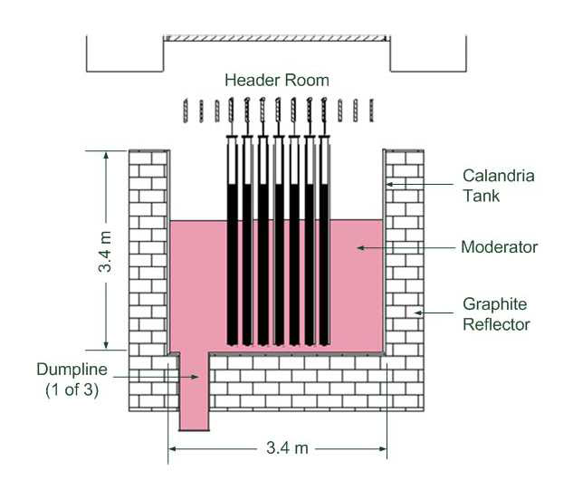
Benchmark Results: Issues
Zero-Energy Deuterium (ZED-II) Research Reactor
Issues with benchmark calculations with Gd concentration
Luiz Leal / IRSN – JEFF meeting - November 2017

Slide 8
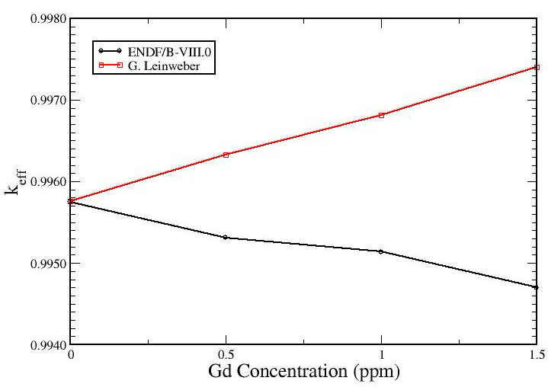
Issue:
Luiz Leal / IRSN – JEFF meeting - November 2017

Slide 9
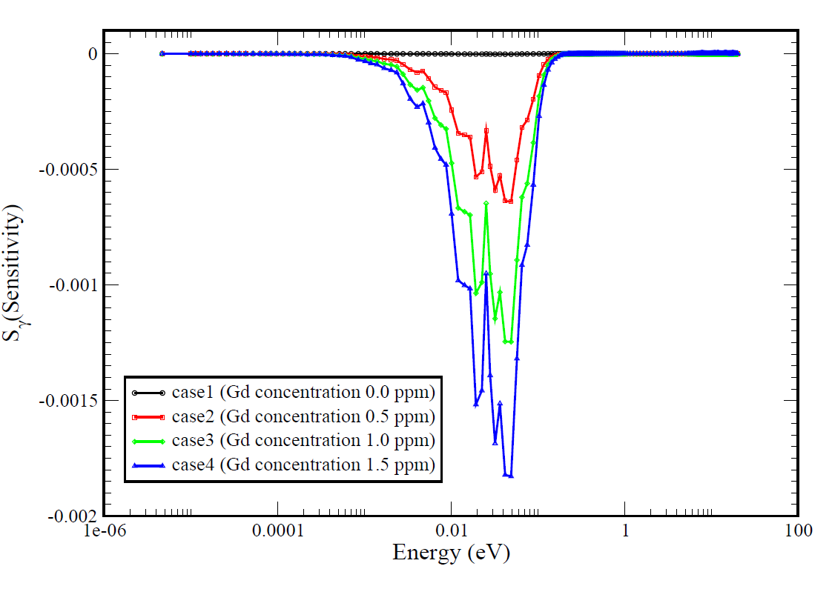
K_{eff} Sensitivity to the Capture Cross Section
Luiz Leal / IRSN – JEFF meeting - November 2017

Slide 10
SAMINT Methodology for Differential and Integral Data Treatment
SAMINT flowchart
Differential data
SAMMY
dσ(E)/dP
SAMINT
dk/dP
dk/dσ(E)
SAMMY
Integral
data
CE TSUNAMI
MCNP-6
Updated
P and δP
ENDF
P = resonance parameters (e.g., E_{λ}, Γ_{γ} , Γ_{n} , Γ_{f} )

Slide 11
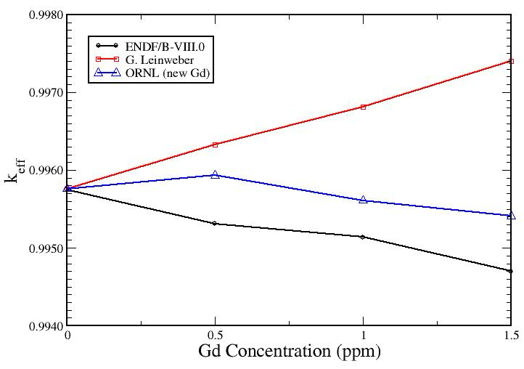
Resolution: Use of SAMMY and SAMINT
Luiz Leal / IRSN – JEFF meeting - November 2017

Slide 12
¹⁵⁷Gd Results
Evaluation | Thermal cross section (b) | Capture resonance integral (b) | Westcott’s factor
ENDF/B-VIII.0 | 252,892.2 | 759.26 | 0.85305
RPI | 225,629.8 | 778.32 | 0.76287
ORNL | 244,071.5 | 806.62 | 0.82467
ANR | 254,000 ± 815 | 754 ± 20 | 0.84715
Luiz Leal / IRSN – JEFF meeting - November 2017

Slide 13
⁹⁵Mo Resonance Evaluation
ORELA experimental data
Data | Energy range (eV) | Nature
Transmission | 0.01−5,000.0 | 96.47% ⁹⁵Mo enriched n = 0.025067 at/b L = 79.83 m
Capture | 0.01−5,000.0 | 96.47% ⁹⁵Mo enriched n = 0.004591 at/b L = 38.42 m
(n, α) | 0.01−5,000.0 | 96.47% ⁹⁵Mo enriched n = 0.0000317 at/b L = 8.84 m

Slide 14
⁹⁵Mo Resonance Evaluation Using SAMMY
Features:
Extension of the resonance energy range from 2,141.2 eV to 5,000 eV LRF = 7 format used (RML)
(n, α) explicitly represented via resonance parameters: ground-state and first excited–state—with energy Q-values of 6,393.55 keV and 5,458.50 keV
Resonance parameters covariance using the compact format, LCOMP = 2

Slide 15
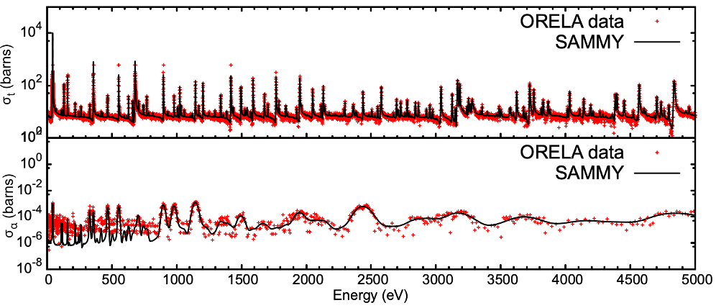
ORELA total and (n, α) cross-section data from thermal up to 5,000 eV

Slide 16
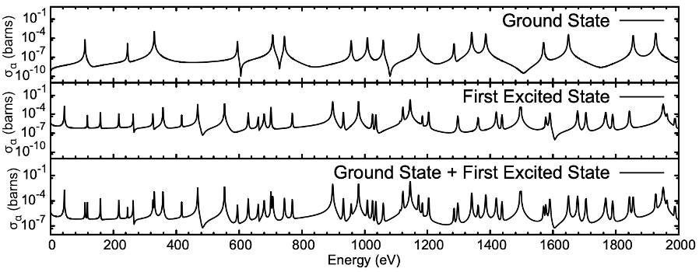
Total (n, α) cross section, ground state, and first excited state

Slide 17
 | Koehler | ORNL | ANR
Capture cross section | 13.4 ± 0.3 | 13.34 ± 0.04 | 13.4 ± 0.3
Resonance integral | 114.21 | 104.15 ± 0.33 | 118 ± 7
Capture cross section at thermal (0.0253 eV) and resonance integral

Slide 18
Covariance

Slide 19
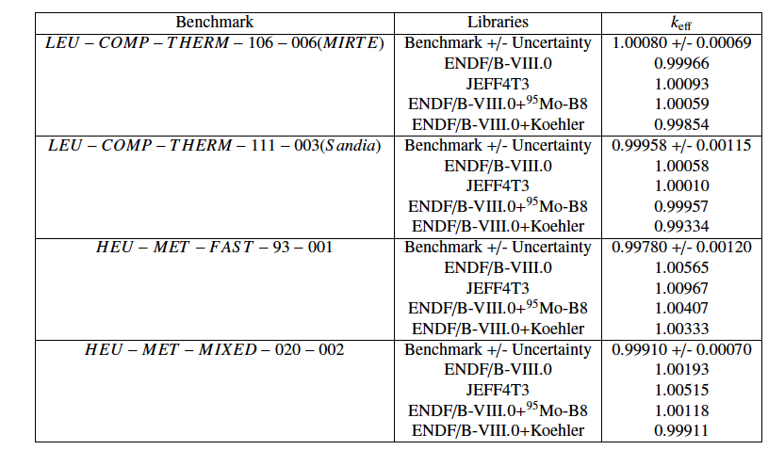
Benchmark Results
LCT-106-006 and LCT-111-003: benchmark experiment dedicated to molybdenum

Slide 20
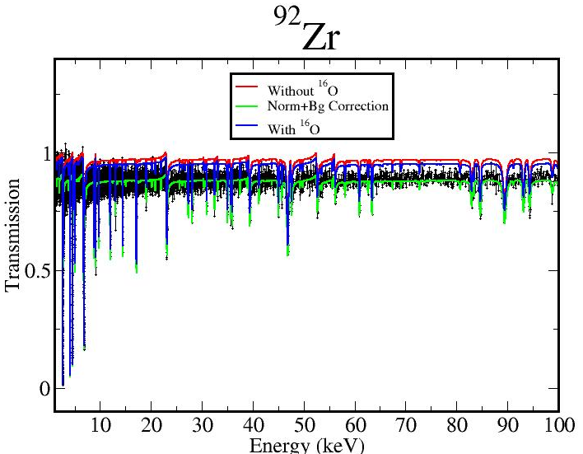
Zirconium Evaluation at ORNL
⁹²Zr
a) One transmission from ORELA:
b) TOF 78.2 m and thickness of 0.00455 at/b
c) ¹⁶O seems to be present in the sample!

Slide 21
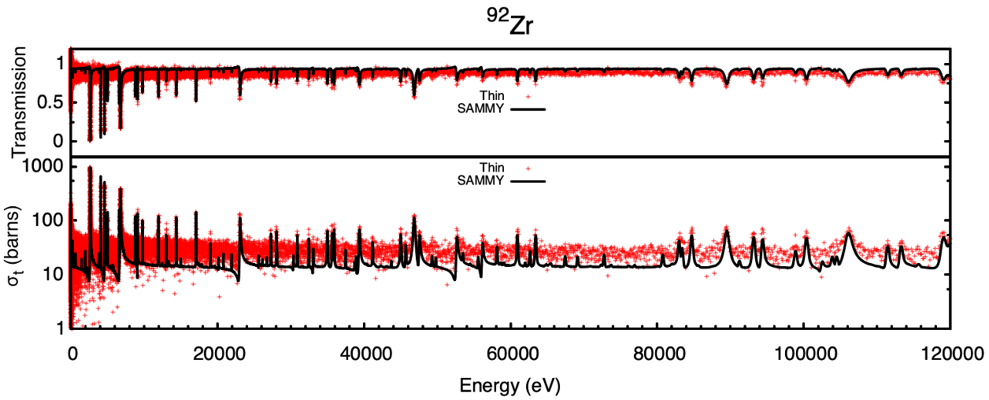
Zirconium Evaluation at ORNL
⁹²Zr
Fit of the ORELA transmission data corrected for the normalization and background and for ¹⁶O:

Slide 22
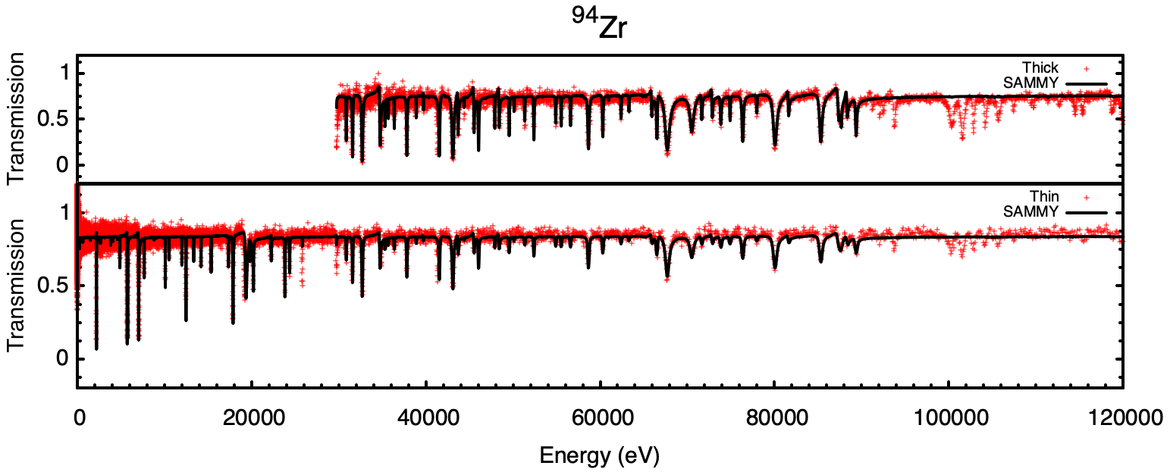
Zirconium Evaluation at ORNL
⁹⁴Zr
a) Two transmissions from ORELA
b) TOF 78.2 m and thicknesses of 0.00565 at/b and 0.02025 at/b

Slide 23
Zirconium Evaluation at ORNL
Some observations:
a) Whether extension of resolved resonance energy region should be examined.
b) Capture data should be included in the fitting as they become available.
c) Coherent and incoherent scattering should be included in the resonance fitting.

Slide 24
Concluding Remarks
Lack of experimental data may hinder the task for Zr and other isotopes.
Hopefully complete the evaluation for other Mo isotopes.
The Gd evaluation will be completed using ENDF/B-VIII.1 information.
Evaluations are processed via the nuclear data processing codes.
Evaluations are tested using benchmark calculations.
Evaluations will include covariances.

