Slide 1
RHIC Performance in Run-24 and Planning for Run-25
(succeeds A. Seryi)
Michiko Minty
Associate Chair for Accelerators and Applications
Accelerator Division Head, C-AD
C-AD MAC-21
16 – 18 December 2024

Slide 2
Outline
RHIC Performance in Run-24
Timeline and achievements
Accelerator availability
Planning for Run-25
Preparations for Run-25
Other beam time requests
Summary
M. Minty C-AD MAC-21 (16-18 Dec 2024)

Slide 3
RHIC Run-24 Timeline and Achievements
M. Minty C-AD MAC-21 (16-18 Dec 2024)

Slide 4
Recent RHIC schedule
Run-22 (p↑+p↑, √s_{NN} ~500 GeV) through 4/18/22
sPHENIX installation and preparation for Run-23
2022
Jan | Feb | Mar | Apr | May | Jun | Jul | Aug | Sep | Oct | Nov | Dec
sPHENIX magnet mapping
Run-23 (Au+Au, √s_{NN}=200 GeV ) 5/1/23 - 8/4/23 (early end)
RHIC repairs, preparation and sPHENIX upgrades for Run-24
sPHENIX installation completed
2023
Jan | Feb | Mar | Apr | May | Jun | Jul | Aug | Sep | Oct | Nov | Dec
CAD prep completed
CAD support for sPHENIX
sPHENIX upgrades completed
Run-24 ( p↑+p↑, √s_{NN} ~200 GeV ) 4/15/24 - 10/1/24
Preparation for Run-25
2024
Jan | Feb | Mar | Apr | May | Jun | Jul | Aug | Sep | Oct | Nov | Dec
CAD repairs and prep completed
Run-24 ( Au+Au, √s_{NN}=200 GeV )
10/1/24 - 10/21/24
RHIC Run-24: funding received for 19 cryo-weeks (+ 6 week carryover from Run-23)
started (6 weeks) later than planned
received approval for an additional 2 cryo-weeks → 27 cryo-weeks total
M. Minty C-AD MAC-21 (16-18 Dec 2024)

Slide 5
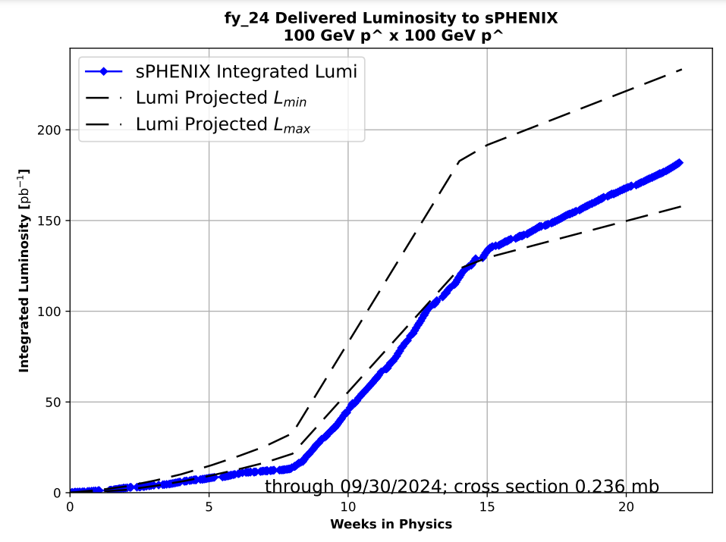
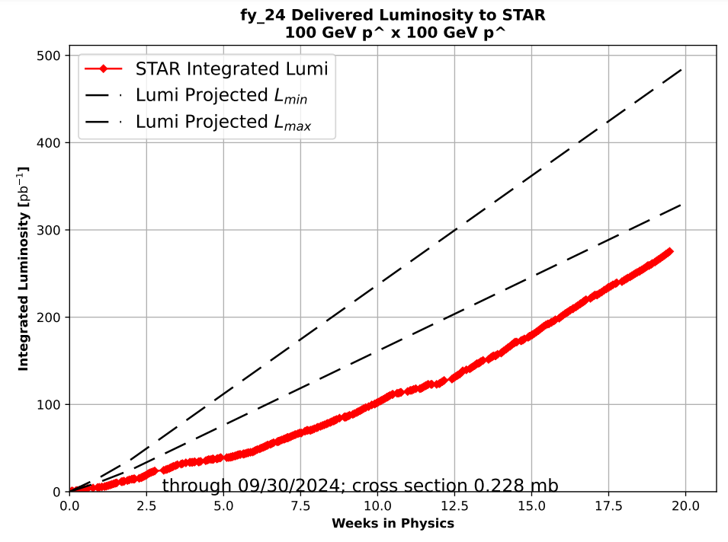
RHIC Run-24
Run coordinator: K. Hock
Timeline
4K cooldown start, start of p↑+p↑ at √s_{NN} ~200 GeV 15 Apr – 1 Oct 2024
Beam injection 19 Apr 2024 (Blue), 23 Apr 2024 (Yellow)
sPHENIX commissioning with beam 27 Apr 2024
STAR physics “declared” 30 Apr 2024
APEX and maintenance alternating weeks starting 8 May 2024
USI (approval to operate with isobutane at sPHENIX) 27 Jul 2024
Start of Au+Au, √s_{NN}=200 GeV 1 – 21 Oct 2024
Physics “declared” 8 Oct 2024
Performance Summary, (p↑+p↑, √s_{NN} ~200 GeV)
All repairs reported at last MAC (feedthrough, DX magnet replacement, USI upgrade) + refined cryo controls successfully completed.
Priority (NPP PAC) for sPHENIX, provided collisions also for STAR.
Run evolved differently than envisioned (next slide), responded to circumstances.
Minimal accelerator downtime due to lack of air conditioning (last year’s challenge), but several (lab-external) power interruptions impacted accelerator availability.
Run goals met for both sPHENIX and STAR.
Performance Summary, (Au+Au, √s_{NN} ~200 GeV)
Priority (NPP PAC) to prepare for RHIC Run-25.
Run goals not met for sPHENIX and C-AD, STAR (planned) run goals met.
sPHENIX - FY24 Delivered Luminosity
100 GeV p↑ x 100 GeV p↑
Integrated Luminosity [nb⁻¹]
Weeks in Physics
STAR - FY24 Delivered Figure of Merit (LP²)
100 GeV p↑ x 100 GeV p↑
Integrated FOM [pb⁻¹]
Weeks in Physics
M. Minty C-AD MAC-21 (16-18 Dec 2024)

Slide 6
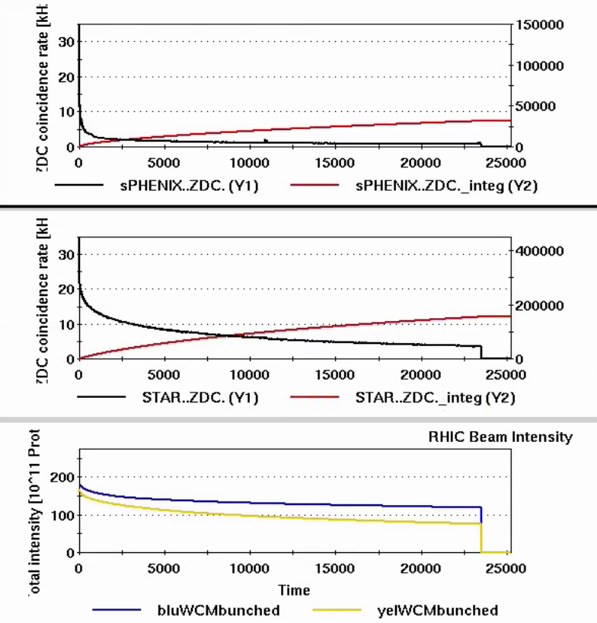
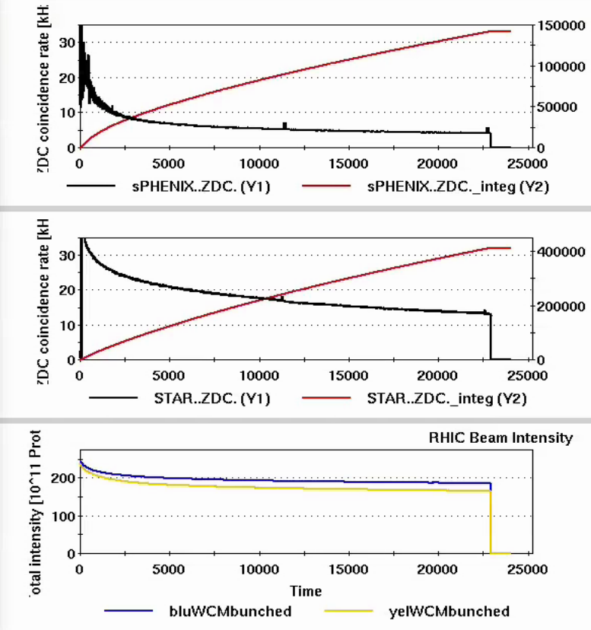
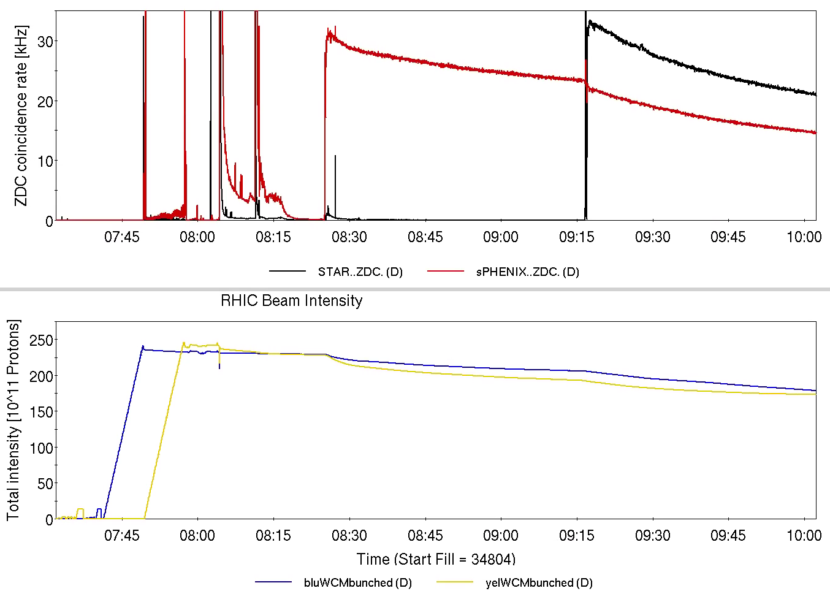
RHIC Run-24, p↑+p↑ at √s_{NN} ~200 GeV
Run coordinator: K. Hock
RHIC 4K cooldown, 15 Apr
Authorization to operate with isobutane at sPHENIX, 27 Jul
STAR physics “declared”, 30 Apr
two-week STAR “low-luminosity” run (using luminosity levelling)
2024
Apr | May | Jun | Jul | Aug
sPHENIX: -2 mrad crossing angle
STAR: 0 mrad (head-on)
(through 25 Jun)
sPHENIX and STAR:
head-on collisions
(25 Jun – 13 Aug)
sPHENIX: +1.5 mrad crossing angle
STAR: 0 mrad (head-on)
(since 13 Aug)
6/25/24
7/15/24
8/17/24
With head-on collisions at both sPHENIX and STAR, beam-beam limit required delayed start of collisions at one of the two experiments (STAR)
M. Minty C-AD MAC-21 (16-18 Dec 2024)

Slide 7
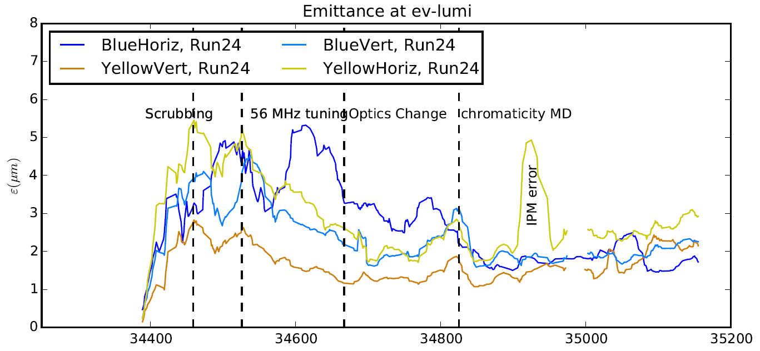
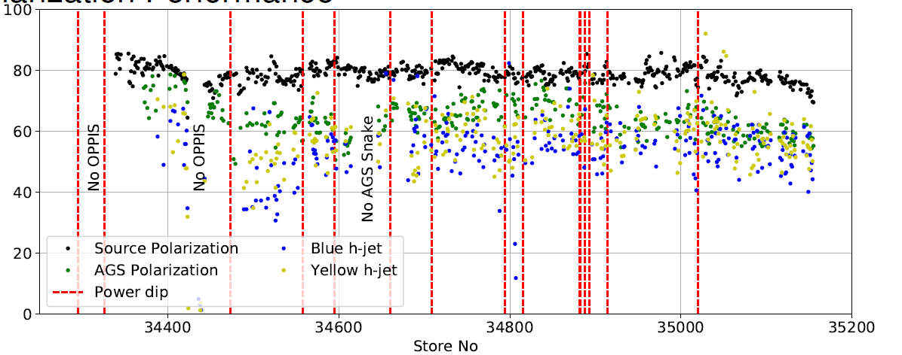
Emittances and Polarization
Run coordinator: K. Hock
Fully damping the 56 MHz (FPC1 and FPC2) resulted in a factor of 3 reduction in emittances
Optics corrections provided a further reduction of emittance and improved beam stability
Further tuning of the chromaticity mitigated beam instabilities and further improved emittances
Smaller emittances translate directly to higher polarization
Emittance (μm)
RHIC Store Number
Ring | <P_{run15}> | <P_{run24}> (preliminary)
Blue | 53.0 | 54.7
Yellow | 57.4 | 57.8
Polarization (%)
RHIC Store Number
Emittances and polarization restored to Run-15 levels.
M. Minty C-AD MAC-21 (16-18 Dec 2024)

Slide 8
RHIC Run-24, Au+Au at √s_{NN} ~200 GeV
Run coordinator: K. Hock
On Oct 8, 2024 high sPHENIX MVTX Detector “auto-recovery events” were reported (not unlike that observed at the LHC). The remainder of the run primarily focused on studies to minimize occurrence. Note: stray particles difficult to detect (MVTX auto-recovery rate upsets not correlated with signals in any RHIC beam loss monitors).
Working hypothesis: off-momentum Au ions lost on aperture and fragments reach sPHENIX MVTX some of which lead to auto-recovery rate upsets.
sPHENIX MVTX Experimental Background Task Force established with accelerator and detector physicists. Simulations are underway or planned to simulate several approaches:
particle tracking under various scenarios
particle tracking with relocated mask serving as momentum collimator
addition of absorber material close to MVTX (FLUKA simulations)
Note: realignment of sPHENIX beam pipe not under consideration at this time.
See next two presentations by K. Hock (on RHIC Run-24 experience) and A. Drees (with Task Force update)
M. Minty C-AD MAC-21 (16-18 Dec 2024)

Slide 9
RHIC Run-24 Availability
M. Minty C-AD MAC-21 (16-18 Dec 2024)

Slide 10
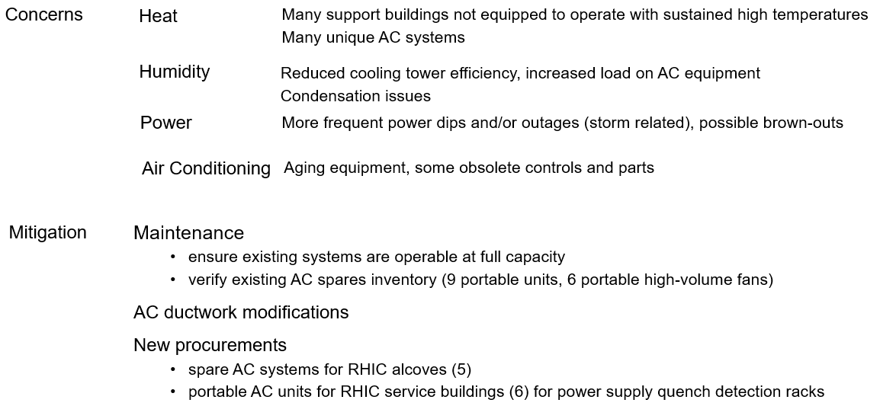
Reliability - operation during summer months
DOE 2023 RHIC S&T Review, M. Minty
Experiment readiness led to accelerator operations during the summer (Run-23 and Run-24).
Concerns and mitigation plans detailed in 2022 RHIC Science & Technology Review:
RHIC Run-23: accelerator availability impacted by air conditioning (AC) availability in building containing RHIC
main magnet power supplies.
RHIC Run-24: strengthened mitigation efforts (next slide), AC tech support, availability tracking efforts
RHIC Run-24 operations not held off by AC
RHIC Run-25: margin for error will be smaller – working to improve on mean time to repair.
M. Minty C-AD MAC-21 (16-18 Dec 2024)

Slide 11
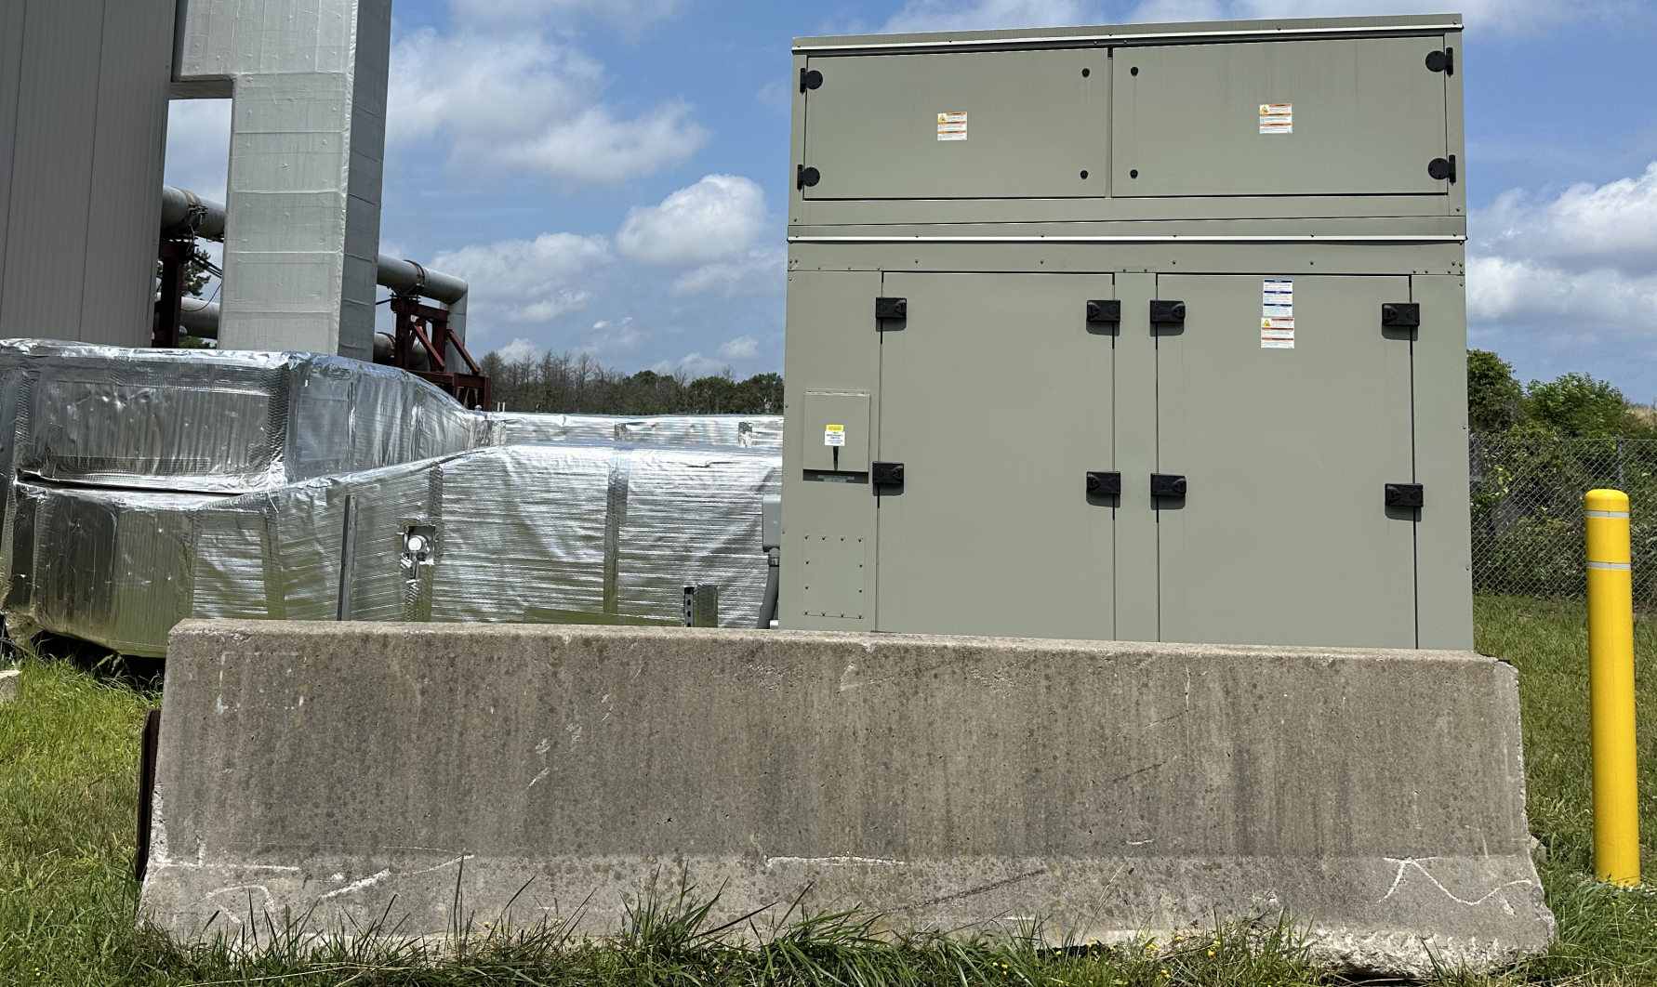
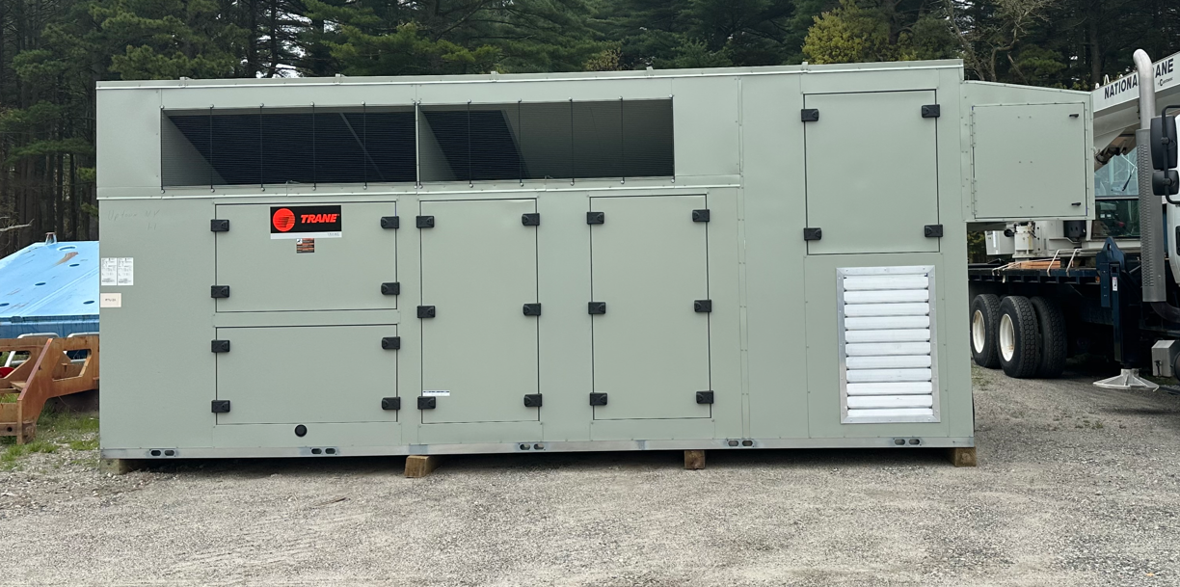
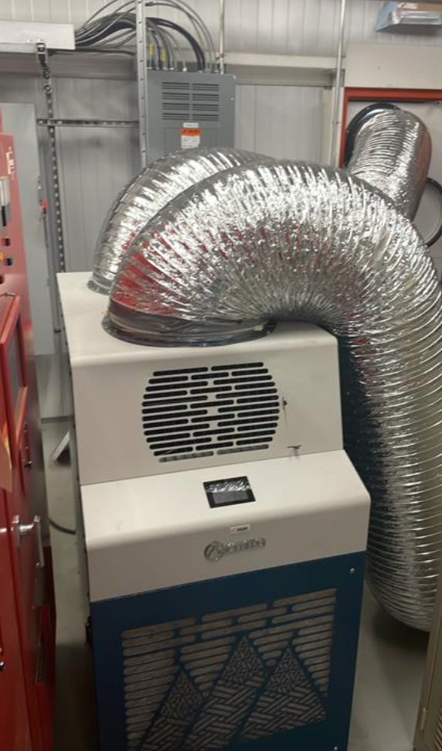
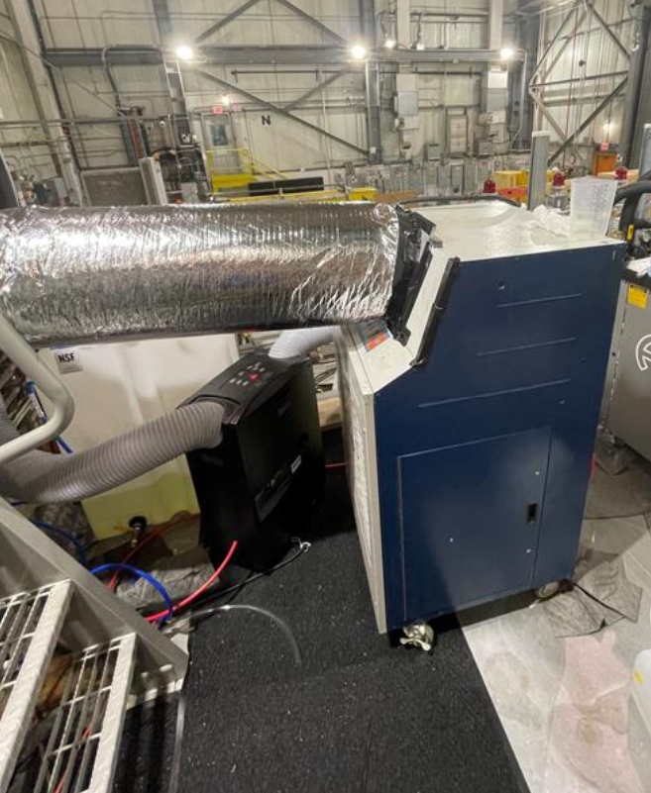
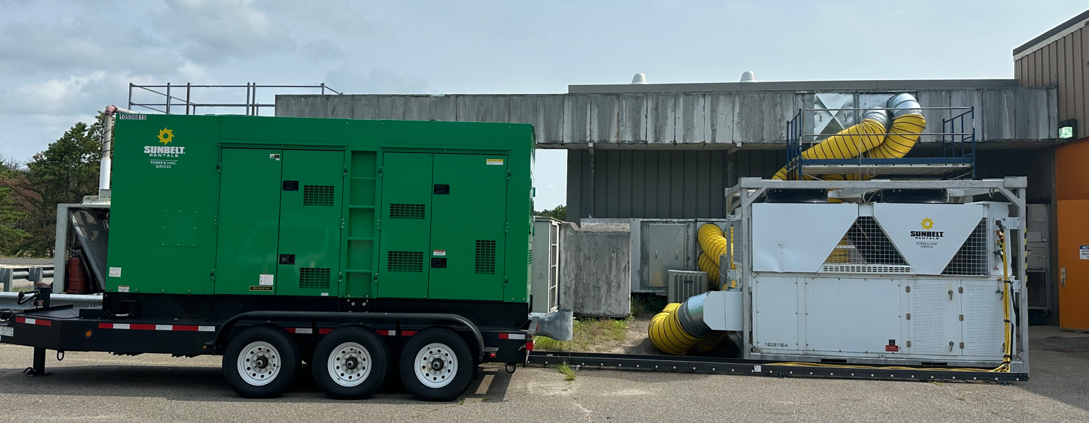
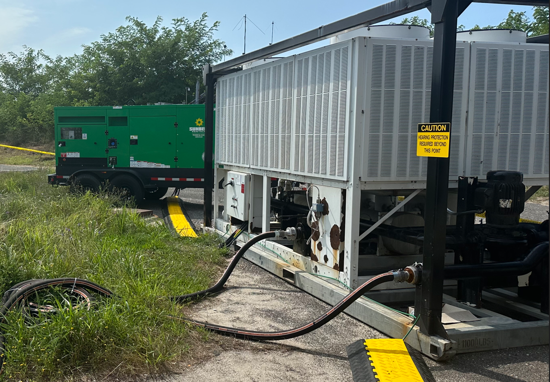
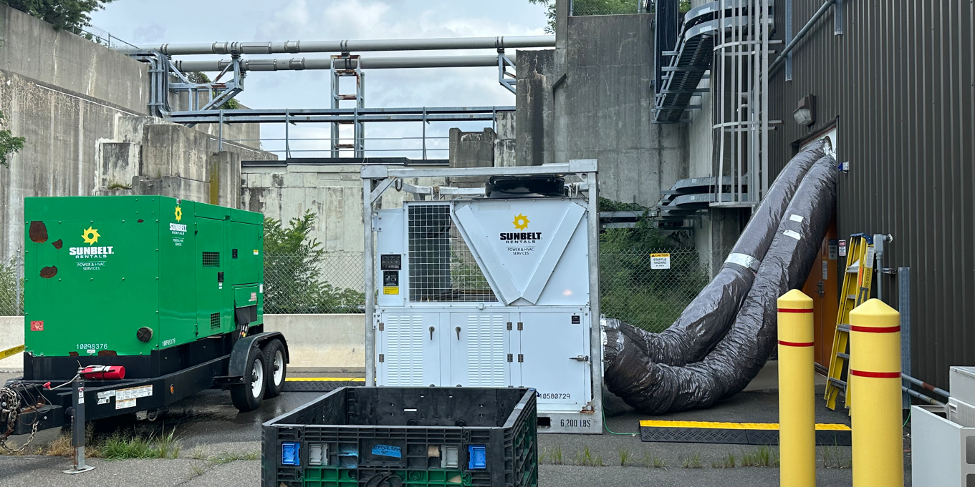
Recent and Future RHIC Run Air Conditioning System Repairs and Upgrades
D. Chan
Completed Repairs during RHIC Run
1000P - condenser Fan Replacement
1002A - Thermostat Failure
1006 - STAR Control Room – System Replaced
1008IR - Condenser Fan and Blade Replacement
1009A - Refrigerant Leak
1002D, 1002F, 1005E, 1007W, 1010A, 1010B - Bard Unit Failures
sPHENIX – Chiller Coil Replacement, Electrical grounding of IR Split Unit and sPHENIX – Gas Mixing House AC Unit
1012 – 50 ton package unit failure, split AC unit
1004A – split AC unit
1006 – 200 ton chiller
1004B – control room and
high bay AC units
1006 – rooftop chiller
Completed Replacements
E18, A18, B18, 1002 Bard Units
1006 Control Room
Upcoming RHIC Maintenance Replacements
1007W, 1005E – Bard Units
1004A – 75 Ton Package Unit
1004B – 50 Ton Package Unit
L18 – 12.5 Ton Package Unit
~ 15 alcove split AC units
RHIC Run 25/26 Preparation
Check existing spare parts inventory to replenish those used in Run-24
Procure contract to ensure availability of larger capacity AC systems with portable generators (May – Oct 2025)
1004B Replacement AC
1004B 2nd Unit
1004A Rental AC Unit
1008 AH Portable AC Unit
1004A Portable AC Unit
1012A Rental AC Unit
911 Rental Chiller
M. Minty C-AD MAC-21 (16-18 Dec 2024)

Slide 12
RHIC Availability
C. Naylor
Au+Au
100 GeV
p↑+p↑, Au+Au
100 GeV
74.4% FY23
80.4% FY24
85.2% 10-year average
RHIC Availability [%]
Time [Fiscal Year]
Availability = beam time / scheduled beam time
Availability goals: 82.5% (< FY20) , 85% (FY21-FY22), 82.5% (FY23), 80.0% (FY24)
RHIC Run FY24: 80.4%
Average over last 10 years: 85.2%
Availability primarily impacted by environmental factors (heat, humidity, storm-related issues) in Run 2023 and by summer storm-related issues in Run 2024.
Availability goal met in FY24.
M. Minty C-AD MAC-21 (16-18 Dec 2024)

Slide 13
Preparations for Run-25/26
M. Minty C-AD MAC-21 (16-18 Dec 2024)

Slide 14
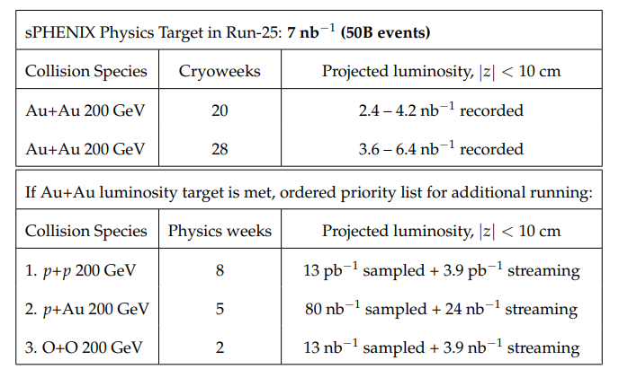
Beam User Requests (presented to NPP PAC, 7-8 Nov 2024)
sPHENIX
J.Haggerty “sPHENIX Summary and Run 25 Plan”
STAR
J.H. Lee “STAR Summary and Run 25 Plan”
Planning guidance for BURs: 20 or 28 week cryoweeks.
Plan to start RHIC Run-25/26 with Au+Au with 100 GeV beams.
NPP PAC will reconvene a few weeks after RHIC Run-25/26 start to further prioritize recommendations.
M. Minty C-AD MAC-21 (16-18 Dec 2024)

Slide 15
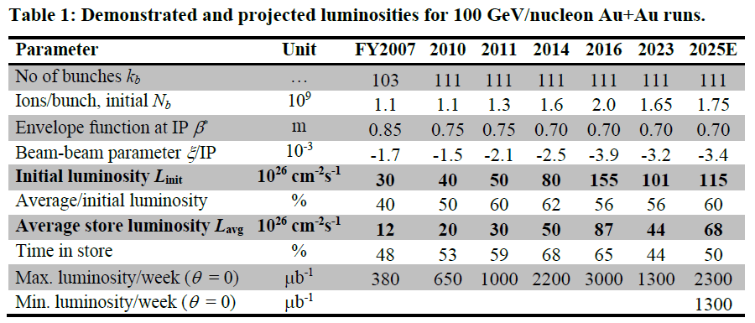
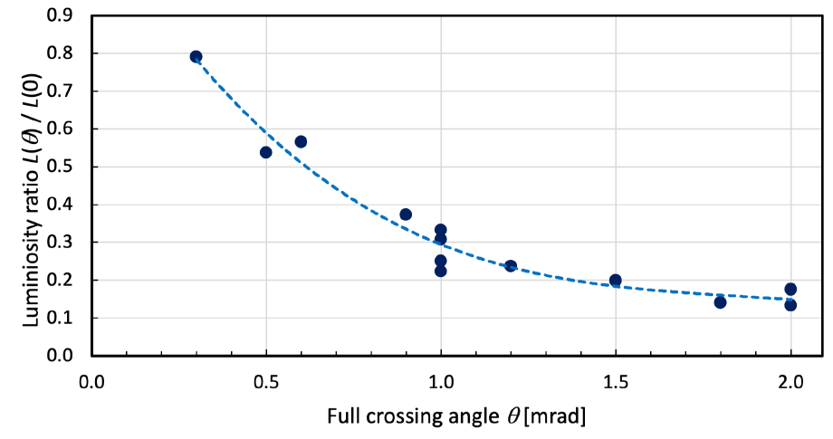
Run 25/26 with 20/28 weeks Au+Au at 100 GeV/n
Note: 2 cryo-weeks were already spent to extend Run-24
W. Fischer et al
RHIC Run start | 0.5 weeks | Final cooldown to 4K
Set-up mode | 2.0 weeks | RHIC re-commissioning and MVTX background studies
Ramp-up mode | 0.5 weeks | 8 hours/day for experiments
Data taking for physics | 14.5 / 22.5 weeks | 24/7 operation for sPHENIX and STAR
Controlled turn-off | 0.5 weeks | End of run after 18 / 26 weeks
Demonstrated and projected luminosities for 100 GeV/n Au+Au runs
Measured lumi ratio with crossing angle
Planning basis: 4K cooldown starting 24 Mar 2025.
M. Minty C-AD MAC-21 (16-18 Dec 2024)

Slide 16
Major Shutdown Activities Prior to Run – 25/26
P. Sampson
Ion Sources
RHIC
EBIS work for RHIC Run-25 with high-intensity Au
LION source installation
No major accelerator upgrades planned
Address sPHENIX “auto-recovery” events
Address higher He leak rate identified in Run-24
56 MHz cavity (commissioning in Run-24)
“Early removals” for EIC
LINAC
First full LINAC maintenance since 2019
Refurbish Bldg. 930 backup chiller; air handlers (continuing)
ARR* preparations
AGS Booster
Sitewide
Possible tower 7 Motor Control Center and Switchgear upgrade
Main Feeder MPO upgrades to continue
High tension wire pole replacement
Alternate feed upgrade
Temple Place upgrades
Vacuum valve replacement and bake
Gauge instrumentation replacements
911 chiller replacement (supplies Booster RF cavities)
LLRF upgrades (continuing)
ARR* preparations
AGS
ARR* preparations
Lighting and legacy cable removals
Cable tray / trench remediation (continuing)
*ARR = Accelerator Readiness Review
(DOE process to verify safe commissioning
and operation of accelerators)
Focus on EBIS preparation, sPHENIX “auto-recovery” events, ARRs, and early removals for the EIC.
M. Minty C-AD MAC-21 (16-18 Dec 2024)

Slide 17
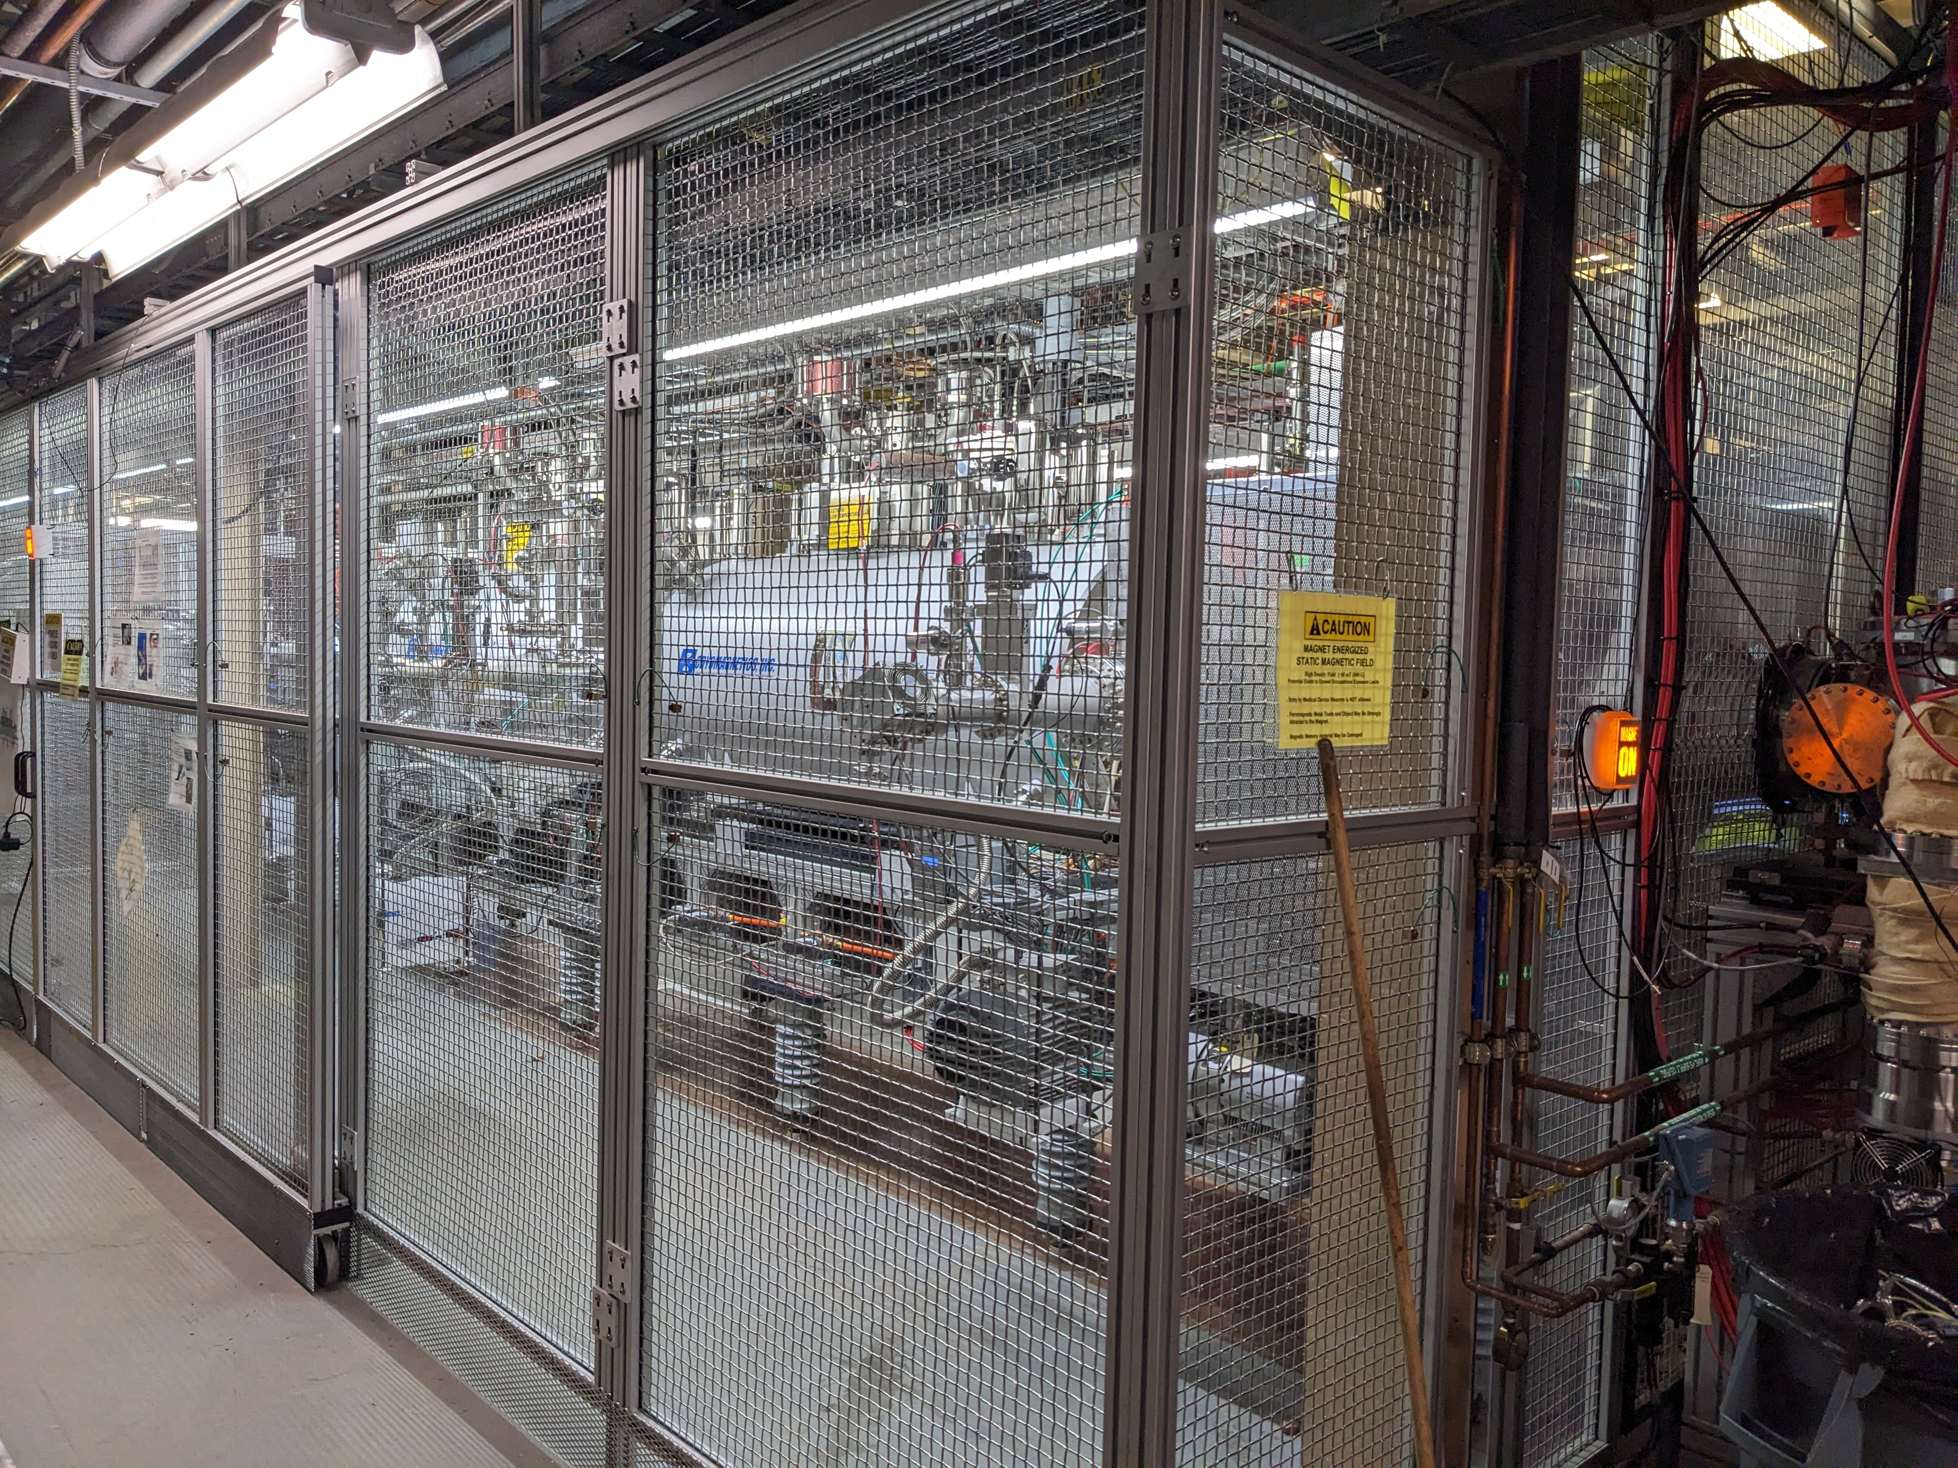
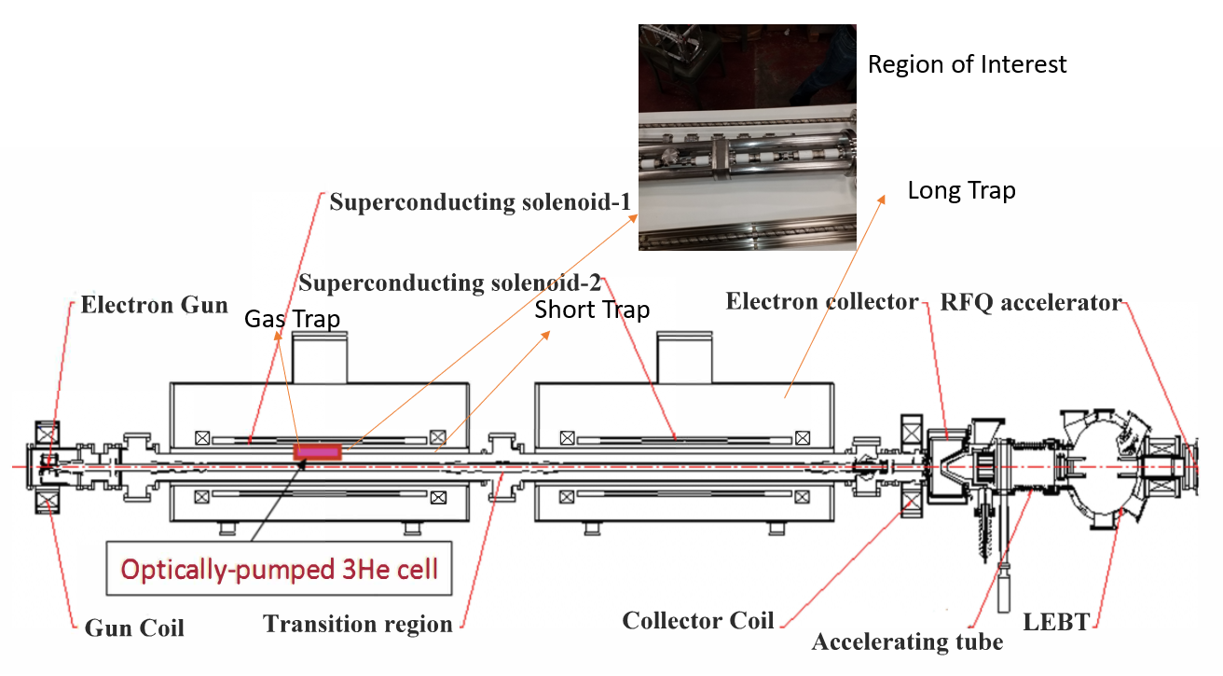
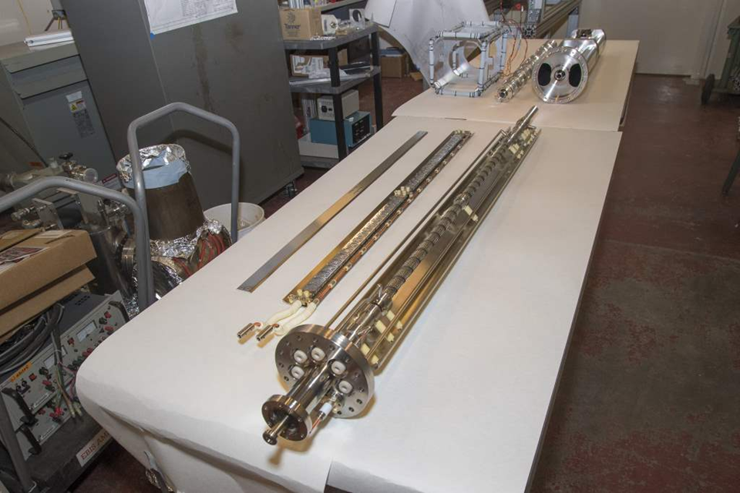
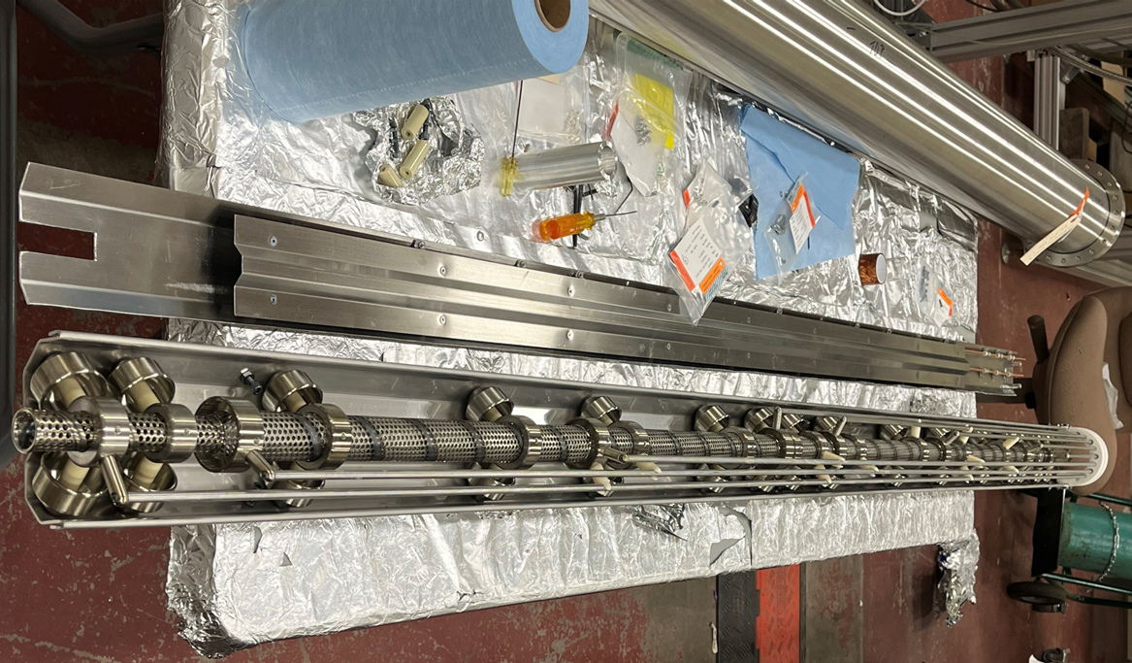
Extended EBIS
E. Beebe et al
Goals - improvements over EBIS
~ 40% more ion intensity
2 mA polarized ³He⁺⁺
better performance with noble gases (gas cell)
provision of ions from H to U
Status
operating for NSRL (since Apr 2023)
demonstrated all ion species (Jun 2023)
past issues for high rep-rate operation:
voltage breakdown
low cathode lifetime (new manufacturer)
cathode replaced (Nov 2024)
drift tube replacement underway
Extended EBIS key components
drift tube (DT4)
Unique gas cell and pump out manifold with a fast Lorentz gas pulse valve
custom linear NEG pumping units in short and long trap regions
See presentation by E. Beebe
M. Minty C-AD MAC-21 (16-18 Dec 2024)

Slide 18
RHIC Machine Protection System (MPS) - update
A. Drees et al
Motivation: protect sPHENIX and RHIC SC magnets
Issue: RHIC abort system thyratrons occasionally fire spontaneously and asynchronously cause ~10 bunches to miss the beam dump
Solution: added series mechanical relays (Run20) and compensated for added time delay of 6ms (~460 turns) via additional inputs to the existing RHIC MPS
Permit Input | Details | Status
BLM | Thresholds tightened | ✔️
BPM-MPS | 36+8 per ring Orbit changes | ✔️ Run20
CPS-BPS | All 18 alcoves equipped Powering failures | ✔️ Run21
sPHENIX | New magnets | ✔️ Run23
NQ-BPS | 143 power supplies Focusing failures | ✔️ Run-24
PHENIX MPC start of run
after Yellow pre-fire 05/11/15
after Yellow pre-fire 06/01/15
M. Purschke
No abort kicker pre-fire mishaps since installation of series relays.
All known failure modes addressed with new inputs.
18
M. Minty C-AD MAC-21 (16-18 Dec 2024)

Slide 19
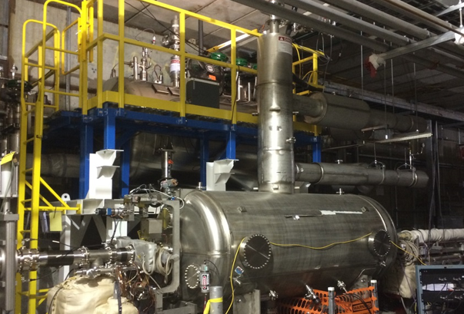
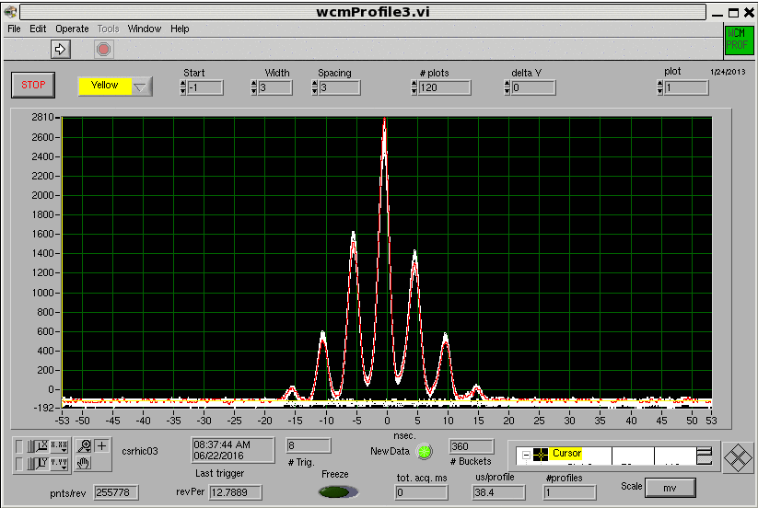
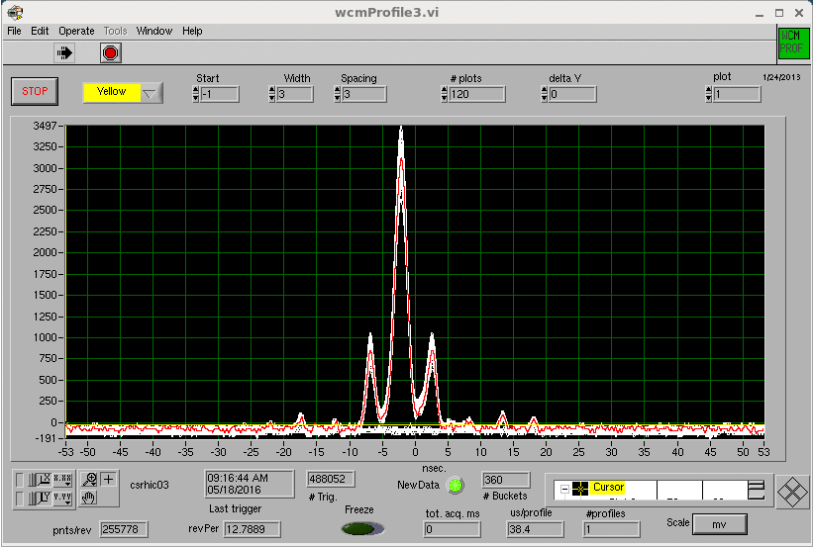
56 MHz cavity – effect on bunch distribution
M. Blaskiewicz, K. Smith, K. Mernick, S. Polizzo, F. Severino, Q. Wu, A. Zaltsman
Increases luminosity in the detector’s vertex
increases peak current in primary bunch and reduces current in satellite bunches
also enables smaller β* at the interaction point due to reduced hourglass effect
Run16 (d+Au): longitudinal distribution (wall current monitor)
~2800
~3500
cavity ON
0.95E9 ions/bunch
cavity OFF
1.36E9 ions/bunch
Peak current with 56 MHz SC cavity substantially higher even with lower bunch intensity
M. Minty C-AD MAC-21 (16-18 Dec 2024)

Slide 20
56 MHz cavity – effect on luminosity
Run16: >15% increase in luminosity in PHENIX (+/- 10 cm) vertex with the 56 MHz cavity
Qiong Wu et al
PHENIX 10cm / ZDC
56 MHz Cavity Voltage (kV)
Time (seconds after lumi-event)
< Run24 - 56 MHz cavity HOM coupler modified
Run24 - cavity reinstalled and commissioned up to 1.3E9 Au ions/bunch (limited by charge from
pre-injectors), ~1.8E9 desired for Run25
- spectrum of HOMs found to be different and possibly insurmountable
Run25 - HOM spectrum to be reevaluated, cavity detuning allows for transparency
Note: luminosity projections (slide 15) do not include potential benefits from the 56 MHz cavity
M. Minty C-AD MAC-21 (16-18 Dec 2024)

Slide 21
Other Beam Time Requests
M. Minty C-AD MAC-21 (16-18 Dec 2024)

Slide 22
Beam Time Requests (beyond Au+Au)
Proposed Activity | Duration | Relevance / Comment
APEX for EIC | up to 2 weeks | needed to inform EIC design
p+Au | 5 weeks minimum | high priority per past PACs, cancelled in 2024 due to funding constraints
FXT at STAR | 3 weeks | 3 energies, 3 species, 3 targets (reference STAR BUR)
CeC | 2-3 weeks | advancements in accelerator science
Note: RHIC Accelerator Safety Envelope (ASE), documenting verifiable bounding conditions, physical and administrative requirements, and credited controls to ensure safe operation and addressing accelerator-specific hazards, expires 31 Dec 2025
M. Minty C-AD MAC-21 (16-18 Dec 2024)

Slide 23
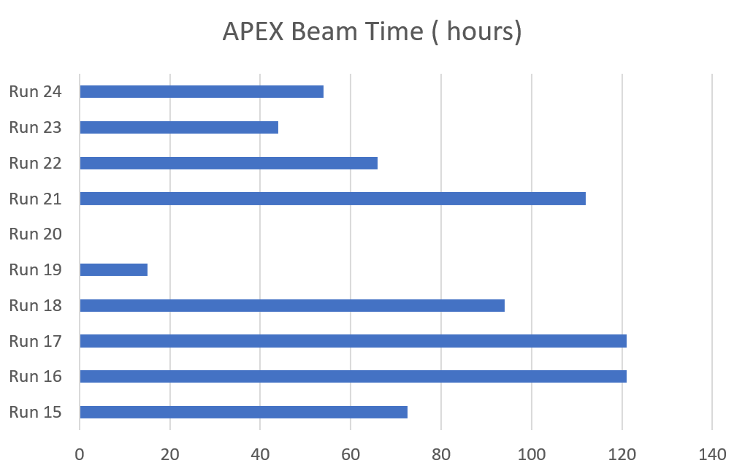
Accelerator Physics Experiments (APEX) - Overview
RHIC Retreat, Nov 2024 - M. Minty
APEX coordinators:
H. Huang (C-AD) and Y. Luo (EIC)
APEX Beam Time (hours)
experiments to inform EIC design
experiments to inform EIC design and beam cooling studies
focus: beam cooling studies
(minimal APEX during BES-II and pandemic)
APEX workshop held March 2024 https://indico.bnl.gov/event/22322/. Featured:
comprehensive list of EIC-related APEX requests for 2024/2025 (next slide)
detailed plans for experiments
M. Minty C-AD MAC-21 (16-18 Dec 2024)

Slide 24
APEX 2024/2025 Objectives
F. Willeke, BNL – EIC
APEX workshop (Mar 2024)
Topic | #Studies | requested Hours | Relevance for EIC
Collective Effects | 2 | 14 | confirm vacuum design
Flat Beam | 3 | 84 | Feasibility flat beam
Instrumentation | 3 | 14 | Confirm concepts & designs
Dynamic Aperture | 2 | 6 | Confirm simulations
Transition Crossing | 3 | 24 | Ensure concept
Hadron Polarization | 4 | 46 | Confirm simulation and design
Beam* Cooling | 9 | 133 | Confirm cooling feasibility, simulation and design
Beam Optics | 2 | 18 | Backup simulations
Radial Shift | 1 | 32 | Confirm feasibility of large beam radial offset in HSR
*coherent electron cooling, electron cooling, and stochastic cooling
Total of 29 studies, 371 hours @ 46.4 shifts, 15.5 days, 2.2 cryo weeks
M. Minty C-AD MAC-21 (16-18 Dec 2024)

Slide 25
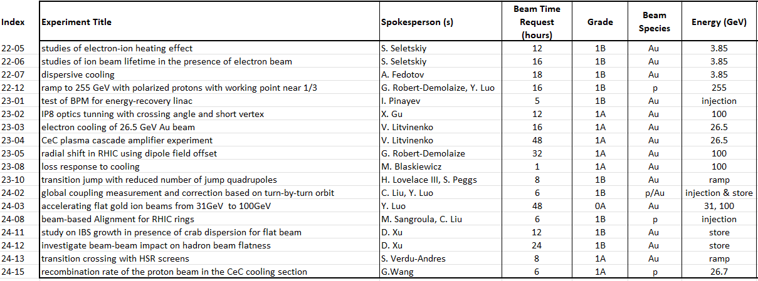
APEX 2024/2025
Y. Luo, H. Huang
Run-24 APEX requests 123 hours (p), 56 hours (Au)
Run-24 APEX experiments performed 87 hours (p), 0 hours (Au)
Run-25 APEX requests (to date) 294 hours
The request for APEX beamtime exceeds planned allocations.
Run-25/26 APEX workshop planned in January 2025.
M. Minty C-AD MAC-21 (16-18 Dec 2024)
Notes:
20 – 2 = 18 cryoweeks → 9 APEX sessions (128 hours) ← deficit 166 hours: 21 shifts or 1 week (with requests to date)
28 – 2 = 26 cryoweeks → 12 APEX sessions (192 hours) ← deficit 102 hours: 13 shifts or 4.5 days (with requests to date)

Slide 26
Summary
M. Minty C-AD MAC-21 (16-18 Dec 2024)

Slide 27
Summary
RHIC performance in RHIC Run-24: p↑+p↑ (24 weeks) and Au+Au (3 weeks) both at √s_{NN} ~200 GeV
Total of 27 cryo-weeks: 19 weeks + 6 week carryover from RHIC Run-23 + additional 2 weeks to be charged to RHIC Run-25.
Prior to RHIC Run-24, all repairs (valve box and splice failures, DX magnet replacement) and re-installation of Siberian snake magnet were completed successfully.
Accelerator operations for both p↑+p↑ and Au+Au evolved differently than expected; provided a wide variety of RHIC beam conditions for sPHENIX commissioning and for physics at STAR
Achieved p↑+p↑ run goals for sPHENIX and STAR
Achieved Au+Au run goal for STAR but not for sPHENIX due to emergent issue with MVTX auto-recovery events.
Accelerator availability: fiscal year (p↑+p↑ run) met 80% target, operation during summer months (environmental controls) very successful yet impacted by storm-related power interruptions; 10-year average is 85.2%.
Planning for Run-25: Au+Au at √s_{NN} ~200 GeV with other operating modes TBD and dependent on budget
Emergent issue with sPHENIX MVTX detector “auto-recovery events” a major concern, accelerator-based potential mitigation efforts under evaluation (next two presentations).
Shutdown activities include EBIS preparation (Tandem as back-up), sPHENIX background mitigation, ARRs, early removals for EIC and preventative maintenance.
Have multiple other beamtime requests prior to end of RHIC-era, possible operation in CY26 contingent on ASE extension/revision.
The NPP PAC plans to reconvene a few weeks after RHIC Run-25 start to provide further recommendations.
M. Minty C-AD MAC-21 (16-18 Dec 2024)

Slide 28
Supplementary Slides
M. Minty C-AD MAC-21 (16-18 Dec 2024)

Slide 29
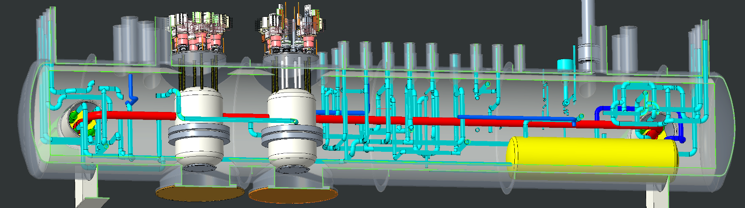
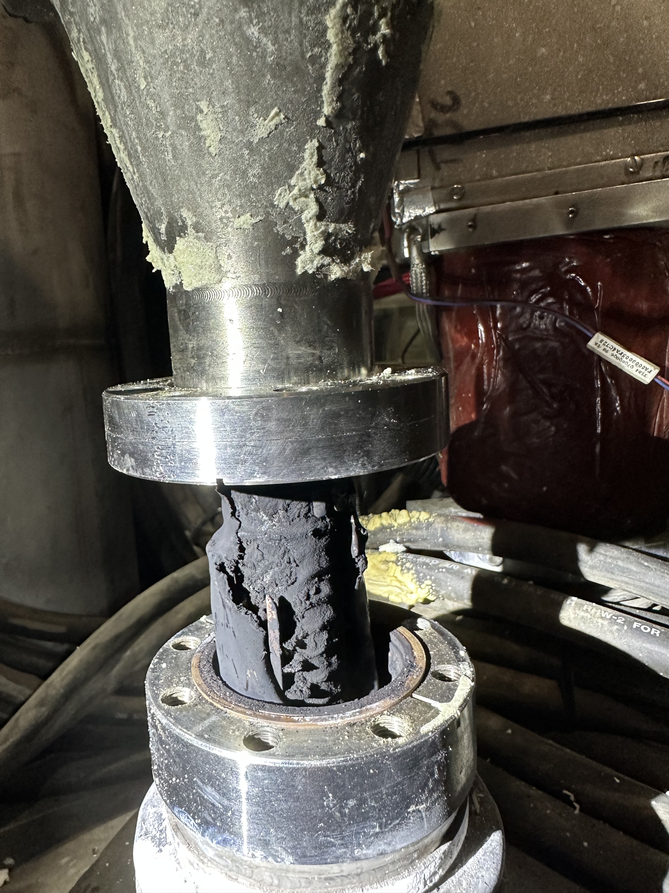
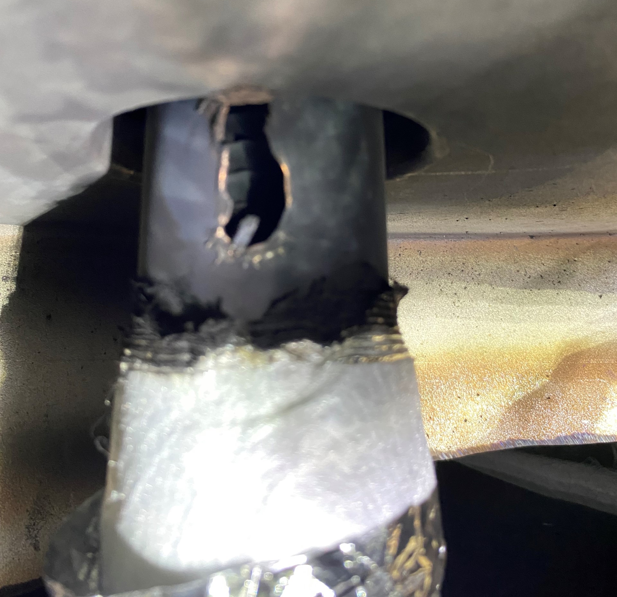
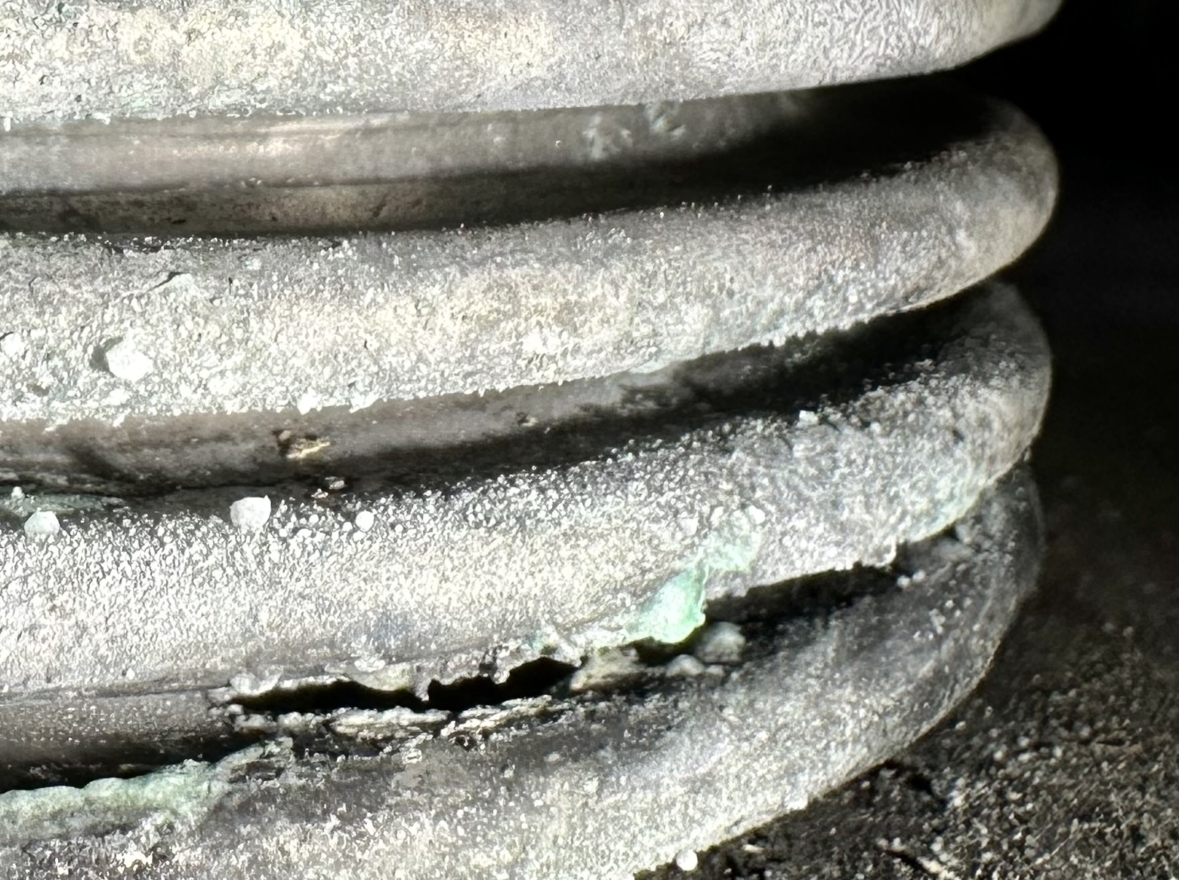
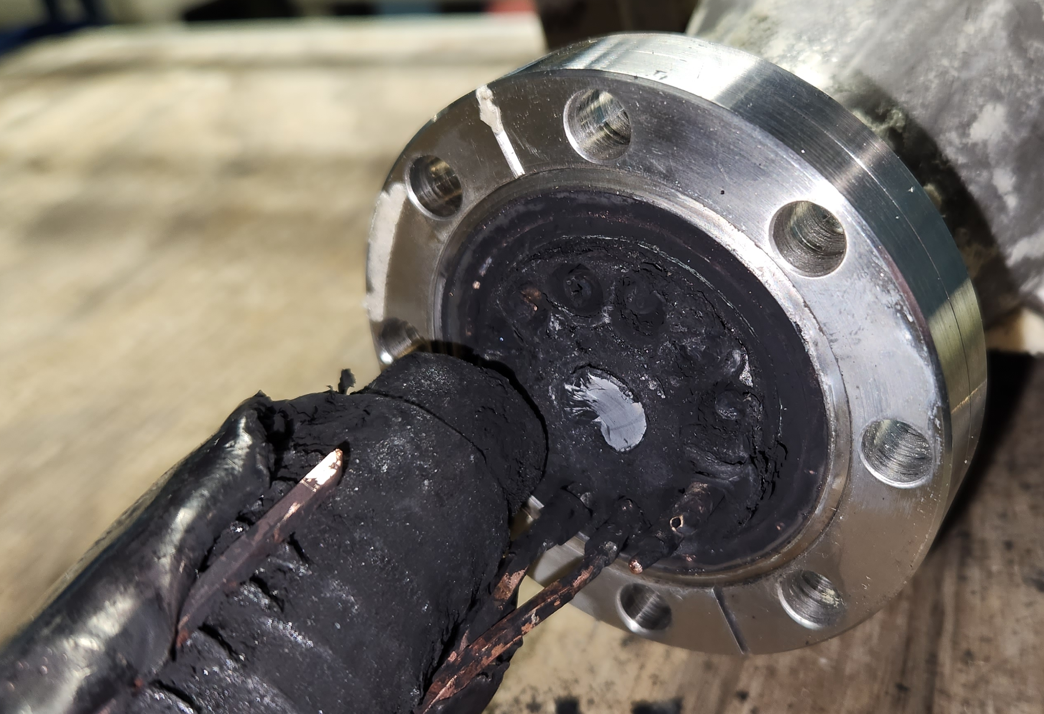
RHIC Run-24 repair work
R. Feder, C. Mi,
J. Escallier et al
Failure of a magnet power supply 150A current lead in 1004B blue valve box (Aug 2023)
External review of causal analysis and engineering solutions (Nov 2023) https://indico.bnl.gov/event/20923/
The damaged components were here
Repaired: current lead
1004B Blue Valve Box
Repaired: current lead
Repaired: Ruptured pipe
Repaired: Ruptured bellows
External review committee concurred with diagnoses and plans for repairs.
M. Minty DOE 2024 RHIC Science & Technology Review

Slide 30
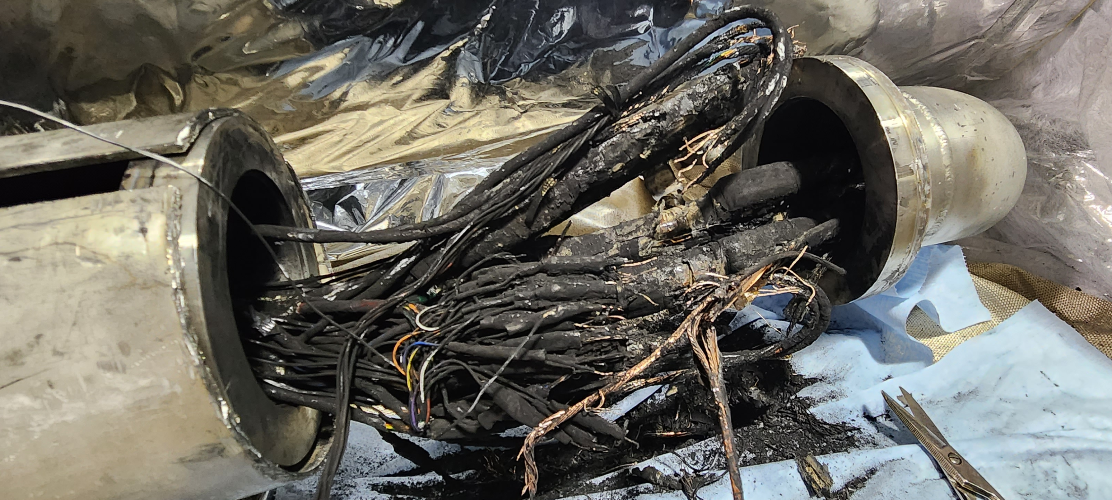
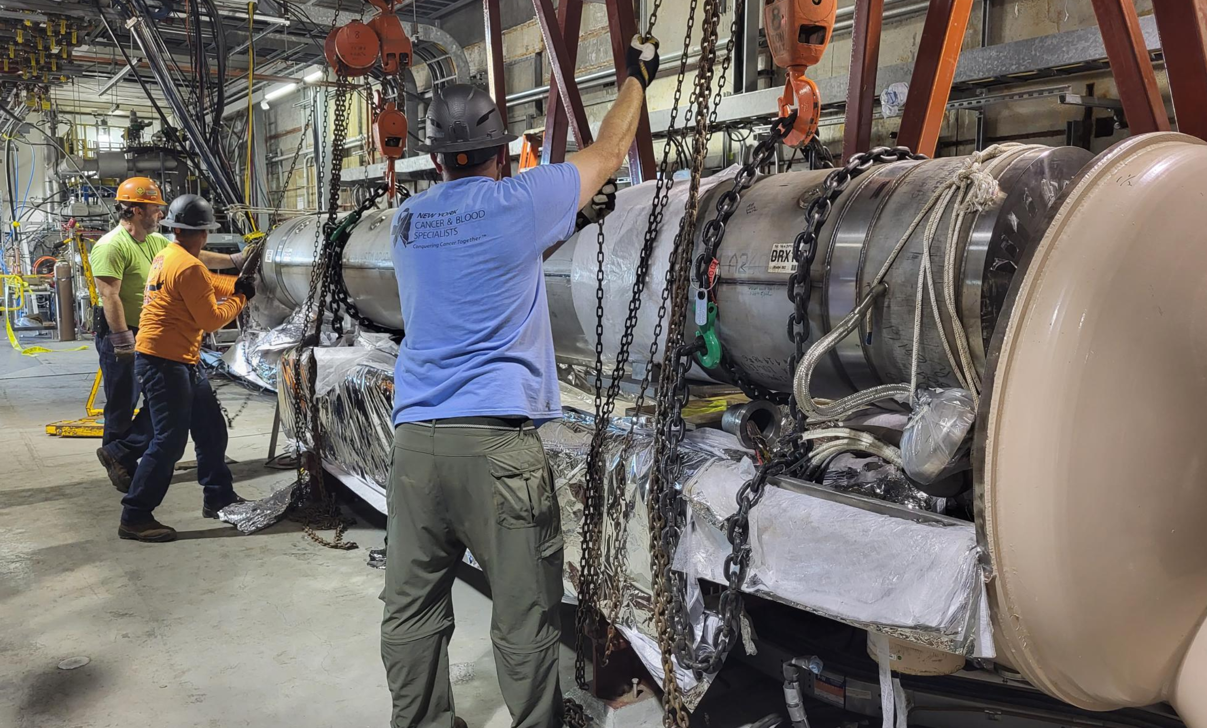
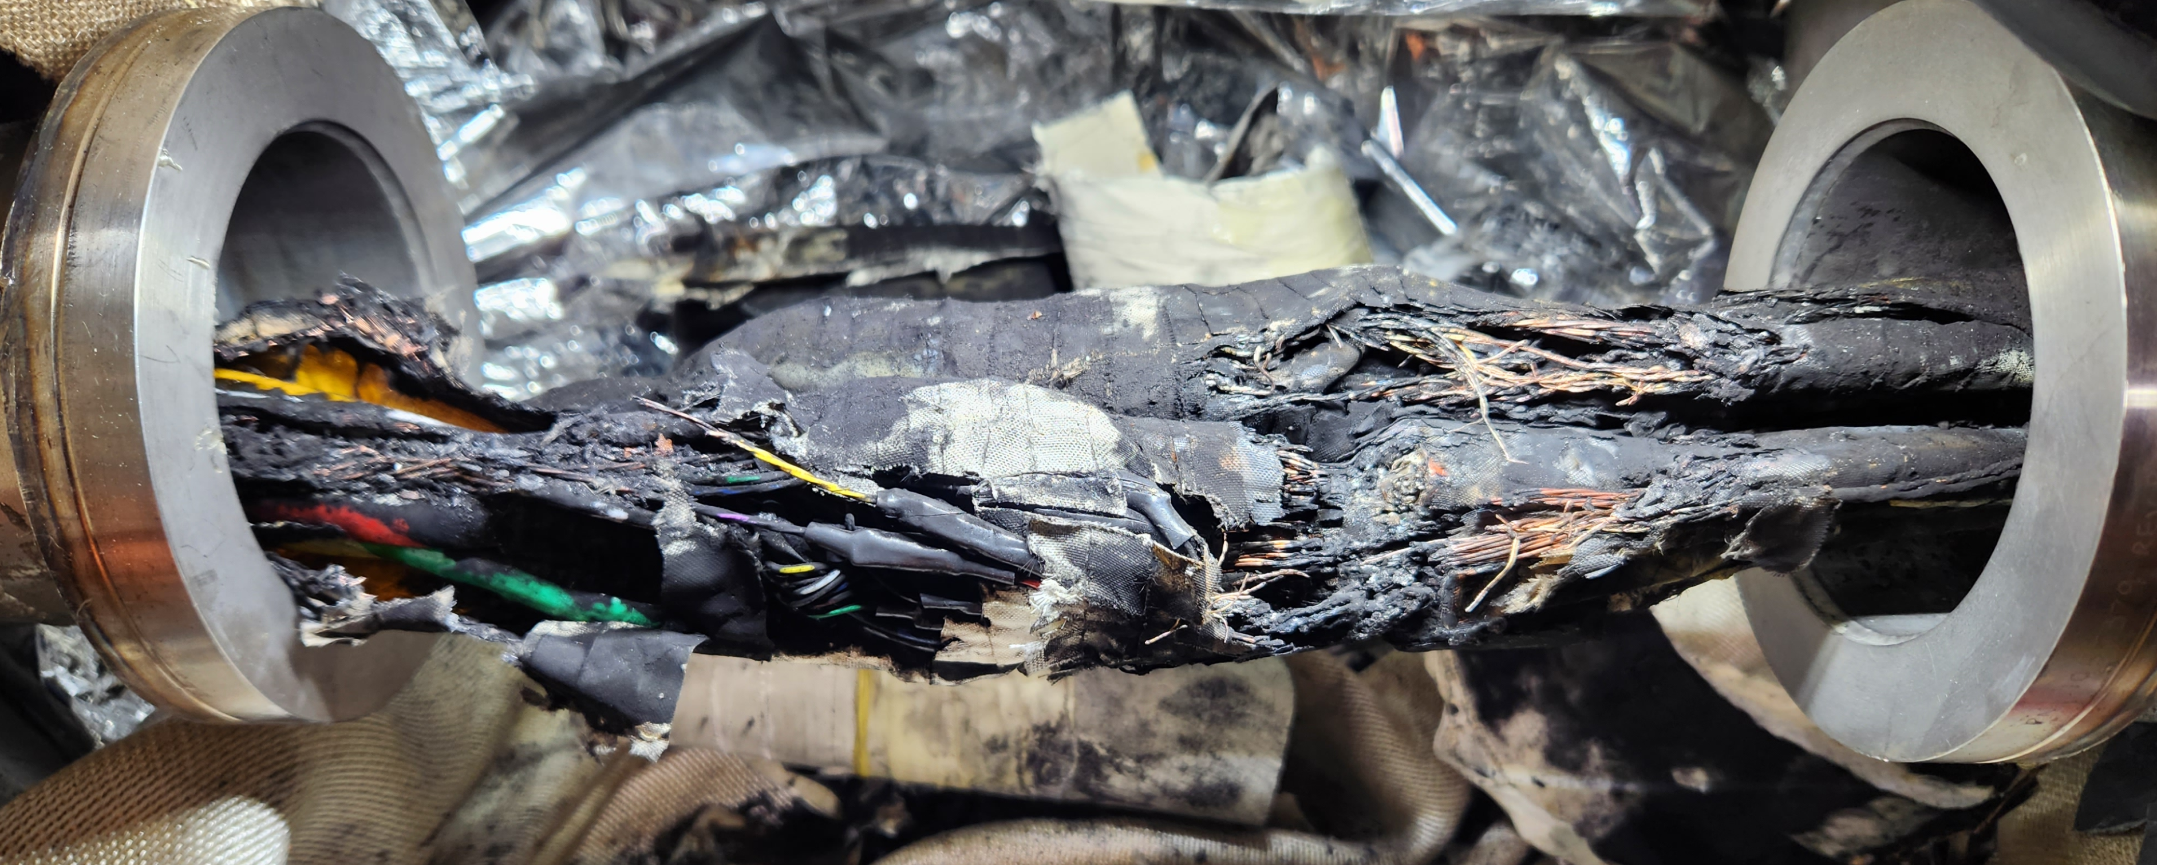
Downstream damage found at 4:00 cable splice joints and in the DX magnet, and later at the B3Q8 diode
8-month recovery effort involving more than 40 people across many disciplines and departments.
C. Mi, R. Feder, et al
Repaired: SC splice joint at can #2
Repaired: sector 4 DX magnet
Repaired: SC splice joint at can #3
All repairs completed, RHIC ASE and USI (additional ODH controls) updated, all systems operating as expected.
M. Minty DOE 2024 RHIC Science & Technology Review

Slide 31
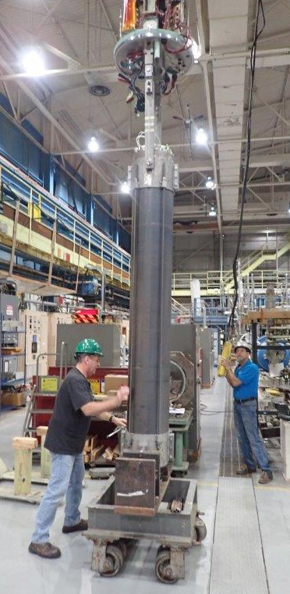
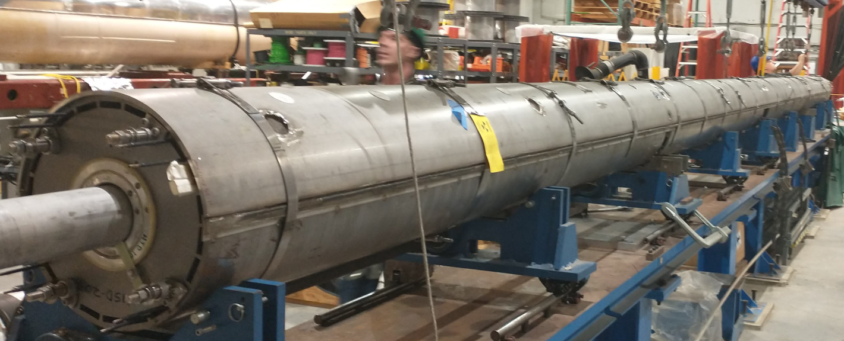
RHIC Blue Snake Magnet
C. Atanasio, M. Hartsough, M. Milidantri et al
Two Snake magnets damaged during Run-22 (13 Dec 2021, 12 Dec 2021).
With strong support of SC Magnet Division, repair completed Jul 2023.
Installed for RHIC Run-24.
Installed prior to Run-24, magnet fully functional and working as expected.
M. Minty DOE 2024 RHIC Science & Technology Review

