Slide 1
Collider-Accelerator Department Machine Advisory Committee
Wolfram Fischer Deputy Associate Laboratory Director for Accelerators, NPP Chair, C-AD
C-AD Machine Advisory Committee
16 December 2024
Notes:
15 min => 10 slides

Slide 2
Committee Members (4-year terms)
Sasha Valishev, FNAL (2025) – Chair
Richard Scrivens, CERN (2025)
Andreas Lehrach, RWTH Aachen (2025)
Uli Wienands, ANL (2025)
Yoichi Sato, J-PARC/KEK (2026)
Ralph Assmann, GSI (2027)

Slide 3
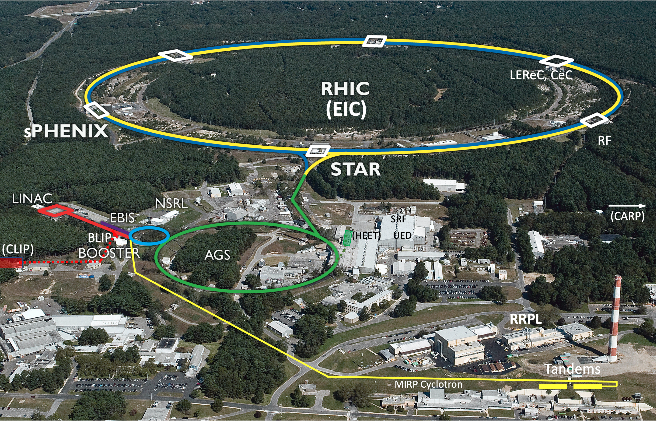
Collider-Accelerator Department facilities
Uniquely flexible and only hadron collider in US for exploration of QCD phase diagram and proton spin
Injectors also used for application programs: - Linac/BLIP for isotope production - Booster/NSRL for space radiation studies
- Tandem for industrial/academic users
R&D for future facilities and application sources, cooling, pol. beams, …

Slide 4
Collider-Accelerator Department
Mission: Design, develop, commission and operate state-of-the-art accelerators to carry out accelerator-based experiments in an environmentally responsible and safe manner. Perform accelerator R&D towards the next generation of accelerator facilities and accelerator applications in support of national needs.
FY2022 → 2023 → 2024 402 → 409 → 390 heads, 398 → 411 → 415* FTE (* Changed method to calculate FTE - now FTE number larger with new method.)
Significant legacy infrastructure issues (AGS started operation in 1960) are being addressed through continuous renovation and replacement of obsolete equipment.

Slide 5
C-AD focus areas
Preparation for final Run-25: Au+Au at 100/nucleon GeV beam energy other modes under consideration: p↑+p↑, p↑+A, O+O, FXT in STAR, APEX for EIC, CeC
Transition to EIC
Workforce transition
Accelerator Readiness Reviews
Removal and Repurposing project
Support for growing Isotope Program, and NSRL
Electronics test facility proposal HEET
R&D

Slide 6
Accelerator Safety, Readiness Reviews
Major effort for department
All legacy accelerators must undergo Accelerator Readiness Reviews
ARR Tandem Nov 2022 – done
ARR AP Hot Cell (IP) Dec 2022 – done
USI sPHENIX sc magnet (IRR w/ external) Mar 2023 – done
ASE Change for RHIC (ODH) Feb 2024 – done
ARR IP Cyclotron (IP) Feb 2024 – done
USI sPHENIX isobutene use July 2024 – done
Large Vertical Test Facility (LVTF) Dec 2024 (Safety Analysis complete, no BHSO approval needed)
ARR ATF (DT Directorate, C-AD assisting) Mar 2025
RHIC decommissioning Sep 2025 (authorization basis docs approved by BHSO)
ARR Linac+Booster Apr 2026
ARR RF Test Facility 2 (new) Sep 2026 (needed with DOE O420.2D, electrons >10 MeV)
ARR RF Test Facility 1 (ERL cave) Mar 2027 (needed with DOE O420.2D, electrons >10 MeV)
ARR AGS Oct 2027
… then need to get ready for EIC ARRs.
Notes:
SVTF will be hard-wired to <10 MeV.

Slide 7
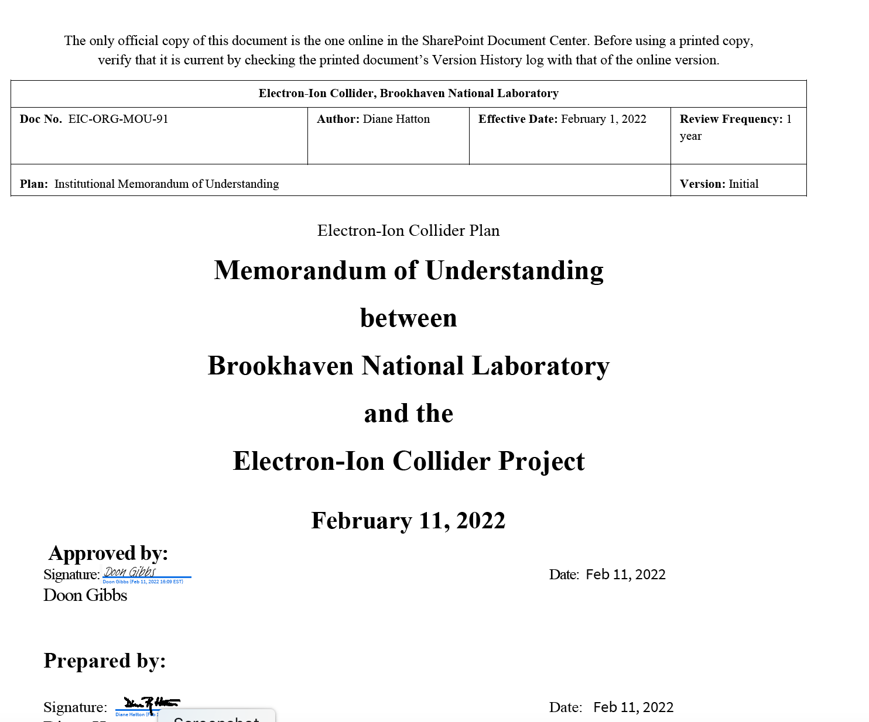
C-AD and EIC
EIC Project has staff at BNL and JLab EIC Directorate at BNL separate from NPP
C-AD staff use for EIC in 3 forms:
Staff transfer
Matrixed staff with individual or group MOUs (>20%, ~70 people)
FY2021 – 17 FTE in C-AD on EIC
FY2022 – 15 FTE in C-AD on EIC
FY2023 – 26 FTE in C-AD on EIC
FY2024 – 33 FTE in C-AD on EIC
also have reversed MOU
EIC project scope and EIC portfolio element execution in C-AD with C-AD staff
C-AD MAC does not review EIC project topics

Slide 8
R&D topics
Run-25
Beam cooling (multiple)
Source development (multiple)
Polarization
Machine Learning
MAC-21 Michiko Minty, Kiel Hock, Angelika Dress
MAC-21 Yichao Jing, Sergei Seletskiy
MAC-21 Ed Beebe
MAC-21 Vincent Schoefer
MAC-21 Georg Hoffstaetter

Slide 9
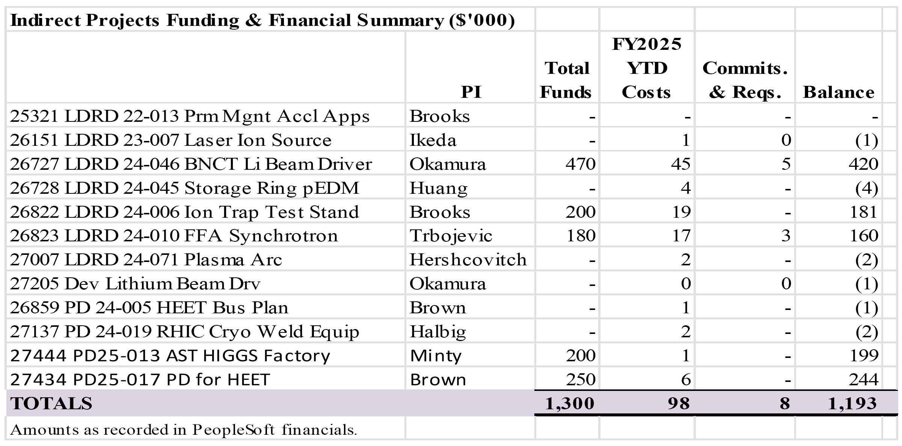
R&D topics – recent and present LDRD
MAC-21
MAC-21
MAC-21

Slide 10
Recommendations from MAC-20

Slide 11
MAC-20 recommendation responses
R1 (Overview): => Rob Michnoff Develop technical and resource plans for continuing to run AGS after completion of RHIC physics runs.
R2 (RHIC performance and repair status): => Rob Michnoff Plan a long-term program of inspections and/or repairs relevant to the failure mode realized in the 1004B valve box incident, aiming to prevent recurrence in the EIC era operation.
R3 (p+p luminosity maximization for sPHENIX): => Kiel Hock Prioritize the modeling of beta*=50cm (and intermediate) optics aiming at achieving the desirable dynamical aperture before Run-24.
R4 (Injector upgrade plans for EIC): => Rob Michnoff Booster PS replacement will be beneficial for increasing performance and reliability of running in the EIC era. Attempts should be made to allocate funding for this item, following the refrigerator upgrade efforts. Schedule the replacement of the booster main magnet power supply carefully, including off-line commissioning before beam operation.
R5 (EBIS status and performance ramp-up plan): => Ed Beebe 1) For the issue of discharges observed in the short trap, consider a dedicated conditioning test under consistent conditions, of the order of half a day, to clarify if the discharges can be conditioned or not, and to understand the “decay time” of this discharge. 2) Make sure the polarized cell integration is ready for installation into the EBIS for a likely installation date at the end of 2024, and that commissioning time for polarized 3He from in the EBIS is allocated.
R6 (Polarization increase in AGS with skew quads – update): => Vincent Schoefer 1) After applying the overall scaling of the correction, polarization measurements should be performed at several intermediate energy steps where the largest polarization losses are expected. In addition, horizontal spin resonance driving terms should be measured at these intermediate energies. 2) Study remaining sources of depolarization by weaker higher order snake resonances or weak hybrid resonances.

Slide 12
MAC-20 recommendation responses
R7 (ML for beam polarization increase (FOA)): => Georg Hoffstaetter Include at least the first-order effect of field overlap between nearby magnets (change in effective magnet field length) in the model.
R8 (ML for luminosity maximization (FOA)): => Georg Hoffstaetter Pay more attention to the results of the optimization runs in order to gain insight of the process as well as better characterize the system being optimized (sPHENIX luminosity, or EBIS as the case may be).
R9 (High-current LION (FOA)): => Masahiro Okamura The LIS technology initiative must be maintained at BNL. Report further achievements in 2024.
R10 (Laser Ion Source (LDRD 23-007)): => Masahiro Okamura Further contacts with potential users of the neutrons to better understand the future requirements.
R11 (Photocathode development (ECA FOA)): => here Review parallel efforts on photocathode production to cross-disseminate lessons learned and maximize community’s success towards establishing photocathode production for EIC and beyond.
R12 (Permanent magnet applications (LDRD 22-013)): => Stephen Brooks Working with collaborators, a) develop practically realistic procedures for tuning long magnets, taking into account the need to integrate magnets with vacuum chambers, while maximizing vertical aperture for the beam; b) Develop practical methods for integrating vacuum chambers into long magnets, possibly taking into account NSLS-II upgrade design efforts.
R13 (Ring cooler feasibility study for EIC): => Sergei Seletskiy The Dept. and the study group are encouraged to assess and provide the effort needed to determine the required design details in line with the EIC project needs.

Slide 13
R20.11 (Photocathode development (ECA FOA))
Review parallel efforts on photocathode production to cross-disseminate lessons learned and maximize community’s success towards establishing photocathode production for EIC and beyond.
Photocathode material development:
Epitaxial growth of alkali antimonide photocathodes with low roughness (< 1nm) and high quantum efficiency (8%~9% at 532 nm) are developed as high intensity electron source for EIC hadron cooling. (ECA FOA)
BNL/ODU/JLab collaboration(FOA) developed Distributed Bragg Reflector Superlattice GaAs(DBR-SL-GaAs) photocathode by MOCVD (QE=2.3%, ESP=90%). Cathode was tested in the polarized gun and generated 11 nC bunch charge, 30 uA average current and highly polarized beam.
BNL/Sandia collaboration developed DBR-SL-GaAs photocathode by MBE (QE=15%, ESP=75%). 7 samples shipped to BNL and tested in the CAD/EIC Mott polarimeter.
BNL/SMI (SBIR) collaboration produced 3 DBR-SL-GaAs samples (QE ~6%, ESP=65%) and tested in the CAD/EIC Mott polarimeter.
SL-GaAs coated with monolayer graphene shows up to 90% polarization, and QE up to 0.3%
There is ongoing effort at BNL (HEP and ARDAP projects) in engineering of III-Nitride photocathodes for spin polarized electron beams.
Photocathode production for RHIC operation:
Cooling gun R&D in CAD: Sequentially grown alkali antimonide photocathodes are produced for RHIC beam cooling operations since 2018. 8~10 cathodes are grown for each production cycle and transported to the RHIC tunnel in UHV transport systems. The storage and transportation of the cathodes presents minimal degradation of cathode QE.
CeC-X: Both alkali antimonide and CsTe coated GaAs photocathodes are tested in the CeC gun.
Photocathode production for EIC hadron cooling:
Epitaxial K₂CsSb photocathodes will be produced on 4H-SiC wafers, mounted on cathode assembly designed to accommodate the wafers.
Cathode production is upgraded from the existing procedure and practice for current RHIC operation, allowing similar transportation scheme to be adapted for EIC.

Slide 14
R20.11 (Photocathode development (ECA FOA))
Synergies:
For the polarized source (SL-GaAs) – Erdong Wang
Efforts (FOA, SBIR) aim to bring the supply chain back to US for stable supply for EIC
Developing potential vendors, may have one reliable vendor at the end.
All these labs sample were tested at CAD/EIC Mott polarimeter for verifying the quality.
Sample structures are well documented, published and shared with each lab.
One Gr-GaAs R&D topic is increase of cathode lifetime for very long continuous operation to save using the wafers.
Multialkali photocathodes – Mengjia Gaowei
Multialkali photocathode development is for EIC hadron cooling
Production part is added to specifically address "towards establishing photocathode production for EIC" in the recommendation
Practices for LEREC and CeC cathodes provide great experience (procedure, apparatus, work force) for EIC cathode production.

Slide 15
MAC-21

Slide 16
MAC-21 Charge
After 24 years of RHIC operation, the Collider-Accelerator Department (C-AD) is preparing for the final RHIC Run with the new sPHENIX and the upgraded STAR detectors in FY 2025 (ending 30 Sep 2025), with a possible extension into FY 2026. After completion of the RHIC physics programs, C-AD will assume responsibility for removal of equipment not needed for the EIC from the RHIC tunnel and experimental halls, will maintain the hadron accelerator complex in a ready state and will continue R&D in accelerator science and technology.
During this year’s MAC we request the committee’s review and advice on (i) the operation with sPHENIX and STAR in the final Run-25, (ii) the plans for maintaining and upgrading the hadron injector complex over the next decade for EIC, and (iii) the presented R&D efforts.
For items (i) and (ii), please address the following charge questions:
Are the technical goals realistic to meet the stated goals?
Are there any technical issues that were missed or need additional attention?
For item (iii), please address, in addition, the following charge question:
Is the accelerator R&D effort well executed, and future work well planned?
Any other comments on the C-AD accelerator operation and R&D are welcome.
It is requested that a concise report responsive to this charge be forwarded to the C-AD Chair, Wolfram Fischer, by 3 January 2025.

