Slide 1
sPHENIX MVTX experimental background task force
A. Drees for the task force team
RHIC MAC meeting Dec 16th 2024

Slide 2
Outline
The inner IR configuration
The task force
  Momentum collimation/warm dispersion bump
  FLUKA simulations of break-up and detector interaction
  Geant simulation
  Effects of non-linear magnetic fields
  Additional monitoring
  tracking
Summary

Slide 3
Inner IR8 configuration

Slide 4
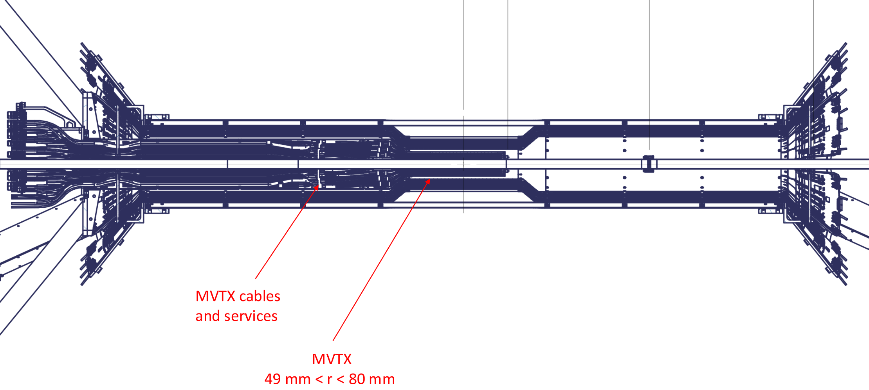
Asymmetric Detector Setup
South (Blue)
North (Yellow)

Slide 5
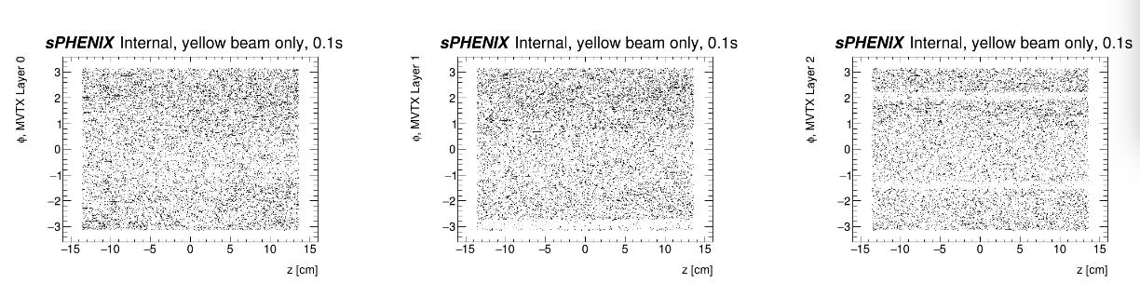
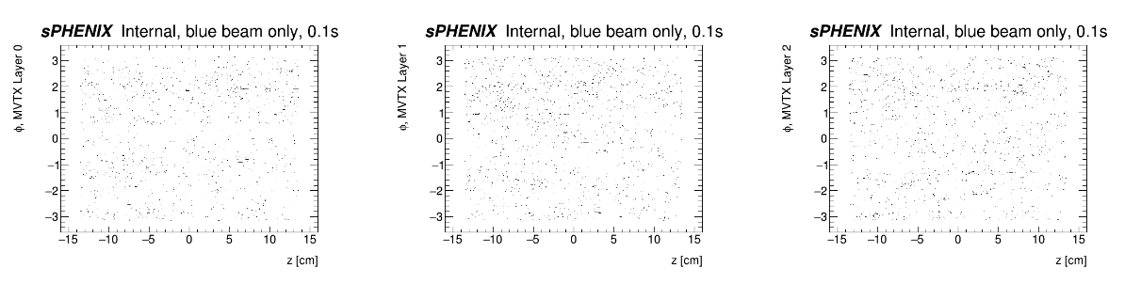
Yellow vs Blue background in MVTX:
Yellow issue much worse than blue
Yellow
Blue
Q: Could the asymmetry be caused by detector asymmetry or blue vs. yellow machine differences?

Slide 6
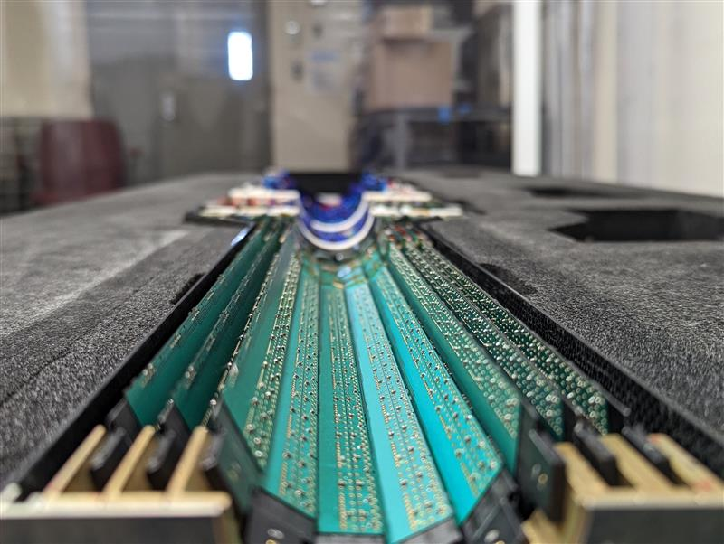
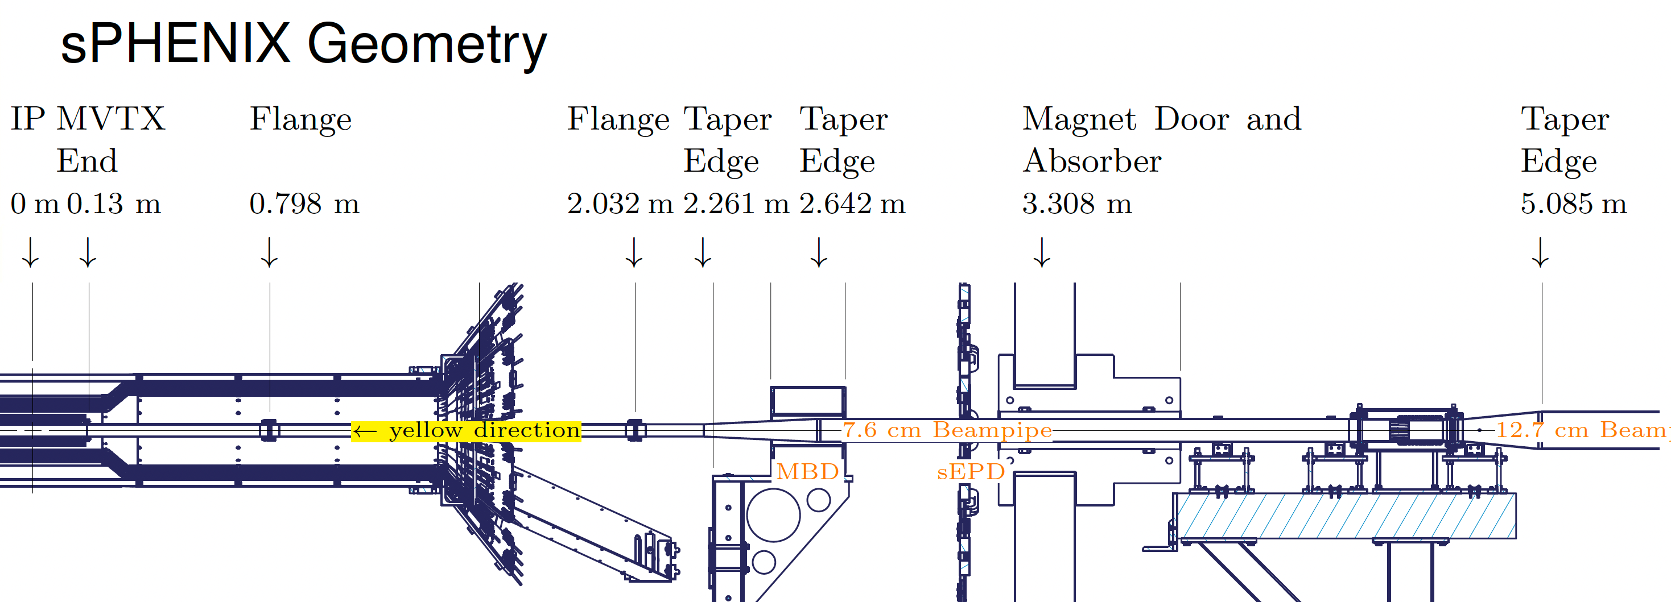
RHIC/MVTX Geometry
Blue:
South
1 flange
no ‘spider’
cables
Yellow:
North
2 flanges
‘spider’
no cables

Slide 7
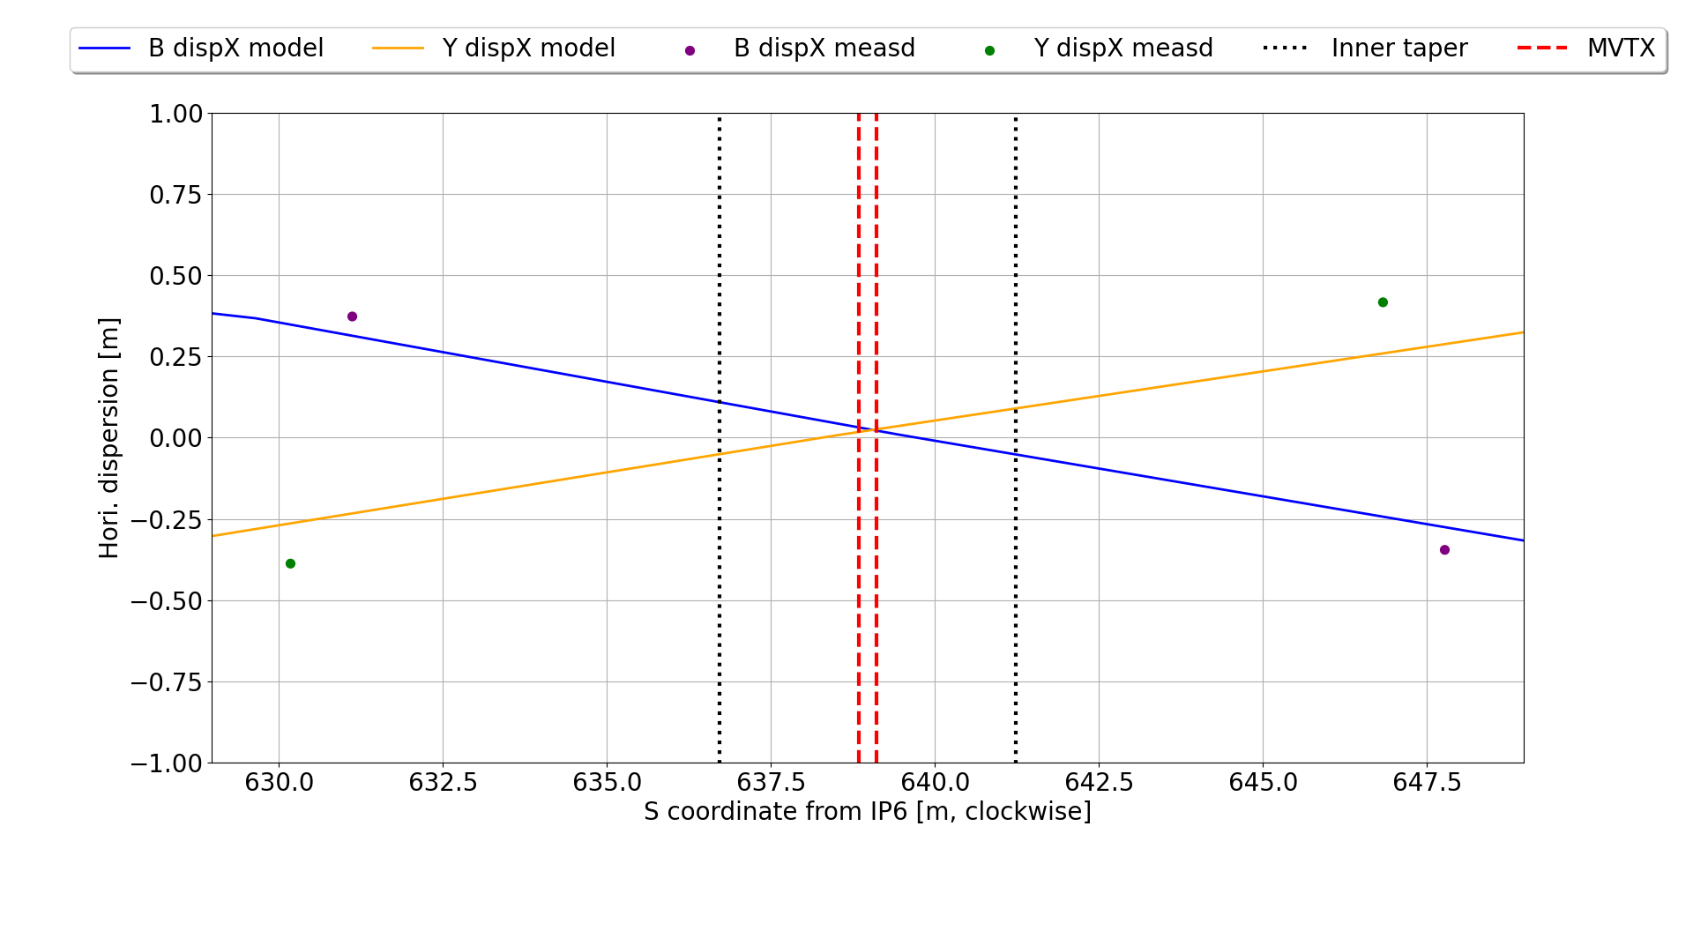
Local Dispersion @ IP8
yellow horizontal dispersion at taper ~15-20 cm
Courtesy: G. Robert-Demolaize

Slide 8
The task force

Slide 9
Task force formation
Members: accelerator and detector physicists
Angelika Drees, Kiel Hock, Guillaume Robert-Demolaize, Chuyu Liu, Henry Lovelace, Travis Shrey, Vincent Schoefer, Brendan Lepore, Lef Skordis, Haixin Huang, Michiko Minty, Cameron Dean, John Haggerty, Kin Yip, Rosi Reed, Jamie Nagle, Sean Still
Schedule: once to twice per week
Goal: identify source, propose and test (simulate) solution candidates, propose solution
Challenge: limited time, coordinate with other shutdown activities, so far, no clear candidates or solution

Slide 10
Task force goals
Making use of the data from run 24:
Identify the source of the backgrounds
  Investigate interactions from residual gas in vacuum
  Simulate shower generated by Au-C, Au-Cu, Au-Fe or Au-h breakup components striking the 2nd taper (Lef, Cameron)
  Investigate effects of local higher-order magnetic fields on backgrounds (Henry, Steve)
  Investigate asymmetry blue vs. yellow (Vincent, Lef)
Mitigate the losses
  We have indication that losses are from off-momentum particles
  Add local shielding inside sPhenix (polyethylene) -> sPhenix
  Create warm dispersion bump and move blue mask to that yellow location (Chuyu, Guillaume, Angelika)
  Tracking simulation to validate approaches (Guillaume, Kiel, Vincent)
Improve instrumentation and monitoring while MVTX is off (John, Sean)

Slide 11
Momentum collimation
(C.Liu, A. Drees, G. Robert-Demolaize)

Slide 12
The idea
The concept is based on the assumption that the sPHENIX background was caused by off-momentum particles.
This assumption stems from the observation that the pre-fire protection bump helped lower the MVTX auto-recovery rate.
The approach involves increasing dispersion in a warm section and relocating the blue mask there to serve as a momentum collimator.
The selected location is chosen for its figure of merit, eta_x / sqrt(beta_x), with higher values being preferable.

Slide 13
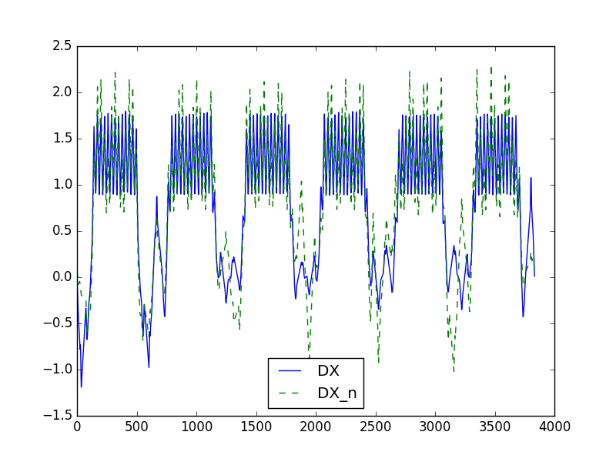
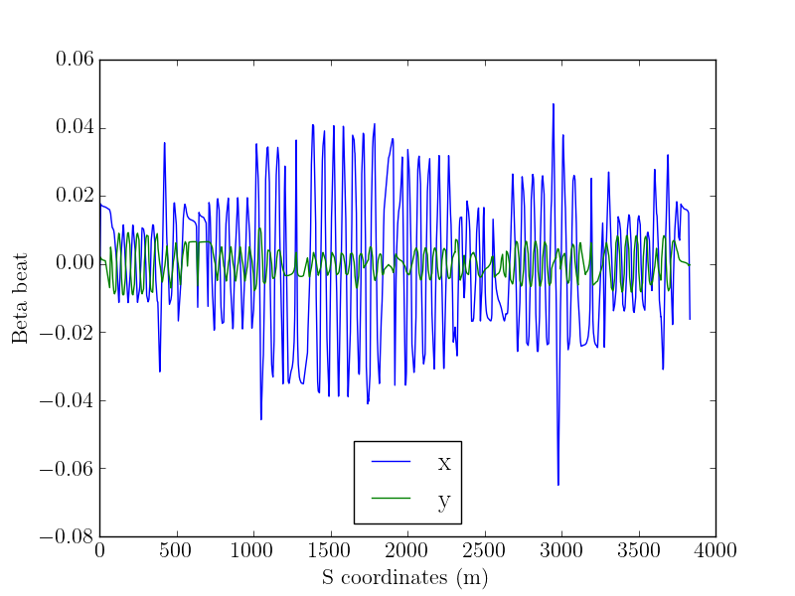
IR4 triplet case #2 (negative dispersion)
Courtesy Chuyu Liu

Slide 14
Comparison of dispersion and FOM
Locations | w/o add. dispersion |  | W add. dispersion |  | Beta_x (m) | Sigma (mm) | Notes
 | Eta_x_max (m) | FOM | Eta_x_max (m) | FOM
IR6 | 1.1 | 0.11 | -0.5 | 0.08 | 2.5 | 0.23 | None of the max FOM is at the triplets
IR8 | 0.96 | 0.11 | 0.55 | 0.1 | 2.5 | 0.23 | They are at the lowest beta locations:
IR10 | 0.28 | 0.06 | 0.28 | 0.05 | 18.6 | 0.63 | next to Q4, the first SC quad of dispersion suppressor, at IR10, 12, 2 and 4
IR12 | 0.24 | 0.05 | 0.11 | 0.03 | 12.2 | 0.51 | Or next to the rotators at IR6 and 8.
IR2 | 0.28 | 0.05 | 0.185 | 0.03 | 6.7 | 0.38
IR4 | 0.25 | 0.05 | 0.55 | 0.12 | 20.4 | 0.66

Slide 15
Gamma T quad rewiring
Rewiring of the Gamma T quads is necessary. While it’s theoretically possible to maintain the Gamma T jumping scheme, there are practical limitations that need to be discussed in detail with the PS experts (still in progress).
The PS work will take 6-8 weeks, requires additional work and changes to the control system for the PS and commissioning time during start-up.
For instance, the IR12 b4 configuration requires an additional power supply, with some groups using 5 quads on a single power supply, and others using 3 quads on one power supply.
Work in progress

Slide 16
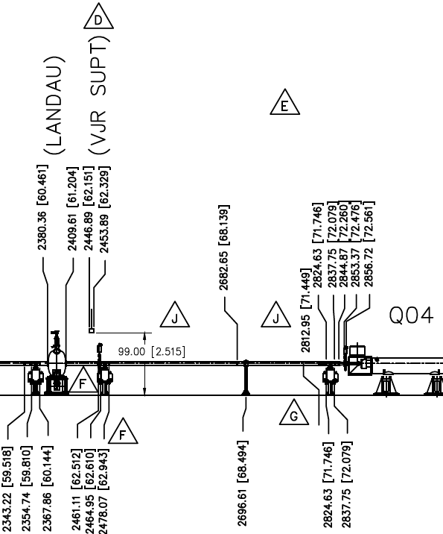
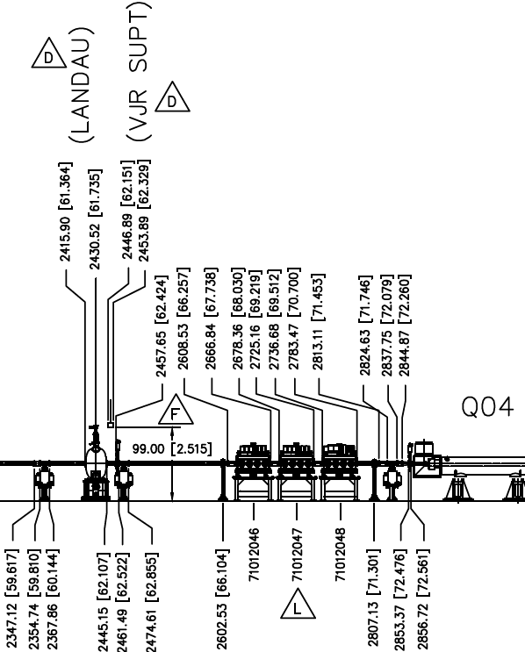
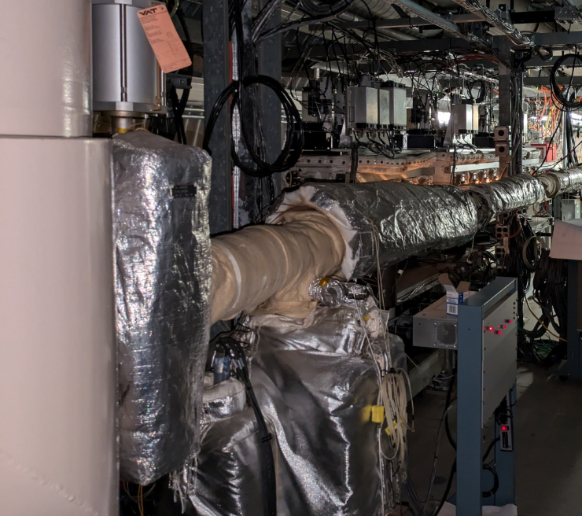
Momentum Collimator Move to sector-4 for sPHENIX Background Improvement
YO4
BI4
~2m from Q04
Tight space, but possible by relocating the cable tray.
Option -2: Tight space, difficult. Closer inspection needed to determine viability
Several weeks of bake-out (all locations)
Courtesy D. Weiss

Slide 17
Comparison of candidates
Three straight sections have been explored. The following table lists the challenges for each of these candidate locations.
Location for Dispersion | Dispersion (m) | # of PS | Space for Mask
IR12 | +0.60 | 4 | Need to move pC polarimeter and Stochastic Cooling devices downstream to make space, bake-out of that area may cause delay and less optimal vacuum
IR4 | +0.5 | 6 | Space available, bake-out takes less time
IR10 | +0.5 | 4 | Space is not available, so the closed orbit would need to be bumped outward to enable scraping at the dump. However, since the dump kickers deflect the beam inward, creating an outward bump would require a stronger kicker. Without sufficient kicker strength, part of the beam could leak out and potentially impact the superconducting magnets.

Slide 18
FLUKA Simulations
(L. Skordis)

Slide 19

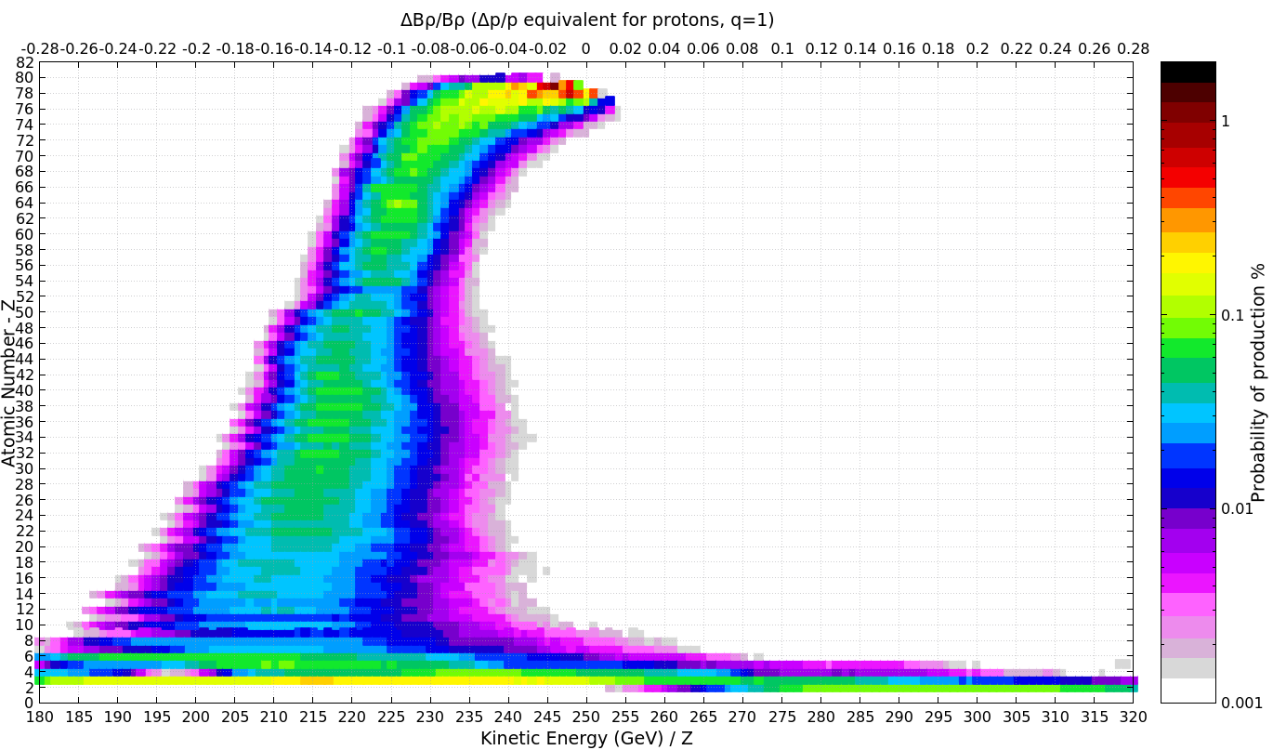
Where do off-momentum particles come from: 100 GeV/u Au to Hydrogen
Au of various Masses and energies
Au197
e.g. He6 at 93.5 GeV/u
A (random) variety of elements and momentum combinations is created
Also considered: Au-Fe, Au-Cu, Au-C
Courtesy: E. Skordis

Slide 20
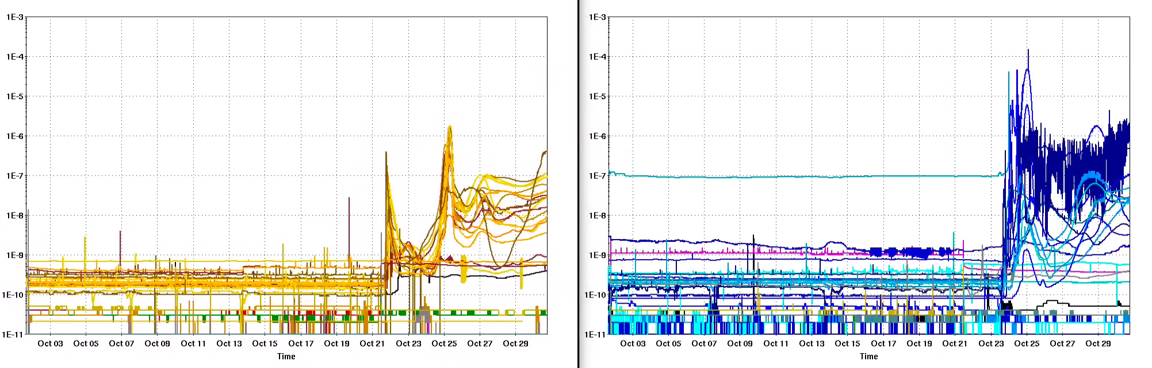
Vacuum Oct ‘24
Yellow: sector 8&9
Blue: sector 6&7
Pressure similar in both rings, in yellow on average slightly lower than in blue (not a candidate to explain the asymmetry).

Slide 21
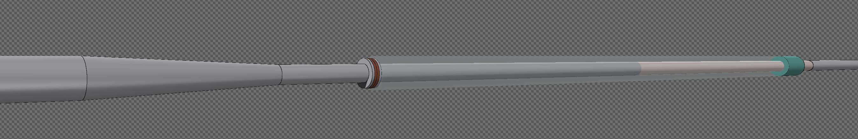
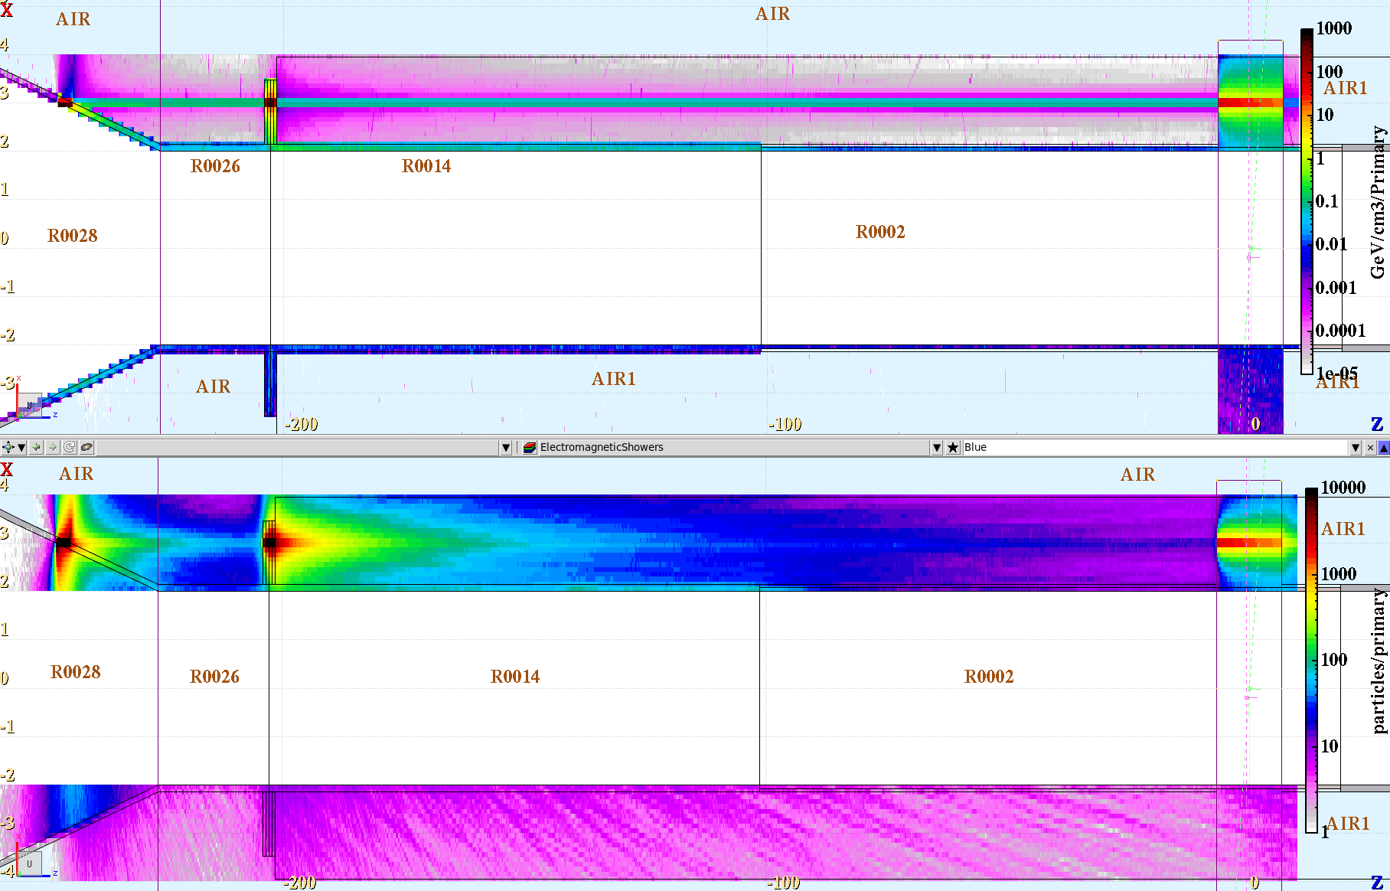
SPHENIX beam pipe Losses no shielding
Au ions 100GeV/u Impacting straight at the beam pipe.
The detector is modeled as a solid block of polyethylene
flange
Courtesy: E. Skordis

Slide 22
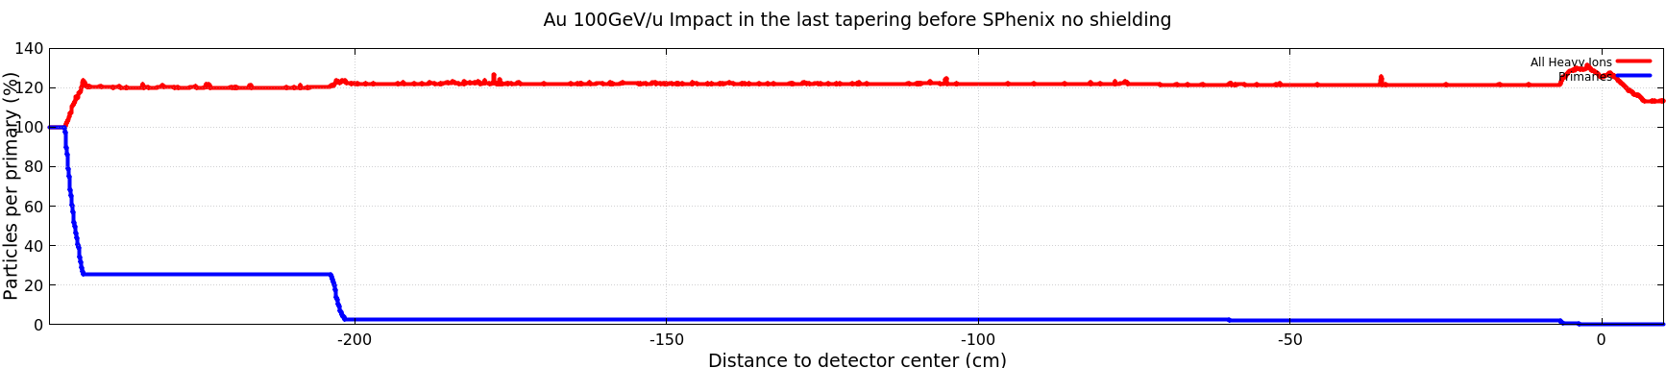
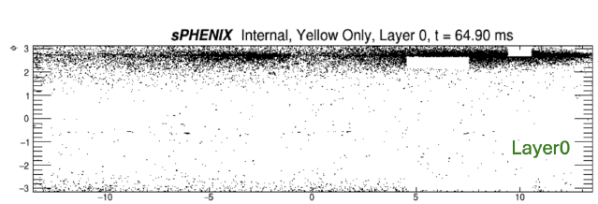
SPHENIX beam pipe Losses no Shielding
Au ions 100GeV/u Impacting straight at the beam pipe.
The detector is modeled as a solid block of polyethylene
About 25% of the initial gold ions survive the impact with the beam pipe. A few percent also survives the impact with the flange
However, a large amount of heavy ion secondaries are produced and continue to travel with small divergence arriving at the detector
Courtesy E. Skordis

Slide 23
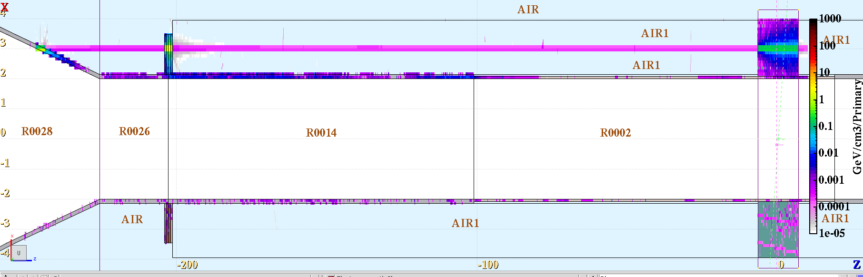
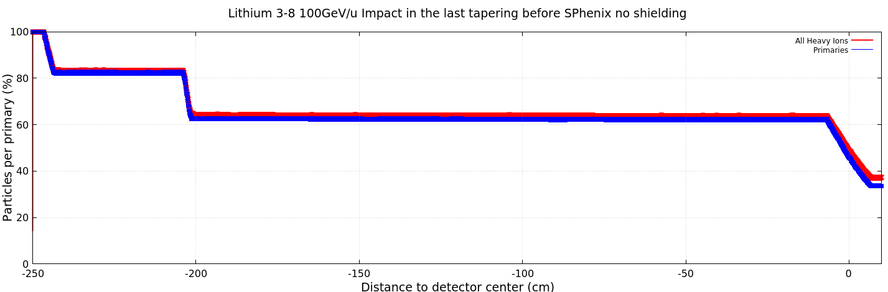
SPHENIX beam pipe Losses no Shielding
Lithium 3-9 100GeV/u Impacting straight at the beam pipe.
The detector is modeled as a solid block of polyethylene
About 80% of the initial lithium ions survive the impact with the beam pipe. Around 60% also survives the impact with the flange
Even with this light ion the impact produces secondaries that travel with small divergence arriving at the detector
E. Skordis

Slide 24
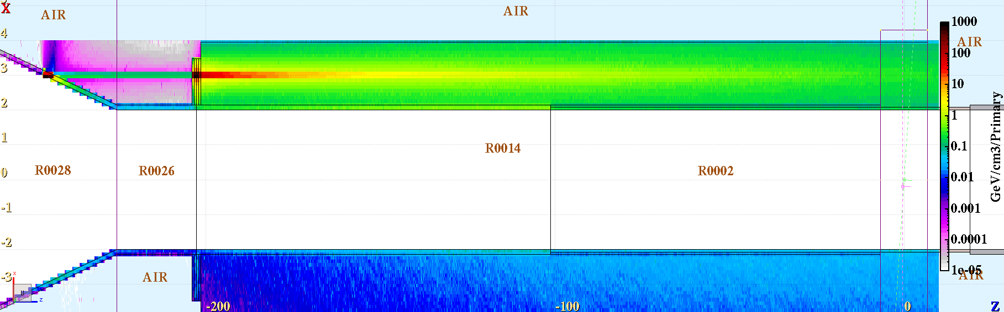
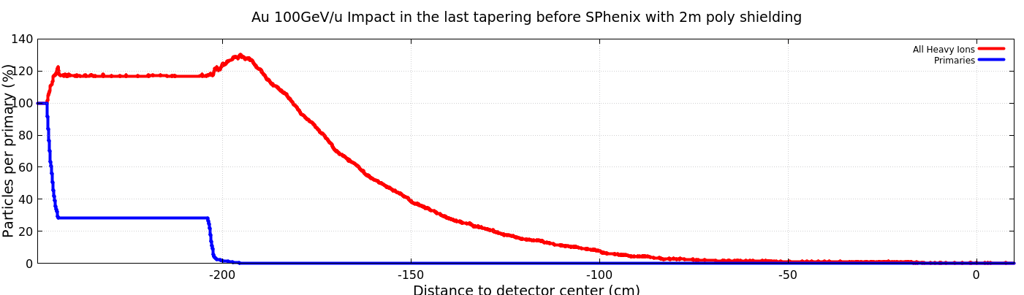
SPHENIX beam pipe Losses with 2m Polyethylene
Au ions 100GeV/u Impacting straight at the beam pipe.
The detector is modeled as a solid block of polyethylene with an extra 2 m upstream
About 25% of the initial gold ions survive the impact with the beam pipe. A few percent also survives the impact with the flange
The amount of secondary heavy ions drastically reduce after 1m of polyethylene.
Courtesy E. Skordis

Slide 25
Geant Simulations
(C. Dean)

Slide 26
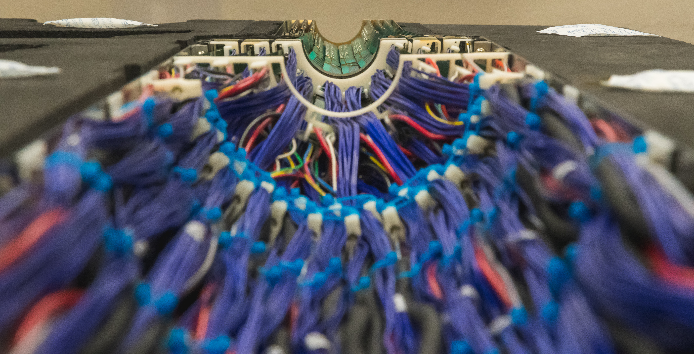
MVTX Cables on the test bench
What is this?
Half of MVTX under construction
All cables connected
Picture taken October 2022

Slide 27
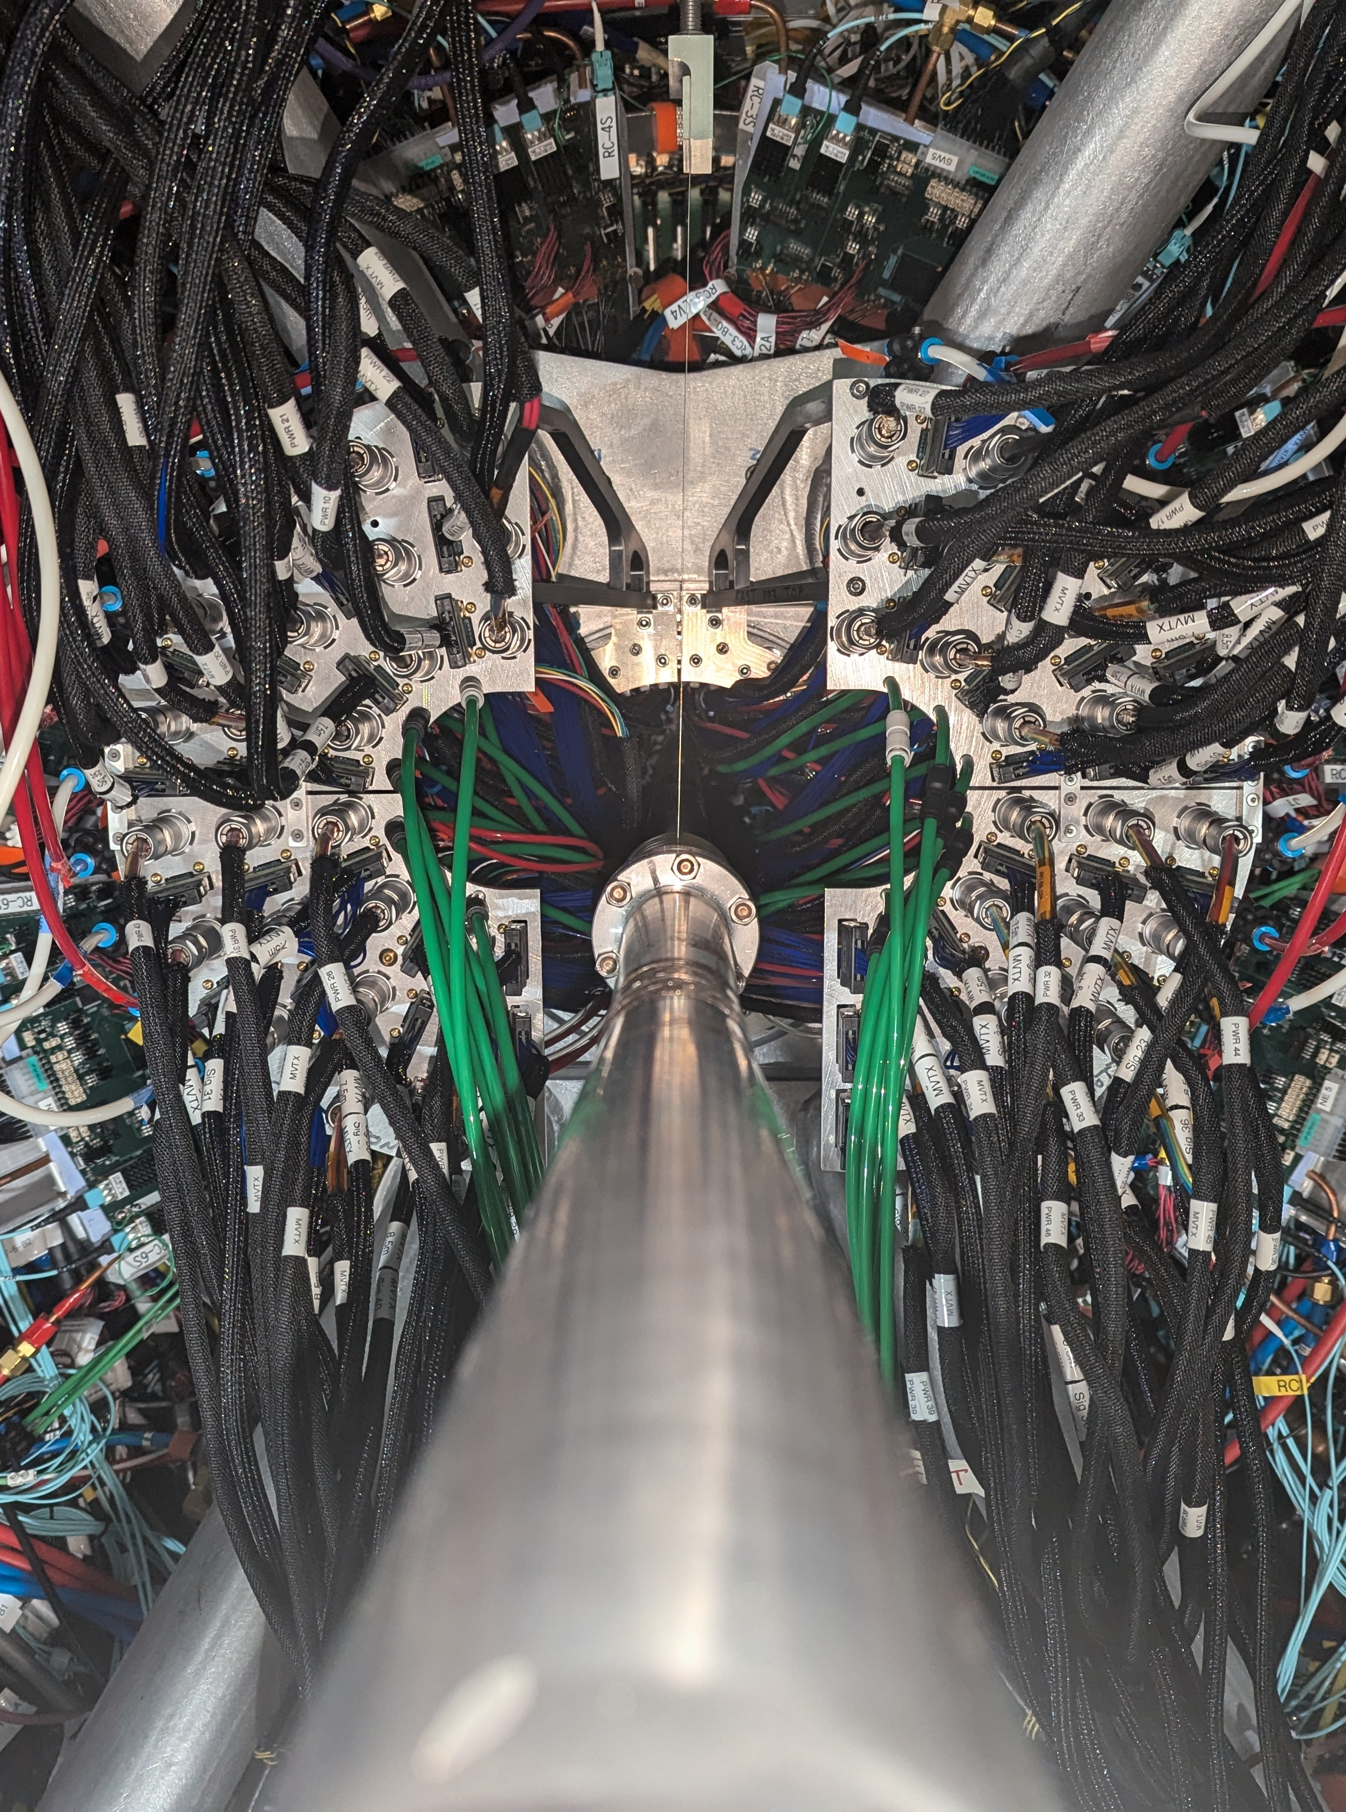
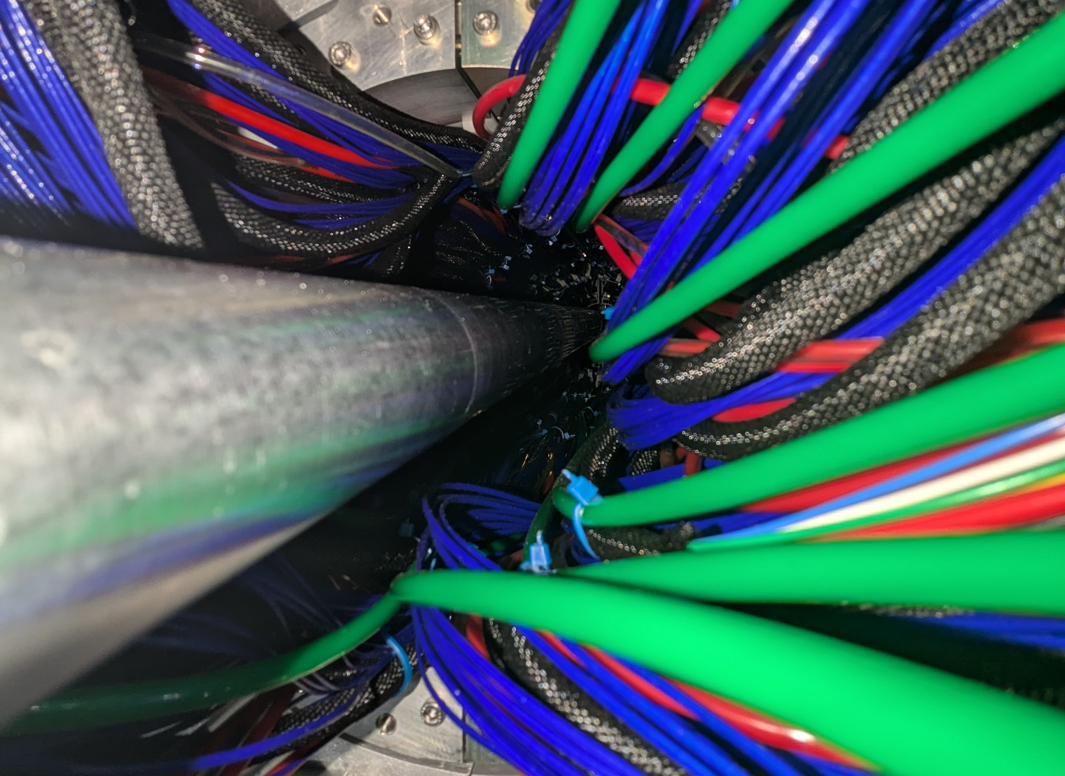
MVTX Cables inside sPhenix
What is this?
MVTX as it is currently installed
We can see past the cables
Beam pipe is visible right up to the detector
Picture taken November 2024

Slide 28
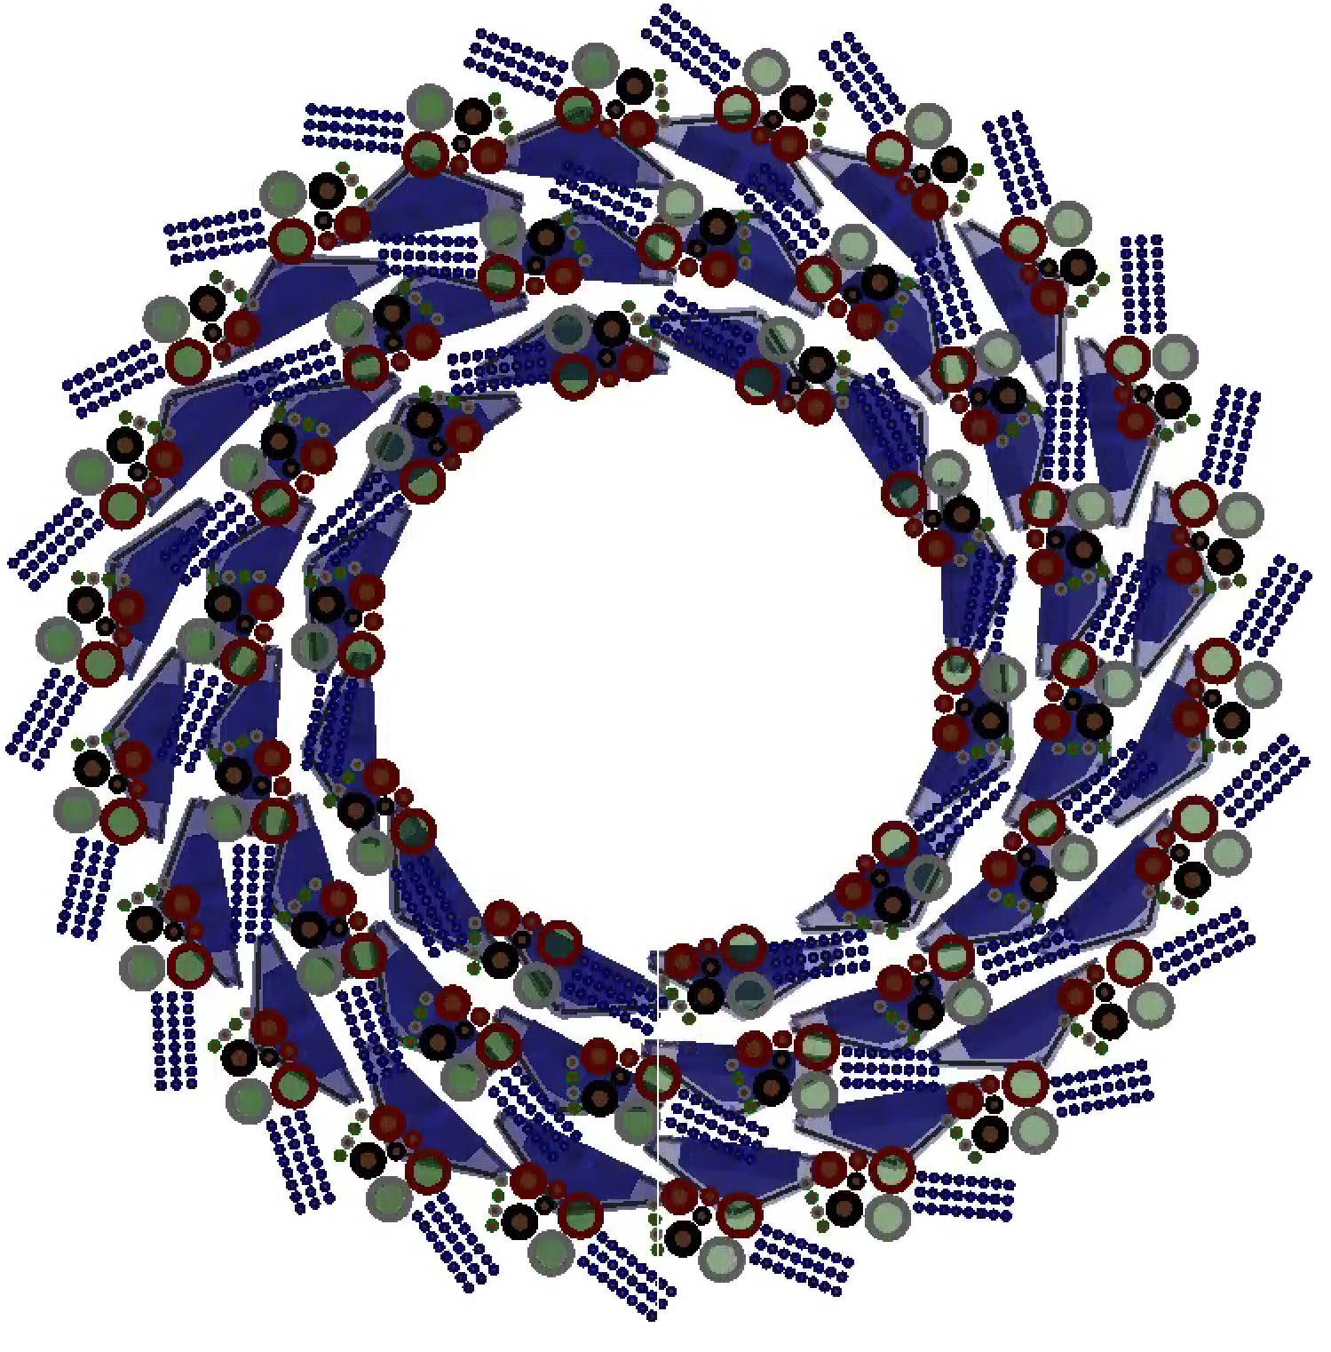
General simulation setup
View from south to north (IP6 to IP8)
Only MVTX staves and some cables drawn
  Cables near detector are not shown for clarity
Blue triangles are the MVTX staves
All 48 cable bundles simulated
Per stave:
  2 x water cooling
  24 x signal traces
  Digital power supply & return,
  core radius = 0.69mm
  Analogue power supply & return,
  core radius = 0.33mm
  Sense, reverse bias and ground,
  core radius = 0.28mm

Slide 29
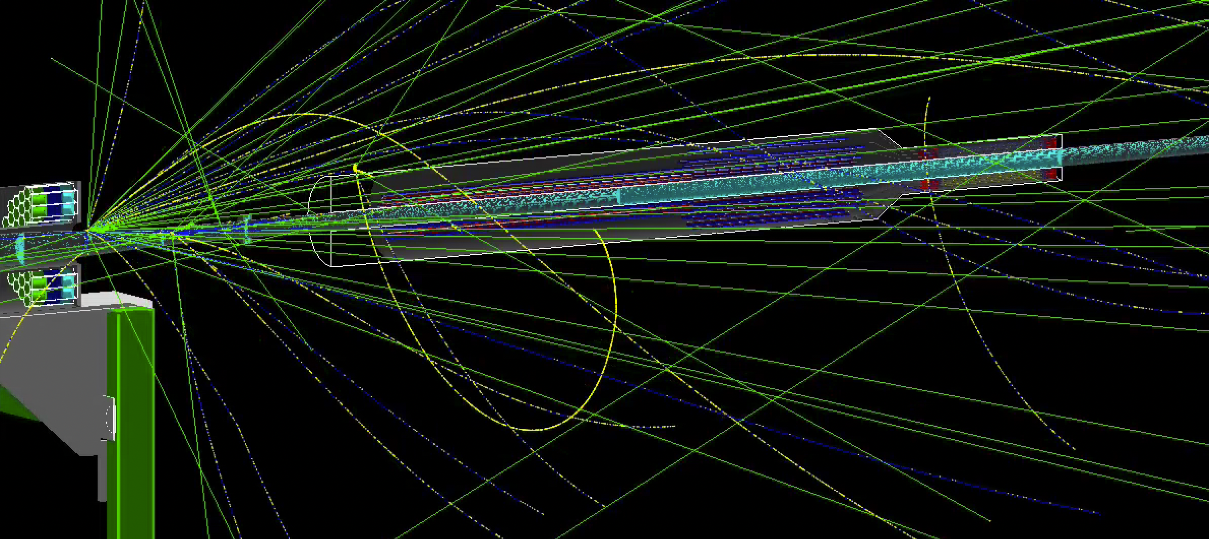
100 GeV gold on south taper

Slide 30
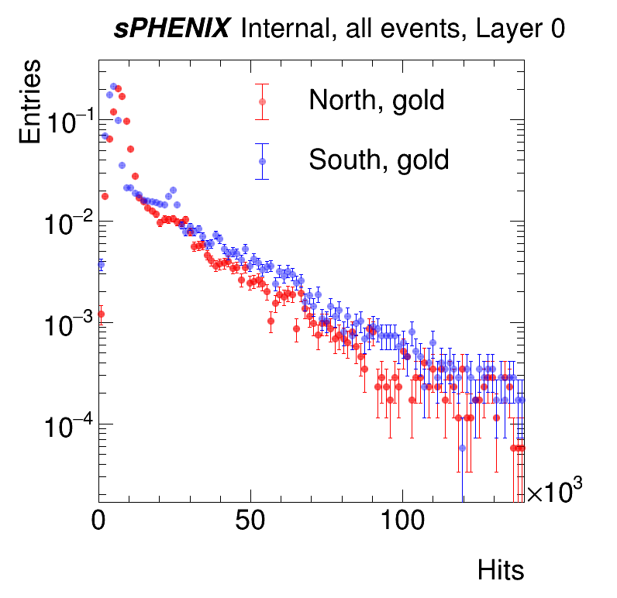
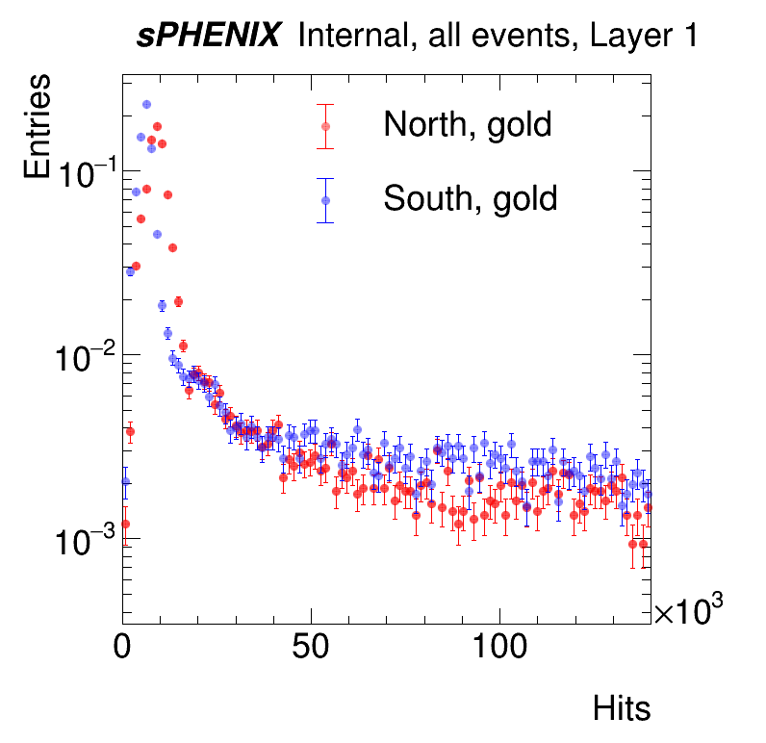
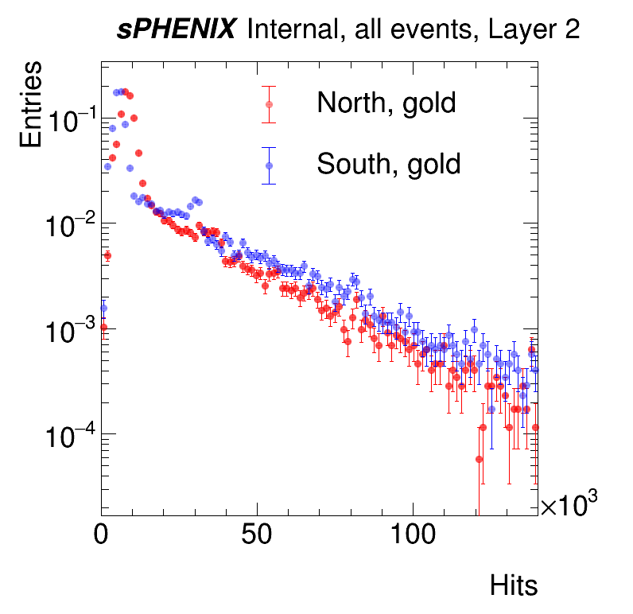
Top – with cables around beam pipe
Bottom – cables in nominal position, away from beam pipe
Both scenarios predict a slightly bigger problem from blue (i.e. south) which is not what we observe

Slide 31
Preliminary Summary
Simulations were performed by having the MVTX cables drape around the beam pipe
Simulations show a strong difference between gold and protons hitting the taper
Small difference seen on layer 2 between hits from the north and south for protons
Difference seen between hits from the north and south for gold when there’s no AR
Pictures taken on 20th Nov. show that the cables are not near the beam pipe, except at the patch panel
AR count indicates more AR on south side when cables are near beam pipe
  Possibly means cables can absorb some particles, but also initiate showers that could lock MVTX up?
Side | Events with hits | Events with AR | % events w/ AR
North | 14090 | 4394 | 31.3 ± 1.7
South | 14085 | 6212 | 44.1 ± 1.5
?

Slide 32
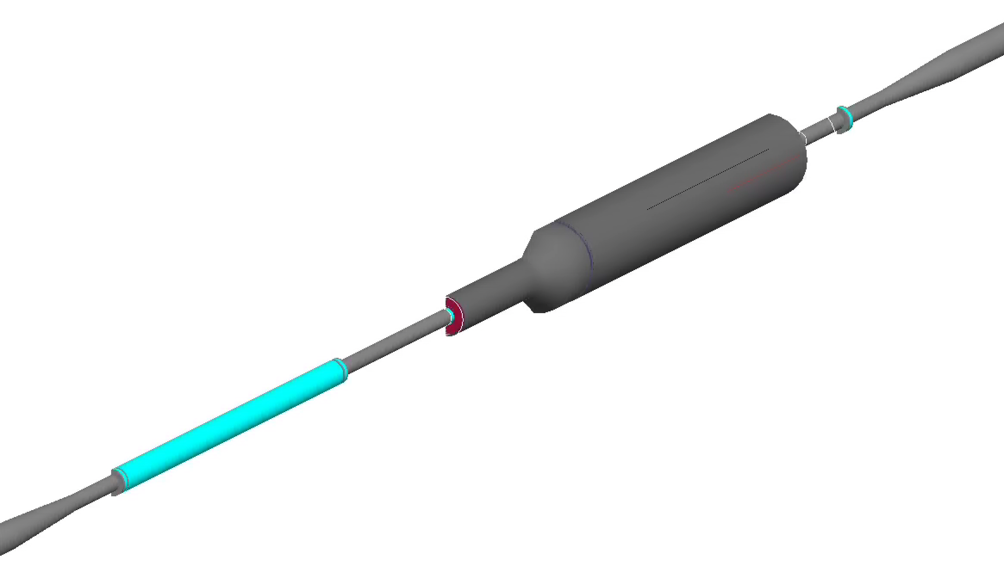
Addition of polyethylene absorber
Flange 1 z position 80.3536 cm
Polyethylene absorber start position 82.0319 cm
Flange 2 z position 203.747 cm
Polyethylene absorber end position 202.219 cm
Max length of absorber is 120 cm
Absorber is same radial size as flange
In reality, Spider exists between flanges
Absorber
Geant simulation with absorber material still in progress

Slide 33
Higher order fields
(H. Lovelace, S. Peggs)

Slide 34
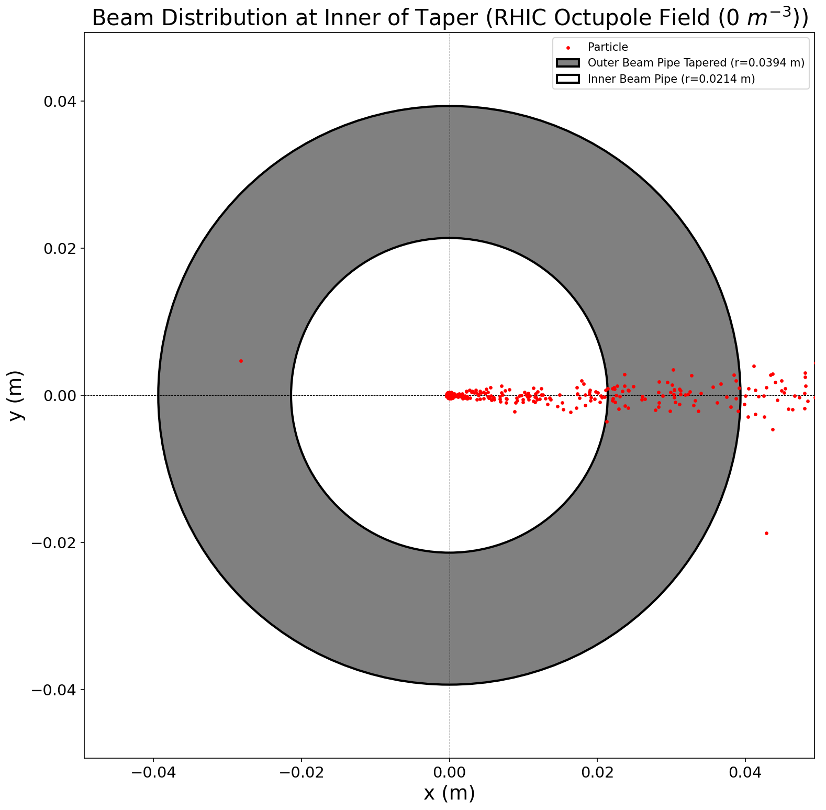
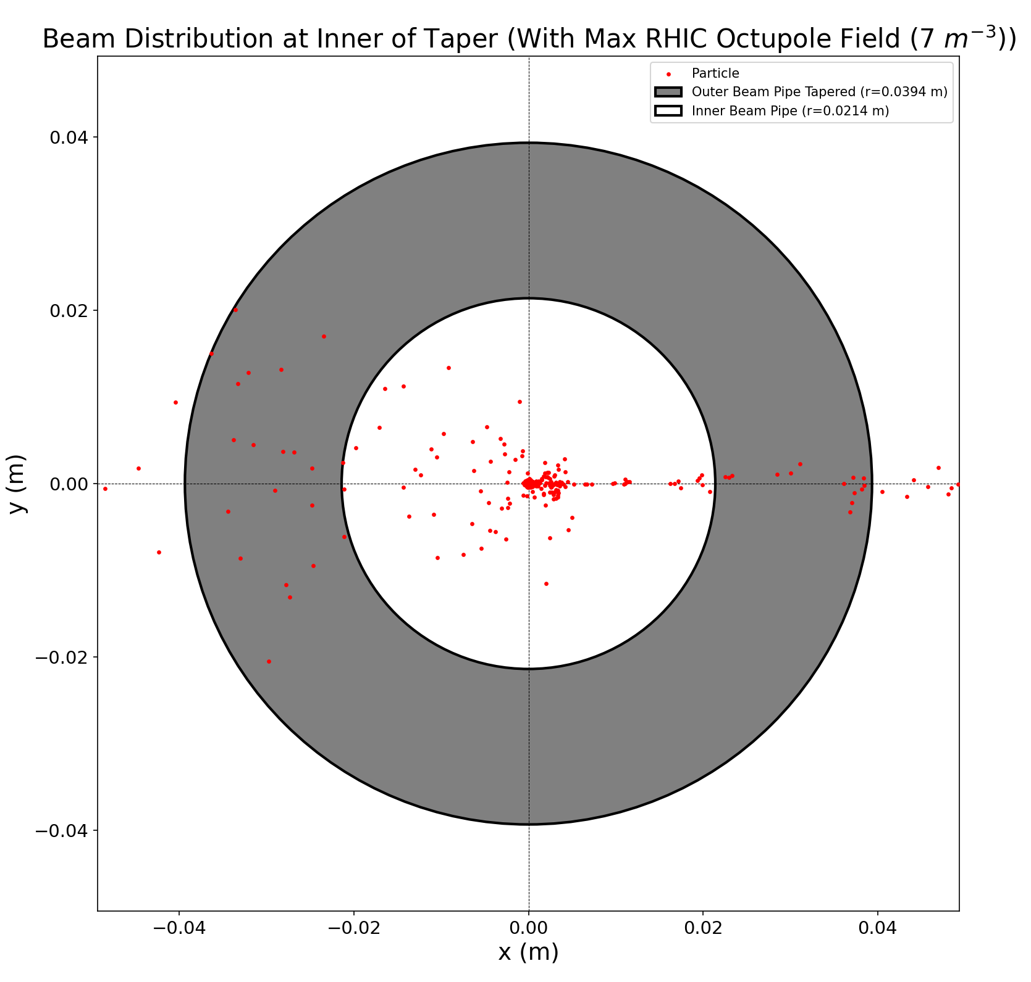
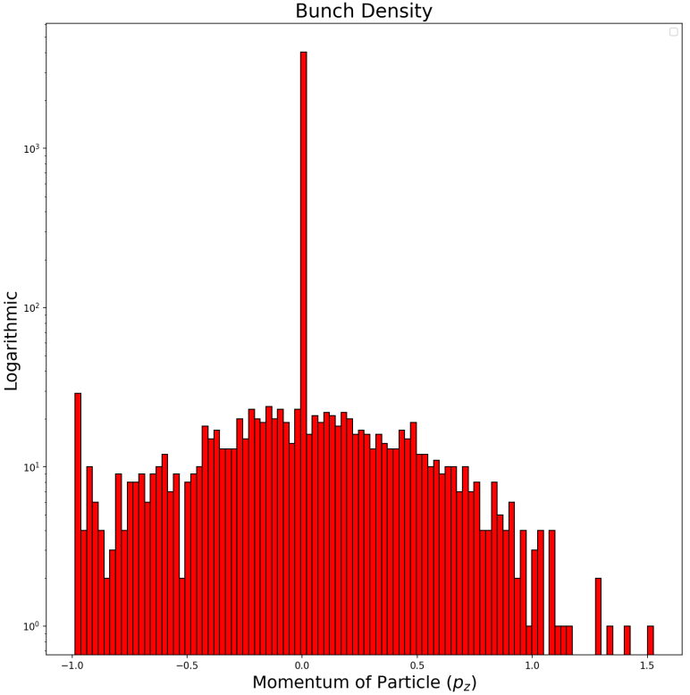
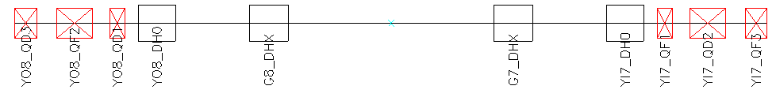
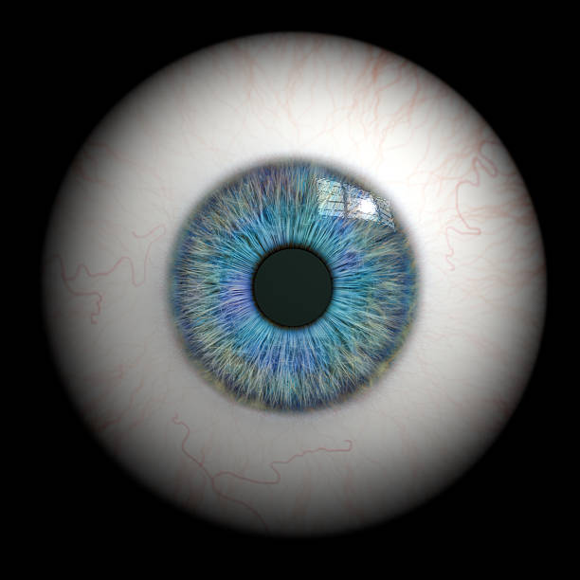

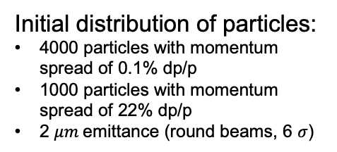
Using Octupole Fields for Background Mitigation
Initial distribution of particles:
4000 particles with momentum spread of 0.1% dp/p
1000 particles with momentum spread of 22% dp/p
2 $μm$emittance (round beams, 6 $σ$)
Work in progress
Beam Direction
Start
View Point
Inner Taper
IP8
Courtesy: Henry Lovelace

Slide 35
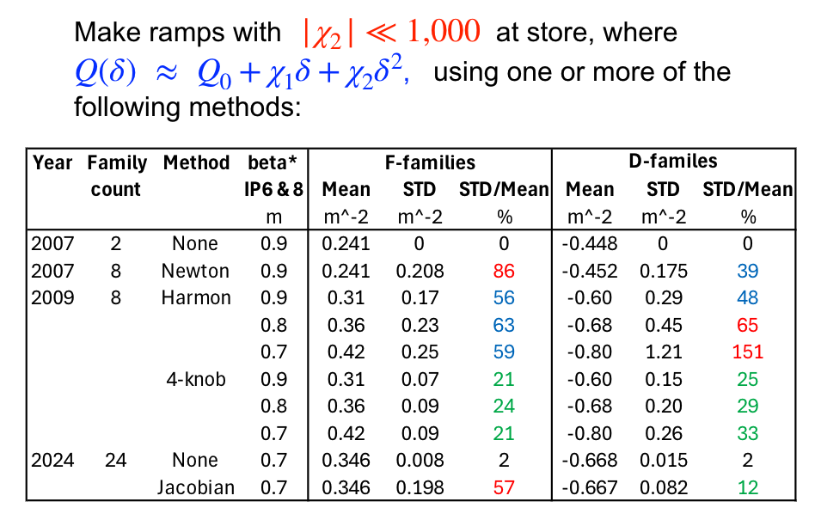
Correcting 2nd order chromaticity
S. Peggs, G. Robert-Demolaize, A. Drees

Slide 36
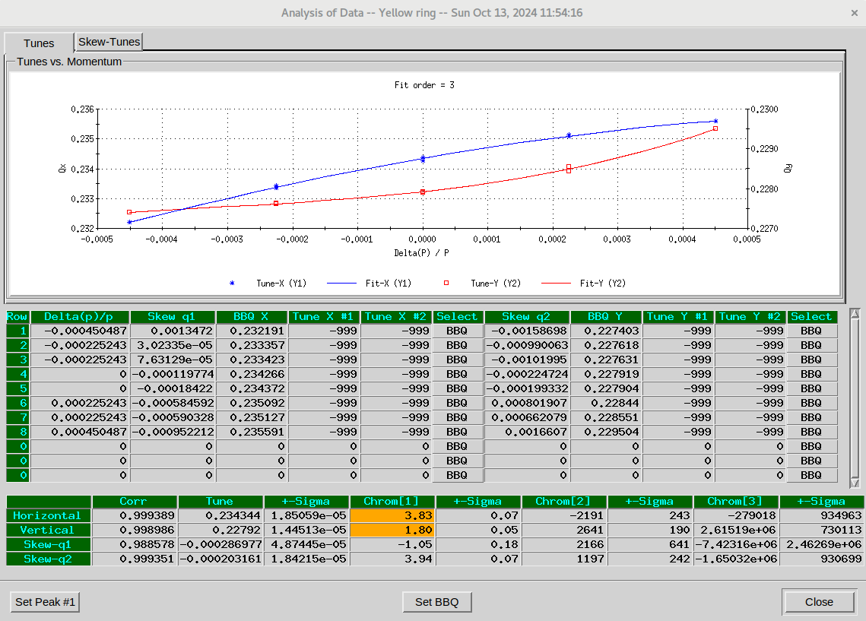
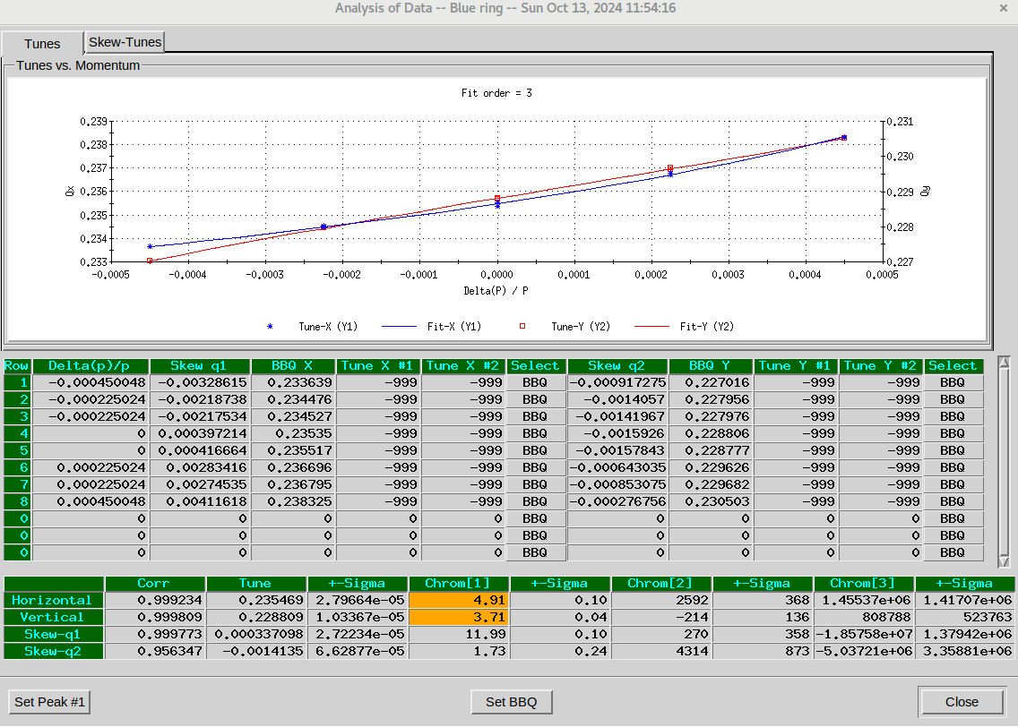
Measured chromaticity Run24
Yellow
Blue
2nd order chromaticity is x5 to x10 smaller than run23, still different in the two rings.

Slide 37
Additional monitoring
(J. Haggerty, S. Still)

Slide 38
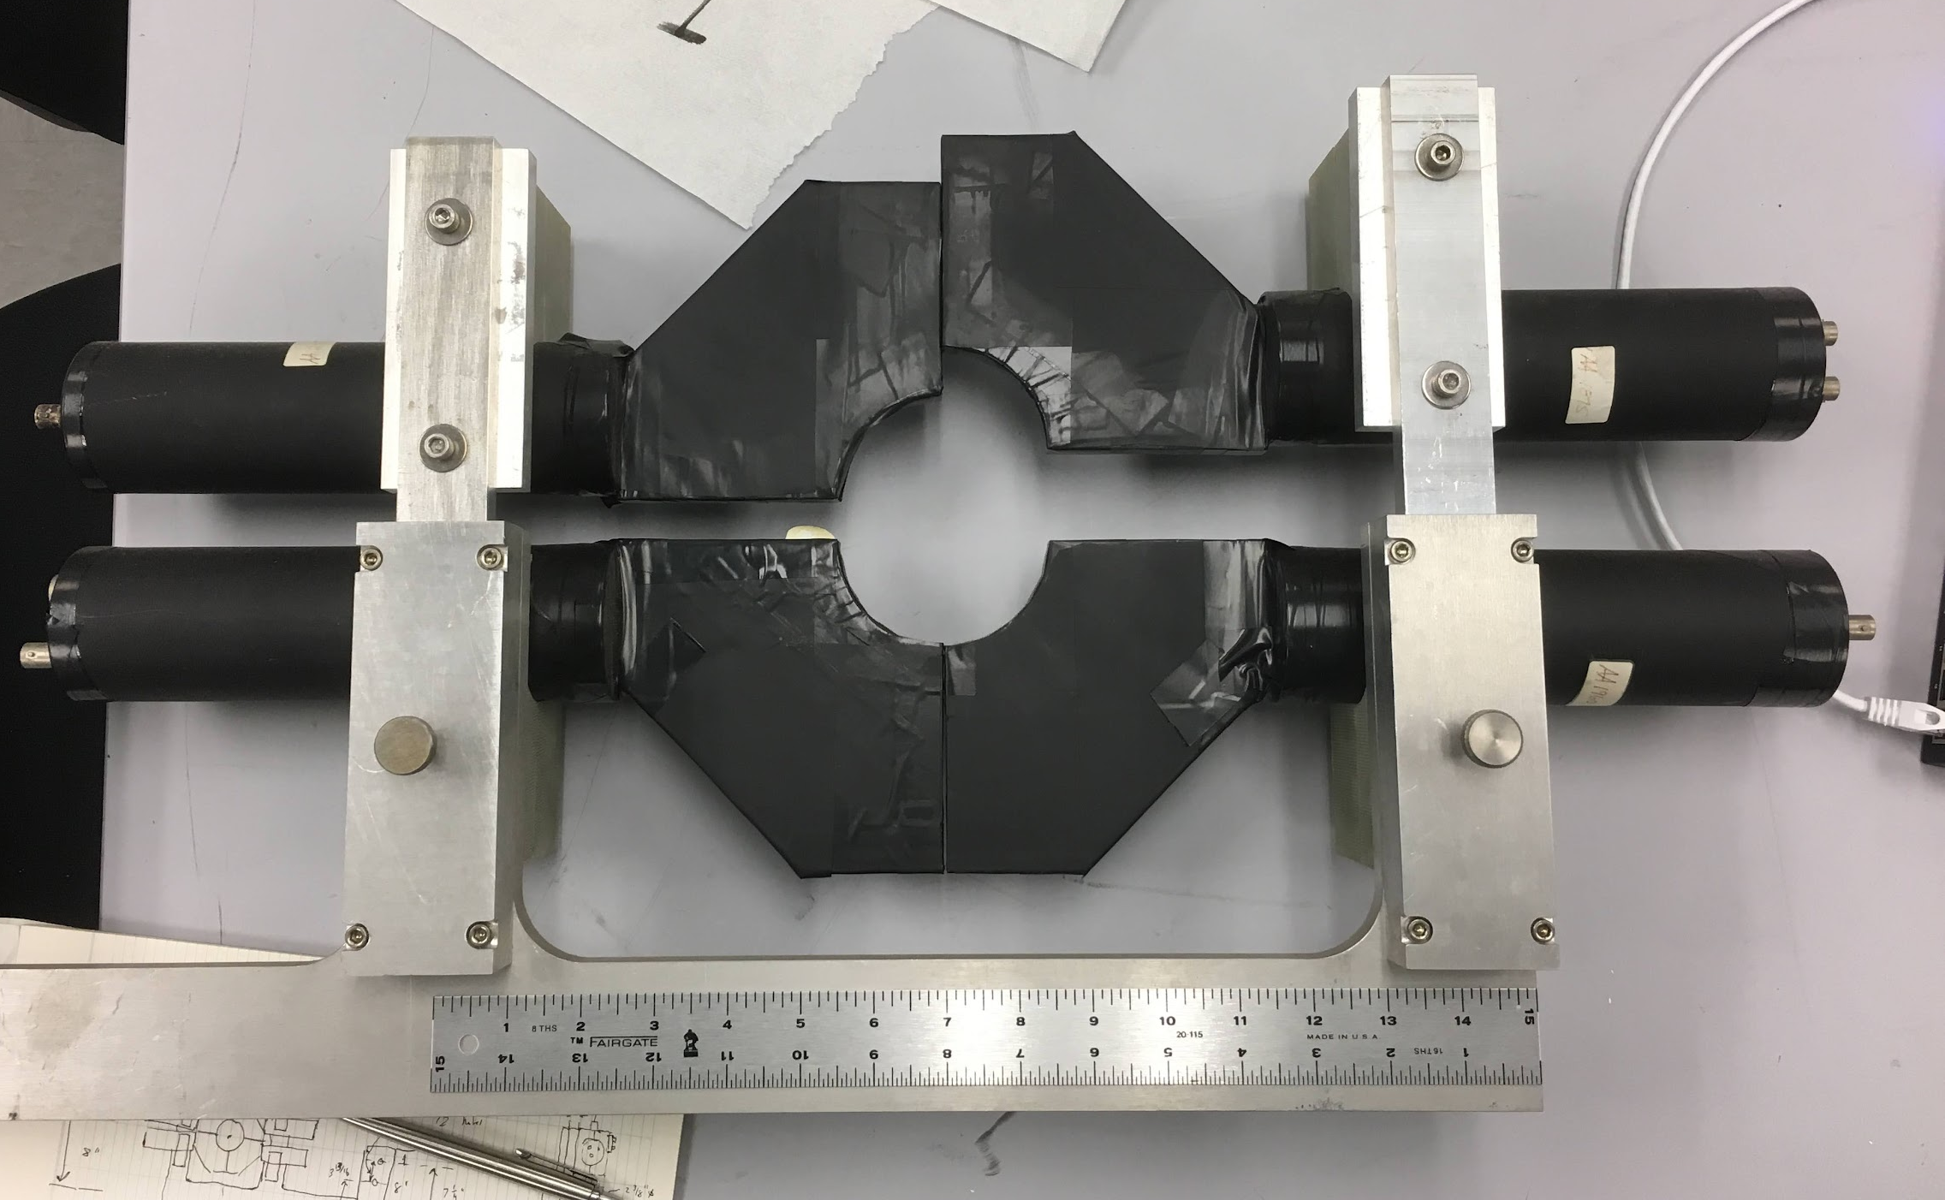

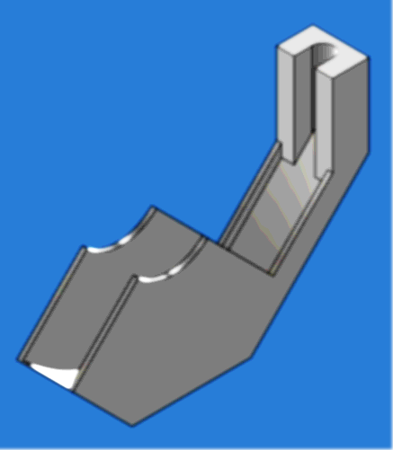
Instrumentation
To be positioned along the beampipe.
Better understand the backgrounds seen in the MVTX
Provide MCR with a feedback signal to steer and tune the beams
Discriminated output signals -> scalers, electronics in Rack 3C6
1 Hz rate
Inner and Outer “Donut” Counters
Pole-tip
door
Pole-tip
door
MVTX
absorber
INTT
MBD
MBD
sEPD
sEPD
South
North
“Outer Donut”
(south)
“Inner Donut” : each is 2 - 5” OD x 1.75” ID
0.7mm thick scintillator
“Outer Donut” : re-purposed pp2pp
detector modules : pmts and scintillator
Courtesy J. Haggerty, S. Still

Slide 39
Tracking (K. Hock) - Zgoubi

Slide 40
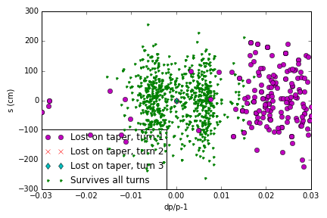
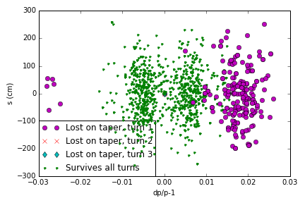
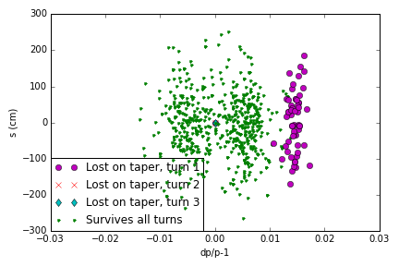
Tracking from various starting points
YO8-DH20
IP10
Start position | Turn 1 | Turn 2 | Turn 3
YO8-DH20 | 208 | 0 | 0
IP10 | 71 | 0 | 0
YI2-TQ4 | 56 | 0 | 0
IP6 | 0 | 0 | 0
IP2
Single turn issue ?

Slide 41
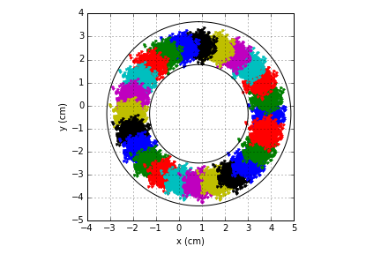
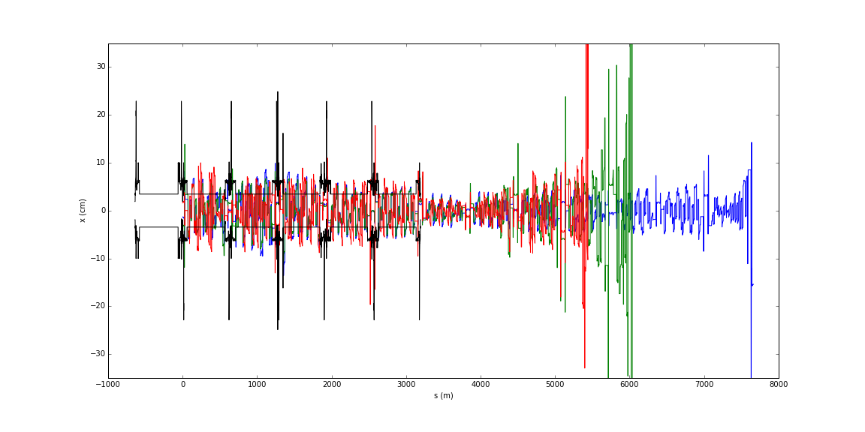
Back-tracking
Initial distribution on the taper
24,000 seeds
‘Donut’ initial distribution
3 particles make it into a 2nd turn
Work in progress (just started)
Confirm with x-track or other

Slide 42
Summary

Slide 43
Conclusions
Off momentum particles are causing the background
  no location/source has been identified (yet)
  Multiple scattering considered
  Single turn issue (not consistent with all data from run 24)
  More tracking/back-tracking needed (add x-track, other)
Mitigations:
Improved monitoring
  Will be installed
Internal shielding (considered by sPhenix)
  Waiting for GEANT simulation/confirmation
Momentum collimation
  Likely not sufficient, too far upstream
  Time and cost expensive (but being worked on)
Higher order fields
  Needs machine development early in run 25

Slide 44
Backup

Slide 45
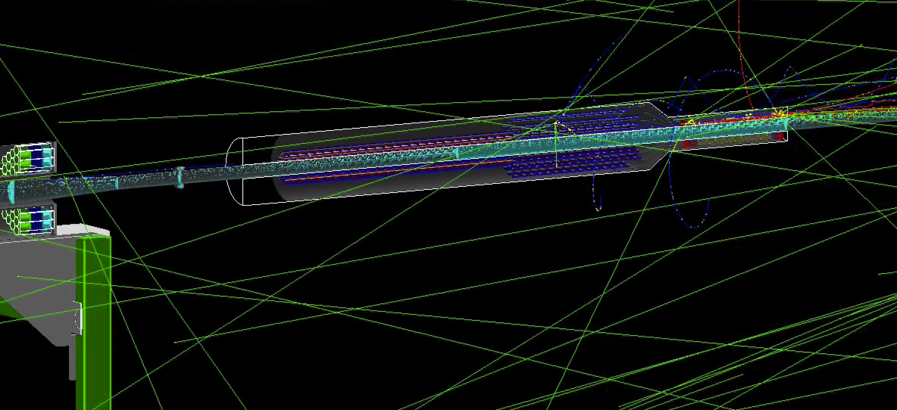
100 GeV proton on south taper

Slide 46
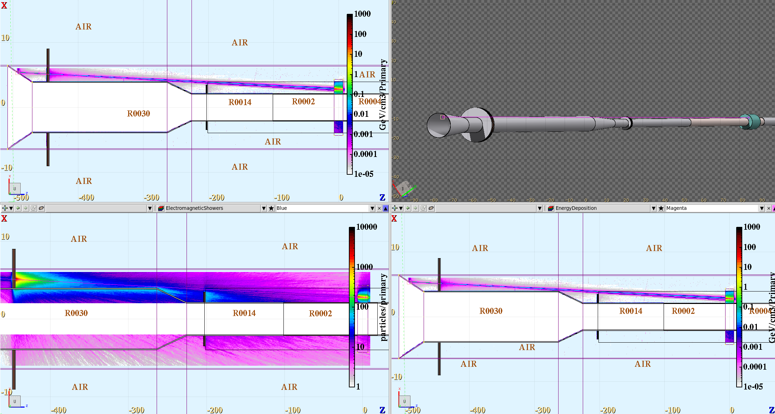
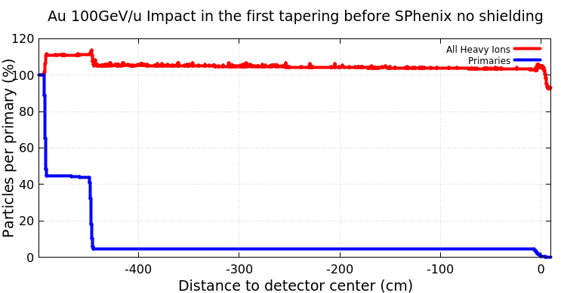
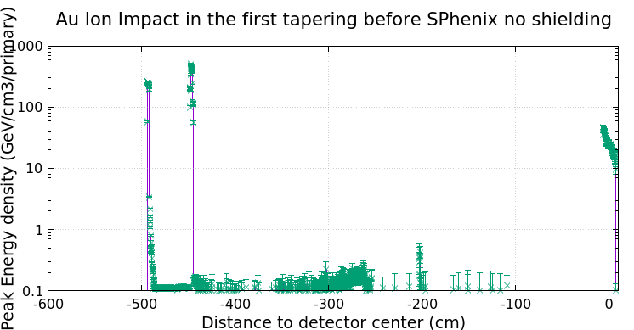
SPHENIX beam pipe Losses with 2m Polyethylene
Au ions 100GeV/u Impacting with a small angle at the beam pipe.
The detector is modeled as a solid block of polyethylene
Very similar observations with the losses on the internal tapering
Courtesy E. Skordis

Slide 47


Slide 48
Momentum Collimator Move Summary for sPHENIX Background Improvement
Vacuum Perspective:
mask location near Q4 are more invasive in all considered sectors, 2-3 weeks of bake-out required at both locations.
YI10 is least invasive location of mask
Mostly Vacuum Group, add Survey and trades
2 straight forward bake outs
YO12 location is most invasive and complicated location
Vacuum, Beam Components and trades
3 bake outs if near Q4
YO4 has some complications
Vacuum, RF, Beam Components and trades
2 straight forward bakeouts

