Slide 1
C-AD Machine Advisory Committee HW Day 1
Wolfram Fischer Deputy Associate Laboratory Director for Accelerators, NPP Chair, C-AD
C-AD Machine Advisory Committee
17 December 2024
Notes:
15 min => 10 slides

Slide 2
HW questions day 1
What was the total sPHENIX Au-Au integrated luminosity goal? How much has been delivered to date?
Clarify the 2025 run plan timeline and funding scenarios, specifically priorities and the decision-making process for the extra beam time beyond Au-Au collisions.
If possible, present downtime statistics breakdown by system, preferably for a long period of operation > one year.
What is the decision process for the background mitigation task force for measures to be implemented by the start of Run-25 (or during Run-25)?
Is more specific information available (beyond conceptual level) on potential momentum collimation design?

Slide 3
Q1: What was the total sPHENIX Au-Au integrated luminosity goal?
sPHENIX goal for Run25 from Beam use request is 7 nb⁻¹ within ±10 cm.
Kiel Hock
How much has been delivered to date?
During Run23, 3 nb⁻¹ was delivered over all vertices for commissioning.
Detector systems were not fully operational until August 2024.
Comments
Current projections calls for a maximum projected luminosity of 2.3 nb⁻¹ delivered/week for 0 mrad crossing angle.
Following 3-weeks of Au in run24, sPHENIX intends to operate with +1 mrad crossing angle.
Operation with a 1 mrad crossing angle will have a maximum delivered luminosity of 0.36 nb⁻¹ delivered/week within ±10 cm.
Delivery with 2 mrad would correspond to 0.3 nb⁻¹ delivered/week within ±10 cm.
At the maximum projected luminosity, it would take 20 weeks to reach sPHENIX’s goal.

Slide 4
Q2: Clarify the 2025 run plan timeline and funding scenarios, specifically priorities and the decision-making process for the extra beam time beyond Au-Au collisions.
ALD asked experiments for 20-week and 28-week plans for PAC on 7-8 Nov 2024
Have spend 2 weeks already for Run-24 run-extension (Au+Au)
Plan to start Run-25 on 24 Mar 2024 with Au+Au
Run length is determined by budget (note: Continuing Resolution expiring on 20 Dec 2024)
Greater budget clarity can helps optimizing run plans for
Total length (possibly to Dec 2025)
Additional modes (p+p, p+Au, O+O, FXT, EIC APEX, CeC)
Reduced or no operation in July and August 2025
O+O, FXT does not require additional resources for preparation

Slide 5
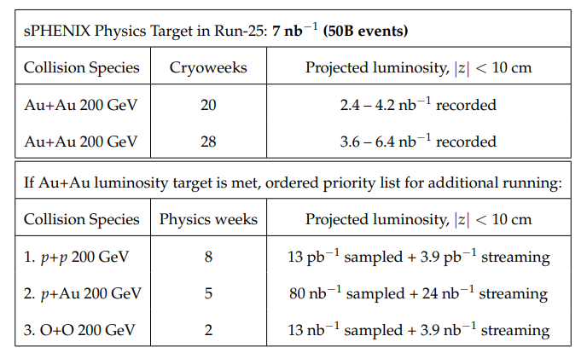
Q2: Beam User Requests (presented to NPP PAC, 7-8 Nov 2024)
sPHENIX
J.Haggerty “sPHENIX Summary and Run 25 Plan”
Michiko Minty
STAR
J.H. Lee “STAR Summary and Run 25 Plan”
Planning guidance for BURs: 20 or 28 week cryoweeks.
Plan to start RHIC Run-25/26 with Au+Au with 100 GeV beams.
NPP PAC will reconvene a few weeks after RHIC Run-25/26 start to further prioritize recommendations.
M. Minty C-AD MAC-21 (16-18 Dec 2024)

Slide 6
Q4: What is the decision process for the background mitigation task force for measures to be implemented by the start of Run-25 (or during Run-25)?
Angelika Drees
Task Force makes a recommendation by early January to C-AD management to prepare for a decision
Will continues studies after that

Slide 7
Q5: Is more specific information available (beyond conceptual level) on potential momentum collimation design?
Chuyu Liu
Next 8 slides

Slide 8
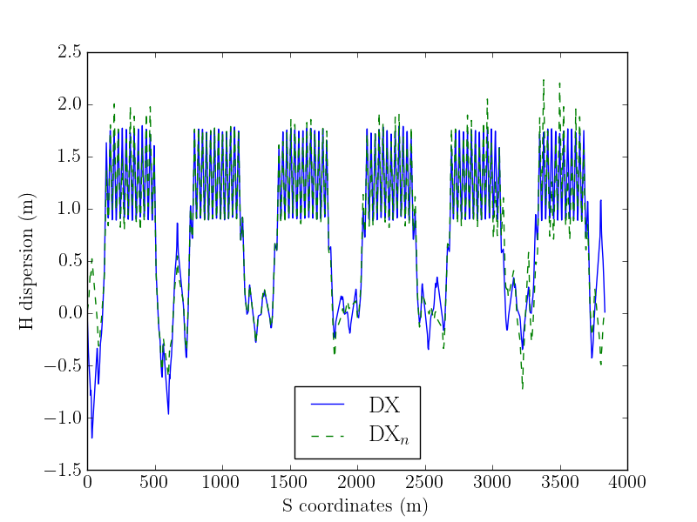
A closer look at the dispersion
Reduced
Increased

Slide 9
A closer look at the FOM
Highest of all warm sections
Warm sections

Slide 10
Knobs for generating dispersion bump
The ideal knobs would be independent quadrupoles at dispersive locations with (2n+1)π/2 phase advance to the intended mask location.
The quads close to this critiria are the gamma-t quads, which are not independent though and are primarily for transition jump. Therefore, we need to add independent PSs to 6 selected quads.
Q8 and Q9, at the start of dispersion suppressor, are included as well, regardless their individual phase advance.
Orbit correctors are capable of generating dispersion as well, which can be used to introduce additional dispersion to make collimation more efficient.

Slide 11
Gamma-t quad Knobs
IP4

Slide 12
Q8/Q9 Knobs

Slide 13
Additional PSs
Six additional PSs are needed to power the selected gamma-t quads individually and independently from the existing transition PS, three on each side of IR4.
These PSs will be connected by relays after energy ramp is completed, then ramped up to currents (<47.5 A).
3 o'clock side of IR4

Slide 14
Currents for additional gamma-t PSs
Magnet PS | Current (A)
yi3_qft17 | -47.5
yi3_qft15 | 30.5
yi3_qft13 | 47.5
yo5_qgt18 | -41
yo5_qgt16 | 47.5
yo5_qgt14 | 44.5

Slide 15
Currents of Q8/Q9
Variable Final Value Initial Value Lower Limit Upper Limit
--------------------------------------------------------------------------------
psqad_ir6 2.31777e+02 2.74281e+02 -2.78000e+02 2.78000e+02
psqfa_ir6 -9.95626e+01 -1.20779e+01 -1.50000e+02 -2.00000e+00
psqfb_ir6 -2.79227e+00 -1.23637e+01 -1.50000e+02 -2.00000e+00
psqad_ir8 1.87517e+02 2.74037e+02 -2.78000e+02 2.78000e+02
psqfa_ir8 -1.01842e+02 -1.14485e+01 -1.50000e+02 -2.00000e+00
psqfb_ir8 -3.41605e+01 -4.96377e+00 -1.50000e+02 -2.00000e+00
psqadi_ir10 -9.64133e+01 -1.38715e+02 -2.78000e+02 2.78000e+02
psqado_ir10 -2.14270e+02 -2.31835e+02 -2.78000e+02 2.78000e+02
psqfai_ir10 -8.46466e+01 -1.09084e+02 -1.50000e+02 -2.00000e+00
psqfbo_ir10 -1.40745e+02 -1.41700e+02 -1.50000e+02 -2.00000e+00
psqad_ir12 -1.11636e+02 -1.76087e+02 -2.80000e+02 2.80000e+02
psqfa_ir12 -3.05538e+01 -6.52819e+01 -1.50000e+02 -2.00000e+00
psqfb_ir12 -1.28867e+02 -1.46880e+02 -1.50000e+02 -2.00000e+00
psqad_ir2 -1.15009e+02 -1.35620e+02 -2.80000e+02 2.80000e+02
psqfa_ir2 -1.09616e+02 -1.13512e+02 -1.50000e+02 -2.00000e+00
psqfb_ir2 -6.43483e+01 -5.56171e+01 -1.50000e+02 -2.00000e+00
psqad_ir4 -1.81837e+02 -1.98203e+02 -2.80000e+02 2.80000e+02
psqfa_ir4 -7.17013e+01 -3.51345e+01 -1.50000e+02 -2.00000e+00
psqfb_ir4 -1.26153e+02 -1.44568e+02 -1.50000e+02 -2.00000e+00

