Slide 1
Polarization increase with AGS skew quads in Run 24
V. Schoefer for team
Chirag Birla, Eiad Hamwi, George Mahler, Haixin Huang, Ioannis Marneris, Keith Zeno, Levente Hajdu, Nicholaos Tsoupas, Richard Lynch, Sorin Badea, Dan Lehn
RHIC Machine Advisory Committee, Dec 16-18th

Slide 2
Overview
Principle: Horizontal resonances in the AGS and correction with skew quads
Installation, equipment checkout, early commissioning overview
Proof of principle experiment
Commissioning
  Orbit effects
  Polarization impact
Future work

Slide 3
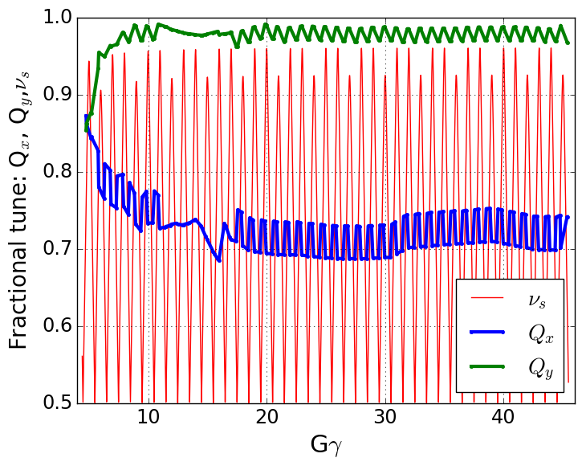
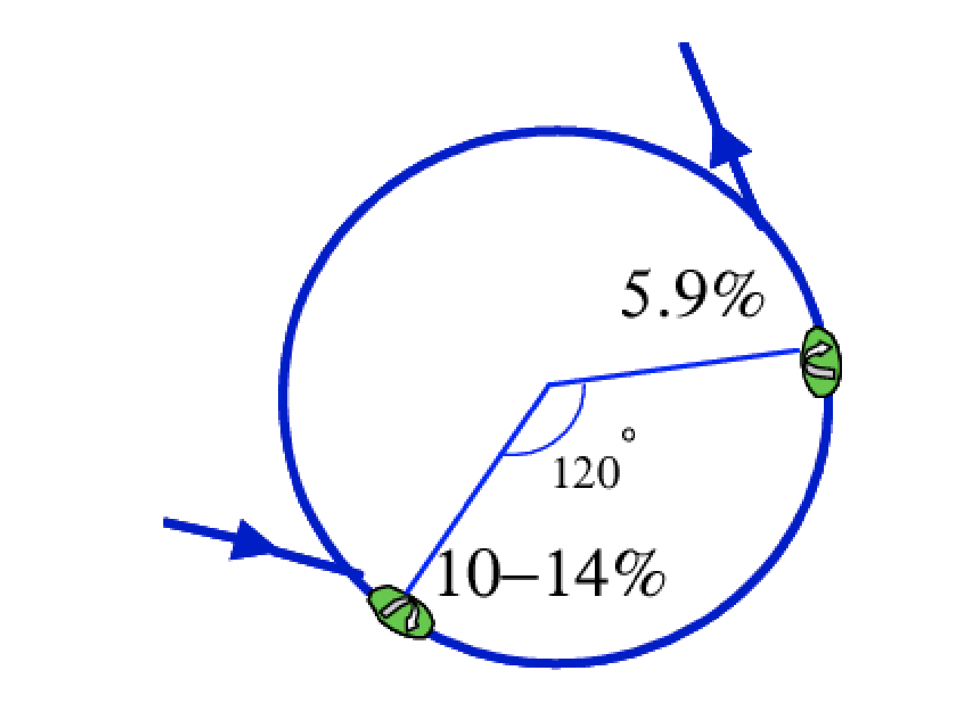
Polarized Protons in AGS
Polarization is preserved in the AGS with two partial helical dipole snakes (10% and 6% rotation)
Provides spin tune ‘gap’ where imperfection and vertical intrinsic resonance condition are never met
  ν_{s} ≠ N (full spin flips)
  ν_{s} ≠ N +/- Q_{y}
Horizontal resonance condition still met
  ν_{s} = N +/- Q_{x}
  Horizontal resonance are weak, but many (82 crossings)
  Currently handled with fast tune jump
    ΔQ_{x} = 0.04, 100 μs
Spin tune gap
Hor resonance crossings
Tune
jump
(pause tune jump
near transition)
Extraction
Injection

Slide 4
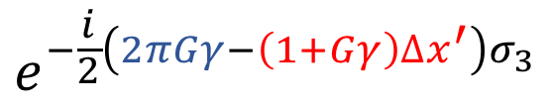
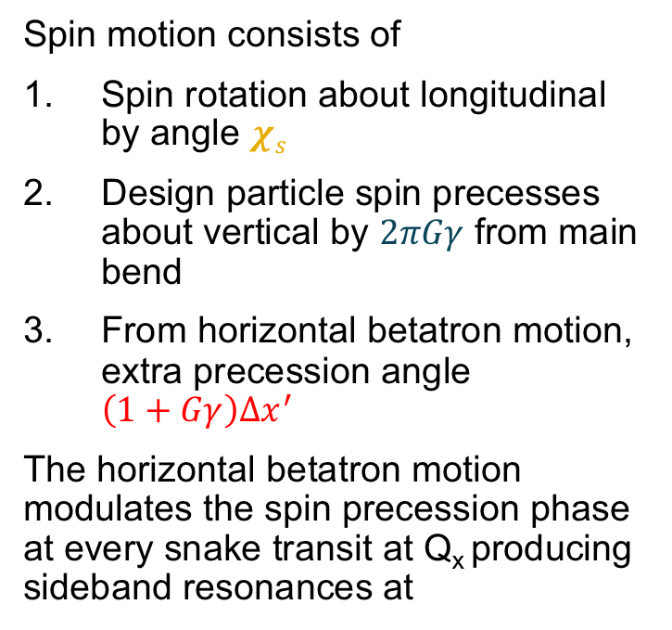

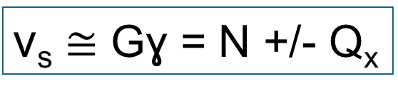
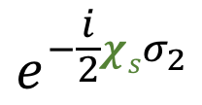
Partial snakes drive horizontal resonances
Simple case (one partial snake)
“Toy AGS ring”
Spin motion consists of
Spin rotation about longitudinal by angle $χs$
Design particle spin precesses about vertical by $2πGγ$ from main bend
From horizontal betatron motion, extra precession angle $\left(1+Gγ\right)∆x^{′}$
The horizontal betatron motion modulates the spin precession phase at every snake transit at Q_{x} producing sideband resonances at
$$e^{−\frac{i}{2}χsσ_{2}}$$
Partial snake
$$e^{−\frac{i}{2}\left(2πGγ−\left(1+Gγ\right)∆x^{′}\right)σ_{3}}$$
$\text{ν}\text{s}$ ≅ Gɣ = N +/- Q_{x}
$∆x^{′}$ = the one-turn change in betatron angle
Same as resonance condition from betatron coupling
Can introduce coupling to exact cancel snake term

Slide 5
Motivation
Tune jump increases polarization 8-10% (relative to uncorrected)
  Simulation indicates this is about half the polarization lost to horizontal resonances
  Tune jump is 100 µs long: requires precise timing, subject to drift
Skew quad correction
  Full cancellation of snake resonance drive with coupling resonance drive 15-20% (relative to uncorrected)
  Correction active for ~1 ms, more tolerant to timing (energy) error

Slide 6
MAC-20 (Dec 2023) Recommendation R6
After applying the overall scaling of the correction, polarization measurements should be performed at several intermediate energy steps where the largest polarization losses are expected. In addition, horizontal spin resonance driving terms should be measured at these intermediate energies.
Single resonance crossing at one intermediate energy accomplished (see later slides). One other energy attempted (GƔ = 35.26) – setup had very low baseline polarization. Not enough time to repeat. Useful effort, to be revisited.
2) Study remaining sources of depolarization by weaker higher order snake resonances or weak hybrid resonances.
Mostly preliminary progress in setting up a Bmad model with full snake field maps, working toward including realistic errors. Not discussed heavily here.

Slide 7
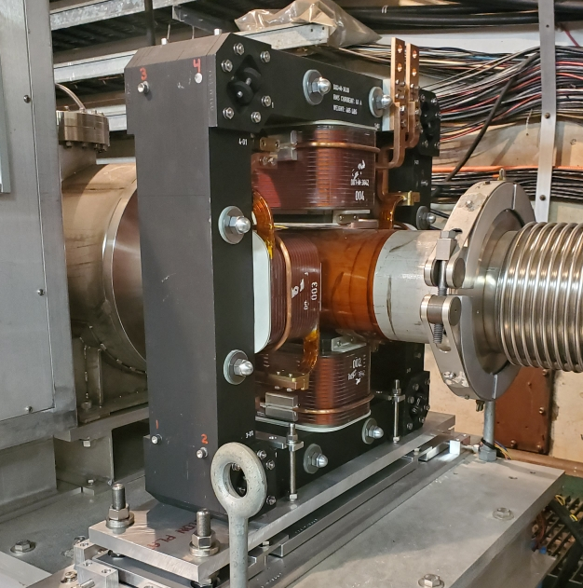
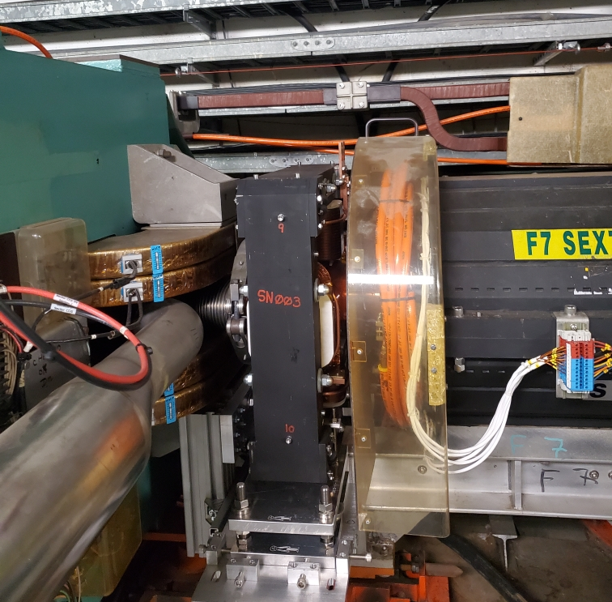
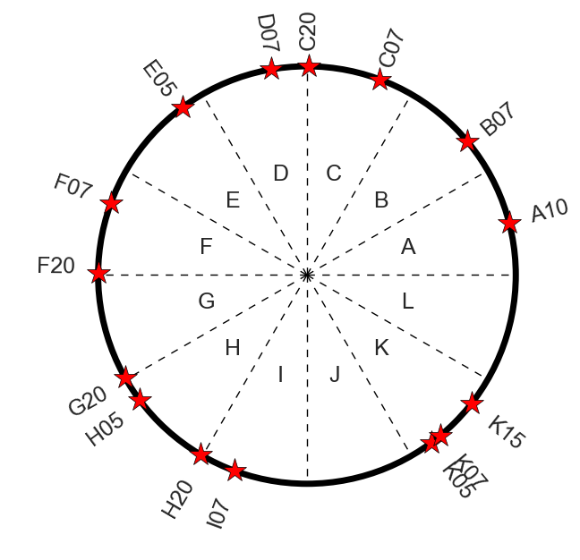
Magnets and locations
A set of 15 skew quadrupoles with integrated skew quadrupole gradient at least 0.2 T meets the physics requirements
  9 placed at narrow locations in the AGS adjacent to sextupoles
  6 locations in longer (mostly empty) straight sections
  Locations determined largely by brute force optimization from the available ~30 locations
  Note: At top energy one AGS main magnet causes ~70° of spin precession
    Geographically close != close in phase
A10
F07
Tune kicker
Main magnet
Chrom sext
Magnet Param |  | unit
Length (mech.) | 0.17 | m
Bore diameter | 0.16 | m
Pole tip field (max) | 0.15 | T
Int grad (max) | 0.32 | T
Current (max) | 275 | A
Current (rms,max) | 60 | A
Lamination thick. | 0.635 | mm
AGS ring
4-Stranded coils
17 turns
Skew quad locations

Slide 8
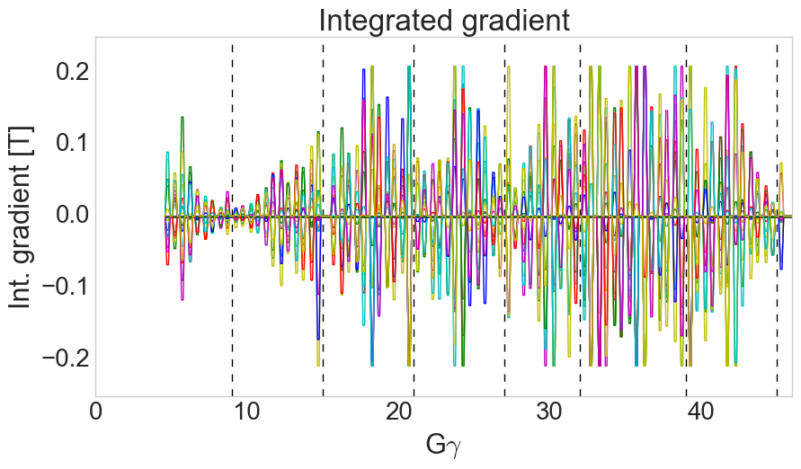
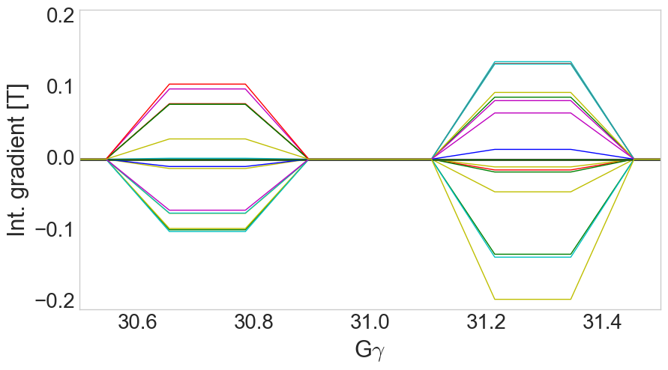
Calculated correction waveforms
Pulsing the skew quads with 1 ms rise, 1.3 ms flattop and 1 ms fall allows changing currents quickly to accommodate new correction vectors every resonance
  Also avoids having skew fields during strong vertical intrinsics (tracking showed small polarization losses at these with skew quads powered)
Calculated resonance strength reducible to zero at almost every resonance
  Tune shift from coupling < 0.005
Each trace= 1 skew quad
1.0 ms
1.3 ms
1.0 ms
8

Slide 9
Commissioning Timeline
Dec ’23 | Jan ’24 | Feb | Mar | Apr | May | Jun | Jul | Aug | Sep | Oct
Unpolarized beam in AGS
RHIC Operation (using AGS tune jump)
Au ops
Delivery of supplies
14 of 15 mags delivered
1 held at p.s. vendor
Polarity checks, orbit tests
RHIC ops
(w/ AGS skew quads)
May 4th
Proof-of-principle experiment
Development of skew quad setup interleaved with RHIC ops
Integrated development time between February start and use for RHIC operations ~20 shifts

Slide 10
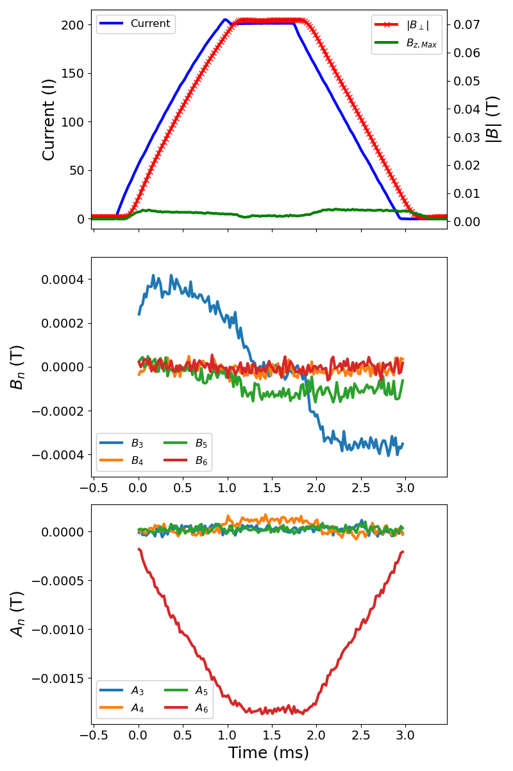
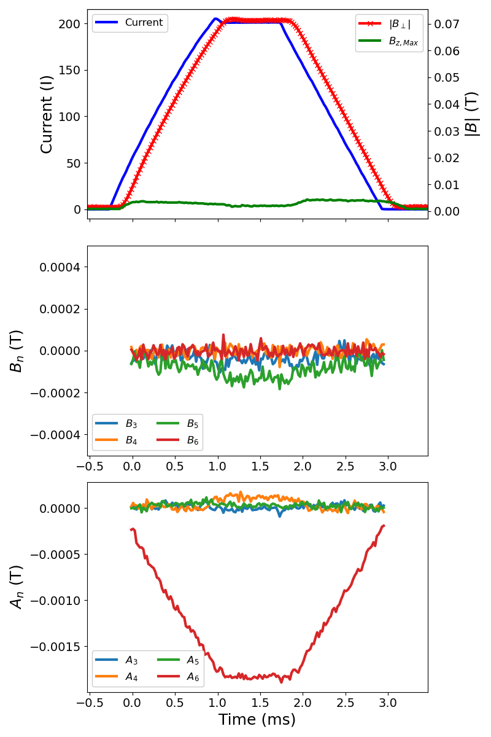
Magnet Measurements
(follow up from previous MAC)
Latch plates: IN
Latch plates: REMOVED
Multipoles measured on magnet #16 with and without the aluminum ‘latch plate’ inserted over the top of the lower magnet yoke (see below).
Support bracket insufficiently well insulated
Normal dB/dt dependent sextupole component vanishes without latch plates. Consistent with removing eddy current effects in lower yoke from the two conducting loops formed by the support
All aluminum latch plates swapped out for G-10 plates
Current, Field magnitudes
Norm. sextupole (blue)
Normal
Absolute Multipole
Skew
Support brackets

Slide 11
Preliminary commissioning tasks
Polarity checks
Beam-based time response checks
Proof-of-principle resonance crossing experiment
Orbit centering in skew quads

Slide 12
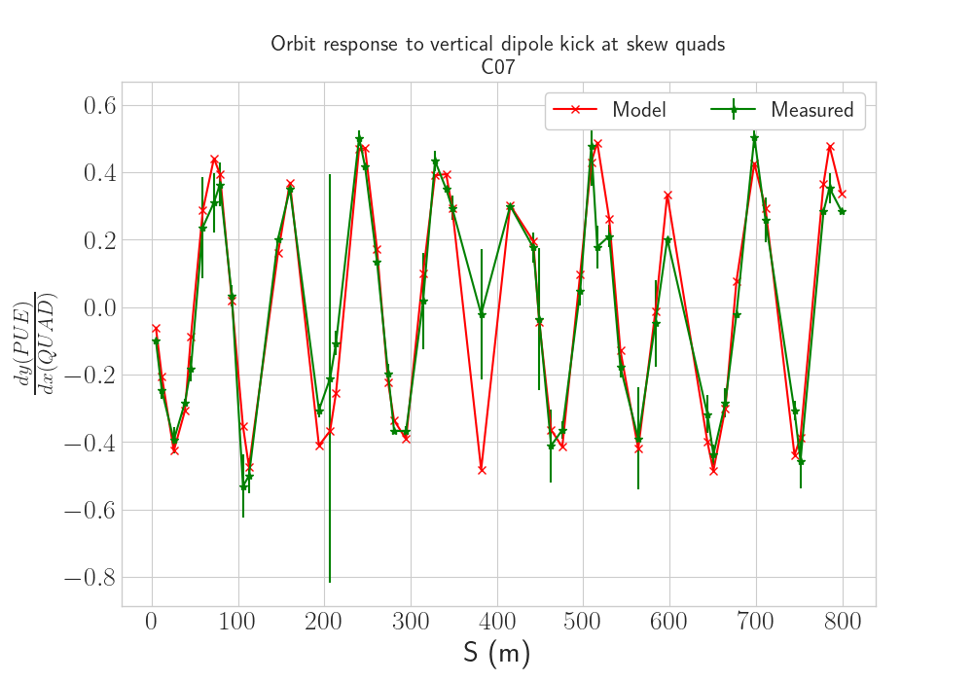
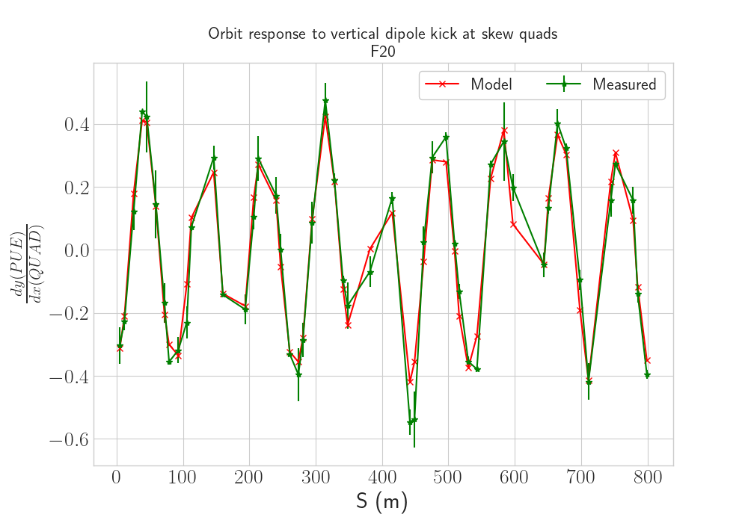
Polarity checks
Vertical orbit response from horizontal orbit shift
Polarity is determined via orbit response
Radial shift introduced : dp/p
Horizontal motion from dispersion at all skew quads of unambiguous sign, horizontal shift predicted using model dispersion
Each skew quad pulsed independently
Vertical orbit response is measured at two values of dp/p, compared to model
Can be done at top energy where model is generally simple
All 15 pass on first check. Easy to reproduce (to verify after p.s. work, long shutdowns, etc).

Slide 13
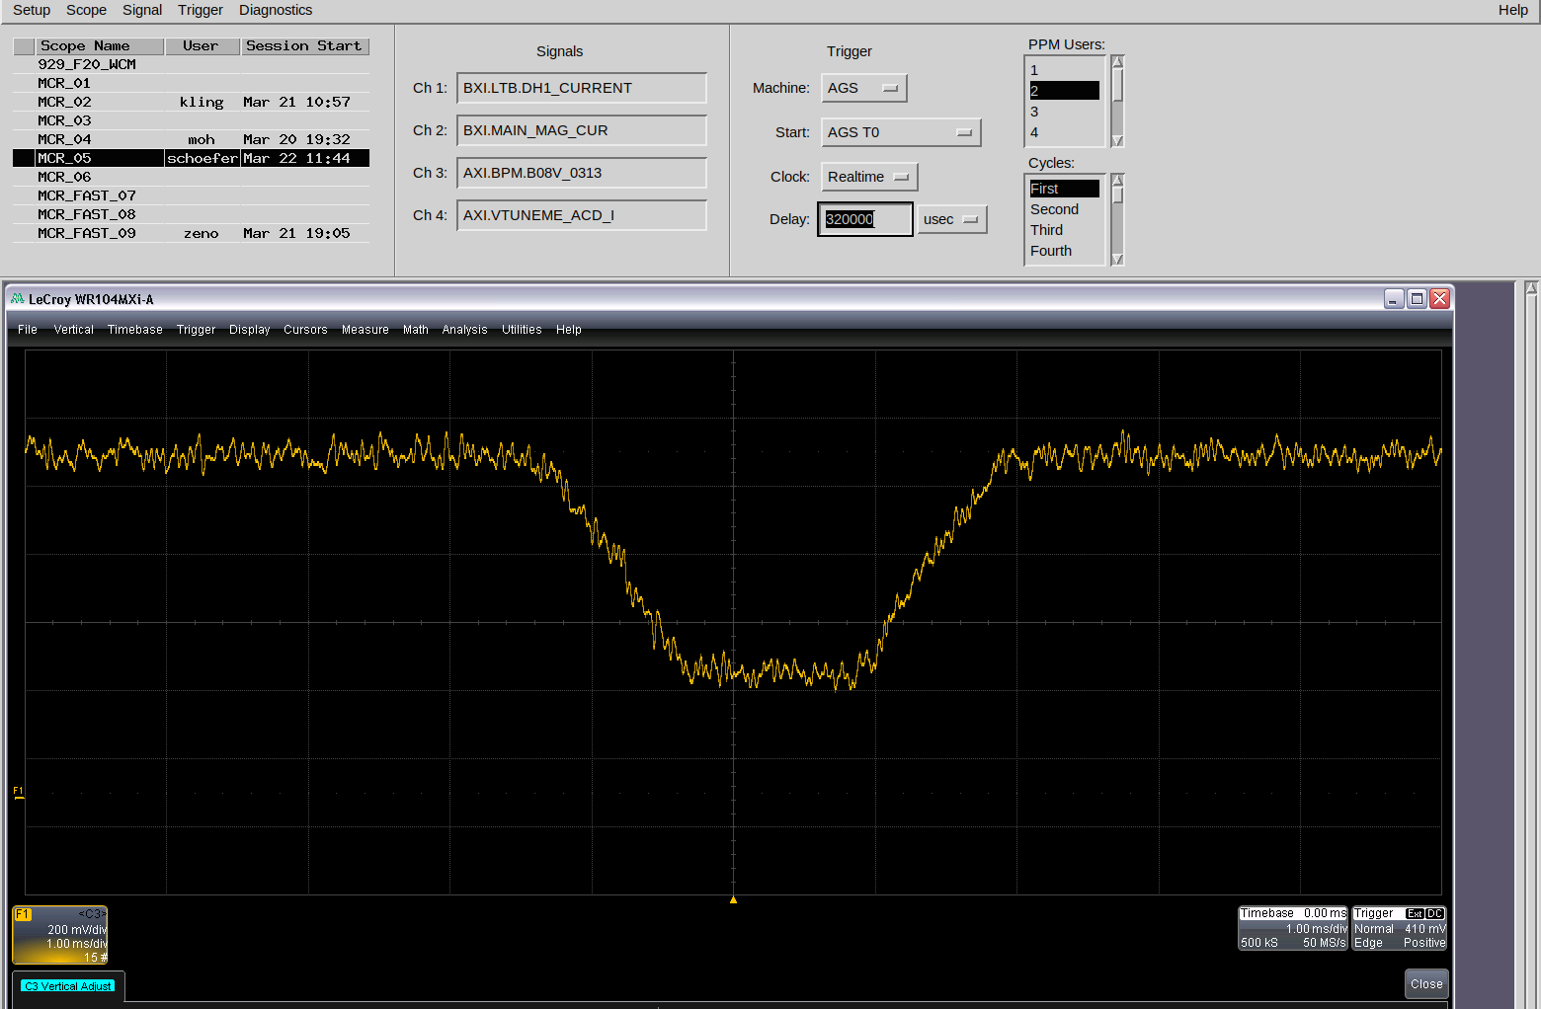
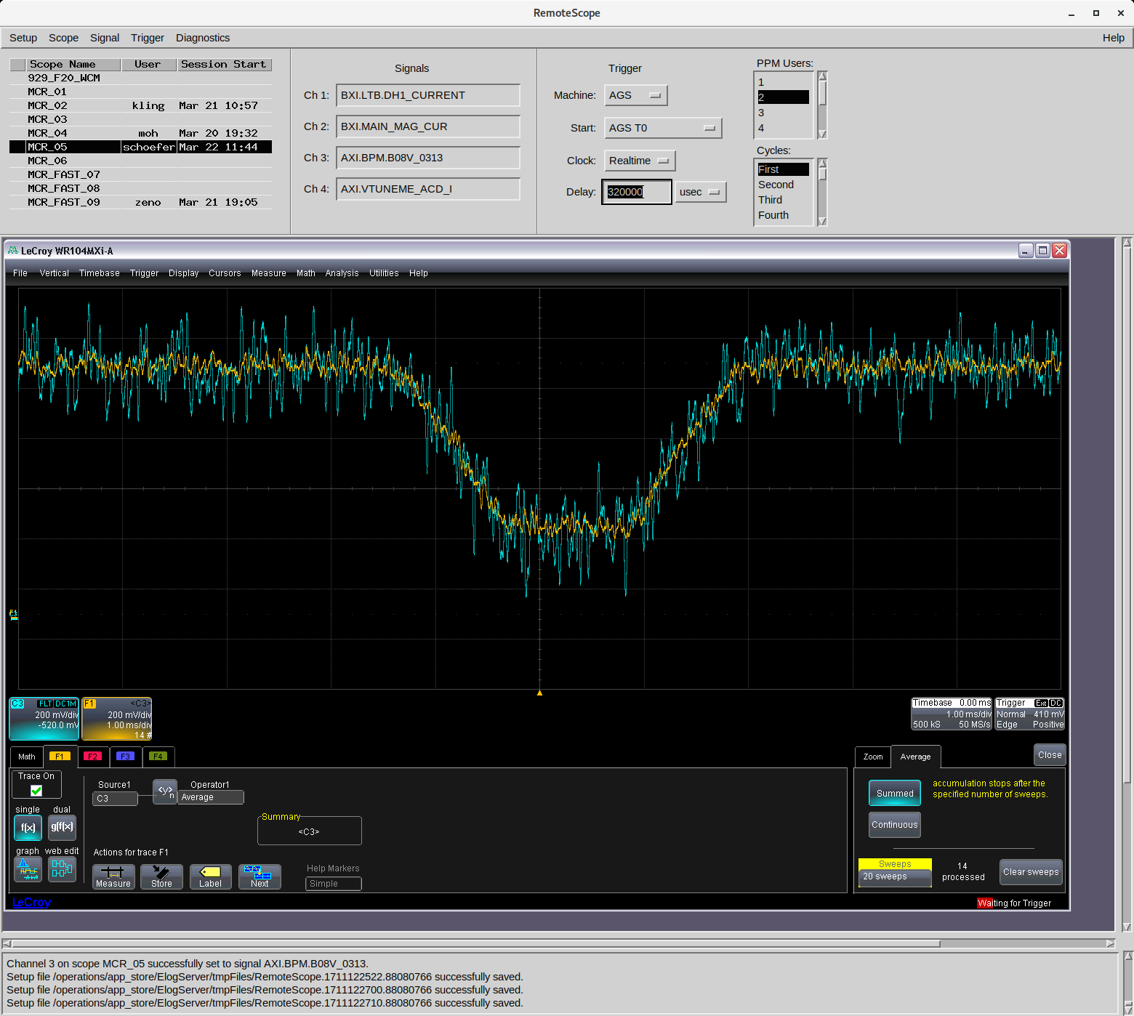
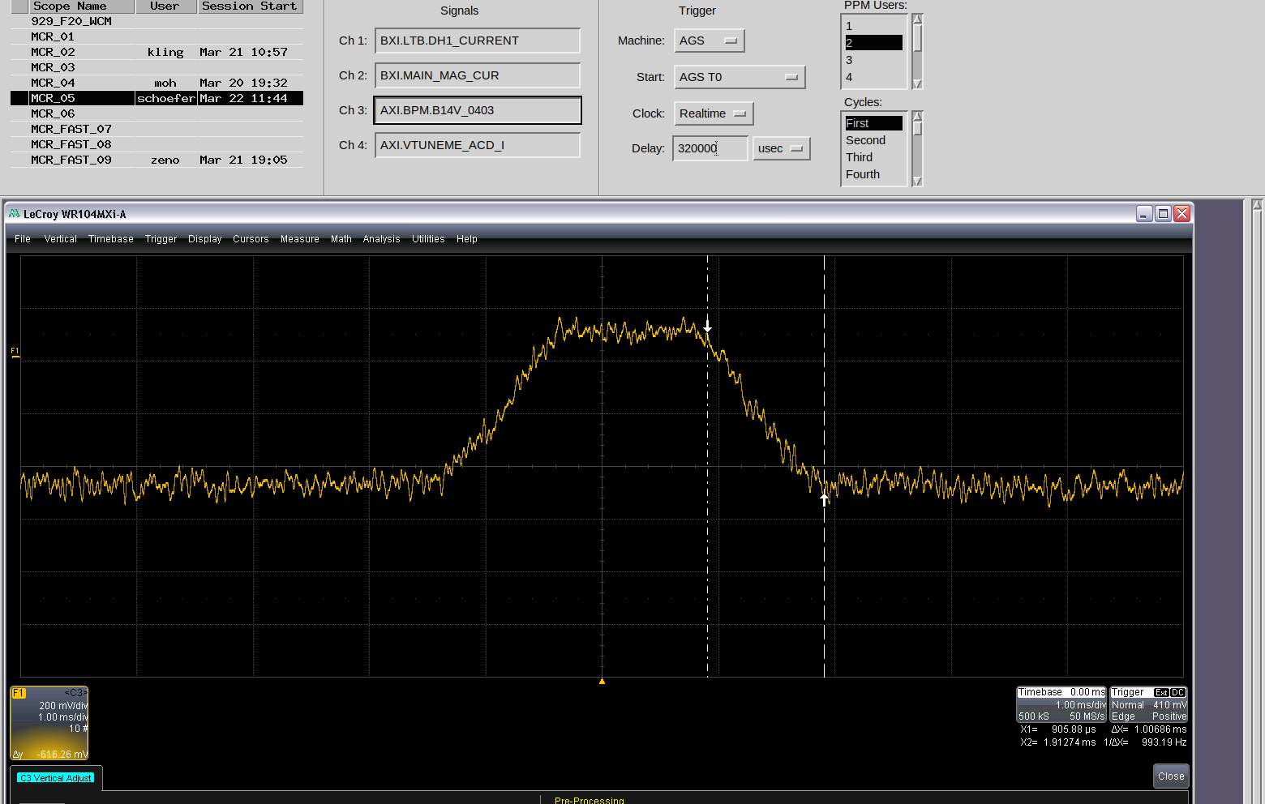
Time response to skew quadrupole pulse
Measure orbit change on analog PUE signal with one quad pulsing to get beam-based time response verification
Flattop is flat? Yes, 1.3 ms flattop
Rise time is as expected? Yes, 1 ms
Pulse delay tolerable? Yes (250 μs by this measure, very close to bench measurement of field response with AGS beam pipe section inserted)
D07
One cycle
Avg (20 cyc)
1 ms
A10

Slide 14
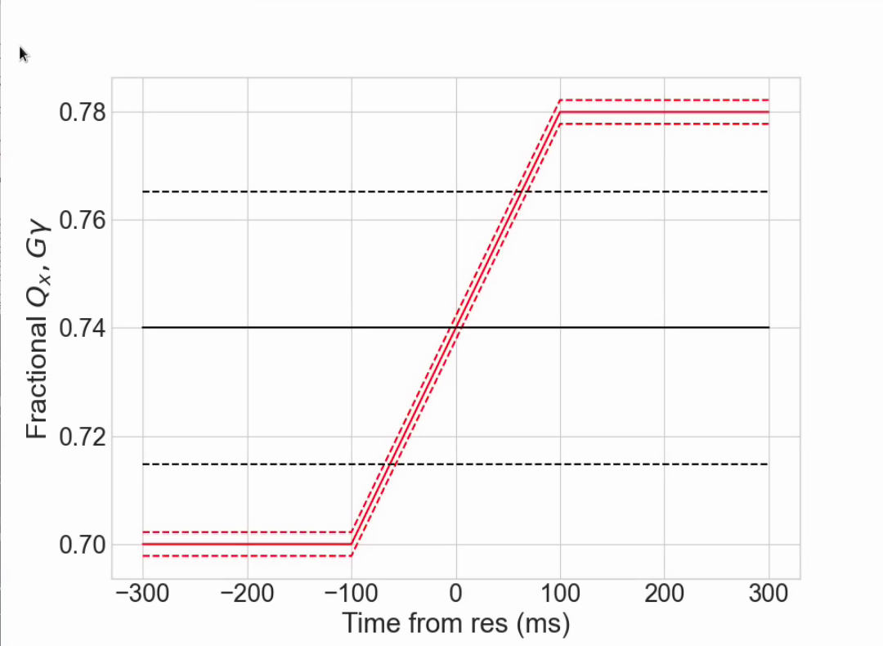
Commissioning: Proof of principle single resonance crossing
At nominal acceleration rate (dGɣ/dθ =4.7 x 10⁻⁵), max polarization loss from a single resonance is 0.1-0.5%
  too small to to measure individually
Configure a crossing at fixed energy: just above nominal extraction, with ramped horizontal tune and very slow ramp rate (>100x longer)
Resonance crossing
Parameter | Value
Gɣ | 45.74
dp/p (full base) | 1x10⁻³
Chrom ξ_{x} | 4
ΔQx | 0.08
Tune ramp length [ms] | 200
Crossing rate (⍺) | 1.7 x 10⁻⁷
Slow crossing gives measurable 20-25% relative polarization loss
14

Slide 15
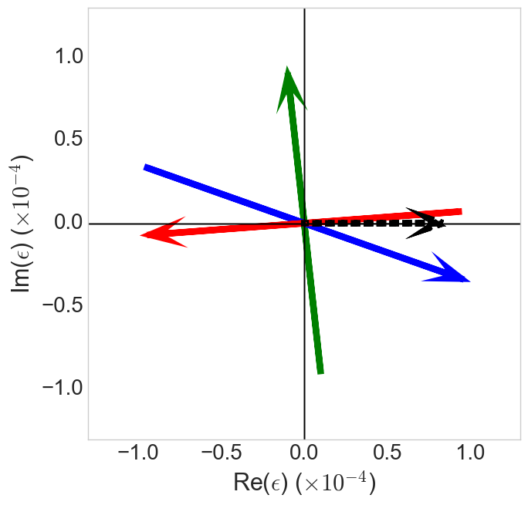
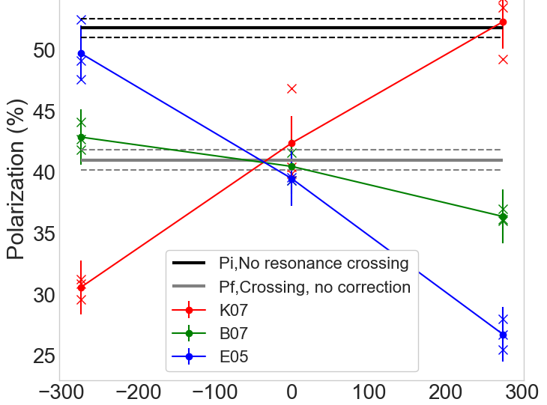
Commissioning: Proof of principle single resonance crossing
Resonance ‘portrait’ at Gɣ = 45.74
Polarization response to skew strength
B07
P_{f}/P_{i} (uncorrected)
0.79 +/- 0.02
|ε|_{meas} = (7.9+/-0.4)x10⁻⁵
|ε|_{mod} = (7.6+/-0.5)x10⁻⁵
|ε| = Res strength
Measured uncertainty is statistical
Model uncertainty is systematic from uncertainty in emittance
Snake drive
K07
E05
Select three skew quads with good relative phasing
K07 in phase with snakes
E05 180º from K07
B07 orthogonal to snake drives
Skew quad arrow length is full current range of supply (arrow head is positive)
Skew quad current (A)
Phasing of skew quads is as expected
Demonstration of total correction
In anti-correcting phase, expect more loss from simple Froissart-Stora estimate
  May be multiple crossings from synchrotron motion during long crossing or flips of high amplitude particles
  To be investigated in simulation

Slide 16
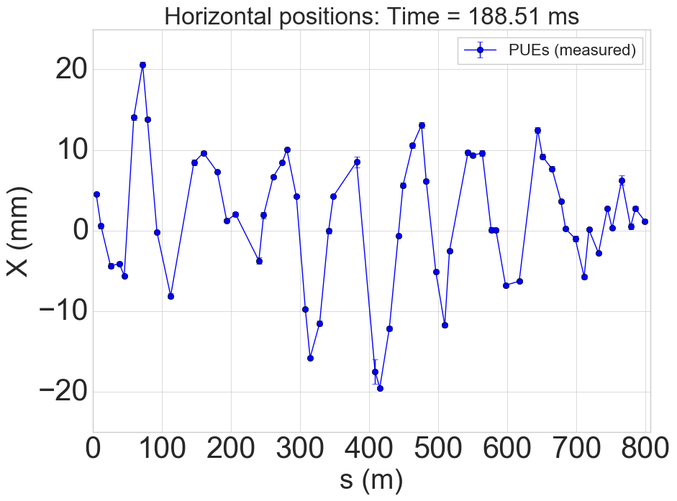
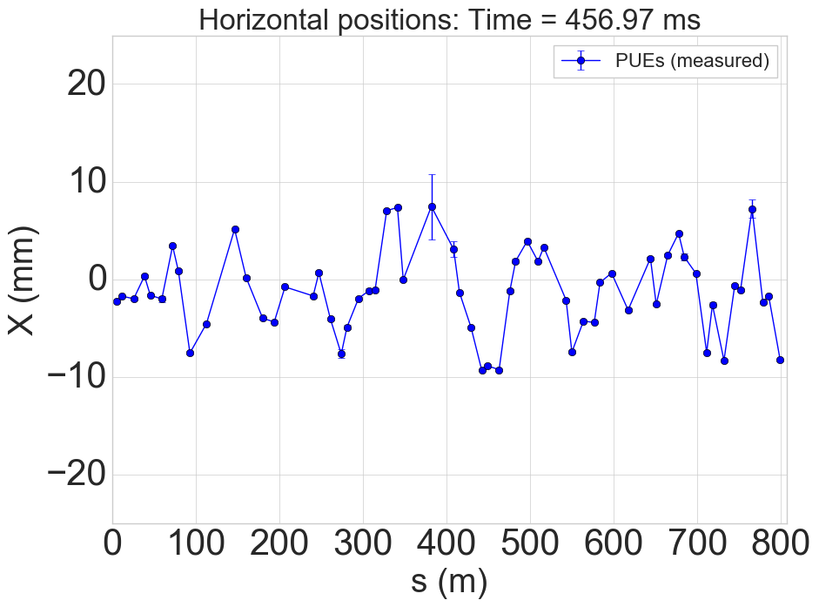
Orbit effects during acceleration
Large horizontal orbit excursions in AGS
High vertical tune (8.985 – 8.991)
Horizontal off-centering in skew quads leads to large vertical orbit changes and beam loss.
Low energy: excursions driven by requirements for helical dipoles
High energy: excursions driven by misalignments
Sample horizontal orbits (at BPMs)
Low energy
High energy
16
16

Slide 17
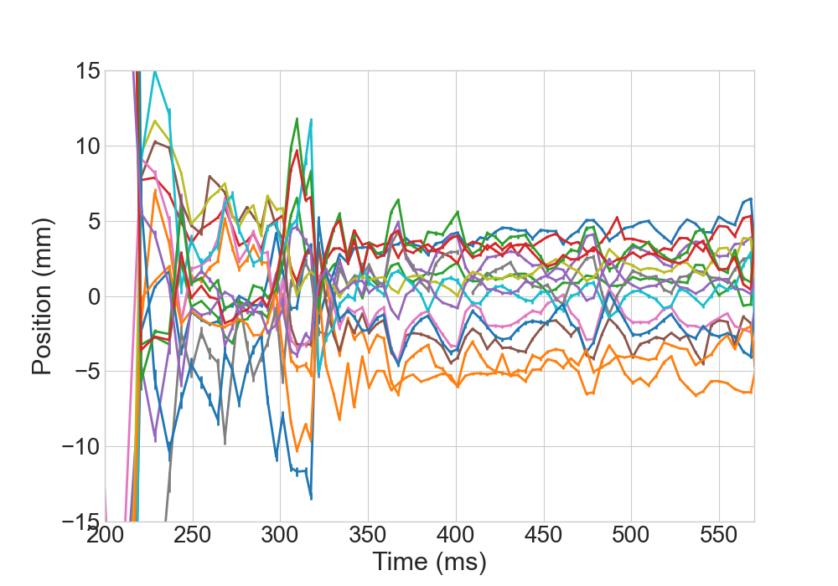
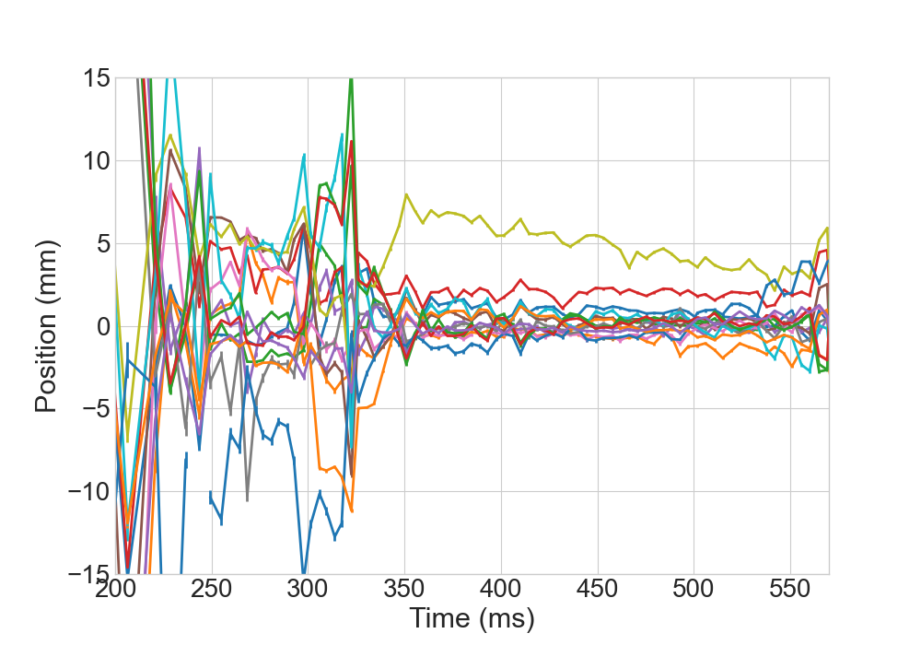
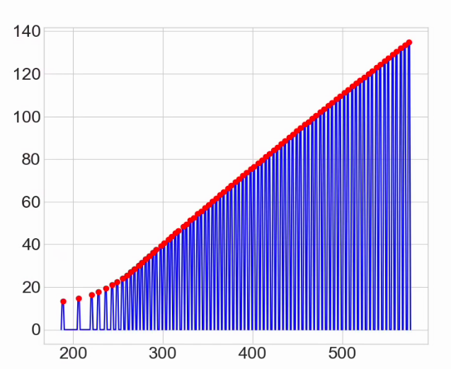
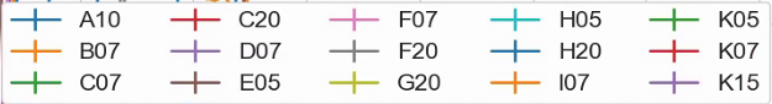
Horizontal position at skew quad
Beam-based centering
No BPMs at skew quadrupole locations
Beam-based orbit offsets measured and corrected
  Skew quads pulsed individually, infer offset from vertical orbit change + model
Orbits at low energy (below transition GƔ ~ 15) not corrected
  Model infrastructure needs to be developed to correct orbit including design orbit specification with backleg windings, injection and snake related manipulations
Before correction
After correction
Sk. Quad current function for orbit measurement
Scales with rigidity
Current (A)
GƔ ~ 15
17
17
Time in cycle (ms)

Slide 18
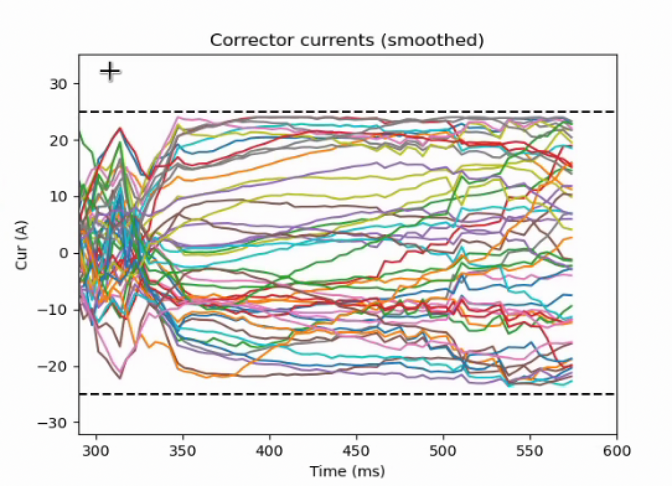
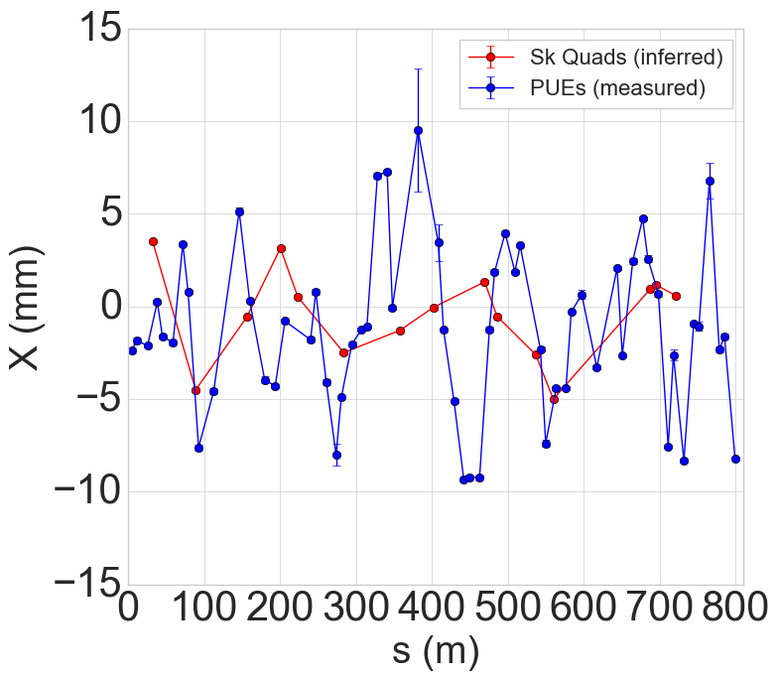
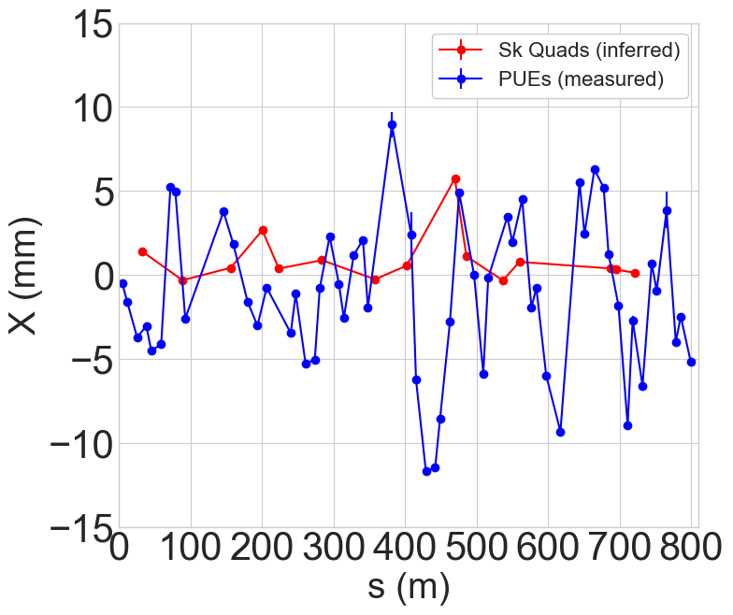
Orbit effects
AGS Hor Orbit Corrector Currents
Centering using orbit steerers accomplished to <2 mm at 13 of 15 locations
Correction objective only at skew quad locations
Outliers at C20 and G20: too demanding on orbit correctors (omitted from most corrections)
Global orbit (at BPMs) not significantly better
Correction in the model above 99% still possible without C,G20
Magnet realignment planned for Run 24 → 25 shutdown to improve base orbit
Discussing adding correctors, upgrading existing correctors
Before correction
After correction
G20
C20

Slide 19
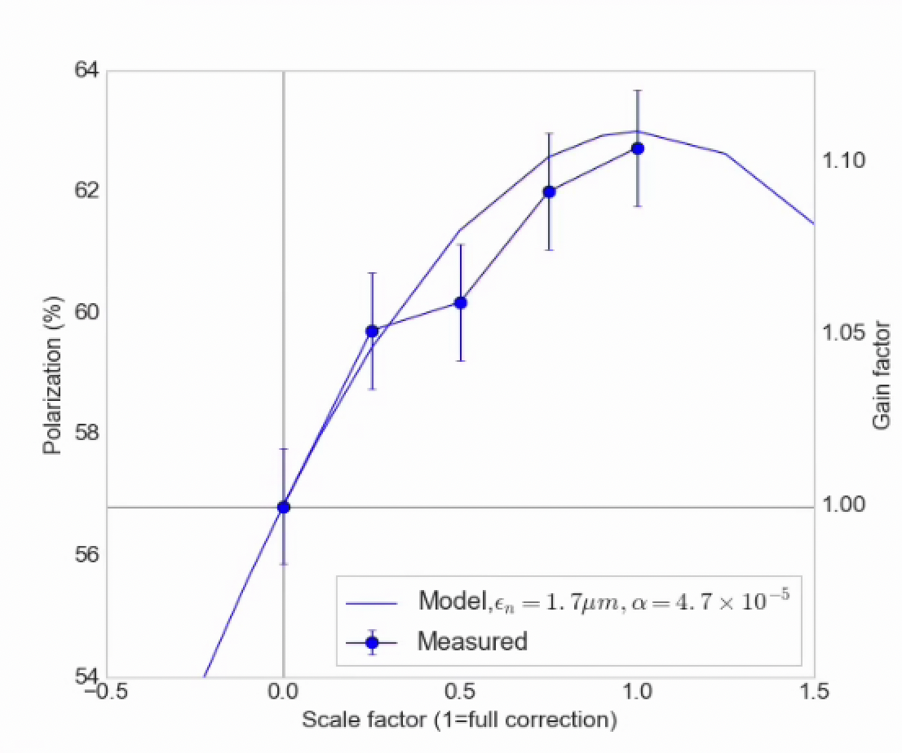
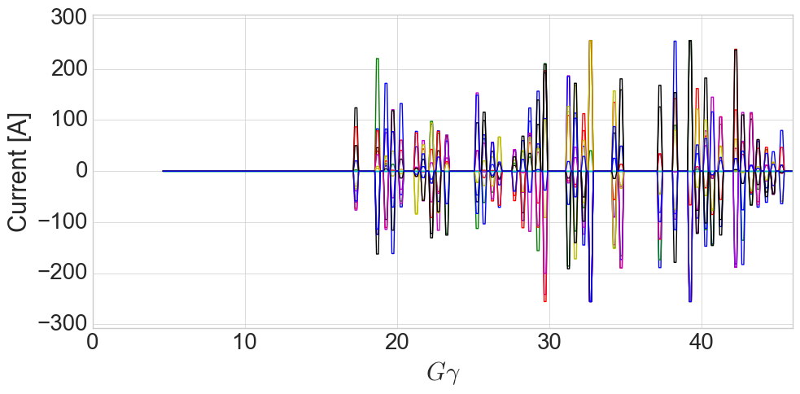
Ramp implementation and Polarization
Early attempts:
  High energy pulses only (avoids difficult low energy optics)
  Omitting several pulses with too large orbit excursions
  Within statistical error of model in terms of gain factor over uncorrected polarization
Correcting only resonance above transition
Skew quad current
Each trace= 1 skew quad

Slide 20
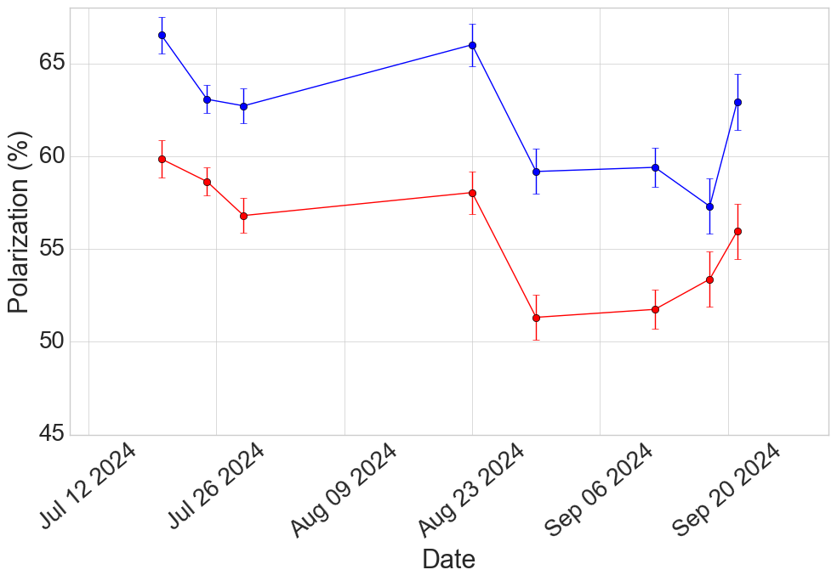
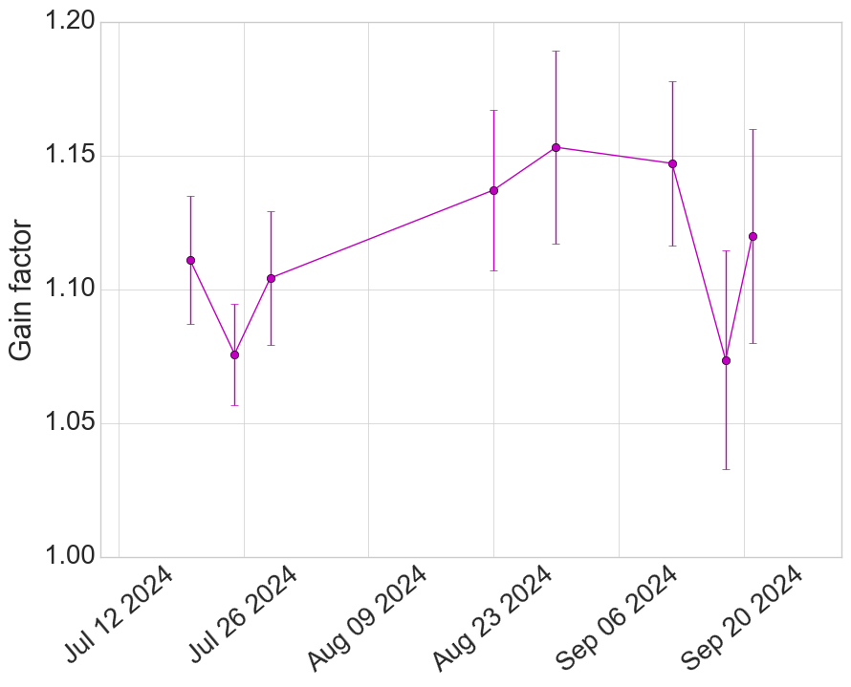
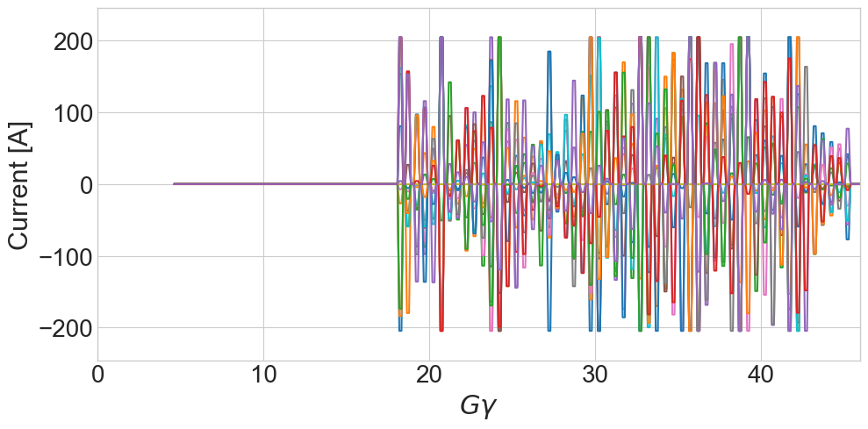
Skew quadrupole commissioning: ramp and polarization
Enabling more pulses via
  Incremental orbit improvements
  Included model-predicted orbit response of the skew quads in the optimization to minimize resulting vertical rms, constraints now:
    Resonance strength, |ε| = 0
    Tune shift from coupling, ΔQ_{y}< 0.005
    Vertical |M_{orm}*(k_{skew}*x_{skew})|_{max} < 2 mm
      Requires some increase in quad current
Polarization comparison
Skew quads ON
Skew quads OFF
Orbit iterations
Add pulses
Skew quad currents
Polarization ratio
Skew Quads ON/OFF
Each trace= 1 skew quad
20

Slide 21
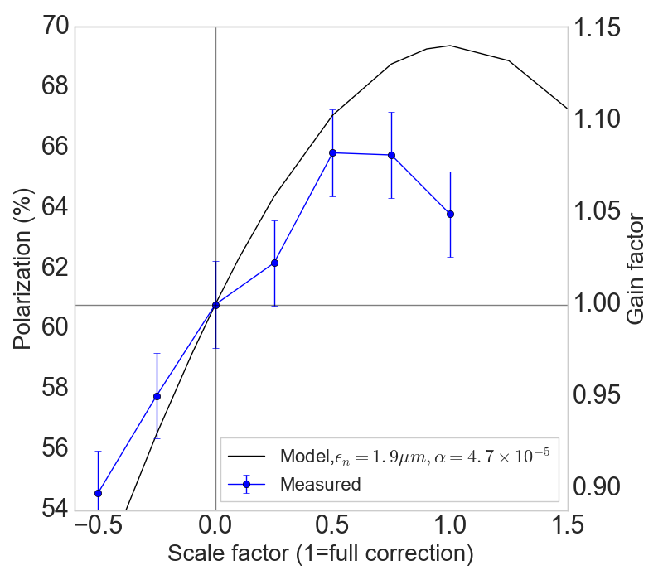
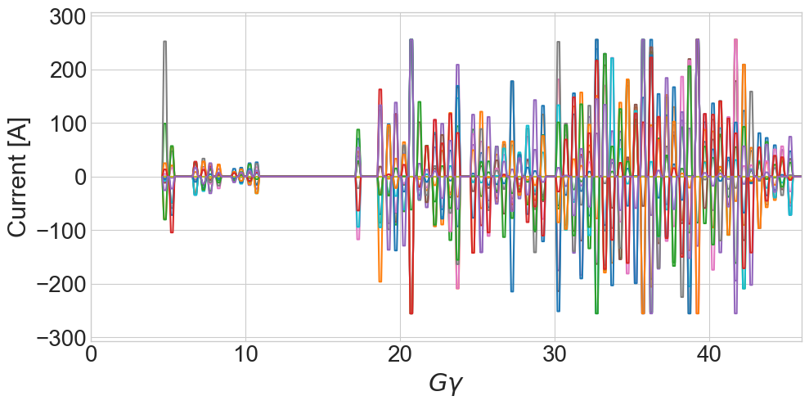
Low energy resonance correction
Benefit from low energy pulses (GƔ < 15) expected to be ~3-4%
Measured benefit ~1%
In some cases negative, less reliable correction
Not totally understood – possible culprits:
Model error is highest at low energy (snakes, orbit feed-down)
Q_{x} closer to Q_{y}: residual coupling from errors will change the drive term addressed by the skew quads
Near GƔ = 9 =0+Q_{y}, very small correction strengths required (easy to provoke extra resonance terms from coupling)
Correcting scaling, full cycle
Orb correction also enables broader scans
Skew quad currents
Intentionally omit
Near transition
Each trace= 1 skew quad

Slide 22
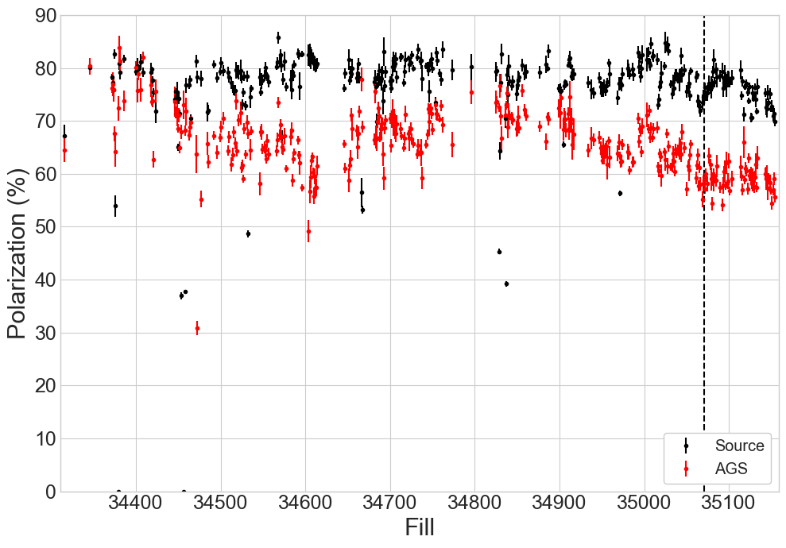
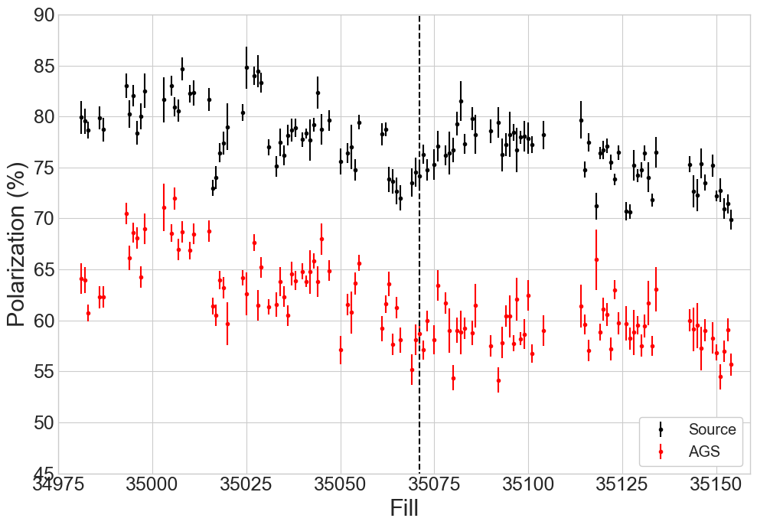
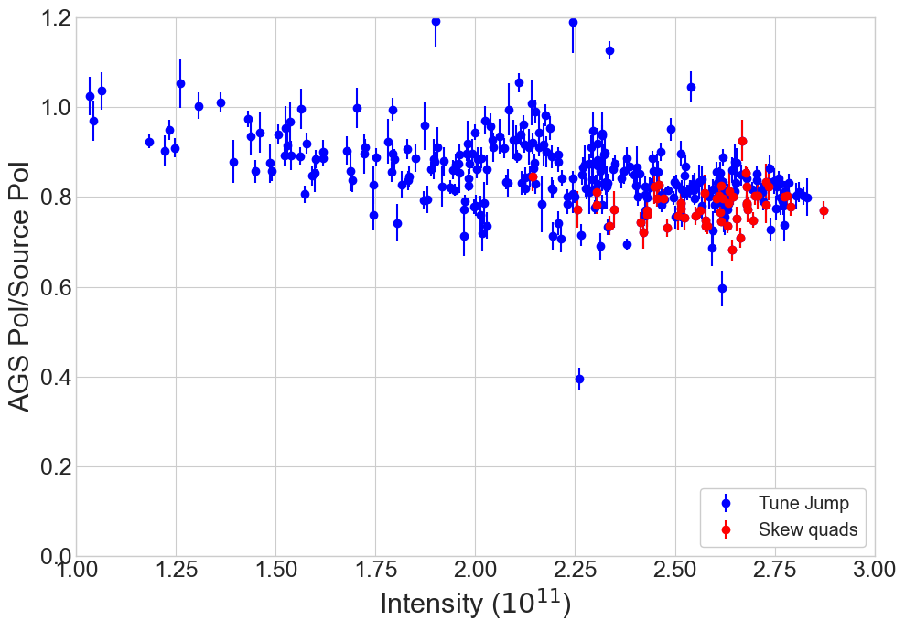
Operations with skew quad correction
Last ~3 weeks of RHIC polarized proton operation, beam delivered from a skew quad correction setup rather than tune jump
No significant downtime of skew quad system
Performance similar to tune jump, especially at highest intensity
Coincides with relatively low polarization in all AGS setups
AGS Pol by RHIC fill
Begin using skew quad setup for RHIC
AGS Pol/Source Pol, by RHIC fill

Slide 23
Prognosis
Gain factor over uncorrected case (after initial orbit iterations):
  Average: 12.6% +/- 1.5 % (relative)
  Peak 15%
Polarization gain from resonance at high energy in good agreement with model predictions
  Model generally more accurate at higher energy
+1% possible from including resonances in the ‘transition gap’
  Requires some model infrastructure
+3% possible from improving model for low energy resonances
Losses from residual coupling resonances, not included in the idealized model need to be estimated
  Unknown magnitude

Slide 24
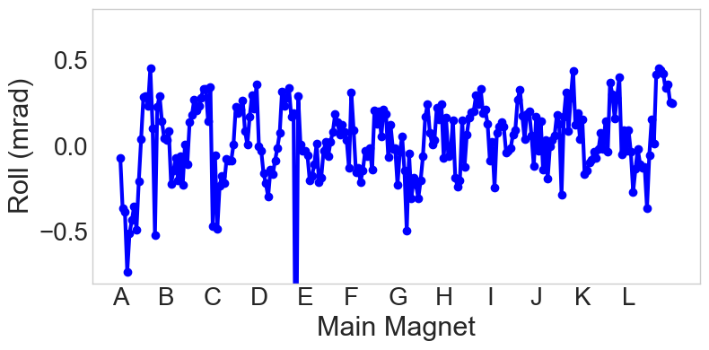
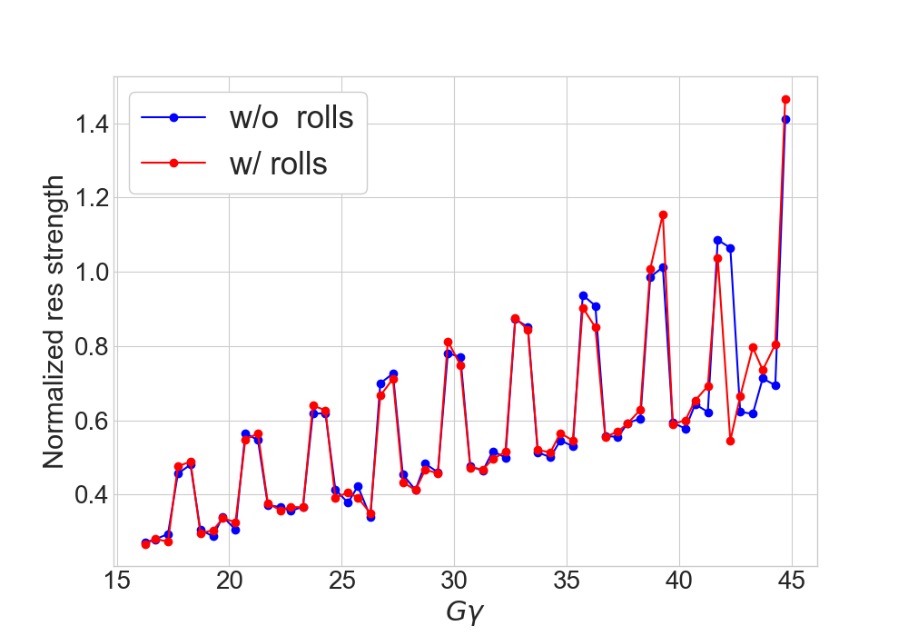
Main magnet roll
AGS Main Magnet Rolls (2012)
Using survey data from 2012 and the Bmad model, polarization loss from residual coupling can be estimated
  Rolls in main magnets is systematically toward backleg of the “C” shape: switches every 10 magnets
Clear effect on resonance strength at highest energies
  Impact on polarization estimated to be small (<0.25% total)
Further model work planned to investigate sensitivities at low energy
  Lattice structure might make it easier to provoke depolarization
Resonance calculations with 2010 main magnet rolls
Small impact at high energy
Working on the low energy model

Slide 25
Future work
Run 25 AGS development time planned behind RHIC for most of the run (including behind Au operation)
  Up to 8 weeks of RHIC operation possible for polarized protons
AGS Survey and realignment planned for this shutdown Run 24 → 25
  Simplifies/improves machine-model match at low energy
  Relaxes required skew quad corrector strength (do not have to include skew quad orbit response constraint)
Resonance correction is heavily model dependent → Develop models with realistic machine errors included
  Requires continued development of the Bmad version of the lattice (to replace SPRINT) for inclusion of all effects
  Rolls and vertical displacement in sextupoles both contribute to unknown sources of depolarization that could be addressed with skew quad correctors
  Longer term: TBT BPMs planned to characterize local optics, including coupling
  All model efforts synergistic with the overall Machine Learning/digital twin effort (see G. Hoffstaetter talk) and efforts to fully characterize other sources of polarization loss
Beam measurements
  More precise characterization of low and high energy resonance contributions and corrections
  More single resonance crossing experiments: focusing on difficult to correct resonances at high energy and some low energy resonances
    Simulation required to fully understand effects of slow crossing
  Measure correction effect with currents calculated using realistic machine errors

Slide 26
Summary
Magnets and power supplies delivered and installed in time for commissioning in Run 24
All commissioning tasks completed successfully: polarity checks, proof-of-principle experiment, orbit centering, demonstration of correction effect during acceleration
Gain factor in dedicated experiments of up to 15% measured, long term average 12.6%
  Exceeds the performance of the tune jump in dedicated measurements
  Similar performance to tune jump in longer term operation (in first commissioning run)
Correction effect consistent enough in operation to replace the tune jump as the default system for horizontal resonance correction
Identified areas for further improvement/study:
  Improve orbit control and alignment
  Simulate effects of machine errors
  Study factors affecting the efficiency of the low energy resonances

Slide 27
Backup slides

Slide 28
Timeline details
Dec 2023: 14/15 magnets in hand and measured (last one held at local power supply vendor for supply testing)
Jan 2024 - Apr: Delivery of power supplies 3-4 supplies every few weeks
  Installation, modification and testing on a continuous basis
Feb 5th: unpolarized beam available in AGS (cold snake and polarized source both unavailable)
  Feb-March: Skew quad polarity tests, development of other proton setups
Mar 29th: Cold snake available: enables start of orbit correction/centering development since orbit/optics in operational configuration
Apr 10th: All 15 magnets and supplies available for testing
Apr 20th: Start of RHIC beam operation, first injections
Apr 24th : Polarized source available → polarized proton beam available in AGS for first time this run
May 4th: Proof-of-principle single resonance crossing experiment: demonstrates skew quad correction principle
  May – Sep: Interleaved development in AGS and RHIC operation. RHIC takes beam from the ‘tune jump’ setup
Sep 7th: RHIC begins taking beam from the skew quad setup
Sep 30th: End of RHIC and AGS polarized proton operation (RHIC switches to Au, proton Linac goes to shutdown)

Slide 29
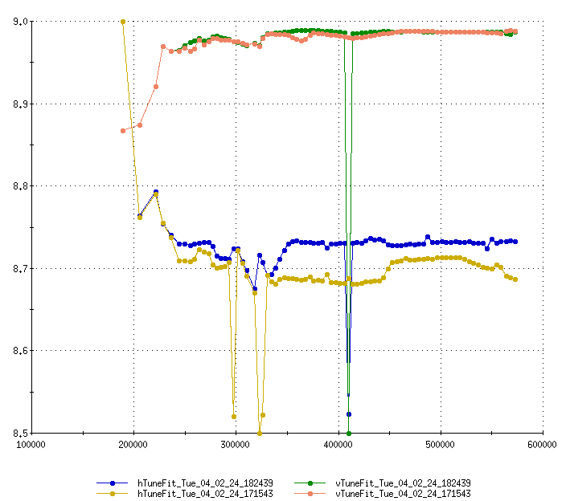
Tune change for resonance timing
Power supply ramping constraints require a minimum 3.7 ms between pulses
Time between resonance depends on tune: GƔ ~ N +/- Q_{x}
Tune jump setup has a base tune of 8.7 (jumps up to 8.74)
Skew quad setup requires at least 8.72. Operations at 8.73
Qy
Tune
Qx
Time

Slide 30
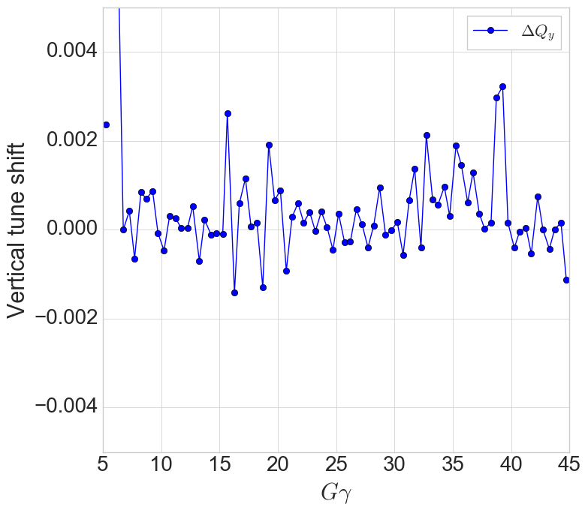
Tune shifts from skew quads
Design goal was vertical tune shift <0.005
Operationally mostly <0.002
One outlier at 0.008

Slide 31




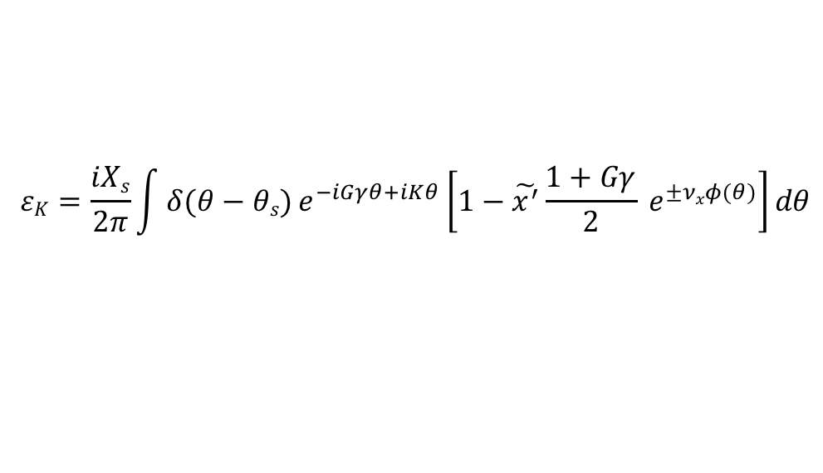
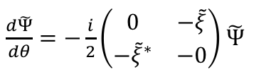



Partial snake resonances are ‘hybrid’ resonances
M.Bai showed horizontal closed orbit motion can interact with a vertical intrinsic to produce a set of sideband resonances*.
Similar procedure shows horizontal betatron motion can interact with the snake spin kick in the same way
$\frac{dΨ}{dθ}=−\frac{i}{2}\left(\begin{matrix}F & −ξ \\ −ξ^{∗} & −F\end{matrix}\right)$ $Ψ$
$$Ψ=\exp{[\frac{i}{2}σ3(Gγθ−(1+Gγ\text{)}\text{x}\text{’(}θ)ρ\text{ ]}\tilde{Ψ}}$$
$\frac{d\tilde{Ψ}}{dθ}=−\frac{i}{2}\left(\begin{matrix}0 & −\tilde{ξ} \\ −{\tilde{ξ}}^{∗} & −0\end{matrix}\right)$ $\tilde{Ψ}$
$$ξ=i Xs δ\left(θ−θs\right)$$
$$spin precessing frame$$
$\tilde{ξ}=i Xs δ\left(θ−θs\right)$ $e^{−i(Gγθ−\left(1+Gγ\right)x^{′}\left(θ\right))}$
$$F=Gγ−\left(1+Gγ\right)x′′(θ)ρ$$
$\tilde{ξ}=i Xs δ\left(θ−θs\right)$ $e^{−i(Gγθ−\left(1+Gγ\right)x^{′}\left(θ\right))}$
$$x^{′}(θ)=\tilde{x^{′}}sin⁡(νxθ)$$
Expansion to get trig out of the exponent. Keep linear terms and Fourier transform:
$$εK=\frac{iXs}{2π}\int{δ(θ−θs)}e^{−iGγθ+iKθ}\left[1−\tilde{x^{′}}\frac{1+Gγ}{2} e^{±νxφ(θ)}\right]dθ$$
*Phys Rev Lett, Vol 84, 6, 2000

Slide 32
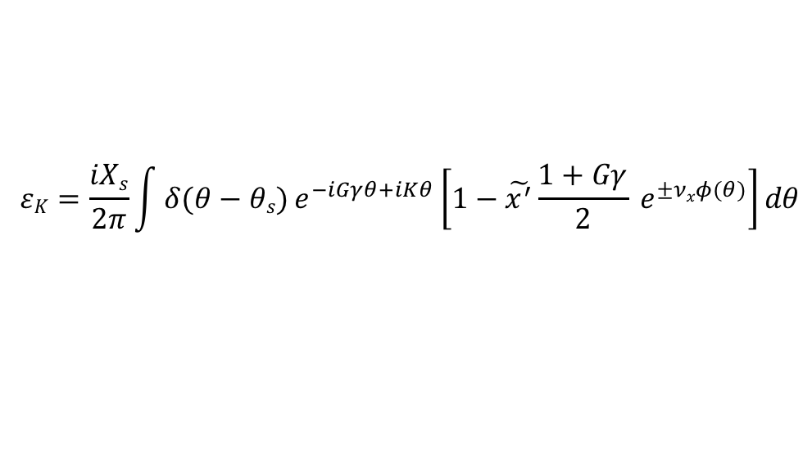

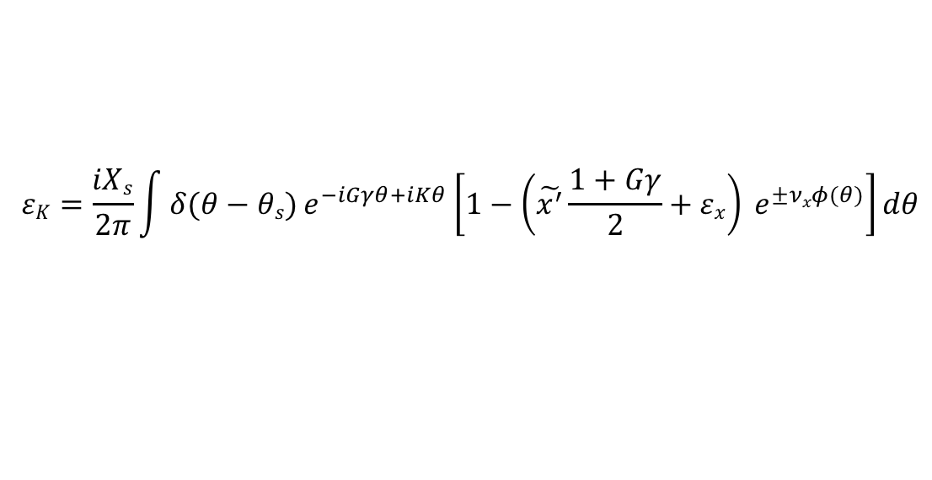
Partial snake resonances are ‘hybrid’ resonances
$$εK=\frac{iXs}{2π}\int{δ(θ−θs)}e^{−iGγθ+iKθ}\left[1−\tilde{x^{′}}\frac{1+Gγ}{2} e^{±νxφ(θ)}\right]dθ$$
Term 1: Amplitude X_{s}/2π, non-zero when $Gγ=K$ , snake imperfections
Term 2: Amplitude ~ $\tilde{x^{′}}$, non-zero when$Gγ±νx=K$ , intrinsic resonance driven by the phase modulation of the snake imperfections
What if another intrinsic resonance is present at frequency ν_{x}:
$ξ=i Xs δ\left(θ−θs\right)$+ ${εxe}^{±νxφ(θ)}$
$$εK=\frac{iXs}{2π}\int{δ(θ−θs)}e^{−iGγθ+iKθ}\left[1−\left(\tilde{x^{′}}\frac{1+Gγ}{2}+εx\right) e^{±νxφ(θ)}\right]dθ$$
A second intrinsic resonance at the horizontal betatron tune can be used to cancel the partial snake resonance term.
Easiest way to make one is with betatron coupling

Slide 33
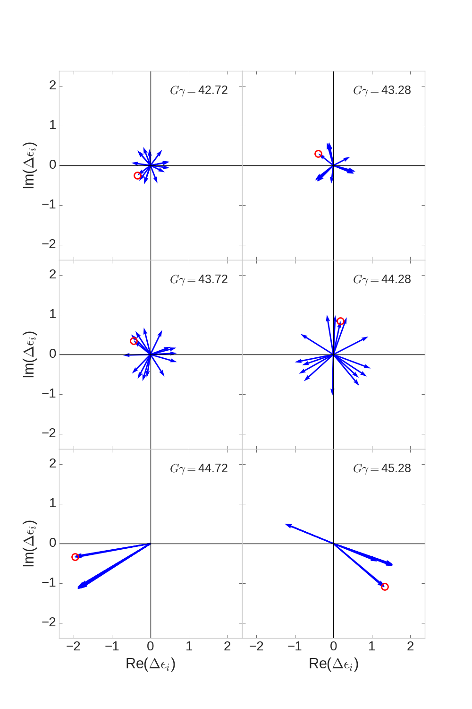
Partial snake resonance suppression with betatron coupling
Skew quad correction vectors (last six hor resonances)
In principle minimizing resonance strength (calculated with SPRINT) and coupling (two complex numbers) takes 4 skew quads
BUT:
There are 82 such linear algebra problems to solve
AND:
Phasing between skew quadrupole terms and snake terms varies wildly resonance to resonance
AND:
Correction vectors are frequently parallel, especially near strong vertical intrinsic resonances
Solution strategy: search for a solution with a distributed number of weaker, fast ramping skew quadrupoles
Phase offset chosen so that snake drive term is purely real
Red circle marks the same skew quad in each frame, phase changes rapidly from resonance to resonance

Slide 34
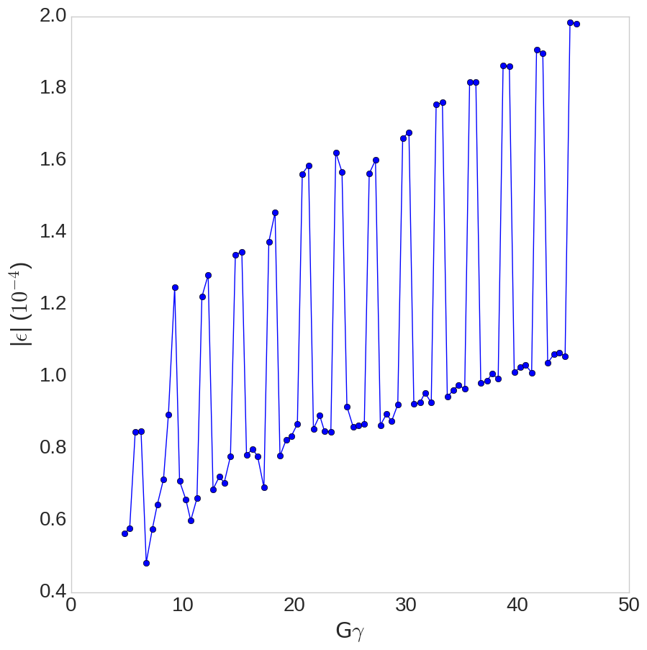

Horizontal resonance strengths in the AGS
Horizontal Resonance Amplitudes in AGS
Two snakes, separated by 1/3 circumference
  Modulated resonance amplitude highest near Gɣ = 3N (when snakes add constructively)
Horizontal resonances occur
every 4-5 ms at the standard AGS acceleration rate
$$ε_{x,rms,norm}=1.67 μm$$

