Slide 1
MAC-20 Recommendation
R12 (Permanent magnet applications (LDRD 22-013)): => Stephen
Working with collaborators, a) develop practically realistic procedures for tuning long magnets, taking into account the need to integrate magnets with vacuum chambers, while maximizing vertical aperture for the beam; b) Develop practical methods for integrating vacuum chambers into long magnets, possibly taking into account NSLS-II upgrade design efforts.
The CEBAF 20GeV energy upgrade collaboration looked for funding to build a full-length magnet in 2024
Both FOA and SBIR were applied for
DOE response was that project was too far in the future to require SBIR funding at present
NSLS-II upgrade has made an assembly of 15 short permanent magnets
Gaps between sections are used for ribs to strengthen vacuum chamber against vertical collapse
Permanent magnets are manufactured from shorter sections regardless
CEBAF design already uses this segmentation to allow magnets to follow beam path curvature to reduce required aperture
Conclude that it may be more effective to manufacture and tune short segments and assemble them onto a girder

Slide 2
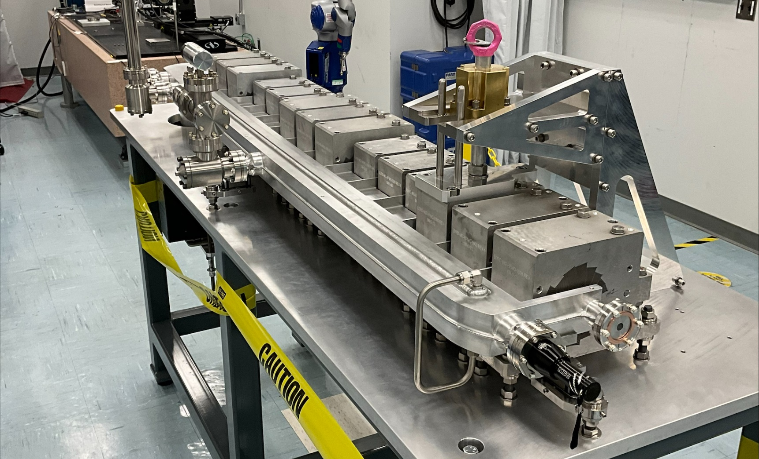
NSLS-II Upgrade Permanent Magnet Assembly & Vacuum Chamber Ribs

