Slide 1
MAC-20 Recommendations

Slide 2
EBIS status and performance ramp-up plan
1) For the issue of discharges observed in the short trap, consider a dedicated conditioning test under consistent conditions, of the order of half a day, to clarify if the discharges can be conditioned or not, and to understand the “decay time” of this discharge.
The major limitation found during EEBIS commissioning was a pressure rise in the gas trap region, which affected the Au³²⁺ion beam intensity and its pulse-to-pulse stability during operation with 12 EEBIS pulses at 5 Hz per 6.6 second supercycle. This effect was especially severe when EEBIS operated with high-current (above 6 A) electron beam. We believe that this pressure rise is caused by E cross B discharges (E - local electric field, B – magnetic field), which develop in the vicinity of the gas trap when operating at high (5 Hz) rep-rate. A summary of experimental observations from tests during which EEBIS was operating with a BaO cathode are included below:
The electron beam plays a key role in initiation of discharges; no pressure rise was observed within one hour time with all EEBIS potentials were applied and the EBIS cycle active, but with the electron beam turned off.
In the presence of a discharge, the vacuum pressure developed consistent with the structure of the electron beam pulse train. Pressure observations were consistent with the aliasing produced by asynchronous sampling of pressure excursions produced by a pulsed electron beam and transient application of high voltages to the EEBIS drift tubes.
Above a certain pressure threshold, the observed behavior on the pressure gauge continued, even when the electron beam was turned off . This is because of the continued application and HV switching of potentials on the EBIS drift tubes and other electrodes such as the cathode and electron beam collector.

Slide 3
EBIS status and performance ramp-up plan
The pressure relaxation time after turning off the electron beam is relatively long - about 30 minutes
The rise in pressure during electron beam propagation, depends on multiple EEBIS settings with the e-gun coil current, which defines the local magnetic field, having the strongest effect. Under certain conditions, a one A change (less than 1%) in this coil current reduced the pressure risetime by a factor of about 10!
Acceptably small gas trap pressure rise was observed after the BaO cathode was replaced by an IrCe cathode. The BaO cathode could not maintain the electron beam current above 6A for the multipulse operation (12P/6.6s supercycle), needed for RHIC operations.
2) Make sure the polarized cell integration is ready for installation into the EBIS for a likely installation date at the end of 2024, and that commissioning time for polarized 3He from in the EBIS is allocated
The He-3 cell installation is postpone for the next 2-3 months break in the RHIC and NSRL schedule:
-(1) due to lack of resources, development of 3He cell is not completed; expected to finish in summer of 2025
-(2) discharge issues will be remediated before 3He cell introduction into EEBIS

Slide 4
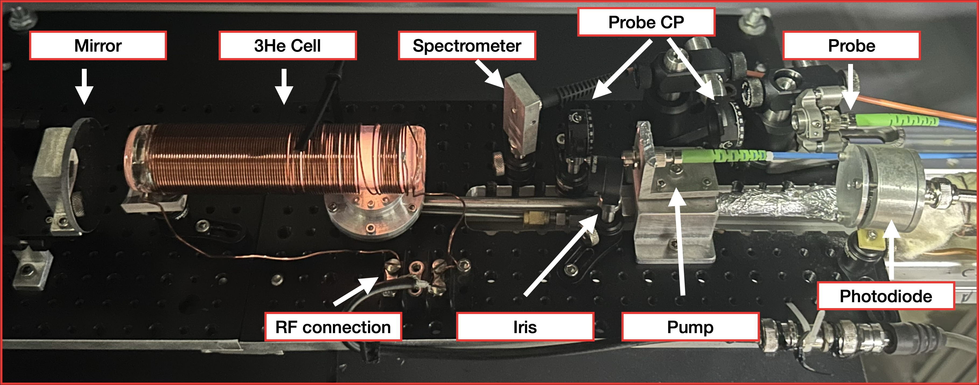
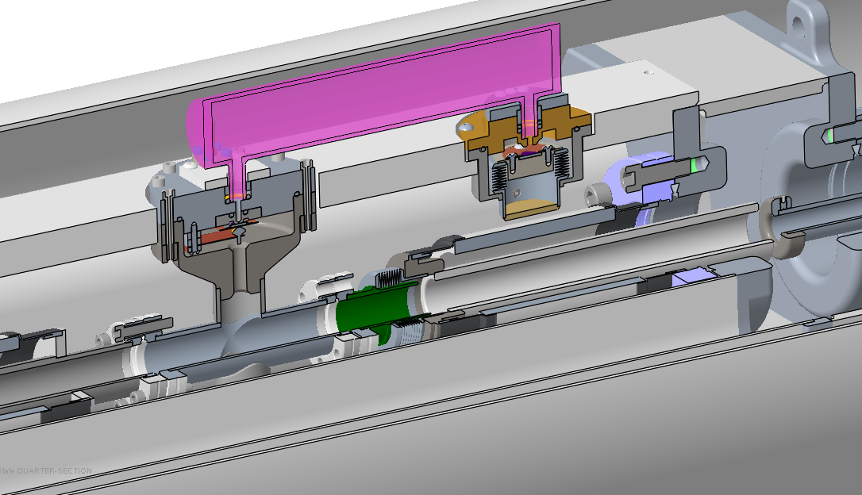
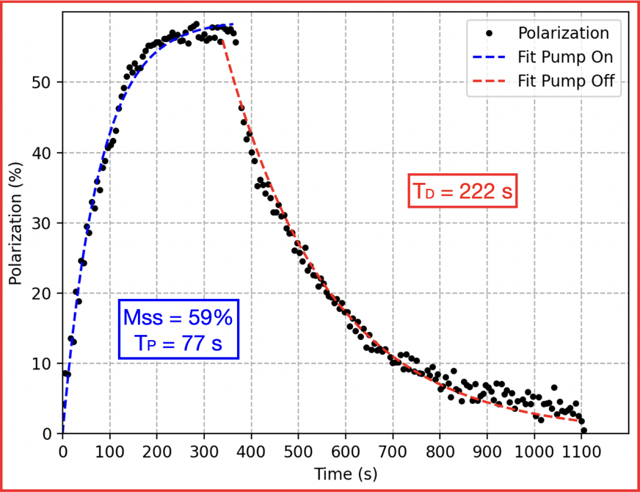
EBIS status and performance ramp-up plan
He-3 cell status
Testing of He-3 cell continues in the test setup with the old EBIS solenoid with same bore size and B-field
Have second gas injection manifold chamber. Designs are completed for next cell assembly. Components are on hand for additional fill valves and other parts.
Verifying that this pulsed valve does not de-polarize the He-3 gas. Then pulsed valve fabrication will start.
An outside company will fabricate the ceramic assembly for the 3He pulsed valve, ~ 12 weeks delivery.
He-3 test setup with RHICEBIS
3D Model of He-cell
Measurement at RHICEBIS

