Slide 1
Extended EBIS (EEBIS) Status
E. Beebe
Dec 16, 2024
MAC21, BNL

Slide 2
Outline
Overview
Intensity Goals
Components
Methods and Measurements
Results and Status
Schedule for Modifications and Testing
Summary
Reference Material

Slide 3
Overview

Slide 4
Polarized ³He²⁺ source development is made in a collaboration between BNL and MIT
E. Beebe¹, G. Atoian¹, B. Coe¹, S. Ikeda¹, T. Kanesue¹, S. Kondrashev¹, R. Milner², M. Okamura¹, D. Raparia¹, J. Ritter¹, B. Schoepfer¹, R. Vorbach, N. Wuerfel²
¹Brookhaven National Laboratory, Upton, NY 11973, USA
²MIT, Cambridge, MA, USA

Slide 5
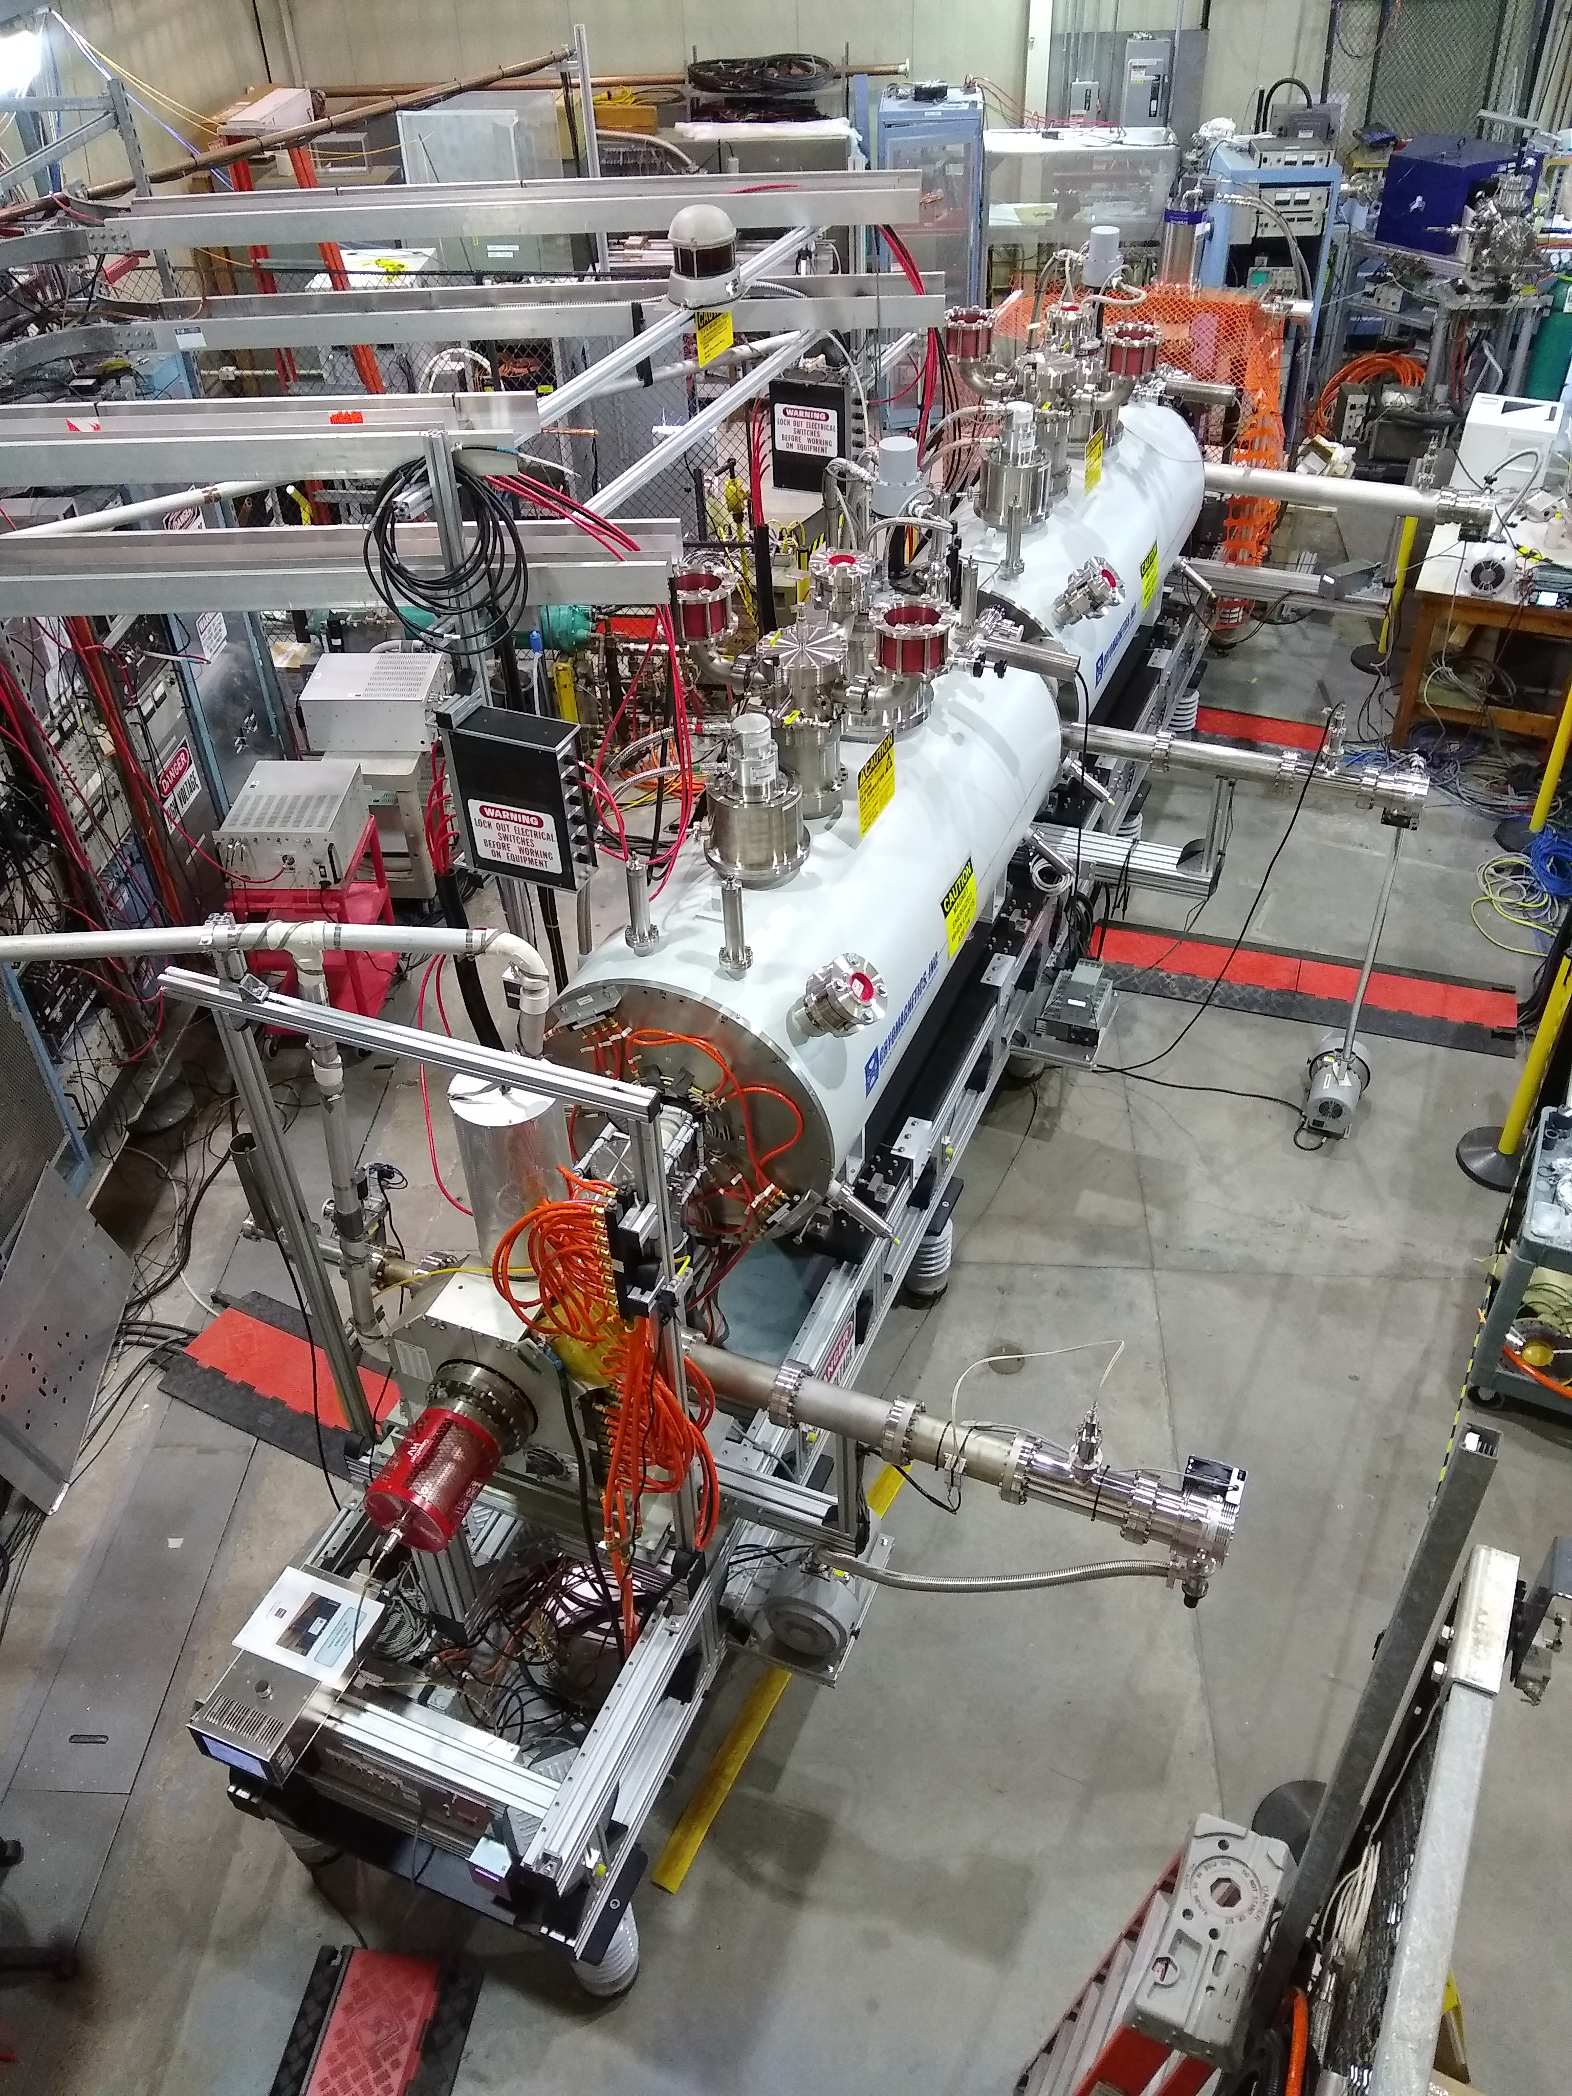
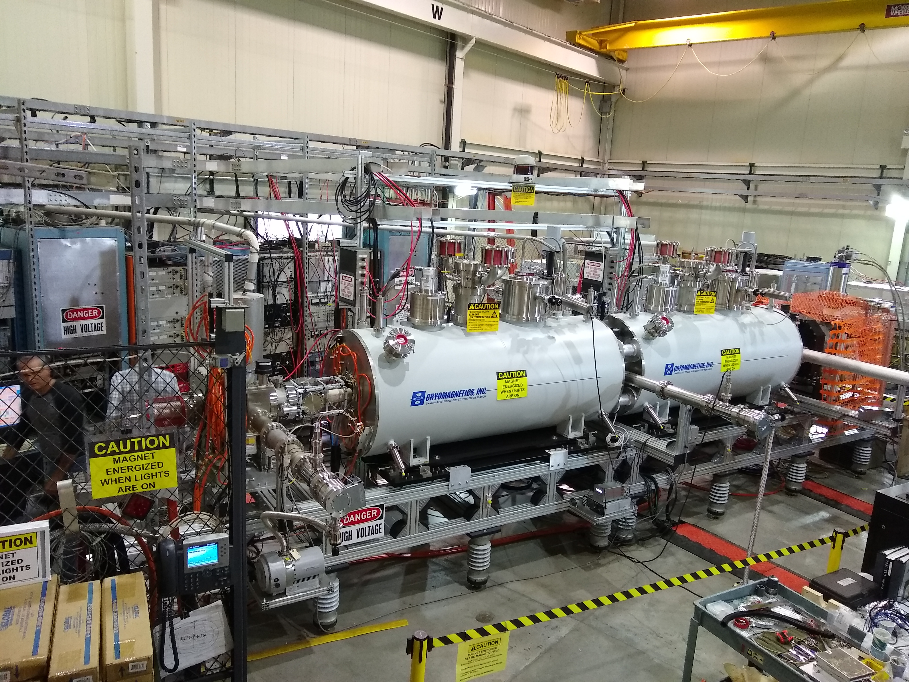
Extended EBIS during development in the EBIS test Lab

Slide 6
The Extended EBIS Three trap System: (gas injection trap, short trap, long trap)
Two identical unshielded 5T superconducting solenoids are used for “Extended” EBIS
The upstream solenoid contains the new features for efficient gas injection and future production of polarized 3He²⁺ ion production:
gas injection / ionization cell at pressures up to 5x10⁻⁶ mbar (2cm diameter, 40cm long)
“External drift tube” construction and differential pump out manifold
(provides space for gas reservoir(s) and high field 3He polarization cell)
Pulsed Lorentz valve operating mounted on the gas ionization cell drift tube via a compact insulator
“short trap”, a 95 cm long ionization region to provide additional highly charged intensity
Future installation: High field 3He polarization cell and purification system (tested in a separate solenoid)
The downstream solenoid contains the “long trap”, a 178 cm long ionization region with good vacuum separation from the upstream modules and the electron collector.

Slide 7
Extended EBIS Features
High-capacity NEGs + Turbo Pumping:
Provide high pumping speed where needed. Pulsed Hydrogen pumping speed measurement system developed to monitor NEG status.
Alignment during EBIS electron beam propagation:
HV cage is partitioned and HV connections are protected such that EBIS experts can enter the HV cage for initial mechanical magnetic alignment
New Electron Gun Cathode:
3M lower temperature oxide cathodes. improved reliability and lifetime, improved beam quality, domestically available, important for BNL and our other colleagues at ANL and FRIB
(Re-testing of higher current IrCe cathode expected before DT modification)

Slide 8
Intensity Goals

Slide 9
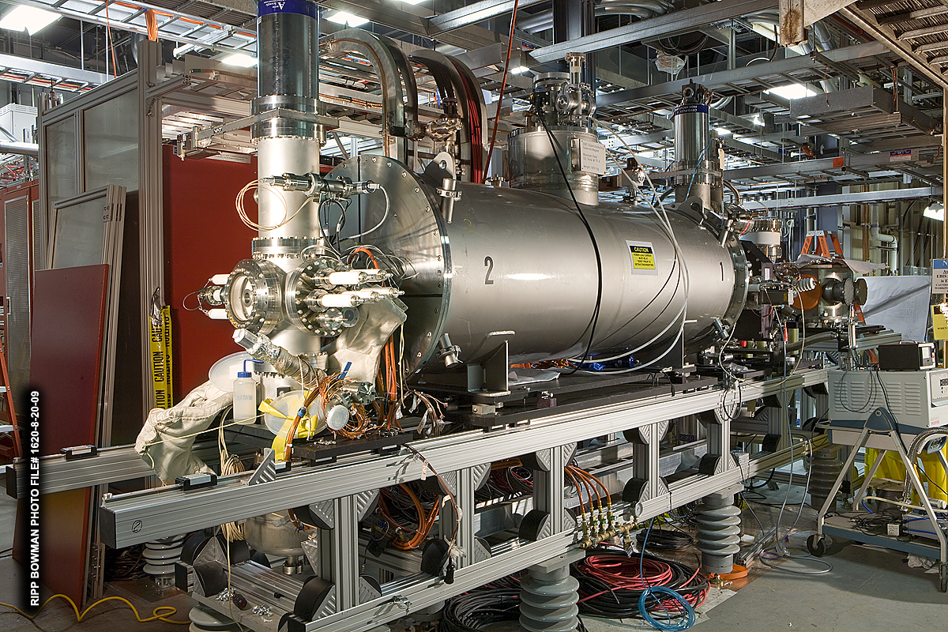
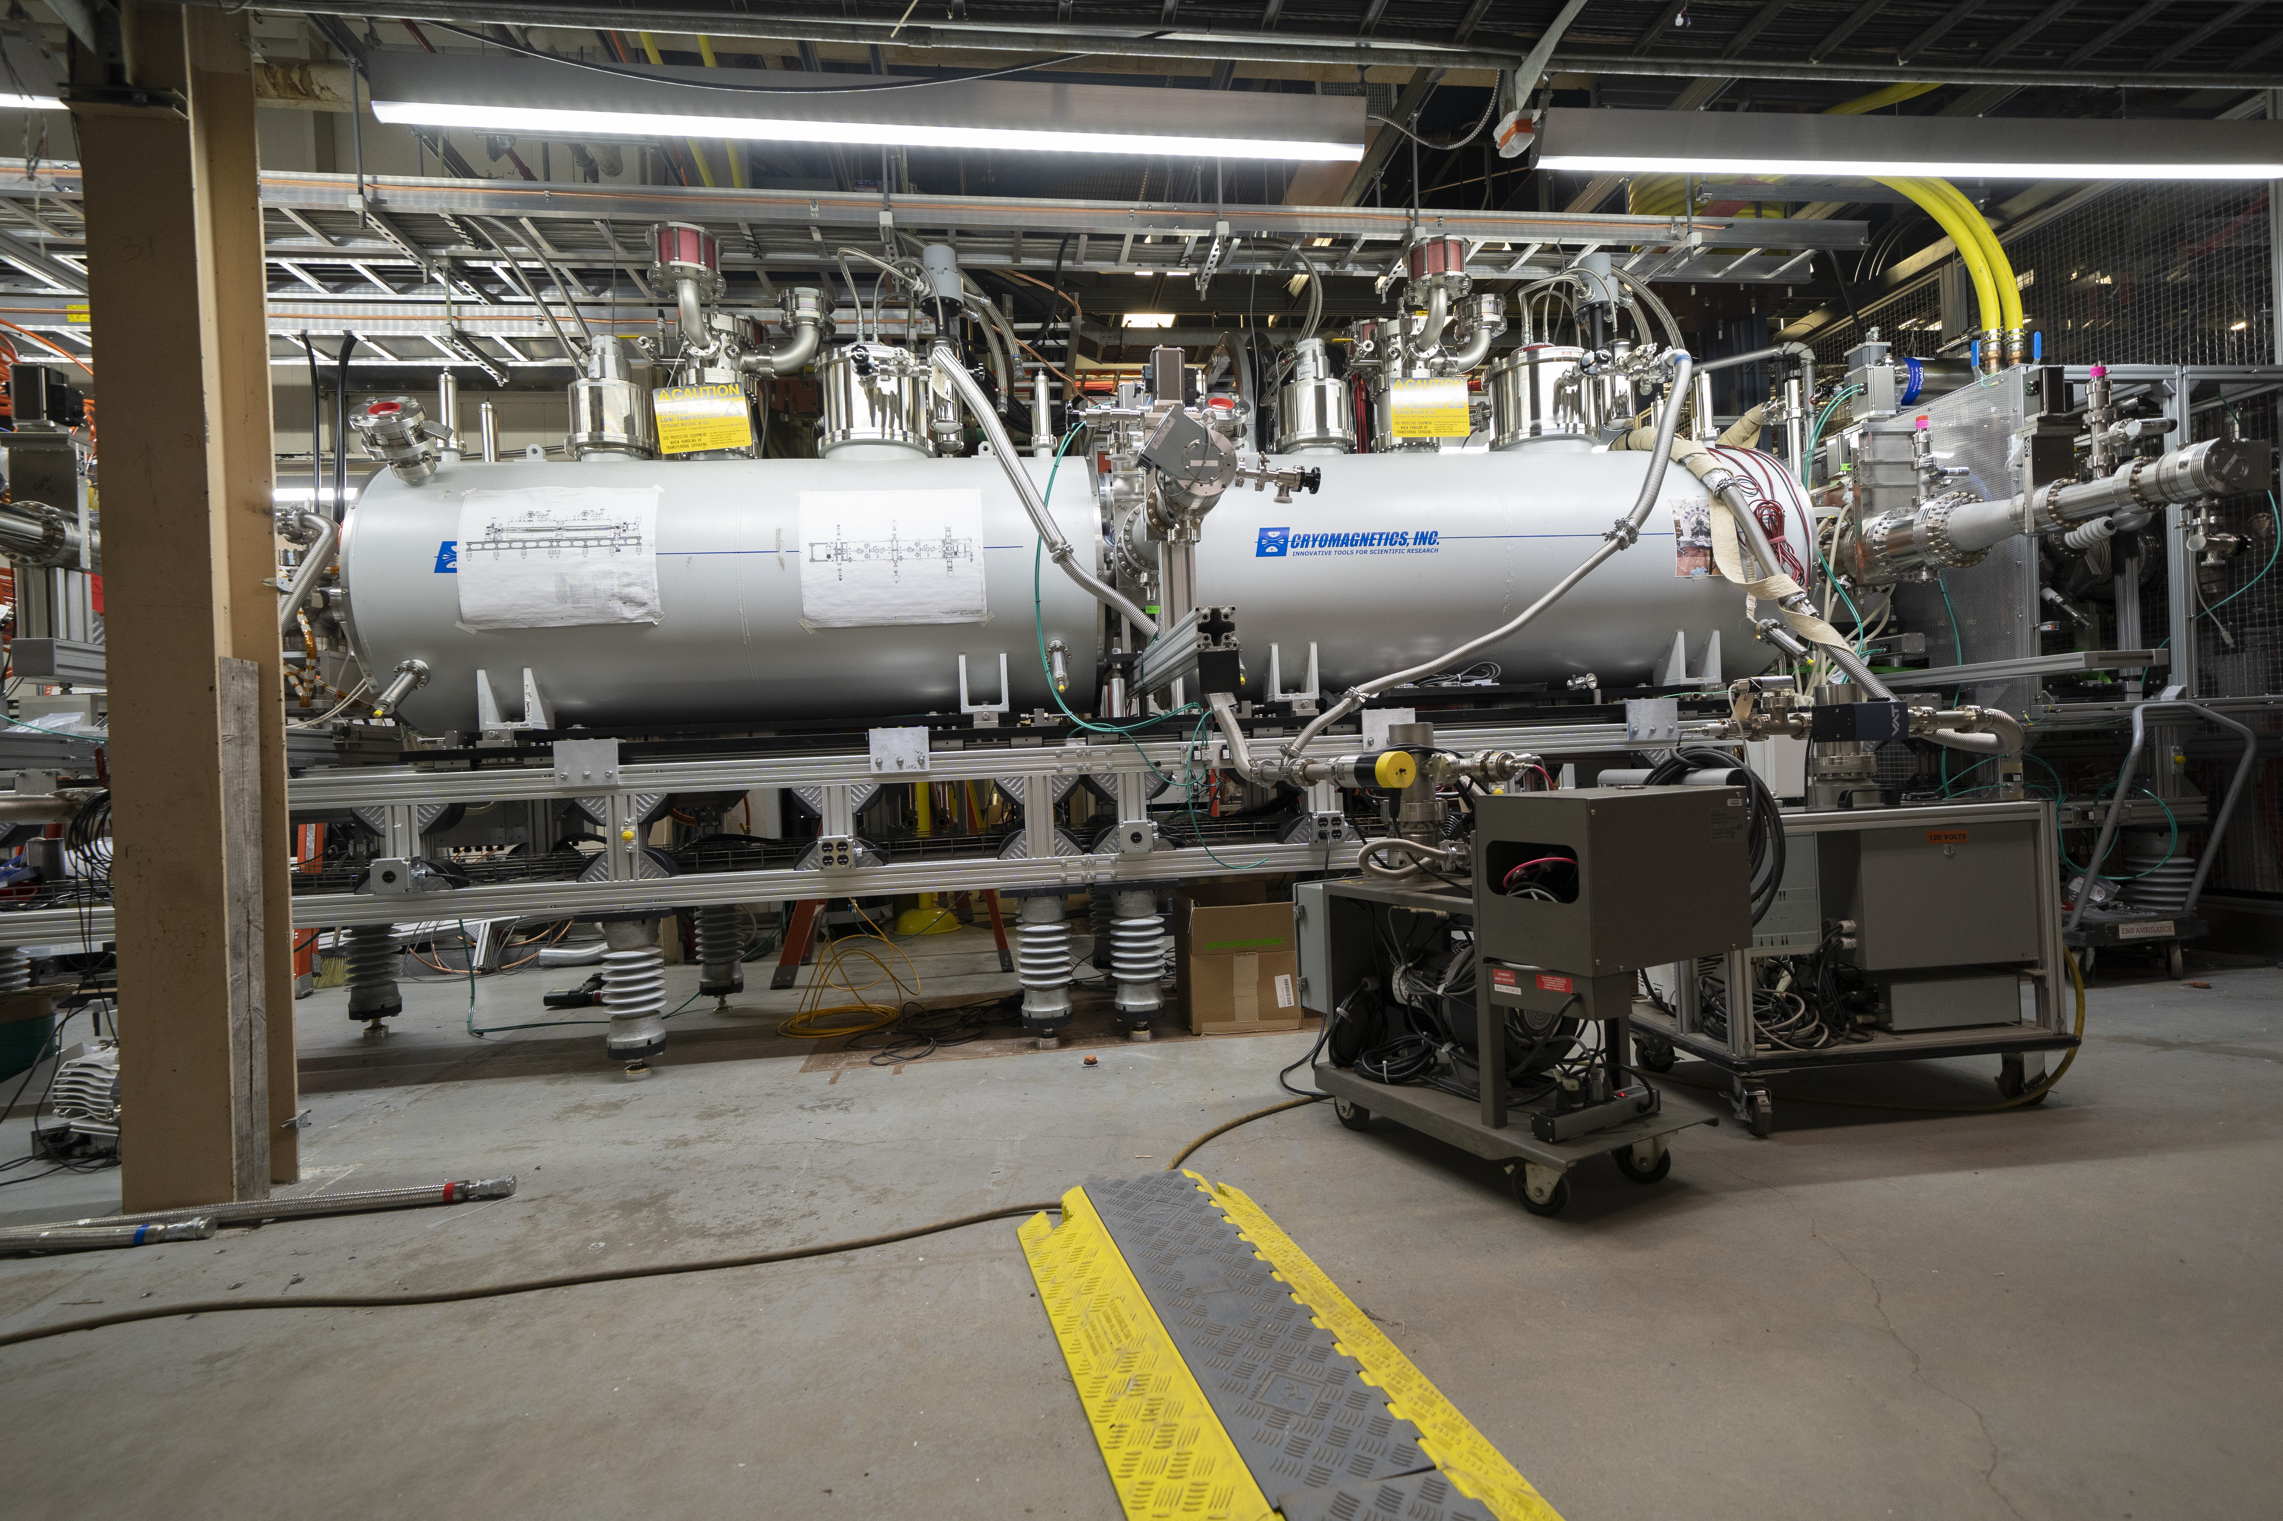
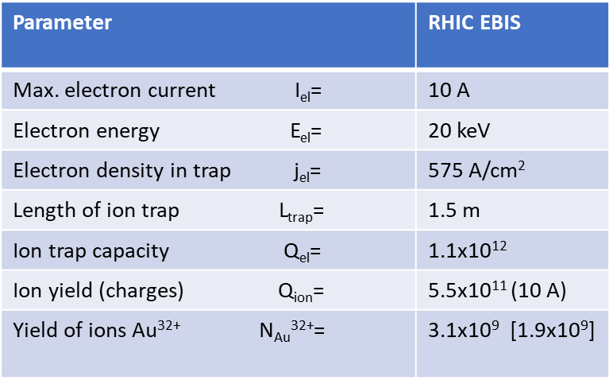
From RhicEBIS to Extended EBIS
From RhicEBIS
To Extended EBIS

Slide 10
Expected Extended EBIS intensities based on RhicEBIS performance
The extended EBIS uses the same electron beam launching and collection system system as RhicEBIS. The upgrade to provide (polarized) ³He²⁺ ions to RHIC and the future EIC results in increased intensities for other ion species:
Higher intensity of light ions can be produced from light gases using a highly efficient gas injection system rather than current RhicEBIS ion injection method.
Ion intensities of externally injected heavy ions benefit from the additional trap capacity provided by the short trap in the first solenoid.
Intensity Estimates for EBIS upgrade (at Extended EBIS exit)
He²⁺ ~ 2.5 - 5 x 10¹¹ ions/pulse
H⁺ ~5 – 10 x 10¹¹ ions/ pulse (2.3 x 10¹¹ ions/ pulse achieved to date)
Au³²⁺ ~2.6x10⁹ ions/pulse (1.4-1.5 times the RhicEBIS output)

Slide 11
EBIS Au32+ intensity :
During the First year of Operation the Newly commissioned multi-trap EEBIS failed to meet intensity requirements for RHIC Au based on Au32+ production.
1.1x10⁹ Au32+ ions/pulse at Booster input achieved (xf108);
(1.25x10⁹ or more required at 12 Pulses/supercycle, 5 Hz repetition rate).
Two problems:
BaO cathode couldn’t maintain adequate current during 12P/sc, 5Hz operation
IrCe cathode installed with 12 days of testing before maintenance period
12P/sc operation at electron currents greater than 7A resulted in vacuum excursions
Drift tube modifications needed for increased voltage holding
Goals for upcoming RHIC run:
Greater than 7A ebeam at 12P/sc, 5Hz good vacuum
1.25 - 1.4x10⁹ Au32+ ions/pulse at 12P/sc at Booster input (xf108)

Slide 12
EEBIS Component Development and Operation in the Test Lab

Slide 13
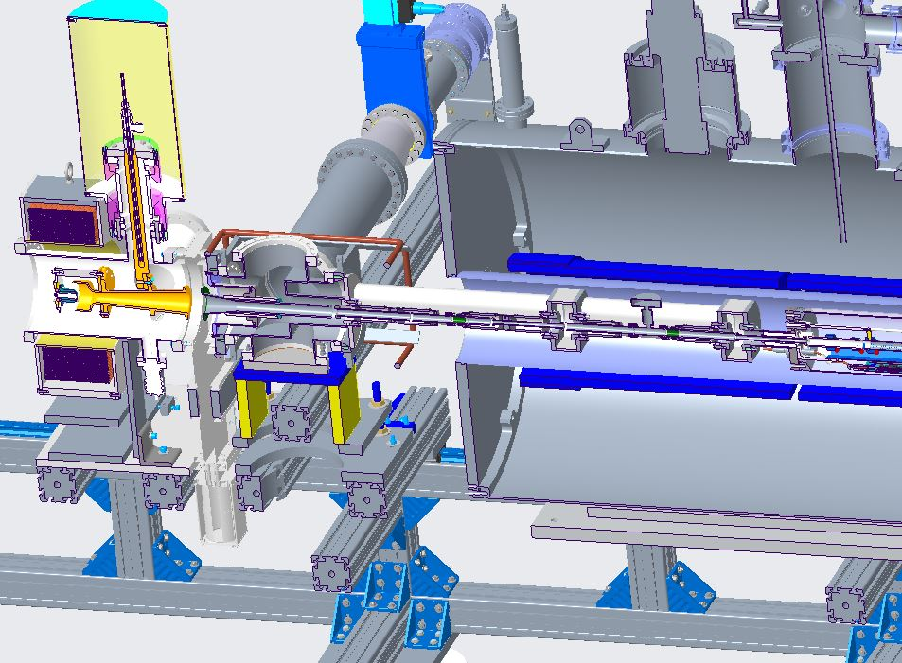
Gas Cell with pump out manifold and external drift tube connections

Slide 14
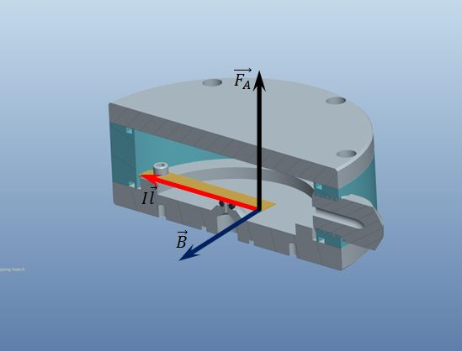
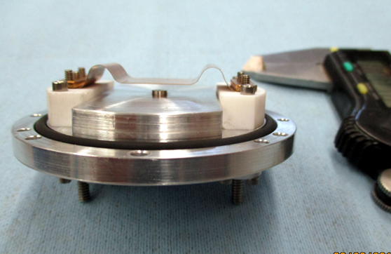
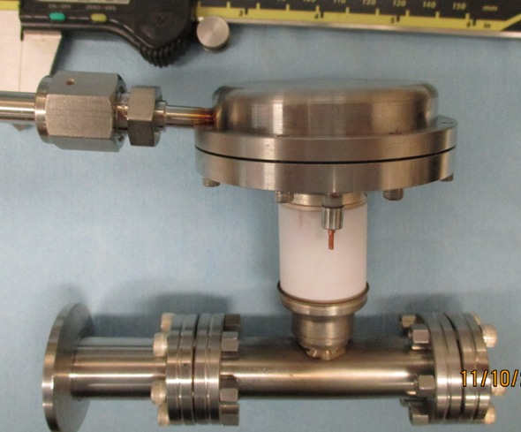
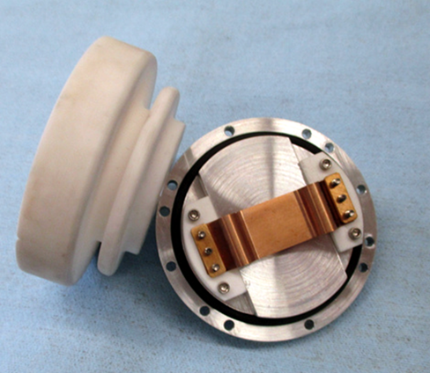
Fast Pulsing Gas Valve
“Electro-magnetic”, [IxB] valve operation principle
Lorentz (Laplace) force moves the flexible conducting plate in the high (~ 3-5 T) magnetic field.
For I=10 A, L=5 cm, F=2.5 N. Current pulse duration ~100-500 us
F
I
B
Pulsed valve for
Un-polarized gas
Injection to the EBIS

Slide 15
EEBIS Installation at the Accelerator Location

Slide 16
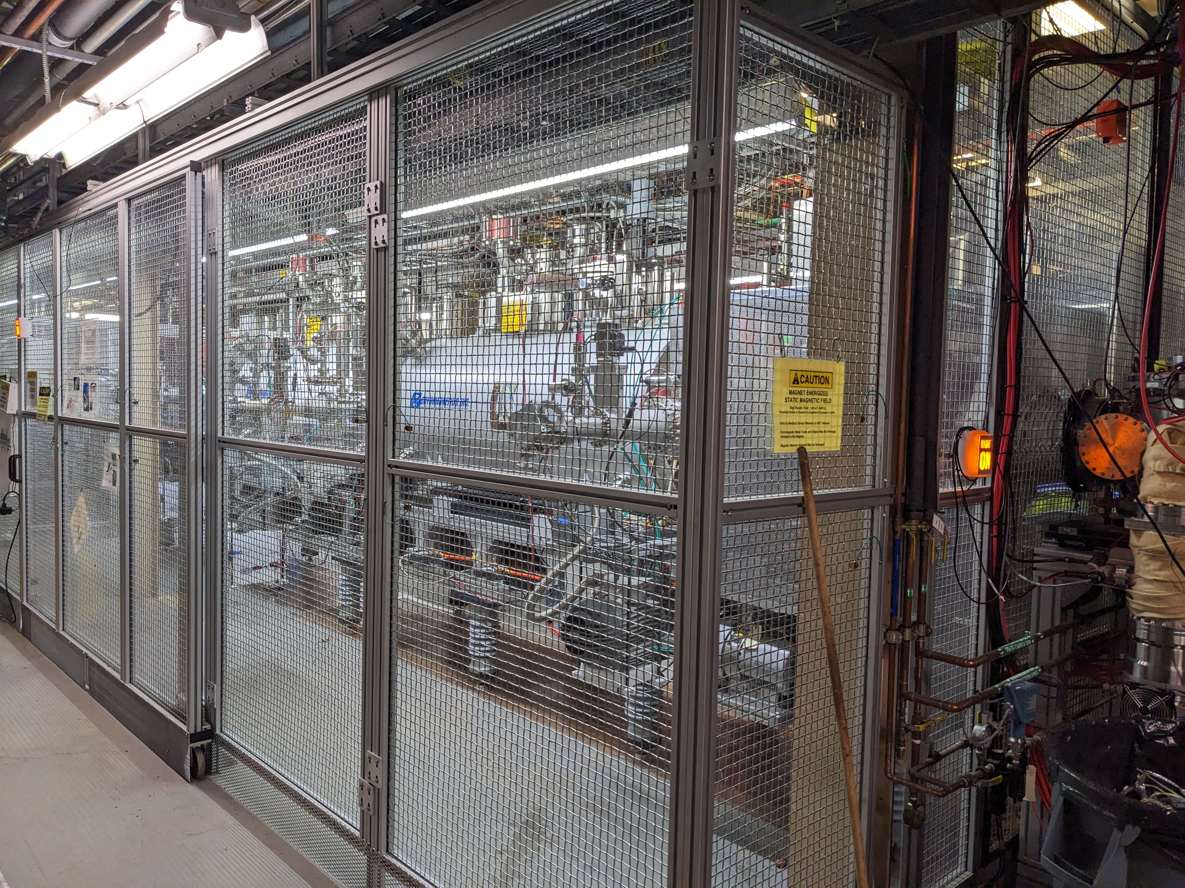
EEBIS – HV Cage

Slide 17
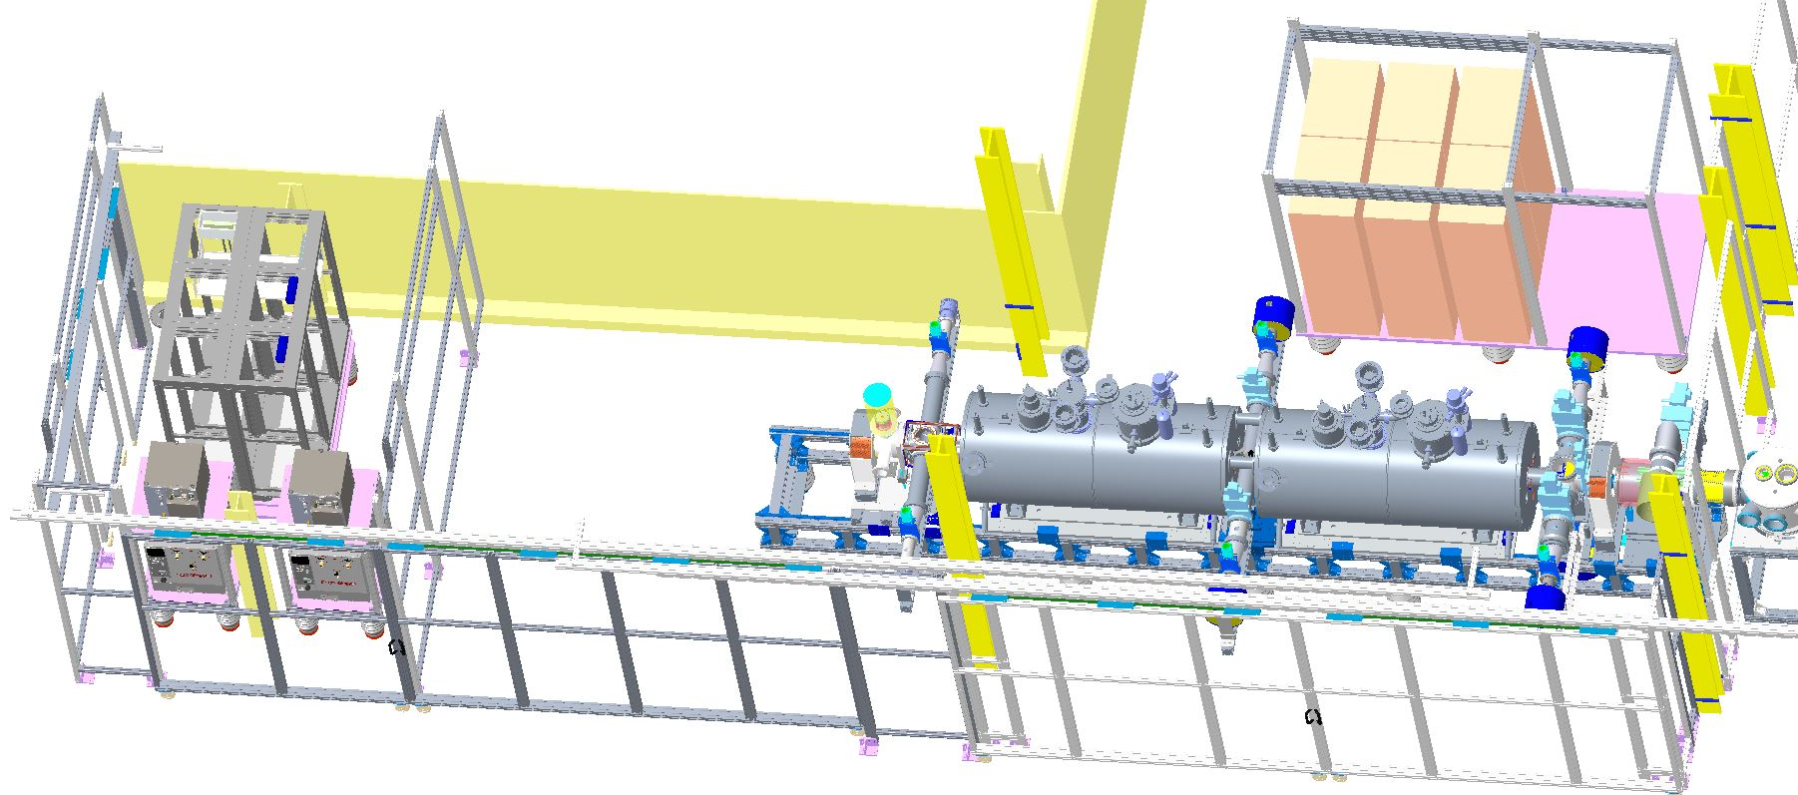
Extended EBIS Installation at Accelerator with High Voltage enclosure
Left: Electron collector supply
Middle: Extended EBIS with two Superconducting Solenoids
Right: Existing Ion injection and LEBT beamlines
Collector supply partition and EBIS shielded connections allows EBIS experts to enter the EBIS and power supply cage during electron beam aided source alignment and other operations not needing platform high voltage. (The entire cage is off limits during HV pulsing for ion injection from the laser ion source (LION) and ion extraction for beam propagation to the accelerator)

Slide 18
Methods and Measurements

Slide 19
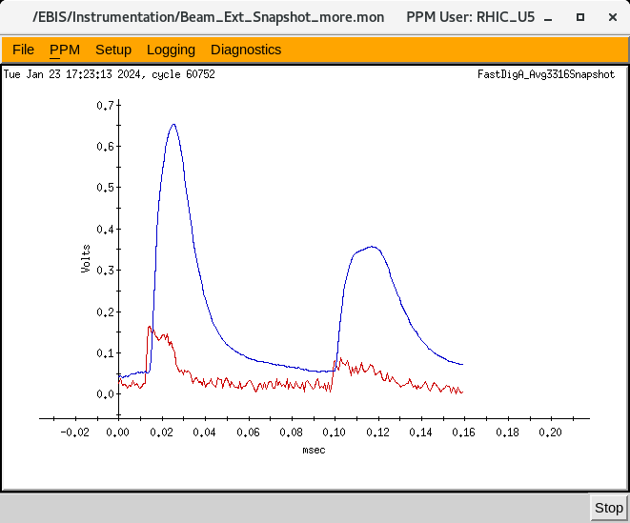
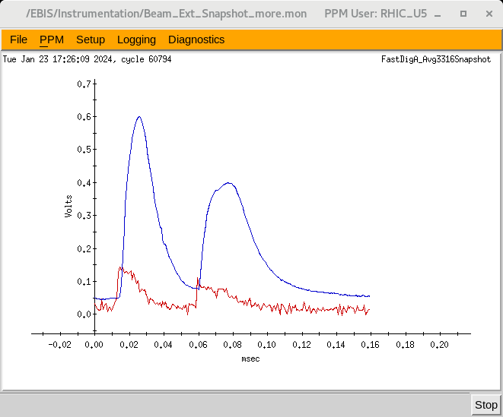
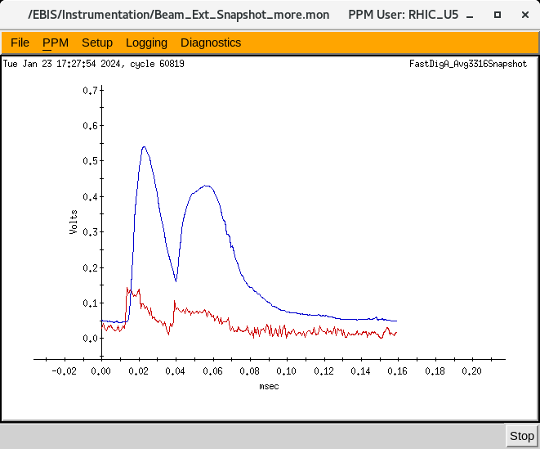
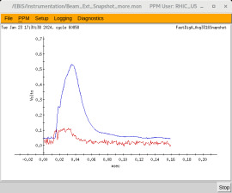
Short and Long Trap Ion Pulse Merging
Peak Separation ~90uS
Timing of the 20kV Behlke Switches is adjusted to extract ions towards the RFQ, first from the Short Trap, and then from the Long Trap.
The Short Trap is located upstream of the Long Trap, so short trap ions must not be impeded by the Long Trap potential barriers during the ion injection or extraction processes.
Intensity
Peak Separation
~30uS
TIME

Slide 20
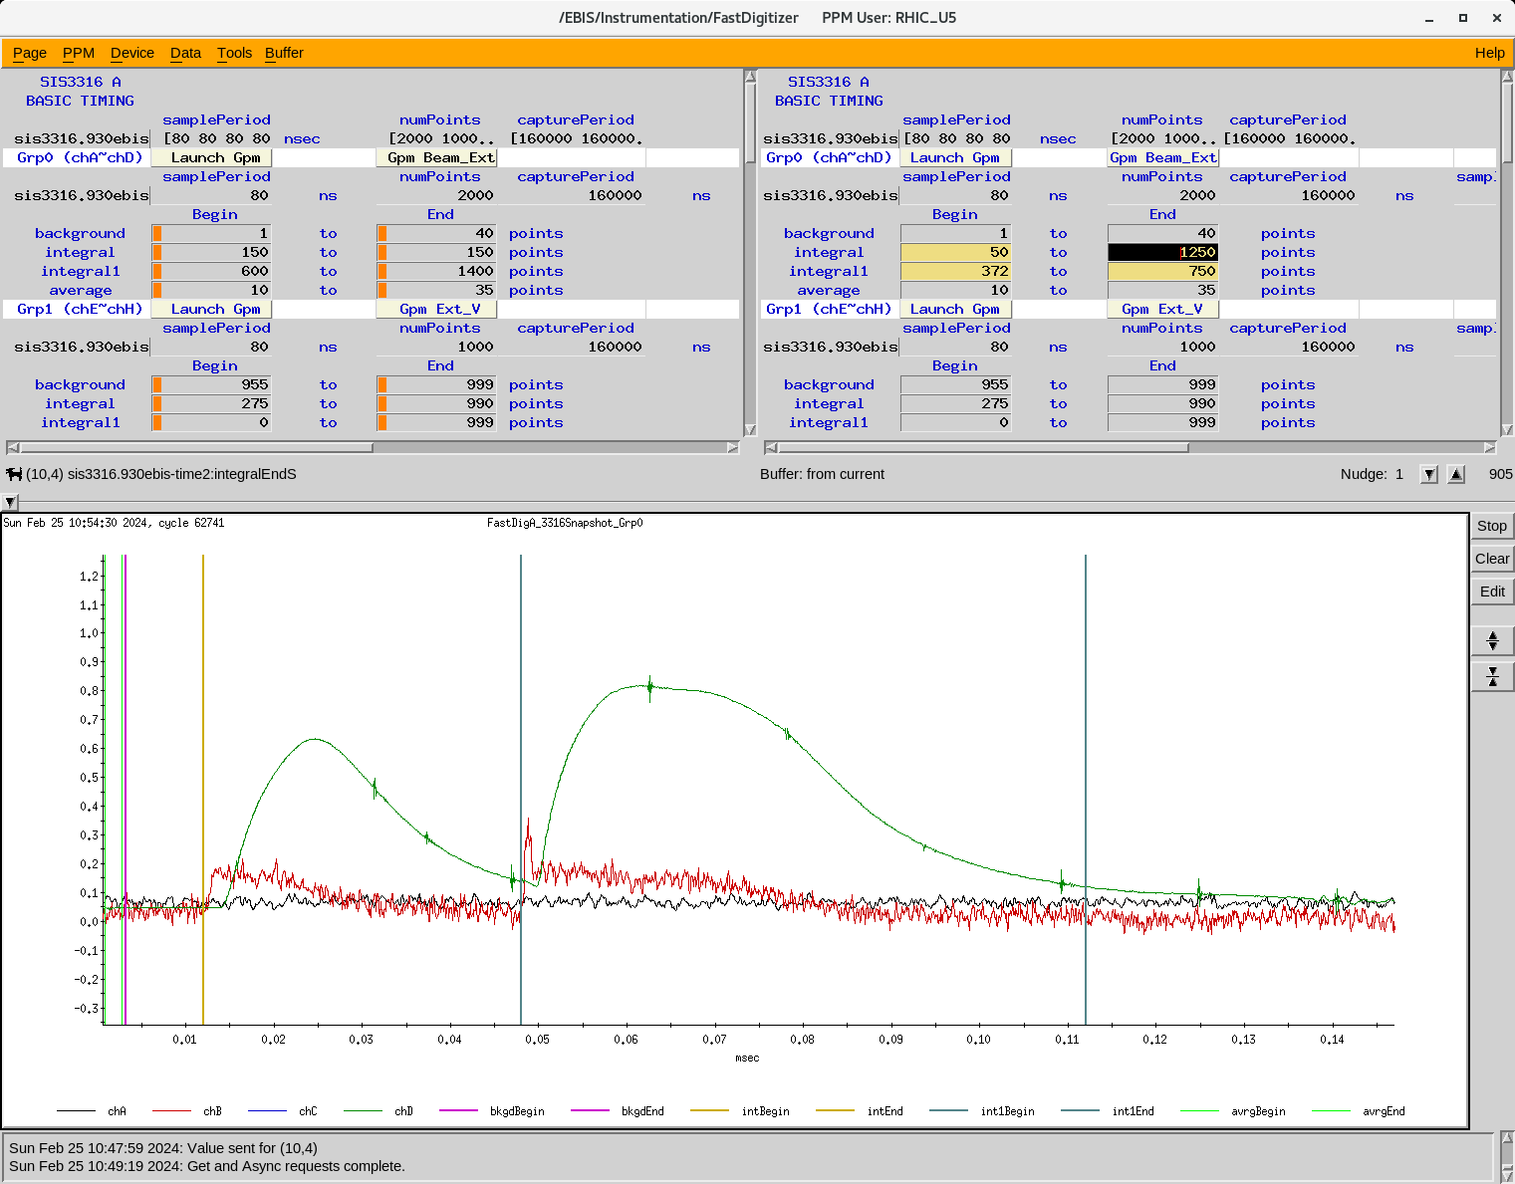
Integration of Short and Long Trap Au32+ pulses
Short trap ions are extracted first and travel over the long trap barriers.
Long trap Barriers are then extracted with a rapid increase in voltages to meet the energy is to meet the RFQ input requirement of 17keV/nucleon.
Integration limits are chosen to track ion intensity from each trap.

Slide 21
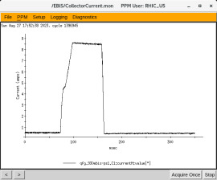
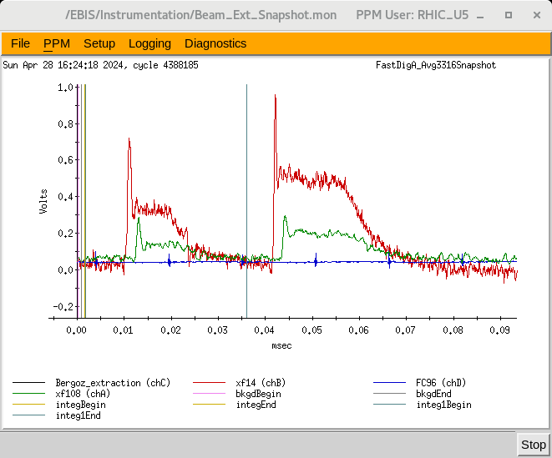
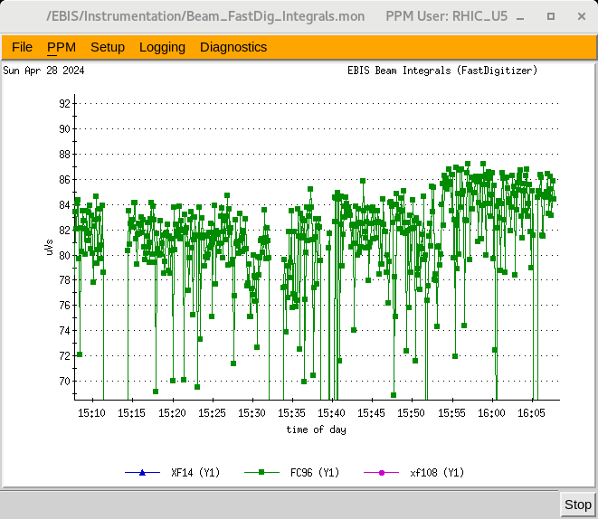
Measurements at EEBIS
8.1A electron beam
Conf2= 60ms wide (at peak value)
Red: xf14 signal
(14 Feet after LINAC)
Green: xf108 signal
(Booster input 108 Feet after LINAC)
Integral of series of FC96 waveforms

Slide 22
Results and Status

Slide 23
Present State of the EBIS source:
EEBIS startup went very quickly with He2+ beam being delivered to NSRL within 3 weeks of the initial electron beam at the accelerator location. It has been used for NSRL operations for 1.5 years.
Gas injection is working with H, 3He, 4He, Ne.
136-Xe gas tests on hold for now.
Remote control of gas handling system valves and pump out system has been established.
Singly charged ion injection from LION into the EBIS LONG TRAP is working with both the Au rotating target for RHIC operations and the various targets Si, Fe, Bi, Ta, Ti, etc. in the xy target system. HCIS2 is operating for Ne+ injection and can be used for Kr+ and Xe+ injection.
Au32+ production for RHIC operations utilizes Au+ injection into both the SHORT and LONG TRAPS. Fast Behlke HV electronics provide 1+ ion capture, confinement and high charge state ion extraction from EEBIS.

Slide 24
Positive results for EBIS NSRL operations
and 3He Program Development
EBIS highly Efficient gas cell was used with H, 4He, 3He
2.3x10¹¹ H+ ions/pulse obtained at EBIS exit;
2.5x10¹⁰ at Booster input @ 2MeV
Intensive NSRL operations during the last 1.5 years:
All NSRL goals were met, including charge states up to Au47+
1-3 week breaks in NSRL operations for:
EBIS source bake out.
Gas injection system hardware
Short Trap Behlke hardware for fast ion capture and extraction
2 weeks dedicated for RHIC Au32+ production
3He program development:
4He2+ from EEBIS transported through chicane to Booster input
~5x10⁹ ions/pulse obtained
about 80-90% as obtained in the direct beamline.
3He2+ from EEBIS used in APEX program

Slide 25
EEBIS improvement with IrCe electron gun cathode
Installed IrCe cathode; used previously in the RhicEBIS
(12 Days of operation after NSRL operation ended and BaO cathode removed).
Electron beams 7.2A, 12P/sc. 5Hz with nominal vacuum 5x10⁻¹⁰mbar
1P/sc, 7.5A ebeam operation:
Booster Input ~ 1.1x10⁹ Au32+ charge/pulse
The progress is promising, but not good enough.
Need minimum of 1.25x10⁹ Au32+ ions/pulse (avg) at 12P/sc, 5Hz
Modifications will be made to drift tubes in the gas trap region.

Slide 26
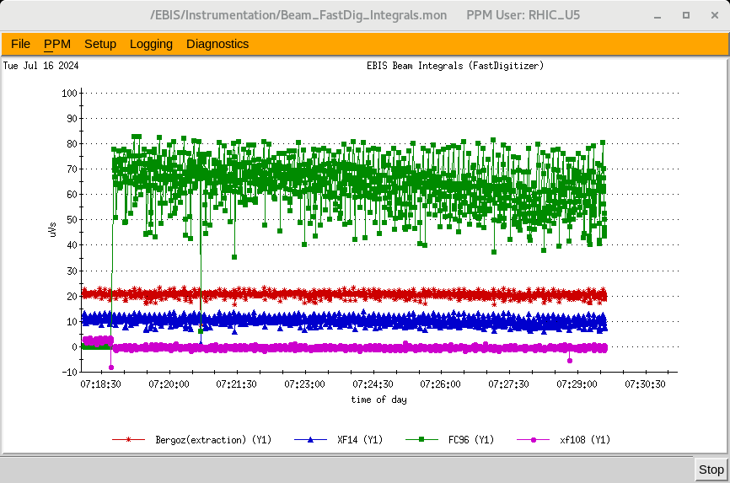
Required EBIS mode for RHIC Au Operations
12 e-beam pulses per supercycle @ 5Hz
6.5A e-, 5Hz
BaO Cathode
July 2024
6.5A e-, 5Hz
IrCe Cathode
Dec. 2024
Decimated ion pulse integral data
55
85
Booster input
9x10⁸ Au32+/pulse
(avg)
Complete
integral data
65
Au32+/pulse Integral data shown was accumulated for about 20 minutes.
2.5
Booster input
7x10⁸ Au32+/pulse (avg)

Slide 27
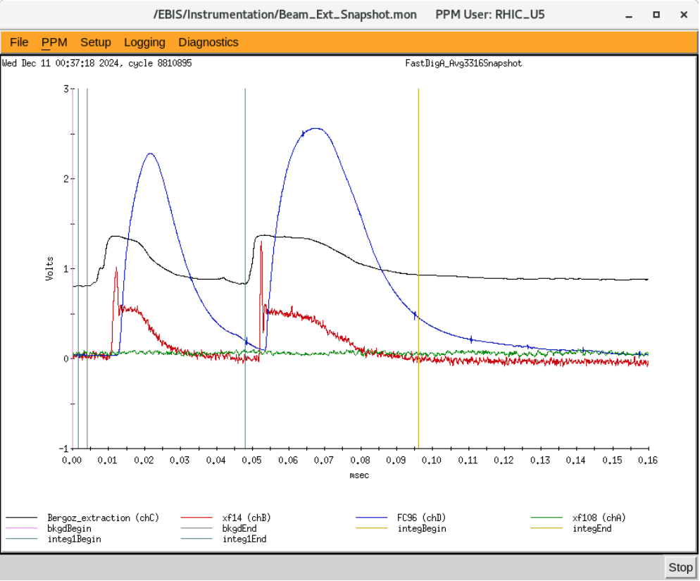
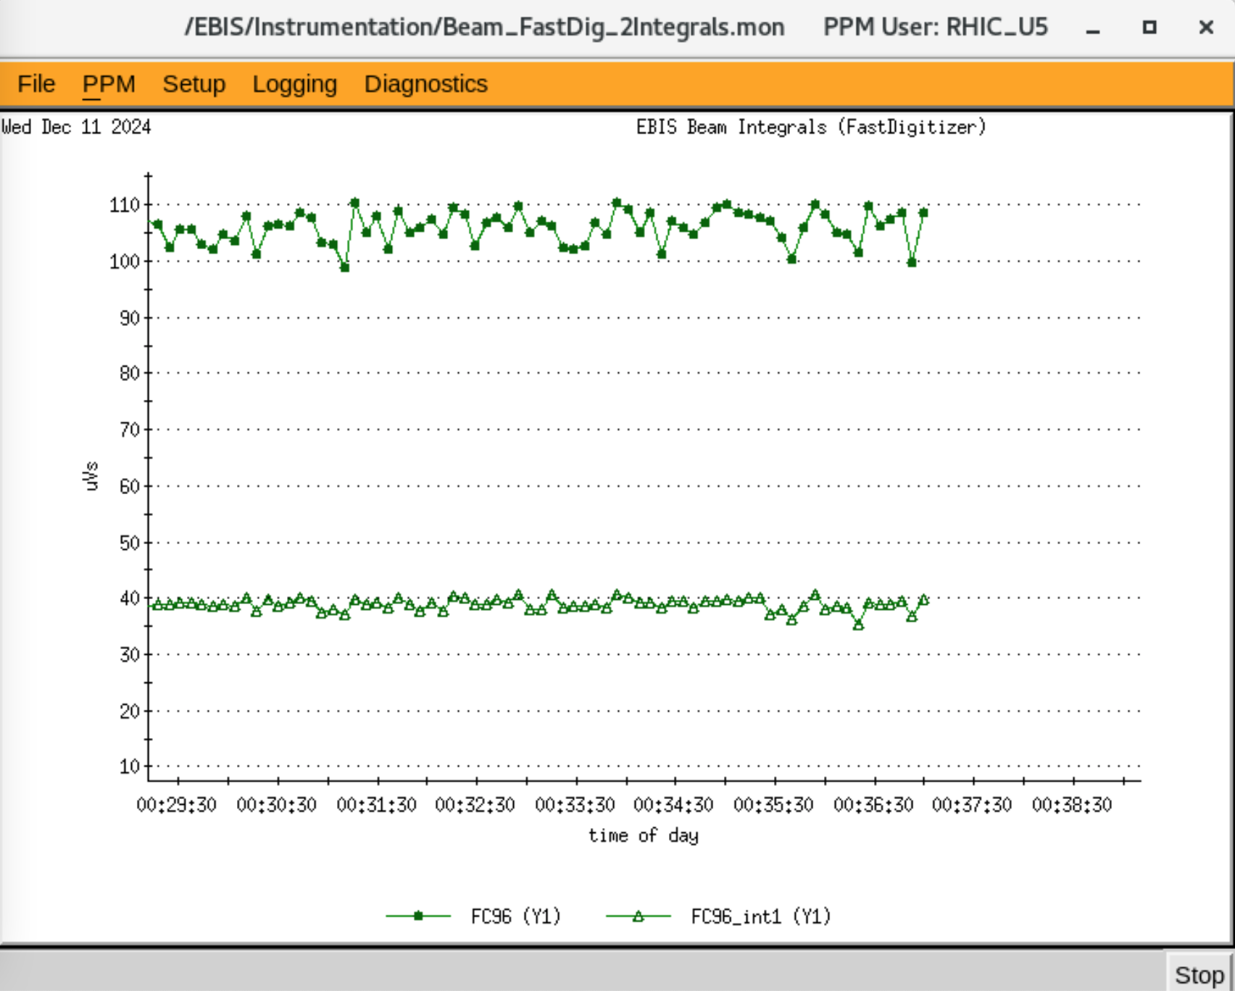
Single electron beam pulse per supercycle EBIS operation
7.5A e-, 5Hz
IrCe Cathode
Dec. 2024
Short and Long Trap Au32+ ion pulses at Booster input (Blue trace)
Dec. 2024
Total Au32+
1.1x10⁹ Ions
per extraction cycle
Long to Short Trap Au32+ Ratio for this case is 1.7
(Dec. 2024)
105
39

Slide 28
Gold Status with EEBIS
Booster input: 1.4x10⁹ Au32+ ions/pulse (Best result, single pulse).
9x10⁸ Au32+ ions/pulse (avg) for 12P/sc @ 5Hz
The present focus is on RHIC Au32+ development with the goal of doubling the present output. This will be done mainly by increasing the electron beam current to the 8-10A level and increasing the Drift Tube voltage holding, requiring internal modifications.
Examination of the LEBT region and injection optics will be made. Improvement of ion transport in the LEBT region, for both injected Au+ and extracted Au32+ ions is expected.

Slide 29
EEBIS Operation Status at the accelerator
1) Electron Beams up to 8.3A for Au32+ production
2) He gas injection, ion transfer to the short or long trap and 4He2+ extraction for NSRL operations
3) External ion injection of 1+ ions into the EBIS long trap with subsequent high charge state extraction to the RFQ, LINAC and Booster.
4) Two user operation on the same super cycle:
NSRL (Various very high charge state ions) + RHIC Au32+
5) Development of the RHIC 12P/sc Au32+ operation has been difficult due to vacuum deterioration in the gas injection region.
6) Matching of NSRL distributions to the RHIC Au32+ distribution provides better source stability.

Slide 30
Tests and Plans
Completed during this accelerator shutdown period:
Re-established EBIS operation after a gun solenoid overheating incident
Switched to IrCe cathode for high electron current, 12P/sc, 5Hz operation
12 days of operation; improvements in e-beam currents > 6A
Au32+ intensity improvement (but still need more !)
Work In progress:
Install new solid state electron collector supply for better reliability
- especially important during joint NSRL and RHIC operations
Open vacuum chamber containing gas trap and short trap, inspect elements and make modifications to eliminate HV discharges
- Improve intensity and stability of Au³²⁺ ion beam (12 pulses at 5 Hz)
Installation of new laser ion source (LION → LION2)
- Increase Energy and 1+ ion currents for injection into EEBIS
- Increase the number of targets available during operation
- More diagnostics
Future upgrades (after next run)
high field 3He polarization setup in the first superconducting solenoid
Install second gas injection valve with remote gas switching

Slide 31
Modifications and Schedule

Slide 32
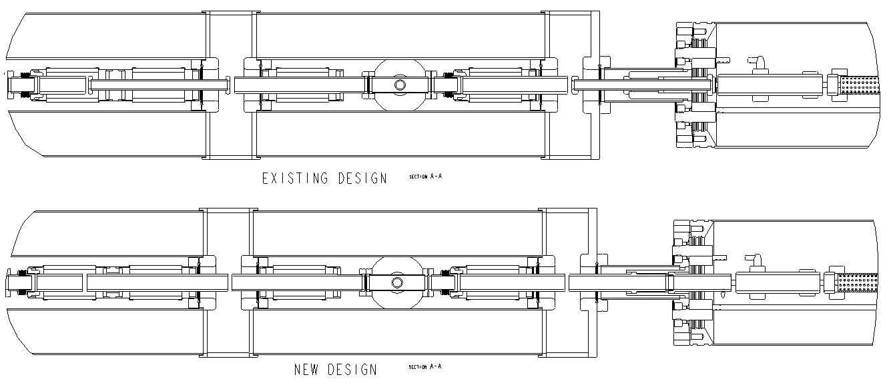
Proposed Drift tube modifications to gas trap region to eliminate HV discharges (present shutdown period)
Upstream Gas Trap Barrier (DT4)
Diameter increase
10mm to 20mm
Downstream Gas Trap Barrier (DT6)
Diameter increase; extend length
HV improvements:
Mounting and Electrical Connection

Slide 33
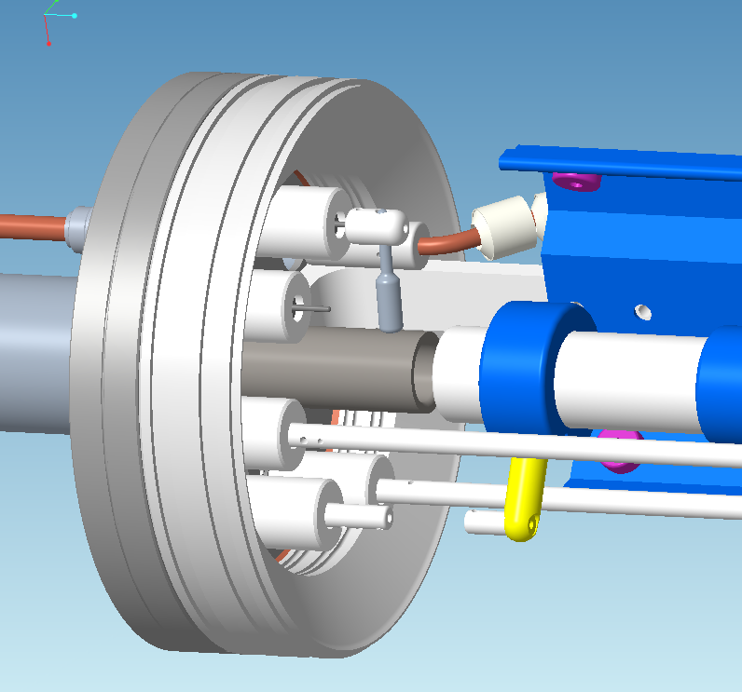
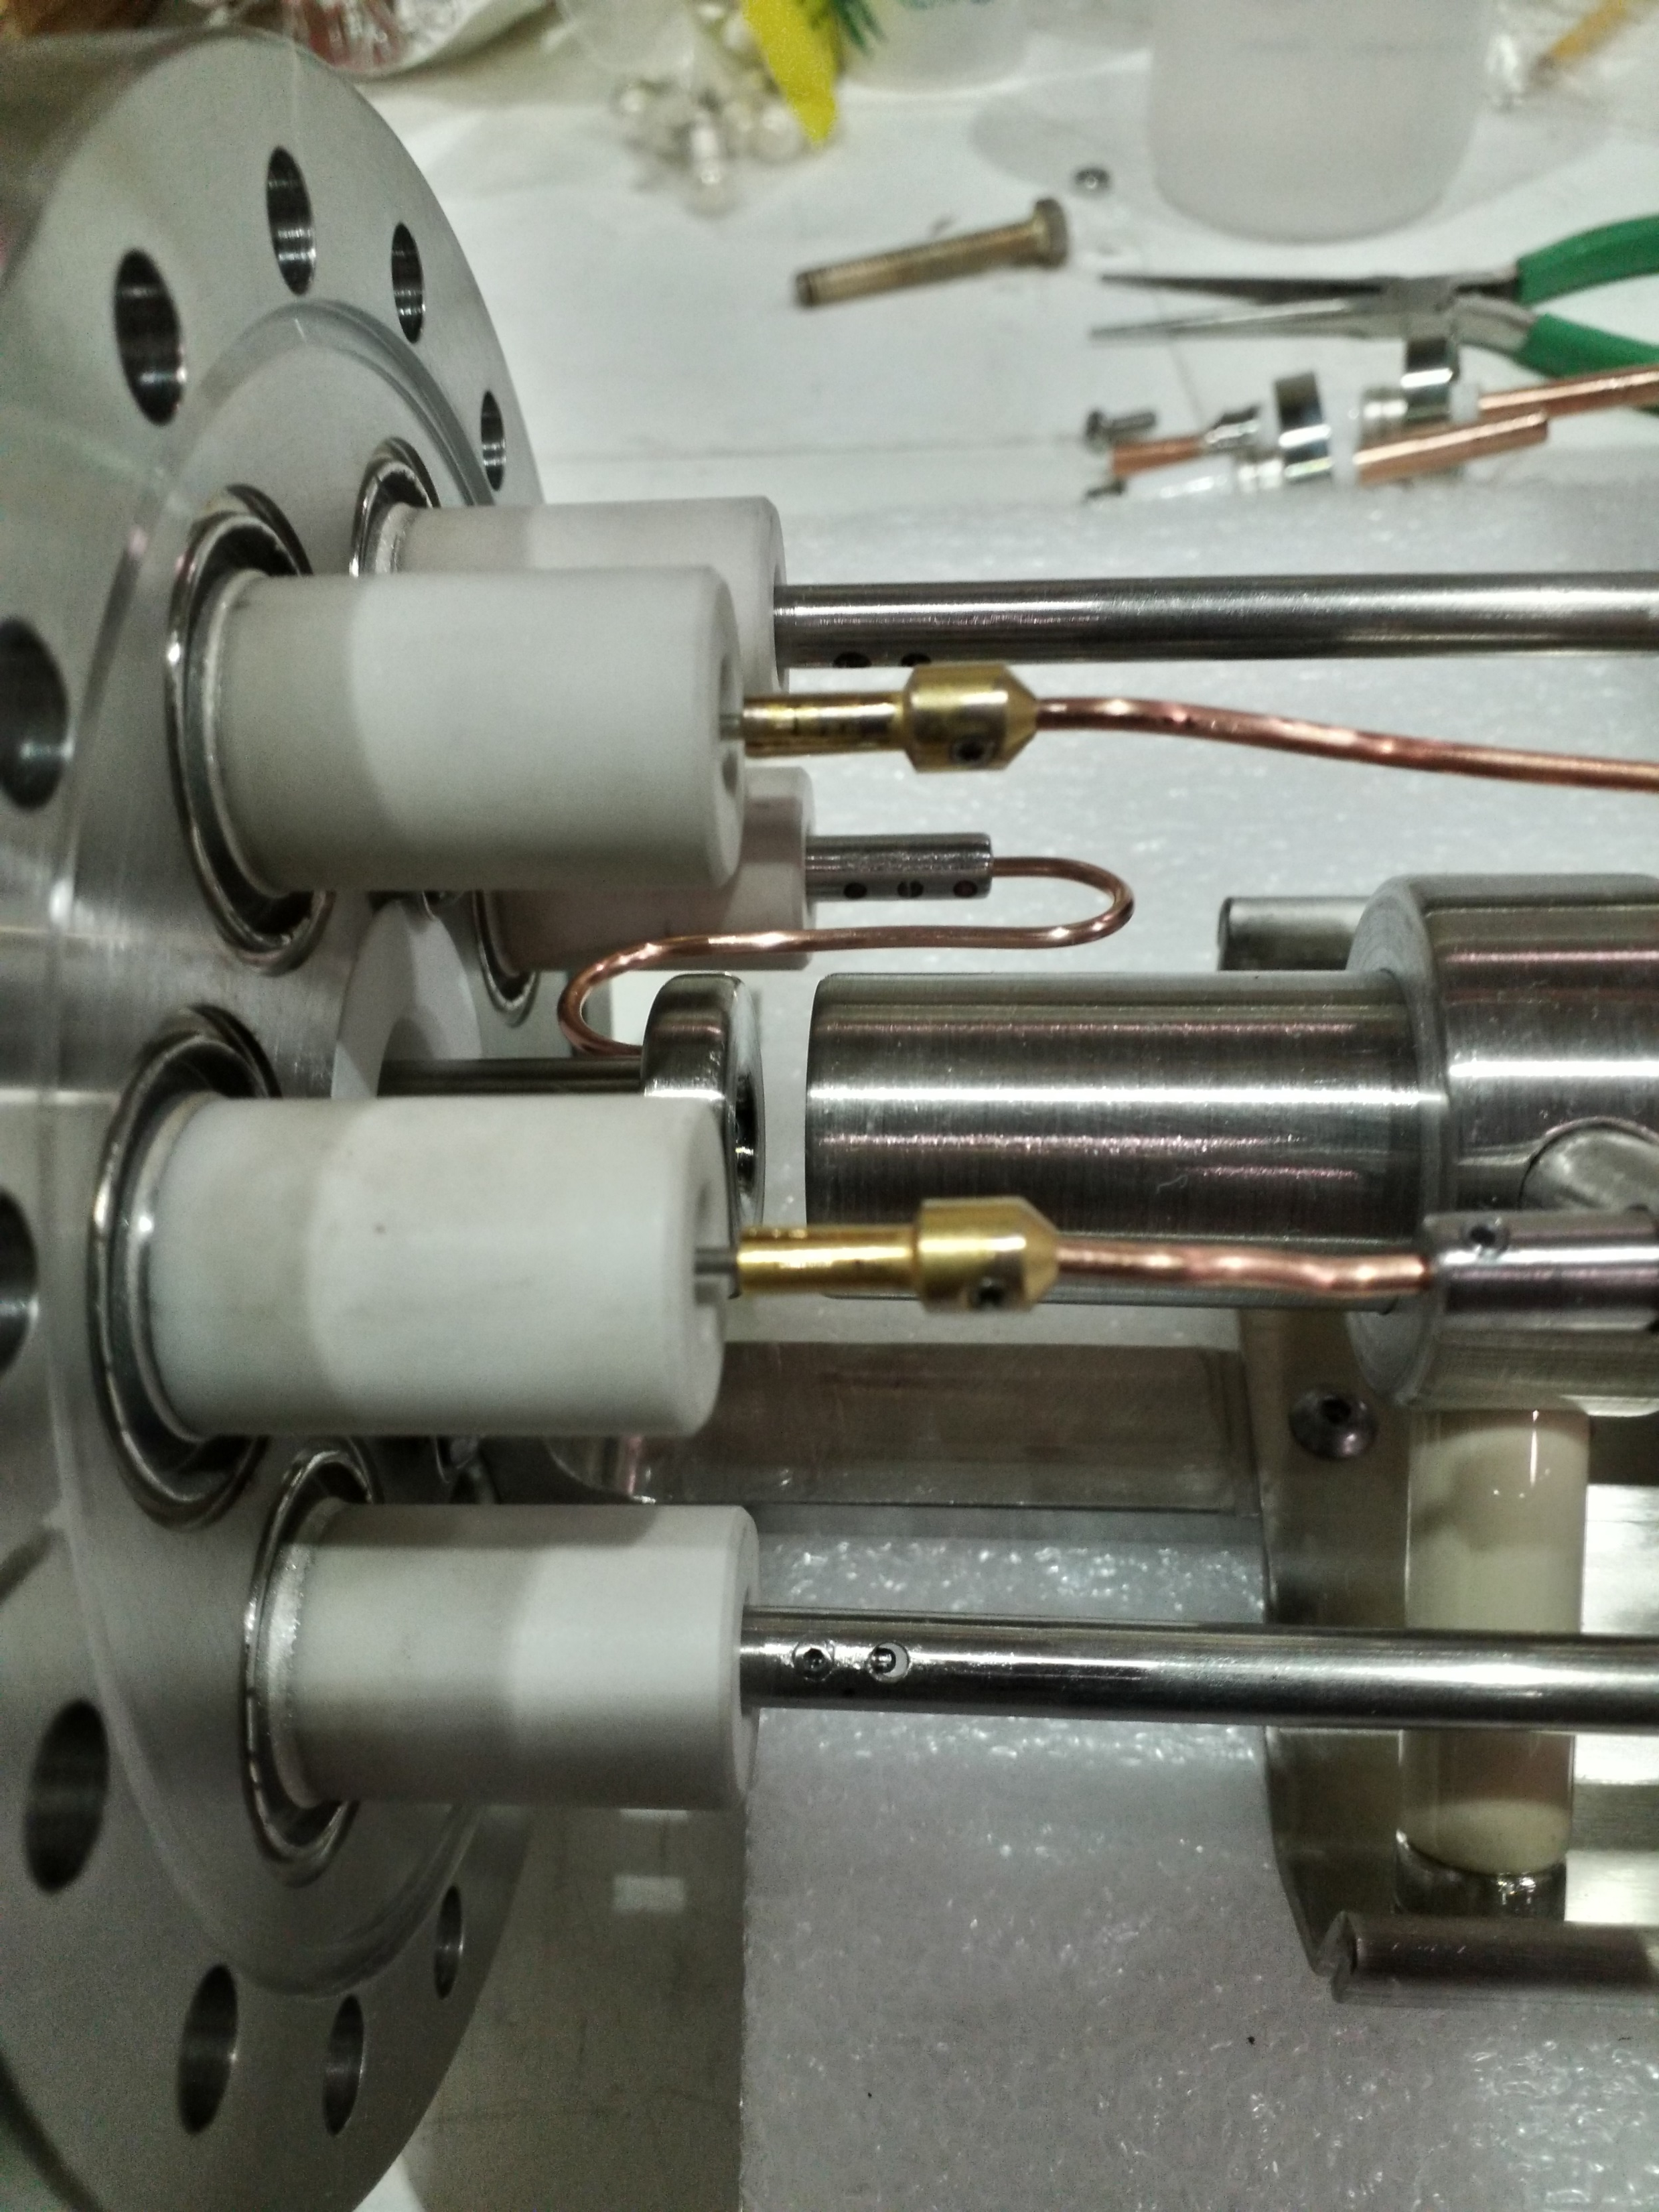
Gas injection region downstream barrier drift tube lengthened
(more direct electrical connection to reduce HV discharging)

Slide 34
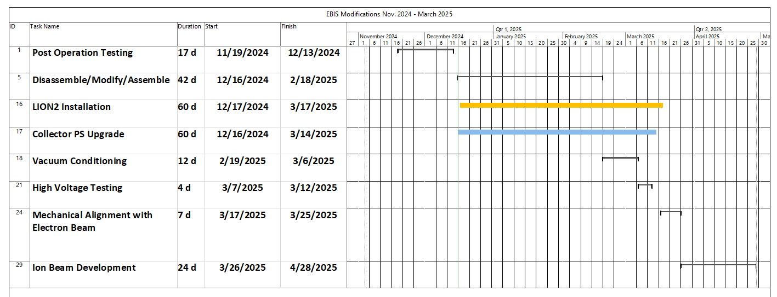
Schedule: EBIS Modification and Testing

Slide 35
Summary

Slide 36
Summary
Extended EBIS commissioning at accelerator location (March 2023):
- March 22 First electron beam
- March 29 First ions from Long Trap residual gas
- April 10 4He2+ set up in Booster from internal gas injection in EEBIS
- April 22 NSRL operations with He+,He2+, C5+, O5+, Si9+
beams setup for use with NSRL GCR testing
Since then, EEBIS provided 4He2+, C5+, O7+, Si11+, Ti17+, Ti18+, Fe20+, Nb23+, Ag29+, Tb35+, Ta38+, Au32+, Au43+, Bi43+ ion beams with required intensity for NSRL operation, and intense beams of unpolarized 3He2+ ions for the accelerator R&D program
Extended EBIS performance of Au32+ at 12P/sc, 5 Hz is currently limited by a pressure rise in the gas trap region and by the relatively low emissivity of the BaO cathodes. This will be addressed during the current shutdown with Drift tube modifications and a switch to an IrCe cathode (used previously in RhicEBIS).
# of ion achieved for RhicEBIS at booster input (12 P , 5Hz,) 1.2x10⁹/pulse
# of ions design for EEBIS (12P, 5Hz) ~1.8 – 2.6x10⁹/pulse
# ion achieved now at Booster input (12P , 5Hz) ~9x10⁹/pulse

Slide 37
Reference Material

Slide 38
Commissioning Milestones (March 2023-April 2024)
March 23 Initial Electron Beam off cathode 200-300mA 0.2Hz, 1-3mA
March 24 1A electron beam to collector after reversing Gun solenoid leads
(limited by drift tube power supply)
March 27-28 Magnetic Mechanical Alignment using electron beam
3A, 30ms e-beams no transverse magnetic steering used
6A, 0.4ms e-beam with some steering correction
March 29-30 First ions from Long Trap residual gas: 8nC, 3A e-beam, 5ms conf.
Helium Gas injection and RGA monitoring systems installed
March 31 Ion output vs Conf time for Gas, Short and Long Traps (Pressure probe)
Helium gas injection tests ( 3.5nC Helium ions from gas trap)
HV platform pulsing test to 500V (for ion beam transport to RFQ)
April 1-2 150C Bore vacuum system bakeout and NEG pump 550C activation
April 3-4 Three Behlke Switch Fast Capture and Extraction system debugged
4He Gas injection, He+ transfer to Long Trap, Ion extraction demonstrated
11nC total charge, at least 50% helium ions
April 8 He2+ propagation through RFQ and HEBT to FC96
April 10 He2+ set up in Booster from internal gas injection in EEBIS

Slide 39
April 11 Long Trap Behlke switches configured for 1+ ion capture by EBIS from LION
April 17 PPM control feature added for CAEN transverse magnetic steering
April 22 First NSRL operations with EEBIS ion beams He+,He2+, O5+, Si9+, C5+
beams from Extended EBIS were setup for use with NSRL GCR testing.
April 24 Ti13+ setup in booster for NSRL
April 27 Fe15+ setup in booster for NSRL
(This allowed Tandem to start RHIC operations with Au)
May NSRL operations
May 26 – June 12 EBIS High Temperature Bake by Vacuum Group
NEG Activation
Flange leak in collector transition found and eliminated
June 13 Pulsed H2 NEG pumping speed measurements
New cathode activation
June 14-17 Superconducting solenoid problems: multiple quenches and recovery
June 17-18 EEBIS Electron beam restart after vacuum improvement by baking, etc.
(4.1A ebeam)

Slide 40
June 19 -20 High Charge states Si11+, Nb23+, Ta38+ and Au32+ easily produced now. The EBIS vacuum is improved greatly after the bake and NEG activation.
June 22 Very high charge states Bi43+ and Au43+ developed
July 1 8A electron beam (1P/sc)
July 8 Au32+ 12P/sc (5.2A ebeam, 35uVs at FC96)
July 27 Au32+ improved distribution, 12P/sc intensity doesn’t change with rep. rate
Stable with most NSRL beams for several hours.
Aug 27 Au32+ Low voltage drift tube distribution with increased cathode bias.
8.3A electron beam achieved (1P/sc operation)
FC96 = 45 uVs with 6.5A ebeam not fully optimized
Oct 2 Short Trap Behlke Switch Partial Mechanical installation
Dec 05-06 4He2+ from EEBIS transported through chicane to FC96
16-18uVs obtained about 80-90% as obtained in the direct beamline.
Dec 22 Short trap Behlke Switch Fast Electronics Installation
Dec 29 Short Trap Behlke Switch High Voltage Testing Complete

Slide 41
Jan 6, 2024 First Highly charged ions after Short Trap installation (Si11+)
(Injected ions trapped and extracted using Long Trap only).
Jan 8-9 Re-start of NSRL setup with EEBIS Beams through ETB line to xf108
Transport of Si11+, Ti17+, Fe20+, Ag29+ Tb35+, Bi43+ from Long Trap
Jan 22 Au+ from LION captured in EEBIS Short Trap; Au32+ extracted
Jan 24 He gas injection with capture and extraction of He2+ from Short Trap
FC96 ~23uVs, XF108 ~2.1uVs (exceeded current Long Trap values)
April 19 Ne+ injected into EBIS from HCIS2; Ne8+ from EBIS used in Booster Ring
April 21 7.1A ebeam; Au32+ FC96 ~ 58uVs
April 27 HV tests with cold cathode (no ebeam): No Discharges Observed
April 28 Au32+ FC96 ~87uVs (1.85E+9 ions/pulse) (1P/sc, 6.9A ebeam);
Au32+ xf108 ~5uVs (1.4E+9 ions/pulse) (~53% of XEBIS goal for 10Ae-)
12P/sc 200ms FC96 ~70uVs , about 20% reduction

