Slide 1
FFA synchrotron for medical applications (LDRD 24-010)
Dejan Trbojevic
December 17, 2024

Slide 2
FFA synchrotron for medical applications (LDRD 24-010)
Dejan Trbojevic
December 17, 2024

Slide 3
OUTLINES
INTRODUCTION
  FFA Medical Applications of the CAD accelerator physics developments status and future
  A success of the LDRD 24-010 will allow further developments and funding
  Essentials of the FLASH radiation cancer therapy
  Advantages of the Fixed Field Alternating Gradient Fixed betatron tunes synchrotron
2. THE NEW ACCELERATOR PHYSICS CONCEPT – FFA Fixed Tunes Synchrotron
  Background - Fixed Field Alternating Gradient Accelerator
  Experiences from CBETA project
  Magnetic Field Expansion
  Tune Dependence on Multipoles
  Orbit Dependence on Energy
  Fixed Betatron Tunes in Range 10 MeV< E_{k} <250 MeV or -73% < dp/p < 43.4%
  Dynamical Aperture Studies
3. LDRD 24-010 GOALS and ACHIVEMENTS
  Permanent Magnet Design, Building and Measuring Magnetic Field
  Arc Assembly with Nine Magnets
  Measurements of the Proton Beam Propagation at NSRL
4. SUMMARY

Slide 4

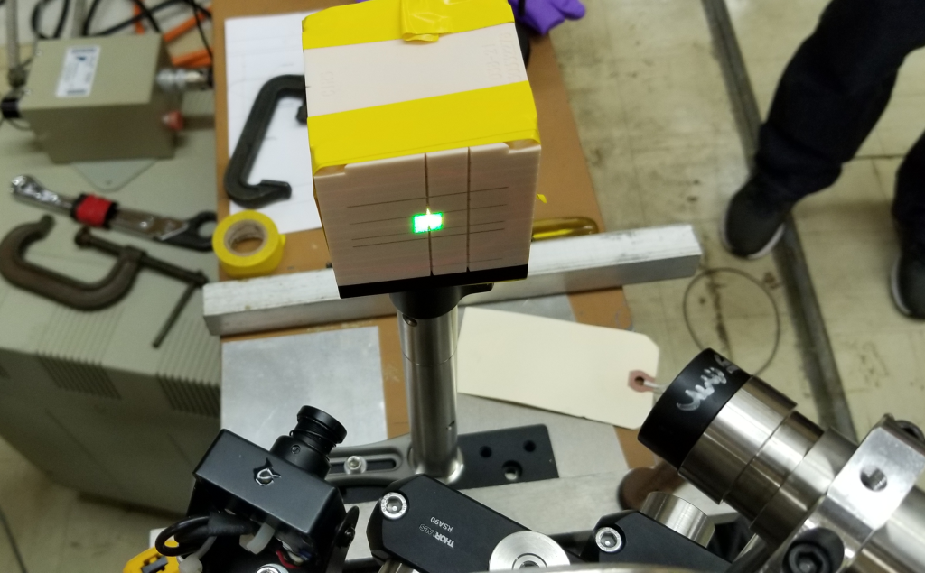
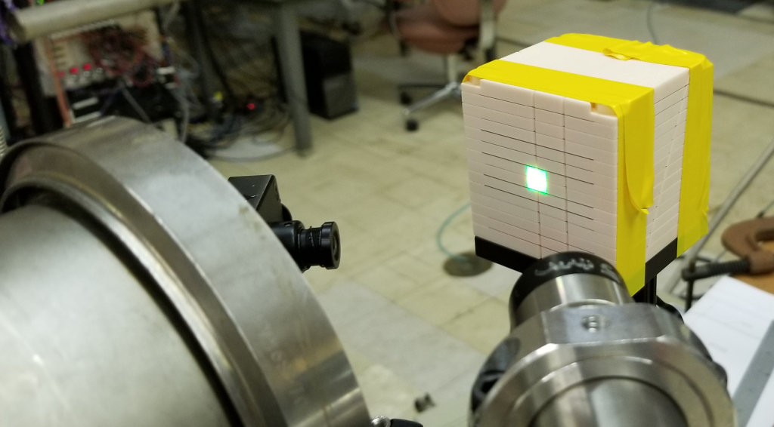
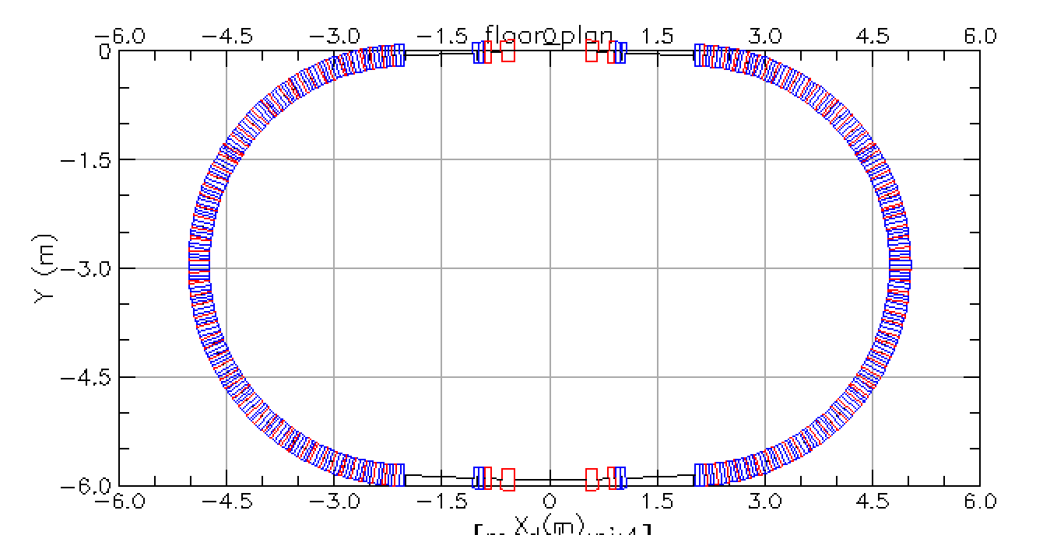
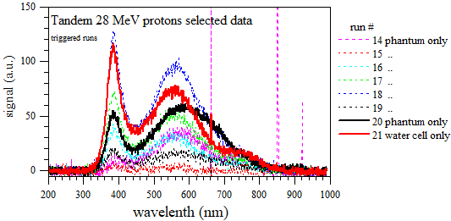
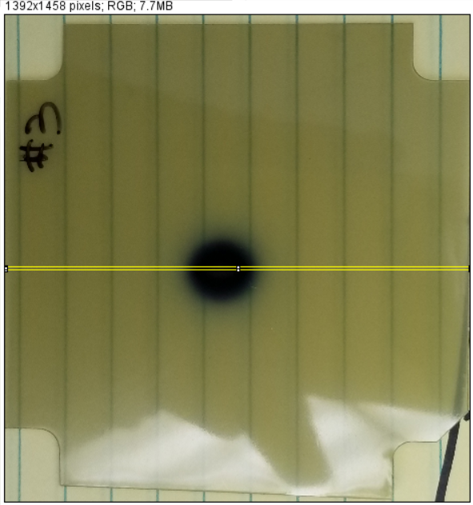
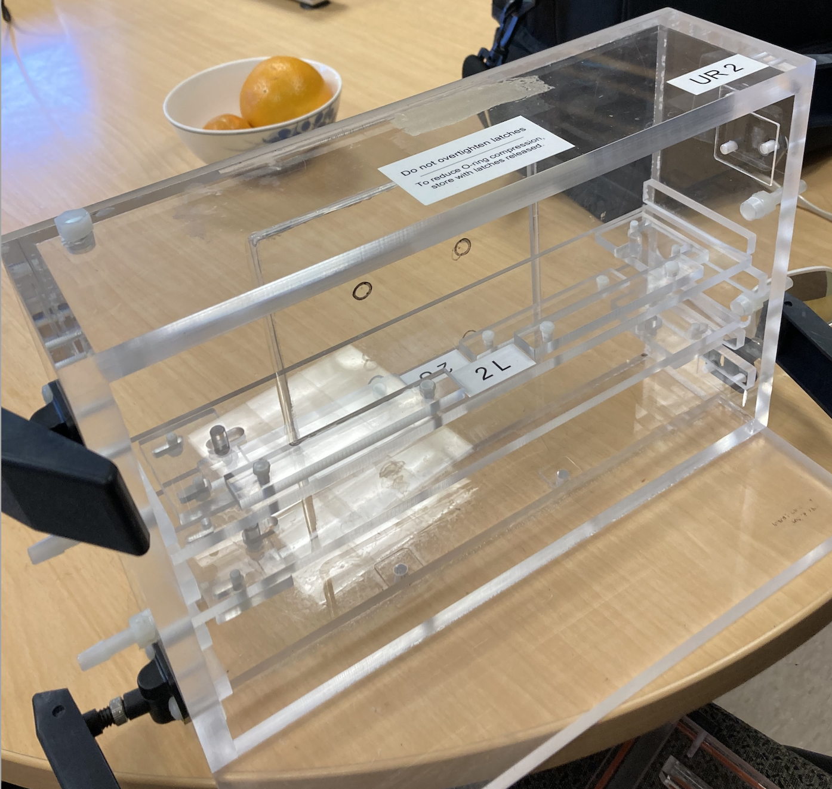
Introduction
A strong collaboration between CAD and Radiation Oncology Department with Chairman Dr. Samuel Ruy of Stony Brook University Hospital (SBU) towards building the Proton Cancer Radiation Therapy Facility for Long Island with ability to do FLASH radiation. We received the Seed Grants from BNL and SBUH expecting additional FLASH therapy grants. The LDRD-24-010 is additional BNL contribution to this program. The LDRD should produce a proof of principle of the fast-cycling synchrotron to let us proceed towards full funding of the FLASH proton cancer radiation facility.
Dear Drs. Ryu and Trbojevic:
I am pleased to inform you that your proposal to the 2023 SBU-BNL Seed Grant Program, Photon FLASH Therapy Targeting for Deep-Seated Tumors, has been selected for funding in the amount of $41,937. Congratulations! The reviewers were impressed with the research focus outlined in your proposal and noted the potential impact of the project…
Tandem FLASH Experiments
CAD BNL-SBU Collaboration
Mouse Holder

Slide 5
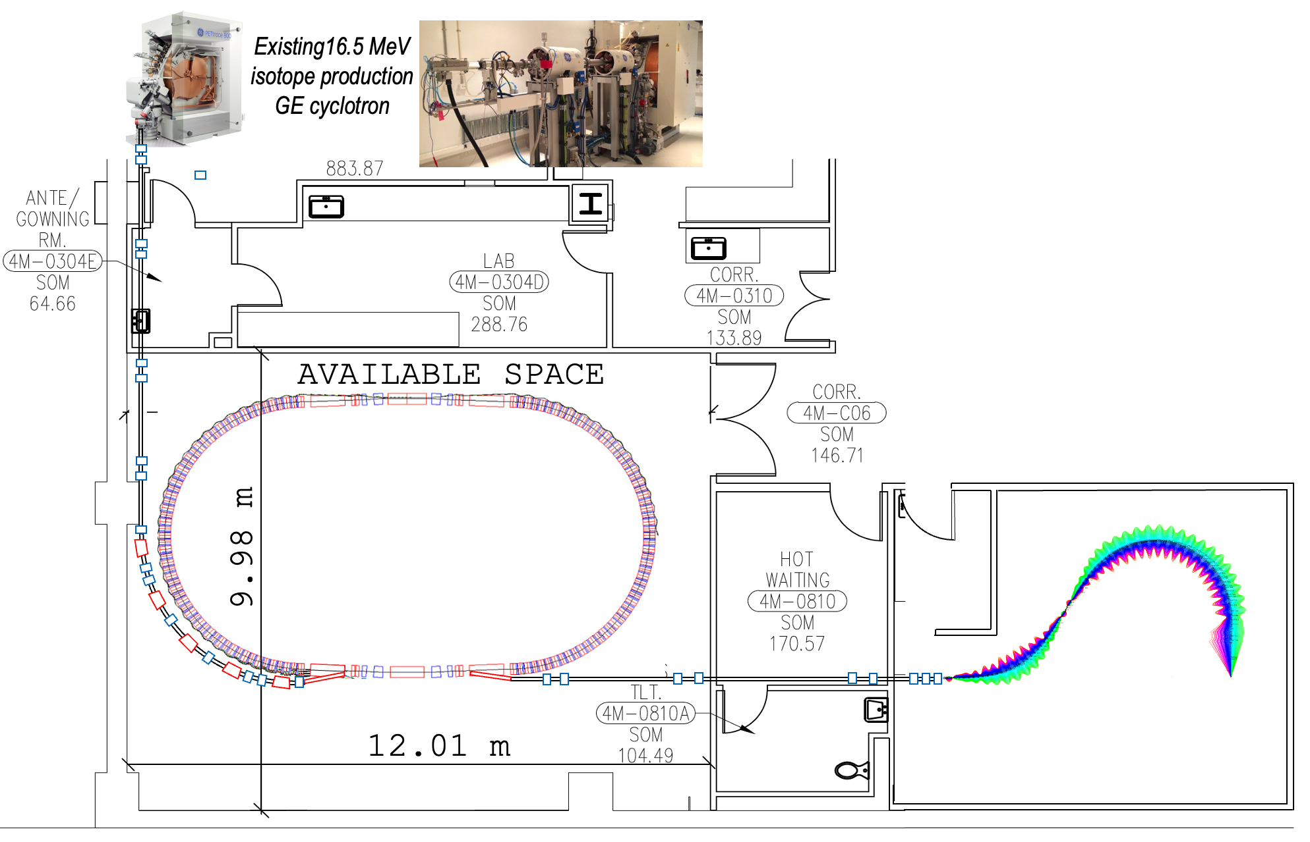
Medical Applications: FLASH Radiation Cancer Therapy Facility at Stony Brook University Hospital with Fast-Cycling Permanent Magnet Synchrotron and Permanent Magnet Gantry
Advantages of the concept:
In proton acceleration within the non-relativistic energy range the main problem is the limitation the speed of magnetic field response to the change of energy. This limitation is now eliminated by using the permanent magnets for the same energy range.
Cost reduction: the cost proposed FLASH radiation therapy facility is estimated to be ~$40M to be compared to ~$200M (Varian Facility in New York city in Harlem)
Simplified operation as there is not a need to change the magnet settings for different proton energies.
Reduction of the power consumption as the permanent magnets do not require electrical power. Exceptions are the correction magnets and RF power amplifiers.
Reduction on radiation shielding as the beam losses in synchrotron if any are controlled.
Reduction of the magnet sizes and weights. The gantry weight is significantly reduced.

Slide 6
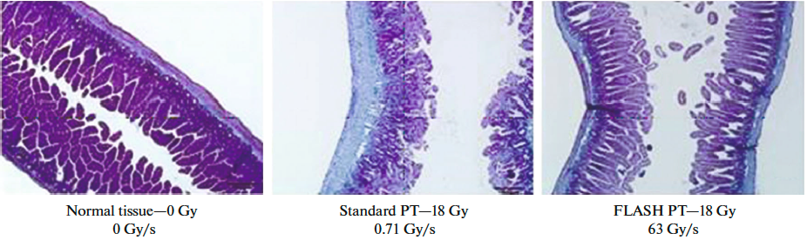
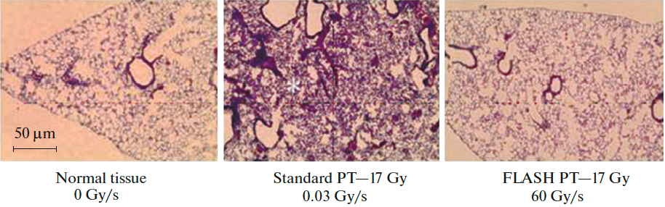
FLASH Radiation Therapy
It has been demonstrated, mostly through multiple experiments with animals and just a few human exposures that the FLASH radiation can decrease the normal tissue injury while maintaining destruction of the tumor cells as in conventional radiotherapy. This proposal removes limitations of the existing proton therapy facilities. It delivers protons with required energies in a very short time without varying the magnetic field. It uses the permanent magnets except in the spot scanning part. Permanent magnets proposal is based on already achieved technology recently demonstrated in the Cornell-Brookhaven National Laboratory Electron Test Accelerator “CBETA” commissioning.
The proton FLASH therapy requirements are 40 Gy/s with respect to 0.01 Gy/s in conventional RT.
To obtain the dose of 40 Gy/s in 100 ms for a volume of 1000 ml (10x10x10 cm) this becomes 4 Gray in 100 ms.
3.8x10¹¹ protons or 60 nC are delivered in 100 ms equivalent to 600 nA.
It is not yet clear why the high radiation in a flash spares the healthy tissue, but it looks like that radiochemical depletion of oxygen occurs induces tissue radio resistance.
Normal Tissue
Regular PT
FLASH
Normal Tissue
Regular PT
FLASH

Slide 7
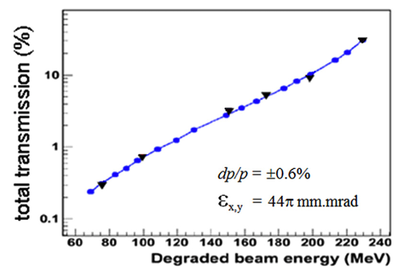
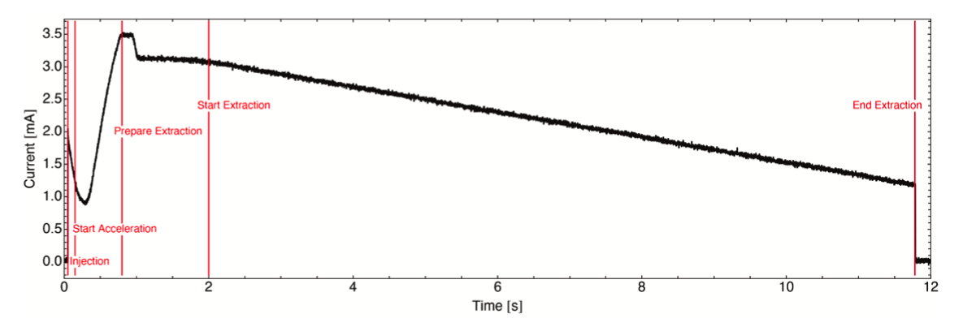
Problems of the existing facilities for FLASH radiation
Major limitations at any existing cancer hadron radiation therapy system or facility are the variable magnetic field requirements for different energy settings. It is hard to adjust the magnetic field within the short time (hysteresis) required for FLASH.
CYCLOTRON based treatment centers required energy degraders as a single 230-250 MeV energy is extracted. At low energies only 1% of the initial beam is delivered to the patient. The beam size – emittance is always significantly enlarged. The synchrotrons are presently cycling with low frequencies and the slow extraction of the beam towards the patients is (Fig. 2) too long for FLASH.
For Synchro-cyclotrons (MEVION and IBA S2C2) the spot scanning has serious problems. It is unlikely that synchro-cyclotrons would be the eventual technology of choice for a pure spot-scanning FLASH proton therapy system.
At present, for AVO system the repetition rate of 200 Hz is simply too slow to enable delivery to anything but small volumes. The pulse repetition frequency of 200 Hz makes it possible to irradiate only 20 separate energy layers within a time window of 100 ms. An increase in this rate by a factor of >500 would be necessary [4] for spot-scanned FLASH delivery to a 1-liter volume.
Transmission due to Degrader
Beam extraction from synchrotrons requires much longer time with respect FLASH time

Slide 8
Comparison of our proposal to the existing Facilities
Accelerator Type | Isochronous Cyclotron |  | Synchrocyclotron |  | Synchrotron | Linear | FFA facility
Vendor | IBA | Varian | IBA | Mevion | Hitachi | AVO | BNL
System | C230 | ProBeam | S2C2 | S250 | ProBeam | LIGHT | FFA
Maximum Energy (MeV) | 230 | 250 | 250 | 250 | 250 | 250 | 250
Minimum Energy (MeV) | 70 | 70 | 70 | 70 | 70 | 37.5 | 10 - 30
Peak Current | 0.3μA | 0.8μA | ~18μA | ~7μA | 4.8 mA | ~40μA | 1.2 mA
Max Ave. Current (nA) | 300 | 800 | ~130 | ~32 | 4.8 | 32 | 530 - 897
Accel. Frequency (MHz) | 106.1 | 72.8 | 87.6-63.2 | 133-90 | 1.3-10 | 3,000 | 378 MHz
Repetition Rate | CW | CW | 1 kHz | 500-750 Hz | CW | 200 Hz | 540-809 Hz
Treatment Pulse Length | >400μs | >400μs | 7μs | 6μs | 0.5 - 5s | 4μs | 725μs
Bunch Length | ~2ns | ~2 ns | ~2 ns | ~2 ns | 25-200 ns | 0.5 ns | ~10–405 ns
Max Part. Per Bunch/Pulse | 100,000 | 70,000 | 8 x 10⁸ | 4 x 10⁸ | 1.5 x 10¹¹ | 10¹⁰ | 1.8 x 10¹¹
Electric Central Field | 1.7 T | 2.4 T | 5.75 T | 9 T | 1.7 T | 25 MV/m | Max 1.8 T
[1] S. Jolly, H. Owen, M. Schippers, C. Welsch, “Technical challenges for FLASH proton therapy.” Phys. Med. 2020, 78, 71–82. https://pubmed.ncbi.nlm.nih.gov/32947086/

Slide 9
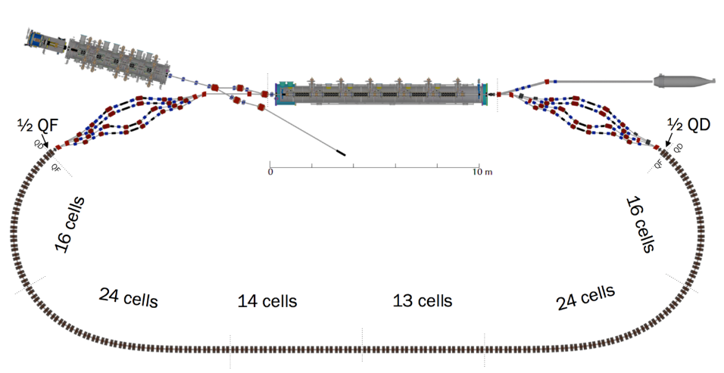
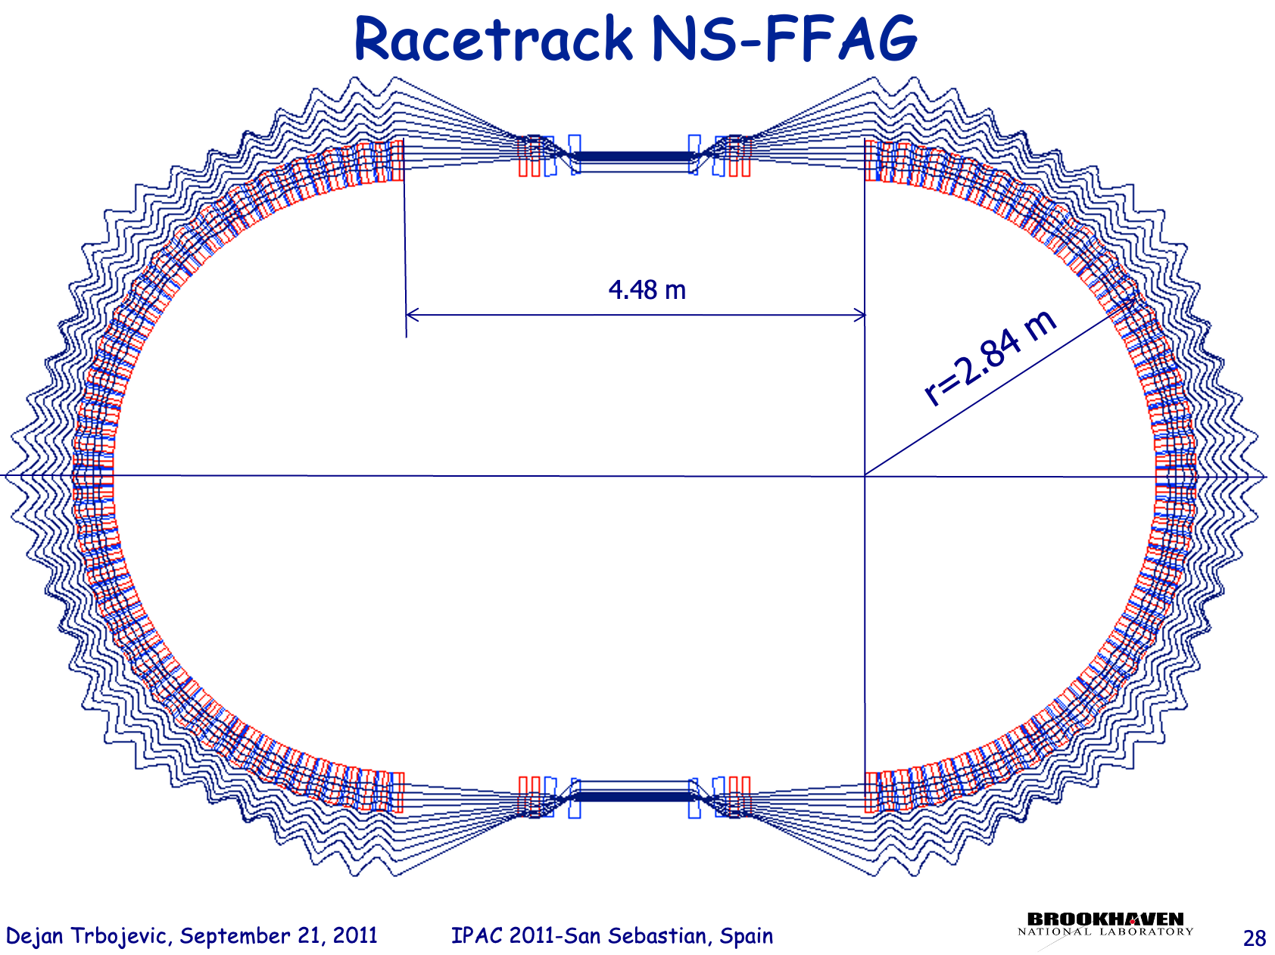
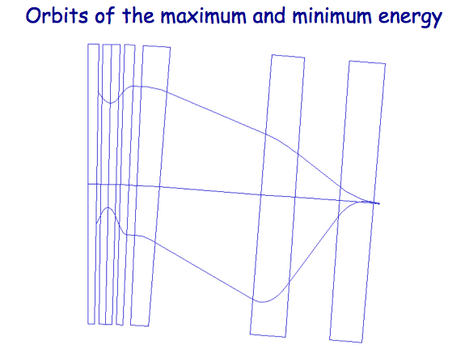
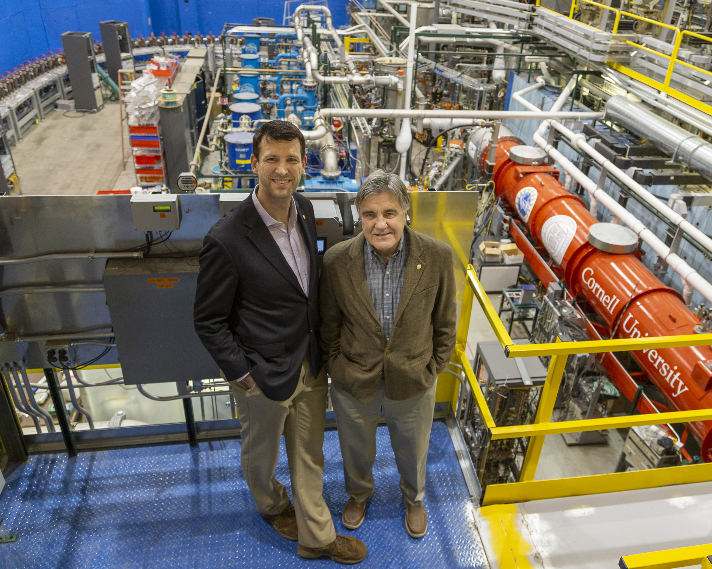
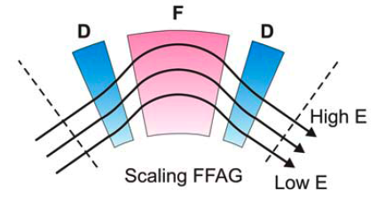
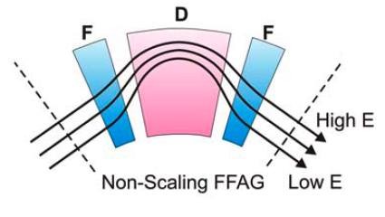
2. NOVEL ACCELERATOR PHYSICS CONCEPT
Background – FFA Gradient Accelerator
IPAC 2011 Contributed at San Sebastian
‘CBETA’ Project is a Proof of Principle
The proposal is based on the existing US patent D. Trbojevic, Title: “Non-scaling fixed field alternating gradient permanent magnet cancer therapy accelerator”, patent number: US 9661737 B2, Date of the patent: May 23, 2017.
https://patentimages.storage.googleapis.com/42/5e/92/f7da1cf617d6e3/US9661737.pdf
3 cm
0.9 meters
B = B_{o}+r G_{o}
B =B_{o}(r/r_{o})^{k}
Dejan Trbojevic – MAC Review December 17, 2024

Slide 10
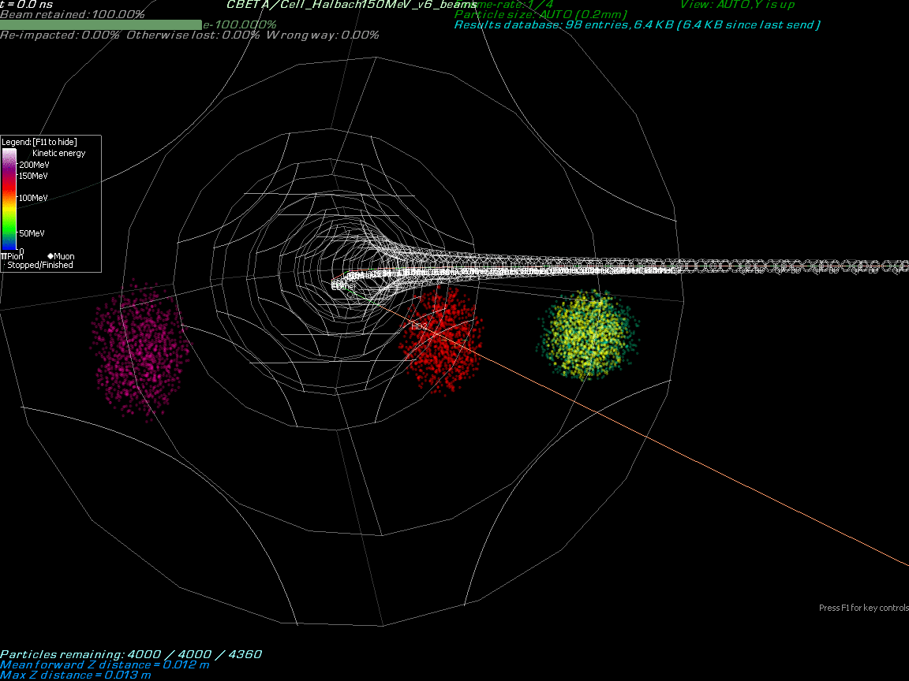
Background: Particles with multiple energies are accelerated in the same Fixed Field Alternating (FFA) Gradient magnets.
This is shown in Stephen Brooks’ simulation of particles’ motion in FFA with 42, 78, 114 and 150 MeV electrons

Slide 11
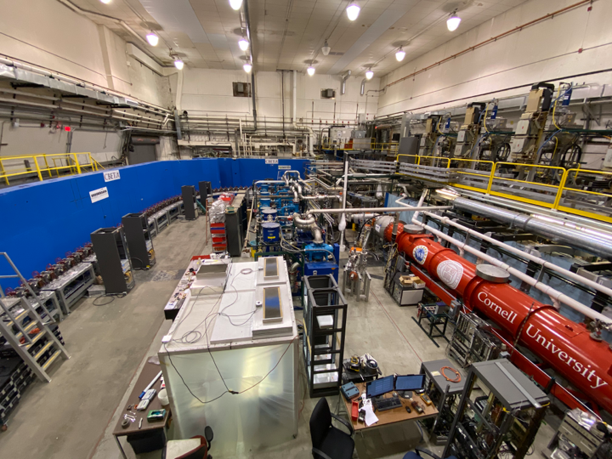
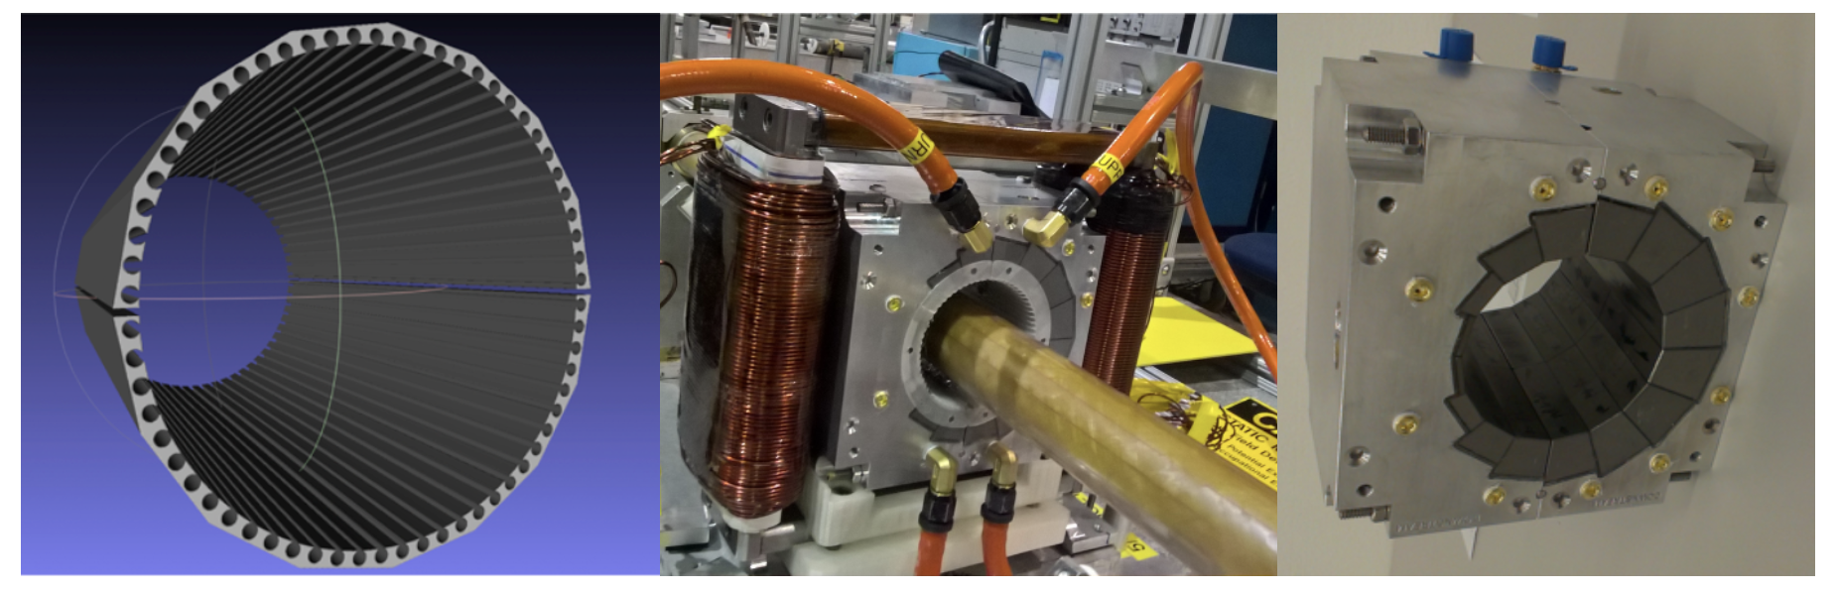
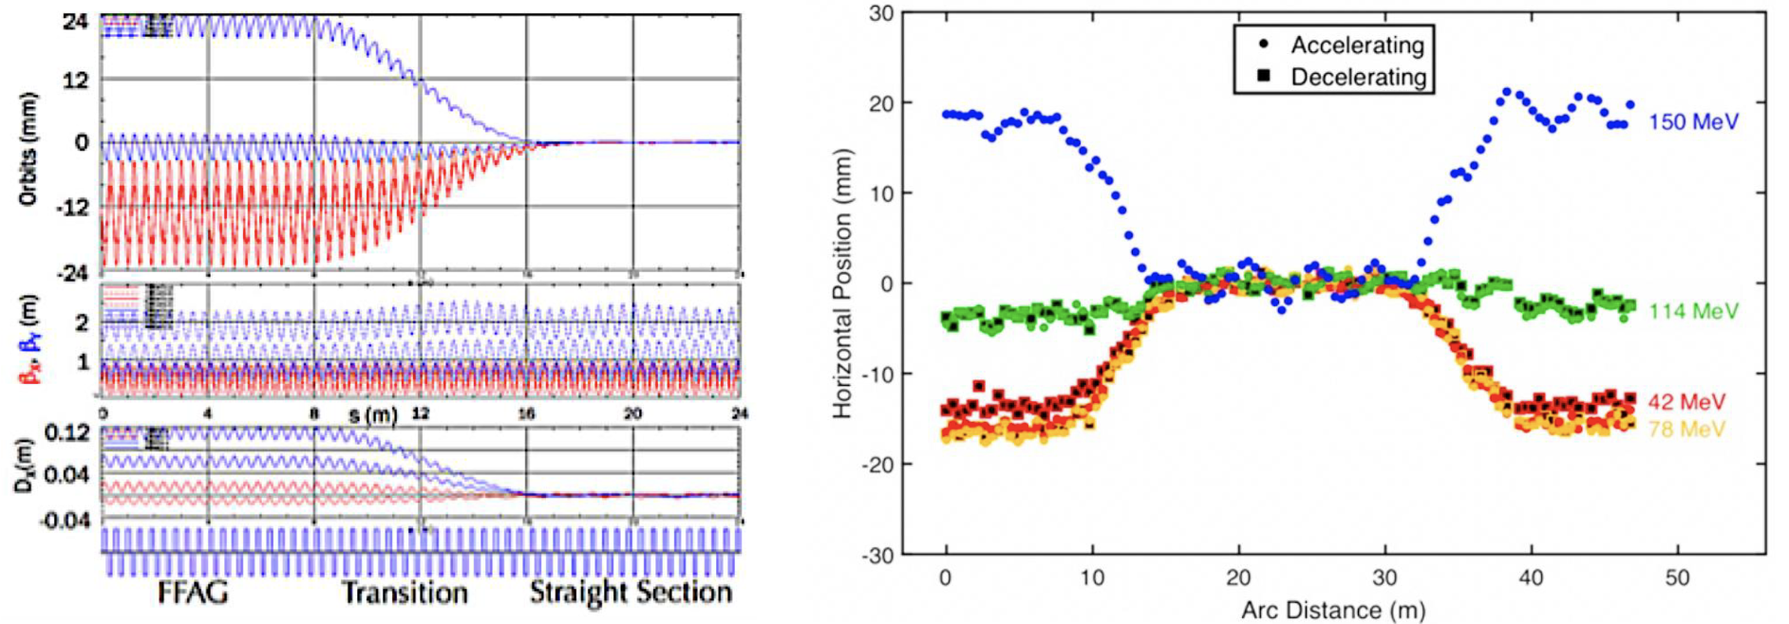
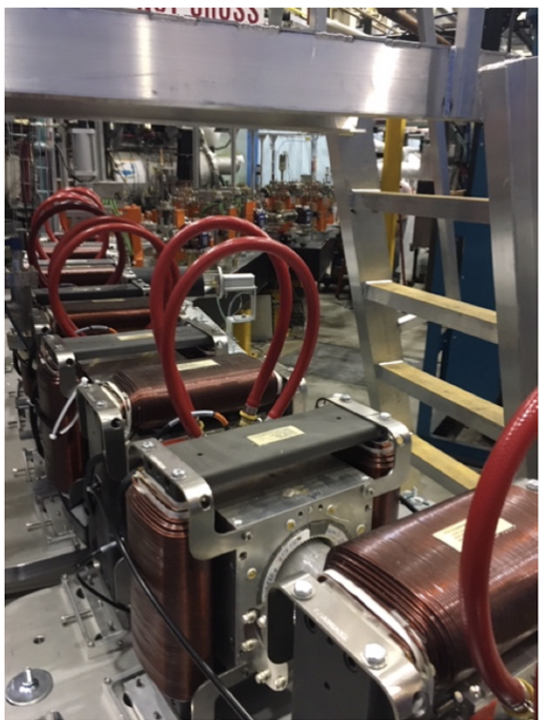
2. THE NEW ACCELERATOR PHYSICS CONCEPT
Using Experiences from Successful Commissioning of the CBETA Project First Four Turn Superconducting ERL with a single return beam line
Full proof of principle for the Non-scaling Fixed Field Alternating Gradient
Merging multiple energy orbits into a single straight-line orbit
Development of the new permanent magnet technology

Slide 12
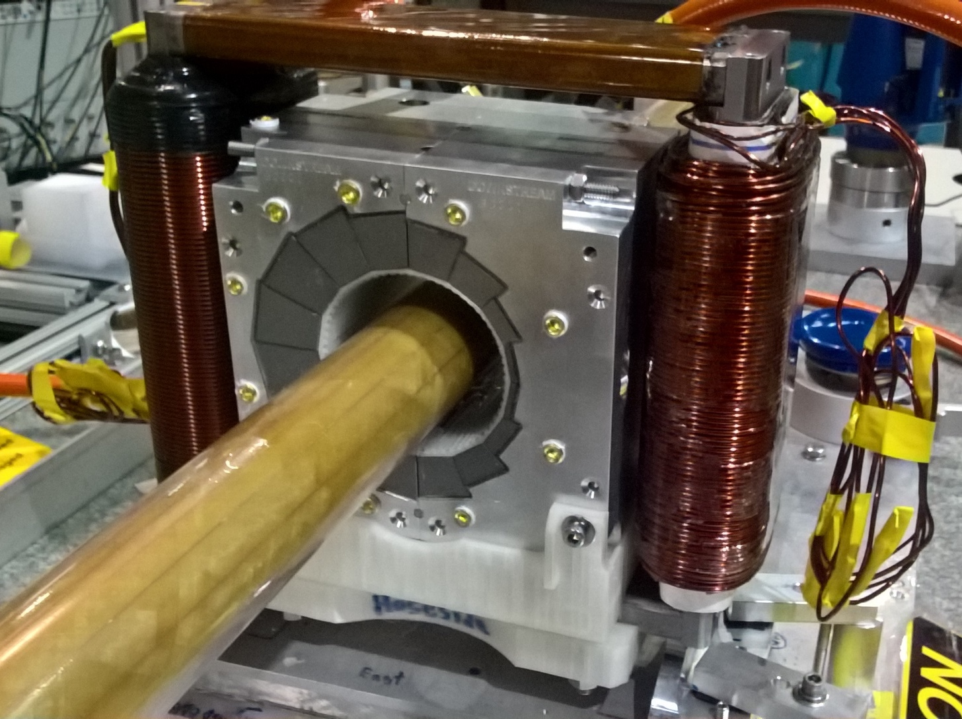
Development of the new permanent magnet technology
Combined Function Permanent Magnet
The Dipole Corrector magnets are made of iron frame with opposite copper windings – this is a vertical dipole corrector
Halbach design made of NdFeB material
This is a combined function magnet dipole + quad
It is measured by the rotating coil at BNL
3D printed multipole corrector pack inside
Window frame corrector coil outside
Temperature stabilised by water (orange hoses)
At BNL Stephen Brooks developed magnetic field ‘harmonic’ iron wires correction method by inserting around vacuum chamber

Slide 13
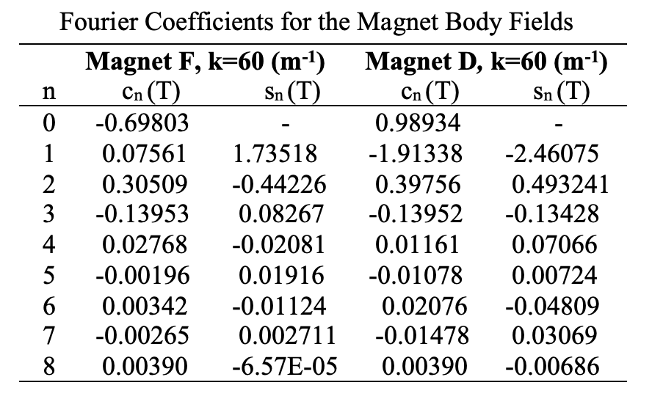
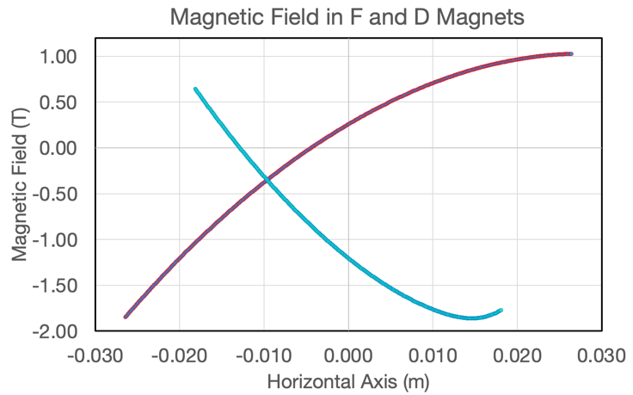
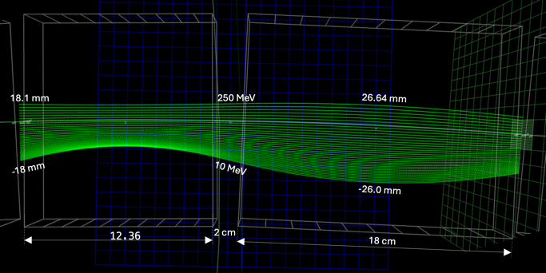
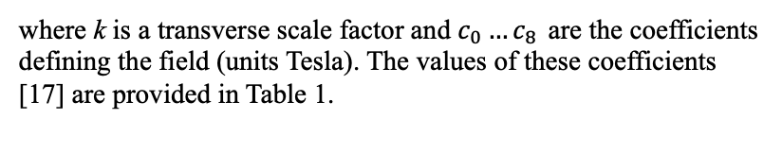
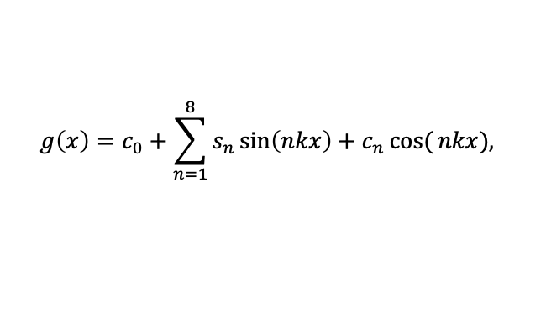
Transverse Magnetic Field Dependence: Taylor expansion replaced with the Fourier series
$$g\left(x\right)=c_{0}+\sum_{n=1}^{8}{s_{n}\sin\left(nkx\right)}+c_{n}\cos{(}nkx),$$
where k is a transverse scale factor and $c_{0}…c_{8 }$are the coefficients defining the field (units Tesla). The values of these coefficients [17] are provided in Table 1.
The stable orbits in a wide energy range are obtained by adjustments of the F and D sextupoles and additional multipoles up to eighteen poles.
D magnet
F magnet

Slide 14
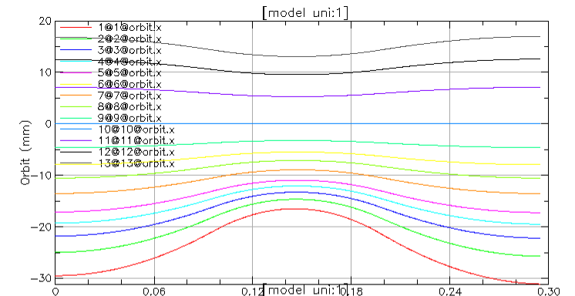
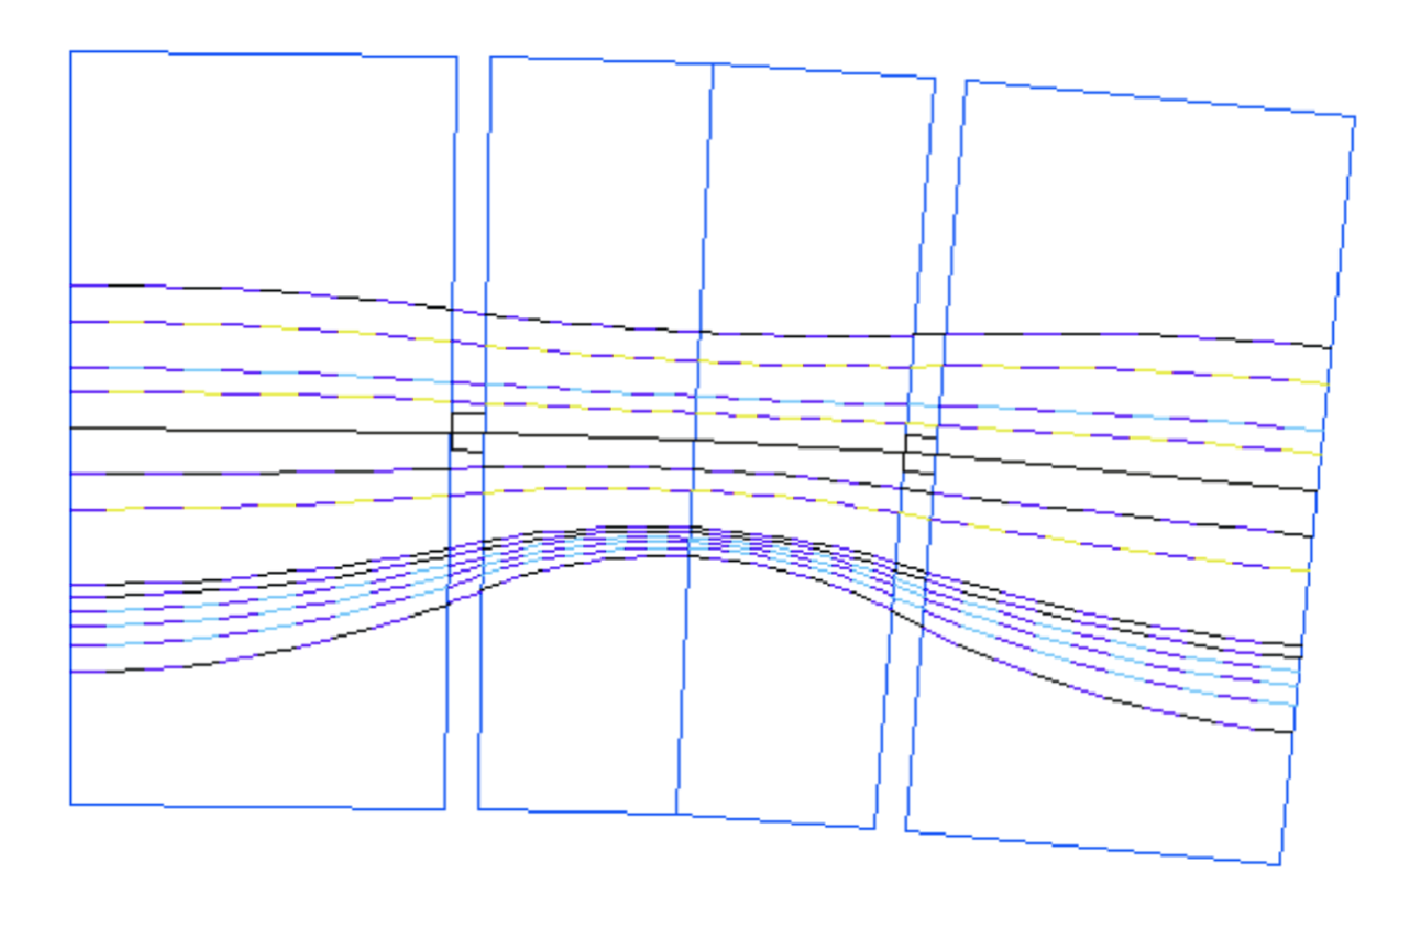
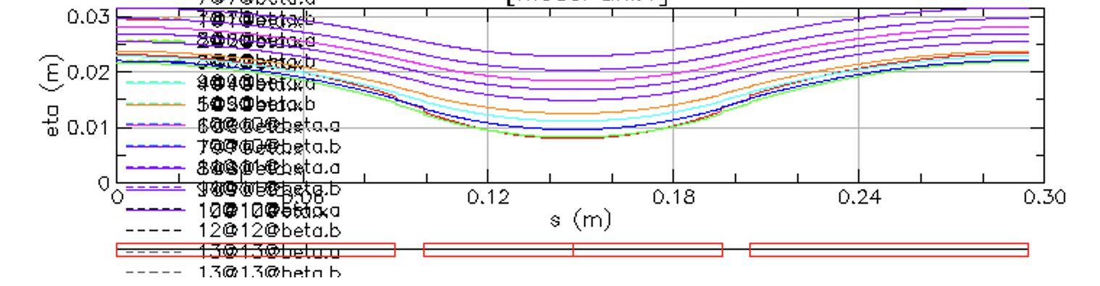
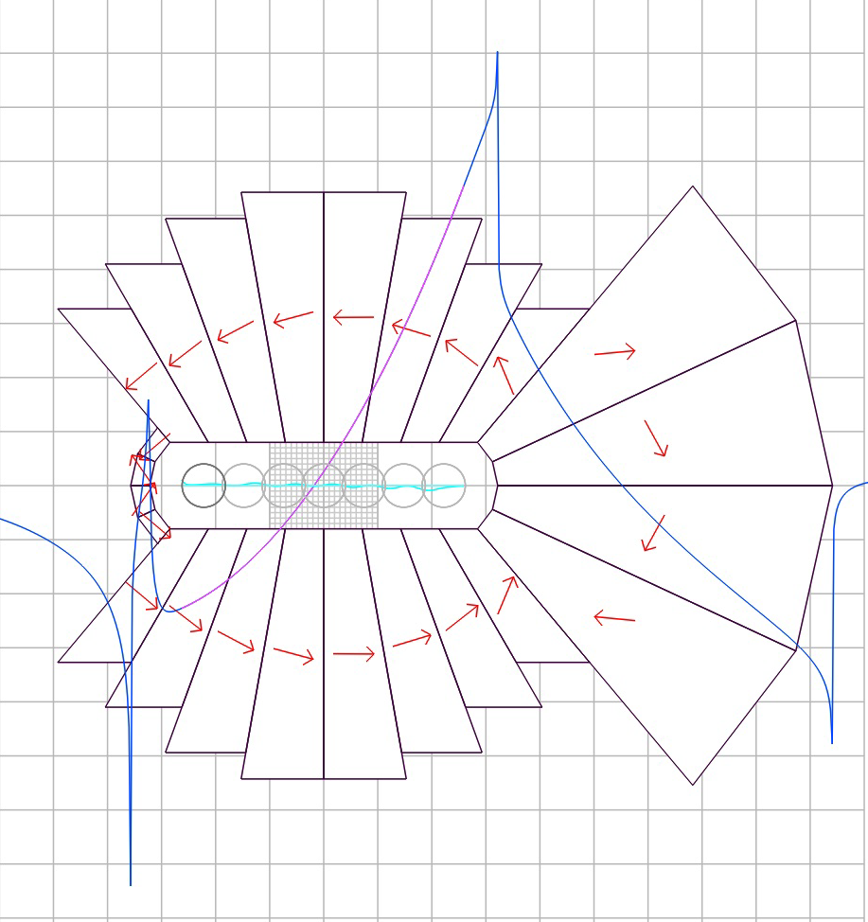
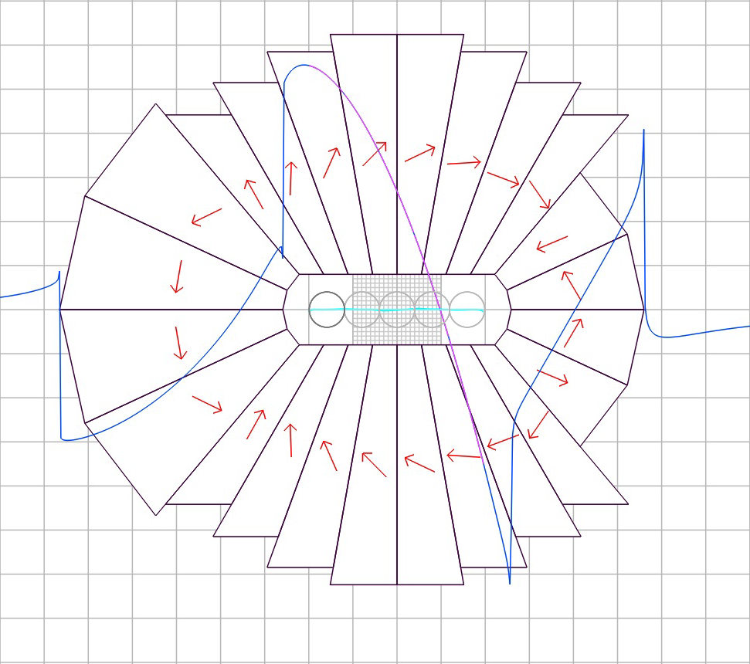
  Orbit Dependence on Energy
250 MeV
129 MeV
250 MeV
19.6 mm
202 MeV
150 MeV
129 MeV
70 MeV
50 MeV
10 MeV
25 MeV
10 MeV
-33.2 mm
DISPERSION
FUNCTION
The length of the focusing magnet 18 cm
The length of the defocusing magnet 9.652 cm
~12.5 cm
~11 cm
~13 cm
~14 cm

Slide 15
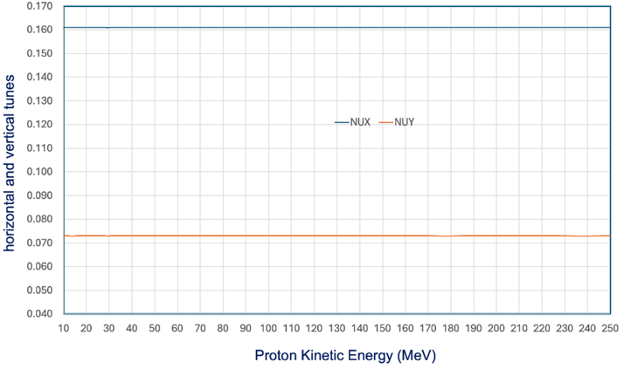
  Fixed Betatron Tunes in Range 10 MeV< E_{k} <250 MeV or in momentum space -73% < δp/p < 43.4%

Slide 16
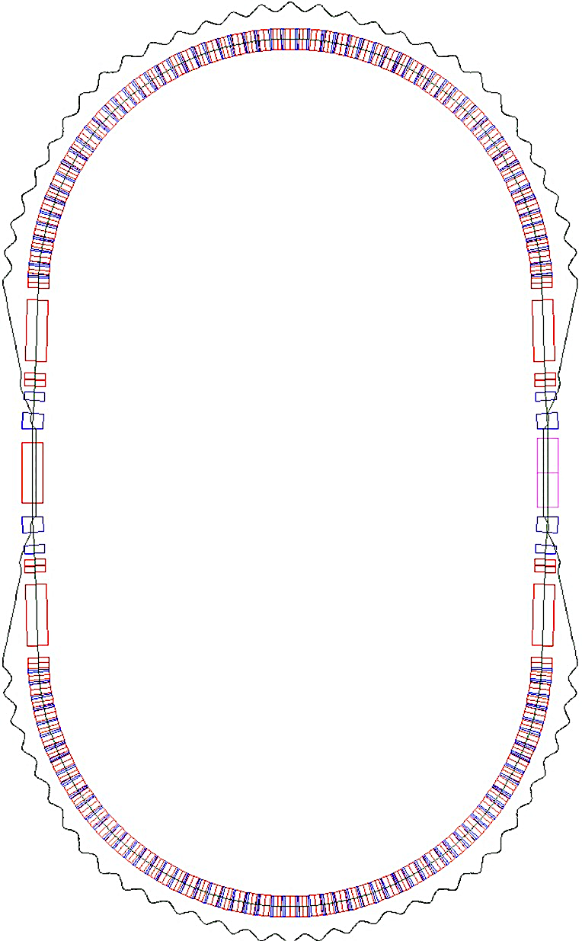
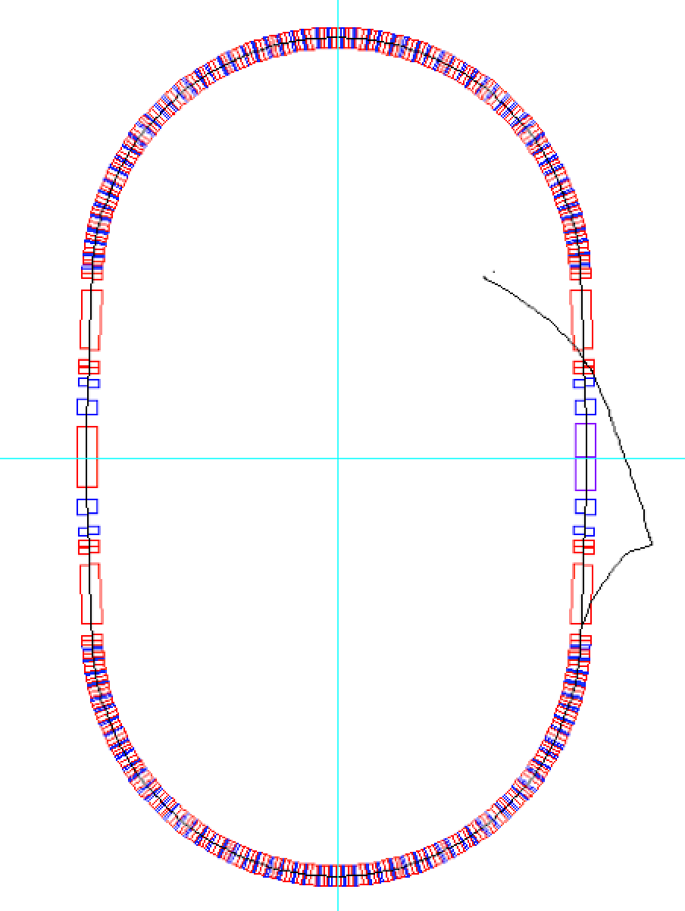
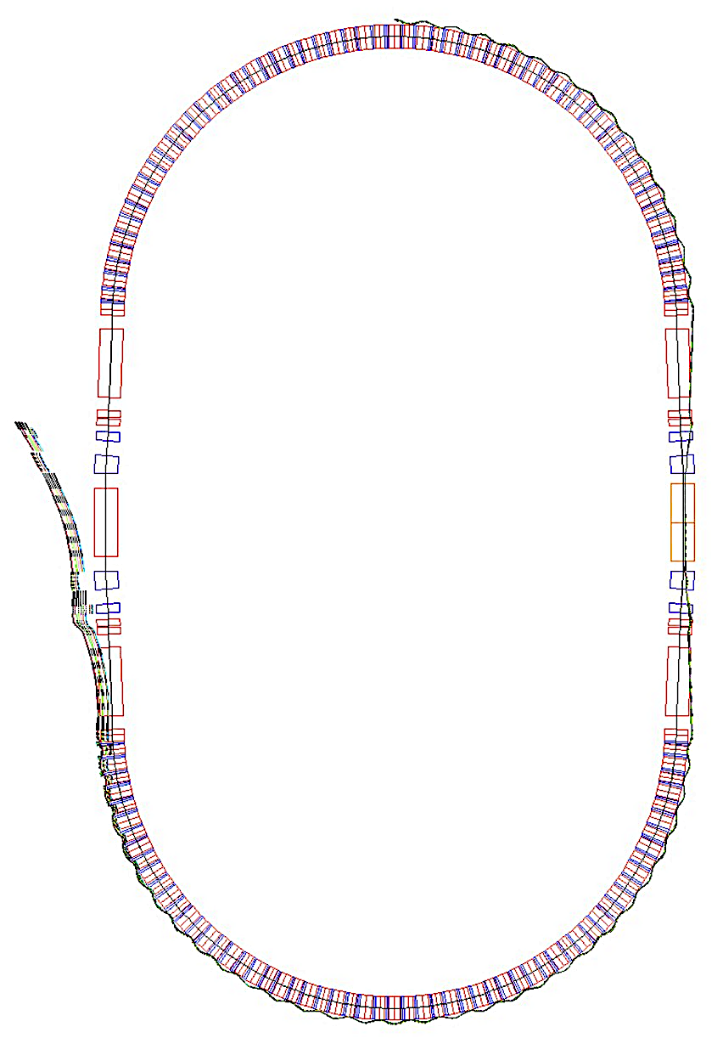
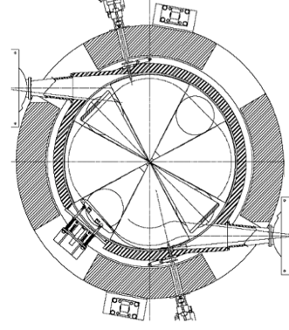



Synchrotron: Injection, Acceleration, Extraction
Cyclotron 10 MeV
RF-1
7 m
RF-2
5.68 m
2.7 m
Magnified injection
orbit
Magnified extraction
orbit
RF-3
Protons orbit at δp/p=+68%

Slide 17
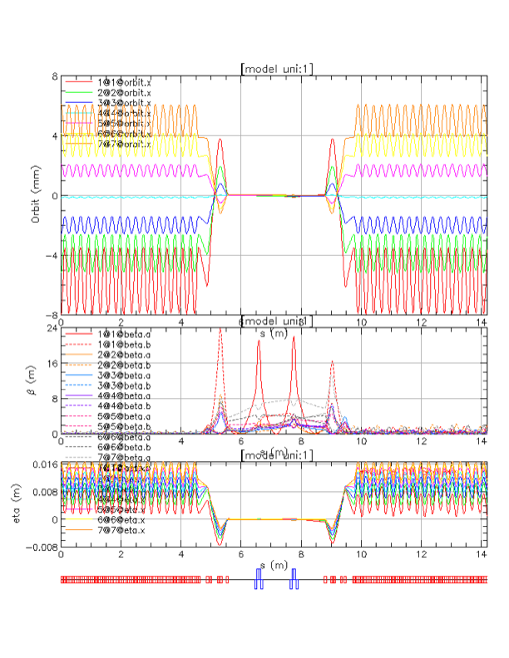
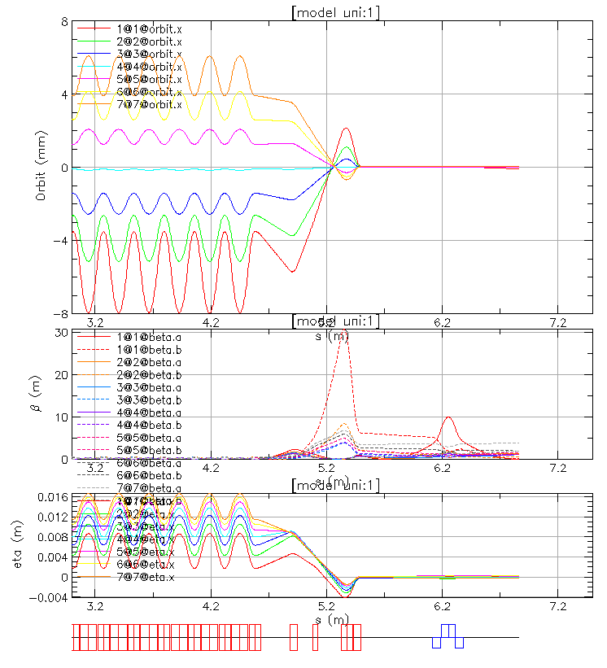
An example of Matching the Multiple Orbits in the Arc to the Single Orbit in the Straight Section

Slide 18
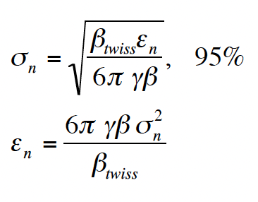
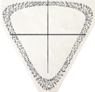
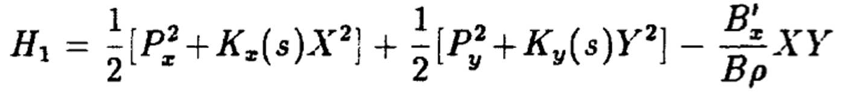
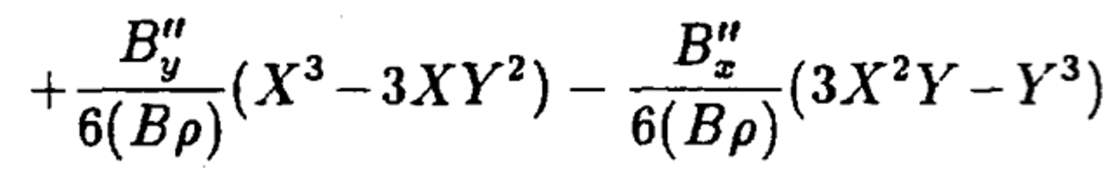
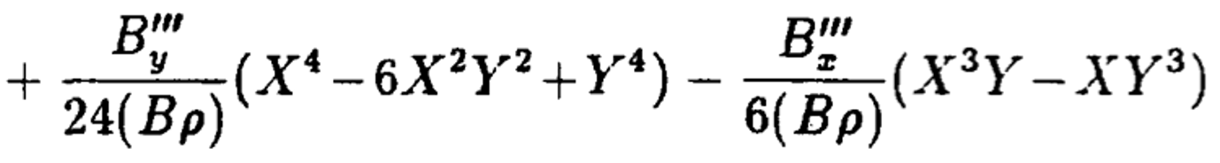










Dynamical Aperture Studies
σ_{x} =1.517 mm
At injection with a kinetic energy of 10 MeV γ β = 1.010657
at 250 MeV γ β = 0.14484
σ_{y} =2.398 mm
$$γβ=\sqrt{γ^{2}−1}$$
“Distortion Functions”:
Tom Collins October 1984
FERMILAB-84/114
After one turn
Sextupole Distortion
X’
$$𝓍′$$
$${\left(βα\right)}_{o}→$$
b
$$ν_{x}$$
$𝓍=X\sqrt{\frac{β_{o}}{β_{x}}}$, $𝓍^{′ }$-$α𝓍= X^{′}\sqrt{β_{o}β_{x} }$
$𝓍^{2}$+$x^{′^{2}}$= $β_{o}ε$
$$𝓍$$
X
$$ν_{x}$$
$$𝓍$$
$$ν_{y}$$
$$𝓍$$
Hamiltonian describing the motion of a single particle beam from N. Merminga and K.Y. Ng Fermilab Note FN-403 1988:
P_{x} and P_{y} are the canonical momenta to the horizontal and vertical displacements X and Y, K_{x}(s) and K_{y}(s) are proportional to the restoring forces due to the ring’s curvature and the field gradients of the normal quadrupoles.
Skew quadrupole potential
Normal Sextupole potential
Skew Sextupole potential
Normal Octupole Potential
Skew Octupole
Potential

Slide 19
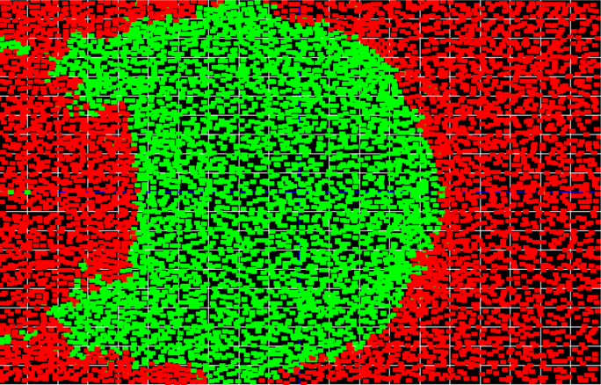
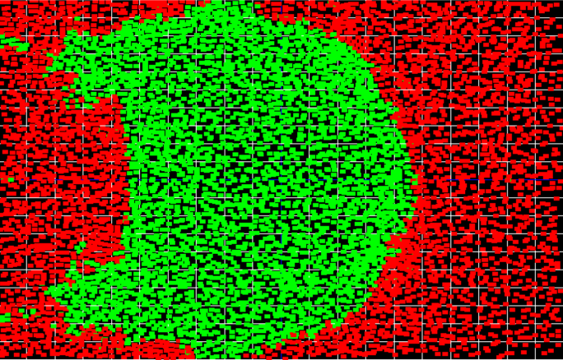
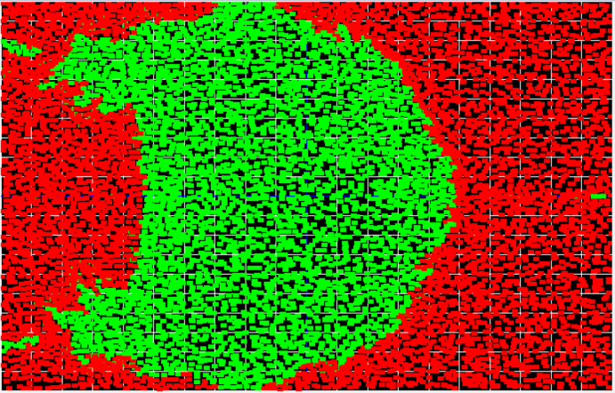
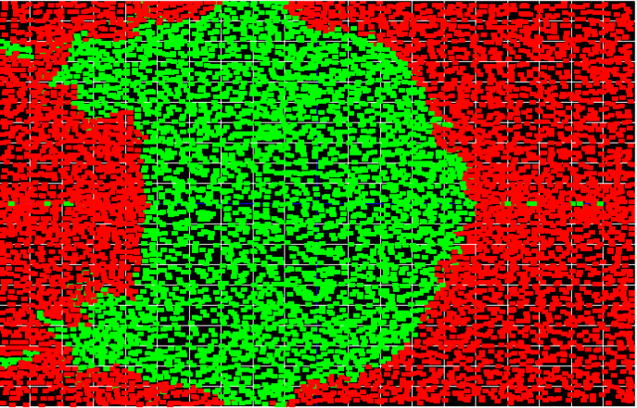
2. ESENTIALS OF THE NEW ACCELERATOR PHYSICS CONCEPT
  Dynamical Aperture Studies
The kinetic energy E_{k}=10MeV
Energy 14 MeV
2.0 cm
2.0 cm
y (cm)
6 mm
5.05 mm
12 mm
10.1 mm
-2.0 cm
-2.0 cm
-2.5 cm
25.27 mm
2.5 cm
-2.5 cm
25.39 mm
2.5 cm
Energy 18 MeV
x (cm)
Energy 50 MeV
2.0 cm
-2.5 cm
2.0 cm
4.46 mm
2.46 mm
8.9 mm
5.3 mm
-2.0 cm
-2.0 cm
-2.5 cm
25.47 mm
2.5 cm
-2.5 cm
25.95 mm
2.5 cm

Slide 20
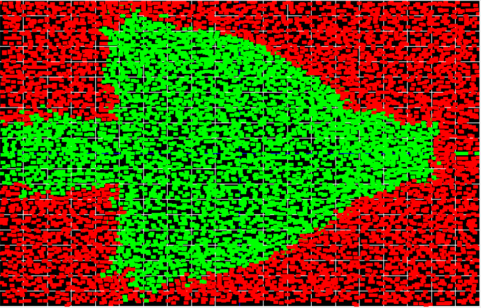

2. ESENTIALS OF THE NEW ACCELERATOR PHYSICS CONCEPT
Dynamical Aperture Studies
Energy 250 MeV
y-axis (cm)
2.0 cm
1.1 mm
2.26 mm
-2.0 cm
-2.5 cm
-2.5 cm
5 cm
x-axis (cm)
-5 cm
-5 cm
5 cm

Slide 21




3. LDRD 24-010 GOALS and ACHIVEMENTS
  Permanent Magnet Design, Building and Measuring Magnetic Field
Figure 2: Focusing
combined function magnet
Figure 3: Defocusing
combined function magnet
Figure 1: Focusing Magnet
9.25 cm
11.75 cm
12.1 cm
11.35 cm
F/2
D
F
D
F
D
Figure 4: Magnet
Assembly
r =3.5 m
F
D
F/2

Slide 22


Permanent Magnet Design, Building and Measuring Magnetic Field

Slide 23

Permanent Magnet Design, Building and Measuring Magnetic Field

Slide 24




  Arc Assembly with Nine Magnets
F/2
D
F
D
F
D
Magnet
Assembly
F
D
F/2
r =3.5 m
½ F
D
F
D
½ F

Slide 25
  Nine Magnets Arc Assembly

Slide 26

  Nine Magnets Arc Assembly

Slide 27

Permanent Magnet Design, Building and Measuring Magnetic Field

Slide 28




Permanent Magnet Design, Building and Measuring Magnetic Field

Slide 29

Measuring the Magnetic Field

Slide 30
Remaining Tasks
  After the quality of the magnetic field is established –there might be necessary to make magnetic field corrections using Stephen Brooks’ method with iron wires within the vertical aperture.
  The magnets will be assembled at the aluminum plate and positions adjusted by the surveying team.
  The magnet assembly with aluminum plate will be transported to the NSRL laboratory and positioned for the experiment.
  The proton beam with energies between 10 MeV and 250 MeV will be propagated through the assembly with radial horizontal positions adjusted for each energy. The proton beam positions will be measured with NSRL position monitors.

Slide 31
5. SUMMARY
Further goals of the LDRD is to transfer the existing technology to the FLASH therapy cancer radiation facility at the Radiation Oncology Department of the Stony Brook University Hospital.
The LDRD results will be used as a proof of principle for the concept of fast-cycling permanent magnet synchrotron for get funding to complete the synchrotron.
This is a proof of principle for a novel type of accelerator where the magnetic field is fixed, and the acceleration rate depends only on the RF.
The present collaboration includes the FLASH therapy experiments on mice at the BNL TANDEM accelerator with the 28.5MeV proton beam.
When the whole proton therapy facility is built the FLASH radiation therapy could be explored. This is significant advantage to any other existing radiation therapy facility as due to fixed magnetic field the treatment could be done is 100ms.
This accelerator opens the door for new proton drivers, Muon collider accelerator as the muon lifetime is very short, and for ADS.

Slide 32
Back Up Slides

Slide 33





2. THE NEW ACCELERATOR PHYSICS CONCEPT
New SYNCHROTRON with the same physical aperture but with a FIXED MAGNETIC FIELD and FIXED BETATRON TUNES
$${\vec{∇}}^{2}φ_{m}=0 and \vec{B}=−μ_{o}\vec{∇}φ_{m } \left(1\right)$$
where the multipole coefficients ‘k’ we limited up to the 12th pole or k=6. The x is the distance on the transverse axis and B₀ is the dipole magnetic field. The bending field values of the two combined function magnets, at the reference energy, were the same B_{0C}=0.54862T defining the reference radius of R_{0C} =3.5 m. In the example we present the reference proton kinetic energy is E_{kC} =129 MeV.
$${φ_{m}=φ}_{o}+\sum_{k=1}^{∞}{r^{k}\left(a_{k}\cos{kθ}+b_{k}\sin{kθ}\right) \left(2\right)}$$
$$−\frac{∆B_{y}}{Bρ}=−\frac{∂φ_{m}}{∂x}, {\frac{B_{x}}{Bρ}=−\frac{∂φ_{m}}{∂y} \left(3\right)}_{ }$$
$$B_{y}= \sum_{k=0}^{∞}{\frac{b_{k}}{k!}} x^{k} transverse vertical field$$
The tune variation dependence on the magnetic field $∆ν_{x}$ and $∆ν_{y}$ are functions of the offsets to the equilibrium orbit $x_{C}$at reference energy E_{KC} of a particle in the radial direction. (We followed the previous work by Sho Ohnuma [1]
$$δv_{x}= \frac{B_{o}l}{2πBρ}β_{x}(b_{1}G_{1}+b_{2}{2x_{C}G}_{1}+b_{3}\left(3x_{C}^{2} G_{1}+G_{3}\right)+b_{4}\left(4x_{C}^{3}G_{1}+4x_{C}G_{3}\right)+b_{5}(5x_{C}^{4}G_{1}+10x_{C}^{2}+G_{5}\text{)}$$
$G_{1}=1/2, G_{3}={(3}/{8)β_{x}ε_{x}}−{(3}/{4)}β_{y}ε_{y},$ $G_{5}=\frac{5}{16}{{(β}_{y}ε_{y})}^{2}+\frac{15}{8}{\left(β_{x}ε_{x}β_{y}ε_{y}\right)+\frac{15}{16}}^{ }(β_{y}ε_{y})^{2}$
$$δv_{y}= \frac{B_{o}l}{2πBρ}β_{x}(b_{1}H_{1}+b_{2}{2x_{C}H}_{1}+b_{3}\left(3x_{C}^{2} H_{1}+H_{3}\right)+b_{4}\left(4x_{C}^{3}H_{1}+4x_{C}H_{3}\right)+b_{5}(5x_{C}^{4}H_{1}+10x_{C}^{2}+H_{5}\text{)}$$
$H_{1}={−1}/2, { H}_{3}=−{(3}/{4)β_{x}ε_{x}}+{(3}/{8)}β_{y}ε_{y},$ $H_{5}=−\frac{5}{16}{{(β}_{y}ε_{y})}^{2}+\frac{15}{8}{\left(β_{x}ε_{x}β_{y}ε_{y}\right)−\frac{15}{16}}^{ }(β_{y}ε_{y})^{2}$
The stable orbits in a wide energy range are obtained by adjustments of the F and D sextupoles and additional multipoles
[1] S. Ohnuma, “Shifts in Betatron Oscillation Frequencies Carried by Average Multipole Fields”, Fermilab, FERMILAB-PBAR-NOTE-324, Jul. 1983.

Slide 34

Time of flight dependence during acceleration

Slide 35



Time of flight dependence during acceleration – Bunch Merging
Radio Frequency (RF)-Acceleration:
Using the harmonic number h=1 the frequency must follow the time of flight: f=1.981 MHz at 19 MeV
f=6.132 MHz at 250 MeV t₂₅₀=163.08 ns
Barrier Bucket merging of multiple bunches
Time of flight for one turn at injection:
τ(10 MeV) = 690.9 ns, h=1→ 1.447 MHz
τ(14 MeV) = 585.7 ns, h=1→ 1.707 MHz
τ(16.5 MeV)= 540.6 ns, h=1→ 1.850 MHz
τ(19 MeV) = 504.8 ns, h=1→ 1.981 MHz
τ(30 MeV) = 405.2 ns, h=1→ 2.468 MHz
Time of flight for one turn at maximum energy:
τ(250 MeV) =163.08 ns, h=1→ MHz

Slide 36


Fast Cycling Synchrotron Cycles
Kinetic
Energy
(MeV)
Extraction #2
250
Ex.1
Ex.2
RF manipulation
Ex.3
16.5-30
Injection
Energy
Second synchrotron cycle
t(ms)
Injection
Porch
One synchrotron cycle
Extraction kicker wave forms
0.8ms < t < 1.85ms
1.3kHz< f < 540 Hz
If the RF kicks are $±$30 kV, during the slip-stacking merge a difference in the time of flight for two 2 energies is 773ps. If the batches are 15 m apart it would take 370 turns to get them aligned. Next step would be to merge into one bucket by snaping the new RF voltage on.
Time of bunch flight 405-550 ns
At the injection porch time of 926 ms there are 1680 turns. 15 turns for 15 Cyclotron bunches and 1650 turns for RF manipulations

Slide 37
Fast Cycling Acceleration with Ferrite cavities
(RF cavities proposed by the Rutherford Lab UK)
 | Choices for injector cyclotron |  |  |  | Units
 | ACSI | GE | TR-19 | IBA
Energy of Injector Cyclotron | 14 | 16.5 | 19 | 30 | MeV
Cyclotron current | 400 | 200 | 400 | 1200 | μA
Treatment charge | 60 | 60 | 60 | 60 | nC
Injection turns | 4 | 4 | 4 | 2 | #
RF acceleration per turn | 29.70 | 29.70 | 29.70 | 44.55 | kV
Calculation | Treatments Options
Turn duration | 585.74 | 540.6 | 504.8 | 405.1 | ns
Charge per turn | 0.234 | 0.108 | 0.151 | 0.486 | nC
Charge per injection | 0.937 | 0.432 | 0.606 | 0.972 | nC
Machine cycles | 65 | 139 | 100 | 62 | #
Machine cycle rate | 540 | 540 | 540 | 809.95 | Hz
Outputs
Treatment time | 120 | 257 | 185 | 76.54 | ms

Slide 38




Previous Measurements of the RHIC Sextant Test

Slide 39


Previous Measurements of the RHIC Sextant Test

