Slide 1
High Energy Cooling R&D
Sergei Seletskiy
For CAD Cooling Studies group in collaboration with G. H. Hoffstaetter and J. Unger (Cornell University)
C-AD Machine Advisory Committee Meeting (MAC-21)
December 16-18, 2024

Slide 2
Outline
Response to recommendation
Introduction
  Cooling requirements for EIC
  Electron cooling approach to EIC High Energy Cooler (HEC)
Ring Electron Cooler (conceptual design)
  Layout
  Achievable design parameters
  REC subsystems
  Challenges, ongoing studies and REC status
ERL based Recirculator (feasibility studies)
  Recirculator concept
  Parameters and requirements
  Challenges and mitigations
Summary

Slide 3
Response to recommendation
R13 (Ring cooler feasibility study for EIC):
The Dept. and the study group are encouraged to assess and provide the effort needed to determine the required design details in line with the EIC project needs.
We have continued efforts to address most challenging questions regarding Ring-based electron cooler design. Progress with design will be discussed in this presentation. Also, we have started to evaluate ERL-based High-Energy Cooler (HEC) which will be described in this presentation.
As part of HEC R&D, we plan to develop most promising scheme, evaluate risks and costs and choose most reliable and cost-effective approach for the EIC.
We estimate that about 2-3 Accelerator Physicist FTE efforts over several years will be needed to develop robust HEC system for the EIC.
Note: The EIC Change Control Process is presently underway to include Low-Energy Cooler (LEC) in project scope and remove high-energy CeC-based cooler from the scope. Continuing HEC accelerator physics and accelerator design R&D is needed to develop a feasible and efficient scheme for the HEC (not necessarily CeC-based).

Slide 4
Introduction

Slide 5
Cooling requirements for Electron Ion Collider (EIC)
Low-Energy Cooling (LEC):
Cooling of protons and ions at injection energy of protons (24 GeV):
The goal of cooling at proton injection energy is to obtain initial proton parameters by cooling the vertical emittance from ~2 um to 0.3-0.5 um (rms normalized). This requires a 13 MeV electron beam.
The Change Control Process is presently underway to include LEC in the EIC project baseline.
High-Energy Cooling (HEC) of protons:
At EIC proton top collision energies, cooling should counteract the longitudinal and transverse emittance growth and maintain close to initial beam emittances.
Robust HEC system capable of fully counteracting emittance growth at collision energies would greatly improve luminosity in the EIC.

Slide 6
High-Energy Cooling for EIC
Previously, the HEC system for the EIC was based on a novel method of micro-bunched Coherent Electron Cooling (CeC). While recent years R&D studies have made significant progress, there are crucial unresolved issues related with extremely tight tolerances on timing electron and hadron beams in the cooler and cooling diagnostic.
An alternative HEC systems based on well-established technique of Electron Cooling were considered in the past and some of the approaches are being explored in greater detail here at CAD.

Slide 7
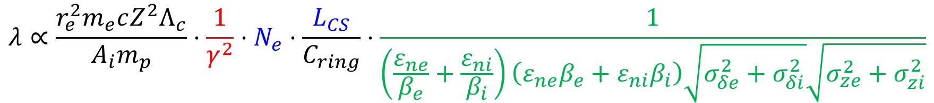
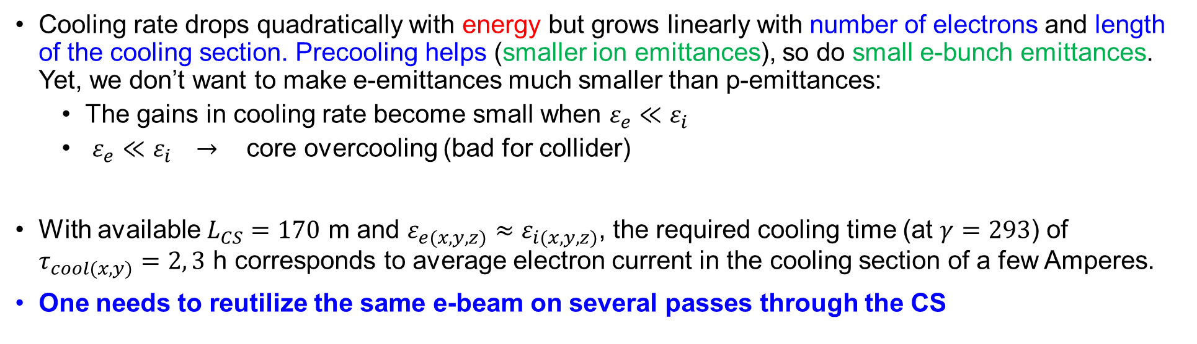
Electron Cooling at high energies
$$λ∝\frac{r_{e}^{2}m_{e}cZ^{2}Λ_{c}}{A_{i}m_{p}}⋅\frac{1}{γ^{2}}⋅N_{e}⋅\frac{L_{CS}}{C_{ring}}⋅\frac{1}{\left(\frac{ε_{ne}}{β_{e}}+\frac{ε_{ni}}{β_{i}}\right)\left(ε_{ne}β_{e}+ε_{ni}β_{i}\right)\sqrt{σ_{δe}^{2}+σ_{δi}^{2}}\sqrt{σ_{ze}^{2}+σ_{zi}^{2}}}$$
Cooling rate drops quadratically with energy but grows linearly with number of electrons and length of the cooling section. Precooling helps (smaller ion emittances), so do small e-bunch emittances. Yet, we don’t want to make e-emittances much smaller than p-emittances:
  The gains in cooling rate become small when $ε_{e}≪ε_{i}$
  $ε_{e}≪ε_{i} →$ core overcooling (bad for collider)
With available $L_{CS}=170$ m and $ε_{e(x,y,z)}≈ε_{i(x,y,z)}$, the required cooling time (at $γ=293$) of $τ_{cool(x,y)}=2, 3$ h corresponds to average electron current in the cooling section of a few Amperes.
One needs to reutilize the same e-beam on several passes through the CS

Slide 8
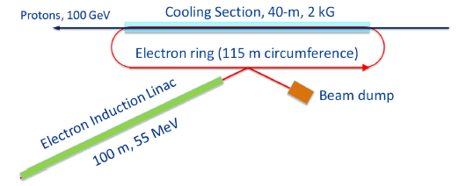
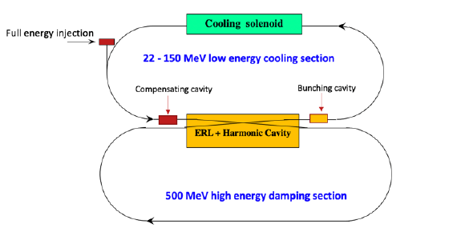
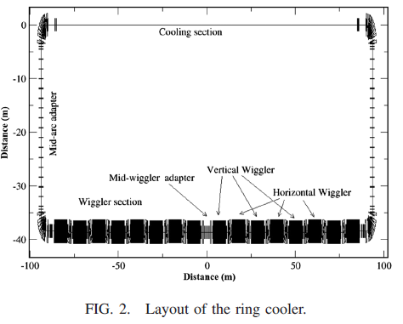
EC-based High-Energy Cooling
Several approaches based on conventional Electron Cooling were considered in the past:
Induction linac based Ring cooler (FNAL):
V. Lebedev, S. Nagaitsev et al.,”CDR: A ring-based electron cooling for EIC”, JINST 16 T01003 (2021).
2. Dual-ring electron accelerator (JLAB):
B. Dhital et al., “Beam dynamics study in a dual energy storage ring for ion beam cooling”, Proc. IPAC21, TUXA07 (2021).
3. ERL-based Circulator Ring (JLAB):
S. Benson et al., ERL19, LINAC20 presentations
4. Storage Ring electron cooler (BNL):
H. Zhao, J. Kewisch et al., “Ring-based electron cooler for high energy beam cooling”, PRAB 24, 043501 (2021)

Slide 9
Recent HEC R&D
The focus of most recent R&D at CAD was on:
Design of storage Ring Electron Cooler (REC) where electron bunches which provide cooling of protons are being cooled themselves via synchrotron radiation.
Progress with REC design will be described in this presentation
ERL-based Recirculator design where electron bunches are supplied by high-brightness electron source.
Initial concept of this approach and required parameters will be presented.
To simplify Technical Design of such electron accelerators, both approaches presently assume electron beam without any magnetization on the cathode and without need of continuous magnetic field in the cooling section.

Slide 10
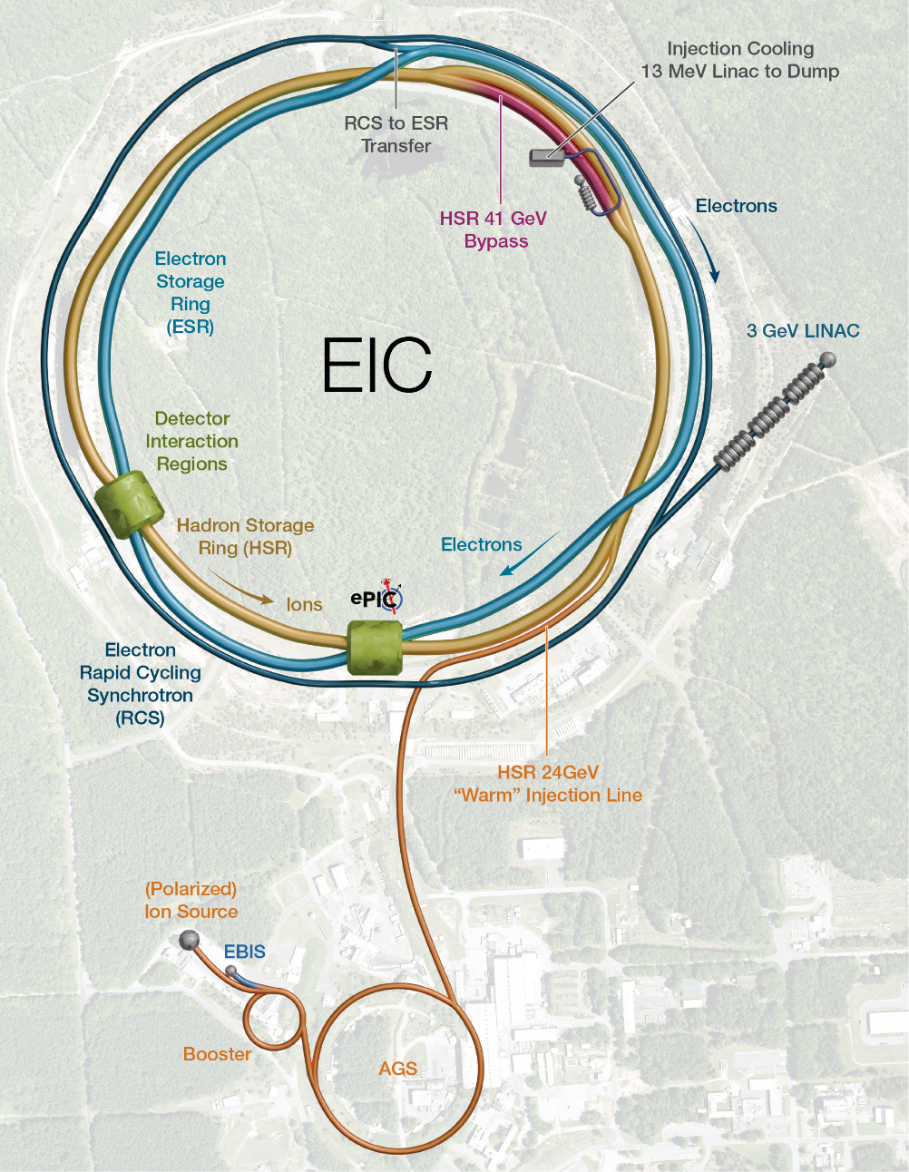
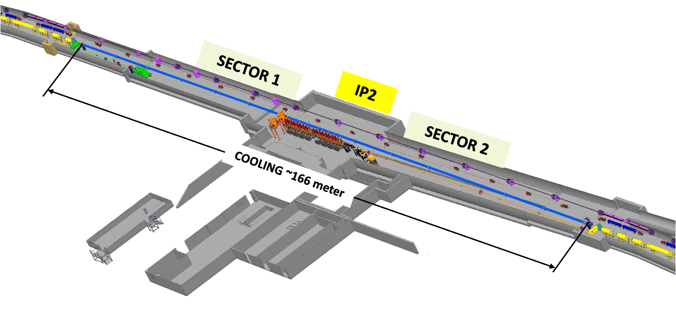
Cooler’s location
Both the Low-Energy Cooler and potential top energy cooler are located at a 2 o’clock hall.
They must share the same section of the Hadron Storage Ring (HSR)
About 170 m of the HSR are available for the cooling section
Low-Energy Cooler layout
ZOOM IN
CS ~170 m
13 MeV Low-Energy cooler

Slide 11
Ring Electron Cooler
Conceptual design in progress

Slide 12
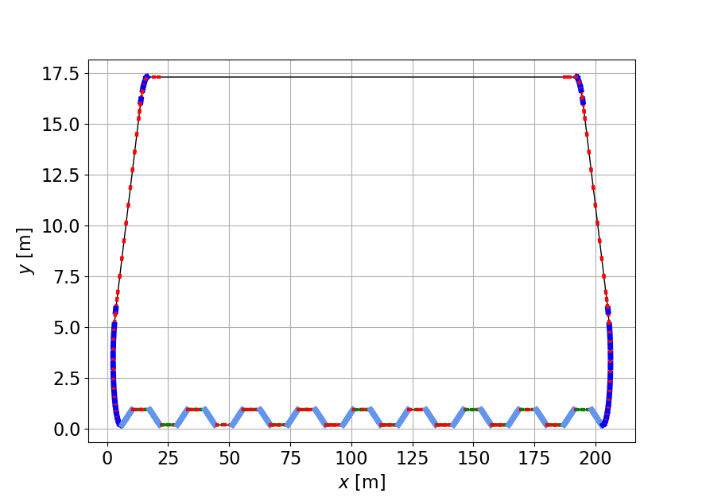
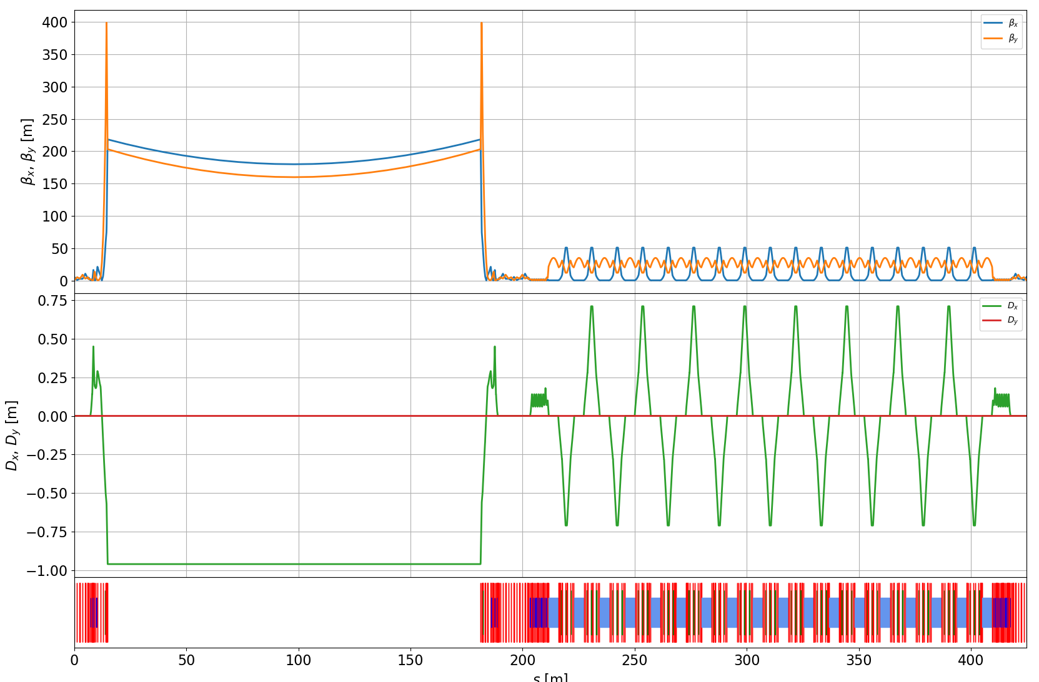
Basic idea and layout
170 m long cooling section (layout is compatible with EIC LEC)
Ring circumference 426 m
140 e-bunches in the ring, each e-bunch makes 9 turns per 1 turn of hadrons in HSR
Electrons are cooled by radiation damping in a wiggler section (18 damping wigglers, each wiggler is 4 m long)
Cooling Section
RF Section
Injection Section
Wiggler Section

Slide 13
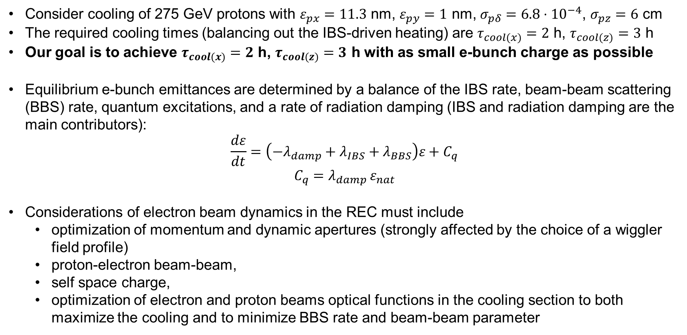
What factors drive REC design parameters
Consider cooling of 275 GeV protons with $ε_{px}=11.3$ nm, $ε_{py}=1$ nm, $σ_{pδ}=6.8⋅{10}^{−4}$, $σ_{pz}=6$ cm
The required cooling times (balancing out the IBS-driven heating) are $τ_{cool(x)}=2$ h, $τ_{cool(z)}=3$ h
Our goal is to achieve $τ_{cool(x)}=2$ h, $τ_{cool(z)}=3$ h with as small e-bunch charge as possible
Equilibrium e-bunch emittances are determined by a balance of the IBS rate, beam-beam scattering (BBS) rate, quantum excitations, and a rate of radiation damping (IBS and radiation damping are the main contributors):
$$\frac{dε}{dt}=\left(−λ_{damp}+λ_{IBS}+λ_{BBS}\right)ε+C_{q}$$
$$C_{q}=λ_{damp }ε_{nat}$$
Considerations of electron beam dynamics in the REC must include
  optimization of momentum and dynamic apertures (strongly affected by the choice of a wiggler field profile)
  proton-electron beam-beam,
  self space charge,
  optimization of electron and proton beams optical functions in the cooling section to both maximize the cooling and to minimize BBS rate and beam-beam parameter

Slide 14
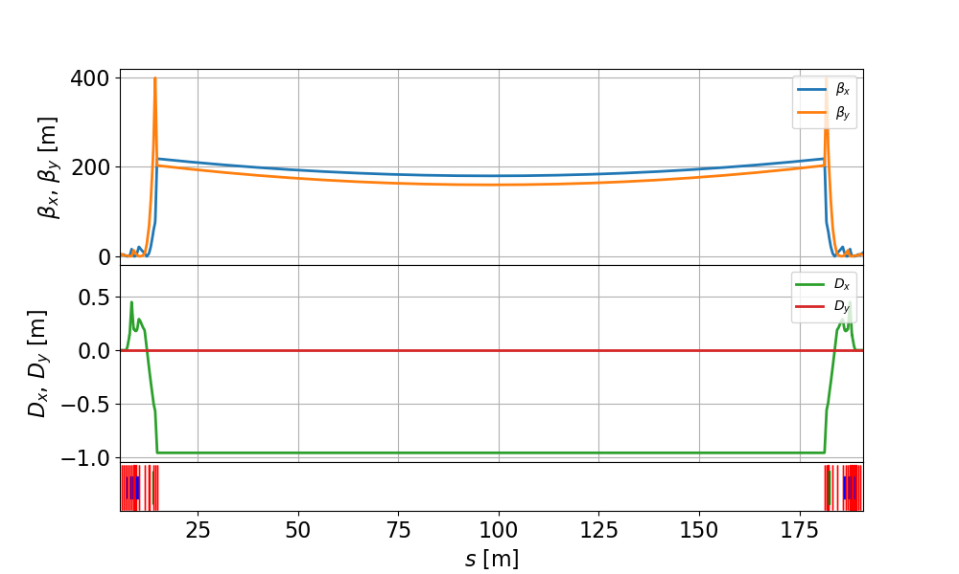
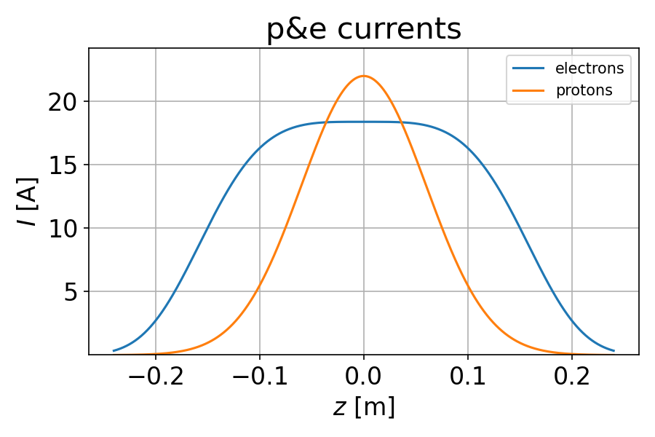
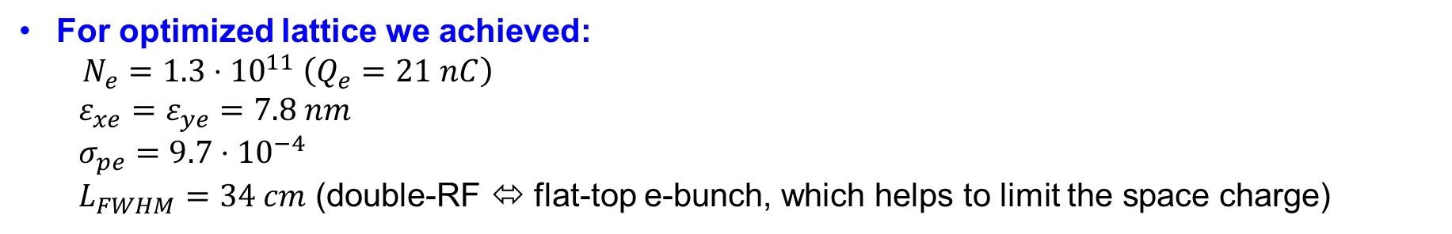
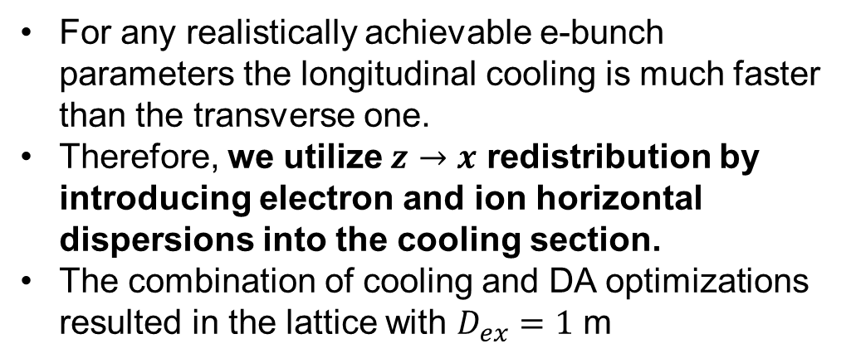
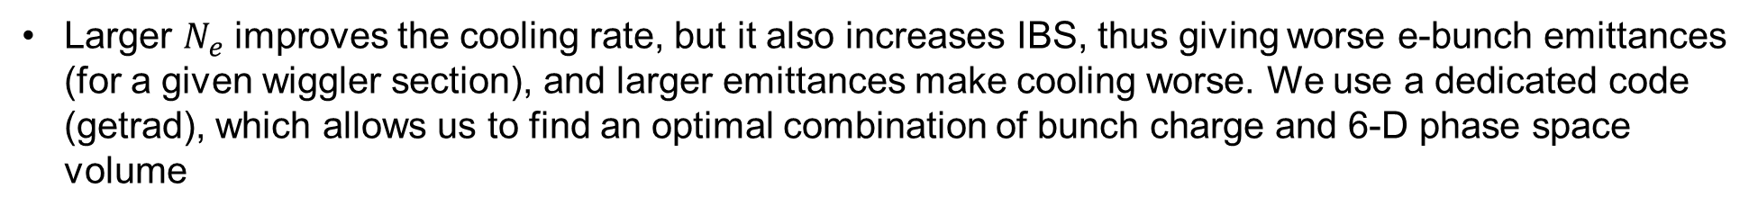
Cooling section and cooling optimization (I)
For any realistically achievable e-bunch parameters the longitudinal cooling is much faster than the transverse one.
Therefore, we utilize $z→x$ redistribution by introducing electron and ion horizontal dispersions into the cooling section.
The combination of cooling and DA optimizations resulted in the lattice with $D_{ex}=1$ m
Larger $N_{e}$ improves the cooling rate, but it also increases IBS, thus giving worse e-bunch emittances (for a given wiggler section), and larger emittances make cooling worse. We use a dedicated code (getrad), which allows us to find an optimal combination of bunch charge and 6-D phase space volume
For optimized lattice we achieved:
$N_{e}=1.3⋅{10}^{11} \left(Q_{e}=21 nC\right)$
  $ε_{xe}=ε_{ye}=7.8 nm$
  $σ_{pe}=9.7⋅{10}^{−4}$
  $L_{FWHM}=34 cm$ (double-RF ⬄ flat-top e-bunch, which helps to limit the space charge)

Slide 15
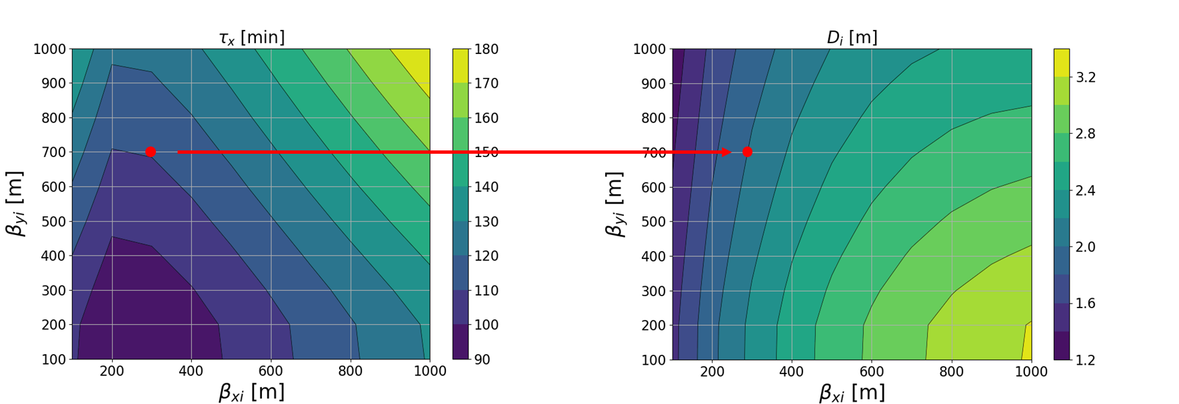
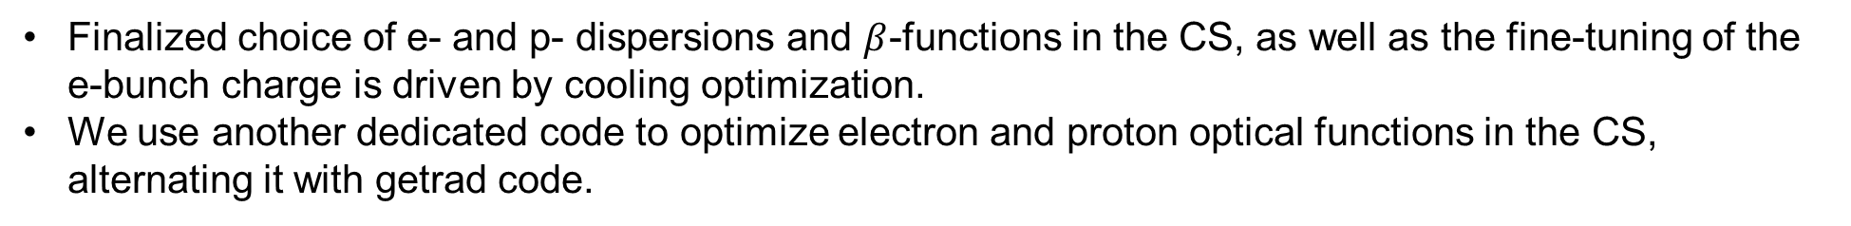
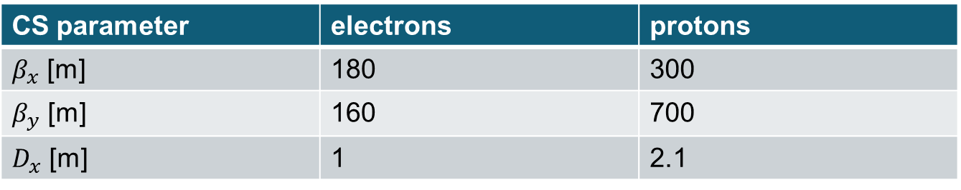
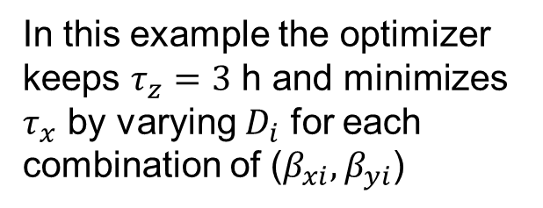
Cooling section and cooling optimization (II)
Finalized choice of e- and p- dispersions and $β$-functions in the CS, as well as the fine-tuning of the e-bunch charge is driven by cooling optimization.
We use another dedicated code to optimize electron and proton optical functions in the CS, alternating it with getrad code.
In this example the optimizer keeps $τ_{z}=3$ h and minimizes $τ_{x}$ by varying $D_{i}$ for each combination of ($β_{xi}, β_{yi}$)
CS parameter | electrons | protons
$β_{x}$ [m] | 180 | 300
$β_{y}$ [m] | 160 | 700
$D_{x}$ [m] | 1 | 2.1

Slide 16
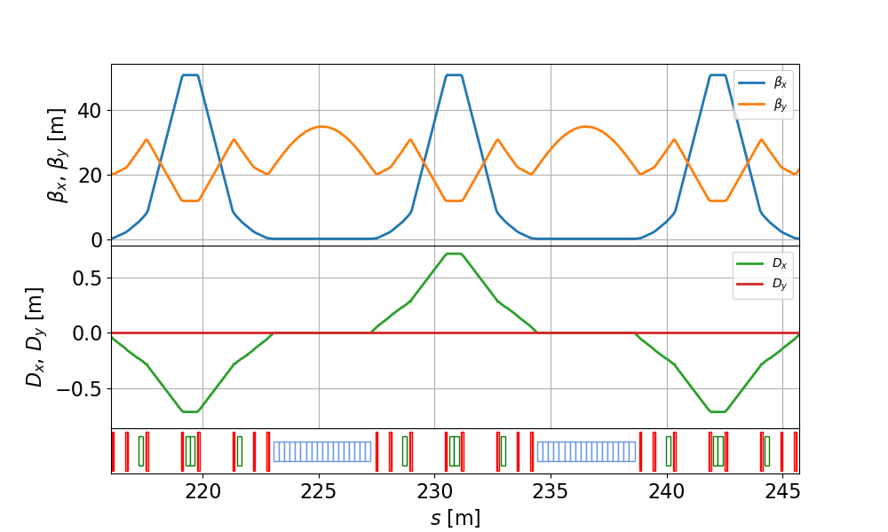
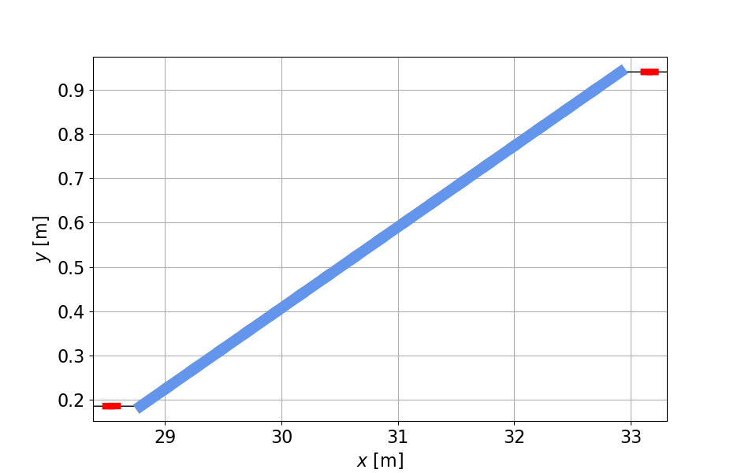

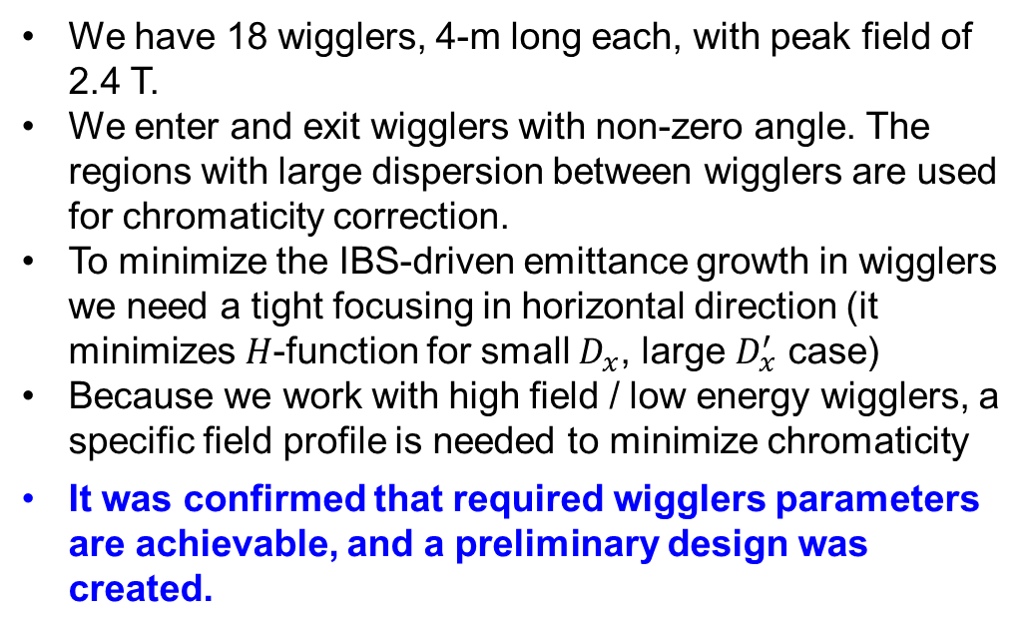

REC wigglers
We have 18 wigglers, 4-m long each, with peak field of 2.4 T.
We enter and exit wigglers with non-zero angle. The regions with large dispersion between wigglers are used for chromaticity correction.
To minimize the IBS-driven emittance growth in wigglers we need a tight focusing in horizontal direction (it minimizes $H$-function for small $D_{x}$, large $D_{x}^{′}$ case)
Because we work with high field / low energy wigglers, a specific field profile is needed to minimize chromaticity
It was confirmed that required wigglers parameters are achievable, and a preliminary design was created.
Wiggler parameter | value
Number of wigglers | 18
Length [m] | 4.2
Peak field [T] | 2.38
Period [m] | 0.2
Gap [cm] | 2
Radiated power (per wiggler) [W] | 674
Radiation angle [mrad] | 3.4
$x$ [m]
$s$ [m]

Slide 17
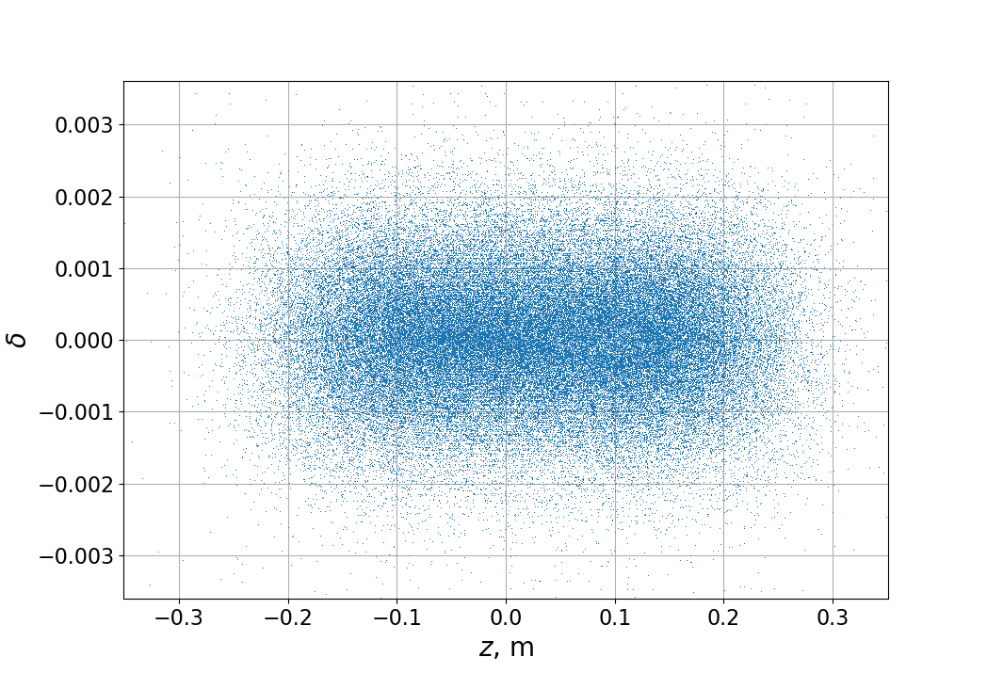
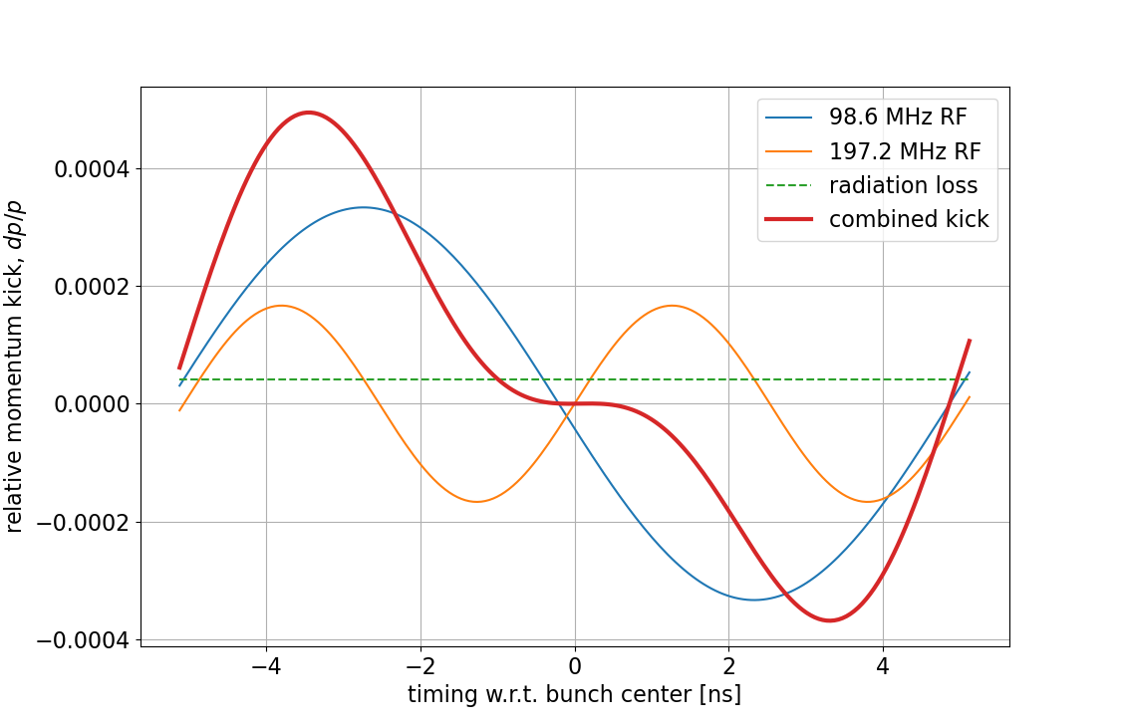
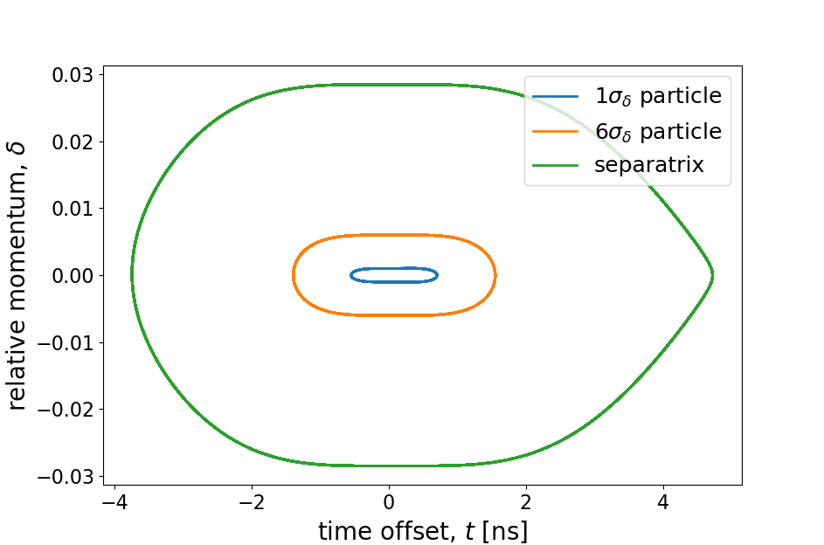
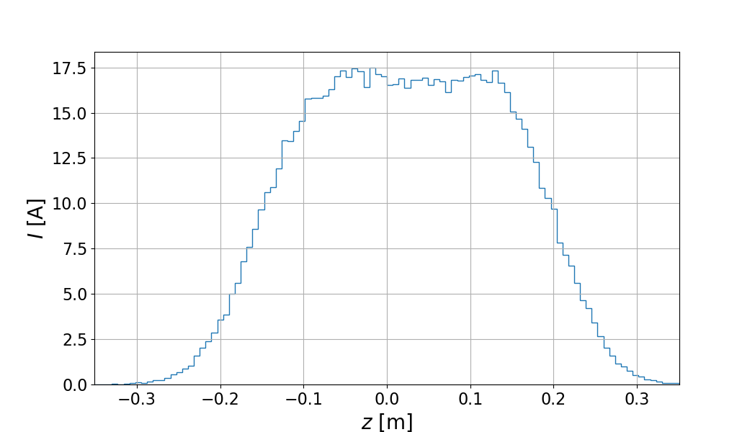
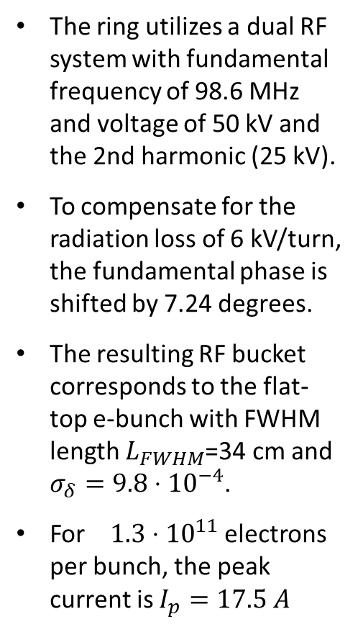
REC RF system
The ring utilizes a dual RF system with fundamental frequency of 98.6 MHz and voltage of 50 kV and the 2nd harmonic (25 kV).
To compensate for the radiation loss of 6 kV/turn, the fundamental phase is shifted by 7.24 degrees.
The resulting RF bucket corresponds to the flat-top e-bunch with FWHM length $L_{FWHM}$=34 cm and $σ_{δ}=9.8⋅{10}^{−4}$.
For $1.3⋅{10}^{11}$ electrons per bunch, the peak current is $I_{p}=17.5 A$

Slide 18
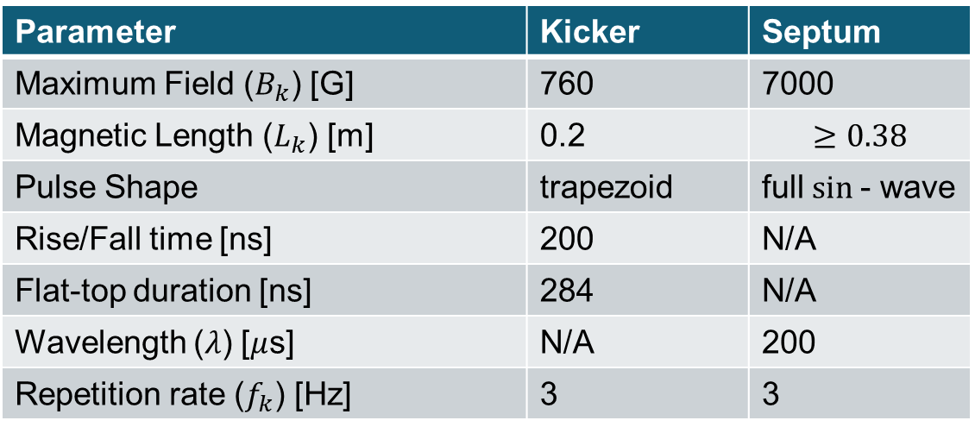
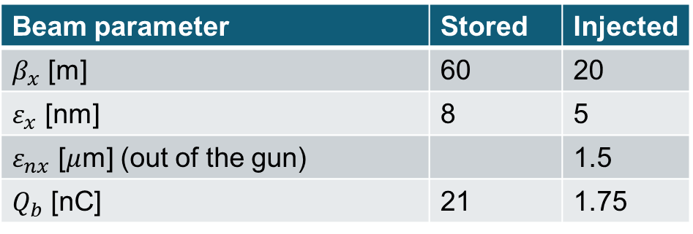
Injection scheme
Beam parameter | Stored | Injected
$β_{x}$ [m] | 60 | 20
$ε_{x}$ [nm] | 8 | 5
$ε_{nx}$ [$μ$m] (out of the gun) |  | 1.5
$Q_{b}$ [nC] | 21 | 1.75
2.5 m
stored beam
fast kickers
injected beam
pulsed septum
Parameter | Kicker | Septum
Maximum Field ($B_{k}$) [G] | 760 | 7000
Magnetic Length ($L_{k}$) [m] | 0.2 | $$≥0.38$$
Pulse Shape | trapezoid | full $sin$- wave
Rise/Fall time [ns] | 200 | N/A
Flat-top duration [ns] | 284 | N/A
Wavelength ($λ$) [$μ$s] | N/A | 200
Repetition rate ($f_{k}$) [Hz] | 3 | 3
We are planning to have a top-off injection replenishing 10% of each bunch every 1.6 s.
Four kickers will create a closed bump bringing the stored beam closer to the injection septum. At the exit of the bump the injected beam will be displaced by 6 mm from the stored beam trajectory.
The injector will be running with $f_{inj}=3 Hz$ injecting into 1/5 of the ring (28 bunches) each time.
Initial injection can be performed with $f_{0}=5$ Hz frequency, filling up the ring in 20 s.

Slide 19
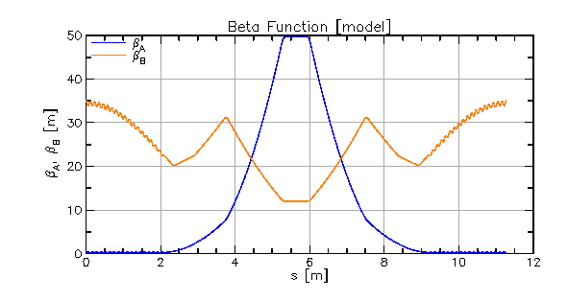
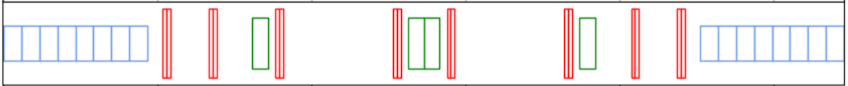
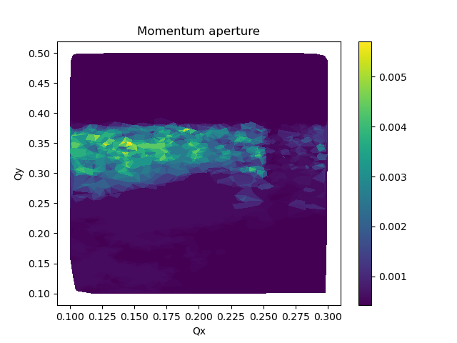
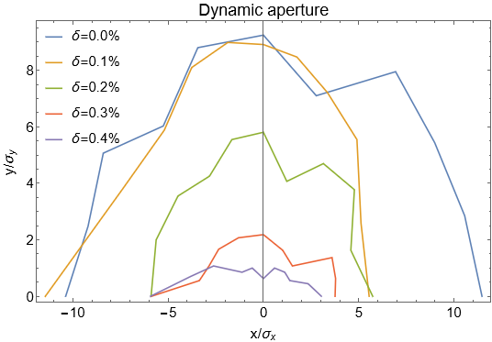
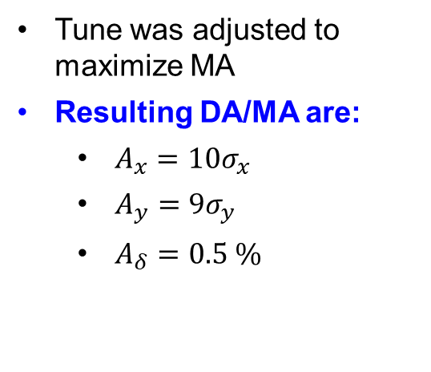
Dynamic and momentum aperture optimization
Optimization of wigglers’ field profile allowed to substantially reduce chromaticity and utilize weaker sextupoles
Phase advance over wiggler and sextupole blocks is an important parameter for dynamic aperture
Two families of octupoles were optimized to reduce non-linear motion
Tune was adjusted to maximize MA
Resulting DA/MA are:
  $A_{x}=10σ_{x}$
  $A_{y}=9σ_{y}$
  $A_{δ}=0.5 \%$

Slide 20
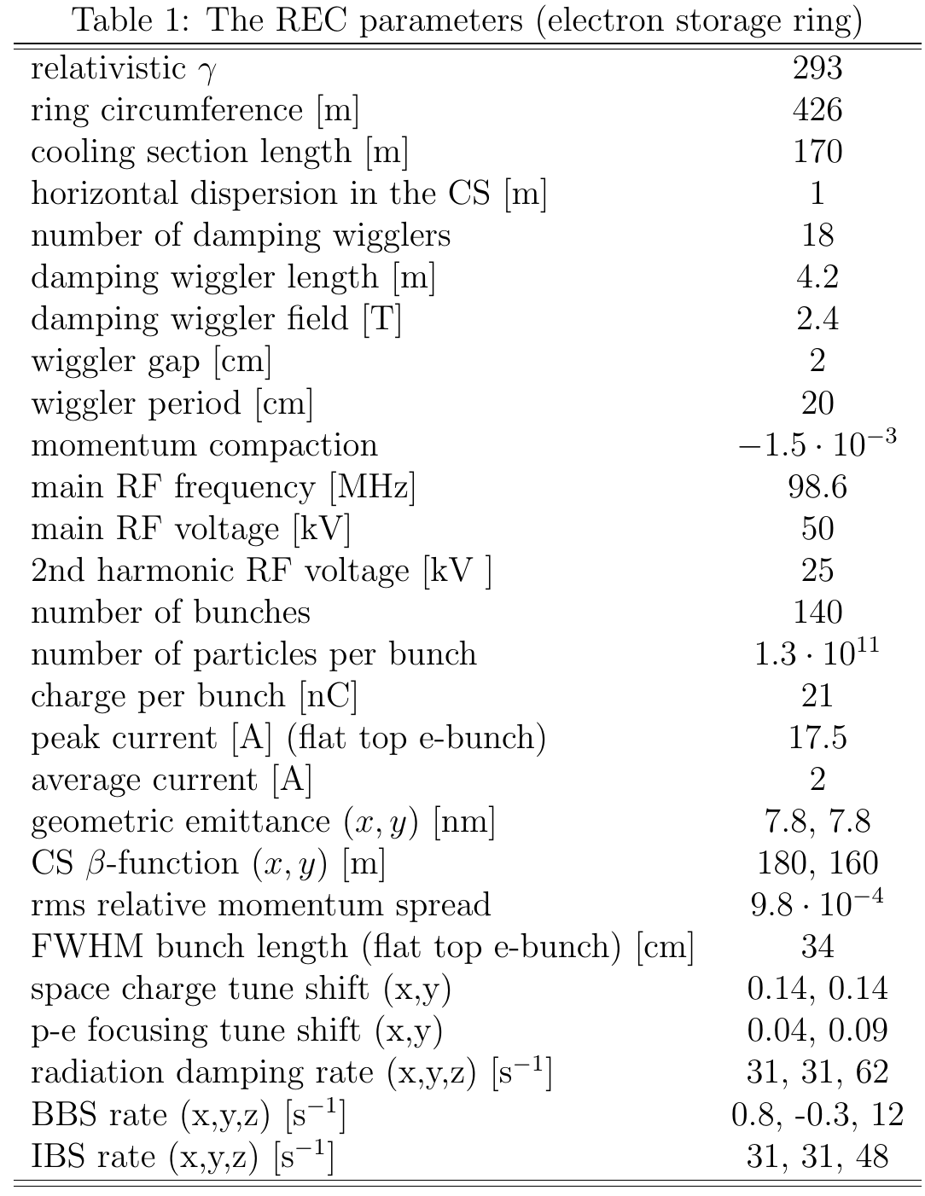
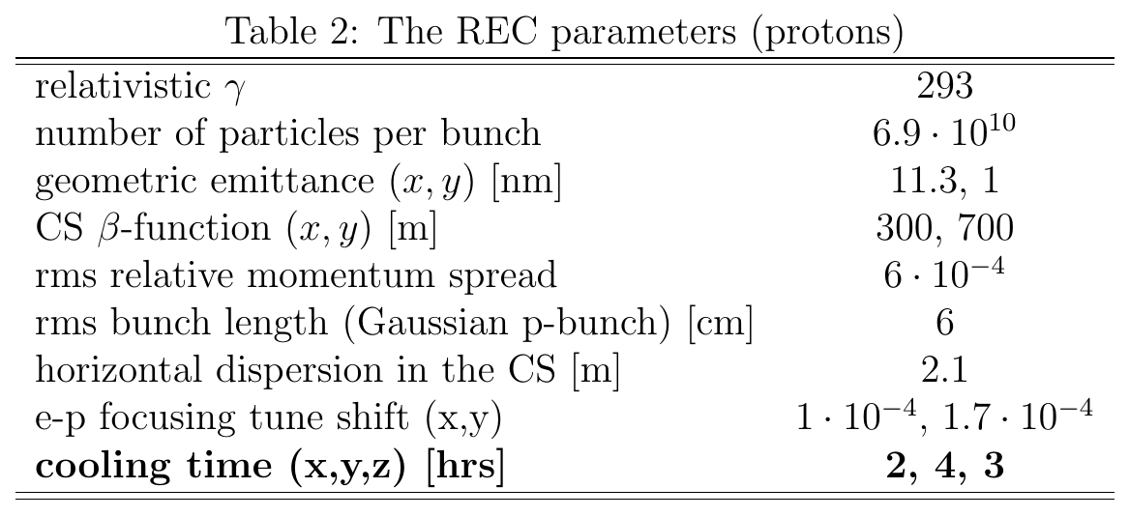
Parameters

Slide 21
Challenges and ongoing work
REC is a low-energy high-current electron storage ring
Careful considerations of collective effects and instabilities are needed
Due to careful lattice optimization the bunch charge required for cooling was significantly reduced. This helps with collective effects.
Touschek lifetime for the full lattice and obtained momentum aperture is 47 s, while vacuum lifetime is 16 s (assuming 0.5 nTorr vacuum)
Vacuum requirements are tight, and worse vacuum will require increasing injection frequency
The ongoing studies include:
  Beam-beam (p-e focusing) and self space charge effects
  Magnets’ setting errors and misalignments
  Tolerances to errors in various subsystems (injection, RF, wigglers) based on cooling requirements

Slide 22
Work to be done
Systematic studies of instabilities must be performed (coherent wiggler instability, transverse mode-coupling instability, transverse and longitudinal coupled-bunch instability, electron-ion instability etc.)
Beam loading in the RF and its effects on longitudinal bunch distribution need to be studied.
Feedbacks (both to keep e-beam quality in the cooling section and to counteract possible instabilities) have to be considered.
Various engineering systems (diagnostic, vacuum, machine protection) must be devised
Bringing REC design to lower energies

Slide 23
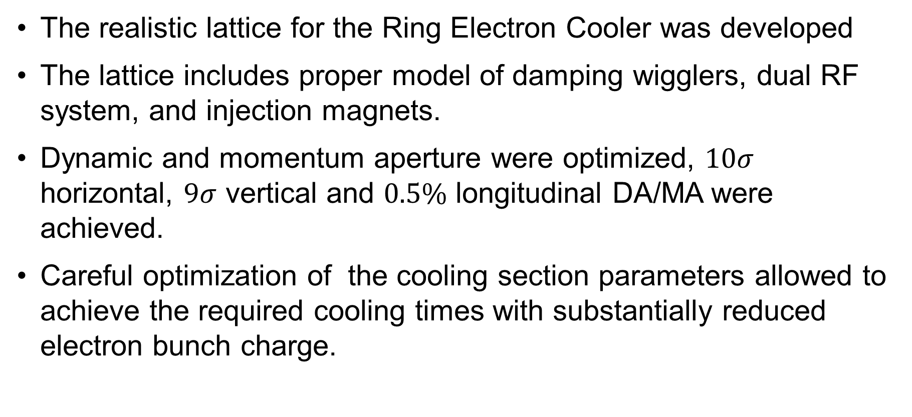
REC conceptual design status
The realistic lattice for the Ring Electron Cooler was developed
The lattice includes proper model of damping wigglers, dual RF system, and injection magnets.
Dynamic and momentum aperture were optimized, $10σ$ horizontal, $9σ$ vertical and $0.5\%$ longitudinal DA/MA were achieved.
Careful optimization of the cooling section parameters allowed to achieve the required cooling times with substantially reduced electron bunch charge.

Slide 24
ERL based Recirculator
Feasibility studies

Slide 25
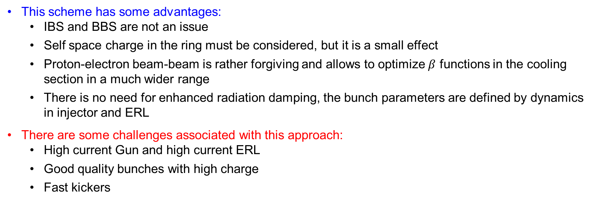
Recirculator concept
e
Electron bunches are accelerated in the ERL
Recirculated in the ring for just a few turns (1-9)
Decelerated and sent to a beam dump
Non-magnetized electron beam is used
A few turns
Fast kicker in
Fast kicker out
Beam dump
ERL
Injector
This scheme has some advantages:
  IBS and BBS are not an issue
  Self space charge in the ring must be considered, but it is a small effect
  Proton-electron beam-beam is rather forgiving and allows to optimize $β$ functions in the cooling section in a much wider range
  There is no need for enhanced radiation damping, the bunch parameters are defined by dynamics in injector and ERL
There are some challenges associated with this approach:
  High current Gun and high current ERL
  Good quality bunches with high charge
  Fast kickers
Note: Similar cooling scheme was suggested at JLAB for JLEIC (https://epaper.kek.jp/erl2019/talks/mocozbs01_talk.pdf).
It utilized magnetized electron beam.

Slide 26
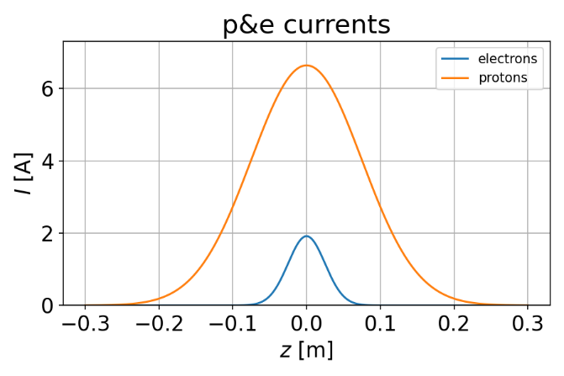
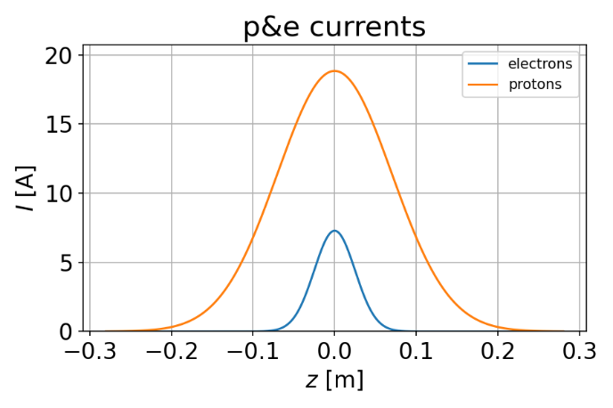
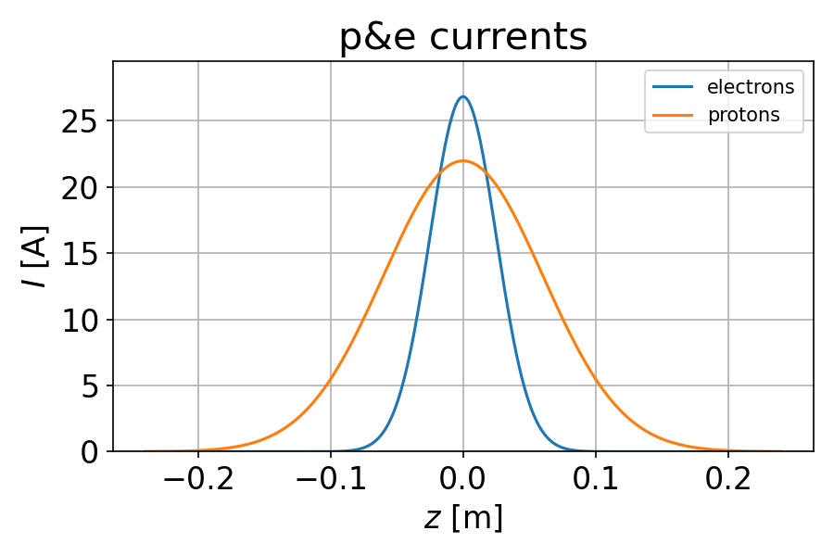
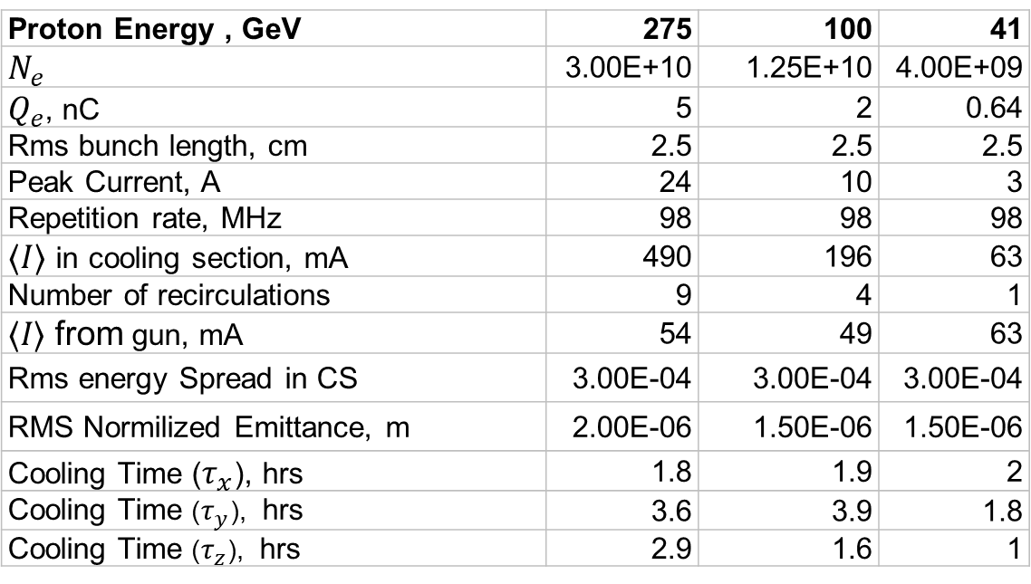
Recirculator parameters
41 GeV protons
Proton Energy , GeV | 275 | 100 | 41
$N_{e}$ | 3.00E+10 | 1.25E+10 | 4.00E+09
$Q_{e}$, nC | 5 | 2 | 0.64
Rms bunch length, cm | 2.5 | 2.5 | 2.5
Peak Current, A | 24 | 10 | 3
Repetition rate, MHz | 98 | 98 | 98
$⟨I⟩$ in cooling section, mA | 490 | 196 | 63
Number of recirculations | 9 | 4 | 1
⟨𝐼⟩ from gun, mA | 54 | 49 | 63
Rms energy Spread in CS | 3.00E-04 | 3.00E-04 | 3.00E-04
RMS Normilized Emittance, m | 2.00E-06 | 1.50E-06 | 1.50E-06
Cooling Time ($τ_{x}$), hrs | 1.8 | 1.9 | 2
Cooling Time ($τ_{y}$), hrs | 3.6 | 3.9 | 1.8
Cooling Time ($τ_{z}$), hrs | 2.9 | 1.6 | 1
100 GeV protons
275 GeV protons

Slide 27
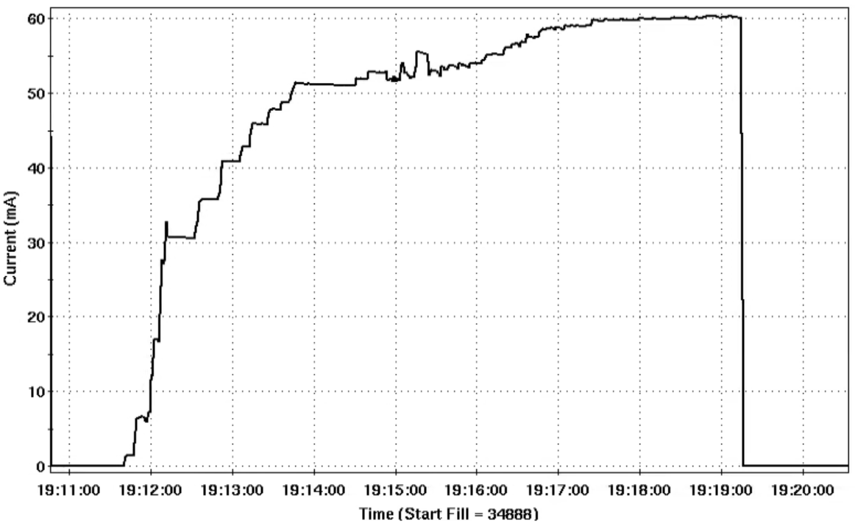
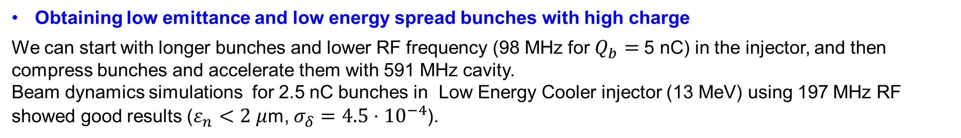

Challenges and mitigation
High current injector (up to 60 mA)
LEReC: Stable 50 mA operation was achieved in 2022. In 2024, 60 mA operation was achieved. The duration of 60 mA test was limited by a specific machine setup, which we had to employ to avoid interference with RHIC program. High current studies with a more practical configuration are planned for 2025.
Cornell: 65 mA current was demonstrated
Beam was ramped down because of high losses in the low power dump
To not interfere with RHIC program we had to use a very unusual configuration of LEReC for high current studies $→$ It takes a lot of tuning to ramp up the current
Obtaining low emittance and low energy spread bunches with high charge
We can start with longer bunches and lower RF frequency (98 MHz for $Q_{b}=$5 nC) in the injector, and then compress bunches and accelerate them with 591 MHz cavity.
Beam dynamics simulations for 2.5 nC bunches in Low Energy Cooler injector (13 MeV) using 197 MHz RF showed good results ($ε_{n}<2 μ$m, $σ_{δ}=4.5⋅{10}^{−4}$).
150 MeV Energy Recovery Linac operating at ~60 mA
Both technical feasibility of such an ERL and relevant beam dynamics must be explored

Slide 28
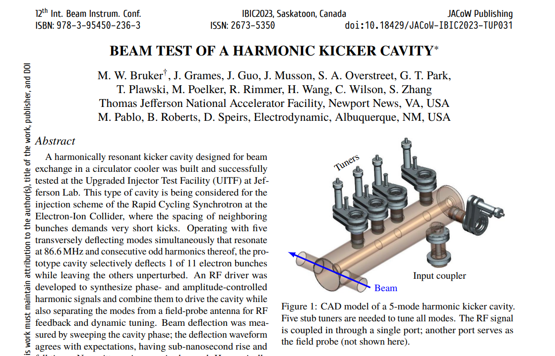
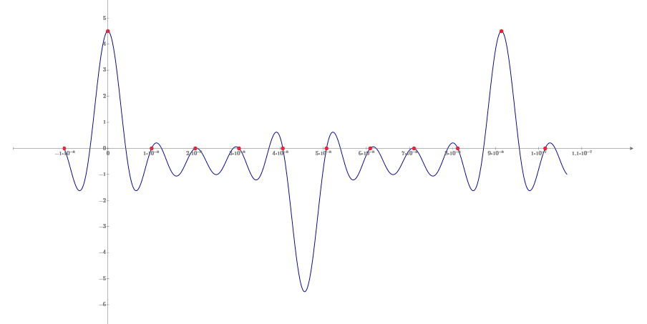
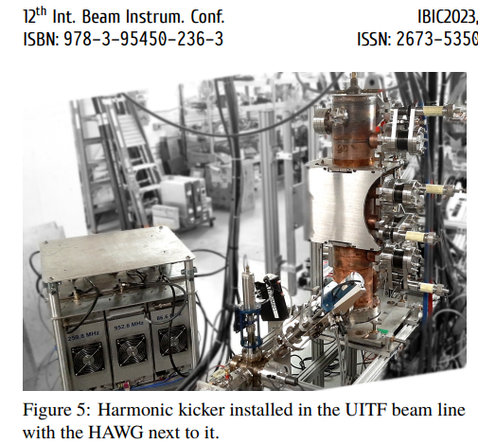
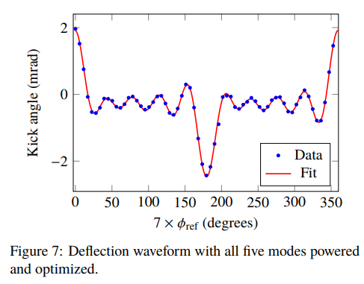
What about kickers?
Operation of harmonic kicker with beam was recently demonstrated at Jlab
For the highest energy we would need to kick every 9th bunch in and out
Blue trace - RF wave form
Red dots - electron bunches
Kicker fundamental 10.95 MHz (1/9th of the proton bunches rep. rate 98 MHz)

Slide 29
Feasibility of ERL based Recirculator
The ERL based Recirculator with a few passes through the cooling section mitigates several beam physics problems associated with the electron storage ring
We established requirements to electron bunch quality and outlined general Recirculator parameters from electron cooling considerations
At a very first look we believe that with proper design of RF, longitudinal gymnastics, and transport system the required bunch quality can be achieved
There are both engineering and physics questions that still must be answered before one can reach a conclusion on feasibility of this approach

Slide 30
Summary
Robust HEC system capable of fully counteracting emittance growth at collision energies would greatly improve luminosity in the EIC.
Recently, significant progress was achieved with conceptual design of Ring-based electron cooler: The realistic lattice for the Ring Electron Cooler was developed including proper model of damping wigglers, dual RF system, and injection magnets. Dynamic and momentum aperture were optimized.
Feasibility study of ERL-based Recirculator started.
Proton beam cooling at high energy in the EIC is conceptually feasible. However, detailed comprehensive R&D is required to determine technical feasibility of various approaches.
As part of HEC R&D, we plan to develop most promising scheme of HEC, evaluate risks and costs and choose most reliable and cost-effective approach for the EIC.
Continuing accelerator design R&D for the HEC shall get us ready to add the HEC as an EIC upgrade.

Slide 31
Backup slides

Slide 32
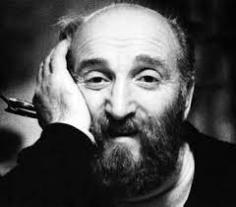






Electron Cooling
In electron cooling a bunch of hadrons co-travels with electrons (with matched $γ$) in a straight section of a hadron storage ring
“Hot” hadron and “cold” electron gases exchange heat, which leads to reduction of the phase space volume occupied by hadrons
Electron cooling was first demonstrated in 1974
Gersh Budker
EC
hadron storage ring
Cooling Section
electrons
hadrons
hadrons
$$m_{e}≪m_{h}$$
$$T_{e}≪T_{h}$$

Slide 33






Dynamical friction
A massive object (a star or an ion) moving through a cloud of lighter bodies (space dust or electrons) experiences Dynamical Friction - a pull from the cloud that slows down the object.
If the force acting between bodies in the system follows the $F∝1/r^{2}$ law, then the dynamical friction force is given by:
Subrahmanyan Chandrasekhar
$$\vec{F}=\frac{4πn_{e}{e^{4}Z}^{2}}{m_{e}}⋅∫Λ_{c}\frac{\vec{v_{i}}−\vec{v_{e}}}{{\left|\vec{v_{i}}−\vec{v_{e}}\right|}^{3}}f_{ve}d^{3}v_{e}$$
Friction Force ($F$) [arb. units]
Each time an ion passes the cooling section (CS) it experiences a friction force which reduces its velocity deviation from an average bunch velocity
hadron velocity relative to electrons’ velocity spread ($v_{i}/Δv_{e}$)

Slide 34








Fully integrated cooling rates
While “small amplitude” formulas give good cooling times: $τ_{x}=50$ min and $τ_{z}=40$ min, the total cooling rate must be obtained by integrating the friction force over 6D distributions of both beams:
If both beams have Maxwell-Boltzmann velocity distributions, then integration over velocities can be reduced to 1D integrals
When both beams have 3D Gaussian density distribution:
When e-bunch has a flat-top longitudinal distribution:

Slide 35



Redistribution of cooling rates
To redistribute cooling between longitudinal and horizontal directions one needs:
  Dependence of a longitudinal cooling force on a horizontal coordinate
  Horizontal ion dispersion in the cooling section (dependence of ions’ longitudinal velocity on their horizontal coordinate)
The redistributed rates [2,3] can be calculated from:
where $λ_{x0}$ and $λ_{z0}$are given by formulas from the previous slide with the following substitutions:

Slide 36





Space charge tune shift
One can increase cooling by increasing e-bunch’s charge while reducing its emittances:
On the other hand, space charge tune shift can be estimated as:
Depending on e-bunch longitudinal density distribution
$$λ∝\frac{N_{e}}{ε_{x,y}^{2}ε_{z}}⋅\frac{L_{CS}}{C_{ring}}$$
Gaussian:
Flat top:
For a fixed $Δν_{e}$, one gets a higher cooling rate for the same $N_{e}$ with a flat top bunch if one makes $L_{ze}>\sqrt{2π}σ_{ze}$

Slide 37


Optical features of REC wigglers (I)
We are working in an unusual range of parameters – a large wiggler field $B_{0}≈2.4 [T]$ and a relatively small beam energy $Bρ≈0.5 [T⋅m]$
Therefore, in our case $b≡\frac{B_{0}}{Bρ}≈4.8 \left[\frac{1}{m}\right]$ is not small, unlike for the usual wigglers, where $b≪1$
Let’s consider an analytic representation of a wiggler field :
$$\begin{matrix}B_{x}=\frac{k_{x}}{k_{y}}B_{0}\sinh\left(k_{x}x\right)\sinh\left(k_{y}y\right)\sin\left(kz\right) \\ B_{y}=B_{0}\cosh\left(k_{x}x\right)\cosh\left(k_{y}y\right)\sin\left(kz\right) \\ B_{z}=\frac{k}{k_{y}}B_{0}\cosh\left(k_{x}x\right)\sinh\left(k_{y}y\right)\cos{(kz)} \\ k_{x}^{2}+k_{y}^{2}=k^{2}; k=\frac{2π}{λ}≈31.4 \left[\frac{1}{m}\right]\end{matrix}$$

Slide 38









Optical features of REC wigglers (II)
Equations of motion:
$$x^{′′}=−\frac{B_{y}}{Bρ}+y^{′}\frac{B_{z}}{Bρ}; y^{′′}=\frac{B_{x}}{Bρ}−x^{′}\frac{B_{z}}{Bρ}$$
Approximate analytic solution:
$$x=\frac{b}{k^{2}}\sin\left(kz\right)+x_{0}\cos\left(\frac{bk_{x}}{\sqrt{2}k}z\right)+\left(x_{0}^{′}−\frac{b}{k}\right)\frac{\sqrt{2}k}{bk_{x}}\sin\left(\frac{bk_{x}}{\sqrt{2}k}z\right)$$
$$y=y_{0}\cos\left(\frac{bk_{y}}{\sqrt{2}k}z\right)+y_{0}^{′}\frac{\sqrt{2}k}{bk_{y}}\sin\left(\frac{bk_{y}}{\sqrt{2}k}z\right)$$
$$k_{x}=15 m^{−1}$$
$$k_{x}=15 m^{−1}$$
$$x [m]$$
$$y [m]$$
$$z [m]$$
$$z [m]$$
Our wigglers work as a thick lens in both $x\&y$ directions (there can be several full oscillations over the length of a wiggler)

Slide 39

Optical features of REC wigglers (III)
Transport matrices:
$$M_{x}\left(z\right)=\left(\begin{matrix}\cos\left(\frac{bk_{x}}{\sqrt{2}k}z\right) & \frac{\sqrt{2}k}{bk_{x}}\sin\left(\frac{bk_{x}}{\sqrt{2}k}z\right) \\ −\frac{bk_{x}}{\sqrt{2}k}\sin\left(\frac{bk_{x}}{\sqrt{2}k}z\right) & \cos\left(\frac{bk_{x}}{\sqrt{2}k}z\right)\end{matrix}\right); M_{y}\left(z\right)=\left(\begin{matrix}\cos\left(\frac{b\sqrt{k^{2}−k_{x}^{2}}}{\sqrt{2}k}z\right) & \frac{\sqrt{2}k}{b\sqrt{k^{2}−k_{x}^{2}}}\sin\left(\frac{b\sqrt{k^{2}−k_{x}^{2}}}{\sqrt{2}k}z\right) \\ −\frac{b\sqrt{k^{2}−k_{x}^{2}}}{\sqrt{2}k}\sin\left(\frac{b\sqrt{k^{2}−k_{x}^{2}}}{\sqrt{2}k}z\right) & \cos\left(\frac{b\sqrt{k^{2}−k_{x}^{2}}}{\sqrt{2}k}z\right)\end{matrix}\right)$$
This gives the expected focusing for small $b$: $\left\langle K_{x}\right\rangle =\frac{B_{0}^{2}}{2{\left(Bρ\right)}^{2}}\frac{k_{x}^{2}}{k^{2}}, \left\langle K_{y}\right\rangle =\frac{B_{0}^{2}}{2{\left(Bρ\right)}^{2}}\left(1−\frac{k_{x}^{2}}{k^{2}}\right)$
Chromaticity is easy to calculate for the matched conditions $\left(β_{x}=\frac{\sqrt{2}k}{bk_{x}}; β_{y}=\frac{\sqrt{2}k}{b\sqrt{k^{2}−k_{x}^{2}}}\right)$:
$$\frac{∂Q_{x}}{∂δ}=−\frac{1}{2π}\frac{B_{0}N_{p}λ}{\sqrt{2}Bρ}\frac{k_{x}}{k}; \frac{∂Q_{y}}{∂δ}=−\frac{1}{2π}\frac{B_{0}N_{p}λ}{\sqrt{2}Bρ}\frac{\sqrt{k^{2}−k_{x}^{2}}}{k}$$
Obtained analytic expressions were cross-checked by Bmad and GPT tracking
For example, in the current lattice we want $β_{x}=30 cm$. This sets $k_{x}=30.7 m^{−1}$ and $β_{y}=1.4 m$, $\frac{∂Q_{x}}{∂δ}=−2.1, \frac{∂Q_{y}}{∂δ}=−0.5$

Slide 40

Importance of proper wiggler focusing
We started with a different wiggler field – a “s-bend wiggler”:
$$B_{x}=B_{0}\cos\left(k_{q}x\right)\sinh\left(k_{q}y\right)$$
$$B_{y}=B_{0}\cosh\left(ky\right)\sin\left(kz\right)+B_{0}\sin\left(k_{q}x\right)\cosh{(k_{q}y)}$$
$$B_{z}=B_{0}\sinh\left(ky\right)\cos{(kz)}$$
For a thick lens case, such a wiggler produces a huge chromaticity in the direction orthogonal to the wiggling plane when $k_{q}→\frac{B_{0}}{2Bρ}$:
$$\frac{∂Q_{y}}{∂δ}=−\frac{NλB_{0}}{2π\sqrt{2}Bρ}\frac{1−k_{q}Bρ/B_{0}}{\sqrt{1−2k_{q}Bρ/B_{0}}}$$
Since the required focusing in the wiggling plane set our $k_{q}≈2.3 m^{−1}$, the chromaticity in a non-wiggling plane from a single wiggler became ~ -11, resulting in an extra chromaticity of ~ -200
Switching to a wiggler with a “sextupole–like” field profile restored our momentum and dynamic aperture
Also, we found an element with a close to zero focusing and an arbitrary large chromaticity – this might be interesting

Slide 41


Preliminary (non-optimized) 3D Geometry of a Possible
Damping Wiggler for EIC REC
Whole Geometry
(with reduced Number
of Periods)
Lower Part
Permanent Magnets
(B_{r} = 1.3 T)
“Iron” Poles
with Shims
(Vanadium
Permendur)
Magnetic Gap ~20 mm
(without Shims)
Shim thickness ~0.75 mm
Period: 200 mm

Slide 42




~Attainable Magnetic Field of a Possible
Damping Wiggler for EIC REC (preliminary Radia calculations)
z = -50 mm
(z)
(x)
x = 5 mm
z = -50 mm
https://github.com/ochubar/Radia
(y)
(x)

Slide 43


Injection (single bunch point of view)
Cooling rate evolution

Slide 44

Injection (transverse acceptance)
We can safely assume the thickness of the septum to be 2 mm:
$β_{x(stored)}=60$ m
$β_{x(injected)}=20$ m
$ε_{stored}=8$ nm
$ε_{injected}=5$ nm
$ε_{n(injected)}=1.5 μ$m
$4σ_{stored}=2.8$ mm, therefore, if stored beam is 17 mm away from the inner edge of the septum knife, then the kicker bump must produce 14.2 mm displacement
2 mm
5.7 mm

Slide 45


Beam dynamics for 2.5 nC

