Slide 1
C-AD Machine Advisory Committee HW Day 2
Wolfram Fischer Deputy Associate Laboratory Director for Accelerators, NPP Chair, C-AD
C-AD Machine Advisory Committee
18 December 2024
Notes:
15 min => 10 slides

Slide 2
HW questions day 2
What is the plan and commitment for using AI/ML tools in Run-25 operations?
What are the plans for including collective effects in the AI/ML developments?
What are the specific plans and expected deliverables in FY25 for the BNCT lithium beam driver work?
Please provide details on the RFQ implementation for BNCT lithium beam driver with 120mA.
After commissioning the Extended EBIS in 2025, what are the priorities for future work on Au and 3He?
What are the specific plans, expected deliverables, and funding needs in FY25 for the FFA work? What constitutes success?
What is the anticipated timeline for the next steps on High-Energy Cooler work, both in FY25 and long term?

Slide 3
Q1: What is the plan and commitment for using AI/ML tools in Run-25 operations?
Georg Hoffstaetter, Kevin Brown
Committed to providing emittance stabilization tools that were implemented by Leve for LtB and BtA optimization, and to help make them popular with the operators.
Since the methods we are using focus on increasing the beam brightness, we don’t need p-p but can use any beam.
However, we still must work on optimizing heavy ion injection into the Booster (both EBIS and TVDG).
We are also working with RadiaSoft to improve emittance measurements and get them to report more consistently, using ML techniques. This can yield first results for Run-25.
New instrumentation is being put in place - a dedicated wall current monitor data acquisition to give us longitudinal emittance through the cycle in both Booster and AGS, a pixel ion chamber in the LtB line for directly measuring coupling, and RF frequency meter in the Booster. Of course, as Vincent stated, there will be p-p studies during the Au-Au ops.

Slide 4
Q2: What are the plans for including collective effects in the AI/ML developments?
Georg Hoffstaetter, Kevin Brown
Already addressing space charge through the bunch split/merge process.
Also looking at a space charge correction in the AGS ion-collecting IPM.
While space charge can already be modeled in Bmad, not yet done for Booster and AGS. Because the ML-based emittance optimization seems to be working well without a complete model, do not plan to pursue space charge modeling with high priority.
For coherent instabilities, have discussed stop band corrections and using ML to optimize them, but that needs more thought.
Is possible that having negative horizontal chromaticity above transition in the AGS is causing problems, but we have very low intensities and seen no evidence of intensity dependent tune shifts.

Slide 5
Masahiro Okamura
Q3:

Slide 6
Masahiro Okamura

Slide 7
Masahiro Okamura

Slide 8
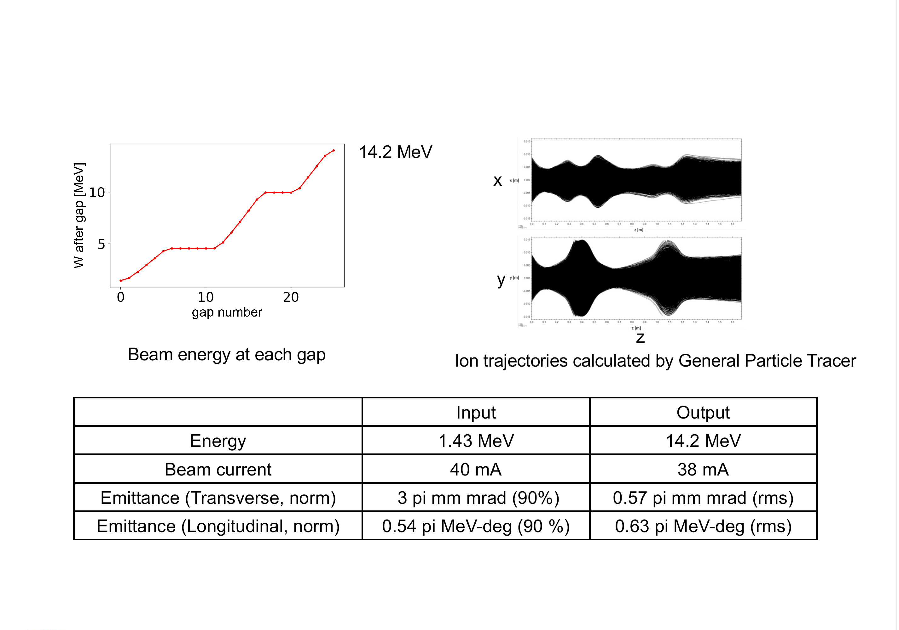
Masahiro Okamura

Slide 9
Masahiro Okamura
Q4:

Slide 10
Masahiro Okamura

Slide 11
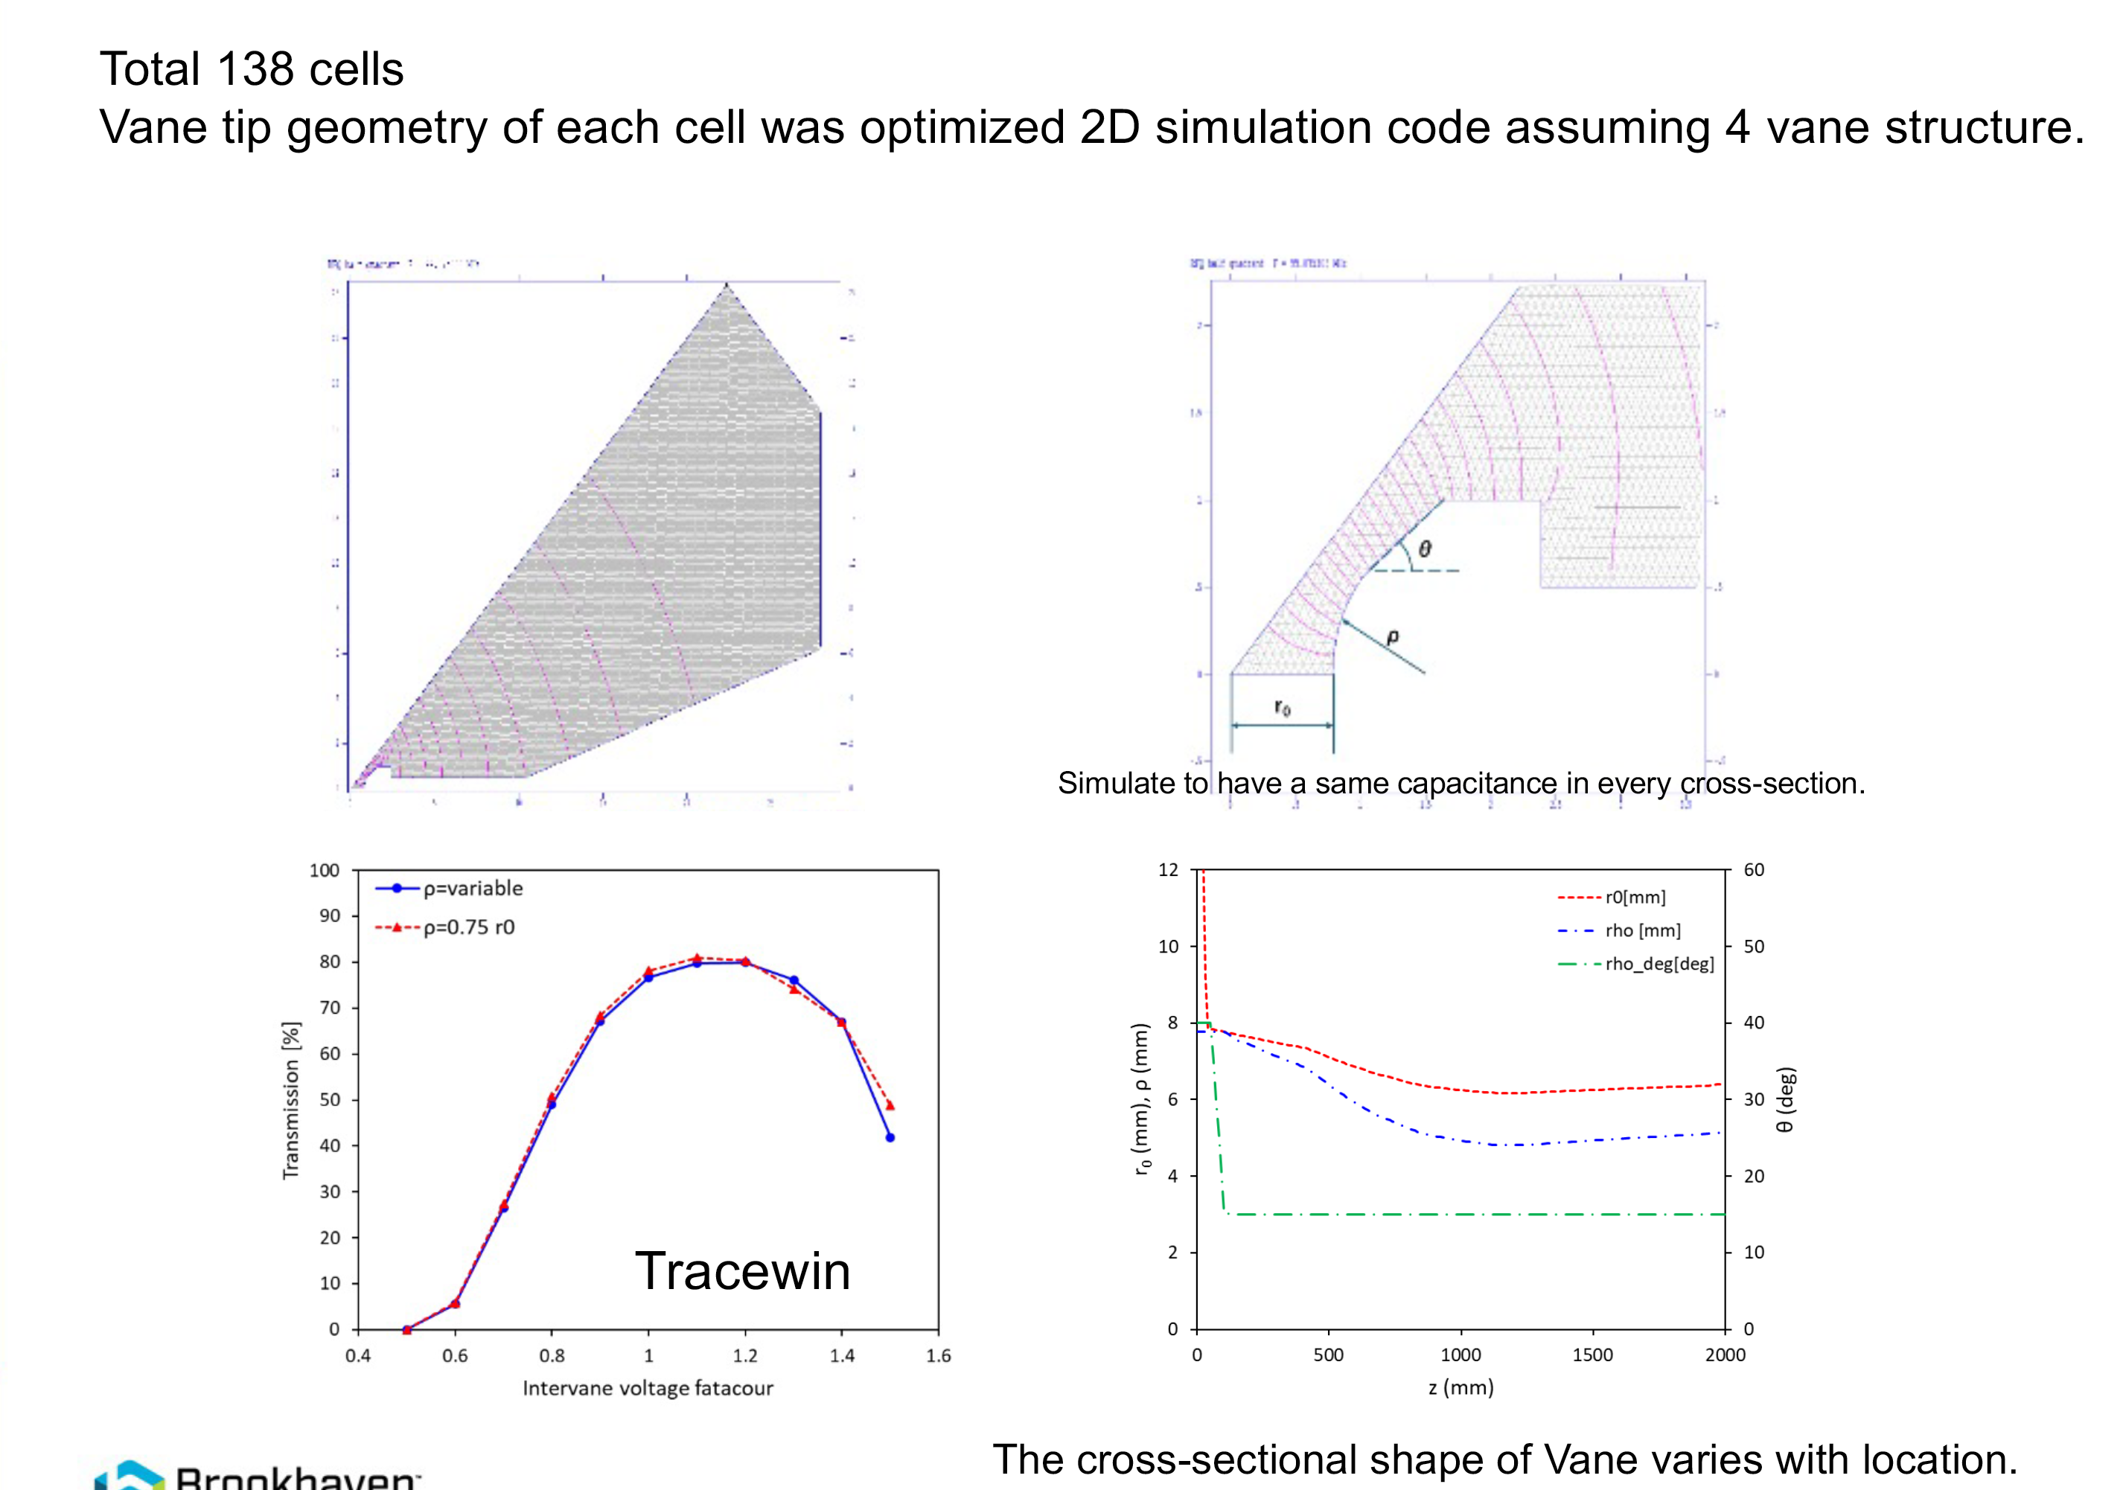
Masahiro Okamura

Slide 12
Masahiro Okamura

Slide 13
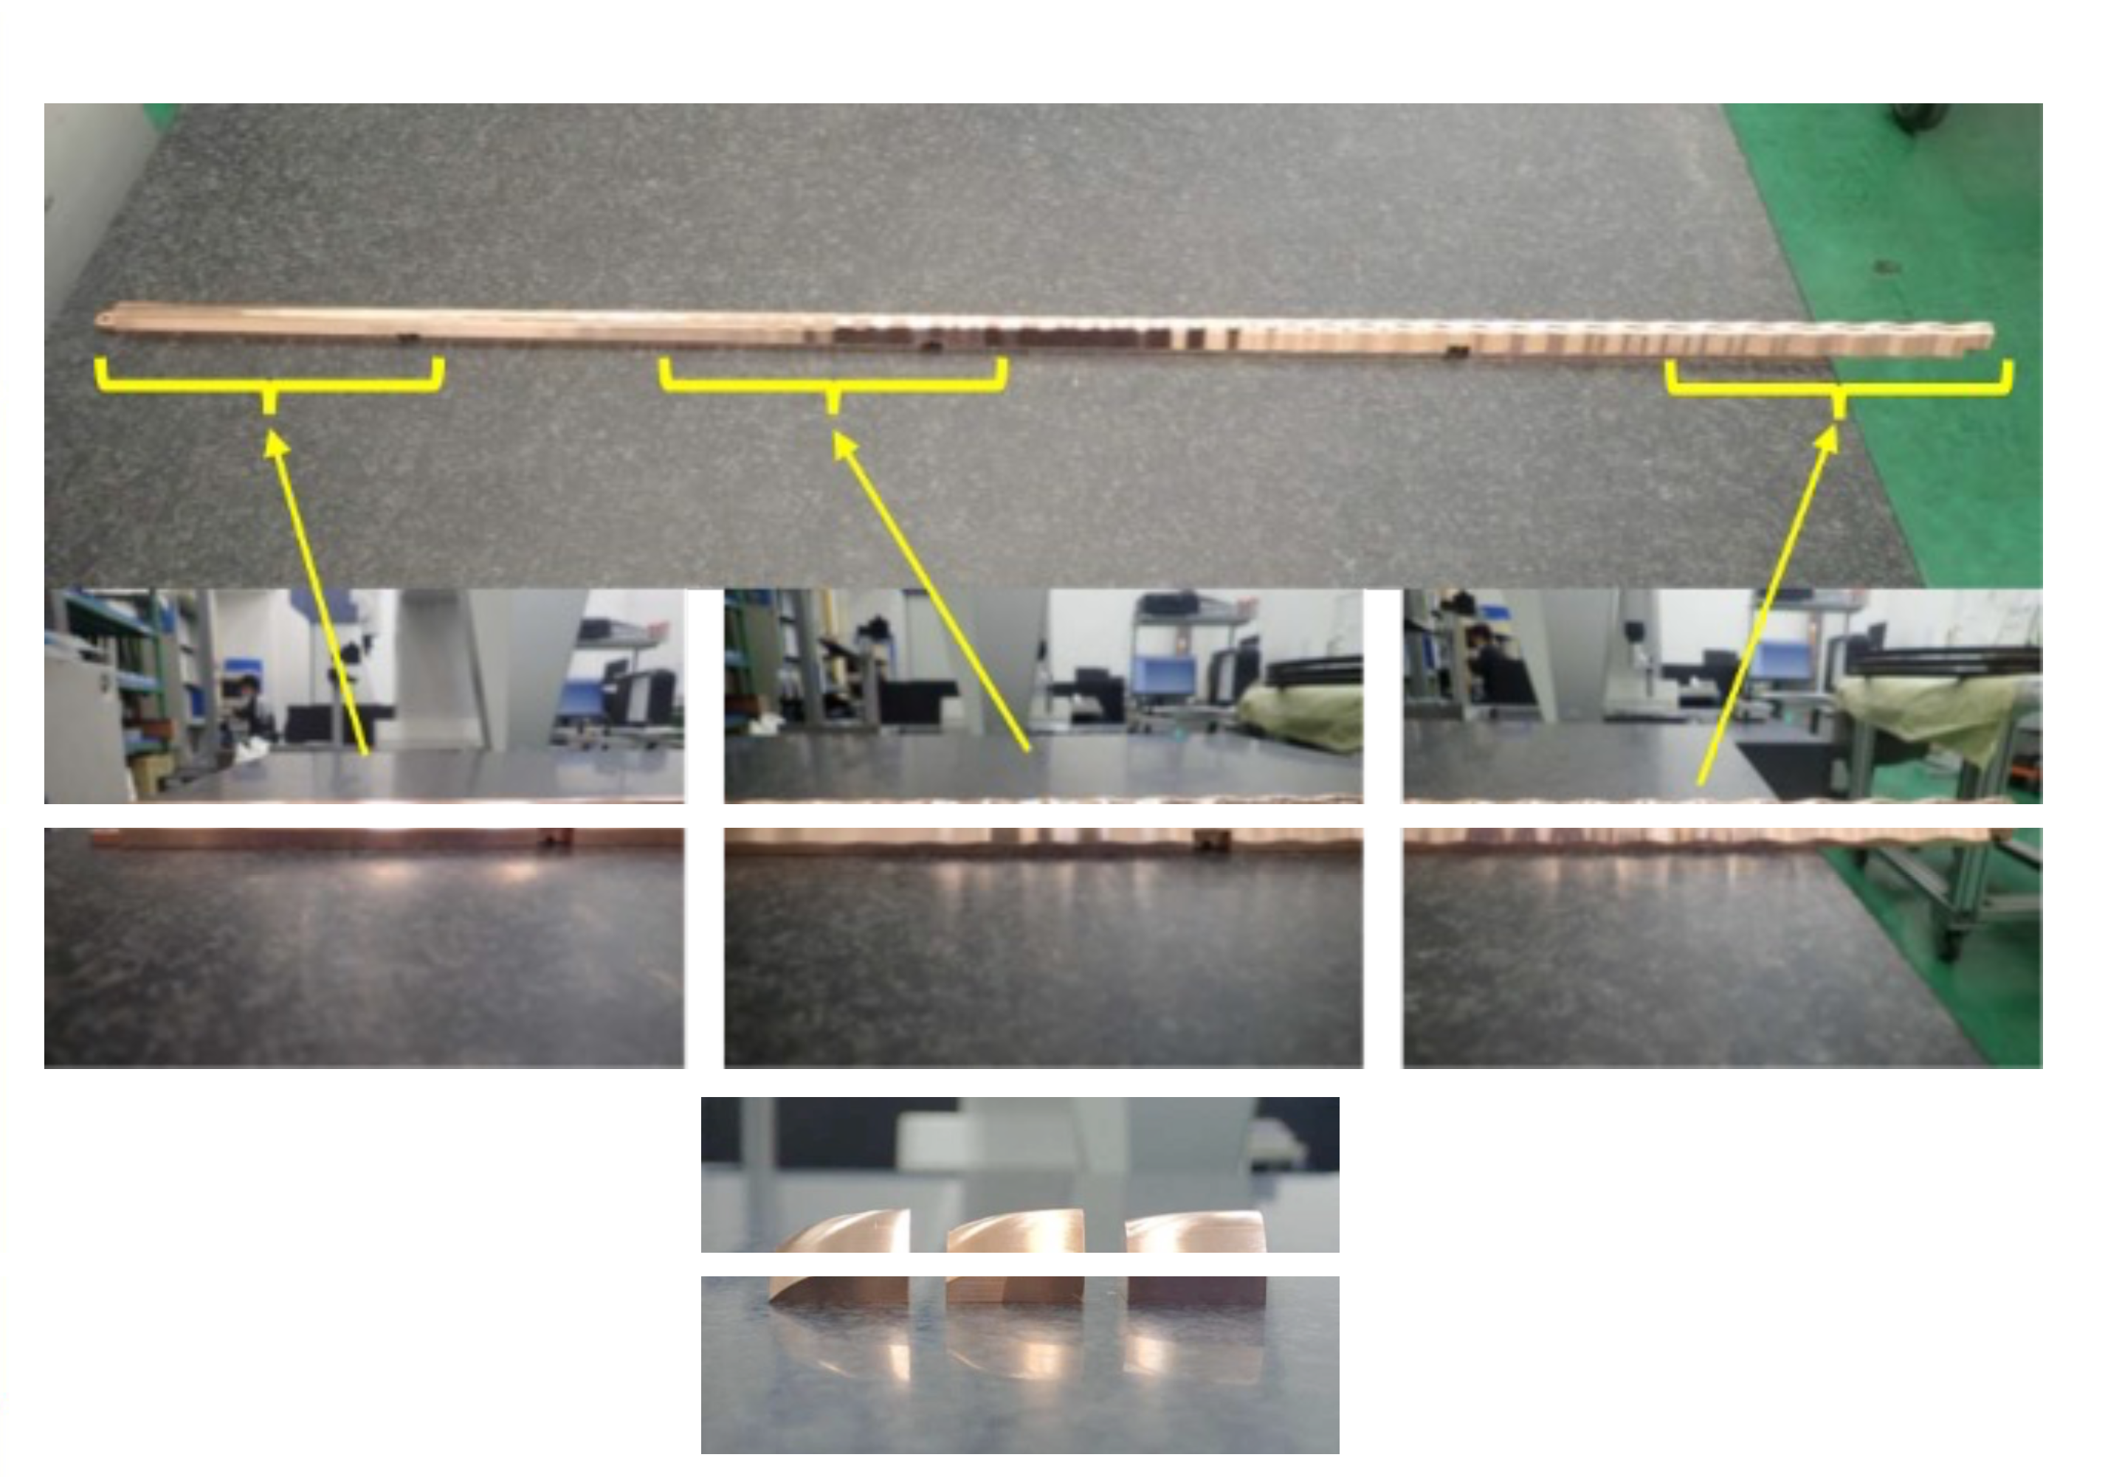
Masahiro Okamura

Slide 14
Q5: After commissioning the Extended EBIS in 2025, what are the priorities for future work on Au and 3He?
Can meet the NSRL requirements with present EBIS performance
Full intensity Au needed again for EIC
Polarized He-3 development has highest priority for new capabilities

Slide 15
Q6: What are the specific plans, expected deliverables, and funding needs in FY25 for the FFA work? What constitutes success?
Dejan Trbojevic
Remaining tasks:
Verify/adjust field quality of FFA magnets
Magnet assembly on Al plate to form a mini-arc
Propagate NSRL proton beam 10-250 MeV through arc
LDRD B funding: $200k in FY25 ($180k remaining)
Completion of tasks above is success for LDRD

Slide 16
Q7:What is the anticipated timeline for the next steps on High-Energy Cooler work, both in FY25 and long term?
Alexei Fedotov,
Sergei Seletskiy
EIC project has recently decided to move HEC efforts off project. This will have significant impact on resources available to work on HEC, especially in FY25, as C-AD Beam Cooling Group group, support several other projects and studies in FY25 (CeC experiment, LEReC APEX cooling studies, High-current R&D, LEC for EIC and many other EIC tasks).
We expect that available resources within C-AD Beam Cooling Group will be further affected by transitioning to the EIC.
With the presently available resources within the group, we expect to complete the ongoing Ring Cooler studies and perform DA studies with realistic wiggler errors by the end of 2025. We plan to produce CDR of Ring Cooler approach on the scale of 2-3 years.
We expect that bringing ERL-based HEC to a CDR level will take additional 2-3 years.

