Slide 1
Nuclear Structure and Decay Data evaluators network (NSDD) and other activities at Nuclear Data Section
Paraskevi (Vivian) Dimitriou
Nuclear Data Section, Division of Physical and Chemical Sciences, International Atomic Energy Agency

Slide 2
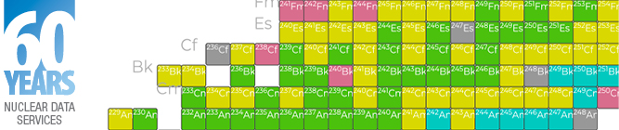
IAEA Nuclear Data Section
60th Anniversary
1964 - 2024

Slide 3
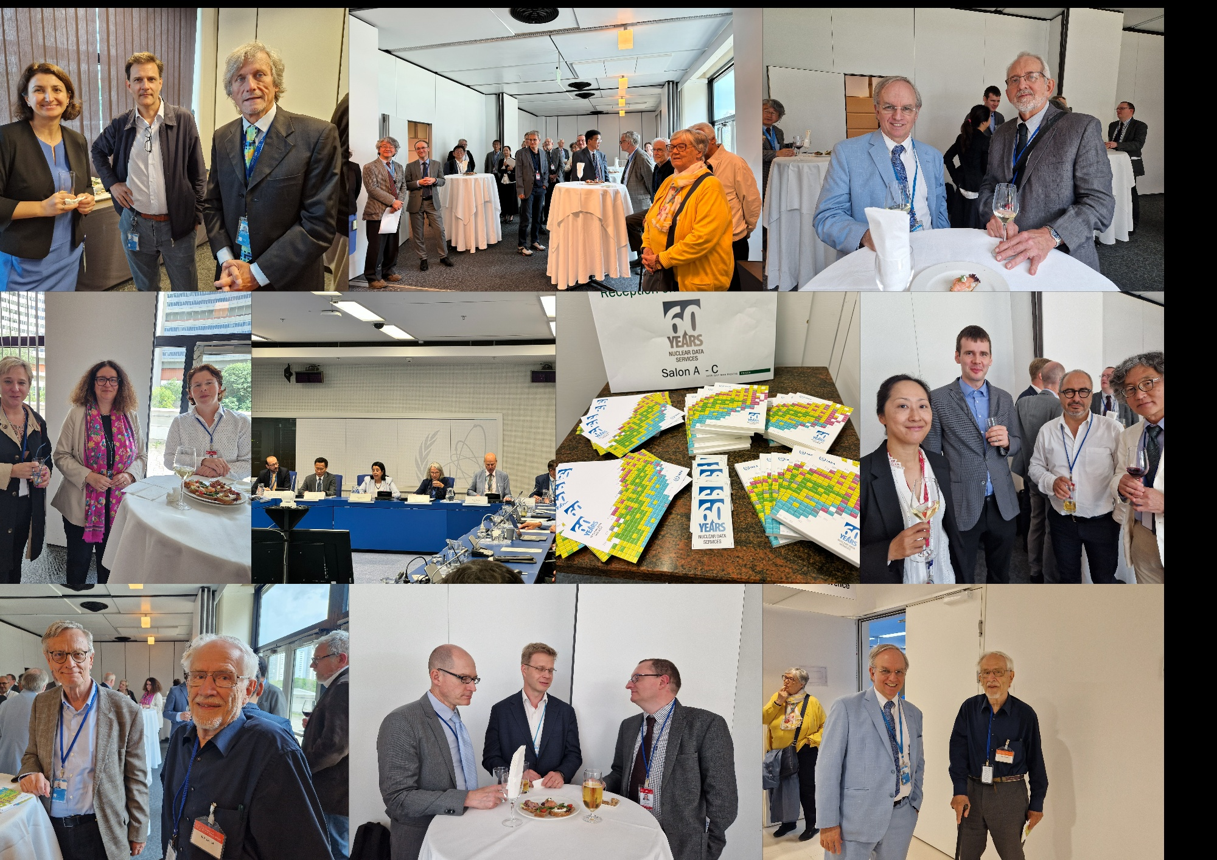
60th Anniversary of Nuclear Data Section
On 3 June 2024 celebrated 60 years of Nuclear Data Services
Presentations by the respective DDG NA, Ms Najat Mokhtar, DIR-NAPC, Melissa Denecke, DIR-NEPK, Mr Wei Huang,
Followed by retrospectives from former staff members, with anecdotes of their time at NDS, and memories of the colleagues who are no longer with us. The celebration ended with small reception.

Slide 4
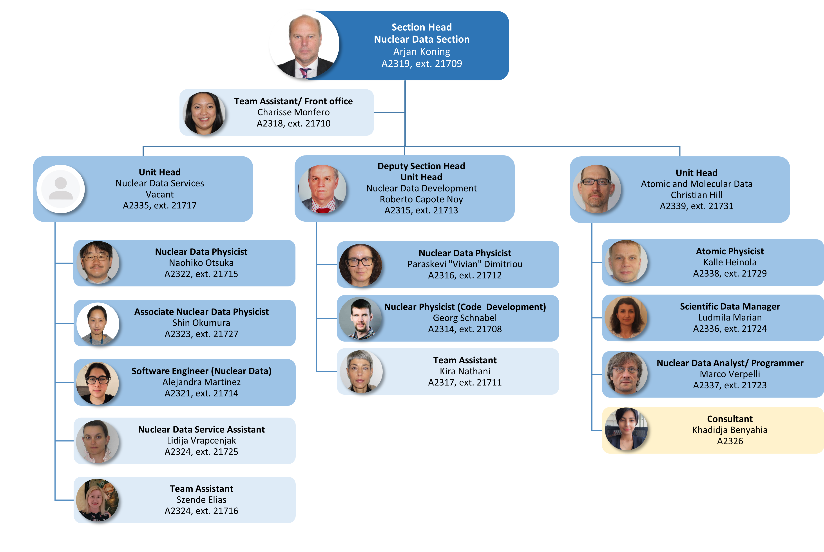

Slide 5

Compound-
Nuclear
Reactions and
Related Topics
(CNR*24)
8 - 12 July 2024
International Atomic Energy Agency Vienna International Centre

Slide 6
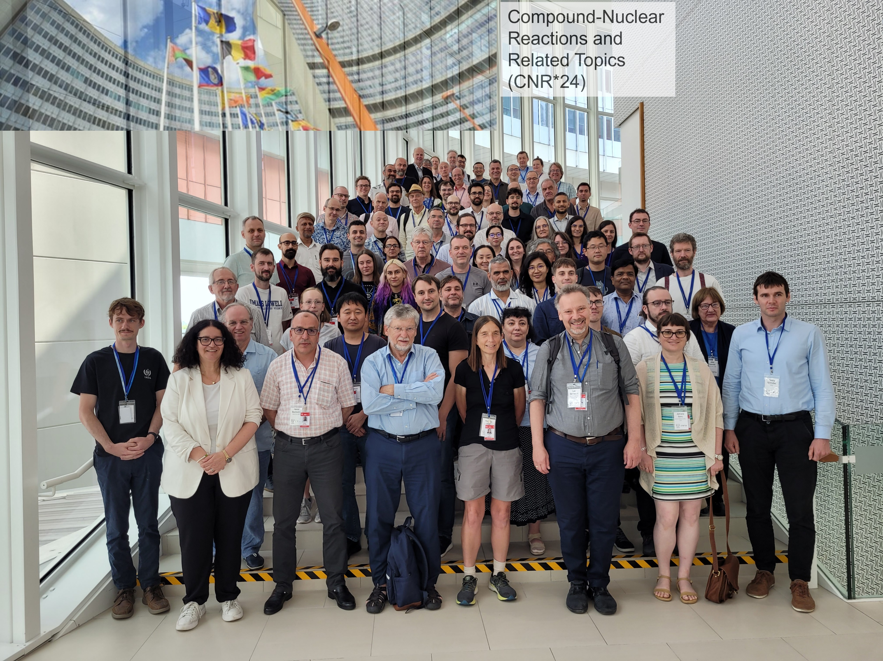
Compound-Nuclear
Reactions and
Related Topics
(CNR*24)
Organisers
  Paraskevi (Vivian) Dimitriou, Roberto Capote, Georg Schnabel
  Kira Nathani (Admin.)
Total of 91 participants from 24 member states; 12 keynote overview talks, 16 invited talks, 24 oral contributions, and 30 poster presentations incl. a special session in memory of Eric Bauge who passed away in May 2022
Proceedings in EPJ Web of Conferences
https://conferences.iaea.org/event/368/

Slide 7
International Network of Nuclear Structure and Decay Data (NSDD)
Under the auspices of the IAEA since 1974
16 Data Centers: ANL/USA, BNL/USA, FRIB/MSU/USA, LBNL/USA, ORNL/USA, Texas A&M/USA, TUNL/USA, Australian Nat. University, Univ. Sofia/Bulgaria, CNDC/China, Jilin Univ/China, ATOMKI/Hungary, VECC/India, JAEA/Japan, IFIN-HH/Romania, PNPI/Russia
Coordinator: Nuclear Data Section
Scientific Secretary: P (Vivian) Dimitriou
Terms of Reference:
  Biennial meetings are organized by IAEA-NDS: policies, tasks and actions are discussed to improve the NSDD databases and user services [main instrument of coordination]
  In the 2-year period in-between, the ENSDF manager (Elizabeth A. Ricard) ) co-ordinates all work related to the preparation of evaluations for ENSDF and incorporation of horizontal evaluations into the ENSDF and publication in Nuclear Data Sheets
  The Scientific Secretary of the network (P. Dimitriou) organizes biennial meetings of the network, sponsors workshops to
  train new evaluators, oversees dissemination of documents, ENSDF Analysis and Checking Codes, and information relevant
  to the network activities [Status of NSDD network document being updated]
  ENSDF and NSR databases stewardship resides with NNDC.
  Both databases are disseminated by both NNDC and IAEA-NDS

Slide 8

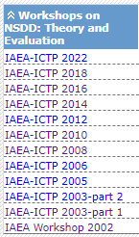
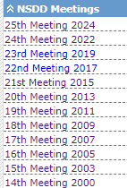
Special Year: 2024
50th Anniversary of the network
First IAEA Meeting to discuss the formation, scope and participation was held in Vienna in 1974: INDC(NDS)-060
50 years later, at the 25th meeting of the network, only one of the very first members of the network was present: Jagdish Tuli (retired)
25 biennial meetings
10 ICTP workshops

Slide 9
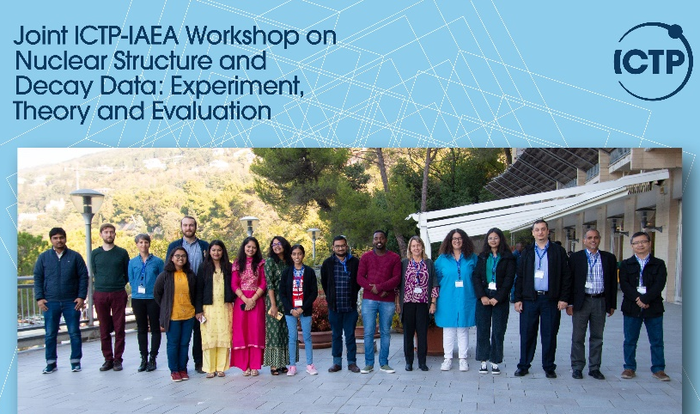
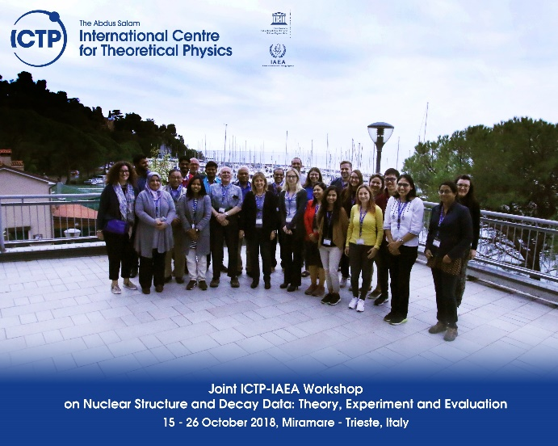
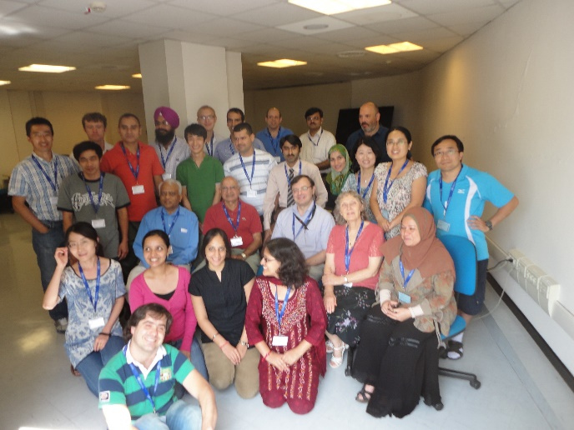
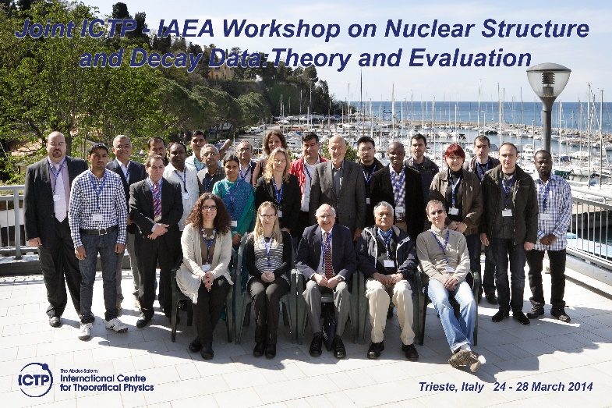
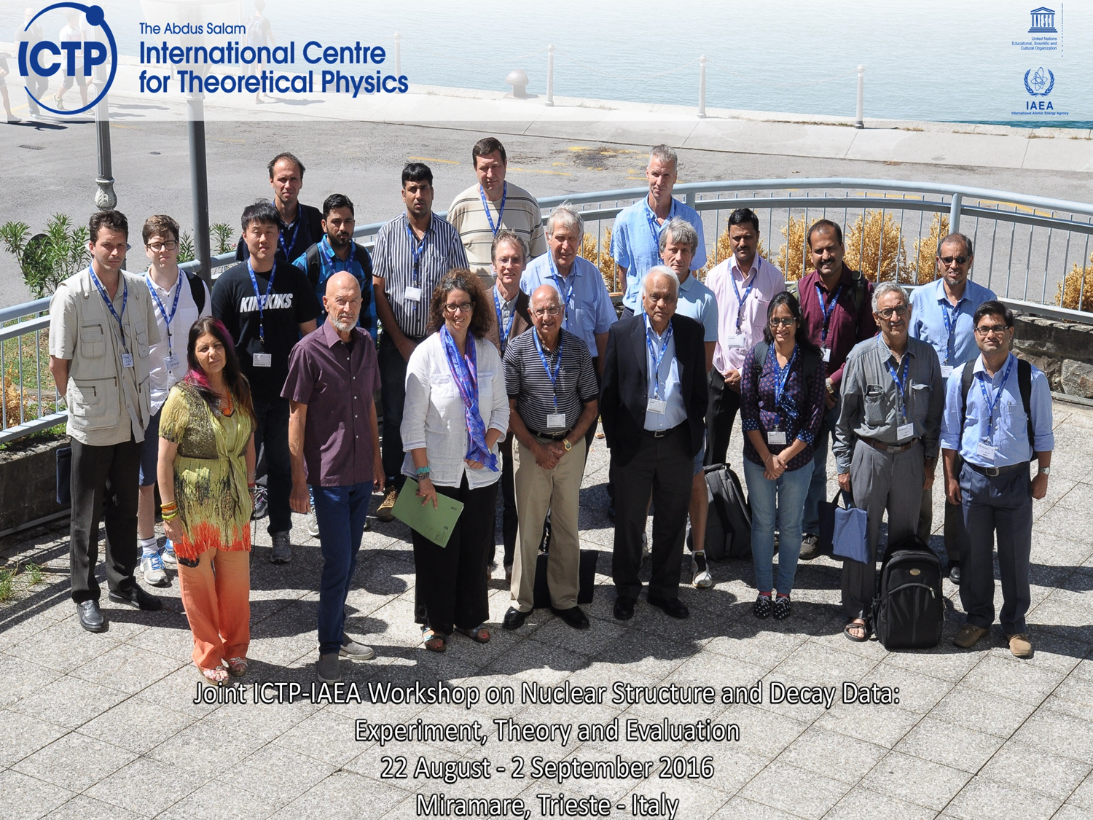
Joint IAEA-ICTP Workshops cont’d
Mass chain evaluation: published
2012: A=211, Nuclear Data Sheets 114, 661 (2013)
2014: A=227, Nuclear Data Sheets 132, 257 (2016)
2016: A=217, Nuclear Data Sheets 147, 382 (2018)
2018: A=218, Nuclear Data Sheets 160, 405 (2019)
2022: A=222, Nuclear Data Sheets 192, 315 (2023)
XUNDL compilation
2016, 2018, 2022: 40 XUNDL datasets were compiled for XUNDL

Slide 10



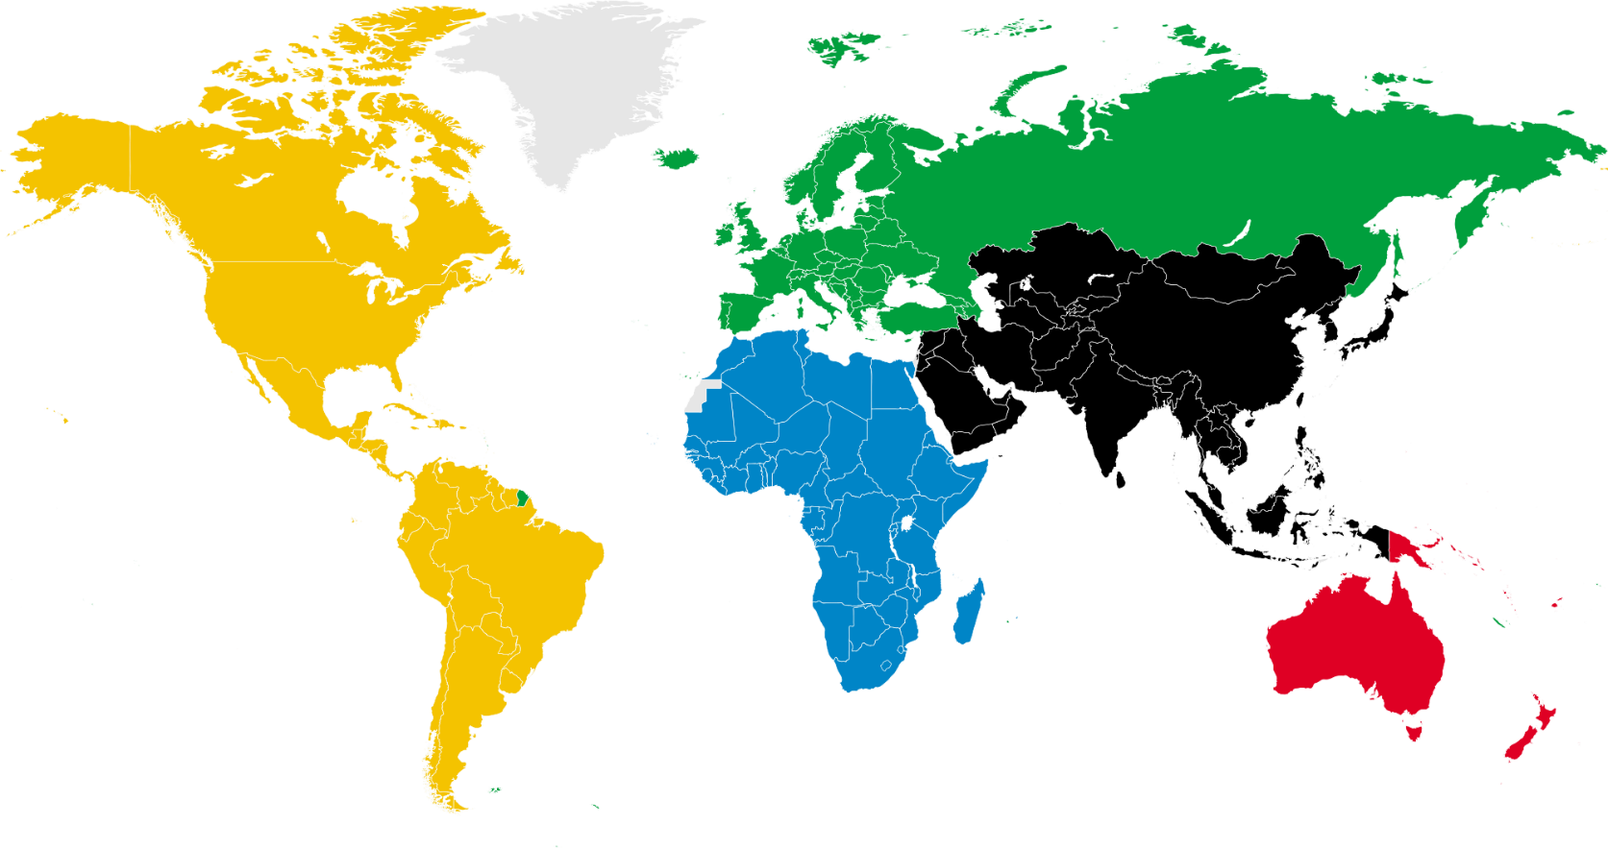
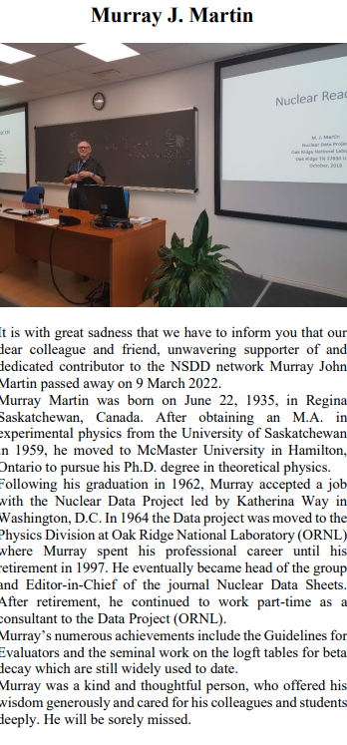
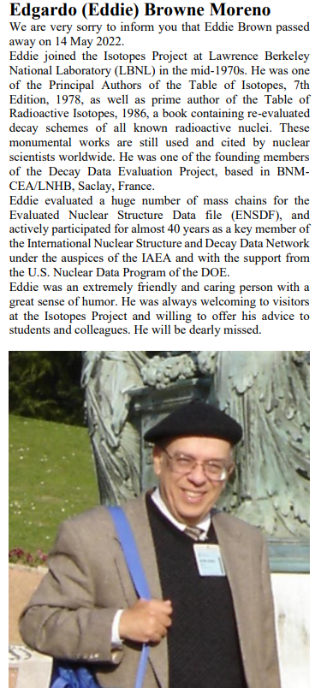
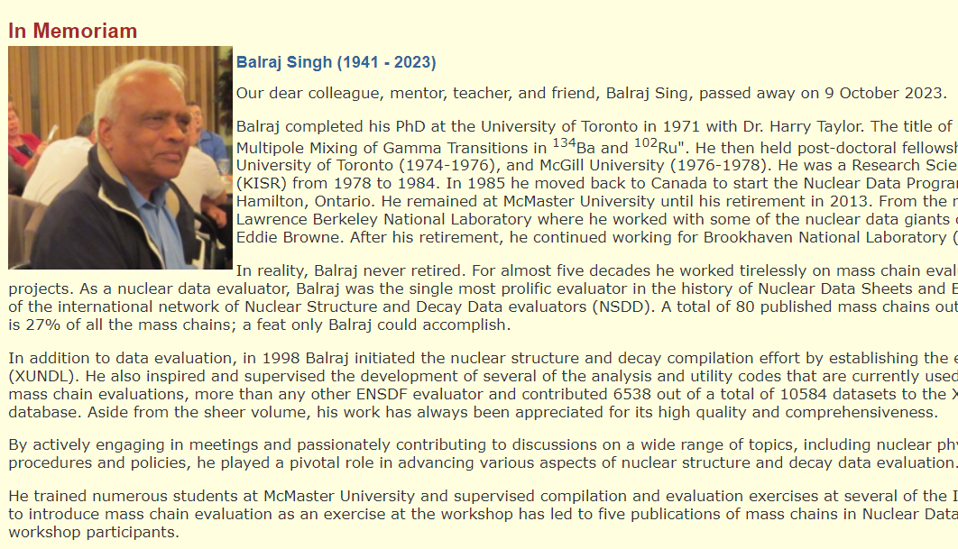
















Since 2021: Loss of 3 pillars of the network
2024: 17→16 NSDD centres + IAEA
Shaofei Zhu - 2021

Slide 11

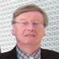

25th Technical Meeting
50th Anniversary
Retrospective
How it all began, 1970’s – 2016, Jagdish Tuli
From the viewpoint of the NDS Section Head, Alan Nichols
The last two decades, Vivian Dimitriou
In turbulent times, Pavel Oblozinsky
15 – 19 April 2024, IAEA, Vienna
24 in-person participants from 13 countries; 19 remote plus 3 IAEA staff
Meeting report: in preparation
Meeting website: https://conferences.iaea.org/event/387/

Slide 12
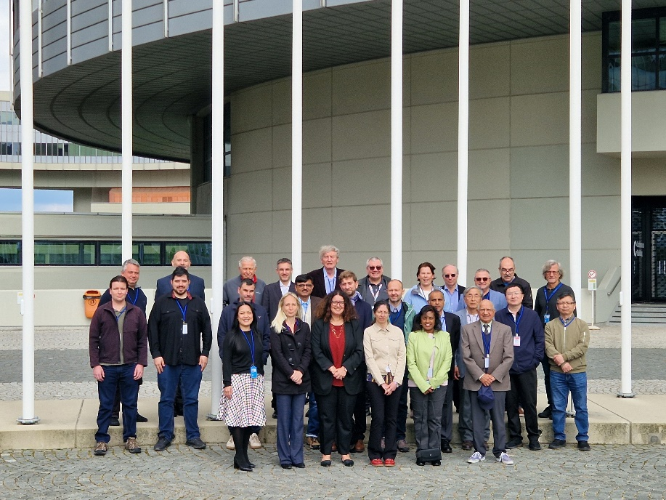
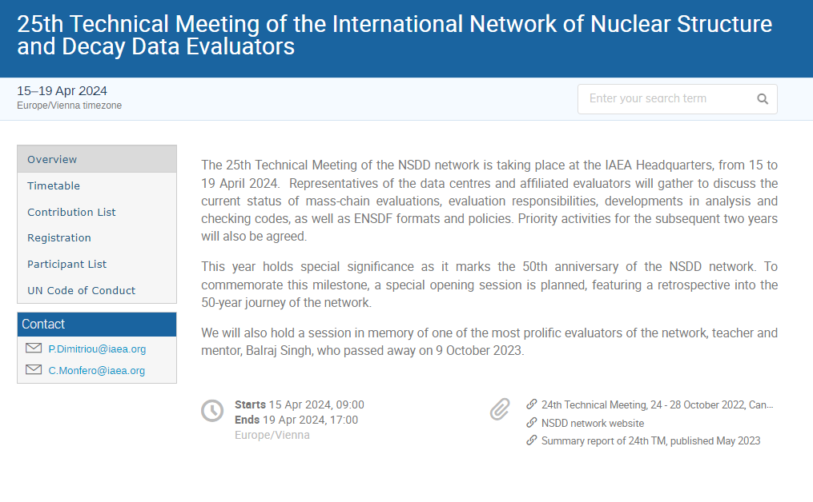
25th Technical meeting
Topics:
  ENSDF codes: new Java ENSDF codes, BetaShape, NS_Radlist, UncTools
  ENSDF modernization (JSON format, new Editor - Demo)
  Uncertainty propagation: new proposal to treat limits: Generalized Normal Distribution
  To be tested for several ENSDF cases
  Treatment of systematic uncertainties: weighted average uncertainty OR minimum measured uncertainty?
  Proposal: organise specialized meeting on Uncertainty Propagation – gather experts to discuss possible PDFs and systematic uncertainties and formulate a new ENSDF policy for discussion
https://conferences.iaea.org/event/387/

Slide 13
Membership: Evolution
Data Center | 1981 | 1986 | 1996 | 2008 | 2015 | 2022 | 2024
North America | 6 | 6 | 6 | 6 | 7 | 8 | 7
Europe | 6 | 5 | 4 | 1 | 2 | 3 | 3
 | NL, UK, FRG, SWD, FRA, BEL | NL, FRG, SWD, FRA, BEL | NL, SWD, FRA, BEL | FRA | HUN, ROM | BUL, HUN, ROM | BUL, HUN, ROM
Russia | 2 | 2 | 2 | 1 | 1 | 1 | 1
Japan | 1 | 1 | 1 | 1 | 1 | 1? | 1?
China | - | 1 | 1 | 2 | 2 | 2 | 2
Kuwait | 1 | 1 | 1 | 1 | - | - | -
Australia | - | - | - | 1 | 1 | 1 | 1
India |  |  |  | 1 | 1 | 1 | 1
Total | 16 | 15 | 15 | 14 | 15 | 17 | 16
Canada left
WEST
EAST

Slide 14
IAEA-NDS seed grants (2007+)
Objective: assist in establishing ENSDF evaluation activity in new evaluators’ institutes
Mass-chain evaluations
Marti (ARG) 2007
Lalkovski (BUL) 2009
Timar (HUN) 2009
Joshi (IND) 2009
Dhindsa (IND) 2012
Abu Saleem (JOR) 2014
Pascu (ROM) 2017
Negret (ROM) 2009
Symochko (UKR) 2010
Chakraborty (IND) 2023
Kumar (IND) 2024
Erturk (TUR) 2009
Stone 2013-present
Nuclear Moments
Mertzimekis 2014 Nuclear Moments
Singh 2015-2022 beta-delayed neutrons
Jain 2019 Atlas of isomers
Horizontal evaluations

Slide 15
Financial support
New contracts for mass chain evaluations:
    Anagha Chakraborty (IND): 2023 – 2026
    Sushi Kumar (IND): 2024 – 2027
Contracts for horizontal evaluations:
  Nick Stone (2018-2023):
    Evaluation of Magnetic Dipole Moments for Long-lived states: INDC(NDS)-0794 (2019)
    Evaluation of Magnetic Dipole Moments for Short-Lived states: INDC(NDS)-0816 (2020)
    Tables of recommended Electric Quadrupole Moments: INDC(NDS)-0833 (2021)
    2023: Updated Compilation Tables of Nuclear Moments, completed: to be uploaded to database
    2024: Revision of Recommended Magnetic Dipole Moments for long-lived states: corrections implemented based on Antusek 2021 paper; report in preparation, to be uploaded to database

Slide 16
NSDD Data Centers effort
ATOMKI (HUN) 2011
IFIN-HH (ROM) 2015
FRANCE left 2015
KUWAIT left 2015
SOFIA U (BUL) 2017
MSU (US) 2015
TAMU (US) 2017
IIT R → VECC (IND) 2019
NNDC - 2019 – 2022 6 new members
10-year recycling of mass chains: require FTE=12 (12 full-time evaluators)

Slide 17
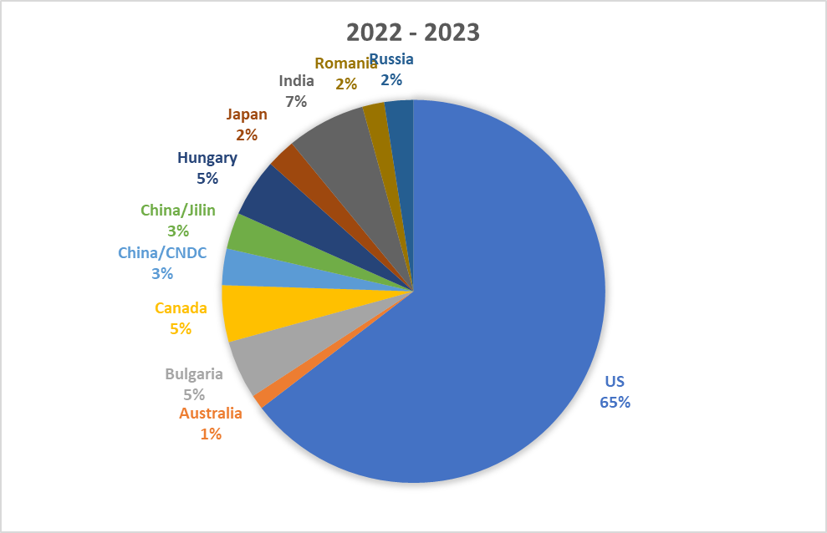
NSDD Data Centers effort cont’d
On paper non-US effort ~ 35% but fragmented across centers
In practice, in recent years, it is <5%
Main reason: lack of properly funded nuclear data program
Other reasons: low priority of ENSDF evaluation and problems attracting new evaluators
Persistent problem: funding for ENSDF evaluation

Slide 18

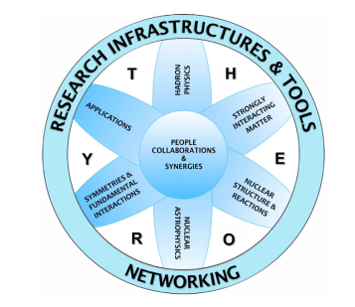
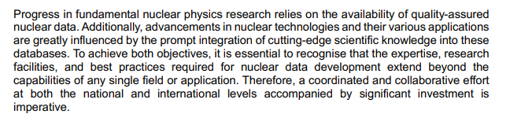
International effort
European ENSDF effort
  Presented at NuPECC Vienna Meeting, 2 Dec 2022
  Organised CM on Needs for a Comprehensive European Plan to acquire and curate Nuclear Data, 25-27 April 2023
  Contributed to NuPECC Long Range Plan 2024
    TWG 9: Open Science and Data: Coord. A.Lemasson (GANIL)
    Section on Nuclear Data and Evaluation: P (Vivian) Dimitriou (IAEA)
    Long Range Plan: Adopted June 2024 (NuPECC Meeting in Lund)
    Executive summary: https://www.nupecc.org/lrp2024/Draft_Executive_Summary_LRP2024.pdf

Slide 19

European ENSDF effort cont’d
  Co-organised Side Event on Nuclear Data at 67th IAEA General Conference
  Nuclear Data Task Force (Cano-Ott, Dimitriou, Leroy, Lewitowicz, Plompen): preparing follow-up actions
    1st action: studies of economic impact of nuclear data - promotional pamphlet
    Special session at JEFF Nuclear Data Week, 25 Nov. 2024

Slide 20

European effort cont’d
Europe
  SANDA (H2020 EURATOM) 2019-2023:Supplying Accurate Nuclear Data for Energy and Non-energy Applications
    Funding for ENSDF evaluation: ~20kEuro per Data Centre
    For the first time ENSDF evaluation was financially supported by EU
  APRENDE (H2023 EURATOM): Addressing Properties of Evaluated Nuclear Data in Europe
    Funding for ENSDF evaluation: ~107.8 kEuro total
    Univ. Sofia – 63 kEuro to fund new evaluator at 24.4 Person Months
    equivalent to FTE=0.5 for duration of project; candidate identified (Yordanov)
This is a huge improvement that will allow Europe to make an impactful contribution
Question: is it sustainable?

Slide 21
International effort cont’d
Japan
  FTE=0.5 to 0.2 in 2011
  Evaluator retired (2021) - Partial funding (following Letters of Support from IAEA, DoE)
  RIKEN contribution:
    H. Sakurai invited to NSDD meeting (2015;2022) and ICTP Workshop (2016)
    started with XUNDL in 2017 (training by F. Konev); compiler left RIKEN
    Director at NSDD 2022: not easy to use research funds for ENSDF evaluation
  JAEA contributed to GC67 Side Event (Tokio Fukahori)
    Wants to support one new ENSDF evaluator
    IAEA will help with seed funding for training and outreach activities
Issue: identify interested candidate to continue ENSDF evaluation effort

Slide 22
International effort cont’d
China
  FTE=0.4 for both DCs: CNDC and Jilin U
  China is investing heavily in nuclear energy and nuclear research; many new NPPs and research facilities have been built in the past decade
  Investing in nuclear data is a natural development
  CNDC contributed to GC67 Side Event
    Discussions held with CIAE and CNDC managers
    Agreement to introduce at least two new evaluators to the network (starting in 2025)
    Training: CNDC, experimental facilities in China, IAEA, and other Data Centers
India
  Seed funding to establish ENSDF evaluation activities at different universities: Chakraborty, Kumar
  Is this sustainable? More efforts needed for sustainable funding and effort
Argentina (Bariloche)
  We are discussing organizing various outreach activities to create awareness and attract interested scientists:
    Webinar
    In-person workshop
    Topics will include nuclear structure and decay data, nuclear reaction data, benchmarking, codes and dissemination tools

Slide 23
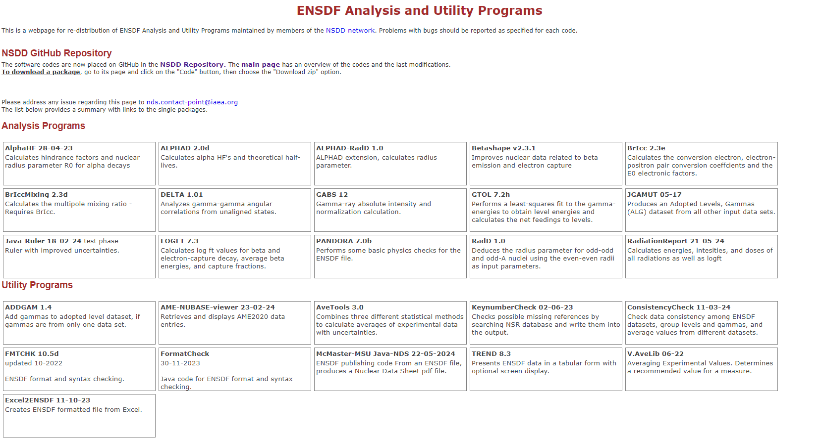
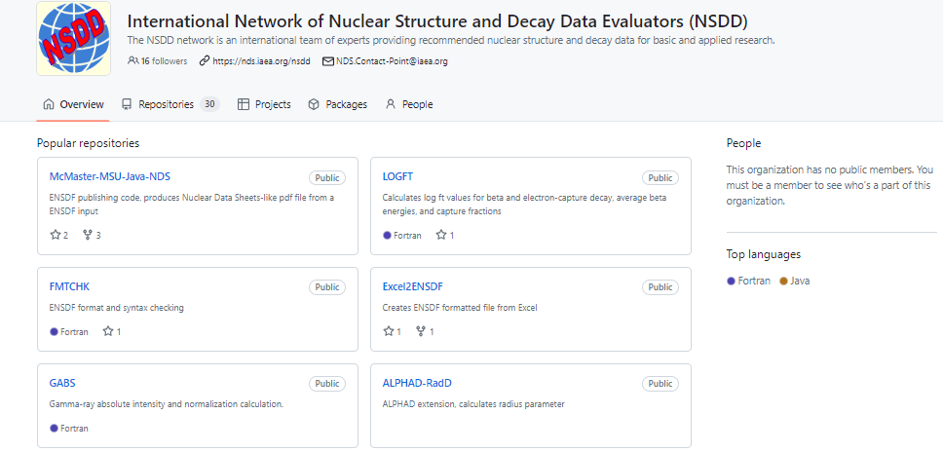
ENSDF Codes

Slide 24
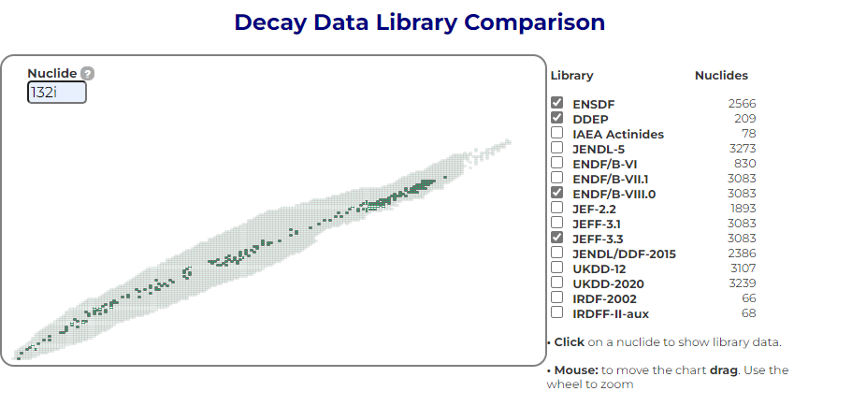
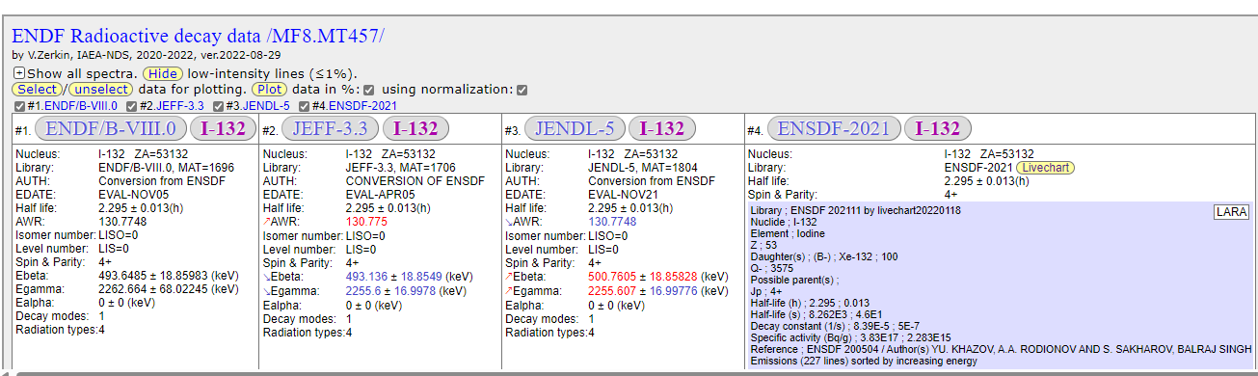
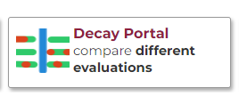
Decay Data Portal
Purpose: access all decay data information at once
Includes all nuclear structure and decay data compiled and evaluated databases and libraries including IAEA CRP evaluations
Combined effort of Marco Verpelli and Viktor Zerkin
Accessible from LiveChart
To be updated

Slide 25
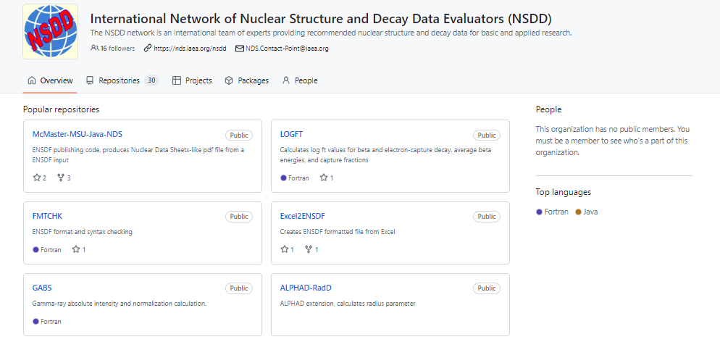
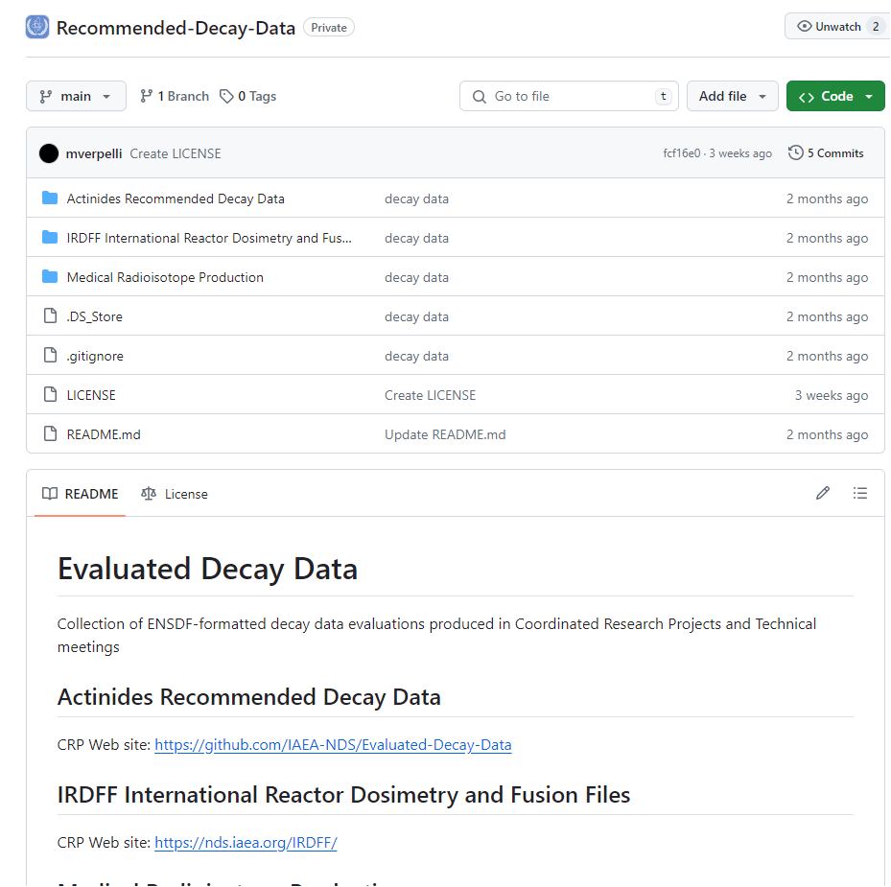
GitHub Repository
NSDD Git Repository (public)
  All ENSDF-related codes
  Ensures versioning and traceability
  New:
IAEA Recommended Decay Data
  All evaluated decay data files from IAEA CRPs (Actinide Decay Data Library, IRDF, Medical CRP, and in future: Decay data for Monitoring)
All NSDD-related documents

Slide 26
New CRPs
Nuclear Data for Basic Sciences and Applications: (2022-2027+)
Updating and improving Nuclear Level Densities for Applications (2024-2028)

Slide 27
CRP: Nuclear Data for Basic Sciences and Applications (2022-2027+)
An extension of the buffer CRP platform for targeted grants in support of nuclear data activities related to our networks (NSDD, INDEN) and other DDP (Stopping, etc.,)
  ENSDF evaluation (IND 26552, IND 28496)
  Stopping Power updates (ARG 28067)
  CZ 25034 Measurement of neutron leakage from O-18(p,n) reaction
  (21/12/2021-20/12/2023)
  CZ 24979 Measurement of prompt capture gammas coming from chlorine and iron neutron capture (27/01/2023-26/01/2024) & MnSO4

Slide 28
New: CRP on Updating and Improving Nuclear Level Densities for Applications
Technical Officer (TO): P. Dimitriou
CM on Nuclear Level Densities, 26-28 June 2023; INDC(NDS)-0883
  Participants: S. Goriely, M. Guttormsen, M. Herman, M. Krticka, A. Voinov, M. Wiedeking
  Purpose: define scope, goals, research objectives, deliverables of the CRP
Proposal submitted and approved internally (Committee for Coordinated Research Activities - NA), 20 March 2024
Call open for proposals: April – August 2024
3 Research Coordination Meetings;
1st Research Coordination Meeting: March 2025
Participation: Belgium, China, Czech Rep., France, Germany, India, Japan, Norway, Russian Federation, Sweden, USA
  ~ 5 Research Contracts + 9 Research Agreements

Slide 29
New CRP: Research Objectives
Main goal: update and improve the Level Densities segment of the Reference Parameter Input Library (RIPL-3, released in 2009)
  Compilation of available experimental information (s-wave resonance spacings, experimentally derived NLDs)
  Evaluation of experimental data with uncertainty analysis
  Theoretical developments (microscopic, shell model, etc)
  Development of global models (phenomenological and semi-microscopic)
  Validation of global models (using selected types of NLD measurements such as evaporation measurements)
  Creation of repository, online interface, and web-APIs to allow easy access to data, both interactively and programmatically
  Publication of technical work, methodology, results and recommendations

Slide 30
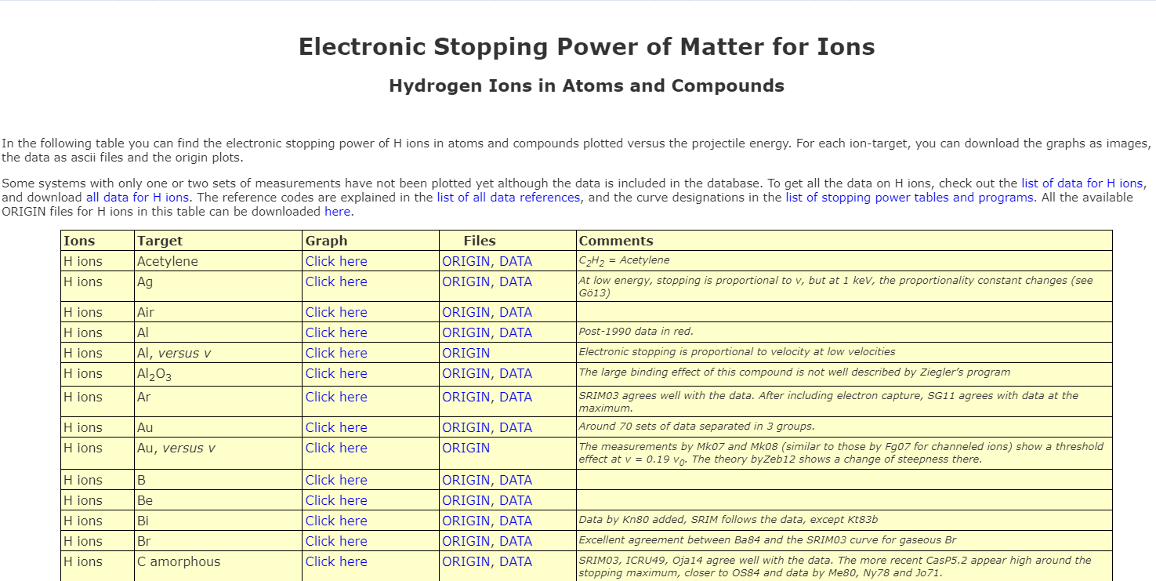
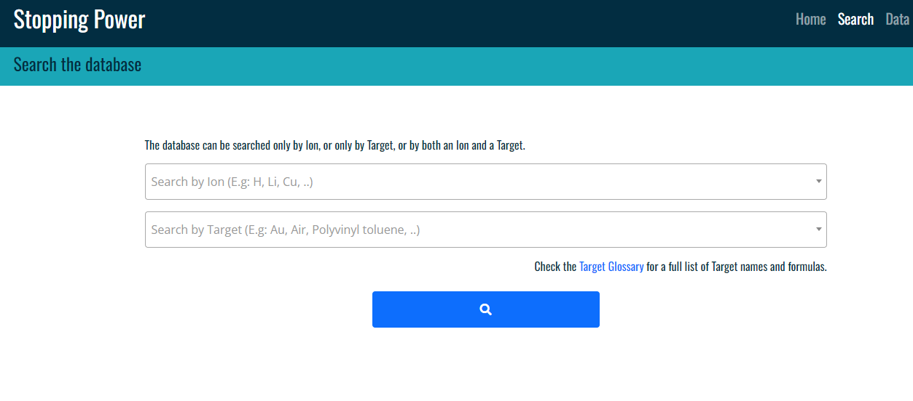
Data Development Projects - ongoing
Stopping Powers: consultant Claudia Montanari
    New: Modernization of stopping power database and retrieval interface (Wed talk)
    New: Display of all stopping data even if only one measurement was performed - requires verification and new SRIM calculations
    Continuous update of experimental stopping data since 2015 (2-3 times a year)
    New Reference article:
    The IAEA electronic stopping power database: Modernization, review, and analysis of the existing experimental data,
    C.C. Montanari, P. Dimitriou, L. Marian, A.M.P. Mendez, J.P. Peralta, F. Bivort-Haiek, Nucl. Instrum. Methods Phys. Res. B 551 (2024)165336,
    https://doi.org/10.1016/j.nimb.2024.165336
In collaboration with Ludmila Marian

Slide 31
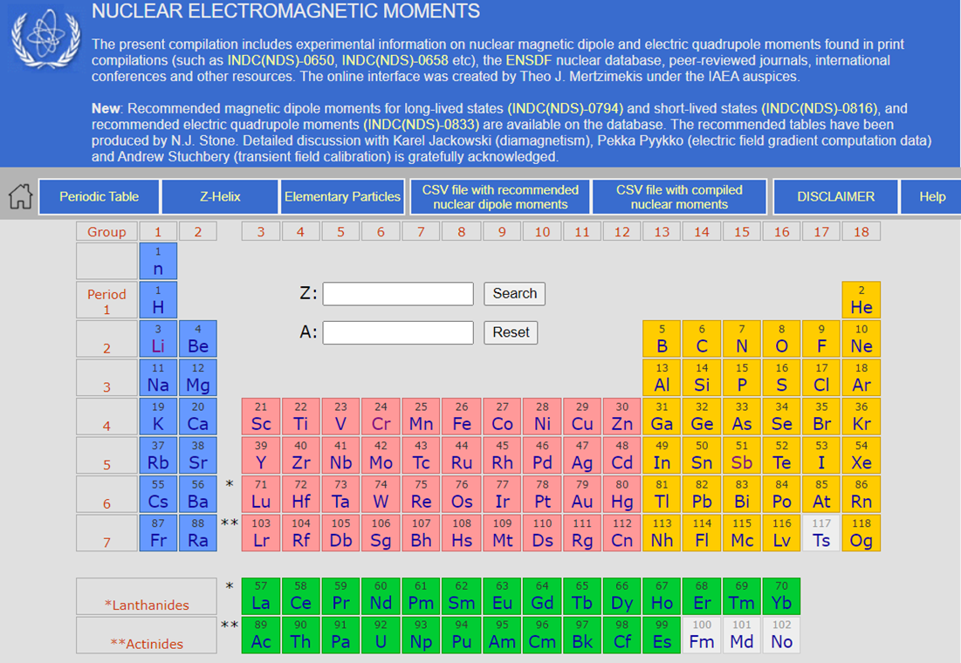
Data Development Projects - ongoing
Nuclear Moments: consultant Nick Stone
    New: Updating of compiled experimental nuclear moments,
      completed, to be published and uploaded
    Evaluation of Magnetic Dipole Moments for Long-lived states: INDC(NDS)-0794 (2019)
    Evaluation of Magnetic Dipole Moments for Short-Lived states: INDC(NDS)-0816 (2020)
    Tables of recommended Electric Quadrupole Moments: INDC(NDS)-0833 (2021)
In collaboration with Marco Verpelli

Slide 32
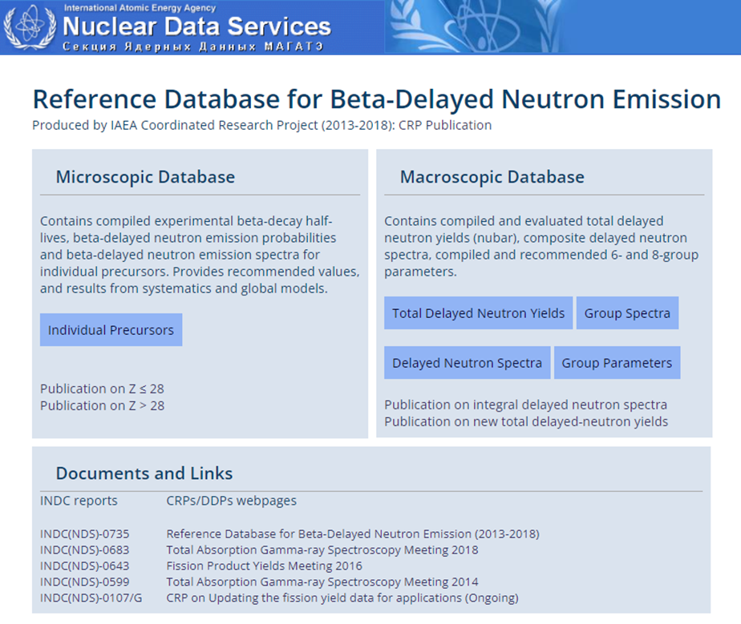
Data Development Projects – ongoing
Beta-delayed neutrons: microscopic, consultant Balraj Singh†
    New: update of Z>28 covering Aug.2020 – Jan. 2022, 56 nuclides
    Ongoing: update pf Z>57 covering Aug. 2020 – April 2023, 118 nuclides, 3 papers; TO BE UPLOADED
    Ongoing: update Z<28 covering Aug. 2015 – April 2023, 242 nuclides, 41 papers; TO BE UPLOADED
In collaboration with Marco Verpelli

Slide 33
Data Development Projects – ongoing
Decay Data for Monitoring Applications (2019 – 2024)
  Monitoring applications: associated with detecting nuclear explosions
  Radionuclide monitoring: measuring radioactivity in atmosphere
Objective: create a decay data library with up-to-date recommended data for radionuclides used in monitoring applications; Collaboration with CTBTO IDC staff
Output:
  data library containing decay and atomic radiation data in ENSDF (and other formats), CSV, etc.
  Publication
Participants: J. Chen (FRIB/MSU), V. Dimitiou (IAEA), T. Kibedi (ANU), F. Kondev (ANL), S. Lalkovski (U. Sofia), A. Negret (IFIN-HH), A. Nichols (U. Surrey), S. Pascu (IFIN-HH), B. Singh (deceased), J. Tuli (retired), M. Verpelli (IAEA)
Codes: J. Chen (FRIB/MSU), T. Kibedi (ANU), M. Verpelli (IAEA)
International Data Center @ CTBTO

Slide 34
Top CTBTO Priority:
30 fission products + noble gases ^{133,133m,135}Xe
Radionuclides | Half-Life |  |  | Decay mode
Zr-95 | 64 |  | d | B-
Nb-95 | 35 |  | d | B-
Zr-97 | 17 |  | h | B-
Mo-99 | 66 |  | h | B-
Ru-103 | 39 1/4 |  | d | B-
Rh-105 | 35 1/3 |  | h | B-
Ru-106 | 373 3/5 |  | d | B-
Cd-115m | 44 3/5 |  | d | B-,IT
Cd-115 | 53 1/2 |  | h | B-
Sb-126 | 12 1/2 |  | d | B-
Sb-127 | 3 6/7 |  | d | B-
Te-131m | 30 |  | h | B-,IT
I-131 | 8 |  | d | B-
I-133 | 20 4/5 |  | h | B-
Xe-133 |  |  | d | B-
Xe-133m |  |  | d | B-
Xe-135 |  |  | h | B-
Te-132 | 3 1/5 |  | d | B-
Cs-136 | 13 1/6 |  | d | B-
Cs-137 | 30 |  | y | B-
Ba-140 | 12 3/4 |  | d | B-
La-140 | 1 2/3 |  | d | B-
Ce-139 |  |  | d | EC
Ce-141 | 32 1/2 |  | d | B-
Ce-143 | 33 |  | h | B-
Ce-144 | 284 8/9 |  | d | B-
Nd-147 | 11 |  | d | B-
Nb-97 | 72.1 |  | m | B-
Rh-106 | 30.07 |  | s | B-
Te-127 | 9.35 |  | h | B-
I-132 | 2.295 |  | h | B-
Pr-143 | 13.57 |  | d | B-
Pr-144 | 17.28 |  | m | B-
Meetings
Kick-off meeting: IAEA, 6-8 May 2019
1st Virtual Meeting: 12 May 2020
2nd Virtual Meeting: 25-27 Aug. 2020
3rd Virtual Meeting: 16 November 2020
4th Virtual Meeting: 17 December 2020
2nd IAEA TM, 24-26 March 2021: INDC(NDS)-0828
3rd IAEA TM, 18-21 July 2022: INDC(NDS)-0851
Final IAEA TM, 23-25 Oct 2023: INDC(NDS)-0890
Evaluation work
establish evaluation policies and procedures - comprehensive decay data evaluation methodology was adopted by the participants
evaluate the decay data sets from “scratch” – not blindly copying from ENSDF or DDEP
review process (by participants) and final editorial review (by the coordinator)
Decay data evaluation:
Parent: Ex, Jp, T1/2 and Q value
Daughter:
➜ Levels: Ex, Jp, and T1/2
➜ Gammas: Eg, Ig (absolute), Mult, d, and aT
➜ Beta/EC properties: absolute emission probabilities
➜ Beta/EC derived properties (log ft, Eave & spectra): calculated using the BETASHAPE code (X. Mougeot, LHNB-CEA-Saclay)
➜ Atomic radiation data and spectra derived properties (energies, intensities & spectra for X rays & conversion and Auger e-): calculated using the BrIccEmis code (T. Kibedi, ANU)
Status:
All evaluations, including reviews and post-review revisions, to be completed by the end of 2024
⇒ Completed library will be available in early 2025
⇒ Publication in ADNDT is envisioned in 2025
⇒ Library is not only relevant to radionuclide monitoring, but can be used in other applications, i.e. nonproliferation, nuclear reactor monitoring, medical applications, etc.

Slide 35
Data Development Projects – ongoing
Evaluation of Photon Strength Functions (2022+)
  Follow-up of CRP on Generating Photon Strength Functions (2016-2019)
Objective: recommend best photon strength function data – evaluated PSF
Output:
  Evaluated PSF
  Systematics of PSF
  PSF web retrieval
Participants: O. Gorbachenko (Kiev U), S. Goriely (ULB), V. Ingeborg (Oslo U), J. Kopecky (JUKO), M. Krticka (Charles U), V. Plujko (Kiev U), R. Schwegner (H), M. Wiedeking (iThemba Labs – now LBNL)
PSF Web retrieval: S. Jongile (iThemba Labs), L. Marian (IAEA), P. Dimitriou (IAEA) (Wed talk)
Meetings:
  28 Nov – 1 Dec 2022: INDC(NDS)-0869; https://www-nds.iaea.org/index-meeting-crp/PSFmeeting2022/
  9 – 11 Oct. 2023: INDC(NDS)-0889; https://conferences.iaea.org/event/365/

Slide 36
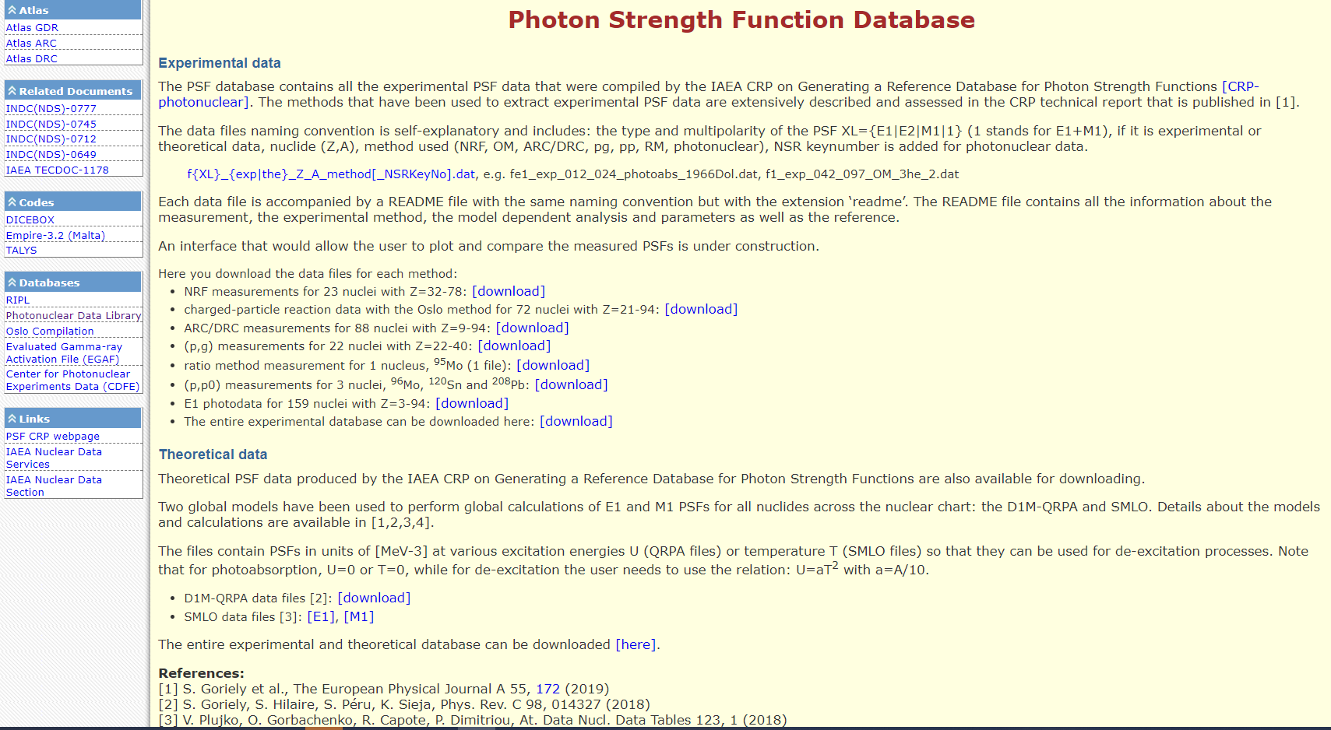
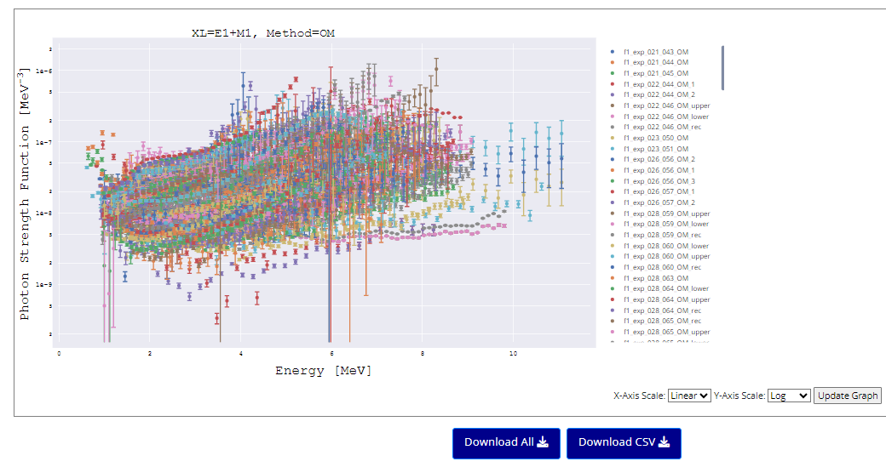
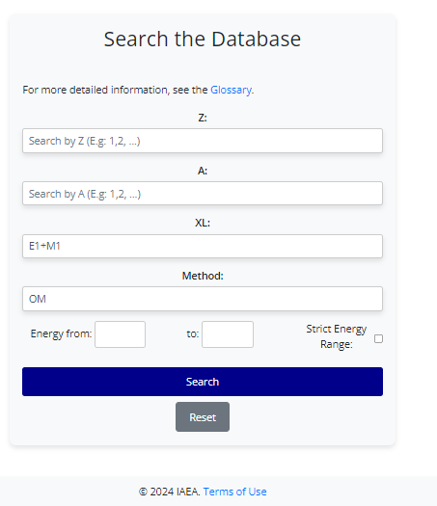
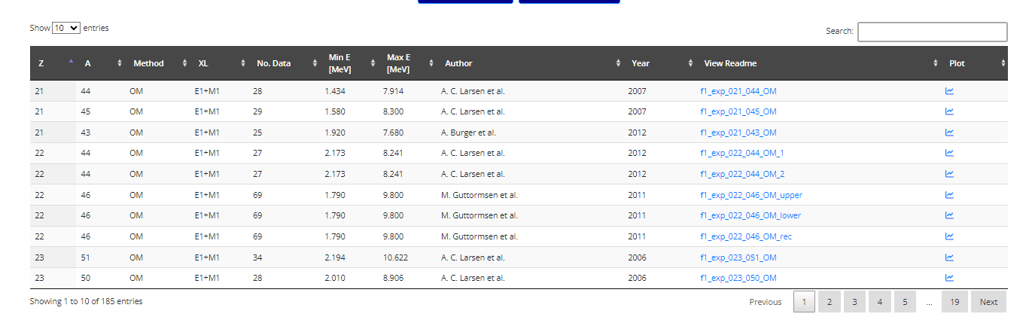
From a static download webpage to an interactive, user-friendly retrieval interface

Slide 37
From a static download webpage to an interactive, user-friendly retrieval interface
PSF database is maintained continuously:
ARC, DRC, and THC data have been updated since v. 2019
A new complete update of all methods (ARC, DRC, THC, NRF, OM, PG, PP, RM, Photonuclear) is ready to be released (v. 2024)

Slide 38
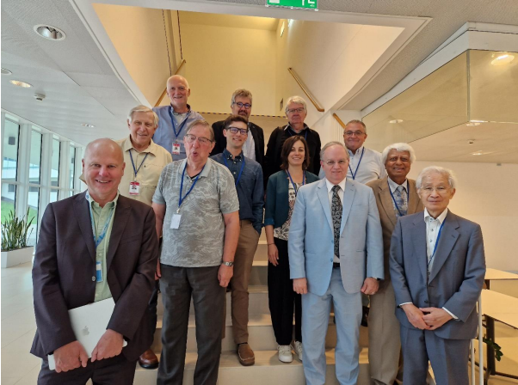
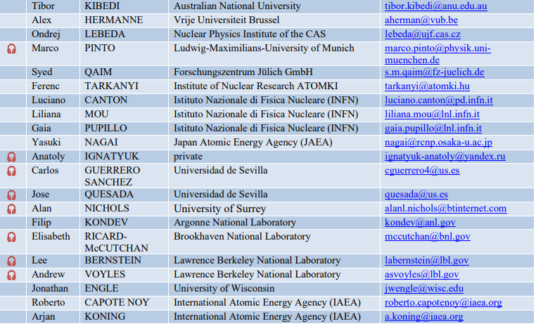
Technical Meeting on Nuclear Data for Medical Applications, 28 -31 Aug 2023
21 participants incl. IAEA
14 presentations
Summary report: INDC(NDS)-0884
Topics
Charged particle-induced reactions
  Insufficient measured data
  Reactions producing radioisotope impurities
  Validation of reaction data
Neutral particle-induced reactions
Theoretical models
Measurements and evaluations of decay data
External beam therapy (proton; carbon; ⁴He)

Slide 39
Technical Meeting on Nuclear Data for Medical Applications, cont’d
Recommendations for the next 5-10 yrs and beyond
New measurements of specific clinical radionuclides:
  ²²⁶Ra(p,2n)²²⁵Ac reaction: to resolve observed discrepancies in the quantification of the gamma-ray emissions of daughters at equilibrium.
  ⁶⁴Cu: positron and 1345.77-keV gamma-ray intensities to resolve discrepancies.
  ⁸⁶Y: positron intensity to resolve discrepancies.
  ¹²⁴I: positron intensity to resolve discrepancies.
  ^{99m}Tc: decay data requires new evaluation as support for Auger-electron calculations.
  ^{72,74}As and ¹⁵²Tb: new measurements and evaluation of reaction and decay data.
  ⁵¹Mn: re-assessment of reaction and decay data
  ¹⁶¹Tb: Auger yield and multiplicity, X-ray and conversion-electron data require assessment to determine the need for further measurements and evaluation.
  ^{149,152,155}Tb: new measurements or evaluations of decay data depending on potential usage.

Slide 40
Technical Meeting on Nuclear Data for Medical Applications, cont’d
Reactions producing problematic radioisotope impurities
  Prioritize in current and future measurements and evaluations
  Incorporate these evaluations into the IAEA Medical Portal
  Priority list of such radionuclides was produced
Validation of current and future cross-section measurements with measurements of integral target yields
International meeting on nuclear reaction and decay data that are required in microdosimetry and Monte-Carlo calculations to characterize Auger-electron emissions
Engage leading users in these fields - the Society for Nuclear Medicine and Molecular Imaging, the European Association of Nuclear Medicine and Molecular Imaging, and the Society for Radiopharmaceutical Science - to emphasize the importance of nuclear data to application-orientated work
Enhance support for training workshops and schools to maintain and develop highly necessary nuclear data expertise

Slide 41
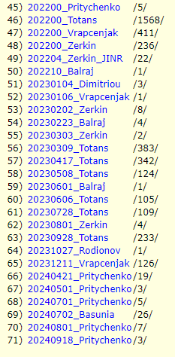
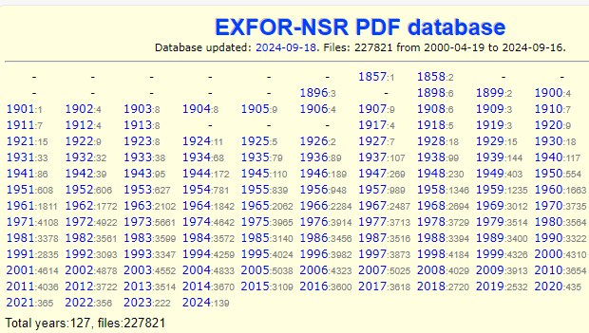
Useful resources
DOI links: all IAEA reports (INDC(NDS)
MyENSDF Webtools: maintained upon
demand
X4-NSR PDF database:
  is maintained – Lidija Vrapcenjak
Evaluators are urged to contribute their PDF files

Slide 42
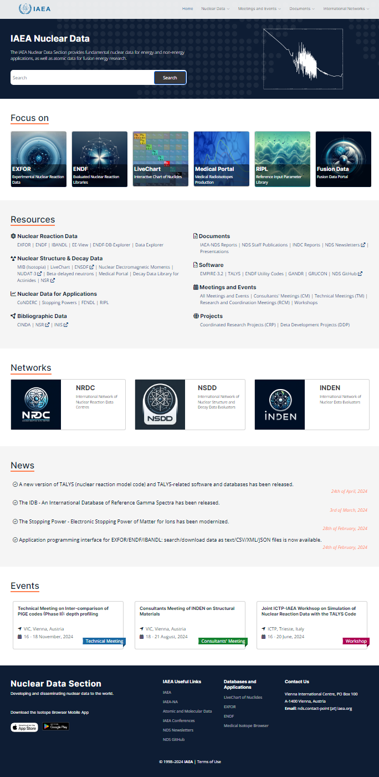
NDS website development (Ludmila Marian and Shin Okumura)
Still subject to changes!!!

Slide 43
Meetings in 2025
TM on Uncertainty Quantification (gathering experts from different fields)
TM on updating the evaluation of nuclear charge radii – last evaluation published in 2013 (Angeli and Marinova): 27-31 Jan 2025
Advanced ENSDF evaluators workshop: for active ENSDF evaluators (not beginners)
ICTP-IAEA Workshop: proposal submitted for 2025
TM on nuclear reactions on unstable targets: new measurement techniques, models, and evaluations
Series of webinars on Stopping Powers

Slide 44
Thank you!
Notes:
Thank you!

