Slide 1
Texas A&M University Cyclotron Institute
TAMU EVALUATION CENTER
USNDP Report FY 2024
N. Nica

Slide 2
Evaluation of Nuclear Structure and Decay Data OVERVIEW
Scope:
Promote and accomplish mass-chain nuclear structure data evaluation at Texas A&M University - Cyclotron Institute as regular activity and foresee future developments.
Address gaps in data through targeted experiments
Promote data-based research
2005-2017: under contract with BNL/NNDC
67% FTE Mass Chain Evaluation
N. Nica (PI, evaluator), J.C. Hardy (scientific adviser)
2018-2024: NSDD Data Center
FY2018: 67% FTE Mass Chain Evaluation
FY2019-2024: 100% FTE Mass Chain Evaluation
N. Nica (PI, evaluator), J.C. Hardy (scientific adviser)

Slide 3
Texas A&M - Cyclotron Institute NSDD Center Contributions
Major Direct Contribution to USNDP/NSDD: Nuclear Data Evaluation
19 publications
Important Contribution to USNDP/NSDD: Precision ICC Measurements
BrIcc adopted the “Frozen Orbitals” calculations
⁹³Nb, ¹⁰³Rh, ¹²⁵Te, ¹²⁷Te, ¹¹¹Cd, ¹¹⁹Sn, ¹³⁴Cs, ¹³⁷Ba, ¹⁹¹Os, ¹⁹³Ir, ¹⁹⁷Pt
18 publications
Texas A&M Contribution to Precision Nuclear Data Production: Precision β-γ Measurements (Standard Model, CKM matrix)
T_{1/2} , Branching Ratios, Efficiency calibration
21 publications
Texas A&M Medical Radioisotopes
⁶⁷Cu, ⁹⁹Mo
4 publications
Double Helix Level Schemes: Mesoscopic Paradigm of Rotational Nuclei
2 publications

Slide 4
Mass Chain Evaluation: 328 nuclei, 23 A-chains
1. N.Nica, Nuclear Data Sheets for A = 252, Nucl.Data Sheets 106, 813 (2005)
8 nuclei: ²⁵²Cm, ²⁵²Bk, ²⁵²Cf, ²⁵²Es, ²⁵²Fm, ²⁵²Md, ²⁵²No, ²⁵²Lr
2. N.Nica, Nuclear Data Sheets for A = 140, Nucl.Data Sheets 108, 1287 (2007)
16 nuclei: ¹⁴⁰Te, ¹⁴⁰I, ¹⁴⁰Xe, ¹⁴⁰Cs, ¹⁴⁰Ba, ¹⁴⁰La, ¹⁴⁰Ce, ¹⁴⁰Pr, ¹⁴⁰Nd, ¹⁴⁰Pm, ¹⁴⁰Sm, ¹⁴⁰Eu, ¹⁴⁰Gd, ¹⁴⁰Tb, ¹⁴⁰Dy, ¹⁴⁰Ho
3. D.Abriola et al., Nuclear Data Sheets for A = 84, Nucl.Data Sheets 110, 2815 (2009)
1 nucleus: ⁸⁴Y
4. N.Nica, Nuclear Data Sheets for A = 147, Nucl.Data Sheets 110, 749 (2009)
16 nuclei: ¹⁴⁷Xe, ¹⁴⁷Cs, ¹⁴⁷Ba, ¹⁴⁷La, ¹⁴⁷Ce, ¹⁴⁷Pr, ¹⁴⁷Nd, ¹⁴⁷Pm, ¹⁴⁷Sm, ¹⁴⁷Eu, ¹⁴⁷Gd, ¹⁴⁷Tb, ¹⁴⁷Dy, ¹⁴⁷Ho, ¹⁴⁷Er, ¹⁴⁷Tm
5. N.Nica, Nuclear Data Sheets for A = 97, Nucl.Data Sheets 111, 525 (2010)
14 nuclei: ⁹⁷Br, ⁹⁷Kr, ⁹⁷Rb, ⁹⁷Sr, ⁹⁷Y, ⁹⁷Zr, ⁹⁷Nb, ⁹⁷Mo, ⁹⁷Tc, ⁹⁷Ru, ⁹⁷Rh, ⁹⁷Pd, ⁹⁷Ag, ⁹⁷Cd
6. J.Cameron, J.Chen, B.Singh, N.Nica, Nuclear Data Sheets for A = 37, Nucl.Data Sheets 113, 365 (2012)
10 nuclei: ³⁷Na, ³⁷Mg, ³⁷Al, ³⁷Si, ³⁷P, ³⁷S, ³⁷Cl, ³⁷Ar, ³⁷K, ³⁷Ca
7. N.Nica, J.Cameron, B.Singh, Nuclear Data Sheets for A = 36, Nucl.Data Sheets 113, 1 (2012)
10 nuclei: ³⁶Na, ³⁶Mg, ³⁶Al, ³⁶Si, ³⁶P, ³⁶S, ³⁶Cl, ³⁶Ar, ³⁶K, ³⁶Ca
8. N.Nica, B.Singh, Nuclear Data Sheets for A = 34, Nucl.Data Sheets 113, 1563 (2012)
11 nuclei: ³⁴Ne, ³⁴Na, ³⁴Mg, ³⁴Al, ³⁴Si, ³⁴P, ³⁴S, ³⁴Cl, ³⁴Ar, ³⁴K, ³⁴Ca
9. B.Singh, N.Nica, Nuclear Data Sheets for A = 77, Nucl.Data Sheets 113, 1115 (2012)
12 nuclei: ⁷⁷Ni, ⁷⁷Cu, ⁷⁷Zn, ⁷⁷Ga, ⁷⁷Ge, ⁷⁷As, ⁷⁷Se, ⁷⁷Br, ⁷⁷Kr, ⁷⁷Rb, ⁷⁷Sr, ⁷⁷Y
10. N.Nica, Nuclear Data Sheets for A = 148, Nucl.Data Sheets 117, 1 (2014)
16 nuclei: ¹⁴⁸Xe, ¹⁴⁸Cs, ¹⁴⁸Ba, ¹⁴⁸La, ¹⁴⁸Ce, ¹⁴⁸Pr, ¹⁴⁸Nd, ¹⁴⁸Pm, ¹⁴⁸Sm, ¹⁴⁸Eu, ¹⁴⁸Gd, ¹⁴⁸Tb, ¹⁴⁸Dy, ¹⁴⁸Ho, ¹⁴⁸Er, ¹⁴⁸Tm
11. N.Nica, Nuclear Data Sheets for A = 141, Nucl.Data Sheets 122, 1 (2014)
16 nuclei: ¹⁴¹Te, ¹⁴¹I, ¹⁴¹Xe, ¹⁴¹Cs, ¹⁴¹Ba, ¹⁴¹La, ¹⁴¹Ce, ¹⁴¹Pr, ¹⁴¹Nd, ¹⁴¹Pm, ¹⁴¹Sm, ¹⁴¹Eu, ¹⁴¹Gd, ¹⁴¹Tb, ¹⁴¹Dy, ¹⁴¹Ho
12. N.Nica, Nuclear Data Sheets for A = 157, Nucl.Data Sheets 132, 1 (2016)
15 nuclei: ¹⁵⁷Nd, ¹⁵⁷Pm, ¹⁵⁷Sm, ¹⁵⁷Eu, ¹⁵⁷Gd, ¹⁵⁷Tb, ¹⁵⁷Dy, ¹⁵⁷Ho, ¹⁵⁷Er, ¹⁵⁷Tm, ¹⁵⁷Yb, ¹⁵⁷Lu, ¹⁵⁷Hf, ¹⁵⁷Ta, ¹⁵⁷W
13. N.Nica, Nuclear Data Sheets for A = 158, Nucl.Data Sheets 141, 1 (2017)
15 nuclei: ¹⁵⁸Nd, ¹⁵⁸Pm, ¹⁵⁸Sm, ¹⁵⁸Eu, ¹⁵⁸Gd, ¹⁵⁸Tb, ¹⁵⁸Dy, ¹⁵⁸Ho, ¹⁵⁸Er, ¹⁵⁸Tm, ¹⁵⁸Yb, ¹⁵⁸Lu, ¹⁵⁸Hf, ¹⁵⁸Ta, ¹⁵⁸W
14. N.Nica, Nuclear Data Sheets for A = 140, Nucl.Data Sheets 154, 1 (2018)
17 nuclei: ¹⁴⁰Sb, ¹⁴⁰Te, ¹⁴⁰I, ¹⁴⁰Xe, ¹⁴⁰Cs, ¹⁴⁰Ba, ¹⁴⁰La, ¹⁴⁰Ce, ¹⁴⁰Pr, ¹⁴⁰Nd, ¹⁴⁰Pm, ¹⁴⁰Sm, ¹⁴⁰Eu, ¹⁴⁰Gd, ¹⁴⁰Tb, ¹⁴⁰Dy, ¹⁴⁰Ho
15. N.Nica, A =155, Nuclear Data Sheets for A = 155, Nucl.Data Sheets 160, 1 (2019)
16 nuclei: ¹⁵⁵Ce, ¹⁵⁵Pr, ¹⁵⁵Nd, ¹⁵⁵Pm, ¹⁵⁵Sm, ¹⁵⁵Eu, ¹⁵⁵Gd, ¹⁵⁵Tb, ¹⁵⁵Dy, ¹⁵⁵Ho, ¹⁵⁵Er, ¹⁵⁵Tm, ¹⁵⁵Yb, ¹⁵⁵Lu, ¹⁵⁵Hf, ¹⁵⁵Ta
16. N.Nica, A =153, Nuclear Data Sheets for A = 153, Nucl.Data Sheets 170, 1 (2020)
16 nuclei: ¹⁵³La, ¹⁵³Ce, ¹⁵³Pr, ¹⁵³Nd, ¹⁵³Pm, ¹⁵³Sm, ¹⁵³Eu, ¹⁵³Gd, ¹⁵³Tb, ¹⁵³Dy, ¹⁵³Ho, ¹⁵³Er, ¹⁵³Tm, ¹⁵³Yb, ¹⁵³Lu, ¹⁵³Hf
17. N.Nica, A =160, Nuclear Data Sheets for A = 160, Nucl.Data Sheets 176, 1 (2021)
17 nuclei: ¹⁶⁰Pr, ¹⁶⁰Nd, ¹⁶⁰Pm, ¹⁶⁰Sm, ¹⁶⁰Eu, ¹⁶⁰Gd, ¹⁶⁰Tb, ¹⁶⁰Dy, ¹⁶⁰Ho, ¹⁶⁰Er, ¹⁶⁰Tm, ¹⁶⁰Yb, ¹⁶⁰Lu, ¹⁶⁰Hf, ¹⁶⁰Ta, ¹⁶⁰W, ¹⁶⁰Re
18. N.Nica , B.Singh, Nuclear Data Sheets for A = 147, Nucl.Data Sheets 181, 1 (2022)
16 nuclei: ¹⁴⁷Xe, ¹⁴⁷Cs, ¹⁴⁷Ba, ¹⁴⁷La, ¹⁴⁷Ce, ¹⁴⁷Pr, ¹⁴⁷Nd, (¹⁴⁷Pm Balraj Singh), ¹⁴⁷Sm, ¹⁴⁷Eu, ¹⁴⁷Gd, ¹⁴⁷Tb, ¹⁴⁷Dy, ¹⁴⁷Ho, ¹⁴⁷Er, ¹⁴⁷Tm
19. N.Nica, Nuclear Data Sheets for A = 141, Nucl.Data Sheets 187, 1 (2023)
17 nuclei : ¹⁴¹Sb, ¹⁴¹Te, ¹⁴¹I, ¹⁴¹Xe, ¹⁴¹Cs, ¹⁴¹Ba, ¹⁴¹La, ¹⁴¹Ce, ¹⁴¹Pr, ¹⁴¹Nd, ¹⁴¹Pm, ¹⁴¹Sm, ¹⁴¹Eu, ¹⁴¹Gd, ¹⁴¹Tb, ¹⁴¹Dy, ¹⁴¹Ho

Slide 5
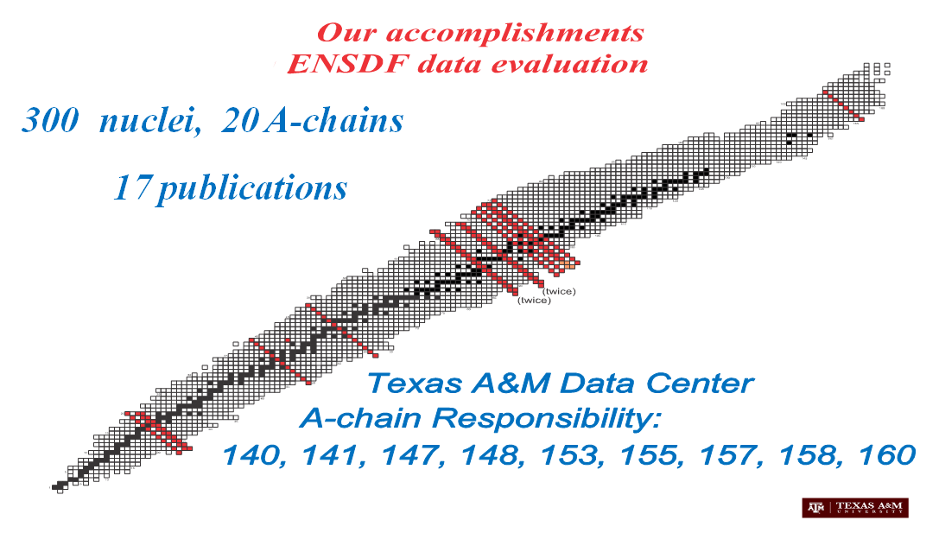
Mass Chain Evaluation: 328 nuclei, 23 A-chains
20. N.Nica, Nuclear Data Sheets for A = 162, Nucl.Data Sheets 195, 1 (2024)
17 nuclei: ¹⁶²Nd, ¹⁶²Pm, ¹⁶²Sm, ¹⁶²Eu, ¹⁶²Gd, ¹⁶²Tb, ¹⁶²Dy, ¹⁶²Ho, ¹⁶²Er, ¹⁶²Tm, ¹⁶²Yb, ¹⁶²Lu, ¹⁶²Hf, ¹⁶²Ta, ¹⁶²W, ¹⁶²Re, ¹⁶²Os
21. N.Nica, Nuclear Data Sheets for A = 154 – Post-review
17 nuclei: ¹⁵⁴Ba, ¹⁵⁴La, ¹⁵⁴Ce, ¹⁵⁴Pr, ¹⁵⁴Nd, ¹⁵⁴Pm, ¹⁵⁴Sm, ¹⁵⁴Eu, ¹⁵⁴Gd, ¹⁵⁴Tb, ¹⁵⁴Dy, ¹⁵⁴Ho, ¹⁵⁴Er, ¹⁵⁴Tm, ¹⁵⁴Yb, ¹⁵⁴Lu, ¹⁵⁴Hf
22. N.Nica, Nuclear Data Sheets for A = 148 – Post-Review
17 nuclei: ¹⁴⁸Xe, ¹⁴⁸Cs, ¹⁴⁸Ba, ¹⁴⁸La, ¹⁴⁸Ce, ¹⁴⁸Pr, ¹⁴⁸Nd, ¹⁴⁸Pm, ¹⁴⁸Sm, ¹⁴⁸Eu, ¹⁴⁸Gd, ¹⁴⁸Tb, ¹⁴⁸Dy, ¹⁴⁸Ho, ¹⁴⁸Er, ¹⁴⁸Tm, ¹⁴⁸Yb
23. N.Nica, Nuclear Data Sheets for A = 156 – Submitted
18 nuclei: ¹⁵⁶La, ¹⁵⁶Ce, ¹⁵⁴Pr, ¹⁵⁶Nd, ¹⁵⁴Pm, ¹⁵⁶Sm, ¹⁵⁴Eu, ¹⁵⁶Gd, ¹⁵⁴Tb, ¹⁵⁶Dy, ¹⁵⁴Ho, ¹⁵⁶Er, ¹⁵⁴Tm, ¹⁵⁶Yb, ¹⁵⁴Lu, ¹⁵⁶Hf, ¹⁵⁴Ta, ¹⁵⁶W
SIZE IS HUGE!
VERY COMPLX
1 A-chain/FY
140, 141, 147, 148, 153, 155, 157, 158, 160, 154, 162
140, 141, 147, 148, 153, 155, 157, 158, 160, 154, 156, 162

Slide 6
Texas A&M - Cyclotron Institute NSDD Center FY2024
20. N.Nica, Nuclear Data Sheets for A = 162, Nucl.Data Sheets 195, 1 (2024), FY2021
17 nuclei: ¹⁶²Nd, ¹⁶²Pm, ¹⁶²Sm, ¹⁶²Eu, ¹⁶²Gd, ¹⁶²Tb, ¹⁶²Dy, ¹⁶²Ho, ¹⁶²Er, ¹⁶²Tm, ¹⁶²Yb, ¹⁶²Lu, ¹⁶²Hf, ¹⁶²Ta, ¹⁶²W, ¹⁶²Re, ¹⁶²Os
21. N.Nica, Nuclear Data Sheets for A = 154, – Post-review, FY2022
17 nuclei: ¹⁵⁴Ba, ¹⁵⁴La, ¹⁵⁴Ce, ¹⁵⁴Pr, ¹⁵⁴Nd, ¹⁵⁴Pm, ¹⁵⁴Sm, ¹⁵⁴Eu, ¹⁵⁴Gd, ¹⁵⁴Tb, ¹⁵⁴Dy, ¹⁵⁴Ho, ¹⁵⁴Er, ¹⁵⁴Tm, ¹⁵⁴Yb, ¹⁵⁴Lu, ¹⁵⁴Hf
22. N.Nica, Nuclear Data Sheets for A = 148 – Post-Review, FY2023
17 nuclei: ¹⁴⁸Xe, ¹⁴⁸Cs, ¹⁴⁸Ba, ¹⁴⁸La, ¹⁴⁸Ce, ¹⁴⁸Pr, ¹⁴⁸Nd, ¹⁴⁸Pm, ¹⁴⁸Sm, ¹⁴⁸Eu, ¹⁴⁸Gd, ¹⁴⁸Tb, ¹⁴⁸Dy, ¹⁴⁸Ho, ¹⁴⁸Er, ¹⁴⁸Tm, ¹⁴⁸Yb
23. N.Nica, Nuclear Data Sheets for A = 156 – Submitted, FY2024
17 nuclei: ¹⁵⁴La, ¹⁵⁴Ce, ¹⁵⁴Pr, ¹⁵⁴Nd, ¹⁵⁴Pm, ¹⁵⁴Sm, ¹⁵⁴Eu, ¹⁵⁴Gd, ¹⁵⁴Tb, ¹⁵⁴Dy, ¹⁵⁴Ho, ¹⁵⁴Er, ¹⁵⁴Tm, ¹⁵⁴Yb, ¹⁵⁴Lu, ¹⁵⁴Hf, ¹⁵⁴Ta
1. Review: A = 63, Review of full mass chain evaluation, FY2024
13 nuclei: ⁶³Ti, ⁶³V, ⁶³Cr, ⁶³Mn, ⁶³Fe, ⁶³Co, ⁶³Ni, ⁶³Cu, ⁶³Zn, ⁶³Ga, ⁶³Ge, ⁶³As, ⁶³Se

Slide 7
Texas A&M - Cyclotron Institute NSDD Center Mass chain evaluations: Statistics
 | A=162 Evaluation | A=154 Evaluation | A=148 Evaluation | A=156 Evaluation | A=200 Review | A=63 Review
Number of Adopted Levels | 1120 | 1256 | 1269 | 1255 | 518 | 1032
Number of Adopted Gammas | 1787 | 2604 | 2049 | 2260 | 899 | 1500
Number of nuclides | 17 | 17 | 17 | 18 | 12 | 13
Number of datasets | 86 | 86 | 97 | 84 | 67 | 108
Number of .ens lines | 21138 | 25401 | 19971 | 25819 | 11912 | 17280
NG/NL | 1.60 | 2.07 | 1.61 | 1.74 | 1.73 | 1.45

Slide 8
Mass chains: Review, Updates & Editorial
Mass Chain A160: FY2017
.ens database file | Number of Publications | Increment | CUT Date
A160_old | 368 |  | 1-Jun-2005
A160_new |  |  | 30-Sept-2017 (15-Aug-2018)
A160_upd.arv | 457 | +89 | 1-May-2021, 3y8m
Mass Chain A147: FY2019
.ens database file | Number of Publications | Increment | CUT Date
A147_old | 449 |  | 14-Nov-2008
A147_new |  |  | 9-Sept-2019
A147_upd.arv | 563 | +114 | 9-Mar-2022, 2y5m
Mass Chain A154: FY2022
.ens database file | Number of Publications | Increment | CUT Date
A154_old | 585 |  | 1-May-2008
A154_new | 630 | +45 | 22-Aug-2022
A154_upd.arv

Slide 9
Texas A&M - Cyclotron Institute NSDD Center Publications FY2024
2024Ni13 At. Data Nucl. Data Tables 160 (2024) 101682
N.Nica
Double helix level scheme of ¹⁷¹Yb nucleus
2024NI10 Nucl.Data Sheets 195, 1 (2024)
N.Nica
Nuclear Data Sheets for A=162

Slide 10
Texas A&M - Cyclotron Institute, NSDD Center Conferences FY2024
N. Nica, "Status of Texas A&M - Cyclotron Institute USNDP Evaluation Center," Nuclear Data Advisory Committee Meeting, Sept 2023, National Nuclear Data Center, Brookhaven National Laboratory, Upton, NY, USA
N. Nica, "TAMU NSDD EVALUATION CENTER Report Oct 2022 – Apr 2024“, 25th Technical Meeting of the Nuclear Structure and Decay Data Network, Apr 14, 2024, IAEA Vienna, Austria
N. Nica, "Data-Based Research Project: How to build a Level Scheme“, 25th Technical Meeting of the Nuclear Structure and Decay Data Network, Apr 18, 2024, IAEA Vienna, Austria
N. Nica, "Developing a New Visualization of High-Spin Level Schemes“, 25th Technical Meeting of the Nuclear Structure and Decay Data Network, Apr 22, 2024, National Institute for Physics and Nuclear Engineering “Horia Hulubei”, Bucharest, Romania – Invited lecture
N. Nica, "Could revisiting the principles of a level scheme bring new insight into high-spin physics?“, 7th Workshop of the Hellenic Institute of Nuclear Physics on Nuclear Structure, Astrophysics and Reaction Dynamics, HINPw7, June 1, 2024, Ioannina, Greece – Invited lecture

Slide 11
A-Chain Evaluation Currency @Texas A&M University
Responsibility:
140, 141, 147, 148, 153, 155, 157, 158, 160, 154, 162, 156
Status:
162 (Sep 2023, since Mar 2007)
141 (Oct 2022)
147 (Mar 2022)
160 (May 2021)
153 (Aug 2020)
155 (Oct 2019)
140 (Nov 2018)
158 (Feb 2017)
157 (Dec 2015)
154 (Aug 2022, post-review, since May 2008)
148 (Oct 2023, post-review)
156 (Mar 2024, submitted FY24, since Mar 2012)
Good Standing@Texas A&M University CI
HELP ENSDF CURRENCY

Slide 12
A-Chain Evaluation FY2024 @Texas A&M University
FY2025: A157 (4-Dec-2015 )
For next year:
Solve backlog:
-A154
-A148
Review A-chain evaluations
XUNDL (limited)
Personnel changes
Not foreseeable

Slide 13
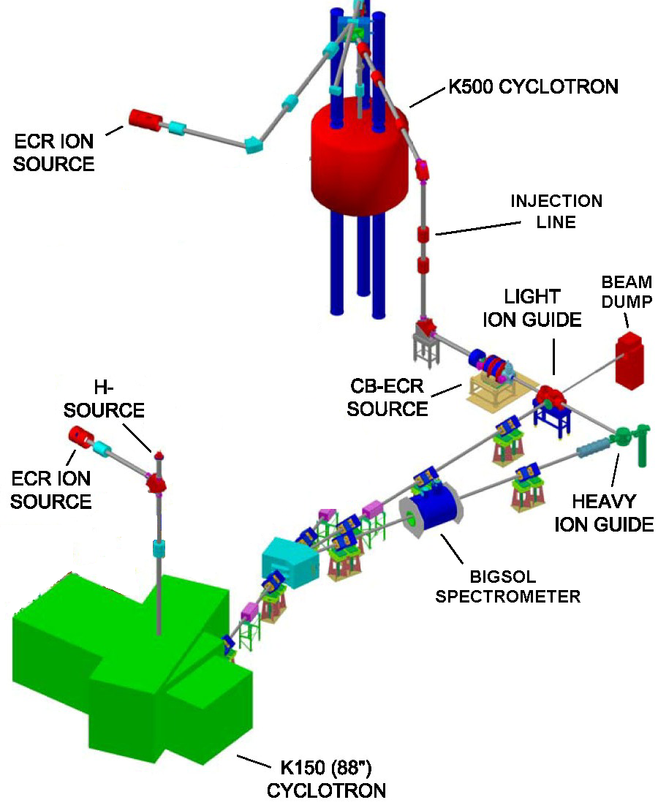
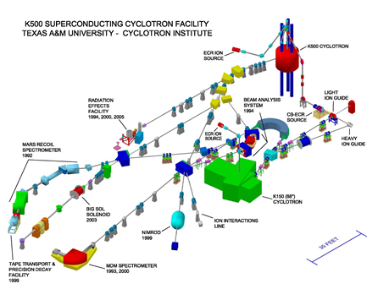
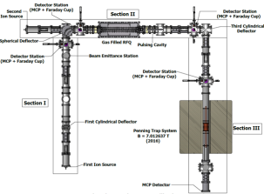
Texas A&M Evaluation Center: Data Evaluation Station at Cyclotron Radioactive Ion Beam Facility to assist experiments and pre-evaluate data
Focus on the Light-Ion Guide (LIG), the Heavy Ion Guide (HIG) and the Charge-Breeding Electron-Cyclotron-Resonance ion source (CB-ECRIS).
TAMUTRAP

Slide 14
Texas A&M NSDD Evaluation Center Strategic Priorities
Continuing ENSDF Mass Chain Evaluation
First Strategic Priority according to the Mission Statement.
All other priorities will be strictly subordinated to this purpose
Produce experimental nuclear data to aid data evaluation
Precision βγ Spectroscopy for T_{1/2} and BR for Standard Model
Reevaluation of data procedures for basic science and data evaluation
Level scheme re-concept based on Repeatability
Second Strategic Priority according to the Mission Statement.
Extend study on multiple level schemes and define mesoscopic paradigm for rotational nuclei

