Slide 1
The strange behavior of the ⁷Be lifetime
J.H. Kelley (NCSU)

Slide 2
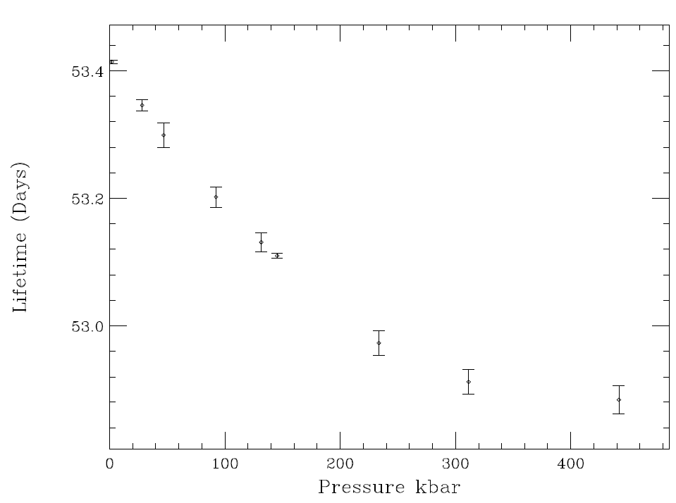
The lifetime can show tremendous variation depending on the environment

Slide 3
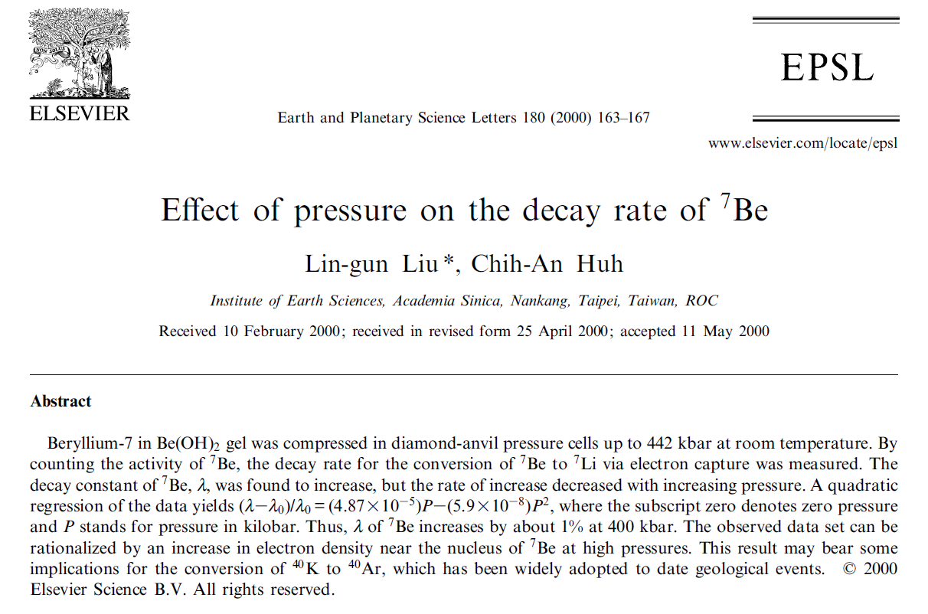
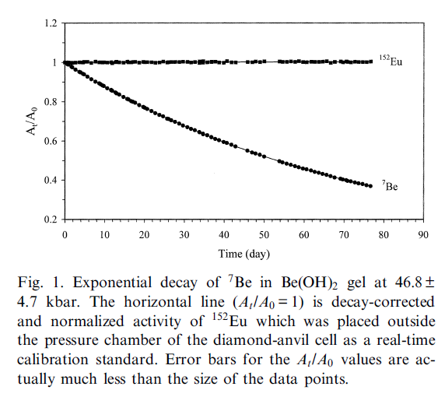
Evaluation Accomplishments

Slide 4
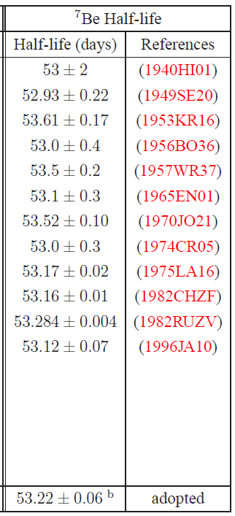
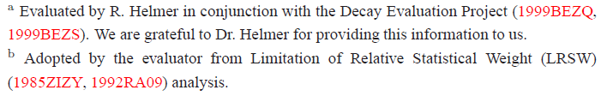
Present Value: Accepted since 2002

Slide 5
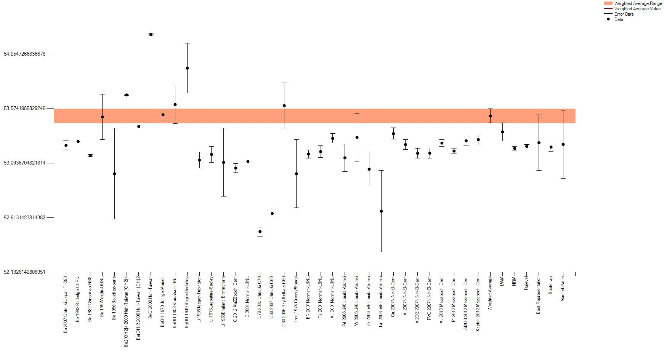
All lifetime measurements.
Oxide and Hydroxide molecules
Produced by reactions
No consensus
C-60 and C-70 Fullerenes
Metallic
7Be
7Be implanted in metal

Slide 6
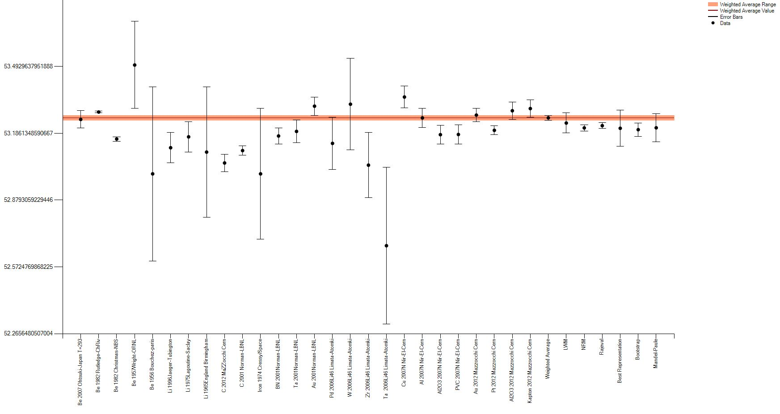
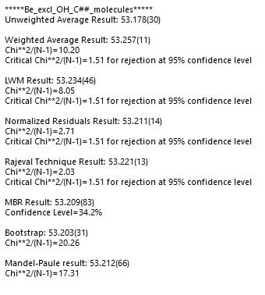
Excluding Molecular results (oxides, hydroxides, Fullerenes)
Some consensus
Christmas-National Bureau of Standards
Rutledge-Chalk River
1982RuZV
Rutledge Chalk River
T=53.284 +/- 0.004 days
1982ChZF
Christmas NBS
T=53.16 +/- 0.01 days

Slide 7
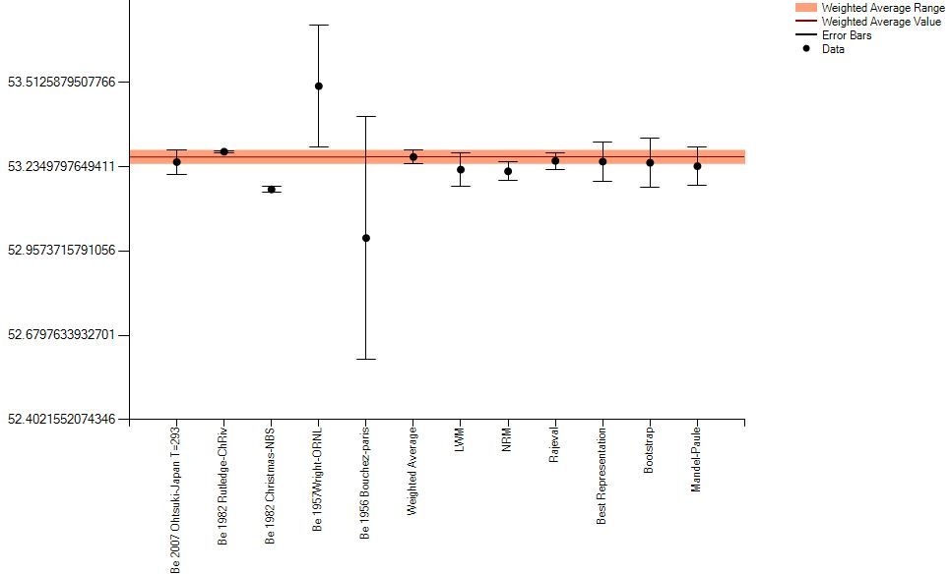
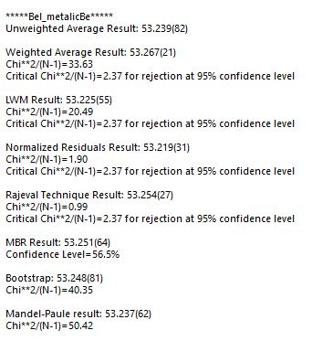
Only metallic Be
Some variation
T=53.23 (dominated by 1982 Rutledge)

Slide 8
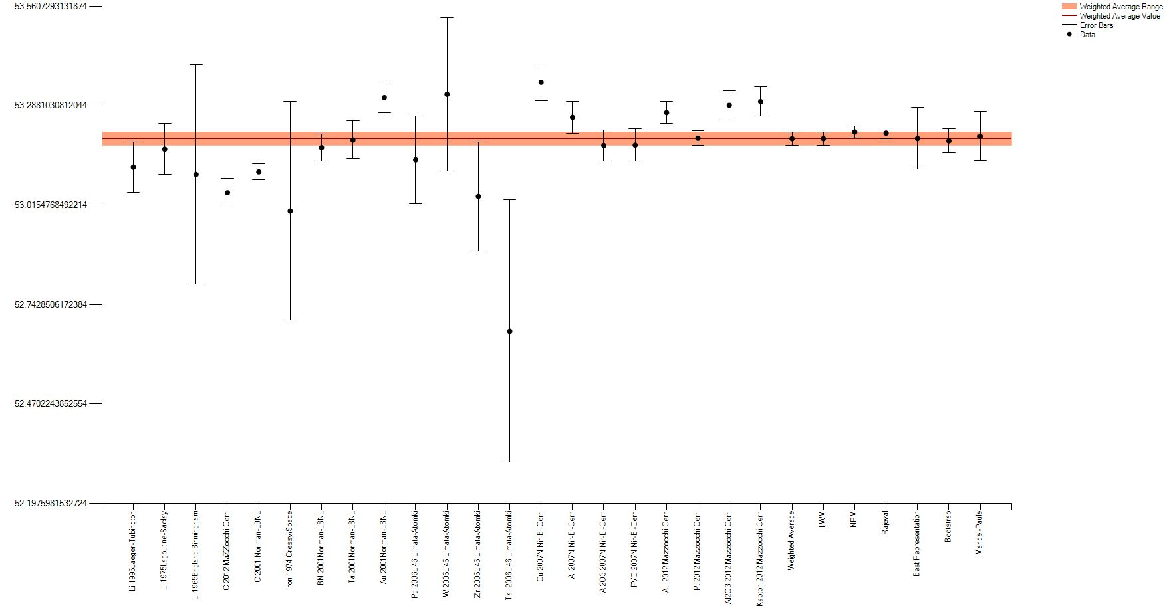
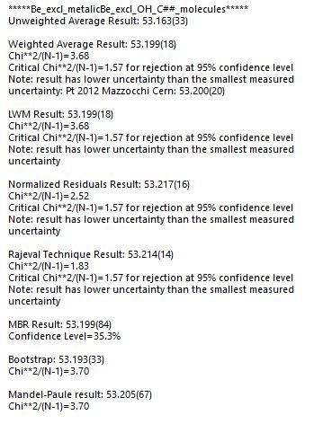
Produced in target and Implanted measurements
T=53.22 days

Slide 9
Excluding Molecular results (oxides, hydroxides, Fullerenes)
Some consensus

Slide 10
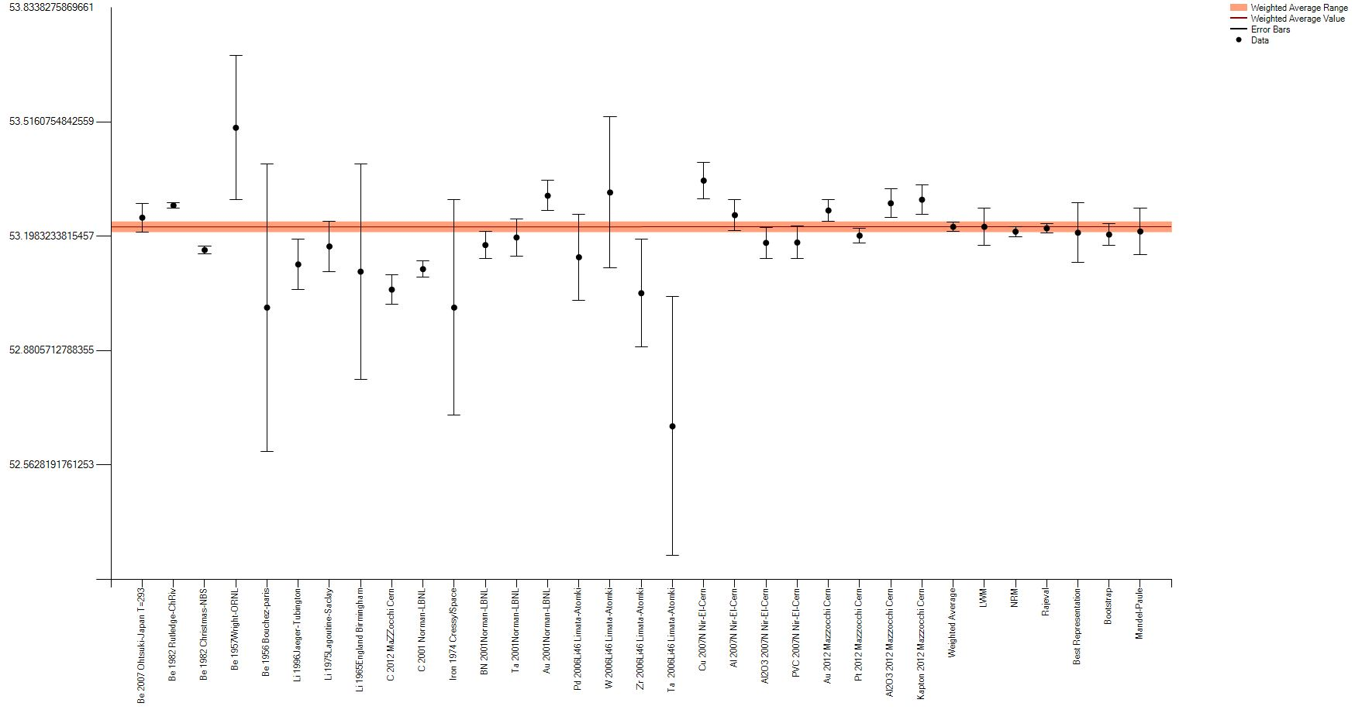
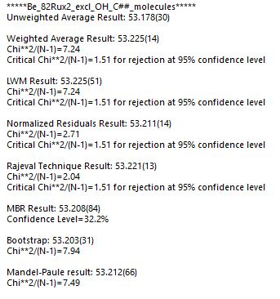
Excluding Molecular results *Small adjustment to Rutledge
2*dT 1982 Rutledge
Better consensus

Slide 11
Comparing different scenerios
All Data (*excluding 2000Huh) T_{1/2}(LWM)=53.37 D 8
Excl Molecules T_{1/2}(LWM)=53.23 D 5 (WA)=53.26 D 1
Excl Molecules (2*DE Rutledge) T_{1/2}(LWM)=53.23 D 5 (WA)=53.23 D 1
Metalic Be T_{1/2}(LWM)=53.23 D 6 (WA)=53.27 D 2
Metalic Be (2*DE Rutledge) T_{1/2}(LWM)=53.23 D 5 (WA)=53.24 D 3
Implanted Be T_{1/2}(LWM)=53.20 D 2 (WA)=53.20 D 2

Slide 12
How to wrap it up?
2*dT 1982 Rutledge
Recommended value T_{1/2}(LWM)= 53.23 D 6
Helmer (DDEP) T_{1/2}(LWM)= 53.22 D 6

