Slide 1
Miscellanea on ENSDF Evaluation: Tools
N. Nica
Cyclotron Institute
Texas A&M University
College Station, Texas, USA

Slide 2
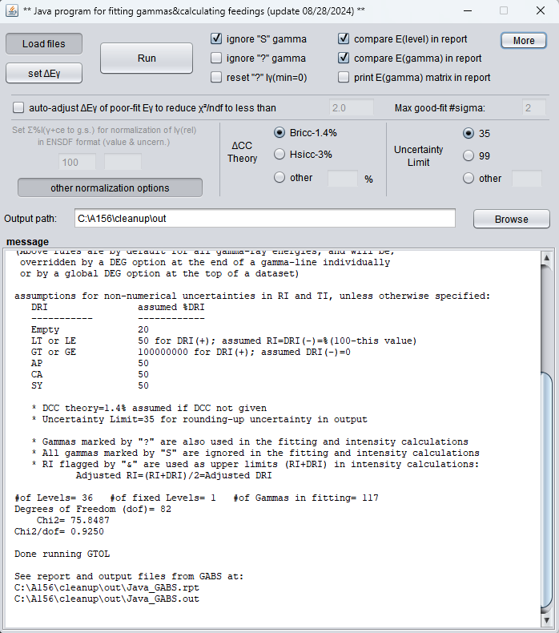
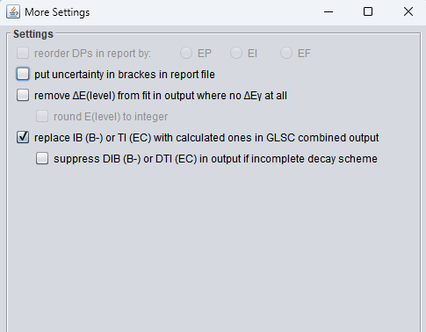
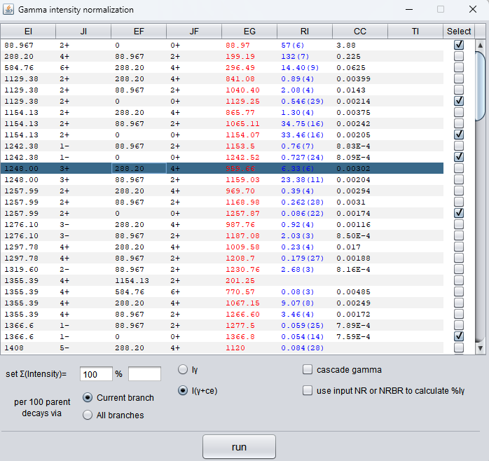
1. GLSC/GABS
Recent improvements in the “More” button
I strongly appreciate the new output called "GLSC_combined.out" which contains both the E(level) values from a GTOL fit and %IG continuation records from GABS calculations.
Proposal:
Mark by default the γ rays to g.s.
Add in the More Setting window option to remove the default marking of the γ rays to g.s.
Would be good to list the whole set of output files in the message window

Slide 3
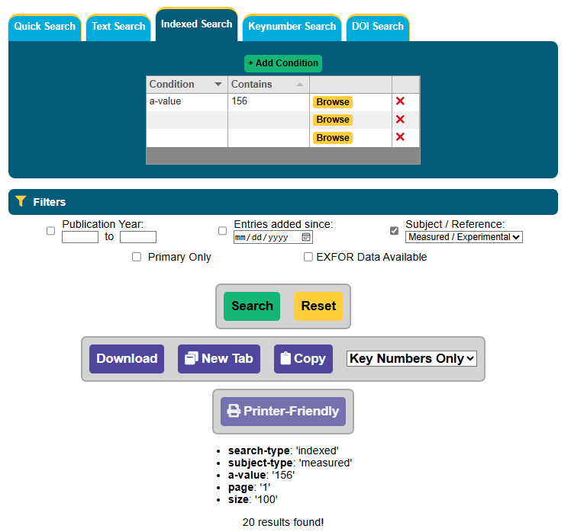
2. NSR - Indexed Search
Critical: There is no more “nuclide A=156” search as in the old NSR that gave all refs. with any of the A=156 nuclides. Condition “a-value” does not do that, which is misleading. Please re-implement it !!!
Important: Very useful “Printer-friendly” button is no longer working. (as it was, in HTML format) Please re-allow it
Search of “nica n” or “n nica” not working
Proposal:
Include all search conditions in the header of the Printer Friendly list (once re-allowed!)
Better diversify searching to all possibilities
“nica n” , “n nica”, etc (if any)

Slide 4
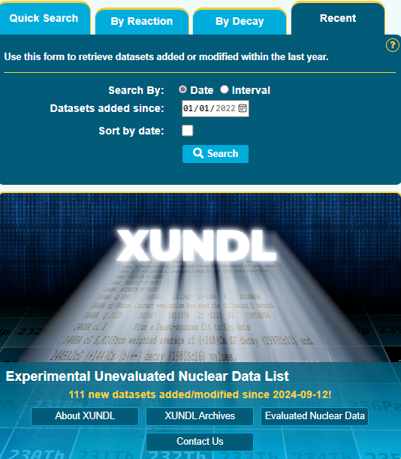
3. XUNDL Search
XUNDL “Quick Search” with “Mass” option produces all the XUNDL dataset for the selected mass chain
XUNDL “Recent” search for “Interval” option is limited to datasets added not earlier than 01/01/2022
ENSDF “Quick Search” with “Mass” option fortunately produces also the list with the links to the XUNDL dataset which came in after the last ENSDF publication, but this is also restrictive
Proposal:
Would it not be possible to extend the XUNDL search capability to look for XUNDL datasets added since a variable date?

Slide 5
4. Manage links
“Evaluators' Corner” page contains useful information especially for the USNDP and NSDD communities
When accessed from “Structure & Decay” menu it gives the correct page
When accessed from “Resources” menu, then “Tools & Codes”, the link Evaluators' Corner is broken
While this is not critical, this is still confusing
Finally, the listing of high-priority nuclides seems not updates since 2020
Proposal:
It would be good to manage that all links in NNDC site be active
It would be good to update the high-priority listings yearly
Evaluators' Corner

