Slide 1
Calculation of r-Process Abundances using ENDF/B-VIII.1, JEFF-3.3, and JENDL-5.0 Libraries
Boris Pritychenko
National Nuclear Data Center, Brookhaven National Laboratory, Upton, NY 11973-5000, USA
October 2, 2024
USNDP 2024

Slide 2
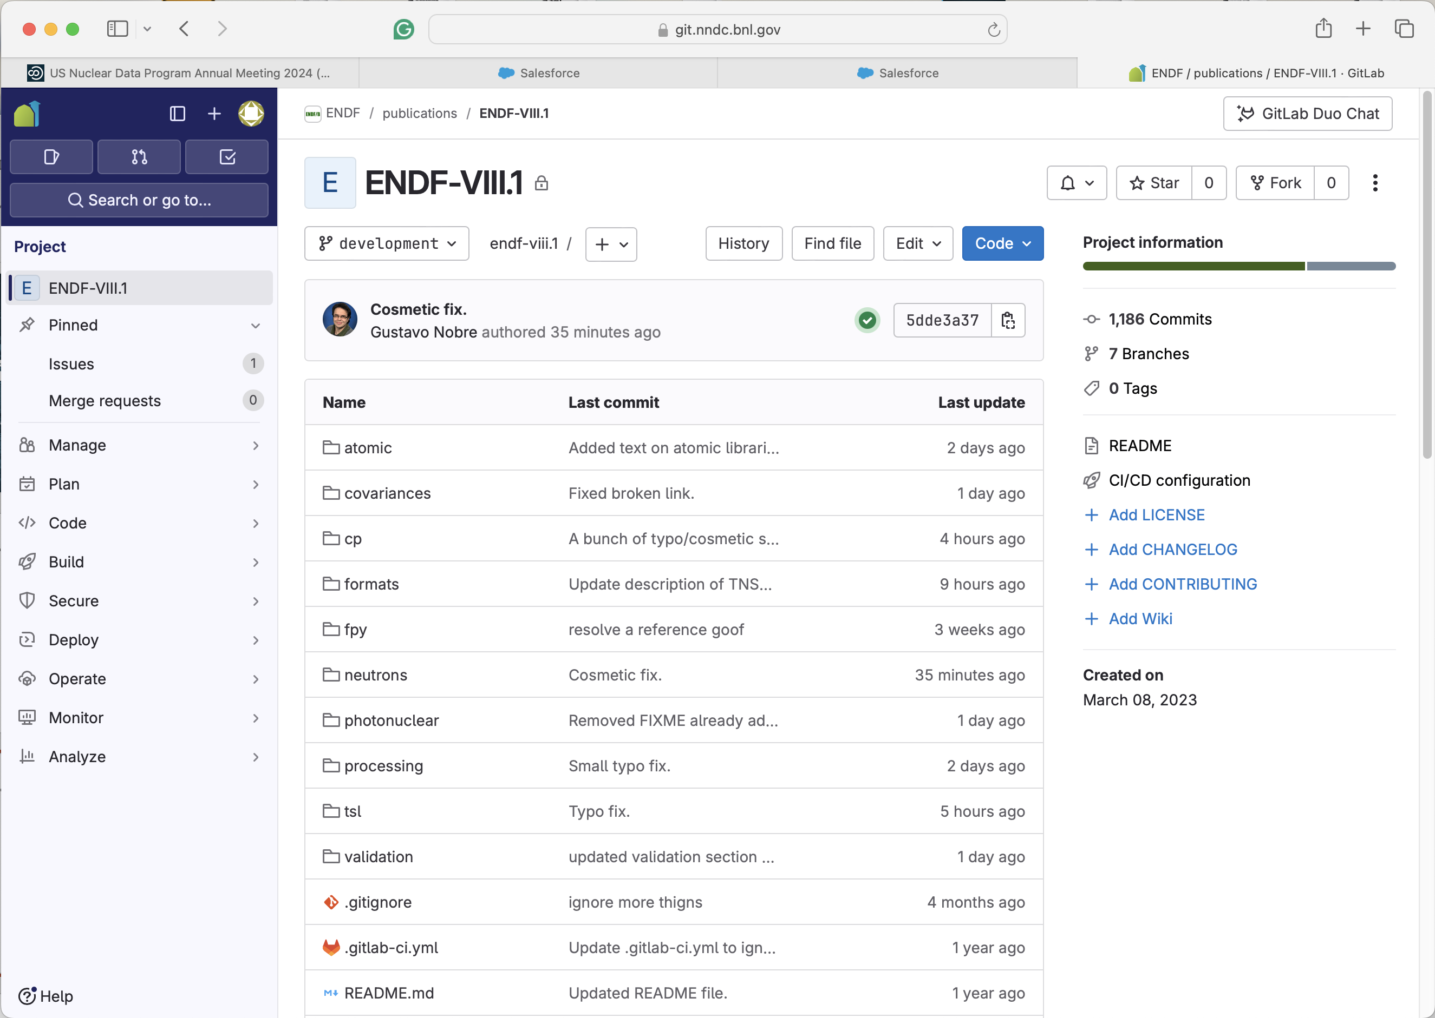
ENDF/B-VIII.1Library Release
CSEWG collaboration is scheduled to release the ENDF/B-VIII.1 library in FY 2024—many details in the presentation of G. Nobre (BNL).

Slide 3
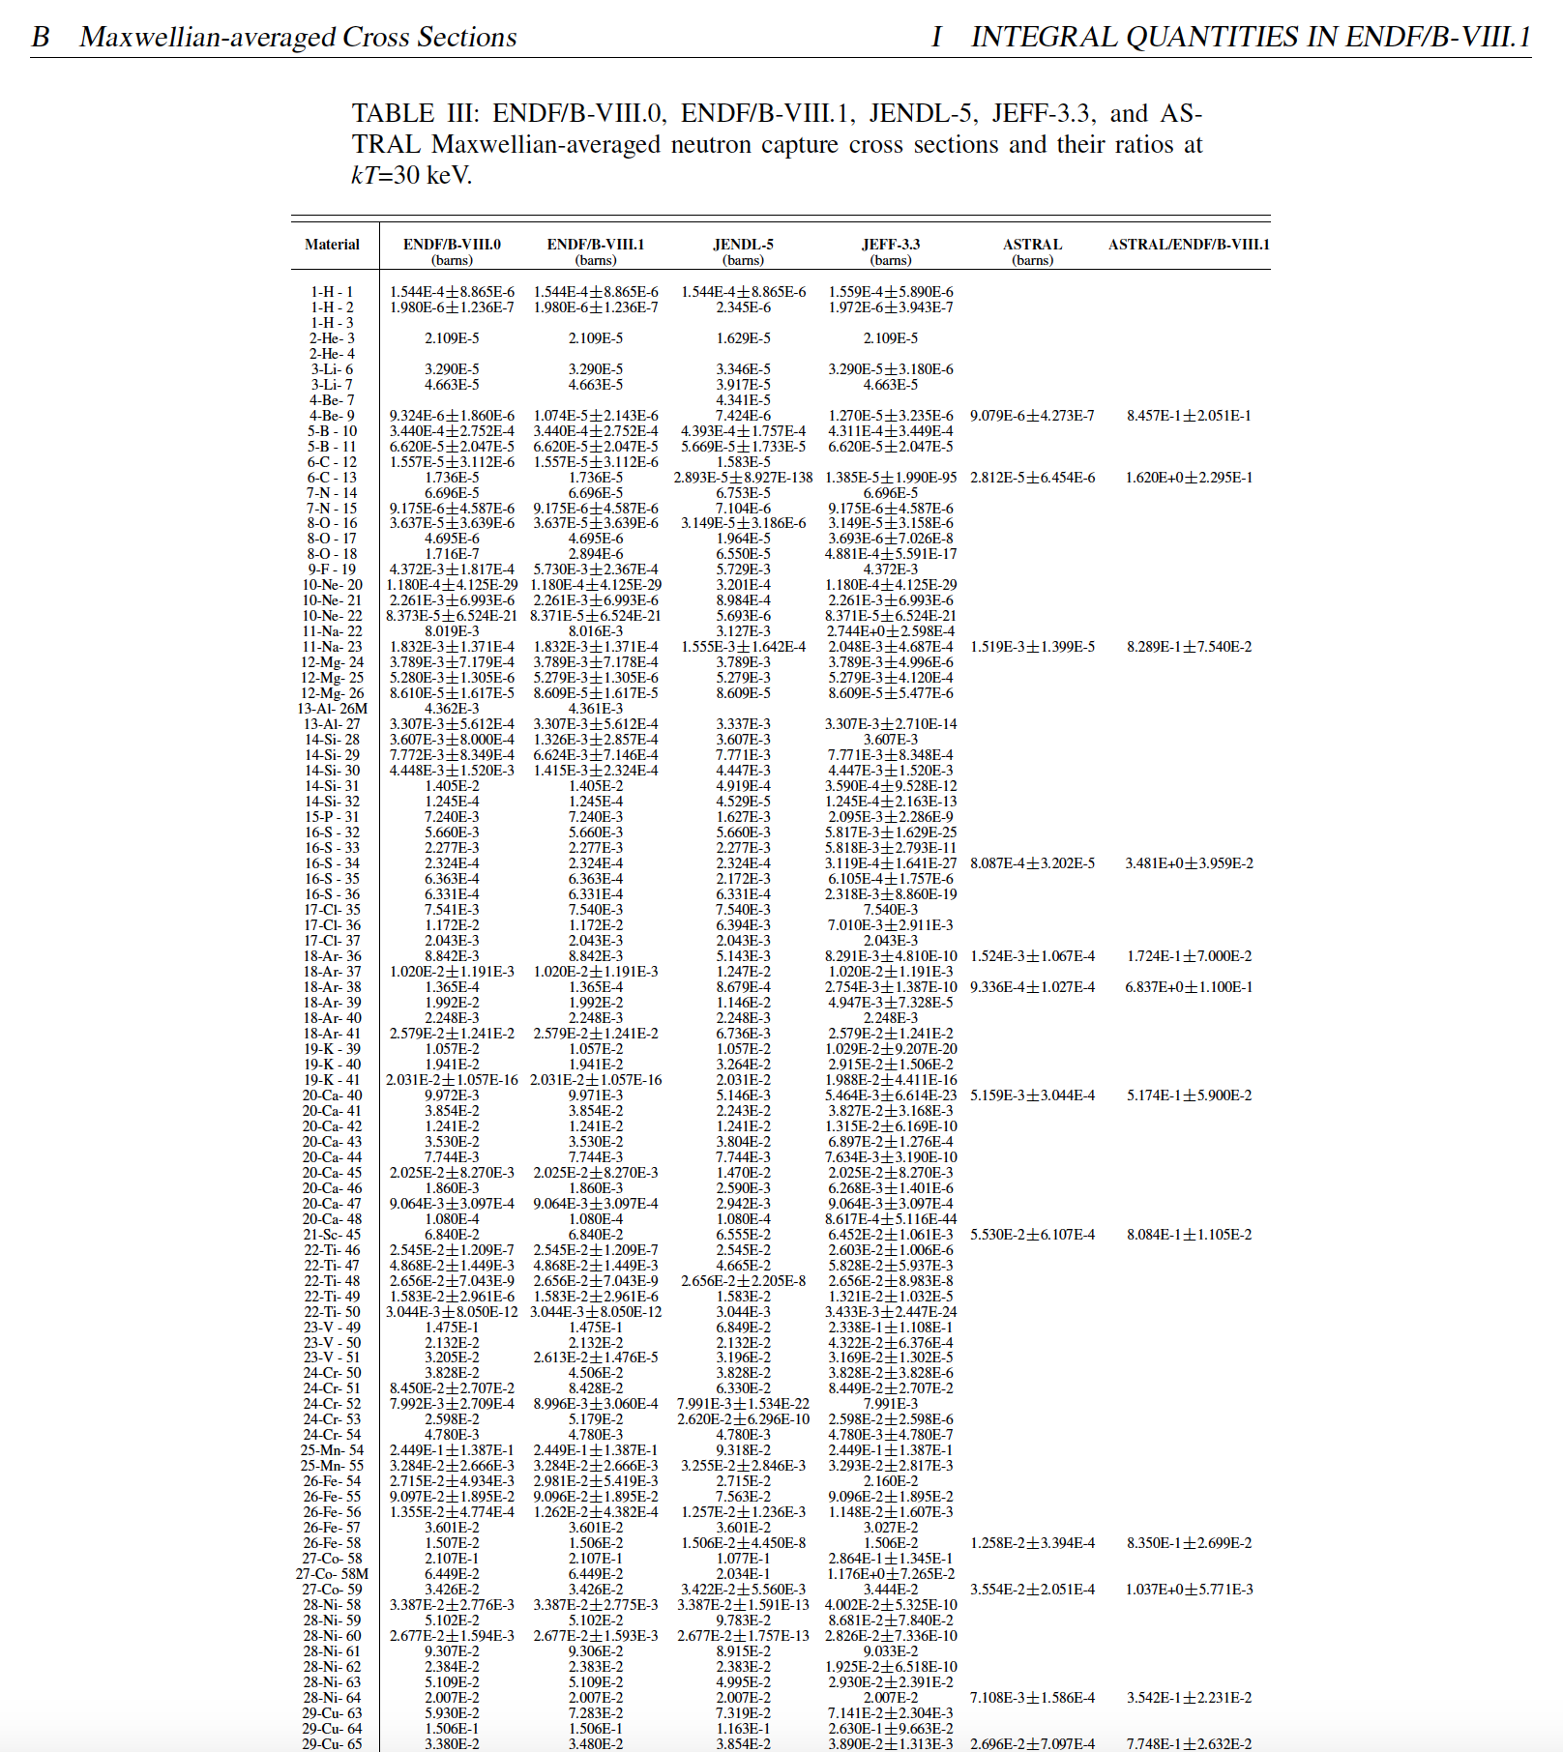
ENFG/B-VIII.1 Integral Values
For library validation purposes Neutron Thermal Cross Sections, Westcott Factors, Resonance Integrals, Maxwellian Averaged Cross Sections, Astrophysical Reaction Rates, and r-process Abundances.
The calculation was extended to JEFF-3.3, JENDL-5.0, CENDL-3.2, and BROND-3.1 libraries.
We will concentrate on astrophysical quantities from ENDF/B-VIII.1, JEFF-3.3, and JENDL-5.0.
ASTRAL library is used for comparative purposes: https://exp-astro.de/astral/

Slide 4
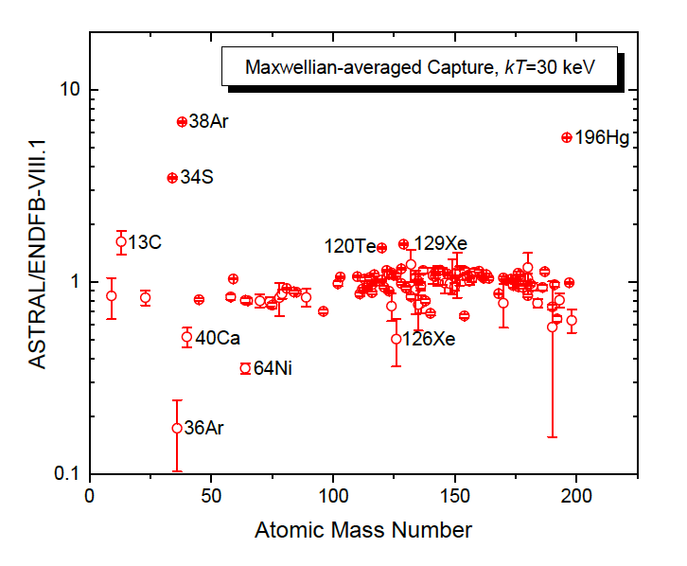
Comparison of ENDF/B-VIII.1 and ASTRAL MACS
Due to the relative scarcity of ASTRAL data, the ratios of ASTRAL to ENDF/B-VIII.1 were chosen to avoid division by zero.
The analysis of the ratios shows agreements in most cases and strong deviations in ¹³C, ³⁴S, ^{36,38}Ar, and ¹⁹⁶Hg and minor deviations in ⁴⁰Ca, ⁶⁴Ni, ¹²⁰Te, and ^{126,129}Xe cases.
The analysis of the EXFOR database shows that there are no experimental data for ^{36,38}Ar and ¹²⁶Xe above thermal region, and the observed differences are due to the issues with theoretical modeling.
In cases of ¹²⁹Xe and ¹⁹⁶Hg, ASTRAL results are based on single measurements that could be deficient.
In ⁴⁰Ca we need to consider three contradictory measurements and choices of ENDF and ASTRAL evaluators.

Slide 5
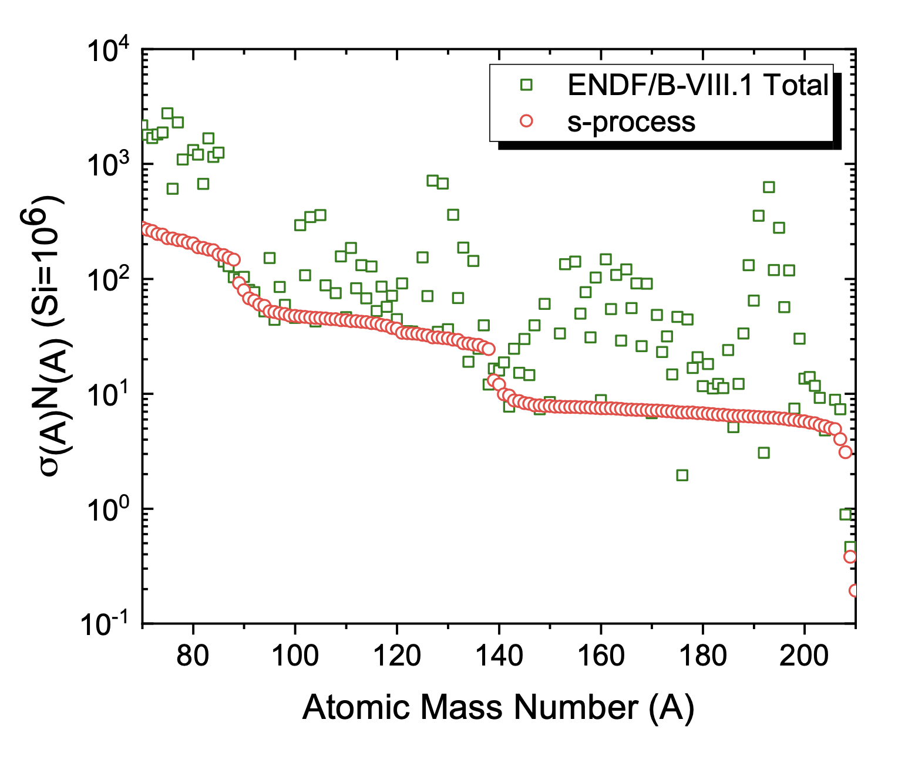
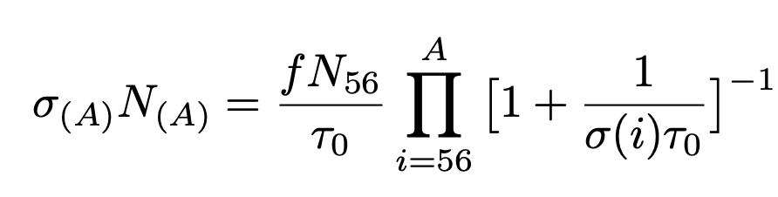
s-Process
Slow-neutron capture (s-process) is reasonably well understood, it starts from ⁵⁶Fe, and its path lies along the valley of stability.
σN systematics for equilibrium conditions in AGB stars:
The total ENDF/B-VIII.1 values include s- and r- (rapid neutron capture) processes.

Slide 6
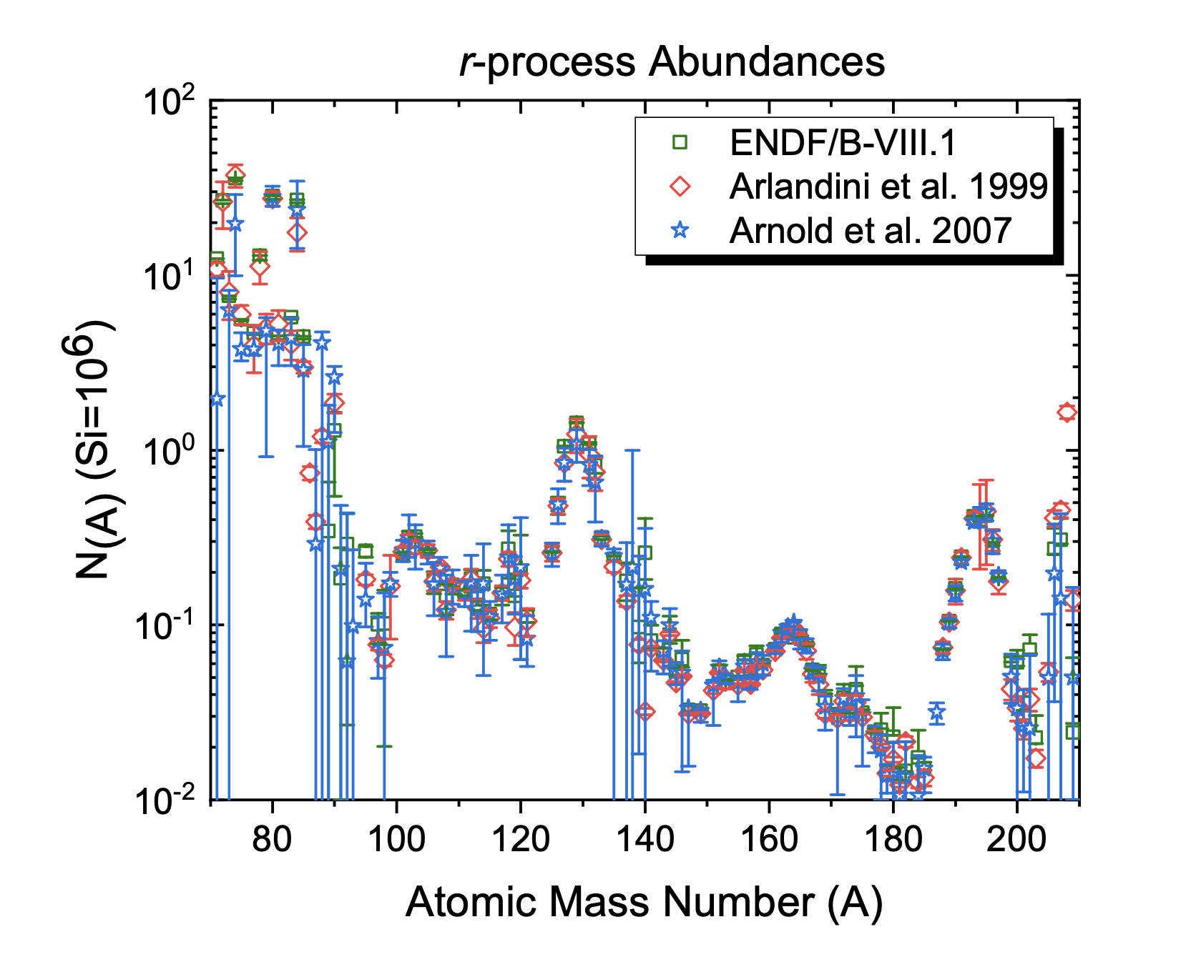
ENDF/B-VIII.1 r-process Abundances
The r-process abundances were extracted using ENDF/B-VIII.1 Maxwellian-averaged Cross Sections and Solar system abundances.
Results agree well with Arlandini et al., and Arnould et al.

Slide 7
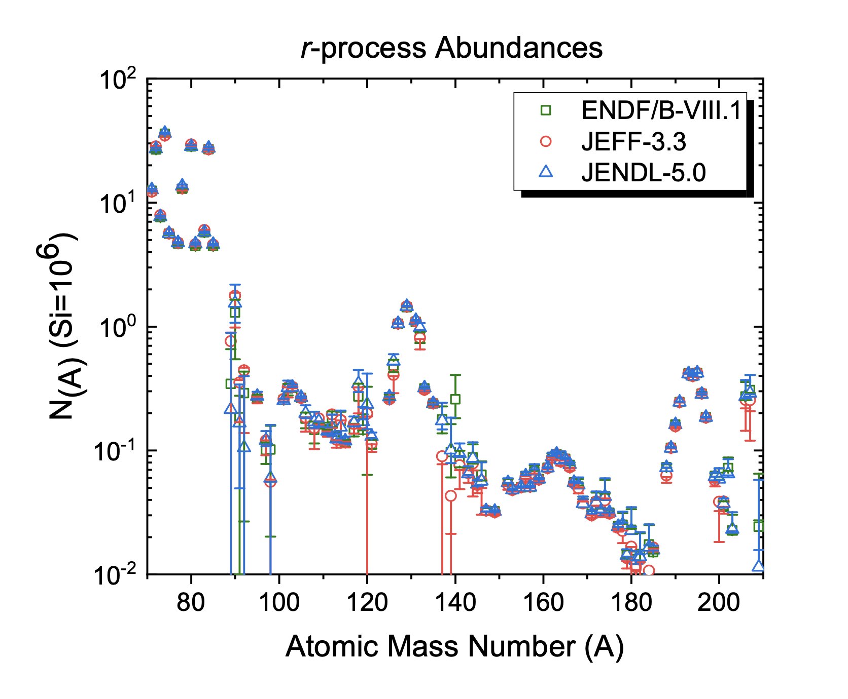
ENDF/B-VIII.1, JEFF-3.3, and JENDL-5.0 r-Process Abundances
Calculation was extended to JEFF-3.3 and JENDL-5.0 libraries.
CENDL-3.2, and BROND-3.1 do not have a sufficient number of target nuclei for the s- process.
Results are comparable with ENDF/B-VIII.1; however, cerium evaluation in ENDF/B-VIII.1 provides a clear preference for the ENDF/B library.

Slide 8
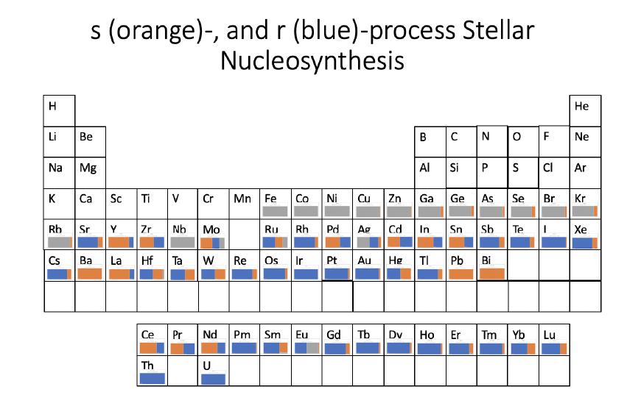
Takeaways
ENDF/B-VIII.1 is the best-evaluated nuclear data library for astrophysics.
R-process abundances for ENDF/B-VIII.1, JEFF-3.3, and JENDL-5.0 have been calculated.
Cerium evaluation (¹⁴⁰Ce) helped to improve ENDF/B, revisiting barium (138Ba) cross sections is needed.

