Slide 1
EIC Preliminary Design & Safety Review of the EIC Auxiliary
Far-Forward/Far-Backward Detectors
February 12th, 2024

Slide 2
What to include
For each of the subsystems:
- the lifetime of each detector
-where what calibrations are done where,
-what is delivered when to BNL, number of pieces sizes and from where
-what Q&A is done of the pieces if arriving at BNL who will be doing this work
-describe if the detector comes assembled or needs to be assembled at BNL
-What workforce / labor do you need from BNL which has not been costed in P6
-If users are coming, please think about what support for the users is needed.
-For the detectors what space and what special conditions the space needs, clean room, gases, size and so on.
-Please have a list of collaborating institutions.

Slide 3
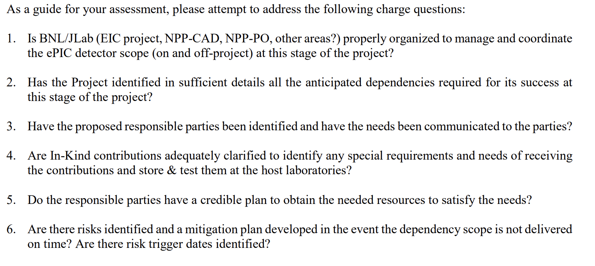
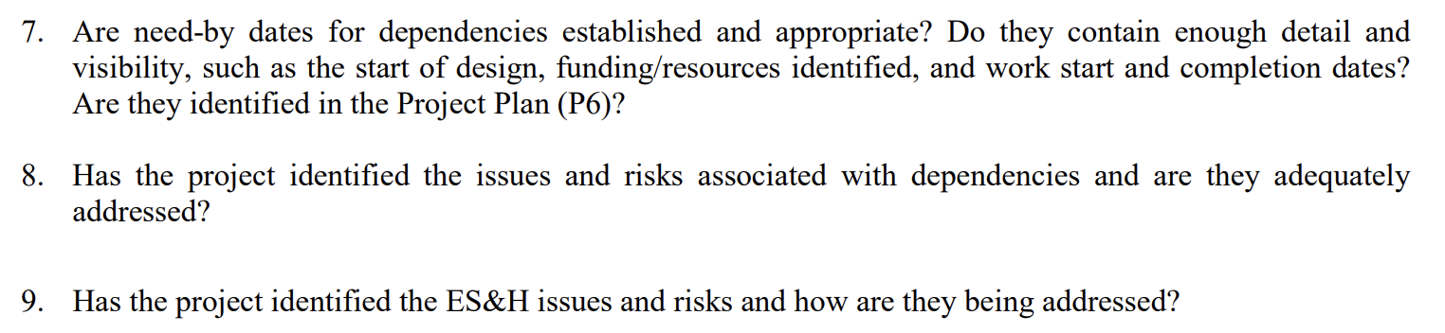
Charge Questions

Slide 5
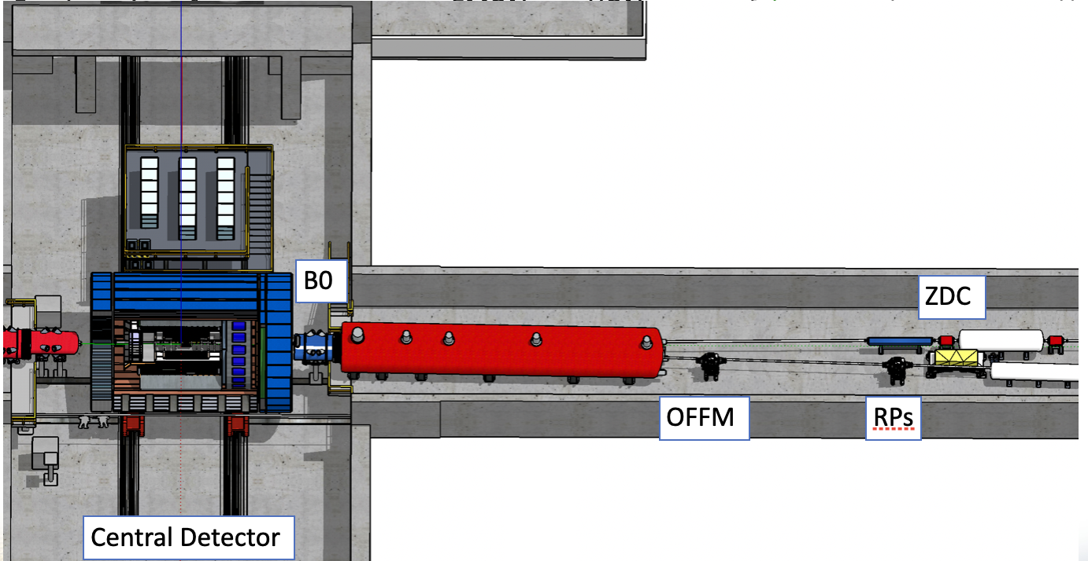






Far-forward: participating institutions
B0 detectors
Tel Aviv University, Israel
Hebrew University of Jerusalem, Israel
Ben Gurion University of the Negev, Israel
ZDC
Riken, Japan
Kobe, Japan
also recently joined Uni’s from Taiwan and
South Korea
Kansas university, USA
PNNL, USA
UCR, USA
RomanPots and OMD
AC-LGAD consortium :
BNL, USA
IJCLab - Orsay, France
OMEGA , France
IRFU/CEA-Saclay, France

Slide 6
Space needed at BNL for AC-LGAD
Space needed at BNL for AC-LGAD sensors production, the bump-bonding, assembly, QA and tests
Roman Pots AC-LGAD modules: 128 ( 3.2x3.2 cm^2 units) or 512 ( ( 1.6x1.6 cm^2 units)
Off-Momentum detectors : 72 ( 3.2x3.2 cm^2 units) or 288 ( 1.6x1.6 cm^2 units)
B0 tracking: 168 (3.2x3.2 cm^2 units) or 672 ( 1.6x1.6 cm^2 units)
Lumi-PS: 164 (3.2cm x 3.2cm units) or 656 (1.6 cm x 1.6cm units) – total for 4 layers

Slide 7
B0 -logistic
Purchasing
Assembly
Tests/QA
EMCAL- crystals
Final Assembly
Inst. A
Inst. A
EMCAL- SiPMs
Arrival to BNL
Tracker- AC-LGADs :
BNL
BNL
BNL
Tracker-EICROC
France
Inst.C
Cooling
Inst.C
Cooling
Inst.C
Cooling
JLAB/BNL
Support Structure
JLAB/BNL
Support Structure
JLAB/BNL
Support Structure

Slide 8
Space needed at BNL for B0 final assembly
Work will include:
assembling tracker layers on the frame , assembling calorimeter modules on the frame, configuring data acquisition systems, operations testing, cosmic tests, alignments, long term stability tests.
Detector assembly and commissioning is expected to continue for 9-12 months.
Required Resources and Potential Hazards
Space Requirements
300 ft 2 for B0 trackers and calorimeter
Floor Loading
No
Crane Capacity
No ( only after integration with B0-magnet)
Power Requirements
No special requirements
Environmental Cooling/Humidity Control
No special requirements
Low Conductivity Water / Process Cooling Water
Not required.
Cryogenics
Not required
Gases
None required.
Air Supply/Exchange
N/A
Clean Space
Standard Lab space
Amenities
What work tables/chairs/cabinets/furnishings will be required?
Standard benches for test equipment and assemble. Electronics + computing racks. Desk and chair working space for 4 people.
Special Equipment/Tooling
N/A
Security
N/A
Waste Production
None

Slide 9
RP/OMD- logistic
Purchasing
Assembly
Tests/QA
Final Assembly,
Tests,
DAQ tests
RP/OMD: AC-LGADs
BNL
RP layers assembly
BNL
RP/OMD
BNL
RP/OMD: EICROC
France?
At BNL:
Space needs at BNL
Cooling
BNL
BNL
BNL
Support/Vacuum :
BNL
BNL
BNL

Slide 10
Space needed at BNL for B0
Work will include:
assembling tracker layers on the frame , assembling calorimeter modules on the frame, configuring data acquisition systems, operations testing, cosmic tests, alignments, long term stability tests.
Detector assembly and commissioning is expected to continue for 9-12 months.
Required Resources and Potential Hazards
Space Requirements
300 ft 2 for B0 trackers and calorimeter
Floor Loading
No
Crane Capacity
No ( yes, only after integration with B0-magnet)
Power Requirements
No special requirements
Environmental Cooling/Humidity Control
No special requirements
Low Conductivity Water / Process Cooling Water
Not required.
Cryogenics
Not required
Gases
None required.
Air Supply/Exchange
N/A
Clean Space
Standard Lab space
Amenities
What work tables/chairs/cabinets/furnishings will be required?
Standard benches for test equipment and assemble. Electronics + computing racks. Desk and chair working space for 4 people.
Special Equipment/Tooling
N/A
Security
N/A
Waste Production
None

Slide 11
ZDC -logistic
Purchasing
Assembly
Tests/QA
EMCAL- crystals
Inst 1
Inst. A
Inst. A
Final Assembly
EMCAL- SiPMs
Inst1
Where? When?
Arrival to BNL
Space needs at BNL
HCAL- Scint, foils, Fe :
UCR
at UCR
at UCR
HCAL - SiPMs:
UCR
Cooling
Inst. C
Inst.C
Inst.C
Support Table
JLAB
JLAB
JLAB

Slide 12
Space needed at BNL for ZDC
Work will include:
assembling calorimeter modules on the table, configuring data acquisition systems, operations testing, cosmic tests, alignments, long term stability tests.
Detector assembly and commissioning is expected to continue for 12–18 months.
Required Resources and Potential Hazards
Space Requirements
ca.500 ft 2
Floor Loading
Yes, ca 3300 kg
Crane Capacity
Yes , ca 3300 kg
Power Requirements
No special requirements
Environmental Cooling/Humidity Control
No special requirements
Low Conductivity Water / Process Cooling Water
Not required.
Cryogenics
Not required
Gases
None required.
Air Supply/Exchange
N/A
Clean Space
Standard Lab space
Amenities
What work tables/chairs/cabinets/furnishings will be required?
Standard benches for test equipment and assemble. Electronics + computing racks. Desk and chair working space for 4 people.
Special Equipment/Tooling
N/A
Security
N/A
Waste Production
None

Slide 13



Far-backward: participating institutions
Low-Q2 tagger - tracker :
Glasgow, UK
Prague, CZ
W&M, USA
Low-Q2 tagger - calorimeter :
Prague, CZ
Lumi system
York, UK
Low-Q2
tagger2
Lumi - photon calorimeter:
Low-Q2
tagger1
Kraków, Poland
Prague, CZ
York, UK
Lumi - pair-spectrometer :
York, UK
Prague, CZ
Kraków, Poland
JLAB/BNL
Houston, USA
IP
Weekly meetings to discuss engineering and integration aspects with JLAB/BNL designers, collaborating institutes
15

Slide 14
Low-Q2
Purchasing
Assembly
Tests/QA
Final Assembly
Tracking layers: Glasgow, UK
Timepix4 +Si :
Glasgow, UK
Tracking layers:
Glasgow, UK
Where? When?
Arrival to BNL
Space needs at BNL
EMCAL :
Inst A
EMCAL
Inst A
EMCAL
Inst A
EMCAL - SiPMs:
Inst A
Cooling :
Inst. B
Inst. B
Inst.B
Support Table
JLAB
JLAB
JLAB

Slide 15
Space needed at BNL for Low-Q2
Trackers work will include: a) assembling tracker frame hardware and table, b) configuring data acquisition systems, c) performing Timepix4 module installations, d) operations testing, e) cosmic tests, and alignments f) long term stability tests.
Calorimeter work will include: a) assembling hardware on the table b) configuring data acquisition systems, c) operations testing, d) cosmic tests, and alignments e) long term stability tests.
Detector assembly and commissioning is expected to continue for 9-12 months.
Required Resources and Potential Hazards
Space Requirements
300 ft 2 for trackers and calorimeters
Floor Loading
No special needs
Crane Capacity
Not required.
Power Requirements
No special requirements
Environmental Cooling/Humidity Control
No special requirements
Low Conductivity Water / Process Cooling Water
Not required.
Cryogenics
Not required
Gases
None required.
Air Supply/Exchange
N/A
Clean Space
Standard Lab space
Amenities
What work tables/chairs/cabinets/furnishings will be required?
Standard benches for test equipment and assemble. Electronics + computing racks. Desk and chair working space for 4 people.
Special Equipment/Tooling
N/A
Security
N/A
Waste Production
None

Slide 16
Lumi Pair Spec (PS)
Purchasing
Assembly
Tests/QA
Final Assembly
Calorimeter materials - York
Calorimeters - York
Calorimeters - York
Calorimeters/trackers – 6 months before pre-ops
Magnets – 12 months before pre-ops
Calorimeter Electronics - York
Trackers
BNL (as part of AC-LGad efforts)
Trackers - BNL/Houston/Tel Aviv
Trackers –
BNL/Houston/TelAviv
Magnets/Vacuum Chamber
BNL
BNL/JLab
BNL/JLab
Support Table
JLab

Slide 17
Lumi Direct Photon Detector (DPD)
Purchasing
Assembly
Tests/QA
Calorimeter materials – York/Krakow
Final Assembly
Calorimeters – Krakow/York
Calorimeters – Krakow/York
Calorimeter Electronics - Krakow
6 months before pre-ops
Support Table
BNL/JLab
BNL/JLab
BNL/JLab

Slide 18
Space needed at BNL for Lumi Detectors (PS/DPD)
Work will include:
assembling tracker layers on the frame , assembling calorimeter modules on the frame, configuring data acquisition systems, operations testing, cosmic tests, alignments, long term stability tests.
Detector assembly and commissioning is expected to continue for 3-6 months.
Required Resources and Potential Hazards
Space Requirements
500 ft 2 for PS trackers and PS/DPD calorimeters
Floor Loading
No
Crane Capacity
No
Power Requirements
No special requirements
Environmental Cooling/Humidity Control
No special requirements
Low Conductivity Water / Process Cooling Water
Not required.
Cryogenics
Not required
Gases
None required.
Air Supply/Exchange
N/A
Clean Space
Standard Lab space
Amenities
What work tables/chairs/cabinets/furnishings will be required?
Standard benches for test equipment and assemble. Electronics + computing racks. Desk and chair working space for 4-6 people.
Special Equipment/Tooling
N/A
Security
N/A
Waste Production
None

Slide 19
Workforce for Lumi Pair Spec
Workforce request/requirements from BNL very limited
1 FTE tech support for 3-6 months to support assembly/cabling efforts
Workforce contribution from collaborating institutions
York
2 FTE for 2 months (PDRA + faculty)
1 FTE for 3 months student
Houston
1 FTE for 1 month (faculty)
1 FTE for 2 months student
Tel Aviv
1 FTE for 2 month (faculty)
Work/office space for users will be needed (outlined in space requirements)

Slide 20
Workforce for Lumi Direct Photon Detector
Workforce request/requirements from BNL very limited
1 FTE tech support for 3-6 months to support assembly/cabling efforts
Workforce contribution from collaborating institutions
Krakow
2 FTE for 2-3 months (PDRA + faculty)
1 FTE for 2-3 months student
York
Overlap with support for PS in some aspects
Low luminosity WSciFi variant
Work/office space for users will be needed (outlined in space requirements)

Slide 21
Lumi Pair Spec Calorimeters – Prototyping QA
Lumi Pair Spec calorimeter prototype construction underway at York
~5-10 prototype modules by end of year
Beam tests for prototype modules planned
Mainz (A2) – 800/1600 MeV e⁻ and up to 800/1600 MeV real γ
Planned – Late 2024
Initial uniformity/performance tests
JLab Hall D (GlueX) beam tests
Planned for Q1/Q2 2025 (depending upon JLab/GlueX beam schedule)
Performance/shower reconstruction testing
Iterate/improve upon design as needed following beam test results

Slide 22
Lumi Pair Spec Calorimeters – Other Details
Lumi Pair Spec modules (3 x 20 x 3 – 180 total) will be assembled at York
Shipped to BNL as modules, full detectors assembled there
Minimum of 6 months before pre-ops period
Each module is ~1kg in weight
Pair Spec – 2x3x20 – 120 modules
DPD – 3x20 – 60 modules (for WSciFi variant)
QA on modules
Cosmics/beam tests (Mainz/JLab) upon construction
Subsequent cosmics tests on arrival at BNL
Calibrations – From QA testing
Procedure being developed
10+ year lifetime for PairSpec in operation
Can potentially extend by cycling layers periodically (between runs?)

Slide 23
Quality Assurance
During the engineering design phase:
considering to production of mockups and engineering test articles to insure the proper functionality and quality.
Full-chain integration with DAQ at early stage.
Beam tests, etc.
During the production and testing:
developing a document with a detailed steps of production and test procedures
production yield control, noise level characterization, light yield, and other parameters.
X-ray, source and beam tests
Hardware status will be included into the data-base.

Slide 24
Environment, safety, and health (ES&H)
We will be using the appropriate ES&H and Radiation Safety measures as dictated by the participating universities and labs(BNL/JLAB). All personnel working within the labs have to have the appropriate training to ensure adherence to these safety protocols.
Flammable materials: fibers
Use of proper storage, extinguishing system, keep away from the open fire or hot temperature.
Electrical/ Cooling/Trip safety:
For operation with HV and Cooling: we will ensure that these are mechanically secure and not a trip hazard, have proper warning signs and follow the lab procedures for electrical safety.
Operation nearby magnets/magnetic fields:
In coordination with accelerator team: flashing signs or lights indicate magnet is on and magnetic fields may be present. Posting signs.
Operation near the beam-pipe and vacuum:
we will require that anyone working near the far-forward/backward detectors to wears ear protection, and will post signage to that effect.

Slide 25
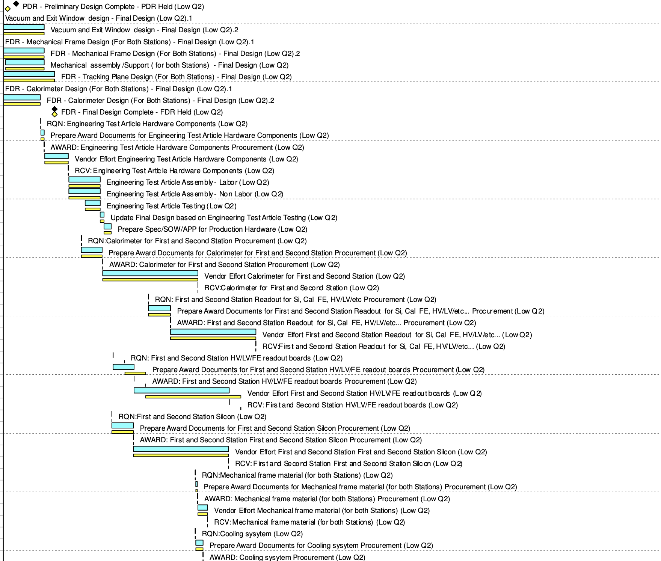
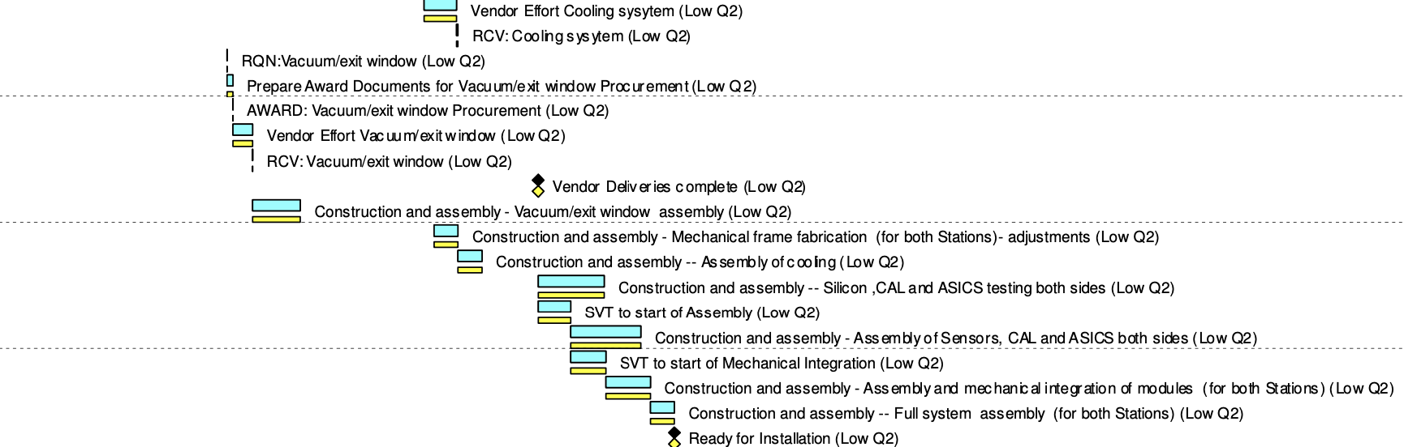
Timeline
now
Pre-OPS
Apr. 2031
CD3A
Nov
2023
CD3B
Oct
2024
CD2/3
Apr
2025
early
CD4
Oct 2032
CD4
Oct
2034
FF/FB review
Apr 2022
R&D, TDR,
engineering test articles
assembly and tests
FF/FB PDR
Feb 2024
FF/FB FDR
May 2025
Detailed schedule for each sub-detector component in P6.
Preliminary design review of ANC detectors in Feb 2024, next review is expecting in May 2025.
The installation of far-forward equipment is at later stage ( after accelerator commissioning ). All scattering chambers that house detectors will be installed from the start of pre-ops. The detector packages will be installed later, after achieving a stable operation of the accelerator.
Luminosity detectors has to be at start of pre-ops.

Slide 26
Installation
IR-6 Far-Forward Region
B0 Tracker and Calorimeter timeline needs to be aligned with accelerator schedule
Off-momentum trackers and Roman Pots will install first only what is needed to be able to install the detectors at a later stage, timeline needs to be aligned with accelerator schedule
ZDC timeline needs to be aligned with accelerator schedule
IR-6 Far-Backward Region
Luminosity Monitor timeline needs to be aligned with accelerator schedule
Low Q² Tagger will install first only what is needed to be able to install the detectors at a later stage, timeline needs to be aligned with accelerator schedule

