Slide 1
Fermilab Test beam update
Henry Klest

Slide 2
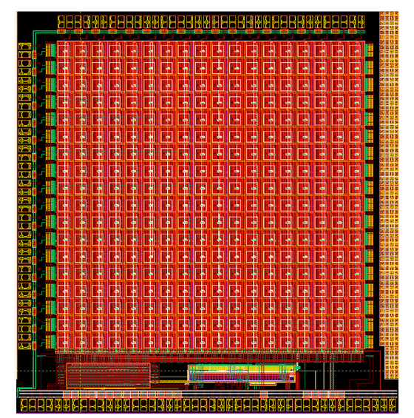
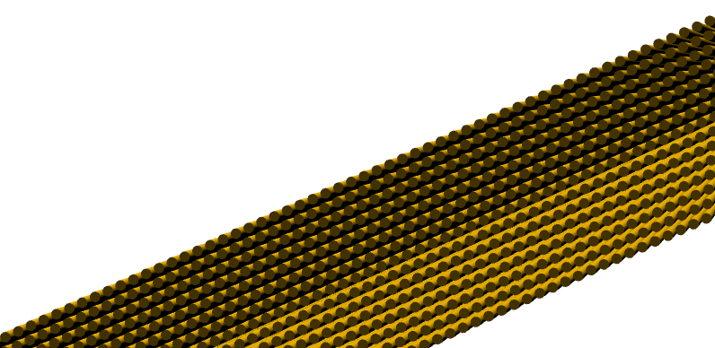
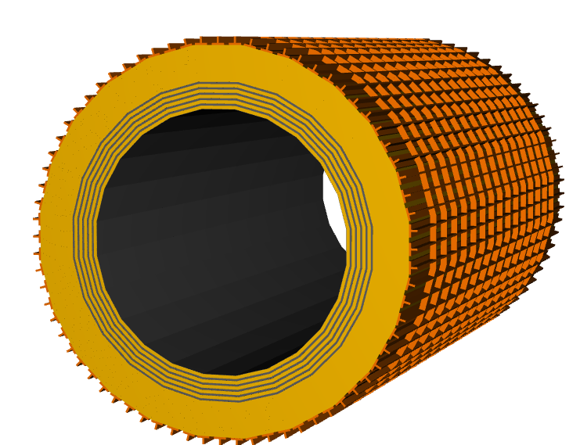
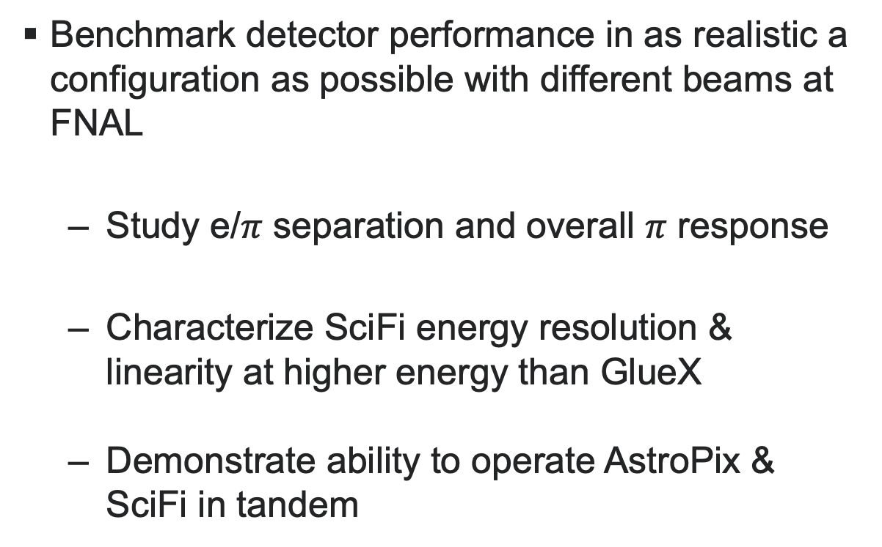
Test Beam R&D Goals
Benchmark detector performance in as realistic a configuration as possible with different beams at FNAL
Study e/$π$ separation and overall $π$ response
Characterize SciFi energy resolution & linearity at higher energy than GlueX
Demonstrate ability to operate AstroPix & SciFi in tandem

Slide 3
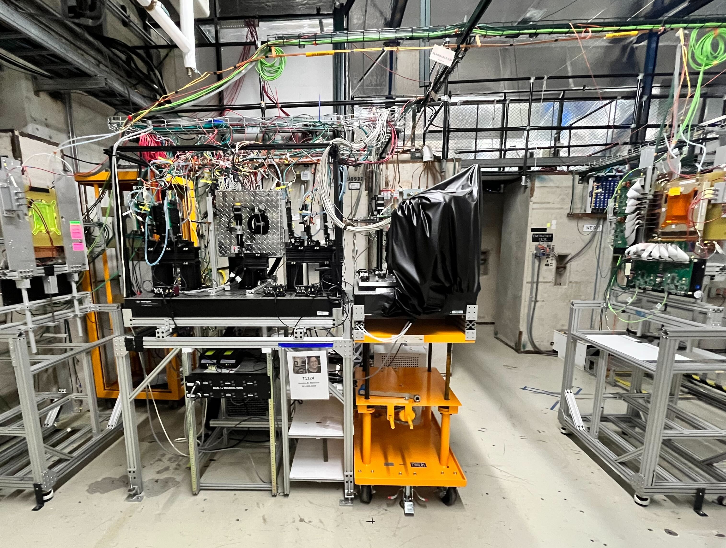
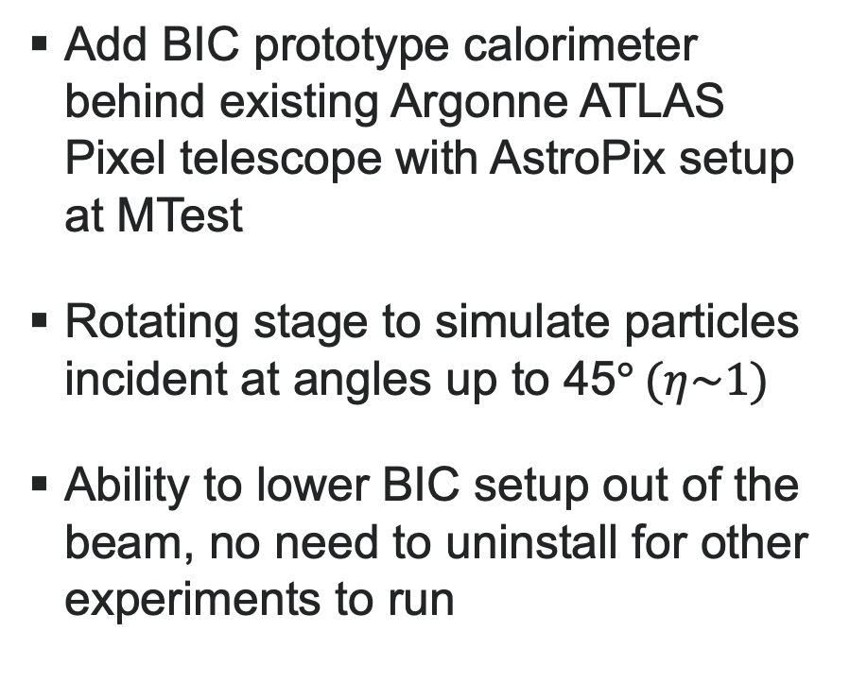
General setup
Add BIC prototype calorimeter behind existing Argonne ATLAS Pixel telescope with AstroPix setup at MTest
Rotating stage to simulate particles incident at angles up to 45$° (η\sim 1)$
Ability to lower BIC setup out of the beam, no need to uninstall for other experiments to run
Current ANL AstroPix Telescope Setup
Baby BCal Setup

Slide 4
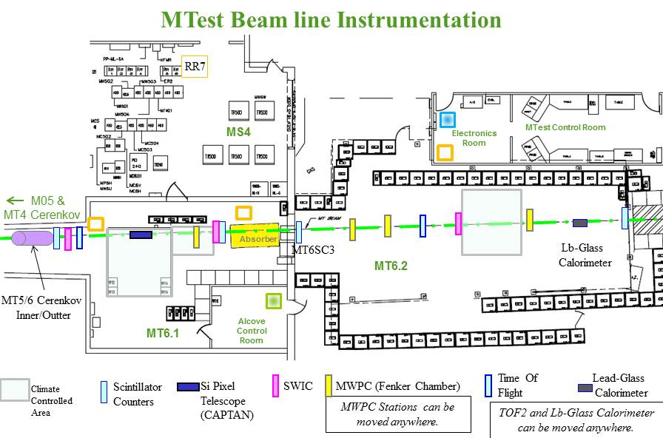
Fermilab test beam facility
Nominal beam is 120 GeV protons from main injector
Secondary hadron/electron beam from sending 120 GeV protons on a 30 cm thick aluminum target
Scintillators provided by FTBF along beamline for trigger
Two Cherenkovs for PID
BIC

Slide 6
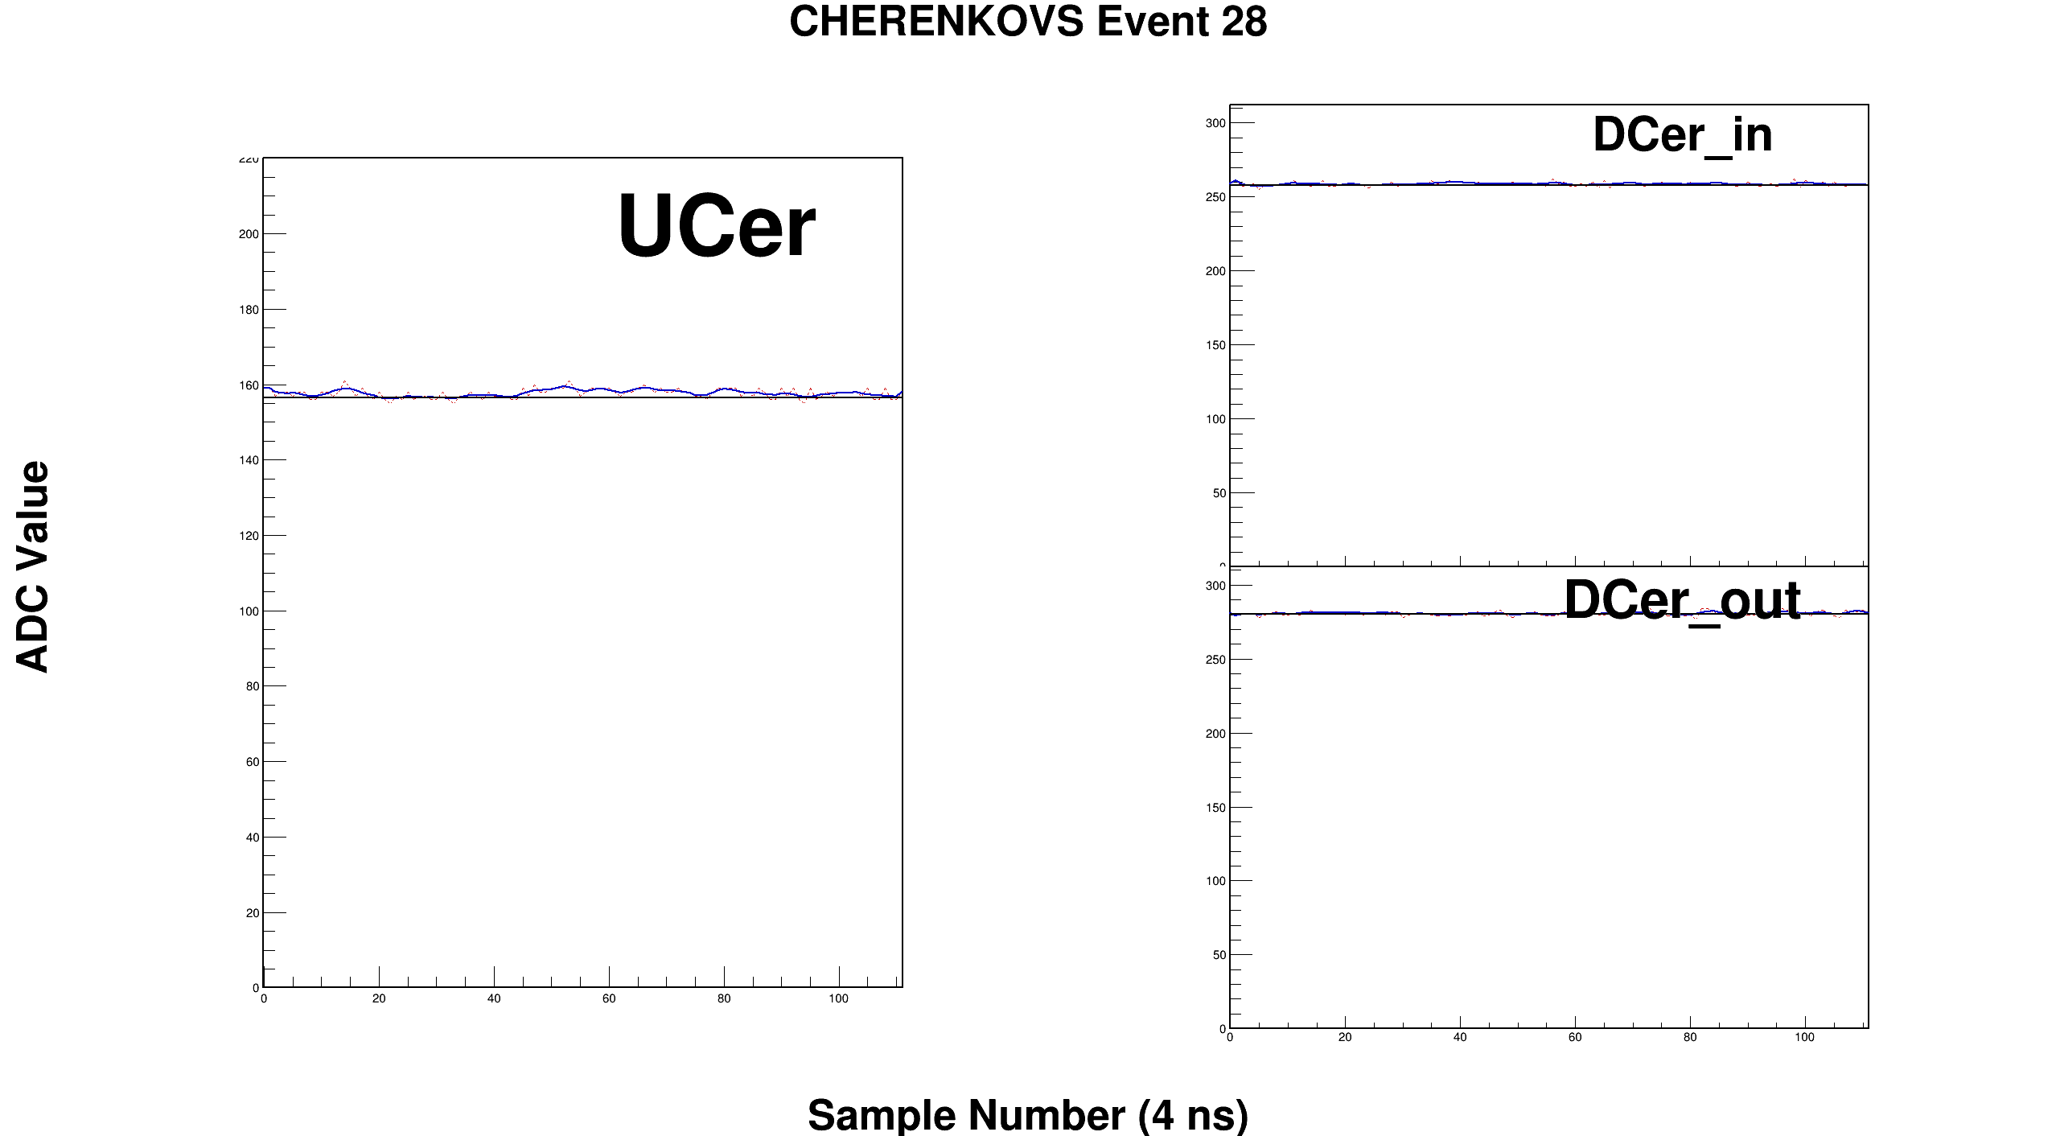

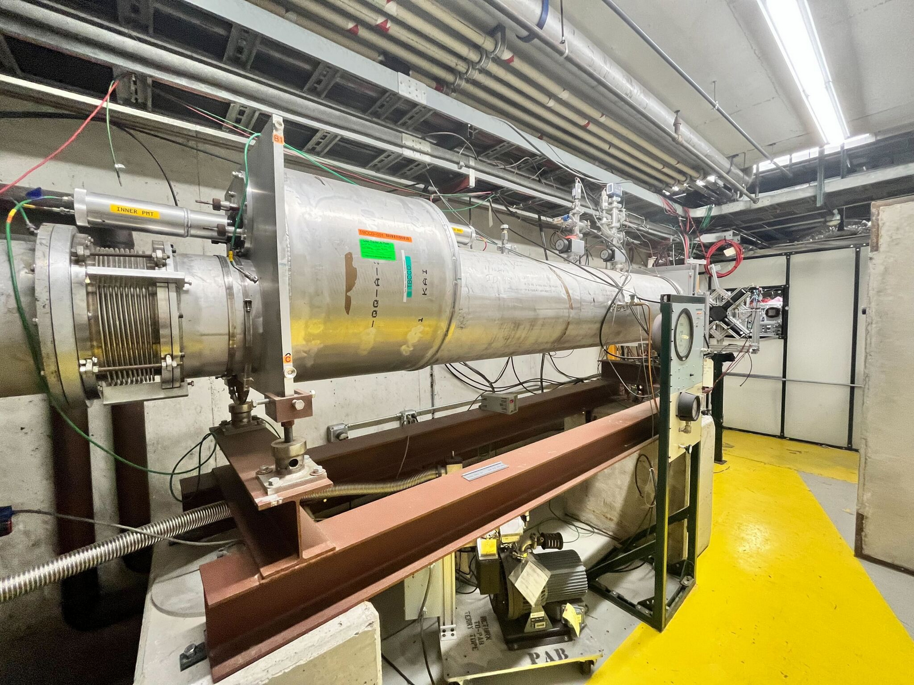
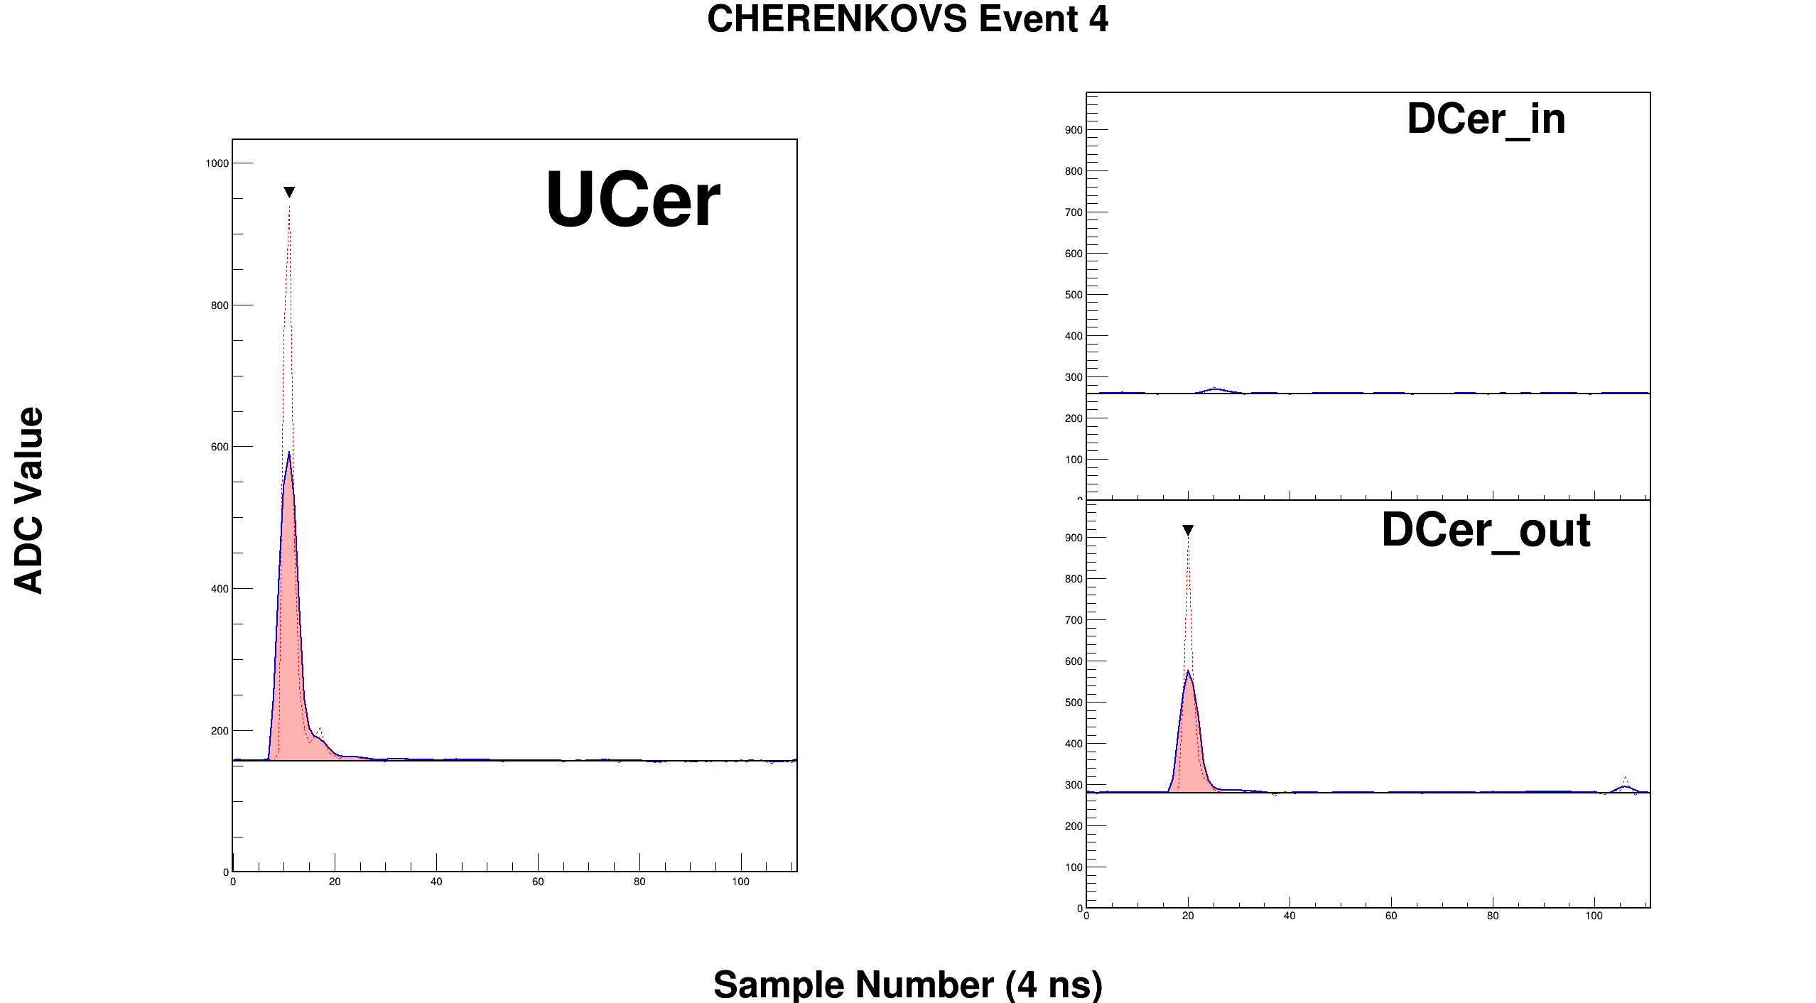
Cherenkov Detectors
Pion event
Downstream Cherenkov
Inner PMT
Upstream Cherenkov
Downstream Cherenkov
Outer PMT
Downstream Cherenkov
Electron event
Downstream Cherenkov
Inner PMT
Upstream Cherenkov
Downstream Cherenkov
Outer PMT

Slide 7
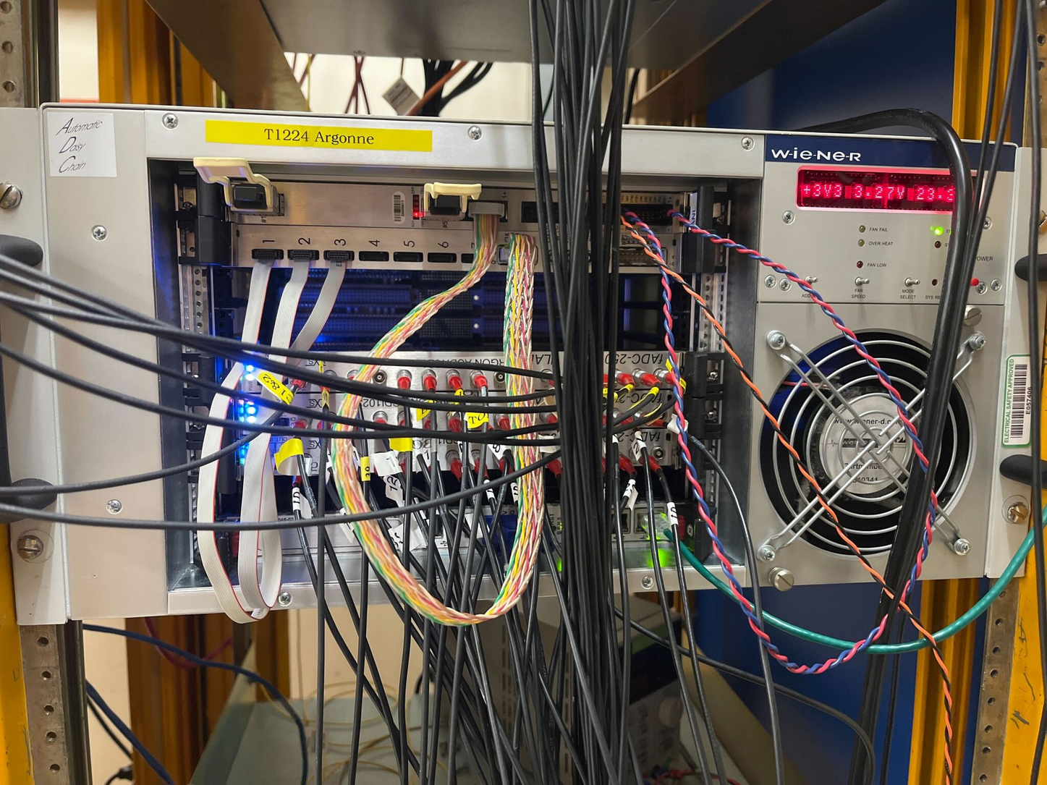
daq
Used 3x 16 channel JLab 250 MHz fADCs in full waveform readout mode
Sent analog signals from the N&S sets of 16 baby BCal channels into two blades of fADC, remaining blade used for FTBF detectors, cosmic ray paddles, AstroPix analog signal

Slide 8
datasets
Due to heat issues at FNAL, only ran for ~30% of our allotted week
DAQ limited to ~7 kHz due to full waveform readout
120 GeV protons
Mostly parasitic overnight
Large dataset, few million events
10 GeV e/pi
Also large dataset, but mostly taken with FADC jumpers set in the wrong positions, so gain is 2x higher than it should be
After the jumper repositioning, took an hour and a half of e/pi at 10 GeV (540K)
10 GeV mu/pi
Taken with a lead sheet in the beam to absorb electrons
Provides a large MIP calibration dataset
Energy scan e/pi
4 GeV (1.4M), 6 GeV (440K), and 8 GeV (320K)
Took a larger 4 GeV because pions are rarer at low energies

Slide 9
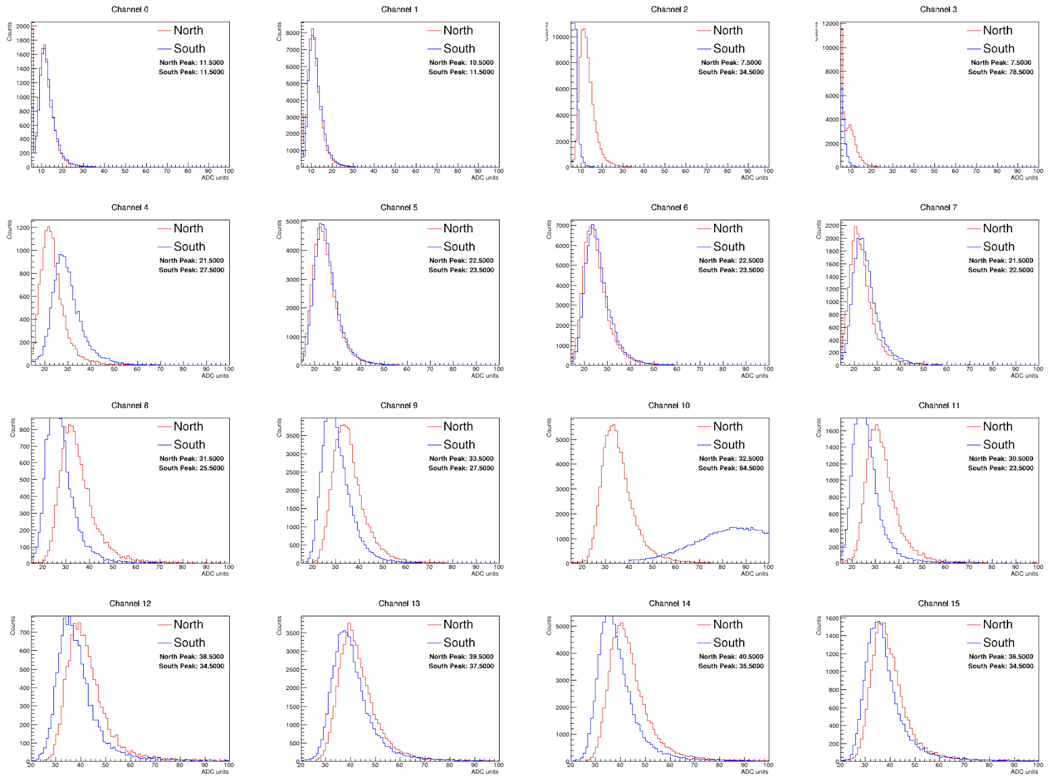
Energy calibration
Plot pulse heights in ADC units for events which left energy only in a line through the calorimeter
Use muon/pion run to get clean MIP sample
Nice MIP peak visible in all channels except for South 2&3

Slide 10
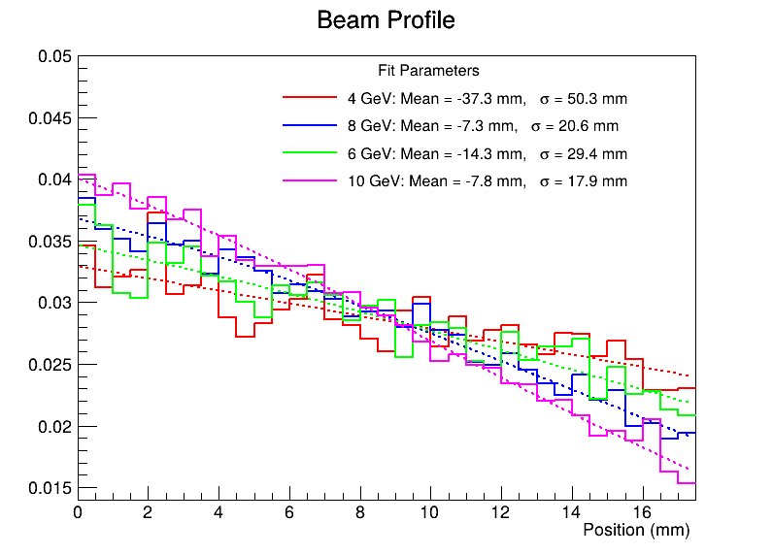
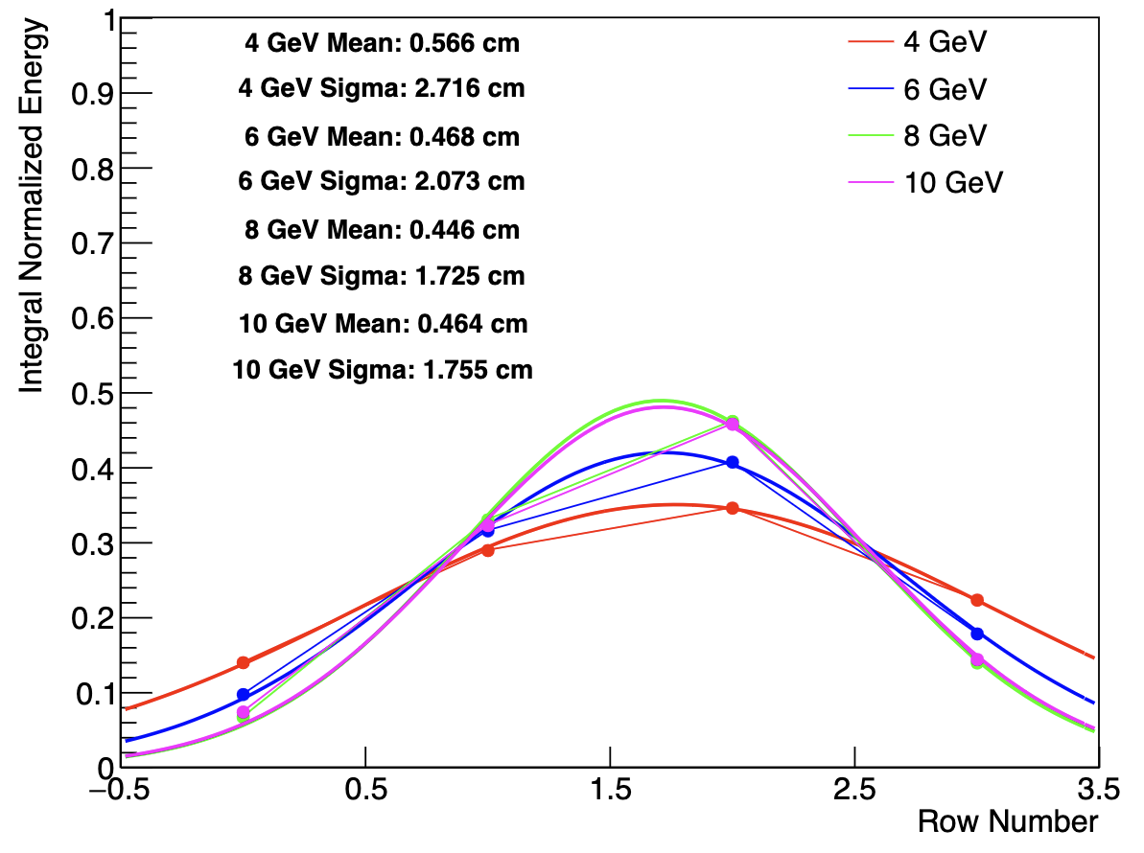
Beam profile
For calo analysis, want to know the profile of the beam in the vertical direction
Determines amount of leakage
Not much info from FTBF detectors
MWPCs were out of gas
SWICs showed poor performance for secondary beams
Have AstroPix & Calo information
Both agree beam widens at lower energy, both agree the beam center is vertically below the center of the calorimeter
AstroPix (centered on calo)
Vertically up
Vertically down

Slide 11
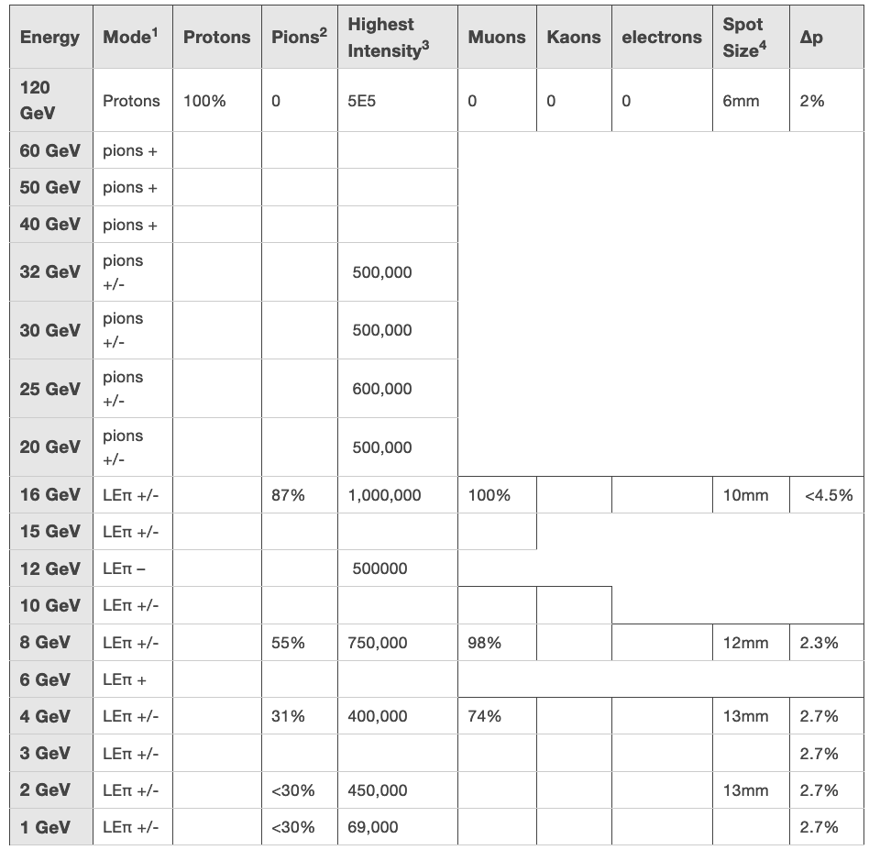
Beam Δp
An important factor in understanding the energy response is the beam momentum spread
This term enters as a constant term on the energy resolution
Quoted beam spread is 2.7% at low energies, improving to 2% at 120 GeV
However, statement from Joe at FTBF is that: ”every calo group is telling me it looks like the momentum spread is higher than the website indicates it should be.”
This number depends on beam tune, which can vary from run to run
We see the 4 GeV beam is physically wider, which suggests it also has a larger momentum spread

Slide 12
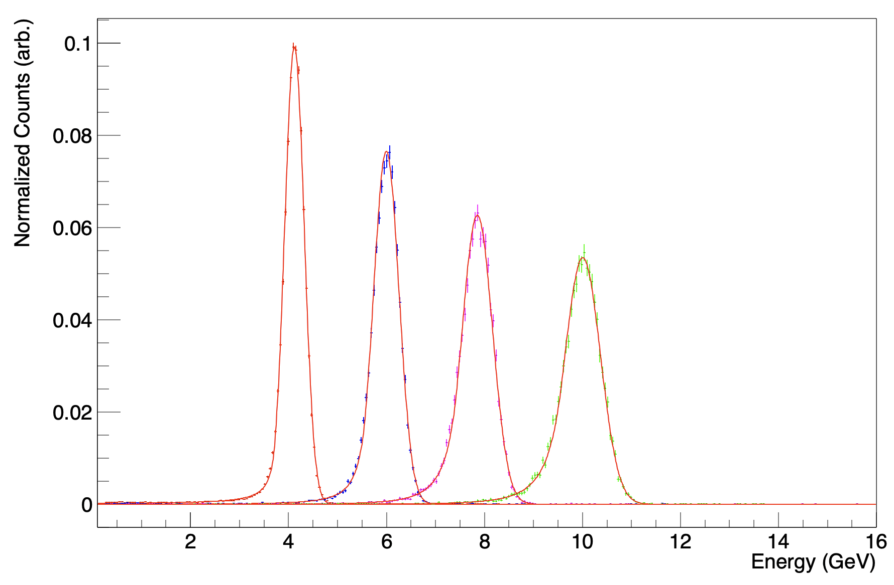
Energy resolution
Now that MIPs provided ADC units to energy conversion factors, can determine EM energy resolution
Select electrons by selecting events where upstream Cherenkov & downstream Cherenkov outer PMT fired
Some refinement cuts necessary
In particular, cuts to remove spurious signals and to improve containment of showers
Total energy from geometric sum of N & S reconstructed energies

Slide 13
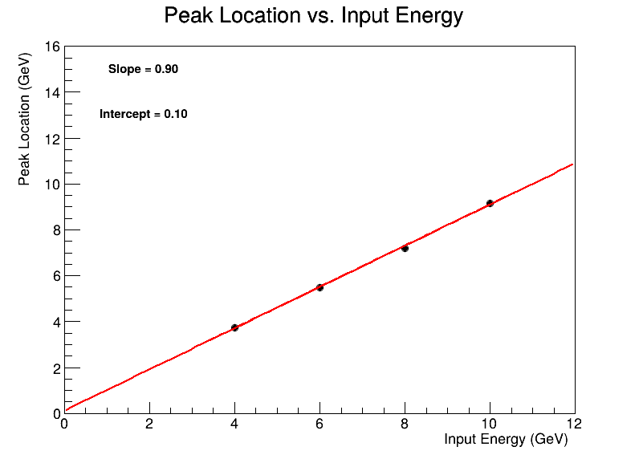
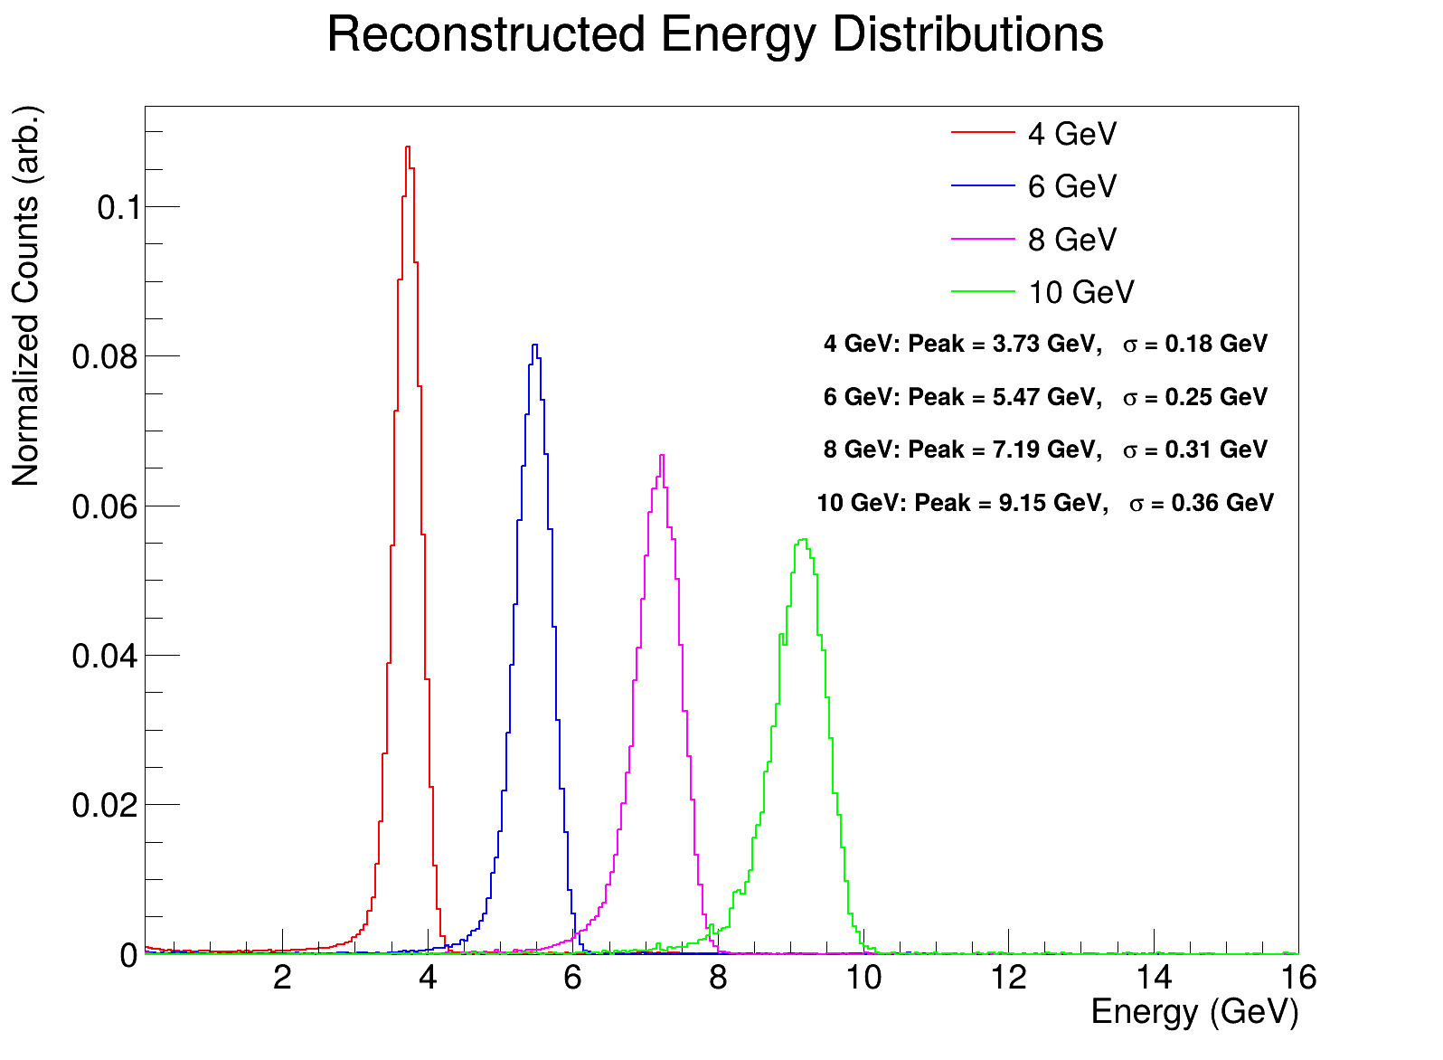
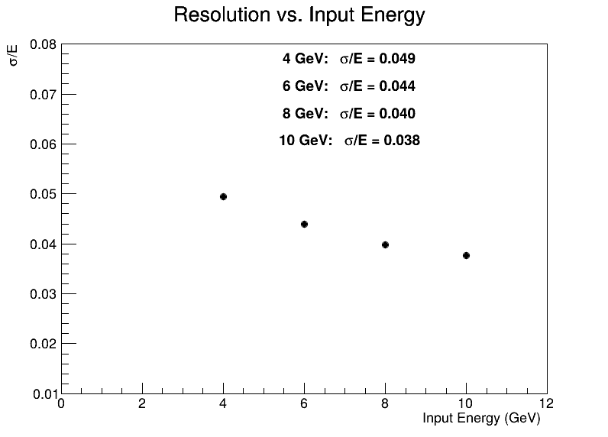
Using only MIP calibration
Containment & data quality cuts applied
Achieves a reasonable resolution, but reconstructs the peaks about 10% lower than the beam energy we requested
No beam spread subtraction!

Slide 14
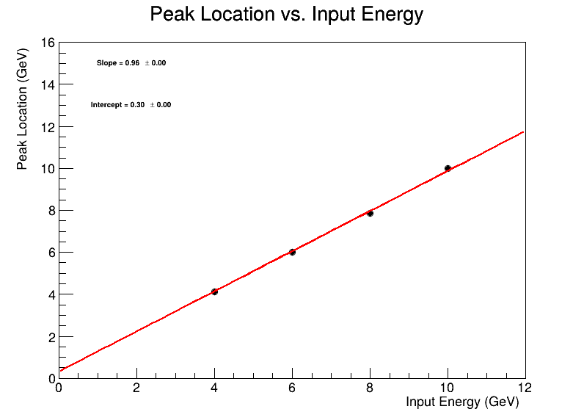
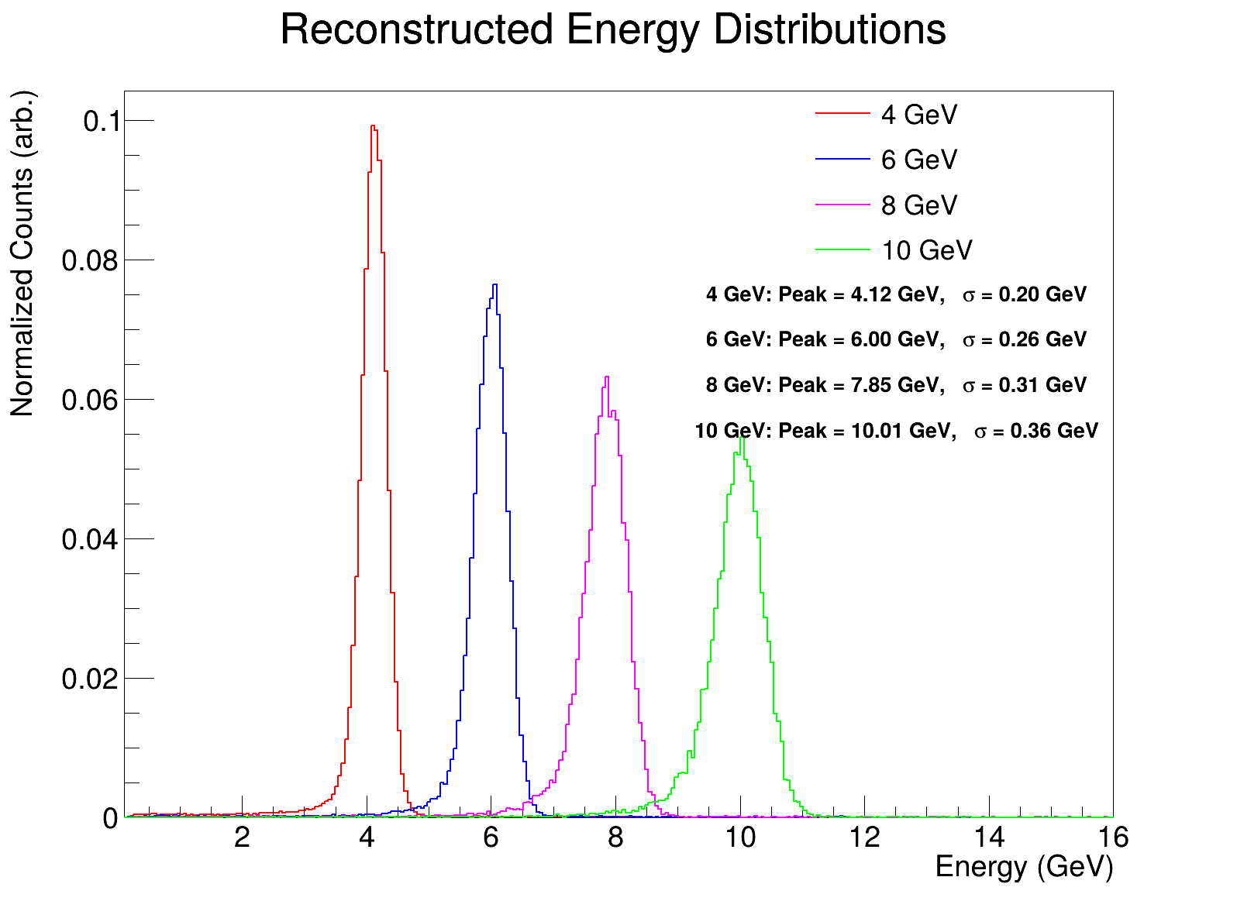

Now using the MIP calibration as a starting point, use known electron beam energy to calibrate the sum of channels on each side to the “correct” energy
Similar to the GlueX technique
This gets the peak locations ~correct (by construction)
No beam spread subtraction!

Slide 15
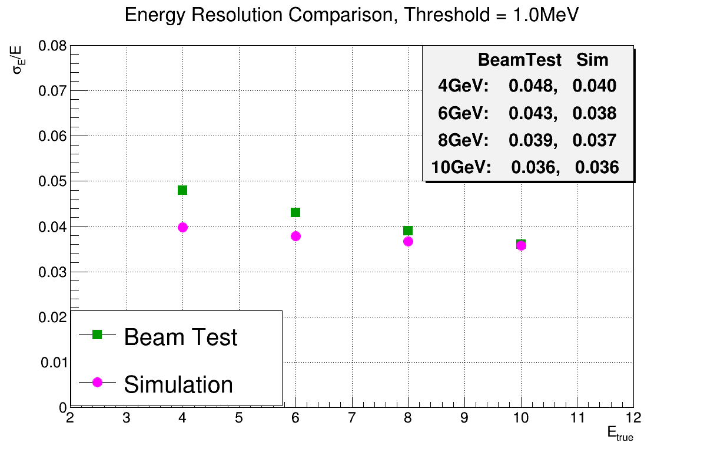
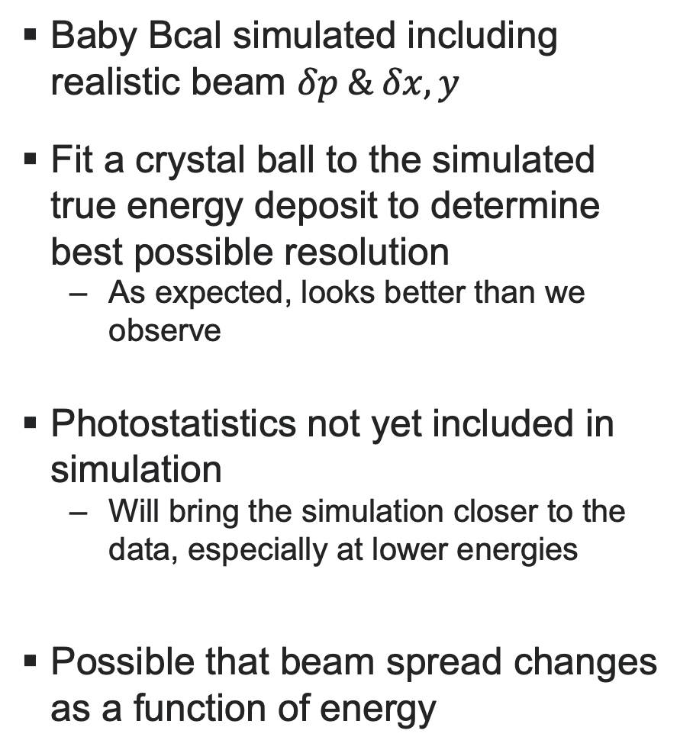
Comparison with Simulation
Baby Bcal simulated including realistic beam $δp \& δx,y$
Fit a crystal ball to the simulated true energy deposit to determine best possible resolution
As expected, looks better than we observe
Photostatistics not yet included in simulation
Will bring the simulation closer to the data, especially at lower energies
Possible that beam spread changes as a function of energy
Baby BCal simulation by Jared Richards

Slide 16
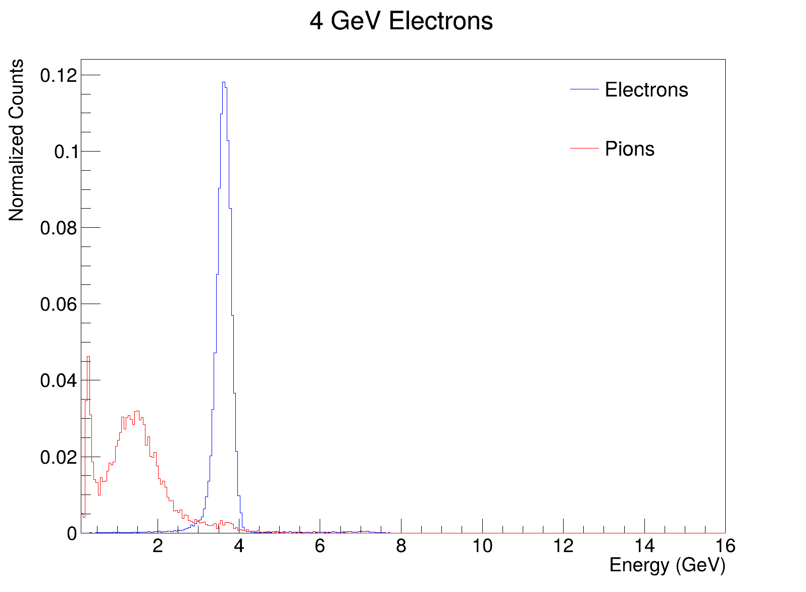
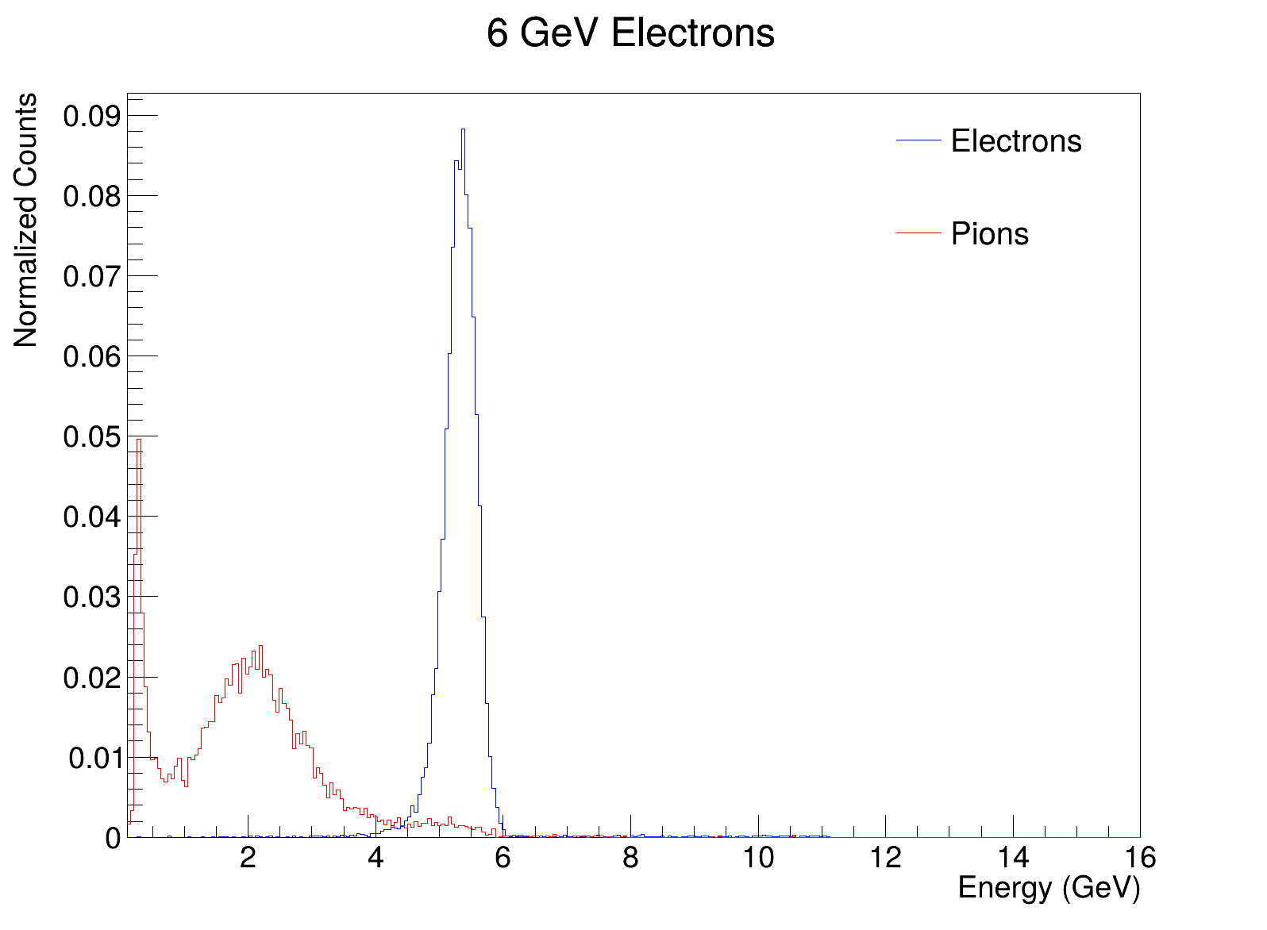
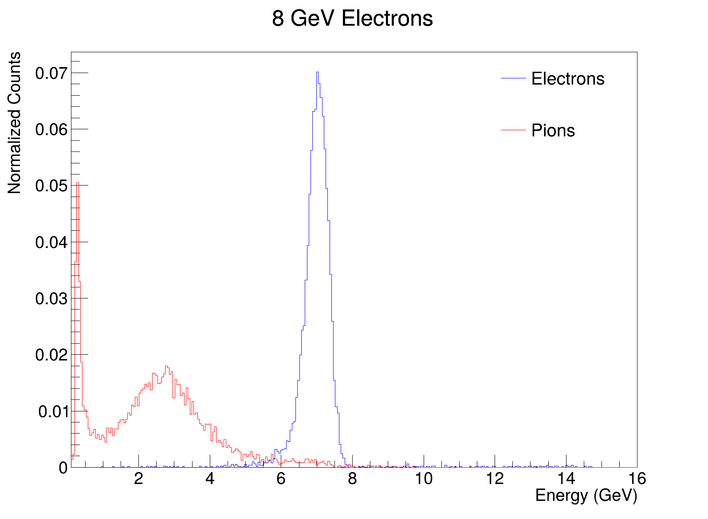
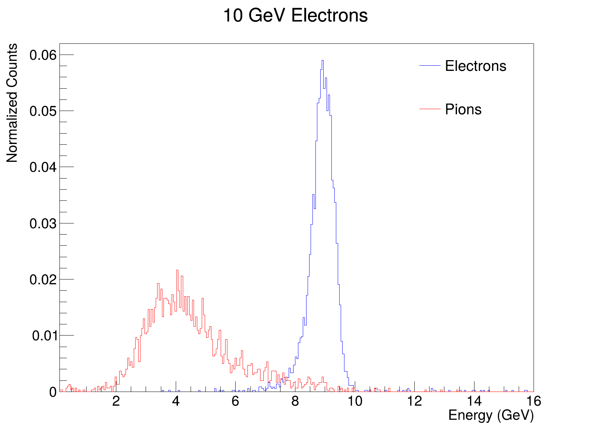
Pion energy response
Pions exhibit a MIP peak (left) and a shower peak (right)
Select pions by requiring no hits in the Cherenkovs
Apply same requirements on pions as applied in the previous slides (centered)
Want to study showering pions to determine electron/pion separation power
Due to longitudinal & transverse segmentation of calo, we can do better than a simple E/p method
Note, pion sample contains energy-dependent admixture of muons!
MIP Peak
No MIP Peak due to hardware thresholds in this run
Shower Peak

Slide 17
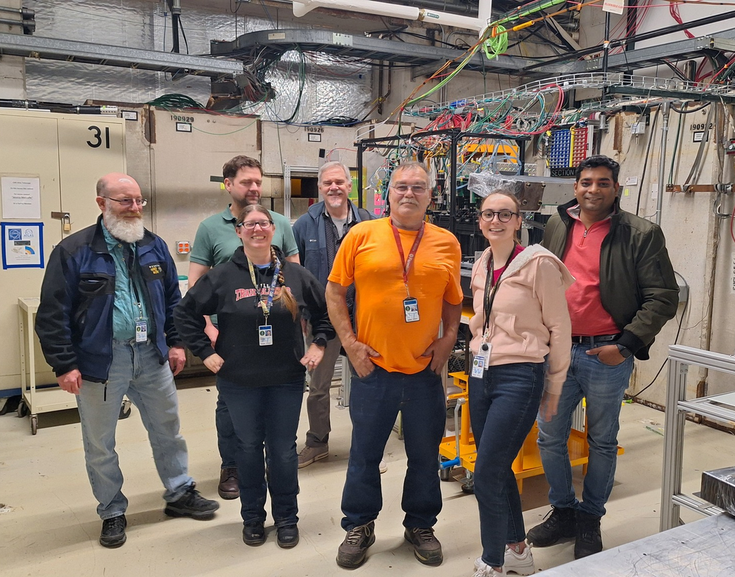

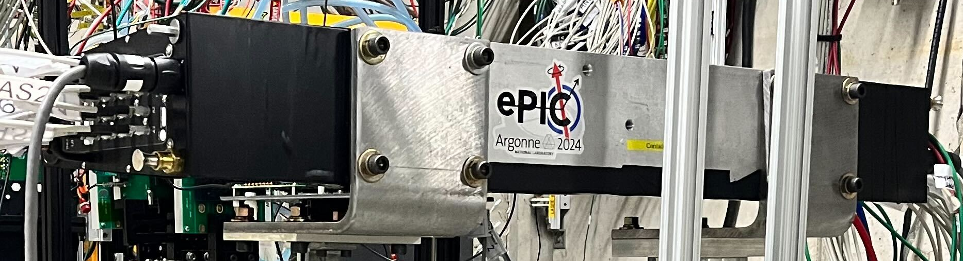
conclusion
Summer FNAL test beam campaign was very successful!
Baby BCal responds essentially as expected
Energy resolution in the right ballpark
Still improving the realism of the simulation
Once simulation is realistic, can obtain quantitative comparison of hadronic responses between simulation & reality

Slide 18
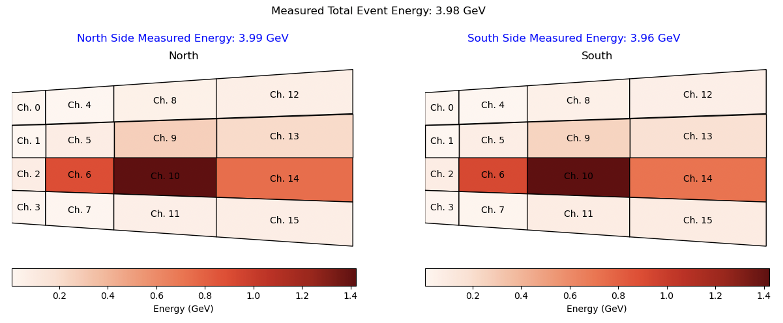
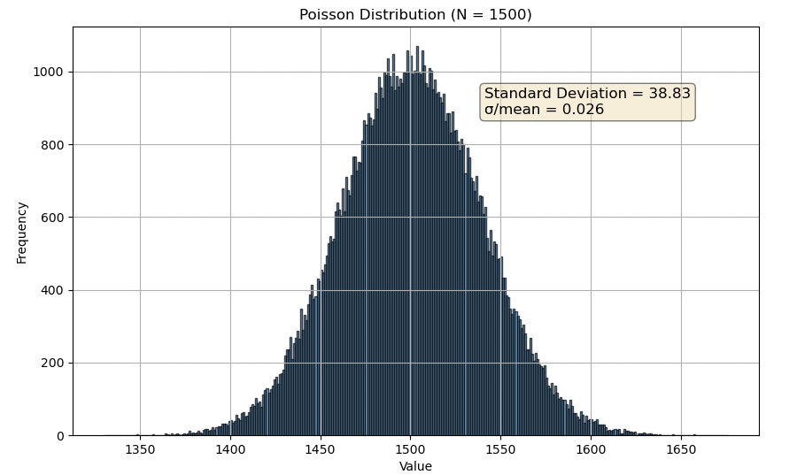
Poisson smearing
Assume 1000 p.e. per GeV
Throw a poissonian with mean of 1500 to approximate the response of the hottest channel in a typical 4 GeV electron event
Standard deviation divided by mean is non-negligible, and is thus far not included in the simulation
Could explain why the 4 GeV data is farther from the simulation than the higher energy data

Slide 19
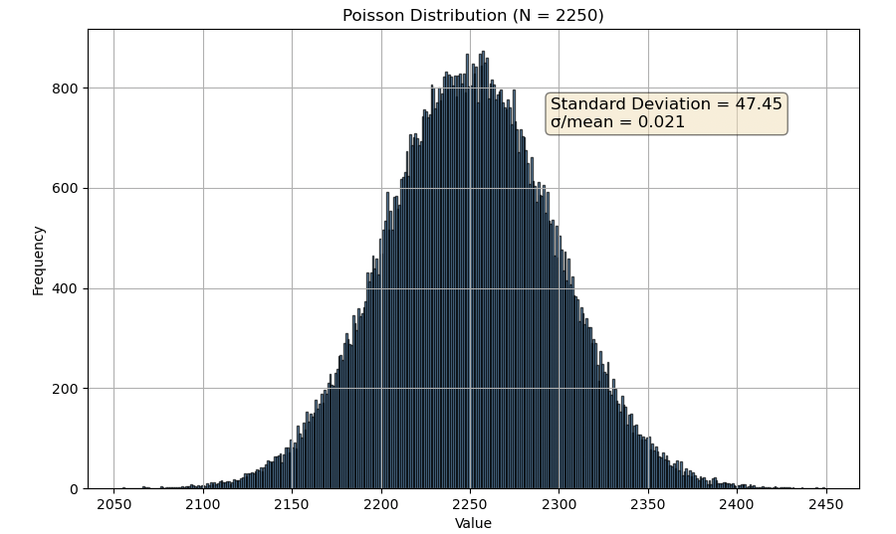
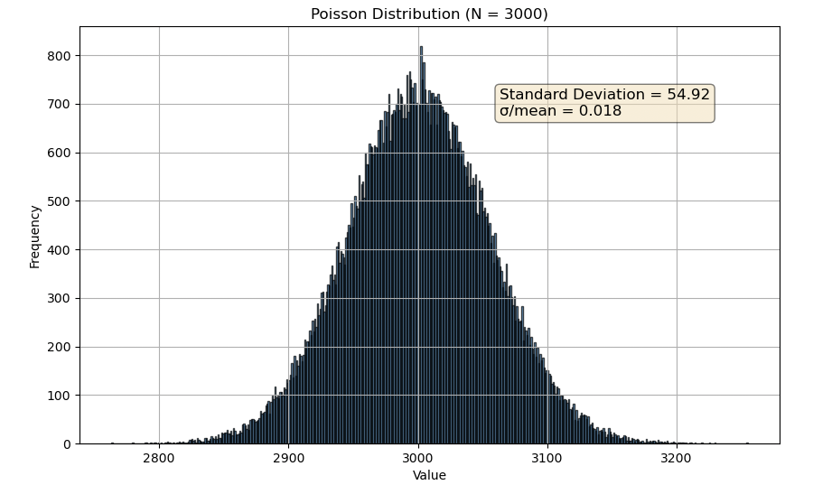
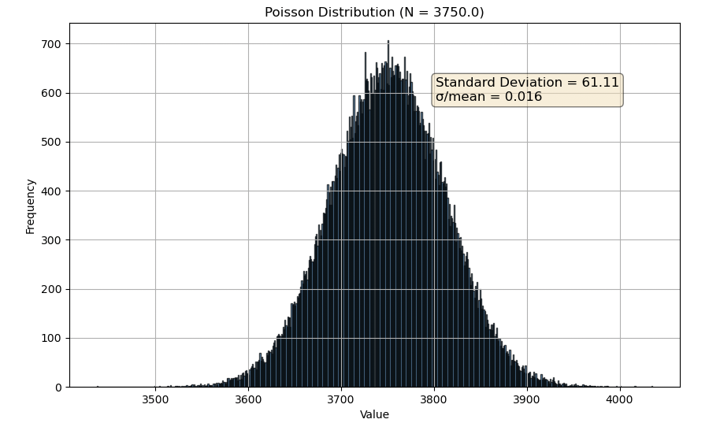
Poisson smearing
4 GeV
6 GeV
8 GeV
10 GeV

Slide 20
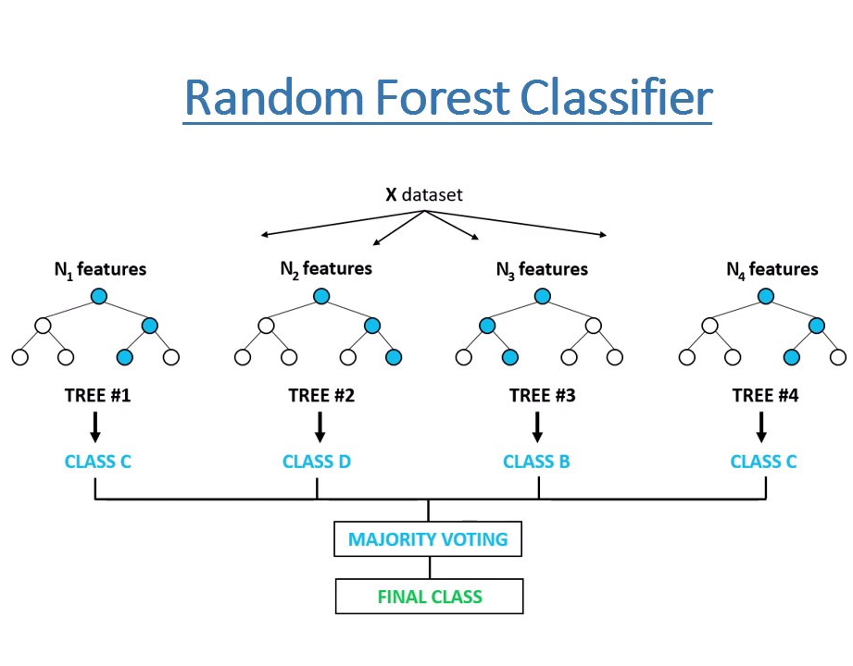
Random forest classification
Tested a random forest ML classifier
Produces a “forest” of 100 decision trees and takes the majority decision
Well suited to binary classification tasks, less prone to overfitting
Provided samples of electron data and pion data selected only with Cherenkov information
Unfortunately, pion sample contains an unknown fraction of muons!
No calibration applied, no channel masking, no cuts
Operates on raw ADC values
Achieved a pi(/mu) rejection factor of ~150 for one run of the 4 GeV data
Pion Rejection Factor at 99.9% electron efficiency: 7.25063
Pion Rejection Factor at 99.0% electron efficiency: 29.55860
Pion Rejection Factor at 97.5% electron efficiency: 55.95882
Pion Rejection Factor at 95.0% electron efficiency: 154.09189
Pion Rejection Factor at 90.0% electron efficiency: 354.23820
Pion Rejection Factor at 80.0% electron efficiency: 938.30952
This is partially but not completely degenerate with E/p method

Slide 21
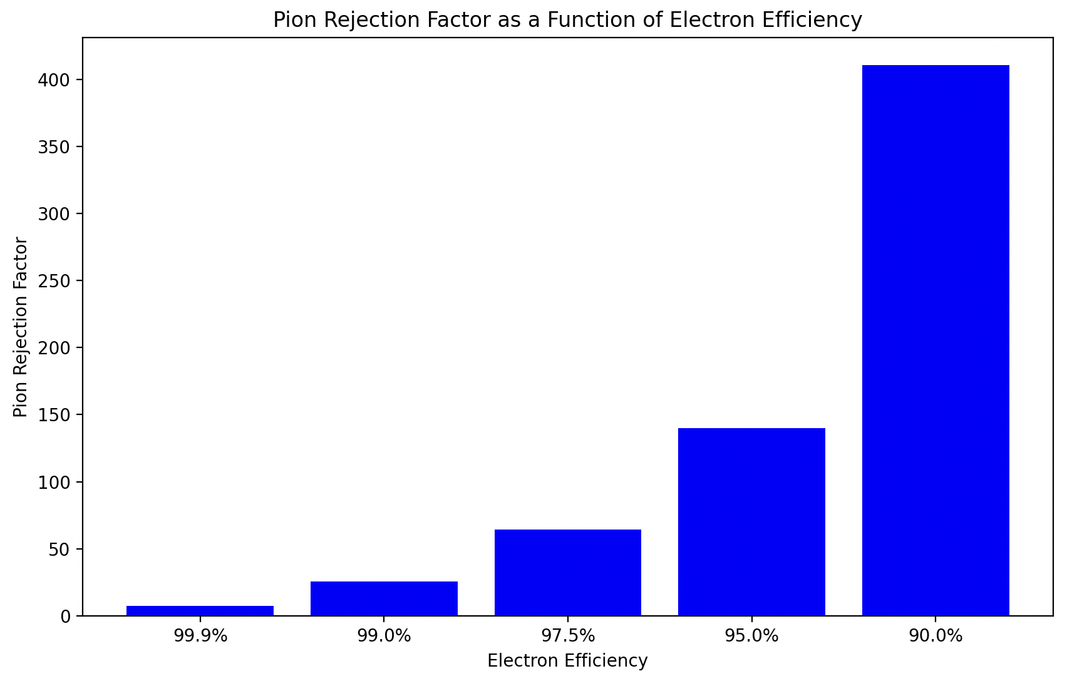
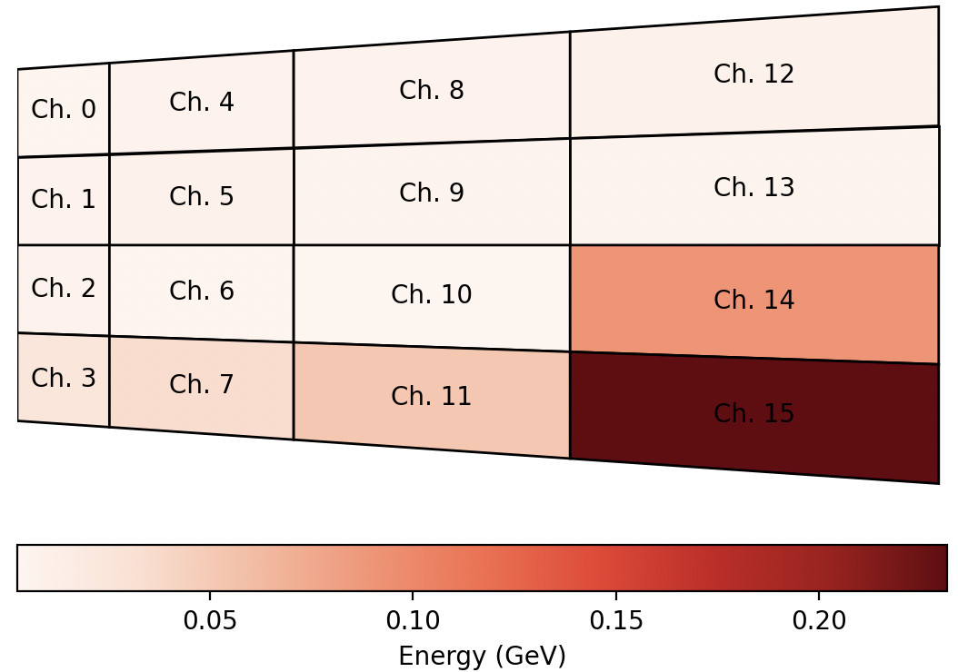
Feature | Importance
North 14 Amplitude | 0.0595
South 15 Amplitude | 0.0564
North 9 Amplitude | 0.0540
North 11 Amplitude | 0.0540
North 15 Amplitude | 0.0530
North 10 Amplitude | 0.0506
North 13 Amplitude | 0.0488
South 14 Amplitude | 0.0463
South 9 Amplitude | 0.0455
North 8 Amplitude | 0.0439
North 12 Amplitude | 0.0406
South 13 Amplitude | 0.0398
South 12 Amplitude | 0.0362
South 11 Amplitude | 0.0358
South 7 Amplitude | 0.0298
South 8 Amplitude | 0.0292
South 6 Amplitude | 0.0249
South 4 Amplitude | 0.0245
North 7 Amplitude | 0.0227
South 10 Amplitude | 0.0227
South 5 Amplitude | 0.0213
North 6 Amplitude | 0.0206
North 4 Amplitude | 0.0195
North 5 Amplitude | 0.0170
North 2 Amplitude | 0.0153
South 0 Amplitude | 0.0138
North 3 Amplitude | 0.0137
South 1 Amplitude | 0.0136
North 0 Amplitude | 0.0133
South 3 Amplitude | 0.0131
North 1 Amplitude | 0.0130
South 2 Amplitude | 0.0075

Slide 22
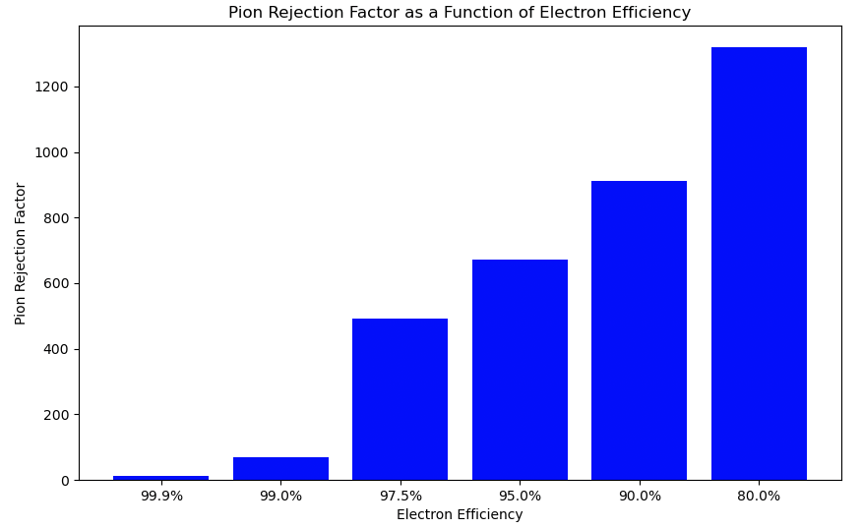
8 GeV:
Pion Rejection Factor at 99.9% electron efficiency: 10.72608
Pion Rejection Factor at 99.0% electron efficiency: 69.08765
Pion Rejection Factor at 97.5% electron efficiency: 491.44534
Pion Rejection Factor at 95.0% electron efficiency: 670.64641
Pion Rejection Factor at 90.0% electron efficiency: 912.68421
Pion Rejection Factor at 80.0% electron efficiency: 1319.42391

Slide 23
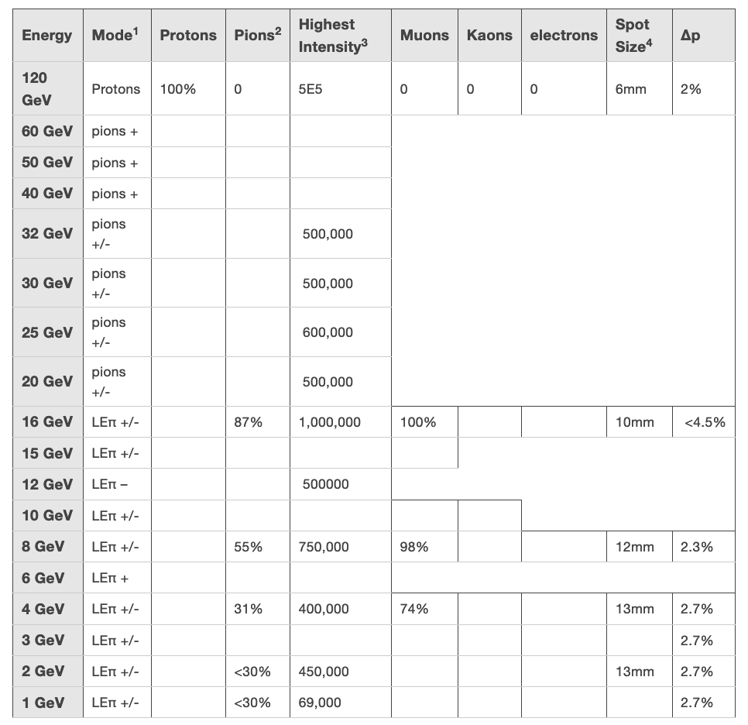
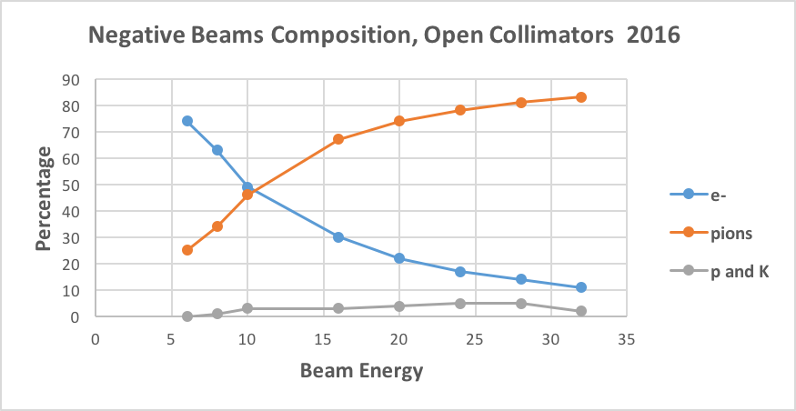
Beam composition

Slide 24
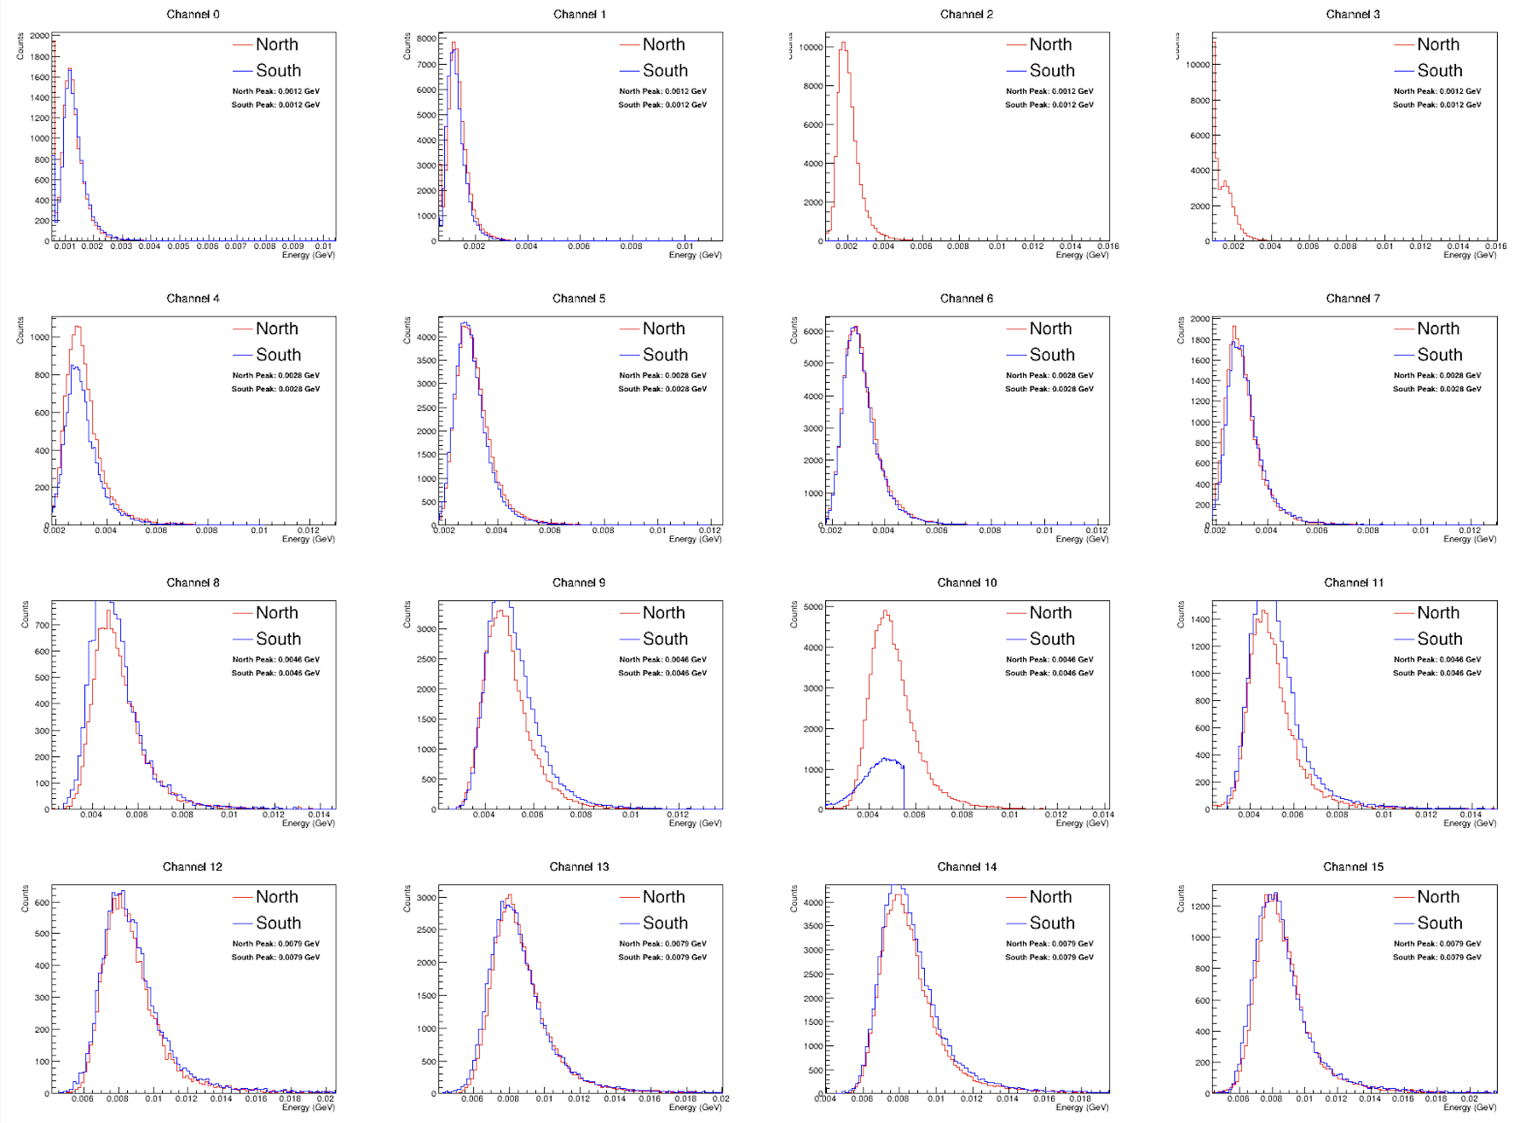
calibration
Convert ADC to energy by adjusting the MIP peak location to the energy deposit determined from simulation
“Manual” calibration used on South 2,3

Slide 25
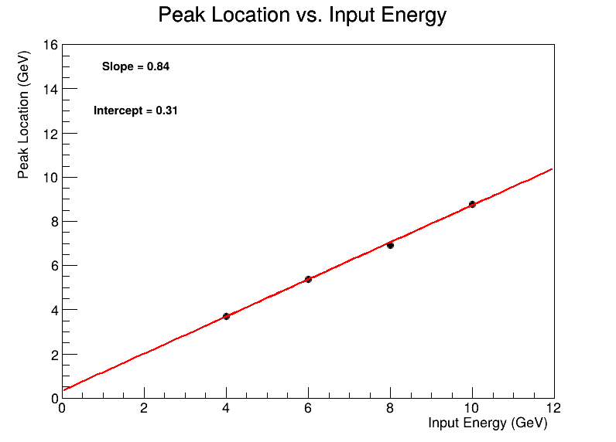
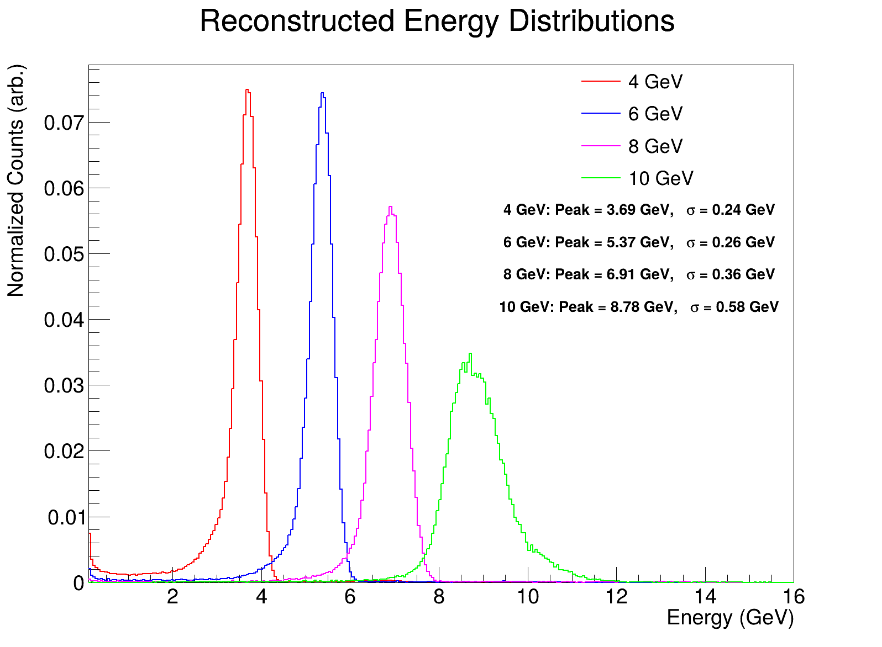
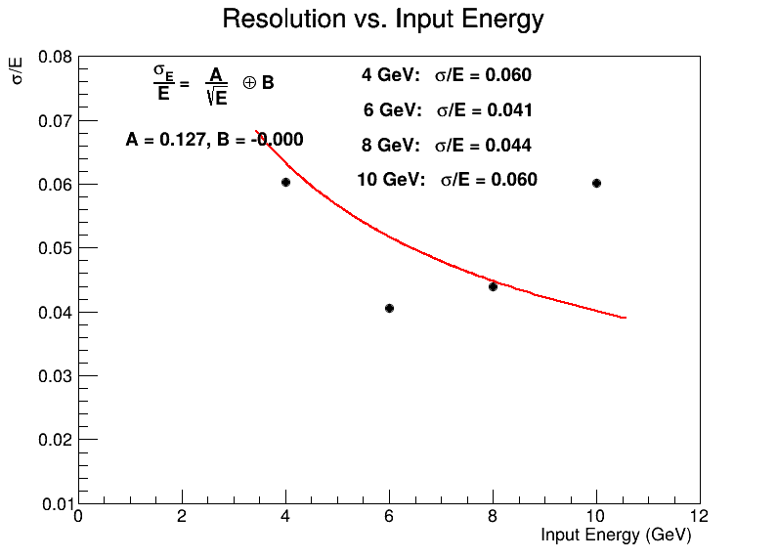
Using only MIP calibration
No containment cuts applied
South 2, 3, 10 included
2.7% beam spread subtracted

Slide 26
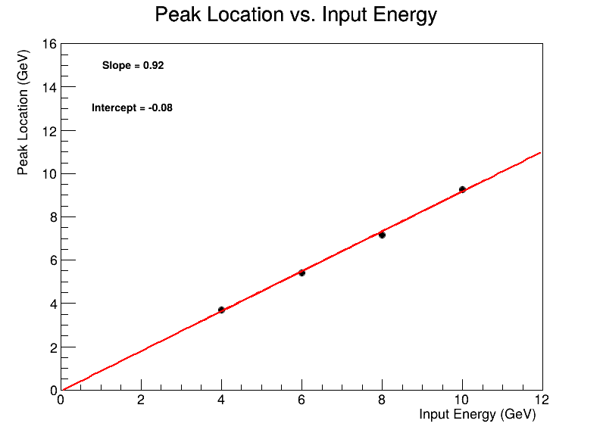
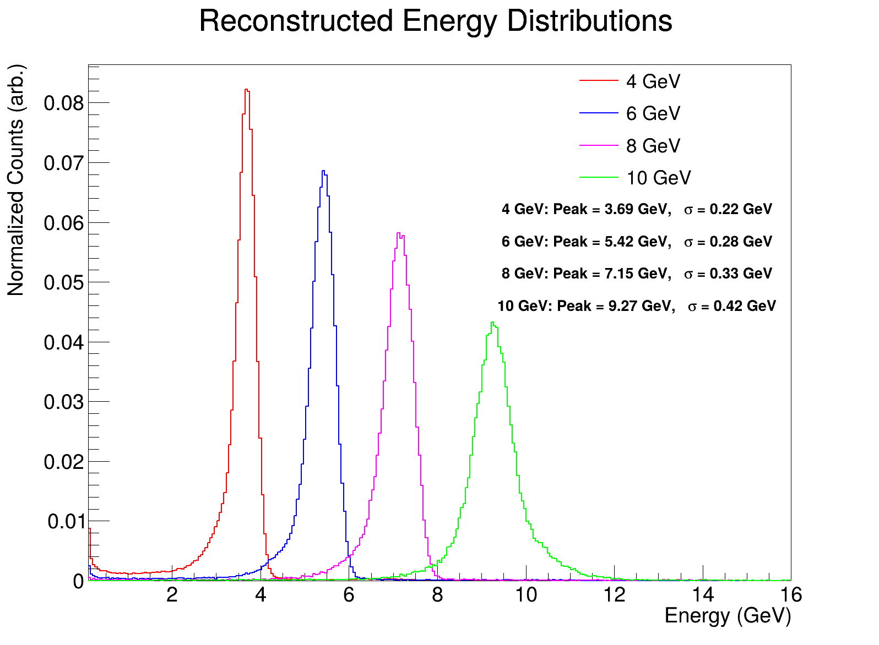
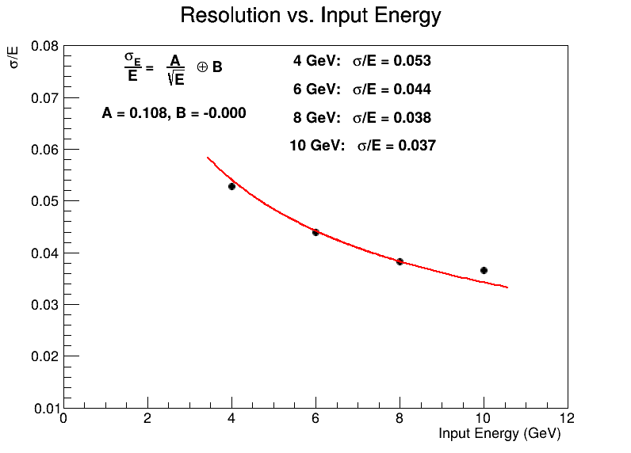
Using only MIP calibration
No containment cuts applied
South 2, 3, 10 set equal to North 2, 3, 10
2.7% beam spread subtracted

Slide 27
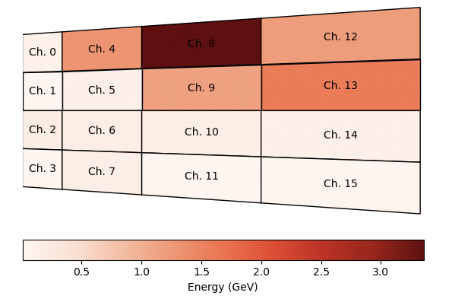
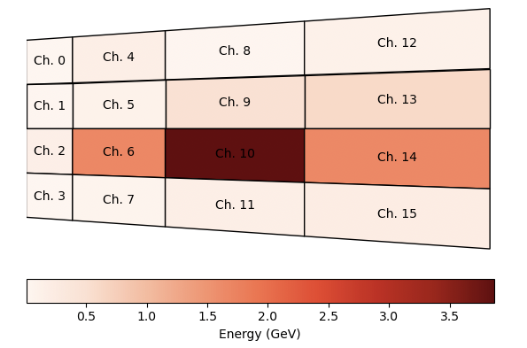
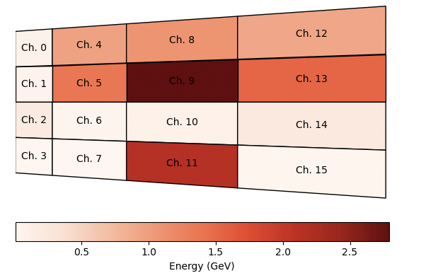
Containment cut
Require that highest energy deposit is in channels 5, 6, 9, or 10
Furthermore, require that second highest energy deposit is neighboring the highest energy deposit
Fails cuts
Passes cuts
Fails cuts

Slide 28



Using only MIP calibration
Containment cuts applied
South 2, 3, 10 set equal to North 2, 3, 10
2.7% beam spread subtracted

Slide 29

10 GeV tail
Weird tail at high energies
Seen only in the 10 GeV data
Clearly non-crystal-ball-like
Seemed like pileup at first, but upon further inspection seems to be localized to channels South 8 & 11, and only in 10 GeV data
Exclude events where N&S channels disagree by > 200 MeV

Slide 30




4 GeV
6 GeV
8 GeV
10 GeV

