Slide 1
Modified sensor geometry

Slide 2
Problems with current BTOF geometry
An enter stave is a single sensor.
Consequently, no dead space between sensors.
BTOF group is thinking of adding a support ring in the middle.
Need to leave a gap in the middle for the ring.

Slide 3
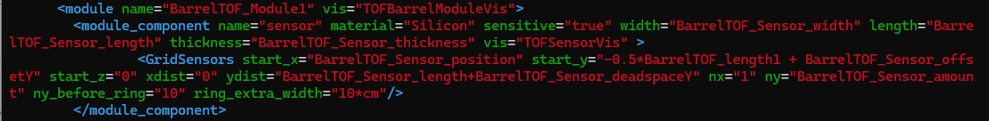
Solution: Modify epic geometry
Status: Ready to do a pull request.
Git repo: https://github.com/ssedd1123/epic
Old tof_barrel.xml:
New tof_barrel.xml:

Slide 4
Meaning of those extra variables
ny: Number of sensors in a stave
ny_before_ring: number of sensors before the ring
Ring
ydist
Distance between centers of two sensors
start_y
ring_extra_width
end_x

Slide 5
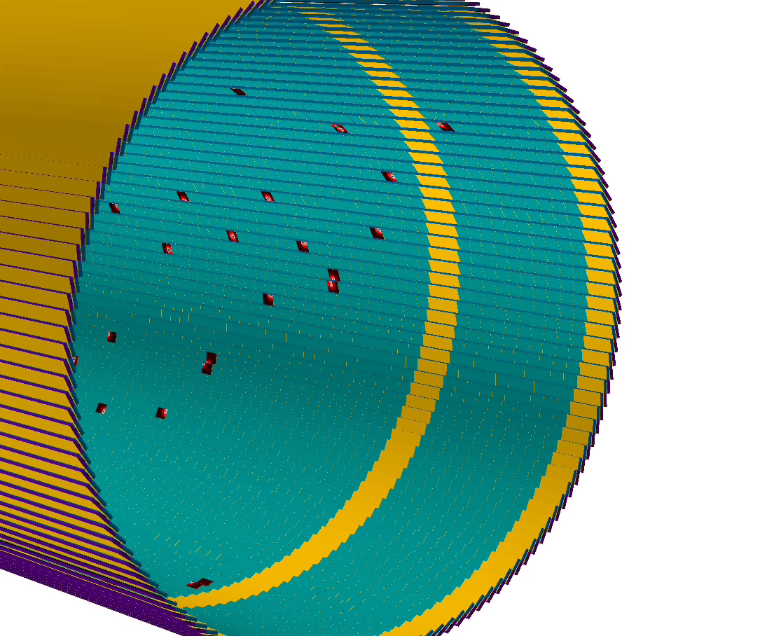
Result
ydist = 4.1 cm (0.1 cm dead space)
ny = 60
ny_before_ring = 10
ring_extra_width = 10 cm
Note: None of these numbers are accurate. Please update when plans are finalized

Slide 6
Conclusion
Please check my repo, see if it’s ready for a push request to epic.

Slide 7
Part 2: Charge spreading

Slide 8
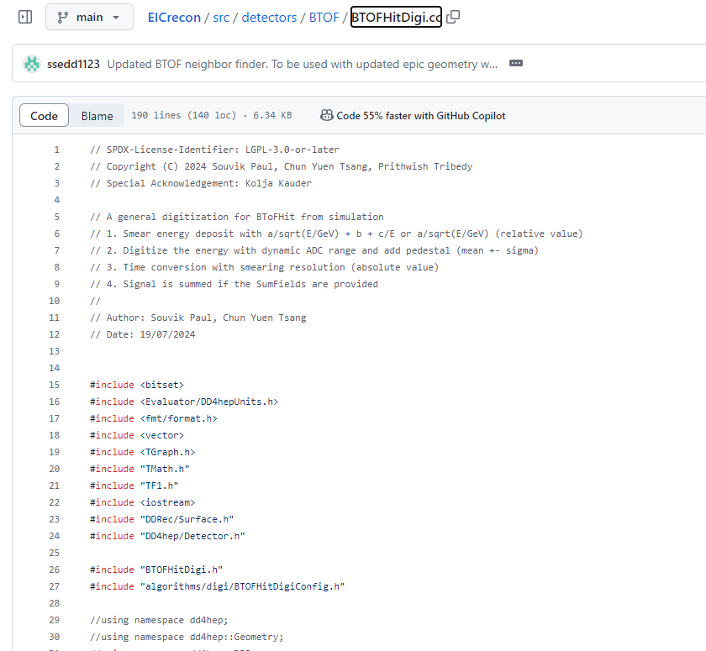
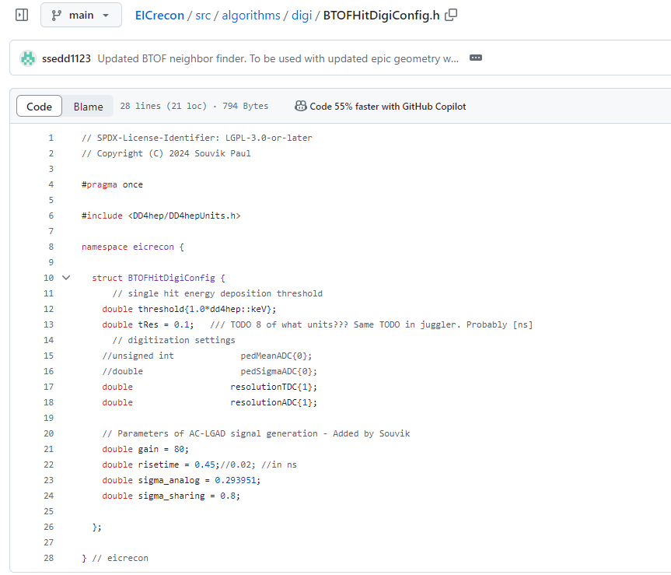
Status: Incorporated Souvik’s charge spreading code into EICrecon class
Git repo: https://github.com/ssedd1123/EICrecon
Parameters for charge spreading

Slide 9
Status: Incorporated Souvik’s charge spreading code into EICrecon class
Git repo: https://github.com/ssedd1123/EICrecon
ADC, TDC values are created by “BTOFHitDigi_factory” class.
Output branch name is “TOFBarrelADCTDC”.

Slide 10
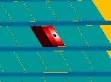
Result
Blue point: Raw hit location.
Color: ADC value (white is the highest, then red, then black is the lowest).
Charge is spread ONLY within a cell!

Slide 11
Conclusion
Please check my repo, see if it’s ready for a push request to EICrecon.

