Slide 1
ePIC Collaboration News
J. Lajoie, S. Dalla Torre
August 9, 2024

Slide 2
Just some news…
We realize it’s only been a short while since the intense summer collaboration meeting, but there’s a lot going on in August and we want to do our best to keep everyone up-to-date
Here’s a few announcements…

Slide 3
Important Meetings w/in ePIC
CA Consortium Meeting
August 14-15th, 2024
The California EIC Consortium is a UC-wide Multicampus Research Programs and Initiatives (MRPI) center focused on the physics of Electron Ion Collider (EIC). We are funded by UC Office of the President. Our consortium consists of four UC campuses (Berkeley, Davis, Los Angeles and Riverside), Cal Poly SLO and three national laboratories (LANL, LBNL and LLNL).

Slide 4
Software Tutorial Series
Next Tutorial: Working with Simulation Output Presenter: Stephen Kay (University of York) Date: Thursday, September 12 Time:
10:00 a.m. (BST) for Africa, Asia, Australia, and Europe.
4:00 p.m. (BST) for Africa, Europe, North America, and South America.
Upcoming Tutorials:
Reconstruction Algorithms
Validation
“Working with Simulation Output” on a monthly basis,
With a focus on the changes to the software and simulation campaigns.
“Full chain” analysis example
We welcome suggestions for future tutorials, including shorter tutorials on specialized topics, such as calorimeter reconstruction as suggested during the collaboration meeting.

Slide 5
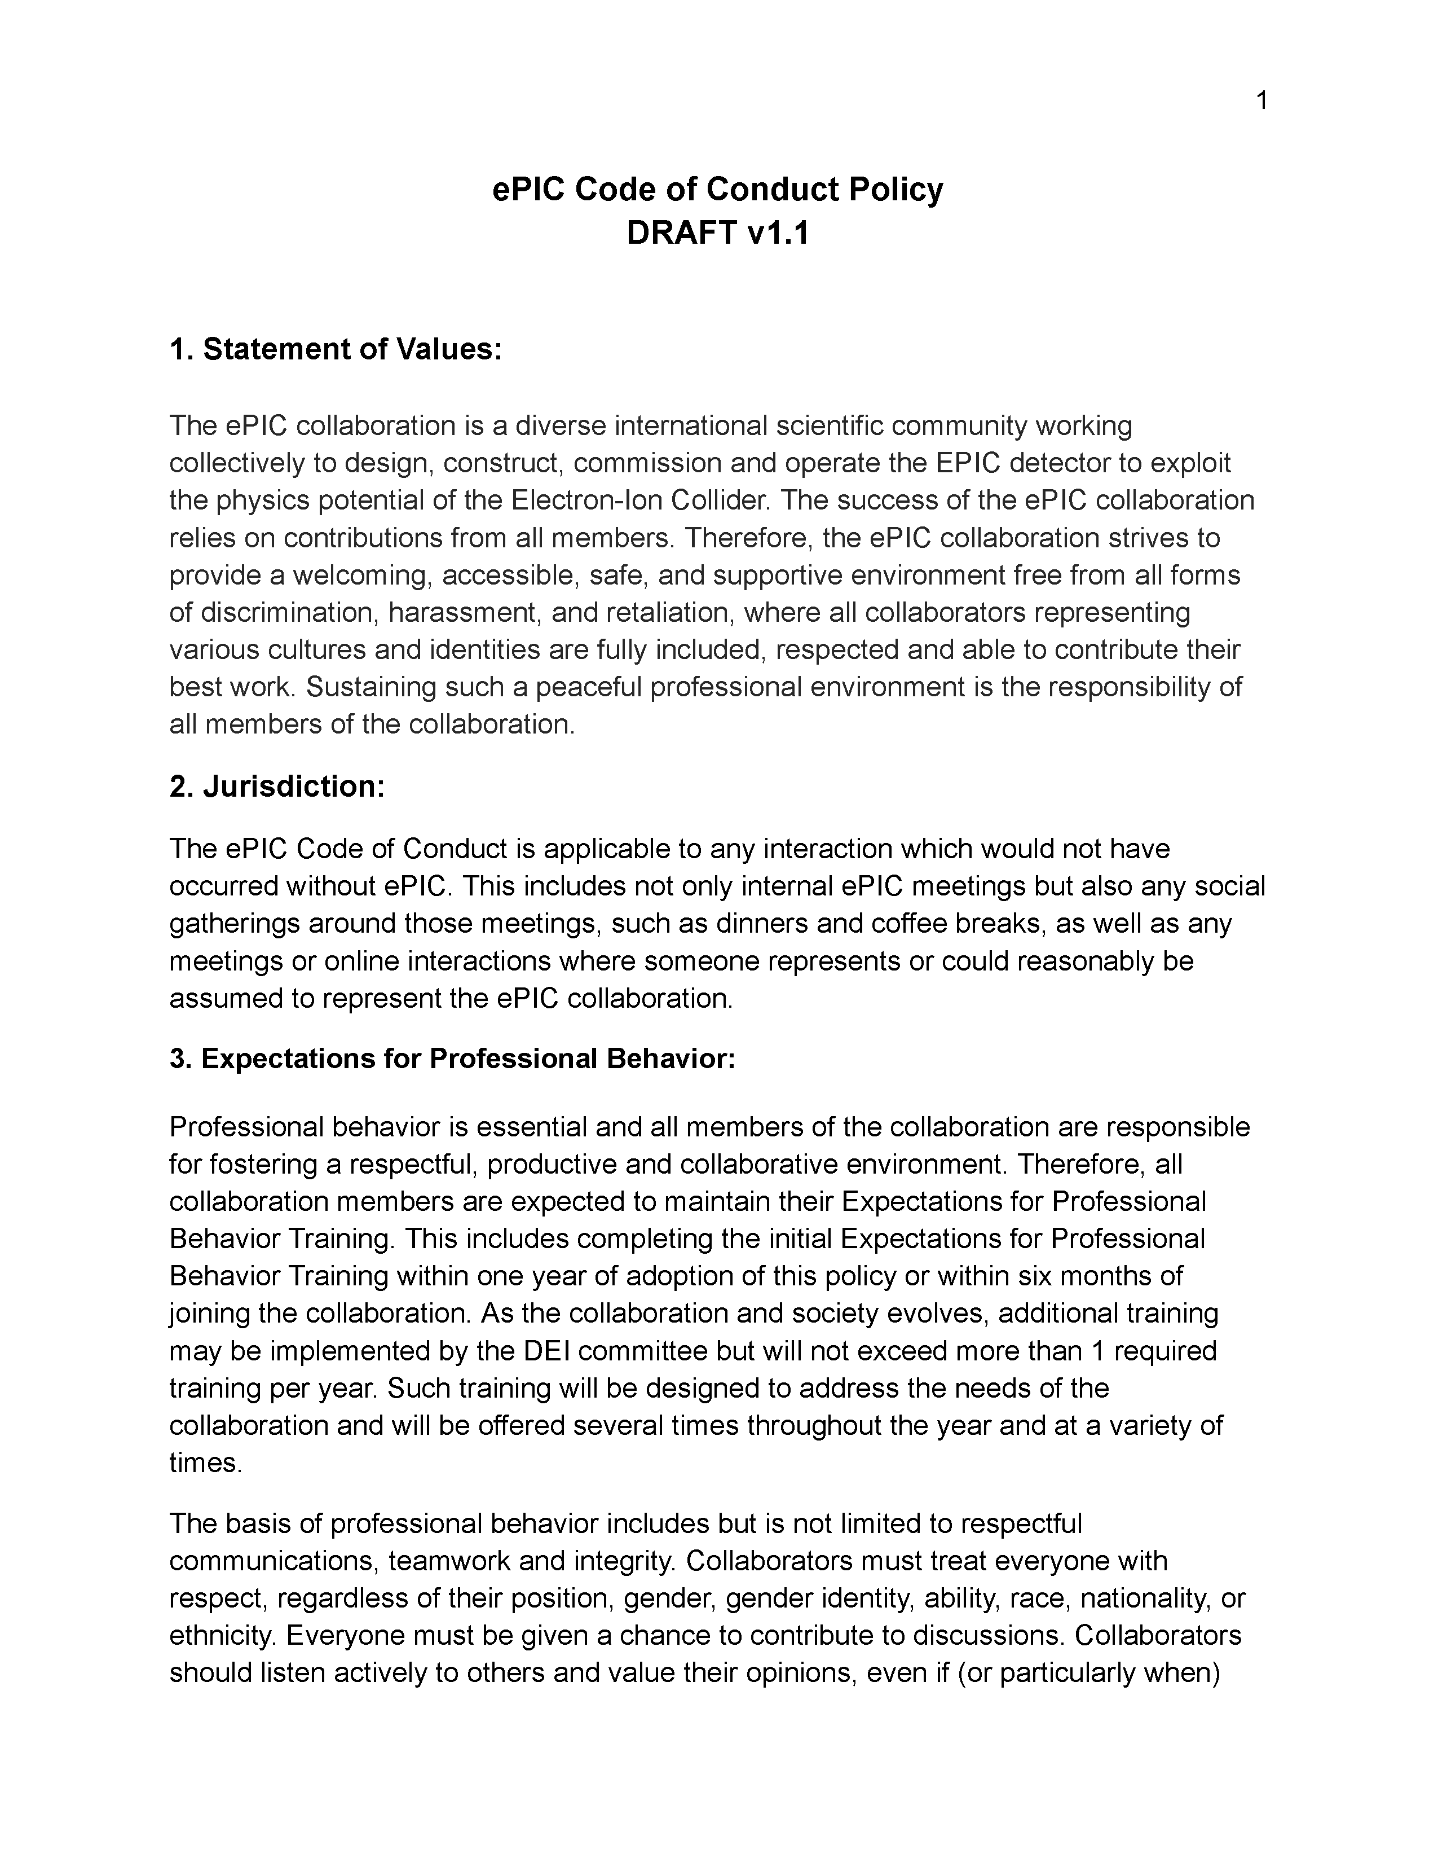
Code of Conduct
Draft code of conduct sent out 7/25
Comments due today, August 9th
Please send all suggestions and feedback directly to Megan Connors (mconnors@gsu.edu)

Slide 6
EIC Project Strategy Workshop
From Jim Yeck’s recent EICUG report
The purpose of the Workshop is to engage stakeholders in the development of plans for delivering the EIC project scope and performance and to consider lessons from other large projects.
There will be a Director’s Review of the EIC Project on October 22-24, 2024, and a DOE Independent Project Review on January 7-9, 2025. The August Workshop will help us prepare for these important reviews.
Sylvia and I will present on “ePIC Collaboration Plans in Support of Early Science”

Slide 7
EIC “Host” Lab User Experience Workshop
Workshop August 26th
We will present “ePIC Collaboration Needs Overview” – will coordinate with EICUG and RHIC/AGS Users Group

Slide 8
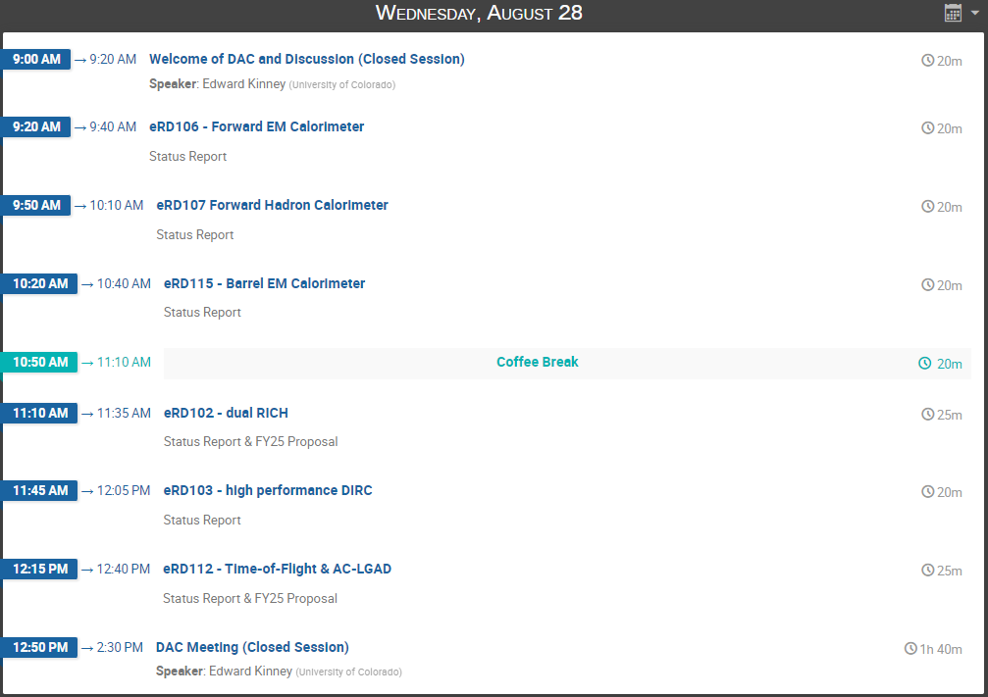
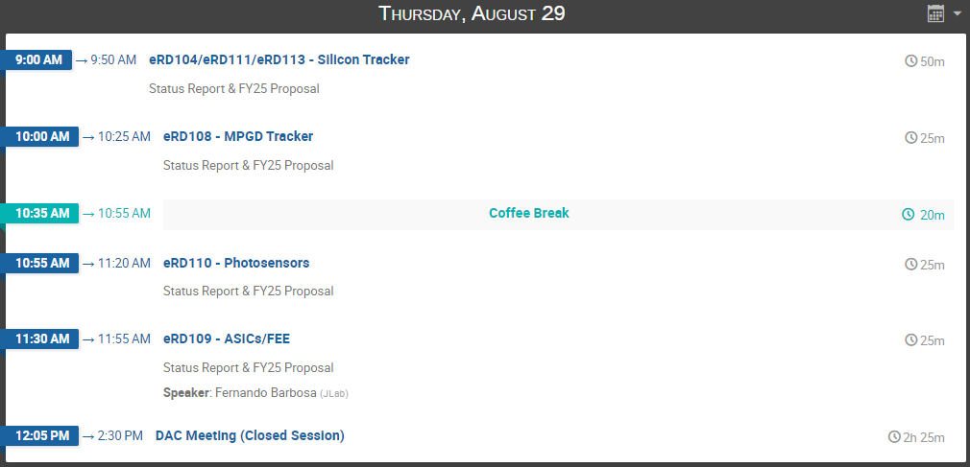
DAC R&D Meeting: August 28-29th
https://indico.bnl.gov/event/24086/
FY’24 Progress Reports and FY’25 Proposals: https://wiki.bnl.gov/conferences/index.php/ProjectRandDFY25

Slide 9
Early Physics with ePIC
From Elke’s recent EICUG talk
At the recent EICUG/ePIC meeting, Elke started the discussion of what the staging the EIC might mean to an early science program, and what that program might look like.
This is a starting point for discussion, and was presented as such.
Lots of hallway discussions, lots of ideas…

Slide 10
ePIC Early Physics Workshop and Discussion
First ePIC Early Physics Workshop:
Sept. 13th, 2024, 10:30AM ET
Between GM’s but we are using the GM time slot. Format and agenda TBD.
An opportunity for the collaboration to consider the EIC early science program, taking into account both the evolution of the EIC and the need to do impactful science.
Should result in tangible actions items.
This will be the first in what will likely be a series of workshops.

Slide 11
Lots of other activity as well…
Progress on collab tools, website
Collaboration database requirements document provided to SDCC
https://zenodo.org/records/13273309
Simulation plot browser is gaining material and functionality
https://eic.jlab.org/epic/image_browser.html#
It’s also time to focus on timelines for pre-TDR…

Slide 12
Summary
August will be a(nother) busy month!
Stay tuned for more information, details and announcements
Next General Meeting – Thursday, August 22nd, 7:30PM ET

Slide 14
Hey John, start the recording….

Slide 15
ePIC Resources
Public Website - https://www.bnl.gov/eic/epic.php
Mailing Lists – https://lists.bnl.gov/mailman/listinfo
Indico Agenda - https://indico.bnl.gov/category/402/
ePIC Software and Computing: https://indico.bnl.gov/category/435/
Wiki - https://wiki.bnl.gov/EPIC
ePIC Software Training:
Landing Page: https://eic.github.io/documentation/landingpage.html
Tutorials: https://eic.github.io/documentation/tutorials.html
Mattermost: https://chat.epic-eic.org
ePIC Zenodo Community: https://zenodo.org/communities/epic

Slide 16
EICUG Membership
The EICUG is a vital organization to promote the interests of the EIC community!
Without the EICUG we would never have gotten far enough to form ePIC!
Please register your institution!
Check with your EICUG IB representative to get registered as a member
https://www.eicug.org/content/join.html

Slide 17
Upcoming Notable Events…
DIS 2024 in Grenoble, France April 8-12th , 2024
https://lpsc-indico.in2p3.fr/event/3268/
ePIC Software and Computing meeting @ CERN April 22nd-26th
https://indico.cern.ch/event/1343984/
EIC RRB Meeting – May 6-7th in Italy
MC4EIC @ Durham University June 5-7th
https://conference.ippp.dur.ac.uk/event/1292/
JLab Users Meeting, June 8-12th
https://www.jlab.org/conference/2024-jluo
4th EIC-Asia Workshop in Shanghai July 1-5, 2024
https://indico.cern.ch/event/1361239/
Joint EICUG/ePIC Collaboration Meeting @ Lehigh University July 22nd-28th
https://indico.bnl.gov/event/20727/

