Slide 1
EIC Project News
E.C. Aschenauer (BNL), R. Ent (JLab)
Co-Associate Directors for the EIC Experimental Program
ePIC Bi-Weekly
August 22nd, 2024

Slide 2
On we go: ePIC Detector Path to CD-3B and to CD-2/CD-3
Detector Design Reviews (organized by the EIC Project):
PDR2: IR Integration and Auxiliary Detectors – February 12, 2024 – main emphasis on baseline choices and progress
PDR1: Tracking Detectors – 20-21 March 2024 – main emphasis on baseline tracking layout, if we are on track and plans
PDR2: Electronics/DAQ – June 10 -11, 2024 – continuation of PDR1 to ensure we are on track and show progress
PDR: Integration, Infrastructure and Installation – July 15, 2024 – barrel and endcaps flux return steel
PDR2: Particle Identification Detectors – Fall 2024
PDR2: Barrel EM Cal – September 18th – emphasis on mechanical design & AstroPix readiness
FDR: Backward & Forward EM Calorimetry, Barrel & Forward HCAL – Fall 2024 → Winter 2024 (late January or February 2025)
PDR2: Polarimetry – timescale TBD (but before CD-2)
FDR for any potential CD-3B scope:
Magnet Power Supply – May 28th 2024
VTRx+/lpGBT add ½ day to electronics/DAQ PDR2 on June 11th 2024
Magnet Steel September 2024
BNL Off-Project Dependency review (organized within BNL) scheduled for August 22-23, 2024
Detector Advisory Committee Meetings 2024/2025:
June 21, 2024: 8th DAC meeting - strategic advice on the planning for the construction phase of the ePIC detector
August 28-29, 2024: 9th DAC meeting - Annual advice on detector R&D status and FY25 completion needs
https://indico.bnl.gov/event/24086/
Spring 2025: 10th DAC meeting - Comprehensive look of DAC to design status and readiness for CD-2.
Software & Computing Reviews (organized by the host labs):
ePIC Detector Software Infrastructure Review https://indico.bnl.gov/event/16676/ – August 22-23, 2022
ePIC Software & Computing review by host labs https://indico.bnl.gov/event/20481/ – October 19-20, 2023
Next ePIC Software & Computing review (by host labs) – September 26-27, 2024

Slide 3
And it starts again

Slide 4
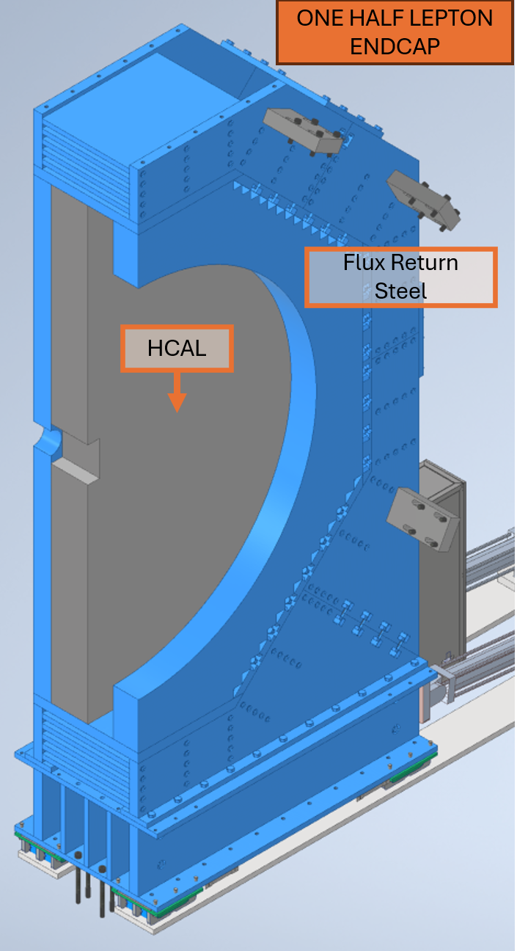
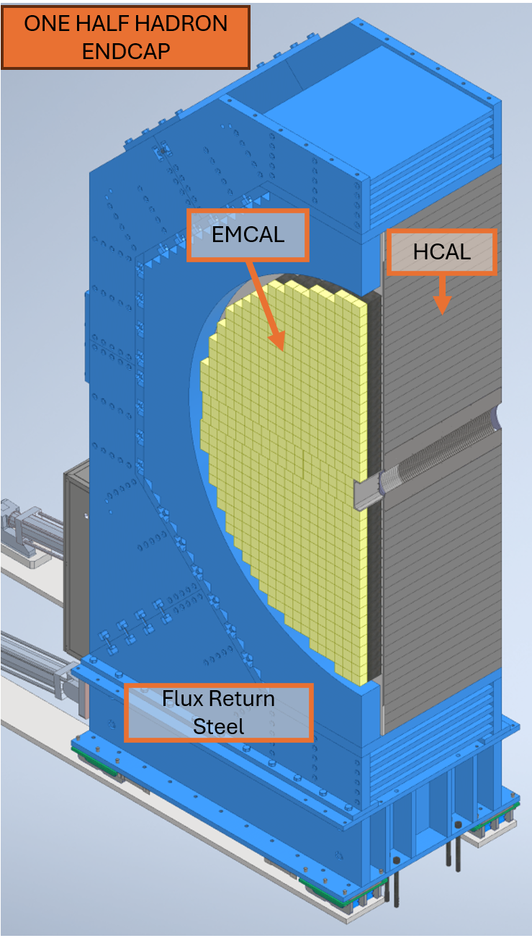
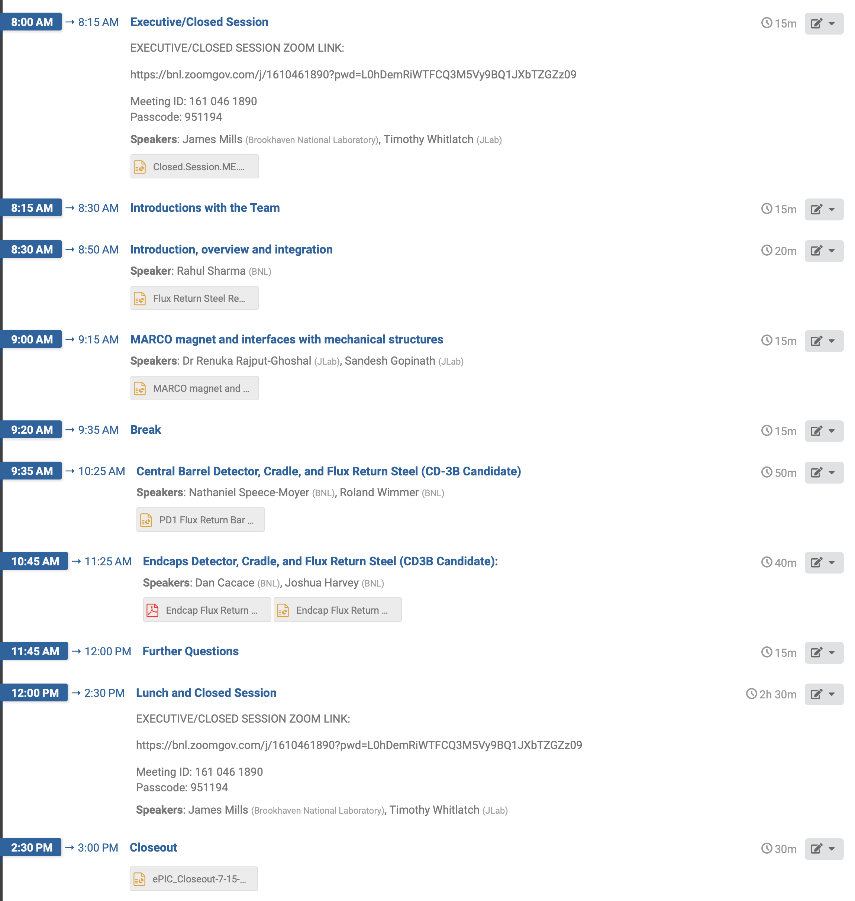
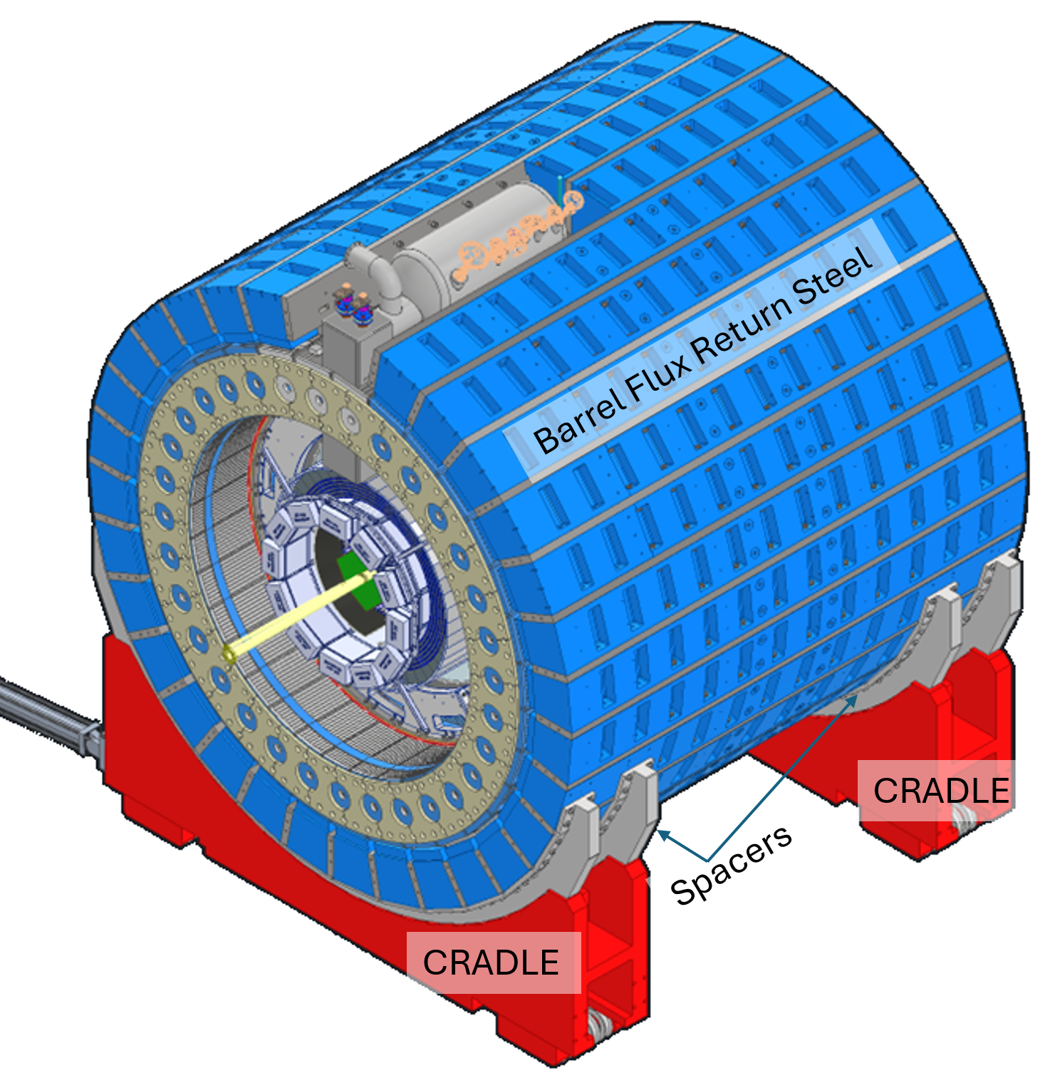
Incremental Preliminary Design Review of the ME design of ePIC
Focus on Barrel and Endcaps flux return
Reviewers: Tim Whitlatch (Jlab) and Jim Mills (BNL)

Slide 5
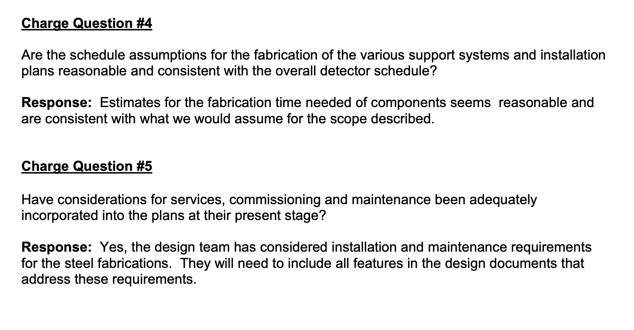
Incremental Preliminary Design Review of the ME design of ePIC
Working on this: define service space requirements, fill factors, tolerance needs, safety factors, etc.

Slide 6
Standardizing
To standardize Readout and keep material budget and services under control we decided to use VTRX+ and LpGBT not only in the MAPS and dRICH, but in all inner detectors (MPGDs, TOF, pfRICH) and the ancillary ones
→ Final production of VTRX+ modules starts ~May 2025, ends December 2026 → VTRX+ & LpGBT CD-3B item

Slide 7
Highlights on what else is going on
6.10.02 Detector & R&D and Physics Design
Detector R&D reports and as applicable FY25 proposals towards P6 milestone completion are on https://wiki.bnl.gov/conferences/index.php?title=ProjectRandDFY25#2024_Progress_Reports_and_FY2025_Proposals. The agenda for the 9th Detector Advisory Committee meeting of August 28-29, 2024, to give advice on the detector R&D is posted at: https://indico.bnl.gov/event/24086/.
6.10.03 Tracking
Designs for the various micro-pattern gaseous based detector types are well underway with engineering test article demonstrators planned. The need for detailed workflow documentation that everybody uses for assembly and later operations was discussed as the quality and performance of these detectors can be sensitive to the environment, cleanliness, and humidity.
A solution to resolve the interference between the μRWell and DIRC has been found to allow for easier maintenance
6.10.04 Particle Identification
We had a CCB-lite meeting to discuss the programmatic change request in detector 6.10.04 to add in the AC-LGAD labor that was mostly missing. It was approved and implemented in P6. Much of this labor may later become in-kind with various countries showing interest.
Continue to work on the technology transfer from BNL-IO to Taiwan for AC-LGADs

Slide 8
Highlights on what else is going on
6.10.05 Electromagnetic Calorimetry
Continuous progress on LLP - items ScIFI
Vendor for fECal SciFis chosen and contract close to signature
Proposals from Vendors for Barrel SciFis received, moving forward with vendor selection
Contract for PbWO4 is making good progress as well
6.10.06 Hadronic Calorimetry
Implemented the lessons learnt from the first engineering test article in the design of the fHCal modules
and produce the next 5 ones.
Got the blessing from the BNL safety committee for the module design
Move in parallel ahead with LLP paperwork to place the contract soon
6.10.07 Detector Magnets
A SOW and the Technical Specifications document have been finalized for the EIC detector solenoid superconductor (CD-3A scope).
The draft documents for a tender package for the magnet construction contract is close to be final. We have iterated a draft 180-page MARCO magnet design report.
6.10.11 IR Integration & Ancillary Detectors
A design to make a 3D-printed mock-up of the detectors that will be located within the warm area of the B0 magnet bore (trackers and electromagnetic calorimeter) is worked on.

