Slide 1

ePIC Collaboration News
J. Lajoie, S. Dalla Torre
August 22, 2024

Slide 2
Hey John, start the recording….

Slide 3
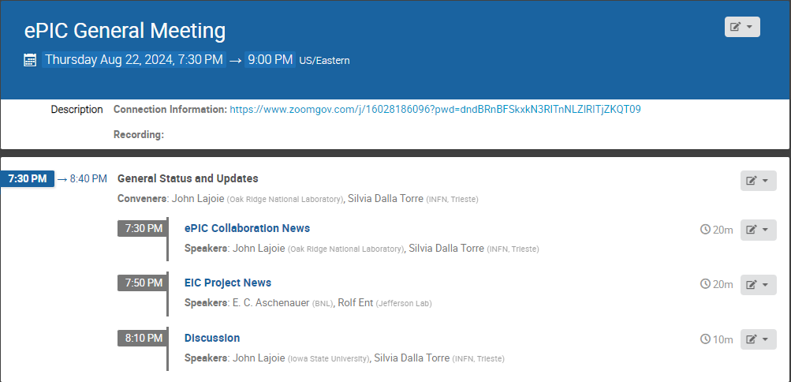
Agenda

Slide 4
News from the SP Office
EIC Strategy Mtg
August 21st
ePIC Early Physics Workshop
Sept. 13, 2024
Everything is continuing at a fast pace coming out of the Lehigh Collaboration Meeting.
ePIC draft pre-TDR Version 1
December 1, 2024
Lehigh Collab. Mtg. July 2024
PDR2: PID Detectors
Summer/Fall 2024
ePIC Software and
Computing Review
Sept. 26-27th
Frascati Collab. Mtg. Jan 2025
FDR: Magnet Flux Return Steel
(poss. CD-3B scope)
Sept. 2024
EIC “Host” Lab User Experience Workshop
August 26th
Detector Advisory Committee R&D Meeting
August 28-28th
ePIC draft pre-TDR Version 0
Sept. 29, 2024
EIC Project CD-3B Review
January 7-9th, 2025

Slide 5
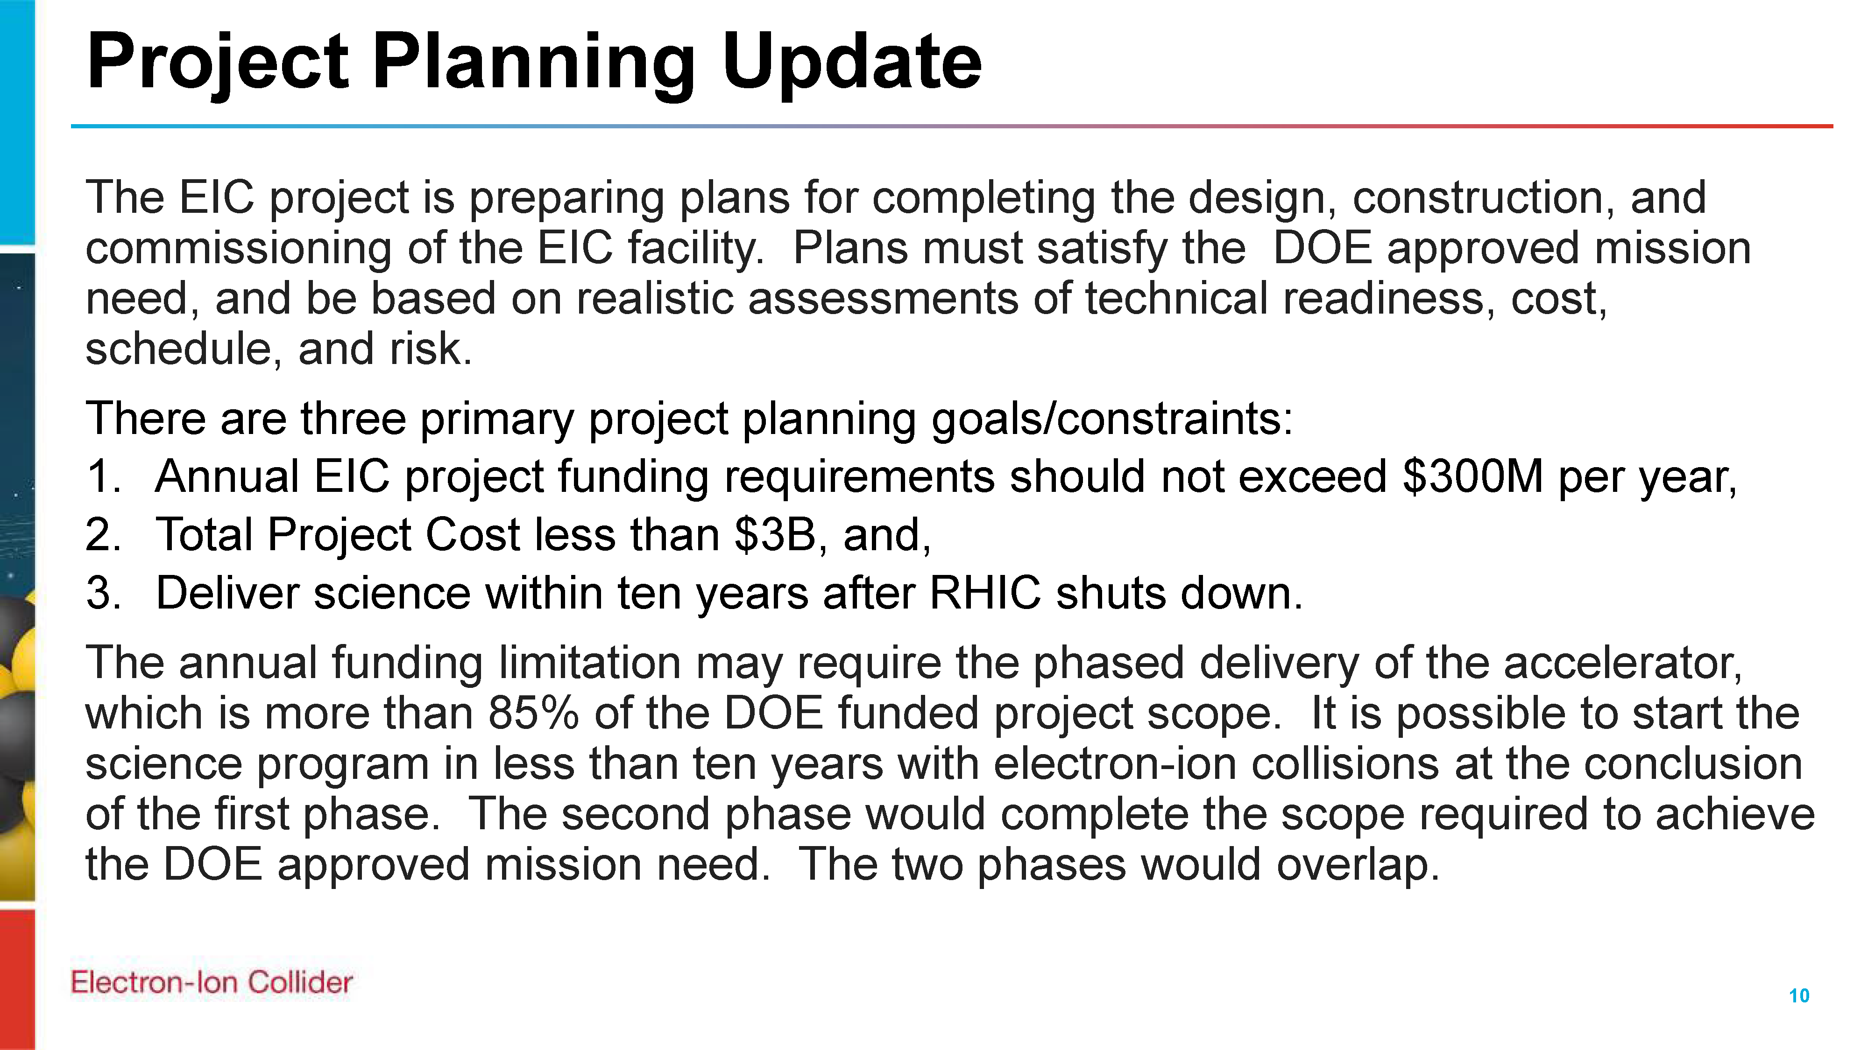
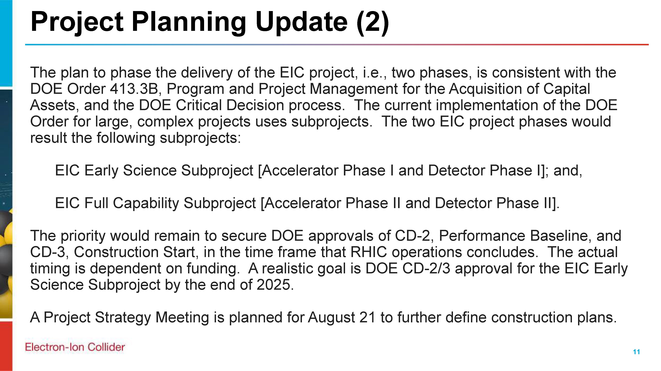
EIC Project Strategy Workshop
From Jim Yeck’s recent EICUG report
The purpose of the Workshop is to engage stakeholders in the development of plans for delivering the EIC project scope and performance and to consider lessons from other large projects.
There will be a Director’s Review of the EIC Project on October 22-24, 2024, and a DOE Independent Project Review on January 7-9, 2025. The August Workshop will help us prepare for these important reviews.
An excellent discussion of the project management issues surrounding “phasing” a large project.
Consensus that detector phasing does not make sense unless technically driven.
Sylvia and I presented on
“ePIC Collaboration Plans in Support of Early Science”

Slide 6

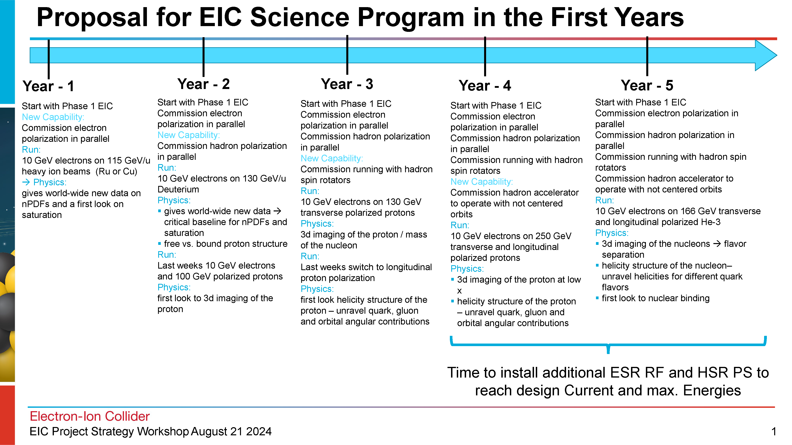
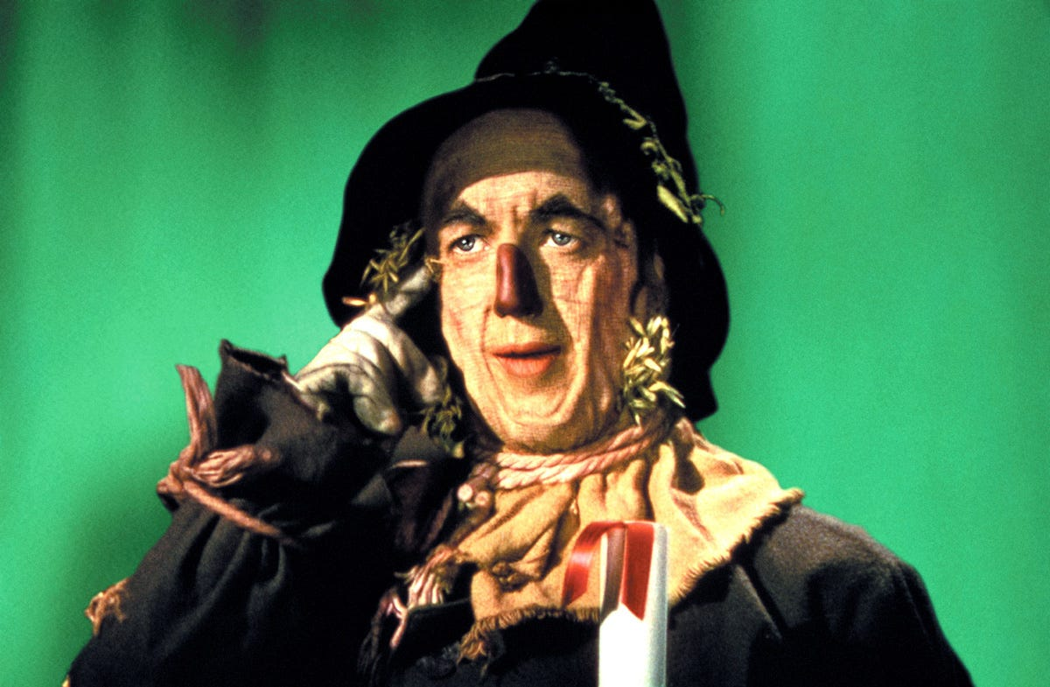
Early Science with ePIC
From Elke’s talk @ Strategy Workshop
At the recent EICUG/ePIC meeting, the discussion of what the staging the EIC might mean to an early science program was initiated.
This starting point has generated a growing discussion within the collaboration - the collaboration is motivated to define a meaningful and impactful early science program within the EIC.

Slide 7
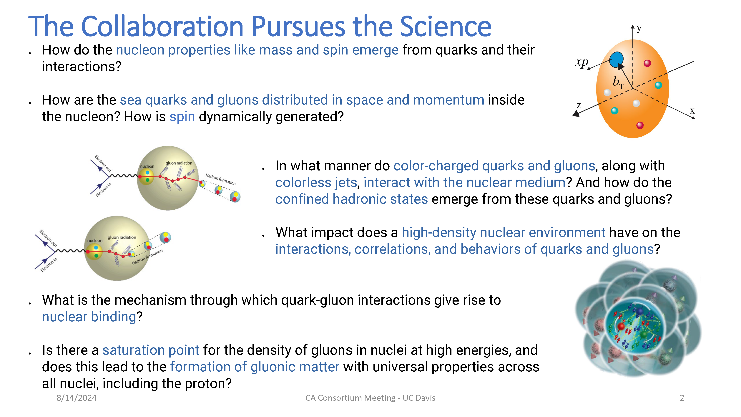
ePIC Early Physics Workshop and Discussion
First ePIC Early Physics Workshop:
Sept. 13th, 2024, 10:30AM ET
Between GM’s but we are using the GM time slot. Full agenda coming soon.
An opportunity for the collaboration to consider the EIC early science program, taking into account both the phasing of the collider, and define an impactful early science program.
Will result in tangible actions items.
Follow-up: parallel session in Frascati, maybe a separate ePIC meeting in March 2025?

Slide 8
Collaboration with the EIC Project
Early science must be meaningful and impactful
The collaboration is the source of the experience to:
  Define the program to do the best science
  Demonstrate the impact to key science drivers
  Communicate the excitement to the NP community
This will require a give-and-take with the EIC project:
  It will require communication for the collaboration to understand what constraints are absolute, and where we can work together to do better science.
    Example: HI species for year one already a productive discussion
The collaboration will want to emphasize both breadth and depth :
  Explore the phase space as quickly as reasonably possible, while ensuring the that every run answers important scientific questions.

Slide 9
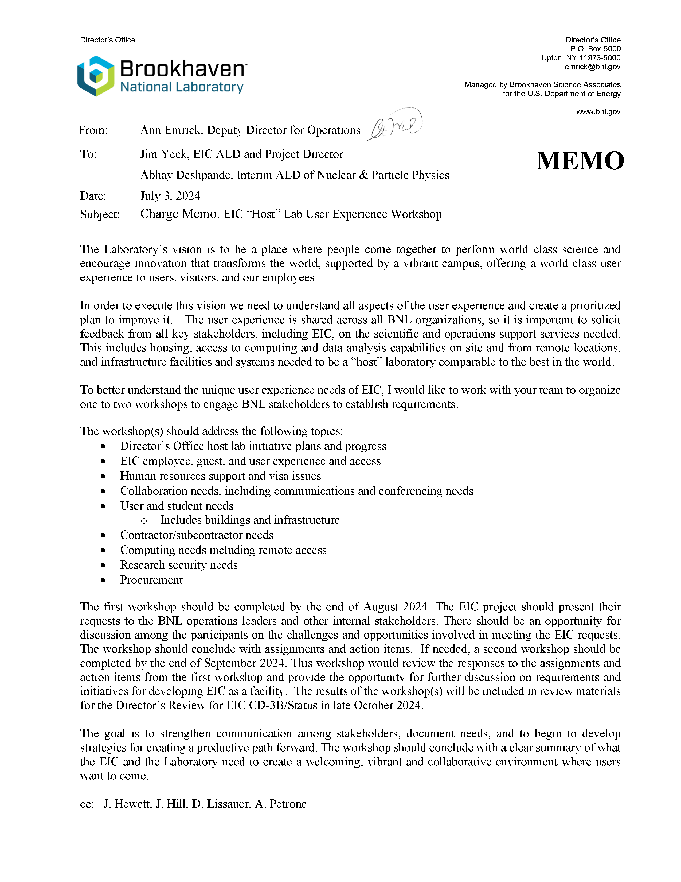
EIC “Host” Lab
User Experience
Workshop
Workshop August 26th
I will present “ePIC Collaboration Needs Overview” – coordinating with EICUG and RHIC/AGS Users Group
Comments and suggestions welcome!

Slide 10
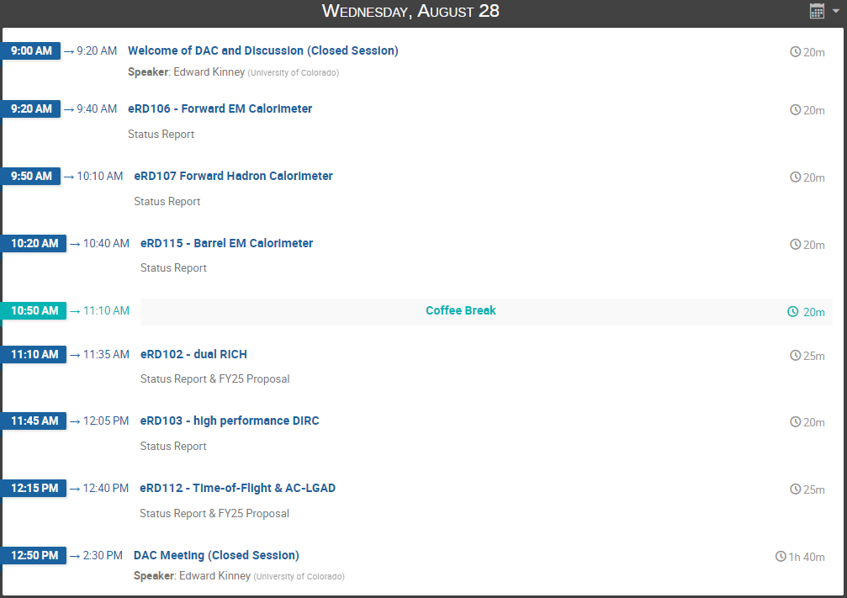
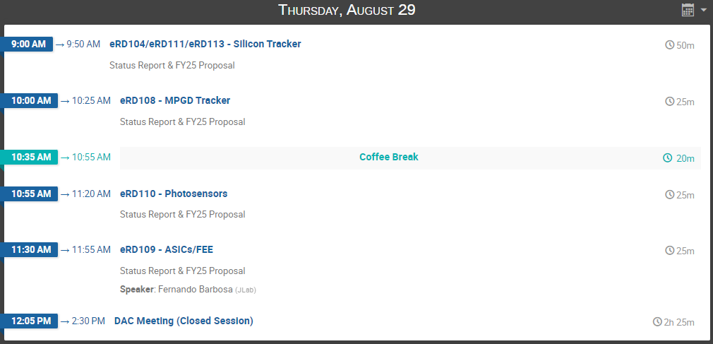
DAC R&D Meeting:
August 28-29th
https://indico.bnl.gov/event/24086/
FY’24 Progress Reports and FY’25 Proposals:
https://wiki.bnl.gov/conferences/index.php/ProjectRandDFY25

Slide 11
ePIC Membership Policy
We have been notified by Bernd and Thomas that voting on the Membership Policy has crossed the threshold.
Expect an announcement of the result from the CC Office very soon.
Assuming the policy is endorsed, the next step will be implementation:
  FY’25 Collaboration and Statements of Service
  In addition, it is clear that we will need some sort of additional exercise to estimate the workforce for ePIC construction:
    Greatly needed to aid in discussion of workforce and research program support
    Discussing how to do this, the EIC EOI’s are a possible model
    Just a “heads-up” that this may be coming soon…

Slide 12
Future Collaboration Meetings
Discussions about future joint EICUG/ePIC meetings:
  Agreed that joint meetings are overall a benefit to both ePIC and the EICUG
  Want to structure future meetings to be more “joint” and “efficient”
    Maintain early-career day at start of meeting
    Combine plenary sessions as much as possible
  Encourage EICUG participation in parallel sessions
    Some possibilities are theory, Det-II, etc.
After consultation with the coordinators, we agreed on:
  Jan 2025 (ePIC) – Frascati (already planned)
  Summer 2025 (EICUG/ePIC) – U.S.
  Jan 2026 (ePIC) – U.S.
  Summer 2026 (EICUG/ePIC) – International
A joint call will be issued for the Summer 2025/26 joint meetings, and at the same time a call for the Jan 2026 ePIC meeting will be issued
  Allows the community and host sites to plan ahead
Note the “double”

Slide 13
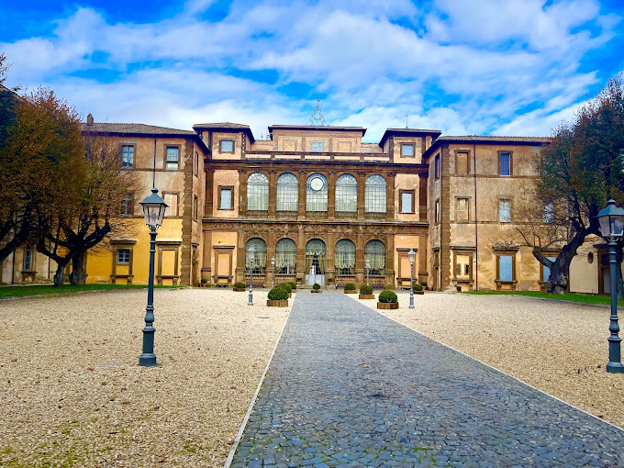
Jan 2025 Collaboration Meeting
Planning for the meeting and parallel sessions/workfests will start very soon to provide a better organized set of parallel and plenary sessions and avoid the crush coming at the end of the year.
Start thinking about a parallel/workfest sessions now – call coming soon.
University of Rome Tor Vergata & INFN
  January 20-24th, 2025
  Via Frascati (Roman Hills)

Slide 14
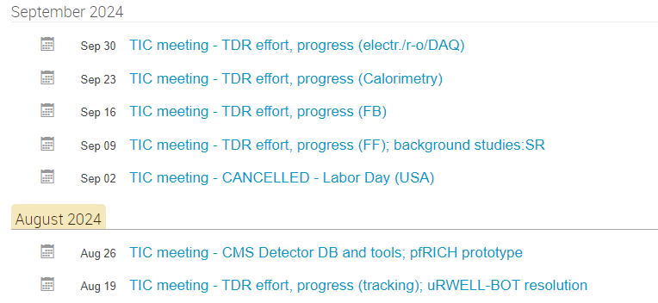
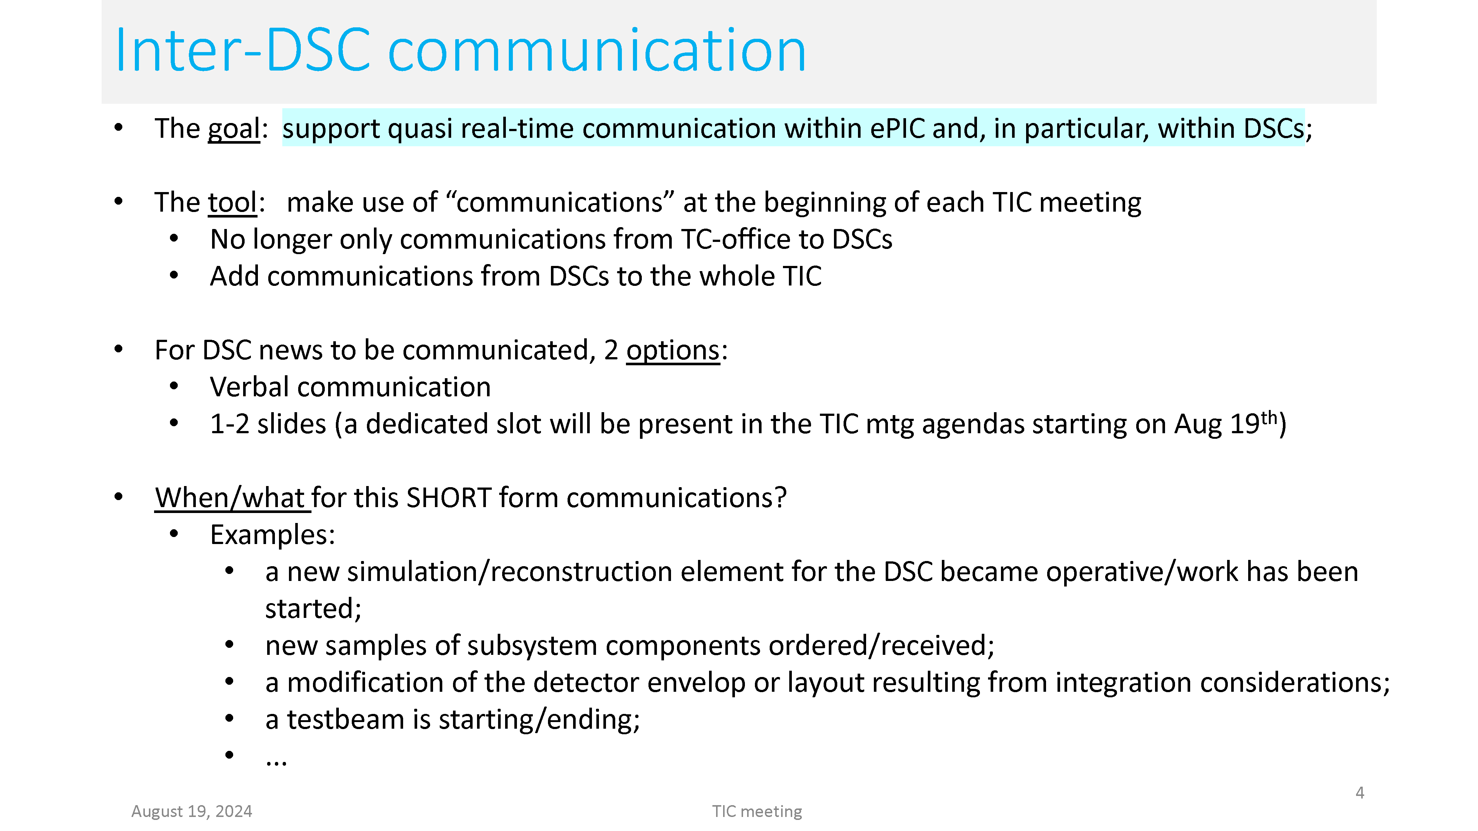
News from Technical Coordination
Following the development of the DSC/CC WG contributions to the TDR with dedicated status reports.

Slide 15
News from Software and Computing
Planning underway for Software and Computing Review
September 26-27th
  Charge has been finalized
  Progress on TDR, development of computing model, international contributions
Recent weekly meeting focused on test beam needs:
  https://indico.bnl.gov/event/24533/
Next ePIC Physics, Software and Computing Discussion August 28th
  https://indico.bnl.gov/event/24585/
Simulation plot browser is gaining material and functionality
  https://eic.jlab.org/epic/image_browser.html#

Slide 16
Software Tutorial Series
Next Tutorial: Working with Simulation Output
Presenter: Stephen Kay (University of York)
Date: Thursday, September 12
Time:
10:00 a.m. (BST) for Africa, Asia, Australia, and Europe.
4:00 p.m. (BST) for Africa, Europe, North America, and South America.
Upcoming Tutorial: Validation and Benchmarking
Presenter: Zachary Sweger (UC Davis)
Date: Thursday, October 3rd
Time:
1:00 p.m. (EST)
“Working with Simulation Output” on a monthly basis,
  With a focus on the changes to the software and simulation campaigns.
  “Full chain” analysis example
We welcome suggestions for future tutorials, including shorter tutorials on specialized topics, such as calorimeter reconstruction as suggested during the collaboration meeting.

Slide 17
News from Analysis
Recent Analysis Coordination Meeting August 16th
  https://indico.bnl.gov/event/24377/
Next Analysis Coordination Meeting August 30th
  https://indico.bnl.gov/event/24378/
Focus on preparation of TDR performance plots and TDR contributions

Slide 18
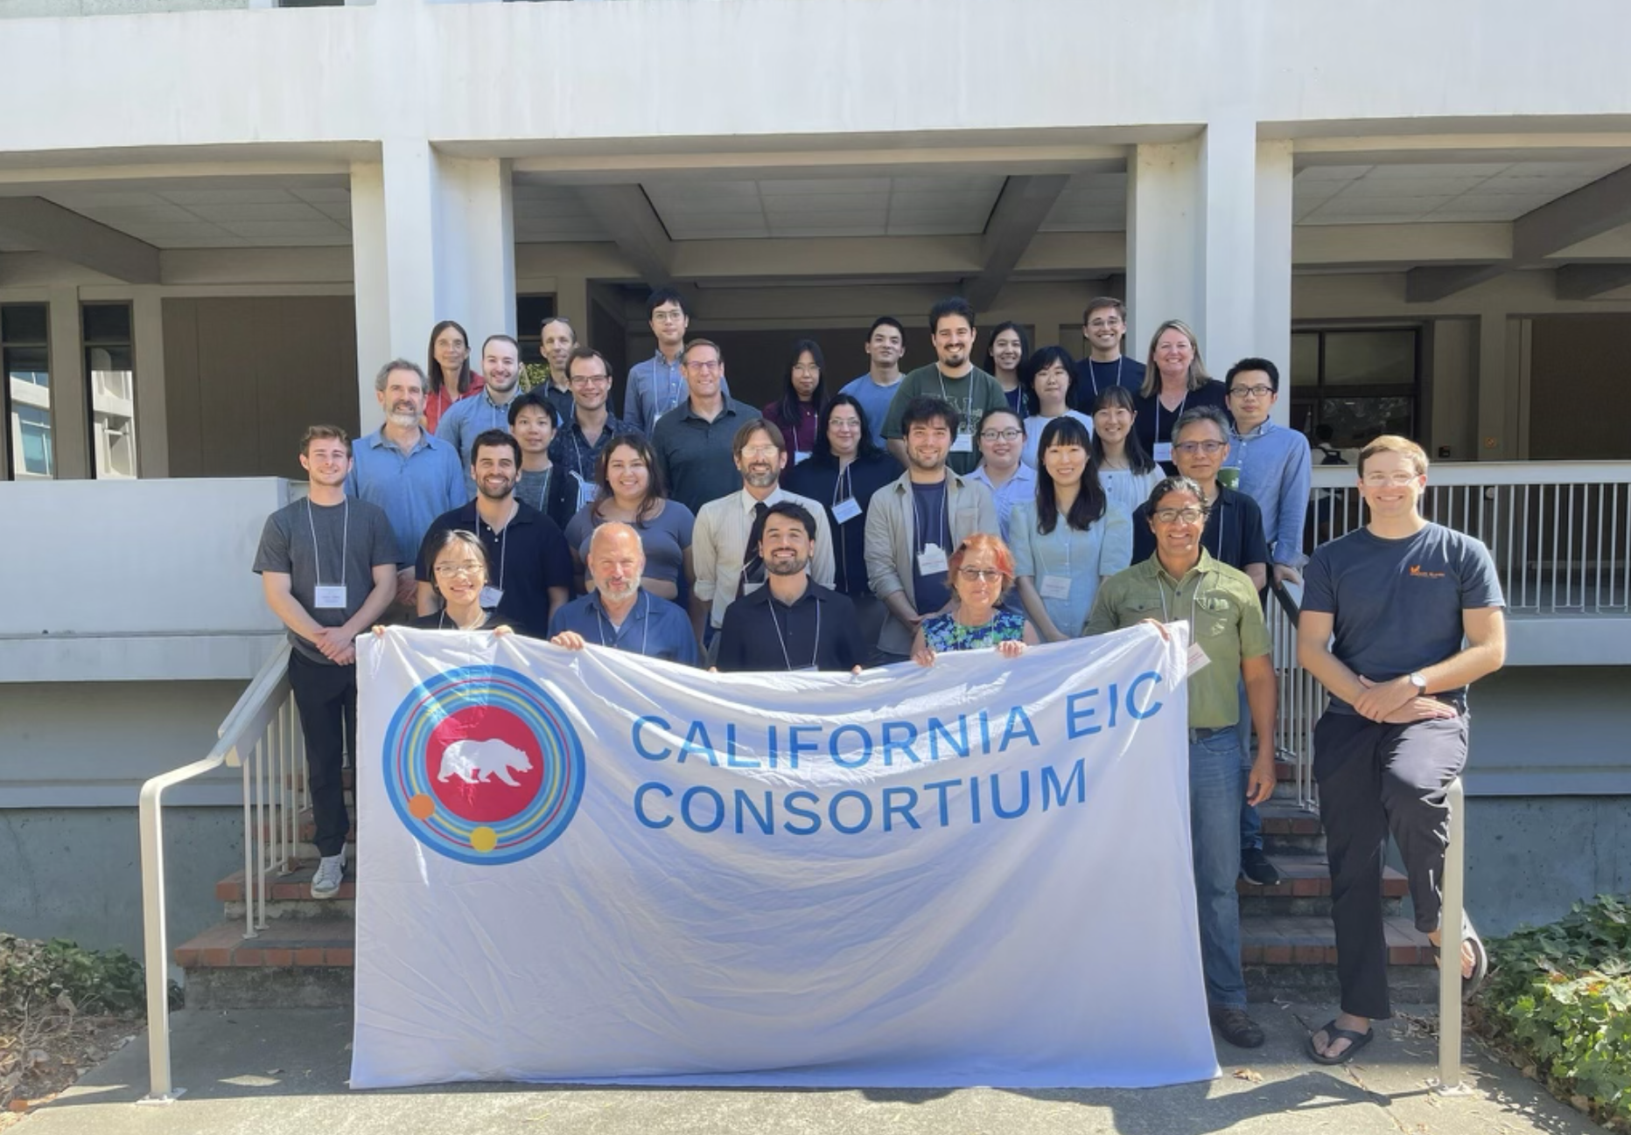
News from Around the Collaboration
CA Consortium Meeting
  August 14-15th, 2024
https://indico.bnl.gov/event/23919/
The California EIC Consortium is a UC-wide Multicampus Research Programs and Initiatives (MRPI) center focused on the physics of Electron Ion Collider (EIC). We are funded by UC Office of the President. Our consortium consists of four UC campuses (Berkeley, Davis, Los Angeles and Riverside), Cal Poly SLO and three national laboratories (LANL, LBNL and LLNL).

Slide 19
Lots of other activity as well…
Other items that you will hear more about in future collaboration meetings:
Progress on collab tools, website
  Collaboration database requirements document provided to SDCC
    https://zenodo.org/records/13273309
  Working on plans for limit access to “collaborators” section of website.
  Seeing more material showing up in Zenodo!

Slide 20
Summary
ePIC and the EIC are making progress on multiple fronts!
ePIC Early Science Workshop – Sept. 13th, 10:30AM ET
Next General Meeting – Friday, Sept. 6th, 10:30AM ET

Slide 21


Slide 22
ePIC Resources
Public Website - https://www.bnl.gov/eic/epic.php
Mailing Lists – https://lists.bnl.gov/mailman/listinfo
Indico Agenda - https://indico.bnl.gov/category/402/
  ePIC Software and Computing: https://indico.bnl.gov/category/435/
Wiki - https://wiki.bnl.gov/EPIC
ePIC Software Training:
  Landing Page: https://eic.github.io/documentation/landingpage.html
  Tutorials: https://eic.github.io/documentation/tutorials.html
Mattermost: https://chat.epic-eic.org
ePIC Zenodo Community: https://zenodo.org/communities/epic

Slide 23


EICUG Membership
The EICUG is a vital organization to promote the interests of the EIC community!
  Without the EICUG we would never have gotten far enough to form ePIC!
Please register your institution!
Check with your EICUG IB representative to get registered as a member
https://www.eicug.org/content/join.html

