Slide 1
EIC Project News
E.C. Aschenauer (BNL), R. Ent (JLab)
Co-Associate Directors for the EIC Experimental Program
Checking for reviewer availability to settle on dates
ePIC Bi-Weekly
September 6th, 2024

Slide 2
On we go: ePIC Detector Path to CD-3B and to CD-2/CD-3
Detector Design Reviews (organized by the EIC Project):
PDR2: IR Integration and Auxiliary Detectors – February 12, 2024 – main emphasis on baseline choices and progress
PDR1: Tracking Detectors – 20-21 March 2024 – main emphasis on baseline tracking layout, if we are on track and plans
PDR2: Electronics/DAQ – June 10 -11, 2024 – continuation of PDR1 to ensure we are on track and show progress
PDR: Integration, Infrastructure and Installation – July 15, 2024 – barrel and endcaps flux return steel
PDR2: Particle Identification Detectors – Fall 2024 (discussion ongoing when is best and what scope)
PDR2: Barrel EM Cal – September 19 – emphasis on mechanical design & AstroPix readiness
FDR: Backward & Forward EM Calorimetry, Barrel & Forward HCAL – Fall 2024 → Winter 2024 (late January or February 2025)
PDR2: Polarimetry – timescale TBD (but before CD-2)
FDR for any potential CD-3B scope:
Magnet Power Supply – May 28th 2024
VTRx+/lpGBT add ½ day to electronics/DAQ PDR2 on June 11th 2024
Magnet Steel September 2024 – Checking for reviewer availability to settle on dates, likely early October
BNL Off-Project Dependency review (organized within BNL) scheduled for August 22-23, 2024
Detector Advisory Committee Meetings 2024/2025:
June 21, 2024: 8th DAC meeting - strategic advice on the planning for the construction phase of the ePIC detector
August 28-29, 2024: 9th DAC meeting - Annual advice on detector R&D status and FY25 completion needs
https://indico.bnl.gov/event/24086/
Spring 2025: 10th DAC meeting - Comprehensive look of DAC to design status and readiness for CD-2.
Software & Computing Reviews (organized by the host labs):
ePIC Detector Software Infrastructure Review https://indico.bnl.gov/event/16676/ – August 22-23, 2022
ePIC Software & Computing review by host labs https://indico.bnl.gov/event/20481/ – October 19-20, 2023
Next ePIC Software & Computing review (by host labs) – September 26-27, 2024

Slide 3
And it starts again

Slide 4
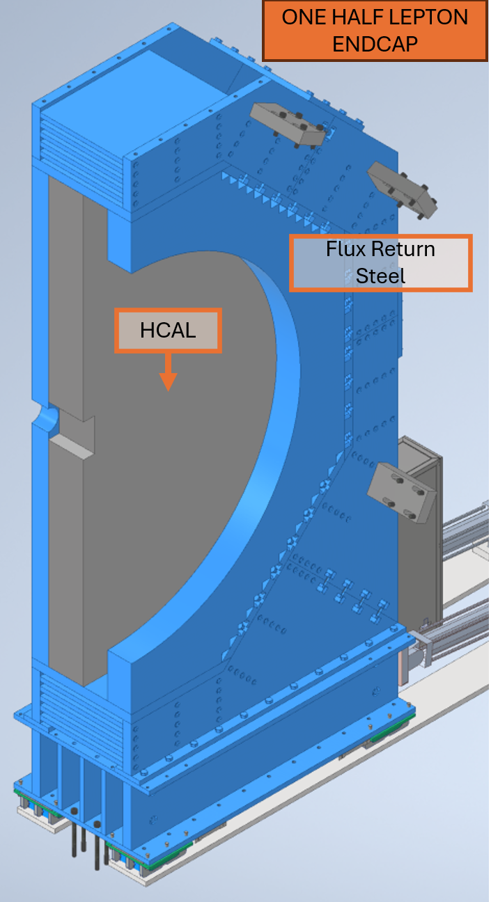
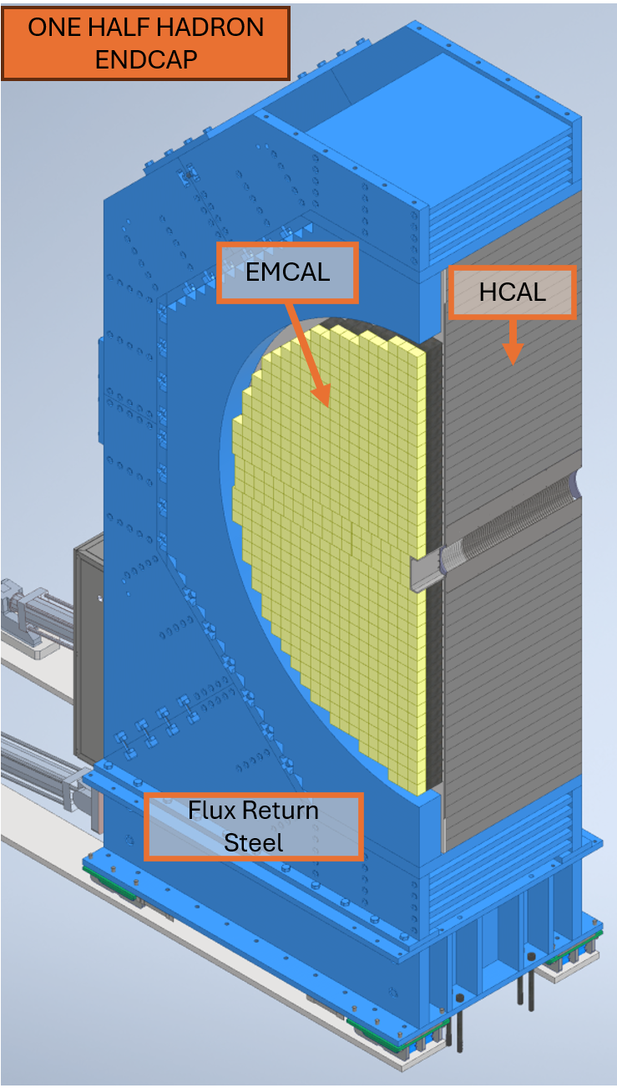
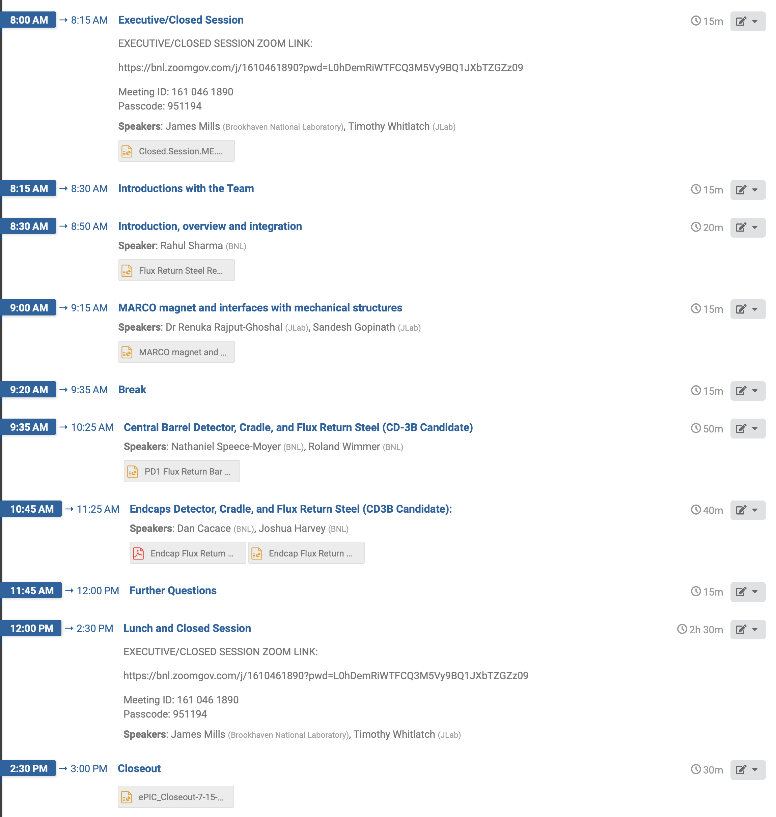
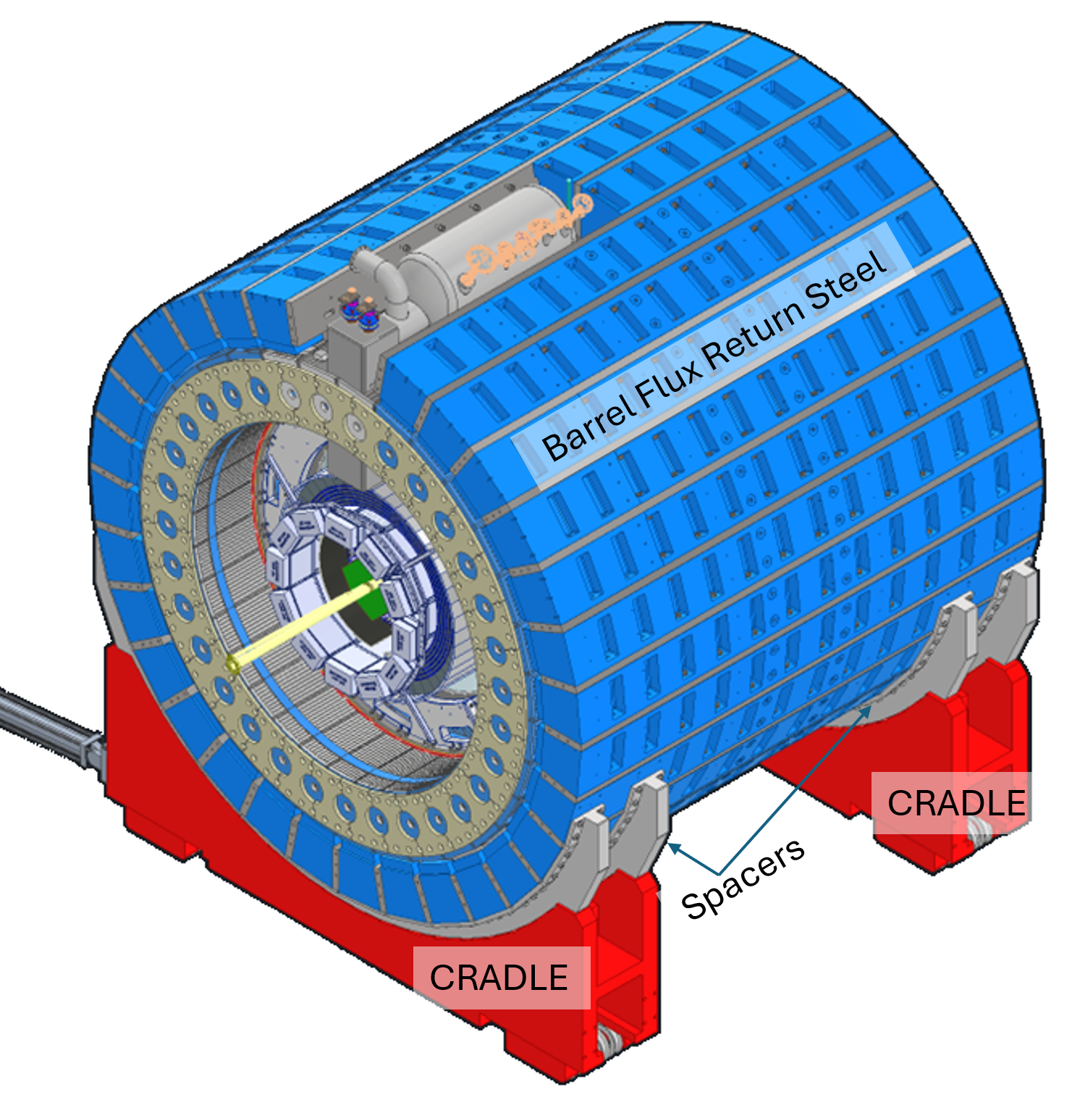
Incremental Preliminary Design Review of the ME design of ePIC
Focus on Barrel and Endcaps flux return
Reviewers: Tim Whitlatch (Jlab) and Jim Mills (BNL)

Slide 5
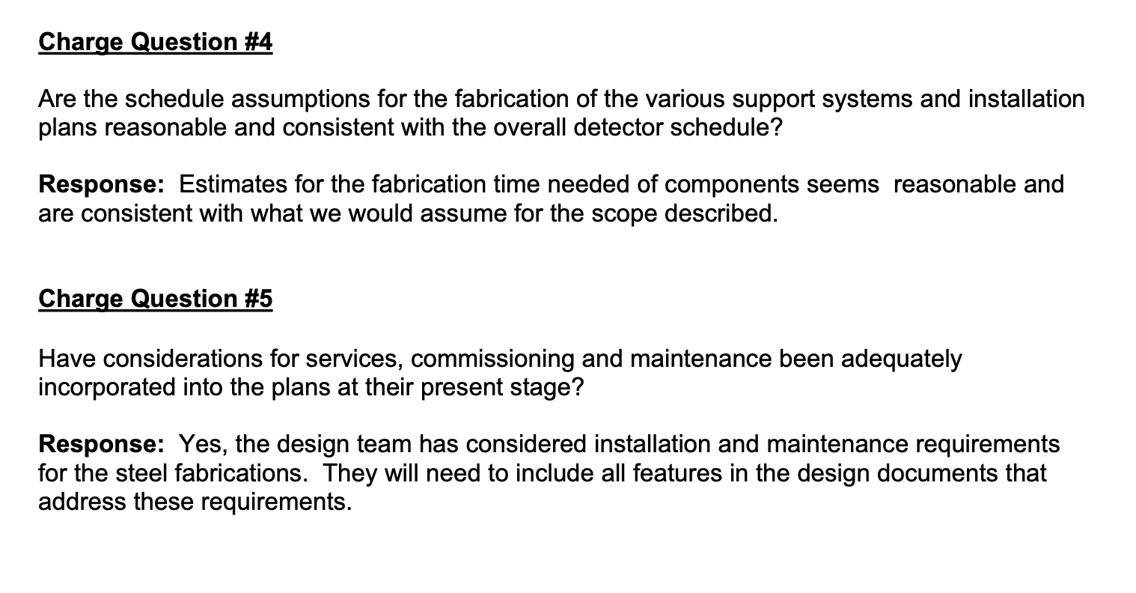
Incremental Preliminary Design Review of the ME design of ePIC
Working on this: define service space requirements, fill factors, tolerance needs, safety factors, etc.

Slide 6
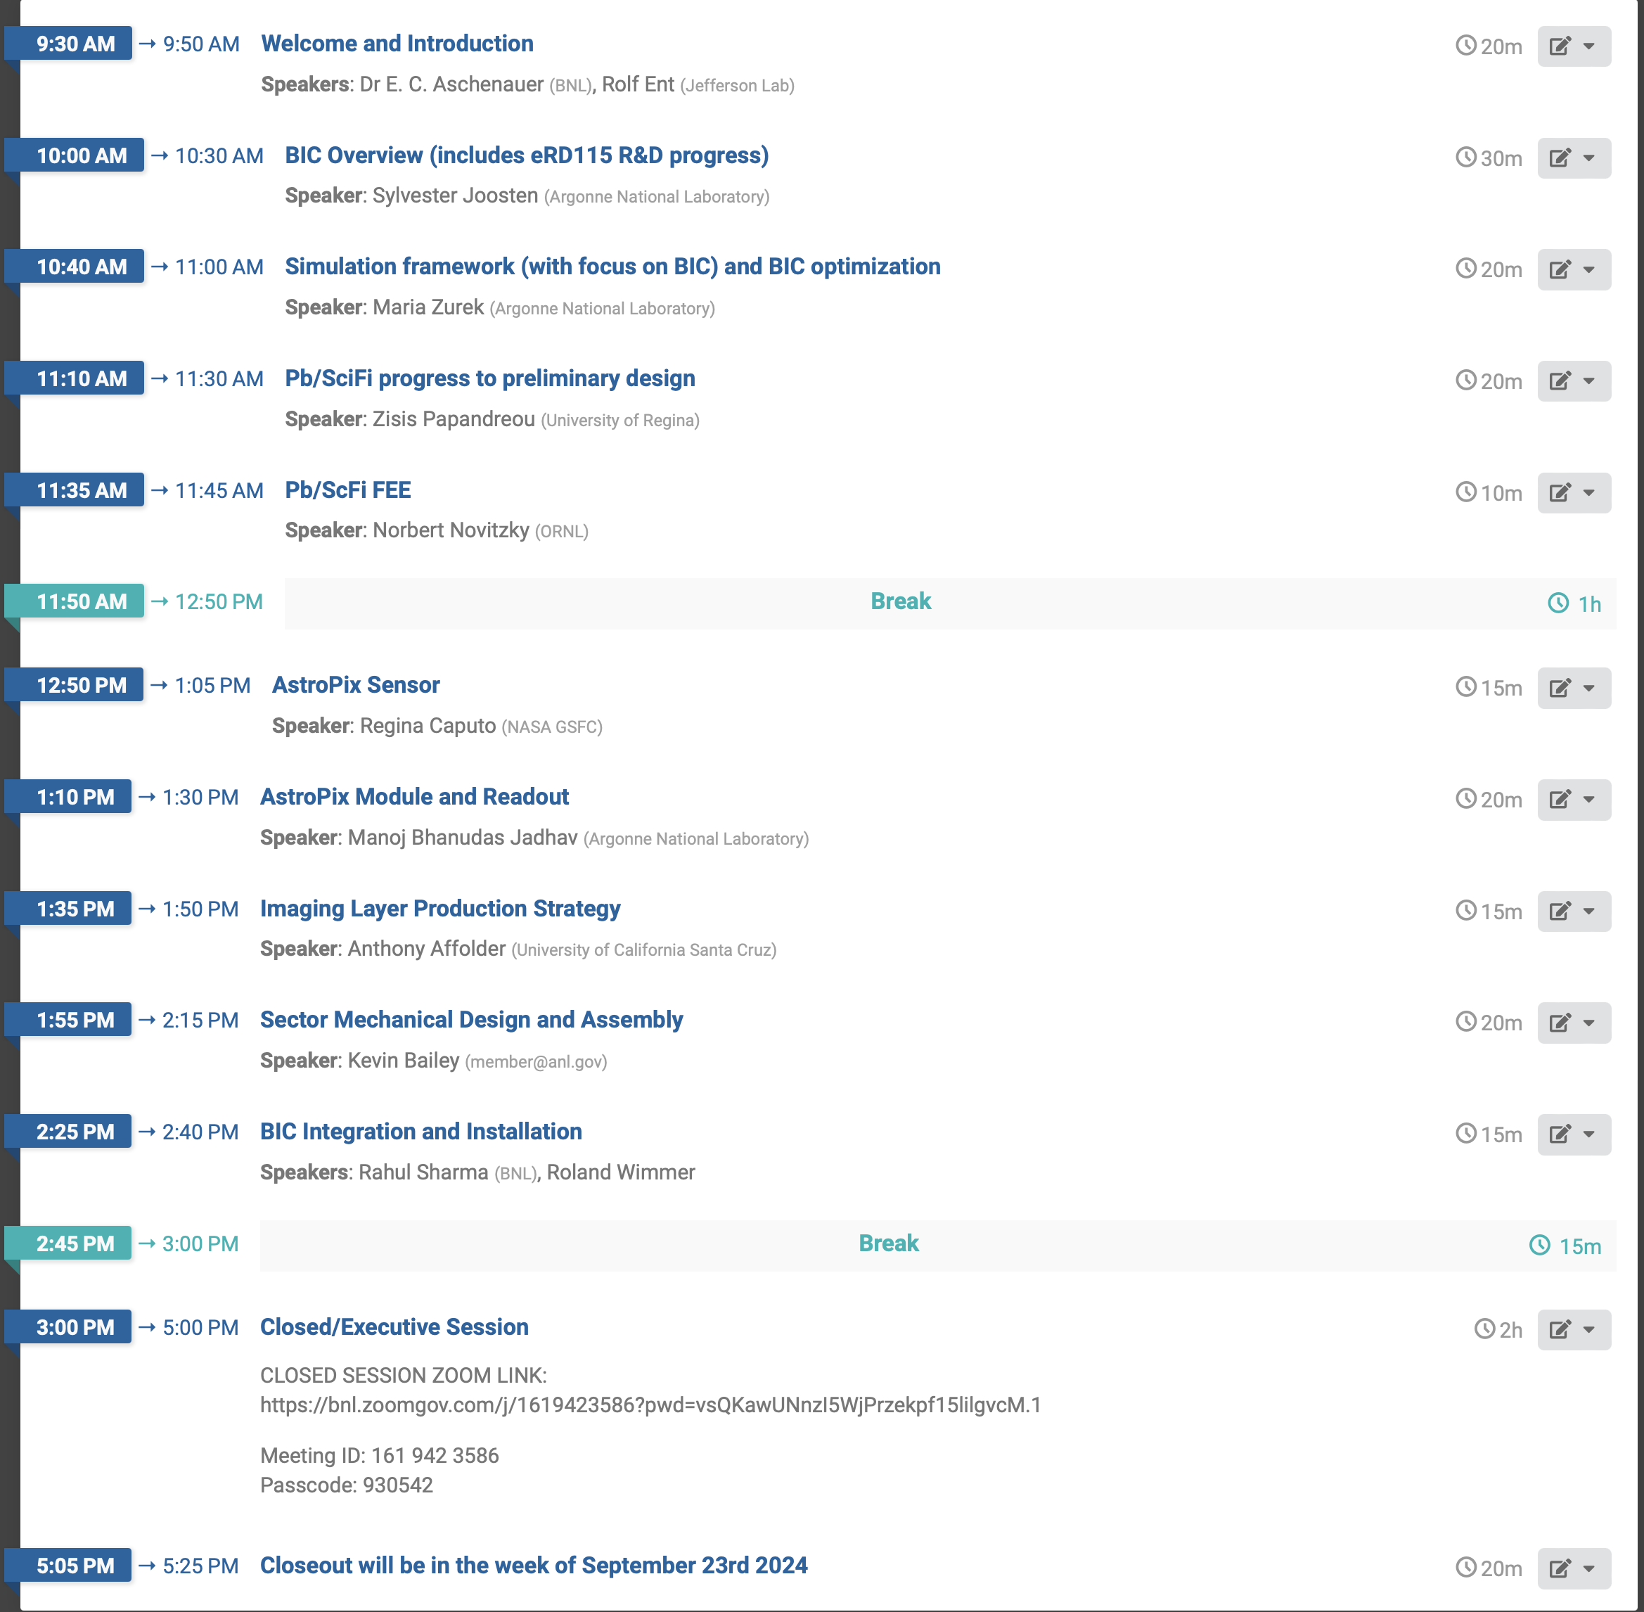
Incremental Preliminary Design and Safety Review of the ePIC Barrel Imaging EMCal - Agenda
Reviewers:
Stefania Beole (UniTo)
Pierlugi Campana (INFN-LNF)
Roman Poeschl (IJCLAB/IN2P3)
Lars Schmitt (GSI)

Slide 7
9th Detector Advisory Committee meeting
6.10.02 Detector & R&D and Physics Design
This was the fourth Detector Advisory Committee meeting looking at detector R&D, after earlier versions to look at the transition of the earlier EIC-related detector R&D program and initiate the FY22 project detector R&D, and have them advise on R&D progress and priorities for FY23, FY24 and FY25.
The 9th Detector Advisory Committee meeting of August 28-29, 2024, to give advice on the detector R&D is posted at: https://indico.bnl.gov/event/24086/. The closeout report is posted here also.
This was the last year of formal project detector R&D, many of our detector R&D milestones have been completed or are near-completion. Some of the later Si/ASIC-related engineering runs are foreseen as Engineering and Design continuations.
Thanks to all, we have made quite some progress in a large variety of foreseen ePIC detector technologies, and are by virtue of this well set up for the future CD-2 baselining.
There will be a more detailed summary of the 9th DAC and detector R&D later, by Thomas.

Slide 8
Standardizing
To standardize Readout and keep material budget and services under control we decided to use VTRX+ and LpGBT not only in the MAPS and dRICH, but in all inner detectors (MPGDs, TOF, pfRICH) and the ancillary ones
→ Final production of VTRX+ modules starts ~May 2025, ends December 2026 → VTRX+ & LpGBT CD-3B item

