Slide 1

ePIC Collaboration News
J. Lajoie, S. Dalla Torre
September 6, 2024

Slide 2
Hey John, start the recording….

Slide 3
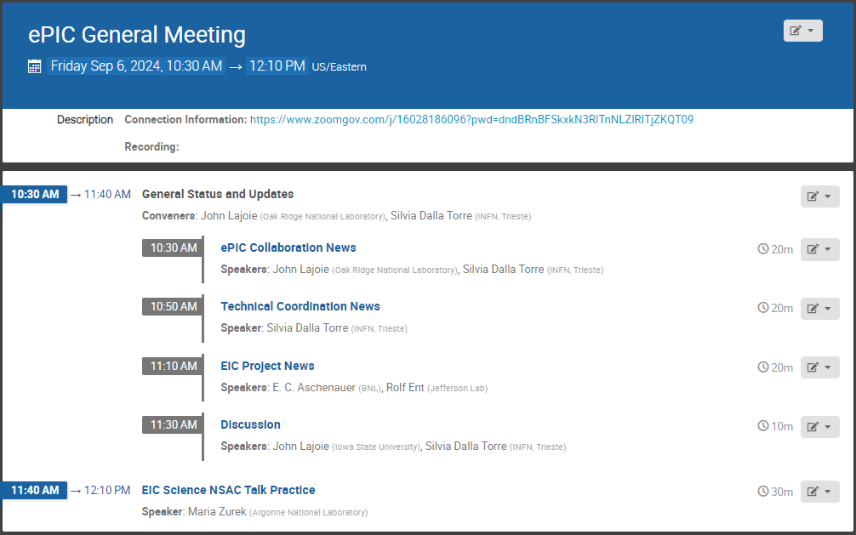
Agenda
Special Event!

Slide 4
Request from Gail Dodge (NSAC Chair)
Dear John:
At our next NSAC meeting on Sept. 12 we are planning to have a discussion about communicating EIC science. The DOE NP management (Linda Horton, Sharon Stephenson, and Paul Mantica) have indicated that they would like the community to take more of a role in making the case for the EIC. Part of this is the issue of communicating the science at the right level to the right audience.
I am planning to break the EIC session up into two talks. First a 10 + 5 minute talk about the EIC science, pitched at a level that is understandable to a scientist who is not a physicist. Then we will have 10 minutes where Richard Milner and Rolf Ent talk about their visualization work and other aspects of communicating the science to the public and other key constituencies such as congressional staffers. Then we will have a discussion about what the nuclear community should be doing or what is needed to help us communicate our science better.
…
Thanks,
Gail
Request received from Gail Dodge 8/21 to identify a speaker for the Sept. 12th NSAC meeting (short timescale!)
Requested names from the Conference and Talks Committee and discussed within the ePIC Coordination Team.
SP Office nominated Maria Zurek to give this talk.

Slide 5

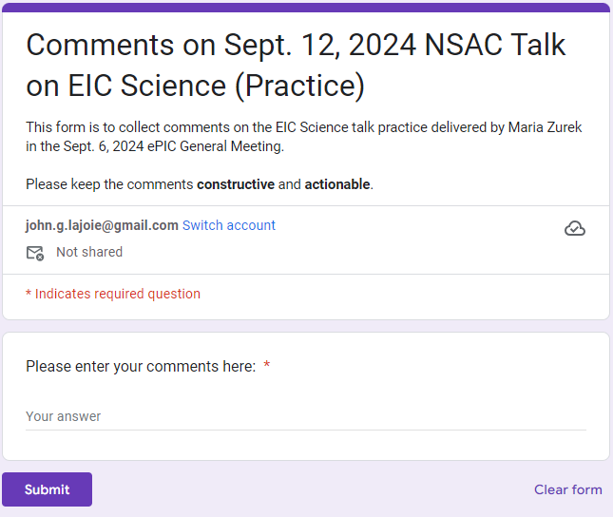
NSAC Practice Talk
https://forms.gle/qJQM2J7M5SbvTW1S8
There will be some time for discussion, but comments and suggestions can also be submitted by Google form.

Slide 6
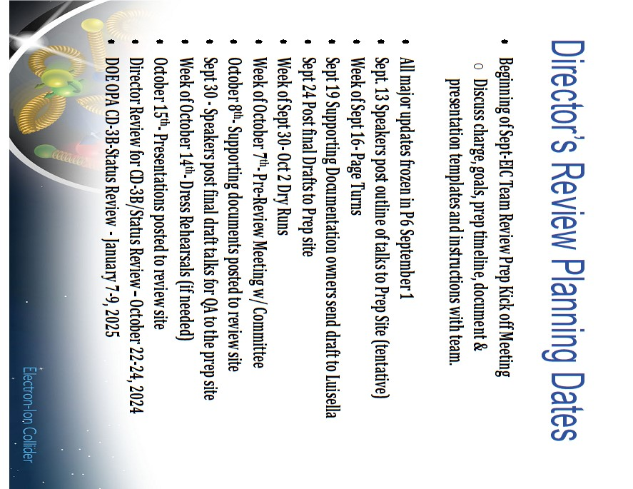
News from the SP Office
EIC Strategy Mtg
August 21st
ePIC Early Physics Workshop
Sept. 13, 2024
FDR: Magnet Flux Return Steel
(poss. CD-3B scope)
early October 2024
Everything is continuing at a fast pace coming out of the Lehigh Collaboration Meeting!
ePIC draft pre-TDR Version 1
December 1, 2024
Detector Advisory
Committee R&D Meeting
August 28-28th
ePIC Software and
Computing Review
Sept. 26-27th
Frascati Collab. Mtg. Jan 2025
Lehigh Collab. Mtg. July 2024
PDR2: Barrel EMCal
September 19th
ePIC draft pre-TDR Version 0
Sept. 29, 2024
Directors Review for CD-3B/Status Review
October 22-24
EIC Project CD-3B/Status Review
January 7-9th, 2025
EIC “Host” Lab User Experience Workshop
August 26th

Slide 7
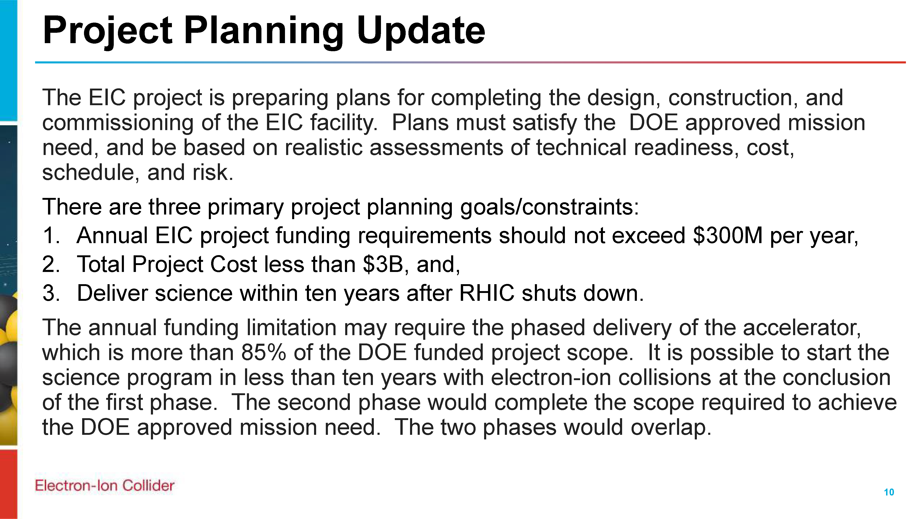
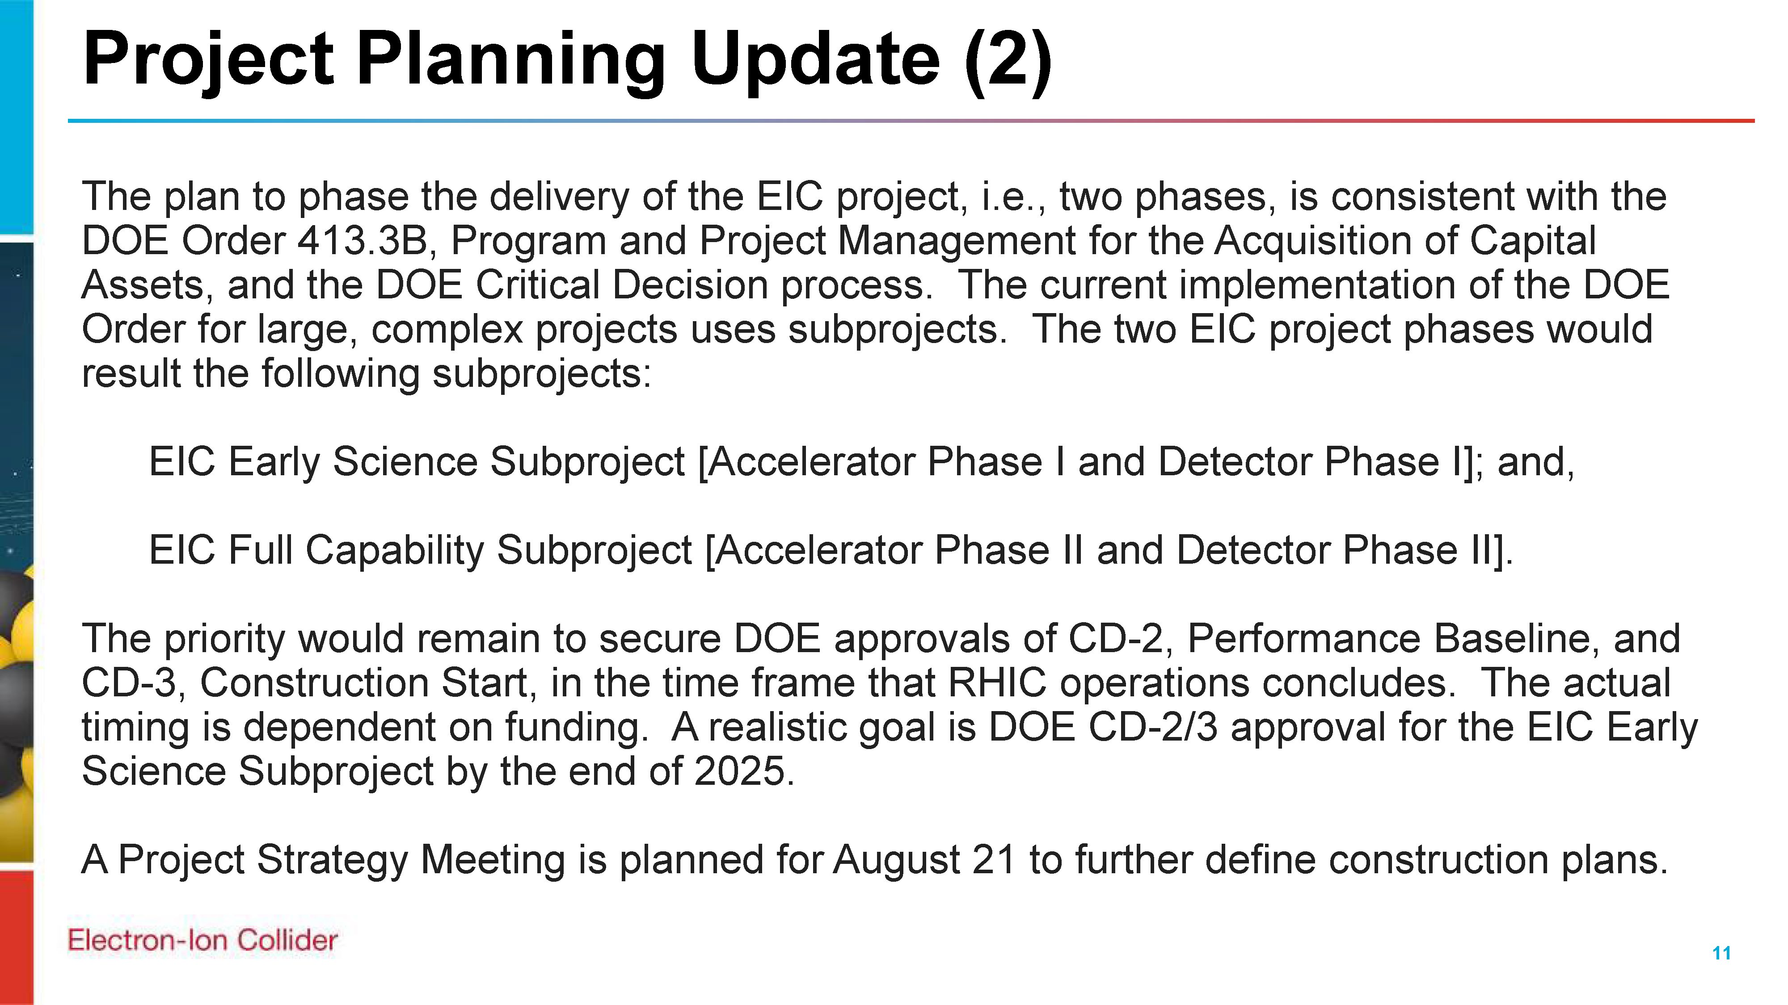
EIC Project Strategy Workshop
From Jim Yeck’s recent EICUG report
The purpose of the Workshop is to engage stakeholders in the development of plans for delivering the EIC project scope and performance and to consider lessons from other large projects.
There will be a Director’s Review of the EIC Project on October 22-24, 2024, and a DOE Independent Project Review on January 7-9, 2025. The August Workshop will help us prepare for these important reviews.
An excellent discussion of the project management issues surrounding “phasing” a large project.
Consensus that detector phasing does not make sense unless technically driven.
Sylvia and I presented on
“ePIC Collaboration Plans in Support of Early Science”

Slide 8

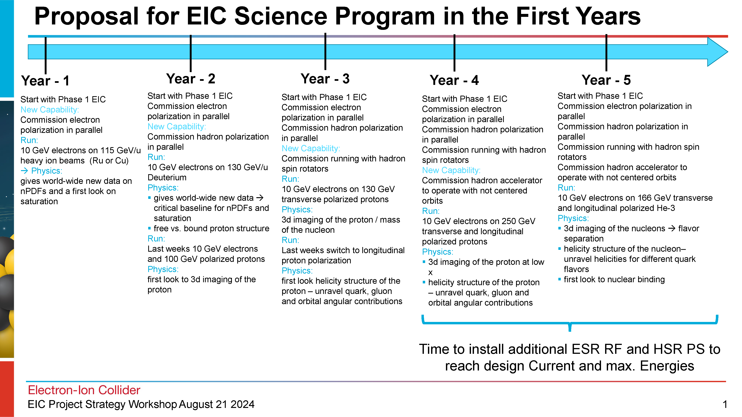
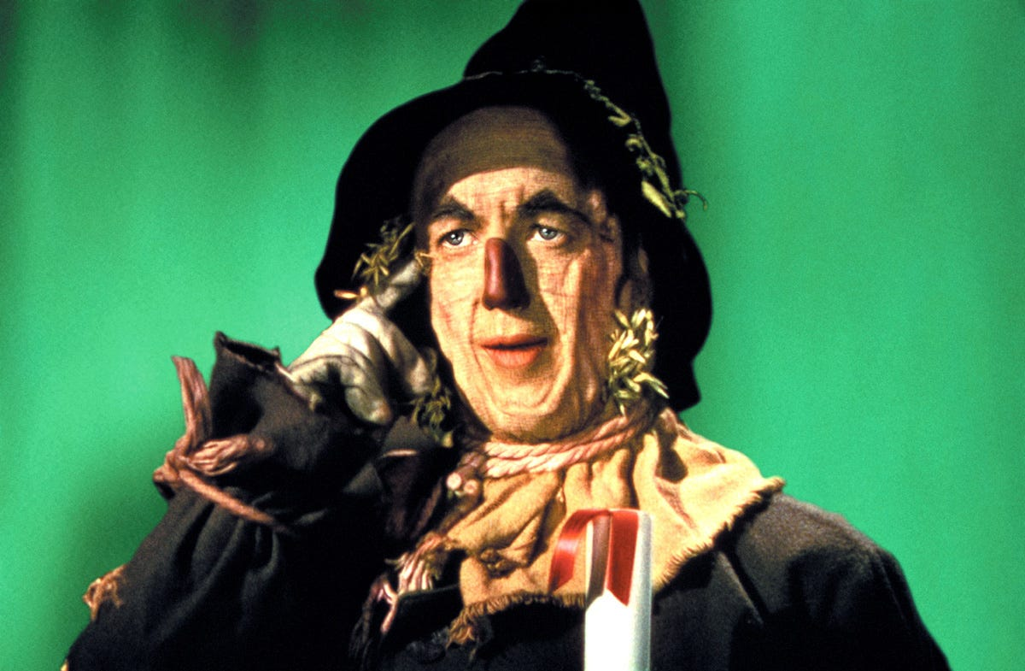
Early Science with ePIC
From Elke’s talk @ Strategy Workshop
At the recent EICUG/ePIC meeting, the discussion of what the staging the EIC might mean to an early science program was initiated.
This starting point has generated a growing discussion within the collaboration - the collaboration is motivated to define a meaningful and impactful early science program within the EIC.

Slide 9
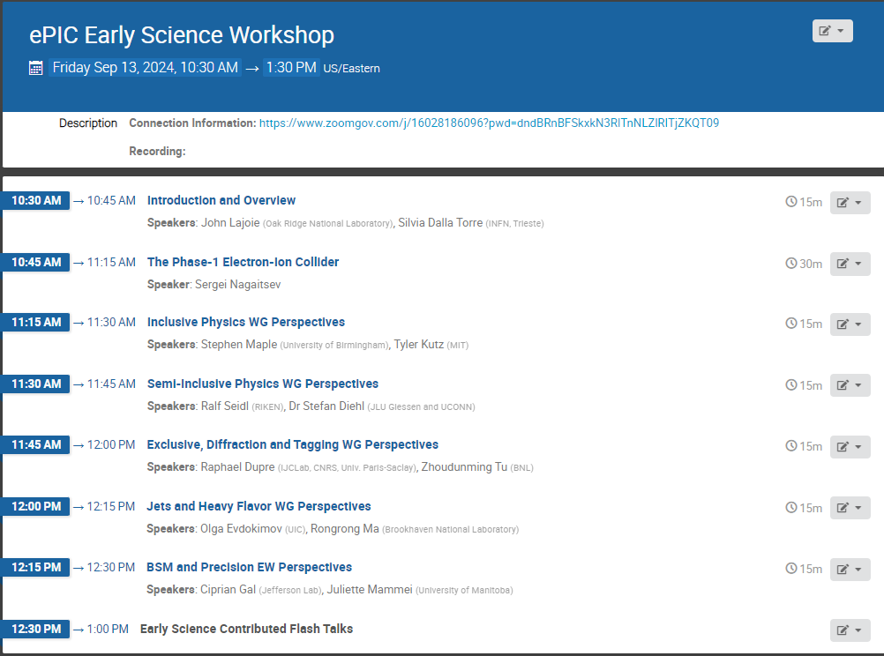
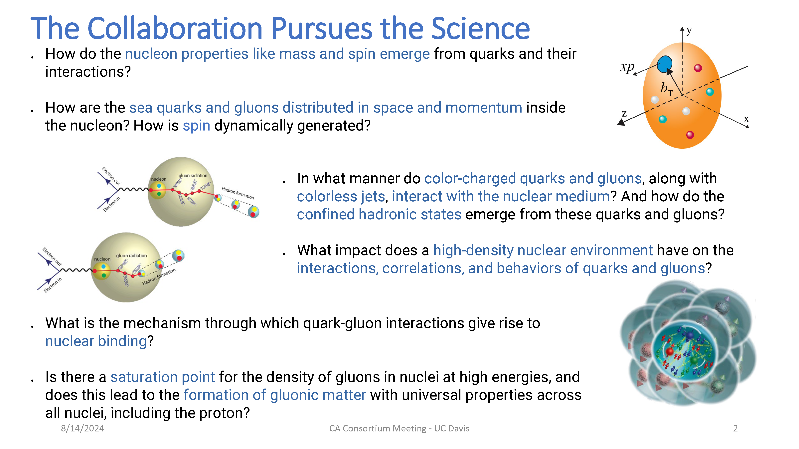
ePIC Early Physics Workshop and Discussion
First ePIC Early Physics Workshop:
Sept. 13th, 2024, 10:30AM ET
https://indico.bnl.gov/event/24432/
Between GM’s but we are using the GM time slot.
An opportunity for the collaboration to consider the EIC early science program, taking into account both the phasing of the collider, and define an impactful early science program.
Will result in tangible actions items.
Follow-up: plenary session in Frascati, maybe a separate ePIC meeting in March 2025?

Slide 10
Collaboration with the EIC Project
Early science must be meaningful and impactful
The collaboration is the source of the experience to:
  Define the program to do the best science
  Demonstrate the impact to key science drivers
  Communicate the excitement to the NP community
This will require a give-and-take with the EIC project:
  It will require communication for the collaboration to understand what constraints are absolute, and where we can work together to do better science.
    Example: HI species for year one already a productive discussion
The collaboration will want to emphasize both breadth and depth :
  Explore the phase space as quickly as reasonably possible, while ensuring the that every run answers important scientific questions.

Slide 11
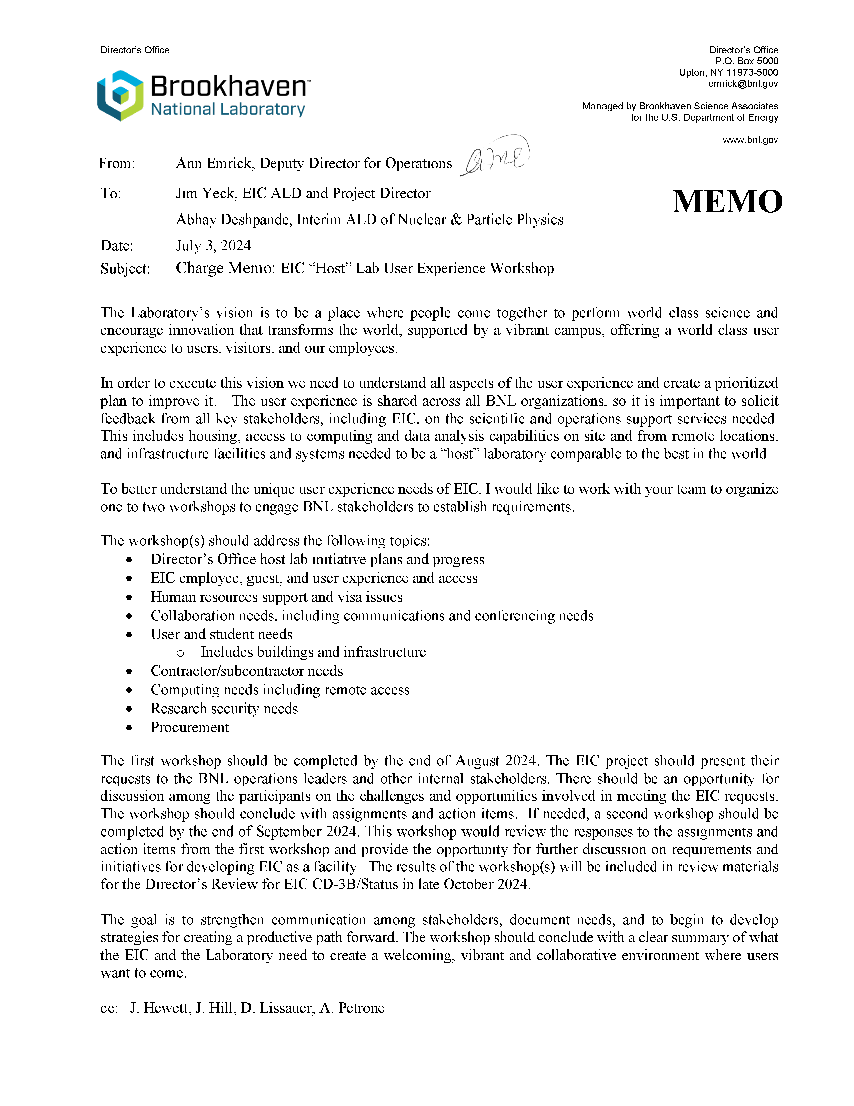
EIC “Host” Lab
User Experience
Workshop
Workshop August 26th
JGL presented “ePIC Collaboration Needs Overview” – coordinating with EICUG and RHIC/AGS Users Group
Excellent discussion! The people present fully recognize the challenges and opportunities.

Slide 12
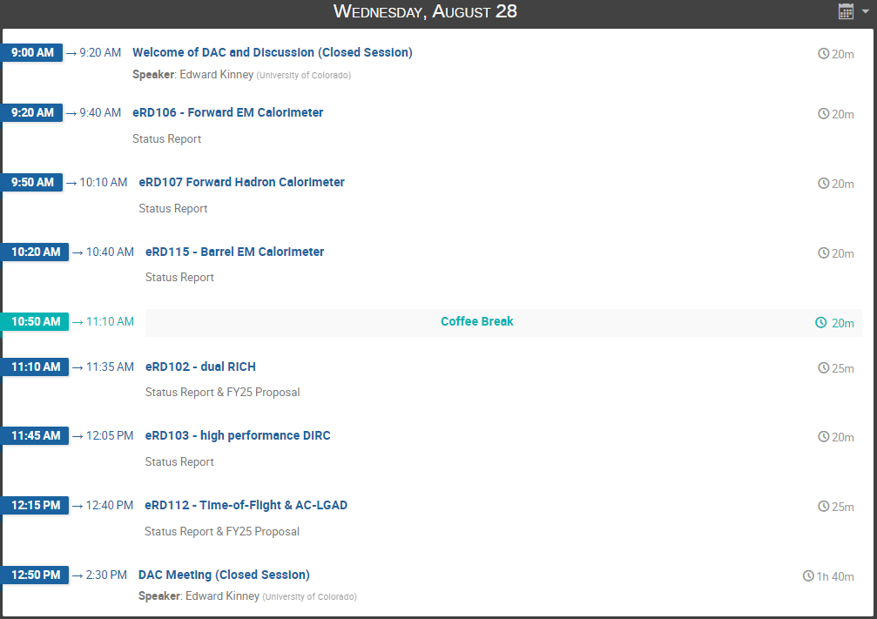
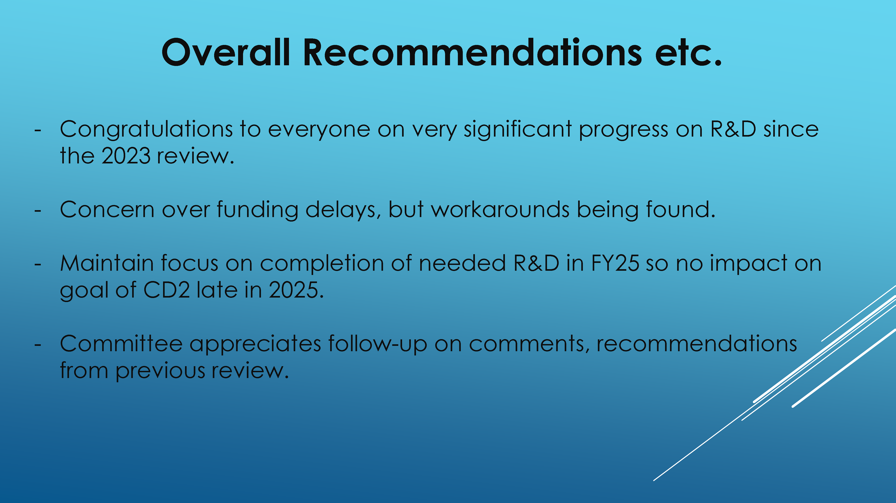
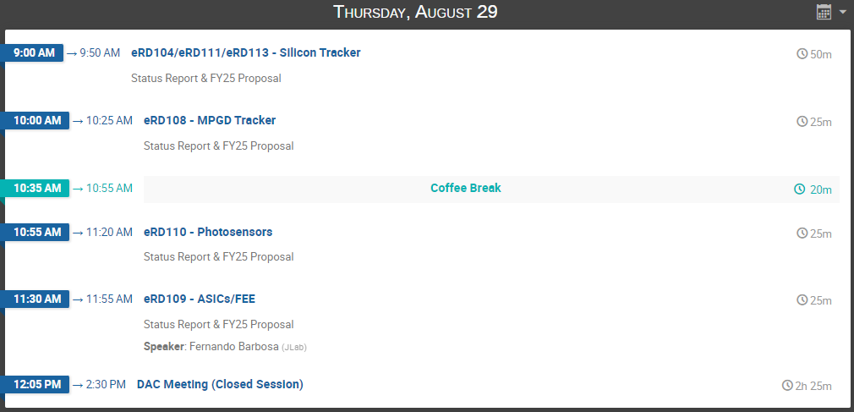
DAC R&D Meeting:
August 28-29th
https://indico.bnl.gov/event/24086/
Closeout held Sept. 3rd. Closeout slides on Indico site.
FY’24 Progress Reports and FY’25 Proposals:
https://wiki.bnl.gov/conferences/index.php/ProjectRandDFY25

Slide 13
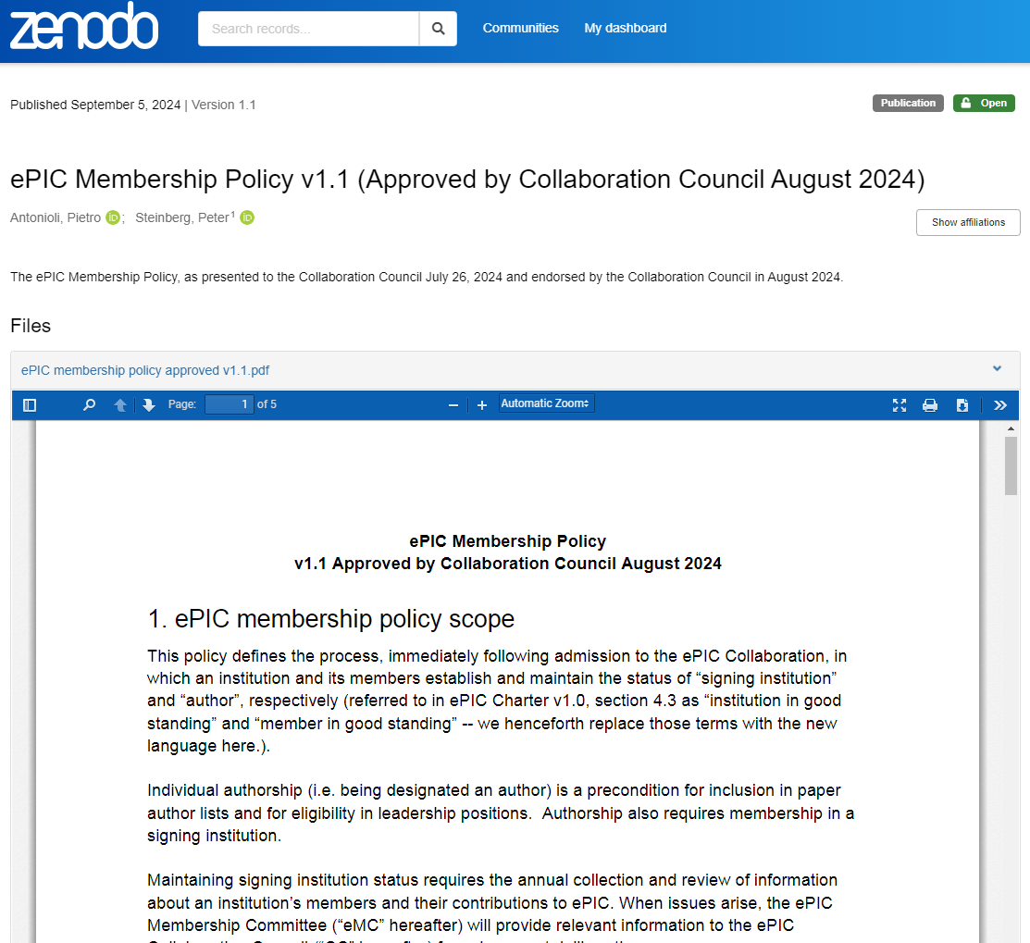
ePIC Membership Policy
https://zenodo.org/records/13693927
The ePIC Membership Policy was approved Collaboration Council
  Announcement from Bernd and Thomas August 29th
The next step will be implementation:
  2025 Collaboration and Statements of Service
  Basic info for collaboration database
  In addition, it is clear that we will need some sort of additional exercise to estimate the workforce for ePIC construction:
    Greatly needed to aid in discussion of workforce and research program support
    Discussing how to do this, the EIC EOI’s are a possible model
    Just a “heads-up” that this will be coming soon…

Slide 14
Future Collaboration Meetings
Discussions about future joint EICUG/ePIC meetings:
  Agreed that joint meetings are overall a benefit to both ePIC and the EICUG
  Want to structure future meetings to be more “joint” and “efficient”
    Maintain early-career day at start of meeting
    Combine plenary sessions as much as possible
  Encourage EICUG participation in parallel sessions
    Some possibilities are theory, Det-II, etc.
After consultation with the coordinators, we agreed on:
  Jan 2025 (ePIC) – Frascati (already planned)
  Summer 2025 (EICUG/ePIC) – U.S.
  Jan 2026 (ePIC) – U.S.
  Summer 2026 (EICUG/ePIC) – International
A joint call will be issued for the Summer 2025/26 joint meetings, and at the same time a call for the Jan 2026 ePIC meeting will be issued
  Allows the community and host sites to plan ahead
Note the “double”

Slide 15
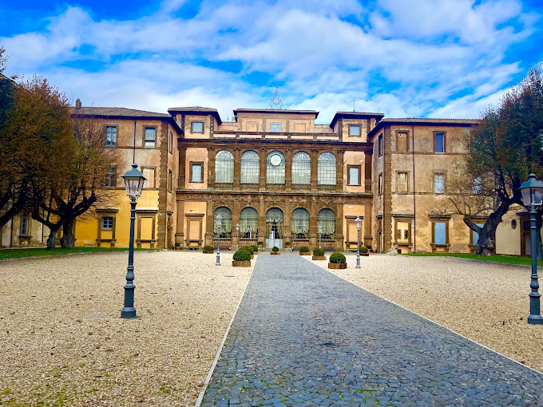
Jan 2025 Collaboration Meeting
University of Rome Tor Vergata & INFN
  January 20-24th, 2025
  Via Frascati (Roman Hills)

Slide 16
DRAFT Jan. 2025 Collab. Meeting Plan
Monday
Jan. 20th
Tuesday
Jan. 21st
Wednesday
Jan. 22nd
Thursday
Jan. 23rd
Friday
Jan. 24th
Plenary 1
Parallel/
Workfest 1
Early Science
Parallel/
Workfest 3
Parallel/
Workfest 4
Morning
Plenary 2
Parallel/
Workfest 2
Excursion
Collaboration Council
Plenary 3
(incl. self-proposed)
Afternoon
NOTE: Parallel/Workfest summaries will not be part of Plenary 3, but instead will be delivered as a Zoom session the following week.
Awaiting feedback from LOC to finalize agenda, call for workfest sessions shortly after that.

Slide 17
Software Tutorial Series
We welcome suggestions for future tutorials.
Next Tutorial: Working with Simulation Output
Presenter: Stephen Kay (University of York)
Date: Thursday, September 12
Time: Delivered twice on this date to cover multiple time zones
10:00 a.m. (BST) for Africa, Asia, Australia, and Europe: https://indico.bnl.gov/event/24623/
4:00 p.m. (BST) for Africa, Europe, North America, and South America: https://indico.bnl.gov/event/24624/
Present “Working with Simulation Output” on a bi-monthly basis:
  Focus on a different “special” item each time.
  Next, early November.
Trial new format of live help desk at same time as tutorials, one week before/after tutorial
    5th September and 19th September -> First one, yesterday!
Upcoming Tutorial: Validation and Benchmarking
Presenter: Zachary Sweger (UC Davis)
Date: Thursday, October 3
Time:
1:00 p.m. (EDT): https://indico.bnl.gov/event/24625/

Slide 18
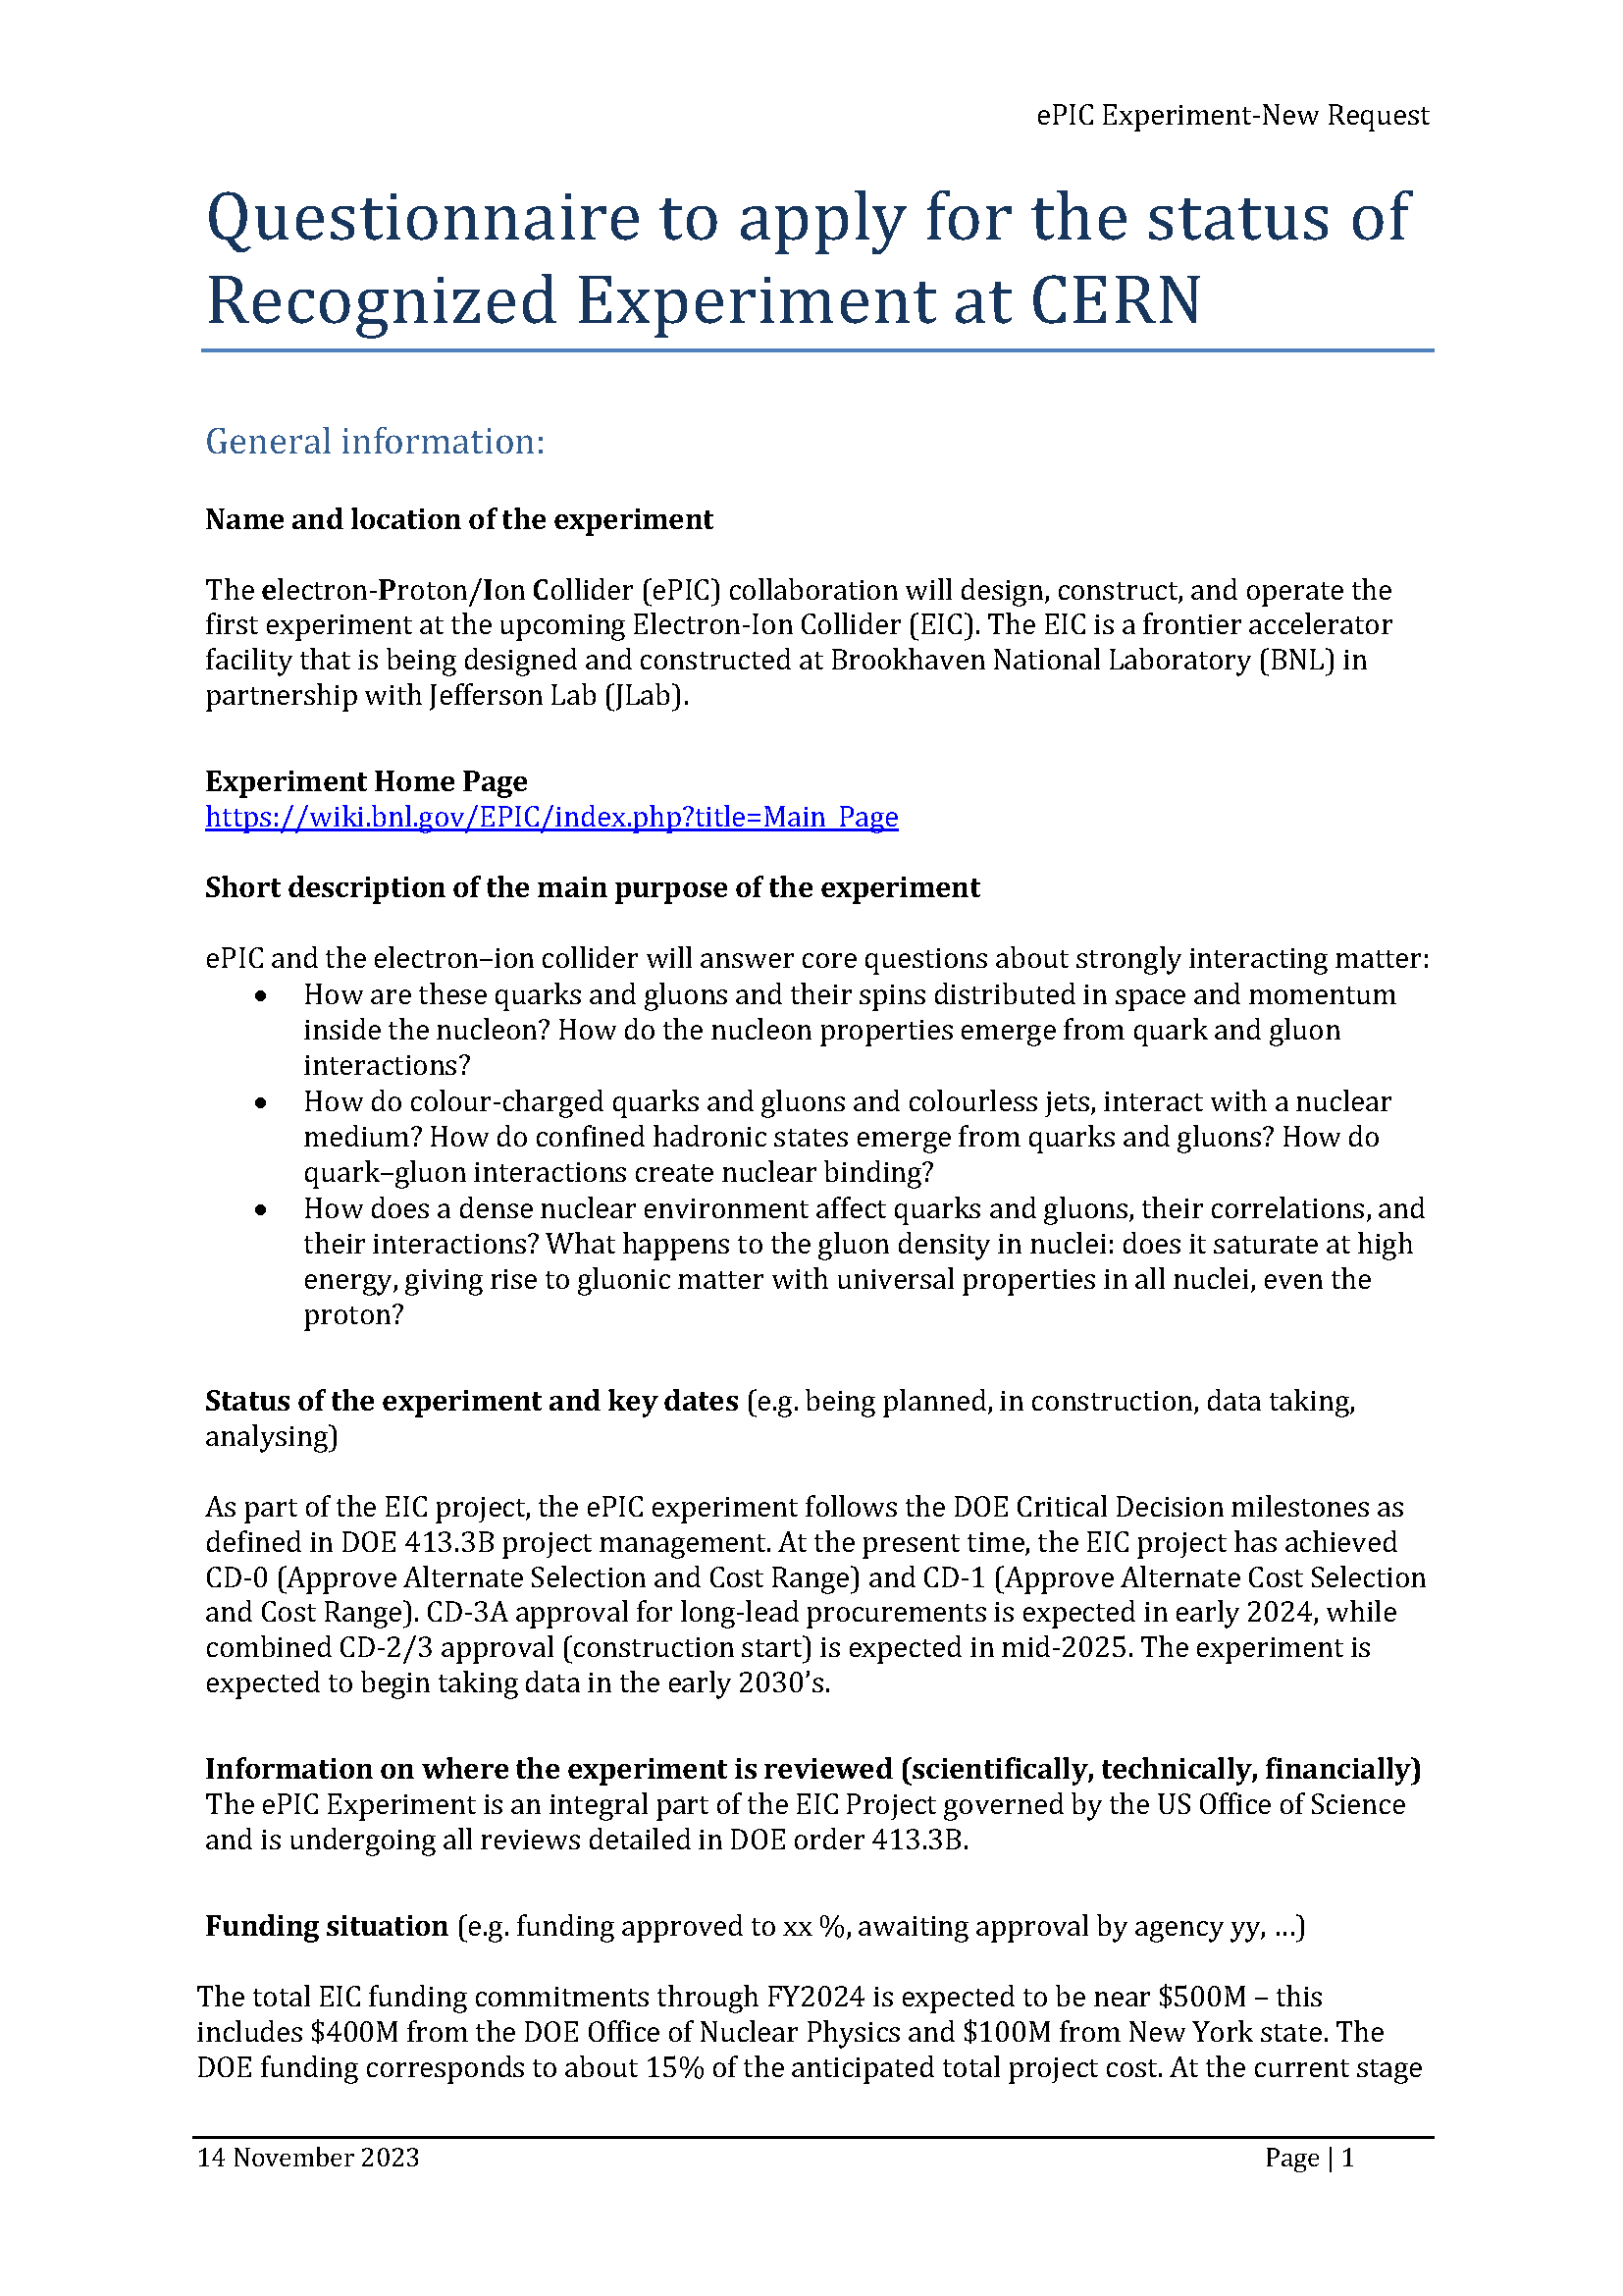
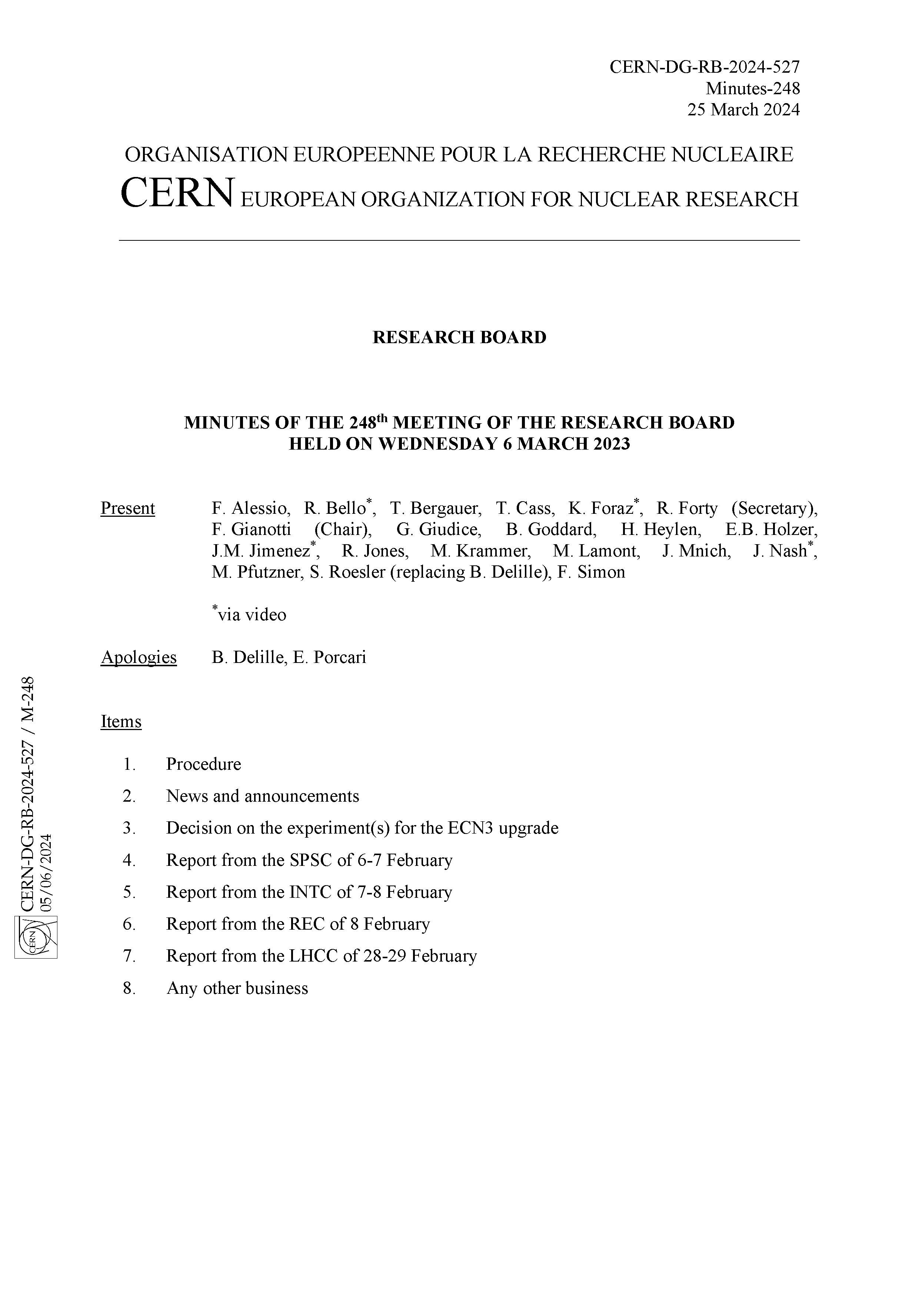
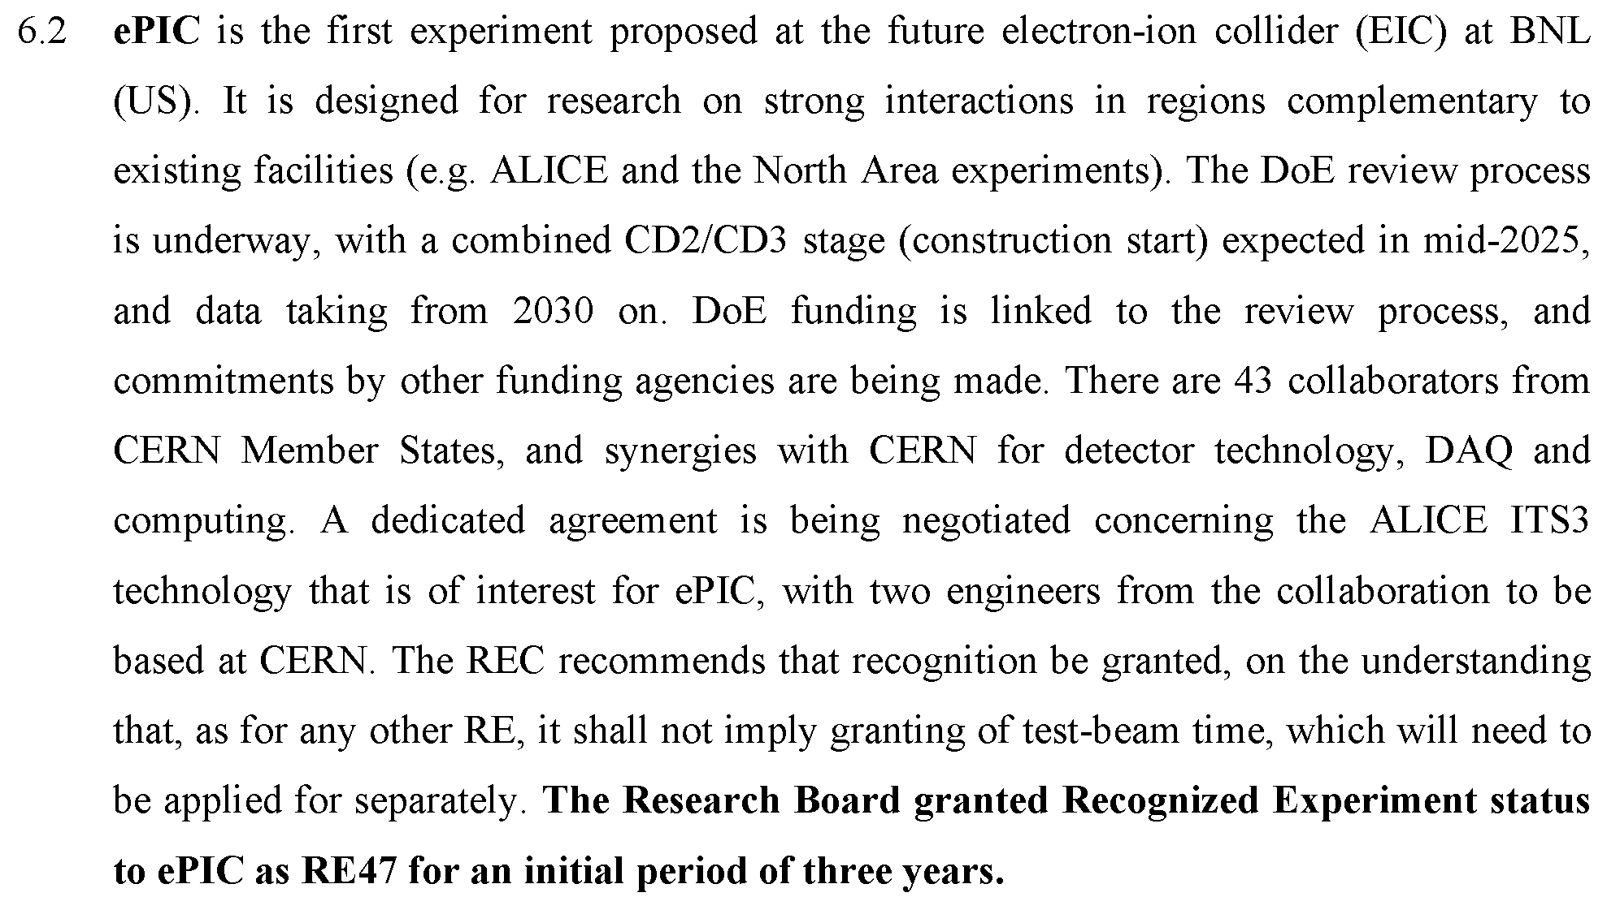
CERN Recognized Experiment
Progress on Recognized Experiment status:
  8/23 email from Helge Meinhard:
  Followed up with Zoom call 9/3
  Sent list of institutions and ePIC CC members
  CERN will draft MOU, expect to receive this by the end of the month.
“I'm pleased to report that the administrative hurdles are out of the way,
I'll reach out to all experiments REC considered earlier this year.”

Slide 19
Summary
Many deadlines for ePIC and EIC in the coming months!
ePIC Early Science Workshop – Sept. 13th, 10:30AM ET
Next General Meeting – Thursday, Sept. 19th, 7:30PM ET

Slide 20


Slide 21
ePIC Resources
Public Website - https://www.bnl.gov/eic/epic.php
Mailing Lists – https://lists.bnl.gov/mailman/listinfo
Indico Agenda - https://indico.bnl.gov/category/402/
  ePIC Software and Computing: https://indico.bnl.gov/category/435/
Wiki - https://wiki.bnl.gov/EPIC
ePIC Software Training:
  Landing Page: https://eic.github.io/documentation/landingpage.html
  Tutorials: https://eic.github.io/documentation/tutorials.html
Mattermost: https://chat.epic-eic.org
ePIC Zenodo Community: https://zenodo.org/communities/epic

Slide 22
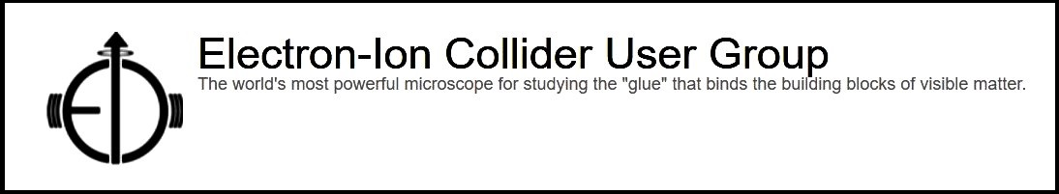

EICUG Membership
The EICUG is a vital organization to promote the interests of the EIC community!
  Without the EICUG we would never have gotten far enough to form ePIC!
Please register your institution!
Check with your EICUG IB representative to get registered as a member
https://www.eicug.org/content/join.html

